Slide 1
Module 9: Troubleshooting Kubernetes
Finding which layer is broken, and fixing it
Container Orchestration · Troubleshooting
YOU WILL BE ABLE TO
Use a symptom-to-layer method and the core kubectl tools
Read Pod states such as Pending, ImagePullBackOff, CrashLoopBackOff and OOMKilled
Diagnose a Service with no endpoints, DNS failures and a NotReady node
Recognize quota and RBAC denials, and find component logs
KCNA Exam Prep Masterclass
Module 9
Notes:
Welcome to Module 9: Troubleshooting Kubernetes. This module is in the Container Orchestration domain, and it covers the topic called Troubleshooting. By the end you will be able to do four things. Use a symptom-to-layer method and the core kube control tools. Read Pod states such as Pending, Image Pull Back Off, Crash Loop Back Off and O O M Killed. Diagnose a Service with no endpoints, D N S failures and a Not Ready node. And recognize quota and R B A C denials, and find component logs.

Slide 2
Case Check-In: Harbor Books Has a Bad Morning
Module 9
CASE CHECK-IN · Harbor Books
A new orders Pod stays Pending, and nobody knows why
The storefront cannot reach catalog, although the catalog Pods are running
One worker node reports NotReady, and a developer's request is rejected as Forbidden
In this module you find which layer is at fault
KCNA Exam Prep Masterclass | Kubernetes and Cloud Native Associate
Module 9: Troubleshooting Kubernetes
2 / 17
Notes:
At Harbor Books, a new orders Pod stays Pending, and nobody knows why. The storefront cannot reach catalog, although the catalog Pods are running. One worker node reports Not Ready, and a developer's request is rejected as Forbidden. In this module you find which layer is at fault.

Slide 3
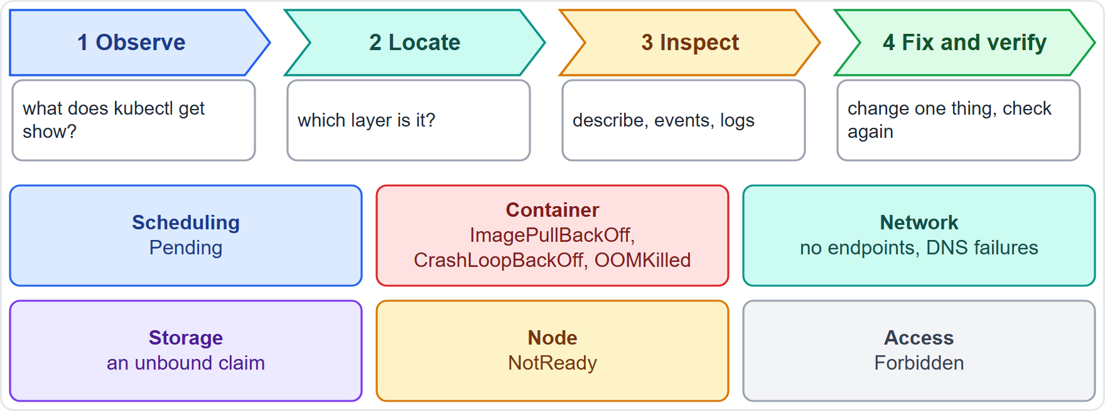
A Symptom-to-Layer Method
Module 9
Start with triage: is the problem in the Pod, in its controller or in the Service?
Read the symptom, then name the layer: scheduling, container, network, storage, node or access
Inspect that layer with describe, events and logs
Change one thing at a time, and check that the symptom is gone
EXAM TIP Symptom first, then the layer, then the matching command.
KCNA Exam Prep Masterclass | Kubernetes and Cloud Native Associate
Module 9: Troubleshooting Kubernetes
3 / 17
Notes:
Good troubleshooting starts with triage. Is the problem in the Pod, in its controller or in the Service? Read the symptom, then name the layer. The layers are scheduling, container, network, storage, node and access. The diagram links each symptom to its layer. Pending points to scheduling. Image Pull Back Off, Crash Loop Back Off and O O M Killed point to the container. No endpoints and D N S point to the network. Then inspect that layer with describe, events and logs. Change one thing at a time, and check that the symptom is gone. Exam tip: symptom first, then the layer, then the matching command.

Slide 4
kubectl Tools for Troubleshooting
Module 9
get shows the state and the restarts; describe ends with the events
logs --previous shows the log of the crashed container
exec runs a command or opens a shell inside a container; debug adds an ephemeral container
top shows CPU and memory use, when the Metrics Server is installed
TERMINAL
kubectl get pods -n shop
kubectl describe pod orders -n shop
kubectl get events -n shop
kubectl logs orders --previous
kubectl exec -it orders -- sh
kubectl top pod -n shop
Look, ask why, read the logs, step inside
EXAM TIP describe says why; logs say what the application printed.
KCNA Exam Prep Masterclass | Kubernetes and Cloud Native Associate
Module 9: Troubleshooting Kubernetes
4 / 17
Notes:
Six kube control commands cover most cases. Get shows the state and the restarts. Describe ends with the events, which explain why. Get events lists recent events for a namespace. Logs with the previous option shows the log of the crashed container. Exec runs a command, or opens a shell, inside a container, and debug adds an ephemeral container. And top shows C P U and memory use, when the Metrics Server is installed. Exam tip: describe says why, and logs say what the application printed.

Slide 5
Pod States and What They Mean
Module 9
State | What it means | First check
Pending | accepted, but not placed on a node yet | the events in describe
ImagePullBackOff | the image cannot be pulled; retries with a growing delay | image name, registry, imagePullSecret
CrashLoopBackOff | the container keeps failing and restarting | logs --previous and the configuration
OOMKilled | the container used more memory than its limit | memory use, a leak, or a higher limit
Evicted | the kubelet ended the Pod under node pressure | free resources on the node
Terminating | a deletion was issued but cannot finish | finalizers and admission webhooks
EXAM TIP Pending is about placement; the BackOff states are about the container.
KCNA Exam Prep Masterclass | Kubernetes and Cloud Native Associate
Module 9: Troubleshooting Kubernetes
5 / 17
Notes:
Six states to know. Pending means the Pod is accepted but not placed on a node yet, so read the events in describe. Image Pull Back Off means the image cannot be pulled, and Kubernetes retries with a growing delay. Check the image name, the registry and the image pull secret. Crash Loop Back Off means the container keeps failing and restarting, so read the previous logs and the configuration. O O M Killed means the container used more memory than its limit. Evicted means the kube let ended the Pod under node pressure. And Terminating means a deletion was issued but cannot finish, often because of finalizers and admission webhooks. Exam tip: Pending is about placement, and the Back Off states are about the container.

Slide 6
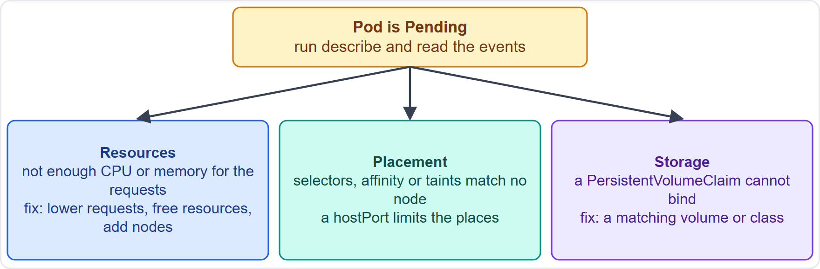
Pending in Detail
Module 9
Pending means the Pod is accepted but not placed; describe shows the scheduler's reason
Resources: not enough CPU or memory for its requests, so free resources, lower the requests or add nodes
Placement: selectors, affinity or taints match no node (Module 5), or a hostPort limits where it can go
Storage: a claim (PVC) that cannot bind keeps the Pod from being placed (Module 7)
EXAM TIP Pending: read the events first.
KCNA Exam Prep Masterclass | Kubernetes and Cloud Native Associate
Module 9: Troubleshooting Kubernetes
6 / 17
Notes:
A Pending Pod has been accepted but not placed. Describe shows the scheduler's reason, and the reason is usually one of three. Resources: not enough C P U or memory for its requests, so free resources, lower the requests or add nodes. Placement: selectors, affinity or taints match no node, as in Module 5, or a host Port limits where it can go. Storage: a claim that cannot bind keeps the Pod from being placed, as in Module 7. The diagram shows the three branches under the Pending Pod. Exam tip: Pending, read the events first.

Slide 7
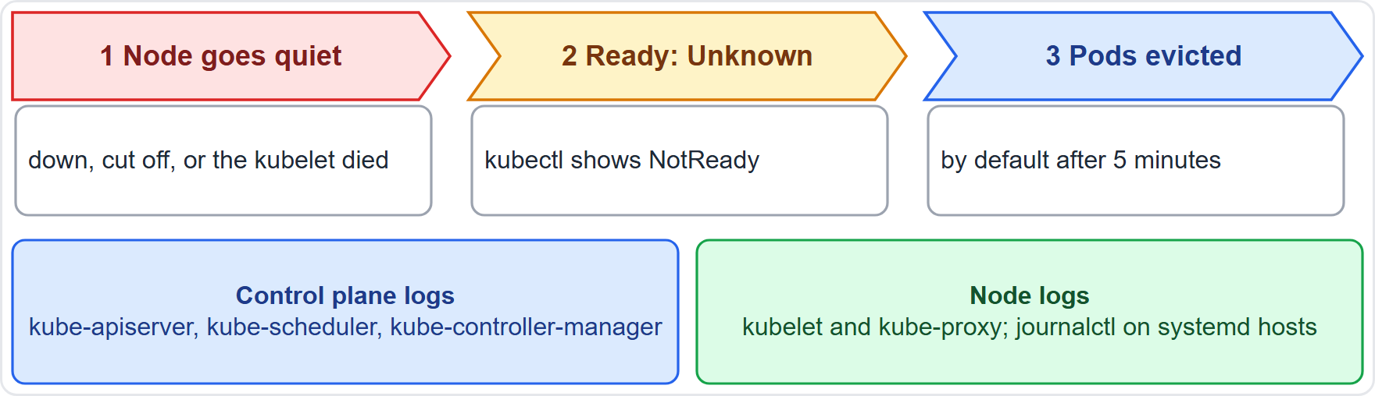
NotReady Nodes and Component Logs
Module 9
A node that is down, cut off, or has a dead kubelet shows NotReady
The node controller sets Ready to Unknown, and by default evicts its Pods after 5 minutes
kubectl get nodes and kubectl describe node show the condition and the events
Logs: kube-apiserver, kube-scheduler, kube-controller-manager on the control plane; kubelet and kube-proxy on workers
On systemd hosts the kubelet and runtime write to journald: use journalctl
EXAM TIP NotReady: look at the node and its kubelet.
KCNA Exam Prep Masterclass | Kubernetes and Cloud Native Associate
Module 9: Troubleshooting Kubernetes
7 / 17
Notes:
When a node stops reporting, it shows Not Ready. The cause may be a node that is down, cut off from the network, or a dead kube let. The node controller marks the Ready condition as Unknown, and by default it evicts the Pods on that node after five minutes. Kube control get nodes and kube control describe node show the condition and the events. For logs, the control plane has the kube A P I server, the kube scheduler and the kube controller manager. Workers have the kube let and kube proxy. On systemd hosts the kube let and the runtime write to journald, so use journal control. Exam tip: Not Ready, look at the node and its kube let.

Slide 8
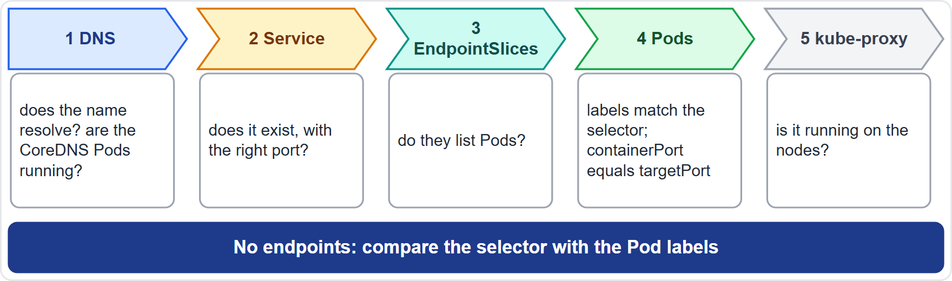
A Service With No Endpoints, and DNS Failures
Module 9
Check in order: does the Service exist, does its name resolve, does it have EndpointSlices
No endpoints points to a selector that matches no Pods; compare it with the Pods' labels
The Pod's containerPort must match the Service's targetPort
DNS: run nslookup from a Pod, and check that the CoreDNS Pods, labeled k8s-app=kube-dns, are running
Then look at kube-proxy and any NetworkPolicy
EXAM TIP No endpoints: compare the selector with the Pod labels.
KCNA Exam Prep Masterclass | Kubernetes and Cloud Native Associate
Module 9: Troubleshooting Kubernetes
8 / 17
Notes:
When a Service does not work, walk the path of a request in order. Does the Service exist? Does its name resolve? Does it have Endpoint Slices? No endpoints points to a selector that matches no Pods, so compare it with the labels of the Pods. The Pod's container Port must match the Service's target Port. For D N S, run ns lookup from a Pod, and check that the Core D N S Pods, labeled k eight s dash app equals kube dash D N S, are running. Then look at kube proxy and any Network Policy. Exam tip: no endpoints, compare the selector with the Pod labels.

Slide 9
Quota and RBAC Denials
Module 9
Rejection | Cause | Check
Forbidden (403) from RBAC | no role grants the action to that user or ServiceAccount | kubectl auth can-i, then the roles and bindings
Forbidden (403) from a quota | the request would break a ResourceQuota, and the message names the constraint | kubectl describe quota in the namespace
Both come from the control plane, and they are policy answers: the cluster is healthy
With quotas on for CPU or memory, a Pod must state requests or limits, or it is rejected
EXAM TIP A 403 is a policy answer, not a broken cluster.
KCNA Exam Prep Masterclass | Kubernetes and Cloud Native Associate
Module 9: Troubleshooting Kubernetes
9 / 17
Notes:
Two kinds of Forbidden, both with status four hundred and three. An R B A C denial means no role grants the action to that user or Service Account. Check with kube control auth can-i, and then the roles and bindings. A quota denial means the request would break a Resource Quota, and the message names the constraint. Check with kube control describe quota in the namespace. Both come from the control plane, and they are policy answers, so the cluster is healthy. With quotas on for C P U or memory, a Pod must state requests or limits, or it is rejected. Exam tip: a four hundred and three is a policy answer, not a broken cluster.

Slide 10
What the Exam Asks: Troubleshooting
Module 9
Pending or ImagePullBackOff
CrashLoopBackOff or OOMKilled
describe or logs
events and state, or what the application printed; --previous for a crashed container
not placed yet, or placed but the image cannot be pulled
the container keeps failing, or it hit its memory limit
No endpoints
NotReady
Forbidden
the selector and the Pod labels do not match
the node or its kubelet; Pods are evicted after 5 minutes by default
RBAC or a quota, not a cluster fault
EXAM TIP Name the layer before you pick a command.
KCNA Exam Prep Masterclass | Kubernetes and Cloud Native Associate
Module 9: Troubleshooting Kubernetes
10 / 17
Notes:
Six pairs to keep apart. Pending or Image Pull Back Off: not placed yet, or placed but the image cannot be pulled. Crash Loop Back Off or O O M Killed: the container keeps failing, or it hit its memory limit. Describe or logs: events and state, or what the application printed, with the previous option for a crashed container. No endpoints: the selector and the Pod labels do not match. Not Ready: the node or its kube let, and Pods are evicted after five minutes by default. And Forbidden: R B A C or a quota, not a cluster fault. Exam tip: name the layer before you pick a command.

Slide 11
Module Recap
Module 9
1
Method
2
Tools
3
Pod states
symptom, layer, inspect, fix one thing, verify
get, describe, events, logs with --previous, exec, debug, top
Pending is placement; ImagePullBackOff is the image; CrashLoopBackOff is the container; OOMKilled is the memory limit
4
Pending
5
Cluster
6
Services and access
resources, placement rules or a claim that cannot bind
a NotReady node means a dead kubelet or network; read the component logs
no endpoints is a selector mismatch; 403 is RBAC or a quota
KCNA Exam Prep Masterclass | Kubernetes and Cloud Native Associate
Module 9: Troubleshooting Kubernetes
11 / 17
Notes:
To recap. The method is symptom, layer, inspect, fix one thing, verify. The tools are get, describe, events, logs with the previous option, exec, debug and top. For Pod states, Pending is placement, Image Pull Back Off is the image, Crash Loop Back Off is the container, and O O M Killed is the memory limit. Pending comes from resources, placement rules or a claim that cannot bind. A Not Ready node means a dead kube let or network, so read the component logs. No endpoints is a selector mismatch, and a four hundred and three is R B A C or a quota. Now five practice questions.

Slide 12
Practice Question 1
Module 9
Q1
A container keeps crashing and restarting. Which command shows the log of its previous, crashed instance?
A
kubectl top pod orders, which shows the CPU and memory use of the Pod
B
kubectl logs orders --previous, which prints the log of the earlier container
C
kubectl get events, which lists recent events for the namespace of the Pod
D
kubectl describe node, which shows the conditions of the node that runs the Pod
KCNA Exam Prep Masterclass | Kubernetes and Cloud Native Associate
Module 9: Troubleshooting Kubernetes
12 / 17
Notes:
Question one. A container keeps crashing and restarting. Which command shows the log of its previous, crashed instance? The four options are on the screen.
[PAUSE 12]
The answer is B. The previous option of the logs command shows the log of the container that crashed. Top shows resource use, and events and describe show state changes but not the application's output.

Slide 13
Practice Question 2
Module 9
Q2
A new Harbor Books orders Pod stays Pending, and describe shows that no node has enough free CPU for its requests. Which actions can fix this?
A
Lower the CPU requests of the Pod, free resources on the nodes, or add nodes
B
Delete the Service of the orders Pods, so that the scheduler can start again
C
Restart the kubelet on every control plane node, so that the Pod is placed
D
Raise the memory limit of the container, because Pending means too little memory
KCNA Exam Prep Masterclass | Kubernetes and Cloud Native Associate
Module 9: Troubleshooting Kubernetes
13 / 17
Notes:
Question two. A new Harbor Books orders Pod stays Pending, and describe shows that no node has enough free C P U for its requests. Which actions can fix this? The four options are on the screen.
[PAUSE 12]
The answer is A. Pending means the Pod is not placed, and here the reason is C P U requests that no node can satisfy. Lowering requests, freeing resources or adding nodes addresses that. A Service, a control plane kube let and a memory limit have nothing to do with it.

Slide 14
Practice Question 3
Module 9
Q3
A worker node shows NotReady in kubectl get nodes. Which cause is likely?
A
Too many labels have been added to the node, so the scheduler refuses to use it
B
The Deployments that run on the node have more replicas than the cluster allows
C
The Service selectors of the cluster do not match the Pods that run on the node
D
The kubelet on the node has stopped, or the node has lost contact with the control plane
KCNA Exam Prep Masterclass | Kubernetes and Cloud Native Associate
Module 9: Troubleshooting Kubernetes
14 / 17
Notes:
Question three. A worker node shows Not Ready in kube control get nodes. Which cause is likely? The four options are on the screen.
[PAUSE 12]
The answer is D. A node that stops reporting, because it is down, cut off or its kube let died, gets the Ready condition Unknown and shows Not Ready. Labels, replica counts and Service selectors do not make a node Not Ready.

Slide 15
Practice Question 4
Module 9
Q4
The Harbor Books storefront cannot reach catalog through its Service. The EndpointSlices of the Service list no addresses, yet the catalog Pods are Running. What is the likely cause?
A
The CoreDNS Pods are not running, so the Service name is not resolved
B
The nodes that run the catalog Pods are NotReady, so the Pods do not respond
C
The selector of the Service does not match the labels of the catalog Pods
D
The Service is of type ClusterIP, which does not get EndpointSlices
KCNA Exam Prep Masterclass | Kubernetes and Cloud Native Associate
Module 9: Troubleshooting Kubernetes
15 / 17
Notes:
Question four. The Harbor Books storefront cannot reach catalog through its Service. The Endpoint Slices of the Service list no addresses, yet the catalog Pods are Running. What is the likely cause? The four options are on the screen.
[PAUSE 12]
The answer is C. Endpoint Slices list the Pods that match the Service selector, so an empty list with running Pods points to a selector or label mismatch. A D N S failure would break name resolution, not the endpoint list, and Cluster I P Services do have Endpoint Slices.

Slide 16
Practice Question 5
Module 9
Q5
A request to create more Pods in a namespace is rejected with 403 Forbidden, and the message says a quota would be exceeded. Which statement is correct?
A
The kubelet evicted the Pods of the namespace because the node ran short of resources
B
The control plane rejected the request because it would break the ResourceQuota of the namespace
C
RBAC denied the request, because the user has no role in the namespace at all
D
The kube-proxy blocked the request, because the Service has too many endpoints
KCNA Exam Prep Masterclass | Kubernetes and Cloud Native Associate
Module 9: Troubleshooting Kubernetes
16 / 17
Notes:
Question five. A request to create more Pods in a namespace is rejected with four hundred and three Forbidden, and the message says a quota would be exceeded. Which statement is correct? The four options are on the screen.
[PAUSE 12]
The answer is B. A request that would violate a Resource Quota is rejected by the control plane with four hundred and three Forbidden, and a message naming the constraint. It is a policy answer, not an eviction, an R B A C denial or a proxy problem.

Slide 17
Answers at a Glance
Module 9
Question | Answer | Why
Q1 | B | logs with the previous option
Q2 | A | Lower requests, free resources or add nodes
Q3 | D | A stopped kubelet or a lost connection
Q4 | C | The selector does not match the Pod labels
Q5 | B | The ResourceQuota was exceeded
KCNA Exam Prep Masterclass | Kubernetes and Cloud Native Associate
Module 9: Troubleshooting Kubernetes
17 / 17
Notes:
Here are the answers at a glance. Question one, B: logs with the previous option. Question two, A: lower requests, free resources or add nodes. Question three, D: a stopped kube let or a lost connection. Question four, C: the selector does not match the Pod labels. Question five, B: the Resource Quota was exceeded.

