Slide 1
Module 10: Application Delivery: CI/CD, GitOps, Helm
How changes reach the cluster, safely and repeatably
Cloud Native Application Delivery · Application Delivery
YOU WILL BE ABLE TO
Tell CI, continuous delivery and continuous deployment apart
Explain the GitOps principles, pull versus push and reconciliation
Compare recreate, rolling, blue/green, canary, A/B and shadow releases
Use Helm charts, releases and values, and Kustomize overlays
KCNA Exam Prep Masterclass
Module 10 · Part 1
Notes:
Welcome to Module 10: Application Delivery: C I slash C D, Git Ops and Helm. This module is in the Cloud Native Application Delivery domain, and it covers the topic called Application Delivery. By the end you will be able to do four things. Tell C I, continuous delivery and continuous deployment apart. Explain the Git Ops principles, pull versus push, and reconciliation. Compare recreate, rolling, blue green, canary, A B and shadow releases. And use Helm charts, releases and values, and Kustomize overlays.

Slide 2
Case Check-In: Harbor Books Ships Every Week
Part 1
CASE CHECK-IN · Harbor Books
A Git repository holds what should run, and every change is a reviewed commit
A new storefront goes to a small share of visitors first, and is rolled back if orders drop
Staging and production run the same application with different settings
In this module you build the delivery path that does all of this
KCNA Exam Prep Masterclass | Kubernetes and Cloud Native Associate
Module 10: Application Delivery: CI/CD, GitOps, Helm
2 / 27
Notes:
At Harbor Books, a Git repository holds what should run, and every change is a reviewed commit. A new storefront goes to a small share of visitors first, and is rolled back if orders drop. Staging and production run the same application with different settings. In this module you build the delivery path that does all of this.

Slide 3
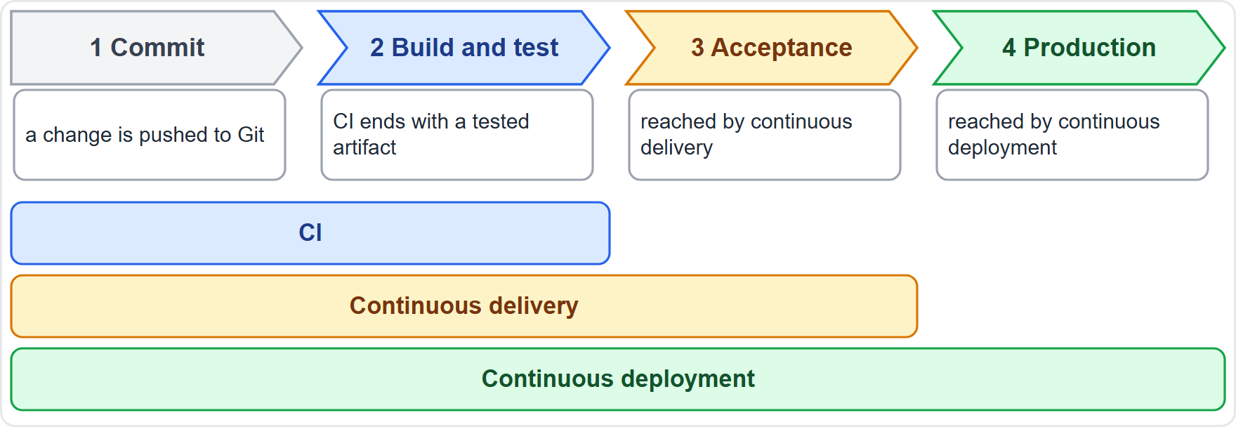
CI, Continuous Delivery and Continuous Deployment
ARCHIVED TOPIC
Part 1
Continuous integration (CI) merges code changes as often as possible, and ends with a tested artifact
Continuous delivery deploys changes automatically to an acceptance environment, with tests and a way to roll back
Continuous deployment carries finished software directly to production
CI is a prerequisite for CD
EXAM TIP CI builds and tests, delivery reaches acceptance, deployment reaches production.
KCNA Exam Prep Masterclass | Kubernetes and Cloud Native Associate
Module 10: Application Delivery: CI/CD, GitOps, Helm
3 / 27
Notes:
This slide is tagged archived topic. One pipeline carries three names. Continuous integration, C I, merges code changes as often as possible, and ends with a tested artifact. Continuous delivery deploys changes automatically to an acceptance environment, with tests and a way to roll back. Continuous deployment carries finished software directly to production. And C I is a prerequisite for C D. The diagram shows the pipeline from commit to production, with a bar for each span. Exam tip: C I builds and tests, delivery reaches acceptance, and deployment reaches production.

Slide 4
Registry, Tags and Digests
Part 1
Reference | What it means
storefront:stable (a tag) | a name that can be moved to point at a different image
storefront@sha256:... (a digest) | a hash of the image content: unique to one version and immutable
A pipeline builds an image, pushes it to a registry, and the cluster pulls it
Deploy by digest when you need the same reference to mean the same image every time
Promote the same artifact from test to production, instead of rebuilding it
EXAM TIP A tag can move; a digest cannot.
KCNA Exam Prep Masterclass | Kubernetes and Cloud Native Associate
Module 10: Application Delivery: CI/CD, GitOps, Helm
4 / 27
Notes:
A pipeline builds an image, pushes it to a registry, and the cluster pulls it. How you name the image matters. A tag is a name that can be moved to point at a different image. A digest is a hash of the image content. It is unique to one version, and it is immutable. So deploy by digest when you need the same reference to mean the same image every time. And promote the same artifact from test to production, instead of rebuilding it. Exam tip: a tag can move, and a digest cannot.

Slide 5
GitOps: The Four Principles
ARCHIVED TOPIC
Part 1
Declarative
Versioned and immutable
Pulled automatically
the desired state is described, not scripted
software agents pull the desired state from the source
it is stored with a complete history, for example in Git
Continuously reconciled
Git is the usual source of truth; drift, rollback and review all become Git operations
agents observe the actual state and keep applying the desired state
EXAM TIP Declarative, versioned and immutable, pulled, continuously reconciled.
KCNA Exam Prep Masterclass | Kubernetes and Cloud Native Associate
Module 10: Application Delivery: CI/CD, GitOps, Helm
5 / 27
Notes:
This slide is tagged archived topic. Git Ops has four principles. Declarative: the desired state is described, not scripted. Versioned and immutable: it is stored with a complete history, for example in Git. Pulled automatically: software agents pull the desired state from the source. And continuously reconciled: agents observe the actual state and keep applying the desired state. Git is the usual source of truth, so drift, rollback and review all become Git operations. Exam tip: declarative, versioned and immutable, pulled, continuously reconciled.

Slide 6
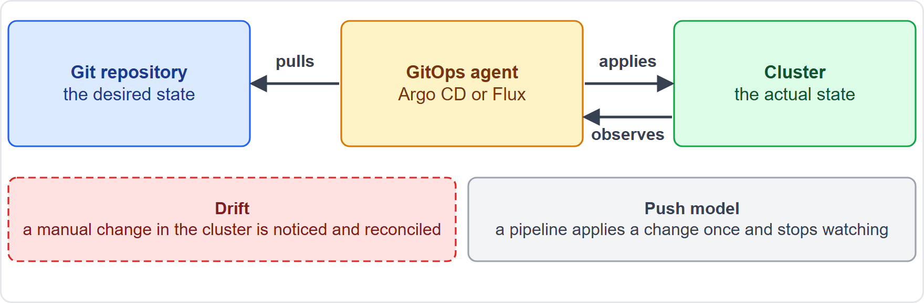
Pull, Drift and Reconciliation
ARCHIVED TOPIC
Part 1
In GitOps the agent pulls the desired state from the source; nothing pushes into the cluster
The agent continuously compares the actual state with the desired state
Drift is the actual state moving away from the desired state
Reconciliation runs whenever there is a divergence, not only on a new commit; traditional CI/CD runs on pre-set triggers
EXAM TIP Pull plus continuous reconciliation is what fixes drift.
KCNA Exam Prep Masterclass | Kubernetes and Cloud Native Associate
Module 10: Application Delivery: CI/CD, GitOps, Helm
6 / 27
Notes:
This slide is tagged archived topic. In Git Ops the agent pulls the desired state from the source. Nothing pushes into the cluster. The agent continuously compares the actual state with the desired state. Drift is the actual state moving away from the desired state, for example after a manual change. Reconciliation runs whenever there is a divergence, not only on a new commit. Traditional C I slash C D runs on pre-set triggers, and a push pipeline acts once and stops watching. Exam tip: pull plus continuous reconciliation is what fixes drift.

Slide 7
Argo CD and Flux
ARCHIVED TOPIC · MOVING
Part 1
Tool | What it is
Argo CD | a GitOps tool for continuous delivery to Kubernetes, with declarative definitions
Flux | keeps clusters in sync with sources such as Git repositories and OCI artifacts, and automates updates
Both are GitOps tools for Kubernetes: they compare a source with the cluster and bring the cluster into line
As of 30 October 2026: Argo, Flux and Helm are CNCF graduated projects
EXAM TIP Argo CD and Flux are GitOps tools; Helm is a package manager.
KCNA Exam Prep Masterclass | Kubernetes and Cloud Native Associate
Module 10: Application Delivery: CI/CD, GitOps, Helm
7 / 27
Notes:
This slide is tagged archived topic. It is also tagged moving, because project status changes. Argo C D is a Git Ops tool for continuous delivery to Kubernetes, with declarative definitions. Flux keeps clusters in sync with sources such as Git repositories and O C I artifacts, and automates updates. Both are Git Ops tools for Kubernetes. They compare a source with the cluster, and bring the cluster into line. As of the thirtieth of October, twenty twenty-six, Argo, Flux and Helm are C N C F graduated projects. Exam tip: Argo C D and Flux are Git Ops tools, and Helm is a package manager.

Slide 8
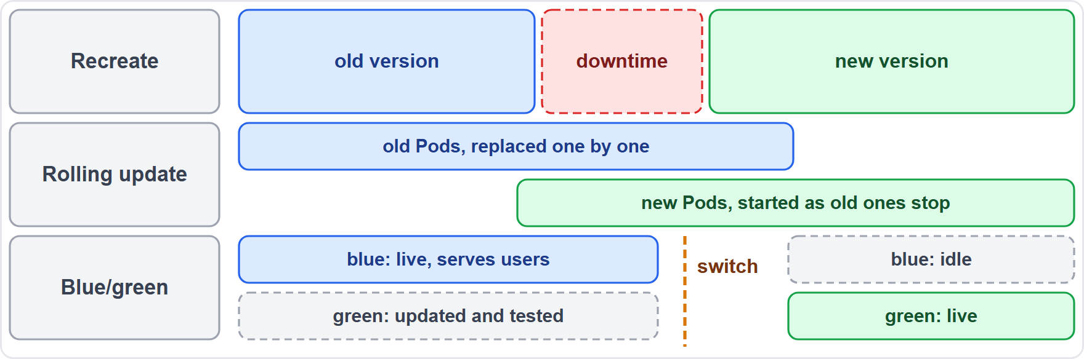
Recreate, Rolling and Blue/Green
Part 1
Recreate: all old Pods are killed first, then the new ones start, so there is downtime
Rolling update: Pods are replaced gradually; it is the Deployment default
Blue/green: two environments; the idle one is updated and tested, then traffic is switched to it
EXAM TIP Recreate has downtime, rolling is gradual, blue/green switches whole environments.
KCNA Exam Prep Masterclass | Kubernetes and Cloud Native Associate
Module 10: Application Delivery: CI/CD, GitOps, Helm
8 / 27
Notes:
Three ways to replace a version. With recreate, all old Pods are killed first, then the new ones start, so there is downtime. A rolling update replaces Pods gradually. It is the Deployment default. With blue green, you keep two environments. The idle one is updated and tested, and then traffic is switched to it. The diagram shows a gap for recreate, an overlap for a rolling update, and a switch for blue green. Exam tip: recreate has downtime, rolling is gradual, and blue green switches whole environments.

Slide 9
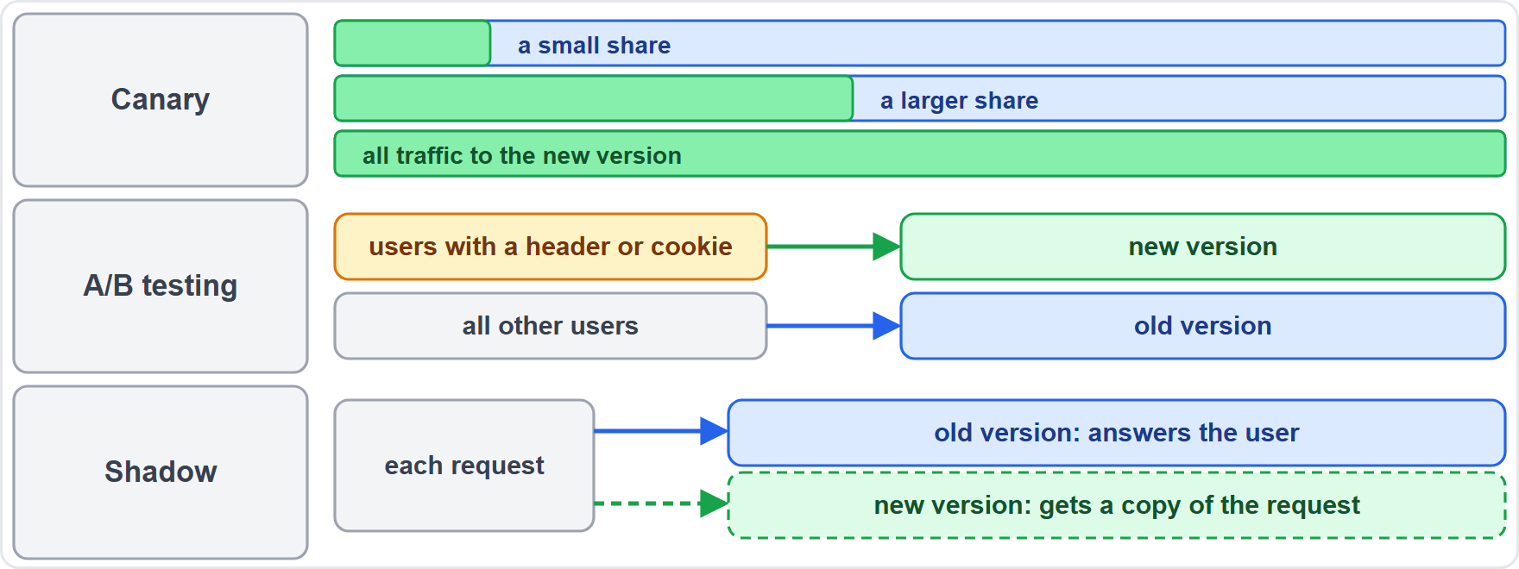
Canary, A/B and Shadow Releases
Part 1
Canary: move traffic gradually to the new version, watch it, then continue or roll back
A/B testing: route a set of users, chosen by HTTP headers or cookies, to the new version
Shadow (mirroring): copy each request to the new version too, for idempotent requests
Canary and A/B need layer 7 traffic control, such as a service mesh or an ingress controller
EXAM TIP Canary shifts a share, A/B picks users, shadow copies requests.
KCNA Exam Prep Masterclass | Kubernetes and Cloud Native Associate
Module 10: Application Delivery: CI/CD, GitOps, Helm
9 / 27
Notes:
Three ways to share traffic with a new version. A canary moves traffic gradually to the new version. You watch it, then continue or roll back. A B testing routes a set of users, chosen by H T T P headers or cookies, to the new version. A shadow release, also called mirroring, copies each request to the new version too, which suits idempotent requests. Canary and A B testing need layer seven traffic control, such as a service mesh or an ingress controller. Exam tip: canary shifts a share, A B picks users, and shadow copies requests.

Slide 10
Progressive Delivery with Argo Rollouts
BEYOND THE CURRICULUM
Part 1
Tool | What it does
Argo Rollouts | a Kubernetes controller and CRDs for blue-green, canary, canary analysis and progressive delivery
Flagger | automates canary, A/B, blue/green and mirroring releases with analysis, promotion and rollback
Both can work with ingress controllers and service meshes to shift traffic gradually
They can read metrics to decide on automatic promotion or rollback
EXAM TIP Progressive delivery: shift gradually, measure, then promote or roll back.
KCNA Exam Prep Masterclass | Kubernetes and Cloud Native Associate
Module 10: Application Delivery: CI/CD, GitOps, Helm
10 / 27
Notes:
This slide is tagged beyond the curriculum. Progressive delivery means shifting traffic gradually, measuring, and then promoting or rolling back. Argo Rollouts adds a controller and C R Ds to Kubernetes, for blue green, canary, canary analysis and progressive delivery. Flagger automates canary, A B, blue green and mirroring releases, with analysis, promotion and rollback. Both can work with ingress controllers and service meshes to shift traffic gradually, and they can read metrics to decide on automatic promotion or rollback. Exam tip: shift gradually, measure, then promote or roll back.

Slide 11
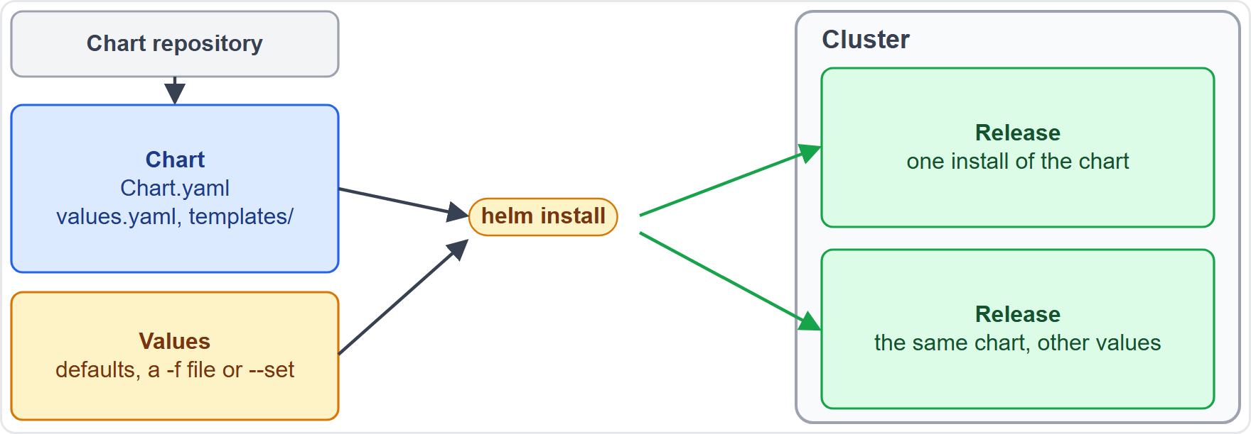
Helm: Charts, Releases and Values
Part 1
Helm is the package manager for Kubernetes
A chart is a package: Chart.yaml, default values.yaml and templates/
A repository collects and shares charts
A release is one installed copy of a chart in a cluster; one chart can make many releases
Helm merges the chart with values to produce the manifests
EXAM TIP Chart plus values makes a release.
KCNA Exam Prep Masterclass | Kubernetes and Cloud Native Associate
Module 10: Application Delivery: CI/CD, GitOps, Helm
11 / 27
Notes:
Helm is the package manager for Kubernetes. A chart is a package. It holds a Chart dot Y A M L file, the default values dot Y A M L file, and a templates folder. A repository collects and shares charts. A release is one installed copy of a chart in a cluster. One chart can make many releases, as in the diagram where the same chart is installed twice. Helm merges the chart with values to produce the manifests. Exam tip: chart plus values makes a release.

Slide 12
Helm in Practice
Part 2
install creates a release from a chart and values, from a -f file or --set
upgrade changes a release and updates only what changed
history lists the revisions; every install, upgrade or rollback adds one, starting at revision one
rollback RELEASE REVISION returns to an earlier revision
TERMINAL
helm install shop-db shop/db -f prod.yaml
helm upgrade shop-db shop/db -f prod.yaml
helm history shop-db
helm rollback shop-db 1
helm uninstall shop-db
Install, upgrade, inspect and roll back a release
EXAM TIP A rollback adds a new revision; it does not erase the history.
KCNA Exam Prep Masterclass | Kubernetes and Cloud Native Associate
Module 10: Application Delivery: CI/CD, GitOps, Helm
12 / 27
Notes:
Four Helm commands cover the basics. Install creates a release from a chart and values, from a file with the dash f option, or with set. Upgrade changes a release, and updates only what changed. History lists the revisions. Every install, upgrade or rollback adds one, starting at revision one. And rollback, with a release name and a revision, returns to an earlier revision. The snippet installs, upgrades, inspects and rolls back the database release, and then uninstalls it. Exam tip: a rollback adds a new revision, and it does not erase the history.

Slide 13
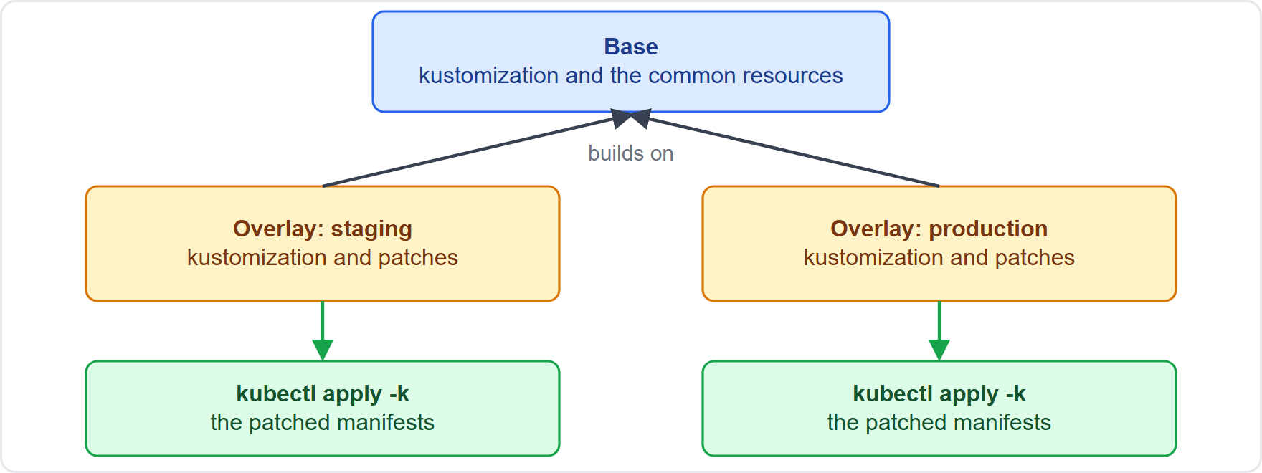
Kustomize: Bases and Overlays
Part 2
Kustomize customizes template-free YAML and leaves the original untouched
A base holds the common resources; an overlay adds patches for a variant such as staging or production
It is built into kubectl: kubectl kustomize shows the result, kubectl apply -k applies it
Helm uses templates and values; Kustomize patches plain YAML
EXAM TIP Helm templates; Kustomize patches.
KCNA Exam Prep Masterclass | Kubernetes and Cloud Native Associate
Module 10: Application Delivery: CI/CD, GitOps, Helm
13 / 27
Notes:
Kustomize customizes template-free Y A M L, and leaves the original untouched. A base holds the common resources. An overlay adds patches for a variant, such as staging or production. It is built into kube control. Kube control kustomize shows the result, and kube control apply dash k applies it. The difference from Helm is simple. Helm uses templates and values. Kustomize patches plain Y A M L. Exam tip: Helm templates, Kustomize patches.

Slide 14
Promotion, Rollback and Infrastructure as Code
BEYOND THE CURRICULUM
Part 2
Topic | The idea
Promotion | the same change moves through the environments, from test to acceptance to production
Rollback | helm rollback, kubectl rollout undo, or in GitOps a Git revert that the agent reconciles
Infrastructure as code | infrastructure is defined in files, not built by hand, so it is reproducible; Crossplane, a CNCF project, builds control planes for applications and infrastructure
EXAM TIP What lives in files and Git can be reviewed, repeated and rolled back.
KCNA Exam Prep Masterclass | Kubernetes and Cloud Native Associate
Module 10: Application Delivery: CI/CD, GitOps, Helm
14 / 27
Notes:
This slide is tagged beyond the curriculum. Promotion means the same change moves through the environments, from test to acceptance to production. For rollback you have helm rollback, kube control rollout undo, or in Git Ops a Git revert that the agent reconciles. And infrastructure as code means infrastructure is defined in files, not built by hand, so it is reproducible. Crossplane, a C N C F project, builds control planes for applications and infrastructure. Exam tip: what lives in files and Git can be reviewed, repeated and rolled back.

Slide 15
What the Exam Asks: Application Delivery
Part 2
CI or CD
Push or pull
Rolling, blue/green or canary
CI builds and tests; delivery reaches acceptance; deployment reaches production
GitOps agents pull the desired state and keep reconciling it
replace gradually, switch whole environments, or shift a share of traffic
Helm or Kustomize
Tag or digest
Argo CD or Flux, or Helm
templates and values in releases, or patches over a base
a tag can move, a digest cannot
GitOps tools, or a package manager
EXAM TIP For a delivery question, ask what moves the change: a pipeline, an agent, a package or a patch.
KCNA Exam Prep Masterclass | Kubernetes and Cloud Native Associate
Module 10: Application Delivery: CI/CD, GitOps, Helm
15 / 27
Notes:
Six pairs to keep apart. C I or C D: C I builds and tests, delivery reaches acceptance, and deployment reaches production. Push or pull: Git Ops agents pull the desired state and keep reconciling it. Rolling, blue green or canary: replace gradually, switch whole environments, or shift a share of traffic. Helm or Kustomize: templates and values in releases, or patches over a base. Tag or digest: a tag can move, and a digest cannot. And Argo C D or Flux, or Helm: Git Ops tools, or a package manager. Exam tip: ask what moves the change.

Slide 16
Module Recap
Part 2
1
Pipelines
2
Images
3
GitOps
CI builds and tests; delivery reaches acceptance; deployment reaches production
a tag can move; a digest is a fixed hash
declarative, versioned and immutable, pulled, continuously reconciled; agents like Argo CD and Flux fix drift
4
Strategies
5
Helm and Kustomize
6
Rollback
recreate, rolling, blue/green, canary, A/B and shadow; progressive delivery adds analysis
helm rollback, kubectl rollout undo or a Git revert
charts and values make releases; bases and overlays patch YAML
KCNA Exam Prep Masterclass | Kubernetes and Cloud Native Associate
Module 10: Application Delivery: CI/CD, GitOps, Helm
16 / 27
Notes:
To recap. For pipelines, C I builds and tests, delivery reaches acceptance, and deployment reaches production. For images, a tag can move, and a digest is a fixed hash. Git Ops is declarative, versioned and immutable, pulled, and continuously reconciled, and agents like Argo C D and Flux fix drift. The release strategies are recreate, rolling, blue green, canary, A B and shadow, and progressive delivery adds analysis. Helm charts and values make releases, and Kustomize bases and overlays patch Y A M L. And rollback is helm rollback, kube control rollout undo or a Git revert. Now ten practice questions.

Slide 17
Practice Question 1
Part 2
Q1
What is the difference between continuous delivery and continuous deployment?
A
Delivery builds the code, and deployment tests it before it is merged
B
Delivery works for containers in a test setup, and deployment works for virtual machines in production
C
Delivery reaches an acceptance environment automatically, and deployment goes on to production
D
Delivery needs a person to approve each step, and deployment skips the tests
KCNA Exam Prep Masterclass | Kubernetes and Cloud Native Associate
Module 10: Application Delivery: CI/CD, GitOps, Helm
17 / 27
Notes:
Question one. What is the difference between continuous delivery and continuous deployment? The four options are on the screen.
[PAUSE 12]
The answer is C. Continuous delivery deploys changes automatically into an acceptance environment, with tests and a way to roll back. Continuous deployment carries finished software directly to production. C I is the build and test stage before both.

Slide 18
Practice Question 2
Part 2
Q2
Harbor Books must be sure that staging and production run exactly the same image, even if someone pushes a different image under an existing tag. Which reference does that?
A
An image digest, which is a hash of the image content and does not change
B
The latest tag, because it points at the image that was tested
C
The name of the registry alone, because a registry holds one version
D
A new tag typed by hand on each node, because tags are checked by the kubelet
KCNA Exam Prep Masterclass | Kubernetes and Cloud Native Associate
Module 10: Application Delivery: CI/CD, GitOps, Helm
18 / 27
Notes:
Question two. Harbor Books must be sure that staging and production run exactly the same image, even if someone pushes a different image under an existing tag. Which reference does that? The four options are on the screen.
[PAUSE 12]
The answer is A. A digest identifies one version of an image and is immutable, while a tag can be moved to a different image. The latest tag can move, and a registry holds many images.

Slide 19
Practice Question 3
Part 2
Q3
Which list gives the four GitOps principles of the OpenGitOps project?
A
Imperative, mutable, pushed by hand and checked once a month by an auditor
B
Scripted, versioned, pushed by the pipeline and reconciled only on a new commit
C
Declarative, mutable, pulled by hand and compared with the cluster once a week
D
Declarative, versioned and immutable, pulled automatically and continuously reconciled
KCNA Exam Prep Masterclass | Kubernetes and Cloud Native Associate
Module 10: Application Delivery: CI/CD, GitOps, Helm
19 / 27
Notes:
Question three. Which list gives the four Git Ops principles of the Open Git Ops project? The four options are on the screen.
[PAUSE 12]
The answer is D. The desired state must be declarative, versioned and immutable, pulled automatically by software agents, and continuously reconciled with the actual state.

Slide 20
Practice Question 4
Part 2
Q4
In GitOps, what does it mean that the desired state is pulled?
A
A person copies the manifests from Git to the cluster each time a change is reviewed
B
An agent fetches the desired state from the source, instead of a pipeline pushing it into the cluster
C
The Git server opens a connection to every node and writes the files that changed
D
The cluster sends its current state to Git, which then decides what to deploy
KCNA Exam Prep Masterclass | Kubernetes and Cloud Native Associate
Module 10: Application Delivery: CI/CD, GitOps, Helm
20 / 27
Notes:
Question four. In Git Ops, what does it mean that the desired state is pulled? The four options are on the screen.
[PAUSE 12]
The answer is B. Software agents read the desired state from the state store whenever they need to, which makes continuous reconciliation possible. A pushed change happens once, and is not watched afterwards.

Slide 21
Practice Question 5
Part 2
Q5
Someone changes the orders Deployment by hand in a cluster that an Argo CD or Flux agent manages from Git. What should happen?
A
Nothing, because a GitOps agent compares the cluster with Git at installation time
B
The agent deletes the Git repository, because the manual change is the new truth
C
The agent notices the drift and reconciles the cluster back to the state in Git
D
The agent sends the manual change to the other clusters, so that they match
KCNA Exam Prep Masterclass | Kubernetes and Cloud Native Associate
Module 10: Application Delivery: CI/CD, GitOps, Helm
21 / 27
Notes:
Question five. Someone changes the orders Deployment by hand in a cluster that an Argo C D or Flux agent manages from Git. What should happen? The four options are on the screen.
[PAUSE 12]
The answer is C. Drift is the actual state moving away from the desired state. The agent keeps observing the cluster, and applies the desired state from Git again. Git stays the source of truth.

Slide 22
Practice Question 6
Part 2
Q6
Which deployment strategy kills all the old Pods before it creates new ones, so that there is downtime?
A
Rolling update, which replaces the Pods gradually while the old ones still serve traffic
B
Recreate, which stops every old Pod first and then starts the new version
C
Blue/green, which keeps two environments and switches the traffic between them
D
Canary, which moves a growing share of the traffic to the new version
KCNA Exam Prep Masterclass | Kubernetes and Cloud Native Associate
Module 10: Application Delivery: CI/CD, GitOps, Helm
22 / 27
Notes:
Question six. Which deployment strategy kills all the old Pods before it creates new ones, so that there is downtime? The four options are on the screen.
[PAUSE 12]
The answer is B. The Recreate strategy stops every existing Pod first, and only then creates the new ones. The other strategies keep serving users with the old version while the new one comes up.

Slide 23
Practice Question 7
Part 2
Q7
Harbor Books wants to send a small share of visitors to a new storefront version, watch the results, and then increase the share or roll back. Which strategy is this?
A
Canary, which moves traffic gradually to the new version and allows a quick rollback
B
Recreate, which replaces the Pods of the whole application at once and accepts a short period of downtime
C
Blue/green, which switches the traffic from one environment to the other at once
D
Shadow, which copies requests to the new version and does not send real users to it
KCNA Exam Prep Masterclass | Kubernetes and Cloud Native Associate
Module 10: Application Delivery: CI/CD, GitOps, Helm
23 / 27
Notes:
Question seven. Harbor Books wants to send a small share of visitors to a new storefront version, watch the results, and then increase the share or roll back. Which strategy is this? The four options are on the screen.
[PAUSE 12]
The answer is A. A canary shifts traffic gradually, so the team can observe the new version in production and roll back if needed. Blue green switches everything at once, and shadow releases copy requests without serving users from the new version.

Slide 24
Practice Question 8
Part 2
Q8
In Helm, what is a release?
A
A package of the manifests that an application needs in order to run
B
A server where charts are collected and shared with other people
C
A file with the default configuration values that a chart provides
D
An instance of a chart that is running in a Kubernetes cluster
KCNA Exam Prep Masterclass | Kubernetes and Cloud Native Associate
Module 10: Application Delivery: CI/CD, GitOps, Helm
24 / 27
Notes:
Question eight. In Helm, what is a release? The four options are on the screen.
[PAUSE 12]
The answer is D. A release is a chart installed in a cluster, and the same chart can be installed many times, each as its own release. The package is the chart, the shared collection is a repository, and the defaults live in values dot Y A M L.

Slide 25
Practice Question 9
Part 2
Q9
Which tool customizes plain YAML with a base and overlays, and is built into kubectl?
A
Helm, which renders templates with values and installs the result as a release in the cluster
B
Flux, which keeps clusters in sync with sources such as Git repositories
C
Kustomize, which patches template-free YAML and applies it with kubectl apply -k
D
Argo Rollouts, which adds canary and blue-green releases to Deployments
KCNA Exam Prep Masterclass | Kubernetes and Cloud Native Associate
Module 10: Application Delivery: CI/CD, GitOps, Helm
25 / 27
Notes:
Question nine. Which tool customizes plain Y A M L with a base and overlays, and is built into kube control? The four options are on the screen.
[PAUSE 12]
The answer is C. Kustomize layers overlays with patches over a base of plain Y A M L, and kube control can build and apply the result. Helm uses templates, Flux is a Git Ops agent, and Argo Rollouts is for progressive delivery.

Slide 26
Practice Question 10
Part 2
Q10
A Helm upgrade of the Harbor Books database release misbehaves. Which command returns to an earlier revision?
A
helm uninstall, which removes the release and its history for good
B
helm rollback with the release name and a revision number
C
helm repo add, which registers another chart repository on the client
D
helm search hub, which lists charts found on Artifact Hub
KCNA Exam Prep Masterclass | Kubernetes and Cloud Native Associate
Module 10: Application Delivery: CI/CD, GitOps, Helm
26 / 27
Notes:
Question ten. A Helm upgrade of the Harbor Books database release misbehaves. Which command returns to an earlier revision? The four options are on the screen.
[PAUSE 12]
The answer is B. The rollback command takes the release name and a revision, and returns the release to that revision, adding a new revision to the history. Uninstall removes the release, and the other commands only deal with repositories and search.

Slide 27
Answers at a Glance
Part 2
Question | Answer | Why
Q1 | C | Delivery reaches acceptance; deployment goes on to production
Q2 | A | A digest is an immutable hash
Q3 | D | Declarative, versioned, pulled, reconciled
Q4 | B | An agent fetches the desired state
Q5 | C | The agent reconciles the drift
Q6 | B | Recreate kills all old Pods first
Q7 | A | A canary shifts a share of traffic
Q8 | D | A release is a chart running in a cluster
Q9 | C | Kustomize patches plain YAML
Q10 | B | helm rollback with a revision
KCNA Exam Prep Masterclass | Kubernetes and Cloud Native Associate
Module 10: Application Delivery: CI/CD, GitOps, Helm
27 / 27
Notes:
Here are the answers at a glance. Question one, C: delivery reaches acceptance, and deployment goes on to production. Question two, A: a digest is an immutable hash. Question three, D: declarative, versioned, pulled, reconciled. Question four, B: an agent fetches the desired state. Question five, C: the agent reconciles the drift. Question six, B: recreate kills all old Pods first. Question seven, A: a canary shifts a share of traffic. Question eight, D: a release is a chart running in a cluster. Question nine, C: Kustomize patches plain Y A M L. Question ten, B: helm rollback with a revision.

