Slide 1
Module 11: Debugging Applications and Rollouts
Finding out why a release stalls, and fixing it
Cloud Native Application Delivery · Debugging
YOU WILL BE ABLE TO
Diagnose a stuck rollout with rollout status, history and undo
Spot probe, image, ConfigMap and Secret mistakes
Use port-forward, exec, previous logs and ephemeral containers
Separate an application fault from a platform fault, in Helm and GitOps too
KCNA Exam Prep Masterclass
Module 11
Notes:
Welcome to Module 11: Debugging Applications and Rollouts. This module is in the Cloud Native Application Delivery domain, and it covers the topic called Debugging. By the end you will be able to do four things. Diagnose a stuck rollout with rollout status, history and undo. Spot probe, image, Config Map and Secret mistakes. Use port forward, exec, previous logs and ephemeral containers. And separate an application fault from a platform fault, in Helm and Git Ops too.

Slide 2
Case Check-In: A Harbor Books Release Sticks
Module 11
CASE CHECK-IN · Harbor Books
A new storefront release stalls: the old Pods are still there, and some new Pods never become Ready
Customers still see the old version, and the team must choose: fix forward or roll back
The same release also goes through Helm and a GitOps agent, so the failure may show up in either tool
In this module you find out why, and who owns the fix
KCNA Exam Prep Masterclass | Kubernetes and Cloud Native Associate
Module 11: Debugging Applications and Rollouts
2 / 18
Notes:
At Harbor Books, a new storefront release stalls. The old Pods are still there, and some new Pods never become Ready. Customers still see the old version, and the team must choose: fix forward, or roll back. The same release also goes through Helm and a Git Ops agent, so the failure may show up in either tool. In this module you find out why, and who owns the fix.

Slide 3
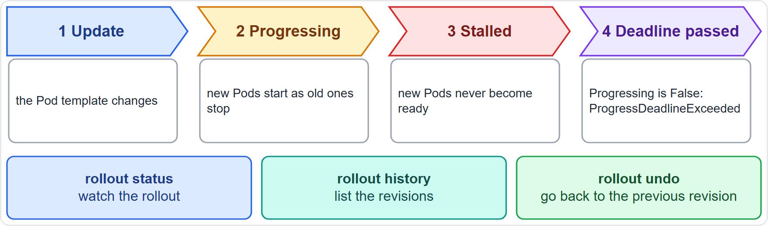
Stuck and Failed Rollouts
Module 11
A rollout can stall because of quota, readiness probe failures, image pull errors, permissions, limit ranges or application misconfiguration
progressDeadlineSeconds is how long the controller waits before it reports no progress; it defaults to 600 seconds
Kubernetes only reports ProgressDeadlineExceeded; it does not roll back for you
rollout status watches, rollout history lists revisions, rollout undo goes back
EXAM TIP Status to see it, history to choose, undo to go back.
KCNA Exam Prep Masterclass | Kubernetes and Cloud Native Associate
Module 11: Debugging Applications and Rollouts
3 / 18
Notes:
A rollout can stall for several reasons: quota, readiness probe failures, image pull errors, permissions, limit ranges, or application misconfiguration. The progress deadline seconds field is how long the controller waits before it reports no progress. It defaults to six hundred seconds. After that, the Deployment reports Progress Deadline Exceeded. Kubernetes only reports this. It does not roll back for you. Three commands help. Rollout status watches, rollout history lists revisions, and rollout undo goes back. Exam tip: status to see it, history to choose, undo to go back.

Slide 4
Probes That Misbehave
Module 11
Probe | When it is wrong
Liveness | too strict: healthy containers are restarted, which can cause cascading failures under load
Readiness | failing: the Pod is removed from the EndpointSlices, so Services send it no traffic, and a rollout cannot finish
Startup | missing for a slow starter: the liveness probe may kill the container before it is up
Liveness does not wait for readiness: use initialDelaySeconds or a startup probe
A readiness probe that never succeeds shows up as new Pods that never become Ready
EXAM TIP Readiness controls traffic; liveness controls restarts.
KCNA Exam Prep Masterclass | Kubernetes and Cloud Native Associate
Module 11: Debugging Applications and Rollouts
4 / 18
Notes:
Probes cause many stuck releases. A liveness probe that is too strict restarts healthy containers, and under load that can cause cascading failures. A failing readiness probe removes the Pod from the Endpoint Slices, so Services send it no traffic, and a rollout cannot finish. A missing startup probe for a slow starter lets the liveness probe kill the container before it is up. Liveness does not wait for readiness, so use initial delay seconds or a startup probe. Exam tip: readiness controls traffic, and liveness controls restarts.

Slide 5
Image, ConfigMap and Secret Errors
Module 11
Symptom | Likely cause | First move
ImagePullBackOff | wrong image name or tag, or a private registry with no imagePullSecret | fix the reference or add the secret
CrashLoopBackOff | an application error, or a configuration error such as a wrong environment variable or a missing file | logs --previous, then the settings
Event about a Secret | the referenced Secret does not exist; the kubelet keeps retrying | create it before the Pods that need it
Empty value | an optional ConfigMap or key is missing | create it, or check the key name
EXAM TIP Read the Pod's events first: they name the missing image or Secret.
KCNA Exam Prep Masterclass | Kubernetes and Cloud Native Associate
Module 11: Debugging Applications and Rollouts
5 / 18
Notes:
Four symptoms to match to causes. Image Pull Back Off usually means a wrong image name or tag, or a private registry with no image pull secret, so fix the reference or add the secret. Crash Loop Back Off means an application error, or a configuration error such as a wrong environment variable or a missing file. Read the previous logs, then the settings. An event about a Secret means the referenced Secret does not exist. The kube let keeps retrying, so create it before the Pods that need it. And an empty value means an optional Config Map or key is missing. Exam tip: read the Pod's events first.

Slide 6
Looking Inside a Running Application
Module 11
logs --previous shows the last output of the crashed container
exec opens a shell in a container, if the image has a shell
port-forward connects a local port to a port in a Pod, to test the application directly
kubectl debug adds an ephemeral container to a running Pod, which helps when the image has no shell
TERMINAL
kubectl logs orders --previous
kubectl exec -it orders -- sh
kubectl port-forward pods/orders 8080:80
kubectl debug -it orders --image=busybox --target=orders
Four ways to look at an application
EXAM TIP exec needs a shell in the image; debug brings its own.
KCNA Exam Prep Masterclass | Kubernetes and Cloud Native Associate
Module 11: Debugging Applications and Rollouts
6 / 18
Notes:
Four commands let you look inside. Kube control logs with the previous option shows the last output of the crashed container. Exec opens a shell in a container, if the image has a shell. Port forward connects a local port to a port in a Pod, so you can test the application directly. And kube control debug adds an ephemeral container to a running Pod, which helps when the image has no shell. The snippet shows all four against the orders Pod. Exam tip: exec needs a shell in the image, and debug brings its own.

Slide 7
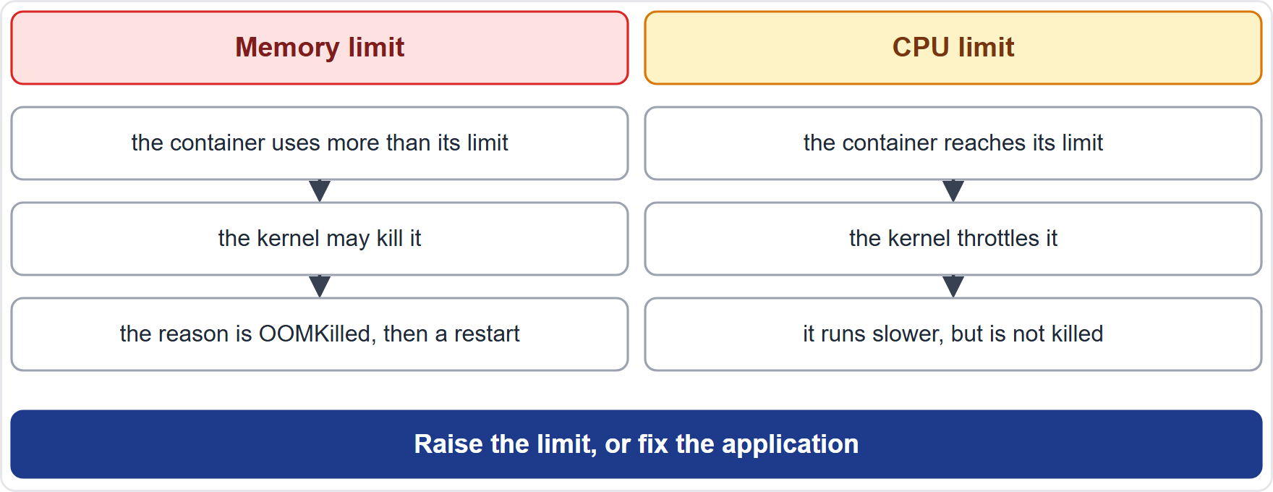
Resource Problems: OOMKilled and Throttling
Module 11
Memory: over its limit, the container may be killed, with the reason OOMKilled, and then restarted
CPU: the limit is enforced by throttling: the container is slowed, not killed
A throttled container is slow, while an OOM-killed container restarts
Check kubectl top and the limits, then raise them or fix the application
EXAM TIP Over the memory limit: killed. Over the CPU limit: slowed.
KCNA Exam Prep Masterclass | Kubernetes and Cloud Native Associate
Module 11: Debugging Applications and Rollouts
7 / 18
Notes:
Limits fail in two different ways. Over its memory limit, a container may be killed, with the reason O O M Killed, and then restarted. A C P U limit is enforced by throttling. The container is slowed down, but it is not killed. So a throttled container is slow, while an O O M killed container restarts. The diagram shows the two columns. To investigate, check kube control top and the limits, and then raise them, or fix the application. Exam tip: over the memory limit, killed. Over the C P U limit, slowed.

Slide 8
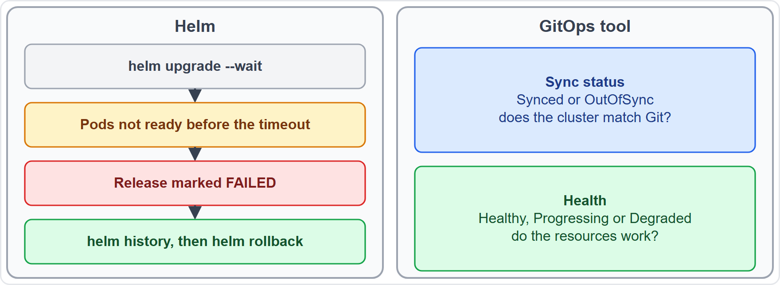
Helm and GitOps Failures
Module 11
Helm: with --wait, a release is marked FAILED if its Pods are not ready within the timeout, five minutes by default; helm history shows it and helm rollback returns
GitOps: OutOfSync means the cluster differs from Git; Degraded means resources are failing, for example a crash loop
The two are independent: an application can be Synced and Degraded, or OutOfSync after a webhook changed an object
EXAM TIP OutOfSync is about Git; Degraded is about the workload.
KCNA Exam Prep Masterclass | Kubernetes and Cloud Native Associate
Module 11: Debugging Applications and Rollouts
8 / 18
Notes:
Release tools add their own failure states. With Helm, when you use the wait option, a release is marked failed if its Pods are not ready within the timeout, which is five minutes by default. Helm history shows it, and helm rollback returns to an earlier revision. With Git Ops, two questions are separate. Out Of Sync means the cluster differs from Git. Degraded means resources are failing, for example a crash loop. An application can be Synced and Degraded. It can also be Out Of Sync after a webhook changed an object. Exam tip: Out Of Sync is about Git, and Degraded is about the workload.

Slide 9
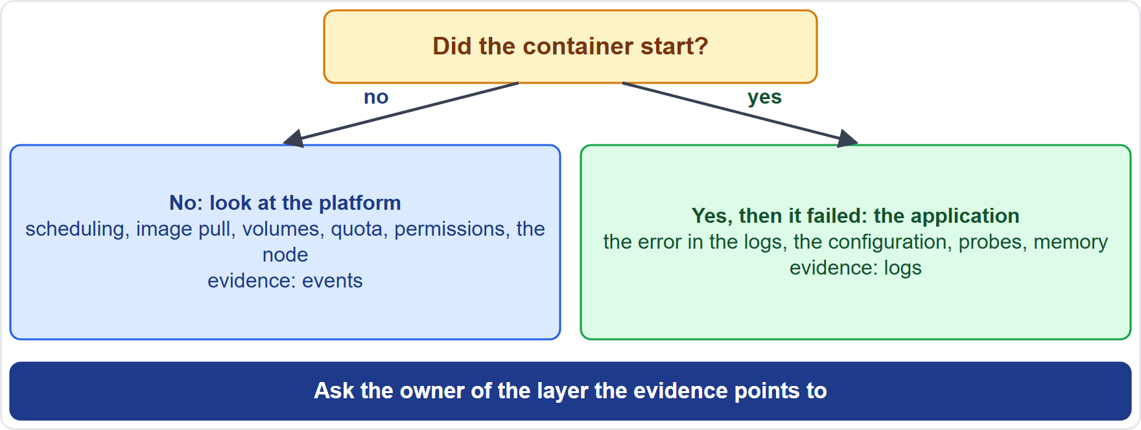
Application Fault or Platform Fault?
Module 11
Ask first: did the container start? If not, look at scheduling, image pull, volumes, quota, permissions and the node
If it started and then failed, look at the logs, configuration, probes and memory
Events point to the platform; logs point to the application
A failed Helm or GitOps release is usually one of these two, seen through a tool
EXAM TIP Events for the platform, logs for the application.
KCNA Exam Prep Masterclass | Kubernetes and Cloud Native Associate
Module 11: Debugging Applications and Rollouts
9 / 18
Notes:
The last skill is deciding who owns the fix. Ask first: did the container start? If not, look at the platform: scheduling, image pull, volumes, quota, permissions and the node. Events point to these. If it started and then failed, look at the application: the logs, the configuration, the probes and the memory. Logs point to these. A failed Helm or Git Ops release is usually one of these two, seen through a tool. Exam tip: events for the platform, logs for the application.

Slide 10
Module Recap
Module 11
1
Rollouts
2
Probes
3
Errors
status, history and undo; the progress deadline only reports a stall
readiness controls traffic, liveness controls restarts, startup protects slow starters
wrong image, bad settings or a missing Secret; read the events and logs --previous
4
Tools
5
Limits
6
Delivery tools
exec, port-forward and ephemeral containers through kubectl debug
memory over the limit is OOMKilled, CPU over the limit is throttled
Helm FAILED after the timeout; GitOps OutOfSync versus Degraded; events for the platform, logs for the application
KCNA Exam Prep Masterclass | Kubernetes and Cloud Native Associate
Module 11: Debugging Applications and Rollouts
10 / 18
Notes:
To recap. For rollouts, use status, history and undo, and remember that the progress deadline only reports a stall. For probes, readiness controls traffic, liveness controls restarts, and startup protects slow starters. For errors, look for a wrong image, bad settings or a missing Secret, and read the events and the previous logs. For tools, use exec, port forward, and ephemeral containers through kube control debug. For limits, memory over the limit is O O M Killed, and C P U over the limit is throttled. And for delivery tools, Helm marks a release failed after the timeout, and Git Ops separates Out Of Sync from Degraded. Now seven practice questions.

Slide 11
Practice Question 1
Module 11
Q1
A rollout is stuck, and the progress deadline has passed. What does Kubernetes do?
A
It rolls the Deployment back to the previous revision on its own, and it deletes the new ReplicaSet with its Pods
B
It reports the stall in the status with the reason ProgressDeadlineExceeded, and takes no other action
C
It scales the Deployment to zero until someone fixes the Pod template of the release
D
It restarts every node that runs a Pod of the Deployment, so that the update can finish
KCNA Exam Prep Masterclass | Kubernetes and Cloud Native Associate
Module 11: Debugging Applications and Rollouts
11 / 18
Notes:
Question one. A rollout is stuck, and the progress deadline has passed. What does Kubernetes do? The four options are on the screen.
[PAUSE 12]
The answer is B. After the deadline the Progressing condition becomes False, with the reason Progress Deadline Exceeded. Kubernetes does not roll back by itself, although a higher-level tool can act on the condition.

Slide 12
Practice Question 2
Module 11
Q2
The new Harbor Books storefront release is stuck, and the team wants to return to the previous version quickly. Which command does that?
A
kubectl rollout status deployment/storefront, which watches the progress of the rollout
B
kubectl rollout history deployment/storefront, which lists the revisions that exist
C
kubectl delete deployment storefront, which removes the Deployment and its Pods
D
kubectl rollout undo deployment/storefront, which goes back to the previous revision
KCNA Exam Prep Masterclass | Kubernetes and Cloud Native Associate
Module 11: Debugging Applications and Rollouts
12 / 18
Notes:
Question two. The new Harbor Books storefront release is stuck, and the team wants to return to the previous version quickly. Which command does that? The four options are on the screen.
[PAUSE 12]
The answer is D. The undo command returns the Deployment to its previous revision. Status and history only show information, and deleting the Deployment removes the application instead of restoring it.

Slide 13
Practice Question 3
Module 11
Q3
New Pods of a Deployment keep failing their readiness probe, although their logs show no errors. What is the effect?
A
The Pods receive no Service traffic, because they are removed from the EndpointSlices, and the rollout cannot finish
B
The kubelet restarts the Pods again and again, because a readiness failure is treated as a crash
C
The Pods are evicted from their nodes at once, because the scheduler reads the probe results
D
The Deployment is scaled up automatically, because failing Pods count as extra demand
KCNA Exam Prep Masterclass | Kubernetes and Cloud Native Associate
Module 11: Debugging Applications and Rollouts
13 / 18
Notes:
Question three. New Pods of a Deployment keep failing their readiness probe, although their logs show no errors. What is the effect? The four options are on the screen.
[PAUSE 12]
The answer is A. A failing readiness probe removes the Pod from the Endpoint Slices of its Services, so it gets no traffic and does not count as ready for the rollout. Restarts come from failing liveness probes.

Slide 14
Practice Question 4
Module 11
Q4
A Harbor Books Pod stays in an error state, and its events say that the Secret it references does not exist. What should the team do?
A
Raise the memory limit of the container, because a missing Secret means that the container has too little memory
B
Add a readiness probe to the Pod, so that the kubelet can find the Secret by itself
C
Create the Secret in the namespace of the Pod, and the kubelet will retry running the Pod
D
Delete the node that runs the Pod, so that its Secrets are copied to another node
KCNA Exam Prep Masterclass | Kubernetes and Cloud Native Associate
Module 11: Debugging Applications and Rollouts
14 / 18
Notes:
Question four. A Harbor Books Pod stays in an error state, and its events say that the Secret it references does not exist. What should the team do? The four options are on the screen.
[PAUSE 12]
The answer is C. The kube let keeps retrying a Pod whose Secret cannot be fetched, and reports an event, so creating the Secret fixes it. Memory limits, probes and nodes are unrelated to a missing Secret.

Slide 15
Practice Question 5
Module 11
Q5
The image of a Pod has no shell, so kubectl exec cannot open one. Which command lets the team troubleshoot inside that Pod?
A
kubectl port-forward, which forwards a local port to a port in the Pod
B
kubectl debug, which adds an ephemeral container with its own tools to the Pod
C
kubectl rollout undo, which returns the Deployment to the previous revision and replaces the Pods again
D
kubectl top pod, which shows the CPU and memory use of the Pod
KCNA Exam Prep Masterclass | Kubernetes and Cloud Native Associate
Module 11: Debugging Applications and Rollouts
15 / 18
Notes:
Question five. The image of a Pod has no shell, so kube control exec cannot open one. Which command lets the team troubleshoot inside that Pod? The four options are on the screen.
[PAUSE 12]
The answer is B. The debug command adds an ephemeral container with its own image and shell to a running Pod. Port forwarding tests connectivity, undo changes the revision, and top shows resource use.

Slide 16
Practice Question 6
Module 11
Q6
A Harbor Books container is restarted again and again, and its last state shows the reason OOMKilled. What does that tell the team?
A
The node ran out of disk space, so the kubelet evicted the Pod from the node and started it again elsewhere
B
The image could not be pulled from the registry, so the container was never able to start at all
C
The container reached its CPU limit and was throttled until it stopped working and had to restart
D
The container used more memory than its limit, so the team should check for a leak or raise the limit
KCNA Exam Prep Masterclass | Kubernetes and Cloud Native Associate
Module 11: Debugging Applications and Rollouts
16 / 18
Notes:
Question six. A Harbor Books container is restarted again and again, and its last state shows the reason O O M Killed. What does that tell the team? The four options are on the screen.
[PAUSE 12]
The answer is D. O O M Killed means that the container used more memory than its limit allowed, so the team should look for a leak or raise the limit. A C P U limit slows a container down but does not kill it, an image problem shows as Image Pull Back Off, and node pressure eviction ends the Pod instead of restarting a container.

Slide 17
Practice Question 7
Module 11
Q7
A GitOps tool shows an application as Synced but Degraded. What does that tell you?
A
The cluster matches what is in Git, but some resources are failing, for example a crash-looping Pod
B
The cluster differs from Git, and the tool has not yet been told to apply the change
C
The Git repository is unreachable, so the tool is unable to compare the cluster with it
D
The sync itself failed, so the tool left the resources of the application unchanged
KCNA Exam Prep Masterclass | Kubernetes and Cloud Native Associate
Module 11: Debugging Applications and Rollouts
17 / 18
Notes:
Question seven. A Git Ops tool shows an application as Synced but Degraded. What does that tell you? The four options are on the screen.
[PAUSE 12]
The answer is A. Sync status asks whether the cluster matches Git, and health asks whether the resources work. Synced with Degraded means the manifests were applied, but a workload, such as a crash-looping Pod, is unhealthy.

Slide 18
Answers at a Glance
Module 11
Question | Answer | Why
Q1 | B | It reports ProgressDeadlineExceeded and does nothing else
Q2 | D | rollout undo goes back to the previous revision
Q3 | A | A failing readiness probe removes the Pod from the endpoints
Q4 | C | Create the missing Secret; the kubelet retries
Q5 | B | kubectl debug adds an ephemeral container
Q6 | D | OOMKilled means the memory limit was exceeded
Q7 | A | Synced matches Git, Degraded means failing resources
KCNA Exam Prep Masterclass | Kubernetes and Cloud Native Associate
Module 11: Debugging Applications and Rollouts
18 / 18
Notes:
Here are the answers at a glance. Question one, B: it reports Progress Deadline Exceeded, and does nothing else. Question two, D: rollout undo goes back to the previous revision. Question three, A: a failing readiness probe removes the Pod from the endpoints. Question four, C: create the missing Secret, and the kube let retries. Question five, B: kube control debug adds an ephemeral container. Question six, D: O O M Killed means the container exceeded its memory limit. Question seven, A: Synced matches Git, and Degraded means failing resources.

