Slide 1
Module 12: Cloud Native Architecture and Principles
What "cloud native" means, and how such systems are designed
Cloud Native Architecture · Principles
YOU WILL BE ABLE TO
State the CNCF cloud native definition and its example technologies
Compare a monolith with microservices, and recognize twelve-factor and resilience ideas
Describe serverless, event-driven design and open standards
Match the personas: developer, platform engineer, SRE, DevOps, security, FinOps
KCNA Exam Prep Masterclass
Module 12
Notes:
Welcome to Module 12: Cloud Native Architecture and Principles. This module is in the Cloud Native Architecture domain, and it covers the topic called Cloud Native Architecture and Principles. By the end you will be able to do four things. State the C N C F cloud native definition and its example technologies. Compare a monolith with microservices, and recognize twelve-factor and resilience ideas. Describe serverless, event-driven design and open standards. And match the personas: developer, platform engineer, S R E, DevOps, security and FinOps.

Slide 2
Case Check-In: Harbor Books Rethinks Its Design
Module 12
CASE CHECK-IN · Harbor Books
The shop began as one program, and it is now split into storefront, catalog, orders and more
The team wants each part to fail and recover alone, and the order-confirmation job to run only when needed
A platform team offers self-service tools, and a site reliability engineer (SRE) watches production
In this module you learn the vocabulary behind these choices
KCNA Exam Prep Masterclass | Kubernetes and Cloud Native Associate
Module 12: Cloud Native Architecture and Principles
2 / 16
Notes:
The Harbor Books shop began as one program. It is now split into storefront, catalog, orders and more. The team wants each part to fail and recover alone, and the order confirmation job to run only when needed. A platform team offers self-service tools, and a site reliability engineer, an S R E, watches production. In this module you learn the vocabulary behind these choices.

Slide 3
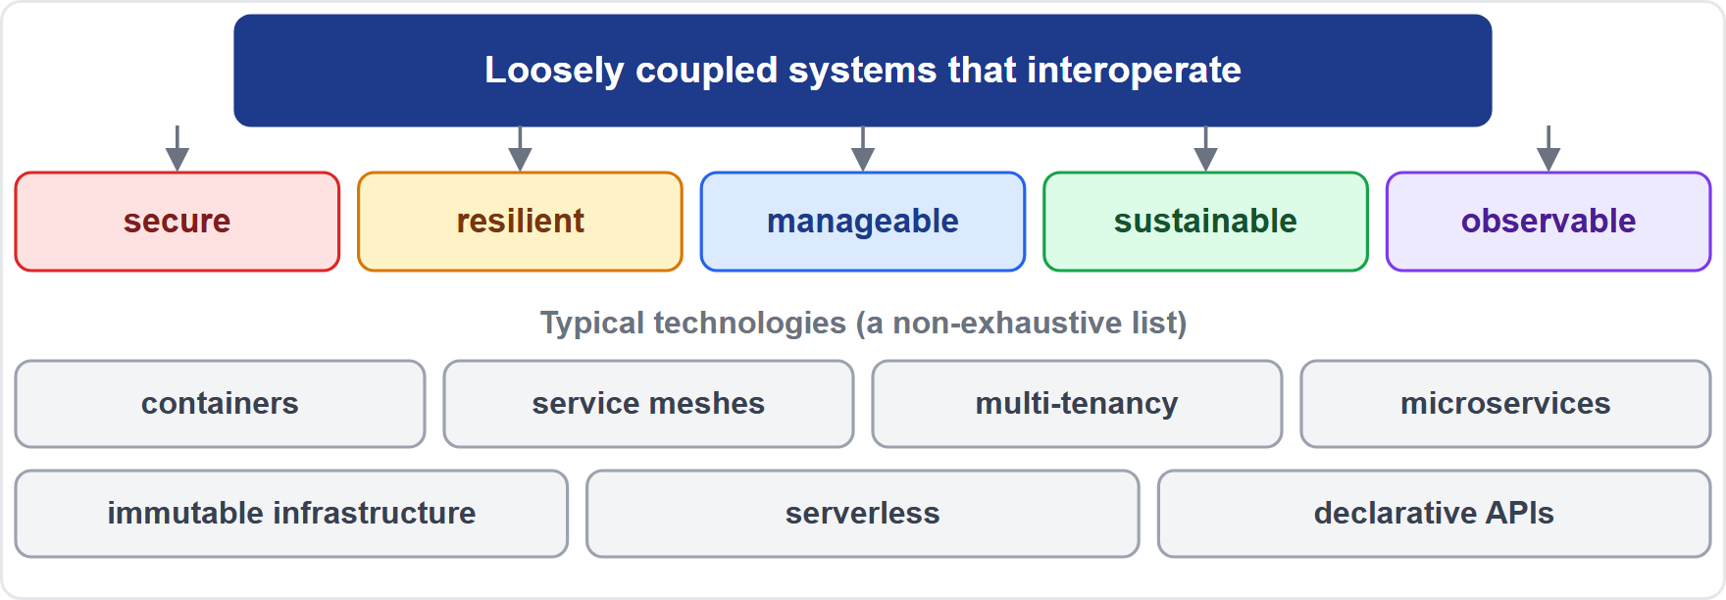
The CNCF Cloud Native Definition
MOVING
Module 12
Cloud native practices let organizations build and run workloads in public, private and hybrid clouds, at scale, in a repeatable way
Its marks: loosely coupled systems that interoperate, and that are secure, resilient, manageable, sustainable and observable
Typical examples: serverless, declarative APIs, containers, microservices, service meshes, multi-tenancy and immutable infrastructure; the list is non-exhaustive
As of 30 October 2026: the current definition is version 1.1, approved in February 2024
EXAM TIP Loosely coupled, plus secure, resilient, manageable, sustainable and observable.
KCNA Exam Prep Masterclass | Kubernetes and Cloud Native Associate
Module 12: Cloud Native Architecture and Principles
3 / 16
Notes:
This slide is tagged moving. The C N C F definition says cloud native practices let organizations build and run workloads in public, private and hybrid clouds, at scale, in a repeatable way. Its marks are loosely coupled systems that interoperate, and that are secure, resilient, manageable, sustainable and observable. Typical examples are serverless, declarative A P Is, containers, microservices, service meshes, multi-tenancy and immutable infrastructure. The list is non-exhaustive. As of the thirtieth of October, twenty twenty-six, the current definition is version one point one, approved in February, twenty twenty-four. Exam tip: loosely coupled, plus the five qualities.

Slide 4
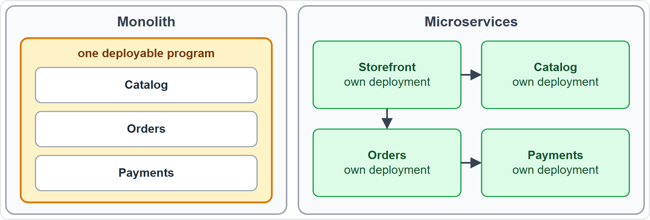
Monolith versus Microservices
Module 12
Monolith: all functionality in one deployable program; the simplest place to start, but harder to maintain as it grows
Microservices: independent services, each focused on one function, that appear to the user as one application
Services can change and be released faster; the price is more parts to network, observe and secure (Module 6, Module 8 and Module 13)
A monolith is usually tightly coupled; microservices aim to be loosely coupled
EXAM TIP A monolith is one program; microservices are many small services.
KCNA Exam Prep Masterclass | Kubernetes and Cloud Native Associate
Module 12: Cloud Native Architecture and Principles
4 / 16
Notes:
A monolith holds all functionality in one deployable program. It is the simplest place to start, but it gets harder to maintain as it grows, and as more developers share the codebase. Microservices are independent services, each focused on one function, that appear to the user as one application. They can change and be released faster. The price is more parts to network, observe and secure, as in Module 6, Module 8 and Module 13. The diagram shows one large box, beside four small services. Exam tip: a monolith is one program, and microservices are many small services.

Slide 5
Twelve-Factor Ideas and Resilience
BEYOND THE CURRICULUM
Module 12
Idea | What it says
Config in the environment | settings that vary between deploys live outside the code
Stateless processes | the app runs as one or more stateless processes
Disposability | processes start and stop at a moment's notice: fast startup, graceful shutdown
Logs as event streams | the app writes events to its output, and the platform collects them
Timeout | how long to wait for a reply, so a call succeeds or fails in a predictable time
Retry | try again a limited number of times after a transient failure
Circuit breaker | stop calling a failing service once a limit is reached
A service mesh (Module 6) can add timeouts, retries and circuit breakers without code changes
EXAM TIP Retries heal blips; a circuit breaker stops hammering a failing service.
KCNA Exam Prep Masterclass | Kubernetes and Cloud Native Associate
Module 12: Cloud Native Architecture and Principles
5 / 16
Notes:
This slide is tagged beyond the curriculum. Four ideas come from the twelve-factor manifesto. Keep config in the environment, outside the code. Run the app as stateless processes. Make processes disposable: they start and stop at a moment's notice, with fast startup and graceful shutdown. And treat logs as event streams. Three resilience settings matter too. A timeout is how long to wait for a reply, so a call succeeds or fails in a predictable time. A retry tries again a limited number of times. And a circuit breaker stops calling a failing service once a limit is reached. A service mesh can add these without code changes. Exam tip: retries heal blips, and a circuit breaker stops hammering a failing service.

Slide 6
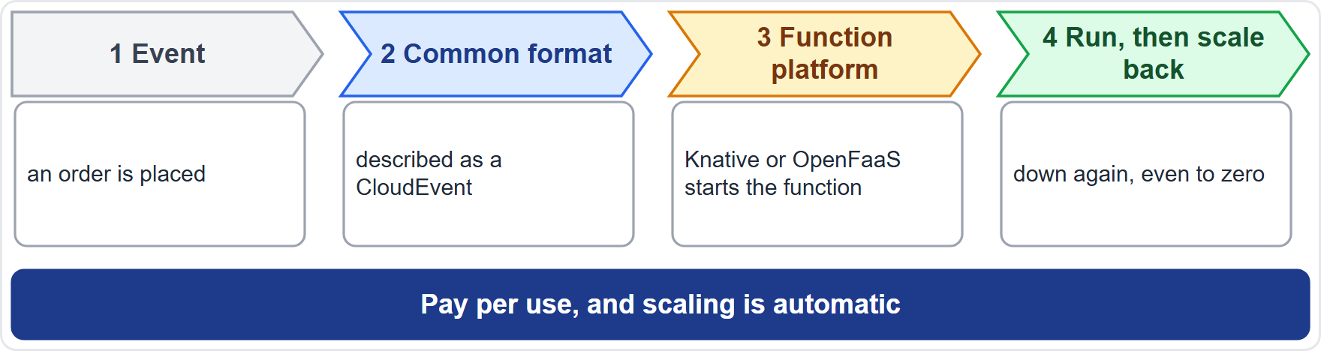
Serverless, Functions and Event-Driven Design
ARCHIVED TOPIC
Module 12
Serverless: servers are abstracted away from you, you pay per use, and scaling is automatic
Knative Serving and OpenFaaS run serverless-style functions and containers on Kubernetes; OpenFaaS can scale to zero
Autoscaling adds and removes capacity by itself (Module 5); serverless platforms go further and can scale to zero
Event-driven design: components react to events, which are changes of state
CloudEvents describes event data in a common format, for interoperability
EXAM TIP Serverless means no servers to manage; event-driven means reacting to changes.
KCNA Exam Prep Masterclass | Kubernetes and Cloud Native Associate
Module 12: Cloud Native Architecture and Principles
6 / 16
Notes:
This slide is tagged archived topic. With serverless, servers are abstracted away from you. You pay per use, and scaling is automatic. Knative Serving and OpenFaaS run serverless-style functions and containers on Kubernetes, and OpenFaaS can scale to zero. Event-driven design means components react to events, which are changes of state. CloudEvents describes event data in a common format, for interoperability. In the diagram, an order event triggers a function, which runs and then scales back down. Autoscaling links back to Module 5. Exam tip: serverless means no servers to manage, and event-driven means reacting to changes.

Slide 7
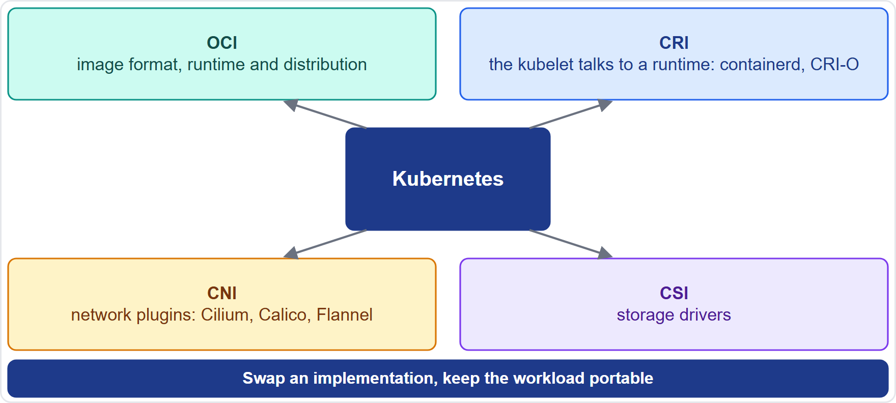
Open Standards and Portability
ARCHIVED TOPIC
Module 12
OCI: open specifications for the image format, runtime and distribution of containers
CRI: how the kubelet talks to a container runtime, for example containerd or CRI-O
CNI: how network plugins connect Pods; CSI: how storage drivers plug in
Open interfaces let you swap an implementation and keep workloads portable across hybrid and multi-cloud setups
EXAM TIP OCI for images, CRI for runtimes, CNI for networks, CSI for storage.
KCNA Exam Prep Masterclass | Kubernetes and Cloud Native Associate
Module 12: Cloud Native Architecture and Principles
7 / 16
Notes:
This slide is tagged archived topic. Four open standards surround Kubernetes. O C I defines the image format, runtime and distribution of containers. C R I defines how the kube let talks to a container runtime, for example containerd or C R I O. C N I defines how network plugins connect Pods, and C S I defines how storage drivers plug in. Because the interfaces are open, you can swap an implementation, and keep workloads portable across hybrid and multi-cloud setups. Exam tip: O C I for images, C R I for runtimes, C N I for networks, and C S I for storage.

Slide 8
Personas and Platform Engineering
ARCHIVED TOPIC
Module 12
Persona | Focus
Developer | writes the application and ships it along the delivery path
Platform engineer | builds self-service tools and workflows that developers use
SRE | applies software engineering to operations, so that code running in production works
DevOps | teams own the whole path from development to production operations
Security (DevSecOps) | adds security responsibilities to that path (Module 8)
FinOps | shared financial accountability for technology spend between engineering, finance and business
Backstage, hosted by the CNCF, is a framework for a developer portal that brings tools, services and documentation together
EXAM TIP Platform engineers build self-service tools; SREs keep production reliable.
KCNA Exam Prep Masterclass | Kubernetes and Cloud Native Associate
Module 12: Cloud Native Architecture and Principles
8 / 16
Notes:
This slide is tagged archived topic. Six personas to know. A developer writes the application and ships it along the delivery path. A platform engineer builds self-service tools and workflows that developers use. An S R E applies software engineering to operations, so that code running in production works. In DevOps, teams own the whole path from development to production operations. Security, or DevSecOps, adds security responsibilities to that path, as in Module 8. And FinOps is shared financial accountability for technology spend between engineering, finance and business. Backstage, hosted by the C N C F, is a framework for a developer portal. Exam tip: platform engineers build self-service tools, and S R Es keep production reliable.

Slide 9
What the Exam Asks: Cloud Native Architecture
Module 12
The definition
Monolith or microservices
Serverless or event-driven
loosely coupled systems that are secure, resilient, manageable, sustainable and observable; the technology list is non-exhaustive
one deployable program, or independent services
no servers to manage and automatic scaling, or reacting to events
OCI, CRI, CNI or CSI
SRE, DevOps or platform engineering
Immutable infrastructure
images, runtimes, networks or storage
reliability in production, shared ownership, or self-service tools
replace rather than change; containers are the example
EXAM TIP For an architecture question, match the term to the problem it solves.
KCNA Exam Prep Masterclass | Kubernetes and Cloud Native Associate
Module 12: Cloud Native Architecture and Principles
9 / 16
Notes:
Six pairs to keep apart. The definition: loosely coupled systems that are secure, resilient, manageable, sustainable and observable, and the technology list is non-exhaustive. Monolith or microservices: one deployable program, or independent services. Serverless or event-driven: no servers to manage and automatic scaling, or reacting to events. O C I, C R I, C N I or C S I: images, runtimes, networks or storage. S R E, DevOps or platform engineering: reliability in production, shared ownership, or self-service tools. And immutable infrastructure: replace rather than change, with containers as the example. Exam tip: match the term to the problem it solves.

Slide 10
Module Recap
Module 12
1
Definition
2
Design
3
Serverless and events
loosely coupled systems that are secure, resilient, manageable, sustainable and observable
monolith versus microservices; twelve-factor ideas; timeouts, retries and circuit breakers
pay per use, automatic scaling, CloudEvents
4
Standards
5
Personas
OCI, CRI, CNI and CSI keep parts swappable and workloads portable
developer, platform engineer, SRE, DevOps, security and FinOps
KCNA Exam Prep Masterclass | Kubernetes and Cloud Native Associate
Module 12: Cloud Native Architecture and Principles
10 / 16
Notes:
To recap. The definition is loosely coupled systems that are secure, resilient, manageable, sustainable and observable. For design, compare monolith with microservices, and know the twelve-factor ideas, and timeouts, retries and circuit breakers. Serverless means pay per use and automatic scaling, and CloudEvents describes events. The standards O C I, C R I, C N I and C S I keep parts swappable and workloads portable. And the personas are developer, platform engineer, S R E, DevOps, security and FinOps. Now five practice questions.

Slide 11
Practice Question 1
Module 12
Q1
According to the CNCF definition, which properties characterize cloud native systems?
A
Tightly coupled systems that are cheap, portable, small and simple to operate, whatever they are built from
B
Monolithic systems that are secure, scalable and run only in a public cloud
C
Loosely coupled systems that are secure, resilient, manageable, sustainable and observable
D
Open source systems that are free of charge and written in a single language
KCNA Exam Prep Masterclass | Kubernetes and Cloud Native Associate
Module 12: Cloud Native Architecture and Principles
11 / 16
Notes:
Question one. According to the C N C F definition, which properties characterize cloud native systems? The four options are on the screen.
[PAUSE 12]
The answer is C. The definition describes loosely coupled systems that are secure, resilient, manageable, sustainable and observable. It names public, private and hybrid clouds, and does not require any one language or license.

Slide 12
Practice Question 2
Module 12
Q2
Which statement compares a monolith with microservices correctly?
A
A monolith is one deployable program, while microservices are independent services that each focus on one function
B
A monolith runs in containers, while microservices run on virtual machines of a cloud, and neither runs anywhere else
C
A monolith is split into services that share a database, while microservices are a single program
D
A monolith is faster to change, while microservices are released once a year at most
KCNA Exam Prep Masterclass | Kubernetes and Cloud Native Associate
Module 12: Cloud Native Architecture and Principles
12 / 16
Notes:
Question two. Which statement compares a monolith with microservices correctly? The four options are on the screen.
[PAUSE 12]
The answer is A. A monolith holds all functionality in a single deployable program. Microservices break an application into independent services, each focused on a specific function, which can be changed and released faster.

Slide 13
Practice Question 3
Module 12
Q3
Harbor Books wants an order-confirmation function that runs only when an order event arrives, and scales down to zero otherwise. Which fits best?
A
A DaemonSet, which keeps one copy of the function running on every node all the time
B
A StatefulSet with a PersistentVolume for each replica, so that the function keeps its state between orders
C
A Deployment with a fixed number of replicas that wait for requests around the clock
D
A serverless platform such as OpenFaaS, which runs functions on events and can scale to zero
KCNA Exam Prep Masterclass | Kubernetes and Cloud Native Associate
Module 12: Cloud Native Architecture and Principles
13 / 16
Notes:
Question three. Harbor Books wants an order confirmation function that runs only when an order event arrives, and scales down to zero otherwise. Which fits best? The four options are on the screen.
[PAUSE 12]
The answer is D. Serverless platforms run functions on demand, scale automatically and can scale to zero, so nothing runs between orders. The other objects keep a fixed set of Pods running all the time.

Slide 14
Practice Question 4
Module 12
Q4
Which standard defines how the kubelet talks to a container runtime?
A
CNI, the Container Network Interface, which defines how network plugins connect Pods to the cluster network
B
CRI, the Container Runtime Interface used between the kubelet and the runtime
C
CSI, which defines how storage systems are exposed to containers
D
CloudEvents, which defines a common format for describing event data
KCNA Exam Prep Masterclass | Kubernetes and Cloud Native Associate
Module 12: Cloud Native Architecture and Principles
14 / 16
Notes:
Question four. Which standard defines how the kube let talks to a container runtime? The four options are on the screen.
[PAUSE 12]
The answer is B. The Container Runtime Interface is how the kube let talks to a runtime such as containerd or C R I O. C N I is for networking, C S I for storage, and CloudEvents for event data.

Slide 15
Practice Question 5
Module 12
Q5
Which role builds self-service tools and workflows so that developers can ship software faster?
A
A site reliability engineer, who makes sure that code running in production works properly
B
A FinOps practitioner, who shares financial accountability for technology spend
C
A platform engineer, who builds a self-service platform for developers
D
A security engineer, who adds security responsibilities to the delivery path
KCNA Exam Prep Masterclass | Kubernetes and Cloud Native Associate
Module 12: Cloud Native Architecture and Principles
15 / 16
Notes:
Question five. Which role builds self-service tools and workflows so that developers can ship software faster? The four options are on the screen.
[PAUSE 12]
The answer is C. Platform engineering builds tools and processes, like a self-service station, that empower developers. S R Es focus on production reliability, FinOps on cost accountability, and DevSecOps on security.

Slide 16
Answers at a Glance
Module 12
Question | Answer | Why
Q1 | C | Loosely coupled, secure, resilient, manageable, sustainable, observable
Q2 | A | A monolith is one program; microservices are independent services
Q3 | D | A serverless platform runs functions on events and scales to zero
Q4 | B | CRI connects the kubelet and the runtime
Q5 | C | Platform engineers build self-service tools
KCNA Exam Prep Masterclass | Kubernetes and Cloud Native Associate
Module 12: Cloud Native Architecture and Principles
16 / 16
Notes:
Here are the answers at a glance. Question one, C: loosely coupled, secure, resilient, manageable, sustainable, observable. Question two, A: a monolith is one program, and microservices are independent services. Question three, D: a serverless platform runs functions on events and scales to zero. Question four, B: C R I connects the kube let and the runtime. Question five, C: platform engineers build self-service tools.

