Slide 1
Module 13: Observability and Cost
Seeing what a system does, and what it costs
Cloud Native Architecture · Observability and Cost
YOU WILL BE ABLE TO
Explain observability and the three signals: metrics, logs and traces
Describe OpenTelemetry, Prometheus and Alertmanager
Define SLI, SLO, SLA and error budget
Name the Kubernetes signals, and the basics of FinOps and OpenCost
KCNA Exam Prep Masterclass
Module 13
Notes:
Welcome to Module 13: Observability and Cost. This module is in the Cloud Native Architecture domain, and it covers the topic called Observability and Cost. By the end you will be able to do four things. Explain observability and the three signals: metrics, logs and traces. Describe Open Telemetry, Prometheus and Alertmanager. Define S L I, S L O, S L A and error budget. And name the Kubernetes signals, and the basics of Fin Ops and Open Cost.

Slide 2
Case Check-In: Harbor Books Wants to See Checkout
Module 13
CASE CHECK-IN · Harbor Books
Checkout feels slow for some customers, and the team needs metrics, logs and traces for the orders service
Management wants a latency target for checkout, and a clear view of how often it is missed
Finance wants to understand the monthly cloud bill for the shop
In this module you learn how to see the system, and what it costs
KCNA Exam Prep Masterclass | Kubernetes and Cloud Native Associate
Module 13: Observability and Cost
2 / 16
Notes:
At Harbor Books, checkout feels slow for some customers. The team needs metrics, logs and traces for the orders service. Management wants a latency target for checkout, and a clear view of how often it is missed. And finance wants to understand the monthly cloud bill for the shop. In this module you learn how to see the system, and what it costs.

Slide 3
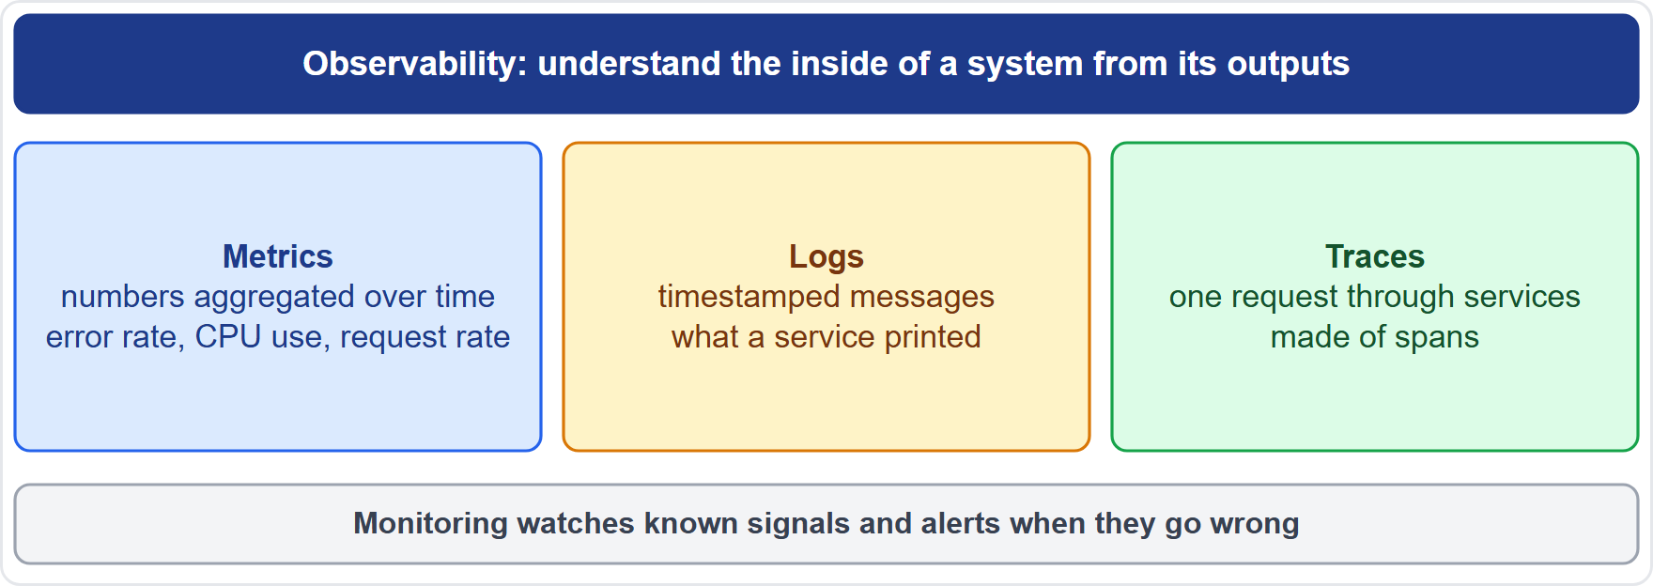
Monitoring, Observability and the Three Signals
Module 13
Observability is understanding a system's internal state from its outputs; it lets you ask new questions, even about unknown unknowns
Monitoring watches known signals and alerts when they go wrong
Metrics: numbers aggregated over time, such as error rate, CPU use and request rate
Logs: timestamped messages; traces: the path of one request through services, made of spans
Code must be instrumented to emit these signals
EXAM TIP Metrics tell you that, logs tell you what, traces tell you where.
KCNA Exam Prep Masterclass | Kubernetes and Cloud Native Associate
Module 13: Observability and Cost
3 / 16
Notes:
Observability means understanding a system's internal state from its outputs. It lets you ask new questions, even about unknown unknowns. Monitoring watches known signals, and alerts when they go wrong. Three signals feed both. Metrics are numbers aggregated over time, such as error rate, C P U use and request rate. Logs are timestamped messages. Traces follow one request through services, and are made of spans. The code must be instrumented to emit these signals. Exam tip: metrics tell you that, logs tell you what, and traces tell you where.

Slide 4
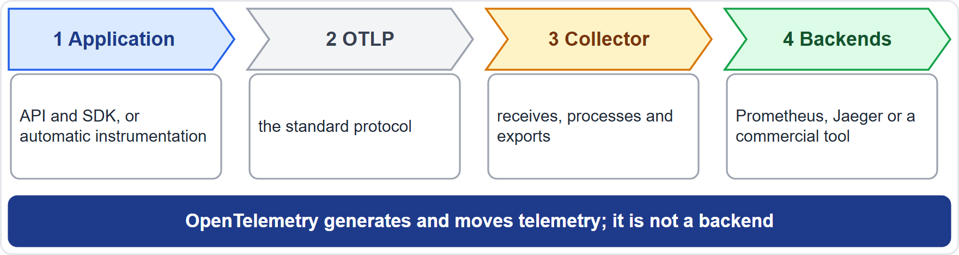
OpenTelemetry: API, SDK and Collector
Module 13
OpenTelemetry (OTel) is an open source, vendor-neutral framework to generate, export and collect traces, metrics and logs
It is not a backend: storing and showing the data is left to tools such as Prometheus and Jaeger
The API and the SDK (software development kit) instrument code; OTLP is the standard protocol; semantic conventions name common data
The Collector receives, processes and exports data, so a service can hand it off quickly
It grew out of OpenTracing and OpenCensus
EXAM TIP OpenTelemetry produces telemetry; it does not store it.
KCNA Exam Prep Masterclass | Kubernetes and Cloud Native Associate
Module 13: Observability and Cost
4 / 16
Notes:
Open Telemetry, or O Tel, is an open source, vendor-neutral framework to generate, export and collect traces, metrics and logs. It is not a backend. Storing and showing the data is left to tools such as Prometheus and Jaeger. The A P I and the S D K, the software development kit, instrument the code. O T L P is the standard protocol, and semantic conventions name common data. The Collector receives, processes and exports data, so a service can hand it off quickly. The project grew out of Open Tracing and Open Census. Exam tip: Open Telemetry produces telemetry, and it does not store it.

Slide 5
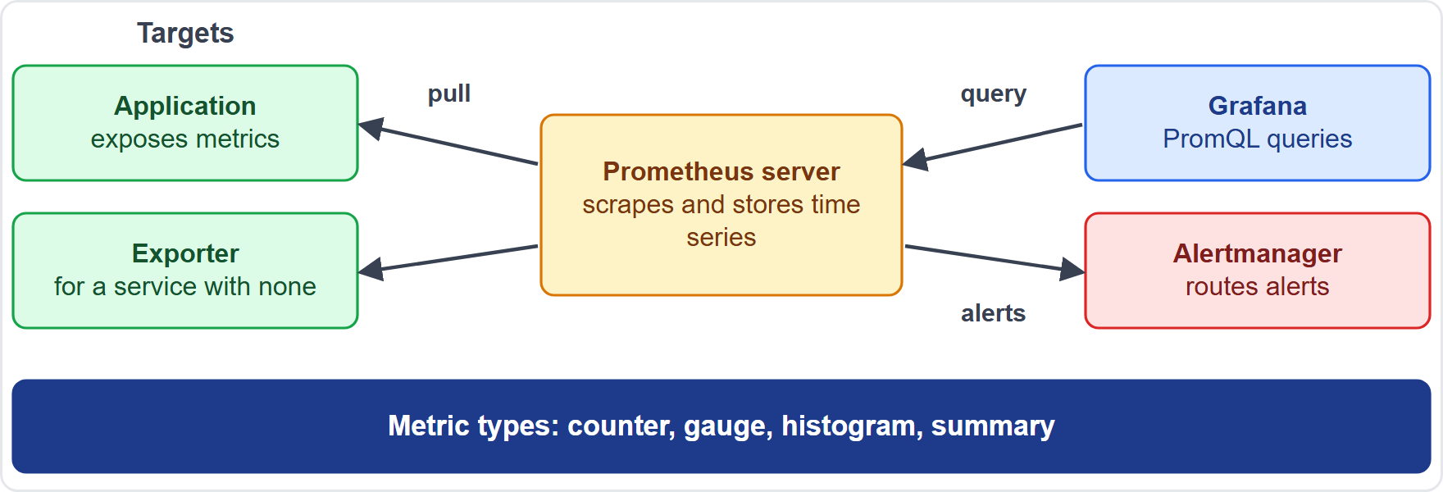
Prometheus: Pull, Exporters and PromQL
ARCHIVED TOPIC
Module 13
Prometheus is an open-source monitoring and alerting toolkit that keeps metrics as time series with labels
It pulls (scrapes) metrics over HTTP from targets; a Pushgateway serves short-lived jobs
Exporters expose metrics for services that have none; targets come from service discovery
PromQL queries the time series
Metric types: counter (only goes up), gauge (up and down), histogram (buckets), summary (quantiles)
EXAM TIP Prometheus pulls; a counter only goes up.
KCNA Exam Prep Masterclass | Kubernetes and Cloud Native Associate
Module 13: Observability and Cost
5 / 16
Notes:
This slide is tagged archived topic. Prometheus is an open-source monitoring and alerting toolkit. It keeps metrics as time series, with labels. It pulls, or scrapes, metrics over H T T P from targets. A Pushgateway serves short-lived jobs. Exporters expose metrics for services that have none of their own, and targets come from service discovery. Prom Q L queries the time series. And there are four metric types. A counter only goes up. A gauge goes up and down. A histogram counts observations in buckets. And a summary calculates quantiles. Exam tip: Prometheus pulls, and a counter only goes up.

Slide 6
Alerting and the Tool Landscape
Module 13
Tool | Role
Alertmanager | takes alerts from Prometheus, then deduplicates, groups and routes them to receivers such as email or PagerDuty
Grafana | dashboards: queries and visualizes metrics wherever they are stored
Fluent Bit | a lightweight agent that collects, processes and forwards logs, metrics and traces
Fluentd | an open-source log collector that unifies logging
Jaeger | a distributed tracing platform
Prometheus decides that an alert fires; Alertmanager decides who hears about it
EXAM TIP Alertmanager routes alerts; Grafana draws dashboards.
KCNA Exam Prep Masterclass | Kubernetes and Cloud Native Associate
Module 13: Observability and Cost
6 / 16
Notes:
Five tools to recognize. Alertmanager takes alerts from Prometheus, then deduplicates, groups and routes them to receivers such as email or Pager Duty. Grafana draws dashboards, querying and visualizing metrics wherever they are stored. Fluent Bit is a lightweight agent that collects, processes and forwards logs, metrics and traces. Fluentd is an open-source log collector that unifies logging. And Jaeger is a distributed tracing platform. Prometheus decides that an alert fires, and Alertmanager decides who hears about it. Exam tip: Alertmanager routes alerts, and Grafana draws dashboards.

Slide 7
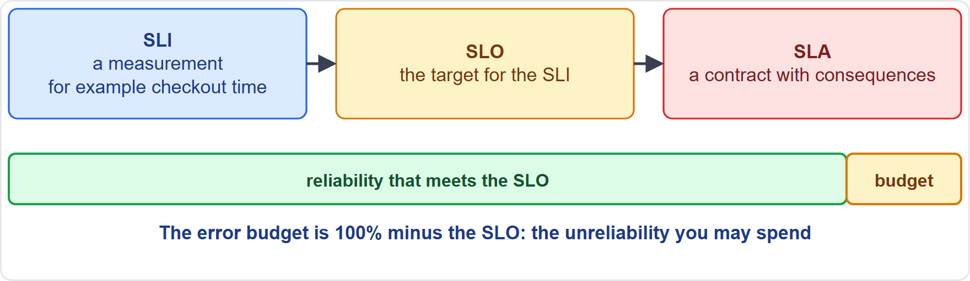
SLI, SLO, SLA and Error Budgets
Module 13
SLI: a measurement of a service's behavior, ideally from the user's point of view
SLO: the target for an SLI; it is how reliability is communicated
SLA: a contract with users, with consequences if the SLOs are missed
Error budget: 100% minus the SLO: the unreliability you may spend; when it is used up, put stability first
100% is the wrong target
EXAM TIP SLI measures, SLO targets, SLA promises.
KCNA Exam Prep Masterclass | Kubernetes and Cloud Native Associate
Module 13: Observability and Cost
7 / 16
Notes:
Three terms, and one budget. An S L I is a service level indicator: a measurement of a service's behavior, ideally from the user's point of view. An S L O is a service level objective: the target for an S L I, and the way reliability is communicated. An S L A is a service level agreement: a contract with users, with consequences if the objectives are missed. The error budget is one hundred percent minus the S L O. It is the unreliability you may spend, and when it is used up, you put stability first. One hundred percent is the wrong target. Exam tip: S L I measures, S L O targets, S L A promises.

Slide 8
Kubernetes Signals
Module 13
Signal | Source | What it tells you
Resource metrics | Metrics Server | CPU and memory of Pods and nodes, for autoscaling and kubectl top; not a monitoring system
Object state | kube-state-metrics | metrics about the state of objects, not the health of the components
Events | the API | what happened to an object: kubectl get events
Audit log | the API server | who did what through the API
Logs | containers, kubelet, control plane | what the components printed
EXAM TIP Metrics Server for autoscaling; kube-state-metrics for object state.
KCNA Exam Prep Masterclass | Kubernetes and Cloud Native Associate
Module 13: Observability and Cost
8 / 16
Notes:
Kubernetes gives you five signals. Metrics Server provides resource metrics, the C P U and memory of Pods and nodes, for autoscaling and kube control top. It is not a monitoring system. Kube state metrics gives metrics about the state of objects, not the health of the components. Events, listed with kube control get events, tell you what happened to an object. The audit log tells you who did what through the A P I. And logs show what containers, the kube let and the control plane printed. Exam tip: Metrics Server for autoscaling, and kube state metrics for object state.

Slide 9
Cost Management and FinOps
ARCHIVED TOPIC
Module 13
Term | Meaning
FinOps | an operational framework and cultural practice: engineering, finance and business share accountability for technology spend
OpenCost | an open source project that shows what Kubernetes and cloud resources cost, now and over time, and how the spend is allocated across applications and teams
Requests and limits (Module 4) and autoscaling (Module 5) shape what a workload reserves, and so what it costs
Cost needs the same visibility as reliability: measure first, then decide
EXAM TIP FinOps is a practice; OpenCost is a tool for seeing spend.
KCNA Exam Prep Masterclass | Kubernetes and Cloud Native Associate
Module 13: Observability and Cost
9 / 16
Notes:
This slide is tagged archived topic. Fin Ops is an operational framework and cultural practice. Engineering, finance and business share accountability for technology spend. Open Cost is an open source project that shows what Kubernetes and cloud resources cost, now and over time, and how the spend is allocated across applications and teams. Requests and limits, from Module 4, and autoscaling, from Module 5, shape what a workload reserves, and so what it costs. Cost needs the same visibility as reliability: measure first, then decide. Exam tip: Fin Ops is a practice, and Open Cost is a tool for seeing spend.

Slide 10
Module Recap
Module 13
1
Observability
2
OpenTelemetry
3
Prometheus
understand the inside from the outside; metrics, logs and traces
generates, exports and collects telemetry; the Collector is the hub; not a backend
pulls time series; PromQL; counter, gauge, histogram, summary; Alertmanager routes alerts
4
Tools
5
Reliability targets
6
Kubernetes signals and cost
Grafana, Fluent Bit, Fluentd and Jaeger
SLI measures, SLO targets, SLA promises; the error budget is 100% minus the SLO
Metrics Server, kube-state-metrics, events, audit; FinOps and OpenCost
KCNA Exam Prep Masterclass | Kubernetes and Cloud Native Associate
Module 13: Observability and Cost
10 / 16
Notes:
To recap. Observability means understanding the inside from the outside, through metrics, logs and traces. Open Telemetry generates, exports and collects telemetry. The Collector is the hub, and it is not a backend. Prometheus pulls time series, uses Prom Q L, has four metric types, and Alertmanager routes alerts. Grafana, Fluent Bit, Fluentd and Jaeger are the other tools. S L I measures, S L O targets, S L A promises, and the error budget is one hundred percent minus the S L O. And Kubernetes signals are Metrics Server, kube state metrics, events and the audit log, with Fin Ops and Open Cost for cost. Now five practice questions.

Slide 11
Practice Question 1
Module 13
Q1
Which signal shows the path of a single request through several services?
A
Metrics, which are numbers aggregated over a period of time
B
Traces, which are made of spans that follow a request across services
C
Logs, which are timestamped messages written by one service at a time
D
Events, which are the changes that Kubernetes records for an object
KCNA Exam Prep Masterclass | Kubernetes and Cloud Native Associate
Module 13: Observability and Cost
11 / 16
Notes:
Question one. Which signal shows the path of a single request through several services? The four options are on the screen.
[PAUSE 12]
The answer is B. A distributed trace follows one request as it propagates through services, and is built from spans. Metrics aggregate numbers, logs are messages, and Kubernetes events describe changes to objects.

Slide 12
Practice Question 2
Module 13
Q2
What does OpenTelemetry provide, and what does it leave to other tools?
A
It stores all metrics itself and leaves only the instrumentation of the code to other tools
B
It builds dashboards and alert rules, and leaves the generation of telemetry to the application
C
It replaces Prometheus and Jaeger, and leaves the Collector to the cloud provider that hosts the cluster
D
It generates, exports and collects telemetry, and leaves storage and visualization to other tools
KCNA Exam Prep Masterclass | Kubernetes and Cloud Native Associate
Module 13: Observability and Cost
12 / 16
Notes:
Question two. What does Open Telemetry provide, and what does it leave to other tools? The four options are on the screen.
[PAUSE 12]
The answer is D. Open Telemetry is a vendor-neutral framework for generating, exporting and collecting traces, metrics and logs. It is not a backend, so storage and visualization are left to tools such as Prometheus, Jaeger and Grafana.

Slide 13
Practice Question 3
Module 13
Q3
How does Prometheus normally collect metrics?
A
It pulls, or scrapes, them over HTTP from targets such as applications and exporters
B
Each application pushes its metrics to the server whenever a request arrives
C
The Alertmanager gathers them from the nodes and passes them to the server
D
The kubelet writes them into etcd, and the server reads them from there later
KCNA Exam Prep Masterclass | Kubernetes and Cloud Native Associate
Module 13: Observability and Cost
13 / 16
Notes:
Question three. How does Prometheus normally collect metrics? The four options are on the screen.
[PAUSE 12]
The answer is A. Prometheus uses a pull model. It scrapes metrics over H T T P from its targets. Pushing is supported only through an intermediary gateway for short-lived jobs, and the Alertmanager only handles alerts.

Slide 14
Practice Question 4
Module 13
Q4
Harbor Books measures how long checkout takes, and then sets a target for that measurement. What are the two called?
A
An SLA for the measurement, and an SLI for the target
B
An error budget for the measurement, and an SLO for the target
C
An SLI for the measurement, and an SLO for the target
D
An SLO for the measurement, and an SLA for the target
KCNA Exam Prep Masterclass | Kubernetes and Cloud Native Associate
Module 13: Observability and Cost
14 / 16
Notes:
Question four. Harbor Books measures how long checkout takes, and then sets a target for that measurement. What are the two called? The four options are on the screen.
[PAUSE 12]
The answer is C. An S L I is a measurement of a service's behavior, and an S L O is the target for it. An S L A is a contract with consequences if the objectives are missed, and the error budget is one hundred percent minus the S L O.

Slide 15
Practice Question 5
Module 13
Q5
What does OpenCost provide?
A
Automatic scaling of Pods when the monthly cloud bill grows too large
B
Visibility into what Kubernetes and cloud resources cost, now and over time, and how that spend is split
C
Encryption of Secrets and of the data of Persistent Volumes in the cluster
D
A query language for the metrics that the Prometheus server stores as time series
KCNA Exam Prep Masterclass | Kubernetes and Cloud Native Associate
Module 13: Observability and Cost
15 / 16
Notes:
Question five. What does Open Cost provide? The four options are on the screen.
[PAUSE 12]
The answer is B. Open Cost shows teams what Kubernetes and cloud resources cost, and how spend is allocated across applications and teams. It does not scale Pods, encrypt data or query metrics.

Slide 16
Answers at a Glance
Module 13
Question | Answer | Why
Q1 | B | Traces follow a request through services
Q2 | D | It generates, exports and collects; it is not a backend
Q3 | A | Prometheus pulls over HTTP
Q4 | C | SLI measures, SLO is the target
Q5 | B | OpenCost shows Kubernetes and cloud spend
KCNA Exam Prep Masterclass | Kubernetes and Cloud Native Associate
Module 13: Observability and Cost
16 / 16
Notes:
Here are the answers at a glance. Question one, B: traces follow a request through services. Question two, D: it generates, exports and collects, and it is not a backend. Question three, A: Prometheus pulls over H T T P. Question four, C: an S L I measures, and an S L O is the target. Question five, B: Open Cost shows Kubernetes and cloud spend.

