Slide 1
Module 14: The Cloud Native Ecosystem and Community
Who runs the ecosystem, how projects mature, and how to take part
Cloud Native Architecture · Community and Collaboration
YOU WILL BE ABLE TO
Describe the CNCF bodies: Governing Board, TOC, TAGs, TCGs and the end user community
Order the maturity levels: sandbox, incubating, graduated, and know archived
Explain SIGs, working groups and KEPs in the Kubernetes community
Name the next exams after the KCNA
KCNA Exam Prep Masterclass
Module 14
Notes:
Welcome to Module 14: The Cloud Native Ecosystem and Community. This module is in the Cloud Native Architecture domain, and it covers the topic called Community and Collaboration. By the end you will be able to do four things. Describe the C N C F bodies: the Governing Board, the T O C, T A Gs, T C Gs and the end user community. Order the maturity levels: sandbox, incubating, graduated, and know archived. Explain S I Gs, working groups and K E Ps in the Kubernetes community. And name the next exams after the K C N A.

Slide 2
Case Check-In: Harbor Books Joins the Community
Module 14
CASE CHECK-IN · Harbor Books
The team relies on open source projects from the CNCF landscape, and wants to judge how mature a project is before adopting it
One engineer wants to report a bug and propose a small change to Kubernetes
A developer asks which exam to take after the KCNA
In this module you learn who governs the ecosystem and how to take part
KCNA Exam Prep Masterclass | Kubernetes and Cloud Native Associate
Module 14: The Cloud Native Ecosystem and Community
2 / 11
Notes:
At Harbor Books, the team relies on open source projects from the C N C F landscape, and wants to judge how mature a project is before adopting it. One engineer wants to report a bug and propose a small change to Kubernetes. A developer asks which exam to take after the K C N A. In this module you learn who governs the ecosystem, and how to take part.

Slide 3
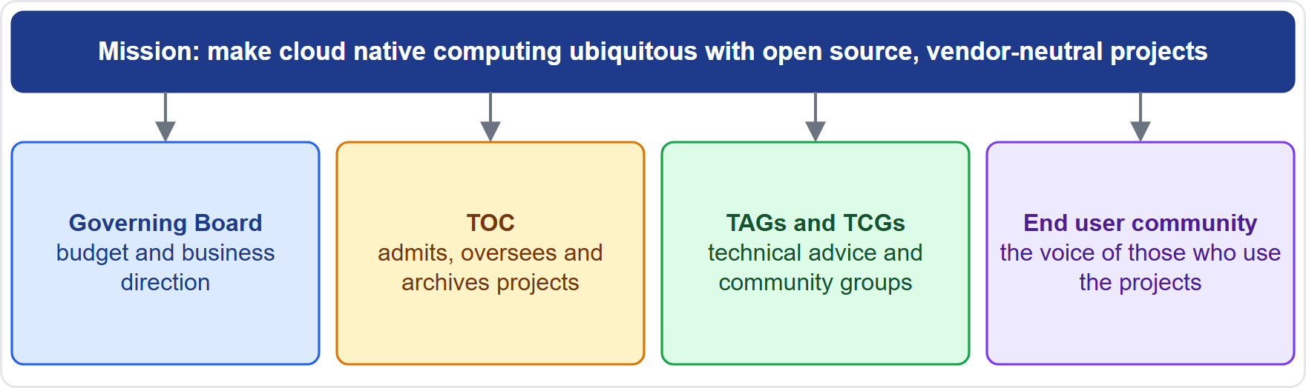
The CNCF and Its Bodies
MOVING
Module 14
Mission: make cloud native computing ubiquitous, by fostering open source, vendor-neutral projects
The Governing Board sets the budget and business direction; the TOC is the technical body that admits, oversees and archives projects
TAGs (technical advisory groups) and TCGs (technical community groups) gather experts around topics
The end user community speaks for the people who use CNCF projects
As of 30 October 2026: five TAGs, such as Security and Compliance, and four TCGs, such as Platform Engineering; earlier TAGs were archived
EXAM TIP The board is business, the TOC is technology, end users bring needs.
KCNA Exam Prep Masterclass | Kubernetes and Cloud Native Associate
Module 14: The Cloud Native Ecosystem and Community
3 / 11
Notes:
This slide is tagged moving. Its mission is ubiquitous cloud native computing, through open source, vendor-neutral projects. The Governing Board sets the budget and the business direction. The T O C, the Technical Oversight Committee, is the technical body. It admits, oversees and archives projects. T A Gs, technical advisory groups, and T C Gs, technical community groups, gather experts around topics. And the end user community speaks for the people who use C N C F projects. As of the thirtieth of October, twenty twenty-six, there are five T A Gs, and four T C Gs, and earlier T A Gs were archived. Exam tip: the board is business, the T O C is technology, and end users bring needs.

Slide 4
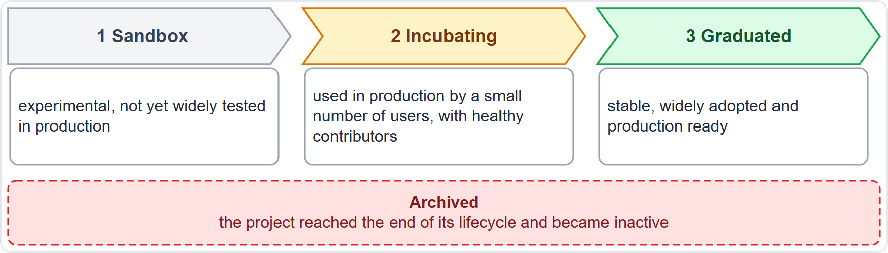
Project Maturity and the Landscape
MOVING
Module 14
Sandbox: experimental, not yet widely tested in production
Incubating: used successfully in production by a small number of users, with a healthy pool of contributors
Graduated: stable, widely adopted and production ready
Archived: the project reached the end of its lifecycle and became inactive
The CNCF landscape is a map of cloud native projects and products
As of 30 October 2026: 39 projects are graduated, including Kubernetes, Prometheus, OpenTelemetry, Argo, Flux and Helm
EXAM TIP Sandbox, incubating, graduated; archived is the end of the road.
KCNA Exam Prep Masterclass | Kubernetes and Cloud Native Associate
Module 14: The Cloud Native Ecosystem and Community
4 / 11
Notes:
This slide is tagged moving. Projects have maturity levels. Sandbox projects are experimental, and not yet widely tested in production. Incubating projects are used successfully in production by a small number of users, with a healthy pool of contributors. Graduated projects are stable, widely adopted and production ready. And archived projects have reached the end of their lifecycle and become inactive. The C N C F landscape is a map of cloud native projects and products. As of the thirtieth of October, twenty twenty-six, thirty-nine projects are graduated, including Kubernetes, Prometheus, Open Telemetry, Argo, Flux and Helm. Exam tip: sandbox, incubating, graduated. Archived is the end of the road.

Slide 5
The Kubernetes Community
Module 14
Group or term | What it is
SIG (Special Interest Group) | a persistent, open group that owns a part of the project and its subprojects
Working group | a temporary group for an issue that crosses SIG boundaries; it owns no code
Committee | chartered for sensitive topics, such as the steering committee or the code of conduct
KEP | a Kubernetes Enhancement Proposal: tracks a new feature through alpha, beta and stable
Release Team | runs each release cycle
Anyone may take part if they follow the Code of Conduct, which Kubernetes takes from the CNCF
Principles: open, welcoming, transparent and merit-based
Ways to contribute: docs, code, issues and talks; KubeCon + CloudNativeCon is the community conference
EXAM TIP SIGs own areas, working groups cross them, KEPs plan features.
KCNA Exam Prep Masterclass | Kubernetes and Cloud Native Associate
Module 14: The Cloud Native Ecosystem and Community
5 / 11
Notes:
The Kubernetes community has several kinds of groups. A S I G, a Special Interest Group, is a persistent, open group that owns a part of the project and its subprojects. A working group is temporary, and handles an issue that crosses S I G boundaries. It owns no code. A committee is chartered for sensitive topics, such as the steering committee or the code of conduct. A K E P, a Kubernetes Enhancement Proposal, tracks a new feature through alpha, beta and stable. And the Release Team runs each release cycle. Anyone may take part if they follow the Code of Conduct. Kube Con plus Cloud Native Con is the community conference. Exam tip: S I Gs own areas, working groups cross them, and K E Ps plan features.

Slide 6
From the KCNA to the Next Exams
MOVING
Module 14
Exam | Format | Notes
KCNA | multiple choice, 90 minutes | no prerequisites; valid for 2 years
KCSA | multiple choice, 90 minutes | the cloud native security associate exam; no prerequisites
CKA | performance-based, in a command line, 2 hours | the administrator exam
CKAD | performance-based, in a command line | the application developer exam
CKS | performance-based, in a command line | the security specialist exam; you must pass the CKA first
As of 30 October 2026: the Linux Foundation suggests the KCSA or the CKA as the next step after the KCNA
EXAM TIP KCNA and KCSA are multiple choice; CKA, CKAD and CKS are hands-on.
KCNA Exam Prep Masterclass | Kubernetes and Cloud Native Associate
Module 14: The Cloud Native Ecosystem and Community
6 / 11
Notes:
This slide is tagged moving. The K C N A is a multiple choice exam of ninety minutes, with no prerequisites, valid for two years. The K C S A is the cloud native security associate exam, also multiple choice, ninety minutes, with no prerequisites. The C K A, the C K A D and the C K S are performance-based. You solve tasks in a command line. The C K A is the administrator exam, and takes two hours. The C K A D is for application developers. The C K S is for security specialists, and you must pass the C K A first. As of the thirtieth of October, twenty twenty-six, the Linux Foundation suggests the K C S A or the C K A as the next step. Exam tip: K C N A and K C S A are multiple choice, and C K A, C K A D and C K S are hands-on.

Slide 7
Module Recap
Module 14
1
CNCF
2
Maturity
3
Kubernetes community
the mission is vendor-neutral open source; the Governing Board is business, the TOC is technology; TAGs and TCGs advise; end users bring needs
sandbox, incubating, graduated, and archived at the end of life; the landscape maps the field
SIGs own areas, working groups cross SIGs, KEPs plan features, the Release Team ships them
4
Taking part
5
Next exams
the Code of Conduct, the contributor guide and KubeCon + CloudNativeCon
KCSA and CKA after the KCNA, then CKAD and CKS
KCNA Exam Prep Masterclass | Kubernetes and Cloud Native Associate
Module 14: The Cloud Native Ecosystem and Community
7 / 11
Notes:
To recap. The C N C F mission is vendor-neutral open source. The Governing Board is business, the T O C is technology, T A Gs and T C Gs advise, and end users bring needs. The maturity levels are sandbox, incubating and graduated, with archived at the end of life, and the landscape maps the field. In Kubernetes, S I Gs own areas, working groups cross S I Gs, K E Ps plan features, and the Release Team ships them. You take part through the Code of Conduct, the contributor guide and Kube Con plus Cloud Native Con. And the next exams are the K C S A and the C K A, then the C K A D and the C K S. Now three practice questions.

Slide 8
Practice Question 1
Module 14
Q1
Which CNCF body is the technical governing body that admits and oversees projects?
A
The Governing Board, which sets the budget and the business direction of the foundation
B
The End User Technical Advisory Board, which speaks for the people who use the projects
C
A Technical Community Group, which gathers a community around a topic such as platform engineering
D
The Technical Oversight Committee, which admits, oversees and archives CNCF projects
KCNA Exam Prep Masterclass | Kubernetes and Cloud Native Associate
Module 14: The Cloud Native Ecosystem and Community
8 / 11
Notes:
Question one. Which C N C F body is the technical governing body that admits and oversees projects? The four options are on the screen.
[PAUSE 12]
The answer is D. The T O C is the technical decision body of the C N C F. The Governing Board handles budget and business direction, the End User T A B speaks for users, and T C Gs and T A Gs are community and advisory groups.

Slide 9
Practice Question 2
Module 14
Q2
Harbor Books wants a project that is stable, widely adopted and production ready. Which CNCF maturity level describes such a project?
A
Graduated, the level for stable and widely adopted projects
B
Incubating, the level for projects that a small number of users run in production
C
Sandbox, the level for experimental projects that are not yet widely tested
D
Archived, the level for projects that reached the end of their lifecycle
KCNA Exam Prep Masterclass | Kubernetes and Cloud Native Associate
Module 14: The Cloud Native Ecosystem and Community
9 / 11
Notes:
Question two. Harbor Books wants a project that is stable, widely adopted and production ready. Which C N C F maturity level describes such a project? The four options are on the screen.
[PAUSE 12]
The answer is A. Graduated projects are stable, widely adopted and production ready. Incubating projects have a smaller base of production users, sandbox projects are experimental, and archived projects are at the end of their lifecycle.

Slide 10
Practice Question 3
Module 14
Q3
What is the difference between a Kubernetes SIG and a working group?
A
A SIG is temporary and owns nothing, while a working group is persistent and owns subprojects
B
A SIG handles the code of conduct, while a working group handles releases
C
A SIG is persistent and owns part of the project, while a working group is temporary and crosses SIG boundaries
D
A SIG is chartered for sensitive topics, while a working group may keep its proceedings private
KCNA Exam Prep Masterclass | Kubernetes and Cloud Native Associate
Module 14: The Cloud Native Ecosystem and Community
10 / 11
Notes:
Question three. What is the difference between a Kubernetes S I G and a working group? The four options are on the screen.
[PAUSE 12]
The answer is C. A S I G is a persistent, open group that owns a part of the project and its subprojects. A working group is temporary and addresses issues that cross S I G boundaries, and it owns no code. Committees handle sensitive topics.

Slide 11
Answers at a Glance
Module 14
Question | Answer | Why
Q1 | D | The TOC admits and oversees projects
Q2 | A | Graduated means stable, widely adopted, production ready
Q3 | C | A SIG is persistent; a working group is temporary
KCNA Exam Prep Masterclass | Kubernetes and Cloud Native Associate
Module 14: The Cloud Native Ecosystem and Community
11 / 11
Notes:
Here are the answers at a glance. Question one, D: the T O C admits and oversees projects. Question two, A: graduated means stable, widely adopted and production ready. Question three, C: a S I G is persistent, and a working group is temporary.

