Slide 1
Quick-Reference Recap
The whole course on a few pages, for the last review
Extra · Quick reference
YOU WILL BE ABLE TO
Match each component to its job, and each need to its object
Recall the levers for Services, storage and scheduling
Name the CNCF projects and what each one does
Translate old names and key terms at a glance
KCNA Exam Prep Masterclass
Module 15
Notes:
Welcome to the quick-reference recap. This is an extra module: the whole course on a few pages, for your last review. By the end you will be able to do four things. Match each component to its job, and each need to its object. Recall the levers for Services, storage and scheduling. Name the C N C F projects and what each one does. And translate old names and key terms at a glance.

Slide 2
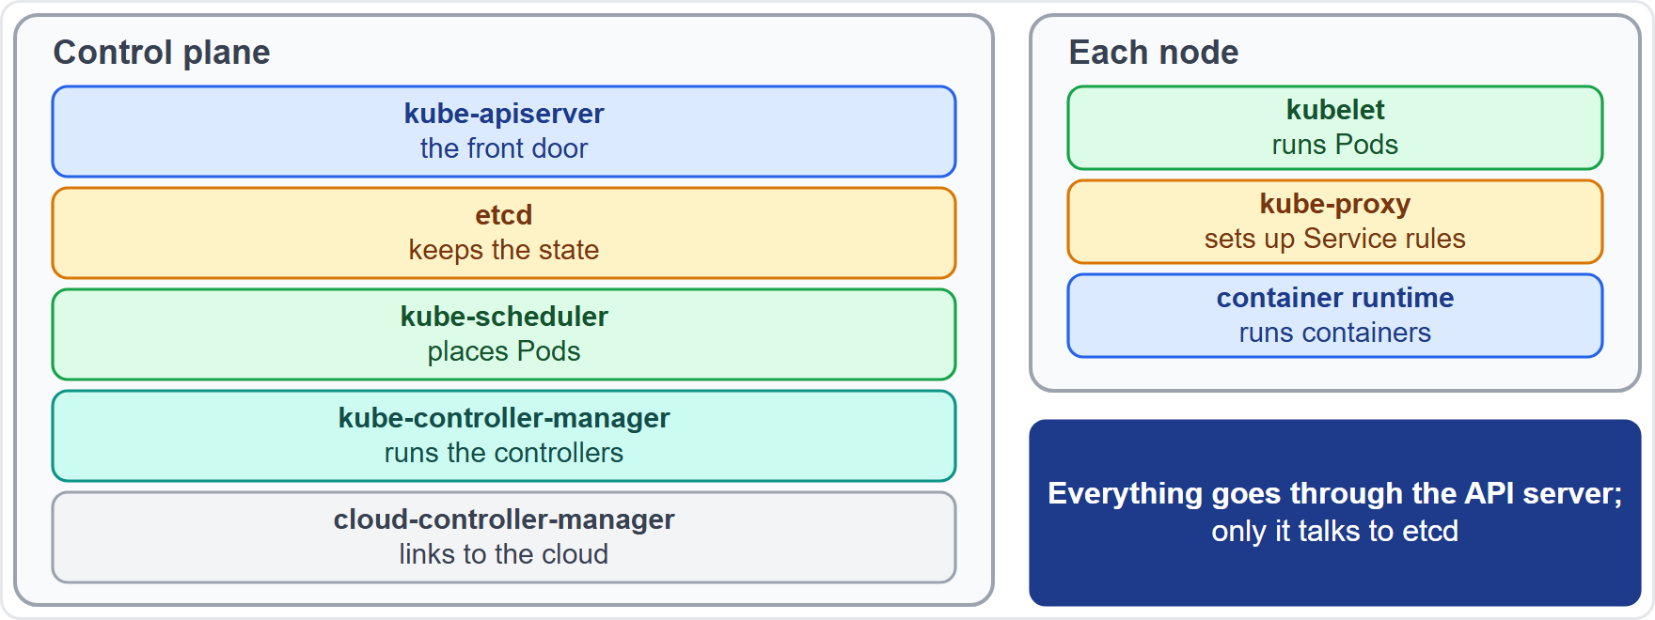
Cluster Components and Their Jobs
Module 15
Control plane: kube-apiserver is the front door; etcd keeps the state; kube-scheduler places Pods; kube-controller-manager runs the controllers
cloud-controller-manager connects the cluster to a cloud provider
Node: the kubelet runs Pods, kube-proxy sets up Service rules, and the container runtime runs containers
Everything talks to the API server, and only the API server talks to etcd
EXAM TIP Everything goes through the API server; only it talks to etcd.
KCNA Exam Prep Masterclass | Kubernetes and Cloud Native Associate
Module 15: Quick-Reference Recap
2 / 12
Notes:
Start with the components. The control plane has five. The kube A P I server is the front door. E T C D keeps the state. The kube scheduler places Pods. The kube controller manager runs the controllers. And the cloud controller manager connects the cluster to a cloud provider. Each node has three. The kube let runs Pods. Kube proxy sets up Service rules. And the container runtime runs containers. Everything talks to the A P I server, and only the A P I server talks to E T C D. Exam tip: everything goes through the A P I server.

Slide 3
Which Object Do I Use?
Module 15
I need to | Use
run a stateless app with rolling updates | Deployment
give each Pod a stable name and its own storage | StatefulSet
run one Pod on every node | DaemonSet
run a task to completion, or on a schedule | Job, CronJob
keep settings out of the image; keep a secret value | ConfigMap, Secret
give Pods a stable address inside the cluster | Service
route HTTP from outside by host and path | Ingress or Gateway API
ask for persistent storage | PersistentVolumeClaim
limit what a namespace can use | ResourceQuota
EXAM TIP Name the need first, then the object that fits.
KCNA Exam Prep Masterclass | Kubernetes and Cloud Native Associate
Module 15: Quick-Reference Recap
3 / 12
Notes:
Here is the which object do I use list. A stateless app with rolling updates is a Deployment. A Pod with a stable name and its own storage is a Stateful Set. One Pod on every node is a Daemon Set. A task that runs to completion is a Job, and on a schedule it is a Cron Job. Settings and secret values go in a Config Map and a Secret. A stable address inside the cluster is a Service. H T T P routing from outside is an Ingress, or the Gateway A P I. Persistent storage is a Persistent Volume Claim. And limiting a namespace is a Resource Quota. Exam tip: name the need first, then the object.

Slide 4
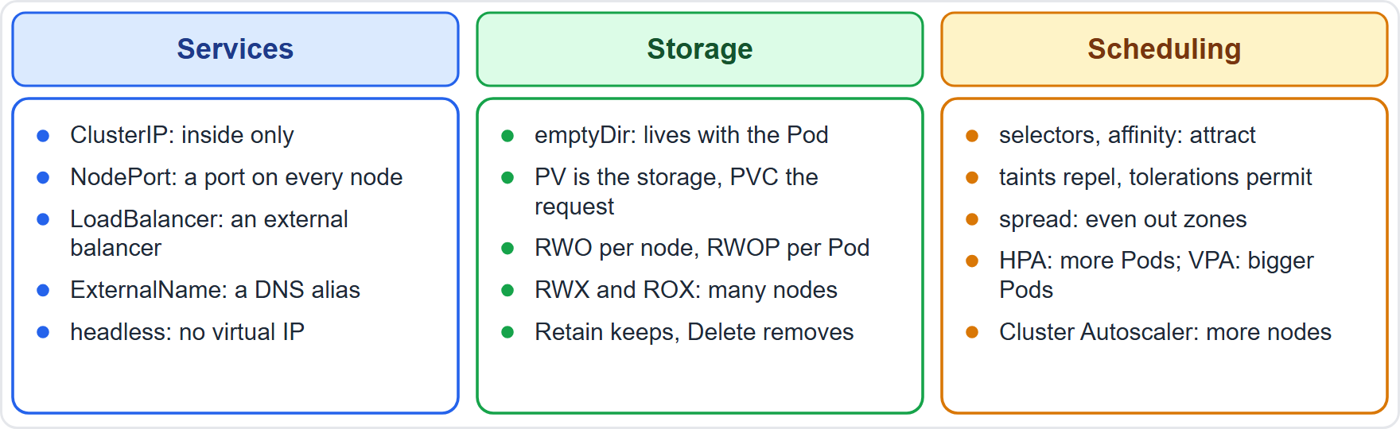
Levers for Services, Storage and Scheduling
Module 15
Services: ClusterIP inside only; NodePort a port on every node; LoadBalancer an external balancer; ExternalName an alias; headless no virtual IP
Storage: emptyDir lives with the Pod; PV is the storage, PVC the request; RWO per node, RWOP per Pod; Retain keeps data, Delete removes it
Scheduling: selectors and affinity attract; taints repel; tolerations permit; HPA adds Pods, VPA resizes them, Cluster Autoscaler adds nodes
EXAM TIP Attract, repel, spread, scale: name the lever's direction.
KCNA Exam Prep Masterclass | Kubernetes and Cloud Native Associate
Module 15: Quick-Reference Recap
4 / 12
Notes:
Three sets of levers. For Services: Cluster I P is inside only. Node Port is a port on every node. Load Balancer is an external balancer. External Name is an alias. And headless has no virtual I P. For storage: empty Dir lives with the Pod. A P V is the storage, and a P V C is the request. R W O is per node, and R W O P is per Pod. Retain keeps data, and Delete removes it. For scheduling: selectors and affinity attract, taints repel, tolerations permit, the H P A adds Pods, the V P A resizes them, and the Cluster Autoscaler adds nodes. Exam tip: attract, repel, spread, scale.

Slide 5
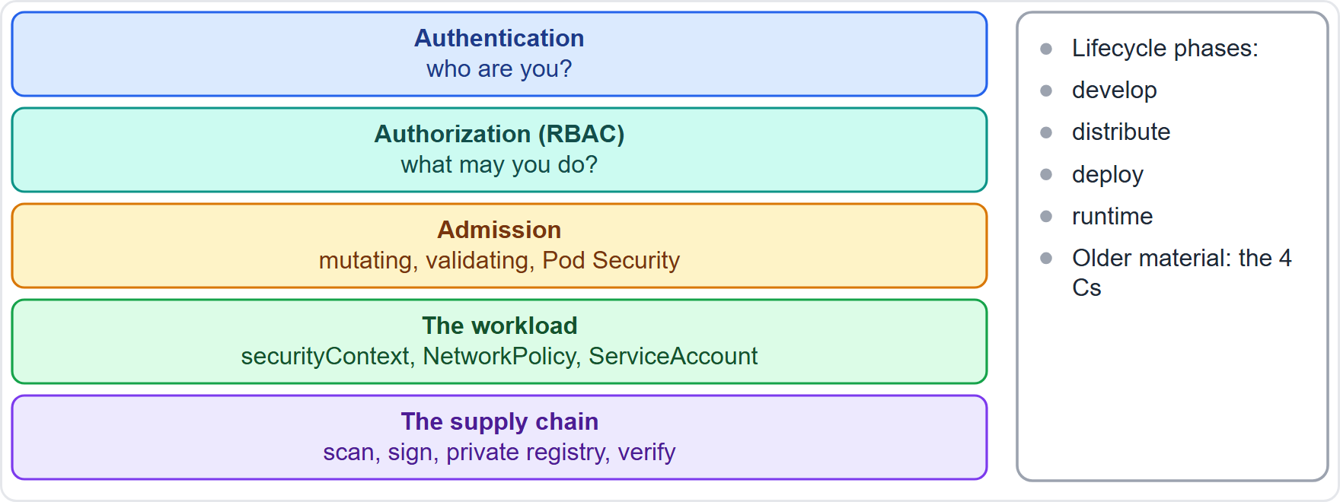
Security Layers and Controls
Module 15
Request path: authentication, then authorization with RBAC, then admission
Admission: mutating first, then validating; Pod Security levels are Privileged, Baseline and Restricted
The workload: a securityContext, a NetworkPolicy and a ServiceAccount with only the access it needs
Supply chain: scan, sign, use a private registry, verify at admission
Phases: develop, distribute, deploy, runtime; older material says the 4 Cs
EXAM TIP Who, what may they do, is the object acceptable, how does it run, where did it come from.
KCNA Exam Prep Masterclass | Kubernetes and Cloud Native Associate
Module 15: Quick-Reference Recap
5 / 12
Notes:
Security works in layers. A request is authenticated, then authorized with R B A C, then admitted. Admission is mutating first, then validating, and Pod Security has the levels Privileged, Baseline and Restricted. The workload has a security Context, a Network Policy and a Service Account with only the access it needs. The supply chain is scanned, signed, held in a private registry and verified at admission. The current docs describe the phases develop, distribute, deploy and runtime, and older material says the four Cs. Exam tip: who, what may they do, is the object acceptable, how does it run, and where did it come from.

Slide 6
Probes, Release Strategies and Signals
Module 15
Topic | Quick answer
Liveness probe | a failure restarts the container
Readiness probe | a failure removes the Pod from the Service endpoints
Startup probe | protects a slow starter from the liveness probe
Recreate, rolling, blue/green | stop all then start; replace gradually; switch whole environments
Canary, A/B, shadow | a share of traffic; chosen users; a copy of each request
Metrics, logs, traces | numbers over time; messages; the path of one request
EXAM TIP Readiness controls traffic; liveness controls restarts.
KCNA Exam Prep Masterclass | Kubernetes and Cloud Native Associate
Module 15: Quick-Reference Recap
6 / 12
Notes:
Six quick answers. A liveness probe failure restarts the container. A readiness probe failure removes the Pod from the Service endpoints. A startup probe protects a slow starter from the liveness probe. Recreate stops everything and then starts. Rolling replaces gradually. And blue green switches whole environments. A canary shifts a share of traffic, A B testing chooses users, and a shadow release copies each request. And metrics are numbers over time, logs are messages, and traces follow one request. Exam tip: readiness controls traffic, and liveness controls restarts.

Slide 7
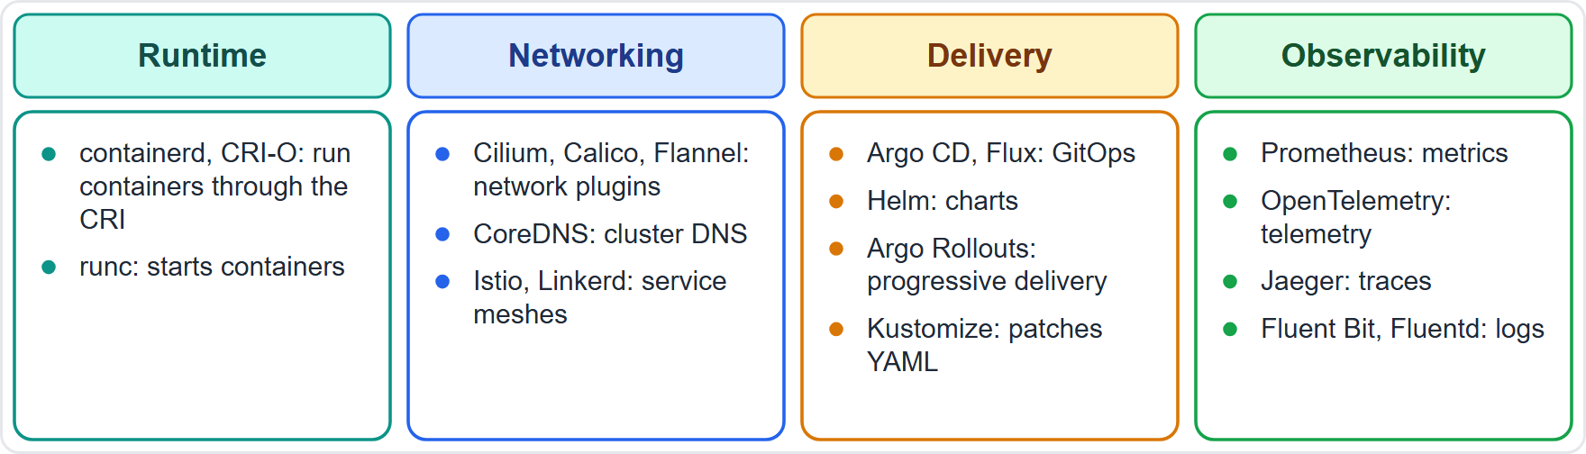
CNCF Projects and Their Jobs
Module 15
Runtime: containerd and CRI-O through the CRI; runc starts containers
Networking: Cilium, Calico and Flannel are network plugins; CoreDNS is cluster DNS; Istio and Linkerd are service meshes
Delivery: Argo CD and Flux are GitOps agents; Helm packages charts; Argo Rollouts does progressive delivery; Kustomize patches YAML
Observability: Prometheus pulls metrics; OpenTelemetry generates telemetry; Jaeger traces; Fluent Bit and Fluentd collect logs
EXAM TIP Learn each project by its one-line job.
KCNA Exam Prep Masterclass | Kubernetes and Cloud Native Associate
Module 15: Quick-Reference Recap
7 / 12
Notes:
Learn each project by its one-line job. In runtime, containerd and C R I O run containers through the C R I, and runc starts them. In networking, Cilium, Calico and Flannel are network plugins, Core D N S is cluster D N S, and Istio and Linkerd are service meshes. In delivery, Argo C D and Flux are Git Ops agents, Helm packages charts, Argo Rollouts does progressive delivery, and Kustomize patches Y A M L. In observability, Prometheus pulls metrics, Open Telemetry generates telemetry, Jaeger traces, and Fluent Bit and Fluentd collect logs. Exam tip: learn each project by its one-line job.

Slide 8
More Projects and Their Jobs
Module 15
Area | Projects and their job
Cluster data | etcd: the key-value store behind the API
Storage | Rook: orchestrates Ceph for file, block and object storage
Scaling | KEDA: event-driven autoscaling
Security and policy | Falco detects odd runtime behavior; OPA Gatekeeper and Kyverno enforce policy; Cosign signs and Trivy scans images
Platform | Crossplane: control planes for infrastructure; Backstage: developer portal; Knative and OpenFaaS: serverless
Events and cost | CloudEvents: a common event format; OpenCost: spend visibility
Load balancing | MetalLB: LoadBalancer Services on bare metal
EXAM TIP Match the job to the project, not the other way round.
KCNA Exam Prep Masterclass | Kubernetes and Cloud Native Associate
Module 15: Quick-Reference Recap
8 / 12
Notes:
More projects, by area. E T C D is the key-value store behind the A P I. Rook orchestrates Ceph for file, block and object storage. K E D A does event-driven autoscaling. For security and policy, Falco detects odd runtime behavior, O P A Gatekeeper and Kyverno enforce policy, Cosign signs images, and Trivy scans them. On the platform side, Crossplane builds control planes for infrastructure, Backstage is a developer portal, and Knative and OpenFaaS are serverless. CloudEvents is a common event format, and Open Cost shows spend. And Metal L B gives Load Balancer Services on bare metal. Exam tip: match the job to the project.

Slide 9
Old and New Names
MOVING · OLD WORDING
Module 15
Older name or fact | Now
PodSecurityPolicy | removed: Pod Security admission replaces it
dockershim | removed: nodes need a CRI runtime such as containerd or CRI-O
Endpoints API | deprecated: EndpointSlices
Ingress | frozen: Gateway API is the successor
The 4 Cs | the lifecycle phases: develop, distribute, deploy, runtime
Five domains, 46/22/16/8/8 | four domains, 44/28/16/12
As of 30 October 2026: the Ingress NGINX controller is retired, so it is not a safe choice for new designs
EXAM TIP Map an old name to its new home and answer the same way.
KCNA Exam Prep Masterclass | Kubernetes and Cloud Native Associate
Module 15: Quick-Reference Recap
9 / 12
Notes:
This slide is tagged old wording. It is also tagged moving, because of one fact about a controller. Older material uses names that have changed. Pod Security Policy was removed, and Pod Security admission replaces it. Dockershim was removed, and nodes need a C R I runtime such as containerd or C R I O. The Endpoints A P I is deprecated, and Endpoint Slices replace it. Ingress is frozen, and Gateway A P I is the successor. The four Cs became the lifecycle phases. And the five domains, forty-six, twenty-two, sixteen, eight and eight, became four, forty-four, twenty-eight, sixteen and twelve. As of the thirtieth of October, twenty twenty-six, the Ingress Nginx controller is retired. Exam tip: map an old name to its new home.

Slide 10
Key Terms in One Line
Module 15
Term | One line
Pod | the smallest deployable unit: containers that share network and storage
Namespace | a way to divide a cluster; the scope for names and quotas
Label and selector | key-value tags, and the queries that connect objects
CRD and operator | a new API kind, and a controller that manages an application
Taint and toleration | repel, and permit
Sidecar | a helper container in the same Pod
Drift | the actual state moving away from the desired state
SLI, SLO, SLA | a measurement, a target, a contract
Immutable infrastructure | replace rather than change
Idempotent | the same result when repeated
EXAM TIP If a term is new in a question, find it in this table first.
KCNA Exam Prep Masterclass | Kubernetes and Cloud Native Associate
Module 15: Quick-Reference Recap
10 / 12
Notes:
Ten terms in one line each. A Pod is the smallest deployable unit, with containers that share network and storage. A namespace divides a cluster, and scopes names and quotas. Labels are key-value tags, and selectors are the queries that connect objects. A C R D is a new A P I kind, and an operator is a controller that manages an application. A taint repels, and a toleration permits. A sidecar is a helper container in the same Pod. Drift is the actual state moving away from the desired state. S L I, S L O and S L A are a measurement, a target and a contract. Immutable infrastructure means replace rather than change. And idempotent means the same result when repeated. Exam tip: if a term is new in a question, find it here first.

Slide 11
More Key Terms in One Line
Module 15
Term | One line
Controller | a loop that compares the actual state with the desired state, and acts
Reconciliation | the repeated act of moving the actual state toward the desired state
Requests and limits | what a container reserves for placement, and the most it may use
Ingress controller | the program that applies the rules of Ingress objects
PV and PVC | a piece of storage, and the request for it
RBAC | roles and bindings that decide who may do what in the API
Admission controller | a step that can change or reject an object before it is stored
GitOps | Git holds the desired state, and an agent keeps the cluster in line
Error budget | the share of failures that the SLO allows
EXAM TIP The glossary file of this module lists many more terms.
KCNA Exam Prep Masterclass | Kubernetes and Cloud Native Associate
Module 15: Quick-Reference Recap
11 / 12
Notes:
Nine more terms. A controller is a loop that compares the actual state with the desired state, and acts. Reconciliation is the repeated act of moving the actual state toward the desired state. Requests are what a container reserves for placement, and limits are the most it may use. An Ingress controller is the program that applies the rules of Ingress objects. A P V is a piece of storage, and a P V C is the request for it. R B A C uses roles and bindings to decide who may do what in the A P I. An admission controller can change or reject an object before it is stored. Git Ops keeps the desired state in Git, with an agent that keeps the cluster in line. And the error budget is the share of failures that the S L O allows. Exam tip: the glossary file of this module lists many more terms.

Slide 12
Module Recap
Module 15
1
Components
2
Objects
3
Levers
the API server in the middle, etcd behind it, scheduler and controllers beside it, kubelet and proxy on nodes
match the need to Deployment, StatefulSet, DaemonSet, Job, Service, Ingress, PVC or ResourceQuota
Service types, storage modes and scheduling levers, each with a direction
4
Security and delivery
5
Projects and names
request path, Pod Security, supply chain; probes and release strategies
one-line jobs for the projects, and old names mapped to new ones
KCNA Exam Prep Masterclass | Kubernetes and Cloud Native Associate
Module 15: Quick-Reference Recap
12 / 12
Notes:
To recap. Components: the A P I server in the middle, E T C D behind it, the scheduler and controllers beside it, and the kube let and proxy on nodes. Objects: match the need to a Deployment, Stateful Set, Daemon Set, Job, Service, Ingress, Persistent Volume Claim or Resource Quota. Levers: Service types, storage modes and scheduling levers, each with a direction. Security and delivery: the request path, Pod Security and the supply chain, then probes and release strategies. And projects and names: one-line jobs, and old names mapped to new ones.

