Slide 1
Exam Technique and Final Review
How to turn what you know into points on the day
Final review · Exam technique
YOU WILL BE ABLE TO
Plan your time: about 90 seconds a question
Read a stem, and handle "most appropriate", "least" and "NOT"
Spot the look-alike traps and the old names
Use flag and review, and prepare for exam day
KCNA Exam Prep Masterclass
Module 16
Notes:
Welcome to the last module: exam technique and final review. Knowing the material is half the job. The other half is turning it into points on the day. By the end you will be able to do four things. Plan your time: about ninety seconds a question. Read a stem, and handle most appropriate, least and not questions. Spot the look-alike traps and the old names. And use flag and review, and prepare for exam day.

Slide 2
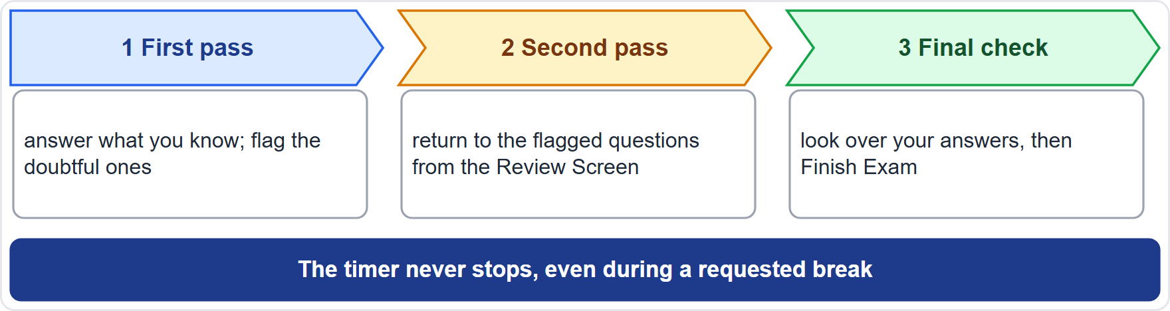
Time: About 90 Seconds a Question
Module 16
60 questions in 90 minutes is about 90 seconds each
First pass: answer what you know quickly, and flag the doubtful ones
Second pass: use the Review Screen to return to the flagged questions
Keep a few minutes for a final check before you click Finish Exam
The timer keeps running, even during a requested break
EXAM TIP Do not sink three minutes into one question: flag it and move on.
KCNA Exam Prep Masterclass | Kubernetes and Cloud Native Associate
Module 16: Exam Technique and Final Review
2 / 11
Notes:
Sixty questions in ninety minutes is about ninety seconds each. Use three passes. In the first pass, answer what you know quickly, and flag the doubtful ones. In the second pass, use the Review Screen to return to the flagged questions. Then keep a few minutes for a final check, before you click Finish Exam. Remember that the timer keeps running, even during a requested break. Exam tip: do not sink three minutes into one question. Flag it and move on.

Slide 3
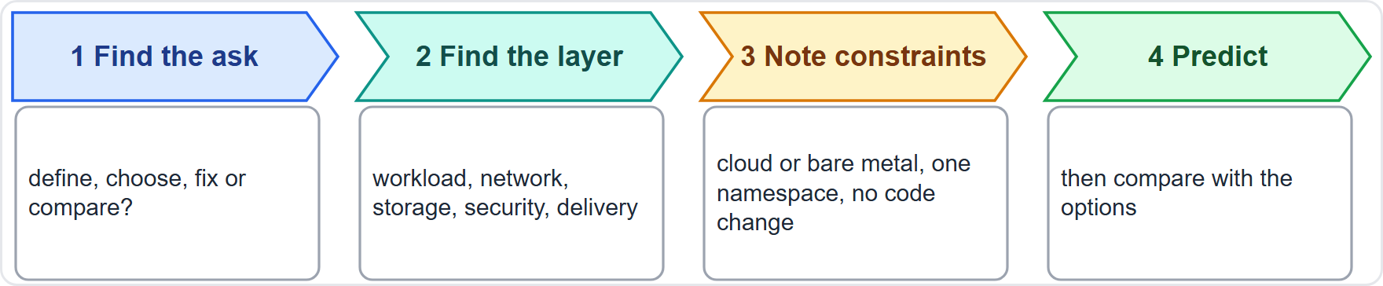
Reading a Stem
Module 16
Find the ask: does it define, choose, fix or compare?
Find the layer: workload, network, storage, security, delivery or architecture
Note the constraints: a cloud or bare metal, one namespace, no code change
Predict the answer first, then compare it with the options
EXAM TIP Read the last line of the stem first: it holds the real question.
KCNA Exam Prep Masterclass | Kubernetes and Cloud Native Associate
Module 16: Exam Technique and Final Review
3 / 11
Notes:
Before you look at the options, make four moves. First, find the ask. Does the question define, choose, fix or compare? Second, find the layer: workload, network, storage, security, delivery or architecture. Third, note the constraints, such as a cloud or bare metal, one namespace, or no code change. And fourth, predict the answer, then compare it with the options. Exam tip: read the last line of the stem first, because it holds the real question.

Slide 4
Most Appropriate, Least and NOT
Module 16
Pattern | What to do
"Most appropriate" | several options may work: pick the one that fits every detail of the scenario with the least extra work
"Least" | pick the smallest change or permission that still works, as in least privilege
"NOT" or "EXCEPT" | find the false statement: test each option as true or false
"First" | look for the dependency: a Secret must exist before the Pod that needs it
"Which component" | name the layer first: API server, scheduler, kubelet or proxy
EXAM TIP Underline the small word that flips the question: NOT, least or first.
KCNA Exam Prep Masterclass | Kubernetes and Cloud Native Associate
Module 16: Exam Technique and Final Review
4 / 11
Notes:
Five patterns come up again and again. With most appropriate, several options may work. Pick the one that fits every detail of the scenario with the least extra work. With least, pick the smallest change or permission that still works, as in least privilege. With not or except, find the false statement by testing each option as true or false. With first, look for the dependency. A Secret must exist before the Pod that needs it. And with which component, name the layer first: A P I server, scheduler, kube let or proxy. Exam tip: underline the small word that flips the question.

Slide 5
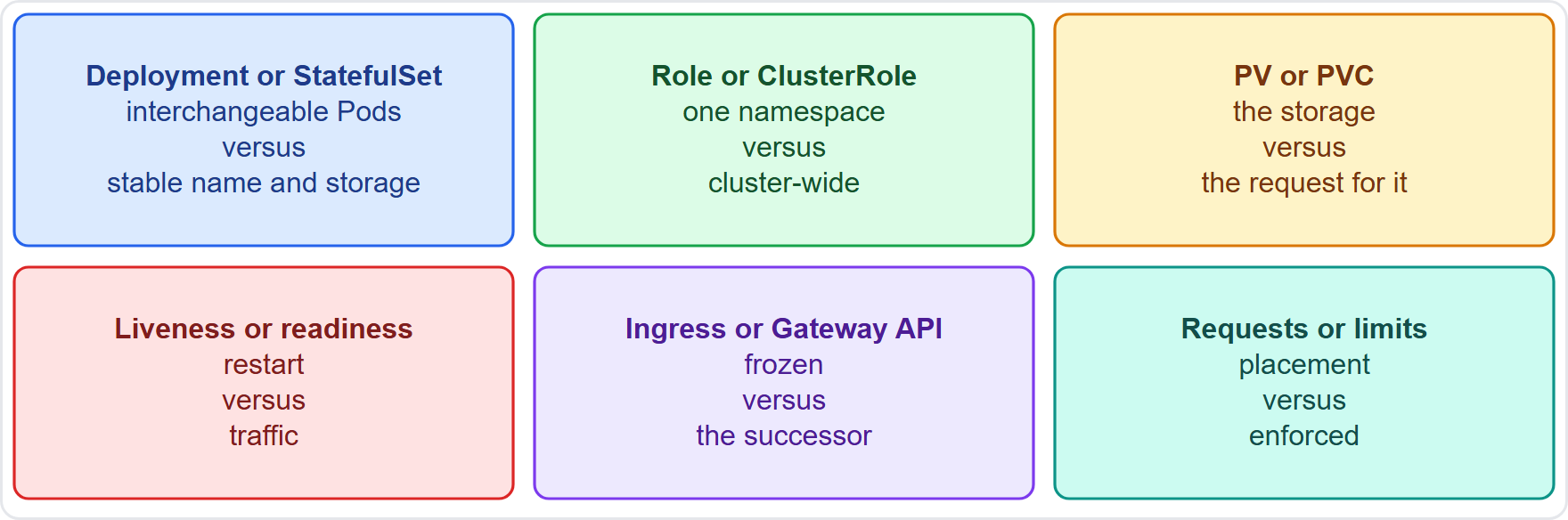
Look-Alike Traps
Module 16
Deployment or StatefulSet: interchangeable Pods, or a stable name and storage
Role or ClusterRole: one namespace, or cluster-wide
PV or PVC: the storage, or the request for it
Liveness or readiness: restart, or traffic
Ingress or Gateway API: frozen, or the successor
Requests or limits: they drive placement, or they are enforced
EXAM TIP When two options look alike, find the one word that separates them.
KCNA Exam Prep Masterclass | Kubernetes and Cloud Native Associate
Module 16: Exam Technique and Final Review
5 / 11
Notes:
Six pairs get confused. Deployment or Stateful Set: interchangeable Pods, or a stable name and storage. Role or Cluster Role: one namespace, or cluster-wide. P V or P V C: the storage, or the request for it. Liveness or readiness: restart, or traffic. Ingress or Gateway A P I: frozen, or the successor. And requests or limits: requests drive placement, and limits are enforced. The diagram puts the key difference beside each pair. Exam tip: when two options look alike, find the one word that separates them.

Slide 6
Eliminating Options
Module 16
Remove options that name the wrong layer, such as a kubelet answer to a scheduling question
Be wary of absolutes such as "always" and "never": Kubernetes has exceptions
Remove options that are true but do not answer the question
Among the rest, choose the one that fits the scenario details
Choose an answer for every question, and change it from the Review Screen if you think again
EXAM TIP Two options left? Reread the stem for the detail that separates them.
KCNA Exam Prep Masterclass | Kubernetes and Cloud Native Associate
Module 16: Exam Technique and Final Review
6 / 11
Notes:
Eliminate before you choose. Remove options that name the wrong layer, such as a kube let answer to a scheduling question. Be wary of absolutes such as always and never, because Kubernetes has exceptions. Remove options that are true but do not answer the question. Among the rest, choose the one that fits the scenario details. And choose an answer for every question. You can change it from the Review Screen if you think again. Exam tip: two options left? Reread the stem for the detail that separates them.

Slide 7
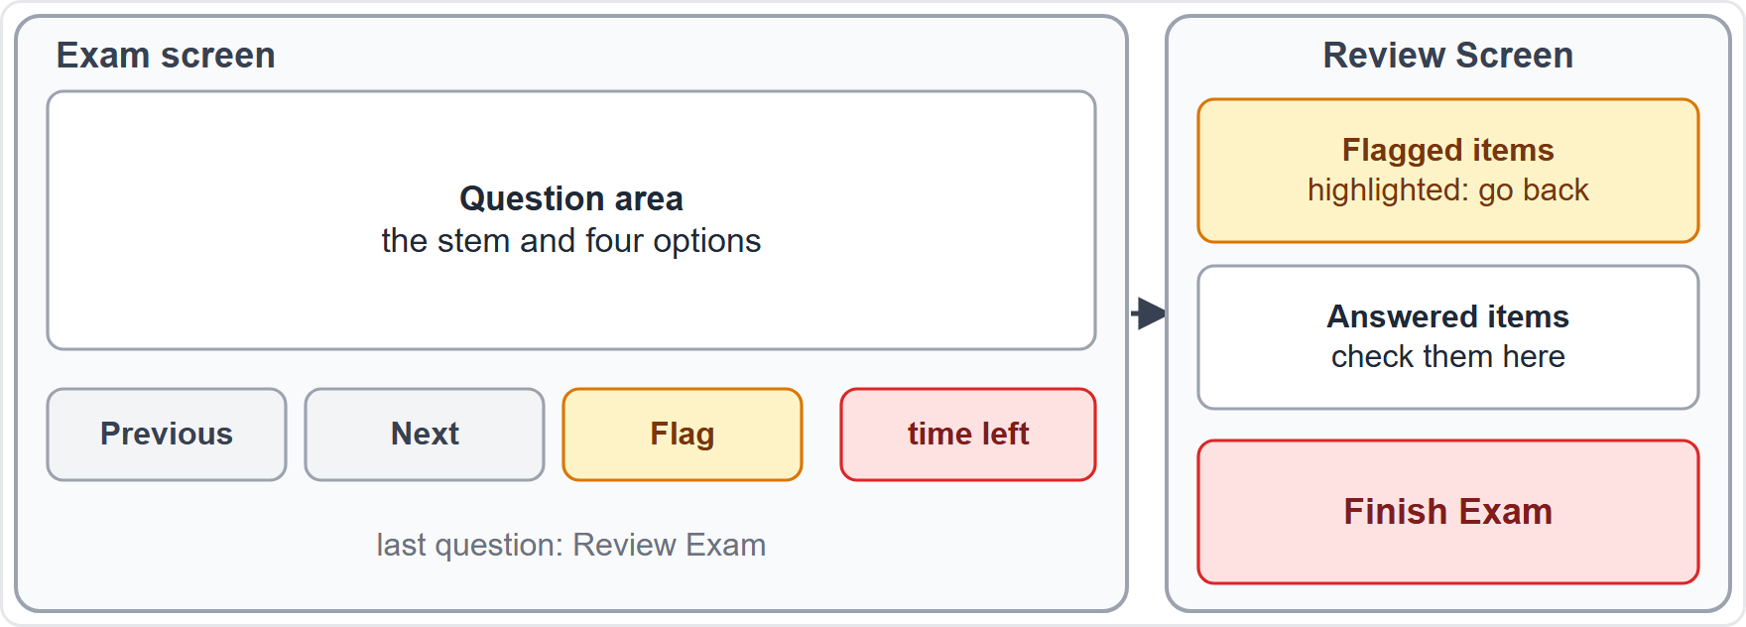
Flag and Review
MOVING
Module 16
Previous and Next move between questions
Flag a question: flagged items are highlighted on the Review Screen, where you can return and update an answer
At the last question, Review Exam leads to the Review Screen and Finish Exam
The timer shows the time left; a requested break does not stop it
After a disconnect, the timer does not pause, and no time can be added back
As of 30 October 2026: this is what the Linux Foundation handbook describes
EXAM TIP Flag early, review once, finish with time to spare.
KCNA Exam Prep Masterclass | Kubernetes and Cloud Native Associate
Module 16: Exam Technique and Final Review
7 / 11
Notes:
This slide is tagged moving. The multiple-choice exam screen has Previous and Next buttons to move between questions. You can flag a question. Flagged items are highlighted on the Review Screen, where you can return and update an answer. At the last question, Review Exam leads to the Review Screen and the Finish Exam button. The timer shows the time left, and a requested break does not stop it. After a disconnect, the timer does not pause, and no time can be added back. As of the thirtieth of October, twenty twenty-six, this is what the Linux Foundation handbook describes. Exam tip: flag early, review once, and finish with time to spare.

Slide 8
Old Names in Older Material
OLD WORDING
Module 16
If a question says | Think
PodSecurityPolicy | removed: Pod Security admission and the three Standards
dockershim | removed: a CRI runtime such as containerd or CRI-O
Endpoints | deprecated: EndpointSlices
The 4 Cs | cloud, clusters, containers, code: the older security layers
Five domains, 46/22/16/8/8 | the earlier curriculum; the current one has four
An old name still points to the same idea: translate it, then answer
EXAM TIP Translate the name, then answer the concept.
KCNA Exam Prep Masterclass | Kubernetes and Cloud Native Associate
Module 16: Exam Technique and Final Review
8 / 11
Notes:
This slide is tagged old wording. A question may use a name from older material. Pod Security Policy was removed, so think Pod Security admission and the three Standards. Dockershim was removed, so think a C R I runtime such as containerd or C R I O. Endpoints is deprecated, so think Endpoint Slices. The four Cs are cloud, clusters, containers and code, the older security layers. And the five domains, forty-six, twenty-two, sixteen, eight and eight, are the earlier curriculum. An old name still points to the same idea. Exam tip: translate the name, then answer the concept.

Slide 9
Exam Day: Rules and Setup
MOVING
Module 16
Area | What the Linux Foundation asks
Delivery | online, proctored remotely by streaming audio, video and screen sharing
Browser | the PSI Secure Browser; run the system check first, and avoid a work-provided device
Camera | a webcam you can move, to show your surroundings
Room | private and quiet, a clutter-free desk, clear walls, good light, the door closed
ID | a valid, government-issued, original ID whose name matches your verified name
As of 30 October 2026: read the Linux Foundation candidate handbook before the day
EXAM TIP Test your setup a few days early, not on the morning.
KCNA Exam Prep Masterclass | Kubernetes and Cloud Native Associate
Module 16: Exam Technique and Final Review
9 / 11
Notes:
This slide is tagged moving. The exam is delivered online, and proctored remotely by streaming audio, video and screen sharing. It runs in the P S I Secure Browser. Run the system check first, and avoid a work-provided device. You need a webcam you can move, to show your surroundings. The room must be private and quiet, with a clutter-free desk, clear walls, good light and the door closed. And you need a valid, government-issued, original I D whose name matches your verified name. As of the thirtieth of October, twenty twenty-six, read the Linux Foundation candidate handbook before the day. Exam tip: test your setup a few days early, not on the morning.

Slide 10
Final Week Checklist
Module 16
Review
Redo
Check
Module 15 and the labels from Module 0
the questions you missed, and say the reason aloud
your system, your room and your ID against the Linux Foundation rules
Rest
Remember
a clear head earns more points than one more hour of notes
the plan: about 90 seconds a question, flag, return, finish
EXAM TIP Confidence comes from a routine you have practiced.
KCNA Exam Prep Masterclass | Kubernetes and Cloud Native Associate
Module 16: Exam Technique and Final Review
10 / 11
Notes:
Here is your final week checklist. Review Module 15 and the labels from Module 0. Redo the questions you missed, and say the reason aloud. Check your system, your room and your I D against the Linux Foundation rules. Rest, because a clear head earns more points than one more hour of notes. And remember the plan: about ninety seconds a question, flag, return, finish. Exam tip: confidence comes from a routine you have practiced.

Slide 11
Module Recap
Module 16
1
Time
2
Stems
3
Patterns
about 90 seconds a question; first pass, second pass, final check
find the ask, the layer and the constraints, and predict first
most appropriate, least, NOT, first, which component
4
Traps and names
5
Exam day
the six look-alike pairs, and the old names mapped to new
flag and review, the timer never stops, and the Linux Foundation rules for room, camera and ID
KCNA Exam Prep Masterclass | Kubernetes and Cloud Native Associate
Module 16: Exam Technique and Final Review
11 / 11
Notes:
To recap. On time, plan about ninety seconds a question, with a first pass, a second pass and a final check. On stems, find the ask, the layer and the constraints, and predict first. Know the patterns: most appropriate, least, not, first, and which component. Know the six look-alike pairs, and the old names mapped to new ones. And on exam day, use flag and review, remember that the timer never stops, and follow the Linux Foundation rules for room, camera and I D. You have done the work. Good luck with the exam.

