Slide 1
Module 0: Course Introduction and Exam Orientation
PMP Exam Prep 2026: PMBOK 8 and the New ECO
The exam, the course and how to study
PMP Exam Prep 2026: PMBOK 8 and the New ECO
Module 0: Course Introduction and Exam Orientation · Part 1
Notes:
Welcome to PMP Exam Prep 2026. This first module is short and practical. Before we study any content, we look at three things. The exam itself. How this course is built. And how to turn what you know into correct answers on test day. It will save you time in every module that follows.

Slide 2
What This Course Does
Part 1
Prepares you for the July 2026 PMP exam, which follows the new exam content outline (ECO)
Teaches the concepts of PMBOK Guide, Eighth Edition, and what PMI expects in scenario questions
Adds diagrams, a running case and five practice questions in each of modules 1 to 14
Original wording, diagrams and questions: independent study material, not affiliated with or endorsed by PMI
EXAM TIP Confirm the current exam format, fees and eligibility on PMI's official site before you book.
PMP Exam Prep 2026 | PMBOK 8 and the New ECO
Module 0: Course Introduction and Exam Orientation
2 / 20
Notes:
This course prepares you for the July 2026 PMP exam. That exam follows a new exam content outline, which we will call the ECO. The course teaches the concepts of PMBOK Guide, Eighth Edition. But knowing the concepts is only half the job. The other half is knowing what PMI expects when a scenario asks what you should do. So every module is built around that. You will find diagrams, a running case, and five practice questions in each of modules one to fourteen. Everything is in original wording. This is independent study material, not affiliated with or endorsed by PMI. And before you book, confirm the current exam format, fees and eligibility on PMI's official site.

Slide 3
What the Course Covers and Leaves Out
Part 1
Covered | Left out
All ECO tasks and their enablers | Eligibility, application, fees and PDUs
PMBOK 8 principles, performance domains and tailoring | Exam logistics and the history of PMBOK editions
Key tools, artifacts and decision rules | Memorizing every input, tool and output
EXAM TIP Learn each process by its purpose, its key outputs and its decision tools; memorizing inputs and outputs is not exam content.
PMP Exam Prep 2026 | PMBOK 8 and the New ECO
Module 0: Course Introduction and Exam Orientation
3 / 20
Notes:
What does the course cover? All the tasks and enablers in the ECO. The principles, the performance domains and the tailoring ideas of PMBOK 8. And the key tools, artifacts and decision rules. What does it leave out? Eligibility, application, fees and professional development units. Exam logistics, and the history of earlier PMBOK editions. And memorizing every input, tool and output of every process, because that is not exam content. Instead, we teach each process by its purpose, its key outputs and its decision tools. A few useful ideas go beyond PMBOK 8, such as the PERT formula. Where that happens, we label them once as exam practice.

Slide 4
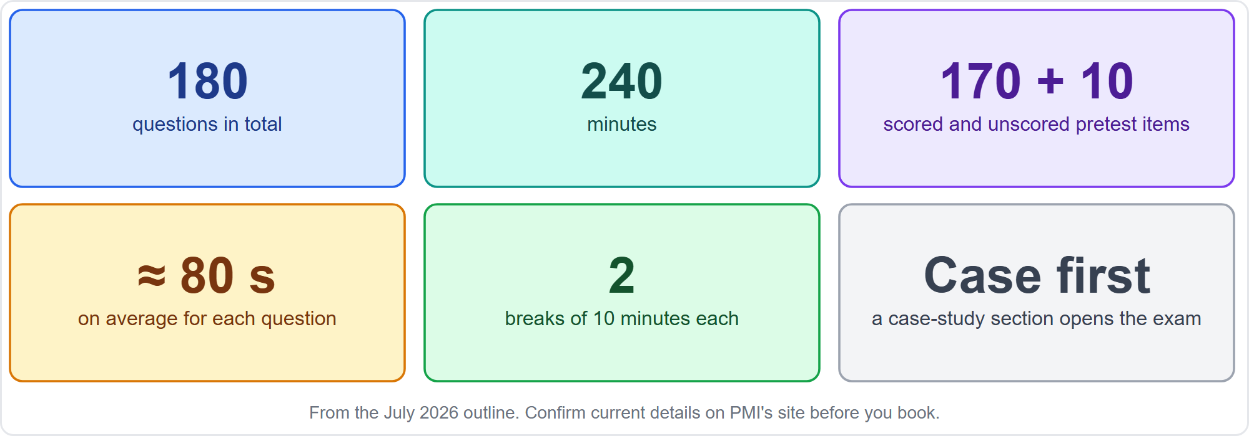
The Exam in Numbers
Part 1
Format from the July 2026 ECO
EXAM TIP You cannot tell which ten items are unscored, so treat every question as scored.
PMP Exam Prep 2026 | PMBOK 8 and the New ECO
Module 0: Course Introduction and Exam Orientation
4 / 20
Notes:
Here is the exam in six numbers. One hundred eighty questions. Two hundred forty minutes. Of the one hundred eighty, one hundred seventy are scored and ten are unscored pretest items, placed at random. You cannot tell which ones they are, so treat every question as scored. That leaves about eighty seconds per question on average. There are two breaks of ten minutes each. And the exam opens with a case-study section. These details come from the July 2026 outline. Always confirm them on PMI's site before you book.

Slide 5
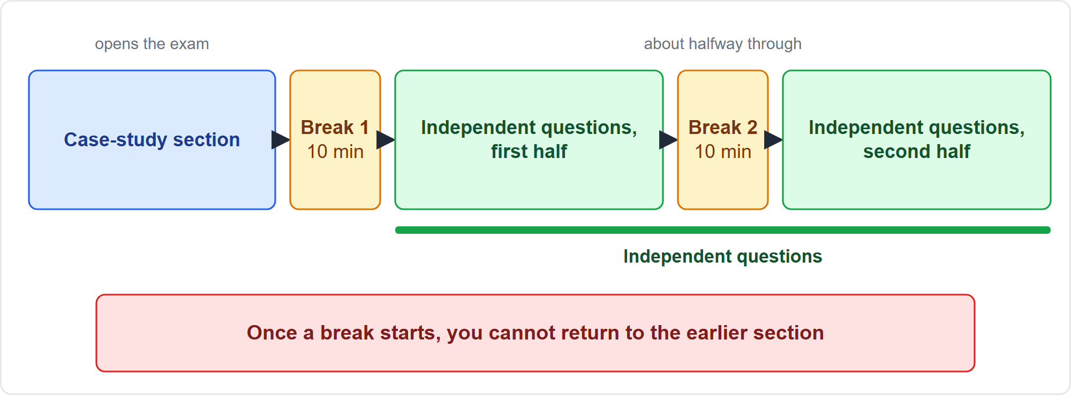
How the Exam Is Laid Out
Part 1
A case-study section, then independent questions, with two breaks
EXAM TIP Flag and revisit only inside the section you are in; a break closes the section behind you.
PMP Exam Prep 2026 | PMBOK 8 and the New ECO
Module 0: Course Introduction and Exam Orientation
5 / 20
Notes:
Now the layout. The exam opens with the case-study section. After it comes the first break. Then the independent questions begin. The second break comes about halfway through them. Here is the rule that matters. Once a break starts, you cannot return to the earlier section. So flag and revisit questions only inside the section you are in, and use the end of each section for your review.

Slide 6
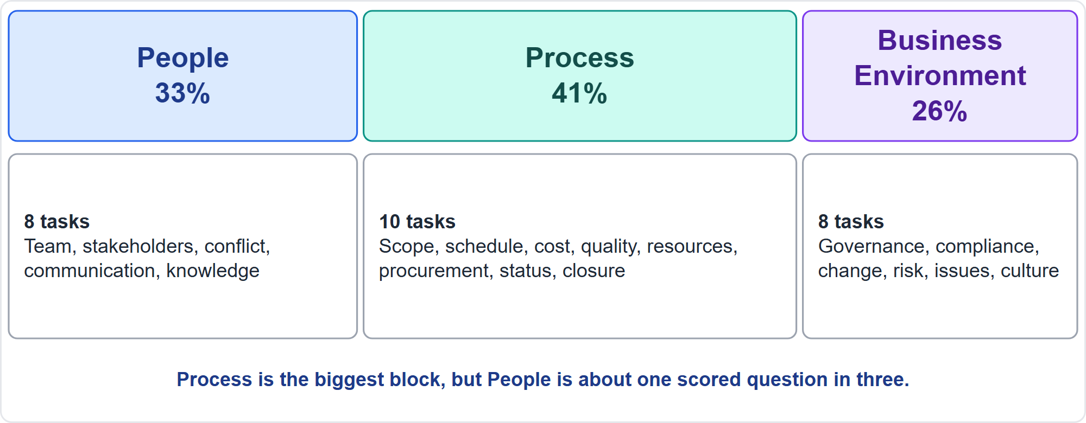
Three Domains, 26 Tasks
Part 1
People 33%, Process 41%, Business Environment 26%
EXAM TIP Do not skip People: it is about one scored question in three.
PMP Exam Prep 2026 | PMBOK 8 and the New ECO
Module 0: Course Introduction and Exam Orientation
6 / 20
Notes:
The exam has three domains. People carries thirty-three percent, with eight tasks. Process carries forty-one percent, with ten tasks. Business Environment carries twenty-six percent, with eight tasks. That makes twenty-six tasks in all. People covers the team, stakeholders, conflict, communication and knowledge. Process covers scope, schedule, cost, quality, resources, procurement, status and closure. Business Environment covers governance, compliance, change, risk, issues and culture. Process is the biggest block. But People is about one scored question in three, so do not skip it.

Slide 7
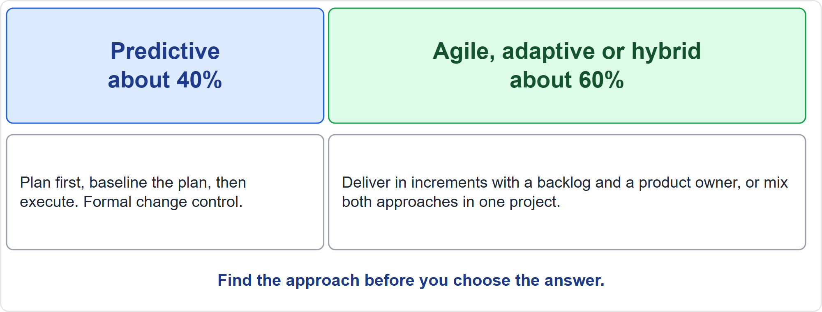
Predictive Versus Agile and Hybrid
Part 1
About 40% predictive, about 60% agile, adaptive or hybrid
EXAM TIP Most items are agile, adaptive or hybrid, so study both worlds.
PMP Exam Prep 2026 | PMBOK 8 and the New ECO
Module 0: Course Introduction and Exam Orientation
7 / 20
Notes:
Across all three domains, about forty percent of the items are predictive. About sixty percent are agile, adaptive or hybrid. Predictive means you plan first, baseline the plan, and then execute, with formal change control. Agile, adaptive and hybrid mean you deliver in increments, with a backlog and a product owner, or you mix both approaches in one project. The same problem can have a different best answer in each. So the first thing to find in a scenario is the approach. And because most items are agile or hybrid, study both worlds.

Slide 8
What Is New in 2026
Part 1
Case items
Graphic items
one situation, then several questions about it
read a chart, matrix or diagram, then answer
More AI
More sustainability
assessing and using AI tools in project work
part of planning, quality, compliance and risk
EXAM TIP AI and sustainability turn up inside scenarios, not only as topics of their own.
PMP Exam Prep 2026 | PMBOK 8 and the New ECO
Module 0: Course Introduction and Exam Orientation
8 / 20
Notes:
Several things are new or stronger in 2026. First, case items: one situation, followed by several questions about it. Second, graphic items: you read a chart, a matrix or a diagram, and then you answer. Third, more AI. And fourth, more sustainability. Do not treat the last two as separate topics only. They turn up inside scenarios about planning, quality, compliance and risk. Module three deals with them directly, and module fourteen practices the graphic formats.

Slide 9
Eight Question Types
Part 1
Format | What you do | Offered
Multiple choice | One best answer | All
Multiple response | Every correct answer | All
Case or scenario | One case, several questions | All
Graphic-based | Read a chart or diagram | All
Matching | Pair items | Test center
Enhanced matching | Drag onto an image | Test center
Point and click | Click the hotspot | Test center
Pull-down list | Choose in each row | Test center
EXAM TIP Module 14 practices the interactive formats.
PMP Exam Prep 2026 | PMBOK 8 and the New ECO
Module 0: Course Introduction and Exam Orientation
9 / 20
Notes:
The ECO lists eight question types. Four are offered in every delivery mode. Multiple choice, where you pick the one best answer. Multiple response, where you pick every correct answer. Case or scenario items. And graphic-based items. Four more exist only at a test center. Matching, where you pair items. Enhanced matching, where you drag items onto an image or into two lists. Point and click, where you click the right spot on an image. And pull-down lists, where you choose from a drop-down in each row. Module fourteen gives you practice with the interactive formats.

Slide 10
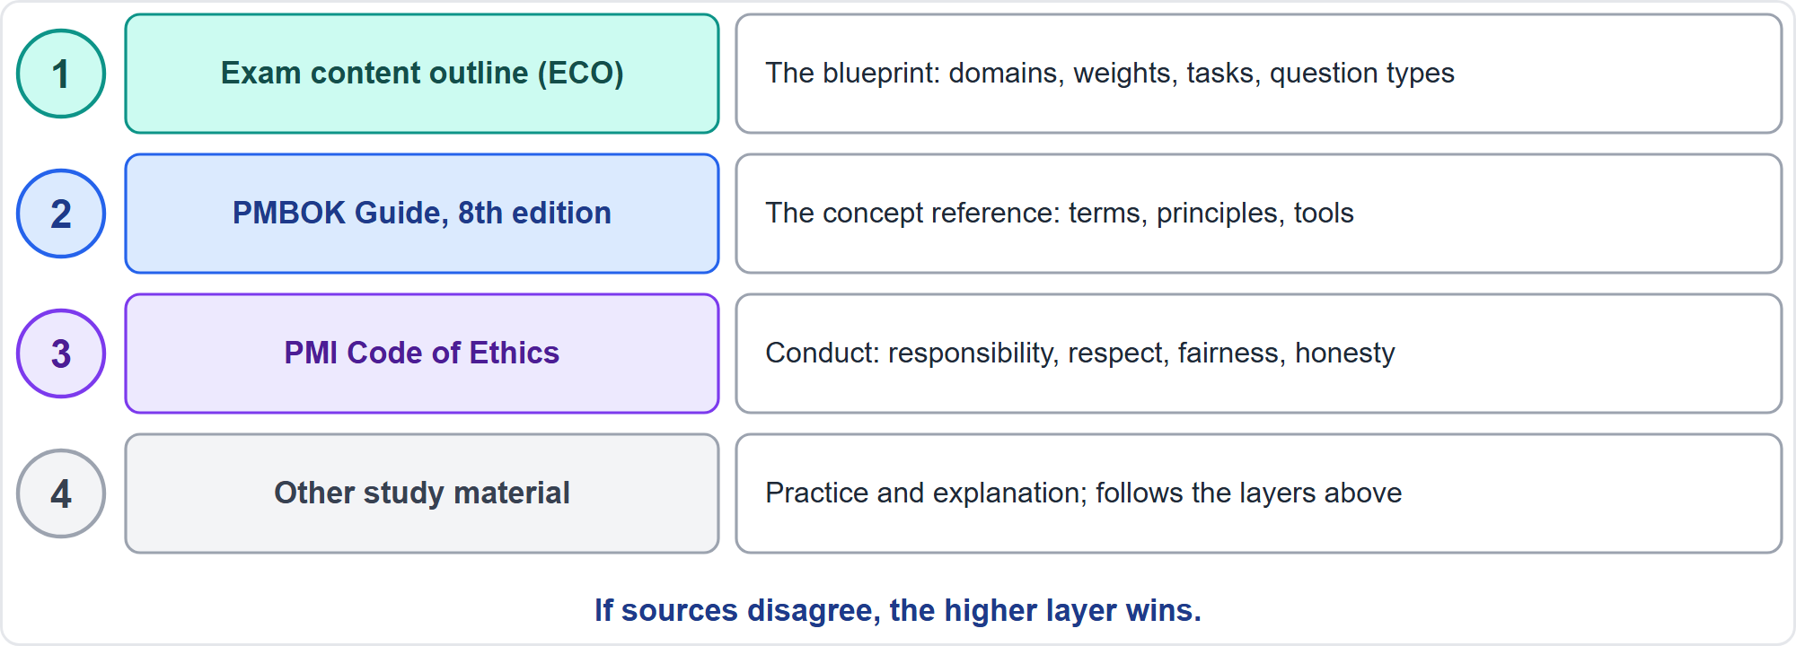
Where Exam Questions Come From
Part 1
The exam is written from the ECO; PMBOK 8 is the concept reference
EXAM TIP When two sources disagree, follow the ECO and PMBOK 8.
PMP Exam Prep 2026 | PMBOK 8 and the New ECO
Module 0: Course Introduction and Exam Orientation
10 / 20
Notes:
Where do exam questions come from? The exam is written from the ECO. That is the blueprint: the domains, the weights, the tasks and the question types. PMBOK Guide, Eighth Edition is the concept reference: the terms, the principles and the tools. The PMI Code of Ethics governs conduct: responsibility, respect, fairness and honesty. Any other study material comes last. Why does the order matter? Because older material sometimes disagrees. It may state a different exam length, or use older process names. When two sources disagree, follow the ECO and PMBOK 8.

Slide 11
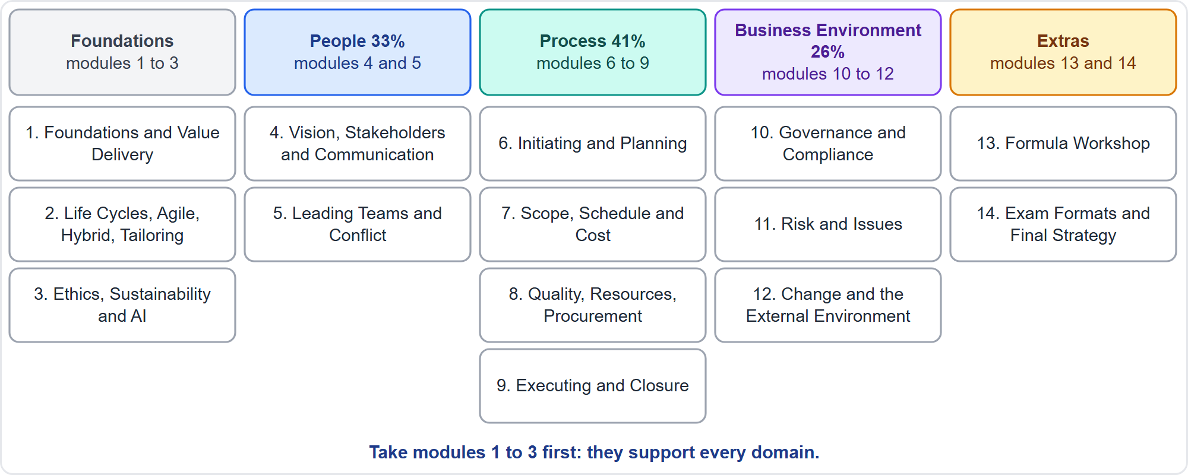
Course Map
Part 1
Fourteen modules after this introduction
EXAM TIP Learn the weights: People 33%, Process 41%, Business Environment 26%.
PMP Exam Prep 2026 | PMBOK 8 and the New ECO
Module 0: Course Introduction and Exam Orientation
11 / 20
Notes:
Here is the course map. Modules one to three are the foundations: project fundamentals and value delivery, life cycles, agile, hybrid and tailoring, and ethics, sustainability and AI. Everything else builds on them. Modules four and five cover the People domain. Modules six to nine cover Process. Modules ten to twelve cover Business Environment. Then come two extras. Module thirteen is a formula workshop with worked examples. Module fourteen covers exam formats, visual practice and final strategy. Take modules one to three first, because they support every domain.

Slide 12
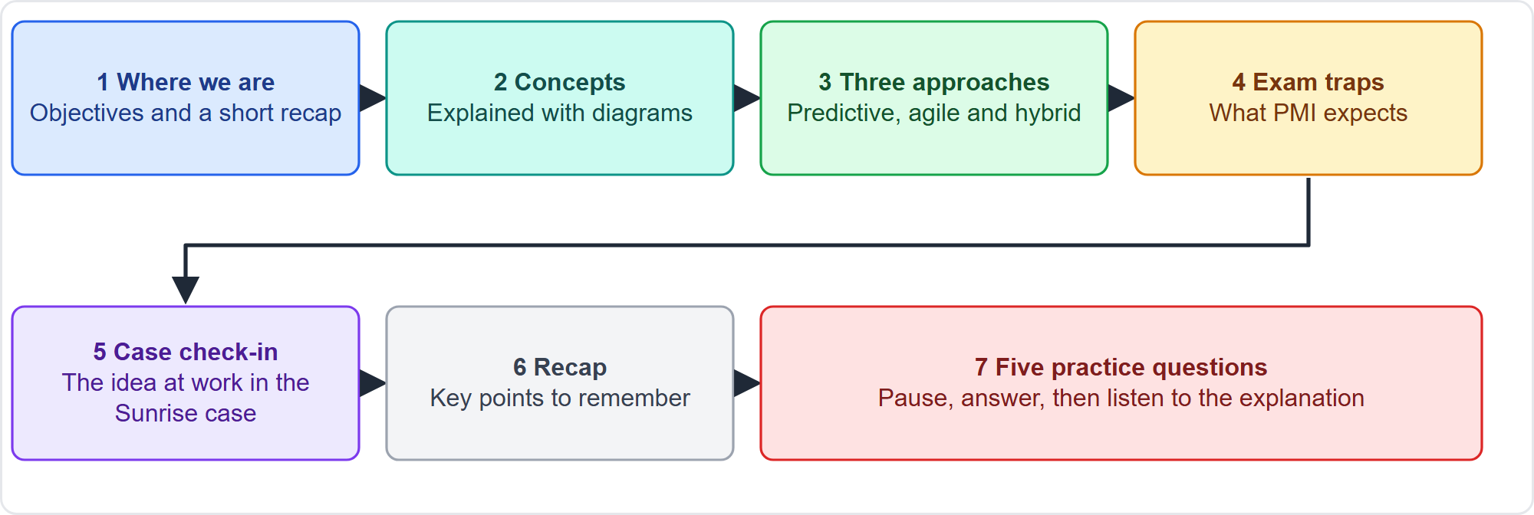
How Each Module Works
Part 1
The same seven steps in every module
EXAM TIP Pause on each practice question and choose your answer before you hear the explanation.
PMP Exam Prep 2026 | PMBOK 8 and the New ECO
Module 0: Course Introduction and Exam Orientation
12 / 20
Notes:
Every module follows the same pattern. It opens with where we are, and the objectives. Then come the concepts, explained with diagrams. Then the contrast between predictive, agile and hybrid. Then a slide on exam traps: what PMI expects. A case check-in shows the idea at work in our running project. A recap lists the key points. And each module ends with five practice questions. When a question appears, pause the video. Choose your answer. Then listen to the explanation. That habit gives you real practice, even from a video.

Slide 13
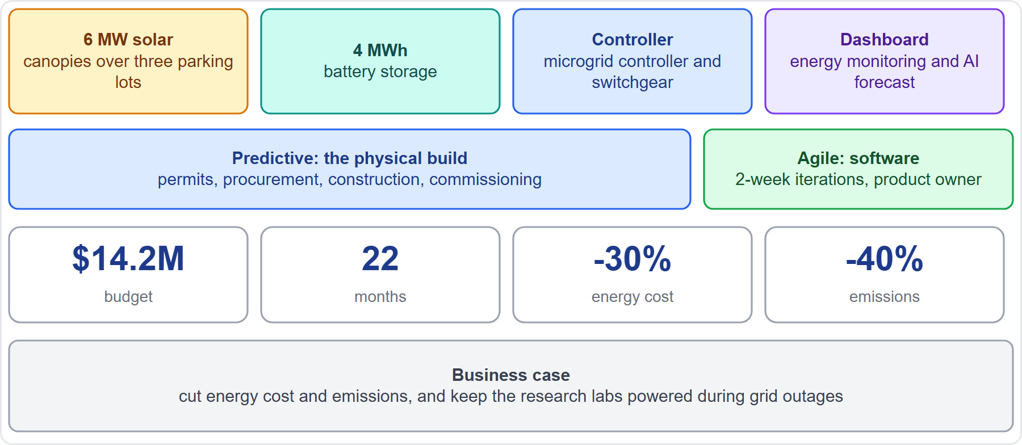
Meet the Running Case
Part 1
CASE CHECK-IN · Sunrise Campus Microgrid
You are the project manager; the project is fictional
Case check-ins show ideas at work in most modules
PMP Exam Prep 2026 | PMBOK 8 and the New ECO
Module 0: Course Introduction and Exam Orientation
13 / 20
Notes:
Meet the running case. You are the project manager of the Sunrise Campus Microgrid, a fictional project at Riverton University. The team builds solar canopies and battery storage, plus an energy dashboard. The numbers are on the screen: six megawatts of solar, four megawatt hours of battery, fourteen point two million dollars, and twenty-two months. The physical build is predictive. The software is agile. So the project is hybrid. In most modules, a case check-in shows how an idea plays out here. The exam facts never depend on the case. It is only a way to make ideas concrete.

Slide 14
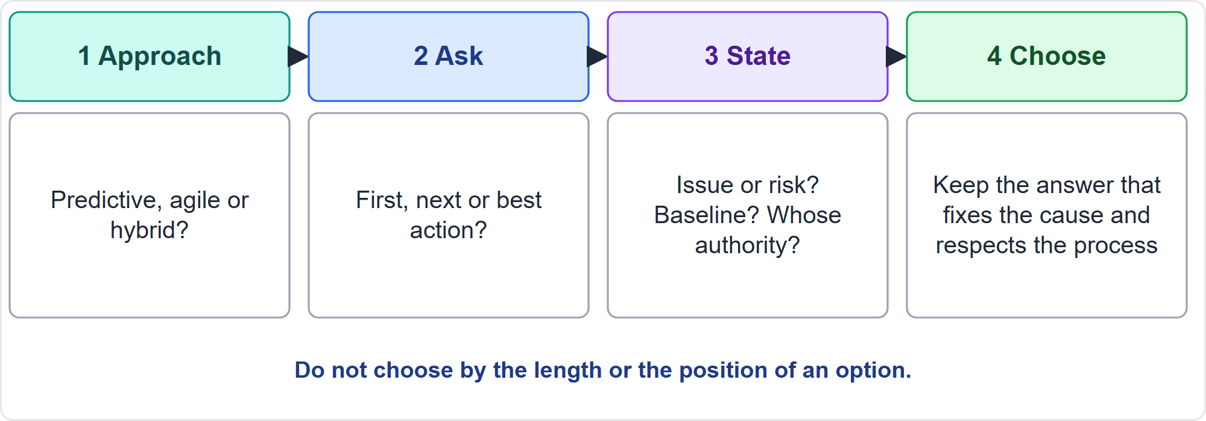
Reading a Scenario Question
Part 1
Approach, ask, state, choose
EXAM TIP Choose by content, never by the length or position of an option.
PMP Exam Prep 2026 | PMBOK 8 and the New ECO
Module 0: Course Introduction and Exam Orientation
14 / 20
Notes:
Here is a method for scenario questions. Step one: find the approach. Is it predictive, agile or hybrid? Step two: find the ask. Is it the first action, the next action, or the best action? Or does it ask for a tool or a term? Step three: find the state. Has the problem happened, which makes it an issue, or might it happen, which makes it a risk? Is there a baseline? Who has the authority? Step four: remove the distractors, and keep the option that fixes the cause, respects the process and protects value. And never choose by the length or the position of an option.

Slide 15
The Four Distractor Types
Part 1
Act without analysis
Analyze instead of engaging
decide alone, approve, implement or build now
study documents when the first move is to talk to the people involved
Escalate or impose too early
Treat the symptom
go to the sponsor or give an order before the parties have tried
log it again, work overtime, resend the message or hide the problem
EXAM TIP When two options look sensible, prefer the one that deals with the cause and keeps the process intact.
PMP Exam Prep 2026 | PMBOK 8 and the New ECO
Module 0: Course Introduction and Exam Orientation
15 / 20
Notes:
Most wrong options fall into four types. First, act without analysis: decide alone, approve, implement or build now. Second, analyze instead of engaging: study documents or collect data, when the first move is to talk to the people involved. Third, escalate or impose too early: go to the sponsor, or give an order, before the parties have tried to resolve it. Fourth, treat the symptom: log it again, work overtime, resend the message or hide the problem. When two options both look sensible, prefer the one that deals with the cause and keeps the process intact.

Slide 16
What the Best Answer Usually Does
Part 1
The scenario shows | The best answer usually | Module
A repeated misunderstanding | Asks the people involved first, then analyzes | 4
Two parties in disagreement | Brings them together to agree | 5
A change request | Assesses impact, then uses change control or the backlog | 12
A risk that has occurred | Treats it as an issue and runs the response | 11
An AI tool's output | A human validates it and stays accountable | 3
EXAM TIP Learn the pattern, not a memorized answer.
PMP Exam Prep 2026 | PMBOK 8 and the New ECO
Module 0: Course Introduction and Exam Orientation
16 / 20
Notes:
Some patterns repeat across the exam. When a misunderstanding keeps repeating, or a group stays silent, the best answer asks the people involved first, and then analyzes the cause. We study that in module four. When two parties disagree, bring them together to agree. Decide directly only for safety or compliance. That is module five. When a change request arrives, assess the impact, then use change control, or the backlog. That is module twelve. When a risk has now occurred, treat it as an issue. That is module eleven. And when an AI tool gives an output, a human validates it and stays accountable. That is module three. Learn the pattern, not a memorized answer.

Slide 17
One Problem, Three Approaches
Part 1
A change request arrives | What happens
Predictive | Impact assessed, then formal change control; baselines updated after approval
Agile | The product owner reprioritizes the backlog; lower priority means deferred, not rejected
Hybrid | Formal control for the baselined envelope; the backlog adapts inside it
EXAM TIP The same problem has a different best answer in each approach: find the approach first.
PMP Exam Prep 2026 | PMBOK 8 and the New ECO
Module 0: Course Introduction and Exam Orientation
17 / 20
Notes:
Take one problem: a change request arrives. In a predictive project, you assess the impact and use formal change control. Baselines are updated after approval. In an agile project, the product owner reprioritizes the backlog. A lower priority means deferred, not rejected. In a hybrid project, both apply. Formal control protects the baselined envelope, such as milestones, committed scope and budget. And the backlog adapts inside it. Same problem, three different best answers. That is why you find the approach first.

Slide 18
Pace Yourself
Part 1
About 80 seconds a question on average: do not stay stuck on one item
Flag hard items and return, but only inside the section you are in
A break closes the section behind you, so use the end of each section to review
In the case section, read the questions first, then the case, and note the facts that matter
In matching items, do not force a match: some choices are decoys
EXAM TIP After a break you cannot go back, so finish your review before it starts.
PMP Exam Prep 2026 | PMBOK 8 and the New ECO
Module 0: Course Introduction and Exam Orientation
18 / 20
Notes:
A few habits for the day itself. You have about eighty seconds a question on average, so do not stay stuck on one item. Flag hard items and come back, but only inside the section you are in. A break closes the section behind you, so use the end of each section for review. In the case section, read the questions first, then the case, and note the facts that matter. Some facts are only noise. And in matching items, do not force a match. Some choices are decoys, and are left unused.

Slide 19
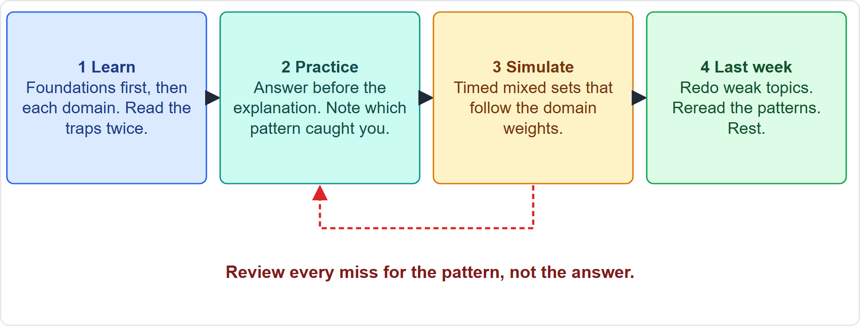
Your Study Plan
Part 1
Learn, practice, simulate, then a last-week review
EXAM TIP Review every miss for the pattern that caught you, not for the right letter.
PMP Exam Prep 2026 | PMBOK 8 and the New ECO
Module 0: Course Introduction and Exam Orientation
19 / 20
Notes:
Here is a study plan in four steps. One: learn. Start with the foundations, then each domain, and read the exam traps and the three-approach table of every module twice. Two: practice by topic. Answer each question before you read the explanation, and note which pattern or distractor caught you. Three: simulate. Take timed mixed sets that follow the domain weights, for example sixty questions in about eighty minutes. Four: the last week. Redo only the topics where you miss more than a third of the questions, reread the patterns and the distractors, and rest. Through all of it, review every miss for the pattern, not for the answer.

Slide 20
Module Recap
Part 1
1
The exam
2
Formats
3
Sources
180 questions in 240 minutes; domains of 33%, 41% and 26%; about 60% agile or hybrid
case and graphic items are new; the interactive formats are test center only
the ECO is the blueprint, PMBOK 8 the concept reference
4
Method
5
Study
6
Next
find the approach, the ask and the state, then remove the distractors
learn, practice by topic, simulate, then a last-week review
Module 1, project foundations and value delivery
PMP Exam Prep 2026 | PMBOK 8 and the New ECO
Module 0: Course Introduction and Exam Orientation
20 / 20
Notes:
Let us recap. The exam has one hundred eighty questions in two hundred forty minutes, three domains weighted thirty-three, forty-one and twenty-six percent, and about sixty percent agile or hybrid items. Case and graphic items are new, and the interactive formats are offered only at a test center. The ECO is the blueprint, and PMBOK 8 is the concept reference. For every scenario, find the approach, the ask and the state, then remove the distractors. And study in four steps: learn, practice, simulate, and review. In Module 1, we start with project foundations and value delivery. See you there.

