Slide 1
Module 1: Project Foundations, Value Delivery and Principles
Part 1 of 3: Projects, value and success
Foundations · background for all three domains
PMP Exam Prep 2026: PMBOK 8 and the New ECO
Module 1 · Part 1
Notes:
Welcome to Module 1. This module gives you the vocabulary and the mindset for everything that follows. Every later module assumes you know what a project is, what value means, how the organization shapes your project, and which six principles guide your decisions. In Part 1, we start with projects, value and success.

Slide 2
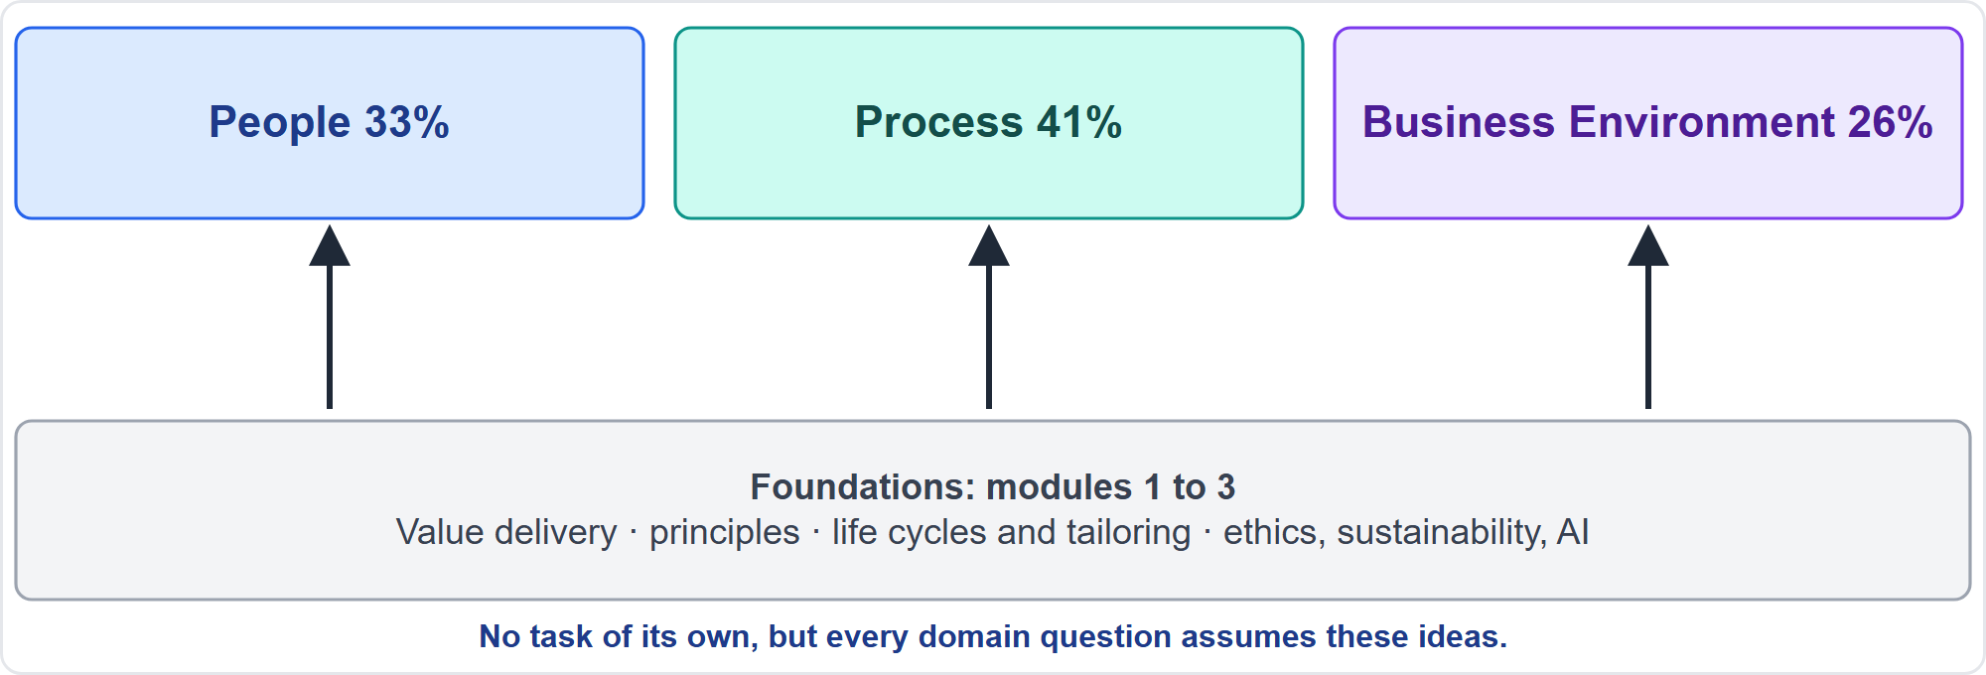
Where This Module Sits in the Exam
Part 1
Foundations carry no task of their own, yet every domain assumes them
EXAM TIP Foundation ideas are tested inside scenarios from every domain, so a weak foundation costs points everywhere.
PMP Exam Prep 2026 | PMBOK 8 and the New ECO
Module 1
2 / 52
Notes:
Here is where this module sits. The exam content outline, the ECO, has no task called foundations. But the ideas in this module appear inside scenarios from all three domains. If you misread what value means, or who has authority in a given structure, you will miss questions in People, in Process and in Business Environment alike. So treat Modules 1 to 3 as the base that the rest of the course stands on.

Slide 3
What You Will Learn
Part 1
Define project, program, portfolio and operations, and how they fit together
Tell outputs, outcomes, benefits and disbenefits apart, and judge success by value
Explain the system for value delivery and why information must flow both ways
Use environmental factors, process assets and structure to read a scenario
Recognize roles, functions, competencies and the PMO
Apply the six principles to find the best answer
PMP Exam Prep 2026 | PMBOK 8 and the New ECO
Module 1
3 / 52
Notes:
By the end of this module you will be able to do six things. Define a project, a program, a portfolio and operations, and say how they fit together. Tell outputs, outcomes, benefits and disbenefits apart, and judge success by value. Explain the system for value delivery. Use environmental factors, process assets and organizational structure to read a scenario. Recognize roles, functions, competencies and the project management office. And apply the six principles to choose the best answer.

Slide 4
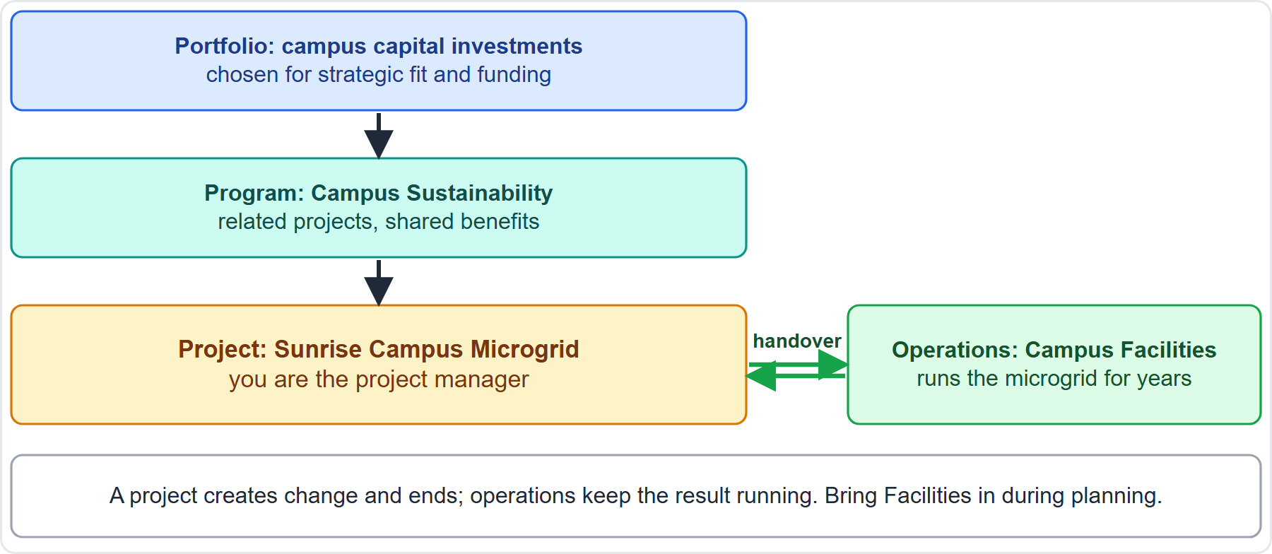
Case Check-In: Where the Microgrid Sits
Part 1
CASE CHECK-IN · Sunrise Campus Microgrid
Portfolio, program, project: the microgrid is one project inside a sustainability program
Operations: Campus Facilities will run it for years, so involve them early
PMP Exam Prep 2026 | PMBOK 8 and the New ECO
Module 1
4 / 52
Notes:
Let us place our running case. The Sunrise Campus Microgrid is a project. It belongs to a Campus Sustainability Program, which sits inside the university's campus capital portfolio. When the microgrid is finished, Campus Facilities will operate it for years. That is operations. So the project creates change and then ends, while operations keep the result running. Notice what that implies: bring Facilities into the planning early, because they will live with the result.

Slide 5
Key Terms
Part 1
Term | Meaning
Project | A temporary initiative in a unique context, undertaken to create value
Project management | Applying knowledge, skills and tools to meet or exceed the intended value
Portfolio | Programs, projects and operations managed as a group for strategic value
Program | Related projects managed together for benefits not available separately
PMO | A unit that centralizes management of portfolios, programs and projects
EXAM TIP Meeting or exceeding value never endorses gold plating or scope creep.
PMP Exam Prep 2026 | PMBOK 8 and the New ECO
Module 1
5 / 52
Notes:
Five terms to fix in your mind. A project is a temporary initiative in a unique context, undertaken to create value. Project management applies knowledge, skills and tools to meet or exceed the intended value. A portfolio is a group of programs, projects and operations managed for strategic value. A program is a set of related projects managed together for benefits that managing them separately cannot give. And the project management office, the PMO, centralizes that management. Note the phrase meet or exceed value. It does not mean adding extras nobody asked for.

Slide 6
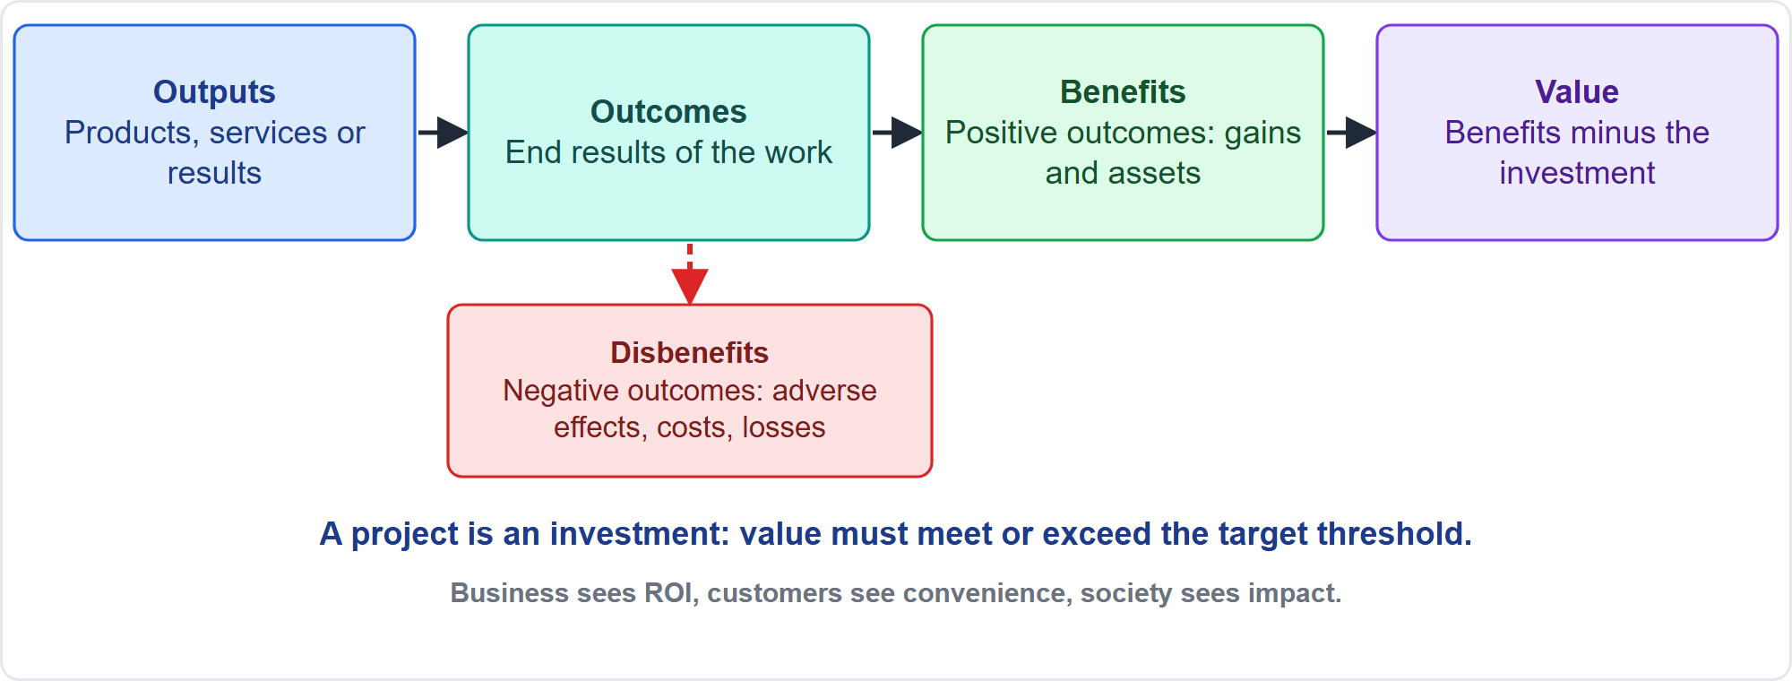
From Output to Value
Part 1
From outputs to value
EXAM TIP Delivering outputs is not the same as realizing benefits; make sure benefits are tracked after delivery.
PMP Exam Prep 2026 | PMBOK 8 and the New ECO
Module 1
6 / 52
Notes:
Follow the chain on the screen. A project produces outputs: products, services or results. Outputs lead to outcomes, the end results of the work. Positive outcomes are benefits, gains or assets for the organization and its stakeholders. Negative outcomes are disbenefits. Value is the excess of financial and nonfinancial benefits over the investment. A project is an investment, so the expected value must meet or exceed the target threshold. And different stakeholders see value differently, so ask what each of them values.

Slide 7
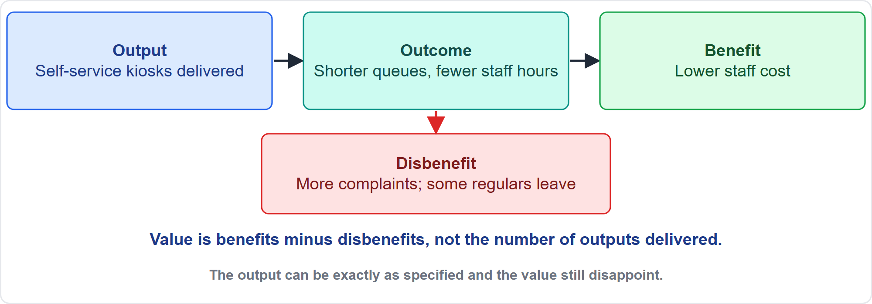
Output, Outcome, Benefit and Disbenefit in Practice
Part 1
Kiosks are the output; the value depends on what follows
EXAM TIP Complaints and lost customers are a disbenefit to weigh against the benefits, not an assumption or an output.
PMP Exam Prep 2026 | PMBOK 8 and the New ECO
Module 1
7 / 52
Notes:
Here is an example. A store installs self-service kiosks. The kiosks are the output. Queues get shorter and staff hours fall: that is the outcome. Lower staff cost is a benefit. But complaints rise, and some regular customers leave. That is a disbenefit, a negative outcome. When you judge the value of the project, you weigh the disbenefit against the benefits. The kiosks may have been delivered exactly as specified, and the value can still disappoint.

Slide 8
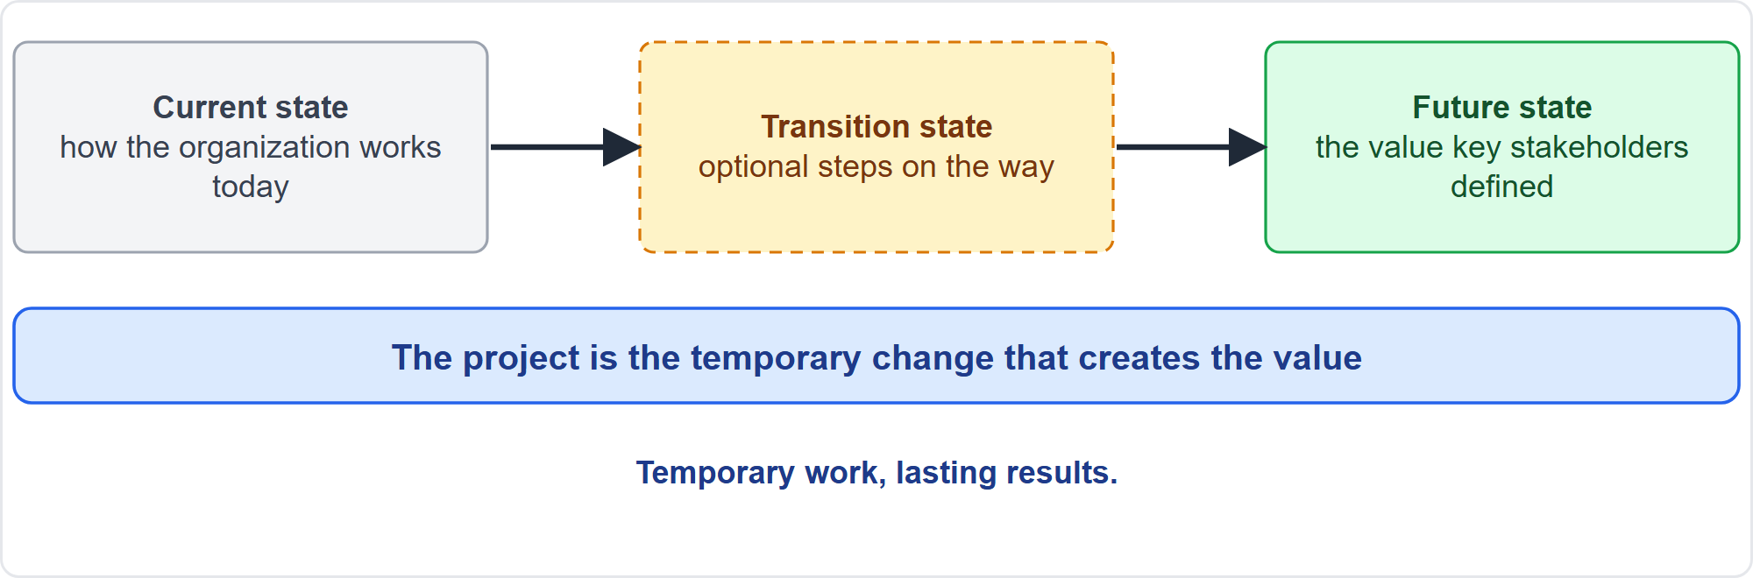
What Makes a Project
Part 1
A project moves the organization to a future state
EXAM TIP A project is temporary, but its deliverables and benefits often last long after it ends.
PMP Exam Prep 2026 | PMBOK 8 and the New ECO
Module 1
8 / 52
Notes:
Three features define a project. First, it is temporary: it has a beginning and an end, although its results often last. Second, it has a unique context. Two similar projects still differ in goals, environment, approach and stakeholders, which is why each one needs tailoring. Third, it creates value through organizational change. It moves the organization from its current state, perhaps through a transition state, to a future state that delivers the value key stakeholders defined.

Slide 9
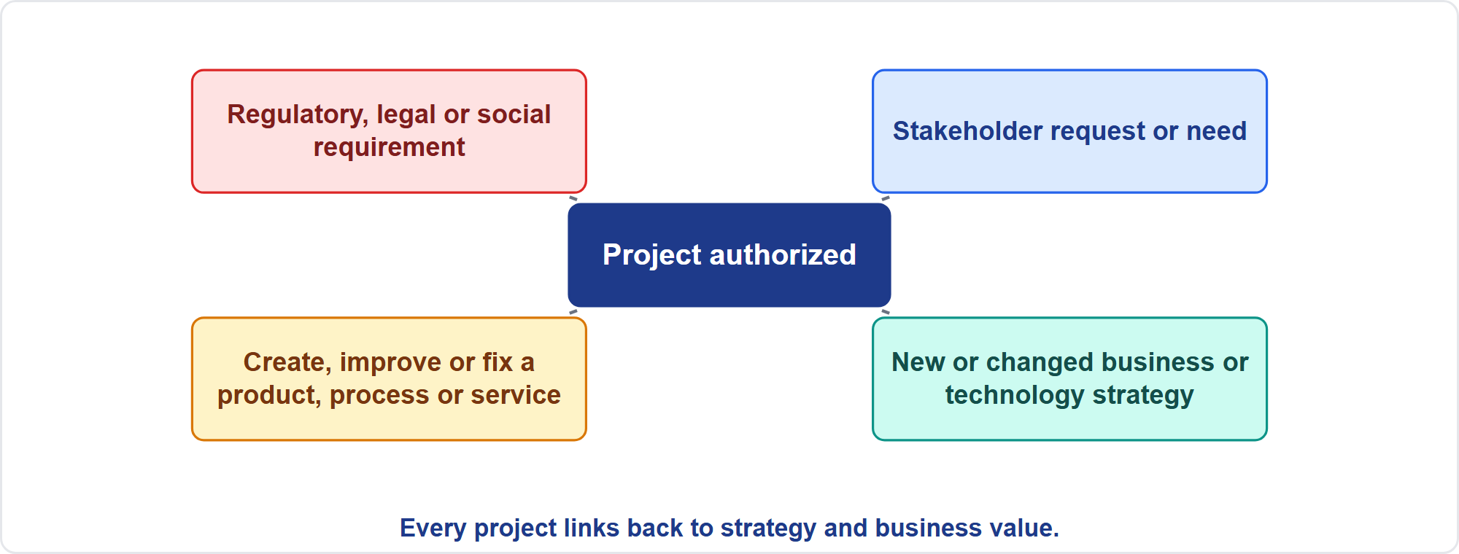
Why Projects Start
Part 1
Four reasons leaders authorize projects
EXAM TIP A project with no link to strategy and business value is a warning sign.
PMP Exam Prep 2026 | PMBOK 8 and the New ECO
Module 1
9 / 52
Notes:
Why do leaders authorize projects? Four common reasons. To respond to regulatory, legal or social requirements. To answer a stakeholder request or need. To follow a new or changed business or technology strategy. Or to create, improve or fix a product, a process, an organization or a service. Whatever the trigger, every project should link back to strategic objectives and business value. If you cannot draw that link, the project is on weak ground.

Slide 10
How Projects End
Part 1
The objectives are achieved
A governing body, the sponsor or the team decides the objectives will not or cannot be met
Resources run out or are no longer available
The need disappears because strategy, priorities or the environment changed
The project is terminated for legal, regulatory or compliance reasons
EXAM TIP End a project formally, with approvals, lessons learned and released resources; do not let it drift.
PMP Exam Prep 2026 | PMBOK 8 and the New ECO
Module 1
10 / 52
Notes:
A project usually ends when one or more of five things happen. The objectives are achieved. Someone with authority decides the objectives will not or cannot be met. Resources, such as funding or people, run out. The need disappears because strategy, priorities or the environment changed. Or the project is terminated for legal, regulatory or compliance reasons. Notice that success is only one of the five. And whatever the reason, end the project formally: approvals, lessons learned, and released resources. Do not let it drift.

Slide 11
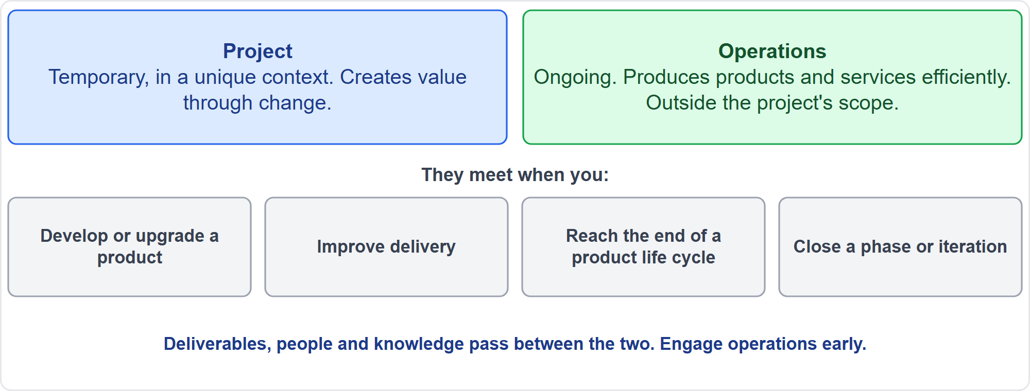
Projects Versus Operations
Part 1
Temporary change versus ongoing production
EXAM TIP Ongoing operations are outside a project's scope; plan the handover of deliverables, people and knowledge.
PMP Exam Prep 2026 | PMBOK 8 and the New ECO
Module 1
11 / 52
Notes:
Projects and operations are different. A project is temporary and creates value through change. Operations are ongoing and produce products and services efficiently. Ongoing operations are outside a project's scope. But they meet at four points. When you develop or upgrade a product. When you improve delivery. At the end of a product life cycle. And at each closeout of a phase or iteration. At those points, deliverables, people and knowledge pass between the two. So engage operations early in planning. It strongly affects long-term success.

Slide 12
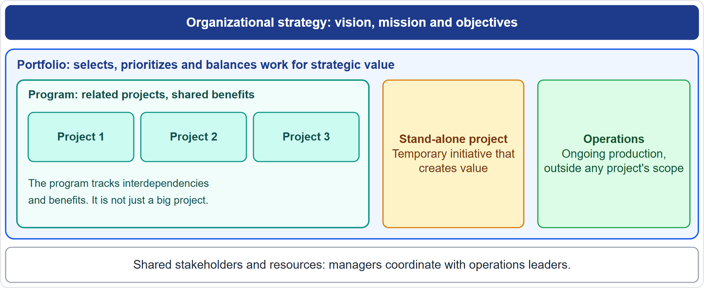
Portfolio, Program and Project
Part 1
How portfolio, program, project and operations fit together
EXAM TIP A program is not just a big project, and a portfolio is about strategic fit.
PMP Exam Prep 2026 | PMBOK 8 and the New ECO
Module 1
12 / 52
Notes:
Look at how the levels fit together. Organizational strategy drives the portfolio, which selects, prioritizes and balances work to maximize value. A program manages related projects together, for benefits that separate management could not give. A program is not just a big project. Stand-alone projects also exist. Operations produce goods and services. And a product has a life cycle that projects and programs help create, enhance and retire. All of them share stakeholders and resources, so their managers coordinate with operations leaders.

Slide 13
Portfolio, Program and Project Compared
Part 1
 | Portfolio | Program | Project
Focus | Strategic value across all work | Benefits from related work | Value from one temporary initiative
Scope | Aligned with strategy | Integrates its component projects | Defined objectives, progressively elaborated
Monitoring | Strategic change, resource allocation | Component progress and benefits realization | Outputs and value
Success | Strategic value delivered | Collective benefits delivered | Value worth the effort and expense
EXAM TIP Programs drive organizational change; they are not merely large projects.
PMP Exam Prep 2026 | PMBOK 8 and the New ECO
Module 1
13 / 52
Notes:
Here is the comparison. A portfolio focuses on strategic value across all the work. Its scope follows strategy, and it monitors strategic change and resource allocation. A program focuses on benefits from related work. It integrates the scope of its component projects, and it monitors their progress and benefits realization. A project focuses on value from one temporary initiative, with defined objectives that are progressively elaborated. Its success is value worth the effort and expense. Remember: programs drive organizational change.

Slide 14
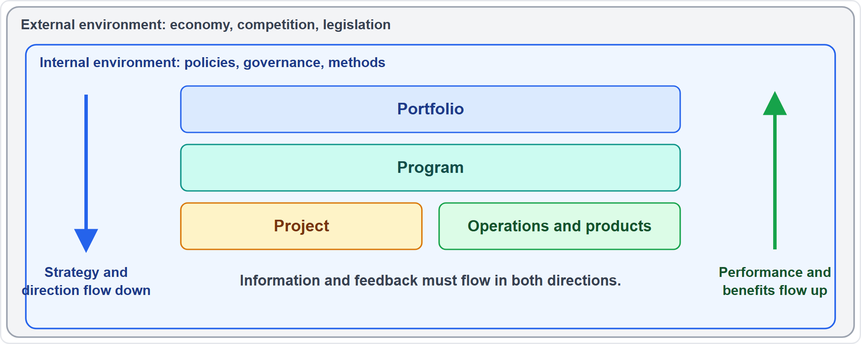
The System for Value Delivery
Part 1
Strategy flows down; performance and benefits flow up
EXAM TIP If a team never sees the link to strategy and the board never sees benefits data, set up two-way information flows.
PMP Exam Prep 2026 | PMBOK 8 and the New ECO
Module 1
14 / 52
Notes:
Organizations deliver value through a system. It sits inside the internal environment, with its policies, governance and methods, which sits inside the external environment of economy, competition and legislation. Portfolios, programs, projects, operations and products are all parts of it. The system works best when information and feedback flow consistently. Strategy and direction flow down. Performance information and benefits analysis flow up. If either direction is broken, set up regular two-way information flows.

Slide 15
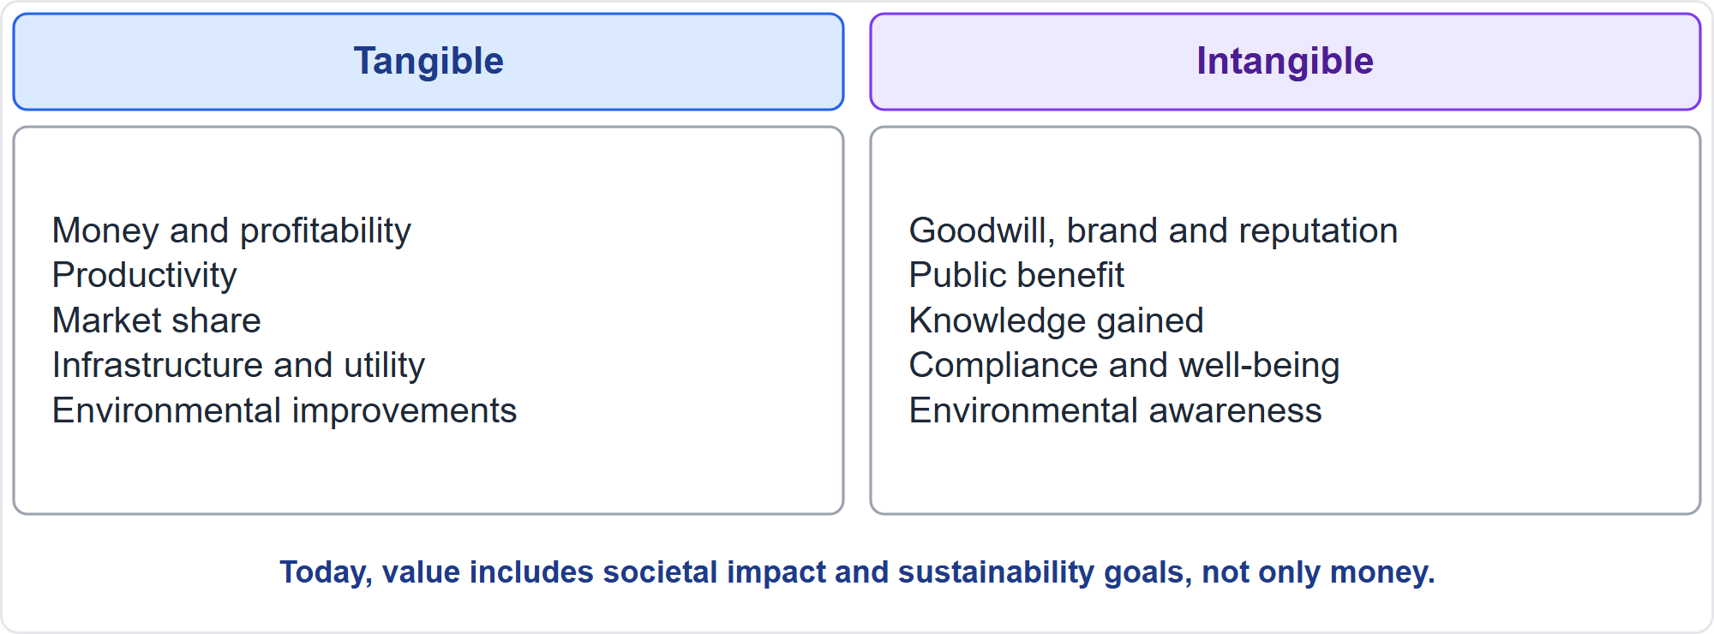
Business Value
Part 1
Tangible and intangible value
EXAM TIP Value today includes societal impact and sustainability goals, not only money.
PMP Exam Prep 2026 | PMBOK 8 and the New ECO
Module 1
15 / 52
Notes:
Business value is the net quantifiable benefit, tangible or intangible. Tangible value includes money, productivity, profitability, market share, infrastructure and utility, along with environmental improvements. Intangible value includes goodwill, brand and reputation, public benefit, acquired knowledge, compliance and employee well-being, along with environmental awareness. Today, value also includes societal impact and sustainability goals. So a project that is financially neutral can still be well worth doing.

Slide 16
Meeting or Exceeding the Value Threshold
Part 1
A project is an investment: expected value must meet or exceed the target threshold
Ways to do it: meet customer needs, deliver within a high-value baseline, help communities and sustainability
Also: improve efficiency and well-being, enable the future state, sustain earlier benefits
Value can arrive during, at the end of, or after the project
Never gold plate: unrequested extras are not value
EXAM TIP If the business case collapses, revalidate value with the sponsor before continuing, even when the schedule is perfect.
PMP Exam Prep 2026 | PMBOK 8 and the New ECO
Module 1
16 / 52
Notes:
Because a project is an investment, its expected value must meet or exceed the target threshold. Projects do that in several ways. They meet customer needs, or deliver within a baseline that represents a high-value outcome. They contribute to communities and sustainability, or improve efficiency and well-being. And they enable the future state, or sustain benefits from earlier work. Value can arrive during the project, at its end, or long after. Never gold plate. And if the business case collapses, revalidate value with the sponsor, even when the schedule is perfect.

Slide 17
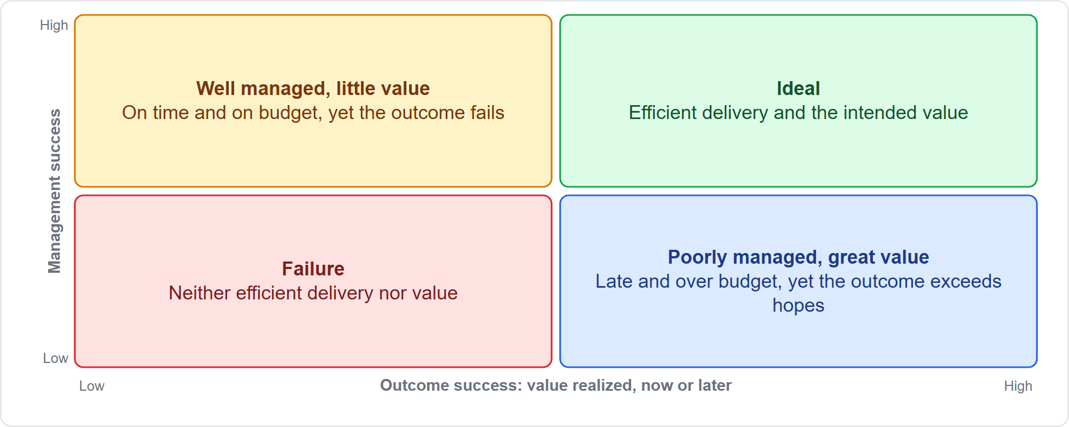
Two Dimensions of Project Success
Part 1
Management success and outcome success are different
EXAM TIP On time and on budget is not enough: look at stakeholder value and the desired outcomes.
PMP Exam Prep 2026 | PMBOK 8 and the New ECO
Module 1
17 / 52
Notes:
Project success is a consensus view. Intended beneficiaries and other stakeholders agree that the project delivered value worth the effort and expense. The matrix shows two dimensions. Management success: cost, scope, time, quality and use of resources. Outcome success: the intended value, realized now or later. A well-managed project can deliver little value, like an overpass built well and then demolished. A poorly managed one can deliver great value, like the Sydney Opera House. Both dimensions matter. The ECO favors stakeholder value.

Slide 18
Fundamentals Traps: What PMI Expects
Part 1
On time and on budget is not enough: revalidate value if the need has changed
Outputs are not outcomes: track benefits after delivery
A program is not a big project; a portfolio is about strategic fit
End projects formally, whatever the reason
Operations are outside scope: plan the handover early
"Meet or exceed value" is not gold plating
EXAM TIP When the plan is fine but the value is gone, the best answer goes back to the sponsor.
PMP Exam Prep 2026 | PMBOK 8 and the New ECO
Module 1
18 / 52
Notes:
Let us collect the traps. On time and on budget is not enough. If the need has changed, revalidate value. Outputs are not outcomes, so track benefits after delivery. A program is not a big project, and a portfolio is about strategic fit. End projects formally, whatever the reason. Operations are outside project scope, but the handover must be planned early. And meeting or exceeding value is never gold plating. When the plan is fine but the value is gone, the best answer goes back to the sponsor.

Slide 19
Part 1 Recap
Part 1
1
Project
2
Value chain
3
Success
temporary, unique context, creates value through change
outputs lead to outcomes; benefits and disbenefits decide value
management success and outcome success, judged by stakeholders
4
Start and end
5
Levels
6
Value system
linked to strategy; ended formally for five possible reasons
portfolio, program, project, with operations alongside
strategy flows down, performance and benefits flow up
PMP Exam Prep 2026 | PMBOK 8 and the New ECO
Module 1
19 / 52
Notes:
Let us recap Part 1. A project is temporary, has a unique context, and creates value through change. Outputs lead to outcomes, and benefits and disbenefits decide the value. Success has two dimensions, management success and outcome success, and stakeholders judge it. Projects start for reasons linked to strategy and end formally for one of five reasons. Portfolio, program and project are different levels, with operations alongside. And in the value system, strategy flows down while performance and benefits flow up.

Slide 20
Environment, Structures and Roles
Part 2
Every project sits inside an environment it can use but cannot fully change
Environmental factors and process assets shape what you can do
Organizational structure decides how much authority you have
Functions, roles and competencies show who does project management work
The PMO often sets the rules you tailor
EXAM TIP In scenarios, ask first: what can I change, what must I adapt to, and who has the authority?
PMP Exam Prep 2026 | PMBOK 8 and the New ECO
Module 1
20 / 52
Notes:
Part 2 looks at the world around the project. Every project sits inside an environment that it can use, but cannot fully change. Environmental factors and process assets shape what you can do. The organizational structure decides how much authority you have. Functions, roles and competencies show who does project management work. And the project management office often sets the rules that you tailor. In every scenario, ask three questions: what can I change, what must I adapt to, and who has the authority?

Slide 21
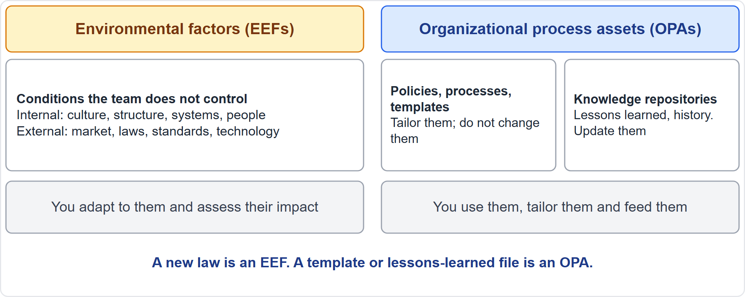
Environmental Factors and Process Assets
Part 2
EEFs are conditions you adapt to; OPAs are assets you use
EXAM TIP A new law is an environmental factor; a template or a lessons-learned file is a process asset.
PMP Exam Prep 2026 | PMBOK 8 and the New ECO
Module 1
21 / 52
Notes:
Two kinds of influence shape every project. Enterprise environmental factors, the EEFs, are conditions the project team does not control. They can enhance or constrain your options. Internal ones include culture, structure, systems and people. External ones include the market, laws, standards and technology. You adapt to them. Organizational process assets, the OPAs, are the organization's own plans, processes, templates and knowledge. You use them, tailor them, and feed them. A new law is an EEF. A template or a lessons-learned file is an OPA.

Slide 22
Environmental Factors in Detail
Part 2
Internal | External
Culture and governance | Marketplace conditions
Organizational structure | Social and cultural influences
Geographic distribution of teams | Legal restrictions, such as data protection
Infrastructure | Research and benchmarking
IT systems | Government and industry standards
Resource availability | Financial conditions: rates, taxes, tariffs
Employee capability | Emerging technologies, such as AI
Financial capability | Physical environment and public health rules
EXAM TIP You do not change an environmental factor; you adapt to it and assess its impact on scope.
PMP Exam Prep 2026 | PMBOK 8 and the New ECO
Module 1
22 / 52
Notes:
Here are environmental factors in more detail. Internal factors include culture, structure and governance, the geographic distribution of teams, infrastructure and IT systems, resource availability and capability, and financial capability. External factors include market conditions and social and cultural influences. They include legal restrictions such as data protection, and government and industry standards. They also include financial conditions such as interest rates and tariffs, emerging technologies such as AI, and the physical environment, including public health rules. When one of these shifts, you adapt. And you assess the impact on scope.

Slide 23
Process Assets: What You Can Change
Part 2
Category | Examples | Can the project update it?
Policies, processes and procedures | Templates, life cycles, change control, supplier lists, closure guidelines | No. Set outside the project; the team may tailor them
Knowledge repositories | Lessons learned, historical data, metrics, earlier project files | Yes. Updated with project information
EXAM TIP Improvements and lessons learned go into the repositories; policies and templates are tailored, not changed.
PMP Exam Prep 2026 | PMBOK 8 and the New ECO
Module 1
23 / 52
Notes:
Process assets come in two categories. Policies, processes and procedures: templates, life cycles, change control procedures, preapproved supplier lists and closure guidelines. The project cannot update these. The PMO or a function outside the project sets them, and they change only through organizational policy. The team may tailor them for the project. Knowledge repositories hold lessons learned, historical data, metrics and earlier project files. The project can and should update these with its own information. So lessons go into the repository, and templates are tailored, not changed.

Slide 24
Organizational Structures
Part 2
Structure | PM authority | PM role | Resources
Functional | Low | Part-time | Low
Matrix: weak | Low | Part-time | Low
Matrix: balanced | Low to moderate | Part-time, embedded skill | Low to moderate
Matrix: strong | Moderate to high | Full-time | Moderate to high
Project-oriented | High to almost total | Full-time | High to almost total
Virtual, hybrid, organic | Varies | Varies | Varies
EXAM TIP There is no one best structure; it depends on size, industry, geography, strategy and complexity.
PMP Exam Prep 2026 | PMBOK 8 and the New ECO
Module 1
24 / 52
Notes:
Structure decides how much authority the project manager has. In a functional organization, work is grouped by job. The project manager has low authority, usually part-time, with low access to resources. A weak matrix is similar. A balanced matrix gives low to moderate authority. A strong matrix gives moderate to high authority, and the project manager is full-time. In a project-oriented organization, authority is high to almost total. Virtual, hybrid and organic structures vary. There is no single best structure. It depends on size, industry, geography, strategy and complexity.

Slide 25
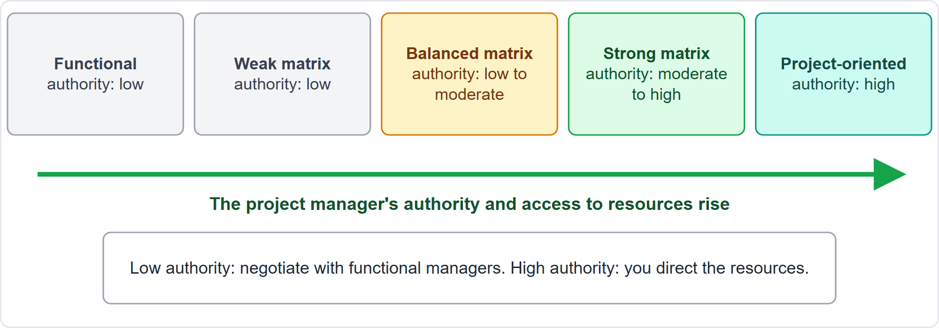
Structure and the Project Manager's Authority
Part 2
Authority and resource access rise from functional to project-oriented
EXAM TIP In a functional or weak matrix, you negotiate and align functional managers; you do not overrule them.
PMP Exam Prep 2026 | PMBOK 8 and the New ECO
Module 1
25 / 52
Notes:
The same idea as a picture. Moving from functional to project-oriented, the project manager's authority and access to resources rise. That changes the best answer. Suppose you need a specialist for two weeks, and their functional manager says operations work comes first. In a functional structure, you cannot give orders. You negotiate a time slot, backed by the business priority and the sponsor's support. Waiting passively, ordering the person, or buying capacity on your own all ignore that route.

Slide 26
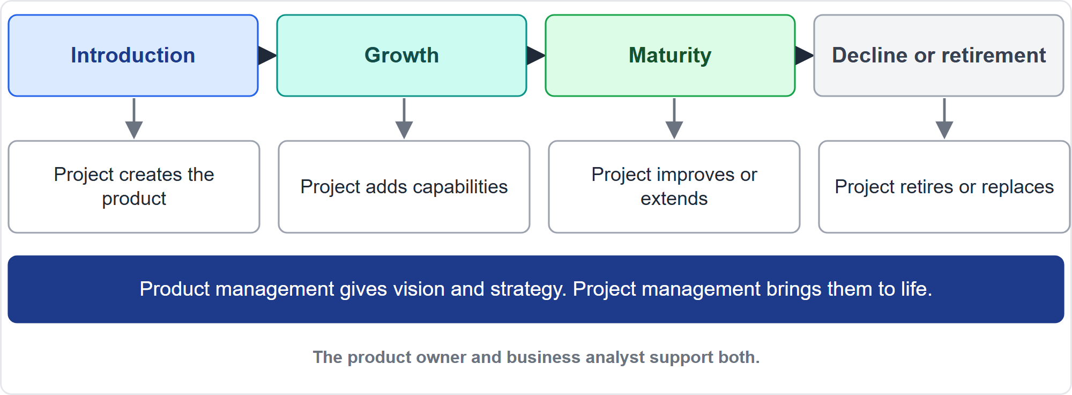
Product Management and the Product Life Cycle
Part 2
Projects can start at any point in a product's life
EXAM TIP The product owner keeps the backlog valuable; the business analyst keeps scope matched to business needs.
PMP Exam Prep 2026 | PMBOK 8 and the New ECO
Module 1
26 / 52
Notes:
Product management looks after a product or service through its whole life cycle: introduction, growth, maturity, and decline or retirement. It integrates people, data, processes and business systems to create, develop and maintain it. Projects and programs can start at any point. One creates the product. Another adds capabilities. Another improves or extends it. Another retires it. Product management supplies the vision and strategy. Project management brings them to life by managing execution, dependencies and resources. The product owner and the business analyst support both.

Slide 27
Functions That Drive Delivery
Part 2
Function | What it does
Oversight and coordination | Aligns effort, removes obstacles, keeps focus
Solicit and manage feedback | Gathers expectations; more needed in agile and hybrid work
Facilitate and support | Builds consensus, resolves conflict, supports change
Perform work | Supplies the skills to deliver the product
Apply expertise | Adds specialist knowledge and spots blind spots
Organizational direction | Prioritizes by value, dependencies and risk
Provide resources | Secures funding, people, facilities and authority
EXAM TIP People perform functions; one person can perform several, and one function can be shared.
PMP Exam Prep 2026 | PMBOK 8 and the New ECO
Module 1
27 / 52
Notes:
People drive delivery by performing functions. Oversight and coordination aligns effort and removes obstacles. Solicit and manage feedback gathers expectations, and matters more in agile and hybrid work. Facilitate and support builds consensus and resolves conflict. Perform work supplies the skills to deliver. Apply expertise adds specialist knowledge. Organizational direction prioritizes by value, dependencies and risk. Provide resources secures funding, people and authority. One person can perform several functions, and several people can share one. Think in functions, not titles.

Slide 28
Roles, Titles and Who Does Project Management
Part 2
Project management team
Sponsor, customer, product owner
can be one person; ideally involved from initiation to closing
give vision and decisions beyond the project manager's authority
Project team
End users
the people who perform the work, coordinated in different ways
engaged continuously so feedback shapes the result
EXAM TIP The essence of project management lies in the function, not the title.
PMP Exam Prep 2026 | PMBOK 8 and the New ECO
Module 1
28 / 52
Notes:
Now roles. The project management team may be one person, ideally involved from initiation through closing. Sponsors, customers and product owners provide decision leadership beyond the project manager's authority. They communicate vision, secure resources and remove obstacles. The project team performs the work. And end users are engaged continuously so their feedback is built in. Titles vary. In agile settings, a product owner, scrum master or team lead may carry project management functions. The essence lies in the function, not the title.

Slide 29
Leadership Styles and Situational Leadership
Part 2
Many leadership styles exist; good leaders switch between them
Situational leadership: directive at critical points, supportive when autonomy helps
Sponsors, customers and product owners lead too, beyond the project manager's authority
Leadership is a function: it can come from any role
EXAM TIP Match the style to the situation: directive in a crisis, supportive when the team can run alone.
PMP Exam Prep 2026 | PMBOK 8 and the New ECO
Module 1
29 / 52
Notes:
Leaders can use many styles, and good ones switch between them. Situational leadership means being directive at critical points, such as a crisis, a safety issue or a compliance deadline. It means being supportive when the team has the skill and the autonomy to run alone. Sponsors, customers and product owners also provide leadership, in areas beyond the project manager's authority. And leadership is a function, not a title. It can come from any role. We return to leadership in Module 5.

Slide 30
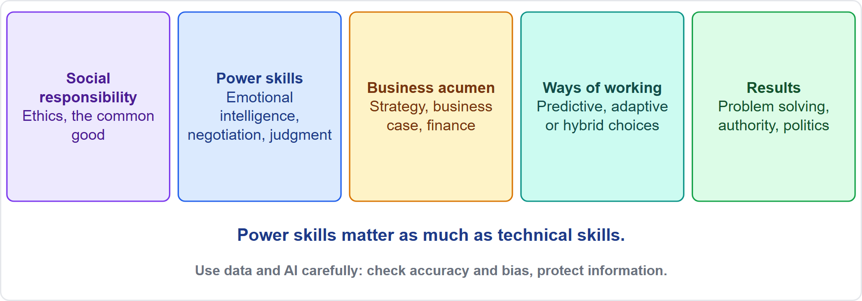
Competencies of the Project Team
Part 2
Five competency areas
EXAM TIP Leadership, communication, negotiation and emotional intelligence count as much as technical skill.
PMP Exam Prep 2026 | PMBOK 8 and the New ECO
Module 1
30 / 52
Notes:
The project team needs five kinds of competence. Social responsibility: ethical decisions, respect for cultural norms, and continuous self-development. Power skills: adaptability, emotional intelligence, critical thinking, judgment, motivation, negotiation and conflict resolution. Business acumen: strategic thinking, the business case and financial analysis. Ways of working: choosing predictive, adaptive or hybrid, and managing change. Results: problem solving, root cause analysis, and dealing with organizational politics. Technology helps, but check data for accuracy and bias, and protect project information.

Slide 31
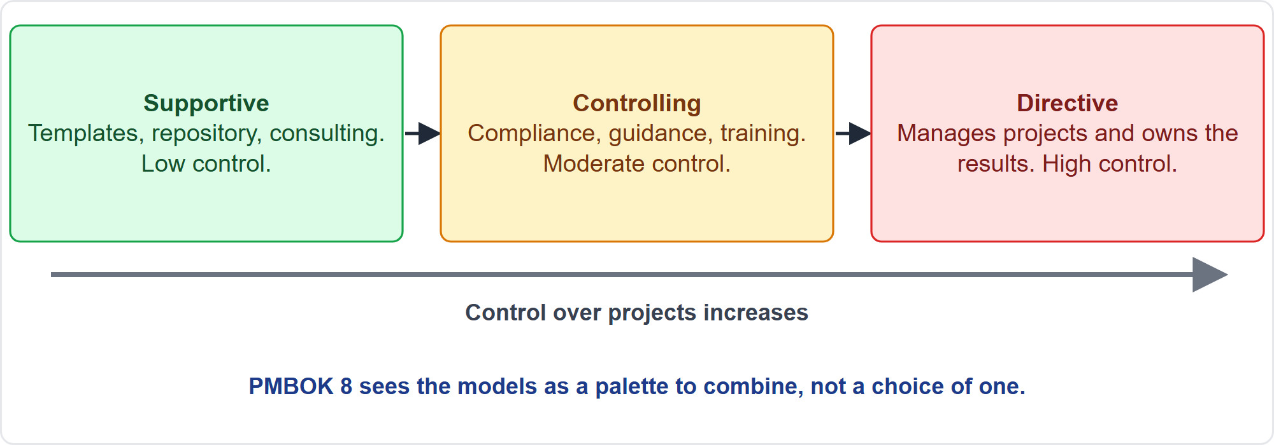
The Project Management Office
Part 2
Three classic PMO types
EXAM TIP A PMO that offers templates and consulting without enforcing them is the supportive type.
PMP Exam Prep 2026 | PMBOK 8 and the New ECO
Module 1
31 / 52
Notes:
A PMO centralizes management activities for portfolios, programs and projects. It often sets the policies, processes and procedures that projects follow. Modern PMOs are customer-centric: they align their services with strategy and with what customers value. Exam questions often use three classic types. A supportive PMO offers templates, a repository and consulting, with low control. A controlling PMO requires compliance, guidance and training, with moderate control. A directive PMO manages projects directly and owns the results. PMBOK 8 treats these as a palette to combine.

Slide 32
Foundations in Predictive, Agile and Hybrid Work
Part 2
 | Predictive | Agile | Hybrid
Coordination | Centralized under a project manager | Decentralized: team, product owner, scrum master share | Self-organized teams inside a coordinated project
Feedback | At milestones and acceptance | Every iteration | Both
Value check | Business case at phase gates | Reprioritized every iteration | Both
EXAM TIP Same principles, different expression: gates in predictive work, iteration reviews in agile work.
PMP Exam Prep 2026 | PMBOK 8 and the New ECO
Module 1
32 / 52
Notes:
The foundations apply in every approach, but they look different. In predictive work, coordination is centralized under a project manager, feedback comes at milestones and acceptance, and the business case is revalidated at phase gates. In agile work, coordination is decentralized: the team, the product owner and the scrum master share project management functions. Feedback comes every iteration, and value is reprioritized every iteration. Hybrid work mixes both: self-organized teams inside a centrally coordinated project, with both kinds of checks.

Slide 33
Environment and Role Traps: What PMI Expects
Part 2
Authority follows structure: negotiate with functional managers; do not order them
Update the right assets: lessons into repositories; templates are tailored
Environmental factors are not yours to change: adapt and assess the impact
Use the defined routes: the PMO resource pool and standard processes
Titles do not decide who does project management
Power skills count as much as technical skills
EXAM TIP Scenario options that bypass the organization's defined routes are usually wrong.
PMP Exam Prep 2026 | PMBOK 8 and the New ECO
Module 1
33 / 52
Notes:
Let us gather the traps from this part. Authority follows structure: in a functional or weak matrix, negotiate with functional managers rather than ordering them. Update the right assets: lessons go into repositories, and templates are tailored, not changed. Environmental factors are not yours to change, so adapt and assess the impact. Use the organization's defined routes, such as the resource pool and standard processes. Titles do not decide who does project management. And power skills count as much as technical skills.

Slide 34
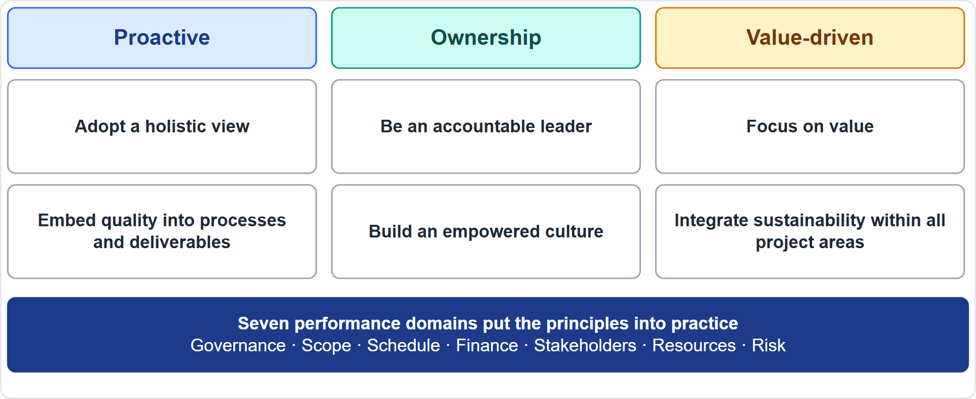
The Mindset and the Six Principles
Part 2
Three dimensions, six principles
EXAM TIP If an option applies a rule rigidly and ignores the context, it is probably not the best answer.
PMP Exam Prep 2026 | PMBOK 8 and the New ECO
Module 1
34 / 52
Notes:
PMBOK 8 reduced the earlier twelve principles to six. They are not prescriptive rules. They reinforce a growth mindset, and they guide decisions. They group into three dimensions. Proactive: adopt a holistic view and embed quality. Ownership: be an accountable leader and build an empowered culture. Value-driven: focus on value and integrate sustainability. The principles do not contradict each other, though they overlap. In a scenario, the best answer often reflects several at once.

Slide 35
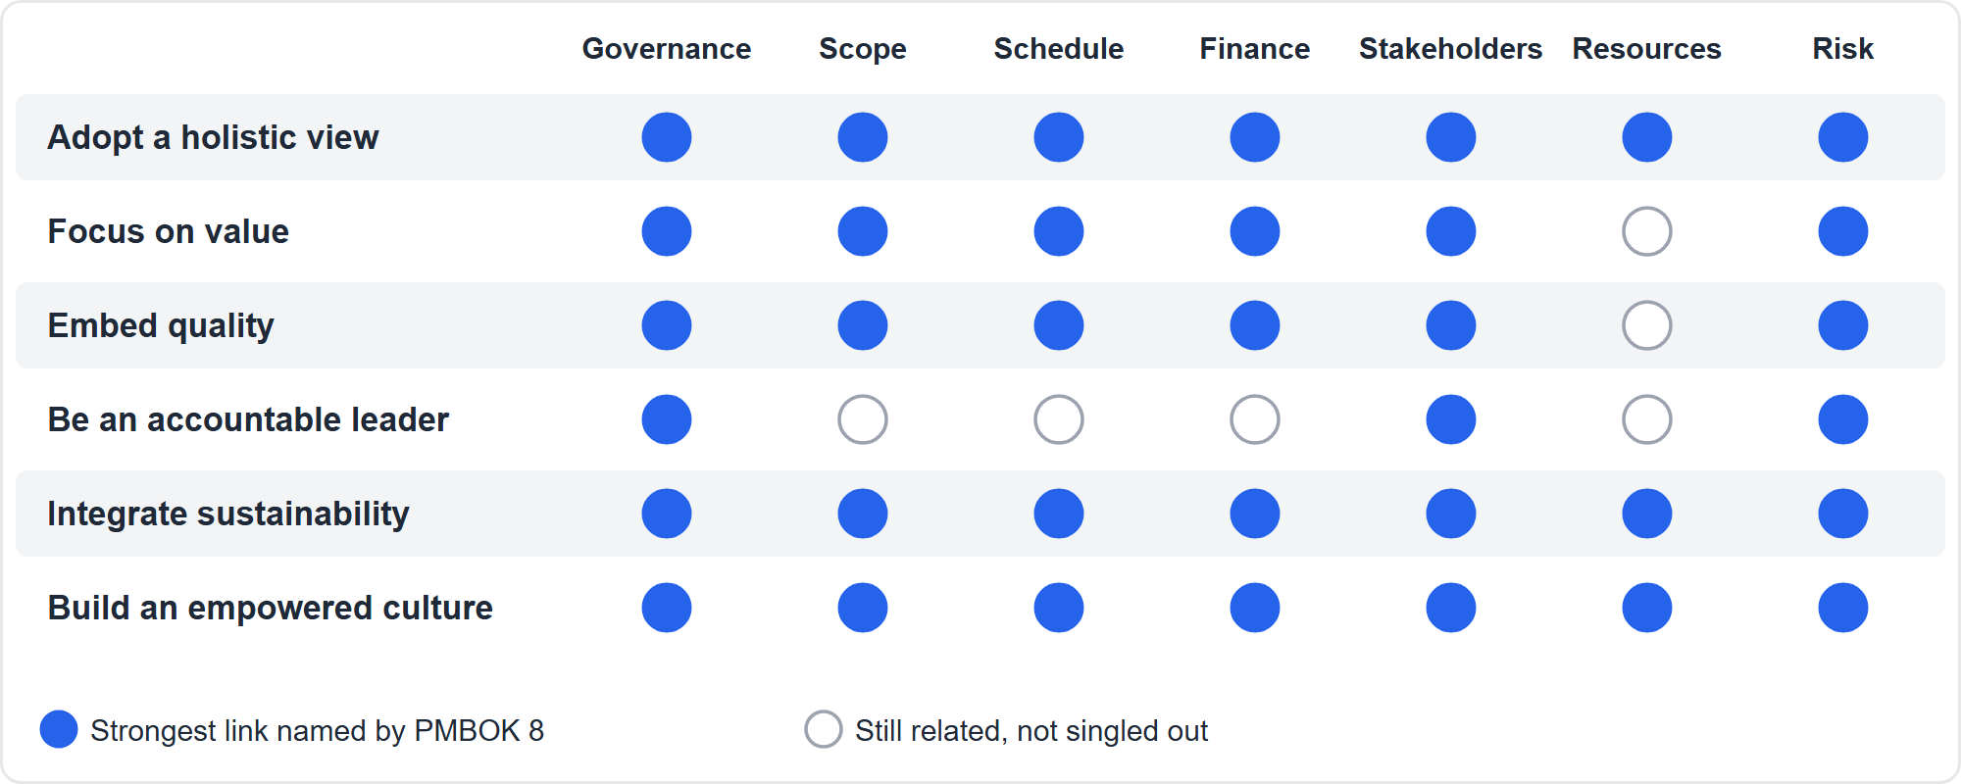
Principles and Performance Domains
Part 2
Which principle shows up most in which domain
EXAM TIP Every principle relates to every domain; learn the strongest links, not a rigid mapping.
PMP Exam Prep 2026 | PMBOK 8 and the New ECO
Module 1
35 / 52
Notes:
The principles are the mindset. The seven performance domains are the mechanics that put them into practice: governance, scope including quality, schedule, finance, stakeholders, resources and risk. Every principle relates to every domain. The map shows the strongest connections. For example, accountable leadership is strongest in governance, stakeholders and risk, while a holistic view, sustainability and an empowered culture span all domains. Do not memorize a grid. Learn why each principle matters.

Slide 36
Part 2 Recap
Part 2
1
EEFs and OPAs
2
Process assets
3
Structure
conditions you adapt to, assets you use
tailor policies and templates; update repositories
authority and resources rise from functional to project-oriented
4
Roles and skills
5
PMO
6
Mindset
judge by function, not title; power skills count
supportive, controlling or directive, often combined
six principles guide behavior; they are not rules
PMP Exam Prep 2026 | PMBOK 8 and the New ECO
Module 1
36 / 52
Notes:
Let us recap Part 2. Environmental factors are conditions you adapt to, and process assets are assets you use. Tailor policies and templates, and update the repositories. Authority and resource access rise from functional to project-oriented structures. Judge functions and roles by what people do, not by title. Power skills count as much as technical skills. A PMO can be supportive, controlling or directive, often a combination. And the six principles are a mindset, not a rulebook. In Part 3, we look at each principle in practice.

Slide 37
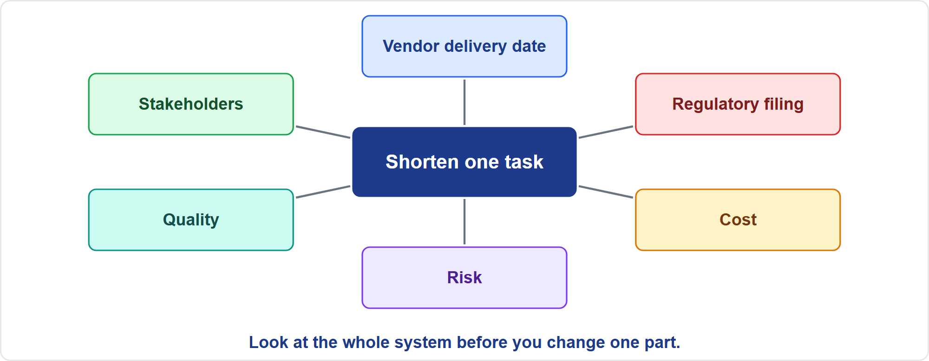
Principle 1: Adopt a Holistic View
Part 3
Consider the whole system before changing one part
EXAM TIP Before acting on a change, assess its effects across scope, schedule, cost, risk, stakeholders and the business case.
PMP Exam Prep 2026 | PMBOK 8 and the New ECO
Module 1
37 / 52
Notes:
Principle one: adopt a holistic view. Understand the project as a system of interdependent parts within a larger system. See patterns, not snapshots, and trace problems to root causes. It aligns the project with strategy, helps manage uncertainty and complexity, and supports balanced risk management. In practice, before acting on a change, look at everything it touches. Shortening one task may move a vendor delivery date and a regulatory filing. So assess the combined impact first, then decide.

Slide 38
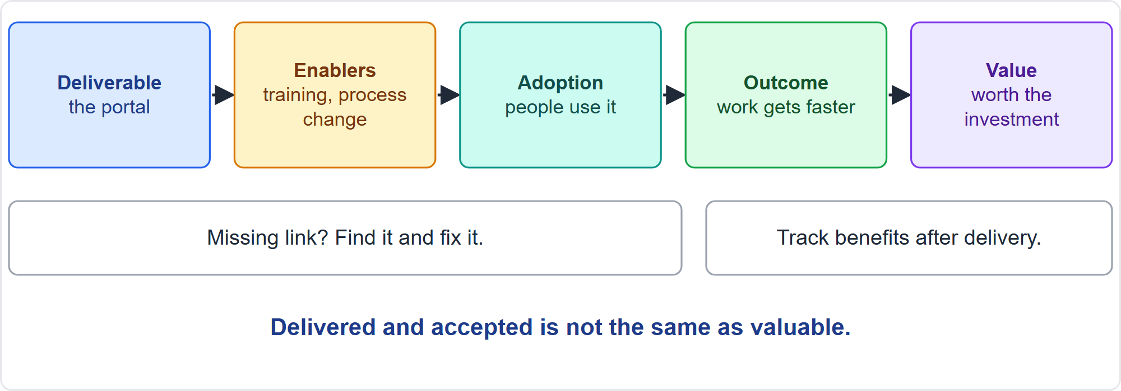
Principle 2: Focus on Value
Part 3
Value needs enablers and adoption
EXAM TIP When the product is delivered but unused, find what blocks adoption and track benefits.
PMP Exam Prep 2026 | PMBOK 8 and the New ECO
Module 1
38 / 52
Notes:
Principle two: focus on value. Value is the ultimate success indicator, and value per unit of investment measures it. The business case guides decisions, and outcomes are reviewed with quality gates, feedback loops and regular reviews. Deliverables alone may not achieve the purpose. Software does not create productivity unless people adopt it, which may need training or process change. If a portal is delivered and few people use it, find what blocks adoption, add the enablers, and track benefits. If misalignment persists, termination may be best.

Slide 39
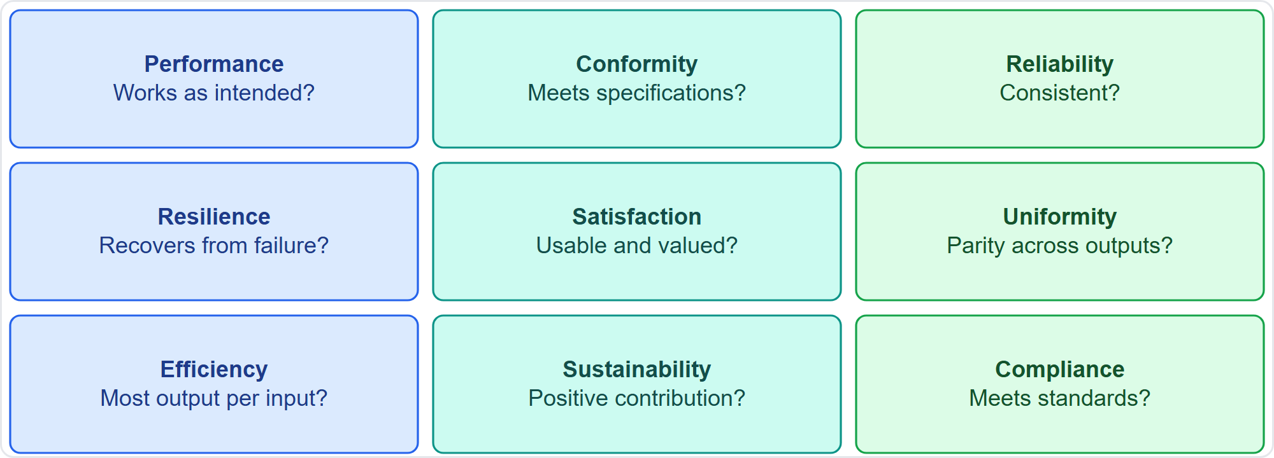
Principle 3: Embed Quality Into Processes and Deliverables
Part 3
Nine dimensions of quality
EXAM TIP Quality is built in, not inspected in at the end: clear acceptance criteria, definition of done and early reviews.
PMP Exam Prep 2026 | PMBOK 8 and the New ECO
Module 1
39 / 52
Notes:
Principle three: embed quality into processes and into deliverables. Quality is measured by conformance to acceptance criteria, the definition of done, fitness for use and efficiency. Build it in early, which people call shifting left. The screen shows nine dimensions: performance, conformity, reliability, resilience, satisfaction, uniformity, efficiency, sustainability and compliance. A product can conform to its specification and still fail on satisfaction if users find it hard to use. When requirements evolve, refine the acceptance criteria regularly and validate them with stakeholders. Use training, inspections and testing for the product, and reviews and audits for the process.

Slide 40
Principle 4: Be an Accountable Leader
Part 3
Take ownership of the project's objectives and of your decisions
Integrity, honesty and fairness guide decisions, especially in tough moments
Respect, humility and availability are the basis of servant leadership
Adapt your style to the situation: directive in a safety emergency
Leadership is shared; authority is position, leadership is behavior
Foster psychological safety
EXAM TIP Lead, do not just enforce, but be directive when safety, compliance or a crisis demands it.
PMP Exam Prep 2026 | PMBOK 8 and the New ECO
Module 1
40 / 52
Notes:
Principle four: be an accountable leader. Take ownership of the objectives and of the decisions. Integrity, honesty and fairness guide you, especially when it is hard. Respect, humility and availability are the basis of servant leadership: work for the team and remove barriers. Adapt your style to the situation. In a safety emergency, be directive. Leadership is shared: any team member or stakeholder can lead at some moment. And authority is position, while leadership is behavior. Foster psychological safety so people speak up.

Slide 41
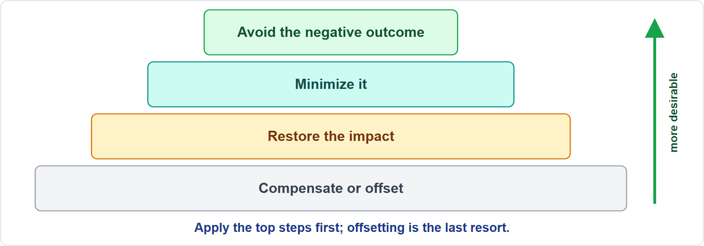
Principle 5: Integrate Sustainability Within All Project Areas
Part 3
Avoid first; offset last
EXAM TIP Sustainability is part of the job: raise it with the sponsor and put measurable goals into the formal documents.
PMP Exam Prep 2026 | PMBOK 8 and the New ECO
Module 1
41 / 52
Notes:
Principle five: integrate sustainability within all project areas. Meet present needs without compromising the ability of future generations to meet theirs. Consider people, planet and society, the triple bottom line. Project managers, teams and sponsors are jointly accountable. Use the pyramid: avoid negative outcomes first, then minimize, then restore, and compensate or offset last. Put sustainability goals into formal documents, such as the charter, business case or contracts. If the goals are missing, raise them with the sponsor. Module 3 covers this in depth.

Slide 42
Principle 6: Build an Empowered Culture
Part 3
Mutual trust and clear roles and responsibilities
Team agreements set early, and upheld by commitment
Diversity of employees, contractors, volunteers and third parties
Stakeholders involved from inception, with clear guidelines
Virtual teams need it most: solve differences proactively
EXAM TIP For a new, diverse or virtual team, the best early action is to create team agreements together.
PMP Exam Prep 2026 | PMBOK 8 and the New ECO
Module 1
42 / 52
Notes:
Principle six: build an empowered culture. This is an environment of mutual trust and clear roles, responsibilities and team agreements. Diversity helps: employees, contractors, volunteers and third parties bring different views. Team agreements set the working norms, and the team creates them at the beginning. Involve stakeholders from inception, with guidelines, so they can add value. Remote and virtual teams benefit most, because time zones and distance make differences harder to solve. If contractors say decisions are made without them, rebuild trust and clarify roles together.

Slide 43
Using the Principles in Scenario Questions
Part 3
The scenario shows | Think | Best answer usually
Delivered, but adoption is low | Value | Check outcomes; add enablers
Ripple effects, recurring problems | Holistic view | Assess impact; find root causes
Late defects, unclear criteria | Quality | Clarify criteria; build checks in earlier
Conflict, blame, tough decisions | Accountable leader | Own it; facilitate
A cheap choice harms people or planet | Sustainability | Raise it; document goals
New or virtual team, unclear roles | Empowered culture | Team agreements; clarify roles
EXAM TIP The best option often reflects more than one principle at once.
PMP Exam Prep 2026 | PMBOK 8 and the New ECO
Module 1
43 / 52
Notes:
Here is how the principles show up in answers. Benefits and adoption are low: think value. Check outcomes, add enablers, revalidate the case. A change with ripple effects or recurring problems: think holistic view. Assess the impact, find root causes, engage the affected people. Late defects or unclear criteria: think quality. Clarify criteria and the definition of done, and build checks in earlier. Conflict and blame: think accountable leader. Own it and facilitate. A cheap choice that harms people or planet: think sustainability. A new or virtual team: think empowered culture.

Slide 44
Principles in Predictive, Agile and Hybrid Work
Part 3
Principle | Predictive | Agile | Hybrid
Holistic view | Integrated plan, dependency analysis | Whole-team view of the backlog | Integrated governance, iterative delivery
Value | Business case at gates | Value-based prioritization each iteration | Fixed commitments plus adaptive priorities
Quality | Quality plan, audits | Definition of done, retrospectives | Both
Leader | Project manager as accountable leader | Servant and shared leadership | Both
Culture | Defined roles, RACI | Self-organizing team, team agreements | Self-organization inside governed boundaries
EXAM TIP The principles apply in every approach; only their expression changes.
PMP Exam Prep 2026 | PMBOK 8 and the New ECO
Module 1
44 / 52
Notes:
The principles apply whatever the approach. The expression differs. Holistic view: an integrated plan in predictive work, a whole-team view of the backlog in agile work. Value: the business case at gates in predictive work, value-based prioritization each iteration in agile work, and both in hybrid work. Quality: a quality plan and audits, versus a definition of done and retrospectives. Leadership: the project manager as accountable leader, versus servant and shared leadership. Culture: defined roles, versus a self-organizing team with team agreements.

Slide 45
Principle Traps: What PMI Expects
Part 3
Value beats activity: protect the outcome, not just the baseline
Think holistically before changing anything
Build quality in; do not inspect it in at the end
Lead, do not only enforce; be directive when the situation demands
Sustainability is part of the job, not an extra
Set team agreements early for new, diverse or virtual teams
EXAM TIP If value cannot be delivered, the best answer recommends a governance review, not silent continuation.
PMP Exam Prep 2026 | PMBOK 8 and the New ECO
Module 1
45 / 52
Notes:
The principle traps. Value beats activity: protect the outcome, not just the baseline. Think holistically before changing anything, because impact assessment comes first. Build quality in. Do not inspect it in at the end. Lead, do not only enforce, but be directive when safety or a crisis demands it. Sustainability is part of the job, not an extra. And set team agreements early for new, diverse or virtual teams. If value cannot be delivered, the best answer recommends a governance review, not silent continuation.

Slide 46
Module Recap
Part 3
1
Value
2
Levels
3
Environment
outputs lead to outcomes; success is stakeholder value, not only schedule and budget
portfolio, program, project, with operations engaged early
adapt to EEFs, use and tailor OPAs, respect structure and authority
4
Roles
5
Principles
6
Next
judge by function, not title; power skills matter
holistic view, value, quality, accountable leader, sustainability, empowered culture
five practice questions
PMP Exam Prep 2026 | PMBOK 8 and the New ECO
Module 1
46 / 52
Notes:
Let us recap the whole module. Value: outputs lead to outcomes, and success is stakeholder value, not only schedule and budget. Levels: portfolio, program and project, with operations engaged early. Environment: adapt to environmental factors, use and tailor process assets, and respect structure and authority. Roles: judge by function, not title, and power skills matter. Principles: holistic view, value, quality, accountable leader, sustainability and empowered culture. Now it is time to test yourself. Five questions follow. For each one, pause the video, choose your answer, and then listen to the explanation.

Slide 47
Practice Question 1
Part 3
Q1
A team released an employee self-service portal on its planned date, and every deliverable was formally accepted. Weeks later few employees use it and the sponsor questions the investment. Which action best applies the focus on value principle?
A
Close the project because every deliverable was formally accepted by the sponsor
B
Report the delivered scope against the baseline to show the project succeeded
C
Find what blocks adoption, add enablers such as training, and track benefits
D
Cut the support budget so that the project recovers part of its cost
PMP Exam Prep 2026 | PMBOK 8 and the New ECO
Module 1
47 / 52
Notes:
Question one. A team released an employee self-service portal on its planned date, and every deliverable was formally accepted. Weeks later few employees use it and the sponsor questions the investment. Which action best applies the focus on value principle? The four options are on the screen. Choose your answer. [PAUSE 12] The answer is C. Focus on value looks past deliverables to outcomes, so the team finds what prevents the benefits and measures the result. Closing the project, reporting scope, or cutting support does nothing to realize the intended value.

Slide 48
Practice Question 2
Part 3
Q2
A part-time project manager in a functional organization needs a database administrator for two weeks, but the administrator's manager says operations work comes first. What should the project manager do?
A
Negotiate a time slot with that manager, backed by the project's business priority
B
Wait until the administrator's operations workload eases before scheduling the work
C
Instruct the administrator to start the project tasks without further discussion
D
Hire an outside administrator and charge the cost to the sponsor's budget
PMP Exam Prep 2026 | PMBOK 8 and the New ECO
Module 1
48 / 52
Notes:
Question two. A part-time project manager in a functional organization needs a database administrator for two weeks, but the administrator's manager says operations work comes first. What should the project manager do? The four options are on the screen. Choose your answer. [PAUSE 12] The answer is A. In a functional structure the project manager has little authority over resources, so access is negotiated with the functional manager, using the business priority and the sponsor's support. Waiting, ordering the person, or buying capacity on your own all ignore that route.

Slide 49
Practice Question 3
Part 3
Q3
While planning a release, the project manager lists items that will shape the work. Which one is an enterprise environmental factor rather than an organizational process asset?
A
The lessons learned repository from earlier similar projects
B
The company's standard change control template for every project
C
The PMO's approved supplier list for hardware purchases
D
A newly enacted data-protection law in the customer's country
PMP Exam Prep 2026 | PMBOK 8 and the New ECO
Module 1
49 / 52
Notes:
Question three. While planning a release, the project manager lists items that will shape the work. Which one is an enterprise environmental factor rather than an organizational process asset? The four options are on the screen. Choose your answer. [PAUSE 12] The answer is D. A law lies outside the team's control and constrains the project, which makes it an environmental factor. Templates, repositories and approved supplier lists belong to the organization and are process assets.

Slide 50
Practice Question 4
Part 3
Q4
A scrum team moves its two best testers to help developers finish stories sooner. Stories are completed faster, but they now queue for testing and the total time to release grows. Which principle was overlooked?
A
Build an empowered culture, which lets team members decide how to share their work
B
Adopt a holistic view, which checks how a change in one step affects the whole flow
C
Focus on value, which orders the backlog by the benefit that each story brings
D
Embed quality, which asks for clear acceptance criteria before work begins on each story
PMP Exam Prep 2026 | PMBOK 8 and the New ECO
Module 1
50 / 52
Notes:
Question four. A scrum team moves its two best testers to help developers finish stories sooner. Stories are completed faster, but they now queue for testing and the total time to release grows. Which principle was overlooked? The four options are on the screen. Choose your answer. [PAUSE 12] The answer is B. A holistic view considers interdependencies, so a gain in one step is checked against its effect on the rest of the system. The other principles matter in general, but none of them explains why moving capacity between linked steps lengthened the whole flow.

Slide 51
Practice Question 5
Part 3
Q5
Three related projects each have their own manager and schedule, yet their releases collide and the combined business benefit depends on all three arriving together. What would help most?
A
Hand the three projects to the portfolio manager, who then schedules them directly
B
Merge the three scopes into one project that runs under a single combined baseline
C
Manage them as a program that coordinates interdependencies and shared benefits
D
Tell each manager to protect its own baseline and report problems every month
PMP Exam Prep 2026 | PMBOK 8 and the New ECO
Module 1
51 / 52
Notes:
Question five. Three related projects each have their own manager and schedule, yet their releases collide and the combined business benefit depends on all three arriving together. What would help most? The four options are on the screen. Choose your answer. [PAUSE 12] The answer is C. A program coordinates related projects to obtain benefits that managing them separately cannot, and it tracks interdependencies and benefits across them. Merging them, defending separate baselines, or asking the portfolio manager to schedule them misses what a program offers.

Slide 52
Answers at a Glance
Part 3
Question | Answer | Why
Q1 | C | The team must look past deliverables and find what blocks adoption, then track benefits
Q2 | A | In a functional structure you negotiate with the functional manager
Q3 | D | A law is outside the team's control; the others are organizational assets
Q4 | B | A gain in one step must be checked against the whole system
Q5 | C | A program coordinates related projects for shared benefits
PMP Exam Prep 2026 | PMBOK 8 and the New ECO
Module 1
52 / 52
Notes:
Here are all five answers together. Question one: C. The team must look past deliverables and find what blocks adoption, then track benefits. Question two: A. In a functional structure you negotiate with the functional manager. Question three: D. A law is outside the team's control. The others are organizational assets. Question four: B. A gain in one step must be checked against the whole system. Question five: C. A program coordinates related projects for shared benefits. That completes Module 1. Next, Module 2 covers life cycles, agile and hybrid ways of working, and tailoring. See you there.

