Slide 1
Module 2: Life Cycles, Agile, Hybrid and Tailoring
Part 1 of 3: Life cycles and development approaches
Process domain · about 60% of exam items involve agile or hybrid work
PMP Exam Prep 2026: PMBOK 8 and the New ECO
Module 2: Life Cycles, Agile, Hybrid and Tailoring · Part 1
Notes:
Welcome to Module 2. About sixty percent of the items on the exam involve agile or hybrid situations, and almost every scenario asks you to know which approach is in play. This module gives you the toolkit. In Part 1, we look at life cycles and the three development approaches: predictive, adaptive and hybrid. Part 2 goes inside agile and hybrid ways of working. Part 3 teaches tailoring.

Slide 2
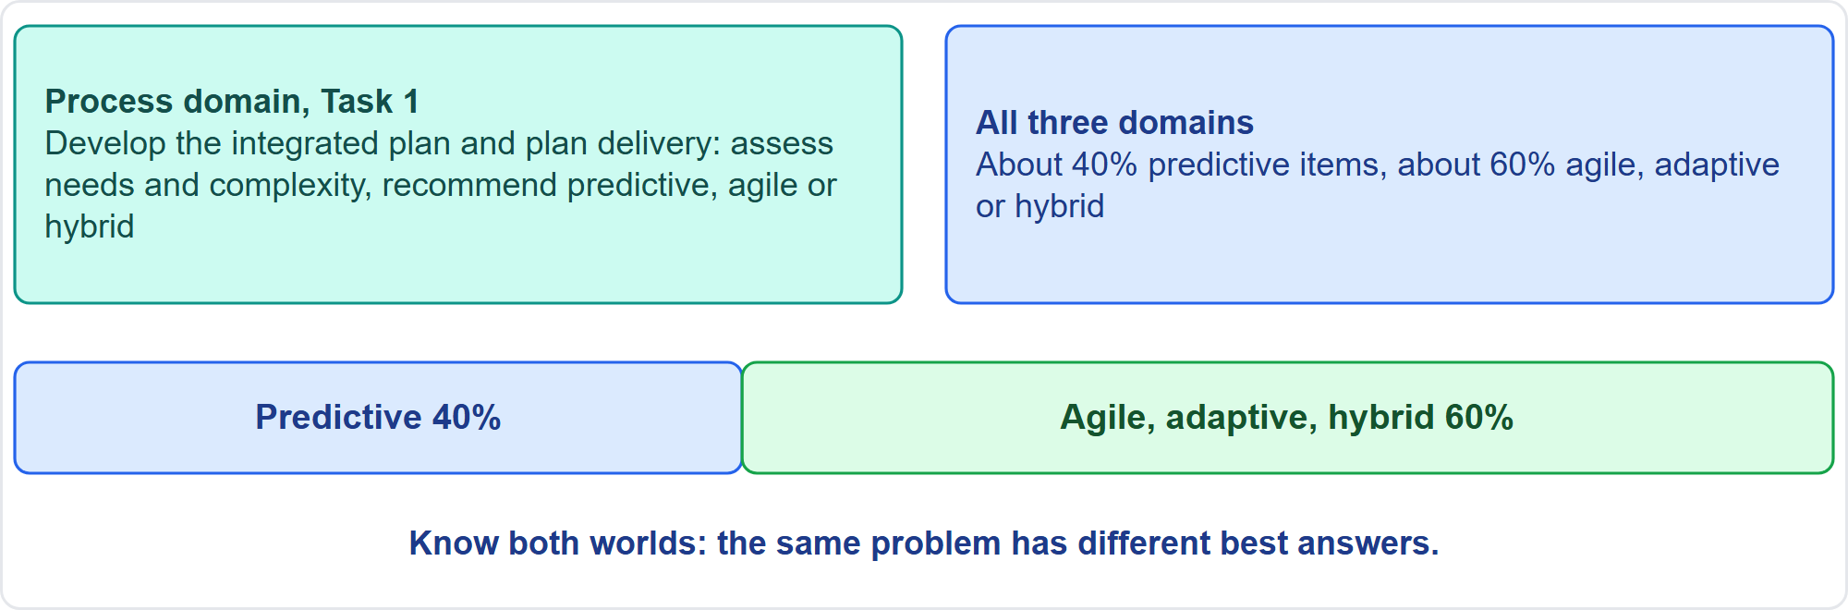
Where This Module Sits in the Exam
Part 1
Process Task 1 and the 40 and 60 percent split
EXAM TIP Match the approach to the context, not to your preference.
PMP Exam Prep 2026 | PMBOK 8 and the New ECO
Module 2: Life Cycles, Agile, Hybrid and Tailoring
2 / 65
Notes:
Here is where this module sits. In the Process domain, Task 1 asks you to develop the integrated plan and plan delivery. That includes assessing needs and complexity, and recommending a predictive, agile or hybrid approach. Beyond that single task, the split runs across all three domains: about forty percent of items are predictive, and about sixty percent are agile, adaptive or hybrid. So you must be comfortable in both worlds. The same problem often has a different best answer in each.

Slide 3
What You Will Learn
Part 1
Describe phases, gates and the life cycle, and how risk and cost of change evolve
Compare predictive, adaptive and hybrid approaches and choose among them
Tell iterative from incremental delivery, and pick a delivery cadence
Use backlogs, iterations, flow and agile measures
Explain hybrid practice: planning, reporting, change control and metrics
Tailor processes, the approach and engagement, and diagnose problems
PMP Exam Prep 2026 | PMBOK 8 and the New ECO
Module 2: Life Cycles, Agile, Hybrid and Tailoring
3 / 65
Notes:
By the end of this module you will be able to do six things. Describe phases, gates and the project life cycle, and explain how risk and the cost of change evolve. Compare predictive, adaptive and hybrid approaches, and choose among them. Tell iterative from incremental delivery, and pick a delivery cadence. Use backlogs, iterations, flow and agile measures. Explain hybrid practice, including planning, reporting, change control and metrics. And tailor processes, the approach and engagement, and diagnose common problems.

Slide 4
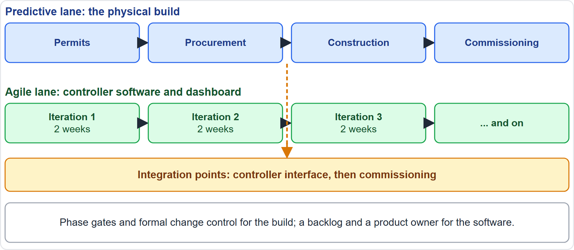
Case Check-In: A Hybrid Project
Part 1
CASE CHECK-IN · Sunrise Campus Microgrid
Predictive lane: permits, procurement, construction and commissioning
Agile lane: controller software and dashboard in 2-week iterations
PMP Exam Prep 2026 | PMBOK 8 and the New ECO
Module 2: Life Cycles, Agile, Hybrid and Tailoring
4 / 65
Notes:
Our running case is a hybrid project. The physical build follows a predictive approach: permits, procurement, construction and commissioning, with phase gates and formal change control. The controller software and the dashboard follow an agile approach, in two-week iterations with a product owner. The two lanes meet at integration points, such as the controller interface and commissioning. Throughout this module, ask which lane a problem sits in, because the best answer depends on it.

Slide 5
Key Terms
Part 1
Term | Meaning
Life cycle | The series of phases a project passes through
Phase gate | The review before the next phase begins
Development approach | How the product is built: predictive, adaptive or hybrid
Timebox | A fixed period, often 1 to 4 weeks
Iterative, incremental | Iterative refines in cycles; incremental delivers usable pieces
Delivery cadence | How often outcomes are delivered
EXAM TIP The development approach is not the same as the development phase, and Focus Areas are not phases.
PMP Exam Prep 2026 | PMBOK 8 and the New ECO
Module 2: Life Cycles, Agile, Hybrid and Tailoring
5 / 65
Notes:
Six terms to fix. The project life cycle is the series of phases a project passes through. A phase is a set of related activities ending in a deliverable, and a phase gate is the review held before the next phase. The development approach is how the product is created and evolved: predictive, adaptive or hybrid. A timebox is a fixed period, often one to four weeks. Iterative work refines through repeated cycles, while incremental work delivers usable pieces. And delivery cadence is how often outcomes are delivered.

Slide 6
Phases and Gates
Part 1
A phase can have a name, number, duration, resource needs, entry criteria and exit criteria
Exit criteria tie to acceptance criteria, contract duties or performance targets
Entry criteria check resources, verified viability and strategic alignment
Gates usually sit at the end of a phase, but can also sit at the start
Organizations often standardize a few life cycles; if none is set, the team picks one
EXAM TIP A life cycle should be flexible: choose the approach, the processes and the phase attributes that fit.
PMP Exam Prep 2026 | PMBOK 8 and the New ECO
Module 2: Life Cycles, Agile, Hybrid and Tailoring
6 / 65
Notes:
Phases have attributes. A phase can carry a name, a number, a duration, resource needs, entry criteria and exit criteria. Exit criteria may tie to acceptance criteria, contractual obligations or performance targets. Entry criteria may check resource availability, verified viability and alignment with organizational goals. Gates normally sit at the end of a phase, but they can also sit at the start, to check alignment, resources and risks before work begins. Organizations often standardize a few life cycles. If none is prescribed, the team picks the best one.

Slide 7
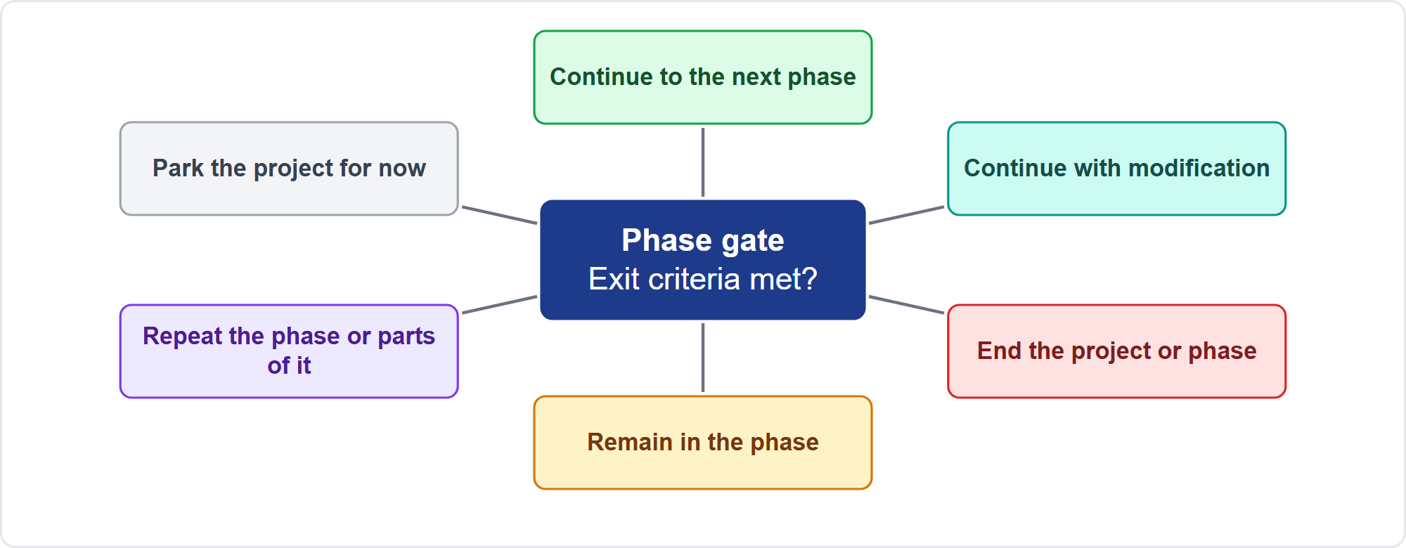
What a Phase Gate Decides
Part 1
A gate is a decision point, not a rubber stamp
EXAM TIP If exit criteria are unmet or value has changed, the options include modify, repeat, hold, park or end.
PMP Exam Prep 2026 | PMBOK 8 and the New ECO
Module 2: Life Cycles, Agile, Hybrid and Tailoring
7 / 65
Notes:
A phase gate compares performance and progress with the project and business documents, and leads to a decision. Often called a go or no-go, it has more than two outcomes. Continue to the next phase. Continue with modification. End the project or phase. Remain in the phase. Repeat the phase or parts of it. Or park the project temporarily, for example for an urgent initiative. So when exit criteria are not met, the best answer reports the facts and lets the gate authority decide. It never records them as met.

Slide 8
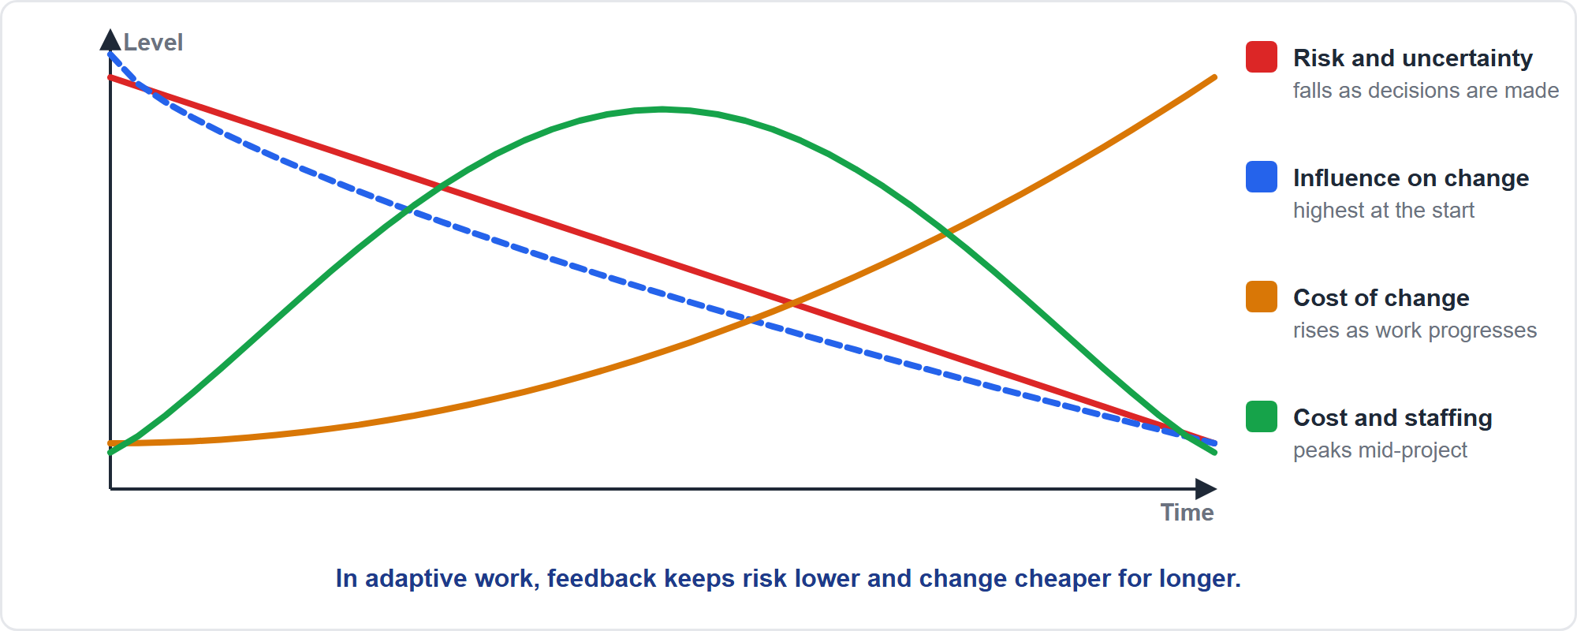
How Variables Change Over Time
Part 1
Risk, influence, cost of change and effort over a predictive project
EXAM TIP In predictive work the cost of change rises over time; a late major request needs impact analysis and change control.
PMP Exam Prep 2026 | PMBOK 8 and the New ECO
Module 2: Life Cycles, Agile, Hybrid and Tailoring
8 / 65
Notes:
Look at how variables change over a predictive project. Cost and staffing start low, rise during the work, and drop rapidly at the end. Risk and uncertainty are greatest at the start and fall as decisions are made and deliverables are accepted. Stakeholders have the most influence on change at the start, when changes can raise value without large cost or schedule impact. That influence falls while the cost of change rises. In adaptive work, stakeholders take part throughout, so risks surface earlier through consistent feedback.

Slide 9
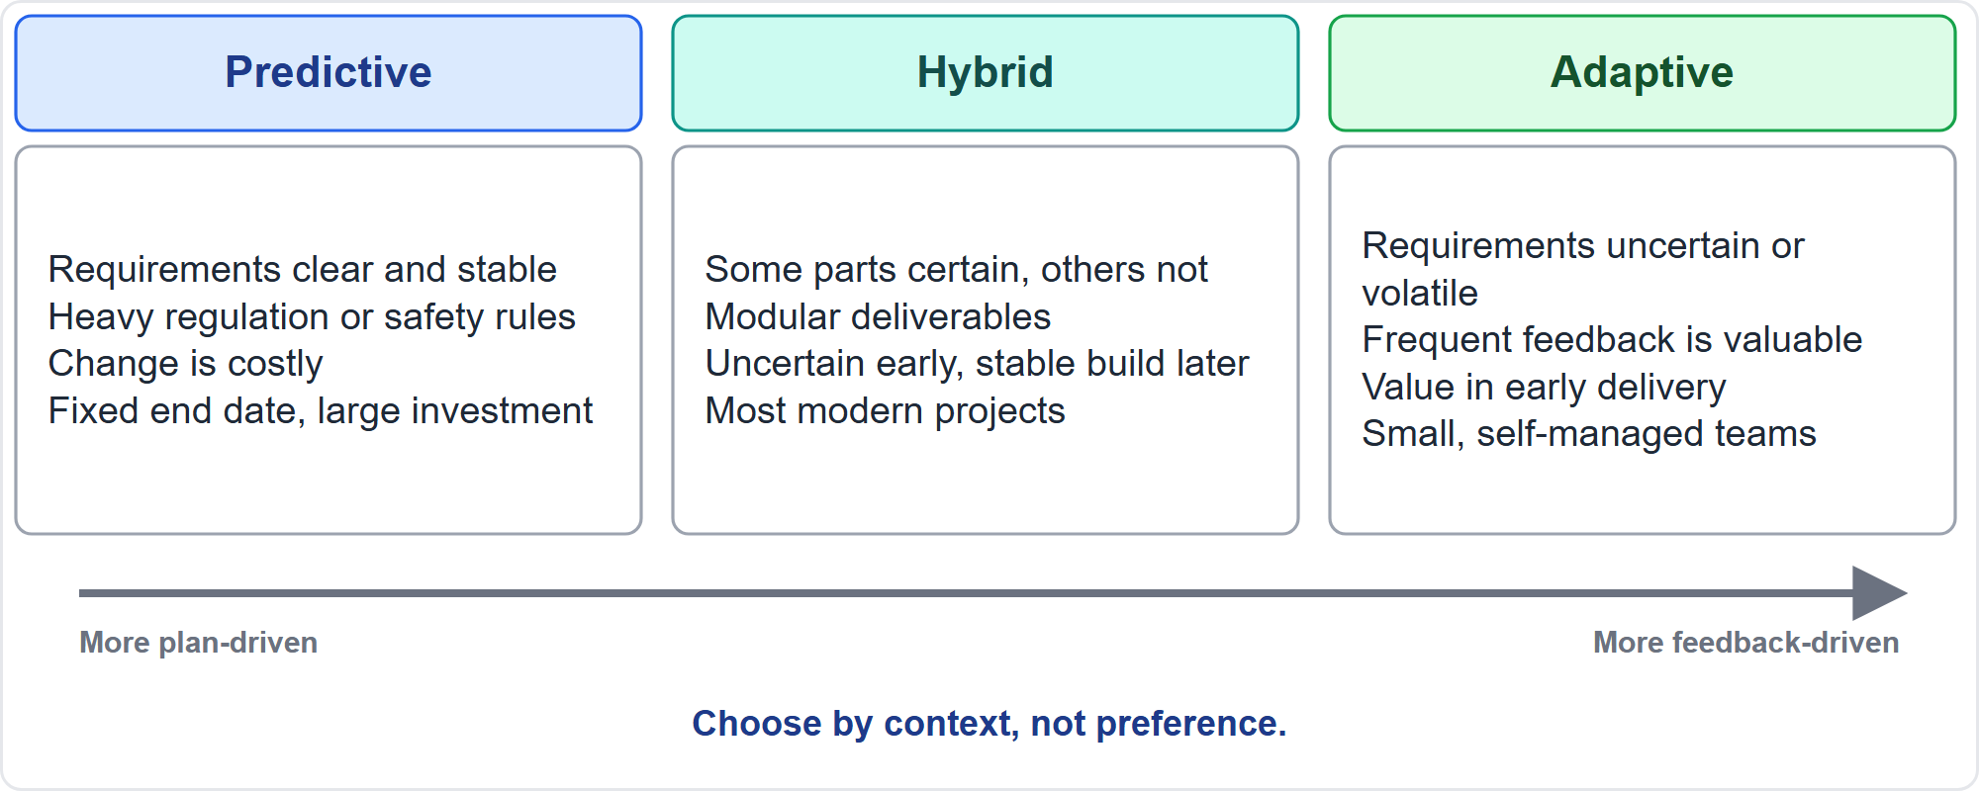
The Spectrum of Approaches
Part 1
Predictive, hybrid and adaptive
EXAM TIP Stable and regulated points to predictive; uncertain and feedback-rich points to adaptive; mixed points to hybrid.
PMP Exam Prep 2026 | PMBOK 8 and the New ECO
Module 2: Life Cycles, Agile, Hybrid and Tailoring
9 / 65
Notes:
Approaches form a spectrum. Predictive sits at one end, adaptive at the other, and hybrid in between. The project manager and the team choose from the project's characteristics. Requirements, scope, timeline and goals. Organizational culture and stakeholder involvement. Risk, technology and complexity. Clear and stable requirements, heavy regulation, costly change and a fixed date favor predictive. Uncertain requirements, valuable early feedback and small self-managed teams favor adaptive. Mixed situations favor hybrid, and most modern projects are mixed.

Slide 10
Predictive Approaches
Part 1
Also called waterfall, plan-driven or traditional
Best when scope can be stabilized early and requirements, cost and risks are well defined
Much of the planning is done up front; robust change control is needed
Suited when iterating costs far more than it gives, and in heavily regulated fields
Incremental delivery is possible inside a predictive project, with scope largely fixed
Typical flow: feasibility, design, build, check, transfer, close
EXAM TIP A regulated, stable project with mandated phase reviews points to predictive with gates and formal change control.
PMP Exam Prep 2026 | PMBOK 8 and the New ECO
Module 2: Life Cycles, Agile, Hybrid and Tailoring
10 / 65
Notes:
Predictive approaches are also called waterfall, plan-driven or traditional. They are best when scope can be stabilized early, and requirements, cost and risks can be defined well. Much of the planning is done up front, and you need robust change control. They suit situations where iterating costs far more than it gives, such as the build phase of construction, and heavily regulated fields such as healthcare. A predictive project can still deliver in increments, with scope largely fixed. A typical flow is feasibility, design, build, check, transfer and close.

Slide 11
Adaptive Approaches
Part 1
Also called change-driven or agile
Best when requirements and solutions are uncertain and volatile
A clear vision at the start; requirements are progressively elaborated with feedback
Iterations of 1 to 4 weeks end with a demonstration; the team picks work from a prioritized backlog
Flow-based scheduling comes from Kanban and the theory of constraints
Agile is a mindset, broader than any framework; its approaches are adaptive
EXAM TIP A start-up with unclear requirements and valuable early feedback points to adaptive delivery in short iterations.
PMP Exam Prep 2026 | PMBOK 8 and the New ECO
Module 2: Life Cycles, Agile, Hybrid and Tailoring
11 / 65
Notes:
Adaptive approaches are also called change-driven or agile. They are best when requirements and technical solutions are highly uncertain and likely to change. You set a clear vision at the start, and requirements are progressively elaborated with feedback. Iterations of one to four weeks end with a demonstration, and the whole team selects work from a prioritized backlog. Flow-based scheduling optimizes the flow of work and comes from Kanban and the theory of constraints. And agile is a mindset, broader than any single framework.

Slide 12
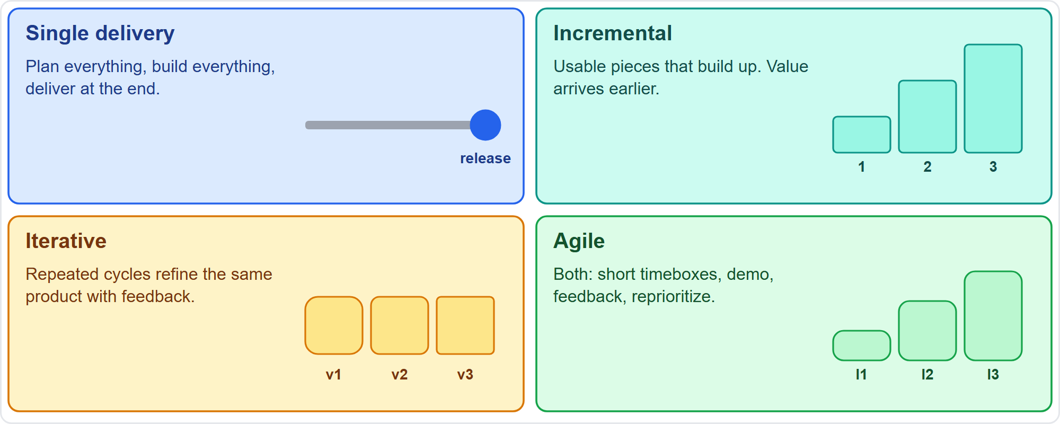
Four Delivery Styles
Part 1
Single, incremental, iterative and agile delivery
EXAM TIP Incremental is not iterative: increments deliver usable parts, iterations refine through cycles; agile usually does both.
PMP Exam Prep 2026 | PMBOK 8 and the New ECO
Module 2: Life Cycles, Agile, Hybrid and Tailoring
12 / 65
Notes:
Four delivery styles. Single delivery plans and builds everything, then delivers at the end. Incremental delivery gives usable pieces, each building on the last, so value arrives earlier. Iterative delivery refines the same product through repeated cycles, from rough to polished, using feedback. Agile is both iterative and incremental, with short timeboxes, a demonstration, feedback and a reprioritized backlog each time. Here is an example. A team releases a payment module in month two and reporting in month four, with the full scope planned at the start. That is incremental delivery inside a predictive project.

Slide 13
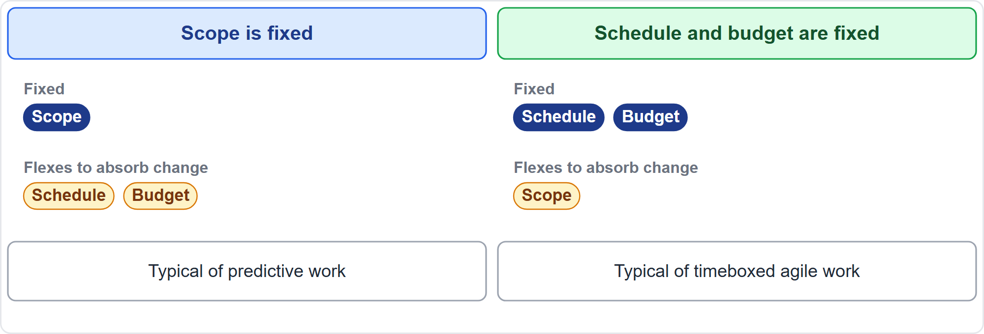
Fixed and Variable Constraints
Part 1
What flexes depends on what is fixed
EXAM TIP With a fixed budget and date, scope flexes: reprioritize the backlog; do not promise everything.
PMP Exam Prep 2026 | PMBOK 8 and the New ECO
Module 2: Life Cycles, Agile, Hybrid and Tailoring
13 / 65
Notes:
Think of constraints as fixed or variable. When scope is fixed, unexpected changes are absorbed by changing the schedule or the budget. That is typical of predictive work. When schedule and budget are fixed, unexpected changes are absorbed by varying scope. That is typical of timeboxed agile work. So when an agile team has a fixed budget and date and new priorities keep arriving, reprioritize the backlog so that the highest-value items fit. Do not promise all the scope.

Slide 14
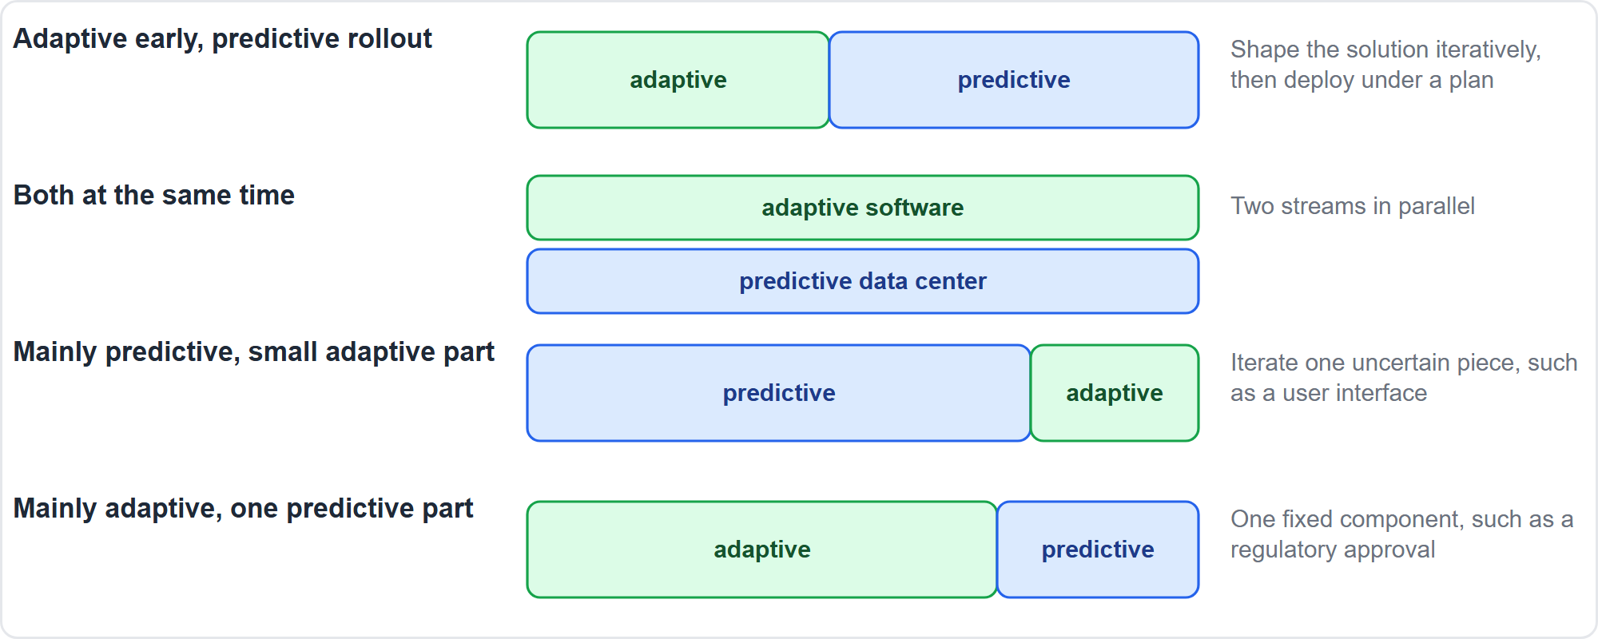
Hybrid Approaches: Four Patterns
Part 1
Four common ways to combine approaches
EXAM TIP Hybrid is a legitimate, often best, answer when a scenario mixes fixed and uncertain elements.
PMP Exam Prep 2026 | PMBOK 8 and the New ECO
Module 2: Life Cycles, Agile, Hybrid and Tailoring
14 / 65
Notes:
Hybrid combines adaptive and predictive elements. PMBOK 8 notes that most modern projects benefit from it: flexibility to adapt, with control over predictable aspects. Four patterns are common. Adaptive early, then a predictive rollout, like designing a custom home iteratively and then building once. Both at the same time, such as software built adaptively while a data center is built predictively. Mainly predictive with one small adaptive part. And mainly adaptive with one fixed component, such as a regulatory approval.

Slide 15
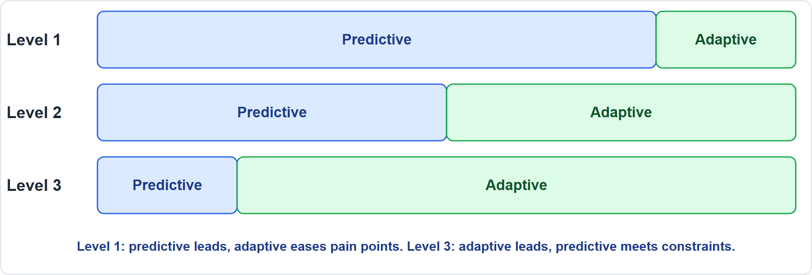
Hybrid Levels
Part 1
How much of each approach
EXAM TIP If a mandatory gated process leads and feedback loops are added to cut rework, predictive dominates: level 1.
PMP Exam Prep 2026 | PMBOK 8 and the New ECO
Module 2: Life Cycles, Agile, Hybrid and Tailoring
15 / 65
Notes:
Disciplined Agile describes three hybrid levels. At level one, predictive dominates, and some adaptive elements reduce pain points. At level two, both approaches contribute significantly. At level three, adaptive dominates, and some predictive elements satisfy business constraints. Suppose a bank must follow a mandatory release process with fixed change windows and audit sign-offs, but the team adds short feedback loops to cut rework. Predictive leads there, with adaptive elements added. That is level one.

Slide 16
Choosing the Approach: Deliverable Factors
Part 1
Factor | Pushes toward
Innovation is high | Adaptive
Requirements are certain and easy to define | Predictive
Scope is less stable | Adaptive
Change is difficult or costly | Predictive
Delivery in components is possible | Adaptive or hybrid
Safety rules are rigorous | Predictive
Frequent user feedback adds value | Adaptive
Heavy regulation needs documentation | Predictive
EXAM TIP Different deliverables in one project may use different approaches.
PMP Exam Prep 2026 | PMBOK 8 and the New ECO
Module 2: Life Cycles, Agile, Hybrid and Tailoring
16 / 65
Notes:
Selection factors come in three groups. First, the deliverables. High innovation pushes toward adaptive. Certain, easy-to-define requirements push toward predictive. Less stable scope pushes toward adaptive. When change is difficult or costly, predictive fits. If the deliverable can be delivered in components, adaptive or hybrid fits. Rigorous safety rules and heavy regulation point to predictive. And significant value from frequent user feedback points to adaptive. Remember that different deliverables in one project may use different approaches.

Slide 17
Choosing the Approach: Project and Organization Factors
Part 1
Factor | Pushes toward
Stakeholders who can be deeply involved | Adaptive
Schedule: value in early partial delivery, or a fixed end date | Adaptive, or predictive
Financing is uncertain | Adaptive, iterative
Large, complex, evolving work | Flexible approaches
Team experience in collaboration and problem solving | Adaptive
Interdependencies with other work | Iterative
Structure and culture: hierarchical, or networked and self-managed | Predictive, or adaptive and hybrid
Team size: often 3 to 9 | Adaptive
EXAM TIP The organization must be able to support the approach: align policies and reporting, or adopt it in steps.
PMP Exam Prep 2026 | PMBOK 8 and the New ECO
Module 2: Life Cycles, Agile, Hybrid and Tailoring
17 / 65
Notes:
The next two groups are project and organization factors. Stakeholders who can be deeply involved favor adaptive. For schedule, value in early partial delivery favors adaptive, while a fixed end date favors predictive. Uncertain financing favors adaptive and iterative work. Large, complex and evolving work needs flexible approaches. Experienced, collaborative teams favor adaptive. Structure and culture matter: hierarchical organizations lean predictive, and networked, self-managed ones lean adaptive or hybrid. Adaptive teams are often three to nine people. A hierarchical organization adopting agile should align policies and reporting, or go step by step.

Slide 18
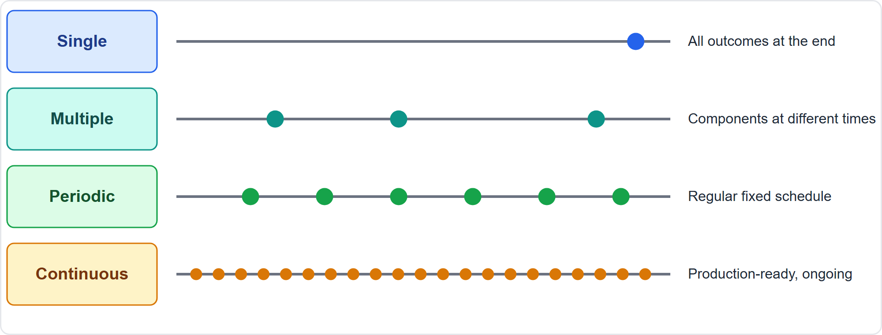
Delivery Cadence
Part 1
Single, multiple, periodic and continuous delivery
EXAM TIP Users who want working features every two weeks and feedback each time point to periodic delivery on a fixed schedule.
PMP Exam Prep 2026 | PMBOK 8 and the New ECO
Module 2: Life Cycles, Agile, Hybrid and Tailoring
18 / 65
Notes:
Delivery cadence describes how often outcomes are delivered. Single delivery: everything at the end. Multiple deliveries: components at different times, in sequence or in parallel, like building security upgrades in stages. Periodic deliveries: multiple deliveries on a regular, fixed schedule, common in adaptive work, such as internal releases every two weeks. Continuous delivery: incrementally delivering value to production on an ongoing basis, with the product always production-ready. In every case, deliveries must meet or exceed the target business objectives.

Slide 19
The Five Focus Areas
Part 1
Focus Area | Purpose
Initiating | Authorize the project; align expectations; define initial scope; identify stakeholders
Planning | Establish scope and objectives; progressive, iterative or rolling-wave planning
Executing | Do the work; the plan may change whenever the change adds value
Monitoring and Controlling | Compare actual with planned; analyze variance; recommend corrective action; runs in parallel
Closing | Close the phase, project or contract; verify outputs, outcomes and benefits; transition
EXAM TIP Focus Areas are not phases. Do not answer "planning is finished" literally.
PMP Exam Prep 2026 | PMBOK 8 and the New ECO
Module 2: Life Cycles, Agile, Hybrid and Tailoring
19 / 65
Notes:
The five Focus Areas are the fundamental actions of any project, whatever the approach. Initiating authorizes the project and aligns expectations. Planning establishes scope and objectives, and it is progressive: iterative or rolling wave, with continual refinement. Executing does the work, and the plan can and should change whenever the change adds value. Monitoring and controlling compares actual with planned, analyzes variance and recommends corrective action, running in parallel. Closing verifies outputs, outcomes and benefits and transitions to operations. They are not phases. In an adaptive project, every iteration contains planning, executing and monitoring and controlling.

Slide 20
Life Cycle Traps: What PMI Expects
Part 1
Match the approach to the context, not preference; hybrid is often right for mixed scenarios
Incremental is not iterative
Focus Areas are not phases; planning continues as the plan is refined
Phase gates are decision points, not rubber stamps
In fixed-budget, fixed-date agile work, scope flexes
Closing verifies outcomes and benefits, not only handover
EXAM TIP The plan may change when change adds value; use the change process, do not follow the baseline rigidly.
PMP Exam Prep 2026 | PMBOK 8 and the New ECO
Module 2: Life Cycles, Agile, Hybrid and Tailoring
20 / 65
Notes:
The traps for Part 1. Match the approach to the context, not to your preference. Hybrid is a legitimate, often best answer for mixed scenarios. Incremental is not iterative. Focus Areas are not phases, so planning continues as the plan is refined. Phase gates are decision points, not rubber stamps. In fixed-budget, fixed-date agile work, scope flexes. And closing verifies outcomes and benefits, not just the handover. Finally, the plan may change when the change adds value. Use the change process, and do not follow the baseline rigidly.

Slide 21
Part 1 Recap
Part 1
1
Life cycle
2
Approaches
3
Delivery
phases with entry and exit criteria; gates decide among six outcomes
predictive, adaptive and hybrid, chosen by context
single, incremental, iterative, agile; cadence from single to continuous
4
Constraints
5
Hybrid
6
Focus Areas
fixed scope flexes time and cost; fixed time and cost flex scope
four patterns and three levels
not phases; planning and control continue
PMP Exam Prep 2026 | PMBOK 8 and the New ECO
Module 2: Life Cycles, Agile, Hybrid and Tailoring
21 / 65
Notes:
Let us recap Part 1. A life cycle has phases with entry and exit criteria, and a gate decides among six outcomes. Predictive, adaptive and hybrid approaches are chosen by context. Delivery can be single, incremental, iterative or agile, with a cadence from single to continuous. When scope is fixed, time and cost flex. When time and cost are fixed, scope flexes. Hybrid has four patterns and three levels. And Focus Areas are not phases, so planning and control continue throughout.

Slide 22
Agile: Mindset and Roles
Part 2
Agile is a mindset of values and principles, broader than any framework
Agile approaches are adaptive: vision first, requirements elaborated by feedback
Servant leadership: serve the needs and growth of team members
Iterations of 1 to 4 weeks; teams often 3 to 9 people
The function matters, not the title
EXAM TIP Be a servant leader: facilitate, remove impediments, coach and shield the team. Do not assign tasks or micromanage.
PMP Exam Prep 2026 | PMBOK 8 and the New ECO
Module 2: Life Cycles, Agile, Hybrid and Tailoring
22 / 65
Notes:
Part 2 goes inside agile and hybrid ways of working. Agile is a mindset of values and principles, broader than any framework. Agile approaches are adaptive: you set a vision first, and requirements are elaborated by feedback. Servant leadership means leading by understanding and addressing the needs and development of team members, in service of the project's business objectives. Iterations last one to four weeks, and teams are often three to nine people. And as always, the function matters, not the title.

Slide 23
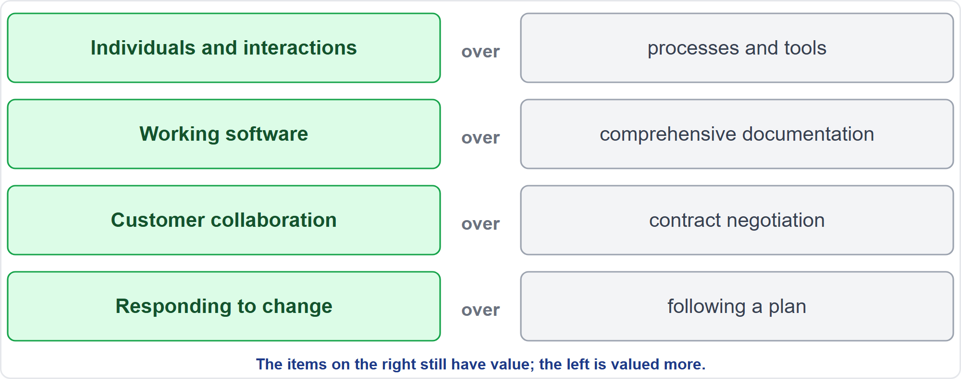
The Four Agile Values
Part 2
Valued more, not valued only
EXAM TIP The manifesto values are exam practice: the right-hand items still matter; the left-hand items matter more.
PMP Exam Prep 2026 | PMBOK 8 and the New ECO
Module 2: Life Cycles, Agile, Hybrid and Tailoring
23 / 65
Notes:
The Agile Manifesto names four values. Individuals and interactions over processes and tools. Working software over comprehensive documentation. Customer collaboration over contract negotiation. And responding to change over following a plan. The items on the right still have value. The items on the left are simply valued more. The wider principles include early and continuous delivery, welcoming change, daily work between business people and the team, sustainable pace, simplicity and self-organizing teams. This is exam practice, not PMBOK 8 text.

Slide 24
Roles in Adaptive Projects
Part 2
Role | Responsibilities
Product owner | Maximizes product value; owns and orders the backlog; voice of the customer; accepts work
Scrum master, agile coach or project manager as servant leader | Facilitates; removes impediments; coaches; shields the team from disruption
Team | Cross-functional, self-organizing, ideally dedicated; decides how to build; commits to the iteration scope
Sponsor, customers, end users | Provide direction, resources and feedback, mainly through the product owner
EXAM TIP Stakeholders do not go around the product owner to the team; priorities come from the product owner.
PMP Exam Prep 2026 | PMBOK 8 and the New ECO
Module 2: Life Cycles, Agile, Hybrid and Tailoring
24 / 65
Notes:
Four groups of roles. The product owner maximizes the value of the product, owns and orders the backlog, speaks for the customer and accepts work. The scrum master, agile coach, or a project manager acting as servant leader, facilitates, removes impediments, coaches and shields the team. They do not assign tasks or micromanage. The team is cross-functional, self-organizing and ideally dedicated. It decides how to build, and commits to the iteration scope. And sponsors, customers and end users give direction, resources and feedback, mostly through the product owner.

Slide 25
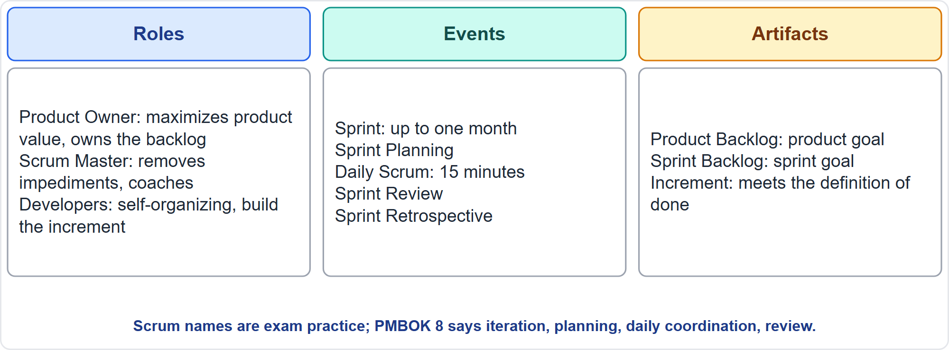
Scrum at a Glance
Part 2
Roles, events and artifacts
EXAM TIP Know the equivalents: sprint is an iteration; daily scrum is the daily coordination meeting.
PMP Exam Prep 2026 | PMBOK 8 and the New ECO
Module 2: Life Cycles, Agile, Hybrid and Tailoring
25 / 65
Notes:
Scrum is one widely used framework, and the exam may use its words. Three roles: product owner, scrum master and developers. One sprint, up to a month, contains four events: sprint planning, the daily scrum of fifteen minutes, the sprint review and the sprint retrospective. Three artifacts: the product backlog with its product goal, the sprint backlog with its sprint goal, and the increment, which meets the definition of done. PMBOK 8 uses neutral names: iteration, iteration planning, daily coordination meeting, review and retrospective.

Slide 26
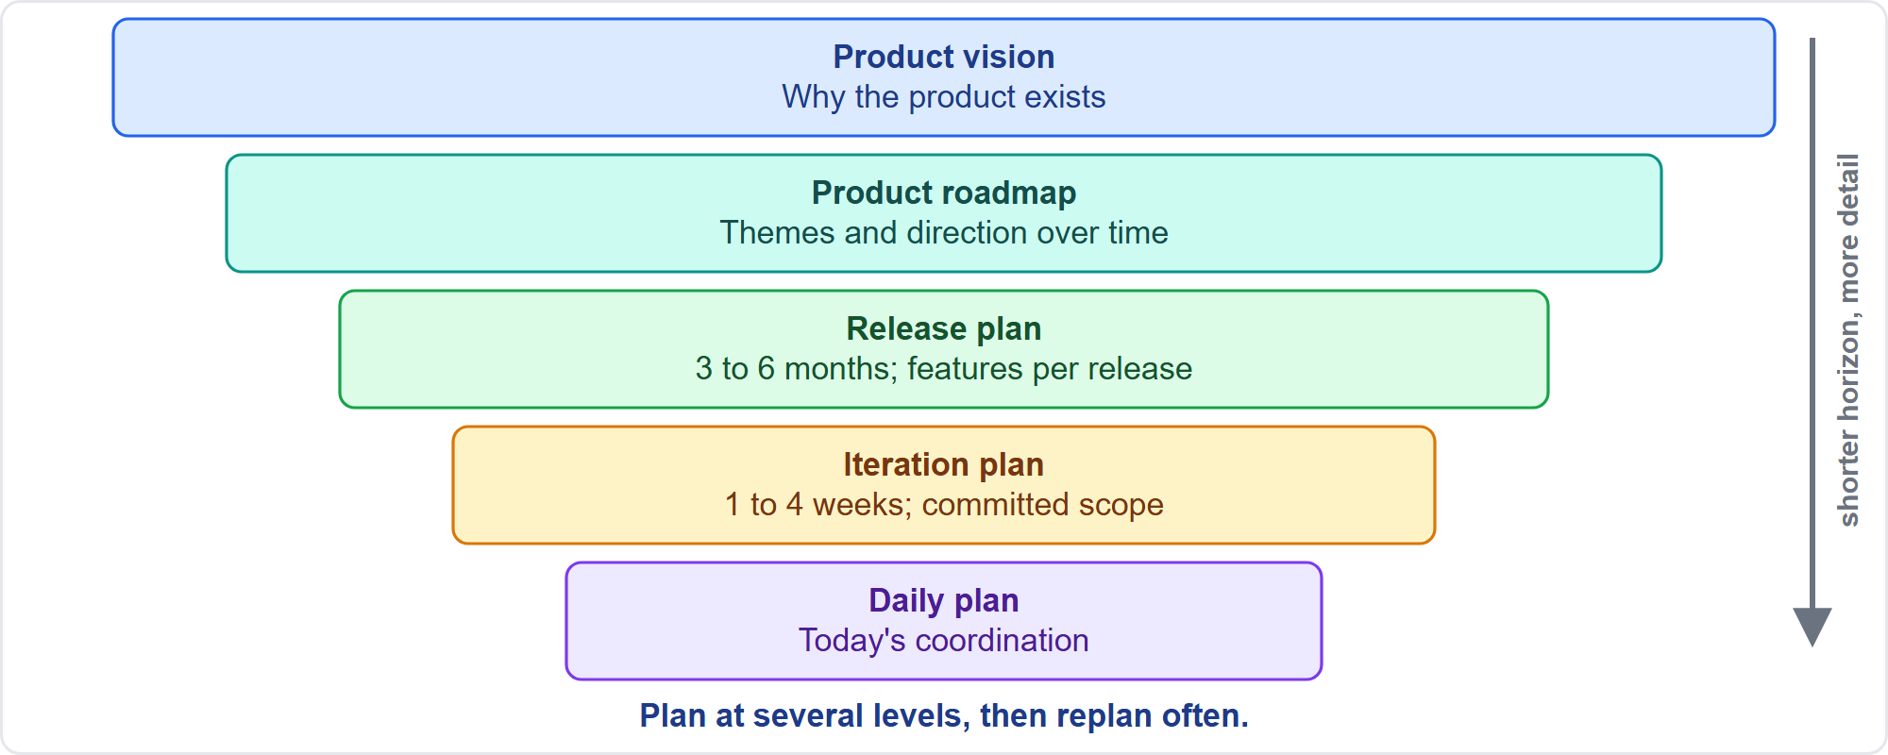
Agile Planning Layers
Part 2
From vision to the daily plan
EXAM TIP Agile does not mean no planning: plan at multiple levels, and report in terms stakeholders recognize.
PMP Exam Prep 2026 | PMBOK 8 and the New ECO
Module 2: Life Cycles, Agile, Hybrid and Tailoring
26 / 65
Notes:
Adaptive teams plan at five layers. The product vision says why the product exists. The product roadmap shows themes and direction over time. A release plan, typically three to six months, shows which features arrive in which release. An iteration plan fixes the committed scope for one to four weeks. And the daily plan is the daily coordination. Each layer is more detailed and shorter than the one above. Agile does not mean no planning. It means planning at several levels, and replanning often.

Slide 27
Backlogs
Part 2
Backlog | Contents
Product backlog | All desired requirements, features, epics and stories; the overall scope and vision
Release backlog | The subset planned for one release
Iteration backlog | Selected stories and tasks for the current iteration
Epic | Large related work, split into user stories
User story | An outcome from a stakeholder's view: role, goal, motivation
EXAM TIP The backlog is ranked by business value; backlog refinement keeps upcoming work ready.
PMP Exam Prep 2026 | PMBOK 8 and the New ECO
Module 2: Life Cycles, Agile, Hybrid and Tailoring
27 / 65
Notes:
A backlog is an ordered list of work, often user stories, prioritized by the business. The product backlog holds all desired requirements, features, epics and stories. It represents the overall scope and vision. The release backlog is the subset planned for one release. The iteration backlog holds the stories and tasks selected for the current iteration. An epic is a large body of related work, split into stories. A user story describes an outcome from a stakeholder's view. Backlog management is how adaptive teams handle change, and refinement keeps upcoming work ready.

Slide 28
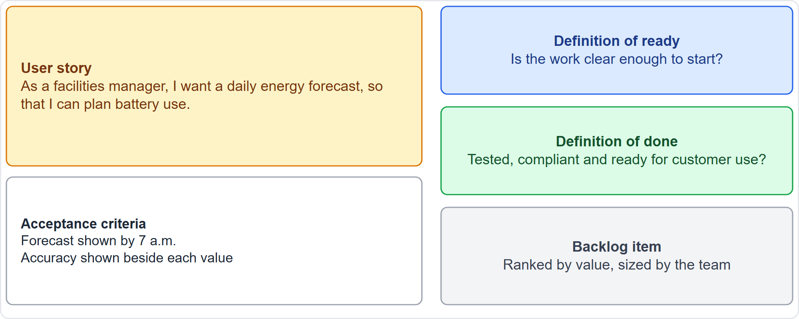
User Stories, Ready and Done
Part 2
A story, its criteria, and the ready and done checklists
EXAM TIP Quality is built in through the definition of done, not a late testing phase.
PMP Exam Prep 2026 | PMBOK 8 and the New ECO
Module 2: Life Cycles, Agile, Hybrid and Tailoring
28 / 65
Notes:
A user story states a role, a goal and a motivation, as in the example: a facilities manager wants a daily energy forecast to plan battery use. Acceptance criteria define the specific functionality and the user expectations to be met. The definition of ready, sometimes called a full kit, confirms that work is clear enough to start, which reduces rework. The definition of done is the checklist of everything a deliverable needs to be ready for customer use: testing, quality and compliance. Building these checks in each iteration is the shift-left idea.

Slide 29
Prioritizing the Backlog
Part 2
MoSCoW
100-point method
Cost of delay
must, should, could, will not have
stakeholders spend 100 points across items
what waiting costs, in value over time
Kano analysis
WSJF
basic, performance and delighter features
cost of delay divided by job size; the highest score goes first
EXAM TIP MoSCoW, 100-point, cost of delay and Kano are named in PMBOK 8; WSJF is exam practice.
PMP Exam Prep 2026 | PMBOK 8 and the New ECO
Module 2: Life Cycles, Agile, Hybrid and Tailoring
29 / 65
Notes:
Backlog items are ranked by business value or importance to the customer, sized by the team, with dependencies in mind. PMBOK 8 names four methods. MoSCoW sorts into must, should, could and will not have. The hundred-point method has stakeholders spend a hundred points across the items. Cost of delay asks what waiting costs. Kano analysis separates basic, performance and delighter features. Exam practice adds weighted shortest job first: cost of delay divided by job size, with the highest score going first. Small, urgent, valuable items rise.

Slide 30
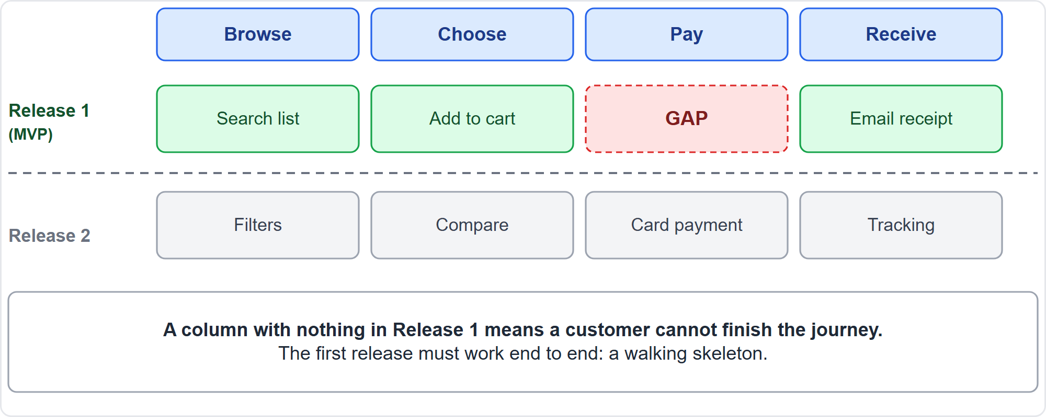
Story Map and the MVP
Part 2
A story map shows whether release 1 works end to end
EXAM TIP A column with nothing in release 1 means a customer cannot finish the journey: that is the MVP gap.
PMP Exam Prep 2026 | PMBOK 8 and the New ECO
Module 2: Life Cycles, Agile, Hybrid and Tailoring
30 / 65
Notes:
A minimum viable product, the MVP, is the fewest features that deliver value, and it defines the first release. A story map helps check it. The backbone of user activities runs left to right. The details sit below each activity. Horizontal slices form releases. The first release must work end to end, like a walking skeleton. Scan the backbone column by column. If one column has nothing in release one, as pay does here, a customer cannot finish the journey, and the first release has a gap. A spike, a short investigation, can reduce a technical unknown first.

Slide 31
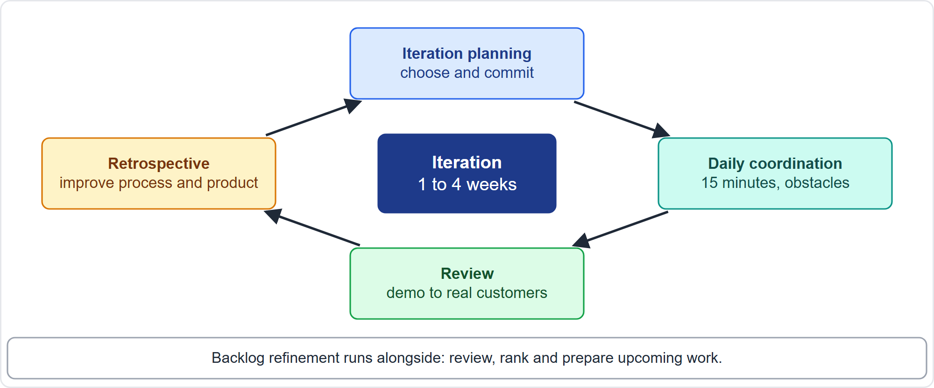
The Iteration Cycle
Part 2
Planning, daily coordination, review, retrospective
EXAM TIP The team's commitment inside an iteration is protected; new requests go to the product owner and the backlog.
PMP Exam Prep 2026 | PMBOK 8 and the New ECO
Module 2: Life Cycles, Agile, Hybrid and Tailoring
31 / 65
Notes:
Each iteration repeats four events. Iteration planning: the team clarifies items, estimates effort and commits to a scope chosen from the prioritized backlog. Daily coordination: no more than fifteen minutes, covering what was done, what is planned and what blocks progress. Review: the team demonstrates completed work to stakeholders and asks for feedback, which shapes the backlog. Retrospective: the whole team explores what worked and what did not, to improve process and product. Backlog refinement runs alongside.

Slide 32
Iteration Events
Part 2
Event | Purpose and key points
Planning | Clarify items and criteria; the team commits to scope from the prioritized backlog
Daily coordination | 15 minutes at most; progress, plan, obstacles; quick problem-solving
Review | Demonstrate work to stakeholders and gather feedback that shapes the backlog
Retrospective | At least once per iteration; actionable improvements with owners
Refinement | Ongoing preparation of upcoming work
EXAM TIP A daily coordination meeting is short and for the team; it is not a status report to the project manager.
PMP Exam Prep 2026 | PMBOK 8 and the New ECO
Module 2: Life Cycles, Agile, Hybrid and Tailoring
32 / 65
Notes:
Here is the same cycle as a table. Planning clarifies the items and criteria, and the team commits to scope from the prioritized backlog. Daily coordination lasts at most fifteen minutes and covers progress, plan and obstacles. It enables quick problem-solving, and it is for the team, not a status report to the project manager. The review demonstrates work and gathers feedback that shapes the backlog. The retrospective happens at least once per iteration, with actionable improvements and owners. Refinement is the ongoing preparation of upcoming work.

Slide 33
Reviews and Retrospectives That Work
Part 2
Reviews need real discussion time and the real customers or end users, not only internal proxies
High feature completion with falling user ratings is output without outcome
Do not wait weeks for feedback by email
Retrospectives must change something: a few improvements, with owners, in the next backlog
If nothing changes, inspect the improvement process itself
EXAM TIP Build structured discussion time and real customers into reviews.
PMP Exam Prep 2026 | PMBOK 8 and the New ECO
Module 2: Life Cycles, Agile, Hybrid and Tailoring
33 / 65
Notes:
Reviews and retrospectives often appear in exam scenarios. A review needs real discussion time, and the real customers or end users in the room, not only internal proxies. If feature completion is high but user ratings are falling, that is output without outcome. Do not wait weeks for feedback by email. A retrospective must change something. Pick a few improvements, give them owners and put them in the next backlog. If nothing changes after several retrospectives, inspect the improvement process itself.

Slide 34
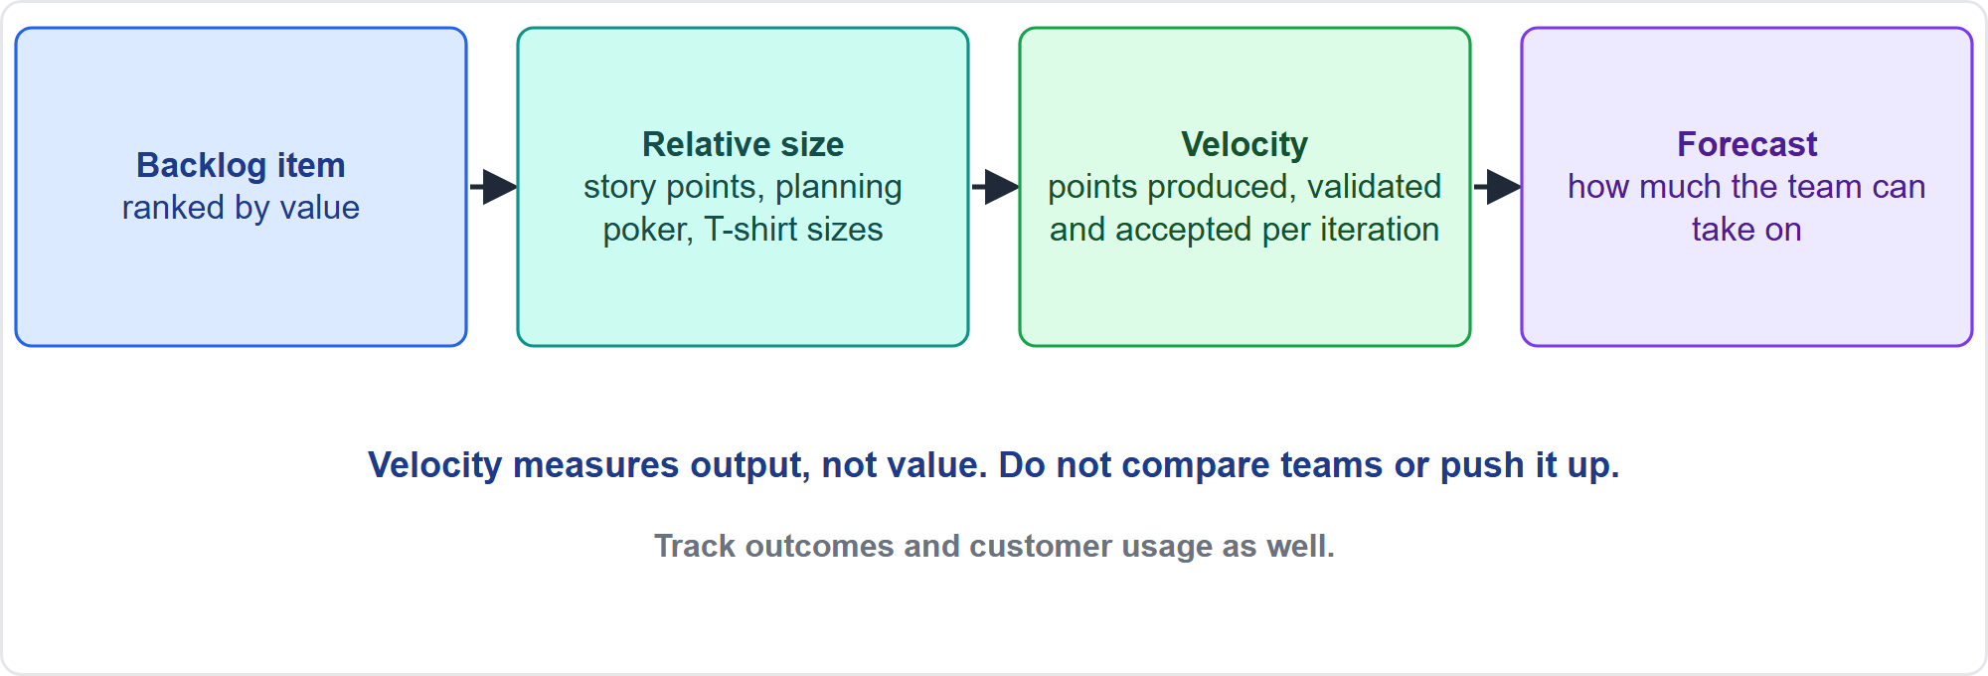
Estimating and Velocity
Part 2
Relative sizing leads to velocity and forecasting
EXAM TIP Do not raise velocity targets to "get more" and do not compare teams; track outcomes and usage as well.
PMP Exam Prep 2026 | PMBOK 8 and the New ECO
Module 2: Life Cycles, Agile, Hybrid and Tailoring
34 / 65
Notes:
Teams estimate in story points, a relative measure of effort. Comparing items is easier than predicting durations, so relative sizing is simpler without losing accuracy. PMBOK 8 names planning poker, story points and T-shirt sizing, among other techniques. Velocity is the rate at which deliverables are produced, validated and accepted within a predefined interval, and it helps forecast what a team can take on. It is team-specific. Do not compare teams or push it up. It measures output, not value, so also track outcomes and customer usage.

Slide 35
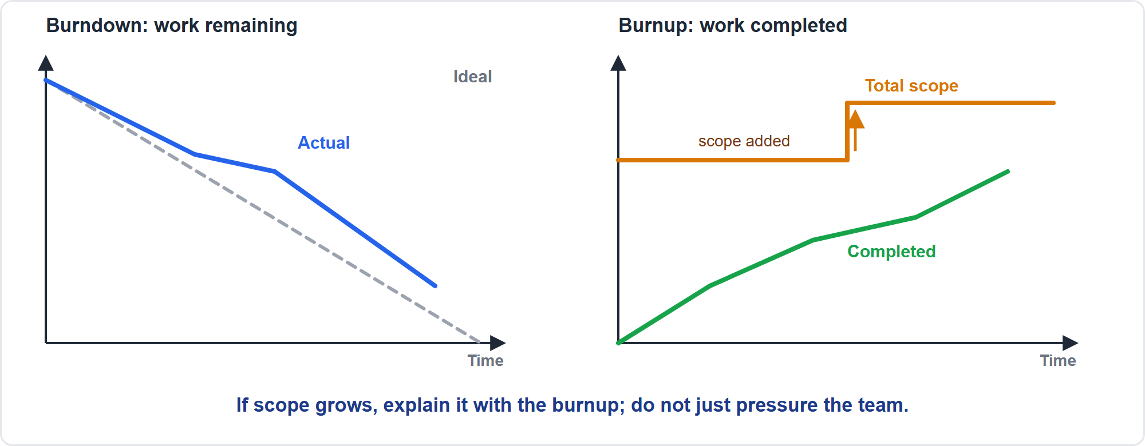
Burndown and Burnup Charts
Part 2
Remaining work against completed work
EXAM TIP Pick the right chart: burnup shows scope growth; burndown shows remaining work.
PMP Exam Prep 2026 | PMBOK 8 and the New ECO
Module 2: Life Cycles, Agile, Hybrid and Tailoring
35 / 65
Notes:
Two charts show progress. A burndown chart shows work remaining against time left. The iteration burndown compares it with an ideal line, and a trend line forecasts completion. A burnup chart shows work completed toward a milestone, with total scope as a line across the top. When scope is added or removed, the scope line moves, so scope changes are visible. If scope grows, explain it with the burnup. Do not just pressure the team to go faster.

Slide 36
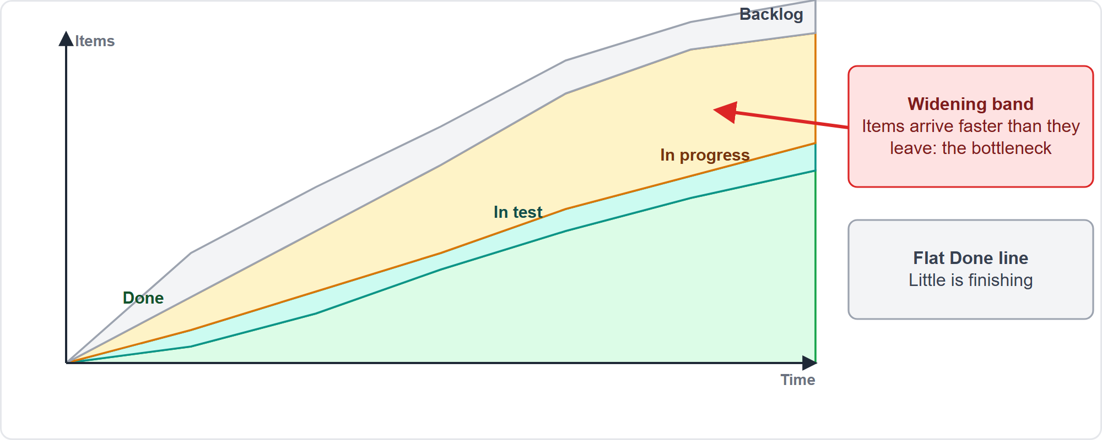
Cumulative Flow and Flow Measures
Part 2
A widening band marks a bottleneck
EXAM TIP Cycle time runs from start to finish of a task; lead time from request to delivery.
PMP Exam Prep 2026 | PMBOK 8 and the New ECO
Module 2: Life Cycles, Agile, Hybrid and Tailoring
36 / 65
Notes:
A cumulative flow diagram shows features completed over time, in each state, and in the backlog. A band that keeps widening marks a state where items arrive faster than they leave: the bottleneck. A flat done line means little is finishing. Know the flow measures. Throughput is items finished per period. Work in progress is items under way. Cycle time runs from starting a task to completing it. Lead time runs from the request to delivery. By Little's law, cycle time equals work in progress divided by throughput, so lower work in progress shortens cycle time. The flow measures and Little's law are exam practice, not PMBOK 8 formulas.

Slide 37
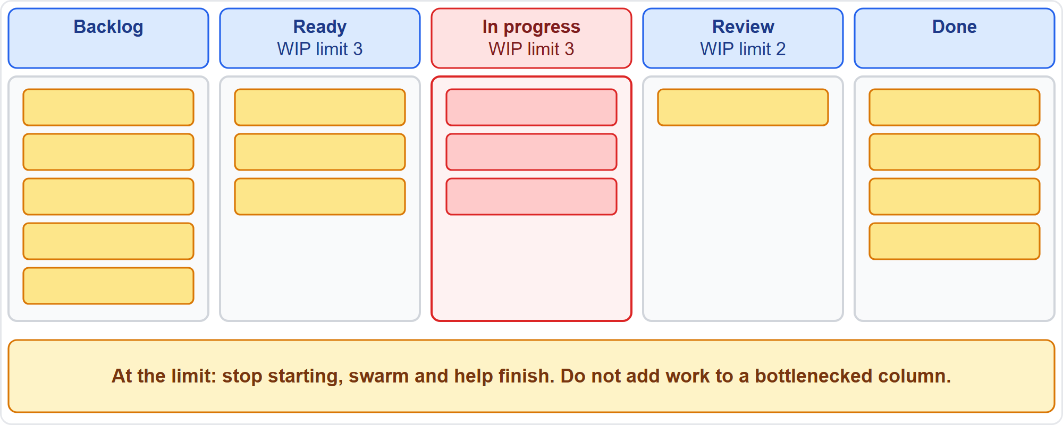
Kanban and WIP Limits
Part 2
Limit work in process
EXAM TIP At a WIP limit, stop starting and help finish; do not add work to a bottlenecked column.
PMP Exam Prep 2026 | PMBOK 8 and the New ECO
Module 2: Life Cycles, Agile, Hybrid and Tailoring
37 / 65
Notes:
Kanban is a visual workflow method that limits work in process, drawing on lean principles. The board shows columns, and each active column has a limit. When a column nears its limit, the team swarms to help the work that is slowing the flow. Do not add work to a bottlenecked column. Kanban has no mandatory roles or iterations. Its principles are to visualize work, limit work in process, manage flow, make policies explicit, implement feedback loops and improve collaboratively.

Slide 38
Lean, Constraints and Visual Controls
Part 2
Lean eliminates waste; value stream mapping shows the steps and time from request to value
Theory of constraints: find and address the biggest limiting factor
Information radiators put progress where people actually look
Continuous improvement: PDCA, Lean, TQM, Six Sigma
Make progress and risks visible in the backlog and on boards
EXAM TIP Transparency means visible where stakeholders look, not buried in a tool.
PMP Exam Prep 2026 | PMBOK 8 and the New ECO
Module 2: Life Cycles, Agile, Hybrid and Tailoring
38 / 65
Notes:
Lean eliminates waste. Value stream mapping documents the steps and the time in a process, from customer request to value realized, so you can find the waste. The theory of constraints finds and addresses the biggest limiting factor. Visual controls and information radiators, such as task boards, burn charts and impediment lists, put progress where people actually look. Low tech, high touch is fine. Continuous improvement uses PDCA, Lean, total quality management and Six Sigma. And transparency means visible where stakeholders look.

Slide 39
Team Environment and Collaboration
Part 2
Team charter: values, agreements and operating guidelines; best when the team writes it
Revisit the charter periodically and with every new member
Colocation helps communication; virtual tools support distributed teams
Dedicated, cross-functional members reduce context switching
Customer talks and tests build trust and quality
Design thinking: understand users, prototype, test
EXAM TIP When team members breach their own charter, facilitate a team discussion on honoring it.
PMP Exam Prep 2026 | PMBOK 8 and the New ECO
Module 2: Life Cycles, Agile, Hybrid and Tailoring
39 / 65
Notes:
The team environment matters. A team charter holds values, agreements and operating guidelines, and works best when the team develops it. Review it periodically, and revisit it with every new member. Colocation improves communication, while virtual collaboration tools support distributed teams. Dedicated, cross-functional members reduce context switching and waiting. Direct customer talks and testing build trust and quality. Design thinking, a human-centered, iterative process of understanding users, prototyping and testing, is popular for new products. If members breach their own charter, facilitate a team discussion.

Slide 40
Agile Across the Performance Domains
Part 2
Domain | Agile practice
Governance | Lightweight; periodic reviews; right-sized controls
Scope | The backlog reflects current needs
Schedule | Release and iteration plans; timeboxes; burn charts
Finance | Budget allocated and revised quarterly; spend tracked per iteration
Stakeholders | Continuous feedback; reviews; information radiators
Resources | Self-organizing, dedicated teams; servant leaders
Risk | Review each iteration; a risk-adjusted backlog
Quality | Definition of done and acceptance criteria in every iteration
EXAM TIP Agile does not mean no governance: tailor controls to contractual or regulatory needs.
PMP Exam Prep 2026 | PMBOK 8 and the New ECO
Module 2: Life Cycles, Agile, Hybrid and Tailoring
40 / 65
Notes:
Here is how agile looks in each domain. Governance is lightweight, with periodic reviews and right-sized controls. Scope lives in a backlog that reflects current needs. Schedule uses release and iteration plans, timeboxes and burn charts. Finance allocates the budget quarterly and revises it quarterly, tracking spend per iteration. Stakeholders give continuous feedback in reviews, with information radiators. Resources are self-organizing, dedicated teams with servant leaders. Risk is reviewed each iteration in a risk-adjusted backlog. And quality sits in the definition of done.

Slide 41
Hybrid Ways of Working in Practice
Part 2
Topic | Hybrid practice
Choosing | Per deliverable: stable, regulated, long-lead items predictive; uncertain items adaptive
Planning | Baseline fixed elements; roadmap and backlog for the rest
Reporting | A schedule executives recognize, with iteration detail beneath
Metrics | Earned value or milestones for predictive streams; burn charts and velocity for agile ones
Change control | Backlog changes via the product owner; baseline changes via formal control
Compliance | Build evidence into the definition of done
EXAM TIP Avoid turning a backlog into a false-precision Gantt chart.
PMP Exam Prep 2026 | PMBOK 8 and the New ECO
Module 2: Life Cycles, Agile, Hybrid and Tailoring
41 / 65
Notes:
Hybrid work needs clear practices. Choose per deliverable: stable, regulated, long-lead items predictive, uncertain items adaptive. Baseline the fixed elements, and use a roadmap and backlog for the rest. Report with a schedule executives recognize, with iteration detail beneath, and avoid turning a backlog into a false-precision Gantt chart. Use earned value or milestones for predictive streams, burn charts and velocity for agile ones, and one consolidated view for governance. Route routine backlog changes through the product owner, and baseline changes through formal control.

Slide 42
Predictive, Agile and Hybrid Compared
Part 2
 | Predictive | Agile | Hybrid
Who manages | Project manager | Self-organizing team with product owner and scrum master | Shared
Plans | Detailed baselined plan | Vision, roadmap, release and iteration plans | Baselines plus backlog
Change | Formal change control | Backlog reprioritization | Tailored mix
Progress | Earned value, milestones | Working increments, velocity, burn charts | Both
Customer | Specifies up front; accepts at milestones | Collaborates continuously | Both
EXAM TIP A strong answer names the mechanism that fits the approach in the scenario.
PMP Exam Prep 2026 | PMBOK 8 and the New ECO
Module 2: Life Cycles, Agile, Hybrid and Tailoring
42 / 65
Notes:
Put the three approaches side by side. Who manages: the project manager in predictive work, a self-organizing team with a product owner and a scrum master in agile work, and a shared arrangement in hybrid. Plans: a detailed baselined plan, versus a vision, roadmap, release and iteration plans, versus baselines plus a backlog. Change: formal change control, versus backlog reprioritization, versus a tailored mix. Progress: earned value and milestones, versus working increments, velocity and burn charts. The customer specifies up front in predictive work, and collaborates continuously in agile work.

Slide 43
Agile Traps: What PMI Expects
Part 2
Servant leader: facilitate and remove impediments; do not assign tasks
The team commits to the iteration scope: route new requests to the product owner
The product owner owns priorities and value
Retrospectives must change something
Velocity is output, not value
Impediments get removed, not just logged; agile is not no planning
EXAM TIP Do not add work mid-iteration to please a senior stakeholder; represent the team's capacity.
PMP Exam Prep 2026 | PMBOK 8 and the New ECO
Module 2: Life Cycles, Agile, Hybrid and Tailoring
43 / 65
Notes:
The traps for agile. Be a servant leader: facilitate and remove impediments. Do not assign tasks. The team commits to the iteration scope, so route new requests to the product owner and the backlog. The product owner owns priorities and value. Impediments get removed, not just logged. Retrospectives must change something. Velocity is output, not value. And agile does not mean no planning or no governance. When a senior stakeholder wants work added mid-iteration, represent the team's capacity and send the request to the product owner.

Slide 44
Part 2 Recap
Part 2
1
Mindset
2
Planning
3
Iteration
agile is broader than any framework; servant leadership; function over title
vision, roadmap, release, iteration, daily; ordered backlogs
planning, daily coordination, review with real customers, retrospective that changes something
4
Measures
5
Flow
6
Hybrid
velocity is output; burnup shows scope; cumulative flow shows bottlenecks
WIP limits, swarming, lean and visual controls
per-deliverable choice, one reporting view, tailored change control
PMP Exam Prep 2026 | PMBOK 8 and the New ECO
Module 2: Life Cycles, Agile, Hybrid and Tailoring
44 / 65
Notes:
Let us recap Part 2. Agile is a mindset broader than any framework, with servant leadership and function over title. Teams plan from vision to daily plan and keep ordered backlogs. Each iteration has planning, daily coordination, a review with real customers, and a retrospective that changes something. Velocity is output, the burnup shows scope, and the cumulative flow diagram shows bottlenecks. Flow uses work in process limits, swarming, lean and visual controls. And hybrid work chooses per deliverable, offers one reporting view and tailors change control. In Part 3, we turn to tailoring.

Slide 45
Tailoring: What It Is
Part 3
Tailoring is the deliberate adaptation of approach, governance and processes to fit context
It is driven by the principles, values and culture
It means mindfully selecting and adjusting what is useful
Projects balance competing demands: speed, cost, value, quality, compliance, change
Policy or a contract may mandate an approach and limit tailoring
EXAM TIP Tailor within policy, justify the change and check it works; never apply the standard rigidly or drop it.
PMP Exam Prep 2026 | PMBOK 8 and the New ECO
Module 2: Life Cycles, Agile, Hybrid and Tailoring
45 / 65
Notes:
Part 3 turns to tailoring. Tailoring is the deliberate adaptation of the approach, governance and processes to fit the project's environment and objectives. It is driven by the principles, and by organizational values and culture. A low risk appetite tends to mean structured processes and oversight, while a higher tolerance may favor agility. Tailoring means mindfully selecting and adjusting what is useful. Projects balance competing demands. And policy or a contract may mandate an approach and limit tailoring. Tailor within policy, justify the change and check that it works.

Slide 46
Why Tailor
Part 3
No single approach fits
Variables
structures range from extensive to minimal
criticality, scale, duration, complexity, standards, culture, stakeholders, maturity
Too few processes
Benefits
make management ineffective; too many waste effort
team commitment, customer orientation, efficient use of resources
EXAM TIP A nuclear reactor project needs far more rigor and reporting than a new office building.
PMP Exam Prep 2026 | PMBOK 8 and the New ECO
Module 2: Life Cycles, Agile, Hybrid and Tailoring
46 / 65
Notes:
Why tailor? There is no single approach for all projects. Structures range from extensive to minimal, and from rigorous to lightweight. Variables include criticality, scale, duration and complexity. They include industry standards and organizational culture. And they include the number of stakeholders and the maturity of project management. A nuclear reactor project needs far more rigor than an office building, and a ten-person team needs far less coordination than a two-hundred-person team. Too few processes make management ineffective, and too many are costly. Teams that help tailor are more committed.

Slide 47
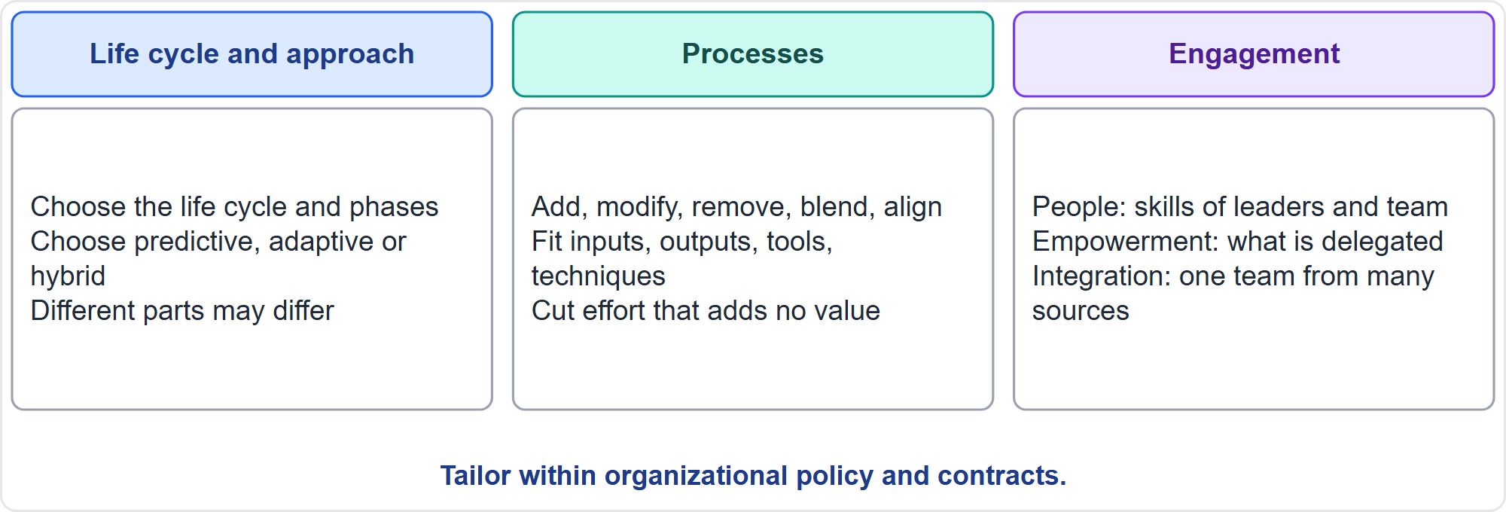
What You Can Tailor
Part 3
Three things to tailor
EXAM TIP A data center with predictive construction and an adaptive computing layer is a hybrid at project level.
PMP Exam Prep 2026 | PMBOK 8 and the New ECO
Module 2: Life Cycles, Agile, Hybrid and Tailoring
47 / 65
Notes:
You can tailor three things. First, the life cycle and development approach: the phases, and predictive, adaptive or hybrid. A data center with predictive construction and an adaptive approach for computing capabilities is a hybrid at project level, though each sub-team experiences only one approach. Second, the processes. Third, engagement. That covers the people, meaning the skills of leaders and team. It covers empowerment, meaning which decisions are delegated. And it covers integration, meaning making one team from contractors, partners and staff.

Slide 48
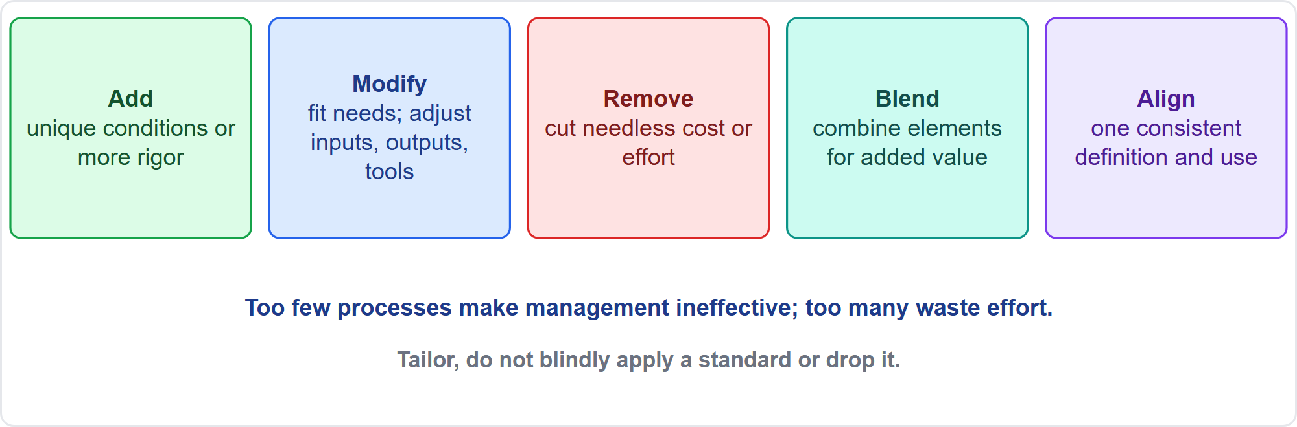
Five Ways to Tailor a Process
Part 3
Add, modify, remove, blend, align
EXAM TIP Do not unilaterally drop required steps; request an approved exception if the policy requires them.
PMP Exam Prep 2026 | PMBOK 8 and the New ECO
Module 2: Life Cycles, Agile, Hybrid and Tailoring
48 / 65
Notes:
You can tailor a process in five ways. Add: for unique conditions or more rigor. Modify: adjust inputs, outputs, tools and techniques to fit your needs. Remove: cut unnecessary cost or effort. Blend: combine elements for added value. Align: give a consistent definition and application across the organization. Too few processes make management ineffective. More than required is wasteful. But do not unilaterally drop required steps. If a policy or contract requires them, request an approved exception.

Slide 49
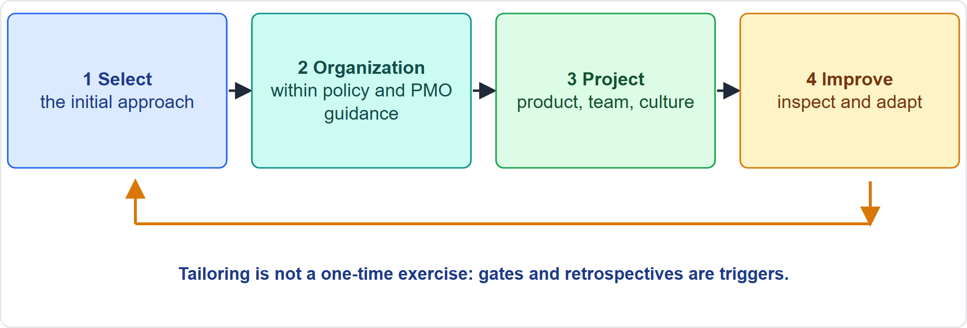
The Tailoring Process
Part 3
Four steps, then keep improving
EXAM TIP Retrospectives, gates and lessons learned are the triggers to inspect and adapt.
PMP Exam Prep 2026 | PMBOK 8 and the New ECO
Module 2: Life Cycles, Agile, Hybrid and Tailoring
49 / 65
Notes:
Tailoring follows four steps. One: select the initial development approach. Two: tailor for the organization, within policy and PMO guidance. Three: tailor for the project, looking at the product, the team and the culture. Four: implement ongoing improvement. It is not a one-time exercise. Issues with how the team works, or how the product evolves, signal further tailoring. Review points, phase gates and retrospectives are chances to inspect and adapt. Rigid persistence with a failing approach is wrong.

Slide 50
Step 1: Select the Initial Approach
Part 3
Use product knowledge, delivery cadence and awareness of the options
A suitability filter is a decision aid that assesses culture, team dynamics and project factors
It guides the choice among predictive, adaptive and hybrid; it is not a rigid method
Combine it with other data, such as requirements stability and regulation
EXAM TIP The filter helps you decide; it does not decide for you.
PMP Exam Prep 2026 | PMBOK 8 and the New ECO
Module 2: Life Cycles, Agile, Hybrid and Tailoring
50 / 65
Notes:
Step one: select the initial development approach. Use product knowledge, the delivery cadence and your awareness of the options. A suitability filter is a decision-making aid that assesses culture, team dynamics and project factors to guide the choice among predictive, adaptive and hybrid. It is not a rigid method, and you combine it with other data, such as requirements stability and regulation. The filter helps you decide. It does not decide for you.

Slide 51
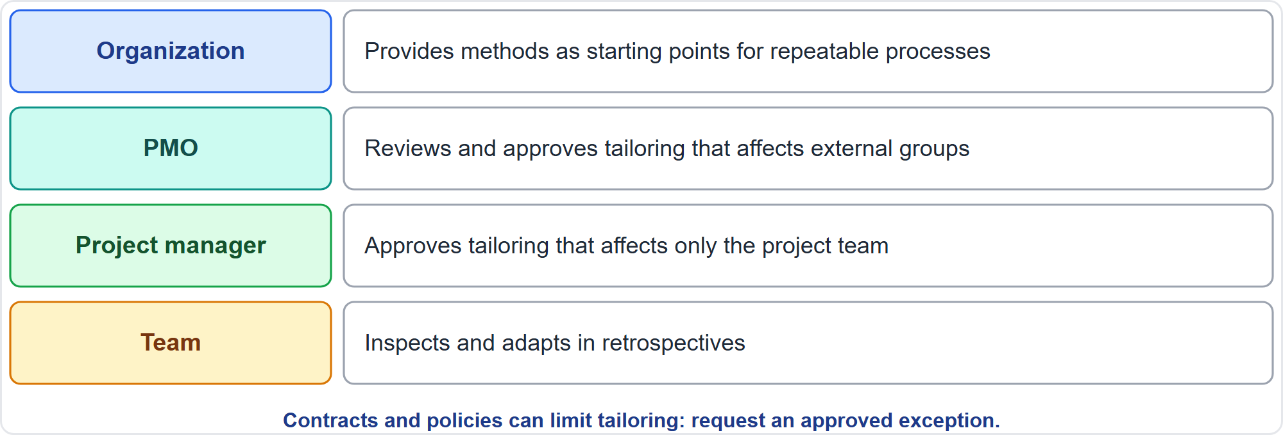
Step 2: Tailor for the Organization
Part 3
Who approves tailoring
EXAM TIP Tailoring that affects only the team needs the project manager; tailoring that affects outside groups may need the PMO.
PMP Exam Prep 2026 | PMBOK 8 and the New ECO
Module 2: Life Cycles, Agile, Hybrid and Tailoring
51 / 65
Notes:
Step two: tailor for the organization. Teams own and improve their processes, but organizations provide methodologies as starting points for repeatable processes and consistent measurement. With process governance, you align tailoring with policy. Consider the program and portfolio context, because aligning tailoring across related projects improves consistency. A PMO often reviews and approves tailored approaches. Tailoring that affects only the project team usually needs just the project manager's approval. Tailoring that affects external groups may need PMO approval. In multi-organization projects, tailor jointly.

Slide 52
Step 3: Tailor for the Project
Part 3
Product or deliverable
Project team
Culture
standards, type, market, technology, timeframe, stability, security, incremental delivery
size, geography, experience, access to the customer, diversity
buy-in, trust, empowerment, and how decisions are made
EXAM TIP Ask questions about the product, the team and the culture before you tailor.
PMP Exam Prep 2026 | PMBOK 8 and the New ECO
Module 2: Life Cycles, Agile, Hybrid and Tailoring
52 / 65
Notes:
Step three: tailor for the project, asking questions about three attributes. The product or deliverable: how much rigor do standards require? Is it a well-known product or intangible? Is the market regulated or fast moving? Is the technology stable? How stable are the requirements, and can it be delivered incrementally? The project team: size, geography, experience, access to the customer, and diversity of skills. And culture: buy-in to the approach, trust that the team will deliver, empowerment, and how decisions are made.

Slide 53
Step 4: Keep Improving
Part 3
Tailoring is not a one-time exercise
Problems with how the team works or how the product evolves signal more tailoring
Review points, gates and retrospectives are chances to inspect and adapt
Keeping the team engaged in improving its process builds pride of ownership and shows trust
The way an organization tailors can itself be tailored
EXAM TIP Do not impose a process change without the team's input.
PMP Exam Prep 2026 | PMBOK 8 and the New ECO
Module 2: Life Cycles, Agile, Hybrid and Tailoring
53 / 65
Notes:
Step four: keep improving. Tailoring is not a one-time exercise. When the team struggles with how it works, or the product evolves, that signals more tailoring. Review points, phase gates and retrospectives are the moments to inspect and adapt the process, the development approach and the delivery frequency. Keeping the team engaged in improving its own process builds pride of ownership, and shows trust. Even the way an organization tailors can itself be tailored. Do not impose a process change without the team's input.

Slide 54
Diagnostics: Quality, Team and Approvals
Part 3
Situation | Tailoring suggestion
Deliverables are poor quality | Find root causes; improve the process, not only add verification
Team members are unsure how to proceed | Assess needs; give guidance, mentoring, training and knowledge sharing
Members are uncooperative and work in silos | Team building and one-to-one conversations to find the cause
Long delays waiting for approvals | Streamline: appoint people authorized to decide up to value thresholds
EXAM TIP Fix the cause, not the symptom.
PMP Exam Prep 2026 | PMBOK 8 and the New ECO
Module 2: Life Cycles, Agile, Hybrid and Tailoring
54 / 65
Notes:
Diagnostics link a situation to a tailoring suggestion. Poor quality: find the root causes and improve the process, rather than only adding more verification. Team members unsure how to proceed: assess their needs, and offer guidance, mentoring, training and knowledge sharing. Members who are uncooperative and work in silos: team building and individual conversations to find the cause. Long delays waiting for approvals: streamline by appointing people who are authorized to decide up to value thresholds. Fix the cause, not the symptom.

Slide 55
Diagnostics: Flow, Stakeholders, Transparency and Risk
Part 3
Situation | Tailoring suggestion
Too much work in progress and waste | Value stream mapping and Kanban boards to visualize and fix
Stakeholders disengaged or negative | Check they get timely, relevant information; tailor communication
No transparency about progress | Collect, analyze, share and discuss the right data; agree the measures
Unprepared issues and risks keep surfacing | Explore root causes; look for gaps in processes or activities
EXAM TIP Periodic reviews, such as retrospectives and lessons learned, show whether the approach works.
PMP Exam Prep 2026 | PMBOK 8 and the New ECO
Module 2: Life Cycles, Agile, Hybrid and Tailoring
55 / 65
Notes:
More diagnostics. Too much work in progress and waste: use value stream mapping and Kanban boards to visualize the work and find fixes. Stakeholders who are disengaged or negative: check they receive timely, relevant information, and tailor the communication methods. No transparency about progress: make sure the right data is collected, analyzed, shared and discussed, and that everyone agrees on the measures. Issues and risks that keep surfacing unprepared: explore root causes, and look for gaps in processes or activities. Periodic reviews show whether the approach works.

Slide 56
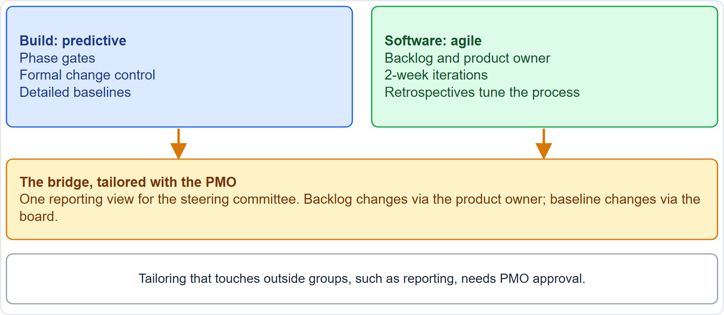
Case Check-In: Tailoring the Microgrid
Part 3
CASE CHECK-IN · Sunrise Campus Microgrid
Build lane: gates, formal change control, detailed baselines
Software lane: product owner, 2-week iterations, retrospectives
PMP Exam Prep 2026 | PMBOK 8 and the New ECO
Module 2: Life Cycles, Agile, Hybrid and Tailoring
56 / 65
Notes:
Let us tailor the microgrid. In the build lane, the team keeps phase gates, formal change control and detailed baselines. In the software lane, a product owner orders the backlog, iterations last two weeks, and retrospectives tune the process. The bridge between them needs tailoring. The steering committee gets one reporting view. Backlog changes go through the product owner, while baseline changes go through the change control board. Because the reporting affects outside groups, the PMO must approve it.

Slide 57
Tailoring in Predictive, Agile and Hybrid Work
Part 3
 | Predictive | Agile | Hybrid
Typically tailored | Planning detail, gates, control rigor | Iteration length, events, definition of done | Which streams use which approach; one reporting view
Owner | Project manager with PMO | Team, in retrospectives | Project manager, leads and PMO
Trigger | Size, criticality, regulation | Retrospective findings, flow data | Both, plus integration problems
Risk if poor | Bureaucracy or weak control | Ritual without value | Mixed signals, duplicated effort
EXAM TIP Poor tailoring has a cost in every approach.
PMP Exam Prep 2026 | PMBOK 8 and the New ECO
Module 2: Life Cycles, Agile, Hybrid and Tailoring
57 / 65
Notes:
Tailoring differs by approach. In predictive work, you tailor planning detail, gates, control rigor and reporting. The project manager owns it, with the PMO, within policy, triggered by size, criticality and regulation. In agile work, you tailor iteration length, events, the definition of done and board design. The team owns it through retrospectives. In hybrid work, you tailor which streams use which approach, the interfaces and one reporting view. Poor tailoring costs something in each approach: bureaucracy, ritual without value, or mixed signals.

Slide 58
Tailoring Traps: What PMI Expects
Part 3
Tailor; do not blindly apply or discard
Contracts and policies limit tailoring: work within them or request an exception
Fix the cause, not the symptom
Tailoring is continuous: retrospectives, gates and lessons learned trigger it
Involve the team in tailoring
Use the PMO when the change affects others
EXAM TIP Slow approvals call for delegated authority thresholds, not pressure.
PMP Exam Prep 2026 | PMBOK 8 and the New ECO
Module 2: Life Cycles, Agile, Hybrid and Tailoring
58 / 65
Notes:
The traps for tailoring. Tailor. Do not blindly apply the standard or discard it. Contracts and policies limit tailoring, so work within them or request an exception. Fix the cause, not the symptom: poor quality calls for root cause and process improvement, slow approvals call for delegated authority thresholds, and silos call for team building. Tailoring is continuous. Involve the team. And use the PMO when the change affects others. Document the reasoning for every tailoring decision.

Slide 59
Module Recap
Part 3
1
Approach
2
Life cycle
3
Agile
match predictive, adaptive or hybrid to the context
gates decide; the cost of change rises over time in predictive work
servant leadership, ordered backlogs, protected iterations, flow and honest measures
4
Hybrid
5
Tailoring
6
Next
per-deliverable choice, one reporting view, tailored change control
four steps, five ways, within policy, continuous
five practice questions
PMP Exam Prep 2026 | PMBOK 8 and the New ECO
Module 2: Life Cycles, Agile, Hybrid and Tailoring
59 / 65
Notes:
Let us recap the whole module. Match predictive, adaptive or hybrid to the context. Gates decide, and the cost of change rises over time in predictive work. In agile work, practice servant leadership, keep ordered backlogs, protect the iteration, manage flow and use honest measures. In hybrid work, choose per deliverable, offer one reporting view and tailor change control. Tailoring has four steps and five ways, stays within policy, and never stops. Now it is time to test yourself. Five questions follow. For each one, pause the video, choose your answer, and then listen to the explanation.

Slide 60
Practice Question 1
Part 3
Q1
A university is building a research laboratory with fixed design drawings and permits, and a visitor tracking app whose features are still unclear to the stakeholders. Which approach should the project manager recommend?
A
A hybrid: predictive for the laboratory build and adaptive for the tracking app
B
A single predictive plan for both deliverables, with a formal baseline for the app features
C
An adaptive approach for both deliverables, with the permits handled as backlog items
D
A predictive approach now, switching the whole project to adaptive after the build
PMP Exam Prep 2026 | PMBOK 8 and the New ECO
Module 2: Life Cycles, Agile, Hybrid and Tailoring
60 / 65
Notes:
Question one. A university is building a research laboratory with fixed design drawings and permits, and a visitor tracking app whose features are still unclear to the stakeholders. Which approach should the project manager recommend? The four options are on the screen. Choose your answer. [PAUSE 12] The answer is A. The scenario mixes a stable, permitted build with an uncertain software feature set, so a hybrid lets each deliverable follow the approach that suits it. One approach for both ignores the difference, and switching the whole project later does not fit work that runs in parallel.

Slide 61
Practice Question 2
Part 3
Q2
A phase review finds that two of the five exit criteria are unmet, yet the contractors for the next phase are already mobilizing. What should the project manager do?
A
Record the criteria as met so the contractors avoid paying for standby time
B
Start the next phase and complete the open criteria in parallel as work proceeds
C
Cancel the project because the gate was not passed at the first attempt
D
Report the unmet criteria and let the gate authority decide the next step
PMP Exam Prep 2026 | PMBOK 8 and the New ECO
Module 2: Life Cycles, Agile, Hybrid and Tailoring
61 / 65
Notes:
Question two. A phase review finds that two of the five exit criteria are unmet, yet the contractors for the next phase are already mobilizing. What should the project manager do? The four options are on the screen. Choose your answer. [PAUSE 12] The answer is D. A gate is a decision point. With unmet criteria, the options include continuing with modification, repeating the phase or parts of it, remaining in it, or ending it. The authority decides on the facts. Pushing ahead, misreporting, or cancelling outright skips that decision.

Slide 62
Practice Question 3
Part 3
Q3
An agile team has a fixed budget and a fixed end date, and new high-priority requests keep arriving. How should the project manager handle this?
A
Ask the sponsor to extend the budget and end date so that everything fits
B
Reprioritize the backlog so the highest-value items fit the limits
C
Reject every new request so that the committed scope is fully protected
D
Ask the team to work overtime until all the requests are delivered
PMP Exam Prep 2026 | PMBOK 8 and the New ECO
Module 2: Life Cycles, Agile, Hybrid and Tailoring
62 / 65
Notes:
Question three. An agile team has a fixed budget and a fixed end date, and new high-priority requests keep arriving. How should the project manager handle this? The four options are on the screen. Choose your answer. [PAUSE 12] The answer is B. When budget and schedule are fixed, scope is the variable, so the product owner reorders the backlog by value and the lowest-value items drop out. Extending the limits, overtime, or blanket refusal ignores the constraint or the value.

Slide 63
Practice Question 4
Part 3
Q4
Halfway through an iteration, a senior executive asks the project manager to add an urgent feature to the team's work. The team has committed to its iteration scope. What should the project manager do?
A
Add the feature to the iteration and ask the team to work faster to absorb it
B
Tell the executive that the team never accepts changes once an iteration has started
C
Take the request to the product owner and explain the team's capacity
D
Ask the team to decide alone, since a self-organizing team may add work as it likes
PMP Exam Prep 2026 | PMBOK 8 and the New ECO
Module 2: Life Cycles, Agile, Hybrid and Tailoring
63 / 65
Notes:
Question four. Halfway through an iteration, a senior executive asks the project manager to add an urgent feature to the team's work. The team has committed to its iteration scope. What should the project manager do? The four options are on the screen. Choose your answer. [PAUSE 12] The answer is C. The team's commitment inside an iteration is protected, and new requests go to the product owner, who decides the order of the backlog by value. Adding work, refusing outright, or leaving the choice to the team misreads who owns priorities.

Slide 64
Practice Question 5
Part 3
Q5
A project's work stalls because every purchase and design decision waits weeks for a single senior approver. Which tailoring suggestion fits best?
A
Appoint people who are authorized to decide up to defined value thresholds
B
Ask the senior approver to review decisions faster and to work through weekends
C
Remove the approval step from the process for all purchases and designs
D
Add a second round of reviews so that the approver sees fewer open items
PMP Exam Prep 2026 | PMBOK 8 and the New ECO
Module 2: Life Cycles, Agile, Hybrid and Tailoring
64 / 65
Notes:
Question five. A project's work stalls because every purchase and design decision waits weeks for a single senior approver. Which tailoring suggestion fits best? The four options are on the screen. Choose your answer. [PAUSE 12] The answer is A. Delays in approvals are a tailoring signal: streamline by delegating authority to decide up to value thresholds, which keeps control while removing the bottleneck. Pressure fixes the symptom, removing approvals drops needed control, and extra reviews add delay.

Slide 65
Answers at a Glance
Part 3
Question | Answer | Why
Q1 | A | A stable build and an uncertain app call for a hybrid
Q2 | D | A gate is a decision point for the authority
Q3 | B | With budget and date fixed, scope flexes
Q4 | C | New requests go to the product owner, not into the iteration
Q5 | A | Delegate approval authority up to value thresholds
PMP Exam Prep 2026 | PMBOK 8 and the New ECO
Module 2: Life Cycles, Agile, Hybrid and Tailoring
65 / 65
Notes:
Here are all five answers together. Question one: A. A stable build and an uncertain app call for a hybrid. Question two: D. A gate is a decision point for the authority. Question three: B. With budget and date fixed, scope flexes. Question four: C. New requests go to the product owner, not into the iteration. Question five: A. Delegate approval authority up to value thresholds. That completes Module 2. Next, Module 3 covers the PMI Code of Ethics, sustainability and artificial intelligence. See you there.

