Slide 1
Module 3: Ethics, Sustainability and AI
Part 1 of 3: Ethics and professional conduct
Cross-cutting topics · new emphasis in 2026
PMP Exam Prep 2026: PMBOK 8 and the New ECO
Module 3: Ethics, Sustainability and AI · Part 1
Notes:
Welcome to Module 3. This module covers three topics that cut across every domain: ethics, sustainability and artificial intelligence. The last two carry new emphasis in 2026. They rarely appear as stand-alone questions. Instead, they hide inside scenarios about procurement, status reports, planning and risk. In Part 1, we start with the PMI Code of Ethics and how it shapes the best answer.

Slide 2
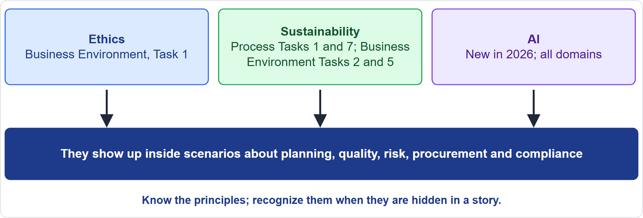
Where This Module Sits in the Exam
Part 1
Three cross-cutting topics
EXAM TIP Ethics, sustainability and AI are rarely labelled as such; spot them inside a story about another topic.
PMP Exam Prep 2026 | PMBOK 8 and the New ECO
Module 3: Ethics, Sustainability and AI
2 / 53
Notes:
Here is where this module sits. Ethics belongs to Business Environment Task 1, which includes ethics and policies. Sustainability appears in four tasks: planning critical information, quality and the cost of quality, compliance requirements and risk execution. AI is new in 2026 and touches all domains. So expect them inside scenarios about planning, quality, risk, procurement and compliance. Know the principles, and learn to recognize them when they are hidden in a story.

Slide 3
What You Will Learn
Part 1
Apply the four values and the aspirational and mandatory standards of the PMI Code
Handle conflicts of interest and ethical dilemmas the way PMI expects
Explain sustainability, the pyramid and the triple bottom line, and put it in the documents
Treat sustainability risks, quality and compliance correctly
Match AI strategies to tasks, and describe the main AI terms
Use AI responsibly: validate, protect data, keep a human accountable
PMP Exam Prep 2026 | PMBOK 8 and the New ECO
Module 3: Ethics, Sustainability and AI
3 / 53
Notes:
By the end of this module you will be able to do six things. Apply the four values and the aspirational and mandatory standards of the PMI Code. Handle conflicts of interest and ethical dilemmas the way PMI expects. Explain sustainability, the pyramid and the triple bottom line, and put sustainability into the project documents. Treat sustainability risks, quality and compliance correctly. Match AI strategies to tasks and describe the main AI terms. And use AI responsibly: validate output, protect data and keep a human accountable.

Slide 4
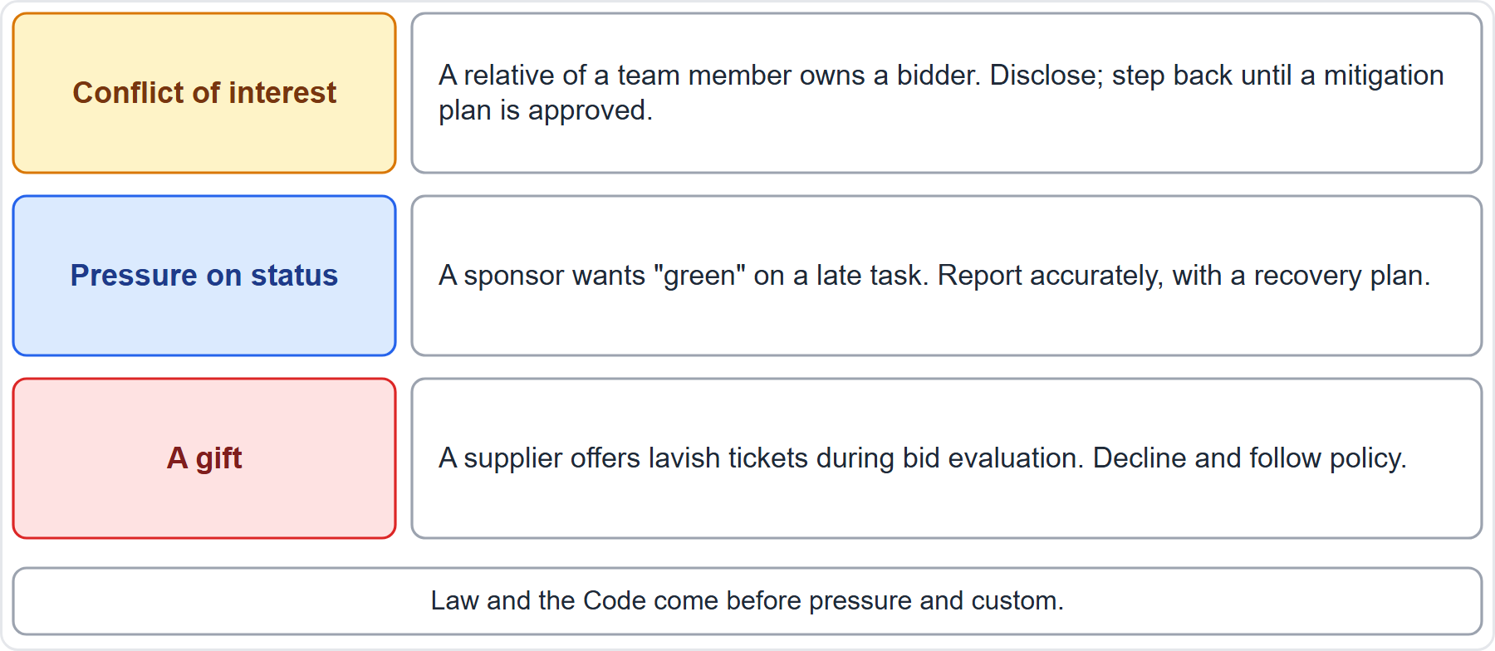
Case Check-In: Three Ethics Moments
Part 1
CASE CHECK-IN · Sunrise Campus Microgrid
Conflict of interest: disclose, then step back
Pressure and gifts: report accurately; decline and follow policy
PMP Exam Prep 2026 | PMBOK 8 and the New ECO
Module 3: Ethics, Sustainability and AI
4 / 53
Notes:
Three ethics moments could arise on our microgrid. First, a relative of a team member owns one of the bidders. The best answer is to disclose the relationship and step back from the decision until a mitigation plan is approved. Second, a sponsor wants a late task reported as green. The best answer is to report accurately, with a recovery plan. Third, a supplier offers lavish tickets during bid evaluation. Decline, and follow policy. In all three, law and the Code come before pressure and custom.

Slide 5
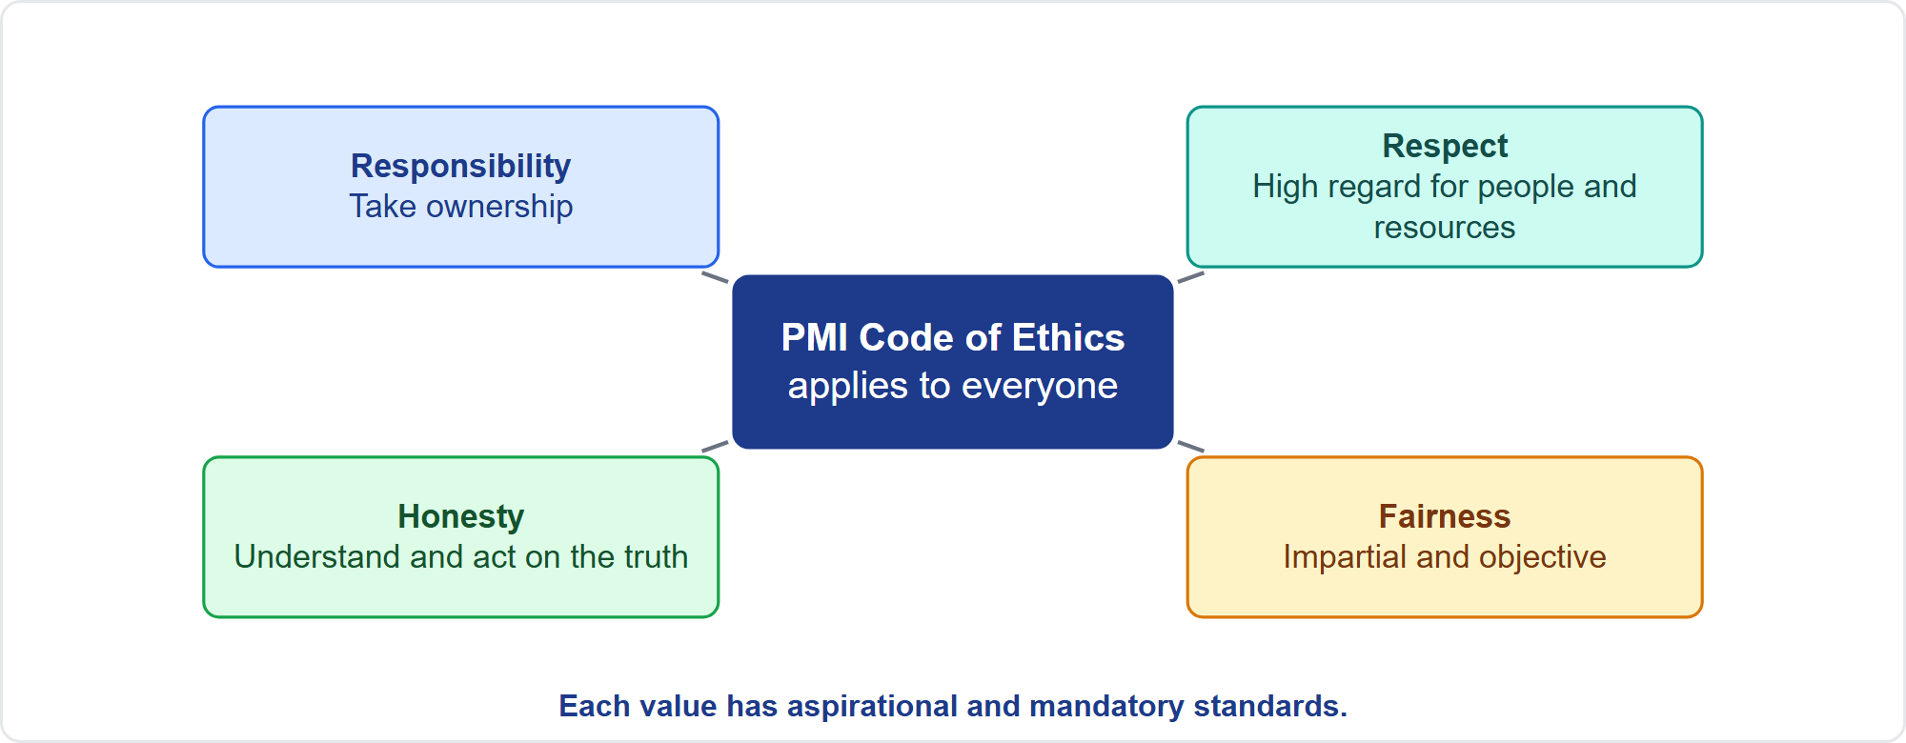
The PMI Code of Ethics
Part 1
Four values, one code for everyone
EXAM TIP The Code applies to all PMI members and to non-members who hold or apply for a PMI certification or volunteer for PMI.
PMP Exam Prep 2026 | PMBOK 8 and the New ECO
Module 3: Ethics, Sustainability and AI
5 / 53
Notes:
The PMI Code of Ethics and Professional Conduct describes what we expect of ourselves and of fellow practitioners. It applies to all PMI members, and to non-members who hold a PMI certification such as the PMP, apply for one, or volunteer for PMI. It names four values the global community rated most important: responsibility, respect, fairness and honesty. Each value comes with aspirational standards and mandatory standards. The Code helps practitioners make wise decisions, especially when pressed to compromise integrity or values.

Slide 6
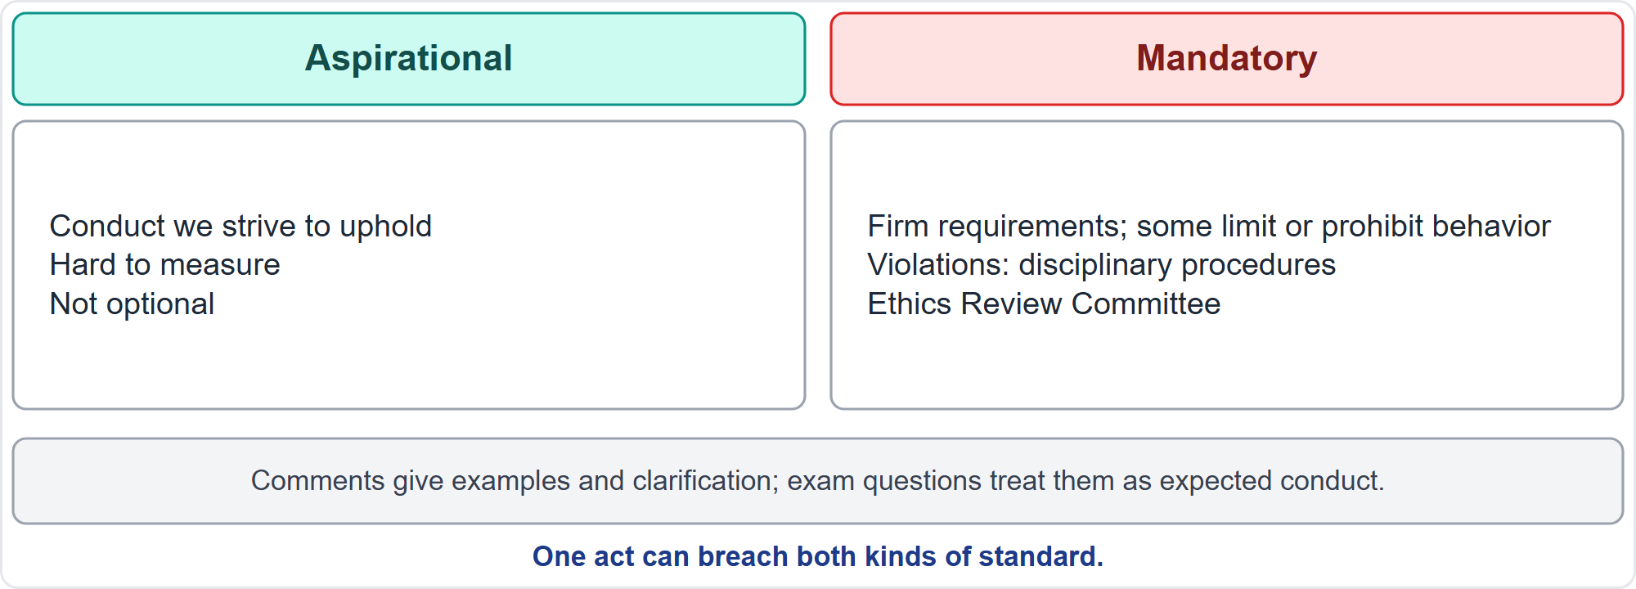
Aspirational and Mandatory Standards
Part 1
Two kinds of standard
EXAM TIP Aspirational does not mean optional; mandatory breaches face disciplinary procedures.
PMP Exam Prep 2026 | PMBOK 8 and the New ECO
Module 3: Ethics, Sustainability and AI
6 / 53
Notes:
Two kinds of standards sit under each value. Aspirational standards describe the conduct we strive to uphold. They are hard to measure, but they are not optional. Mandatory standards are firm requirements. Some limit or prohibit behavior, and violations are subject to disciplinary procedures before PMI's Ethics Review Committee. The Code also carries comments, which give examples and clarification. Comments are not mandatory parts of the Code, but exam questions treat them as expected conduct. One act can breach both aspirational and mandatory standards.

Slide 7
Responsibility
Part 1
Take ownership of decisions, actions and consequences
Act in the interest of society, public safety and the environment
Accept only assignments that match your qualifications; disclose gaps to key stakeholders
Own errors, correct them promptly, protect confidential information
Mandatory: know and uphold laws and rules; report unethical or illegal conduct; file complaints only on facts
Do not retaliate against people who raise concerns
EXAM TIP Report on facts: no unsubstantiated accusations and no gossip.
PMP Exam Prep 2026 | PMBOK 8 and the New ECO
Module 3: Ethics, Sustainability and AI
7 / 53
Notes:
Responsibility is the duty to take ownership of decisions, actions and consequences. Aspirationally, act in the interest of society, public safety and the environment. Accept only assignments that match your qualifications. For a stretch assignment, make sure key stakeholders hear about your gaps in good time. Own errors, correct them promptly, and protect confidential information. Mandatory standards: inform yourself of the laws and rules that govern your work, report unethical or illegal conduct, and file complaints only when facts support them. And never retaliate against someone who raises a concern.

Slide 8
Respect
Part 1
Show high regard for people, money, reputation, safety and the environment
Learn others' norms and customs; listen to understand
Approach people directly when you disagree; stay professional even if it is not returned
Mandatory: negotiate in good faith
Do not use your expertise or position to benefit yourself at others' expense
No abusive conduct; respect property rights
EXAM TIP Go to the person first; use the proper channel if the issue is serious or unresolved.
PMP Exam Prep 2026 | PMBOK 8 and the New ECO
Module 3: Ethics, Sustainability and AI
8 / 53
Notes:
Respect is the duty to show high regard for ourselves, others and the resources entrusted to us. Aspirationally, learn the norms and customs of others, and listen to understand. Approach people directly when you disagree, and stay professional even when it is not returned. Avoid gossip. Mandatory standards: negotiate in good faith, and do not use the power of your expertise or position to benefit yourself at others' expense. Do not act abusively, and respect property rights. If an issue is serious or unresolved, go to the proper channel.

Slide 9
Fairness
Part 1
Decide impartially and objectively, free of self-interest, prejudice and favoritism
Be transparent in decisions; re-examine your own impartiality
Give equal access to information to those entitled to it, such as all bidders
Mandatory: disclose real or potential conflicts of interest
Do not hire, fire, reward, punish or award contracts on personal grounds
No discrimination; apply rules without favoritism
EXAM TIP Equal information for all bidders; no favoritism or nepotism in procurement or hiring.
PMP Exam Prep 2026 | PMBOK 8 and the New ECO
Module 3: Ethics, Sustainability and AI
9 / 53
Notes:
Fairness is the duty to make decisions and act impartially and objectively, free of self-interest, prejudice and favoritism. Aspirationally, be transparent in decisions, and keep re-examining your own impartiality. Give equal access to information to those entitled to it, such as all bidders in a tender. Mandatory standards: proactively disclose real or potential conflicts of interest. Do not hire, fire, reward, punish or award contracts on personal grounds. Do not discriminate. And apply organizational rules without favoritism or prejudice.

Slide 10
Honesty
Part 1
Seek the truth and be truthful in communication and conduct
Give accurate information on time
Have the courage to share bad news; do not bury it or shift blame
Create an environment where others feel safe to tell the truth
Mandatory: no deception, half-truths or withholding that misleads
No dishonest behavior for personal gain
EXAM TIP Half-truths and misleading omissions are as unprofessional as outright lies.
PMP Exam Prep 2026 | PMBOK 8 and the New ECO
Module 3: Ethics, Sustainability and AI
10 / 53
Notes:
Honesty is the duty to understand the truth and act truthfully. Aspirationally, seek the truth, give accurate information in time, and have the courage to share bad news even when it may be poorly received. Do not bury information or shift blame. Create an environment in which others feel safe to tell the truth. Mandatory standards: do not engage in or condone deception. That includes false statements, half-truths, information out of context, and withholding information in a way that misleads. And no dishonest behavior for personal gain.

Slide 11
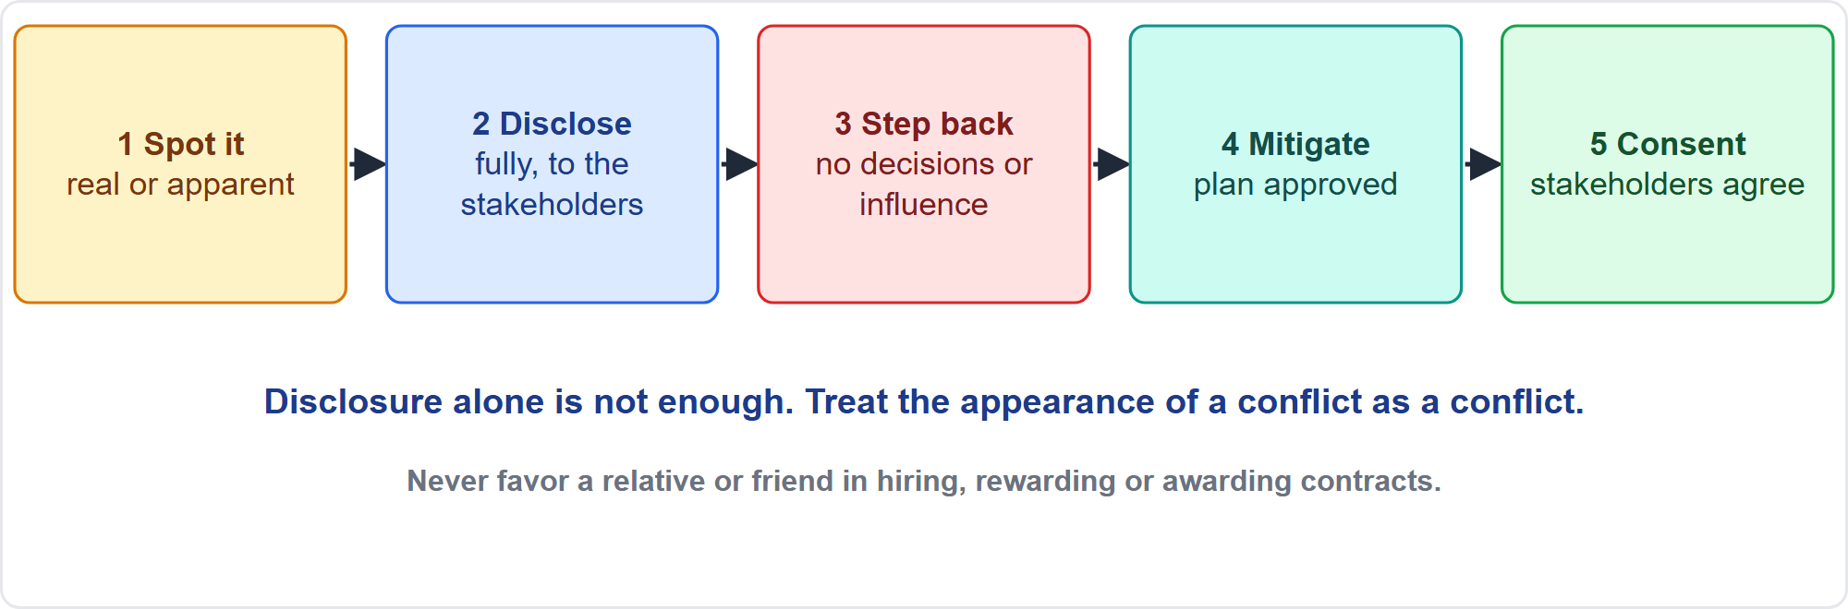
Conflicts of Interest
Part 1
Disclose, then step back
EXAM TIP Treat the appearance of a conflict as a conflict.
PMP Exam Prep 2026 | PMBOK 8 and the New ECO
Module 3: Ethics, Sustainability and AI
11 / 53
Notes:
Conflicts of interest are one of the most challenging issues in practice. Look for them actively, and help others spot them. When you realize you have one, follow the sequence. Disclose it fully to the appropriate stakeholders. Then step back: do not take part in the decision or try to influence the outcome. Proceed only when you have made full disclosure, have an approved mitigation plan, and have the stakeholders' consent. Treat the appearance of a conflict as a conflict. If your brother-in-law's company is bidding, staying silent is not an option.

Slide 12
Ethics in PMBOK 8
Part 1
Where | What it says
Accountable leader | Integrity, honesty and fairness for everyone
Integrity | Share risks and assumptions; bad news early; accurate status
Respect | Dialogue over debate; be open about biases
Governance | Ethics and policies sit in process assets
Risk | Ethical and reputation risks need judgment
Procurement, AI | Impartiality and confidentiality; AI bias, privacy, accountability
EXAM TIP Ethics is not a separate chapter in the exam; it is part of how every domain is done.
PMP Exam Prep 2026 | PMBOK 8 and the New ECO
Module 3: Ethics, Sustainability and AI
12 / 53
Notes:
PMBOK 8 weaves ethics into the whole guide. The accountable leader principle requires integrity, honesty and fairness of everyone. Integrity means sharing risks, stating assumptions and the basis of estimates, delivering bad news early, and making status reports an accurate picture of progress. Respect prefers dialogue, which resolves differences, over debate, which wins or loses. Governance aligns with ethical principles, and ethics and policies sit in process assets. Ethical and reputation risks may not fit numeric scales. Procurement needs impartiality and confidentiality in claims. And AI brings bias, privacy and accountability risks.

Slide 13
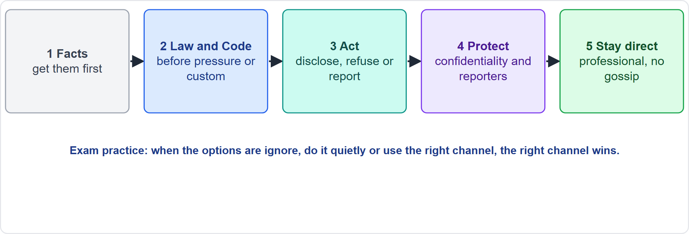
A Practical Flow for Ethical Dilemmas
Part 1
What the PMI answer usually does
EXAM TIP When the options are ignore, do it quietly, or use the right channel, the right channel is usually correct, once you have the facts.
PMP Exam Prep 2026 | PMBOK 8 and the New ECO
Module 3: Ethics, Sustainability and AI
13 / 53
Notes:
Here is a practical flow, labelled as exam practice. Get the facts first. Then put law and the Code ahead of pressure from a boss, a customer or local custom. Act. Disclose conflicts, gaps and errors. Refuse improper requests, such as bribes or falsified status. And report violations to the appropriate body or management, but only on facts. Protect confidential information and the people who raise concerns. And stay direct and professional with the person involved, without gossip. When the options are ignore, do it quietly, or use the right channel, the right channel is usually correct.

Slide 14
Situations and Best Responses
Part 1
Situation | Best response
A vendor offers a lavish gift during bid evaluation | Decline and follow policy
A relative's company is bidding | Disclose; step out until mitigation is approved
A sponsor wants "green" on a late project | Report accurately, with a recovery plan
You find your own billing error | Own it, correct it, inform those affected
You are asked for a competitor's confidential data | Refuse; protect confidentiality
EXAM TIP Truth over comfort: never misreport status, hours, quality or risks.
PMP Exam Prep 2026 | PMBOK 8 and the New ECO
Module 3: Ethics, Sustainability and AI
14 / 53
Notes:
Here are five common situations. A vendor offers a lavish gift during bid evaluation: decline and follow policy. A relative's company is bidding: disclose, and step out until a mitigation plan is approved and the stakeholders consent. A sponsor asks you to report green on a late project: report accurately, with the facts and a recovery plan. You find your own estimating or billing error: own it, correct it promptly, and inform those affected. You are asked for a competitor's confidential data: refuse. The theme is truth over comfort.

Slide 15
More Situations and Best Responses
Part 1
Situation | Best response
You are asked to lead work beyond your experience | Disclose the gaps to key stakeholders
A partner demands a "facilitation payment" | Refuse; it is bribery; involve legal
A team member uses unlicensed software | Stop it and report to management
A colleague reports discrimination | Take it to the right body; protect the reporter
A defect or safety risk would embarrass the sponsor | Share it early and factually
EXAM TIP Law and the Code beat local custom and pressure.
PMP Exam Prep 2026 | PMBOK 8 and the New ECO
Module 3: Ethics, Sustainability and AI
15 / 53
Notes:
Five more situations. You are asked to lead work beyond your experience: disclose your gaps to key stakeholders so they can decide. A local partner demands a facilitation payment: refuse, because it is bribery, take it to legal and compliance, and remember that custom is no excuse. A team member uses unlicensed software: stop it and report to the appropriate management. A colleague reports discriminatory behavior: take it to the appropriate body, protect the reporter from retaliation, and keep it factual. A defect or safety risk would embarrass the sponsor: share it early and factually.

Slide 16
Ethics in Predictive, Agile and Hybrid Work
Part 1
 | Predictive | Agile | Hybrid
Transparency | Accurate status reports, baselines, change logs | Information radiators, honest burn charts, open reviews | Both
Honesty about progress | No "watermelon" reports: green outside, red inside | True velocity and impediments; no inflated story points | Consistent truth across streams
Fairness | Fair bids; equal information to bidders | Fair prioritization; no favoritism in the backlog | Both
Psychological safety | Safe to raise issues at gates | Safe to speak up in retrospectives | Both
EXAM TIP Ethics is approach-neutral; only its expression differs.
PMP Exam Prep 2026 | PMBOK 8 and the New ECO
Module 3: Ethics, Sustainability and AI
16 / 53
Notes:
Ethics is the same in every approach. Only the expression differs. Transparency means accurate status reports, baselines and change logs in predictive work, and information radiators, honest burn charts and open reviews in agile work. Honesty about progress means no watermelon reports, green outside and red inside, and in agile work it means reporting true velocity and impediments, with no inflated story points. Fairness means equal information to bidders, or no favoritism in the backlog. And psychological safety means people can raise issues at gates, or speak up in retrospectives.

Slide 17
Ethics Traps: What PMI Expects
Part 1
Truth over comfort: never misreport; share bad news early with facts and options
Disclose conflicts, then step back until mitigation is approved
Law and the Code beat custom and pressure; no bribes, even "facilitation"
Report, but on facts; no unsubstantiated accusations or gossip
Protect confidentiality and intellectual property; do not retaliate
Own your mistakes and be honest about your qualifications
EXAM TIP Fair process in procurement and hiring: equal access to information, no favoritism or nepotism.
PMP Exam Prep 2026 | PMBOK 8 and the New ECO
Module 3: Ethics, Sustainability and AI
17 / 53
Notes:
The ethics traps. Truth over comfort: never misreport, and share bad news early, with facts and options. Disclose conflicts, then step back until mitigation is approved. Law and the Code beat custom and pressure, so no bribes, even if they are called facilitation. Report, but on facts, with no unsubstantiated accusations or gossip. Protect confidentiality and intellectual property, and never retaliate. Own your mistakes, and be honest about your qualifications. In procurement and hiring, give equal access to information, with no favoritism or nepotism.

Slide 18
Part 1 Recap
Part 1
1
Code
2
Responsibility and respect
3
Fairness
four values; aspirational and mandatory standards; applies to certification holders
ownership, reporting on facts, direct and professional conduct
impartial decisions, equal information, conflicts disclosed
4
Honesty
5
Conflicts
6
Dilemmas
truthful, timely, bad news early, no half-truths
disclose, step back, mitigate, get consent
facts, law and Code, disclose or refuse or report, protect people
PMP Exam Prep 2026 | PMBOK 8 and the New ECO
Module 3: Ethics, Sustainability and AI
18 / 53
Notes:
Let us recap Part 1. The Code has four values, with aspirational and mandatory standards, and it applies to certification holders. Responsibility and respect mean ownership, reporting on facts, and direct, professional conduct. Fairness means impartial decisions, equal information and conflicts disclosed. Honesty means truthful, timely information, bad news early, and no half-truths. For a conflict, disclose, step back, mitigate and get consent. For a dilemma, get the facts, put law and the Code first, disclose, refuse or report, and protect people. In Part 2, we turn to sustainability.

Slide 19
Sustainability: The Principle
Part 2
Meet present needs without compromising the ability of future generations to meet theirs
Integrate it across all project areas and phases
Project managers, teams and sponsors are jointly accountable
Consider people, planet, society and value at tactical, operational and strategic levels
It belongs to the value-driven mindset with Focus on Value
EXAM TIP Sustainability is part of the job, not an optional add-on.
PMP Exam Prep 2026 | PMBOK 8 and the New ECO
Module 3: Ethics, Sustainability and AI
19 / 53
Notes:
Part 2 covers sustainability, the fifth principle you met in Module 1. The principle says: meet present needs without compromising the ability of future generations to meet theirs. Integrate it across all project areas and all phases. Project managers, teams and sponsors are jointly accountable. It means considering people, planet, society and value in everything you do, at tactical, operational and strategic levels. It belongs to the value-driven side of the mindset, alongside Focus on Value. And it is part of the job, not an add-on.

Slide 20
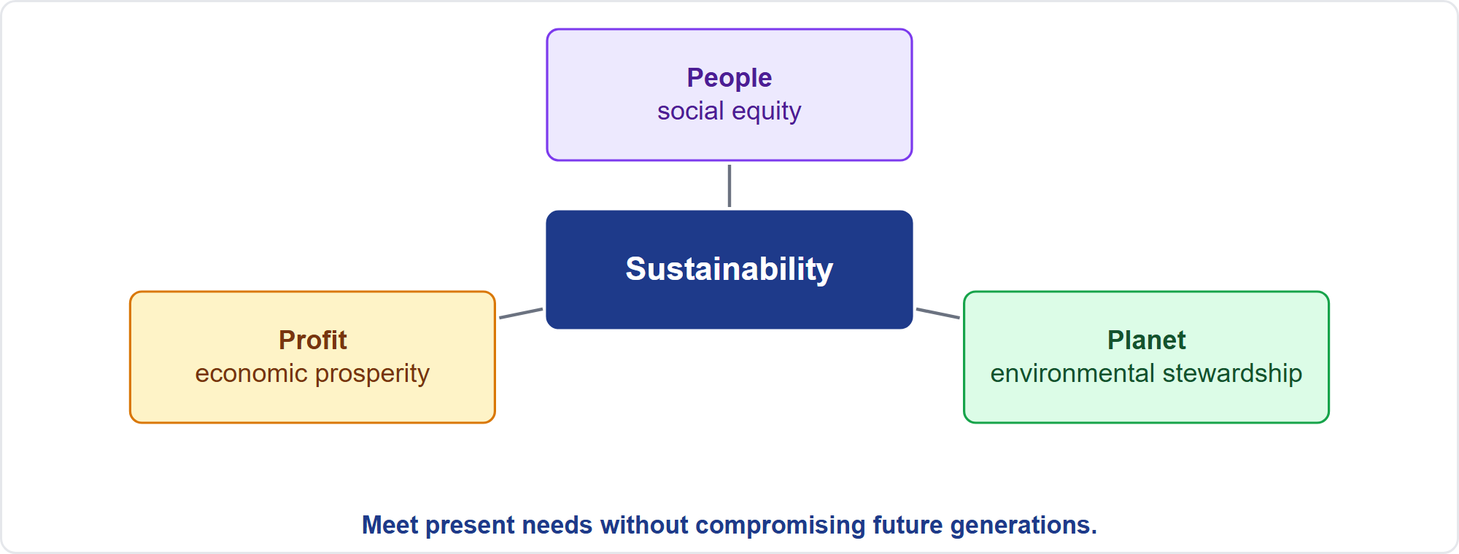
The Triple Bottom Line
Part 2
People, planet and profit
EXAM TIP Sustainability addresses environmental, social and economic impacts together.
PMP Exam Prep 2026 | PMBOK 8 and the New ECO
Module 3: Ethics, Sustainability and AI
20 / 53
Notes:
The triple bottom line balances three things. Social equity: people. Environmental stewardship: planet. Economic prosperity: profit. Sustainability addresses environmental, social and economic impacts, the well-being of people globally, and the wise use of natural resources. It may include adopting technology responsibly while identifying and mitigating adverse impacts on the organization, community and environment. A project that pays off financially but harms people or the planet is not balanced.

Slide 21
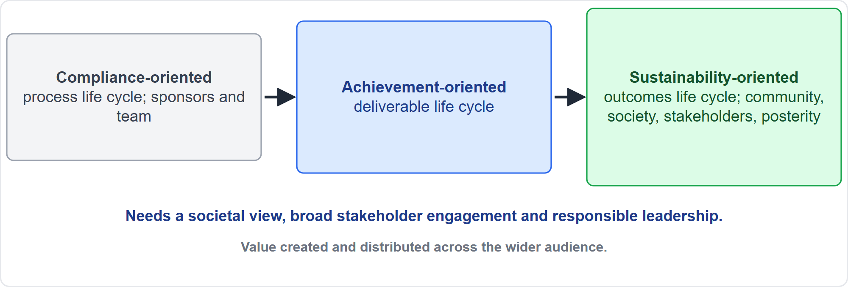
How Management Orientation Widens
Part 2
From compliance to sustainability
EXAM TIP Sustainability-oriented management looks at outcomes and everyone influenced, including future generations.
PMP Exam Prep 2026 | PMBOK 8 and the New ECO
Module 3: Ethics, Sustainability and AI
21 / 53
Notes:
Management orientation can widen in three steps. Compliance-oriented management focuses on the process life cycle, sponsors and the team. Achievement-oriented management focuses on the deliverable life cycle. Sustainability-oriented management focuses on the outcomes life cycle and on all influential communities, society, stakeholders and posterity. It needs a societal perspective on projects and outcomes, and broad stakeholder engagement, sometimes called management for stakeholders. It also needs responsible leadership, and a holistic focus on the value created and distributed across the wider audience.

Slide 22
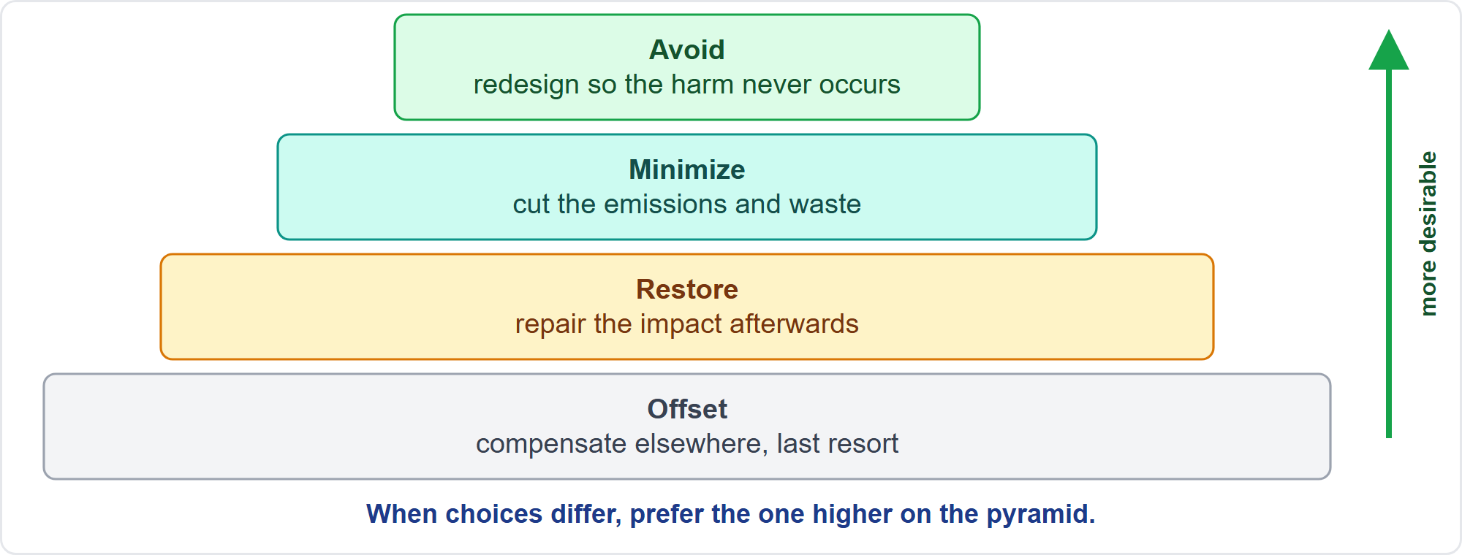
The Sustainability Pyramid
Part 2
Avoid, minimize, restore, offset
EXAM TIP When choices differ, prefer the one higher on the pyramid.
PMP Exam Prep 2026 | PMBOK 8 and the New ECO
Module 3: Ethics, Sustainability and AI
22 / 53
Notes:
The sustainability pyramid ranks strategies for any externality a project creates, from most to least desirable. Best: avoid the negative outcome altogether, for example by redesigning so the harm never occurs. Next: minimize the negative outcomes generated. Then: restore the impact of negative outcomes. Least desirable: compensate or offset for the outcomes you generated. So when two options differ, prefer the one higher on the pyramid. Redesign to avoid the harm, rather than offset it afterwards.

Slide 23
Why Sustainability Matters
Part 2
Organizational
Operational
retention, stakeholder relations, resilience, governance, reputation
innovation, productivity from less waste, design for sustainability
Financial
Customers and stakeholders
lower material and energy costs, lower operating costs, sustainable finance
satisfaction, market growth, new opportunities
EXAM TIP Sustainability can need more funding, yet it can reduce financial threat to the project.
PMP Exam Prep 2026 | PMBOK 8 and the New ECO
Module 3: Ethics, Sustainability and AI
23 / 53
Notes:
Sustainability brings four kinds of benefit. Organizational: employee satisfaction and retention, better stakeholder relations, resilience, stronger governance and reputation. Operational: innovation in internal processes, and productivity from minimizing waste. Financial: savings from lower material and energy use, lower operating costs and waste, and more investment from sustainable finance investors. Customers and stakeholders: satisfaction, growth in demand for sustainable products and new market opportunities. Sustainability may need additional funding, but it can reduce financial threat to the project and the funding organization.

Slide 24
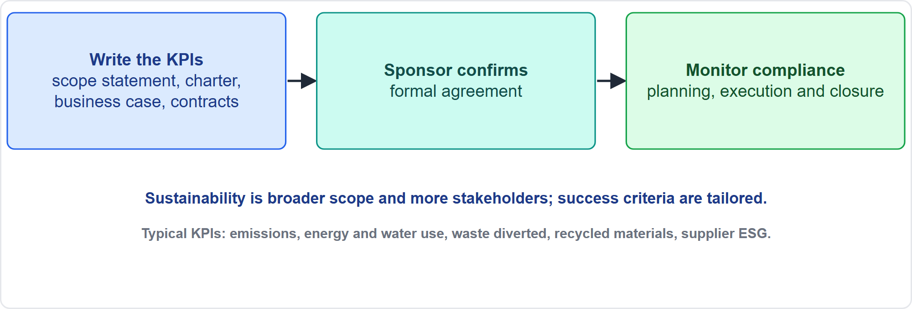
Putting Sustainability Into the Project
Part 2
KPIs in writing, confirmed, monitored
EXAM TIP Put it in writing: KPIs in the charter, scope statement, business case or contracts, and track them.
PMP Exam Prep 2026 | PMBOK 8 and the New ECO
Module 3: Ethics, Sustainability and AI
24 / 53
Notes:
How do you put sustainability into the project? Write sustainability key performance indicators into the scope statement, charter, business case, contracts or other authorizing documents. The sponsor confirms them. Then monitor compliance during planning, execution and closure. Doing so needs a societal perspective, broad stakeholder engagement and responsible leadership. Remember that it can add cost and complexity through a broader scope and more stakeholders, and that there are no universal criteria, so success is tailored to the project.

Slide 25
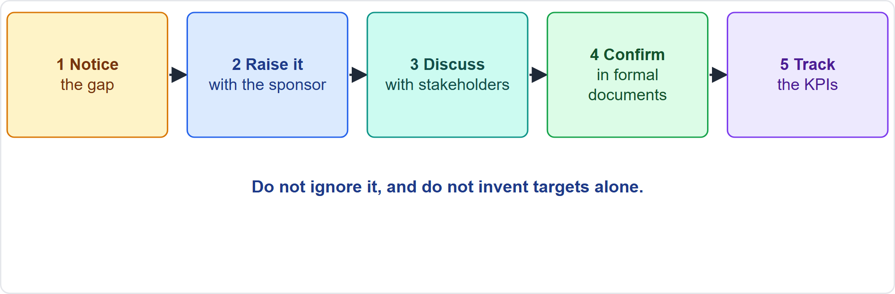
When Sustainability Goals Are Missing
Part 2
Raise it, discuss it, confirm it
EXAM TIP Do not ignore missing goals and do not set targets alone: raise them with the sponsor.
PMP Exam Prep 2026 | PMBOK 8 and the New ECO
Module 3: Ethics, Sustainability and AI
25 / 53
Notes:
What if the business case has no sustainability goals? Suppose the hosting site runs mostly on high-emission power, and the organization has public ESG commitments. Notice the gap. Raise it with the sponsor. Discuss the impact with stakeholders. Seek to confirm goals in the formal documents. Then track the indicators. Do not ignore the gap because it is outside the approved scope, and do not cancel the project or switch suppliers quietly. Even without formal goals, encourage the discussion.

Slide 26
Sustainability in the Domains: Governance to Finance
Part 2
Domain | Sustainability in practice
Governance | Transparent, collaborative communication; sustainability goals in governance practices
Scope | Deliverables meet sustainability goals; WBS or backlog activities to manage emissions or biodiversity
Schedule | Minimize carbon footprint and resource use; teams may offer ideas to speed up, slow or stop work
Finance | Include investments that bring long-term savings and environmental benefit
EXAM TIP A scope check outcome to look for: sustainability is considered in the project scope.
PMP Exam Prep 2026 | PMBOK 8 and the New ECO
Module 3: Ethics, Sustainability and AI
26 / 53
Notes:
Sustainability appears in every domain. Governance: transparent communication, and sustainability goals built into governance practices. Scope: deliverables meet sustainability goals, and the work breakdown structure or backlog includes activities to manage them, such as assessing carbon dioxide emissions or the impact on local biodiversity. Schedule: minimize carbon footprint and resource use, and let teams offer ideas to accelerate, slow or stop activities. Finance: include sustainability investments that promote long-term savings and environmental benefit.

Slide 27
Sustainability in the Domains: Stakeholders to Quality
Part 2
Domain | Sustainability in practice
Stakeholders | Education and collaboration; stakeholders may hold moral rights, such as protecting a historic site
Resources | Sustainable materials and practices; value chain impact; green human resource management
Risk | Team sets thresholds; early identification of long-term environmental, regulatory and societal risks
Procurement | Source-selection criteria and ESG terms in contracts, with measurable outcomes
Quality | Sustainability is a quality dimension; less rework means less waste
EXAM TIP Include sustainability criteria and ESG terms in procurement when it is an organizational goal.
PMP Exam Prep 2026 | PMBOK 8 and the New ECO
Module 3: Ethics, Sustainability and AI
27 / 53
Notes:
Now the other domains. Stakeholders: engagement includes sustainability education and collaboration, and some stakeholders hold moral rights, such as protecting a historic site. Resources: prioritize sustainable materials and practices, consider every stage of the value chain, and use green human resource management. Risk: the team sets thresholds, and sustainability helps identify long-term environmental, regulatory and societal risks early. Procurement: source-selection criteria may include sustainability, and contracts can embed environmental, social and governance terms with measurable outcomes. Quality: sustainability is a dimension, and less rework means less waste.

Slide 28
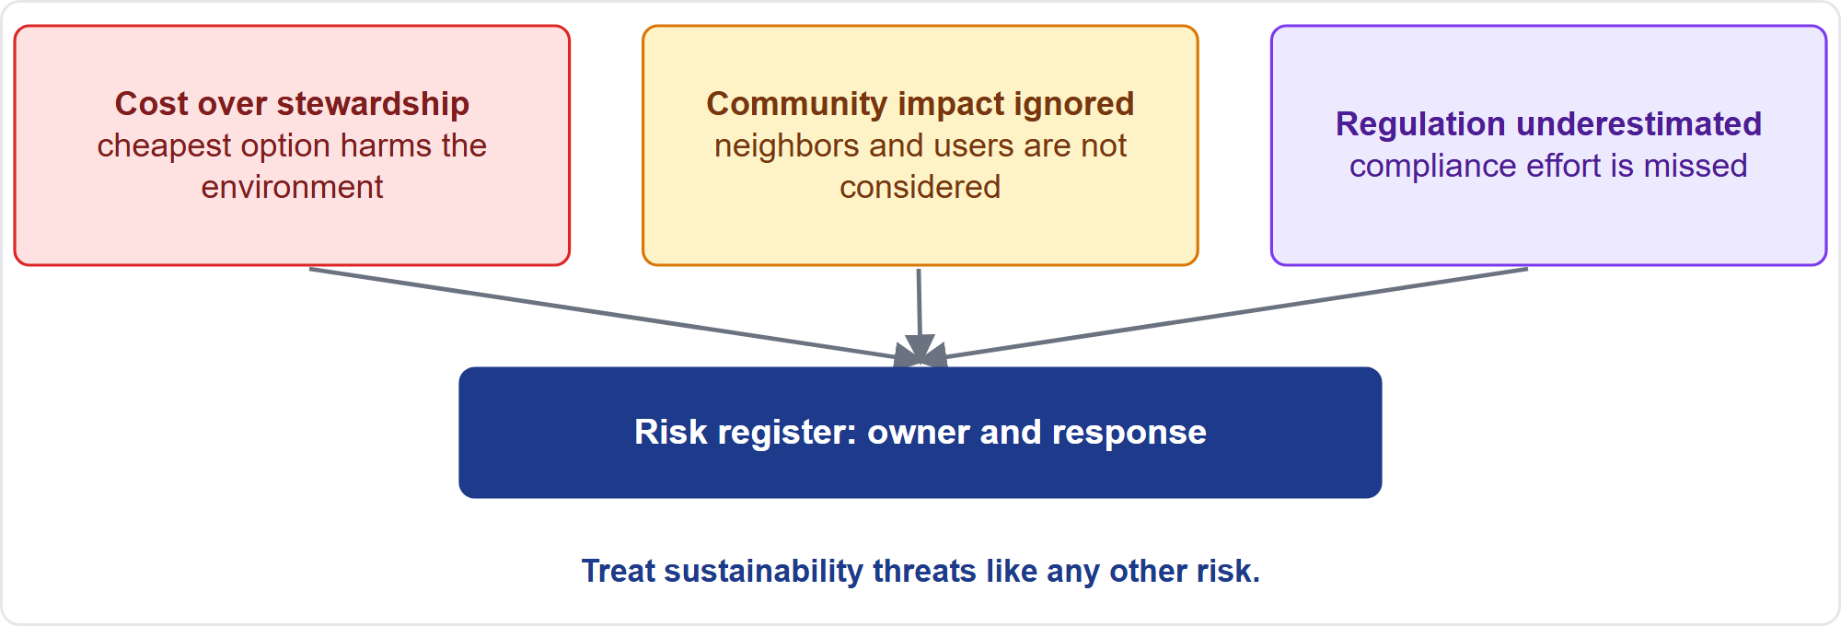
Sustainability Risks
Part 2
Three classic sustainability risks
EXAM TIP Community opposition and underestimated regulation are classic sustainability risks.
PMP Exam Prep 2026 | PMBOK 8 and the New ECO
Module 3: Ethics, Sustainability and AI
28 / 53
Notes:
Sustainability risks arise when activities fail to balance societal, economic and environmental considerations. Three classic examples. Prioritizing cost over environmental stewardship. Failing to account for community impacts. And underestimating sustainability-related regulatory compliance. The consequences are negative outcomes, stakeholder dissatisfaction, and long-term harm to reputation or performance. Treat them like any other risk: record them in the risk register with owners and responses.

Slide 29
Sustainability Examples from PMBOK 8
Part 2
Construction
Technology
Renewable energy, risk
cheapest materials may harm health and the environment; pick low-impact sources, involve communities
lower resource use, less waste, better efficiency, social impact, smaller carbon footprint
regular stakeholder meetings, risk assessments and simulation for green-energy goals
EXAM TIP Present the trade-off with data: total value, not lowest price.
PMP Exam Prep 2026 | PMBOK 8 and the New ECO
Module 3: Ethics, Sustainability and AI
29 / 53
Notes:
PMBOK 8 gives examples. In construction, the cheapest materials may harm the environment and health. A sustainability-minded team plans material needs, selects low-impact sources, involves local communities, and considers recycled materials, while still tracking return on investment. In technology projects, eco-friendly practices lower resource use and waste and improve efficiency, and the social impact can include access to education and healthcare. In a renewable energy project, the team tailors risk management with regular stakeholder meetings, regular risk assessments and simulation, to advance green-energy goals.

Slide 30
Cost of Quality and Compliance
Part 2
Poor quality and rework consume resources and create emissions and waste
Prevention and appraisal costs are an investment; failure costs harm budget and environment
Add sustainability criteria to quality requirements and the definition of done
Confirm which sustainability requirements apply: regulations, reporting duties, contract clauses
Classify, check threats, and monitor compliance throughout
EXAM TIP Reduce waste through quality: fewer defects and less rework protect both budget and environment.
PMP Exam Prep 2026 | PMBOK 8 and the New ECO
Module 3: Ethics, Sustainability and AI
30 / 53
Notes:
Two ECO enablers link sustainability to other tasks. For the cost of quality, remember that poor quality and rework consume resources and create emissions and waste. Prevention and appraisal costs are an investment, while failure costs, such as rework, scrap and returns, harm both the budget and the environment. Add sustainability criteria to quality requirements and the definition of done. For compliance, confirm which sustainability requirements apply: environmental regulations, reporting duties and contract clauses. Classify them, check threats to compliance, and monitor throughout.

Slide 31
KPIs and Tailoring Sustainability
Part 2
Emissions and energy
Waste and materials
Community
CO2e, energy and water use
waste diverted from landfill, share of recycled or sustainable materials
biodiversity and community impact measures
Supply chain
People
supplier ESG compliance rate
workforce well-being indicators
EXAM TIP These are illustrations only; each project agrees its own measures with stakeholders.
PMP Exam Prep 2026 | PMBOK 8 and the New ECO
Module 3: Ethics, Sustainability and AI
31 / 53
Notes:
Here are typical sustainability indicators. These are illustrations. Each project defines its own. Emissions and energy: carbon dioxide equivalent, energy use and water use. Waste and materials: waste diverted from landfill and the share of recycled or sustainable materials. Community: biodiversity and community impact measures. Supply chain: the supplier ESG compliance rate. People: workforce well-being indicators. There are no universal sustainability criteria, so agree the measures with stakeholders. This is exam practice, not PMBOK 8 text.

Slide 32
Sustainability in Predictive, Agile and Hybrid Work
Part 2
 | Predictive | Agile | Hybrid
Goals | Charter, business case, scope baseline, contracts | Backlog items and definition of done | Baseline for committed goals; backlog for evolving ones
Planning | WBS activities; schedule and budget lines | Prioritize stories by value; re-evaluate each iteration | Mix
Monitoring | Compliance checks at gates and in reports | Reviews each iteration; metrics on the radiator | Both
Risk | Register entries with owners | Risk-adjusted backlog | Both
EXAM TIP Same principle, different home: baseline documents in predictive work, backlog in agile work.
PMP Exam Prep 2026 | PMBOK 8 and the New ECO
Module 3: Ethics, Sustainability and AI
32 / 53
Notes:
Sustainability looks different by approach. In predictive work, goals live in the charter, business case, scope baseline and contracts, with work breakdown structure activities and budget lines. Compliance is checked at gates and in reports, and risks sit in the register with owners. In agile work, sustainability criteria sit in backlog items and the definition of done. Stories are prioritized by value and re-evaluated each iteration. And risks sit in the risk-adjusted backlog. Hybrid uses a baseline for committed goals and the backlog for evolving ones.

Slide 33
Sustainability Traps: What PMI Expects
Part 2
Part of the job: include it in scope, risk, quality, procurement and compliance
Goals missing? Raise them with the sponsor; do not ignore or invent targets
Prefer higher on the pyramid: avoid, minimize, restore, then offset
Total value, not lowest price: present the trade-off with data
Put it in writing and track the KPIs
Tailor the measures; accountability is joint
EXAM TIP Treat sustainability threats as risks with owners and responses.
PMP Exam Prep 2026 | PMBOK 8 and the New ECO
Module 3: Ethics, Sustainability and AI
33 / 53
Notes:
The sustainability traps. It is part of the job: include it in scope, risk, quality, procurement and compliance. If goals are missing, raise them with the sponsor. Do not ignore the gap or invent targets. Prefer options higher on the pyramid. Think total value, not the lowest price, and present the trade-off with data. Put it in writing and track the indicators. Tailor the measures, because there are no universal criteria. Accountability is joint among sponsors, project managers and teams. And treat sustainability threats as risks.

Slide 34
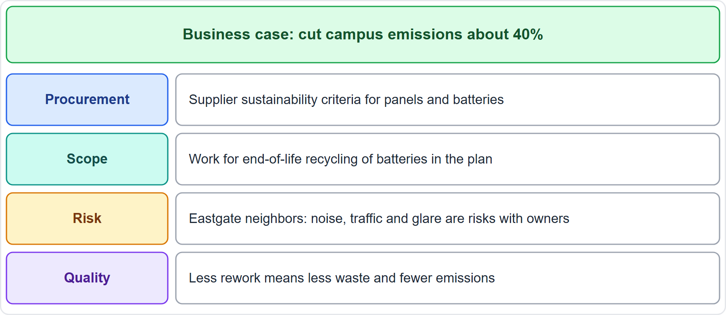
Case Check-In: Sustainability on the Microgrid
Part 2
CASE CHECK-IN · Sunrise Campus Microgrid
Business case: cut campus emissions about 40%
Where it shows up: procurement criteria, scope work, risks, quality
PMP Exam Prep 2026 | PMBOK 8 and the New ECO
Module 3: Ethics, Sustainability and AI
34 / 53
Notes:
Our microgrid exists to cut campus emissions by about forty percent, so sustainability runs through it. In procurement, supplier sustainability criteria apply to panels and batteries. In scope, the plan includes end-of-life recycling for batteries. In risk, the Eastgate neighbors' concerns about noise, traffic and glare are risks with owners and responses. In quality, less rework means less waste and fewer emissions. Notice that a good business case is not enough: the goals have to show up in the work.

Slide 35
Part 2 Recap
Part 2
1
Principle
2
Triple bottom line
3
Pyramid
meet present needs without harming future generations; joint accountability
people, planet, profit
avoid, minimize, restore, offset
4
In the project
5
Domains
6
Missing goals
KPIs in documents, confirmed by the sponsor, monitored throughout
scope work, procurement terms, risks, quality
raise them with the sponsor
PMP Exam Prep 2026 | PMBOK 8 and the New ECO
Module 3: Ethics, Sustainability and AI
35 / 53
Notes:
Let us recap Part 2. The principle is to meet present needs without harming future generations, with joint accountability. The triple bottom line balances people, planet and profit. The pyramid says avoid, minimize, restore, then offset. In the project, put the indicators in the documents, have the sponsor confirm them, and monitor throughout. Sustainability shows up in scope work, procurement terms, risks and quality. And when goals are missing, raise them with the sponsor. In Part 3, we cover AI.

Slide 36
AI in Project Management
Part 3
New in 2026, across all domains
AI can shift work from routine tasks to strategy, stakeholder engagement and improvement
Project managers become strategists and change managers
Impact depends on the quality of inputs and on human oversight
You need to know the terms, strategies and risks
EXAM TIP AI recommends; a human decides and stays accountable.
PMP Exam Prep 2026 | PMBOK 8 and the New ECO
Module 3: Ethics, Sustainability and AI
36 / 53
Notes:
Part 3 covers artificial intelligence, new in the 2026 outline. PMBOK 8 says AI can shift project work from repetitive tasks toward strategy, stakeholder engagement, innovation and improvement. Project managers should be skilled strategists and change managers, with AI supporting decisions, automating routine work and improving forecasting. But the impact of AI depends on the quality of its inputs and on human oversight. So you need to know the terms, the adoption strategies and the risks.

Slide 37
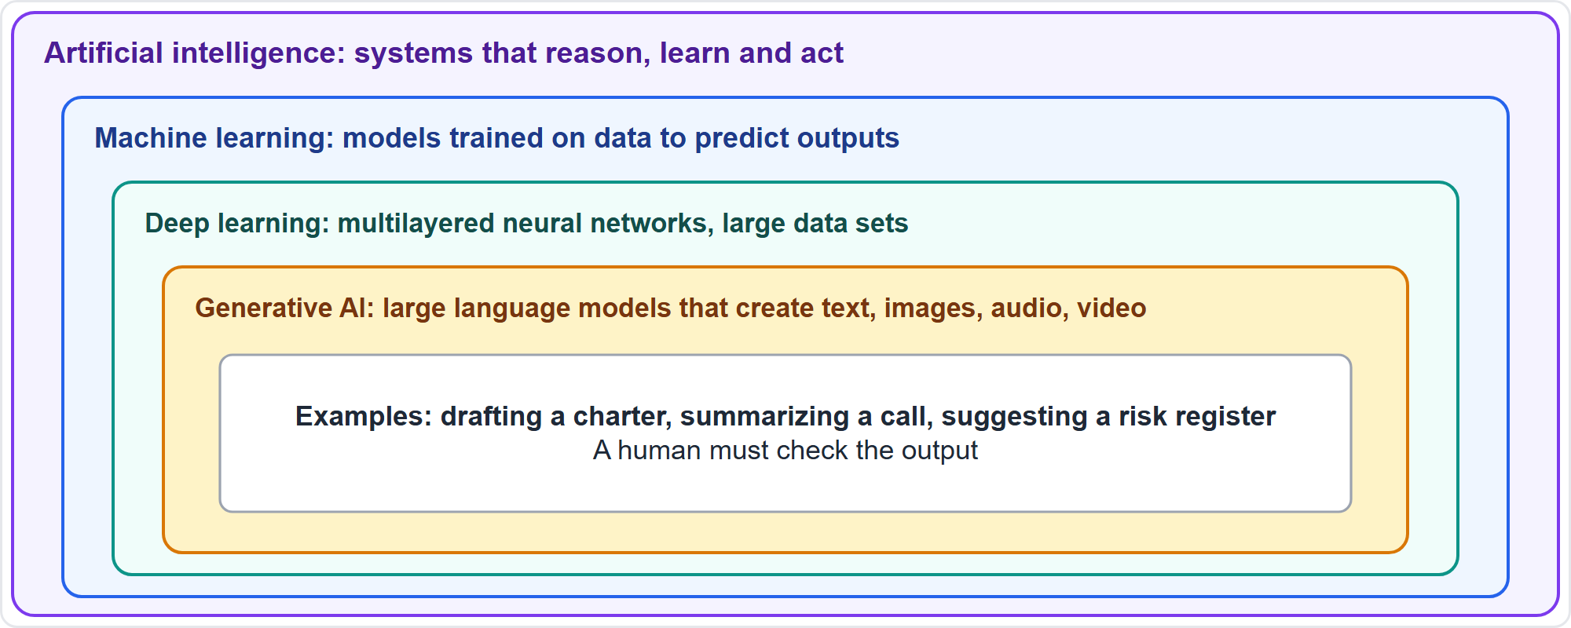
How the AI Terms Nest
Part 3
AI, machine learning, deep learning, generative AI
EXAM TIP Generative AI creates new content from large language models; a human must check the output.
PMP Exam Prep 2026 | PMBOK 8 and the New ECO
Module 3: Ethics, Sustainability and AI
37 / 53
Notes:
Four terms nest inside each other. Artificial intelligence is technology that simulates human behavior: systems that can reason, learn and act autonomously. Machine learning is a subfield that uses data to train models that predict outputs. Deep learning is more advanced machine learning, with multilayered neural networks that need large data sets. Generative AI is a subset of deep learning that applies large language models to generate new text, speech, pictures and video. It can draft a charter or summarize a call, but a human must check the output.

Slide 38
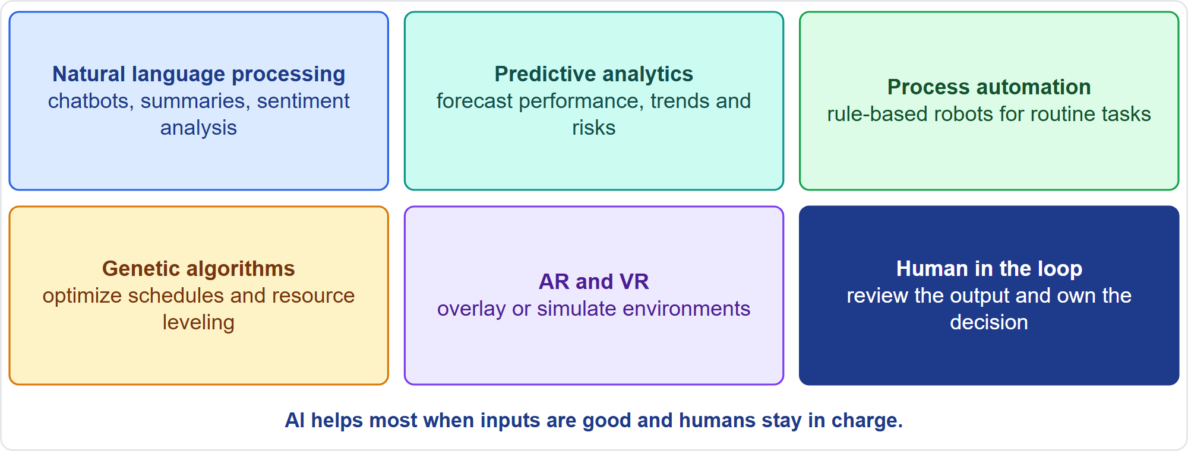
Other AI Tools
Part 3
Tools a project may meet
EXAM TIP Use sentiment analysis ethically to engage stakeholders, never for surveillance or manipulation.
PMP Exam Prep 2026 | PMBOK 8 and the New ECO
Module 3: Ethics, Sustainability and AI
38 / 53
Notes:
Other AI tools appear in the guide. Natural language processing handles natural language: chatbots, speech recognition, summarization and sentiment analysis. Predictive analytics uses machine learning on current and historical data to forecast performance, trends and risks. Process automation uses rule-based software robots for repeatable tasks, such as scheduling meetings. Genetic algorithms optimize by natural selection, exploring many options, for example in scheduling and resource leveling. Augmented and virtual reality overlay or simulate environments. In every case, a human reviews the output and owns the decision.

Slide 39
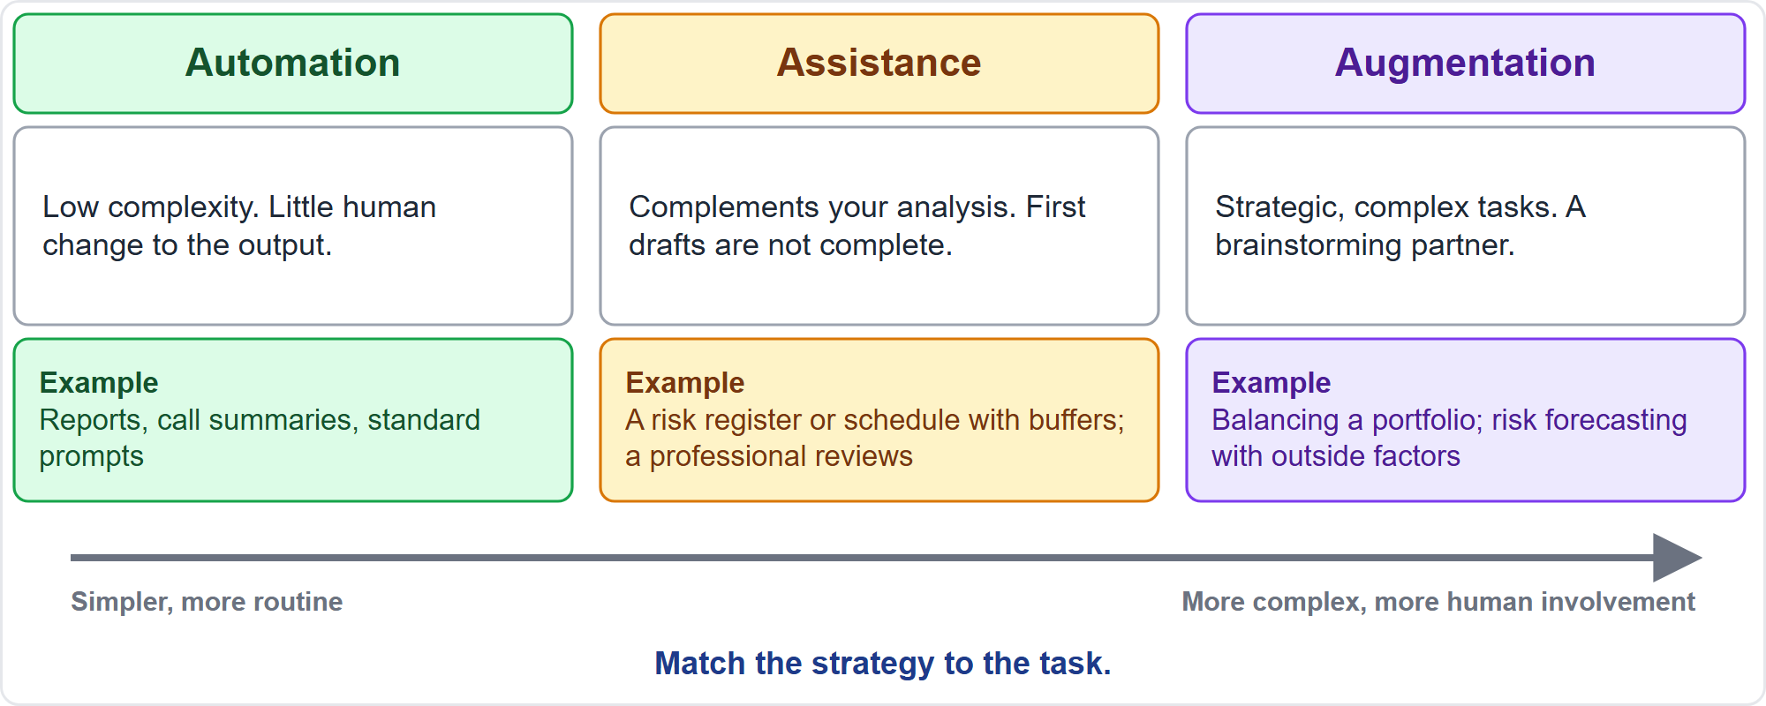
Three Ways to Adopt AI
Part 3
Automation, assistance, augmentation
EXAM TIP Automate routine work, use AI to assist analysis with review, and augment complex strategic work with human judgment.
PMP Exam Prep 2026 | PMBOK 8 and the New ECO
Module 3: Ethics, Sustainability and AI
39 / 53
Notes:
PMBOK 8 describes three adoption strategies. Classify tasks by complexity and the need for human supervision. Automation: low-complexity tasks with little human change to the output, such as report generation, document analysis and call summaries, and reusing standard prompts. Assistance: the tool complements your analysis, and first drafts are not complete, like a risk register or a schedule with buffers. A professional reviews for accuracy. Augmentation: complex strategic tasks, where AI is a brainstorming partner, such as balancing a portfolio or forecasting risk.

Slide 40
AI Use Cases by Domain
Part 3
Domain | Example use (strategy)
Governance | Project selection from data (augmentation); automated reporting (automation); early-warning signals (assistance)
Risk | Risk identification from history (augmentation); impact analysis (assistance)
Stakeholders | Sentiment analysis, used ethically (augmentation); personalized communication (augmentation)
Schedule | Dynamic scheduling and conflict resolution (assistance)
Procurement | Contract analysis for risk and compliance
Knowledge | Interview bots capture knowledge, but risk exposing sensitive data and hallucinations
EXAM TIP Decide per project where AI assists; involve cybersecurity to judge whether the risk is acceptable.
PMP Exam Prep 2026 | PMBOK 8 and the New ECO
Module 3: Ethics, Sustainability and AI
40 / 53
Notes:
Here are use cases across domains. Governance: data-driven project selection, automated reporting, and early-warning signals from pattern recognition. Risk: identification and assessment from historical data, and impact analysis. Stakeholders: sentiment analysis, used ethically, and personalized communication. Schedule: dynamic scheduling and conflict resolution. Procurement: contract analysis for risk, faster negotiation and compliance. Knowledge: interview bots help capture knowledge, but risk exposing sensitive information and hallucinations. Decide per project where AI assists, and involve the cybersecurity team to judge whether the risk is acceptable.

Slide 41
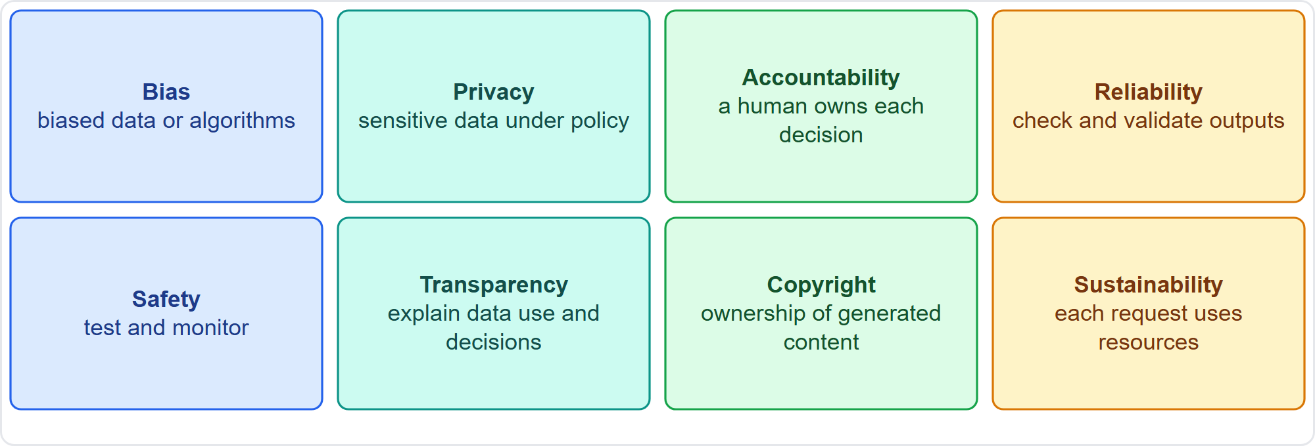
Eight Concerns for Responsible Use
Part 3
Bias, privacy, accountability and five more
EXAM TIP A human must be accountable for each decision, with accountability clearly defined.
PMP Exam Prep 2026 | PMBOK 8 and the New ECO
Module 3: Ethics, Sustainability and AI
41 / 53
Notes:
PMBOK 8 names eight concerns for responsible use. Bias: AI trained on biased data or built with biased algorithms. Privacy: AI uses large, sensitive data sets under privacy policies and laws. Accountability: a human must be accountable for each decision. Reliability: check and validate outputs, because they may be biased, incorrect or irrelevant. Safety: design, test and monitor to the required level. Transparency: explain how data is used and how decisions are made. Copyright: ownership of generated content is a dilemma. Sustainability: each request consumes electricity, water and other resources.

Slide 42
Bias, Privacy and Accountability in Practice
Part 3
Bias: diversify training data, test periodically for bias, involve different teams
Privacy: secure the data and collect it under a privacy policy
Accountability: a named human owns each decision
Reliability: verify outputs; correct hallucinations before use
Policy first: organizational AI guidelines are the foundation for acceptable use
Culture: foster awareness and ethical use in the team
EXAM TIP Do not apply a biased tool to decisions about people.
PMP Exam Prep 2026 | PMBOK 8 and the New ECO
Module 3: Ethics, Sustainability and AI
42 / 53
Notes:
How do you manage the main concerns? For bias, diversify training data, test periodically with a focus on bias, and involve different teams in development. For privacy, secure the data and collect it under a privacy policy. For accountability, define who is accountable for each decision, and make sure it is a human. For reliability, verify outputs and correct hallucinations before use. Organizational AI guidelines are the foundation for acceptable use. And foster a culture of awareness and ethical use within the team. This aligns with the Code of Ethics: responsibility, honesty and fairness.

Slide 43
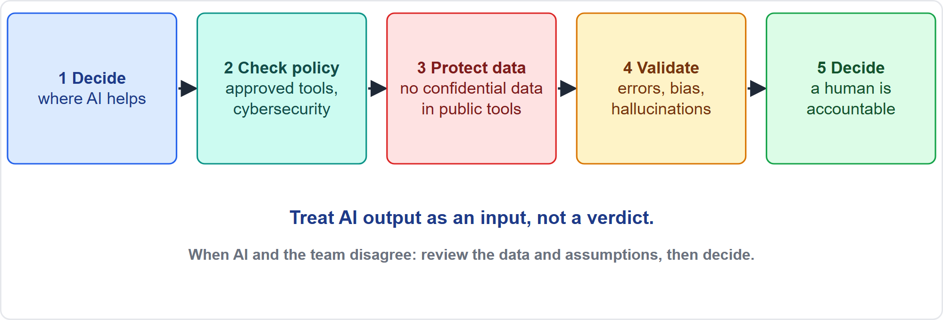
Using AI Well as a Project Manager
Part 3
Decide, check policy, protect data, validate, decide
EXAM TIP When an AI forecast conflicts with the team's view, investigate the data and assumptions; neither obey nor ignore it.
PMP Exam Prep 2026 | PMBOK 8 and the New ECO
Module 3: Ethics, Sustainability and AI
43 / 53
Notes:
Here is a practical workflow, labelled as exam practice. Decide where AI helps, such as drafting, data analysis and forecasting, and where human judgment must lead, such as stakeholder relationships, ethics and trade-offs. Check policy first: approved tools, data classification, and cybersecurity or legal advice when needed. Protect data: never paste confidential, personal or contractual data into unapproved or public tools. Validate outputs against data and experts. Then decide and document. Treat AI forecasts as inputs, not verdicts.

Slide 44
AI in Predictive, Agile and Hybrid Work
Part 3
 | Predictive | Agile | Hybrid
Planning | Predictive analytics; baseline optimization | Backlog drafting; velocity-based forecasting | Both
Monitoring | Automated reports; early-warning against baselines | Dashboards, burn charts, flow metrics with alerts | One dashboard
Collaboration | Meeting minutes; reminders | Retrospective summaries; interview bots | Both
Caution | A forecast does not replace baseline governance | Bot summaries do not replace team conversation | One accountable human view
EXAM TIP AI does not replace leadership, communication or stakeholder engagement.
PMP Exam Prep 2026 | PMBOK 8 and the New ECO
Module 3: Ethics, Sustainability and AI
44 / 53
Notes:
AI works in every approach. In planning, predictive projects use predictive analytics and baseline optimization, and agile teams use backlog drafting and velocity-based forecasting. In monitoring, predictive projects use automated reports and early-warning signals against baselines, and agile teams use dashboards, burn charts and flow metrics with alerts. In collaboration, AI helps with meeting minutes and reminders, or retrospective summaries and interview bots. The cautions differ: a forecast does not replace baseline governance, and bot summaries do not replace team conversation.

Slide 45
AI Traps: What PMI Expects
Part 3
A human stays accountable: AI recommends; people decide and own the result
Validate before you trust: errors, bias, hallucinations
Protect sensitive data; use approved tools only
Policy and cybersecurity come first for new tools
Match the strategy to the task
AI versus the team's view: investigate and reconcile
EXAM TIP Pasting confidential data into a public chatbot is a breach: stop, report under policy, use approved tools.
PMP Exam Prep 2026 | PMBOK 8 and the New ECO
Module 3: Ethics, Sustainability and AI
45 / 53
Notes:
The AI traps. A human stays accountable: AI recommends, people decide and own the result. Validate before you trust, because output may contain errors, bias or hallucinations. Protect sensitive data, and use approved tools only. Policy and cybersecurity come first when adopting a new tool. Match the strategy to the task. And when AI conflicts with the team's view, investigate and reconcile. Do not obey it, and do not ignore it. Also be transparent about AI use where it affects people, and know the legal position on generated content.

Slide 46
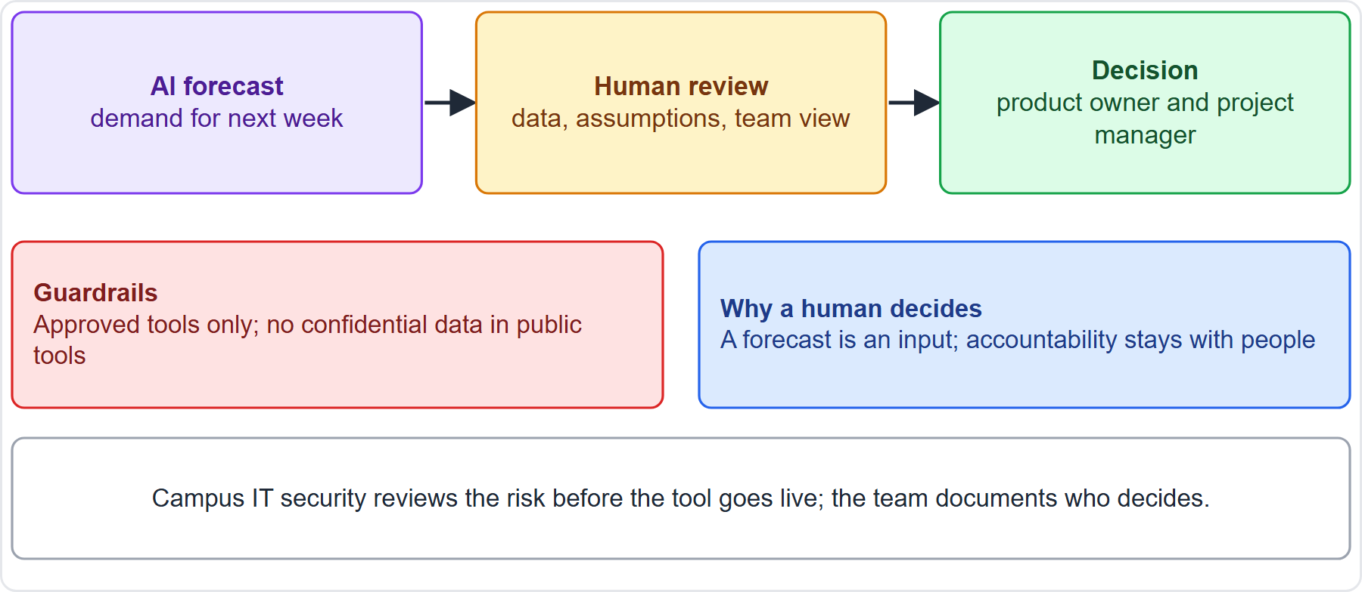
Case Check-In: The Dashboard's AI Forecast
Part 3
CASE CHECK-IN · Sunrise Campus Microgrid
Forecast is an input: the team reviews data and assumptions
Guardrails: approved tools, no confidential data in public tools
PMP Exam Prep 2026 | PMBOK 8 and the New ECO
Module 3: Ethics, Sustainability and AI
46 / 53
Notes:
Our dashboard includes a demand forecast that uses AI. Treat the forecast as an input. When it disagrees with the team's view, the team reviews the data and assumptions together, then the product owner and project manager decide. Set guardrails: approved tools only, and no confidential data in public tools. Campus IT security reviews the risk before the tool goes live, and the team documents who decides. That is the pattern the exam rewards: AI informs, humans decide and stay accountable.

Slide 47
Module Recap
Part 3
1
Ethics
2
Sustainability
3
AI terms
four values; disclose and step back; truth over comfort; law and Code first
avoid before offset; goals in the documents; raise gaps with the sponsor
AI, machine learning, deep learning, generative AI
4
AI strategies
5
Responsible use
6
Next
automate, assist, augment
validate, protect data, keep a human accountable
five practice questions
PMP Exam Prep 2026 | PMBOK 8 and the New ECO
Module 3: Ethics, Sustainability and AI
47 / 53
Notes:
Let us recap the whole module. Ethics: four values, disclose and step back, truth over comfort, and law and the Code first. Sustainability: avoid before offset, put goals in the documents, and raise gaps with the sponsor. AI terms: artificial intelligence, machine learning, deep learning and generative AI. AI strategies: automate, assist, augment. Responsible use: validate, protect data and keep a human accountable. Now it is time to test yourself. Five questions follow. For each one, pause the video, choose your answer, and then listen to the explanation.

Slide 48
Practice Question 1
Part 3
Q1
A project manager discovers that her brother-in-law owns one of the companies bidding on a contract that she helps evaluate. What should she do?
A
Ask her brother-in-law to withdraw his company's bid from the evaluation process
B
Evaluate that bid last so that it cannot influence her other scores
C
Say nothing, because she is confident that she can evaluate it fairly
D
Disclose the relationship and step out of the evaluation until resolved
PMP Exam Prep 2026 | PMBOK 8 and the New ECO
Module 3: Ethics, Sustainability and AI
48 / 53
Notes:
Question one. A project manager discovers that her brother-in-law owns one of the companies bidding on a contract that she helps evaluate. What should she do? The four options are on the screen. Choose your answer. [PAUSE 12] The answer is D. Real or apparent conflicts of interest must be disclosed, and the person refrains from the decision until a mitigation plan is approved and the stakeholders consent. Confidence in your own fairness, pressuring the bidder, or reordering the work does not remove the conflict.

Slide 49
Practice Question 2
Part 3
Q2
A sponsor under pressure asks the project manager to report the release as on track, although the team is three weeks behind its release plan. What should the project manager do?
A
Ask the PMO to submit the status report in the project's place
B
Report on track now and hope that the team recovers the three weeks
C
Report the true status with the facts and a recovery plan for the delay
D
Report on track to the sponsor and give the real status only to the team
PMP Exam Prep 2026 | PMBOK 8 and the New ECO
Module 3: Ethics, Sustainability and AI
49 / 53
Notes:
Question two. A sponsor under pressure asks the project manager to report the release as on track, although the team is three weeks behind its release plan. What should the project manager do? The four options are on the screen. Choose your answer. [PAUSE 12] The answer is C. Honesty requires accurate, timely information, and bad news is shared early with facts and options. Shifting the report, reporting green, or giving different versions to different groups all mislead.

Slide 50
Practice Question 3
Part 3
Q3
The business case for a data-center migration has no sustainability goals, yet the planned hosting site runs mostly on high-emission power and the organization has public ESG commitments. What should the project manager do?
A
Raise the impact with the sponsor and seek confirmed sustainability goals
B
Cancel the migration until the organization sets a formal emissions target
C
Switch to a greener hosting site quietly and report the change at closure
D
Proceed with the plan because emissions are outside the approved scope
PMP Exam Prep 2026 | PMBOK 8 and the New ECO
Module 3: Ethics, Sustainability and AI
50 / 53
Notes:
Question three. The business case for a data-center migration has no sustainability goals, yet the planned hosting site runs mostly on high-emission power and the organization has public ESG commitments. What should the project manager do? The four options are on the screen. Choose your answer. [PAUSE 12] The answer is A. Sustainability applies across all project areas, so when goals are missing the project manager still raises the impact with the sponsor and seeks formal confirmation. Proceeding blindly, canceling, or deciding alone skips that discussion.

Slide 51
Practice Question 4
Part 3
Q4
A project manager pasted a client's confidential contract terms into a free public AI chatbot to draft a summary. What should she do now?
A
Delete the conversation and keep the incident entirely to herself
B
Stop, report the exposure under policy and use only approved tools
C
Ask colleagues to use the same chatbot to share the time savings
D
Continue using the chatbot, since the summary is accurate and useful
PMP Exam Prep 2026 | PMBOK 8 and the New ECO
Module 3: Ethics, Sustainability and AI
51 / 53
Notes:
Question four. A project manager pasted a client's confidential contract terms into a free public AI chatbot to draft a summary. What should she do now? The four options are on the screen. Choose your answer. [PAUSE 12] The answer is B. Confidential data must be protected under privacy and security policy, so she stops, owns the mistake and reports the exposure. Continuing, hiding it, or spreading the practice makes the breach worse.

Slide 52
Practice Question 5
Part 3
Q5
An AI forecasting tool predicts that a release will slip by three weeks, but the scrum team believes its sprint plan is sound. What should the project manager do?
A
Ask the tool vendor to adjust the forecast to match the team's view
B
Disregard the forecast because the team knows the work much better
C
Accept the forecast as it stands and replan the whole schedule immediately
D
Review the tool's data and assumptions with the team before deciding
PMP Exam Prep 2026 | PMBOK 8 and the New ECO
Module 3: Ethics, Sustainability and AI
52 / 53
Notes:
Question five. An AI forecasting tool predicts that a release will slip by three weeks, but the scrum team believes its sprint plan is sound. What should the project manager do? The four options are on the screen. Choose your answer. [PAUSE 12] The answer is D. AI output is an input to be validated, so the project manager reconciles it with the team's analysis and actual progress before deciding. Obeying it, dismissing it, or asking the vendor to change it each skips that validation.

Slide 53
Answers at a Glance
Part 3
Question | Answer | Why
Q1 | D | Disclose the conflict and step out until it is resolved
Q2 | C | Honesty means reporting the true status with a recovery plan
Q3 | A | Raise the missing goals with the sponsor and seek confirmation
Q4 | B | Stop, own the mistake and report it under policy
Q5 | D | AI output is an input to validate with the team
PMP Exam Prep 2026 | PMBOK 8 and the New ECO
Module 3: Ethics, Sustainability and AI
53 / 53
Notes:
Here are all five answers together. Question one: D. Disclose the conflict and step out until it is resolved. Question two: C. Honesty means reporting the true status with a recovery plan. Question three: A. Raise the missing goals with the sponsor and seek confirmation. Question four: B. Stop, own the mistake and report it under policy. Question five: D. AI output is an input to validate with the team. That completes Module 3. Next, Module 4 covers the common vision, stakeholder engagement and communication. See you there.

