Slide 1
Module 4: Vision, Stakeholders and Communication
Part 1 of 3: A shared vision, and who the stakeholders are
People domain · ECO tasks 1, 4, 5, 6 and 8
PMP Exam Prep 2026: PMBOK 8 and the New ECO
Module 4: Vision, Stakeholders and Communication · Part 1
Notes:
Welcome to Module 4. This is the first of the People domain modules, and the People domain is one third of the PMP exam. In this module we look at three connected skills: building a shared vision, working with stakeholders, and communicating with them. In Part 1, we start with the vision: what it is, how you build it, and what to do when people keep getting it wrong.

Slide 2
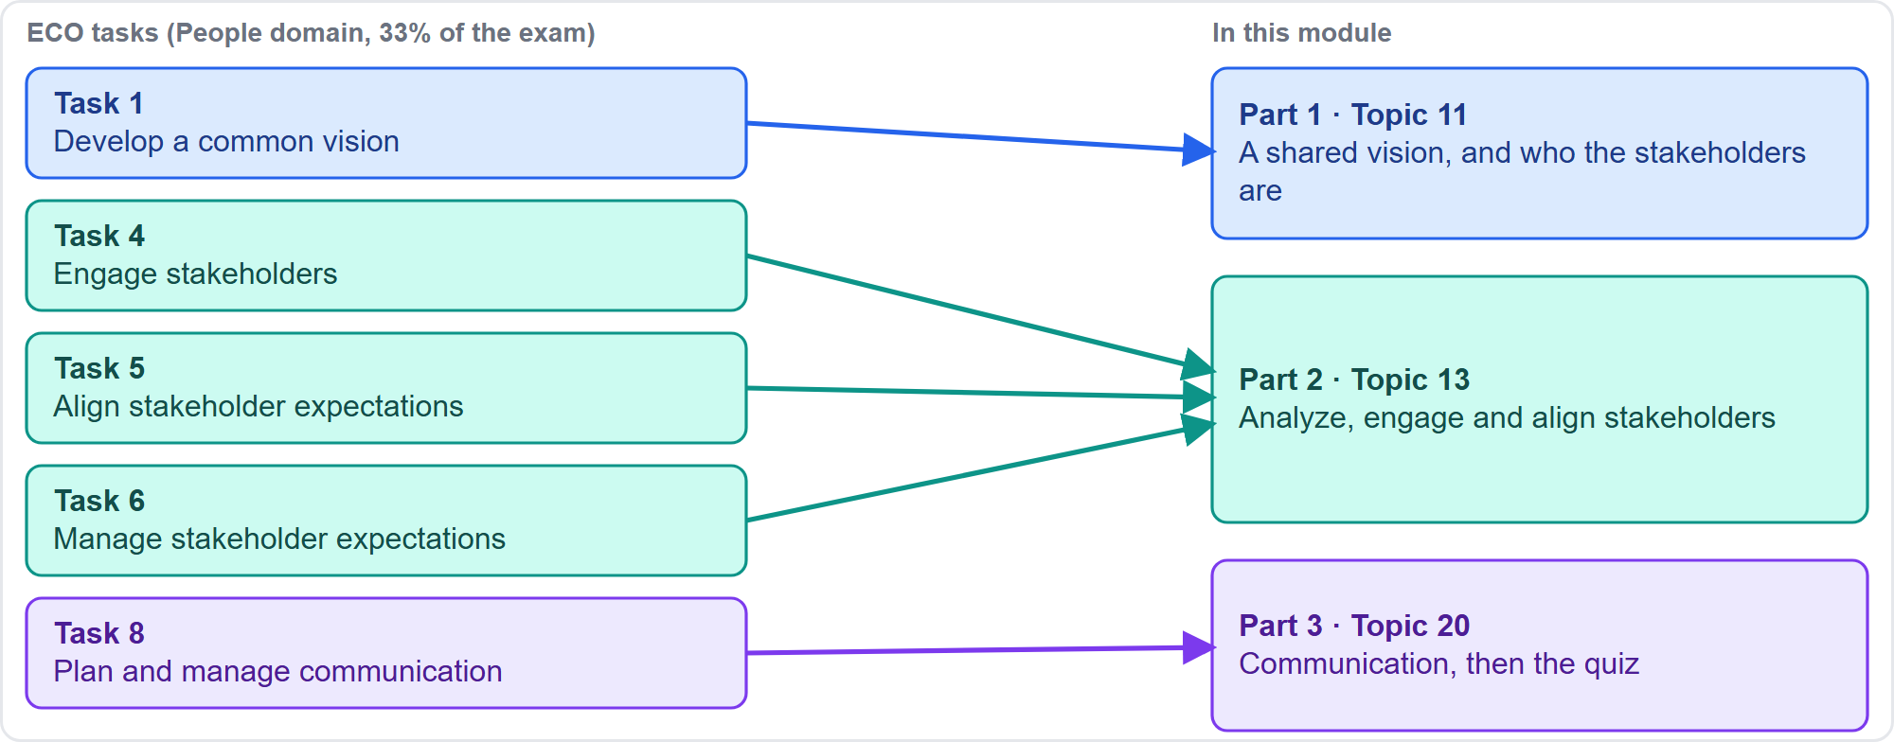
Where This Module Sits in the Exam
Part 1
The People domain is one third of the exam: about one scored question in three
EXAM TIP People questions reward talking to the people involved before analyzing documents, escalating or imposing a fix.
PMP Exam Prep 2026 | PMBOK 8 and the New ECO
Module 4: Vision, Stakeholders and Communication
2 / 65
Notes:
Here is where this module sits. The exam content outline, which we will call the ECO, gives the People domain about one third of the exam. This module covers five of its eight tasks. Develop a common vision. Engage stakeholders. Align expectations. Manage expectations. And plan and manage communication. They map to three parts of this module, as the diagram shows. One habit pays off across all of them. When a People question describes a problem with a person or a group, the best answer usually starts by talking with the people involved. Do that before analyzing documents, escalating, or imposing a fix.

Slide 3
What You Will Learn
Part 1
Describe a good project vision, and develop, promote and keep it current
Find the root cause when a vision keeps being misunderstood
Identify, analyze and classify stakeholders with grids, salience and directions of influence
Use the assessment matrix to turn engagement gaps into a plan
Align and manage expectations, and read early warning signals
Plan communication: models, methods, feedback loops and reporting
PMP Exam Prep 2026 | PMBOK 8 and the New ECO
Module 4: Vision, Stakeholders and Communication
3 / 65
Notes:
By the end of this module you will be able to describe a good project vision, and to develop it, promote it, and keep it current. You will know how to find the root cause when a vision keeps being misunderstood. You will identify, analyze and classify stakeholders with the standard models. You will use the engagement assessment matrix to turn gaps into a plan. You will align and manage expectations, and spot early warning signals. And you will plan communication, from models and methods to feedback loops and reporting.

Slide 4
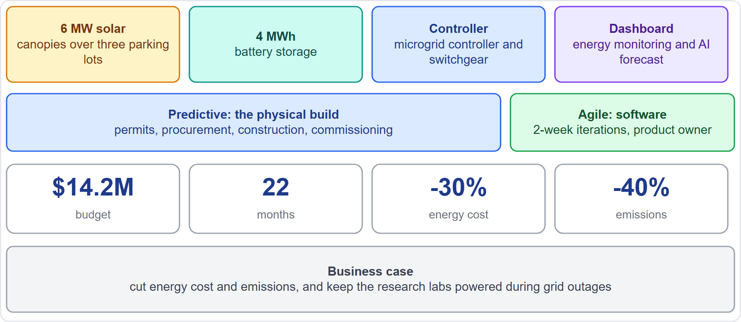
Case Check-In: The Sunrise Campus Microgrid
Part 1
CASE CHECK-IN · Sunrise Campus Microgrid
Hybrid delivery: the physical build is predictive, the dashboard is agile
You are the project manager; the sponsor is Elena Vasquez
PMP Exam Prep 2026 | PMBOK 8 and the New ECO
Module 4: Vision, Stakeholders and Communication
4 / 65
Notes:
Throughout this course we will follow one fictional project, so the ideas stay concrete. Riverton University is building a solar and battery microgrid on its east campus. The budget is fourteen point two million dollars, over twenty-two months, and your sponsor is Elena Vasquez, the Vice-President for Campus Operations. The project is hybrid. The physical build, with permits, procurement and construction, is predictive. The monitoring dashboard and the controller software are agile. And you are the project manager. The diagram on the right gives the one-page snapshot. Keep it in mind as we go.

Slide 5
What a Project Vision Is
Part 1
A short statement of the project's purpose and the future it creates
Realistic but attractive: it motivates and keeps people pulling the same way
It guides daily local decisions: does this move us toward the outcome?
It is about outcomes, not a list of deliverables
A good vision is clear, concise and actionable
EXAM TIP A vision describes purpose and outcomes, and it is short enough to remember.
PMP Exam Prep 2026 | PMBOK 8 and the New ECO
Module 4: Vision, Stakeholders and Communication
5 / 65
Notes:
A project vision is a short statement of the project's purpose and of the future it creates. It is realistic, but attractive. That is what makes it a powerful motivational tool, because it keeps people pulling in the same direction. It also guides daily decisions. When someone on the team faces a small choice, they can ask: does this move us toward the intended outcome? Notice the focus. A vision is about outcomes and purpose, not a list of deliverables. And PMBOK 8 describes a good vision in three words: clear, concise and actionable.

Slide 6
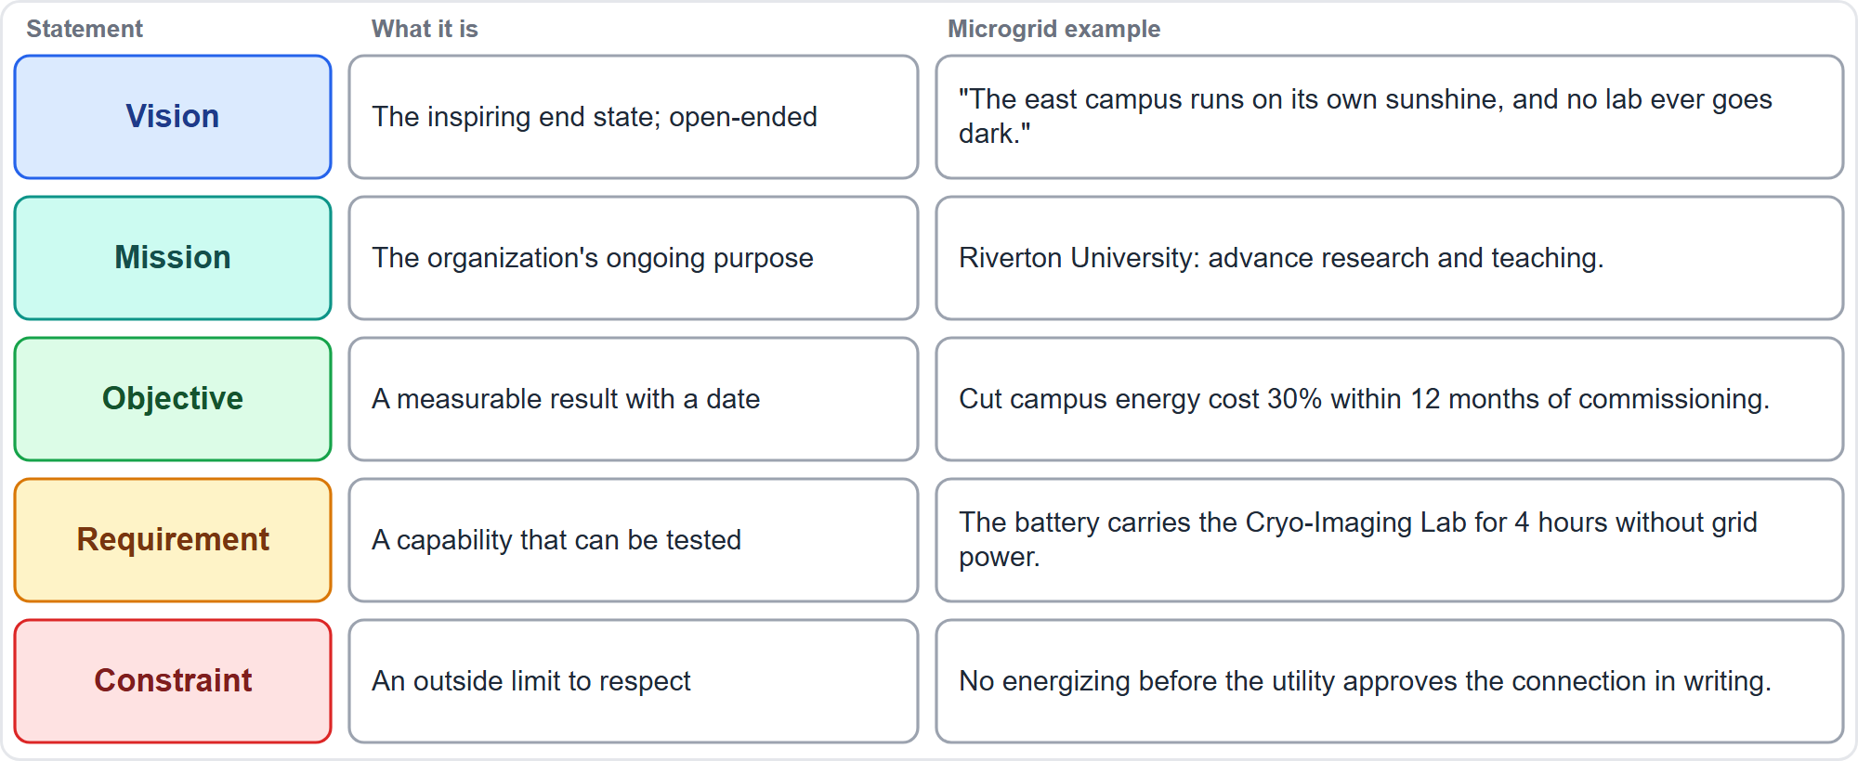
Vision, Mission, Objective, Requirement, Constraint
Part 1
Exam practice, not PMBOK 8 wording: sort each statement before it goes into the charter
EXAM TIP Sort each statement first: a vision is open-ended, an objective is measurable with a date, a requirement is testable, a constraint is an outside limit.
PMP Exam Prep 2026 | PMBOK 8 and the New ECO
Module 4: Vision, Stakeholders and Communication
6 / 65
Notes:
Practice questions often ask you to sort statements before they go into a charter, so here is a simple way to separate five kinds. A vision is the inspiring end state, and it is open-ended. A mission is the organization's ongoing purpose, and whom it serves. An objective is a measurable result with a date. A requirement is a capability the deliverable must have, which can be tested. And a constraint is an outside limit the project must respect, such as a legal deadline. This sorting is common exam practice rather than PMBOK 8 wording, and the diagram shows an example for each from our microgrid.

Slide 7
Four Questions a Good Vision Answers
Part 1
Purpose
Success
What is the project's purpose?
What defines successful project work?
A better future
Drift
How will the future be better once the outcomes are delivered?
How will the team know it is drifting away from the vision?
EXAM TIP The fourth question is the one people forget: a useful vision tells you how to recognize drift.
PMP Exam Prep 2026 | PMBOK 8 and the New ECO
Module 4: Vision, Stakeholders and Communication
7 / 65
Notes:
When a vision is developed together, it answers four questions. First, what is the project's purpose? Second, what defines successful project work? Third, how will the future be better once the outcomes are delivered? And fourth, how will the team know it is drifting away from the vision? That last question is the one people forget, and it is valuable. A vision that tells you how to recognize drift gives the team an early warning. If a scenario describes drift, you already know the vision was supposed to help you spot it.

Slide 8
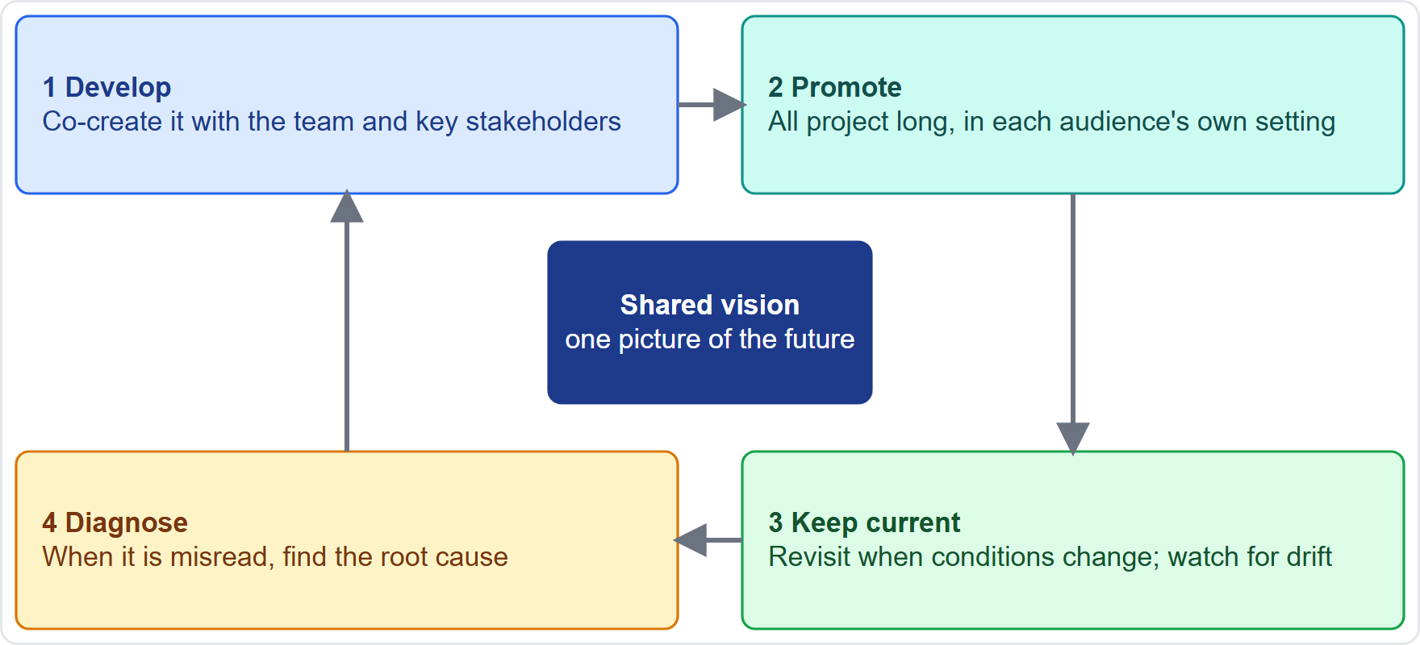
The Vision Cycle
Part 1
Develop, promote, keep current, and diagnose misunderstanding
EXAM TIP The four vision tasks: develop it together, promote it, keep it current, and find the root cause of a misunderstanding.
PMP Exam Prep 2026 | PMBOK 8 and the New ECO
Module 4: Vision, Stakeholders and Communication
8 / 65
Notes:
Here is the cycle you will apply to any vision. First you develop it, together with key stakeholders. Then you promote it, so everyone understands it and keeps it in mind. Then you keep it current, because the context will change. And when people still misunderstand it, you diagnose why, rather than just repeating yourself. Those four ideas match the four vision tasks in the exam outline. Help ensure a shared vision. Promote it. Keep it current. And break down situations to find the root cause of a misunderstanding.

Slide 9
Develop the Vision Together
Part 1
Co-create it with the team and key stakeholders; a vision handed down rarely creates ownership
Draw on the business case, benefits plan, charter and stakeholder analysis
Use workshops, interviews, brainstorming and a project canvas
Agile: set a clear product vision at the start, in a concise statement
Leaders disagree on success? Bring them together and agree one statement
EXAM TIP Shared means co-created and checked, not just announced.
PMP Exam Prep 2026 | PMBOK 8 and the New ECO
Module 4: Vision, Stakeholders and Communication
9 / 65
Notes:
The word to remember here is together. A vision handed down from above, without input, rarely creates ownership. So you develop it collaboratively with the team and the key stakeholders, using what you already have: the business case, the benefits plan, the charter and your stakeholder analysis. Workshops, interviews, brainstorming and a project canvas all help. On an agile project, a clear product vision is set at the start, often in a concise statement. And if two senior leaders define success differently, bring them together and agree one statement, rather than recording both versions.

Slide 10
Case Check-In: A Vision for the Microgrid
Part 1
CASE CHECK-IN · Sunrise Campus Microgrid
Workshop with Elena, the Cryo-Imaging Lab, the Sustainability Council and the residents' association
The vision they agreed: "Riverton's east campus runs on its own sunshine, and no lab ever goes dark."
The lab's fear of outages shaped the second half of the sentence
It now heads the charter and the dashboard's product vision
PMP Exam Prep 2026 | PMBOK 8 and the New ECO
Module 4: Vision, Stakeholders and Communication
10 / 65
Notes:
Let us build the vision for our microgrid. You run a workshop with Elena, the Cryo-Imaging Lab, the Sustainability Council and the residents' association. Together they agree this sentence: Riverton's east campus runs on its own sunshine, and no lab ever goes dark. Notice how the second half comes from the lab, whose fear of outages was the biggest concern. That is co-creation at work. The sentence now heads the charter, and it becomes the product vision for the dashboard team as well.

Slide 11
Promote the Vision
Part 1
Communicate it throughout the project, not only at kickoff
Refer to it when the team decides and solves problems
Connect daily work to purpose, and recognize contributions
Make it visible: kickoff, team charter, roadmaps, information radiators, onboarding for new members
Check understanding: ask people to say what the vision is
EXAM TIP If a group keeps asking why, explain what the vision means in their own setting instead of resending the document.
PMP Exam Prep 2026 | PMBOK 8 and the New ECO
Module 4: Vision, Stakeholders and Communication
11 / 65
Notes:
A vision is not something you announce once at kickoff. You communicate it throughout the project. You refer to it when the team makes decisions and solves problems. You connect daily work to purpose, and you recognize contributions. You make it visible: in the kickoff, the team charter, roadmaps and information radiators. And, importantly, in onboarding for new members. And you check understanding by asking people to say what the vision is. One more exam point: if a group keeps asking why, explain what the vision means in their own setting. Resending the same document will not help.

Slide 12
Keep the Vision Current
Part 1
Context changes: market, regulation, technology, needs and feedback
Revisit at phase gates, reviews and roadmap updates, and when benefits fall behind
Agree changes with the sponsor and governance; use change control where baselined
Watch for drift: unrequested features, conflicting descriptions, benefits not appearing
Not every wobble changes the vision: sometimes the work must realign to it
EXAM TIP Not every wobble changes the vision: sometimes the work must realign to it; use change control where the plan is baselined.
PMP Exam Prep 2026 | PMBOK 8 and the New ECO
Module 4: Vision, Stakeholders and Communication
12 / 65
Notes:
Context changes. Markets move, regulations arrive, technology shifts, and stakeholder needs evolve. So you revisit the vision at phase gates, at reviews and roadmap updates, and whenever benefits fall behind. If the change affects objectives or success criteria, you agree it with the sponsor and governance, and use change control where the plan is baselined. Watch for signs of drift: features nobody requested, stakeholders describing different outcomes, benefits not appearing. But not every wobble means changing the vision. Sometimes it is the work that must realign to it.

Slide 13
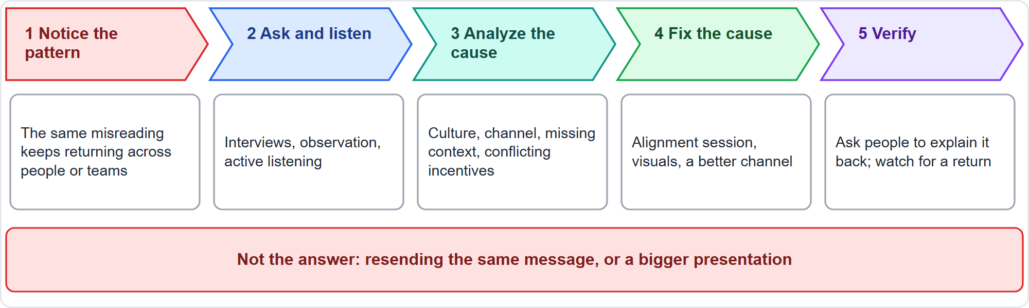
When the Vision Keeps Being Misunderstood
Part 1
Another email is not the answer: find out why
EXAM TIP Repeated misunderstanding despite clarifications means find the root cause, not send the message again.
PMP Exam Prep 2026 | PMBOK 8 and the New ECO
Module 4: Vision, Stakeholders and Communication
13 / 65
Notes:
Here is a classic exam scenario. People keep misreading the vision, even though clarifications were sent, and acknowledged. The tempting answers are another email, or a bigger presentation. The diagram shows the better path. You notice the pattern. You ask and listen, to learn how people understand it. You analyze the root cause. You fix that cause. And you verify. The principle is simple. When clarifications keep failing, the problem is not the amount of information. Find out why.

Slide 14
Finding the Root Cause
Part 1
Step | What to do
Notice the pattern | The same misunderstanding recurs across people, teams or work packages
Ask and listen | Interviews, observation and active listening: how do people understand it?
Analyze causes | Root cause analysis; look for culture, channel, missing context, conflicting incentives
Fix the cause | Alignment session, visuals, examples, a better channel; resolve conflicting objectives
Verify | Have people explain it back; check that the misunderstanding does not return
EXAM TIP Find the cause before you fix it: ask and listen, analyze, fix, then check that the misunderstanding does not return.
PMP Exam Prep 2026 | PMBOK 8 and the New ECO
Module 4: Vision, Stakeholders and Communication
14 / 65
Notes:
Let us look at those steps more closely. First, notice the pattern: the same misunderstanding appears across people, teams or work packages. Second, ask and listen, using interviews, observation and active listening. Third, analyze the causes with root cause analysis. Typical causes include culture, the wrong or one-way channel, missing context, conflicting incentives, and unspoken assumptions. Fourth, fix the cause, perhaps with an alignment session, visuals, or a better channel. And fifth, verify it by having people explain the vision back to you, and by checking that the misunderstanding does not return.

Slide 15
The Vision in Predictive, Agile and Hybrid Work
Part 1
 | Predictive | Agile | Hybrid
Lives in | Business case, charter, scope statement | Product vision, roadmap, release goals | Both
Owned by | Sponsor and project manager | Product owner with the team | Shared
Refreshed at | Phase gates, change control | Every review and roadmap update | Both
Typical failure | A frozen document nobody reads | Teams pulling stories for their own picture | Groups with different pictures
EXAM TIP Identify the approach first: predictive visions live in the charter and business case, agile ones in the product vision and roadmap.
PMP Exam Prep 2026 | PMBOK 8 and the New ECO
Module 4: Vision, Stakeholders and Communication
15 / 65
Notes:
The same idea lives in different places depending on the approach. In predictive work, the vision lives in the business case, the charter and the scope statement, and the sponsor and project manager own it. In agile work, it lives in the product vision, the roadmap and release goals, and the product owner owns it with the team. In hybrid work, it is shared. The typical failures differ too: a frozen document nobody reads, teams pulling stories for their own picture of the product, or different groups holding different pictures.

Slide 16
Vision Traps: What PMI Expects
Part 1
Repeated misunderstanding: find the root cause; do not resend the message
Conflicting definitions of success: align the leaders on one statement
Teams read it differently: hold a joint alignment session
Conditions change: confirm and update the vision with the sponsor
New members and vendors need it too: keep promoting it
EXAM TIP The best answer talks to the people involved before analyzing, escalating or documenting.
PMP Exam Prep 2026 | PMBOK 8 and the New ECO
Module 4: Vision, Stakeholders and Communication
16 / 65
Notes:
Let us collect the traps. Repeated misunderstanding: find the root cause, and do not resend the message. Conflicting definitions of success: align the leaders on one statement. Teams reading the vision differently: hold a joint alignment session, because tightening acceptance criteria does not create shared understanding. Conditions change: confirm and update the vision with the sponsor. And remember new members and vendors, who need the vision too. Across all of these, the best answer talks to the people involved before analyzing, escalating or documenting.

Slide 17
Who Is a Stakeholder?
Part 1
Anyone who may affect, be affected by, or perceive itself to be affected by the project
Internal or external, individual or group; supportive, neutral or opposed
They change over time: review at least at every phase
The two named key skills: negotiation and conflict management
A register entry is not engagement: classification must become planned action
EXAM TIP A person who only feels affected is still a stakeholder, and low power never means ignore.
PMP Exam Prep 2026 | PMBOK 8 and the New ECO
Module 4: Vision, Stakeholders and Communication
17 / 65
Notes:
PMBOK 8 defines a stakeholder as an individual, group or organization that may affect, be affected by, or perceive itself to be affected by a decision, activity or outcome. Notice the last part: perceive itself to be affected. Stakeholders can be internal or external, and supportive, neutral or opposed. Effective engagement covers all three attitudes. They change over time, so you review them at least at every phase. PMBOK 8 names two key skills for working with them: negotiation and conflict management. And a name in a register is not engagement. The classification must turn into planned action. A person who only feels affected is still a stakeholder, and low power never means ignore.

Slide 18
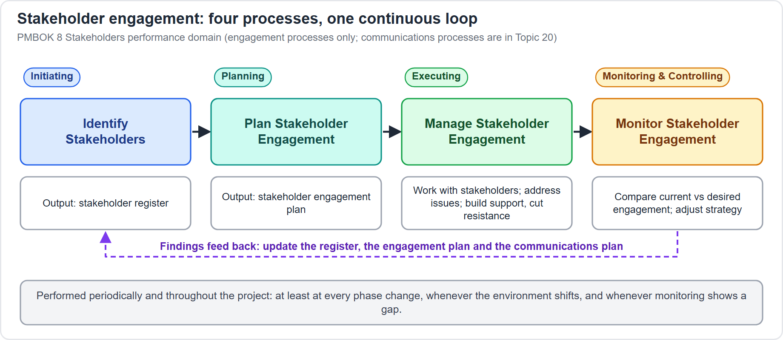
The Four Engagement Processes
Part 1
Identify, plan, manage and monitor, each in its own focus area
EXAM TIP Match each process to its focus area: identify in Initiating, plan in Planning, manage in Executing, monitor in Monitoring and Controlling.
PMP Exam Prep 2026 | PMBOK 8 and the New ECO
Module 4: Vision, Stakeholders and Communication
18 / 65
Notes:
PMBOK 8 has four processes for engaging stakeholders. Identify Stakeholders starts in Initiating. Plan Stakeholder Engagement happens in Planning, and produces the stakeholder engagement plan. Manage Stakeholder Engagement runs throughout Executing, with the benefit of more support and less resistance. And Monitor Stakeholder Engagement, in Monitoring and Controlling, checks how effective engagement is and adjusts it. The communications processes belong to the same domain, and we will meet them in Part 3.

Slide 19
Identify Stakeholders
Part 1
Look in the charter, business case, agreements, requirements and logs, and in organizational records
Techniques: surveys, brainstorming, document analysis, expert meetings
Record who they are, their role, stake, expectations, attitude and interest
Keep the register alive: identification never ends
Missed someone? Engage them now and update the register
EXAM TIP Continuous identification acts as a risk management strategy.
PMP Exam Prep 2026 | PMBOK 8 and the New ECO
Module 4: Vision, Stakeholders and Communication
19 / 65
Notes:
Where do you find stakeholders? In the project charter, the business case, and agreements and contracts. In requirements documents, and the issue and change logs. And in organizational records, such as policies and past projects. Surveys, brainstorming, document analysis and meetings with experts help. For each one, you record who they are, their role, their stake, their expectations, their attitude and their interest. And identification never ends. If you discover an influential stakeholder late, engage them now and update the register. Continuous identification acts as a risk management strategy.

Slide 20
Part 1 Recap
Part 1
1
Vision
2
Develop and promote
3
Keep current
short, outcome-focused, clear, concise and actionable
co-create it, then keep it alive in each audience's own context
revisit on change and watch for drift
4
Root cause
5
Stakeholder
6
Identify
when it is misread, listen, analyze, fix and verify
anyone who may affect, be affected by, or feel affected by the project
look in many documents, and never finish
PMP Exam Prep 2026 | PMBOK 8 and the New ECO
Module 4: Vision, Stakeholders and Communication
20 / 65
Notes:
Let us recap Part 1. A vision is short and focused on outcomes: clear, concise and actionable. You develop it by co-creating it, and you promote it all project long, in each audience's own context. You keep it current by revisiting it when conditions change, and by watching for drift. When it is misunderstood, you find the root cause: listen, analyze, fix, verify. And a stakeholder is anyone who may affect, be affected by, or feel affected by the project. You identify them from many documents, and you never finish. In Part 2, we analyze and engage them.

Slide 21
Module 4: Vision, Stakeholders and Communication
Part 2 of 3: Analyze, engage and align stakeholders
People domain · ECO tasks 4, 5 and 6
PMP Exam Prep 2026: PMBOK 8 and the New ECO
Module 4: Vision, Stakeholders and Communication · Part 2
Notes:
Welcome to Part 2. You have a vision, and you have a list of stakeholders. Now we analyze them: the kinds of stake they hold, how to map them, and the gap between where they are and where you need them. Then we plan engagement, and align and monitor their expectations.

Slide 22
Five Kinds of Stake
Part 2
Interest
Rights
Ownership
affected by a decision related to the project or its outcome
a legal or moral claim, such as safety law or protecting a heritage site
legal title to an asset or property
Knowledge
Contribution
specialist knowledge, or knowledge of the organization's power structures
funds, other resources, or advocacy and political cover
EXAM TIP One stakeholder can hold several kinds of stake; noticing which one tells you how to approach them.
PMP Exam Prep 2026 | PMBOK 8 and the New ECO
Module 4: Vision, Stakeholders and Communication
22 / 65
Notes:
PMBOK 8 names five kinds of stake. Interest means being affected by a decision related to the project or its outcome. Rights are legal or moral claims, such as safety law or protecting a heritage site. Ownership is legal title to an asset or property. Knowledge is specialist knowledge, or knowledge of the organization's power structures. And contribution means funds or other resources, or intangible support such as advocacy and political cover. One stakeholder can hold several. Noticing which stake someone holds tells you how to approach them.

Slide 23
Mapping Models at a Glance
Part 2
Model | What it does | Best for
Power / interest grids | Group by authority, concern, influence or impact | Small projects, simple relationships
Stakeholder cube | Combines grid elements in three dimensions | Richer pictures of the community
Salience model | Power, urgency and legitimacy (proximity for teams) | Large, complex communities
Directions of influence | Upward, downward, outward, sideward | Seeing where pressure comes from
Prioritization | Rank stakeholders and their requirements | Many stakeholders, changing membership
EXAM TIP Choose the model that fits the community: grids for small projects, the salience model for large and complex ones.
PMP Exam Prep 2026 | PMBOK 8 and the New ECO
Module 4: Vision, Stakeholders and Communication
23 / 65
Notes:
Once you have the list, you map it. The grids group stakeholders by power, interest, influence or impact, and suit small projects. The stakeholder cube combines the grid elements in three dimensions. The salience model uses power, urgency and legitimacy, and suits large, complex communities. Directions of influence show where pressure comes from: upward, downward, outward and sideward. And prioritization ranks stakeholders and their requirements. Methods include MoSCoW, which sorts items into must, should, could and won't, and the hundred-point method. You choose the model that fits the community. The next slides show the three you will meet most.

Slide 24
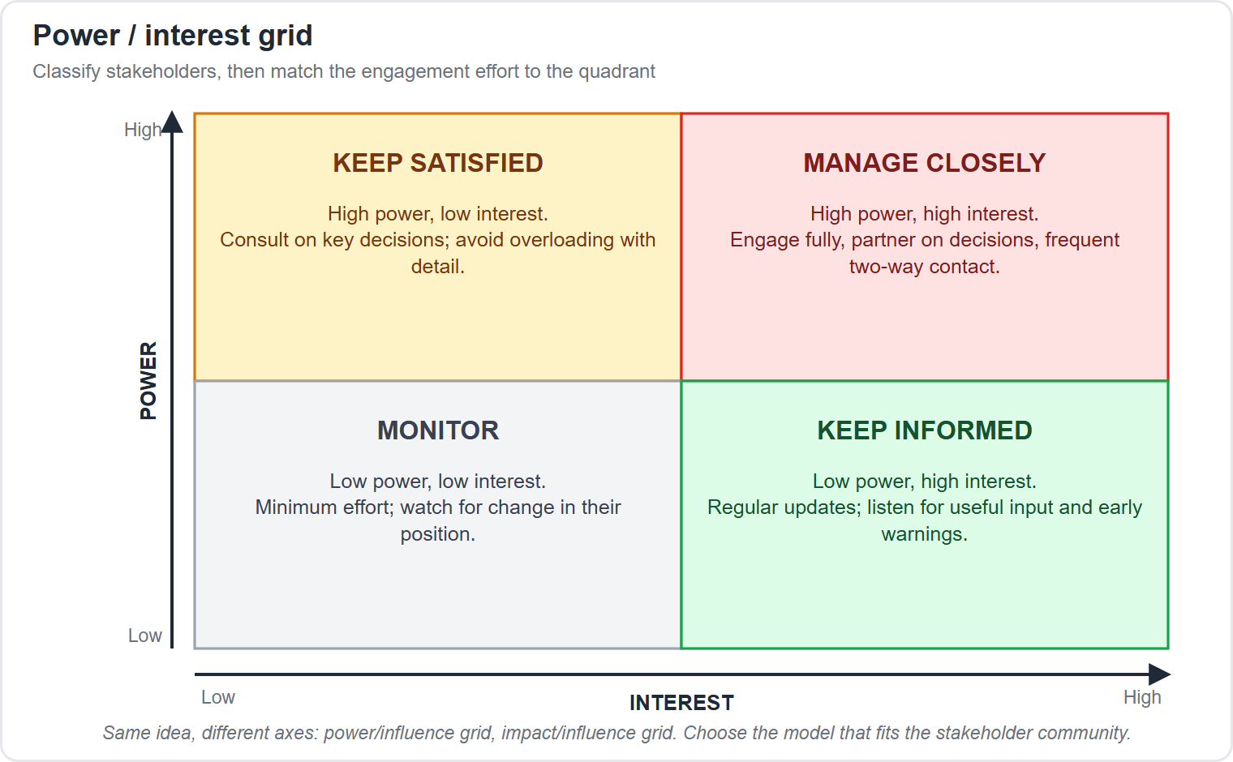
The Power and Interest Grid
Part 2
Manage closely: high power, high interest
Keep satisfied: high power, low interest
Keep informed: low power, high interest
Monitor: low power, low interest
EXAM TIP Power and interest decide the strategy: high power with high interest means manage closely.
PMP Exam Prep 2026 | PMBOK 8 and the New ECO
Module 4: Vision, Stakeholders and Communication
24 / 65
Notes:
The power and interest grid is the one you will meet most. High power, high interest: manage closely. High power, low interest: keep satisfied, consult them on key decisions without overloading them. Low power, high interest: keep informed. Low power, low interest: monitor, with minimal effort. These four quadrant names are standard exam wording rather than PMBOK 8 text. The strategy follows the quadrant, so if an exam scenario gives you power and interest, you can name the strategy straight away.

Slide 25
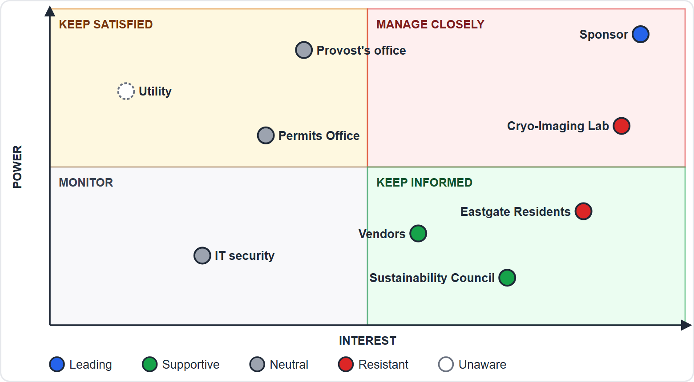
Case Check-In: Mapping the Microgrid Stakeholders
Part 2
CASE CHECK-IN · Sunrise Campus Microgrid
Utility: high power, low interest, unaware of the detail
Lab and residents: high interest and resistant; the residents can still slow the permits
PMP Exam Prep 2026 | PMBOK 8 and the New ECO
Module 4: Vision, Stakeholders and Communication
25 / 65
Notes:
Here are our microgrid stakeholders on the grid, colored by attitude. The utility has high power and low interest, and does not yet know the detail. The Cryo-Imaging Lab has high interest and real power over the cut-over date, and it is resistant. The Eastgate Residents have lower power and high interest, and they are resistant too, but they can slow the permits, so do not ignore them. And the sponsor is in the manage closely corner. Notice that the map alone does not decide the plan. We need to know where each one is, and where we need them to be.

Slide 26
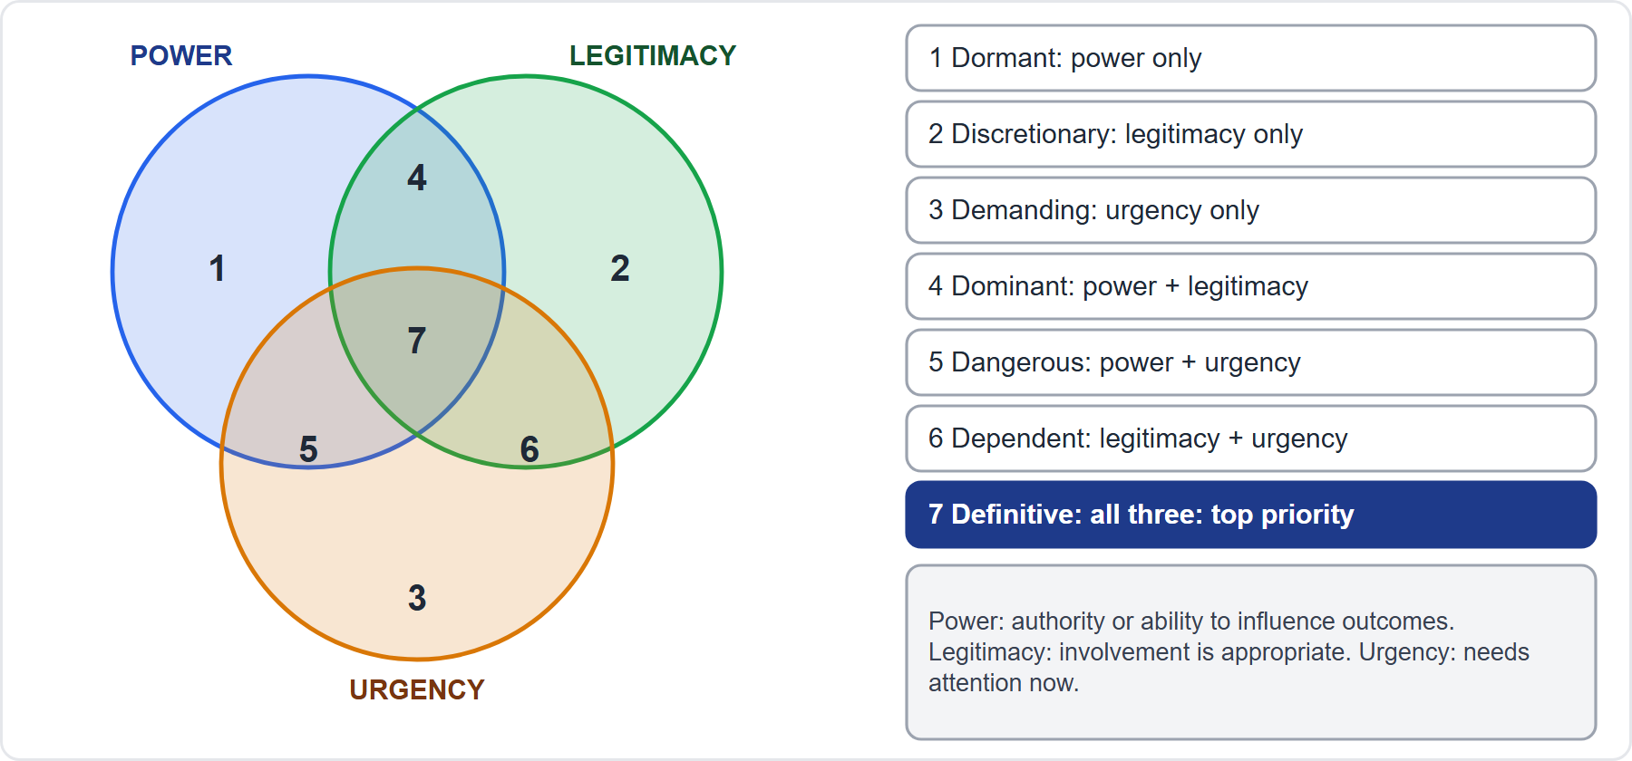
The Salience Model
Part 2
The more attributes a stakeholder holds, the more attention it needs
EXAM TIP A stakeholder holding all three attributes, the definitive class, ranks first.
PMP Exam Prep 2026 | PMBOK 8 and the New ECO
Module 4: Vision, Stakeholders and Communication
26 / 65
Notes:
The salience model scores each stakeholder on three attributes. Power is their level of authority, or their ability to influence the project's outcomes. Legitimacy is whether their involvement is appropriate. Urgency is the need for immediate attention. For team-level analysis, proximity replaces legitimacy. Combining the three gives seven classes, from dormant, with power only, to definitive, with all three. The practical rule is simple: the more attributes a stakeholder holds, the more attention they need, and a definitive stakeholder ranks first. PMBOK 8 names the model and its three attributes. The seven class names appear in some exam material, so it helps to recognize them.

Slide 27
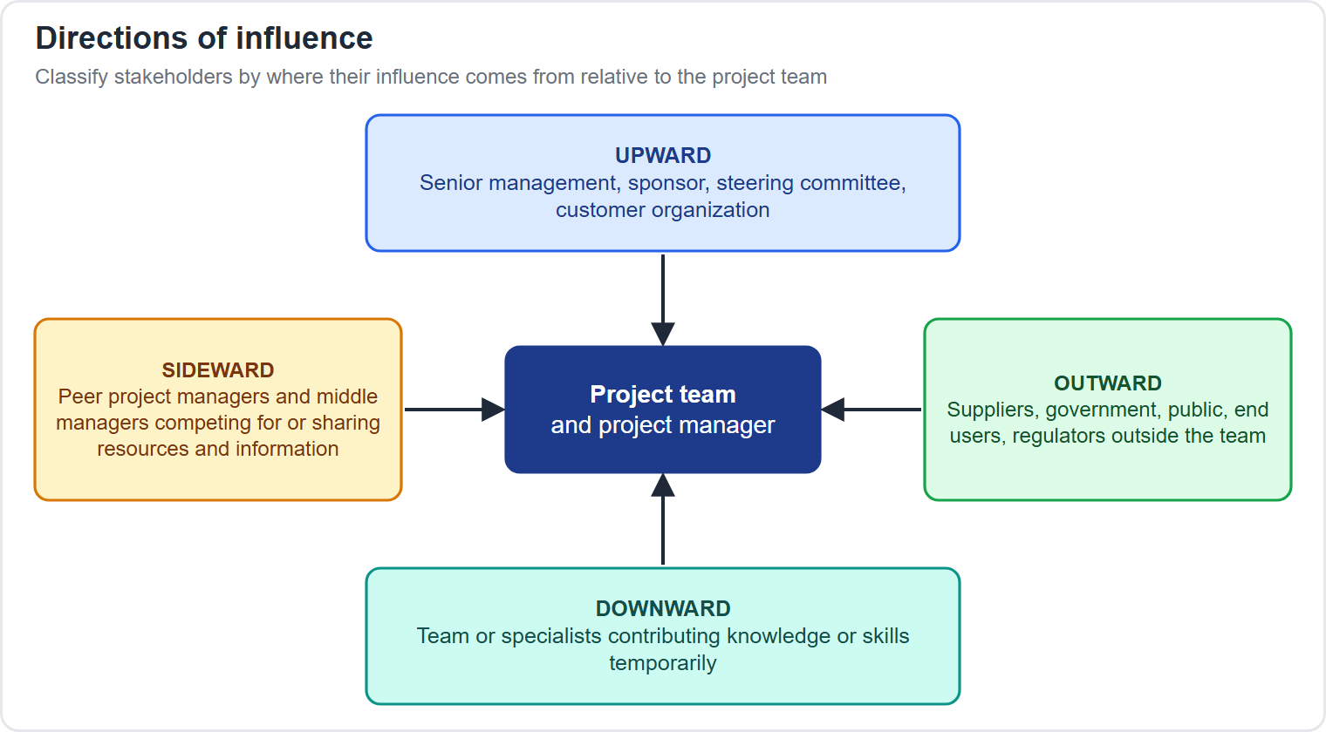
Directions of Influence
Part 2
Where the pressure on the project comes from
EXAM TIP Name the direction of the pressure: peers competing for your specialists are sideward influence.
PMP Exam Prep 2026 | PMBOK 8 and the New ECO
Module 4: Vision, Stakeholders and Communication
27 / 65
Notes:
Directions of influence tell you where pressure comes from. Upward is senior management, the sponsor and the steering committee. Downward is the team and specialists. Outward is outside groups, such as suppliers, regulators and end users. Sideward is peers, such as managers of other projects who compete for the same specialists. If a scenario says most of the pressure on scope comes from managers of other projects sharing your people, that is sideward. Knowing the direction helps you choose how to communicate and negotiate.

Slide 28
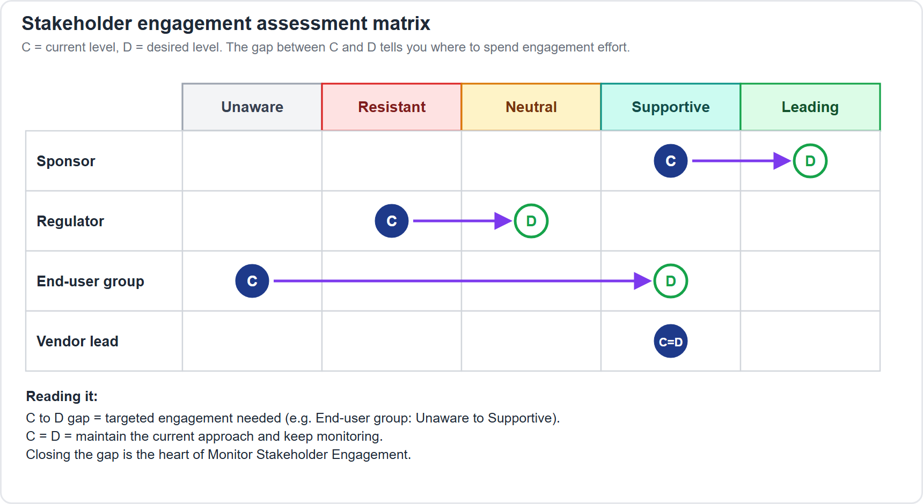
Engagement Levels and the Assessment Matrix
Part 2
C is current engagement, D is desired engagement; the gap sets the effort
EXAM TIP Not everyone must be leading: set the desired level by what the project needs from that person.
PMP Exam Prep 2026 | PMBOK 8 and the New ECO
Module 4: Vision, Stakeholders and Communication
28 / 65
Notes:
The stakeholder engagement assessment matrix uses five levels. Unaware: they do not know about the project. Resistant: they know, but resist the change. Neutral: aware, neither supportive nor unsupportive. Supportive: aware and in favor. Leading: actively working to make the project a success. For each stakeholder you mark C, the current level, and D, the desired level, the one you judge essential for success. The gap between C and D directs how much effort that stakeholder needs. Not everyone must be leading. You set the desired level by what the project needs from that person.

Slide 29
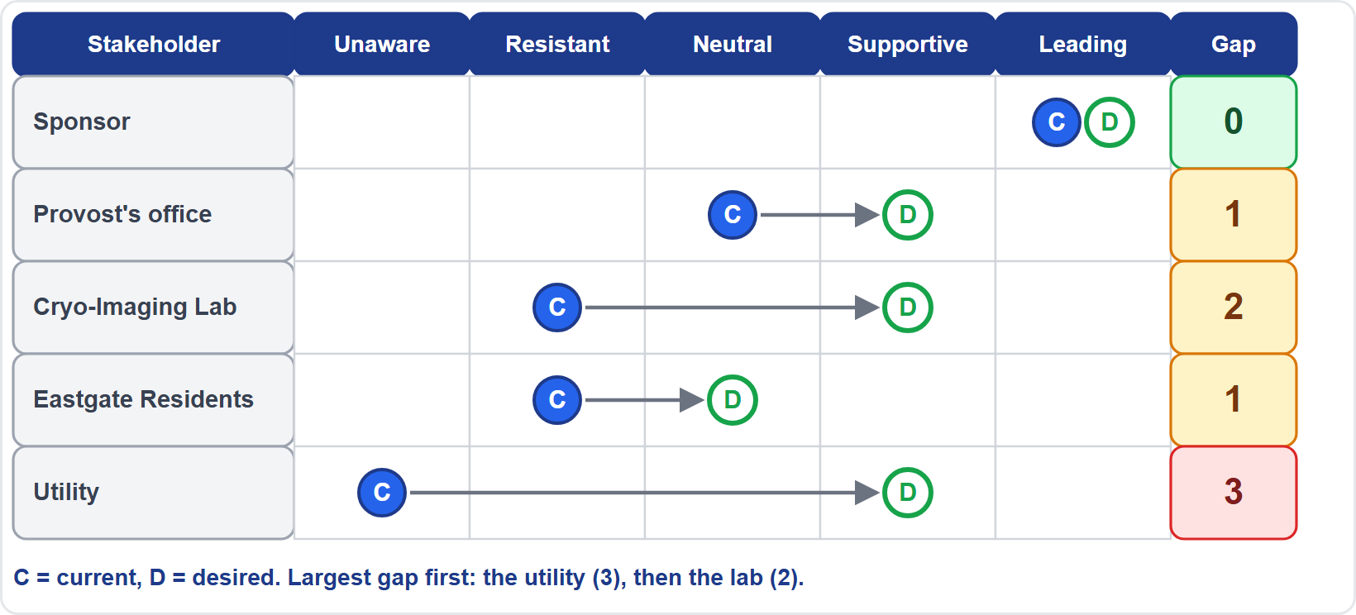
Case Check-In: The Engagement Gap
Part 2
CASE CHECK-IN · Sunrise Campus Microgrid
Largest gap first: the utility, then the lab
The residents only need to reach neutral
PMP Exam Prep 2026 | PMBOK 8 and the New ECO
Module 4: Vision, Stakeholders and Communication
29 / 65
Notes:
Here is the matrix for five of our stakeholders. Look at the gap column. The utility has the largest gap: unaware today, but we need them supportive for the grid connection. That surprises people, because the utility looked like a low-interest party on the grid. The lab must move from resistant to supportive before the cut-over, a gap of two levels. The residents only need to reach neutral. And the sponsor already sits where we need her. The gaps tell you where effort goes first, and they connect the map to a plan.

Slide 30
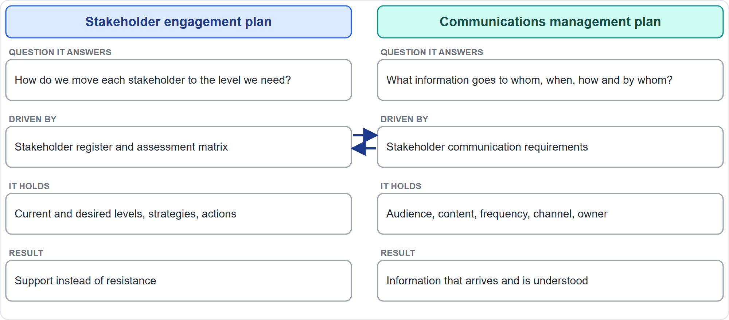
Engagement Plan Versus Communications Plan
Part 2
One moves stakeholders to the level you need, the other moves information
EXAM TIP Engagement plan equals strategy to reach the desired level; communications plan equals information flow.
PMP Exam Prep 2026 | PMBOK 8 and the New ECO
Module 4: Vision, Stakeholders and Communication
30 / 65
Notes:
This distinction is a favorite exam trap. The stakeholder engagement plan answers one question: how do we move each stakeholder to the engagement level we need? It is driven by the stakeholder register and the assessment matrix, and it holds strategies and actions. The communications management plan answers a different one: what information goes to whom, when, how, and by whom? It is driven by communication requirements. The two must stay consistent. The engagement plan sets the strategy, and the communications plan puts it into practice as information flow. A communications plan alone does not move a resistant stakeholder.

Slide 31
Executing the Engagement Plan
Part 2
Manage Stakeholder Engagement is ongoing two-way communication, not a one-off announcement
Address concerns before they become issues
Use negotiation and conflict management where interests clash
Work with the sponsor, and confirm agreements
Keep the change log, issue log, lessons learned and stakeholder register current
The benefit: more support, less resistance
EXAM TIP Executing the plan is active work: you talk, negotiate and adjust; you do not just file the plan.
PMP Exam Prep 2026 | PMBOK 8 and the New ECO
Module 4: Vision, Stakeholders and Communication
31 / 65
Notes:
A plan is only useful when you carry it out. Manage Stakeholder Engagement is ongoing two-way communication, not a one-off announcement. You address concerns before they become issues. You negotiate and manage conflict where interests clash, and you work with the sponsor and confirm agreements. And you keep your records current: the change log, the issue log, the lessons learned register and the stakeholder register. The benefit, in PMBOK 8's words, is more support and less resistance. In exam terms, executing the plan means doing something with people, not filing the document.

Slide 32
Skills for Engaging Stakeholders
Part 2
Influencing
Negotiation
Political awareness
persuade without authority, listen, keep mutual trust
reach agreement, win support, resolve conflicts
read formal and informal power
Cultural awareness
Active listening
Emotional intelligence
adapt to differences to reduce misunderstanding
acknowledge, clarify, confirm, address barriers
manage your own emotions and others'
EXAM TIP With no authority over the person, expect influencing and negotiation, not instruction.
PMP Exam Prep 2026 | PMBOK 8 and the New ECO
Module 4: Vision, Stakeholders and Communication
32 / 65
Notes:
PMBOK 8 names the skills that make engagement work. Influencing is often needed in a matrix, where you have no direct authority: you persuade, listen, and keep mutual trust. Negotiation aims at agreement, and can build trust and harmony. Political awareness means reading formal and informal power. Cultural awareness means adapting your communication to differences. Active listening means acknowledging, clarifying, confirming and addressing barriers. And emotional intelligence means managing your own emotions and recognizing those of others. If an exam scenario involves someone with no authority over a department, expect influencing, not instructing.

Slide 33
Building Trust and Tailoring Communication
Part 2
Be transparent: share bad news early and keep commitments
Listen before responding, and involve people in decisions that affect them
Treat everyone fairly and respectfully: the Code of Ethics values at work
Fit the channel to the stakeholder: email for formal updates, messaging for quick questions, face to face for sensitive topics
Adjust the level of detail to the role; use multilingual updates for global audiences
EXAM TIP Share bad news early and fit the channel to the stakeholder: face to face for sensitive topics.
PMP Exam Prep 2026 | PMBOK 8 and the New ECO
Module 4: Vision, Stakeholders and Communication
33 / 65
Notes:
Trust is built through behavior. Be transparent, and share bad news early. Keep your commitments. Listen before you respond, and involve people in the decisions that affect them. Treat everyone fairly and respectfully, which mirrors the Code of Ethics values of honesty, fairness and respect. Then tailor how you communicate. Fit the channel to the stakeholder: email for formal updates, messaging for quick questions, face to face for sensitive topics. Adjust the level of detail to the role. And for global audiences, consider multilingual updates and virtual forums.

Slide 34
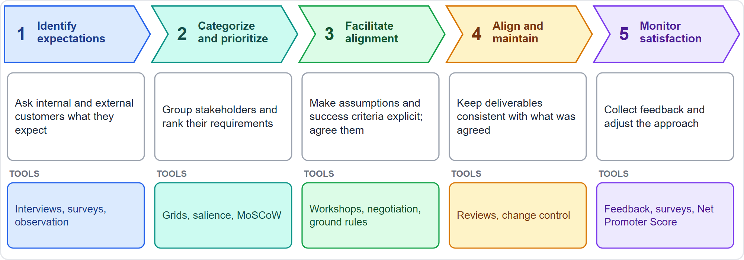
Aligning and Managing Expectations
Part 2
A project can meet scope, schedule and budget and still fail on expectations
EXAM TIP Satisfaction is part of the project objectives: surface assumptions before you baseline.
PMP Exam Prep 2026 | PMBOK 8 and the New ECO
Module 4: Vision, Stakeholders and Communication
34 / 65
Notes:
A project can meet scope, schedule and budget and still fail on expectations. So satisfaction is part of the project objectives. The diagram shows a working sequence of five steps, built from the expectation tasks in the exam outline. Identify expectations, from internal and external customers. Categorize and prioritize. Facilitate alignment, making assumptions, constraints and success criteria explicit, and agreeing them. Align and maintain the outcomes, and route new requests through change control. And monitor satisfaction and respond. The crucial move is surfacing unspoken assumptions before you baseline. An assumption of no interruption to service, against a planned outage window, will hurt you later.

Slide 35
Early Signals and the Best Response
Part 2
Signal | Best response
Plan followed, but expectations not met | Acknowledge the gap; engage on what remains
Informal remarks about quality | An early signal: meet the person
People stopped contributing; input went nowhere | Show how their input shapes the outcome
Averages are stable, key accounts stop attending | Averages hide unhappy people: contact them
Behavior changes, or a change shifts who is affected | Reclassify or re-analyze; adjust the engagement
EXAM TIP Respond to the people involved: meet, ask, re-engage. Do not just review documents or send more information.
PMP Exam Prep 2026 | PMBOK 8 and the New ECO
Module 4: Vision, Stakeholders and Communication
35 / 65
Notes:
Exam scenarios often hide a small signal. This table shows common ones. The plan was followed, but the partner says expectations were not met: acknowledge the gap and engage on what remains. Informal remarks about quality: treat them as an early satisfaction signal, and meet the person. People stopped contributing because input went nowhere: show how their input shapes the outcome. Stable averages with key accounts missing: contact those accounts. A stakeholder's behavior changes, or a change shifts who is affected: reclassify or re-analyze, and adjust the engagement. The pattern is the same each time. Respond directly to the people involved, before reviewing documents or sending more information. This table is common exam practice.

Slide 36
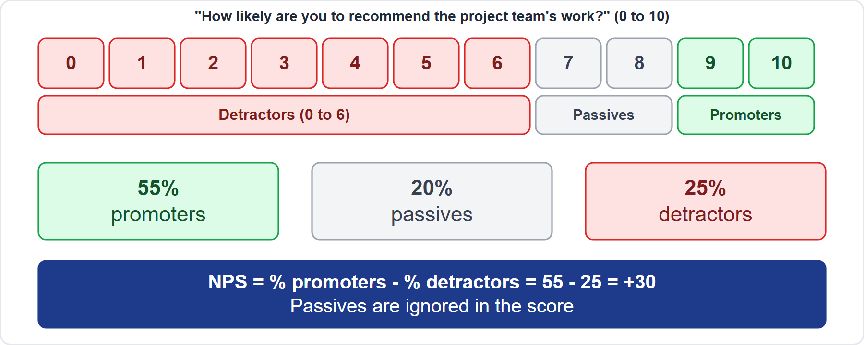
Is Engagement Working?
Part 2
Interviews and surveys, and periodic alignment on the project's objectives
Net Promoter Score: percent promoters minus percent detractors
The number of change requests to requirements, and feedback on increments
A falling score is a signal to talk to stakeholders
EXAM TIP Passives are ignored in the score, and a falling score means talk to stakeholders, not send longer reports.
PMP Exam Prep 2026 | PMBOK 8 and the New ECO
Module 4: Vision, Stakeholders and Communication
36 / 65
Notes:
How do you know engagement is working? PMBOK 8 suggests several checks. Interviews and surveys, and periodic alignment on the project's objectives. The number of change requests to requirements, and feedback on increments. And indicators such as the Net Promoter Score. People rate from zero to ten how likely they are to recommend your work. Nine and ten are promoters, seven and eight are passives, and zero to six are detractors. The score is the percentage of promoters minus the percentage of detractors. With fifty-five percent promoters and twenty-five percent detractors, the score is thirty. Passives are ignored. A falling score is a signal to talk to stakeholders.

Slide 37
Sponsor, Customer, Product Owner and End Users
Part 2
Role | What they provide | If they are absent
Sponsor | Authority, resources, charter and plan approval, benefits realization | Decisions stall; the project drifts from strategy
Customer | Expectations and acceptance, internal or external | Requirements are guessed
Product owner | Value and backlog priorities | Teams build what they imagine
End users | Continuous feedback on usefulness | You may deliver something nobody can use
EXAM TIP An active sponsor is a critical success factor: if yours is absent, meet them; do not bypass them.
PMP Exam Prep 2026 | PMBOK 8 and the New ECO
Module 4: Vision, Stakeholders and Communication
37 / 65
Notes:
Some stakeholders give decision leadership outside your authority. The sponsor provides authority and resources, approves the charter and plan, and makes sure the long-term benefits are realized. The customer provides expectations and acceptance. The product owner provides value and backlog priorities. End users provide continuous feedback on usefulness. Their involvement increases the likelihood of success, and their absence hurts. An active sponsor is a critical success factor. If yours has missed several reviews and decisions are waiting, meet them, explain the need and agree a realistic way to stay involved. Do not decide for them, and do not bypass them.

Slide 38
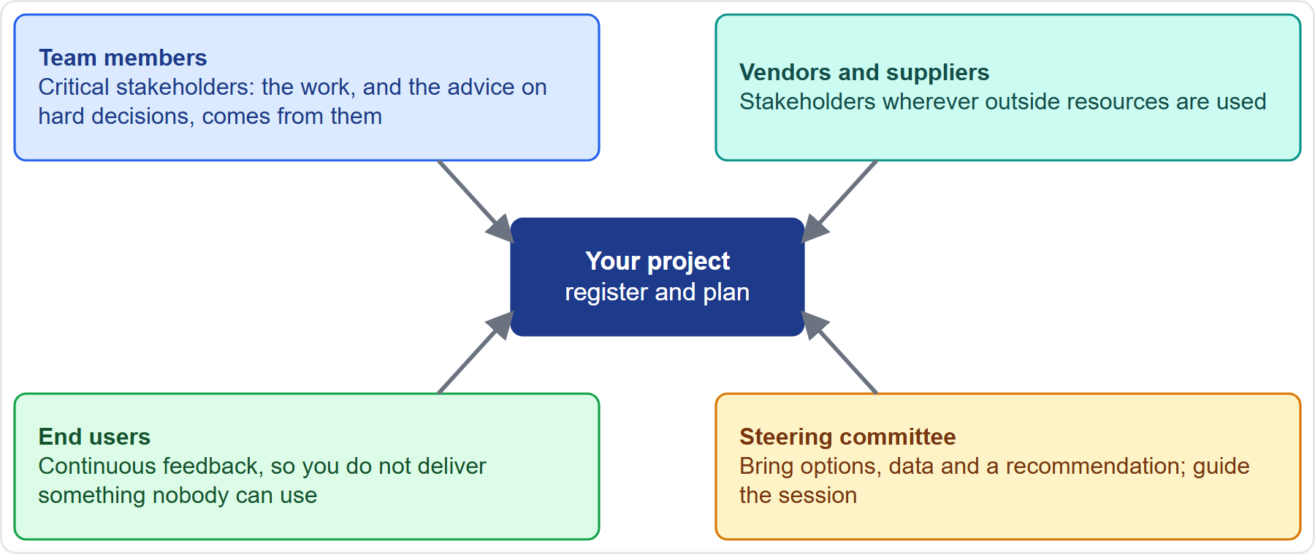
Do Not Forget These Stakeholders
Part 2
A stakeholder missing from the register is a risk: add, analyze and plan their engagement
EXAM TIP A vendor whose late input delays a milestone, but who is not in the register, is a missing stakeholder: add them and plan their engagement.
PMP Exam Prep 2026 | PMBOK 8 and the New ECO
Module 4: Vision, Stakeholders and Communication
38 / 65
Notes:
Four groups are easy to forget. Team members are critical stakeholders. The work, and the recommendations for hard decisions, come from them, so involve them. Vendors and suppliers are stakeholders wherever you use outside resources. If a vendor's late input delays a milestone and the vendor is not in your register, that is a registration failure, not just a contract problem. End users give continuous feedback, which keeps you from delivering something nobody can use. And steering committees decide faster when you bring options, data and a recommendation, and guide the session. A stakeholder missing from the register is a risk.

Slide 39
Coaching Versus Mentoring
Part 2
 | Coaching | Mentoring
Purpose | Help a person find the solution to a specific problem, by asking questions | Counsel and guide by sharing knowledge, skills and experience
Horizon | Goal-oriented and specific | Long-term relationship
Typical use | Coaching a new product owner, or helping a resistant stakeholder understand a change | Pairing junior and senior team members
EXAM TIP Coaching asks questions so the person finds the answer; mentoring shares experience.
PMP Exam Prep 2026 | PMBOK 8 and the New ECO
Module 4: Vision, Stakeholders and Communication
39 / 65
Notes:
The exam outline asks you to organize and act on mentoring opportunities, so you need to tell coaching and mentoring apart. Coaching helps a person find the solution to a specific problem on their own, by asking the right questions. It is goal-oriented and specific. Mentoring counsels and guides by sharing knowledge, skills and experience, and it is a long-term relationship. Use coaching for a new product owner who must develop judgment, or to help a resistant stakeholder understand a change. Use mentoring when you pair junior and senior team members. If the scenario says the person should find the answer themselves, think coaching.

Slide 40
Stakeholder Engagement in Predictive, Agile and Hybrid Work
Part 2
 | Predictive | Agile | Hybrid
Identification | Up front; refreshed at gates | Continuous | Up front, then continuous
Mechanisms | Plan, reports, steering committee | Product owner, reviews, radiators | Milestone and iteration reviews
Feedback | At milestones and gates | Every iteration | Both
Typical failure | Surprise at the end | One-way demos | Unclear who decides
EXAM TIP Identify the approach first, because the best engagement answer depends on it.
PMP Exam Prep 2026 | PMBOK 8 and the New ECO
Module 4: Vision, Stakeholders and Communication
40 / 65
Notes:
Engagement looks different by approach. In predictive work, you identify most stakeholders up front, refresh the register at gates, and engage through the plan, status reports and the steering committee. In agile work, identification is continuous, and the product owner, reviews, retrospectives and information radiators carry engagement, with feedback every iteration. Hybrid combines the two. The typical failures differ: surprise at the end, one-way demos or an absent product owner, and unclear decision rights. When you read a scenario, identify the approach first, because the best answer depends on it.

Slide 41
Stakeholder Traps: What PMI Expects
Part 2
Unhappy or resistant stakeholder: understand first; do not escalate
Late-found or low-power stakeholder: engage now, update the register, never ignore regulators or communities
Engagement plan is not the communications plan
Conflicting demands: bring the parties together and align on objectives
Following the plan is not the same as satisfied stakeholders
Bad news: share it early, factually, with options
PMP Exam Prep 2026 | PMBOK 8 and the New ECO
Module 4: Vision, Stakeholders and Communication
41 / 65
Notes:
Let us gather the traps for stakeholders. With an unhappy or resistant stakeholder, understand first, and do not escalate. A late-discovered stakeholder is engaged now, with the register updated, and low-power stakeholders such as regulators and communities are never ignored. The engagement plan is not the communications plan. With conflicting demands, bring the parties together and align on project objectives. Following the plan is not the same as satisfied stakeholders. And share bad news early, factually, with options. If you remember one thing from this slide, it is the first: the first move is to understand, not to escalate.

Slide 42
Part 2 Recap
Part 2
1
Stakeholder
2
Identify and analyze
3
Map
may affect, be affected by, or feel affected
register, five stakes, never finished
grids, salience, directions of influence
4
Gap
5
Plan
6
Align
current versus desired engagement sets the effort
the engagement plan turns gaps into actions
expectations made explicit, monitored, signals read early
PMP Exam Prep 2026 | PMBOK 8 and the New ECO
Module 4: Vision, Stakeholders and Communication
42 / 65
Notes:
Let us recap Part 2. A stakeholder is anyone who may affect, be affected by, or feel affected. You identify and analyze them continuously, using a register and the five kinds of stake. You map them with grids, salience and directions of influence. The gap between current and desired engagement sets the effort. The engagement plan turns gaps into actions. And you align expectations by making them explicit, monitoring satisfaction, and reading early signals. In Part 3, we look at communication, and then you will practice with five exam-style questions.

Slide 43
Module 4: Vision, Stakeholders and Communication
Part 3 of 3: Communication, and practice
People domain · ECO task 8 and the module quiz
PMP Exam Prep 2026: PMBOK 8 and the New ECO
Module 4: Vision, Stakeholders and Communication · Part 3
Notes:
Welcome to Part 3. We will look at how communication is planned and managed. We will look at the models and methods behind it, and at how feedback loops and reporting work. Then you will practice with five questions.

Slide 44
What Communications Management Does
Part 3
Purpose: the right information to the right people at the right time, in a form they can use
Much of project work is engaging and communicating
It stays consistent with the stakeholder engagement plan
Three processes: plan, manage and monitor communications
The communications management plan says how, when and by whom
EXAM TIP Communication serves the engagement plan: the right information to the right people at the right time.
PMP Exam Prep 2026 | PMBOK 8 and the New ECO
Module 4: Vision, Stakeholders and Communication
44 / 65
Notes:
The purpose of communications management is an efficient and effective flow of information between the team and its stakeholders. That means the right information to the right people at the right time, in a form they can use. Much of project work is engaging and communicating. It stays consistent with the stakeholder engagement plan. It has three processes: plan, manage and monitor communications. And the communications management plan describes how, when and by whom information will be administered and shared. It is a living document, and it needs revising when the situation changes.

Slide 45
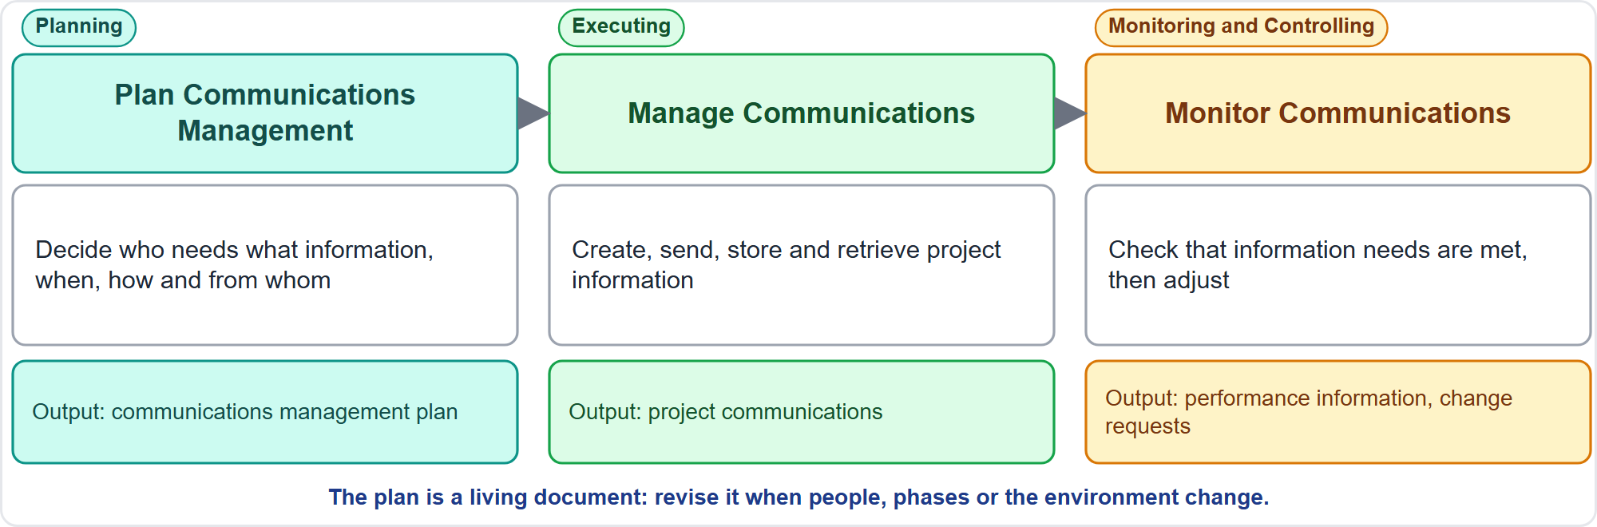
The Three Communication Processes
Part 3
Plan in Planning, manage in Executing, monitor in Monitoring and Controlling
EXAM TIP Plan, manage and monitor sit in Planning, Executing, and Monitoring and Controlling; adjust the methods and raise a change request if needed.
PMP Exam Prep 2026 | PMBOK 8 and the New ECO
Module 4: Vision, Stakeholders and Communication
45 / 65
Notes:
Here are the three processes. Plan Communications Management happens in Planning, and produces the communications management plan. Manage Communications happens in Executing: collecting, creating, distributing, storing and retrieving project information. And Monitor Communications, in Monitoring and Controlling, makes sure the information needs of the project and its stakeholders are met. If the flow is not working, you adjust the methods, frequency or content, update the plan, and raise a change request if needed.

Slide 46
Define the Communication Strategy
Part 3
Analyze stakeholders and what each needs to know
Run a communication requirements analysis: audiences, channels, languages, legal needs, development approach
Categorize information: internal or external, sensitive or public, general or detailed
Choose methods and technology for each audience and message
Define content, detail, frequency, owner and escalation in the plan
Review and revise as people, phases and the environment change
EXAM TIP Find out what each stakeholder needs before you write the plan; do not assume.
PMP Exam Prep 2026 | PMBOK 8 and the New ECO
Module 4: Vision, Stakeholders and Communication
46 / 65
Notes:
How do you define a communication strategy? First, analyze the stakeholders and their information needs. Second, run a communication requirements analysis, looking at audiences, channels, languages, legal needs and the development approach. Third, categorize the information: internal or external, sensitive or public, general or detailed. Fourth, choose methods and technology for each audience. Fifth, define content, detail, frequency, owner and escalation in the plan. And sixth, review and revise it as people, phases and the environment change. The exam point is the order: find out what each stakeholder needs before writing the plan.

Slide 47
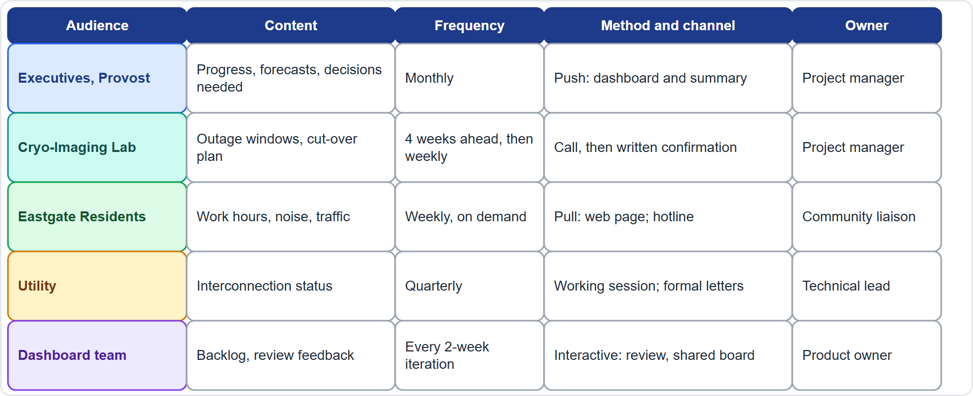
Case Check-In: The Communication Plan
Part 3
CASE CHECK-IN · Sunrise Campus Microgrid
One plan, five audiences: each gets its own content, rhythm, channel and owner
PMP Exam Prep 2026 | PMBOK 8 and the New ECO
Module 4: Vision, Stakeholders and Communication
47 / 65
Notes:
Here is a sketch of the communications plan for the microgrid. The executives get a monthly dashboard that explains every red item. The lab gets early notice of outage windows, by a call first and then in writing, because a missed window harms their equipment. The residents get a construction hotline and a pull web page, so they can check at their own discretion. And the utility gets formal letters, plus a quarterly working session. Each audience has its own content, frequency, channel and owner. One plan, five different ways of communicating.

Slide 48
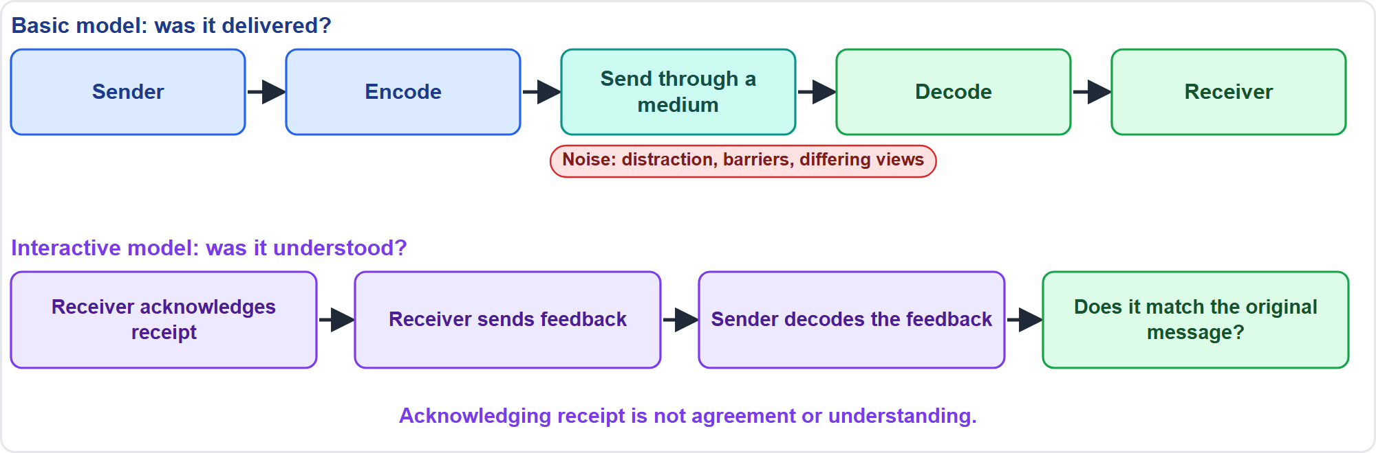
Basic and Interactive Communication
Part 3
Delivered is not the same as understood
EXAM TIP Acknowledging receipt does not mean the receiver understood or agreed.
PMP Exam Prep 2026 | PMBOK 8 and the New ECO
Module 4: Vision, Stakeholders and Communication
48 / 65
Notes:
The basic model has a sender who encodes a message, transmits it through a medium, and a receiver who decodes it. It checks that the message was delivered, not that it was understood. The interactive model adds acknowledgment and feedback. But be careful: acknowledging receipt does not mean agreement or comprehension. If the sender sees that the feedback matches the original message, communication has succeeded. That is why a team that confirms by email, and then uses the old format, shows delivery without understanding.

Slide 49
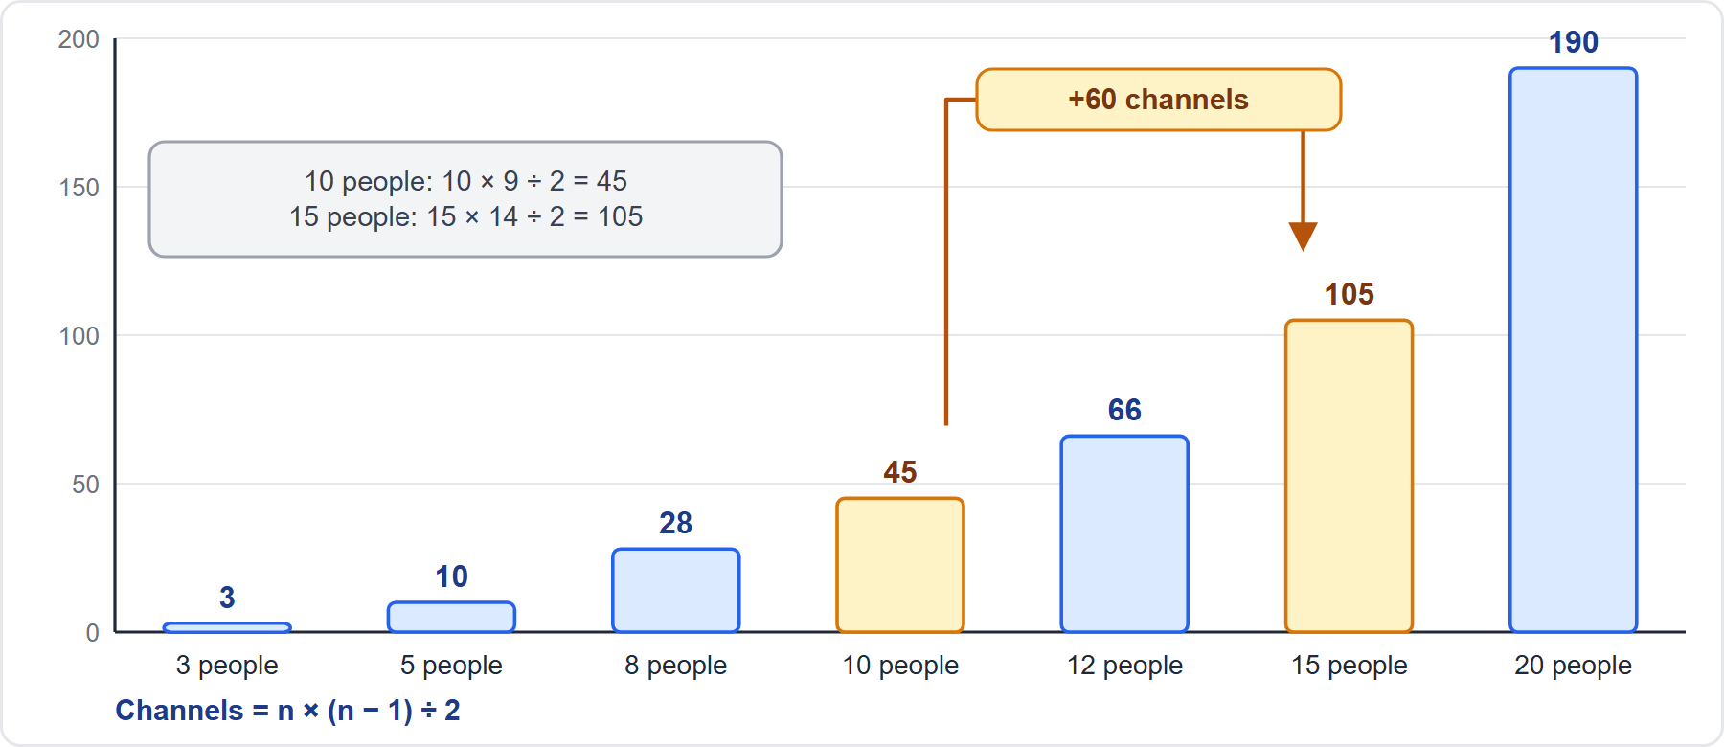
Channels Grow Faster Than Teams
Part 3
Channels = n × (n − 1) ÷ 2
EXAM TIP The formula is exam practice; PMBOK 8 asks you to consider the number of potential channels.
PMP Exam Prep 2026 | PMBOK 8 and the New ECO
Module 4: Vision, Stakeholders and Communication
49 / 65
Notes:
As teams grow, the number of potential communication channels grows much faster. The formula is n times n minus one, divided by two. Ten people have forty-five channels. Fifteen people have one hundred and five. So adding five people adds sixty channels. The chart shows the shape of that growth. The formula itself is exam practice, because PMBOK 8 only asks you to consider the number of potential channels, but calculation questions use it. The management lesson is to add structure, tools, and smaller teams as the group grows.

Slide 50
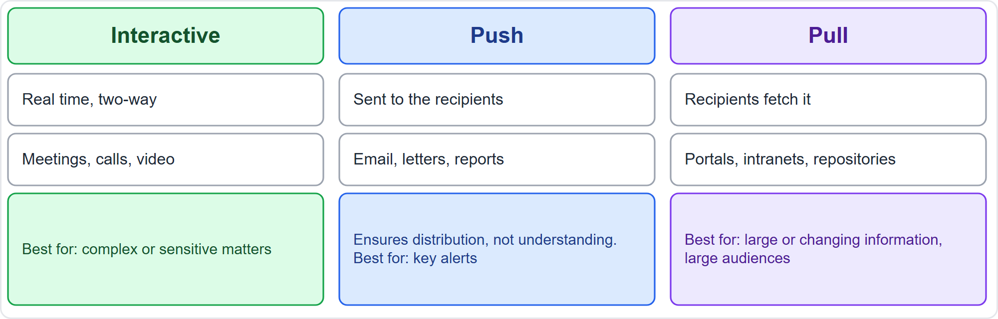
Push, Pull and Interactive
Part 3
Pull for large or changing information, push for alerts, interactive for complex or sensitive matters
EXAM TIP Pull for large or changing information, push for key alerts, interactive for complex or sensitive matters.
PMP Exam Prep 2026 | PMBOK 8 and the New ECO
Module 4: Vision, Stakeholders and Communication
50 / 65
Notes:
There are three methods. Interactive communication is multidirectional and in real time: meetings, calls and video conferences. Push communication is sent to recipients, such as email, letters and reports. It ensures distribution, but not receipt or understanding. Pull communication is accessed at the recipient's discretion: portals, intranets and repositories. It suits large or frequently updated information and large audiences. The rule of thumb: pull for large or changing information, push for key alerts, and interactive for complex or sensitive matters.

Slide 51
Common Barriers and the Usual Fix
Part 3
Barrier | Typical sign | Fix
Information overload | The decision is buried in a long pack | Lead with the decision
Filtering | Bad news is softened on the way up | A safe channel; ask for facts
Jargon | One word, different meanings | Define terms; check understanding
Cultural difference | Public yes, private doubt | Follow up one to one
Wrong medium | Safety notice by email to people without email | Fit the channel to the receiver
EXAM TIP Fix the barrier, not the symptom: lead with the decision, open a safe channel, define terms, follow up one to one.
PMP Exam Prep 2026 | PMBOK 8 and the New ECO
Module 4: Vision, Stakeholders and Communication
51 / 65
Notes:
Communication fails for predictable reasons. Information overload: the decision you need is buried in a long pack, so lead with the decision. Filtering: bad news is softened on its way up, so create a safe channel. Jargon: a word means different things to different teams, so define terms and check understanding. Cultural difference: public agreement but private doubt, so follow up one to one and learn the norms. And the wrong medium: a safety notice sent by email to people with no email access. This table is exam practice.

Slide 52
Promote Transparency and Collaboration
Part 3
Reachable information
Honest and early
Safe and open
put it where stakeholders actually look, not only in the team's room
share risks and bad news early; keep status accurate
dialogue, not win-lose debate
Regular collaboration
Fit the person
Storytelling
daily coordination, retrospectives, reviews with the real customers and time for feedback
written or asynchronous input, multilingual updates
carries lessons and culture, especially tacit knowledge
EXAM TIP Transparency means stakeholders can reach the information, not that it is posted where only the team sees it.
PMP Exam Prep 2026 | PMBOK 8 and the New ECO
Module 4: Vision, Stakeholders and Communication
52 / 65
Notes:
The exam outline asks you to promote transparency and collaboration. Make information reachable: put it where stakeholders actually look. An information radiator hidden in the team's room does not create transparency. Report honestly and early, with accurate status and bad news delivered early. Create a safe, open environment, where people have dialogue, not win-lose debate. Build regular collaboration into the rhythm: daily coordination meetings, retrospectives, and reviews with the real customers, not proxies, and structured time for their feedback. Fit the person: allow written or asynchronous input, and multilingual updates. And use storytelling, which carries lessons and culture, especially tacit knowledge.

Slide 53
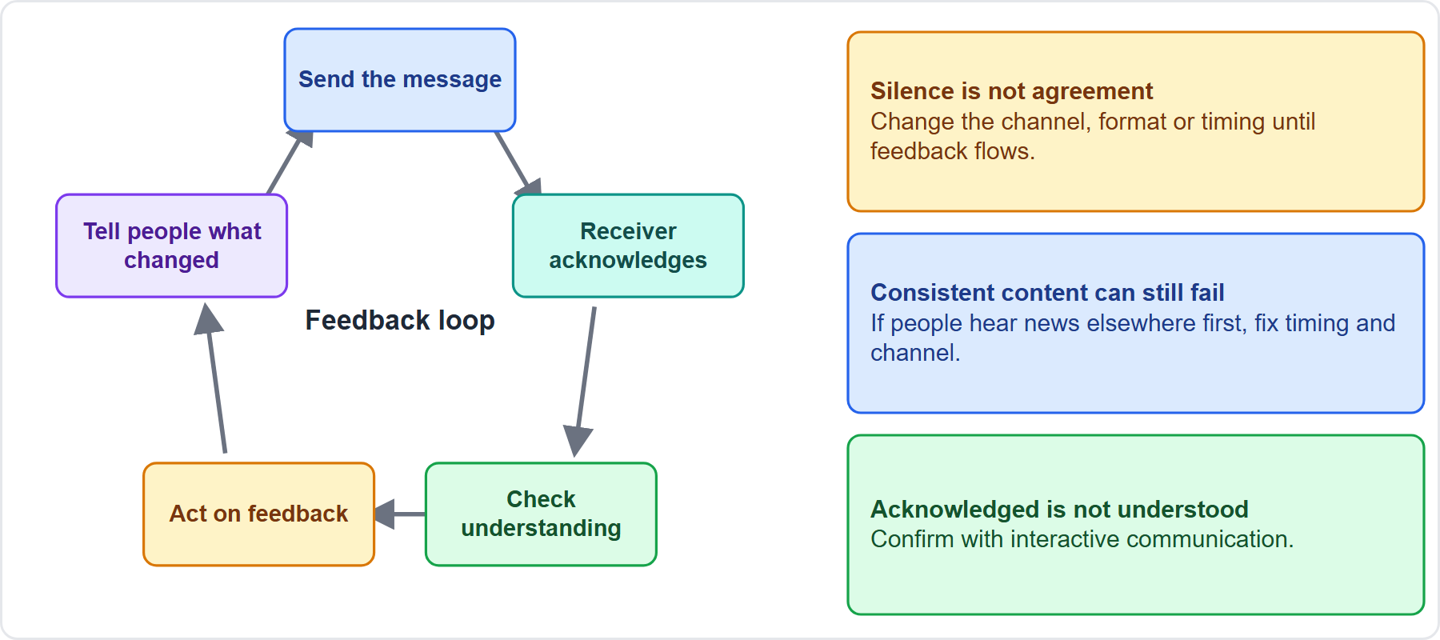
Transparency and the Feedback Loop
Part 3
Close the loop by telling people what changed because of their feedback
EXAM TIP Silence is not agreement: change the channel, format or timing until feedback flows.
PMP Exam Prep 2026 | PMBOK 8 and the New ECO
Module 4: Vision, Stakeholders and Communication
53 / 65
Notes:
Good communication is transparent, and it has a feedback loop. You send information, receivers acknowledge it, you check understanding, you act on the feedback, and you tell people what changed because of it. That last step closes the loop. Two lessons come from this. First, silence is not agreement. If a group never responds, find a channel and format that draws feedback, such as a short call or a named contact. Second, consistent content can still fail. If people hear news from other sources first, the problem is timing and channel, not content.

Slide 54
Meetings, Styles, AI and Confidentiality
Part 3
Meetings
Daily coordination meeting
Communication styles
an agenda with objectives, the right people, on time, actions recorded with owners
up to 15 minutes, for the team; not a status report to the manager
assess each person's preferred method, format and content, especially unsupportive stakeholders
AI in communications
Confidential information
assess its use, check AI drafts for accuracy and bias, keep confidential data out of unapproved tools
released only by the person the plan names
EXAM TIP A meeting without an agenda, the right people and recorded actions is the problem to fix, not a longer meeting.
PMP Exam Prep 2026 | PMBOK 8 and the New ECO
Module 4: Vision, Stakeholders and Communication
54 / 65
Notes:
Five practical points. Meetings need an agenda with objectives, the right participants, a start and finish on time, and actions recorded with owners. A daily coordination meeting is short, up to fifteen minutes, and for the team, not a status report to the project manager. A communication styles assessment finds each person's preferred method, format and content. PMBOK 8 also asks you to assess the use of AI in communications: check AI-drafted material for accuracy and bias, and keep confidential project data out of unapproved tools. And confidential information is released only by the person your communications plan names.

Slide 55
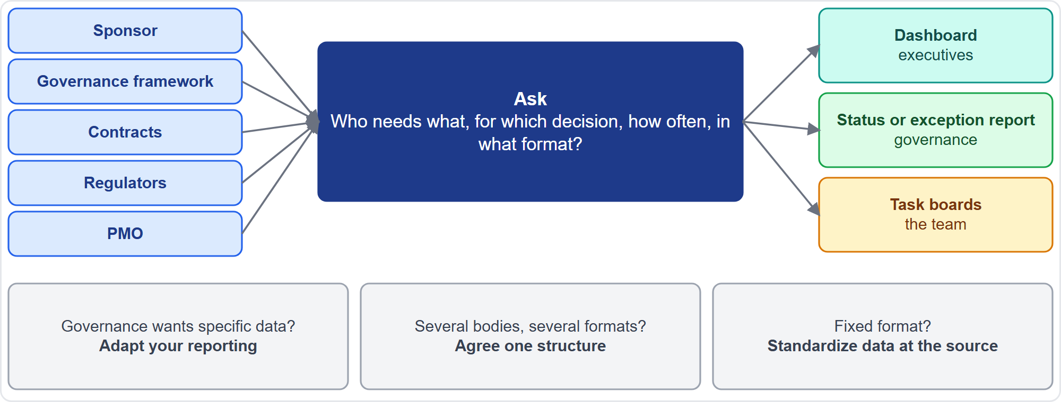
Understand Reporting Requirements
Part 3
Ask first, then design the reports; keep artifacts accessible and controlled in one repository
EXAM TIP The project does not decide whether governance's requirement is needed: it provides what governance requires.
PMP Exam Prep 2026 | PMBOK 8 and the New ECO
Module 4: Vision, Stakeholders and Communication
55 / 65
Notes:
Before you design reports, understand the requirements. Ask who needs what, for which decision, how often, and in what format. Sources include the sponsor, the governance framework, contracts, regulators and the PMO. If governance asks for specific data, such as earned value, adapt your reporting to provide it. The project does not decide whether the requirement is needed. If several oversight bodies want different formats, agree one reporting structure with them, through the sponsor, with a single source of truth. If the format is fixed, standardize the data at the source. Keep artifacts accessible and controlled.

Slide 56
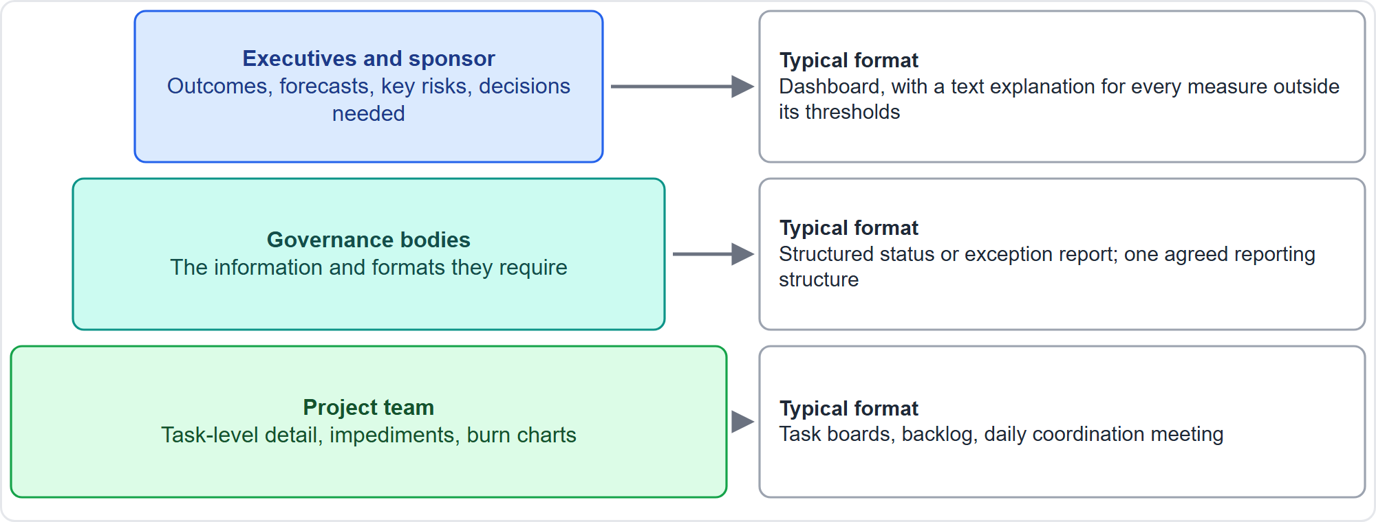
Reporting: One Size Does Not Fit All
Part 3
Tailor level, format and detail to each audience
EXAM TIP A dashboard needs a text explanation for any measure outside its thresholds.
PMP Exam Prep 2026 | PMBOK 8 and the New ECO
Module 4: Vision, Stakeholders and Communication
56 / 65
Notes:
Reports must fit their audience. Executives want a summary: outcomes, forecasts, key risks and the decisions needed, usually on a dashboard. Governance bodies want milestones, variances and risks. The team needs detail, on boards and backlogs. One long report rarely serves both an executive and an engineer. A dashboard shows progress against key measures, often in red, amber and green, but needs a text explanation for any measure outside its thresholds. If governance asks for specific information, such as earned value, adapt your reporting to provide it. If several bodies ask for different formats, agree one reporting structure with them.

Slide 57
Communication in Predictive, Agile and Hybrid Work
Part 3
 | Predictive | Agile | Hybrid
Plan | Formal communications management plan | Light plan plus working agreements | Formal for governance, team rhythm inside
Information flow | Scheduled reports, newsletters, town halls | Continuous: daily coordination, reviews, shared boards | Both
Transparency | Reports and dashboards to governance | Information radiators, burn charts | Dashboards for sponsors, boards for the team
Feedback | Interviews, surveys, review meetings | Every review and retrospective, customers in the room | Both
EXAM TIP Match the approach in the scenario to the expected answer: a formal plan for predictive, working agreements and radiators for agile.
PMP Exam Prep 2026 | PMBOK 8 and the New ECO
Module 4: Vision, Stakeholders and Communication
57 / 65
Notes:
Communication also varies by approach. Predictive projects have a formal communications management plan, with scheduled reports, newsletters and town halls. Agile projects use a light plan and working agreements, with communication built into daily coordination meetings, reviews and shared boards. Transparency comes from information radiators and burn charts. Feedback happens in every review and retrospective, with the real customers in the room. Hybrid uses a formal plan for governance and customers, and the team's own rhythm inside. Match the approach in the scenario to the expected answer.

Slide 58
Communication Traps: What PMI Expects
Part 3
Needs first: analyze requirements before writing the plan
Acknowledged is not understood: use interactive communication to check
Clarifications keep failing: find the root cause
Silence is not agreement: change channel, format or timing
Bad news: early, factual, with impact and options
Transparency, governance and AI: reachable information, what governance requires, verified AI output
PMP Exam Prep 2026 | PMBOK 8 and the New ECO
Module 4: Vision, Stakeholders and Communication
58 / 65
Notes:
Here are the communication traps. Find out what each stakeholder needs before writing the plan. Acknowledged is not understood, so check with interactive communication. When clarifications keep failing, find the root cause. Silence is not agreement, so change the channel, format or timing until feedback flows. Deliver bad news early and factually, with impact and options. Transparency means information stakeholders can actually reach. Give governance what it requires, and agree one reporting structure when several bodies ask. And use AI carefully, checking its output and keeping confidential data out of unapproved tools.

Slide 59
Module Recap
Part 3
1
Vision
2
Stakeholders
3
Gap
co-create it, promote it, keep it current
identify, analyze, classify, never stop
current versus desired engagement drives effort
4
Expectations
5
Communication
6
Reporting
explicit, aligned, monitored
requirements, methods, feedback loop
tailored to each audience
PMP Exam Prep 2026 | PMBOK 8 and the New ECO
Module 4: Vision, Stakeholders and Communication
59 / 65
Notes:
For vision: co-create it, promote it, keep it current. For stakeholders: identify, analyze and classify them, and never stop. The gap between current and desired engagement drives your effort. Expectations are made explicit, aligned and monitored. Communication starts from requirements, and uses the right methods and a feedback loop. And reporting is tailored to each audience. Now it is time to test yourself. Five questions follow. For each one, pause the video, choose your answer, and then listen to the explanation.

Slide 60
Practice Question 1
Part 3
Q1
Interviews show that a one-way recorded briefing, full of idioms, left team leads in six countries with three different readings of the project's goals. What should the project manager do?
A
Email a full written transcript of the briefing and ask every lead to study it before the next call
B
Run interactive sessions with visuals and local examples, then have the leads explain it back
C
Replace the leads whose reading differs from the sponsor's with colleagues who share the sponsor's view
D
Circulate the sponsor's reading to every country as the single official interpretation of the goals
PMP Exam Prep 2026 | PMBOK 8 and the New ECO
Module 4: Vision, Stakeholders and Communication
60 / 65
Notes:
Question one. Interviews show that a one-way recorded briefing, full of idioms, left team leads in six countries with three different readings of the project's goals. What should the project manager do? The four options are on the screen. Choose your answer. [PAUSE 12] The answer is B. The cause is a one-way channel and idiomatic language, so the fix is interactive sessions with visuals and local examples, checked by having the leads explain the goals back. Resending a transcript, replacing people or imposing one reading does not address the cause.

Slide 61
Practice Question 2
Part 3
Q2
A resident living near the worksite, who is not directly affected by the construction, starts a petition because she believes the noise will harm local children. The team says she is not a stakeholder. How should the project manager respond?
A
Ask the city to deal with the petition on the project's behalf
B
Agree, because only people with a legal or contractual link are stakeholders
C
Treat her as a stakeholder, since perceived impact counts, and engage her about her concerns
D
Add her to the register but contact her only after the work is complete
PMP Exam Prep 2026 | PMBOK 8 and the New ECO
Module 4: Vision, Stakeholders and Communication
61 / 65
Notes:
Question two. A resident living near the worksite, who is not directly affected by the construction, starts a petition because she believes the noise will harm local children. The team says she is not a stakeholder. How should the project manager respond? The four options are on the screen. Choose your answer. [PAUSE 12] The answer is C. A stakeholder may perceive itself to be affected, and low power never means ignore. Handing the petition to the city, excluding her, or contacting her only after the work leaves a potential opponent unengaged.

Slide 62
Practice Question 3
Part 3
Q3
On the engagement assessment matrix the sponsor is currently neutral but needs to be leading, while the quality lead is supportive and needs to be supportive. Where should effort go first?
A
On the quality lead, because supportive stakeholders can slip away if they are ignored
B
On both equally, because every stakeholder should be brought to the leading level
C
On neither, because neutral and supportive are both acceptable engagement levels
D
On the sponsor, because the gap between current and desired engagement is largest
PMP Exam Prep 2026 | PMBOK 8 and the New ECO
Module 4: Vision, Stakeholders and Communication
62 / 65
Notes:
Question three. On the engagement assessment matrix, the sponsor is currently neutral but needs to be leading, while the quality lead is supportive and needs to be supportive. Where should effort go first? The four options are on the screen. Choose your answer. [PAUSE 12] The answer is D. The gap between current and desired engagement directs the effort. The sponsor's gap is two levels, and the quality lead has none. Not everyone needs to reach the leading level.

Slide 63
Practice Question 4
Part 3
Q4
A program team grows from 10 to 15 people. By how many do the potential communication channels increase?
A
By 60, from 45 channels to 105
B
By 5, one new channel for each new member
C
By 23, the same 50 percent as the team
D
By 50, one channel from each new member to each existing member
PMP Exam Prep 2026 | PMBOK 8 and the New ECO
Module 4: Vision, Stakeholders and Communication
63 / 65
Notes:
Question four. A program team grows from ten to fifteen people. By how many do the potential communication channels increase? The four options are on the screen. Choose your answer. [PAUSE 12] The answer is A. Channels equal n times n minus one, divided by two. Ten people give forty-five channels, fifteen people give one hundred and five, so the increase is sixty. Counting only one channel per new member understates the growth.

Slide 64
Practice Question 5
Part 3
Q5
A project has a communications management plan that lists who receives which reports and when, yet several key stakeholders remain resistant. What is missing?
A
A longer distribution list for each report, so that every stakeholder receives every update
B
A stakeholder engagement plan that sets target engagement levels and how to reach them
C
A more detailed schedule that shows the exact date and time of every planned update
D
A risk register entry for each resistant stakeholder, without any further actions planned
PMP Exam Prep 2026 | PMBOK 8 and the New ECO
Module 4: Vision, Stakeholders and Communication
64 / 65
Notes:
Question five. A project has a communications management plan that lists who receives which reports and when, yet several key stakeholders remain resistant. What is missing? The four options are on the screen. Choose your answer. [PAUSE 12] The answer is B. The communications plan says what information goes to whom. The engagement plan is what moves each stakeholder to the level the project needs. A longer distribution list or a more detailed schedule moves information, not people.

Slide 65
Answers at a Glance
Part 3
Question | Answer | Why
Q1 | B | One-way channel and idioms caused it: use interactive sessions and explain-back
Q2 | C | Perceived impact makes her a stakeholder; low power never means ignore
Q3 | D | The largest gap between current and desired engagement gets effort first
Q4 | A | n(n−1)÷2: 45 channels become 105, so 60 more
Q5 | B | The engagement plan is what moves resistant stakeholders; the communications plan moves information
PMP Exam Prep 2026 | PMBOK 8 and the New ECO
Module 4: Vision, Stakeholders and Communication
65 / 65
Notes:
Here are all five answers together. Question one: B. A one-way channel and idioms caused the misunderstanding, so use interactive sessions and explain-back. Question two: C. Perceived impact makes her a stakeholder. Question three: D. The largest gap between current and desired engagement gets the effort first. Question four: A. Forty-five channels become one hundred and five, so sixty more. Question five: B. The engagement plan moves resistant stakeholders, while the communications plan moves information. That completes Module 4. Next, Module 5 covers leading the team, conflict and knowledge. See you there.

