Slide 1
Module 5: Leading Teams: Leadership, Conflict and Knowledge
Part 1 of 3: Leading the team
People domain · ECO tasks 2, 3 and 7
PMP Exam Prep 2026: PMBOK 8 and the New ECO
Module 5 · Part 1
Notes:
Welcome to Module 5. This module is the second of the People domain modules, and it is about the team itself. In Part 1, we look at leading the team: expectations, leadership style, empowerment and problem solving. Part 2 covers people, motivation and conflict. Part 3 covers knowledge: how to find it, capture it and transfer it. Throughout, the best answers tend to talk to the people involved first.

Slide 2
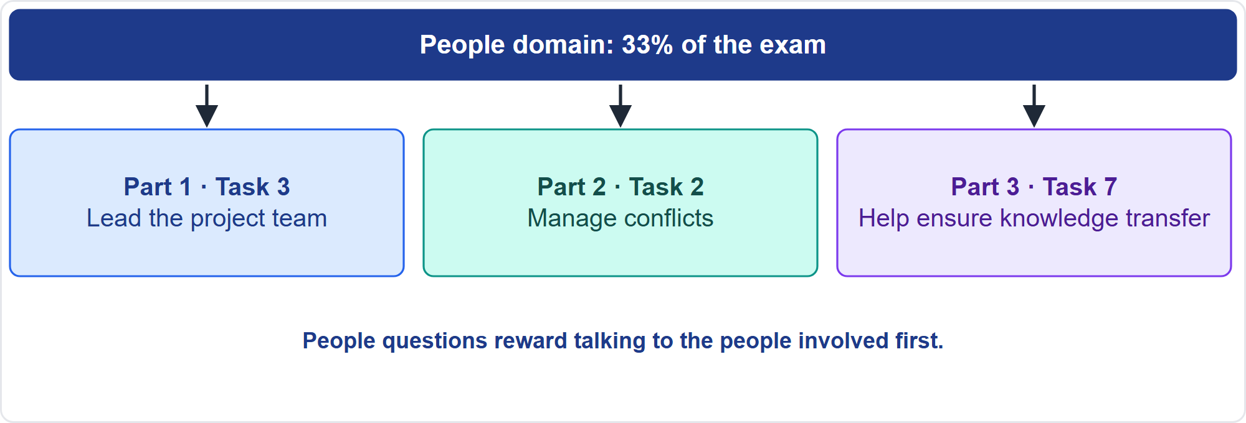
Where This Module Sits in the Exam
Part 1
Three People-domain tasks
EXAM TIP People questions reward talking to the people involved before analyzing documents, escalating or imposing a fix.
PMP Exam Prep 2026 | PMBOK 8 and the New ECO
Module 5
2 / 59
Notes:
Here is where this module sits. The People domain carries about a third of the exam. This module covers three of its eight tasks. Task three: lead the project team. Task two: manage conflicts. Task seven: help ensure knowledge transfer. They map to our three parts. The habit that pays off across all three: talk to the people involved before analyzing documents, escalating or imposing a fix.

Slide 3
What You Will Learn
Part 1
Set team-level expectations, a team charter and the right leadership style
Empower the team, solve problems and represent the team's voice
Support varied perspectives, motivate people and clarify roles
Run the conflict process: source, context, technique, agreement, escalation
Set and enforce ground rules
Identify, capture and transfer critical knowledge
PMP Exam Prep 2026 | PMBOK 8 and the New ECO
Module 5
3 / 59
Notes:
By the end of this module you will be able to do six things. Set team-level expectations, a team charter and the right leadership style. Empower the team, solve problems and represent the team's voice. Support varied perspectives, motivate people and clarify roles. Run the conflict process: source, context, technique, agreement and escalation. Set and enforce ground rules. And identify, capture and transfer critical knowledge.

Slide 4
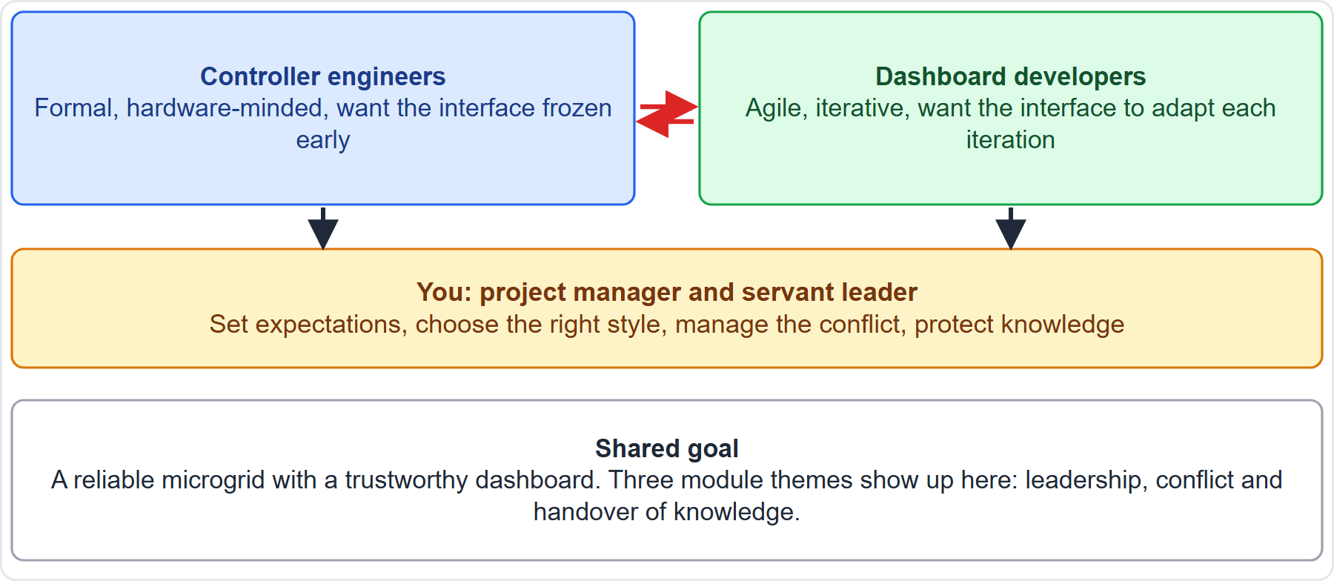
Case Check-In: Two Teams, One Goal
Part 1
CASE CHECK-IN · Sunrise Campus Microgrid
Controller engineers and dashboard developers work at different rhythms
You set expectations, choose a style, manage conflict and protect knowledge
PMP Exam Prep 2026 | PMBOK 8 and the New ECO
Module 5
4 / 59
Notes:
In our case, two teams must work together. The controller engineers are formal and hardware-minded, and they want the interface frozen early. The dashboard developers are agile and iterative, and they want the interface to adapt each iteration. Both share one goal: a reliable microgrid with a trustworthy dashboard. You are the project manager and servant leader. Over this module you will set expectations, choose a leadership style, manage the conflict and protect critical knowledge.

Slide 5
Key Terms
Part 1
Term | Meaning
Lead the Team | Improve competencies, interactions and the environment to raise performance
Servant leadership | Serve the needs and development of team members to enable top performance
Centralized or distributed | Authority with one accountable person, or spread across empowered teams
Team charter | The team's values, communication, decision and conflict rules, and agreements
Emotional intelligence | Identifying and managing your own and others' emotions
Empowerment | Authority over how the work is done, within boundaries
EXAM TIP Leadership is useful to every member, whether authority is centralized or shared.
PMP Exam Prep 2026 | PMBOK 8 and the New ECO
Module 5
5 / 59
Notes:
Six terms. Lead the team means improving competencies, interactions and the team environment to raise performance. Servant leadership means serving the needs and development of team members to enable the highest performance. Management can be centralized, with authority and accountability held by one person, or distributed, with authority spread across empowered teams. The team charter holds the team's values, communication guidelines, decision and conflict rules, and agreements. Emotional intelligence is the ability to identify and manage your own and others' emotions. And empowerment is authority over how work is done, within boundaries.

Slide 6
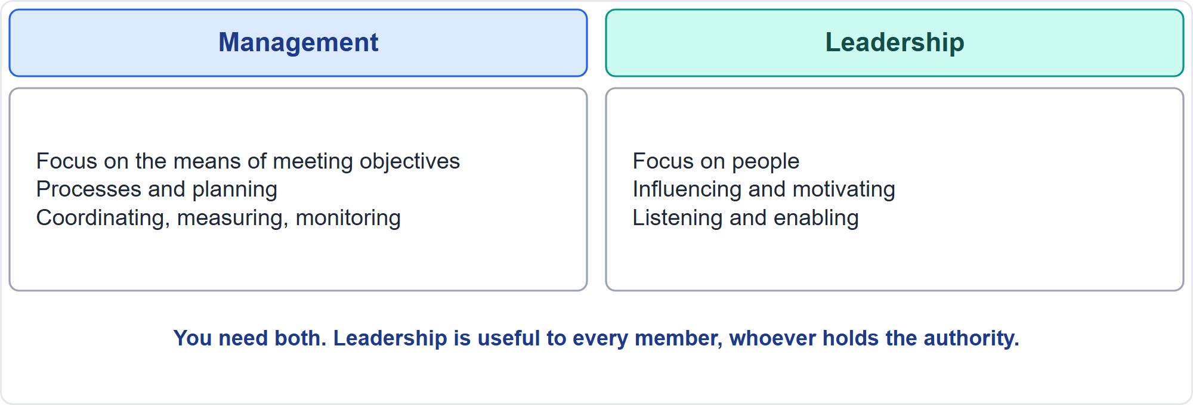
Management Versus Leadership
Part 1
Means versus people
EXAM TIP Leadership is behavior, not position; it is useful to all members.
PMP Exam Prep 2026 | PMBOK 8 and the New ECO
Module 5
6 / 59
Notes:
Management and leadership are different. Management activities focus on the means of meeting objectives: effective processes, planning, coordinating, measuring and monitoring. Leadership activities focus on people: influencing, motivating, listening and enabling. Leadership is the knowledge, skills and behaviors needed to guide, motivate and direct a team to achieve business goals. It includes negotiation, resilience, communication, problem solving, critical thinking and interpersonal skills. It is useful to all members, whether authority is centralized or shared. You need both management and leadership.

Slide 7
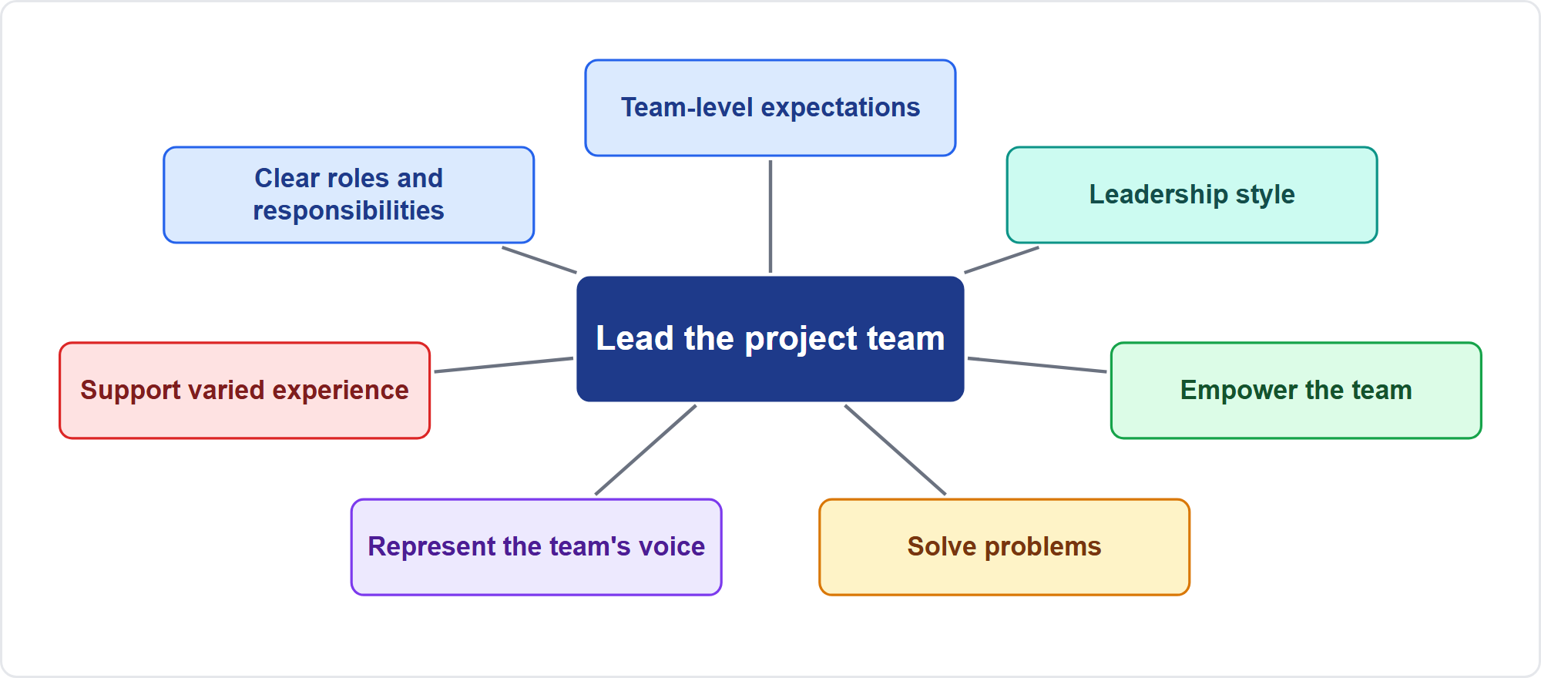
Seven Enablers of Leading the Team
Part 1
The ECO's seven enablers
EXAM TIP Expect scenario questions that test one enabler at a time: a new team, a team in conflict, a team that stopped contributing.
PMP Exam Prep 2026 | PMBOK 8 and the New ECO
Module 5
7 / 59
Notes:
The ECO lists seven enablers for leading the project team. Establish expectations at the team level. Determine an appropriate leadership style. Empower the team. Solve problems. Represent the voice of the team. Support varied experiences, skills and perspectives. And establish clear roles and responsibilities. We take the first five in this part, and the last two, along with motivation, at the start of Part 2.

Slide 8
Establish Expectations at the Team Level
Part 1
Vision and objectives: communicate them and use them when the team decides
Team charter and working agreements: co-created values, communication, decisions, conflict, meetings
Ground rules and norms: agreed behavior, with a way to handle violations
Performance and quality expectations: definition of done, acceptance criteria, reporting
Kickoff: a deliberate start with purpose, roles and decision rules
Guidance and growth: goals for improvement and support for individual development
EXAM TIP Revisit the team charter when new members join and when the context changes.
PMP Exam Prep 2026 | PMBOK 8 and the New ECO
Module 5
8 / 59
Notes:
Start with expectations at the team level. Communicate the vision and objectives, and use them when the team decides and solves problems. Co-create a team charter and working agreements covering values, communication, decision-making, conflict resolution and meeting rules. Agree ground rules and norms, with a way to handle violations. Set performance and quality expectations, such as the definition of done and acceptance criteria. Hold a deliberate kickoff. And give guidance and growth: goals for improvement and support for individual development. Revisit the charter when new members join.

Slide 9
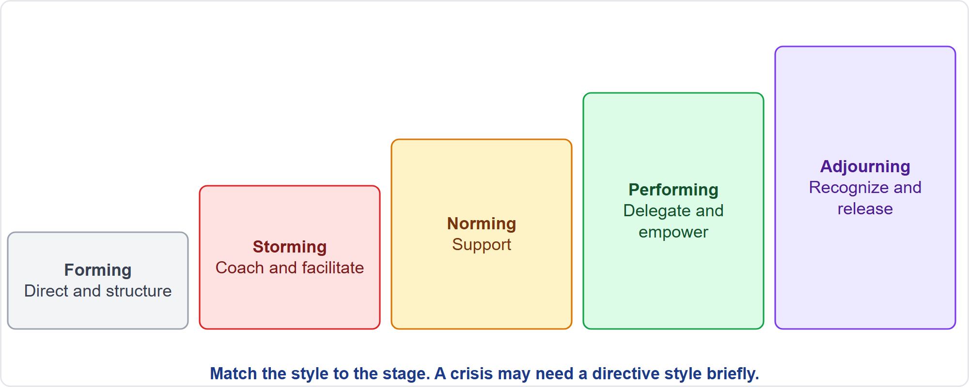
Stages of Team Development
Part 1
Forming to adjourning
EXAM TIP New team: structure and direction. Storming: facilitation. Mature team: delegation and servant leadership.
PMP Exam Prep 2026 | PMBOK 8 and the New ECO
Module 5
9 / 59
Notes:
Teams develop through stages: forming, storming, norming, performing and adjourning. The leadership emphasis changes with them. A new team needs structure and direction: vision, roles, expectations and ground rules. A team storming over approach needs coaching and facilitation: surface issues and reinforce agreements. A norming team needs support. A performing team needs delegation and servant leadership: remove impediments and protect the team. At adjourning, recognize and release. In a crisis, be directive briefly, then return to your normal style.

Slide 10
Choosing a Leadership Style
Part 1
Team
Task
Organization
maturity, stage, competence and willingness
complexity, urgency and risk
culture, governance, centralized or distributed
Approach and place
Newness
development approach, team location
new work calls for more oversight; experienced teams self-manage
EXAM TIP Match the style to the situation: no style fits every moment.
PMP Exam Prep 2026 | PMBOK 8 and the New ECO
Module 5
10 / 59
Notes:
How do you choose a style? Weigh the team: its maturity, stage, competence and willingness. Weigh the task: its complexity, urgency and risk. Weigh the organization: its culture and governance, centralized or distributed. Weigh the development approach and where the team sits. And weigh how new the work is to the organization: new work calls for more oversight and a more direct style, while experienced teams are more self-managing. No style fits every moment.

Slide 11
Style by Situation
Part 1
Situation | Style emphasis
Newly formed team, unclear roles | Directing and structuring: vision, roles, expectations, ground rules
Conflict over approach | Coaching and facilitating: surface issues, reinforce agreements
Maturing team | Supporting and delegating
High-performing, experienced team | Servant leadership and empowerment
Crisis, safety or compliance | Directive for the moment, then return and review
Matrix environment, little authority | Influence: persuade, listen, build mutual trust
EXAM TIP Do not impose a decision to end a storming debate; facilitate and reinforce the team's agreements.
PMP Exam Prep 2026 | PMBOK 8 and the New ECO
Module 5
11 / 59
Notes:
Here is a quick guide. A newly formed team with unclear roles needs directing and structure. A conflict over approach needs coaching and facilitation. A maturing team needs support and delegation. A high-performing, experienced team needs servant leadership and empowerment. A crisis, a safety issue or a compliance deadline calls for a directive style for the moment, then return to your normal style and review. And in a matrix environment with little authority, rely on influence: persuade, listen, and build mutual trust.

Slide 12
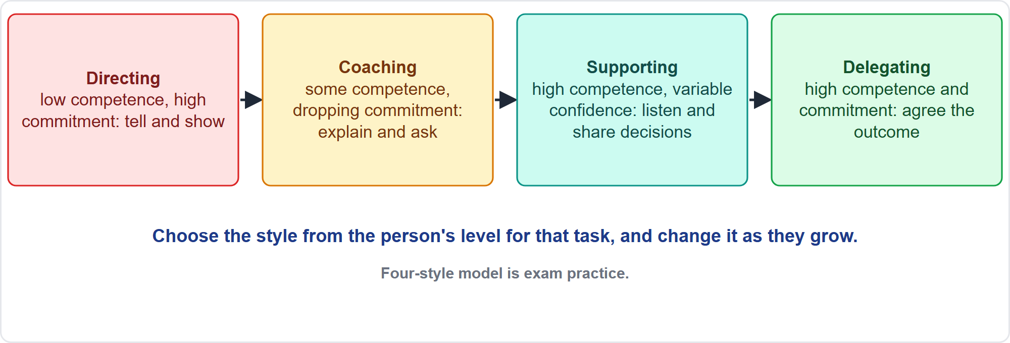
Situational Leadership
Part 1
Competence and commitment decide the style
EXAM TIP Situational leadership: choose the style from the person's competence and commitment for that task, and change it as they grow.
PMP Exam Prep 2026 | PMBOK 8 and the New ECO
Module 5
12 / 59
Notes:
PMBOK 8 names situational leadership. The four-style model is exam practice. Choose the style from the person's competence and commitment for that task. A low-competence, high-commitment beginner needs directing: tell, show and check closely. Someone with some competence and dropping commitment needs coaching: explain, ask questions, encourage. Someone with high competence and variable confidence needs support: listen, praise and share the decision. Someone with high competence and high commitment gets delegation: agree the outcome and leave the how to them.

Slide 13
Styles and the Risk of Overuse
Part 1
Style | Strength | Risk when overused
Servant | Clears the way for the team | Decisions drift when a firm call is needed
Transactional | Clear rewards for results | People do only what is rewarded
Transformational | Inspires commitment to change | Constant stretch exhausts people
Laissez-faire | Maximum autonomy | Goals blur and disputes fester
Directive | Speed and clarity in a crisis | Resentment and passivity
Participative | Buy-in and better decisions | Slow decisions, blurred accountability
EXAM TIP PMBOK 8 pairs Theory X with hands-on, top-down leadership and Theory Y with coaching; servant leadership suits self-managing teams.
PMP Exam Prep 2026 | PMBOK 8 and the New ECO
Module 5
13 / 59
Notes:
Every style has a strength and a risk when overused. Servant leadership clears the way, but decisions can drift when the team needs a firm call. Transactional leadership gives clear rewards, but people do only what is rewarded. Transformational leadership inspires commitment, but constant stretch exhausts people. Laissez-faire gives maximum autonomy, but goals blur. Directive leadership gives speed in a crisis, but breeds resentment. Participative leadership builds buy-in, but decisions slow down. PMBOK 8 pairs Theory X with hands-on leadership, Theory Y with coaching, and servant leadership with self-managing teams.

Slide 14
Empower the Team
Part 1
Delegate decisions about how work is done, within clear boundaries
Create the conditions: trust, clear purpose, skills, information, safety to speak
Motivate through autonomy, mastery and purpose
Stay available: coach, remove barriers, protect the team; do not abdicate
Escalate decisions beyond the team's authority with analysis and a recommendation
Healthy metrics but falling morale? Meet the team first
EXAM TIP A mature team that backs decisions with evidence should decide how to distribute its own daily work.
PMP Exam Prep 2026 | PMBOK 8 and the New ECO
Module 5
14 / 59
Notes:
Empower the team. Delegate decisions about how the work is done and about the details of deliverables, within clear boundaries: decision rights, guardrails and escalation points. Create the conditions: trust, clear purpose, skills, information and safety to speak. Stay available: coach, remove barriers and protect the team, but do not abdicate. Escalate decisions beyond the team's authority, with analysis and a recommendation. Two signals to read correctly. Healthy metrics with falling morale: meet the team first. A mature team whose tasks are still assigned by the project manager: let the team distribute its daily work.

Slide 15
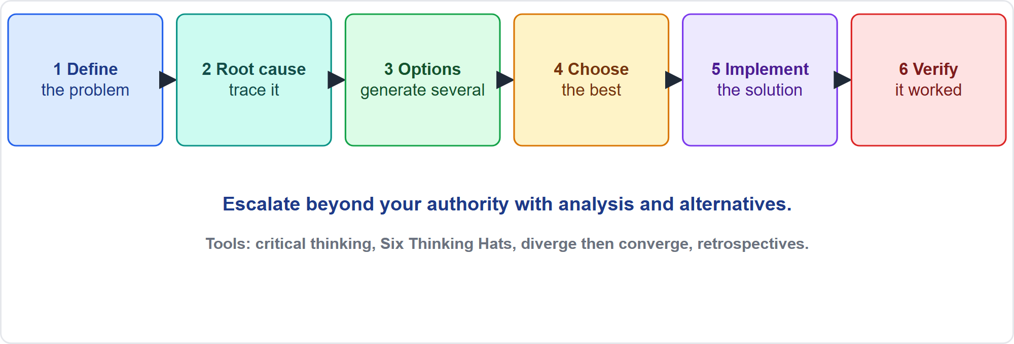
Solve Problems
Part 1
Define, root cause, options, choose, implement, verify
EXAM TIP Facilitate rather than solve everything yourself; involve the people closest to the work and verify the fix.
PMP Exam Prep 2026 | PMBOK 8 and the New ECO
Module 5
15 / 59
Notes:
PMBOK 8 gives a structured approach to problem solving. Define the problem. Identify the root cause. Generate possible solutions. Choose the best. Implement it. And verify effectiveness. Useful tools include critical thinking, which questions assumptions and spots bias. Also root cause analysis and Six Thinking Hats. Decision-making methods that diverge and then converge limit groupthink. And retrospectives help too. As a leader, facilitate rather than solve everything yourself, and escalate beyond your authority with alternatives.

Slide 16
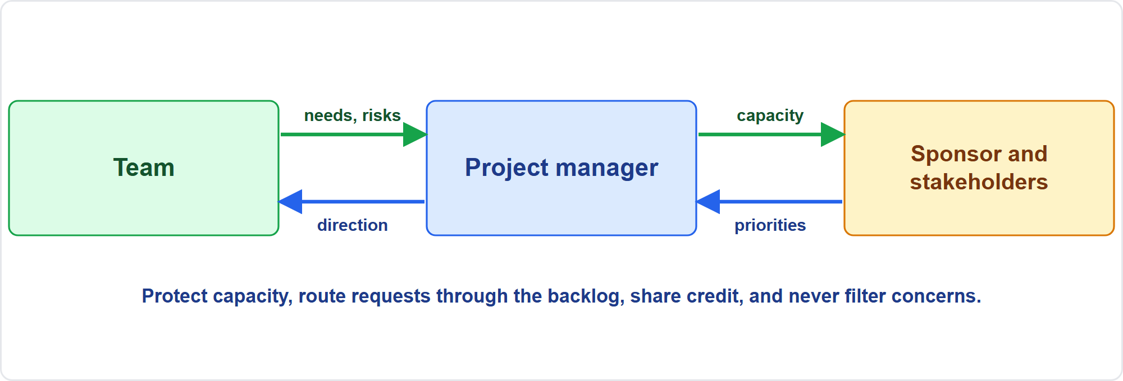
Represent the Voice of the Team
Part 1
Needs go up, decisions come down
EXAM TIP When the team asks you to represent it against unplanned mid-iteration requests, do so: show capacity and trade-offs.
PMP Exam Prep 2026 | PMBOK 8 and the New ECO
Module 5
16 / 59
Notes:
Represent the voice of the team. Speak for the team to the sponsor, governance and stakeholders: capacity limits, impediments, risks, needs and achievements. Protect the team by routing new requests through the backlog or change process, and by showing trade-offs and capacity data. Bring insight upward and decisions downward, transparently, and share credit. Do not speak for the team without its input, and do not filter its concerns. Remove the impediments that the team cannot remove itself.

Slide 17
Leadership in Predictive, Agile and Hybrid Work
Part 1
 | Predictive | Agile | Hybrid
Leadership model | Centralized; the project manager directs | Distributed and servant; the team self-organizes | Centralized for the envelope; distributed inside iterations
Roles | Defined by the RAM, functional or matrix roles | Product owner, team, facilitator | Both
Team | Specialists assigned by managers | Dedicated, cross-functional, about 3 to 9 | Mix
Decisions | Escalation and approval chains | Team decides how; product owner decides priority | Both
Improvement | Lessons at gates | Retrospective every iteration | Both
EXAM TIP Psychological safety is the foundation for candid retrospectives.
PMP Exam Prep 2026 | PMBOK 8 and the New ECO
Module 5
17 / 59
Notes:
Leadership looks different by approach. In predictive work, leadership is centralized: the project manager directs and coordinates, and roles come from the responsibility matrix. In agile work, leadership is distributed and servant, and the team self-organizes. The product owner, team and facilitator hold the roles. Decisions: escalation chains in predictive work, the team decides how and the product owner decides priority in agile work. Improvement comes at gates, or in a retrospective every iteration. Hybrid is centralized for the envelope and distributed inside iterations.

Slide 18
Leadership Traps: What PMI Expects
Part 1
Match style to stage and situation; crises may need a directive style briefly
Do not impose a decision to end a storming debate; facilitate
Empower within boundaries: do not micromanage and do not abdicate
Represent the team's voice and protect its capacity when asked
Adapt the process to people; do not force them to change their nature
Authority must match responsibility; one accountable owner per activity
EXAM TIP Healthy metrics can hide disengagement: meet the team before choosing a fix.
PMP Exam Prep 2026 | PMBOK 8 and the New ECO
Module 5
18 / 59
Notes:
The traps for Part 1. Match the style to the stage and situation, and use a directive style only briefly in a crisis. Do not impose a decision to end a storming debate. Facilitate and reinforce the team's agreements. Empower within boundaries: do not micromanage, and do not abdicate. Represent the team's voice and protect its capacity when it asks you to. Adapt the process to people, for example by accepting written input, rather than forcing people to change. And make authority match responsibility. Healthy metrics can hide disengagement, so meet the team first.

Slide 19
Part 1 Recap
Part 1
1
Expectations
2
Style
3
Situational leadership
vision, charter, ground rules, kickoff, quality expectations
by stage and situation; directive briefly in a crisis
competence and commitment decide
4
Empowerment
5
Problem solving
6
Voice of the team
decision rights within boundaries
define, root cause, options, choose, implement, verify
protect capacity; do not filter concerns
PMP Exam Prep 2026 | PMBOK 8 and the New ECO
Module 5
19 / 59
Notes:
Let us recap Part 1. Set expectations with a vision, a charter, ground rules and a kickoff. Choose the style by stage and situation, and be directive only briefly in a crisis. Situational leadership looks at competence and commitment for the task. Empower the team with decision rights within boundaries. Solve problems by defining, finding the root cause, generating options, choosing, implementing and verifying. And represent the team's voice: protect its capacity, and do not filter its concerns. In Part 2, we look at people, motivation and conflict.

Slide 20
Support Varied Experiences, Skills and Perspectives
Part 2
A safe, respectful, nonjudgmental environment; welcome disagreement as dialogue, not debate
Adapt to people: written or asynchronous input for those quiet in meetings
Mix seniority to create coaching and mentoring
Cultural intelligence: adjust communication and recognition without stereotyping
Be open about bias, yours and the team's
Watch workload and burnout; support flexibility
EXAM TIP Adapt the process to people; do not force people to change.
PMP Exam Prep 2026 | PMBOK 8 and the New ECO
Module 5
20 / 59
Notes:
Part 2 begins with people. Create a safe, respectful and nonjudgmental environment, and welcome disagreement as dialogue rather than debate. Adapt to people: written or asynchronous input suits members who are quiet in meetings but strong in writing. Mix seniority and expertise to create coaching and mentoring. Coaching asks questions to help a person find a solution, while mentoring is long-term guidance by sharing experience. Use cultural intelligence without stereotyping. Be open about bias. And watch workload and signs of burnout.

Slide 21
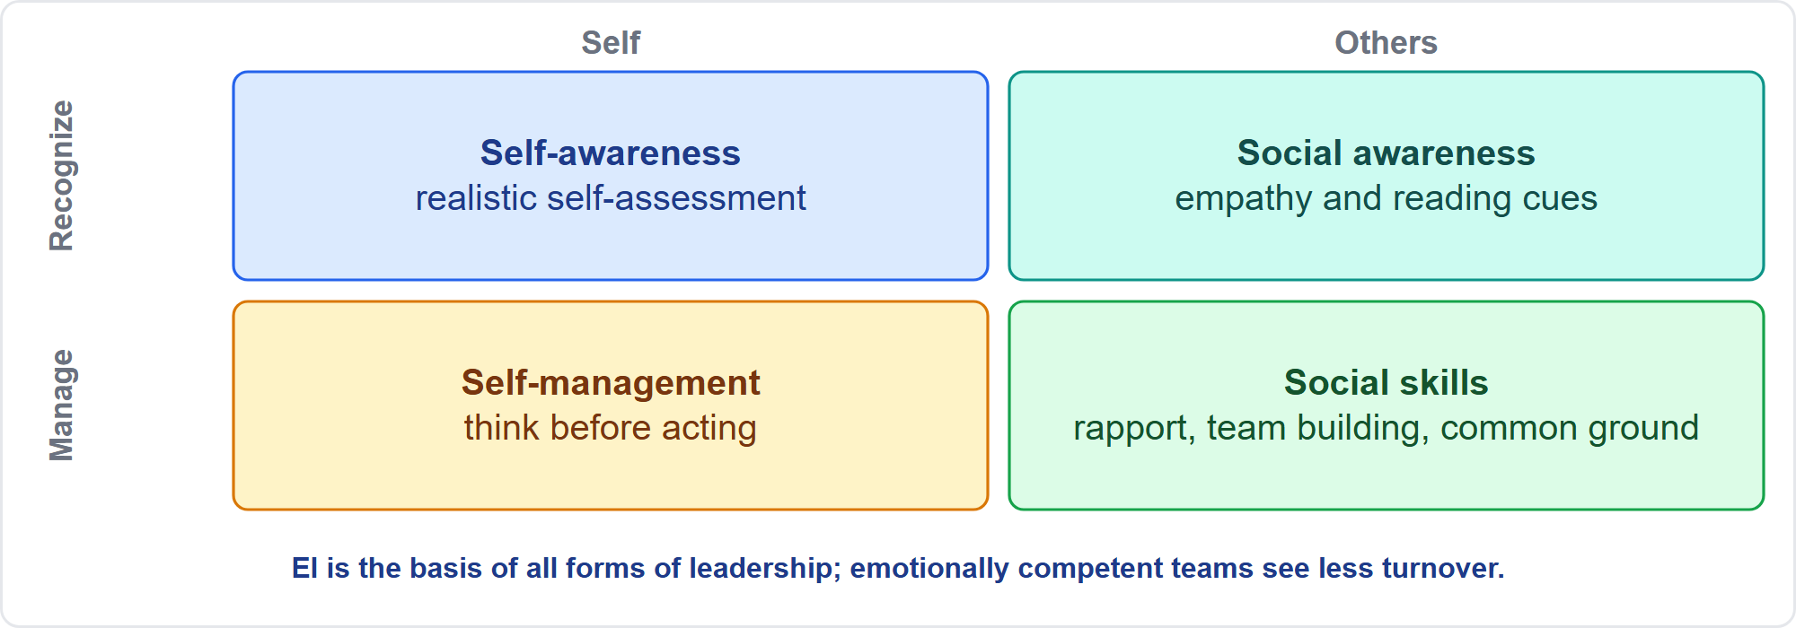
Emotional Intelligence
Part 2
Four areas of emotional intelligence
EXAM TIP Emotionally competent teams are more effective and have less turnover.
PMP Exam Prep 2026 | PMBOK 8 and the New ECO
Module 5
21 / 59
Notes:
Emotional intelligence has four areas. Self-awareness: a realistic self-assessment. Self-management: thinking before acting. Social awareness: empathy and reading cues. Social skills: building rapport, building teams and finding common ground. Emotional intelligence is the basis of all forms of leadership, and emotionally competent teams are more effective, with less turnover. Use skill matrices and individual and team assessments, such as surveys, interviews and focus groups, to understand strengths and preferences.

Slide 22
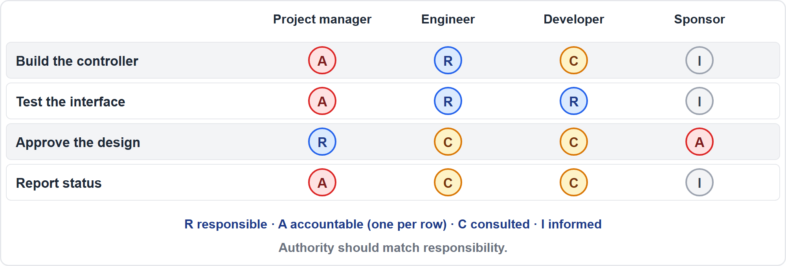
Clear Roles and Responsibilities
Part 2
A responsibility assignment matrix
EXAM TIP Authority should match responsibility; clarify who directs whose people, especially with vendors.
PMP Exam Prep 2026 | PMBOK 8 and the New ECO
Module 5
22 / 59
Notes:
Establish clear roles and responsibilities. A role is a function. A responsibility is a duty. Authority is the right to decide, approve and apply resources. And competence is skill and capacity. Authority should match responsibility. Use a responsibility assignment matrix, such as a RACI chart, with one accountable owner per activity. Fill competence gaps through training, coaching, mentoring or reassignment. In agile teams, titles vary and the functions matter. With vendors, clarify who directs whose people and the reporting lines. Revisit roles when people join, leave or change.

Slide 23
Motivation Theories
Part 2
Theory | Core idea
Maslow | Needs run from basic to self-actualization; a met need stops motivating
Herzberg | Hygiene factors prevent dissatisfaction; motivators create satisfaction
McClelland | Needs for achievement, power and affiliation
McGregor X, Y, Z | X: people avoid work; Y: people seek responsibility; Z: long-term commitment
Pink | Autonomy, mastery and purpose
Vroom | Effort leads to performance, reward and valued results
EXAM TIP Once pay is fair, growth, autonomy and purpose motivate; money alone does not fix disengagement.
PMP Exam Prep 2026 | PMBOK 8 and the New ECO
Module 5
23 / 59
Notes:
Motivation theories appear in scenarios as cues. Maslow: needs run from basic to self-actualization, and a satisfied need stops motivating. Herzberg: hygiene factors such as pay and conditions prevent dissatisfaction, while motivators such as achievement and recognition create satisfaction. McClelland: needs for achievement, power and affiliation. McGregor: Theory X assumes people avoid work, Theory Y assumes they seek responsibility, Theory Z adds long-term commitment. Pink: autonomy, mastery and purpose. Vroom, as exam practice: people are motivated when effort leads to performance, and performance to a valued reward.

Slide 24
Recognition, Rewards and Team Building
Part 2
Understand what motivates each person; culture changes what is meaningful
Intangible rewards can be as effective as money
Recognize throughout the project, not only at the end; celebrate quick wins
Team building is continuous: from a short agenda item to an off-site event
Training can be formal or informal, scheduled or unplanned
Virtual teams: use technology and relationship time to build trust
EXAM TIP Recognize early and often, in ways that fit the culture.
PMP Exam Prep 2026 | PMBOK 8 and the New ECO
Module 5
24 / 59
Notes:
Recognition and rewards: understand what motivates each person, because cultural differences change what is meaningful. Money is tangible, but intangible rewards can be as effective or more. Most members are motivated by growth, accomplishment, appreciation and applying their skills. Recognize throughout the project, not only at the end, and celebrate quick wins. Team building is a continuous process, from a five-minute agenda item to an off-site event, and it is valuable for remote teams. Training can be formal or informal.

Slide 25
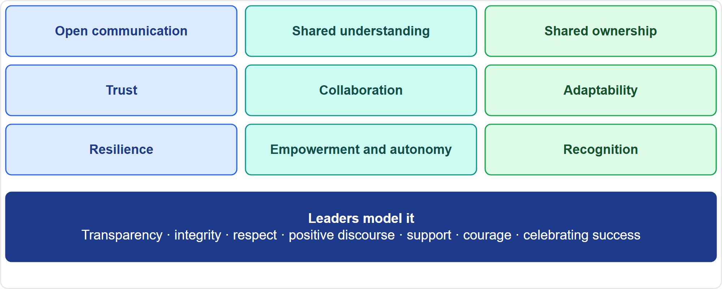
High-Performing Teams
Part 2
Characteristics and leader role-modeling
EXAM TIP Use performance assessments, such as lower turnover and higher cohesion, to choose training or coaching.
PMP Exam Prep 2026 | PMBOK 8 and the New ECO
Module 5
25 / 59
Notes:
High-performing teams show open communication, shared understanding and shared ownership. They show trust and collaboration. They show adaptability and resilience. And they show empowerment and autonomy, and recognition. Leaders role-model transparency, integrity, respect, positive discourse, support, courage and celebrating success. Team performance assessment, formal or informal, looks at indicators such as improved skills, lower turnover and greater cohesion. Use the findings to choose training, coaching or other changes. For virtual teams, try to hold at least one face-to-face meeting.

Slide 26
Conflict: What It Is
Part 2
Conflict is inevitable; sources include scarce resources, scheduling priorities and personal work styles
Managed well, it brings creativity and better decisions
Address it early, usually in private, directly and collaboratively
Team members try first; the project manager facilitates if it escalates
If disruption continues, formal procedures may apply, including disciplinary action
EXAM TIP Do not wait for conflict to explode, and do not raise it in front of the whole team.
PMP Exam Prep 2026 | PMBOK 8 and the New ECO
Module 5
26 / 59
Notes:
Now conflict. Conflict is inevitable in a project environment. Sources include scarce resources, scheduling priorities and personal work styles. Managed well, differences of opinion can increase creativity and improve decisions. PMBOK 8's core rules: address conflict early, usually in private, with a direct and collaborative approach. Team members are initially responsible for resolving a conflict that becomes negative. If it escalates, the project manager helps facilitate. If disruptive conflict continues, formal procedures may be used, including disciplinary action.

Slide 27
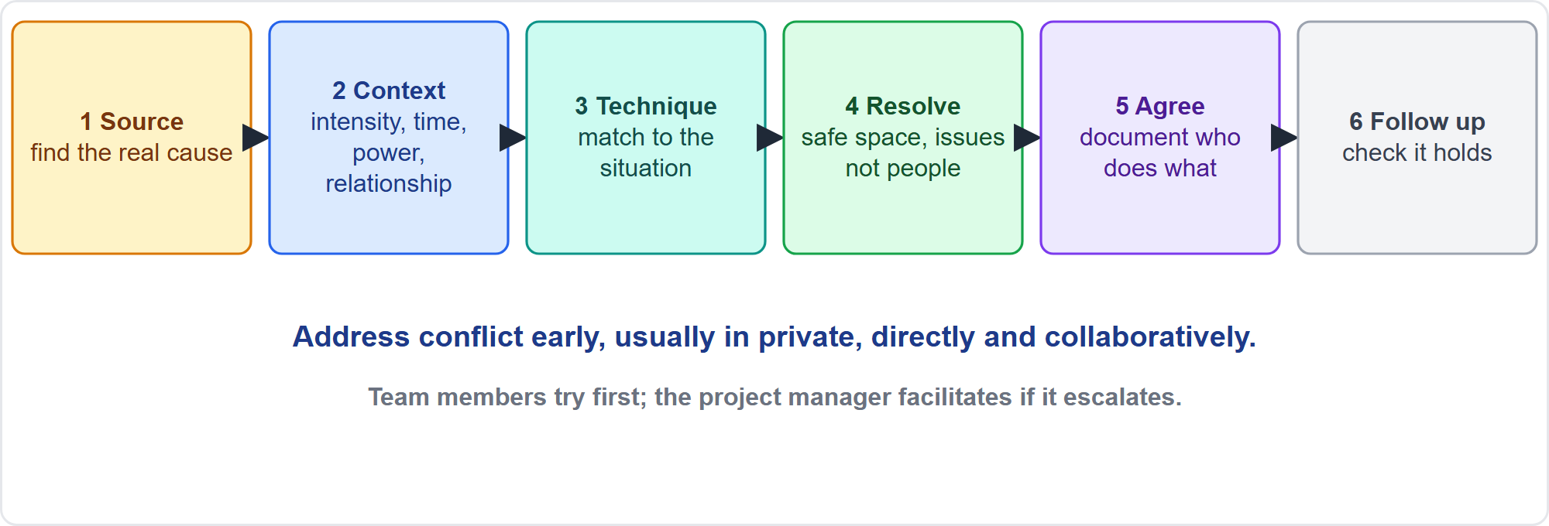
Managing a Conflict Step by Step
Part 2
Source, context, technique, resolve, agree, follow up
EXAM TIP Find the source first, then choose the technique.
PMP Exam Prep 2026 | PMBOK 8 and the New ECO
Module 5
27 / 59
Notes:
The conflict process has six steps. One, identify the source. Two, analyze the context. Three, choose a technique that fits. Four, run the resolution in a safe space, focusing on issues, not people. Five, agree and document who will do what. Six, follow up to check that it holds. Escalate in steps if it does not. Notice that choosing a technique comes third. Many wrong answers jump straight to a technique, a punishment or an escalation before finding the source.

Slide 28
Sources of Conflict
Part 2
Source | Example
Scarce resources | Two teams compete for the same specialist or budget
Scheduling priorities | Different views on what comes first
Personal work styles | Preferences for planning, pace and detail
Roles and accountability | Two parties think they own the work, or nobody does
Requirements and expectations | Hidden or contradictory expectations
Incentives and objectives | Goals that reward opposing behaviors
Communication, culture, change | Misreadings, remote work, an unrecorded informal change
EXAM TIP Personality clashes: address behavior and the work, not the person.
PMP Exam Prep 2026 | PMBOK 8 and the New ECO
Module 5
28 / 59
Notes:
Know the common sources. Scarce resources: two teams competing for the same specialist or budget. Scheduling priorities. Personal work styles. Roles and accountability: two parties believe they own the work, or nobody does. Requirements and expectations, even from the same signed document. Incentives and objectives that reward opposing behaviors, such as speed against thoroughness. And communication, culture and change, including an informal change nobody recorded. With personality clashes, address behavior and the work, not the person.

Slide 29
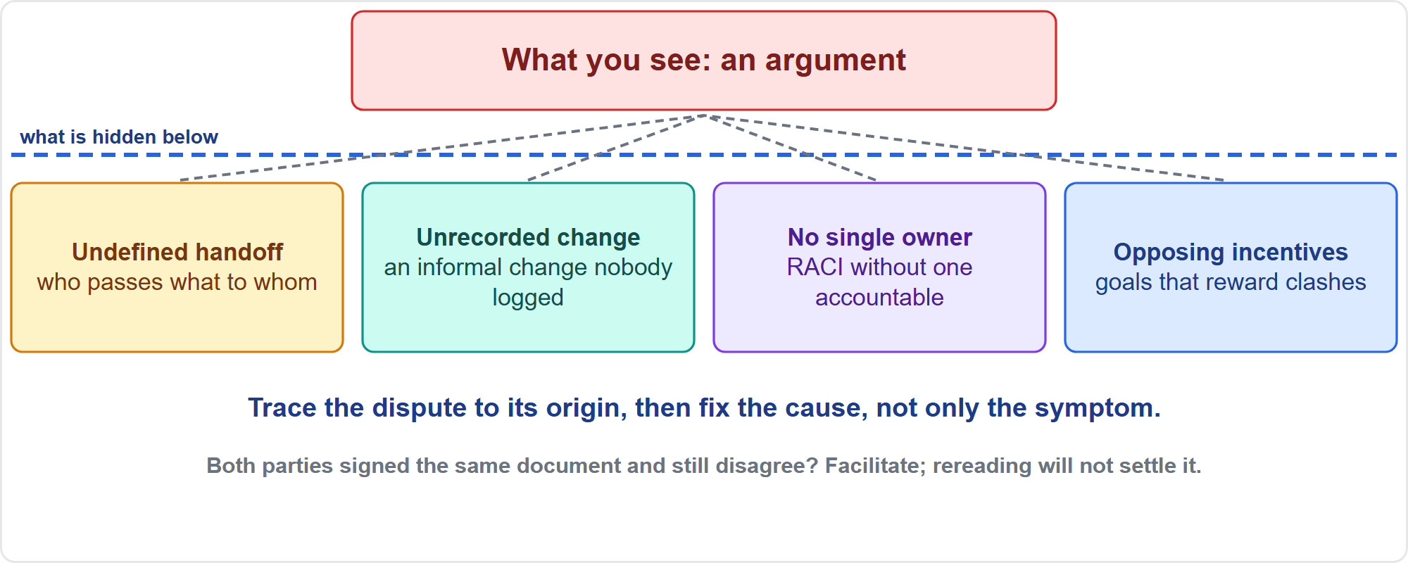
Find the Real Source
Part 2
The argument and its cause
EXAM TIP Fix the cause, not the symptom: mediation alone will not fix opposing incentives; involve the managers who set them.
PMP Exam Prep 2026 | PMBOK 8 and the New ECO
Module 5
29 / 59
Notes:
The argument you see is rarely the cause. Under the surface may be an undefined handoff, an informal change that nobody recorded, a gap in accountability where no single owner exists, or incentives that reward opposing behavior. Trace the dispute back to its origin, then fix the cause, not only the symptom. If opposing incentives drive repeated clashes, work with the managers who set them to align objectives. And if both parties signed the same document and still disagree, facilitate a discussion. Rereading the text will not settle it.

Slide 30
Analyze the Context
Part 2
Importance and intensity
Time pressure
Relative power
of the conflict
for resolving it
of the people involved
Importance of the relationship
Motivation
to resolve it, short and long term
EXAM TIP Also consider safety, compliance or ethics elements, and whether the cause is structural or personal.
PMP Exam Prep 2026 | PMBOK 8 and the New ECO
Module 5
30 / 59
Notes:
Analyze the context before choosing a technique. PMBOK 8 lists five factors. The importance and intensity of the conflict. The time pressure for resolving it. The relative power of the people involved. The importance of maintaining a good relationship. And the motivation to resolve it, in the short or long term. In addition, consider who is involved, and whether both positions are sound. Consider whether there is a safety, compliance or ethics element. And consider whether the cause is structural or personal.

Slide 31
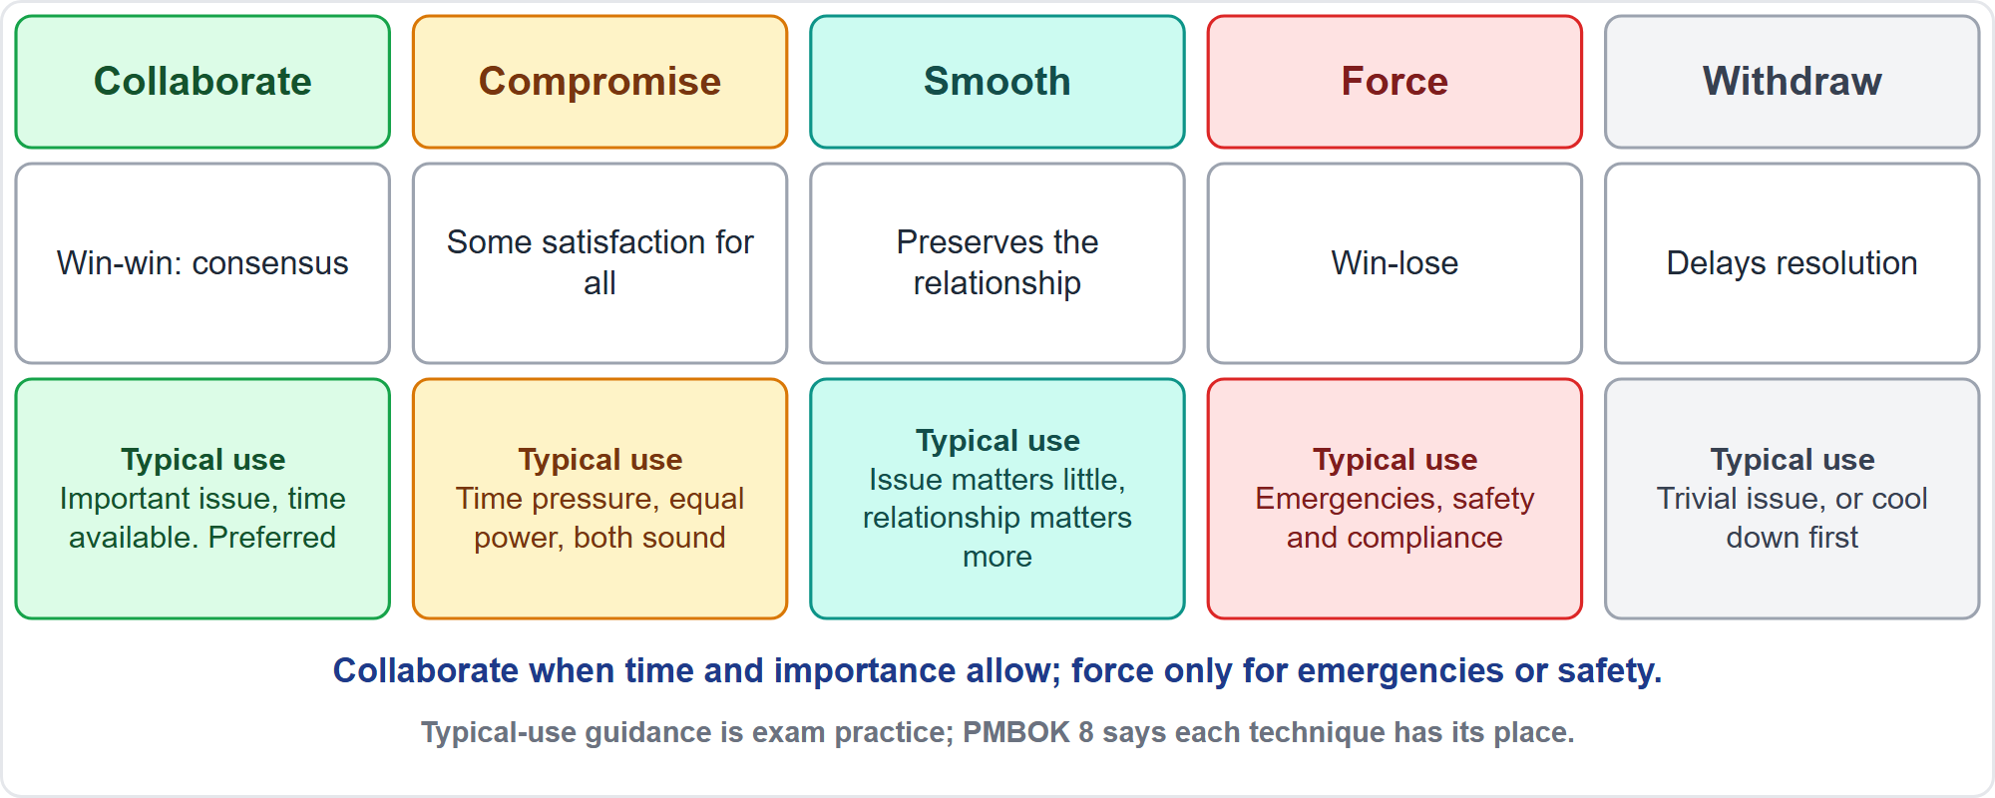
Five Resolution Techniques
Part 2
Collaborate, compromise, smooth, force, withdraw
EXAM TIP Collaborate when time and importance allow; compromise when time is short and both positions are sound; force only for emergencies or safety.
PMP Exam Prep 2026 | PMBOK 8 and the New ECO
Module 5
31 / 59
Notes:
Five techniques. Collaborate, also called problem-solve, incorporates multiple viewpoints and gives consensus and commitment: win-win. Compromise searches for solutions that give some satisfaction to all parties, and is occasionally lose-lose. Force, or direct, pushes one viewpoint, and is win-lose. Smooth, or accommodate, emphasizes agreement to preserve the relationship. Withdraw, or avoid, retreats from or postpones the conflict. PMBOK 8 says each has its place. The typical-use guidance is exam practice: collaborate when time and importance allow, and force only for emergencies or safety.

Slide 32
Running the Resolution
Part 2
Create a safe space; keep communication open and respectful
Focus on the issues, not the people; do not assign blame
Focus on the present and future, not the past
Search for alternatives together
Facilitate an agreement, document who will do what, and follow up
Escalate in steps when needed
EXAM TIP Two defensible dates from two directors: facilitate a joint session to agree one date; more analysis will not settle it.
PMP Exam Prep 2026 | PMBOK 8 and the New ECO
Module 5
32 / 59
Notes:
How do you run the resolution? Create a safe space, and keep communication open and respectful in words, tone and body language. Focus on the issues, not the people, because conflict arises when people perceive situations differently. Focus on the present and future, not the past. Search for alternatives together, moving the conflict into a problem-solving space. Facilitate an agreement, document who will do what, and follow up. And escalate in steps when needed. When two directors expect different dates, hold a joint session to agree one.

Slide 33
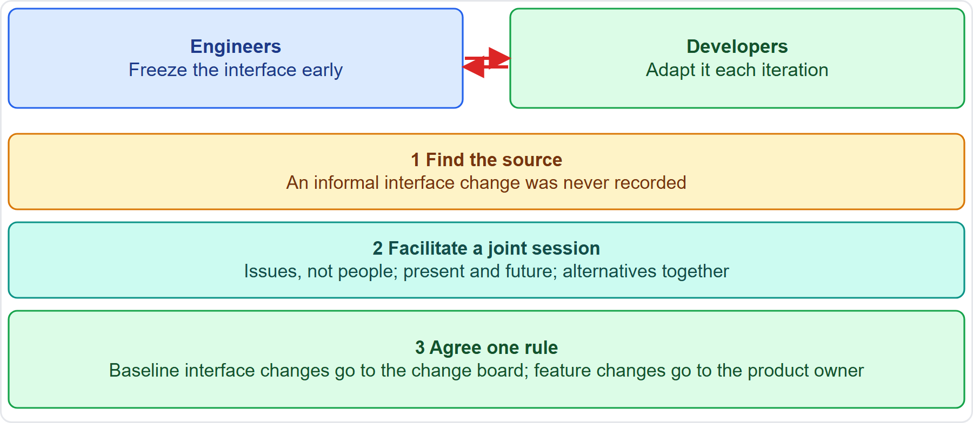
Case Check-In: The Interface Conflict
Part 2
CASE CHECK-IN · Sunrise Campus Microgrid
Source: an informal interface change was never recorded
Resolution: a facilitated session and one change rule
PMP Exam Prep 2026 | PMBOK 8 and the New ECO
Module 5
33 / 59
Notes:
Back to our case. The engineers want the interface frozen. The developers want it adapted each iteration. First, find the source. Here, an informal interface change was never recorded, so each team believes it is right. Second, facilitate a joint session, focusing on issues, not people, on the present and future, and on alternatives together. Third, agree one rule: baseline interface changes go to the change board, and feature changes go to the product owner. Then document it and follow up.

Slide 34
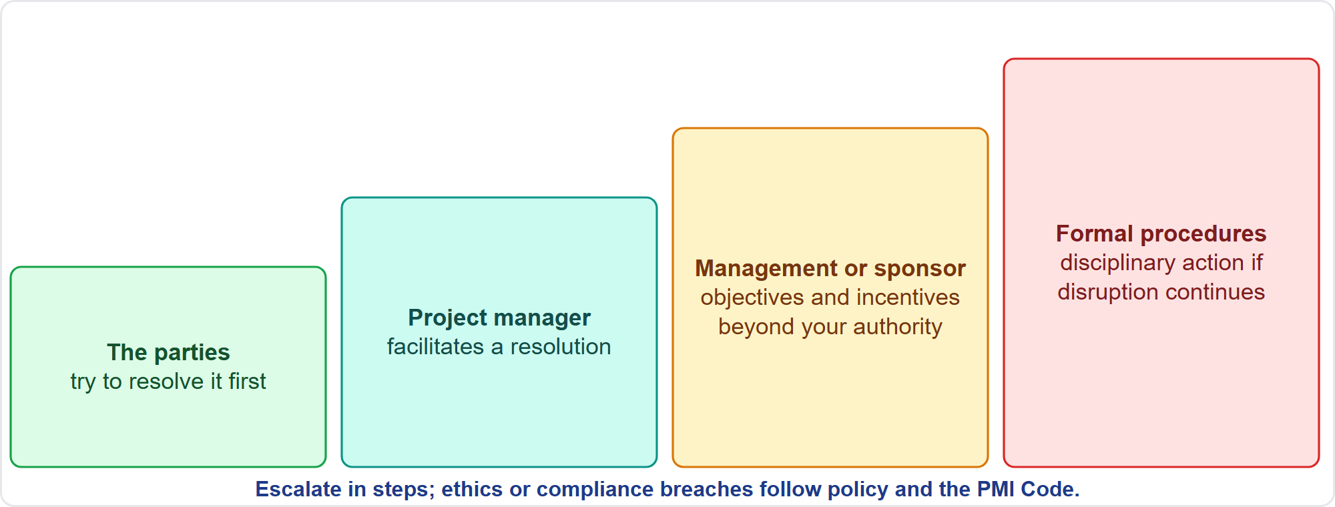
Escalating in Steps
Part 2
Parties, project manager, management, formal procedures
EXAM TIP Ethics or compliance violations follow organizational policy and the PMI Code.
PMP Exam Prep 2026 | PMBOK 8 and the New ECO
Module 5
34 / 59
Notes:
Escalate in steps. First, the parties involved try to resolve it. Second, the project manager facilitates a satisfactory resolution. Third, management or the sponsor steps in, for example when objectives and incentives are beyond your authority. Fourth, formal procedures, including disciplinary action, if disruptive conflict continues. Ethics or compliance violations follow organizational policy and the PMI Code of Ethics. A common wrong answer jumps to the last step, or to escalation before the parties have tried.

Slide 35
Ground Rules and Conflict Principles
Part 2
Tell people the rules of the game early: how to raise and resolve disagreements, who facilitates, when to escalate
Put them in the team charter, communications plan and vendor agreements
State four principles: respectful communication; issues not people; present and future; alternatives together
Include external stakeholders at kickoff and when new parties join
Model the behavior; prevent with role definition, clear priorities and shared objectives
EXAM TIP Prevention counts: ground rules, role definition and communication planning reduce conflict.
PMP Exam Prep 2026 | PMBOK 8 and the New ECO
Module 5
35 / 59
Notes:
Communicate the conflict principles early. Tell people the rules of the game: how disagreements are raised and resolved, who facilitates, and when matters escalate. Put them in the team charter, the communications plan and, for vendors and partners, in the agreements, including dispute resolution clauses. State the four principles: open and respectful communication, issues not people, present and future, and alternatives together. Include external stakeholders at kickoff. Model the behavior. And prevent conflict with ground rules, role definition, clear priorities and shared objectives.

Slide 36
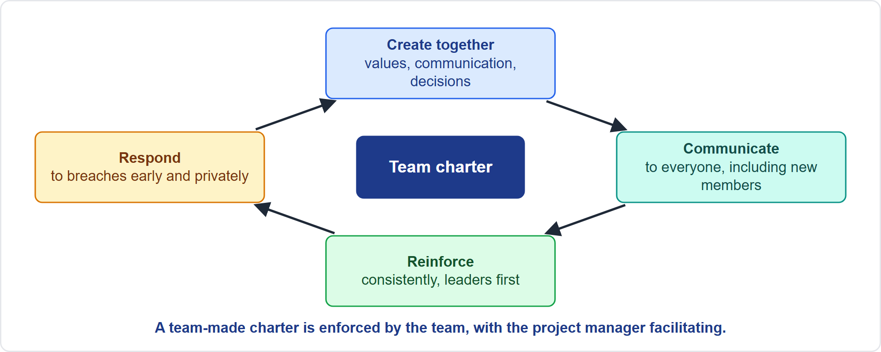
Ground Rules That Stick
Part 2
Create, communicate, reinforce, respond
EXAM TIP New members help shape the ground rules; revisit the agreement with the whole team.
PMP Exam Prep 2026 | PMBOK 8 and the New ECO
Module 5
36 / 59
Notes:
Ground rules stick when the team owns them. Create them together: the charter works best when the team develops it. Communicate them to everyone, including new members, who should help shape the rules rather than be handed them privately. Reinforce them consistently: leaders follow them first, adherence is recognized, and they apply to everyone. And respond to breaches early and privately. Revisit them when new members join and when the context changes, such as virtual working or a new vendor. Make it safe to speak up.

Slide 37
Rectifying Ground Rule Violations
Part 2
Step | What to do
1 Notice early | Watch behavior; address small breaches
2 Talk privately | State facts; listen; assume no motive
3 Refer to the agreement | Remind the person of the team's rule
4 Involve the team | Facilitate a team discussion on honoring it
5 Coach and follow up | Support; recognize improvement
6 Fix the system | Update unclear or unworkable rules together
7 Use formal routes | Repeated or serious breaches go to management
EXAM TIP Do not issue a new imposed rule or lecture one person privately: facilitate a team discussion on honoring the agreement.
PMP Exam Prep 2026 | PMBOK 8 and the New ECO
Module 5
37 / 59
Notes:
When a ground rule is violated, follow these steps. Notice early, and address small breaches before they grow. Talk privately, stating facts, listening to the reason, and not assuming motives. Refer to the agreement the team created. If the charter is the team's, involve the team: facilitate a team discussion on honoring it, rather than enforcing individually or imposing a new process. Coach and follow up. Fix the system if the rule is unclear or unworkable. And use formal routes for repeated or serious breaches. Ethics violations follow the Code.

Slide 38
Conflict in Predictive, Agile and Hybrid Work
Part 2
 | Predictive | Agile | Hybrid
Ground rules | Team charter and policy; project manager enforces within authority | Working agreements owned by the team | Charter for the whole; agreements inside teams
First responders | Parties, then project manager and functional managers | The team, then the servant leader | Both
Priority conflicts | Change control and sponsor decisions | Product owner orders the backlog | Both
Forum | Status and issue meetings | Daily coordination, retrospectives | Both
EXAM TIP In a weak matrix, align the functional managers who set priorities.
PMP Exam Prep 2026 | PMBOK 8 and the New ECO
Module 5
38 / 59
Notes:
Conflict handling differs by approach. In predictive work, the team charter and organizational policy set the ground rules, and the project manager enforces them within authority. The parties come first, then the project manager and functional managers. Priority conflicts go to change control and sponsor decisions. In agile work, working agreements belong to the team, the team responds first with the servant leader facilitating, and the product owner orders the backlog for priority conflicts. Forums are daily coordination meetings and retrospectives. Hybrid combines both.

Slide 39
Conflict Traps: What PMI Expects
Part 2
Find the source first; the visible argument is rarely the cause
Collaborate when time allows; compromise when time is short; force only for emergencies; avoid or smooth only for minor issues
Early, private and direct conflict handling
Team members try first; the project manager facilitates; formal procedures last
Issues, not people; present and future, not the past
Align objectives when incentives conflict; a team-made charter is enforced by the team
EXAM TIP New members help shape ground rules; revisit the agreement with the whole team.
PMP Exam Prep 2026 | PMBOK 8 and the New ECO
Module 5
39 / 59
Notes:
The traps for conflict. Find the source first. Collaborate when time allows, compromise when time is short, force only for emergencies, and avoid or smooth only for minor issues. Address conflict early, privately and directly. Team members try first, the project manager facilitates, and formal procedures come last. Focus on issues, not people, and on the present and future. Align objectives when incentives conflict. A team-made charter is enforced by the team. And new members help shape the ground rules.

Slide 40
Part 2 Recap
Part 2
1
People
2
Motivation
3
Conflict process
inclusion, emotional intelligence, clear roles with one accountable owner
growth, autonomy, purpose; recognize early and often
source, context, technique, resolve, agree, follow up
4
Techniques
5
Escalation
6
Ground rules
collaborate, compromise, force, smooth, withdraw
parties, project manager, management, formal procedures
co-created, communicated, reinforced, enforced by the team
PMP Exam Prep 2026 | PMBOK 8 and the New ECO
Module 5
40 / 59
Notes:
Let us recap Part 2. For people: include everyone, build emotional intelligence, and clarify roles with one accountable owner. Motivate with growth, autonomy and purpose, and recognize early and often. The conflict process runs source, context, technique, resolution, agreement and follow-up. The five techniques are collaborate, compromise, force, smooth and withdraw. Escalate from the parties, to the project manager, to management, to formal procedures. And ground rules are co-created, communicated, reinforced and enforced by the team. In Part 3, we turn to knowledge.

Slide 41
Knowledge: Why It Matters
Part 3
Manage Project Knowledge uses existing knowledge and creates new knowledge for the project and the organization
It is more than documenting or collecting lessons at the end
Knowledge management connects people; information management connects people to information
Lessons learned show how events were or should be addressed
Critical knowledge held by one person is a risk
EXAM TIP Capture critical knowledge from people before they leave; do not wait for closure.
PMP Exam Prep 2026 | PMBOK 8 and the New ECO
Module 5
41 / 59
Notes:
Part 3 covers knowledge. Manage Project Knowledge means using existing knowledge and creating new knowledge to achieve project objectives and contribute to organizational learning. It is more than documenting, or collecting lessons at the end. Knowledge management connects people, to create and share knowledge. Information management connects people to information. Lessons learned show how events were or should be addressed to improve future performance. And critical knowledge held by one person is a risk. Capture it from people before they leave.

Slide 42
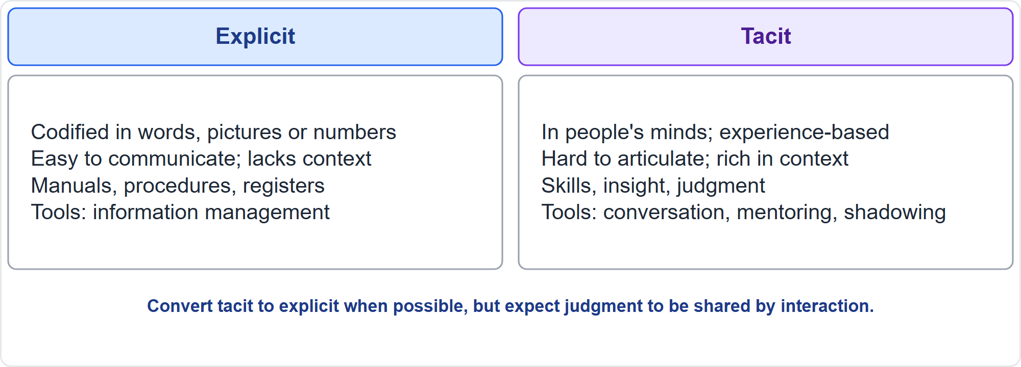
Explicit and Tacit Knowledge
Part 3
Codified versus in people's minds
EXAM TIP Tacit knowledge needs interaction: shadowing, pairing, mentoring and hands-on practice. Documents alone will not carry judgment.
PMP Exam Prep 2026 | PMBOK 8 and the New ECO
Module 5
42 / 59
Notes:
Two kinds of knowledge. Explicit knowledge is formal and codifiable in words, pictures or numbers, and is easy to communicate, such as manuals and procedures. It lacks context and can be misread. Tacit knowledge is embedded in a person's mind: skills, insight and practical judgment. It has context but is hard to articulate and transfer. Share tacit knowledge through a collaborative, trust-filled environment: conversation, mentoring, team building, face-to-face interaction and brainstorming. Convert tacit to explicit when possible, but expect judgment to be shared by interaction.

Slide 43
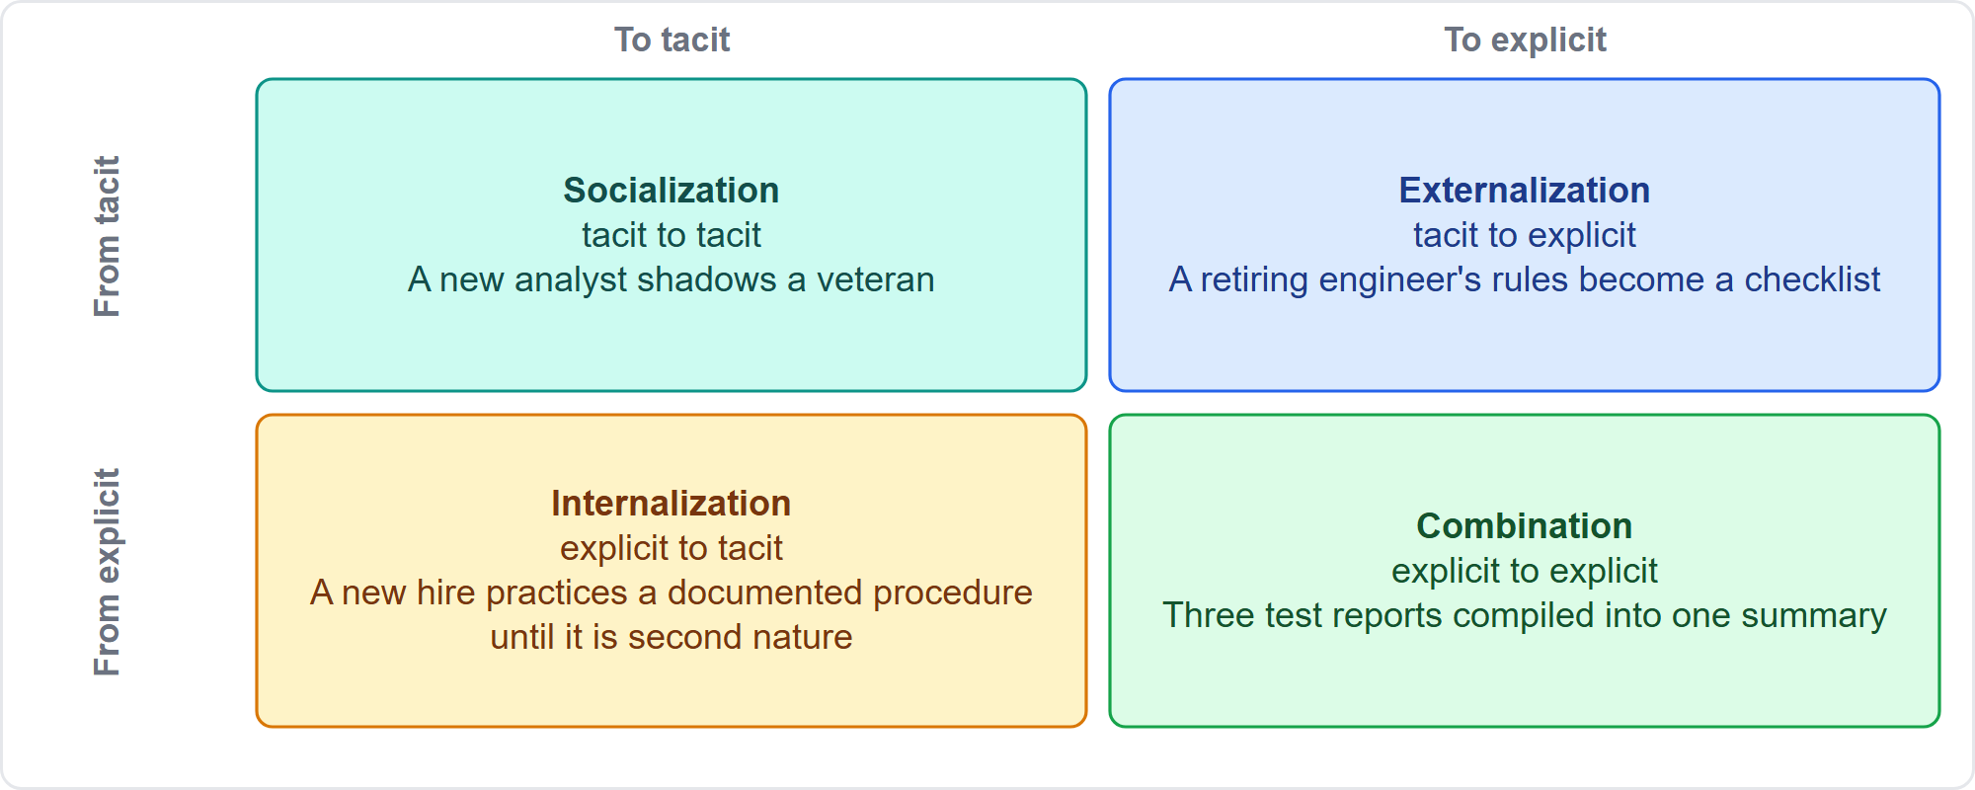
How Knowledge Changes Form
Part 3
Socialization, externalization, internalization, combination
EXAM TIP Identify the mode from the starting and ending form of the knowledge.
PMP Exam Prep 2026 | PMBOK 8 and the New ECO
Module 5
43 / 59
Notes:
As exam practice, four modes describe how knowledge changes form. Socialization: tacit to tacit, like a new analyst shadowing a veteran. Externalization: tacit to explicit, like a retiring engineer's troubleshooting rules written up as a checklist. Combination: explicit to explicit, like three test reports compiled into one summary. Internalization: explicit to tacit, like a new hire running a documented procedure until it becomes second nature. To name the mode, look at the starting form and the ending form.

Slide 44
The Manage Project Knowledge Process
Part 3
Aspect | Detail
Benefits | Use earlier knowledge; collect new knowledge for later work
Tools | Expert judgment, after-action reviews, postmortems, retrospectives, storytelling
Outputs | Lessons learned register; plan and asset updates
Plan it | Decide how and when lessons are captured and shared
Who | The people doing the work, in any medium
AI | A source, with risks: exposed data, hallucinations
EXAM TIP The lessons learned register is created early and updated throughout, then moved to the organization's repository.
PMP Exam Prep 2026 | PMBOK 8 and the New ECO
Module 5
44 / 59
Notes:
Here is the process. The benefit is to use earlier knowledge and collect new knowledge to support operations and future work. Tools include expert judgment, knowledge and information management, after-action reviews, in-progress postmortems, retrospectives, storytelling and interpersonal skills. The main output is the lessons learned register, plus plan updates and process asset updates. Plan how and when lessons will be captured. The people doing the work capture them, in text, audio, video or pictures. AI can be a source, but exposes sensitive data and may hallucinate.

Slide 45
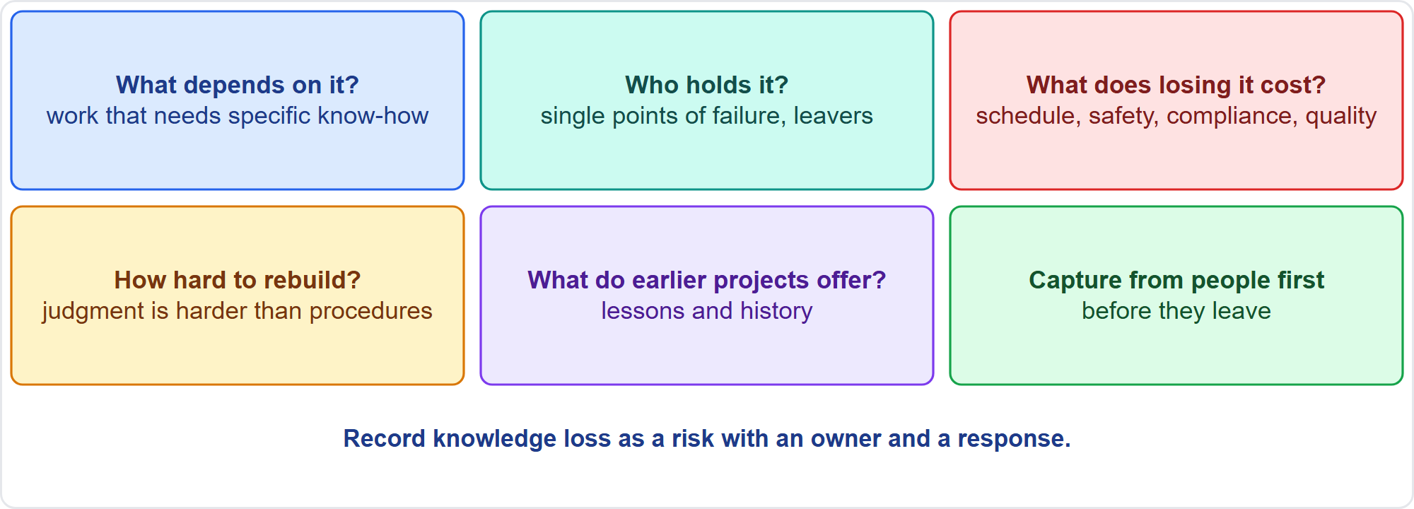
Identify Knowledge Critical to the Project
Part 3
Five questions and one rule
EXAM TIP Identify and capture knowledge from people first; documents can be reviewed afterward.
PMP Exam Prep 2026 | PMBOK 8 and the New ECO
Module 5
45 / 59
Notes:
How do you identify critical knowledge? Ask five questions. What must the project, the next phase or operations be able to do that depends on specific know-how? Who holds it? Look for single points of failure such as experts, vendor specialists, retirees and people whose assignment is ending. What would losing it cost? How hard is it to rebuild? Judgment is harder to rebuild than procedures. And what do earlier projects offer? Capture from people first, before they leave, and record knowledge loss as a risk.

Slide 46
Gather Explicit Knowledge
Part 3
Lessons learned register: situation, impacts, recommendations, actions
Capture continuously, not only at closure; then move to the organizational repository
Make records searchable and categorized, with a way to contact the originator
Use information management: libraries, web search, the project information system, document systems
Walk the next team through the key lessons; do not just send a log
EXAM TIP If the next team says the logs were never useful, the problem is access and interaction, not more detail in the log.
PMP Exam Prep 2026 | PMBOK 8 and the New ECO
Module 5
46 / 59
Notes:
Gather explicit knowledge in the lessons learned register. Each entry has a category and a description of the situation, the impacts, the recommendations and the proposed actions. It covers challenges, problems, realized risks and opportunities. Capture continuously, not only at closure. At the end, the register moves to the organization's lessons learned repository. Make records searchable and categorized, with a way to contact the originator. Use information management too: libraries, web search, the project information system and document systems. And walk the next team through the key lessons instead of just sending a log.

Slide 47
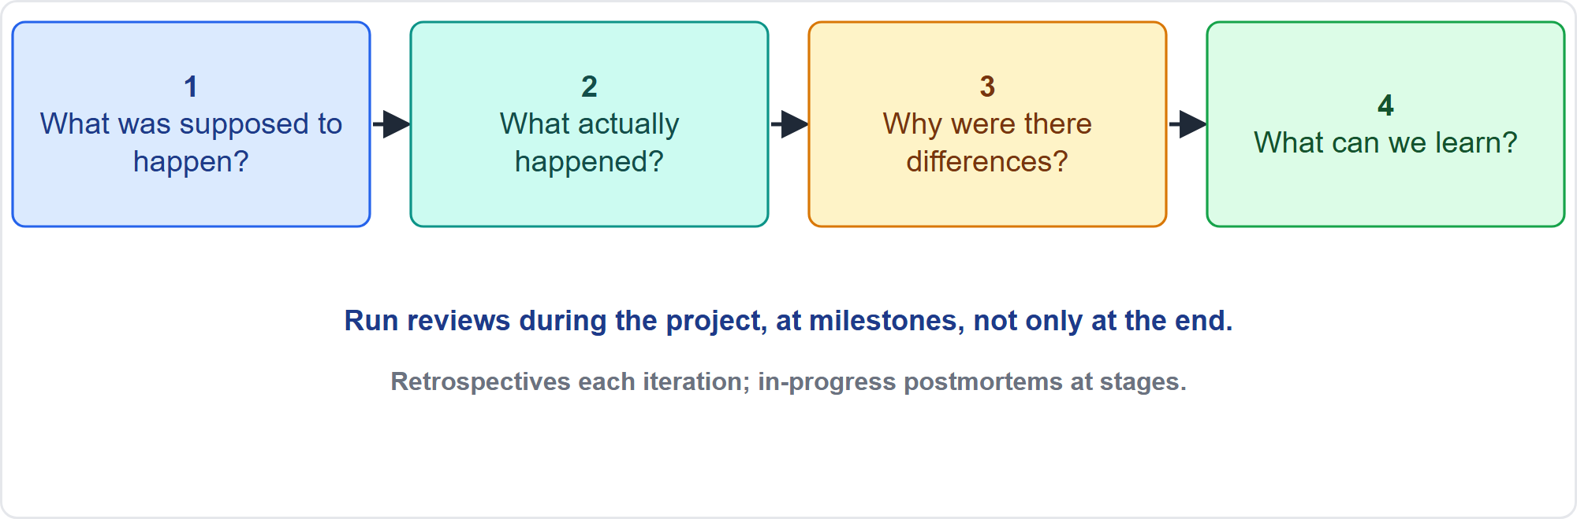
Gather Tacit Knowledge
Part 3
The four questions of an after-action review
EXAM TIP Retrospectives at least every iteration; in-progress postmortems at stages of the life cycle.
PMP Exam Prep 2026 | PMBOK 8 and the New ECO
Module 5
47 / 59
Notes:
Gather tacit knowledge through interaction. After-action reviews ask four questions: what was supposed to happen, what actually happened, why were there differences, and what can we learn. Run retrospectives at least every iteration, and in-progress postmortems at stages of the life cycle. Use work shadowing and reverse shadowing, pairing, mentoring, interviews, including AI interview bots, learning-review workshops and brainstorming. Storytelling conveys lessons and good practice in a relatable, memorable way, and is particularly effective for tacit knowledge.

Slide 48
Foster an Environment for Knowledge Transfer
Part 3
Condition | How to build it
Trust and safety | People share mistakes when not punished; blameless reviews
Open collaboration | Conversations, communities of practice, forums, virtual tools
Time and space | Schedule retrospectives, cafés, seminars, and protect the time
Mentoring and shadowing | Pair successors with experts during the work
Hands-on practice | Receivers practice the task with support before handover
Usable repository | Searchable, owned, and walked through with the next team
Recognition | Recognize sharing and use of lessons
EXAM TIP Watching is not doing: receivers should perform the task with support before handover.
PMP Exam Prep 2026 | PMBOK 8 and the New ECO
Module 5
48 / 59
Notes:
Foster an environment where transfer works. Trust and psychological safety: people share mistakes when they will not be punished, so run blameless reviews. Open collaboration: conversations, communities of practice, forums and virtual tools. Time and space: schedule and protect retrospectives, knowledge cafés and seminars. Mentoring and shadowing: pair successors with experts during the work. Hands-on practice: watching is not doing, so receivers should perform the task with support before handover. A usable repository, walked through with the next team. And recognition for sharing and using lessons.

Slide 49
Applying Knowledge
Part 3
Pull earlier lessons into the plan: address the specific causes of past delays, not a generic buffer
Look for patterns: recurring issues point to changes in procedures and checklists
Feed process assets: the repository, templates, standards, checklists
Hand over with practice and support; confirm the receivers can operate the result
Include vendors: transfer their expertise to the people who will maintain the system
EXAM TIP Make knowledge loss a risk: register it, assign an owner and plan the transfer.
PMP Exam Prep 2026 | PMBOK 8 and the New ECO
Module 5
49 / 59
Notes:
Applying knowledge is where it pays off. Pull earlier lessons into the plan. If a previous project's delays had specific causes, such as late permits or commissioning problems, adjust the plan to address those causes rather than adding a generic buffer. Look for patterns: recurring issues point to changes in procedures and checklists. Feed process assets. Hand over with practice and support, and confirm that the receivers can operate the result. Include vendors and contractors, transferring their expertise to the people who will maintain the system.

Slide 50
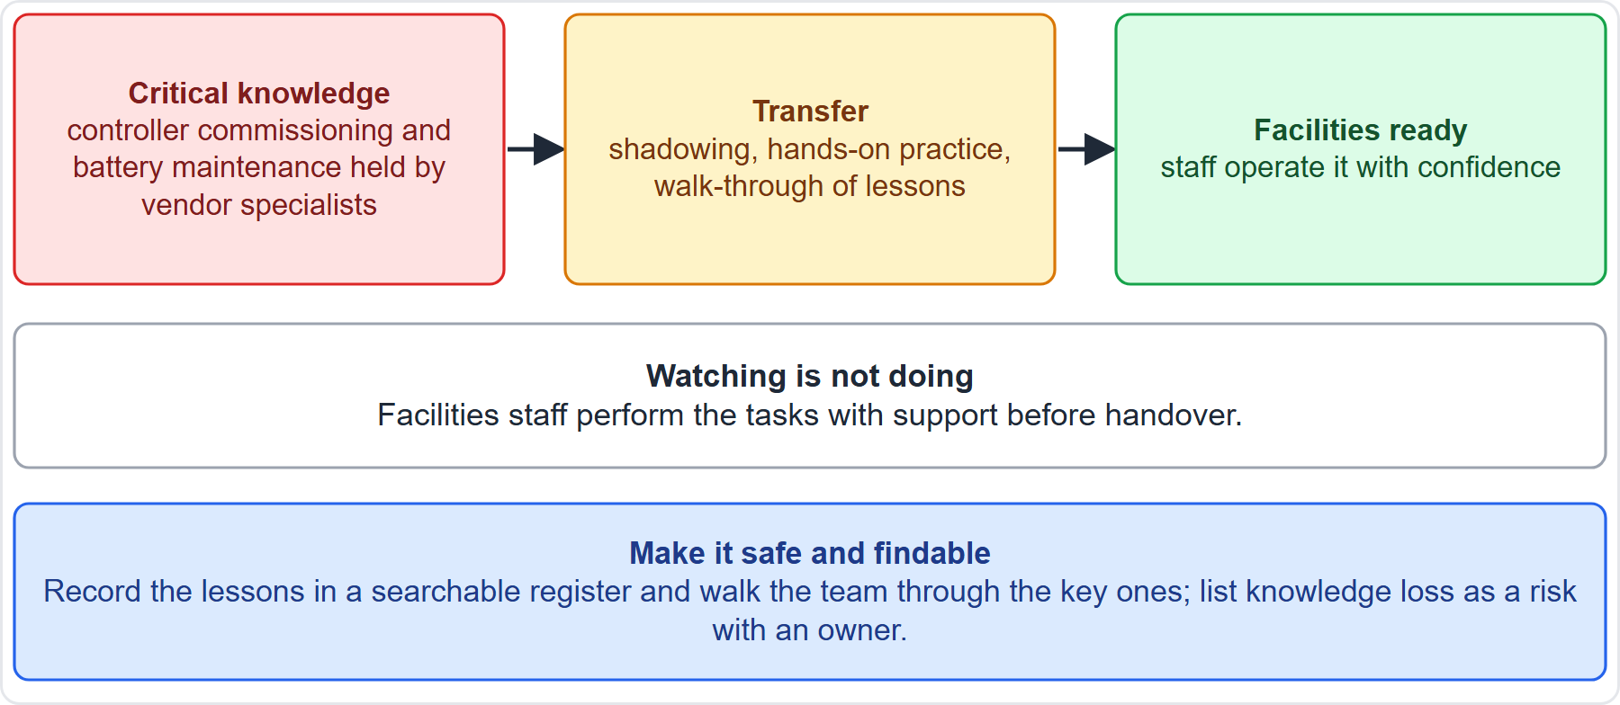
Case Check-In: Handover to Campus Facilities
Part 3
CASE CHECK-IN · Sunrise Campus Microgrid
Critical knowledge: commissioning and battery maintenance sit with vendor specialists
Transfer: shadowing, hands-on practice, a walk-through of lessons
PMP Exam Prep 2026 | PMBOK 8 and the New ECO
Module 5
50 / 59
Notes:
Our microgrid will be operated by Campus Facilities. The critical knowledge, such as controller commissioning and battery maintenance, sits with vendor specialists. So record the loss of that knowledge as a risk with an owner, and plan the transfer. Pair Facilities staff with the specialists during commissioning, have them perform the tasks with support before handover, and walk them through the lessons in a searchable register. Watching is not doing. Confirm that Facilities can operate the system before the specialists leave.

Slide 51
Knowledge in Predictive, Agile and Hybrid Work
Part 3
 | Predictive | Agile | Hybrid
Cadence | Lessons at phase ends and gates, plus postmortems | Retrospective every iteration; continuous sharing | Retrospectives inside iterations; gate reviews for the envelope
Tacit transfer | Mentoring, shadowing, handover training | Pairing, swarming, shared ownership | Both
Records | Lessons register and formal repository | Lightweight notes and working agreements | Both
Actions | Update plans, procedures, process assets | A few improvements in the next backlog | Both
EXAM TIP Commit to a few improvements with owners; a long list with no owner is not learning.
PMP Exam Prep 2026 | PMBOK 8 and the New ECO
Module 5
51 / 59
Notes:
Knowledge looks different by approach. In predictive work, lessons come at phase ends and gates, with in-progress postmortems, and final lessons at closure. Transfer uses mentoring, shadowing and handover training, and records go into the lessons register and a formal repository. In agile work, there is a retrospective every iteration and continuous sharing, with pairing, swarming and shared ownership, and lightweight notes. Actions are a few improvements committed to the next backlog. Hybrid combines both.

Slide 52
Knowledge Traps: What PMI Expects
Part 3
Tacit knowledge needs interaction; documents alone will not carry judgment
Capture critical knowledge from people before they leave
Watching is not doing; receivers practice before handover
Capture lessons continuously, not only at the end
Lessons must be usable: searchable, owned and walked through
Make knowledge loss a risk; foster psychological safety; use AI responsibly
EXAM TIP Use earlier lessons in the plan, specifically, instead of a generic buffer.
PMP Exam Prep 2026 | PMBOK 8 and the New ECO
Module 5
52 / 59
Notes:
The traps for knowledge. Tacit knowledge needs interaction: shadowing, pairing, mentoring and hands-on practice. Capture critical knowledge from people before they leave, and do not start with document reviews. Watching is not doing, so receivers practice before handover. Capture lessons continuously. Lessons must be usable: searchable, categorized, owned, and walked through with the next team. Make knowledge loss a risk. Foster psychological safety. And use AI responsibly: approved tools, no sensitive data exposure, and verified output.

Slide 53
Module Recap
Part 3
1
Lead
2
People
3
Conflict
expectations, style by situation, empowerment within boundaries, the team's voice
inclusion, emotional intelligence, clear roles, motivation
source first, five techniques, escalate in steps, ground rules owned by the team
4
Knowledge
5
Case
6
Next
identify critical knowledge, capture from people, practice before handover
two teams, one interface rule, one handover plan
five practice questions
PMP Exam Prep 2026 | PMBOK 8 and the New ECO
Module 5
53 / 59
Notes:
Let us recap the whole module. Lead: set expectations, choose the style by situation, empower within boundaries and represent the team's voice. People: include everyone, build emotional intelligence, clarify roles and motivate with growth, autonomy and purpose. Conflict: find the source first, choose among five techniques, escalate in steps, and keep ground rules owned by the team. Knowledge: identify critical knowledge, capture it from people, and have receivers practice before handover. Now it is time to test yourself. Five questions follow. For each one, pause the video, choose your answer, and then listen to the explanation.

Slide 54
Practice Question 1
Part 3
Q1
A newly formed project team has unclear roles and no agreed way of working, and members keep asking the project manager what is expected of them. Which approach fits best?
A
Delegate all decisions to the team so that members learn by solving problems
B
Set the vision, define roles and agree ground rules and norms with the team
C
Wait for conflicts to appear and then coach each member one to one
D
Use a participative style and let the team vote on every working method
PMP Exam Prep 2026 | PMBOK 8 and the New ECO
Module 5
54 / 59
Notes:
Question one. A newly formed project team has unclear roles and no agreed way of working, and members keep asking the project manager what is expected of them. Which approach fits best? The four options are on the screen. Choose your answer. [PAUSE 12] The answer is B. A new team needs structure and direction, so the project manager sets the vision, clarifies roles and agrees ground rules and expectations. Delegating everything, waiting for conflict, or voting on every method leaves the team without the structure it is asking for.

Slide 55
Practice Question 2
Part 3
Q2
Two leads keep arguing about who owns testing of the controller interface. The responsibility matrix lists both as responsible and nobody as accountable. What should the project manager do?
A
Clarify the roles and assign one accountable owner for the testing
B
Ask the sponsor to decide which of the two leads is the better tester
C
Tell both leads to resolve it between themselves before the next status meeting
D
Split the testing evenly between them and ask them to stop arguing about it
PMP Exam Prep 2026 | PMBOK 8 and the New ECO
Module 5
55 / 59
Notes:
Question two. Two leads keep arguing about who owns testing of the controller interface. The responsibility matrix lists both as responsible and nobody as accountable. What should the project manager do? The four options are on the screen. Choose your answer. [PAUSE 12] The answer is A. The argument is a symptom of a missing accountable owner, so the project manager fixes the cause by clarifying roles and naming one accountable owner. Escalating, leaving it to the leads, or splitting the work leaves the cause in place.

Slide 56
Practice Question 3
Part 3
Q3
A team wrote its own charter, which says that decisions are made in the daily coordination meeting. One member keeps making decisions alone. What should the project manager do?
A
Send the member a written warning and copy the member's functional manager
B
Issue a new rule that the project manager must approve every team decision
C
Facilitate a team discussion on honoring the charter the team created
D
Privately lecture the member and then leave the matter alone afterwards
PMP Exam Prep 2026 | PMBOK 8 and the New ECO
Module 5
56 / 59
Notes:
Question three. A team wrote its own charter, which says that decisions are made in the daily coordination meeting. One member keeps making decisions alone. What should the project manager do? The four options are on the screen. Choose your answer. [PAUSE 12] The answer is C. A charter the team created is best enforced by the team, with the project manager facilitating a discussion about honoring the agreement. Warnings, new imposed rules, or a private lecture bypass the team's ownership of its own agreement.

Slide 57
Practice Question 4
Part 3
Q4
A senior engineer who alone knows how to troubleshoot the battery controller will retire in six weeks. What should the project manager do first?
A
Ask the engineer to write a full manual of the troubleshooting procedures
B
Add the retirement to the risk register and review it at the next gate
C
Order the vendor to supply a replacement specialist at the project's cost
D
Start shadowing and interviews now and pair a successor with the engineer
PMP Exam Prep 2026 | PMBOK 8 and the New ECO
Module 5
57 / 59
Notes:
Question four. A senior engineer who alone knows how to troubleshoot the battery controller will retire in six weeks. What should the project manager do first? The four options are on the screen. Choose your answer. [PAUSE 12] The answer is D. Tacit know-how is captured from people before they leave, through shadowing, interviews and pairing, with hands-on practice for the successor. A manual alone loses the judgment, a risk entry without action loses the window, and ordering a replacement skips the transfer.

Slide 58
Practice Question 5
Part 3
Q5
The operations team that received the last project's deliverables says its 300-page lessons log was never useful. What is the best way to help the next team?
A
Make the lessons searchable and walk the team through the key ones
B
Add more detail to every entry so that nothing is left out of the log
C
Ask the team to read the full log before the project kickoff meeting
D
Replace the log with a short summary written once at project closure
PMP Exam Prep 2026 | PMBOK 8 and the New ECO
Module 5
58 / 59
Notes:
Question five. The operations team that received the last project's deliverables says its 300-page lessons log was never useful. What is the best way to help the next team? The four options are on the screen. Choose your answer. [PAUSE 12] The answer is A. Lessons must be usable: searchable, categorized and owned, with a walk-through that connects the next team to the key lessons. More detail, a mandatory read, or a single closing summary do not fix access and interaction.

Slide 59
Answers at a Glance
Part 3
Question | Answer | Why
Q1 | B | A new team needs vision, roles and ground rules
Q2 | A | The cause is a missing accountable owner, so assign one
Q3 | C | A team-made charter is enforced by the team, with you facilitating
Q4 | D | Capture tacit knowledge from the person now, by shadowing and pairing
Q5 | A | Make lessons findable and walk the next team through them
PMP Exam Prep 2026 | PMBOK 8 and the New ECO
Module 5
59 / 59
Notes:
Here are all five answers together. Question one: B. A new team needs vision, roles and ground rules. Question two: A. The cause is a missing accountable owner, so assign one. Question three: C. A team-made charter is enforced by the team, with you facilitating. Question four: D. Capture tacit knowledge from the person now, by shadowing and pairing. Question five: A. Make lessons findable and walk the next team through them. That completes Module 5. Next, Module 6 covers business cases, charters, benefits and integrated planning. See you there.

