Slide 1
Module 6: Initiating, Value Delivery and Integrated Planning
Part 1 of 3: Initiating and the value case
Process domain · ECO tasks 1 and 3
PMP Exam Prep 2026: PMBOK 8 and the New ECO
Module 6 · Part 1
Notes:
Welcome to Module 6. This is the first of the Process domain modules, and the Process domain carries forty-one percent of the exam. We start where every project starts: with a business case, a charter and a clear picture of value. Then we plan how to deliver that value. In Part 1, we cover initiating: the business documents, the charter, and how to start a project on solid ground.

Slide 2
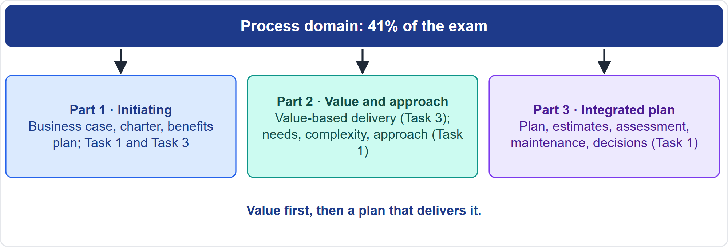
Where This Module Sits in the Exam
Part 1
Task 1 and Task 3 of the Process domain
EXAM TIP When the value case changes, the best answer goes back to the sponsor before the plan continues.
PMP Exam Prep 2026 | PMBOK 8 and the New ECO
Module 6
2 / 70
Notes:
Here is where this module sits. The Process domain holds ten tasks. This module covers two of them. Task one: develop the integrated plan and plan delivery, which includes assessing needs, recommending an approach, and estimating. Task three: value-based delivery, which includes value components, measurement, prioritization and incremental delivery. In Part 1, we cover initiating. In Part 2, value and the approach. In Part 3, the integrated plan, estimates and decisions.

Slide 3
What You Will Learn
Part 1
Explain the business case, benefits management plan and charter, and who owns each
Run initiating: authority, value, stakeholders, assumptions, approach, governance
Define and measure value, and verify that benefits can be tracked
Prioritize by value, deliver incrementally, and check value throughout
Assess needs and complexity, recommend an approach and an execution strategy
Integrate the plan, estimate, maintain it and decide with data
PMP Exam Prep 2026 | PMBOK 8 and the New ECO
Module 6
3 / 70
Notes:
By the end of this module you will be able to do six things. Explain the business case, the benefits management plan and the charter, and who owns each. Run initiating: authority, value, stakeholders, assumptions, approach and governance. Define and measure value, and verify that benefits can be tracked. Prioritize by value, deliver incrementally and check value throughout. Assess needs and complexity, and recommend an approach and an execution strategy. And integrate the plan, estimate, maintain it, and decide with data.

Slide 4
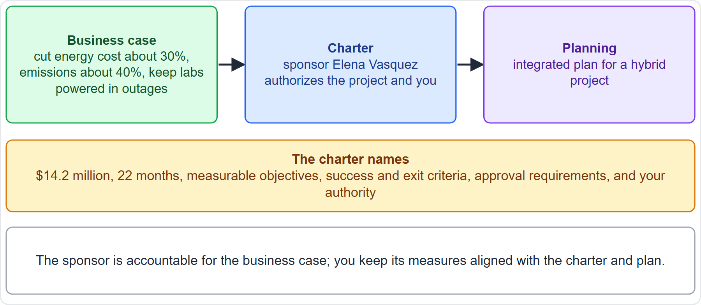
Case Check-In: From Business Case to Charter
Part 1
CASE CHECK-IN · Sunrise Campus Microgrid
Business case: cut energy cost and emissions, keep labs powered
Charter: Elena Vasquez authorizes the project and gives you authority
PMP Exam Prep 2026 | PMBOK 8 and the New ECO
Module 6
4 / 70
Notes:
In our case, the business case came first. The university wants to cut campus energy cost by about thirty percent, cut emissions by about forty percent, and keep research labs powered during grid outages. Elena Vasquez, the sponsor, then authorizes the project through a charter. It names the budget of fourteen point two million dollars, the twenty-two months, measurable objectives, success and exit criteria, approval requirements, and your authority. The sponsor is accountable for the business case. You keep its measures aligned with the charter and the plan.

Slide 5
The Initiating Focus Area
Part 1
Initiating defines a new project or phase, often with formal authorization
Align stakeholder expectations with the project's purpose and scope
Define initial scope, commit initial funds, identify stakeholders, assign project management roles
Typical artifacts: the project charter and the stakeholder register
The sponsor gives the minimum information needed to start
It happens at project start and for each phase
EXAM TIP Projects are authorized only when aligned with strategic objectives, with the business case and benefits considered from the start.
PMP Exam Prep 2026 | PMBOK 8 and the New ECO
Module 6
5 / 70
Notes:
Initiating defines a new project or a new phase, often with formal authorization to start. Its purpose is to align stakeholder expectations with the project's purpose and scope. You define the initial scope, commit initial financial resources, identify stakeholders and assign project management roles. The typical artifacts are the project charter and the stakeholder register. The sponsor supplies the minimum information needed to start. Initiating happens at the start of the project and again for each phase. Projects are authorized only when aligned with strategic objectives.

Slide 6
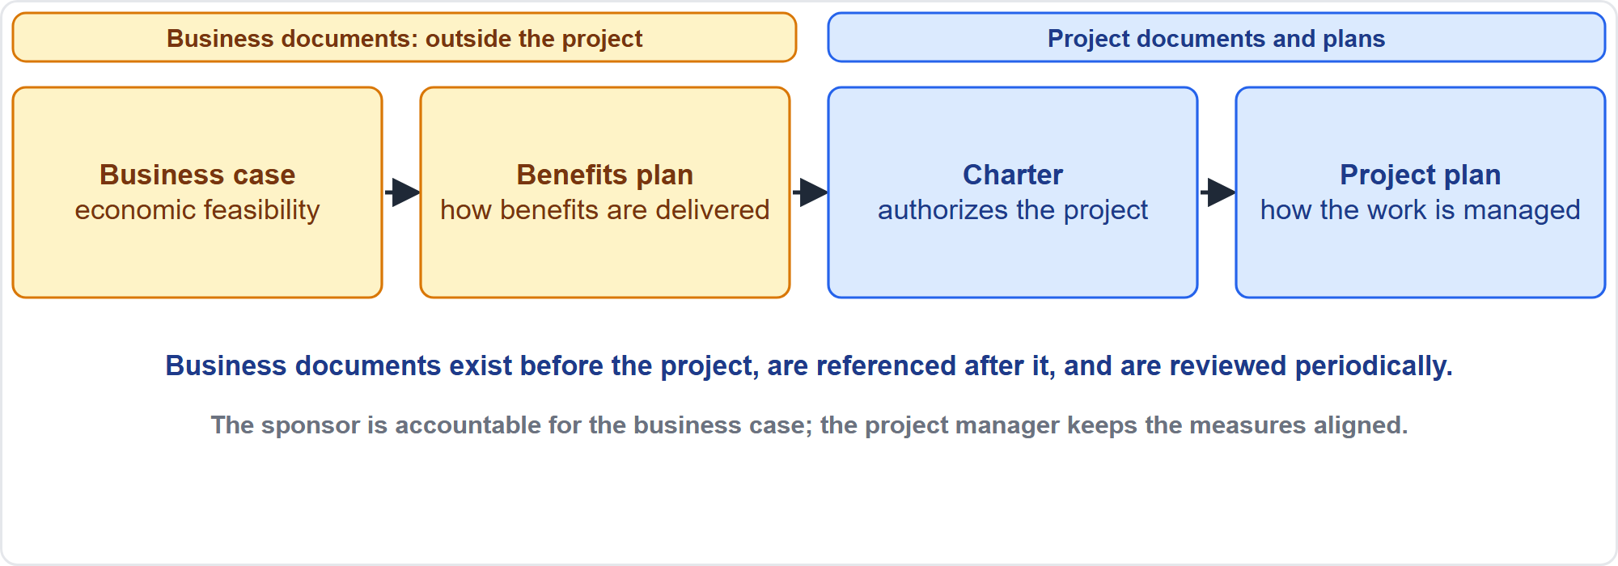
Business Documents and the Project
Part 1
Business documents feed the project
EXAM TIP The business case and benefits management plan are business documents, not project documents.
PMP Exam Prep 2026 | PMBOK 8 and the New ECO
Module 6
6 / 70
Notes:
Two business documents come first: the business case and the benefits management plan. They generally originate outside the project, and they are inputs to it. They are developed before the project, referenced after it ends, and reviewed periodically. That makes them business documents, not project documents and not parts of the project management plan. In some organizations they are kept at program level. The charter and the project management plan sit inside the project. The sponsor is accountable for the business case.

Slide 7
The Business Case
Part 1
Aspect | Detail
Definition | A documented economic feasibility study that shows the benefits are valid
Content | Objectives and reasons; costs, benefits, how value will be created; success criteria
Uses | Before initiation, for a go or no-go decision; to measure success at the end
Accountable | The sponsor develops and maintains it
Project manager | Recommends and oversees so measures stay aligned with the plan, charter and benefits plan
EXAM TIP The sponsor is accountable for the business case; the project manager keeps its measures aligned and recommends updates.
PMP Exam Prep 2026 | PMBOK 8 and the New ECO
Module 6
7 / 70
Notes:
The business case is a documented economic feasibility study. It establishes the validity of the benefits to be delivered, and it is the basis for authorizing further work. It contains the objectives and reasons for the project: costs, benefits, how value will be created, and the success criteria. It may be used before initiation, for a go or no-go decision, and at the end to measure success. The project sponsor is generally accountable for developing and maintaining it. The project manager recommends and oversees, so the success measures stay aligned.

Slide 8
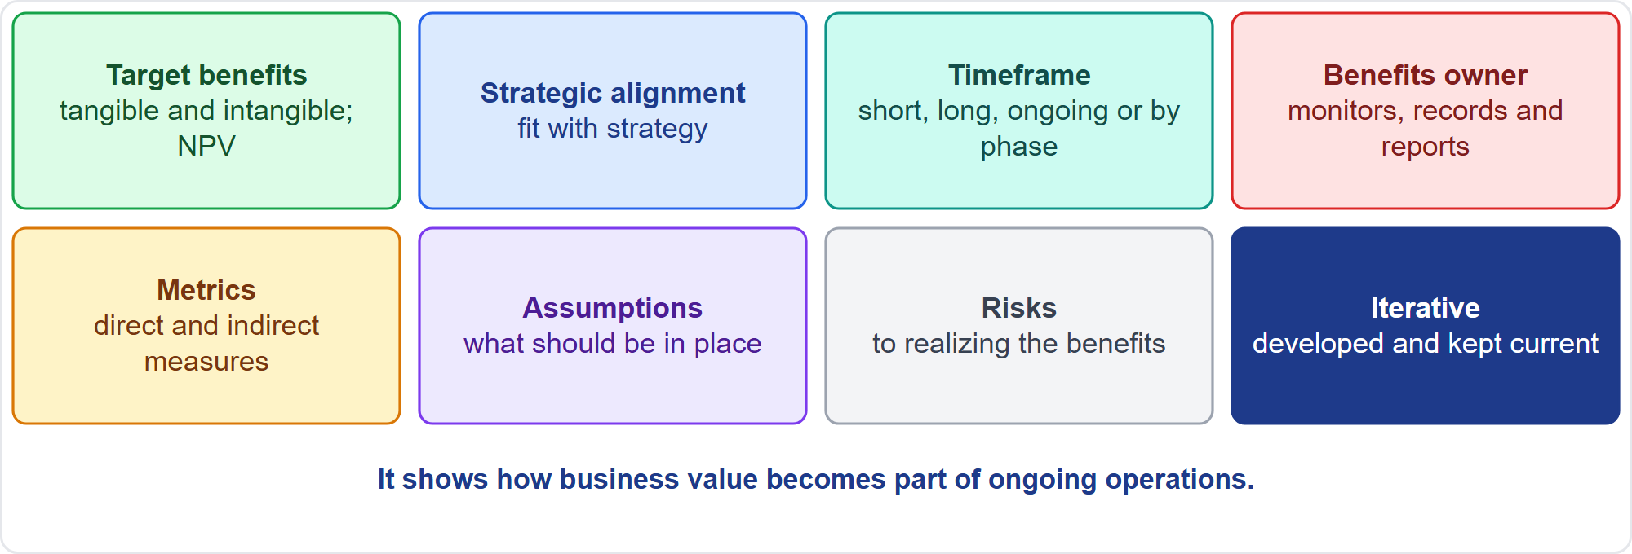
The Benefits Management Plan
Part 1
Seven elements and an iterative habit
EXAM TIP The benefits owner monitors, records and reports realized benefits over the timeframe, even after the project ends.
PMP Exam Prep 2026 | PMBOK 8 and the New ECO
Module 6
8 / 70
Notes:
The benefits management plan explains how benefits will be created, maximized and sustained: how and when they will be delivered and how they will be measured. It has seven elements. Target benefits, tangible and intangible, with financial value possibly expressed as net present value. Strategic alignment. The timeframe for realizing benefits: short term, long term, ongoing or by phase. The benefits owner, accountable for monitoring, recording and reporting realized benefits. Metrics. Assumptions. And risks to realizing the benefits. It is developed iteratively and describes how value becomes part of operations.

Slide 9
Agreements
Part 1
Agreements define the project's initial intentions
Forms: contract, service-level agreement, memorandum of understanding, letter of agreement, purchase order, email, even a verbal agreement
They must comply with local, national and international contract law
In cross-corporate projects, contracts bind the organizations
Each organization still needs its own internal charter to deliver its obligations
EXAM TIP A contract may start cross-organizational work, but each organization still needs an internal charter.
PMP Exam Prep 2026 | PMBOK 8 and the New ECO
Module 6
9 / 70
Notes:
Agreements are another input to initiating. An agreement is any document or communication that defines the initial intentions of a project. It can be a contract, a service-level agreement, or a memorandum of understanding. It can be a letter of agreement or a purchase order. It can even be an email, or a verbal agreement. They may be simple or complex, and they must comply with local, national and international contract law. In cross-corporate projects, contracts bind the organizations, but each organization still needs its own internal charter to deliver its obligations.

Slide 10
The Initiate Project or Phase Process
Part 1
Item | Detail
Purpose | Authorize the start and give the project manager authority to allocate resources; link the project to the business case and strategy
Inputs | Business case, benefits plan, agreements, environmental factors, process assets
Tools | Expert judgment; brainstorming and interviews; facilitation; meetings; RAM; project canvas
Outputs | Project charter and assumption log
Frequency | Once, or at certain points such as each phase
EXAM TIP At initiation, assess the need, expected value, size, complexity and the fitting approach.
PMP Exam Prep 2026 | PMBOK 8 and the New ECO
Module 6
10 / 70
Notes:
The Initiate Project or Phase process officially authorizes the start of a project and grants the project manager the authority to allocate organizational resources, by creating a project charter. It creates a direct link between the project, the business case and strategic goals. Inputs: the business case, benefits plan, agreements, environmental factors and process assets. Tools: expert judgment, brainstorming and interviews, facilitation, meetings, a responsibility assignment matrix and a project canvas. Outputs: the project charter and the assumption log. At initiation, also ask what the need is, how complex the work is, and which approach fits.

Slide 11
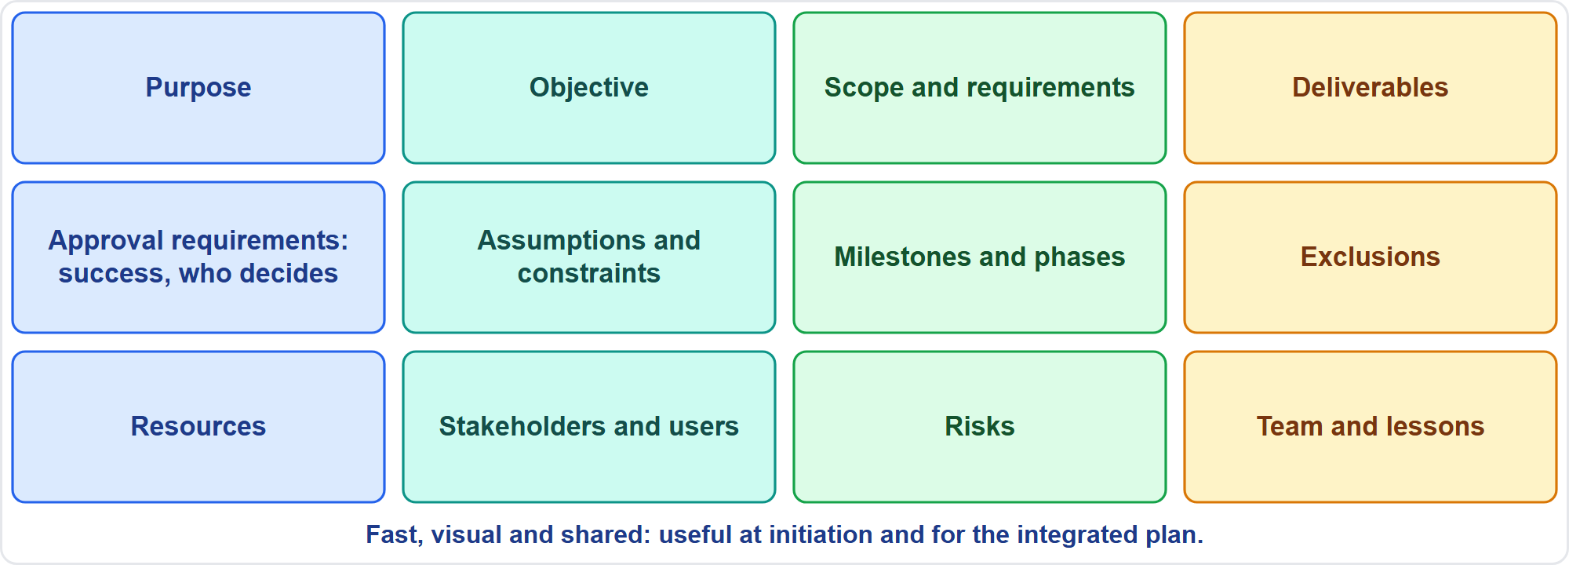
The Project Canvas
Part 1
A one-page view of the project
EXAM TIP A canvas is a quick tool for shared understanding at initiation and for the integrated plan.
PMP Exam Prep 2026 | PMBOK 8 and the New ECO
Module 6
11 / 70
Notes:
A project canvas is a one-page visual that outlines the project's key elements for a quick, shared understanding. Typical sections: purpose, objective, scope and requirements, and deliverables. Then project approval requirements, such as what success is and who decides. Then assumptions and constraints, milestones and phases, and scope exclusions. Then resources, stakeholders and users, risks, and the team and lessons learned. It is fast, visual and shared, so it is useful at initiation, and later for the integrated plan. Two related tools: the responsibility matrix and the assumption log.

Slide 12
The Project Charter
Part 1
Point | Detail
Definition | A document issued by the initiator or sponsor that formally authorizes the project and gives the project manager authority to apply resources
Role | A partnership between the performing and requesting organizations
Who writes it | The sponsor or project manager, with the initiating entity
Project manager | Assigned as early as possible, ideally during charter development and always before planning begins
Changes | Approved by the sponsor or initiator
EXAM TIP A project manager without a charter lacks formal authority to apply resources.
PMP Exam Prep 2026 | PMBOK 8 and the New ECO
Module 6
12 / 70
Notes:
The project charter is a document issued by the project initiator or sponsor that formally authorizes the existence of the project. It gives the project manager the authority to apply organizational resources. It forms a partnership between the performing and requesting organizations. The sponsor or the project manager writes it, together with the initiating entity. The project manager should be assigned as early as possible, ideally during charter development, and always before planning begins. The sponsor approves the charter and any changes to it.

Slide 13
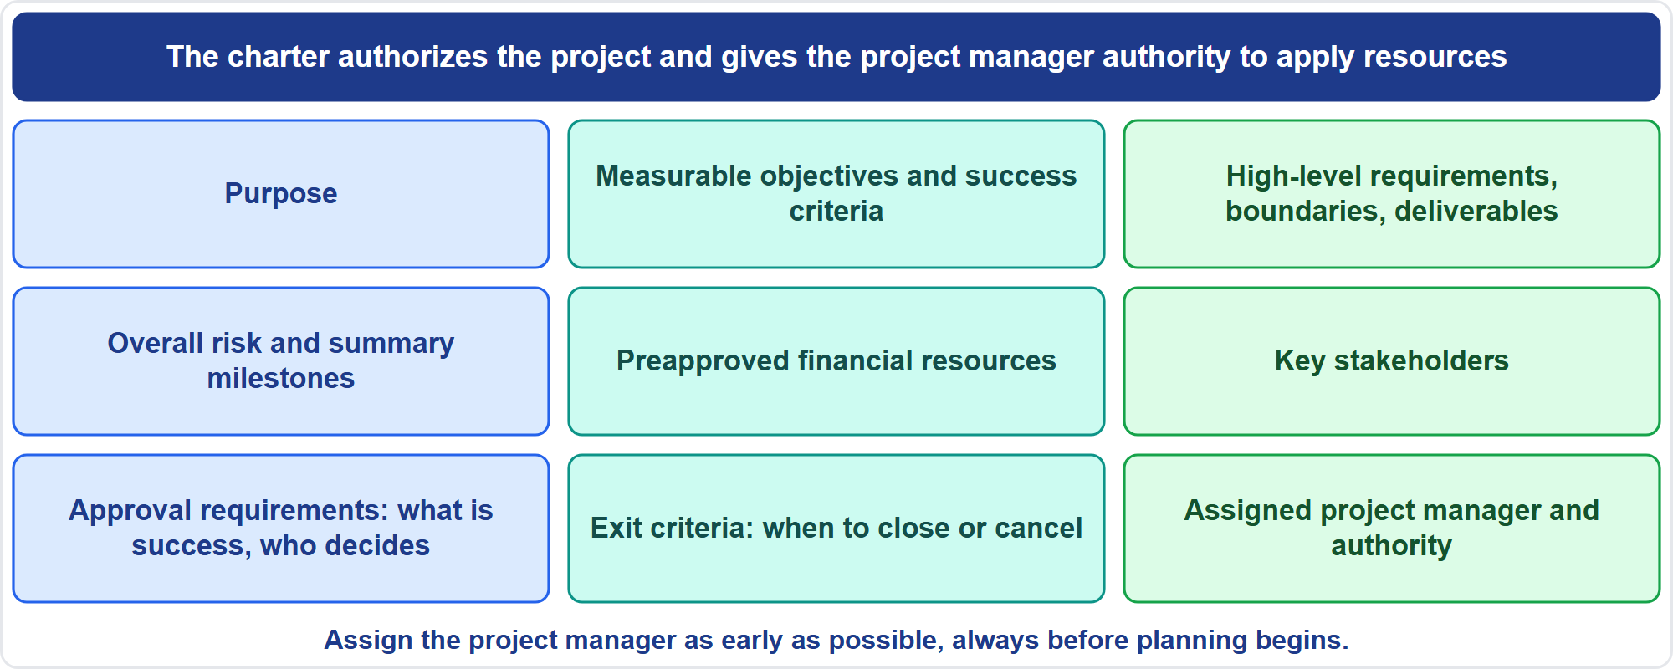
What a Charter Contains
Part 1
Nine content items
EXAM TIP Success criteria and exit criteria belong in the charter, so the team knows when to close or cancel.
PMP Exam Prep 2026 | PMBOK 8 and the New ECO
Module 6
13 / 70
Notes:
A charter contains nine things. The project purpose. Measurable objectives and success criteria. High-level requirements, boundaries and key deliverables. Overall project risk and a summary milestone schedule. Preapproved financial resources. A list of key stakeholders. Project approval requirements: what constitutes success, who decides and who approves. Project exit criteria: the conditions to close or cancel the project or phase. And the assigned project manager with responsibility and authority level. Success and exit criteria in the charter tell the team when to close or cancel.

Slide 14
Charter, Scope Statement and Plan
Part 1
 | Charter | Scope statement | Management plan
Level | High level | Detailed scope | Integrated plan and baselines
Purpose | Authorize the project and the manager | Common understanding; boundary for requests | How the work is executed, controlled and closed
Contains | Purpose, objectives, milestones, funds | Deliverables, acceptance criteria, exclusions | Subsidiary plans, baselines, approach
Owner | Sponsor or initiator | Project team | Project manager and team
EXAM TIP Charter, scope statement and plan differ in level of detail, not just in name.
PMP Exam Prep 2026 | PMBOK 8 and the New ECO
Module 6
14 / 70
Notes:
These three documents can look redundant, but they differ in level of detail. The charter is high level. It authorizes the project and the project manager. It contains purpose, objectives, milestones and funds, and the sponsor owns it. The scope statement is a detailed description of scope. It gives a common understanding, and a boundary for judging whether requests are inside or outside scope. It contains deliverables, acceptance criteria and exclusions, and the team owns it. The project management plan describes how the work will be executed, controlled and closed.

Slide 15
Charters in Adaptive Approaches
Part 1
More flexible: a minimal worksheet or a concise vision statement
Just enough structure, while requirements and priorities evolve
It answers some or all of: why, who, what, where, when, how, and who is the customer
Funding may come in time-boxed tranches; the business case is revisited as value is reprioritized
The product owner and team shape the vision; the project manager or scrum master facilitates alignment
EXAM TIP A sponsor who cannot yet detail requirements should not block the start: elaborate progressively.
PMP Exam Prep 2026 | PMBOK 8 and the New ECO
Module 6
15 / 70
Notes:
In adaptive approaches, charters are more flexible. They can be a minimal worksheet or a concise vision statement, a moderately detailed document at most. The idea is just enough structure while requirements and priorities evolve. An adaptive charter answers some or all of these questions. Why is the project being undertaken? Who will be engaged? What is it about? Where, when and how will it be carried out? And who is the customer? Funding may come in time-boxed tranches, and the business case is revisited as value is reprioritized. The product owner and team shape the vision, and the project manager or scrum master facilitates alignment. If the sponsor cannot yet describe detailed requirements, start anyway, and elaborate progressively.

Slide 16
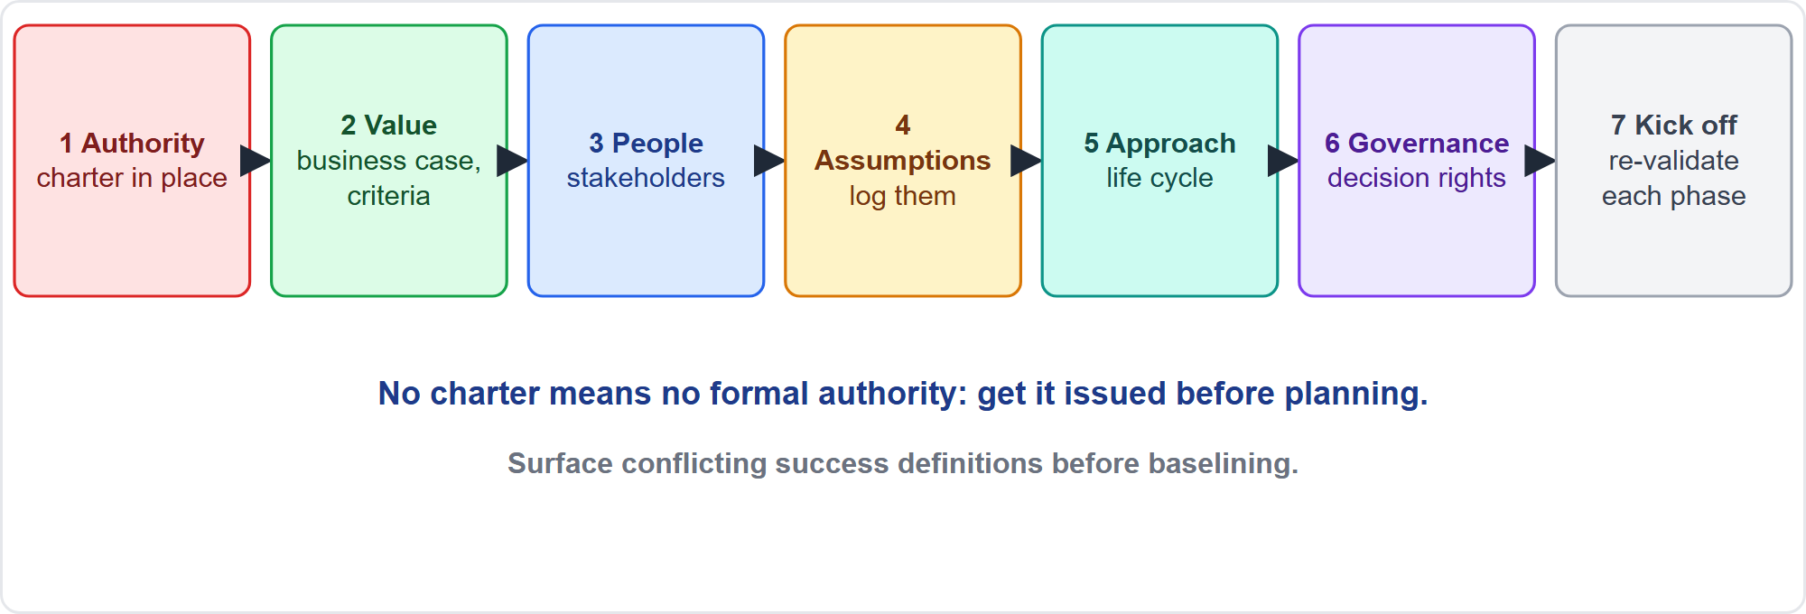
Initiating in Practice
Part 1
Seven steps
EXAM TIP If conflicting definitions of success exist, bring the leaders together to agree one statement before baselining.
PMP Exam Prep 2026 | PMBOK 8 and the New ECO
Module 6
16 / 70
Notes:
Here is initiating in practice, in seven steps. One, confirm authorization and authority. No charter means no formal authority, so work with the sponsor to get one before planning. Two, confirm the value case, and surface conflicting definitions of success before baselining. Three, identify stakeholders and engage the sponsor and key stakeholders. Four, record assumptions and constraints. Five, choose the initial approach and life cycle. Six, clarify governance: decision rights, thresholds and escalation. Seven, kick off, and re-validate at every phase.

Slide 17
Initiating in Predictive, Agile and Hybrid Work
Part 1
 | Predictive | Agile | Hybrid
Charter | Formal: measurable objectives, milestones, funds, exit criteria | Lightweight: vision statement or canvas | Formal for committed parts, light for the rest
Business case | Authorizes the whole project; revalidated at gates | Revisited as value is reprioritized each iteration or release | Both
Initiation | At start and each phase | Vision and roadmap, then continuous refinement | Mixed
Project manager | Often drafts the charter | Product owner shapes the vision; PM facilitates | Shared
EXAM TIP Phases are initiated too: re-check the business case and readiness at each gate.
PMP Exam Prep 2026 | PMBOK 8 and the New ECO
Module 6
17 / 70
Notes:
Initiating differs by approach. In predictive work, the charter is formal, with measurable objectives, milestones, funds and exit criteria, and the business case is revalidated at gates. In agile work, a lightweight charter, a vision statement or a canvas is enough, and the business case is revisited as value is reprioritized each iteration or release. In hybrid work, the charter is formal for committed or contractual aspects and light for the rest. And phases are initiated too, so re-check the business case at each gate.

Slide 18
Initiating Traps: What PMI Expects
Part 1
The charter authorizes the project and the project manager; planning follows it
Business case and benefits plan are business documents; the sponsor is accountable
Revalidate value, not just performance; take changes to the sponsor
Charter, scope statement and plan are different documents
Surface hidden assumptions and conflicting expectations before baselining
Decision rights belong in governance from the start
EXAM TIP Do not wait for perfect information: the sponsor gives the minimum, and you elaborate progressively.
PMP Exam Prep 2026 | PMBOK 8 and the New ECO
Module 6
18 / 70
Notes:
The traps for initiating. The charter authorizes the project and the project manager, and planning follows it. The business case and benefits management plan are business documents, and the sponsor is accountable. Revalidate value, not just performance, and take changes to the sponsor. The charter, scope statement and plan are different documents. Surface hidden assumptions and conflicting expectations before baselining. And decision rights belong in governance from the start. If trade-offs or spending limits have no owner, work with the sponsor to define them. Do not infer or take them.

Slide 19
Value: The Core Ideas
Part 1
Value is the excess of financial and nonfinancial benefits over the investment
Outputs lead to outcomes, outcomes to benefits, benefits to value
Value per unit of investment is the ultimate success indicator
Value can be realized during, at the end of, or after the project
A deliverable may not achieve the purpose alone: software without training does not raise productivity
Value is perceived differently: business, customers, governments
EXAM TIP When asked whether the project is delivering value, check the benefit target, not feature counts.
PMP Exam Prep 2026 | PMBOK 8 and the New ECO
Module 6
19 / 70
Notes:
Now value. Value is the excess of financial and nonfinancial benefits over the investment. Outputs lead to outcomes, outcomes lead to benefits, and benefits lead to value. Value per unit of investment is the ultimate success indicator. Value can be realized during the project, at the end, or after completion, and it may be intertwined with operations or a program. A deliverable may not achieve the purpose alone: software without training does not raise productivity. And different stakeholders, such as the business, customers and governments, perceive value differently. Check the benefit target, not feature counts.

Slide 20
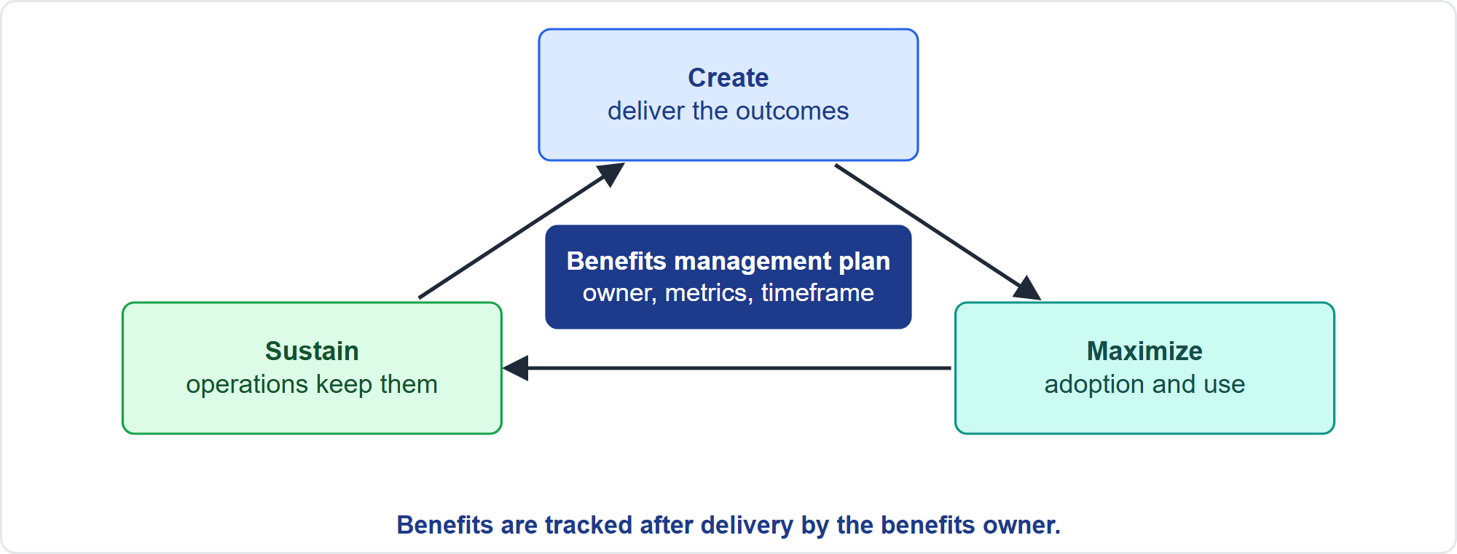
The Benefits Cycle
Part 1
Create, maximize, sustain
EXAM TIP Make sure a measurement system and a benefits owner exist before closing: benefits are tracked after the project.
PMP Exam Prep 2026 | PMBOK 8 and the New ECO
Module 6
20 / 70
Notes:
Benefits go through a cycle: create, maximize and sustain, all governed by the benefits management plan. Create: deliver the outcomes. Maximize: make sure people adopt and use them. Sustain: make sure operations keep delivering them. Because benefits often arrive after the project ends, the benefits owner keeps recording and reporting them. So before closing, make sure that a measurement system and a benefits owner exist. Otherwise the project delivers outputs, and nobody checks the value.

Slide 21
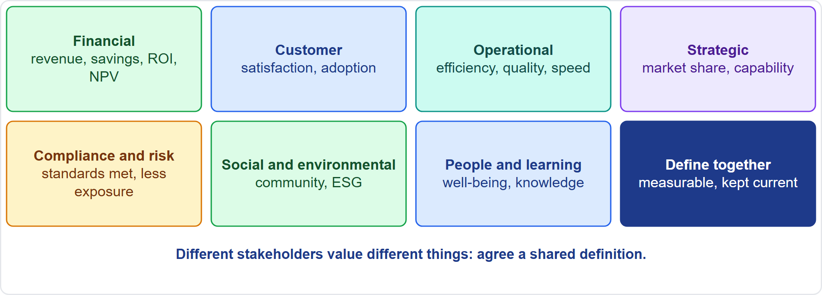
Identify Value Components With Stakeholders
Part 1
Seven kinds of value
EXAM TIP When stakeholders define value differently, facilitate a shared definition and link it to the business case; do not assume.
PMP Exam Prep 2026 | PMBOK 8 and the New ECO
Module 6
21 / 70
Notes:
Different stakeholders value different things, so define value together at the start, and keep it current. Seven value components. Financial: revenue, savings, return, net present value. Customer: satisfaction, adoption, retention. Operational: efficiency, quality, speed. Strategic: market share, capability. Compliance and risk: standards met, less exposure. Social and environmental: community benefit, sustainability. People and learning: well-being and knowledge. Agree measurable descriptions, and how value will be judged. Interviews, workshops, surveys, customer talks and design thinking all help uncover it.

Slide 22
Part 1 Recap
Part 1
1
Business documents
2
Charter
3
Canvas
business case and benefits plan, owned by the sponsor
authorizes the project and the project manager
one page for shared understanding
4
Initiating steps
5
Value chain
6
Benefits cycle
authority, value, people, assumptions, approach, governance
outputs, outcomes, benefits, value
create, maximize, sustain, with an owner
PMP Exam Prep 2026 | PMBOK 8 and the New ECO
Module 6
22 / 70
Notes:
Let us recap Part 1. The business case and the benefits management plan are business documents, and the sponsor is accountable. The charter authorizes the project and the project manager. A canvas gives one page for shared understanding. Initiating runs through authority, value, people, assumptions, approach and governance. Value runs from outputs to outcomes to benefits. And benefits follow a cycle of create, maximize and sustain, with an owner. In Part 2, we measure and deliver value, and plan the approach.

Slide 23
Uncover and Measure Value
Part 2
Ask through interviews, focus groups, workshops and surveys
Watch users through customer talks and tests and design thinking
Use the business case, strategy and benefits plan
Agree measurable descriptions of value
Value is not only profit: it can be social or environmental
Sometimes spending more is right because value depends on a date
EXAM TIP Agree what value means with stakeholders and write it down with measures.
PMP Exam Prep 2026 | PMBOK 8 and the New ECO
Module 6
23 / 70
Notes:
Part 2 is about delivering and measuring value. To uncover value, ask: use interviews, focus groups, workshops and surveys. Watch users through customer talks and tests, and design thinking. Use the business case, the strategy and the benefits plan. Agree measurable descriptions of value. Remember that value is not only profit: it can be social or environmental. Sometimes spending more is right, because the value depends on being available by a date. Agree what value means with stakeholders, and write it down with measures.

Slide 24
Financial Measures
Part 2
Measure | Meaning and decision rule
ROI | Net benefit divided by cost; higher is better
NPV | Present value of benefits minus costs; accept above zero; choose the higher
IRR | The discount rate where NPV is zero; accept above the required rate
Payback | Time to recover the investment; shorter is better; ignores later value
Benefit-cost ratio | Present value of benefits divided by costs; above 1 is acceptable
Sunk cost | Money already spent; ignore it when deciding
EXAM TIP PMBOK 8 names ROI, IRR, payback, ROA, ROACE and NPV; the decision rules are exam practice.
PMP Exam Prep 2026 | PMBOK 8 and the New ECO
Module 6
24 / 70
Notes:
PMBOK 8 names several financial measures. Return on investment, internal rate of return, and payback period. Return on assets, return on average capital employed, and net present value. The decision rules are exam practice. Return on investment: higher is better. Net present value: accept if above zero, and choose the higher among alternatives. Internal rate of return: accept if above the required rate. Payback: shorter is better, but it ignores later value. Benefit-cost ratio: above one is acceptable. And ignore sunk cost.

Slide 25
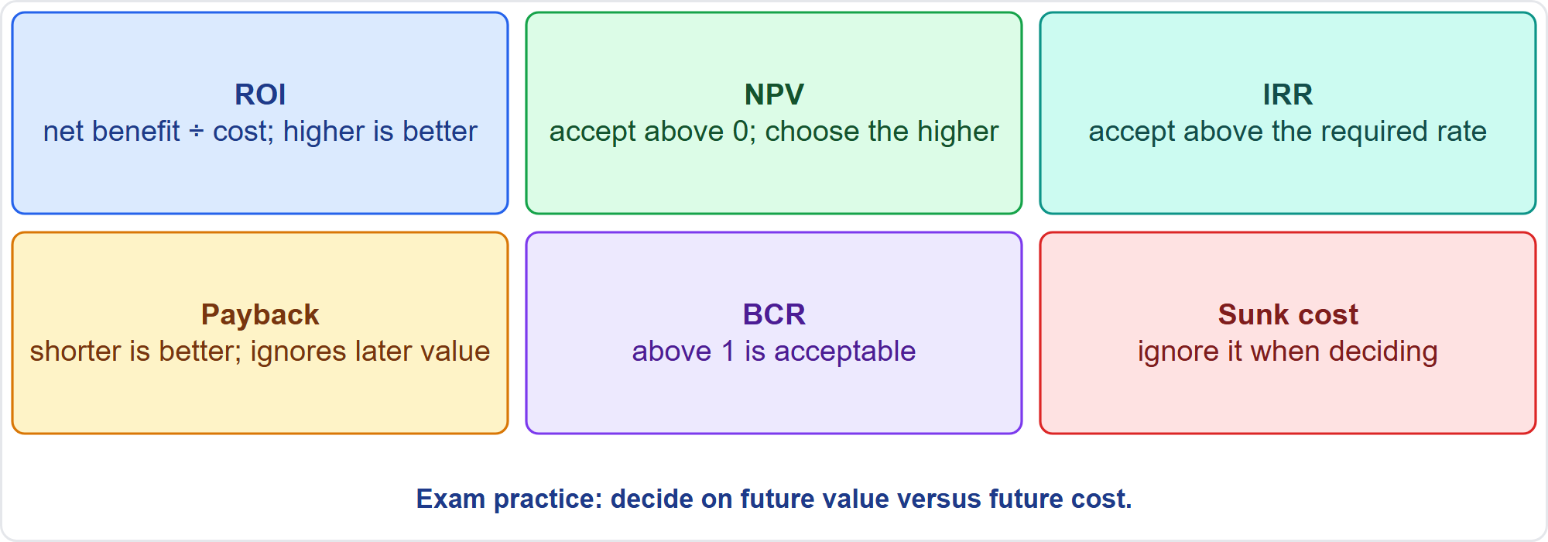
Decision Rules at a Glance
Part 2
Six rules
EXAM TIP Sunk cost is irrelevant: decide on future value versus future cost.
PMP Exam Prep 2026 | PMBOK 8 and the New ECO
Module 6
25 / 70
Notes:
Here are the rules together. Return on investment: net benefit divided by cost, and higher is better. Net present value: accept above zero, and choose the higher. Internal rate of return: accept when above the required rate. Payback: shorter is better, though it ignores later value and the time value of money. Benefit-cost ratio: above one is acceptable. And sunk cost: ignore it when deciding. Sunk cost never justifies continuing. Decide on future value against future cost.

Slide 26
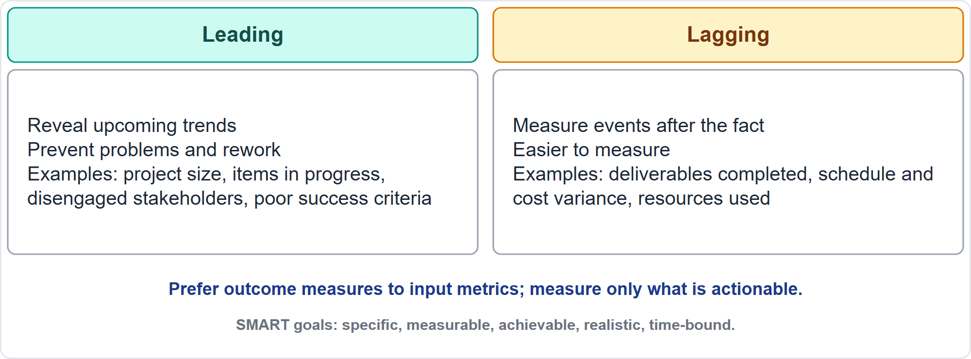
Leading and Lagging Indicators
Part 2
Look ahead and look back
EXAM TIP Prefer leading indicators and outcome measures: they prevent problems and rework.
PMP Exam Prep 2026 | PMBOK 8 and the New ECO
Module 6
26 / 70
Notes:
Governance needs target metrics aligned to strategy, signaling mechanisms and feedback mechanisms. Leading indicators reveal upcoming changes or trends, so they prevent problems and rework. Examples: the size of the project, items in progress in the backlog, disengaged stakeholders and poorly defined success criteria. Lagging indicators measure events after the fact, and are easier to measure: deliverables completed, schedule and cost variance. Prefer outcome measures to input metrics such as utilization. Use SMART goals, and measure only what is relevant and actionable.

Slide 27
Measurement Pitfalls
Part 2
Hawthorne effect
Vanity metric
Demoralization
measuring something changes behavior
shows data but guides no decision
unachievable targets sink morale
Misuse
Confirmation bias
Correlation versus causation
gaming, short-term over long-term, easy work out of sequence
seeing only what supports your view
late and over budget are not necessarily cause and effect
EXAM TIP Beware measuring only volume: you will get volume, not satisfaction.
PMP Exam Prep 2026 | PMBOK 8 and the New ECO
Module 6
27 / 70
Notes:
PMBOK 8 warns of six measurement pitfalls. The Hawthorne effect: measuring something changes behavior, so measure only deliverable volume and you get volume, not satisfaction. A vanity metric shows data but guides no decision. Demoralization: unachievable targets sink morale. Misuse: gaming, favoring the short term over the long term, or doing easy out-of-sequence work. Confirmation bias: seeing only information that supports your view. And correlation versus causation: being late and over budget are not necessarily cause and effect.

Slide 28
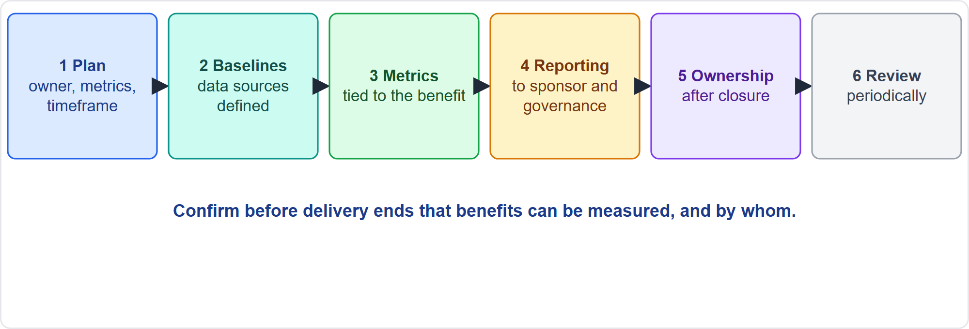
Verify That a Measurement System Tracks Benefits
Part 2
Six checks before delivery ends
EXAM TIP Metrics must be tied to the benefit target, not to activity volume.
PMP Exam Prep 2026 | PMBOK 8 and the New ECO
Module 6
28 / 70
Notes:
Before delivery ends, verify that benefits can be measured, and who will measure them. One: a benefits management plan exists, with target benefits, owner, metrics, timeframe, assumptions and risks. Two: baselines and data sources are defined, so improvement can be shown, such as average handling time before and after. Three: metrics are tied to the benefit target, not to activity volume. Four: a reporting rhythm exists to the sponsor and governance. Five: ownership after closure. Six: periodic review.

Slide 29
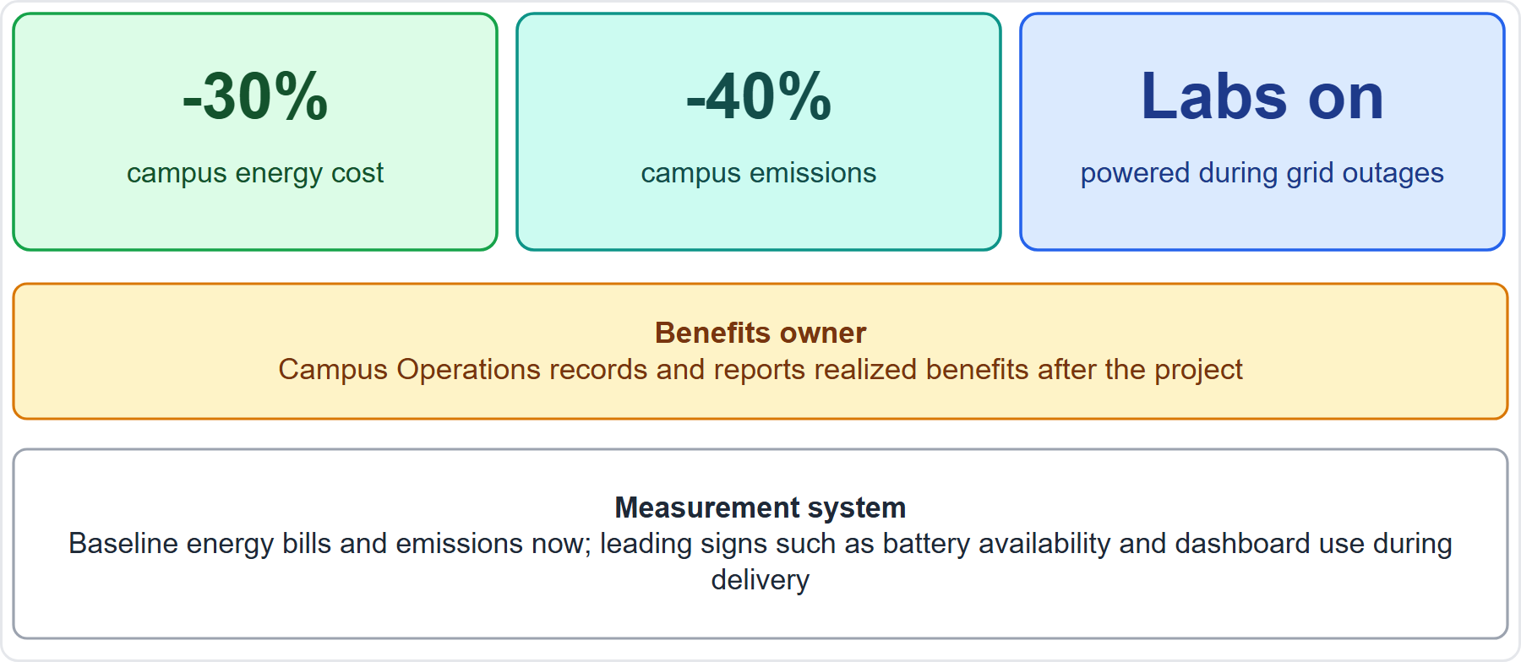
Case Check-In: Value Measures for the Microgrid
Part 2
CASE CHECK-IN · Sunrise Campus Microgrid
Targets: energy cost down about 30%, emissions down about 40%, labs powered in outages
Benefits owner: Campus Operations records and reports after the project
PMP Exam Prep 2026 | PMBOK 8 and the New ECO
Module 6
29 / 70
Notes:
Let us verify our measurement system. The targets are energy cost down about thirty percent, emissions down about forty percent, and labs powered during grid outages. The benefits owner is Campus Operations, which records and reports realized benefits after the project. Baseline energy bills and emissions now, so improvement can be demonstrated. During delivery, watch leading signs such as battery availability and dashboard use. Without a baseline and an owner, the project would deliver equipment, and nobody could show the value.

Slide 30
Prioritize by Value and Stakeholder Feedback
Part 2
Backlog: ranked by business value or customer importance, sized by the team, with dependencies considered
Feedback loops: iteration reviews, customer talks, demos give evidence to reorder priorities
Predictive: prioritization decides which requirements enter scope and which phase delivers them
Prioritize requirements and stakeholders
Rank by measurable value and data, not by the seniority of the person asking
EXAM TIP If a demo shifts what users value, reprioritize the backlog by the latest value and feedback.
PMP Exam Prep 2026 | PMBOK 8 and the New ECO
Module 6
30 / 70
Notes:
Prioritize work by value and stakeholder feedback. In an adaptive backlog, items are ranked by business value or importance to the customer. The team sizes them, with dependencies and constraints considered. So the highest-value items are delivered next. Feedback loops, such as iteration reviews, customer talks and demos, give the evidence to reorder priorities. In predictive work, prioritization drives which requirements enter scope and which phase delivers them. Rank by measurable value and data, not by the seniority of the person asking. If a demo shifts what users value, reprioritize.

Slide 31
Prioritization Methods
Part 2
MoSCoW
100-point method
Cost of delay
must, should, could, will not have
stakeholders spend 100 points across items
the value lost by waiting
Kano analysis
Multicriteria decision analysis
basic, performance and delighter features
weighted criteria score and rank the options
EXAM TIP Use value-based methods and evidence, not who shouts loudest.
PMP Exam Prep 2026 | PMBOK 8 and the New ECO
Module 6
31 / 70
Notes:
Five methods help prioritize. MoSCoW: must, should, could and will not have. The hundred-point method: stakeholders spend a hundred points across items. Cost of delay: the value lost by waiting. Kano analysis: basic, performance and delighter features. Multicriteria decision analysis: weighted criteria produce a score for each alternative, and the alternatives are ranked. Use value-based methods and evidence. Do not rank by who asks loudest.

Slide 32
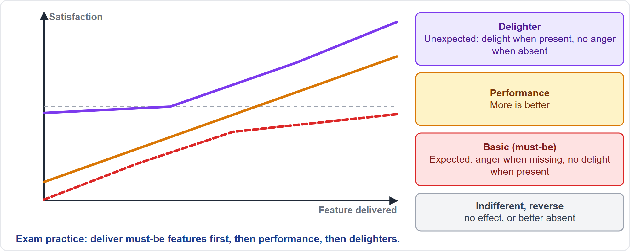
The Kano Model
Part 2
Three kinds of feature
EXAM TIP Basic features cause anger when missing but no delight when present; delighters delight when present and cost nothing in anger when absent.
PMP Exam Prep 2026 | PMBOK 8 and the New ECO
Module 6
32 / 70
Notes:
The Kano model, as exam practice, sorts features by two questions: how do you feel if it is present, and how do you feel if it is absent? Basic or must-be features are expected: anger when missing, but no delight when present. Performance features: more is better. Delighters, or attractive features, are unexpected: delight when present, and no anger when absent. Indifferent features have no effect, and reverse features are better absent. Deliver must-be features first, then performance, then delighters.

Slide 33
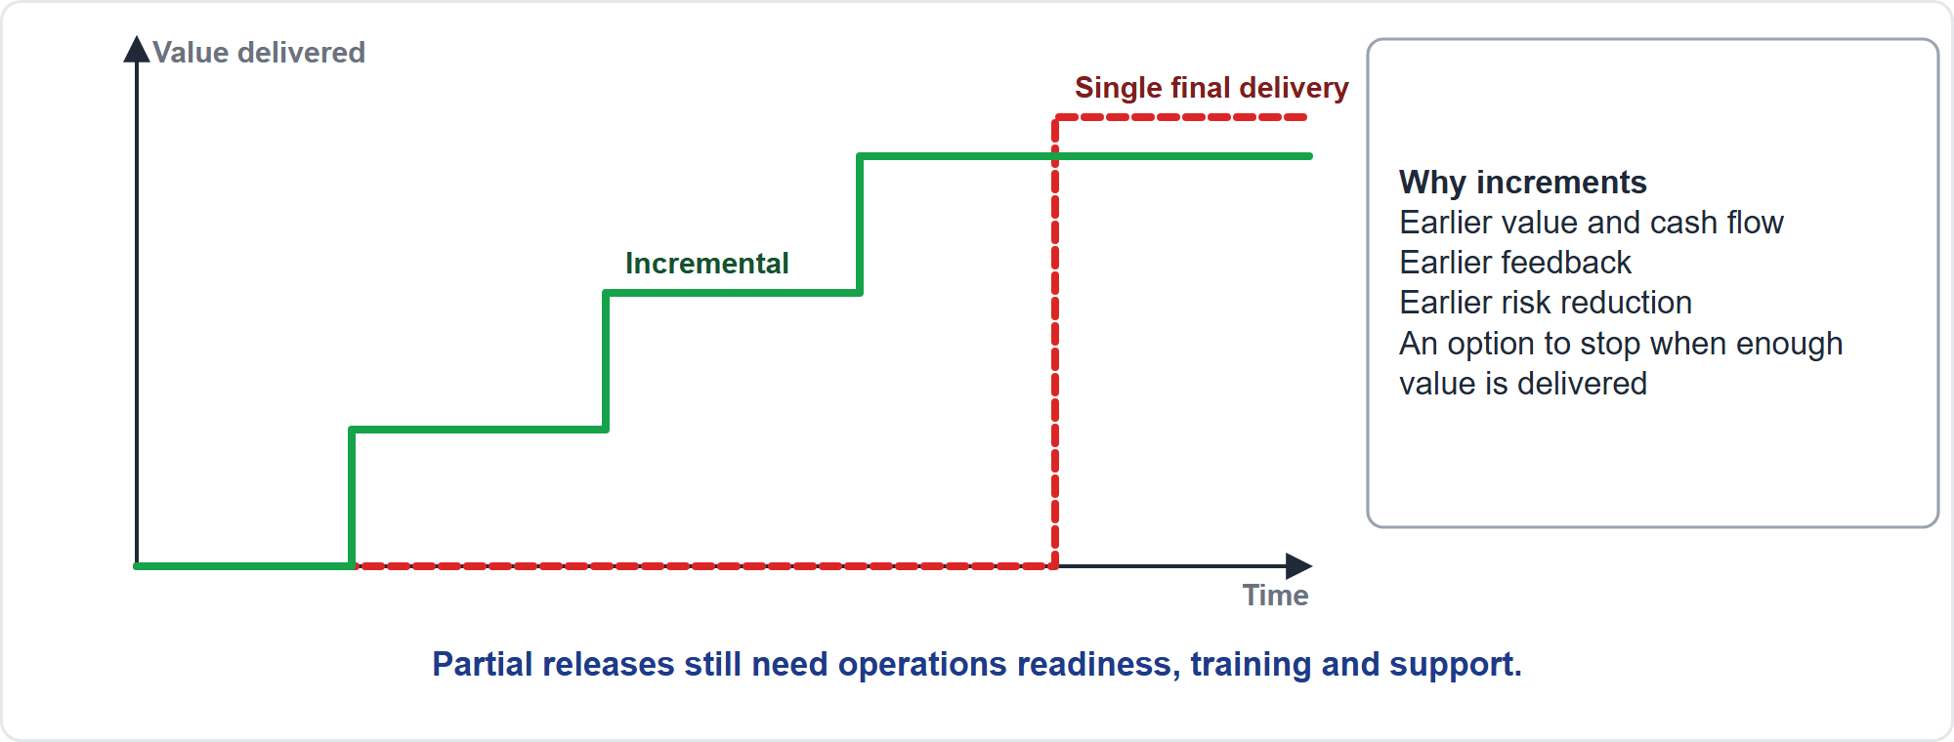
Deliver Value Incrementally
Part 2
Earlier value, feedback and risk reduction
EXAM TIP If value can be delivered earlier through an MVP, a pilot or phases, recommend it and weigh the trade-offs.
PMP Exam Prep 2026 | PMBOK 8 and the New ECO
Module 6
33 / 70
Notes:
Incremental delivery gives usable segments, each providing value and building on the last. It works inside predictive projects, with planned increments and fixed scope, and it is the natural rhythm of adaptive ones. The benefits: earlier value and cash flow, earlier feedback, earlier risk reduction, and an option to stop when enough value is delivered. A minimum viable product defines the first release. The limits: not everything can be split, and partial releases still need operations readiness, training and support.

Slide 34
Examine Business Value Throughout the Project
Part 2
Governance scenario | Meaning
Initiation | A venture is deemed worthwhile; resources launch it
Replanning | Revising any plan element that needs deliberate review
Expansion or contraction | Changing constraints to preserve or capture value
Early termination, positive cause | The desired value has been achieved
Early termination, negative cause | The desired value is no longer achievable
EXAM TIP Termination is a valid value decision and goes through governance; ignore sunk costs.
PMP Exam Prep 2026 | PMBOK 8 and the New ECO
Module 6
34 / 70
Notes:
Value is checked continuously, not only at gates. PMBOK 8 describes governance scenarios in which the overarching value proposition is the primary factor. Initiation: a venture is deemed worthwhile. Replanning: revising any plan element that needs deliberate review. Expansion or contraction: changing constraints to preserve or capture value. Early termination for a positive cause: the desired value has been achieved. Early termination for a negative cause: the desired value is no longer achievable. Triggers to revisit the business case include market changes, new regulation and benefits tracking below target.

Slide 35
Evaluate Delivery Options
Part 2
Option | Use when | Shows value by
Single final delivery | Value exists only as a whole | Final outcome measurement
Phased or incremental | Scope is understood; partial use is valuable | Early usage and benefits
Pilot, MVP, prototype | Demand or fit is uncertain | Evidence from a limited segment
Periodic or continuous | Frequent feedback, fast change | Regular working releases
Demos and reviews | Always | Stakeholders see working results
EXAM TIP Present the choice to the sponsor with expected value, cost, risk and timing.
PMP Exam Prep 2026 | PMBOK 8 and the New ECO
Module 6
35 / 70
Notes:
Choose how to deliver so that value is shown early and credibly. A single final delivery suits value that exists only as a whole, such as a cut-over, and shows value through final outcome measurement. Phased or incremental delivery suits understood scope with valuable partial use. A pilot, an MVP or a prototype suits uncertain demand, and gives evidence from a limited segment before full investment. Periodic or continuous delivery suits frequent feedback. Demos and reviews always help. Present the choice to the sponsor with expected value, cost, risk and timing.

Slide 36
Value in Predictive, Agile and Hybrid Work
Part 2
 | Predictive | Agile | Hybrid
Value definition | Business case and requirements up front | Product vision and outcomes; value tested by delivery | Committed value plus evolving value
Prioritization | Requirements and scope baseline | Value-ordered backlog | Both
Delivery | Phased or single; incremental where planned | Frequent increments, MVP | Mixed
Measures | Milestones, earned value, benefits at gates | Working increments, usage, outcomes | Both
Value review | Gates and formal review | Every iteration or release | Both
EXAM TIP Velocity is an input only; outcomes and usage show value.
PMP Exam Prep 2026 | PMBOK 8 and the New ECO
Module 6
36 / 70
Notes:
Value looks different by approach. In predictive work, value is defined in the business case and requirements up front. Prioritization shapes the scope baseline. Delivery is phased or single. And value is reviewed at gates. In agile work, value is defined through product vision and outcomes, and tested by delivery. The backlog is ordered by value, increments are frequent, and there is a review every iteration or release. Measures are working increments, usage and outcomes, and velocity is an input only. Hybrid combines committed value with evolving value.

Slide 37
Value Traps: What PMI Expects
Part 2
Outputs are not benefits: check the benefit target
Value over plan compliance: on time and on budget is not enough
Agree what value means and write it down with measures
Reprioritize by value and feedback; do not rank by seniority
Look for earlier value: MVP, pilot, phases
Sunk cost is irrelevant; termination is a valid value decision
EXAM TIP Make sure a measurement system and a benefits owner exist before closing.
PMP Exam Prep 2026 | PMBOK 8 and the New ECO
Module 6
37 / 70
Notes:
The traps for value. Outputs are not benefits, so check the benefit target. Value beats plan compliance: on time and on budget is not enough, so revalidate the business case when conditions change. Agree what value means and write it down with measures. Reprioritize by value and feedback, and do not rank by seniority. Look for earlier value through an MVP, a pilot or phases. Sunk cost is irrelevant, and termination is a valid value decision that goes through governance. And choose outcome metrics over activity metrics.

Slide 38
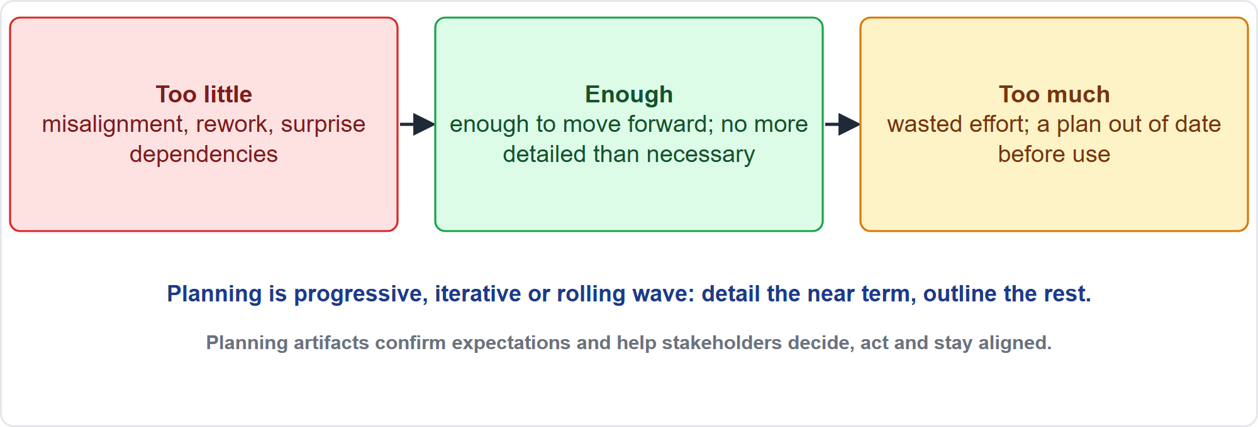
Planning: How Much?
Part 2
Too little, enough, too much
EXAM TIP Plan progressively: do not detail far-off work that lacks information, and do not skip planning in predictive work either.
PMP Exam Prep 2026 | PMBOK 8 and the New ECO
Module 6
38 / 70
Notes:
Now the planning half of the module. How much planning is right? PMBOK 8 says the time spent planning depends on the circumstances, and planning should give enough information to move forward appropriately, but be no more detailed than necessary. Too little planning causes misalignment, rework and surprise dependencies. Too much wastes effort, and gives a plan that is out of date before it is used. Planning is progressive, iterative or rolling wave: detail the near term, outline the rest.

Slide 39
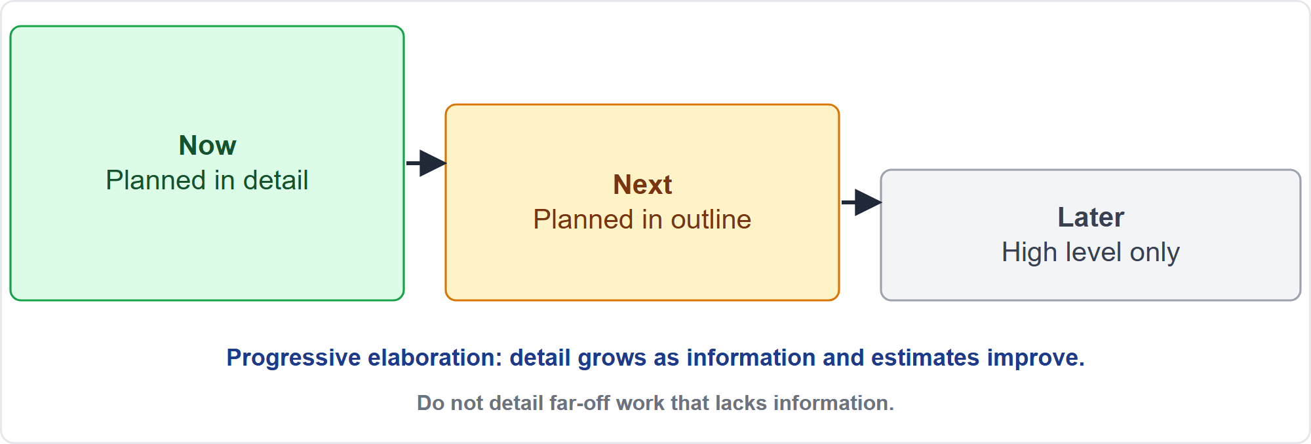
Rolling Wave Planning
Part 2
Detail the near term, outline the rest
EXAM TIP Planning does not end at the first baseline: detail is added as information arrives.
PMP Exam Prep 2026 | PMBOK 8 and the New ECO
Module 6
39 / 70
Notes:
Rolling wave planning is a technique of progressive elaboration. Near-term work is planned in detail. The next wave is planned in outline. Later work stays at a high level, and is decomposed as information arrives. It avoids two errors: detailing far-off work when information is missing, and skipping planning altogether. In predictive projects, planning is progressive within phases. In adaptive projects, it shows up as a roadmap, a release plan and a detailed iteration plan. Planning continues throughout. The first baseline is not the end of it.

Slide 40
Assess Needs, Complexity and Magnitude
Part 2
Dimension | Questions | Effect on the plan
Needs | What value, expectations, requirements, compliance and sustainability needs? | Scope, success measures, priorities, approach
Complexity | How hard to manage because of people, systems and ambiguity? | Flexible approaches, stakeholder work, dependency mapping
Magnitude | Budget, duration, team size, stakeholders, criticality? | Governance rigor, reserves, reporting, PMO involvement
EXAM TIP Assess first: the approach, rigor, estimates and reserves are consequences of the assessment, not preferences.
PMP Exam Prep 2026 | PMBOK 8 and the New ECO
Module 6
40 / 70
Notes:
Assess needs, complexity and magnitude before choosing the approach and estimating. Needs: what value is the project meant to deliver, what do stakeholders expect, and which compliance, security or sustainability needs apply. They drive scope, success measures and priorities. Complexity: how hard it is to manage because of people, systems and ambiguity. It calls for flexible approaches and dependency mapping. Magnitude: budget, duration, team size, stakeholders and criticality. It calls for more governance rigor and reserves. Assess first.

Slide 41
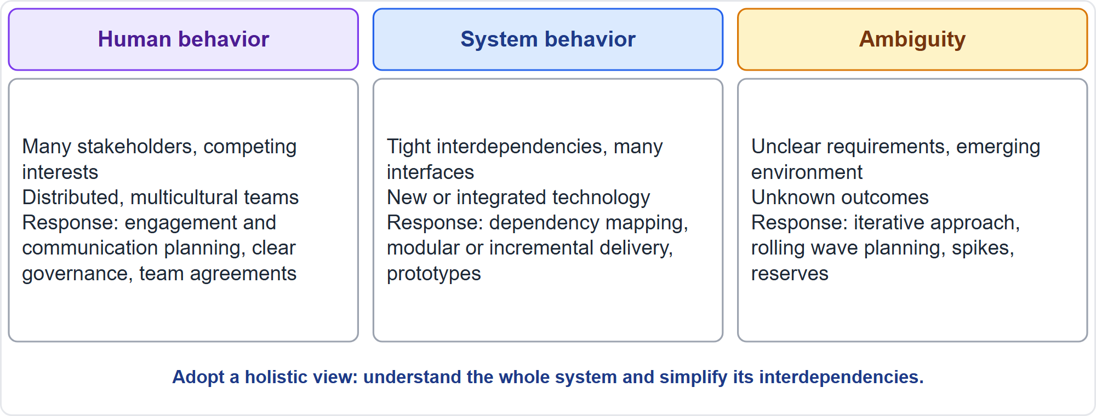
Sources of Complexity
Part 2
People, systems, ambiguity
EXAM TIP For highly complex work look at the whole system and simplify; for uncertainty build in progressive discovery.
PMP Exam Prep 2026 | PMBOK 8 and the New ECO
Module 6
41 / 70
Notes:
PMBOK 8 names three sources of complexity. Human behavior: many stakeholders with competing interests, distributed or multicultural teams, politics. The response is stakeholder engagement and communication planning, clear governance and team agreements. System behavior: tight interdependencies, many interfaces, new or integrated technology. The response is dependency mapping, modular or incremental delivery and prototypes. Ambiguity: unclear requirements and unknown outcomes. The response is an iterative approach, rolling wave planning, spikes and reserves.

Slide 42
Recommend the Development Approach
Part 2
Clues in the scenario | Likely best fit
Stable requirements; costly change; heavy regulation or safety | Predictive
Emerging requirements; high innovation; users available; early value | Adaptive
Part fixed or regulated, part exploratory | Hybrid
Scope well understood but phased delivery pays off | Predictive with incremental delivery
EXAM TIP The project manager recommends; the sponsor or governance approves; record the choice and reasoning in the plan.
PMP Exam Prep 2026 | PMBOK 8 and the New ECO
Module 6
42 / 70
Notes:
Use clues in the scenario to recommend the approach. Stable requirements, costly change, heavy regulation or safety point to predictive. Emerging requirements, high innovation, users available for frequent feedback, and value in early delivery point to adaptive. Part fixed or regulated and part exploratory points to hybrid. Well-understood scope where phased delivery pays off points to predictive with incremental delivery. The project manager recommends and the sponsor or governance approves. Record the choice and reasoning in the plan, and revisit it when conditions change.

Slide 43
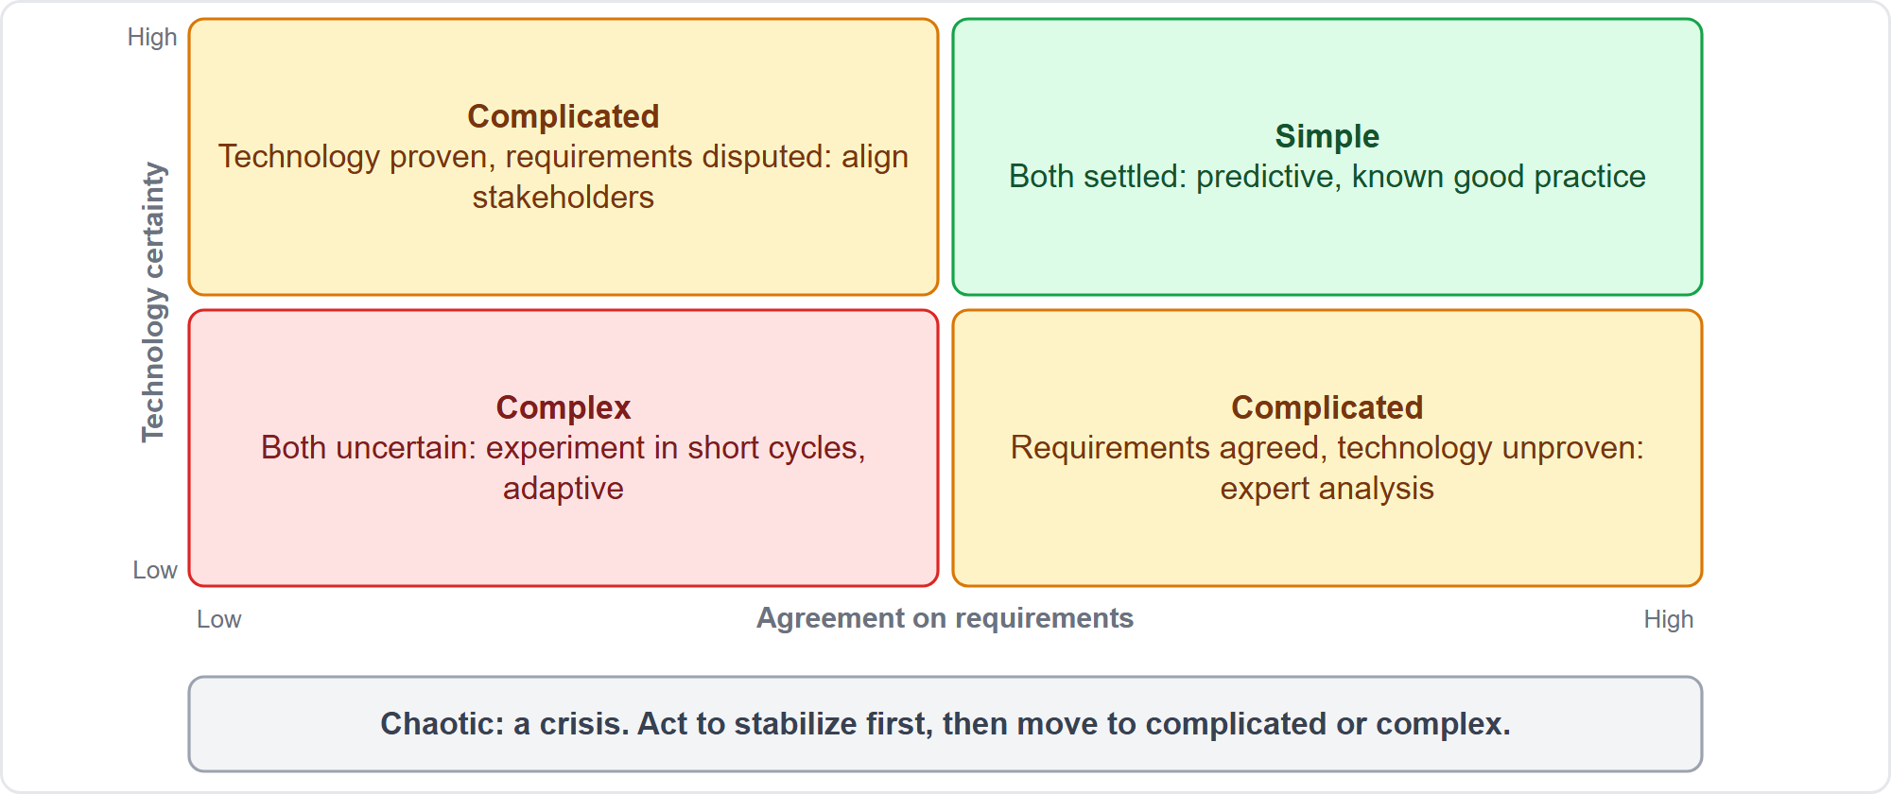
Complexity Zones
Part 2
Simple, complicated, complex, chaotic
EXAM TIP Complex: experiment in short cycles; chaotic: act to stabilize first.
PMP Exam Prep 2026 | PMBOK 8 and the New ECO
Module 6
43 / 70
Notes:
As exam practice, a Stacey-type graph places a project by how far its requirements are from agreement and how far its technology is from certainty. Both settled: simple, so use predictive and known good practice. One uncertain, either disputed requirements with proven technology or agreed requirements with unproven technology: complicated, so use analysis, expert input and structured alignment. Both uncertain: complex, so experiment in short cycles with an adaptive approach. A crisis is chaotic: act to stabilize first.

Slide 44
Critical Information Requirements
Part 2
Information need | Examples
Decisions | Business case indicators, variance thresholds, risk exposure, success metrics
Compliance evidence | Audit trails, test records, security and privacy evidence
Sustainability data | Energy, materials, emissions, waste, supplier performance
Delivery information | Standards, interfaces, assumptions, dependencies
Stakeholder needs | Who needs what, when and in what form
EXAM TIP Identify information requirements in planning and plan their collection; a new one after baselining goes through change control.
PMP Exam Prep 2026 | PMBOK 8 and the New ECO
Module 6
44 / 70
Notes:
Decide early which information the project must produce, collect and receive. Decisions for the sponsor and governance need business case indicators, variance thresholds, risk exposure and success metrics. Compliance needs evidence: audit trails, test records, security and privacy records. Sustainability data, the ECO's example, covers energy, materials, emissions, waste and supplier performance. Delivery needs standards, interfaces and dependencies. And stakeholders need information in a suitable form. Plan collection into tasks, budget and roles. A new requirement after baselining goes through change control.

Slide 45
Recommend an Execution Strategy
Part 2
Decision | Options
Life cycle | Predictive phases, iterative, incremental, hybrid
Delivery cadence | Single, multiple, periodic, continuous
Rollout pattern | Big bang, phased, pilot then rollout, parallel run
Sourcing | Make, buy or a mix
Delivery solution | Build custom, buy off the shelf, adapt
Governance and team | Structured or self-governing; colocated or remote
EXAM TIP Favor strategies that deliver value early, learn quickly and avoid one big, irreversible bet.
PMP Exam Prep 2026 | PMBOK 8 and the New ECO
Module 6
45 / 70
Notes:
An execution strategy decides how the project will deliver. Choose the life cycle, the delivery cadence, and the rollout pattern: big bang, phased, pilot then rollout, or parallel run. Choose sourcing: make, buy or a mix. Choose the delivery solution: build custom, buy off the shelf or adapt. Buy now and fill the remaining gap in later increments when a product meets most needs and a custom build would delay all value. Choose the governance and team model. Favor strategies that deliver value early and avoid one big, irreversible bet.

Slide 46
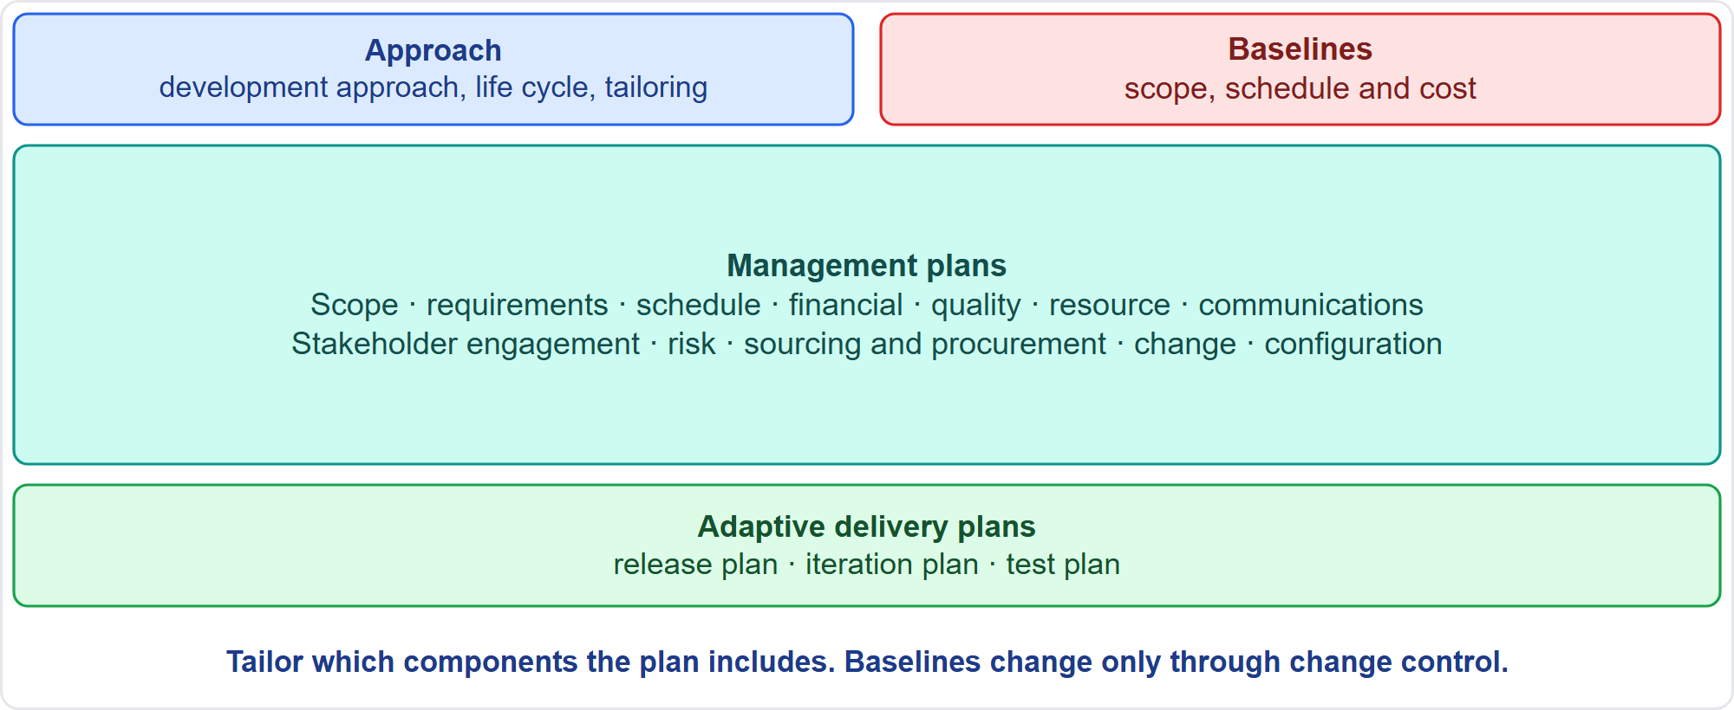
The Project Management Plan
Part 2
Approach, management plans, adaptive plans, baselines
EXAM TIP The plan says how the work is managed; it is a living document, and baselines change only through change control.
PMP Exam Prep 2026 | PMBOK 8 and the New ECO
Module 6
46 / 70
Notes:
Next, the plan itself. The project management plan describes how the project will be executed, monitored and controlled, and closed. It is the basis for all project decisions and a living document. It contains the approach: the development approach, life cycle and tailoring decisions. It contains management plans. Scope, requirements, schedule and financial. Quality, resource, communications and stakeholder engagement. Risk, sourcing, procurement, change and configuration. Adaptive plans: release, iteration and test. And three baselines: scope, schedule and cost.

Slide 47
Part 2 Recap
Part 2
1
Measures
2
Indicators
3
Benefits tracking
ROI, NPV, IRR, payback, benefit-cost ratio; ignore sunk cost
leading and lagging; outcome over input; avoid pitfalls
plan, baselines, owner, reporting, review
4
Prioritizing
5
Incremental delivery
6
Assessment and plan
by value and feedback; MoSCoW, Kano, cost of delay
earlier value, feedback and risk reduction
needs, complexity, approach, information, strategy, plan components
PMP Exam Prep 2026 | PMBOK 8 and the New ECO
Module 6
47 / 70
Notes:
Let us recap Part 2. For measures, know return on investment, net present value, internal rate of return, payback and benefit-cost ratio, and ignore sunk cost. Use leading and lagging indicators, prefer outcomes to inputs, and avoid the measurement pitfalls. Verify the benefits tracking: plan, baselines, owner, reporting and review. Prioritize by value and feedback. Deliver incrementally for earlier value, feedback and risk reduction. Assess needs, complexity and magnitude, then choose the approach, the information requirements and the strategy. The project management plan holds the approach, the management plans and three baselines. In Part 3, we integrate and maintain it.

Slide 48
Plan Versus Project Documents
Part 3
 | Management plan | Project documents
Says | How the work is managed | Data and status
Examples | Scope, schedule, risk, communications plans; baselines | Risk register, issue log, assumption log, change log, lessons learned
Change | Revised and re-approved as needed; baselines through change control | Updated routinely
EXAM TIP The PMBOK 8 change management plan sets up the change control board and system, not organizational change.
PMP Exam Prep 2026 | PMBOK 8 and the New ECO
Module 6
48 / 70
Notes:
Keep the plan and the project documents apart. The plan says how the work is managed. Project documents record data and status and change constantly: the risk register, issue log, assumption log, stakeholder register, change log and lessons learned register. Documents are updated routinely. Baselines change only through change control. Management plans are revised and re-approved as needed. Watch the PMBOK 8 term: the change management plan sets up the change control board and system. It is about controlling changes to the project, not organizational change.

Slide 49
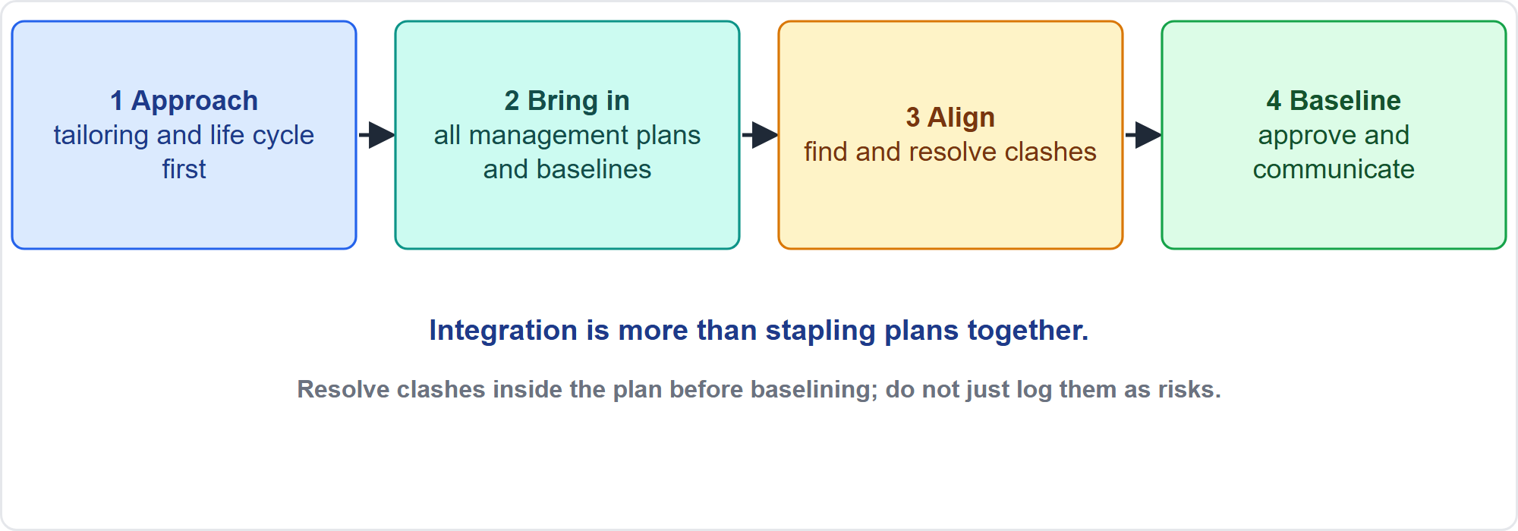
Integrate and Align Project Plans
Part 3
Approach first, then align everything
EXAM TIP Resolve cross-plan conflicts inside the integrated plan before baselining; do not log a known clash as a risk and baseline anyway.
PMP Exam Prep 2026 | PMBOK 8 and the New ECO
Module 6
49 / 70
Notes:
The Integrate and Align Project Plans process builds one project management plan. Step one: establish overall tailoring considerations and determine the development approach and life cycle. Step two: bring in all management plans and baselines from the domains, and verify their alignment. Then baseline, document and communicate. The plan can be called a governance plan, an execution plan or an implementation plan, but it must make the decision-making framework transparent. Integration is more than stapling plans together: find and resolve clashes before baselining.

Slide 50
Cross-Checks Between Plans
Part 3
Check | Typical clash
Schedule and sourcing | Lead times and contract dates against the work that needs the items
Schedule and resources | Availability, calendars, shared equipment
Cost and everything | Budget phasing against purchases; reserves against risk
Quality and schedule | Hold points, test and review time
Risk and plans | Responses reflected in schedule, budget, resources
Requirements and scope | Every requirement traced to a deliverable
Assumptions | The same assumption used the same way everywhere
EXAM TIP Where stakeholders hold conflicting or unstated expectations, surface and agree them before baselining.
PMP Exam Prep 2026 | PMBOK 8 and the New ECO
Module 6
50 / 70
Notes:
Cross-check the plans against each other. Schedule and sourcing: lead times and contract dates against the work that needs the items. Schedule and resources: availability, calendars and shared equipment. Cost against everything: budget phasing against purchases, and reserves against risk. Quality and schedule: hold points and test time. Risk and plans: responses reflected in the schedule, budget and resources. Requirements and scope: every requirement traced to a deliverable. And assumptions used the same way everywhere. Surface conflicting expectations before baselining.

Slide 51
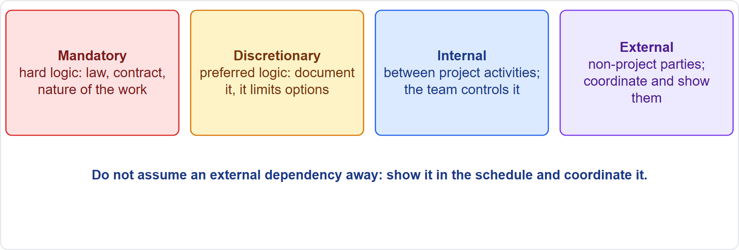
Dependencies
Part 3
Two attributes: logic and control
EXAM TIP External dependencies are shown and coordinated, not assumed to follow standard timelines.
PMP Exam Prep 2026 | PMBOK 8 and the New ECO
Module 6
51 / 70
Notes:
Each dependency has attributes. Mandatory dependencies, or hard logic, are required by law, contract or the nature of the work, like a foundation before the superstructure. Discretionary dependencies, or soft logic, come from good practice or preference. Document them, because they limit later options and create float. Internal dependencies are between project activities, and the team controls them. External dependencies involve non-project parties, such as a regulator approval or a utility connection. The team does not control them, so show them and coordinate them.

Slide 52
Gaps and Continued Business Value
Part 3
Gaps: missing scope, resource types, roles, approvers, acceptance criteria, compliance or sustainability work
Risks without owners or responses are gaps too
Compare the integrated cost, schedule and benefits with the business case
If the numbers no longer justify the investment, take updated figures and options to the sponsor
Do not cut quality or risk responses just to force a number
EXAM TIP The sponsor and governance decide: rescope, change funding, phase or stop.
PMP Exam Prep 2026 | PMBOK 8 and the New ECO
Module 6
52 / 70
Notes:
Check the consolidated plan for gaps. Look for missing scope or work, missing resource types such as equipment and materials, missing roles or approvers, and missing acceptance criteria. Also look for missing compliance or sustainability work, missing dependencies on other projects, and risks without owners or responses. Then check continued business value. Compare the integrated cost, schedule and benefit picture with the business case. If the numbers no longer justify the investment, take the updated figures and options to the sponsor and governance. The decision is theirs.

Slide 53
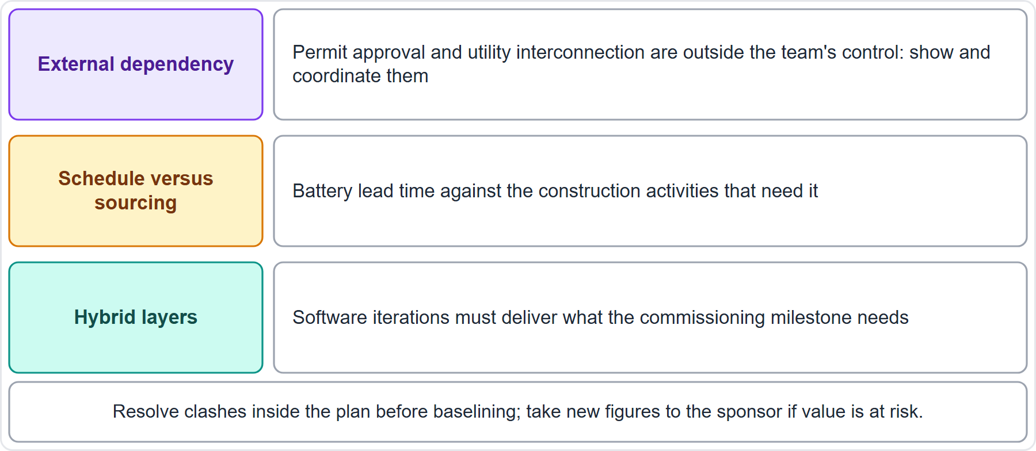
Case Check-In: Integrating the Microgrid Plan
Part 3
CASE CHECK-IN · Sunrise Campus Microgrid
External dependencies: permits and utility interconnection
Cross-checks: battery lead time, software iterations against commissioning
PMP Exam Prep 2026 | PMBOK 8 and the New ECO
Module 6
53 / 70
Notes:
Let us integrate the microgrid plan. Permit approval and the utility interconnection are external dependencies. Show them in the schedule and coordinate them, rather than assume standard timelines. Check schedule against sourcing: does the battery lead time fit the construction activities that need it? Check the hybrid layers: do the software iterations deliver what the commissioning milestone needs? If a clash appears, resolve it inside the integrated plan before baselining. If the numbers threaten value, take them to the sponsor.

Slide 54
Estimating Techniques
Part 3
Technique | Use when | Watch out
Expert judgment | Any stage; unusual work | Bias; combine with data
Analogous | Early, little detail, similar history | Less accurate; the history must be truly similar
Parametric | Repeatable work with reliable data | Depends on the model and data
Bottom-up | Detail exists; setting a baseline | Most effort; needs defined scope
Three-point | Uncertain activities | Needs honest ranges
Relative sizing | Adaptive work; story points | Team-specific; not hours
EXAM TIP Match the technique to the information available.
PMP Exam Prep 2026 | PMBOK 8 and the New ECO
Module 6
54 / 70
Notes:
Match the estimating technique to the information available. Expert judgment suits any stage, but beware bias. Analogous estimating uses historical data from a similar activity as a gross value, adjusted for known differences. It suits early stages with little detail, and it is reliable only when the earlier work is similar in fact. Parametric estimating uses a statistical relationship, for repeatable work with reliable data. Bottom-up estimating decomposes and aggregates, and suits baselines. Three-point suits uncertain work. Relative sizing suits adaptive work.

Slide 55
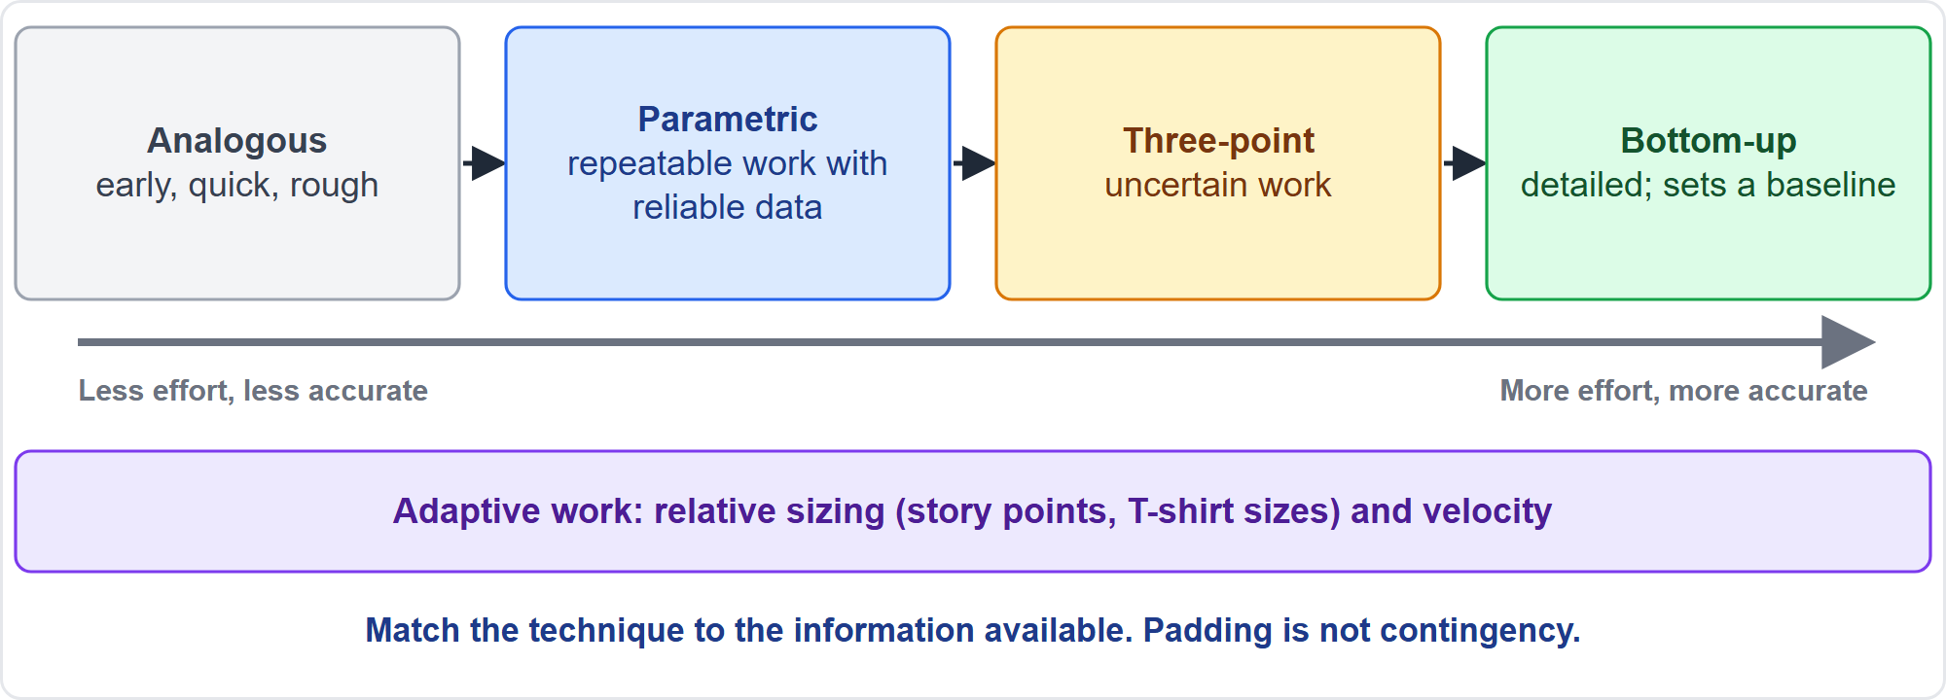
Estimating by Effort and Accuracy
Part 3
Effort against accuracy
EXAM TIP Analogous data must be comparable; different technology or scale means re-estimate with relevant experts.
PMP Exam Prep 2026 | PMBOK 8 and the New ECO
Module 6
55 / 70
Notes:
As a study aid, techniques run from less effort and less accuracy to more effort and more accuracy. Analogous is quick and rough. Parametric needs reliable data. Three-point handles uncertainty. Bottom-up is the most accurate, but needs the most effort and a defined scope. Adaptive work uses relative sizing and velocity. If the earlier work used different technology or scale, analogous data is not comparable: re-estimate with relevant experts. Padding a flawed basis keeps it flawed.

Slide 56
Estimating Formulas
Part 3
Formula | Notes
Triangular: tE = (tO + tM + tP) ÷ 3 | PMBOK 8
PERT: tE = (tO + 4 tM + tP) ÷ 6 | Exam practice; common on the exam
Standard deviation: (tP − tO) ÷ 6 | Exam practice
Range: tE ± 1 SD about 68%; ± 2 SD about 95% | Exam practice
Duration: effort ÷ (resources × availability) | Exam practice
EXAM TIP Use the formula the question names. Example: 10, 16 and 28 days give PERT 17, triangular 18, SD 3.
PMP Exam Prep 2026 | PMBOK 8 and the New ECO
Module 6
56 / 70
Notes:
Know the estimating formulas. The triangular formula, in PMBOK 8, averages optimistic, most likely and pessimistic. The beta or PERT formula weights the most likely four times, and divides by six. It is exam practice, and very common. Standard deviation is pessimistic minus optimistic, divided by six. One standard deviation covers about sixty-eight percent. Duration equals effort divided by resources times availability. Example: ten, sixteen and twenty-eight days give a PERT estimate of seventeen, a triangular estimate of eighteen, and a standard deviation of three. Use the formula the question names.

Slide 57
Basis of Estimates and Good Practice
Part 3
Basis of estimates: assumptions, constraints, level of detail, range, confidence level, risks
Involve the people who will do the work; use history and benchmarks
Estimate all resource types: people, equipment, materials, facilities
Padding is not contingency: use visible assumptions, ranges and an explicit risk-based reserve
An estimate is a forecast with a range; a baseline is a commitment
Adaptive: relative sizing and velocity; AI can propose, humans validate
EXAM TIP Estimates come from, or with, the people doing the work, and are documented in a basis of estimates.
PMP Exam Prep 2026 | PMBOK 8 and the New ECO
Module 6
57 / 70
Notes:
Good estimating practice. Document a basis of estimates. That means assumptions, constraints and the level of detail. It means the range, such as plus or minus ten percent, the confidence level, and the risks that influence it. Involve the people who will do the work, and use historical data. Estimate all resource types, not only labor. Padding is not contingency: hidden margins at every level distort the baseline, so use visible assumptions, ranges and an explicit reserve sized from risk analysis. An estimate is a forecast with a range, and a baseline is a commitment.

Slide 58
Maintain the Integrated Plan
Part 3
Trigger | Action
Approved change request | Update every affected plan, baseline and document; communicate
Corrective or preventive action | Update plans if it changes how work is done
Performance results and forecasts | Re-forecast; replan through change control if needed
Lessons, retrospectives, gate reviews | Improve plan, process and approach
New risks, issues or external change | Reassess impact on plan and business value
More information | Add detail for the next wave of work
EXAM TIP Baselines change only through formal change control, even to correct an error.
PMP Exam Prep 2026 | PMBOK 8 and the New ECO
Module 6
58 / 70
Notes:
The plan is a living document, so maintain it deliberately. An approved change request: update every affected plan, baseline and document, and communicate. A corrective or preventive action: update plans if it changes how work is done. Performance results and forecasts: re-forecast, and replan through change control if the baseline no longer reflects reality. Lessons, retrospectives and gate reviews: improve the plan. New risks, issues or external change: reassess the impact on the plan and on business value. More information: add detail. Baselines change only through change control, even to correct an error.

Slide 59
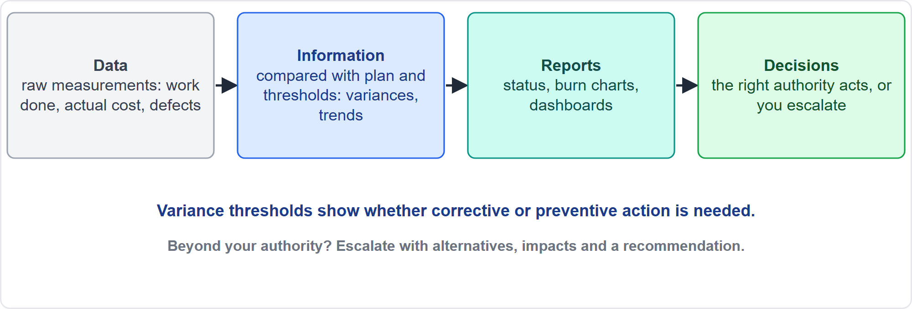
From Data to Decisions
Part 3
Data, information, reports, decisions
EXAM TIP Beyond your authority? Escalate with alternatives, impacts and a recommendation.
PMP Exam Prep 2026 | PMBOK 8 and the New ECO
Module 6
59 / 70
Notes:
Decisions rest on a chain. Work performance data is raw observations: work completed, actual costs and dates, story points done, defects. Work performance information is data compared with the plan, thresholds and context: variances, trends and forecasts. Compared with variance thresholds, it shows whether corrective or preventive action is needed. Work performance reports compile information to generate decisions, actions or awareness: status reports, burn charts, dashboards. Then the right authority decides. If it is beyond your authority, escalate with alternatives and a recommendation.

Slide 60
Voting and Decision Rules
Part 3
Technique | Meaning
Unanimity | Everyone agrees on one course of action
Majority | More than 50% support
Plurality | The largest block decides, even without a majority
Autocratic | One person decides for the group
Multicriteria analysis | A matrix with weighted criteria scores and ranks the options
EXAM TIP Diverge, then converge: gather options individually first to limit groupthink.
PMP Exam Prep 2026 | PMBOK 8 and the New ECO
Module 6
60 / 70
Notes:
PMBOK 8 names several decision techniques. Unanimity: everyone agrees. Majority: more than fifty percent support. Plurality: the largest block decides, even without a majority, which helps with more than two options. Autocratic: one person decides for the group. Multicriteria decision analysis: a matrix with weighted criteria scores and ranks the alternatives. Unilateral decisions are fast but error-prone. Group decisions tap more knowledge and build buy-in, but take time. Gather options individually first, then converge, to limit groupthink.

Slide 61
Good Decision Practice
Part 3
Define the decision and criteria, then gather and check the data
Generate alternatives, analyze, and decide at the right level
Communicate and act, then review the outcome
Escalate decisions beyond your authority, with alternatives and a recommendation
Beware unreliable data, vanity metrics, confirmation bias and correlation mistaken for cause
A human stays accountable, even when AI analyzes the data
EXAM TIP Decisions with several criteria call for a structured method such as multicriteria analysis.
PMP Exam Prep 2026 | PMBOK 8 and the New ECO
Module 6
61 / 70
Notes:
A sound sequence for decisions, as exam practice. Define the decision and the criteria. Gather and check the data. Generate alternatives, and analyze them. Decide at the right level. Communicate and act. And review the outcome. Escalate decisions beyond your authority, with alternatives and a recommendation. Beware unreliable data, vanity metrics, confirmation bias, and mistaking correlation for cause. AI can analyze data, but a human stays accountable. For decisions with several criteria, use a structured method such as multicriteria analysis.

Slide 62
Integrated Planning in Predictive, Agile and Hybrid Work
Part 3
 | Predictive | Agile | Hybrid
Planning depth | Detailed up front; elaboration within phases | Vision, roadmap, release plan; detail for the current iteration | Detailed for fixed parts; rolling wave for the rest
The plan is | Formal plan with baselines | Roadmap, backlog, definition of done | Formal envelope plus backlog inside
Estimating | Analogous, then bottom-up; baseline | Story points; velocity forecasts | Bottom-up for fixed, points for backlog
Maintaining | Change control for baselines | Backlog refinement; product owner | Both
EXAM TIP In hybrid schedules, show milestones with iterations beneath; do not turn a backlog into a false-precision Gantt chart.
PMP Exam Prep 2026 | PMBOK 8 and the New ECO
Module 6
62 / 70
Notes:
Integrated planning differs by approach. Predictive: detailed planning up front, with progressive elaboration within phases. A formal plan with baselines. Analogous estimates early, and bottom-up for the baseline. And change control to maintain it. Agile: a vision, roadmap and release plan. Detail only for the current iteration. Estimates in story points, with velocity forecasts. And backlog refinement guided by the product owner. Hybrid: detailed plans for fixed or regulated parts, rolling wave for the rest, and milestones with iterations beneath.

Slide 63
Planning Traps: What PMI Expects
Part 3
Resolve cross-plan clashes before baselining; baselines change only through change control
Assess needs, complexity and magnitude first, then recommend the approach
Hybrid is legitimate; recommend, get approval, document
Plan progressively; match the estimating technique to the information
Padding is not contingency; show dependencies and basis of estimates
Revalidate business value when the plan changes; take figures to the sponsor
EXAM TIP Identify information requirements early; a new one after baselining goes through change control.
PMP Exam Prep 2026 | PMBOK 8 and the New ECO
Module 6
63 / 70
Notes:
The traps for planning. Resolve cross-plan clashes inside the plan before baselining, and remember that baselines change only through change control. Assess needs, complexity and magnitude first, then recommend the approach. Hybrid is a legitimate answer: recommend, get approval and document. Plan progressively, and match the estimating technique to the information available. Padding is not contingency. Show external dependencies. Revalidate business value when the plan changes, and take the figures to the sponsor. Do not cut quality or risk responses to force a number.

Slide 64
Module Recap
Part 3
1
Initiating
2
Value
3
Assessment
charter authorizes; business documents are the sponsor's
measures, indicators, benefits owner, incremental delivery
needs, complexity, magnitude; approach; execution strategy
4
Plan
5
Estimates and decisions
6
Next
integrated, aligned, baselined, maintained through change control
technique by information; data to decisions; escalate with options
five practice questions
PMP Exam Prep 2026 | PMBOK 8 and the New ECO
Module 6
64 / 70
Notes:
Let us recap the whole module. Initiating: the charter authorizes the project and the project manager, and the business documents belong to the sponsor. Value: use measures and leading indicators, name a benefits owner, and deliver incrementally. Assessment: needs, complexity and magnitude, then the approach and execution strategy. The plan: integrated, aligned, baselined and maintained through change control. Estimates and decisions: choose the technique by the information available, move from data to decisions, and escalate with options. Now it is time to test yourself. Five questions follow. For each one, pause the video, choose your answer, and then listen to the explanation.

Slide 65
Practice Question 1
Part 3
Q1
A project manager joins a project that is already under way and cannot find an approved charter. The sponsor says to just keep going. What should the project manager do first?
A
Ask the project team to approve and sign a charter on the sponsor's behalf
B
Carry on with the detailed planning and obtain the charter at a later date
C
Write the charter personally and treat it as approved by default from now
D
Ask the sponsor to issue a charter that names the project manager
PMP Exam Prep 2026 | PMBOK 8 and the New ECO
Module 6
65 / 70
Notes:
Question one. A project manager joins a project that is already under way and cannot find an approved charter. The sponsor says to just keep going. What should the project manager do first? The four options are on the screen. Choose your answer. [PAUSE 12] The answer is D. A charter formally authorizes the project and gives the project manager the authority to apply resources, and the sponsor or initiator issues it before planning continues. Planning without it, self-approving it, or having the team approve it all lack that authority.

Slide 66
Practice Question 2
Part 3
Q2
A project is on time and on budget, but a competitor has just launched a free product that makes much of the planned benefit unlikely. What should the project manager do?
A
Continue delivering to the baseline because performance is on track
B
Cut the remaining scope until the project costs less than the competitor charges
C
Take the changed market to the sponsor and revalidate the business case
D
Wait for the benefits tracking at closure to confirm whether value was lost
PMP Exam Prep 2026 | PMBOK 8 and the New ECO
Module 6
66 / 70
Notes:
Question two. A project is on time and on budget, but a competitor has just launched a free product that makes much of the planned benefit unlikely. What should the project manager do? The four options are on the screen. Choose your answer. [PAUSE 12] The answer is C. The value case has changed, so the project manager goes to the sponsor, who is accountable for the business case, to revalidate it before the plan continues. Continuing on track, trimming scope blindly, or waiting until closure ignores the changed value.

Slide 67
Practice Question 3
Part 3
Q3
The promised benefit of a new support tool, a 15 percent cut in call-handling time, can be measured only six months after launch. The sponsor wants early signs of progress. What should the project manager propose?
A
Report the number of tool features completed in each month of delivery
B
Track early proxies such as pilot-team handling time and weekly tool usage
C
Tell the sponsor that nothing can be reported before six months have passed
D
Survey the project team on how satisfied it is with the delivered features
PMP Exam Prep 2026 | PMBOK 8 and the New ECO
Module 6
67 / 70
Notes:
Question three. The promised benefit of a new support tool, a 15 percent cut in call-handling time, can be measured only six months after launch. The sponsor wants early signs of progress. What should the project manager propose? The four options are on the screen. Choose your answer. [PAUSE 12] The answer is B. Leading indicators and proxies tied to the benefit target give early evidence, while outputs such as features completed say little about the benefit. Feature counts, silence, or team satisfaction do not track the intended outcome.

Slide 68
Practice Question 4
Part 3
Q4
While integrating the plans, the project manager finds that the battery supplier's lead time is longer than the construction schedule assumes. What should the project manager do?
A
Resolve the clash inside the integrated plan before baselining, then re-verify
B
Record the clash as a risk and baseline the plan as it stands today
C
Ask the supplier to promise the shorter lead time without a change in price
D
Shorten the construction durations in the schedule and leave the sourcing plan alone
PMP Exam Prep 2026 | PMBOK 8 and the New ECO
Module 6
68 / 70
Notes:
Question four. While integrating the plans, the project manager finds that the battery supplier's lead time is longer than the construction schedule assumes. What should the project manager do? The four options are on the screen. Choose your answer. [PAUSE 12] The answer is A. Conflicts between plans are found and resolved inside the integrated plan before baselining, by adjusting the plans and re-verifying that they align. Logging it as a risk, wishful promises, or changing only one plan leaves the clash in place.

Slide 69
Practice Question 5
Part 3
Q5
A team needs a quick early estimate with little detail, but the organization completed a very similar project last year. Which technique fits best?
A
Bottom-up estimating of every work package in the new project plan
B
A three-point estimate for every activity in the new project plan
C
Analogous estimating from last year's project, adjusted for differences
D
Parametric estimating with a model built from other organizations' data
PMP Exam Prep 2026 | PMBOK 8 and the New ECO
Module 6
69 / 70
Notes:
Question five. A team needs a quick early estimate with little detail, but the organization completed a very similar project last year. Which technique fits best? The four options are on the screen. Choose your answer. [PAUSE 12] The answer is C. With little detail and comparable history, analogous estimating gives a quick gross value adjusted for known differences, though it is less accurate. Bottom-up needs detail that does not exist yet, three-point needs ranges per activity, and parametric needs a reliable model.

Slide 70
Answers at a Glance
Part 3
Question | Answer | Why
Q1 | D | Only the sponsor's charter gives the project manager authority
Q2 | C | The value case changed, so revalidate it with the sponsor
Q3 | B | Leading proxies tied to the benefit give early evidence
Q4 | A | Clashes between plans are resolved before baselining
Q5 | C | Little detail and similar history call for analogous estimating
PMP Exam Prep 2026 | PMBOK 8 and the New ECO
Module 6
70 / 70
Notes:
Here are all five answers together. Question one: D. Only the sponsor's charter gives the project manager authority. Question two: C. The value case changed, so revalidate it with the sponsor. Question three: B. Leading proxies tied to the benefit give early evidence. Question four: A. Clashes between plans are resolved before baselining. Question five: C. Little detail and similar history call for analogous estimating. That completes Module 6. Next, Module 7 covers scope, schedule and finance management. See you there.

