Slide 1
Module 7: Scope, Schedule and Cost
Part 1 of 3: Scope management
Process domain · ECO tasks 2, 8 and 6
PMP Exam Prep 2026: PMBOK 8 and the New ECO
Module 7: Scope, Schedule and Cost · Part 1
Notes:
Welcome to Module 7. Scope, schedule and cost are the classic triple constraint, and they are tightly linked: a change in one moves the others. This module covers all three. In Part 1, we start with scope: how to define it, structure it, control it and get it accepted. Part 2 covers the schedule, including the critical path. Part 3 covers cost: budgets, reserves and earned value.

Slide 2
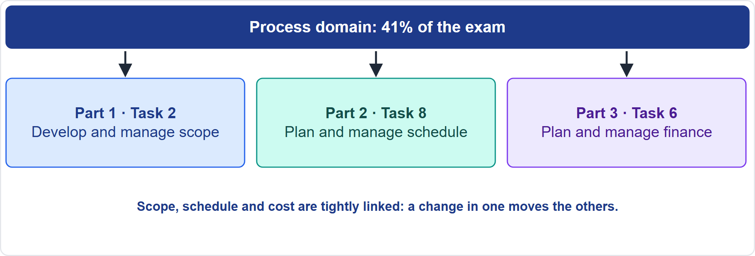
Where This Module Sits in the Exam
Part 1
Three Process-domain tasks
EXAM TIP Always ask how a change in one of scope, schedule or cost affects the other two.
PMP Exam Prep 2026 | PMBOK 8 and the New ECO
Module 7: Scope, Schedule and Cost
2 / 71
Notes:
Here is where this module sits. The Process domain has ten tasks, and this module covers three. Task two: develop and manage scope. Task eight: plan and manage schedule. Task six: plan and manage finance. Each has a part. Remember that the three are tightly linked. A scope change hits schedule and cost immediately. So the best answer often asks how a change in one affects the other two, and routes it through the right control.

Slide 3
What You Will Learn
Part 1
Elicit requirements, write the scope statement and build the WBS or backlog
Control scope: creep, gold plating, verification and validation
Build the schedule: logic, estimates, critical path, float and compression
Forecast and control schedule in predictive, agile and hybrid work
Build the budget, reserves and cost baseline
Use earned value to forecast and respond to variances
PMP Exam Prep 2026 | PMBOK 8 and the New ECO
Module 7: Scope, Schedule and Cost
3 / 71
Notes:
By the end of this module you will be able to do six things. Elicit requirements, write the scope statement and build the work breakdown structure or backlog. Control scope: creep, gold plating, verification and validation. Build the schedule: logic, estimates, the critical path, float and compression. Forecast and control the schedule in predictive, agile and hybrid work. Build the budget, reserves and cost baseline. And use earned value to forecast and respond to variances.

Slide 4
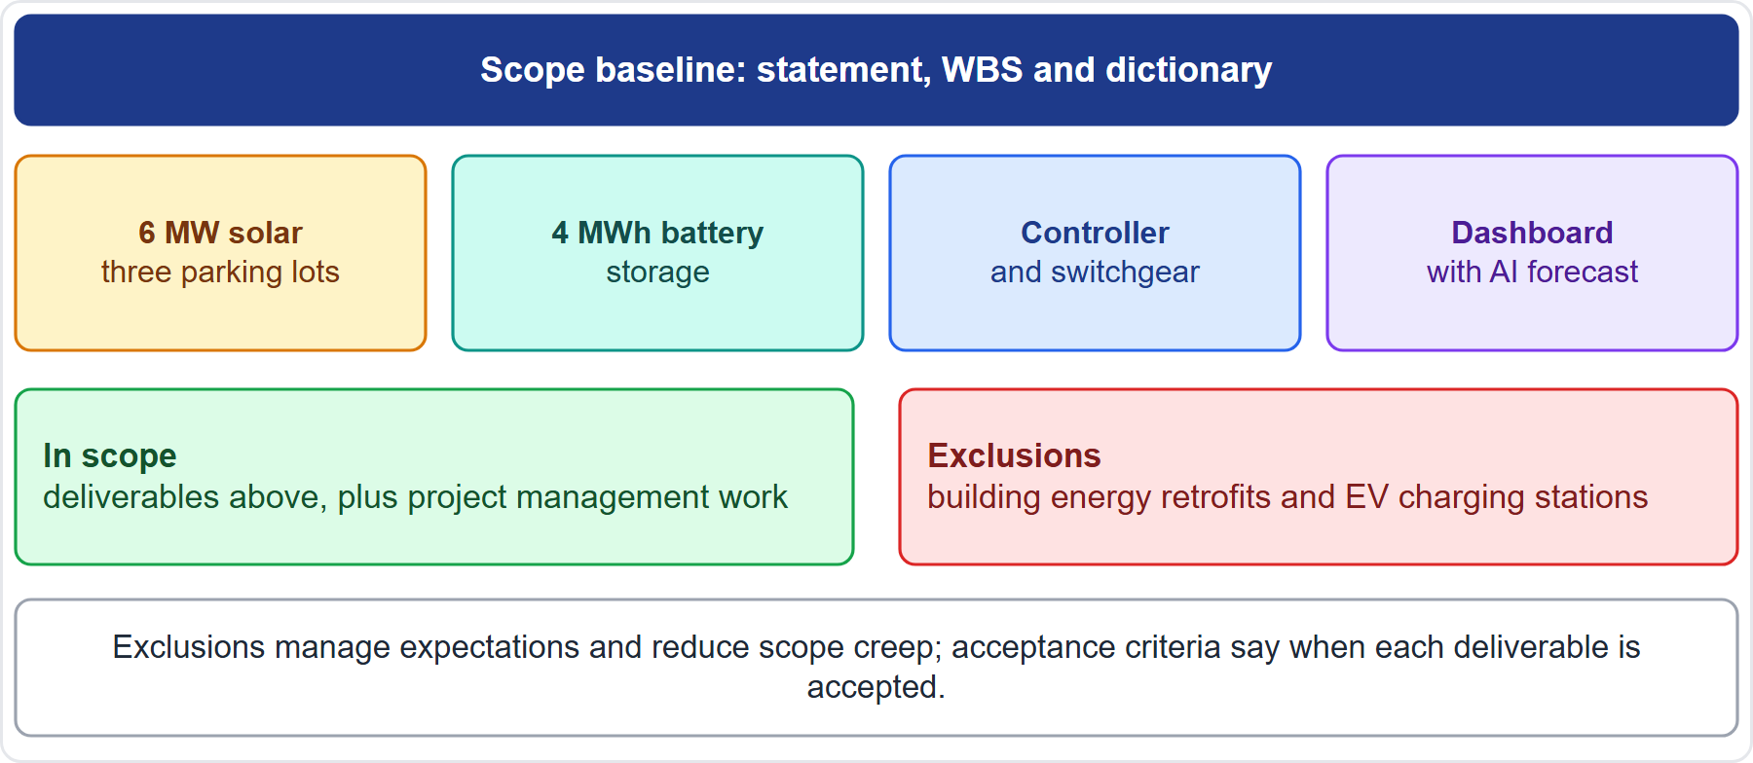
Case Check-In: The Microgrid's Scope
Part 1
CASE CHECK-IN · Sunrise Campus Microgrid
In scope: solar, battery, controller, dashboard, plus project management work
Out of scope: building retrofits and EV charging stations
PMP Exam Prep 2026 | PMBOK 8 and the New ECO
Module 7: Scope, Schedule and Cost
4 / 71
Notes:
Our microgrid has a clear scope. The deliverables are six megawatts of solar canopies, four megawatt hours of battery storage, the controller and switchgear, and the dashboard. Project management work is in scope too. Campus-wide building retrofits and electric vehicle charging stations are out of scope. Writing exclusions down manages expectations and reduces scope creep. Acceptance criteria will say when each deliverable counts as accepted. The scope statement, work breakdown structure and dictionary together form the scope baseline.

Slide 5
Scope: Key Terms
Part 1
Term | Meaning
Product scope | Features and functions of the product, service or result
Project scope | The work needed to deliver the product
Requirement | A condition or capability that must be present to satisfy a need
Deliverable | A unique, verifiable product, result or capability
Scope baseline | Approved scope statement, WBS and WBS dictionary
Scope creep | Uncontrolled expansion without adjusting time, cost and resources
Verification, validation | Built correctly; accepted by the customer
EXAM TIP The scope domain aims at all the work required, and only the work required.
PMP Exam Prep 2026 | PMBOK 8 and the New ECO
Module 7: Scope, Schedule and Cost
5 / 71
Notes:
Key terms. Product scope covers the features and functions of the product. Project scope is the work needed to deliver it. A requirement is a condition or capability that must be present to satisfy a business need. A deliverable is a unique, verifiable product, result or capability. The scope baseline is the approved scope statement, work breakdown structure and WBS dictionary. Scope creep is uncontrolled expansion without adjustments to time, cost and resources. Verification checks the deliverable is built correctly. Validation checks that the customer accepts it.

Slide 6
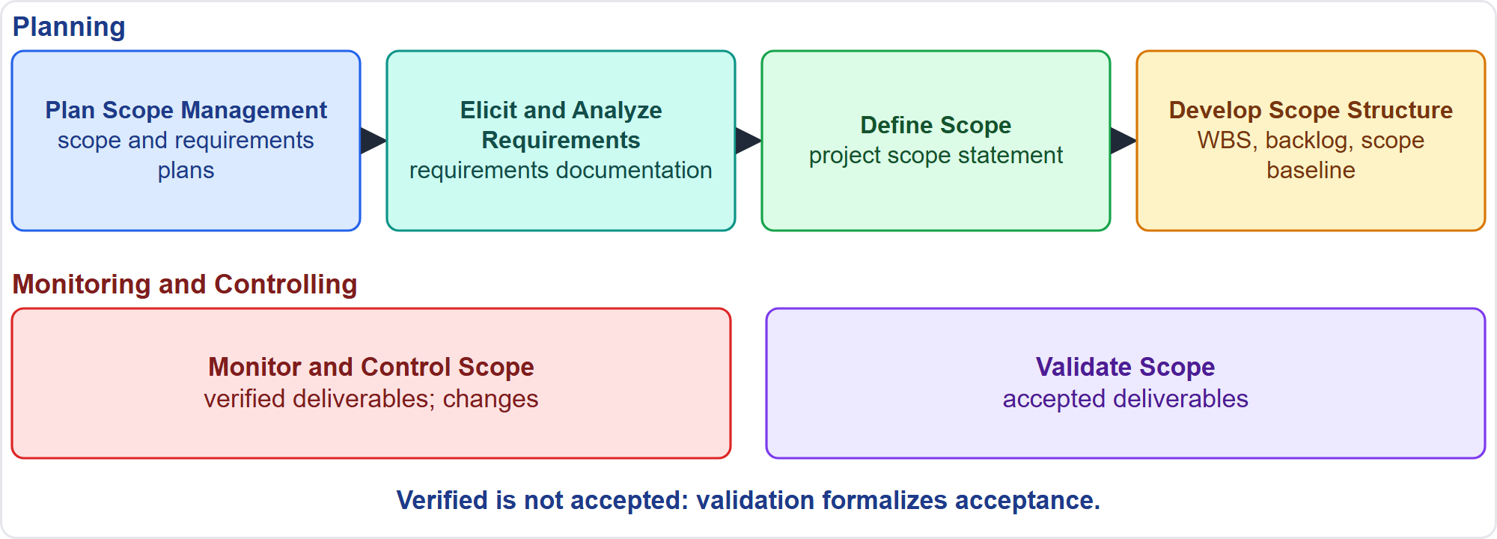
The Six Scope Processes
Part 1
Four planning processes, two control processes
EXAM TIP Verified deliverables come from Monitor and Control Scope; accepted deliverables come from Validate Scope.
PMP Exam Prep 2026 | PMBOK 8 and the New ECO
Module 7: Scope, Schedule and Cost
6 / 71
Notes:
There are six scope processes. Four are in Planning. Plan Scope Management produces the scope and requirements management plans. Elicit and Analyze Requirements produces requirements documentation. Define Scope produces the project scope statement. Develop Scope Structure produces the scope baseline, and in adaptive work the backlog. Two are in Monitoring and Controlling. Monitor and Control Scope produces verified deliverables and manages changes. Validate Scope produces accepted deliverables. Note the difference: verified, then accepted.

Slide 7
Plan Scope Management
Part 1
The scope management plan says how scope is defined, structured, baselined and accepted
The requirements management plan covers analysis, tracking, reporting, prioritization, change authorization and traceability
Formal or informal, broad or detailed, built around the life cycle
The goal is value in every approach; adaptive scope is more iterative and collaborative
EXAM TIP Plan scope management also removes work that adds no value.
PMP Exam Prep 2026 | PMBOK 8 and the New ECO
Module 7: Scope, Schedule and Cost
7 / 71
Notes:
Plan Scope Management produces two plans. The scope management plan describes how the project scope statement is prepared and how the work breakdown structure is created. It also describes how the scope baseline is approved and maintained, and how formal acceptance is obtained. The requirements management plan, sometimes called a business analysis plan, describes how requirements are analyzed, documented and managed, including prioritization, change authorization and traceability. Both can be formal or informal. Adaptive scope management is more iterative and collaborative.

Slide 8
Eliciting Requirements
Part 1
Technique | Notes
Interviews | Direct and individual; experts, executives, confidential topics
Focus groups | Prequalified stakeholders; moderated discussion
Surveys | Many respondents; quick; statistical analysis
Observation | Watch people work; uncovers hidden requirements
Nominal group | Everyone contributes before discussion; limits dominant voices
Prototypes, design thinking | Early feedback on a working model
Document analysis, benchmarking | Contracts, regulations, logs; comparable organizations
EXAM TIP Use observation when users cannot or will not articulate their needs.
PMP Exam Prep 2026 | PMBOK 8 and the New ECO
Module 7: Scope, Schedule and Cost
8 / 71
Notes:
Elicitation techniques fit different situations. Interviews are direct and individual, ideal for experts, executives and confidential topics. Focus groups bring prequalified stakeholders together under a moderator. Surveys reach many respondents quickly. Observation, or job shadowing, uncovers hidden requirements when users cannot or will not articulate their needs. The nominal group technique has everyone contribute before discussion, which limits dominant voices. Prototypes and design thinking give early feedback. Document analysis and benchmarking draw on contracts, regulations and comparable organizations.

Slide 9
Practical Rules for Requirements
Part 1
Before baselining, a requirement is unambiguous, traceable, complete, consistent and acceptable to key stakeholders
Conflicting requirements: make the conflict visible and discuss trade-offs together
A vague goal: agree measurable outcomes first; acceptance criteria follow
Signed but read differently: facilitate a discussion; the document cannot settle it
Compliance and sustainability are requirements: confirm them early
Adaptive: user stories with acceptance criteria in a value-ordered backlog
EXAM TIP Do not just rank conflicting requirements or pick the senior person's request.
PMP Exam Prep 2026 | PMBOK 8 and the New ECO
Module 7: Scope, Schedule and Cost
9 / 71
Notes:
Some practical rules. Before baselining, a requirement should be unambiguous, measurable and testable, traceable, complete, consistent and acceptable to key stakeholders. If requirements conflict, make the conflict visible to everyone involved and discuss the trade-offs together. Do not just rank them or pick the senior person's request. If a goal is vague, such as improve engagement, agree measurable outcomes first. If signed requirements are read differently, facilitate a discussion. And treat compliance and sustainability needs as requirements.

Slide 10
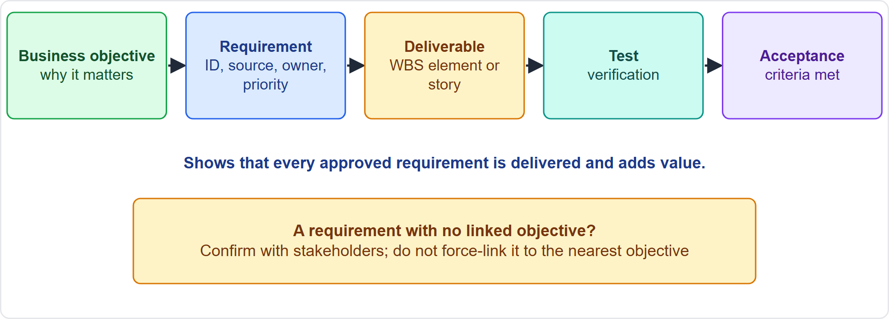
Requirements Traceability
Part 1
From objective to acceptance
EXAM TIP A requirement with no business objective is confirmed with stakeholders, not force-linked to the closest objective.
PMP Exam Prep 2026 | PMBOK 8 and the New ECO
Module 7: Scope, Schedule and Cost
10 / 71
Notes:
A requirements traceability matrix links each requirement from its origin to the deliverable that satisfies it, and onward to design, test and acceptance. It shows that every approved requirement is delivered, that each adds business value, and it structures change management of product scope. Typical attributes: identifier, source, priority, owner, status and acceptance criteria. If a requirement links to no business objective, confirm with stakeholders whether it belongs in scope. Do not attach it to the nearest objective to finish the matrix. That fakes traceability.

Slide 11
Define Scope: The Scope Statement
Part 1
Element | Content
Scope description | Progressive elaboration of the product, service or result
Deliverables | Unique, verifiable outputs, including documentation
Acceptance criteria | Conditions to meet before deliverables are accepted
Exclusions | What is out of scope; manages expectations
Assumptions and constraints | Recorded with the scope and in the assumption log
EXAM TIP The charter is high level; the scope statement is the detailed description and the baseline for judging requests.
PMP Exam Prep 2026 | PMBOK 8 and the New ECO
Module 7: Scope, Schedule and Cost
11 / 71
Notes:
The project scope statement is a detailed description of the project and product scope. It gives a common understanding among stakeholders, and it is the baseline for judging whether a request is inside or outside the project's boundaries. It contains the scope description, the deliverables, the acceptance criteria, the exclusions, and the assumptions and constraints. Define Scope also identifies quality requirements and standards. The charter has high-level information. The scope statement is the detailed description. In adaptive work, scope is described at a high level, as a roadmap with releases.

Slide 12
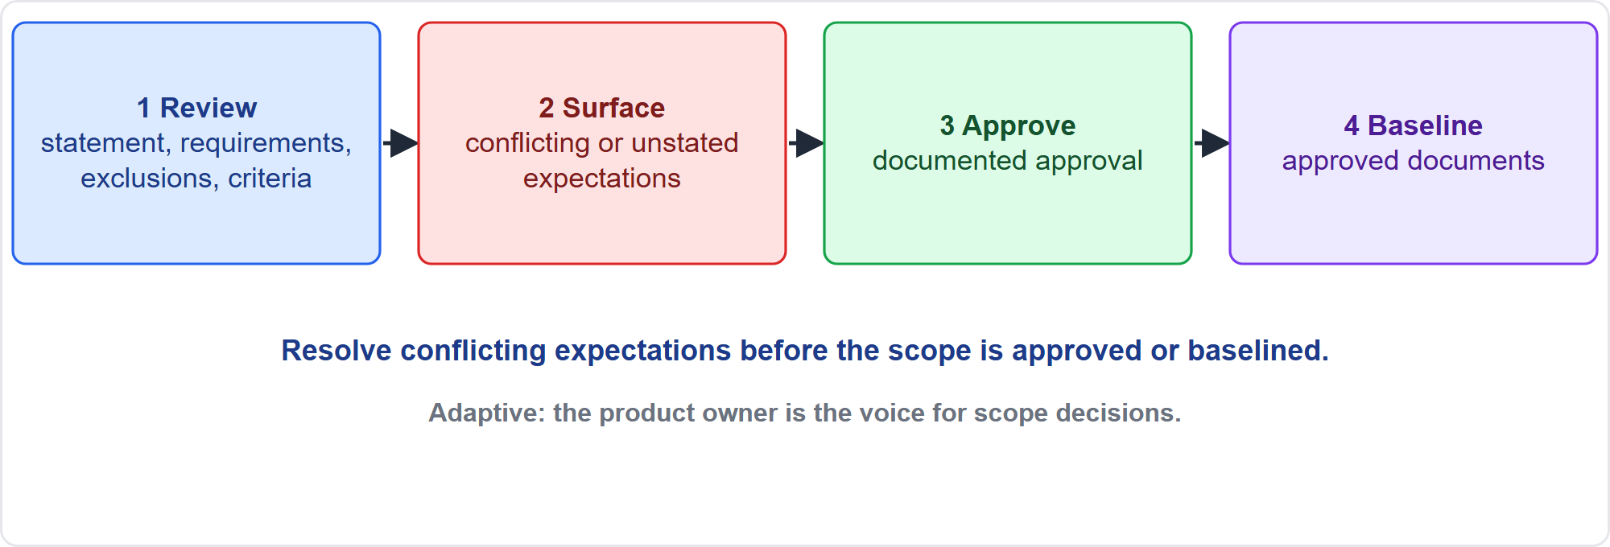
Obtaining Stakeholder Agreement on Scope
Part 1
Review, surface, approve, baseline
EXAM TIP Surface and resolve conflicting or unstated expectations before the scope is approved or baselined.
PMP Exam Prep 2026 | PMBOK 8 and the New ECO
Module 7: Scope, Schedule and Cost
12 / 71
Notes:
Obtaining stakeholder agreement has four steps. Review the scope statement, requirements, exclusions and acceptance criteria with key stakeholders and the sponsor. Surface and resolve conflicting or unstated expectations before the scope is approved. Obtain documented approval. The approved documents form the baseline. In adaptive work, agree the vision, the minimum viable product, the prioritization criteria and the definition of done at planning events. The product owner is the voice for scope decisions, and stakeholder feedback is built into every iteration.

Slide 13
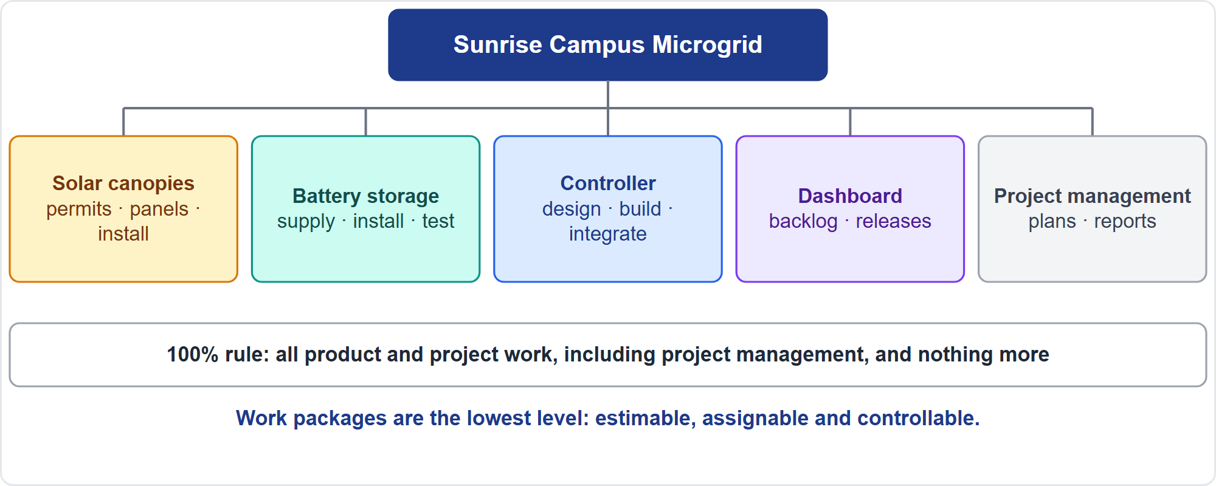
The Work Breakdown Structure
Part 1
Deliverables down to work packages
EXAM TIP The WBS covers 100 percent of the scope, including project management work, and nothing outside it.
PMP Exam Prep 2026 | PMBOK 8 and the New ECO
Module 7: Scope, Schedule and Cost
13 / 71
Notes:
The work breakdown structure is a hierarchical decomposition of the total scope into deliverables and work packages. Our microgrid has five top-level branches: solar canopies, battery storage, the controller, the dashboard and project management. The hundred percent rule says the WBS contains all product and project work, including project management, and nothing more. Branches name what is produced, deliverables, and activities come later in the schedule. Work packages are the lowest level, and they are estimable, assignable and controllable.

Slide 14
WBS Rules and Structure
Part 1
Rule | Detail
Decomposition | Identify deliverables, structure the WBS, decompose, assign identifiers
Right depth | Necessary and sufficient for the parent; estimable and controllable
Too much | Wasted effort and roll-up problems
Rolling wave | Far-future work stays as a planning package
WBS dictionary | Description, assumptions, responsible party, milestones, cost, quality, acceptance
Control account | A control point where scope, budget and schedule integrate
EXAM TIP Do not detail far-future work, and do not leave deliverables undecomposed.
PMP Exam Prep 2026 | PMBOK 8 and the New ECO
Module 7: Scope, Schedule and Cost
14 / 71
Notes:
A few WBS rules. Decompose to the right depth: components must be necessary and sufficient for the parent deliverable, and estimable, assignable and controllable. Too much decomposition wastes effort and causes roll-up problems. Far-future work that cannot be decomposed yet stays as a planning package, and is detailed later. The WBS dictionary describes each element: description of work, assumptions, responsible party, milestones, cost, quality requirements and acceptance criteria. A control account is a management control point that integrates scope, budget and schedule.

Slide 15
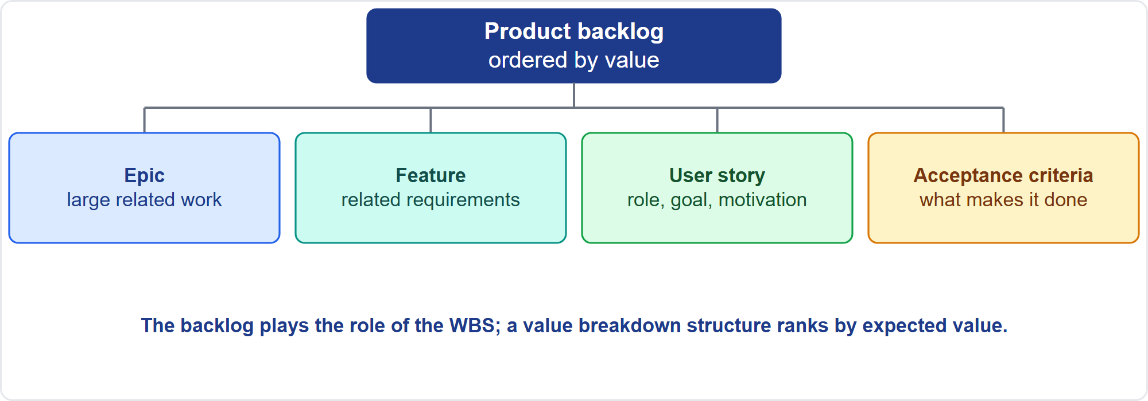
Adaptive Scope Structure
Part 1
Epics, features, stories
EXAM TIP In adaptive work the scope baseline is set at the start of each iteration, and the product owner approves changes without formal change control.
PMP Exam Prep 2026 | PMBOK 8 and the New ECO
Module 7: Scope, Schedule and Cost
15 / 71
Notes:
In adaptive work, the product backlog corresponds to the work breakdown structure. Work items break down into epics, features and user stories, ordered by value. An epic is a large body of related work. A feature is a set of related requirements that provides value. A user story states an outcome from a stakeholder's perspective. The scope baseline is defined at the start of each iteration, and usually the product owner approves changes dynamically, without formal change control. A value breakdown structure lets a team rank deliverables by expected value.

Slide 16
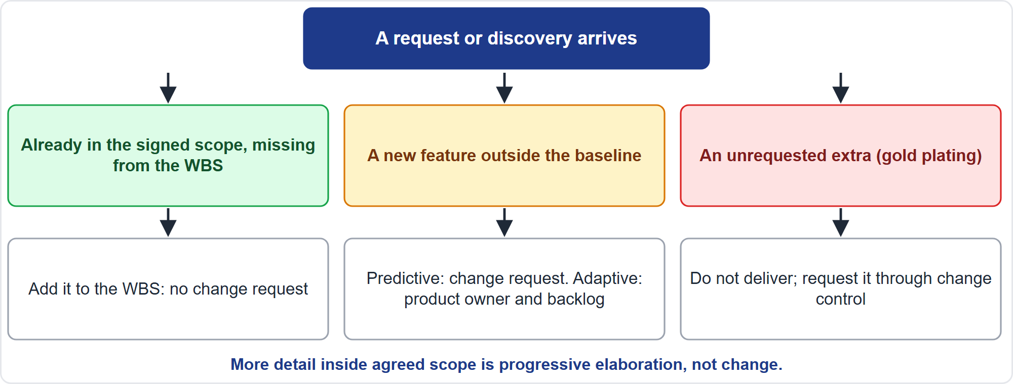
Is It a Scope Change?
Part 1
Three cases, three responses
EXAM TIP Already in the agreed scope but missing from the WBS? Add it: no change request is needed.
PMP Exam Prep 2026 | PMBOK 8 and the New ECO
Module 7: Scope, Schedule and Cost
16 / 71
Notes:
Not every discovery is a change. If work is already in the signed scope but missing from the work breakdown structure, add it. It is not a change, so no change request is needed. If a stakeholder asks for a new feature outside the baseline, it is a change. Predictive work uses a change request and impact assessment. Adaptive work uses the product owner and the backlog. If the team wants to add an unrequested extra to delight the customer, that is gold plating: do not deliver it unapproved. More detail inside agreed scope is progressive elaboration, not change.

Slide 17
Monitor and Control Scope
Part 1
Compare actual results with the baseline or backlog; manage changes; measure quality and value
Variance, trend and root cause analysis, audits and inspections
Adaptive: backlog management and refinement; a burnup chart shows scope added versus work done
Vendor delivers more than specified? Evaluate the impact and process it through change control
Mid-iteration request? Route it to the product owner; show trade-offs and capacity
Changes can be tailored: routine backlog changes flow, contract thresholds need approval
EXAM TIP Control formally even when a change is good.
PMP Exam Prep 2026 | PMBOK 8 and the New ECO
Module 7: Scope, Schedule and Cost
17 / 71
Notes:
Monitor and Control Scope compares actual results with the baseline or backlog, manages changes, and measures the quality and value of deliverables. Tools include variance, trend and root cause analysis, audits and inspections. In adaptive work, backlog management and refinement keep scope current. A burnup chart shows scope added against work completed, so growing scope is not mistaken for a slow team. If a vendor delivers more than specified, even for free, evaluate the impact and process it through change control. Control formally even when the change is good.

Slide 18
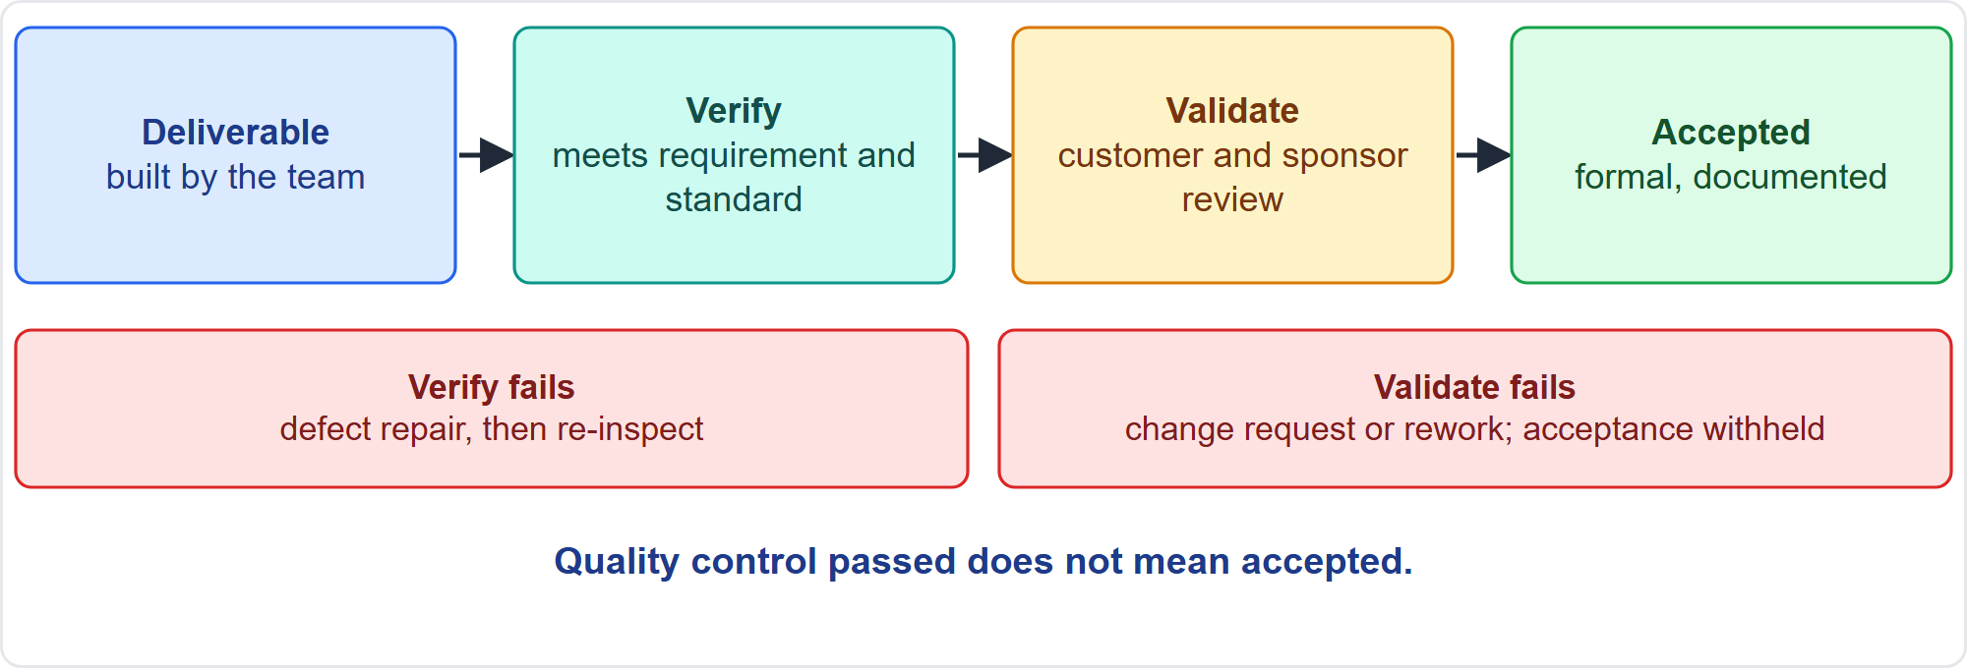
Verify, Then Validate
Part 1
Built correctly, then accepted
EXAM TIP Quality control passed does not equal accepted: hold a formal acceptance review against the criteria defined up front.
PMP Exam Prep 2026 | PMBOK 8 and the New ECO
Module 7: Scope, Schedule and Cost
18 / 71
Notes:
Verification and validation are different. Verification asks: is it built correctly, does it comply with the requirement, specification and quality standard? The project team and quality function do it, and the output is verified deliverables. If it fails, repair the defect and re-inspect. Validation asks: is it what the customer needs, and do they accept it? The customer, sponsor or authorized acceptor does it, and the output is accepted deliverables. If it fails, a change request or rework follows, and acceptance is withheld. Verified is not accepted.

Slide 19
Validate Scope
Part 1
Check the processes that reach quality standards and formalize acceptance
Tools: inspection, customer talks and tests, review meetings
Transition readiness matters: scope can be complete while the receiving team is not ready
Accepted deliverables feed closure; each phase closes formally
Adaptive: a sprint review validates each increment against the definition of done and story criteria
Early prototypes expose gaps between a specification and what users expected
EXAM TIP Do not close a phase on technical completion alone: formal acceptance and transition readiness come first.
PMP Exam Prep 2026 | PMBOK 8 and the New ECO
Module 7: Scope, Schedule and Cost
19 / 71
Notes:
Validate Scope checks the processes used to reach quality standards and formalizes acceptance. Tools include inspection, customer talks and tests, and review meetings. Transition readiness matters: scope can be complete while the receiving team is not ready, for example when support staff are not trained, so validate readiness before handover. Accepted deliverables feed closure, and each phase closes formally. In adaptive work, a sprint review validates each increment against the definition of done and the story's acceptance criteria. Do not close a phase on technical completion alone.

Slide 20
Scope, Quality and Sustainability
Part 1
Quality is a feature of scope: functional and nonfunctional requirements and target thresholds
Define Scope captures quality requirements; Monitor and Control measures them; Validate checks the processes
A customer-required sustainability criterion is a quality requirement
The WBS or backlog should include sustainability work, such as assessing emissions
Scope metrics: scope definition accuracy; unplanned deliverables over total; unchanged requirements over total
EXAM TIP PMBOK 8 prints scope creep and requirements stability upside down; the meaningful forms are unplanned over total and unchanged over total.
PMP Exam Prep 2026 | PMBOK 8 and the New ECO
Module 7: Scope, Schedule and Cost
20 / 71
Notes:
Quality is a feature of scope. Functional and nonfunctional requirements and target thresholds trade off with cost and schedule like any other scope. Define Scope captures quality requirements, Monitor and Control Scope measures them, and Validate Scope checks quality processes and obtains acceptance. A customer-required sustainability criterion, such as water-use certification, is a quality requirement, and the work breakdown structure or backlog should include work to manage sustainability. For metrics, scope creep is unplanned deliverables over total, and requirements stability is unchanged requirements over total.

Slide 21
Scope in Predictive, Agile and Hybrid Work
Part 1
 | Predictive | Agile | Hybrid
Definition | Detailed up front: statement, requirements | High level: vision, roadmap, MVP | Baseline for the envelope; backlog for the rest
Structure | WBS and dictionary | Product backlog | WBS at the top, backlog beneath
Baseline | Formal change control | Per iteration; product owner approves | Milestones and committed scope; backlog adapts
Priority | Mandatory versus optional | By value, reordered continually | Value order inside constraints
Acceptance | Formal, against criteria | Definition of done; sprint review | Increments plus milestone acceptance
EXAM TIP Fixed date and uncertain scope: fix the date and deliver prioritized increments.
PMP Exam Prep 2026 | PMBOK 8 and the New ECO
Module 7: Scope, Schedule and Cost
21 / 71
Notes:
Scope differs by approach. Predictive: detailed up front, with a work breakdown structure and dictionary. A baseline changed only through formal change control. Priorities of mandatory against optional. And formal acceptance. Agile: high-level scope and a product backlog. A baseline per iteration, with the product owner approving changes. Value-based ordering. And acceptance through the definition of done and sprint reviews. Hybrid: a baseline for the committed envelope and a backlog for the evolving parts. With a fixed date and uncertain scope, fix the date and deliver prioritized increments.

Slide 22
Scope Traps: What PMI Expects
Part 1
Already in agreed scope but missing from the WBS? Add it; no change request
A change request is for work outside the baseline
Verified is not accepted; define acceptance criteria and exclusions up front
Make conflicting requirements visible; do not rank or pick one
No gold plating, even free upgrades go through impact assessment
Decompose to the right level; the WBS covers 100% of scope
EXAM TIP Do not close a phase on technical completion alone.
PMP Exam Prep 2026 | PMBOK 8 and the New ECO
Module 7: Scope, Schedule and Cost
22 / 71
Notes:
The traps for scope. Already in agreed scope but missing from the work breakdown structure? Add it, with no change request. A change request is for work outside the baseline. Verified is not accepted, so define acceptance criteria and exclusions up front. Make conflicting requirements visible and resolve them together. No gold plating: even a free upgrade goes through impact assessment and change control. Decompose to the right level, and remember the work breakdown structure covers one hundred percent of scope. In agile work, route new requests to the backlog.

Slide 23
Part 1 Recap
Part 1
1
Requirements
2
Scope statement
3
WBS or backlog
elicited, traceable, with acceptance criteria
deliverables, criteria, exclusions, agreed with stakeholders
100% rule, right depth, rolling wave
4
Control
5
Verify, then validate
6
Quality and sustainability
in-scope omissions added; new requests through change control or the product owner
formal acceptance and readiness
are part of scope
PMP Exam Prep 2026 | PMBOK 8 and the New ECO
Module 7: Scope, Schedule and Cost
23 / 71
Notes:
Let us recap Part 1. Requirements are elicited, traceable and tied to acceptance criteria. The scope statement holds deliverables, acceptance criteria and exclusions, agreed with stakeholders before baselining. The work breakdown structure or backlog follows the hundred percent rule, the right depth and rolling wave planning. For control, in-scope omissions are added, and new requests go through change control or the product owner. Verify, then validate, with formal acceptance and transition readiness. And quality and sustainability are part of scope. In Part 2, we turn to the schedule.

Slide 24
Schedule: Key Terms
Part 2
Term | Meaning
Schedule model | The plan for activities, durations and dependencies
Schedule baseline | Approved model; changes only through change control
Milestone | A significant point with zero duration
Effort and duration | Labor units needed; work periods to complete
Critical path | Longest path; shortest possible project duration
Float | Total, free and negative float
Lead and lag | Successor earlier or later than the logic implies
Reserve (buffer) | Visible time protecting the date from uncertainty
EXAM TIP Reserves are kept visible and tied to risk; padding hidden in estimates is not a reserve.
PMP Exam Prep 2026 | PMBOK 8 and the New ECO
Module 7: Scope, Schedule and Cost
24 / 71
Notes:
Part 2 covers the schedule. Key terms. The schedule model represents the plan for executing activities. The schedule baseline is the approved version, changed only through change control. A milestone is a significant point with zero duration. Effort is the labor units needed, and duration is the work periods needed to complete an activity. The critical path is the longest path, and it determines the shortest possible project duration. Float is the room to delay. A lead lets a successor start earlier, a lag delays it. And a schedule reserve is visible time protecting the date from uncertainty.

Slide 25
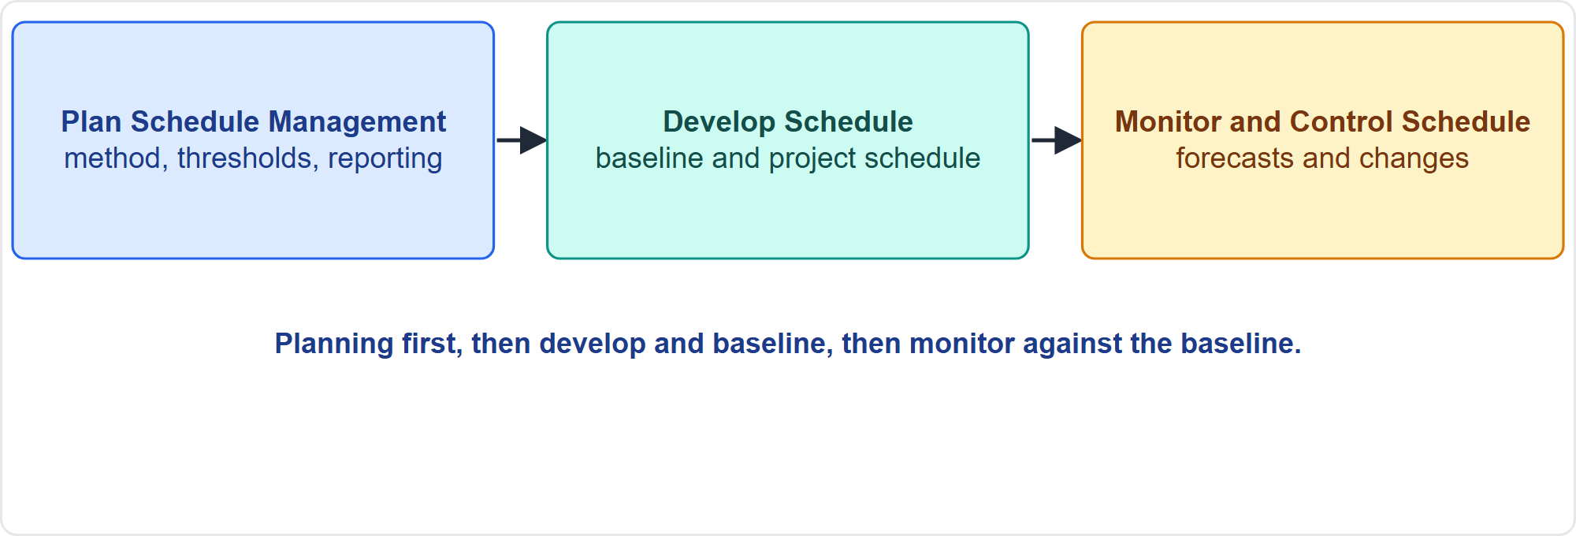
The Three Schedule Processes
Part 2
Plan, develop, monitor
EXAM TIP Any change to the baseline or agreed schedule is approved through integrated change control.
PMP Exam Prep 2026 | PMBOK 8 and the New ECO
Module 7: Scope, Schedule and Cost
25 / 71
Notes:
Three schedule processes. Plan Schedule Management sets policies, procedures and documentation, and produces the schedule management plan. Develop Schedule analyzes sequences, durations, resources and constraints to create the schedule model, and produces the schedule baseline and the project schedule. Monitor and Control Schedule tracks status, updates the schedule, and manages changes to the baseline, producing schedule forecasts and change requests. Any change to the baseline or agreed schedule goes through integrated change control.

Slide 26
Plan Schedule Management
Part 2
Element | What it defines
Model and tool | The scheduling method
Release and iteration length | Timeboxes; timeboxing limits scope creep
Accuracy and units | Acceptable range; hours, days, weeks
Control thresholds | Variance limits that trigger action
Performance rules | Percent complete, earned value techniques
Reporting | Format and frequency
EXAM TIP Prepare the schedule to match the approach: milestones for predictive, timeboxes for adaptive, milestones with iterations for hybrid.
PMP Exam Prep 2026 | PMBOK 8 and the New ECO
Module 7: Scope, Schedule and Cost
26 / 71
Notes:
The schedule management plan defines how the schedule is developed, monitored and controlled. It sets the scheduling method and tool, and the release and iteration length. It sets the level of accuracy and units of measure. It sets control thresholds that trigger action. It also sets rules of performance measurement, such as percent complete and earned value, and reporting formats. Timeboxing minimizes scope creep by forcing essential features first. Prepare the schedule to match the approach: milestones, dependencies and critical paths for predictive, timeboxed schedules for adaptive, and milestones with iterations beneath for hybrid.

Slide 27
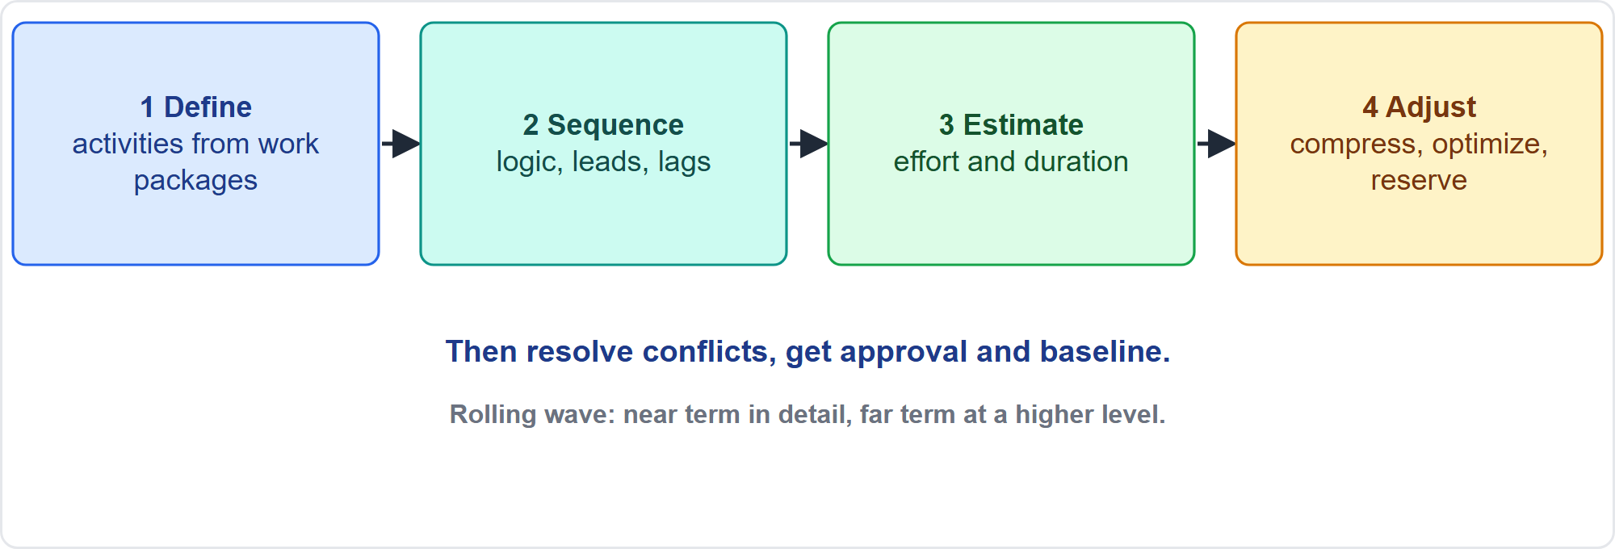
Develop Schedule: Four Steps
Part 2
Define, sequence, estimate, adjust
EXAM TIP Estimates come from the people most familiar with the work, with documented assumptions.
PMP Exam Prep 2026 | PMBOK 8 and the New ECO
Module 7: Scope, Schedule and Cost
27 / 71
Notes:
Developing the schedule has four steps. Define activities: decompose work packages into activities that can be estimated, scheduled and controlled. Determine sequence: logical relationships between activities. Estimate effort and duration, using the people most familiar with the work. Adjust. If the draft is unacceptable, apply compression, resource optimization, reserves or alternative logic. And confirm dates do not clash with calendars or other projects. Then resolve conflicts, involve stakeholders, approve and baseline. Where detail is unknown, use rolling wave planning.

Slide 28
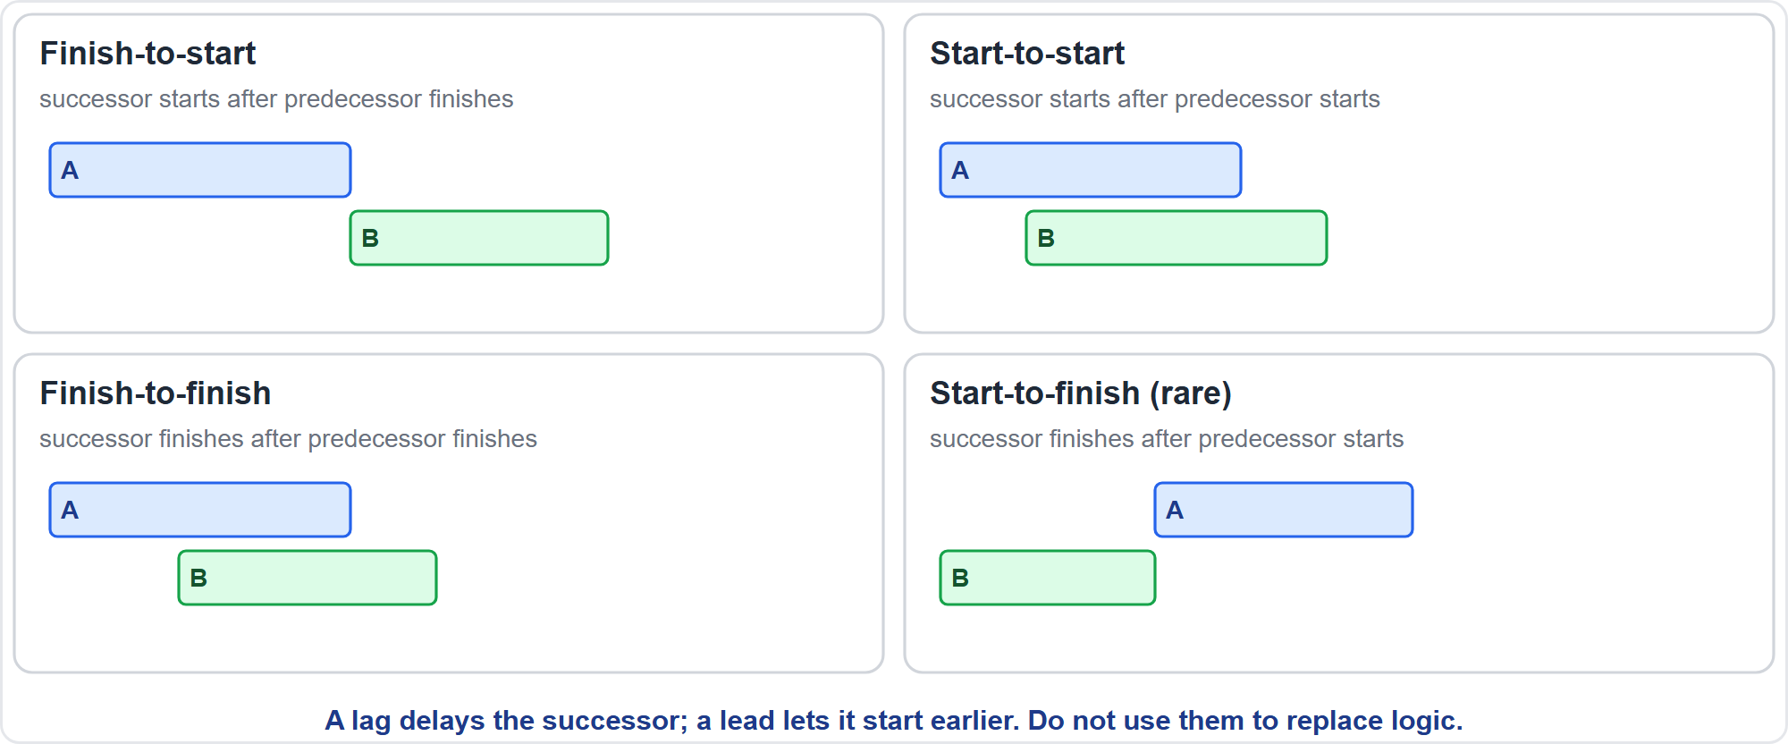
Logical Relationships
Part 2
Four relationships
EXAM TIP Mandatory, discretionary, internal and external say why a dependency exists; they are not logical relationships.
PMP Exam Prep 2026 | PMBOK 8 and the New ECO
Module 7: Scope, Schedule and Cost
28 / 71
Notes:
Four logical relationships. Finish-to-start: the successor starts after the predecessor finishes. This is the most common. Start-to-start: the successor starts after the predecessor starts. Finish-to-finish: the successor finishes after the predecessor finishes. Start-to-finish: the successor finishes after the predecessor starts. It is rare. A lag delays the successor, a lead lets it start earlier, and neither should replace the schedule logic. Every activity except the first and last needs a predecessor and a successor, and closed loops must be avoided.

Slide 29
Estimating Durations
Part 2
People who do the work estimate, using resource calendars
Some work has fixed duration regardless of resources
Doubling resources does not halve duration: diminishing returns, ramp-up and coordination
Record assumptions and data behind each estimate
Watch cognitive bias: planning fallacy, Hofstadter's law
Benchmarks and history support estimates when data are accurate, quantifiable and scalable
EXAM TIP More people do not shorten work in proportion; consider ramp-up and coordination.
PMP Exam Prep 2026 | PMBOK 8 and the New ECO
Module 7: Scope, Schedule and Cost
29 / 71
Notes:
Estimating durations. People most familiar with the work estimate, using resource calendars. Some work has a fixed duration regardless of resources, like a twenty-four-hour stress test. Doubling resources does not halve duration, because of diminishing returns, learning curves and coordination. Record the assumptions and data behind each estimate. Watch for cognitive bias such as the planning fallacy. Historical data and benchmarks support analogous and parametric estimates, and they are reliable when the data are accurate, the parameters quantifiable and the model scalable.

Slide 30
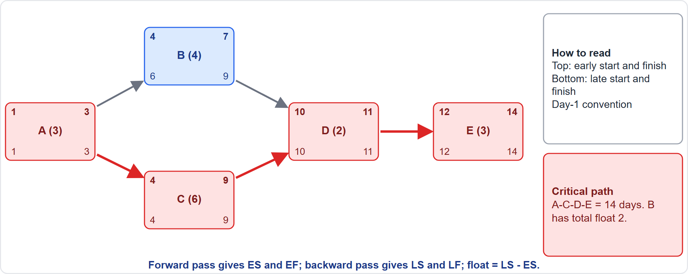
Critical Path Method
Part 2
A worked network
EXAM TIP PMBOK 8 uses the day-1 convention: EF = ES + duration − 1. Check which convention the item uses.
PMP Exam Prep 2026 | PMBOK 8 and the New ECO
Module 7: Scope, Schedule and Cost
30 / 71
Notes:
Here is a worked example. Activity A takes three days. It is followed by B, four days, and C, six days, which run in parallel. Both feed D, two days, then E, three days. Forward pass: A runs days one to three. B runs four to seven. C runs four to nine. D starts day ten and finishes day eleven. E runs twelve to fourteen. The longest path is A, C, D, E: fourteen days. That is the critical path. Backward pass shows B can slip two days: total float two. PMBOK 8 uses the day-one convention.

Slide 31
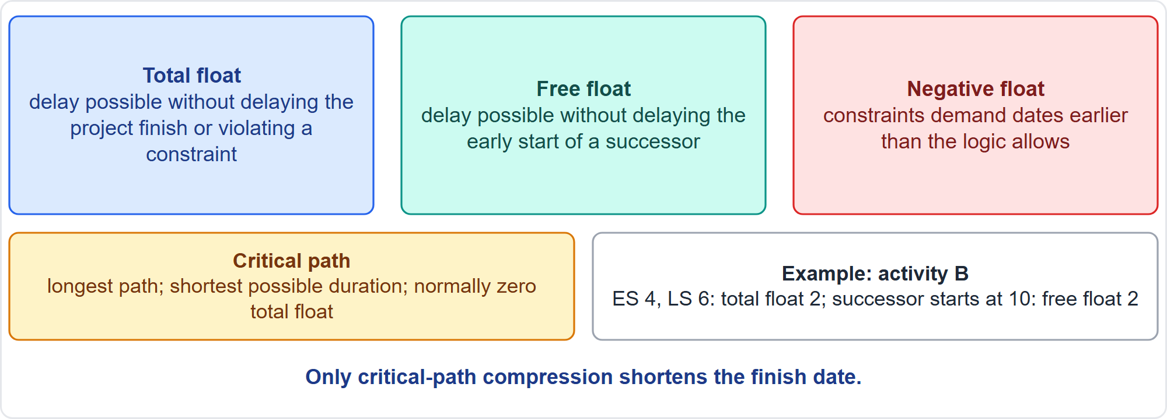
Float
Part 2
Three kinds of float
EXAM TIP Total float is shared along a path; free float is the delay that does not disturb the next activity.
PMP Exam Prep 2026 | PMBOK 8 and the New ECO
Module 7: Scope, Schedule and Cost
31 / 71
Notes:
Float is the room to delay. Total float is the delay possible without delaying the project finish date or violating a constraint. It equals late start minus early start. Free float is the delay possible without delaying the early start of a successor. Negative float occurs when constraints demand dates earlier than the logic and durations allow. In our example, activity B has total float of two, and free float of two. The critical path has normally zero total float. Total float is shared along a path.

Slide 32
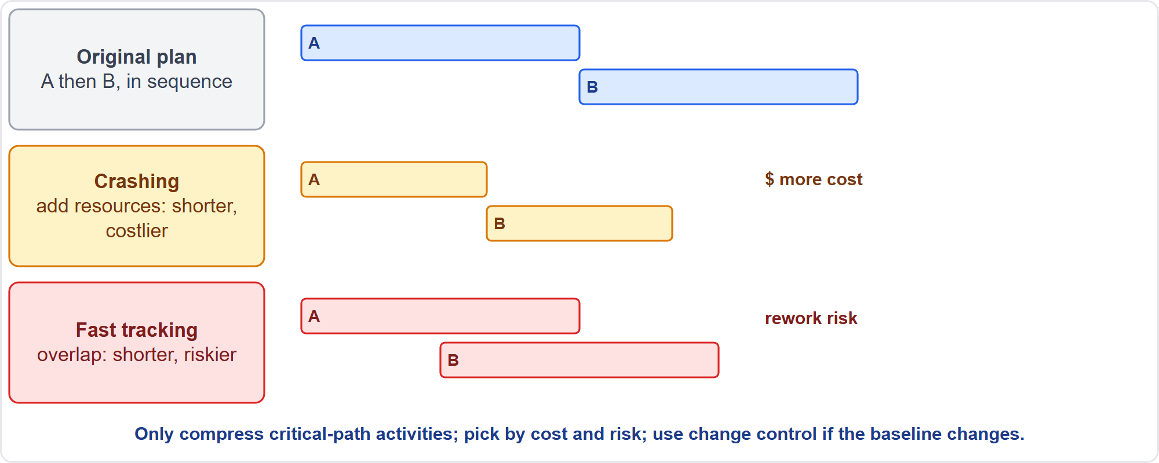
Schedule Compression
Part 2
Crashing and fast tracking
EXAM TIP Only compressing critical-path activities shortens the finish date; pick by cost and risk.
PMP Exam Prep 2026 | PMBOK 8 and the New ECO
Module 7: Scope, Schedule and Cost
32 / 71
Notes:
Compression shortens the schedule without reducing scope. Crashing adds resources, such as overtime, extra people or expedited delivery. It raises cost, and may not produce a viable result. Fast tracking does in parallel what was planned in sequence. It adds rework and quality risk, coordination effort and possibly cost. Only compressing critical-path activities shortens the finish date. Do not add resources to a non-critical activity to recover a late project. Pick by cost and risk, and use change control if the baseline changes.

Slide 33
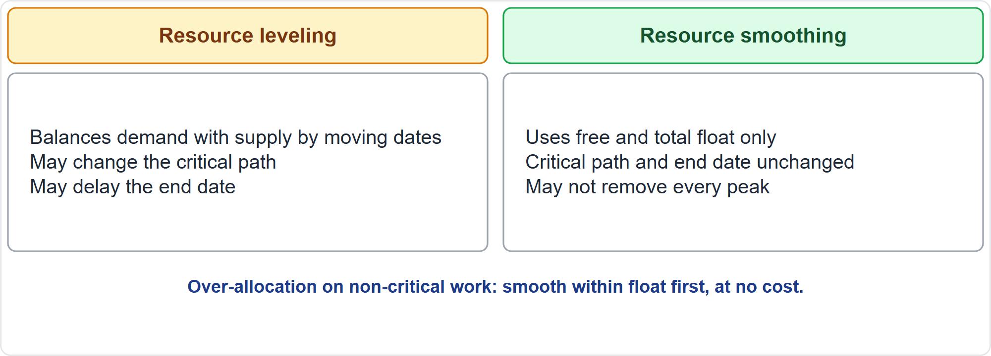
Resource Leveling and Smoothing
Part 2
Two ways to balance resources
EXAM TIP Over-allocation on non-critical work: smooth within float first; leveling can delay the end date.
PMP Exam Prep 2026 | PMBOK 8 and the New ECO
Module 7: Scope, Schedule and Cost
33 / 71
Notes:
Resource optimization has two techniques. Resource leveling moves dates to balance demand with supply, when resources are over-allocated or limited. It may change the critical path and delay the end date. Resource smoothing uses free and total float only, so the critical path and end date are unchanged, though it may not solve every peak. So for an over-allocation on non-critical activities, smooth within float first. It costs nothing. Leveling can move the end date.

Slide 34
Other Schedule Analysis Tools
Part 2
Critical chain
What-if scenarios
Simulation
one project buffer and feeding buffers instead of task padding
late delivery, strike, permit change; size reserves
probability of meeting a date
Reserve analysis
Aggregating reserves
are reserves sufficient for the remaining risk?
where paths converge or diverge
EXAM TIP Critical path drag is how much time a critical activity adds to the project.
PMP Exam Prep 2026 | PMBOK 8 and the New ECO
Module 7: Scope, Schedule and Cost
34 / 71
Notes:
Other tools help. The critical chain method, based on the theory of constraints, replaces task-level buffers with one project buffer and feeding buffers on a resource-leveled critical path. What-if scenario analysis computes schedules under scenarios such as a late delivery, a strike or a permit change, and helps size reserves. Simulation gives the probability of meeting a date. Reserve analysis asks whether reserves are sufficient for the remaining risk. Critical path drag, from PMBOK 8, is how much time a critical activity adds to the project.

Slide 35
The Schedule Baseline
Part 2
After conflicts are resolved and stakeholders approve, the model becomes the schedule baseline
The working project schedule is updated with actuals and forecasts; the baseline stays fixed
With the scope and cost baselines it forms the performance measurement baseline
Changes to the baseline, even corrections of errors, go through change control
Check dates against resource calendars and other projects
EXAM TIP A baseline is a commitment; a forecast is a prediction that is reissued as data arrive.
PMP Exam Prep 2026 | PMBOK 8 and the New ECO
Module 7: Scope, Schedule and Cost
35 / 71
Notes:
After conflicts are resolved and stakeholders approve, the schedule model becomes the schedule baseline, with baseline start and finish dates. The working project schedule is then updated with actuals and forecasts, while the baseline stays fixed. Together with the scope and cost baselines, it forms the performance measurement baseline. Changes to the baseline, even corrections of errors, go through change control. Check dates against resource calendars and other projects. A schedule forecast is a prediction of future conditions based on current progress, and it is reissued as work performance data arrive.

Slide 36
Coordinate With Other Projects and Operations
Part 2
Area | Actions
External dependencies | Identify, agree dates with owners, show as milestones, track as risks
Shared resources | Check calendars; agree release dates with functional managers or the PMO
Operations constraints | Change freezes, peak seasons, maintenance and outage windows as constraints
Program and portfolio | Align release dates and interfaces through the program or PMO
Governance | Escalate conflicts beyond your authority
EXAM TIP Do not assume standard timelines for external parties.
PMP Exam Prep 2026 | PMBOK 8 and the New ECO
Module 7: Scope, Schedule and Cost
36 / 71
Notes:
Coordinate with other projects and operations. External dependencies, such as permits, utility connections and other projects' deliverables. Identify them. Agree dates with the owners. Show them as milestones or constraints. And track them as risks. Shared resources: check calendars and competing assignments, and agree release dates with functional managers or the PMO. Operations constraints, such as change freezes and outage windows, belong in the schedule as constraints. Align release dates through the program, and escalate conflicts beyond your authority.

Slide 37
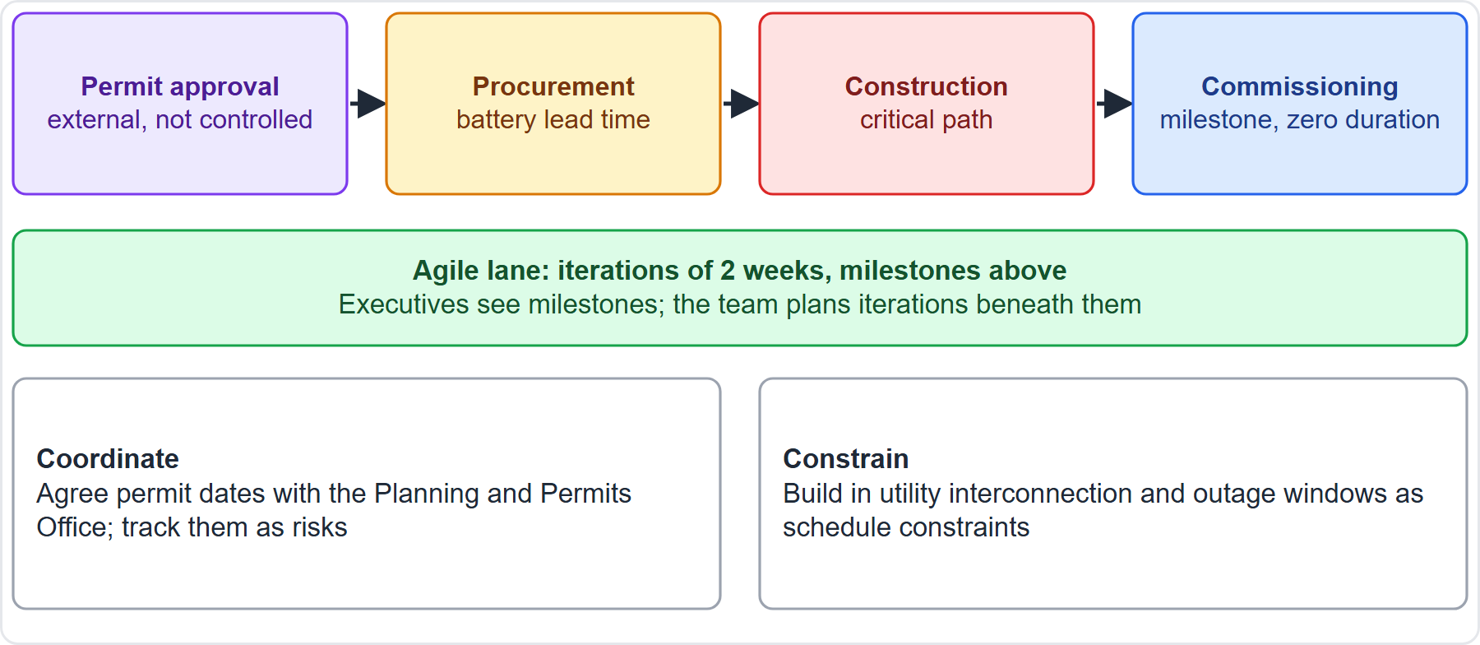
Case Check-In: The Microgrid Schedule
Part 2
CASE CHECK-IN · Sunrise Campus Microgrid
External dependency: permit approval and utility interconnection
Hybrid view: milestones on top, 2-week iterations beneath
PMP Exam Prep 2026 | PMBOK 8 and the New ECO
Module 7: Scope, Schedule and Cost
37 / 71
Notes:
Our microgrid schedule has a clear external dependency. Permit approval and the utility interconnection are not controlled by the team. Agree dates with the Planning and Permits Office and the utility, show them as milestones, and track them as risks. Battery lead time drives procurement. Construction is on the critical path. Commissioning is a zero-duration milestone. Beneath, the software lane runs in two-week iterations. Executives see milestones, and the team plans iterations beneath them.

Slide 38
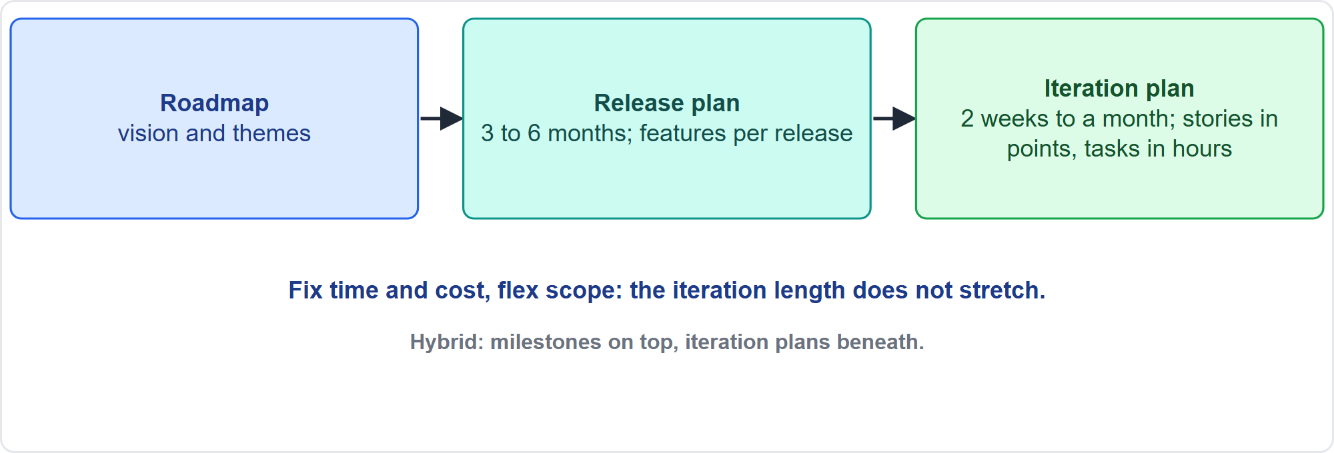
Agile Scheduling
Part 2
Roadmap, release, iteration
EXAM TIP The iteration length does not stretch to absorb unfinished work.
PMP Exam Prep 2026 | PMBOK 8 and the New ECO
Module 7: Scope, Schedule and Cost
38 / 71
Notes:
Adaptive scheduling works in layers. A roadmap gives vision and themes. A release plan, typically three to six months, is a high-level timeline that fixes the number of iterations and shows which features arrive when. An iteration plan is a detailed plan for the current iteration, two weeks to a month, with stories in points and tasks in hours. Fix time and cost, and flex scope: deliver prioritized increments. The iteration length does not stretch to absorb unfinished work.

Slide 39
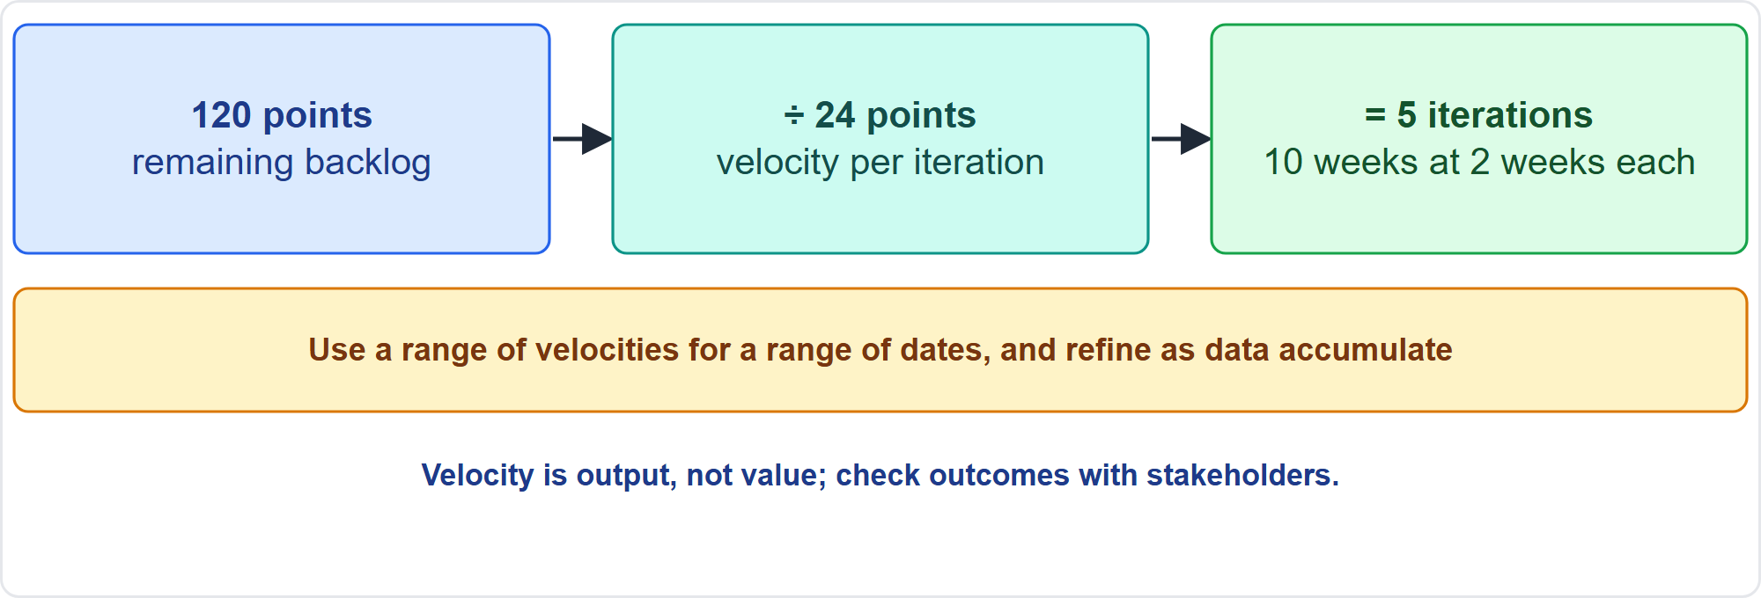
Forecasting With Velocity
Part 2
Backlog divided by velocity
EXAM TIP A burnup showing scope rising as fast as work completes means steady delivery with growing scope, not a slow team.
PMP Exam Prep 2026 | PMBOK 8 and the New ECO
Module 7: Scope, Schedule and Cost
39 / 71
Notes:
Velocity is the rate at which deliverables are produced, validated and accepted per iteration. As exam practice, forecast with remaining backlog divided by velocity. With one hundred twenty points remaining and a velocity of twenty-four, that is five iterations, ten weeks at two weeks each. Use a range of velocities for a range of dates, and refine as data accumulate. A burnup chart shows scope growth. If scope rises as fast as work completes, the team is delivering steadily while scope grows. Velocity is output, not value.

Slide 40
Hybrid and Other Scheduling Approaches
Part 2
Hybrid: executives see milestones with iteration plans beneath
Do not convert a backlog into a detailed Gantt chart: false precision
Some streams use Kanban or the critical path method
Location-based scheduling: quantities by location, production rates, crew sizes
Lean scheduling: pull planning, look-ahead planning, the Last Planner System
Keep each WBS element at a commensurate level of detail
EXAM TIP Every change in an iteration does not go through a change board: tailor control to the baseline envelope.
PMP Exam Prep 2026 | PMBOK 8 and the New ECO
Module 7: Scope, Schedule and Cost
40 / 71
Notes:
In hybrid work, executives see milestones with iteration plans beneath them. A detailed Gantt chart built from a backlog adds false precision, so avoid it. Some streams may use Kanban or the critical path method. PMBOK 8 also describes location-based scheduling, with quantities allocated to locations, production rates and crew sizes. It describes lean scheduling too, with pull planning, look-ahead planning and the Last Planner System. Keep each element's schedule at a commensurate level of detail. And do not send every iteration change through a change board.

Slide 41
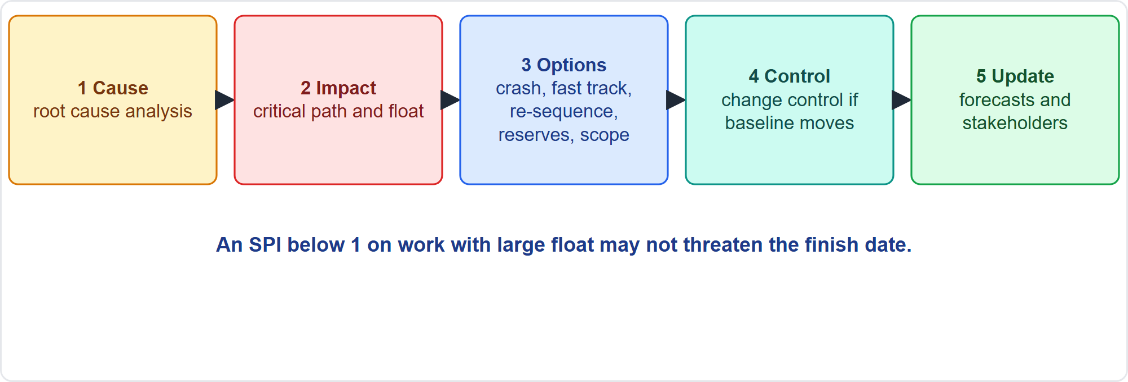
Monitor and Control the Schedule
Part 2
Five steps for a variance
EXAM TIP An SPI below 1 on work with large float may not threaten the finish date; delay on the critical path does.
PMP Exam Prep 2026 | PMBOK 8 and the New ECO
Module 7: Scope, Schedule and Cost
41 / 71
Notes:
When the schedule varies, respond in five steps. Find the cause, using root cause analysis. Check the effect on the critical path and float. An SPI below one on work with large float may not threaten the finish date, while delay on the critical path does. Evaluate options: crash, fast track, re-sequence, use or reassess reserves, reduce scope through change control, or escalate if beyond your authority. Use change control when the baseline would change. Update forecasts and communicate. In adaptive work, compare work delivered and accepted with estimates.

Slide 42
Schedule Variance Measures
Part 2
Measure | Formula | Reading
Schedule variance | EV − PV | Negative: behind plan
Schedule performance index | EV ÷ PV | Below 1: behind; above 1: ahead
Variance analysis | Baseline against actual | Review cause and degree
Trend analysis | Project results from history | Early warning of slippage
EXAM TIP SPI or SV is not the whole story: analyze the critical path and float before deciding the end date is at risk.
PMP Exam Prep 2026 | PMBOK 8 and the New ECO
Module 7: Scope, Schedule and Cost
42 / 71
Notes:
Schedule variance is earned value minus planned value. Negative means behind plan. The schedule performance index is earned value divided by planned value. Below one means behind, above one ahead. Variance analysis compares baseline with actual, reviewing cause and degree. Trend analysis projects future results from history, an early warning of slippage. But do not stop at the index: analyze the critical path and float before deciding that the end date is at risk. Contracted work needs regular status updates and reviews to confirm supplier reports.

Slide 43
Schedule in Predictive, Agile and Hybrid Work
Part 2
 | Predictive | Agile | Hybrid
Form | Detailed schedule, network, critical path | Roadmap, release plan, iteration plans | Milestones on top; iterations or Kanban beneath
Estimating | Parametric, bottom-up, three-point | Story points, velocity | Both
Control | Baseline against actual; SV, SPI | Delivered and accepted work; burn charts | Milestones formally; iterations by burn charts
Flex | Fix scope, control change | Fix time and cost, flex scope | Fix milestones and date, flex content
Tools | CPM, crashing, fast tracking | Timeboxing, refinement, retrospectives | Both
EXAM TIP Use relative sizing for uncertain agile work instead of padding hour estimates.
PMP Exam Prep 2026 | PMBOK 8 and the New ECO
Module 7: Scope, Schedule and Cost
43 / 71
Notes:
Schedule looks different by approach. Predictive: a detailed schedule with a network and critical path, and parametric or bottom-up estimates. Control is baseline against actual, with schedule variance and the index. Tools include the critical path method, crashing and fast tracking. Agile: roadmap, release and iteration plans. Story points and velocity. Control through delivered and accepted work and burn charts. And a fixed timebox with flexible scope. Hybrid: milestones on top, iterations beneath. Use relative sizing for uncertain agile work.

Slide 44
Schedule Traps: What PMI Expects
Part 2
Only critical-path compression shortens the finish date
Crashing costs money; fast tracking adds risk; neither cuts scope
Smooth within float first; leveling can move the end date
More people do not shorten work in proportion
Padding is not a reserve; show external dependencies and constraints
Baseline changes, even error corrections, go through change control
EXAM TIP When two stakeholders expect different dates, facilitate agreement rather than analyzing both dates further.
PMP Exam Prep 2026 | PMBOK 8 and the New ECO
Module 7: Scope, Schedule and Cost
44 / 71
Notes:
The traps for schedule. Only critical-path compression shortens the finish date. Crashing costs money, fast tracking adds risk, and neither cuts scope. Smooth within float first, because leveling can move the end date. More people do not shorten work in proportion. Padding is not a reserve, and external dependencies and operations constraints belong in the schedule. Baseline changes, even corrections of errors, go through change control. In agile work, fix the timebox and flex scope. When two stakeholders expect different dates, facilitate agreement.

Slide 45
Finance: Key Terms
Part 2
Term | Meaning
Funding | How the project gets its money
CapEx, OpEx | Investment in assets; day-to-day running costs
Cost estimate | Likely cost of resources for an activity
Cost baseline | Approved time-phased budget, excluding management reserve
Performance measurement baseline | Scope, schedule and cost baselines together
BAC | Budget at completion: the total planned value
Life cycle cost | Later cost of use, maintenance and support
EXAM TIP Total funds equal the cost baseline plus the management reserve.
PMP Exam Prep 2026 | PMBOK 8 and the New ECO
Module 7: Scope, Schedule and Cost
45 / 71
Notes:
Part 2 ends with the vocabulary for finance, which Part 3 develops. Funding is how the project gets its money. Capital expenditure is investment in assets, and operating expenditure is day-to-day running cost. A cost estimate is the likely cost of resources for an activity. The cost baseline is the approved time-phased budget, excluding management reserve. The performance measurement baseline is the scope, schedule and cost baselines together. Budget at completion is the total planned value. Life cycle cost includes later cost of use, maintenance and support.

Slide 46
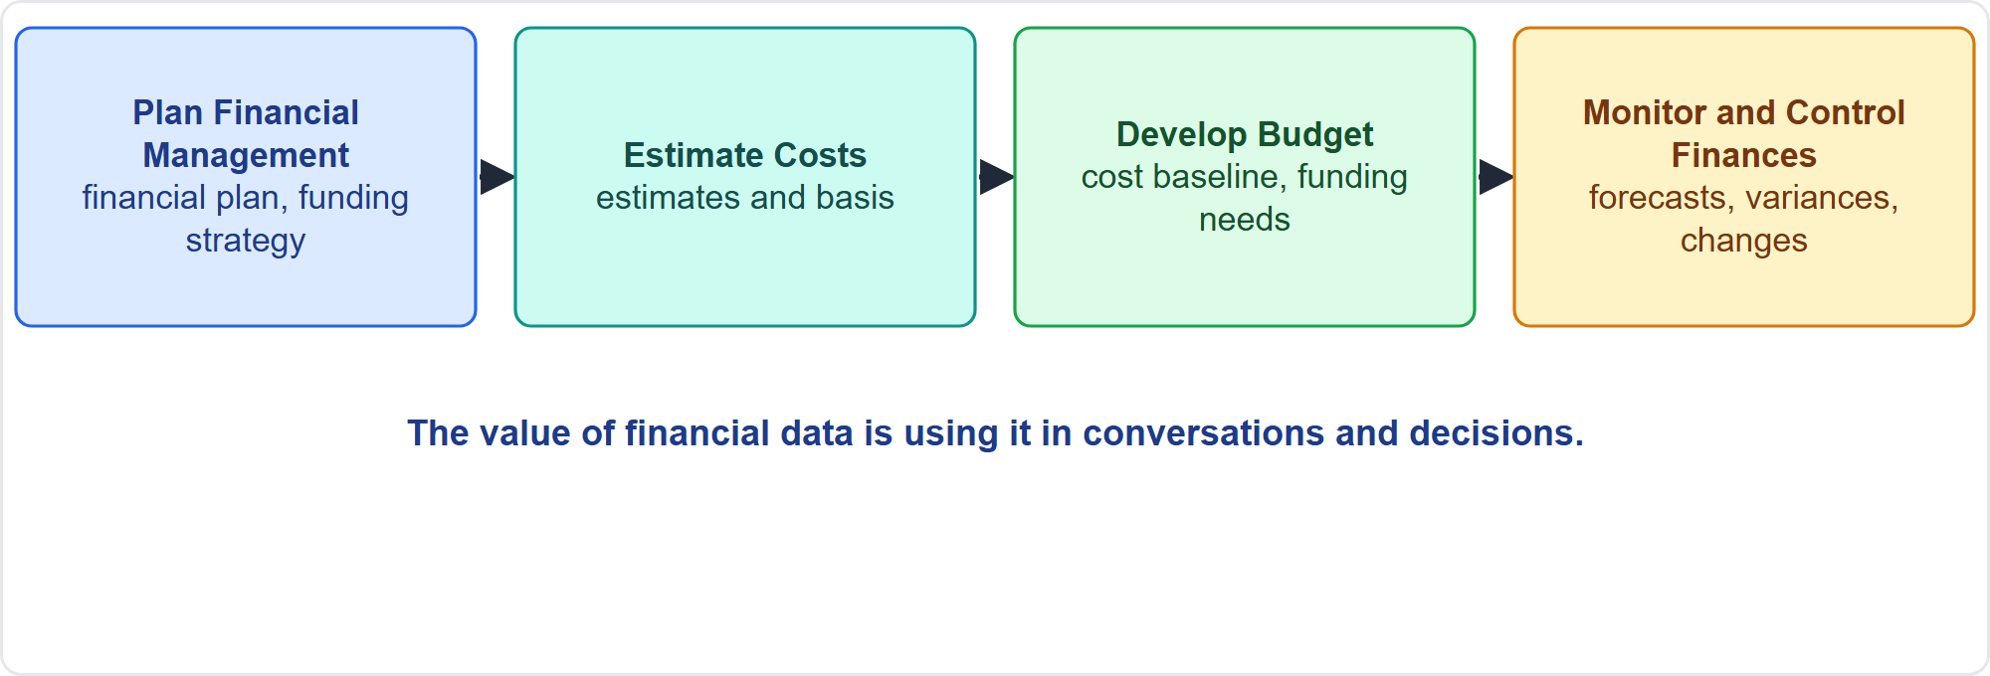
The Four Finance Processes
Part 2
Plan, estimate, budget, monitor
EXAM TIP The value of financial data is using it in conversations and decisions, not collecting it.
PMP Exam Prep 2026 | PMBOK 8 and the New ECO
Module 7: Scope, Schedule and Cost
46 / 71
Notes:
Four finance processes. Plan Financial Management defines how revenues and expenses will be estimated, budgeted, managed and controlled, and produces the financial management plan and funding strategy. Estimate Costs approximates the cost of resources needed. Develop Budget aggregates estimates into an authorized cost baseline. Monitor and Control Finances tracks spending, manages changes to the baseline and forecasts, and keeps the project financially viable. The domain aims at value, not only low cost.

Slide 47
Plan Financial Management
Part 2
Element | What it defines
Units and precision | Hours, days or currency; rounding
Accuracy | Acceptable range, such as plus or minus ten percent
Control accounts | WBS components linked to the accounting system
Thresholds | Variance limits that trigger action
Measurement rules | Earned value rules and EAC method
Reporting | Formats, frequency and audiences
Other | Funding choices, currency exchange procedure, cost recording
EXAM TIP If the board asks for earned value data, adapt the reporting; the project does not decide whether the requirement is needed.
PMP Exam Prep 2026 | PMBOK 8 and the New ECO
Module 7: Scope, Schedule and Cost
47 / 71
Notes:
The financial management plan describes how costs will be planned, structured and controlled. It sets units of measure and the level of precision. It sets the level of accuracy, such as plus or minus ten percent. And it sets control accounts, which link WBS components to the accounting system. It sets control thresholds, rules of performance measurement including how the estimate at completion is calculated, reporting formats, and procedures for currency fluctuations. Define who gets which reports. If the board requires earned value data, adapt the reporting.

Slide 48
Part 2 Recap
Part 2
1
Schedule baseline
2
Critical path and float
3
Compression and leveling
from logic, estimates and adjustments, changed only by change control
only critical compression shortens the finish
crash, fast track, level, smooth
4
Agile and hybrid
5
Variance response
6
Finance basics
timeboxes, velocity forecasts, milestones with iterations
cause, critical path, options, change control
baseline, BAC, CapEx, OpEx, the financial management plan
PMP Exam Prep 2026 | PMBOK 8 and the New ECO
Module 7: Scope, Schedule and Cost
48 / 71
Notes:
Let us recap Part 2. The schedule baseline comes from logic, estimates and adjustments, and changes only through change control. On the critical path, only critical compression shortens the finish. Crash, fast track, level or smooth, by cost and risk. Agile and hybrid scheduling use timeboxes, velocity forecasts, and milestones with iterations beneath. When a variance appears, find the cause, check the critical path, evaluate options, and use change control. And we met the finance basics: baseline, budget at completion, capital and operating expenditure, and the financial management plan. In Part 3, we turn to funding, budgets and earned value.

Slide 49
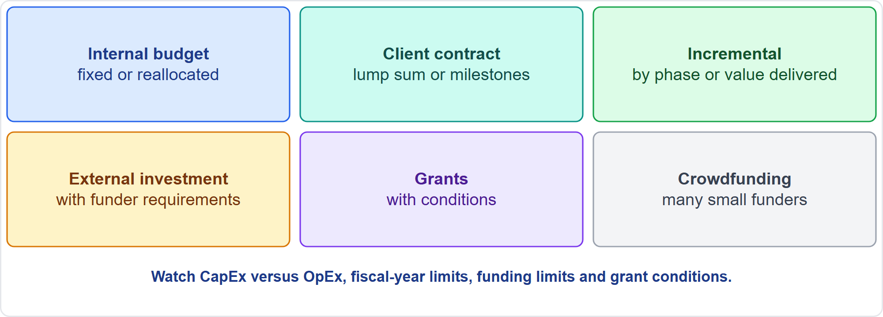
Funding and Financial Needs
Part 3
Six funding strategies
EXAM TIP Plan spend tracking: decide when cost is recognized: committed, ordered, delivered or incurred.
PMP Exam Prep 2026 | PMBOK 8 and the New ECO
Module 7: Scope, Schedule and Cost
49 / 71
Notes:
Analyze financial needs. How much money and when? Funding requirements come from the cost baseline, often incremental and uneven. From where? Choose a funding strategy: internal budgets, a client contract, incremental disbursement, external investment, grants or crowdfunding. Under what constraints? Capital or operating expenditure, fiscal-year limits and grant conditions. What value is expected? And what will it cost over the product's life? Plan spend tracking by deciding when cost is recognized: committed, ordered, delivered or incurred.

Slide 50
Estimate Costs
Part 3
Estimate all resources charged: labor, materials, equipment, services, facilities
Special categories: inflation allowance, cost of financing, contingency
Techniques: expert judgment, analogous, parametric, bottom-up, three-point, COCOMO for software
Consider alternatives: make or buy, buy or lease, share resources
Output: cost estimates and the basis of estimates
Estimates are refined as the project progresses
EXAM TIP Estimating only labor is a gap.
PMP Exam Prep 2026 | PMBOK 8 and the New ECO
Module 7: Scope, Schedule and Cost
50 / 71
Notes:
Estimate costs for all resources charged to the project: labor, materials, equipment, services and facilities. Add special categories, such as an inflation allowance, the cost of financing and contingency. Techniques include expert judgment, analogous, parametric, bottom-up and three-point estimating, plus the constructive cost model for software. Consider alternatives: make or buy, buy or lease, share resources. Outputs are the cost estimates and the basis of estimates. Estimates are refined as the project progresses, and accuracy improves.

Slide 51
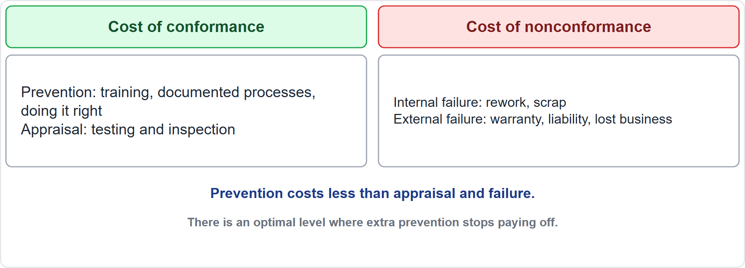
Cost of Quality
Part 3
Conformance and nonconformance
EXAM TIP Prevention costs less than appraisal and failure.
PMP Exam Prep 2026 | PMBOK 8 and the New ECO
Module 7: Scope, Schedule and Cost
51 / 71
Notes:
Cost of quality has two sides. The cost of conformance is money spent to avoid failures. That includes prevention, such as training, documented processes and doing it right. And it includes appraisal, such as testing and inspection. The cost of nonconformance is money spent because of failures. Internal failure is found by the project, such as rework and scrap. External failure is found by the customer, such as warranty, liability and lost business. Prevention costs less than appraisal and failure. There is an optimal level where extra prevention stops paying off.

Slide 52
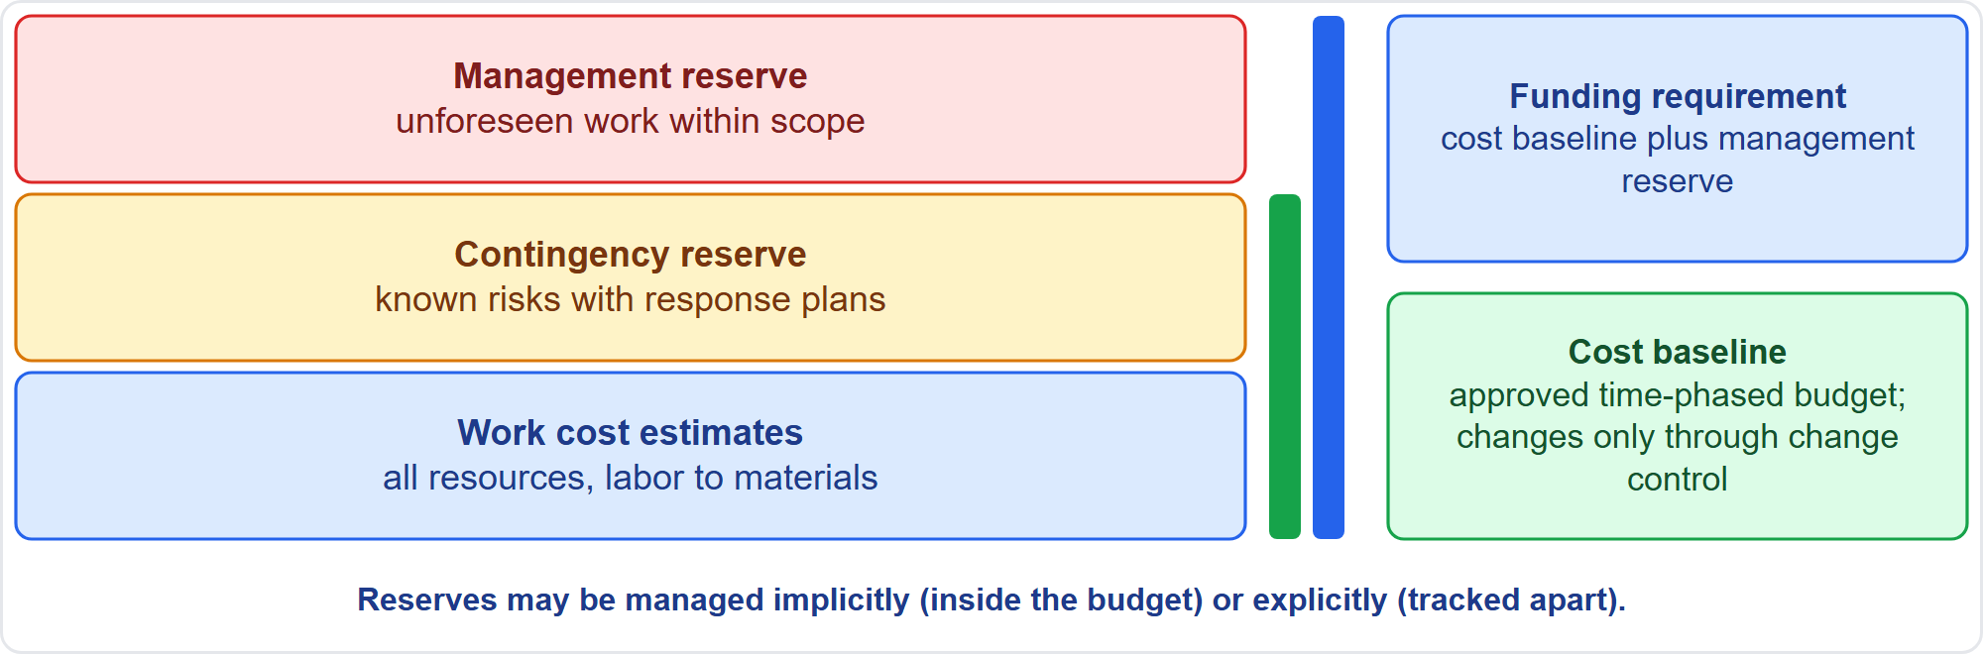
Develop the Budget
Part 3
Estimates, contingency, management reserve
EXAM TIP The cost baseline excludes management reserve and changes only through change control.
PMP Exam Prep 2026 | PMBOK 8 and the New ECO
Module 7: Scope, Schedule and Cost
52 / 71
Notes:
Develop Budget aggregates work package estimates to control accounts and then the project total. Reserve analysis and historical information review refine the budget. If planned spending exceeds a funding limit, funding limit reconciliation reschedules work to level out the rate of spending, or obtains more funds. Work cost estimates plus contingency form the cost baseline, the approved time-phased budget. Management reserve is added on top for funding. Reserves may be managed implicitly, inside the budget, or explicitly, tracked apart.

Slide 53
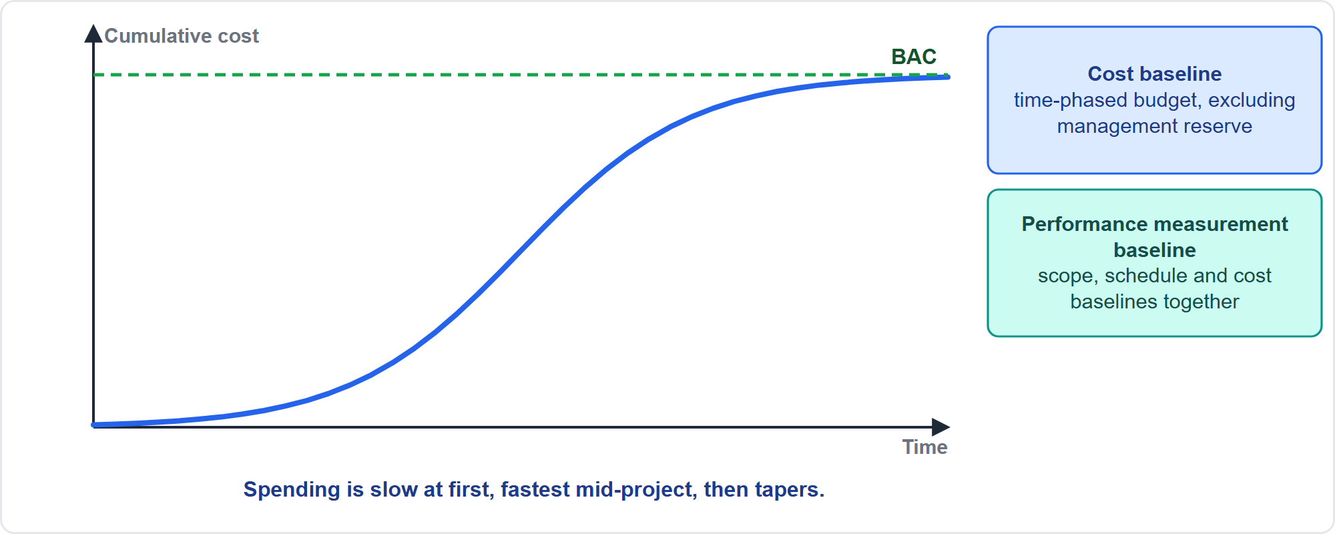
The Cost Baseline as an S-Curve
Part 3
Cumulative planned spend
EXAM TIP The cost baseline plus the scope and schedule baselines form the performance measurement baseline.
PMP Exam Prep 2026 | PMBOK 8 and the New ECO
Module 7: Scope, Schedule and Cost
53 / 71
Notes:
The cost baseline is a time-phased budget, usually drawn as an S-curve. Cumulative planned spend starts slowly, rises fastest in the middle of the project, and tapers as it approaches the budget at completion. Project funding requirements follow from the baseline, including contingency, and total funds equal the cost baseline plus the management reserve. Together with the scope and schedule baselines, the cost baseline forms the performance measurement baseline, used to measure and control execution. It changes only through formal change control.

Slide 54
Contingency Versus Management Reserve
Part 3
 | Contingency reserve | Management reserve
Covers | Known risks with response strategies | Unforeseen work within scope
Where | In the cost or schedule baseline | In addition to the baseline
Released by | Reserve protocols in the risk plan | Usually senior management
Sizing | Percentage, fixed amount or quantitative analysis | A management decision
EXAM TIP Size contingency from expected monetary values or simulation, and show it clearly in the cost documentation.
PMP Exam Prep 2026 | PMBOK 8 and the New ECO
Module 7: Scope, Schedule and Cost
54 / 71
Notes:
Two reserves, two purposes. A contingency reserve covers known risks with active response strategies, the known unknowns. It sits in the cost or schedule baseline, and is released per the reserve protocols in the risk management plan. It can be sized by a percentage, a fixed amount or quantitative analysis. A management reserve covers unforeseen work within scope, the unknown unknowns. It is in addition to the baseline, never part of it, and is usually released by senior management. Show contingency clearly. Do not hide it in estimates.

Slide 55
Managing Reserves
Part 3
Use contingency when identified risks occur; reduce or release it as risks pass
Use management reserve only for unforeseen in-scope work, with the approval path set by the organization
Using it normally needs a change request so the baseline reflects the new authorization
Reserve burning faster than progress is a governance signal: reassess and tell the sponsor
Do not quietly top up from the management reserve
Small and government projects often hold larger buffers
EXAM TIP Example: risks with expected values of 30, 20 and 20 thousand suggest about 70 thousand of contingency.
PMP Exam Prep 2026 | PMBOK 8 and the New ECO
Module 7: Scope, Schedule and Cost
55 / 71
Notes:
How to manage reserves. Use contingency when identified risks occur, and reduce or release it as risks pass. Use management reserve only for unforeseen in-scope work, through the approval path the organization sets. Using it normally needs a change request, so the baseline reflects the new authorization. If reserves burn faster than progress, that is a governance signal: reassess adequacy against remaining risks and tell the sponsor. Do not quietly top up from management reserve. Small and government projects often hold larger buffers. As an example, expected values of thirty, twenty and twenty thousand suggest about seventy thousand of contingency.

Slide 56
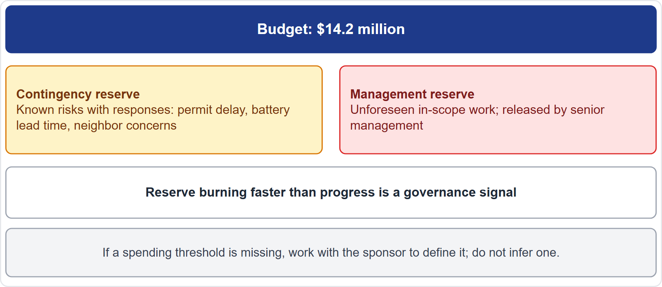
Case Check-In: Reserves on the Microgrid
Part 3
CASE CHECK-IN · Sunrise Campus Microgrid
Contingency: known risks such as permit delay and battery lead time
Management reserve: unforeseen in-scope work, released by senior management
PMP Exam Prep 2026 | PMBOK 8 and the New ECO
Module 7: Scope, Schedule and Cost
56 / 71
Notes:
Back to our microgrid budget of fourteen point two million dollars. Contingency covers known risks with responses: a permit delay, the battery lead time, and neighbor concerns. Management reserve covers unforeseen in-scope work, and senior management releases it. If contingency burns faster than progress, that is a governance signal: reassess it and tell Elena Vasquez. And if a spending threshold is missing for a decision above your authority, work with the sponsor to define it. Do not infer one.

Slide 57
Earned Value Measures
Part 3
Measure | Formula | Reading
PV | Budget for scheduled work | What should be done
EV | Budget for work completed | What was done
AC | Realized cost of work performed | What it cost
CV | EV − AC | Negative: over budget
SV | EV − PV | Negative: behind
CPI | EV ÷ AC | Below 1: over budget
SPI | EV ÷ PV | Below 1: behind
EXAM TIP CPI is cost efficiency; SPI is schedule efficiency: do not mix them.
PMP Exam Prep 2026 | PMBOK 8 and the New ECO
Module 7: Scope, Schedule and Cost
57 / 71
Notes:
Earned value measures. Planned value is the authorized budget for scheduled work: what should be done. Earned value is the budget for work actually completed: what was done. Actual cost is the realized cost of the work performed. Cost variance is earned value minus actual cost: negative means over budget. Schedule variance is earned value minus planned value: negative means behind. The cost performance index is earned value over actual cost, and below one means over budget. The schedule performance index is earned value over planned value, and below one means behind.

Slide 58
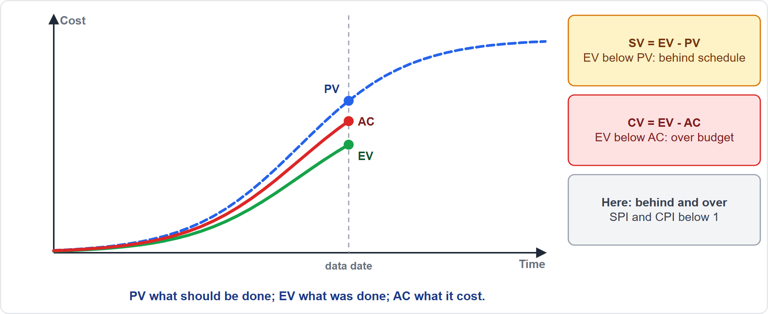
Earned Value Curves
Part 3
PV, EV and AC
EXAM TIP Forecast total cost with the estimate at completion, not the BAC and not the SPI.
PMP Exam Prep 2026 | PMBOK 8 and the New ECO
Module 7: Scope, Schedule and Cost
58 / 71
Notes:
Here are the three curves. Planned value is the dashed curve: what should have been done by each date. Earned value is the green curve: the budget value of the work actually done. Actual cost is the red curve: what it cost. At the data date, earned value is below planned value, so the project is behind schedule. Earned value is also below actual cost, so it is over budget. Read the indices together: a cost index below one with a schedule index above one means schedule recovered at a cost.

Slide 59
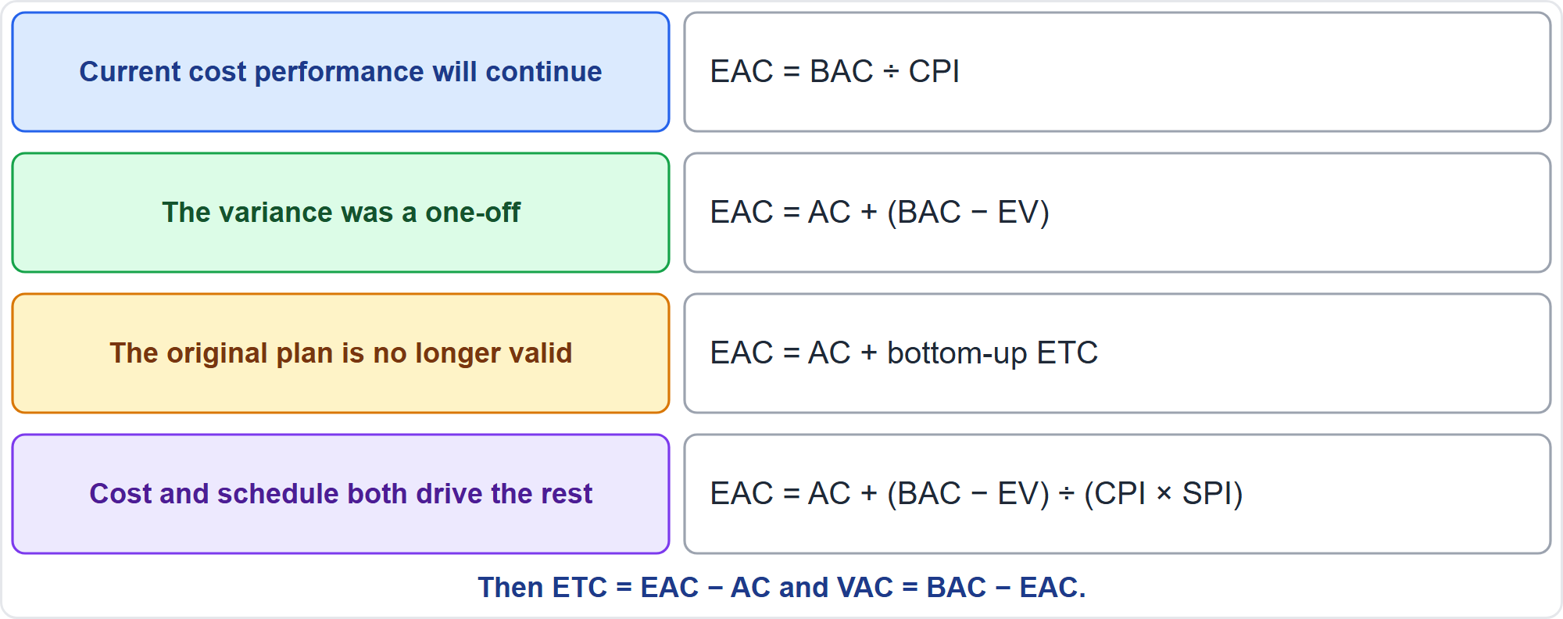
Estimate at Completion
Part 3
Four formulas
EXAM TIP Read the assumption words in the question to choose the formula.
PMP Exam Prep 2026 | PMBOK 8 and the New ECO
Module 7: Scope, Schedule and Cost
59 / 71
Notes:
The estimate at completion has four formulas, and the assumption chooses. If current cost performance will continue, EAC equals BAC divided by CPI. If the variance was a one-off and future work goes at the planned rate, EAC equals actual cost plus BAC minus earned value. If the original plan is no longer valid, EAC equals actual cost plus a bottom-up estimate to complete. If both cost and schedule performance affect the remaining work, divide the remaining budget by CPI times SPI. Then ETC equals EAC minus AC, and VAC equals BAC minus EAC.

Slide 60
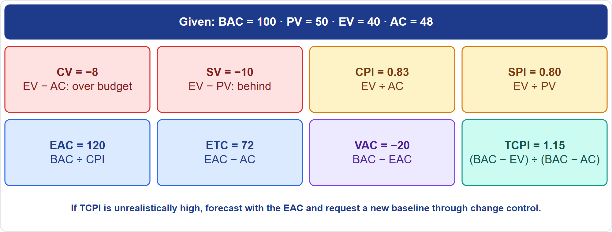
A Worked Earned Value Example
Part 3
BAC 100, PV 50, EV 40, AC 48
EXAM TIP If the TCPI is unrealistically high, forecast with the EAC and request a new baseline through change control.
PMP Exam Prep 2026 | PMBOK 8 and the New ECO
Module 7: Scope, Schedule and Cost
60 / 71
Notes:
Work an example. BAC is one hundred, planned value fifty, earned value forty, actual cost forty-eight. Cost variance: forty minus forty-eight, negative eight. Schedule variance: forty minus fifty, negative ten. CPI: forty over forty-eight, about 0.83. SPI: forty over fifty, 0.80. If performance continues, EAC is one hundred divided by 0.83, about one hundred twenty. ETC is one-twenty minus forty-eight, seventy-two. VAC is negative twenty. The to-complete performance index is sixty over fifty-two, about 1.15. If that is unrealistic, forecast with the EAC.

Slide 61
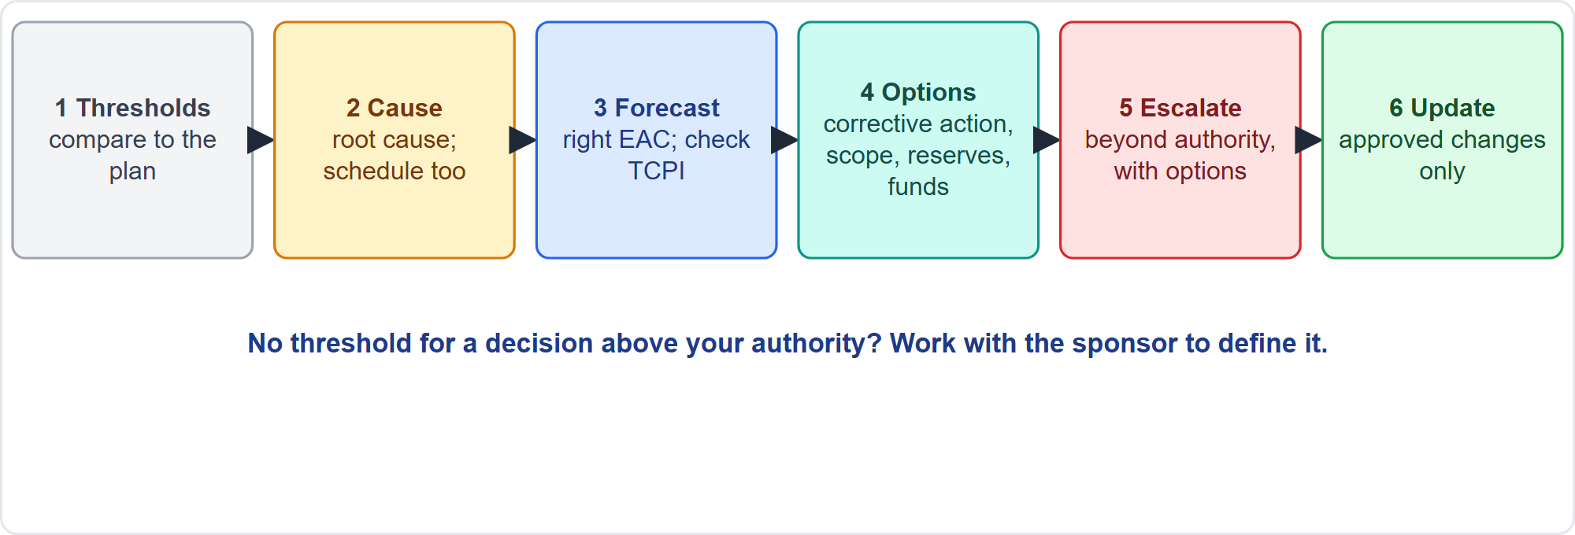
Responding to a Financial Variance
Part 3
Six steps
EXAM TIP An over-budget, ahead-of-schedule result may be paid-for speed: read cost and schedule together.
PMP Exam Prep 2026 | PMBOK 8 and the New ECO
Module 7: Scope, Schedule and Cost
61 / 71
Notes:
When a financial variance appears, follow six steps. Compare it with the thresholds in the financial plan. Find the cause, and consider schedule performance too. Forecast with the right EAC, and check the to-complete index. Evaluate options: corrective action, scope or quality trade-offs through change control, reserves per protocol, schedule changes or additional funds. Escalate through governance when thresholds or authority are exceeded, bringing options. Update baselines and plans only through approved change requests, and communicate the forecast.

Slide 62
Anticipating Future Finance Challenges
Part 3
Challenge | Response
Inflation, exchange rates | Inflation allowance; follow the currency procedure
Resource cost and availability | Plan resources early
Contract type | Fixed price shifts overrun risk to the seller
Funding limits and timing | Funding limit reconciliation; funding proposals
Regulation and compliance cost | Controls such as SOX or GDPR; compliance threats are risks
Life cycle cost | Weigh operating and maintenance costs
Revenue shortfall | Track revenue forecasts and the business case
EXAM TIP Cutting design reviews may lower project cost but raise the product's operating cost.
PMP Exam Prep 2026 | PMBOK 8 and the New ECO
Module 7: Scope, Schedule and Cost
62 / 71
Notes:
Anticipate finance challenges. Inflation and exchange rates: include an inflation allowance and follow the plan's currency procedure. Resource cost and availability: plan resources early, because constraints raise cost. Contract type: a fixed-price contract shifts overrun risk to the seller, while time and materials keeps it with the buyer. Funding limits and timing: reconcile funding limits. Regulation: controls such as SOX or GDPR add cost, and compliance threats are risks. Life cycle cost: weigh operating and maintenance costs, not only project cost. Revenue shortfalls: track the business case.

Slide 63
Finance in Predictive, Agile and Hybrid Work
Part 3
 | Predictive | Agile | Hybrid
Budgeting | Full budget and baseline up front; reserves | By quarter or increment; revised quarterly | Baseline for the envelope; incremental funding for iterations
Spend curve | S-curve | Flatter, steady burn per iteration | Mixed
Funding | Lump sum or milestones | Incremental, tied to value | Both
Tracking | Earned value against the baseline | Spend per iteration against value; earned value in story points | Both
Change | Change control | Backlog reprioritization within the envelope | Change control for the envelope
EXAM TIP Quarterly totals alone arrive too late in adaptive work: track spend per iteration.
PMP Exam Prep 2026 | PMBOK 8 and the New ECO
Module 7: Scope, Schedule and Cost
63 / 71
Notes:
Finance differs by approach. Predictive: a full budget and cost baseline up front, with reserves. An S-curve, and lump sum or milestone funding. Earned value against the performance baseline. And change control for baseline changes. Agile: budget allocated by quarter or increment, and revised quarterly. A flatter spend curve, and incremental funding tied to value. Spend tracked per iteration against delivered value. And earned value in story points. Hybrid: a baseline for the fixed envelope and incremental funding for the iterative parts.

Slide 64
Finance Traps: What PMI Expects
Part 3
Forecast with the EAC, not the BAC and not the SPI
Choose the EAC formula by the assumption
The cost baseline excludes management reserve; it changes only through change control
Contingency versus management reserve: known risks versus unknown-unknowns
Reserve burning fast is a governance signal; do not quietly refill
Read CPI and SPI together; estimate all resource types
EXAM TIP If no threshold exists above your spending authority, work with the sponsor to define it.
PMP Exam Prep 2026 | PMBOK 8 and the New ECO
Module 7: Scope, Schedule and Cost
64 / 71
Notes:
The traps for finance. Forecast total cost with the estimate at completion, not the budget at completion and not the schedule index. Choose the formula by the assumption. The cost baseline excludes management reserve and changes only through change control. Contingency covers identified risks, while management reserve covers unknown unknowns. Reserve burning fast is a governance signal, so reassess and inform the sponsor. Read the cost and schedule indices together. And estimate all resource types, not only labor.

Slide 65
Module Recap
Part 3
1
Scope
2
Schedule
3
Cost
requirements, statement, WBS or backlog, control, verify then validate
logic, critical path, float, compression, velocity, baseline control
estimates, budget, baseline, reserves, funding
4
Earned value
5
Linked constraints
6
Next
PV, EV, AC, variances, indices, four EAC formulas
a change in one moves the other two
five practice questions
PMP Exam Prep 2026 | PMBOK 8 and the New ECO
Module 7: Scope, Schedule and Cost
65 / 71
Notes:
Let us recap the whole module. Scope: requirements, the statement, the work breakdown structure or backlog, control, and verify then validate. Schedule: logic, the critical path, float, compression, velocity, and baseline control. Cost: estimates, budget, baseline, reserves and funding. Earned value: planned value, earned value, actual cost, variances, indices and four formulas for the estimate at completion. And remember the constraints are linked. Now it is time to test yourself. Five questions follow. For each one, pause the video, choose your answer, and then listen to the explanation.

Slide 66
Practice Question 1
Part 3
Q1
During a review, the project manager finds that an installation task listed in the signed scope statement is missing from the work breakdown structure. What should the project manager do?
A
Submit a change request and wait for the board to approve the task
B
Ask the sponsor to add the task to the contract as a new item
C
Add the task to the WBS and update the related plans and documents
D
Leave it out of the WBS because the scope baseline is already approved
PMP Exam Prep 2026 | PMBOK 8 and the New ECO
Module 7: Scope, Schedule and Cost
66 / 71
Notes:
Question one. During a review, the project manager finds that an installation task listed in the signed scope statement is missing from the work breakdown structure. What should the project manager do? The four options are on the screen. Choose your answer. [PAUSE 12] The answer is C. Work that is already in the agreed scope is not a change, so it is added to the work breakdown structure and the related plans and documents are updated. A change request, a contract addition or leaving it out all treat an in-scope omission as something it is not.

Slide 67
Practice Question 2
Part 3
Q2
A subcontractor's panels passed every inspection and test, but the customer has not formally accepted them. What should the project manager do next?
A
Hold a formal acceptance review against the acceptance criteria defined up front
B
Close the work package because quality control confirmed that the panels are correct
C
Ask the subcontractor to repeat the tests until the customer signs the acceptance form
D
Mark the panels as accepted and report any customer concerns later
PMP Exam Prep 2026 | PMBOK 8 and the New ECO
Module 7: Scope, Schedule and Cost
67 / 71
Notes:
Question two. A subcontractor's panels passed every inspection and test, but the customer has not formally accepted them. What should the project manager do next? The four options are on the screen. Choose your answer. [PAUSE 12] The answer is A. Verification confirms correctness, but the customer must formally accept the deliverable against the acceptance criteria, so the next step is a formal acceptance review. Closing on test results, repeating tests, or marking it accepted skips the customer's acceptance.

Slide 68
Practice Question 3
Part 3
Q3
Several resources are over-allocated on activities that have float, and the finish date must not change. Which technique should the project manager use?
A
Resource leveling, moving activities until demand matches supply for every resource
B
Resource smoothing, using the available float on the affected activities
C
Crashing the activities by adding people from another project
D
Fast tracking the affected activities so that they run in parallel
PMP Exam Prep 2026 | PMBOK 8 and the New ECO
Module 7: Scope, Schedule and Cost
68 / 71
Notes:
Question three. Several resources are over-allocated on activities that have float, and the finish date must not change. Which technique should the project manager use? The four options are on the screen. Choose your answer. [PAUSE 12] The answer is B. Smoothing uses free and total float only, so the critical path and finish date stay unchanged while the peaks are reduced. Leveling can change the critical path and delay the end date, and crashing and fast tracking spend money or add risk without need.

Slide 69
Practice Question 4
Part 3
Q4
A project has a BAC of 200, an EV of 80 and an AC of 100. The cost overrun is expected to continue at the current rate. What is the EAC?
A
220
B
280
C
120
D
250
PMP Exam Prep 2026 | PMBOK 8 and the New ECO
Module 7: Scope, Schedule and Cost
69 / 71
Notes:
Question four. A project has a BAC of 200, an EV of 80 and an AC of 100. The cost overrun is expected to continue at the current rate. What is the EAC? The four options are on the screen. Choose your answer. [PAUSE 12] The answer is D. CPI is EV divided by AC, which is 0.8, and with current cost performance continuing, EAC equals BAC divided by CPI: 200 divided by 0.8 is 250. 220 treats the variance as a one-off, and the other values do not follow from any EAC formula for these numbers.

Slide 70
Practice Question 5
Part 3
Q5
Halfway through the project, the contingency reserve has been used much faster than the work has progressed, and more risks are likely. What should the project manager do?
A
Refill the contingency quietly from the management reserve when it runs low
B
Stop reporting reserve use so that stakeholders are not alarmed
C
Reassess the reserve against remaining risks and inform the sponsor
D
Reduce testing so that the remaining contingency can last much longer
PMP Exam Prep 2026 | PMBOK 8 and the New ECO
Module 7: Scope, Schedule and Cost
70 / 71
Notes:
Question five. Halfway through the project, the contingency reserve has been used much faster than the work has progressed, and more risks are likely. What should the project manager do? The four options are on the screen. Choose your answer. [PAUSE 12] The answer is C. A reserve burning faster than progress is a governance signal, so the project manager reassesses its adequacy against remaining risks and tells the sponsor. Quietly topping up, hiding the use, or cutting testing avoid the governance conversation.

Slide 71
Answers at a Glance
Part 3
Question | Answer | Why
Q1 | C | Work already in agreed scope is added to the WBS without a change request
Q2 | A | Verified is not accepted, so hold a formal acceptance review
Q3 | B | Smoothing uses float, so the end date stays put
Q4 | D | BAC divided by CPI of 0.8 gives 250
Q5 | C | A fast-burning reserve is a governance signal for the sponsor
PMP Exam Prep 2026 | PMBOK 8 and the New ECO
Module 7: Scope, Schedule and Cost
71 / 71
Notes:
Here are all five answers together. Question one: C. Work already in agreed scope is added to the WBS without a change request. Question two: A. Verified is not accepted, so hold a formal acceptance review. Question three: B. Smoothing uses float, so the end date stays put. Question four: D. BAC divided by CPI of 0.8 gives 250. Question five: C. A fast-burning reserve is a governance signal for the sponsor. That completes Module 7. Next, Module 8 covers quality, resource and procurement management. See you there.

