Slide 1
Module 8: Quality, Resources and Procurement
Part 1 of 3: Quality management
Process domain · ECO tasks 7, 4 and 5
PMP Exam Prep 2026: PMBOK 8 and the New ECO
Module 8: Quality, Resources and Procurement · Part 1
Notes:
Welcome to Module 8. Quality, resources and procurement are the machinery that makes a plan deliverable: how good the work must be, who and what does it, and what you buy from outside. In Part 1, we start with quality: how to plan it, build it in, control it, and improve it. Part 2 covers resources and the start of procurement. Part 3 completes procurement, including contracts, negotiation and disputes.

Slide 2
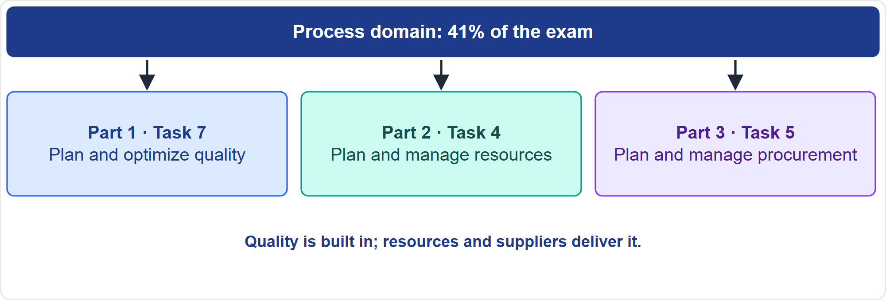
Where This Module Sits in the Exam
Part 1
Three Process-domain tasks
EXAM TIP Quality questions reward prevention and early, continuous checks; procurement questions reward fairness and the right contract for the risk.
PMP Exam Prep 2026 | PMBOK 8 and the New ECO
Module 8: Quality, Resources and Procurement
2 / 67
Notes:
Here is where this module sits. The Process domain has ten tasks, and this module covers three. Task seven: plan and optimize quality. Task four: plan and manage resources. Task five: plan and manage procurement. Quality questions reward prevention and early, continuous checks. Resource questions reward realistic capacity and following the right route. Procurement questions reward fairness and choosing the contract type that fits the risk.

Slide 3
What You Will Learn
Part 1
Plan quality requirements, metrics and tests, and build quality in
Tell assurance from control, read control charts, and use the basic tools
Plan and acquire resources, optimize them, and keep them well
Decide make or buy, select sources fairly and pick a contract type
Negotiate, manage suppliers and contracts, and handle claims
Manage cost of quality and drive continuous improvement
PMP Exam Prep 2026 | PMBOK 8 and the New ECO
Module 8: Quality, Resources and Procurement
3 / 67
Notes:
By the end of this module you will be able to do six things. Plan quality requirements, metrics and tests, and build quality in. Tell assurance from control, read control charts and use the basic tools. Plan and acquire resources, optimize them and keep people well. Decide make or buy, select sources fairly and pick a contract type. Negotiate, manage suppliers and contracts, and handle claims. And manage the cost of quality and drive continuous improvement.

Slide 4
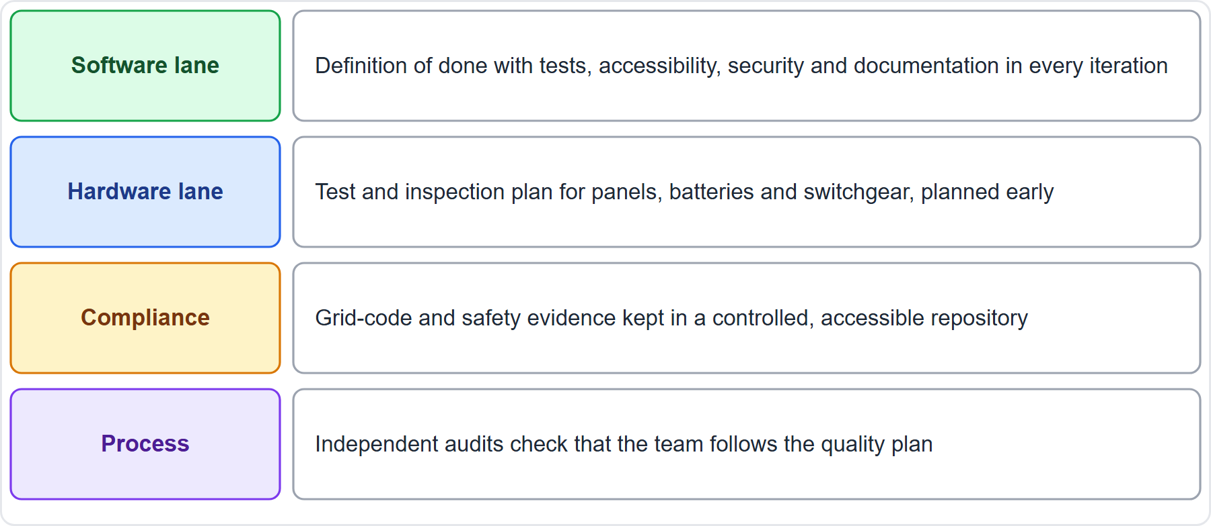
Case Check-In: Quality on the Microgrid
Part 1
CASE CHECK-IN · Sunrise Campus Microgrid
Software lane: definition of done in every iteration
Hardware lane: a test and inspection plan, with compliance evidence kept accessible
PMP Exam Prep 2026 | PMBOK 8 and the New ECO
Module 8: Quality, Resources and Procurement
4 / 67
Notes:
On the microgrid, quality is planned differently in each lane. The software lane uses a definition of done that includes tests, accessibility, security and documentation in every iteration. The hardware lane has a test and inspection plan for panels, batteries and switchgear, planned early. Grid-code and safety evidence is kept in a controlled, accessible repository, so auditors can find it. And independent audits check that the team follows the quality plan. Quality is built in, not inspected in at the end.

Slide 5
Quality: Key Terms
Part 1
Term | Meaning
Quality | The degree to which inherent characteristics meet or exceed target objectives
Quality assurance | Using processes effectively and following standards
Quality control | Creating deliverables that meet specifications and thresholds
Quality metric | An attribute and how assurance will verify compliance
Specification, tolerance | A required attribute; the acceptable variation
Definition of done | Criteria for work to count as complete
EXAM TIP Grade is not quality: a lower grade can be right; failing the requirements is not.
PMP Exam Prep 2026 | PMBOK 8 and the New ECO
Module 8: Quality, Resources and Procurement
5 / 67
Notes:
Key terms. Quality is the degree to which the inherent characteristics of a deliverable help meet or exceed the project's target objectives. Quality assurance uses project processes effectively and follows standards. Quality control creates deliverables that meet defined specifications and thresholds. A quality metric describes an attribute and how assurance will verify compliance. A specification is a required attribute, and tolerance is the acceptable variation. The definition of done lists the criteria for work to count as complete. And grade is not quality: low grade is not a problem, low quality is.

Slide 6
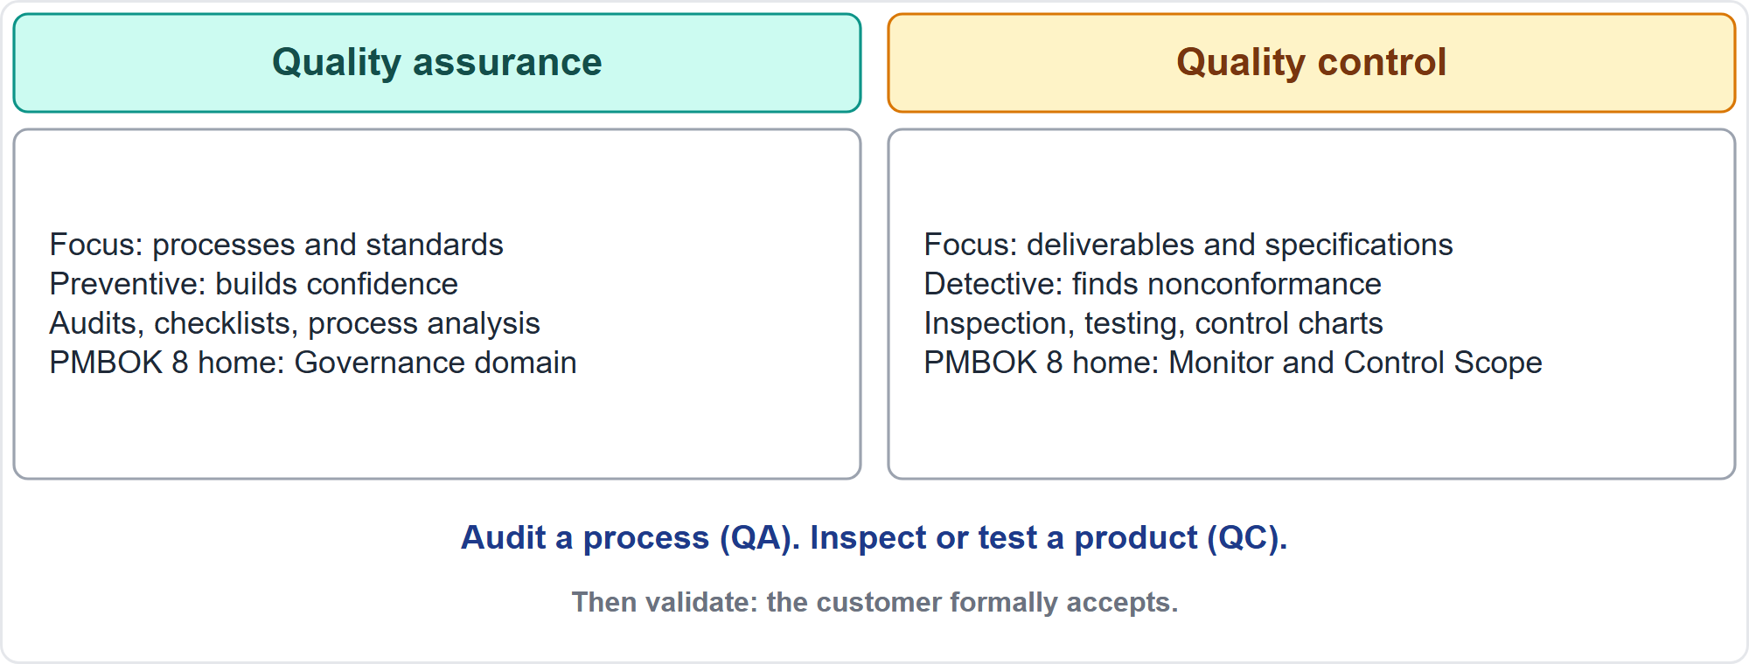
Quality Assurance Versus Quality Control
Part 1
Process versus product
EXAM TIP An audit of procedures is quality assurance; inspection and testing of deliverables is quality control.
PMP Exam Prep 2026 | PMBOK 8 and the New ECO
Module 8: Quality, Resources and Procurement
6 / 67
Notes:
Quality assurance and quality control differ. Assurance focuses on processes and standards. It is preventive and builds confidence that future output will conform. Its tools are audits, checklists and process analysis, and in PMBOK 8 it lives in the Governance domain. Control focuses on deliverables and their specifications. It is detective: it finds nonconformance so it can be repaired. Its tools are inspection, testing and control charts, and it lives in Monitor and Control Scope. A memory aid: audit a process, inspect or test a product.

Slide 7
Gather Quality Requirements
Part 1
Sources: stakeholder needs, the business case, contracts, regulations and standards, organizational policy, product attributes
Capture them as requirements in the documentation and the traceability matrix
Make them measurable and testable; a vague goal needs measurable outcomes
Identify them in Define Scope, with how compliance will be demonstrated
Compliance and customer sustainability criteria are quality requirements
Agile: acceptance criteria and a definition of done on each story
EXAM TIP A compliance or standards requirement is a quality requirement: plan how compliance is verified and evidenced.
PMP Exam Prep 2026 | PMBOK 8 and the New ECO
Module 8: Quality, Resources and Procurement
7 / 67
Notes:
Gather quality requirements from stakeholder expectations, the business case, contracts, regulations and standards, organizational policies and product attributes. Capture them as requirements, in the requirements documentation and the traceability matrix. Make them measurable and testable: if the goal is high quality, agree measurable outcomes first. Identify them in Define Scope, including how compliance will be demonstrated. Regulatory requirements and customer-required sustainability criteria are quality requirements. In agile work, use acceptance criteria and a definition of done.

Slide 8
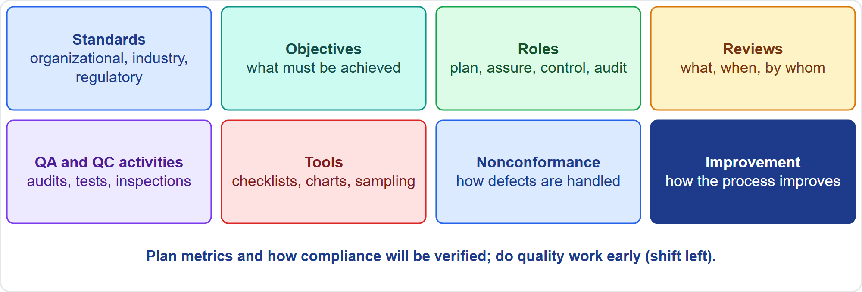
The Quality Management Plan
Part 1
Eight components
EXAM TIP Plan how compliance will be verified, not only which specifications apply.
PMP Exam Prep 2026 | PMBOK 8 and the New ECO
Module 8: Quality, Resources and Procurement
8 / 67
Notes:
The quality management plan describes how the organization's policies and procedures will be applied to reach quality objectives. It may include quality standards and quality objectives. It covers roles and responsibilities, and the deliverables and processes subject to review. It covers planned quality assurance and control activities, tools and methodologies, and procedures for nonconformance and continuous improvement. Plan quality metrics and the way assurance will verify them. Review the plan early, so decisions use accurate information, with a sharper focus on value and less rework.

Slide 9
Plan Tests and Inspections
Part 1
Plan how each deliverable will be tested or inspected to meet needs and reliability goals
Tests depend on the industry: software, construction, hardware
Specifications without verification methods leave a gap
Put quality activities in the schedule, budget and resources
Do quality work as early as possible: shift left
Prevention first: training, documented processes, checklists, definition of ready
EXAM TIP Quality is planned in, not inspected in: preventing a defect costs less than finding it, and finding it early costs less than finding it late.
PMP Exam Prep 2026 | PMBOK 8 and the New ECO
Module 8: Quality, Resources and Procurement
9 / 67
Notes:
Plan test and inspection activities: how each product or deliverable will be tested or inspected to meet stakeholder needs and performance and reliability goals. Tests depend on the industry, such as unit and regression tests in software, strength and soil tests in construction, and stress screening in hardware. Specifications without verification methods leave a gap. Put quality activities into the schedule, budget and resources, and do quality work as early as possible, which people call shifting left. Prevention comes first: training, documented processes, checklists and a definition of ready.

Slide 10
Manage Quality Assurance
Part 1
Tool | Use
Quality audit | A structured, independent check that activities follow policies and procedures
Checklists | Reminders from history; never exhaustive; also confirm readiness
Process analysis | Find non-value-added steps and constraints; value stream mapping
Problem solving | Define, find the root cause, solve, verify the fix
Outputs | Quality report, change requests, plan updates
EXAM TIP Audits are independent and constructive: cooperate, share good practices and act on findings through change control.
PMP Exam Prep 2026 | PMBOK 8 and the New ECO
Module 8: Quality, Resources and Procurement
10 / 67
Notes:
Manage Quality Assurance turns the plan into executable activities that follow standards and policies. A quality audit is a structured, independent process, usually by a team outside the project, scheduled or random. Its aim is to find good practices, nonconformities and gaps, share good practices and offer help positively. Checklists come from history and lessons learned, and are never exhaustive. Process analysis finds non-value-added steps. Outputs are a quality report and change requests. Audit findings that change an approved process go through change control.

Slide 11
Quality Control: Inspect, Test, Measure
Part 1
Inspection examines a work product against standards: reviews, peer reviews, walkthroughs; it also verifies defect repairs
Testing is an organized search for errors and nonconformance; early testing is cheaper
Variance, trend and root cause analysis; performance reviews
Statistical sampling when testing every unit is costly or destructive
Results: QC measurements, verified deliverables, quality reports, change requests
QC passed is not acceptance: the customer validates
EXAM TIP Verified is not accepted: quality control passes, then the customer validates.
PMP Exam Prep 2026 | PMBOK 8 and the New ECO
Module 8: Quality, Resources and Procurement
11 / 67
Notes:
Quality control happens inside Monitor and Control Scope, using data from the work. Inspection examines a work product to see whether it conforms to documented standards, and it also verifies defect repairs. Testing is an organized investigation to find errors, defects and nonconformance, and early testing finds problems sooner and cheaper. Use variance, trend and root cause analysis. Use statistical sampling when testing every unit is costly or destructive. Results are quality control measurements and verified deliverables. Then the customer validates.

Slide 12
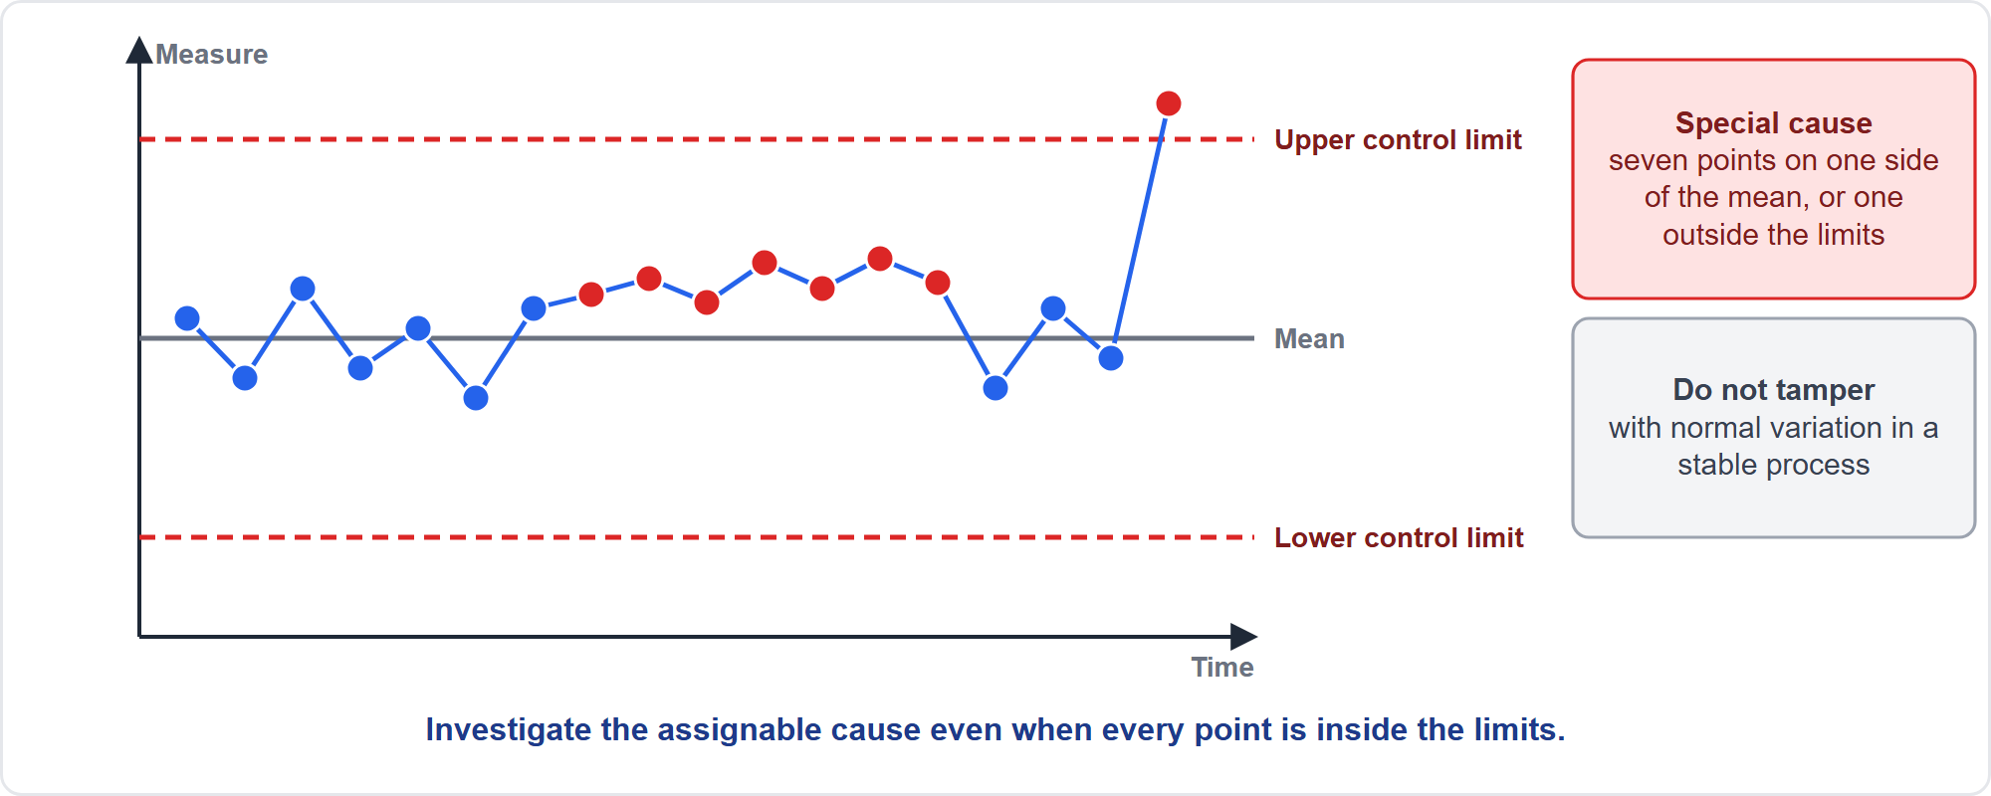
Control Charts
Part 1
Is the process stable?
EXAM TIP Seven consecutive points on one side of the mean (exam practice), or a clear trend, signals a special cause even inside the limits: investigate; do not adjust a stable process.
PMP Exam Prep 2026 | PMBOK 8 and the New ECO
Module 8: Quality, Resources and Procurement
12 / 67
Notes:
A control chart shows whether a process is stable and predictable. It has a mean and control limits, calculated from the process data, usually plus or minus three standard deviations. Special-cause signals include a point outside the control limits. They include about seven consecutive points on one side of the mean, the rule of seven. And they include a run of points trending in one direction. Investigate the assignable cause even if every point is inside the limits. And do not adjust a stable process because of normal variation. The rule of seven and the three-sigma limits are exam practice. PMBOK 8 describes control charts without numeric rules.

Slide 13
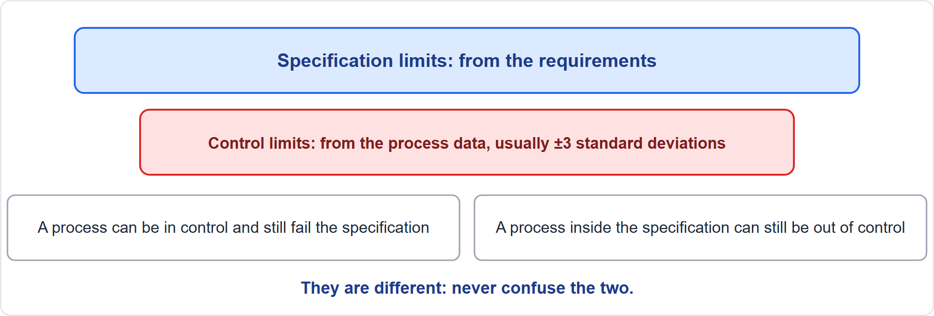
Control Limits Versus Specification Limits
Part 1
Two different sets of limits
EXAM TIP Control limits are not specification limits; a process can be in control and still fail the specification.
PMP Exam Prep 2026 | PMBOK 8 and the New ECO
Module 8: Quality, Resources and Procurement
13 / 67
Notes:
Control limits and specification limits are different. Specification limits come from the requirements. Control limits come from the process's own data, using standard statistical methods. A process can be in control and still fail the specification, because it is stable but centered in the wrong place. A process inside the specification can still be out of control, and so unpredictable. For normal data, plus or minus one standard deviation covers about sixty-eight percent, two about ninety-five, and three about ninety-nine point seven. Six Sigma is about three point four defects per million.

Slide 14
The Basic Quality Tools
Part 1
Tool | Use
Cause-and-effect (fishbone) | Trace an effect to root causes
Flowchart | Map steps, decisions and handoffs; find waste
Checklist, check sheet | Remind; tally defects by type
Histogram | Show the distribution of data
Pareto chart | Rank causes by frequency; fix the vital few first
Scatter diagram | Show correlation; correlation is not proof of cause
Affinity diagram | Group ideas or causes
Root cause analysis | Find the underlying reason; removing it stops recurrence
EXAM TIP Find the root cause before fixing, then verify the fix worked.
PMP Exam Prep 2026 | PMBOK 8 and the New ECO
Module 8: Quality, Resources and Procurement
14 / 67
Notes:
Know the basic quality tools. The cause-and-effect diagram, or fishbone, traces an effect to root causes. A flowchart maps steps, decisions and handoffs, and finds weak points and waste. A checklist or check sheet reminds and tallies defects by type. A histogram shows the distribution of data. A Pareto chart ranks causes by frequency so you fix the vital few first. A scatter diagram shows correlation, which is not proof of cause. An affinity diagram groups ideas. Root cause analysis finds the underlying reason, and removing it stops recurrence. Pareto analysis is exam practice.

Slide 15
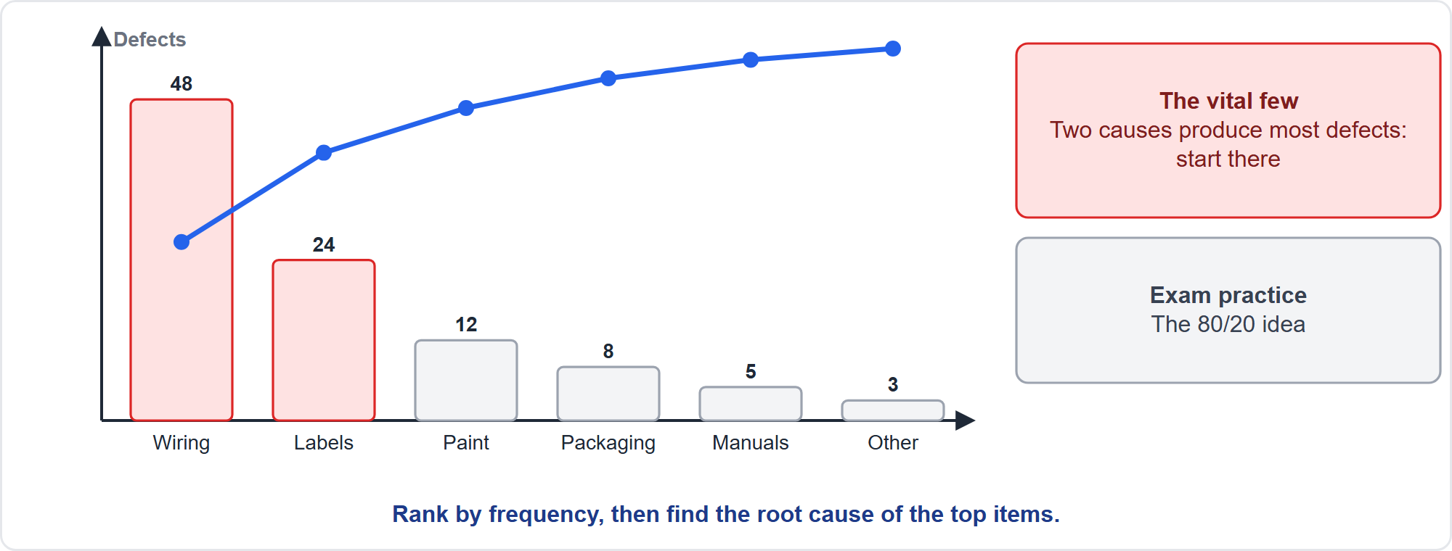
Pareto Analysis
Part 1
The vital few
EXAM TIP Start with the vital few causes; then find their root causes and verify the fix.
PMP Exam Prep 2026 | PMBOK 8 and the New ECO
Module 8: Quality, Resources and Procurement
15 / 67
Notes:
Here is a Pareto chart of defect causes on a hardware deliverable. Causes are ranked by frequency, with a cumulative line. Two causes, wiring and labels, produce most of the defects. That is the vital few: the eighty-twenty idea. So start there. Do not spread effort evenly across all causes. Then find the root cause of the top items, fix it, and verify that the fix worked. Pareto is exam practice. PMBOK 8 lists the other basic tools.

Slide 16
Ongoing Quality Reviews
Part 1
Reviews run throughout each phase, not only at gates
Types: peer reviews, design and code reviews, inspections, test results, gate reviews, audits, sprint reviews, retrospectives, and definition-of-done checks
Defects accumulate between infrequent reviews and are then found late
Make results visible in quality reports and dashboards
Agree actions and feed findings back into the plan and process
EXAM TIP Reviews are ongoing, not only at phase gates.
PMP Exam Prep 2026 | PMBOK 8 and the New ECO
Module 8: Quality, Resources and Procurement
16 / 67
Notes:
Reviews should run throughout each phase, not only at phase gates, because defects accumulate between infrequent reviews and deeper end-of-phase reviews still find them late. Review types include peer reviews, design and code reviews, and inspections. They include test results, gate reviews and quality audits. And they include sprint reviews, retrospectives, and definition-of-done checks in every iteration. Make results visible in quality reports and dashboards, agree actions, and feed findings back into the plan and the process.

Slide 17
Quality in Agile Work
Part 1
Quality is built in through the definition of done: automated tests, accessibility, security, documentation, compliance
Acceptance criteria on each story; update them as the product evolves
Test inside the iteration; a separate testing phase at the end finds defects late
Compliance checks belong in every iteration, not a final audit
Sprint reviews need real feedback time and real customers
EXAM TIP Definition of done includes tests, documentation and compliance; agree it with the team and product owner, not unilaterally.
PMP Exam Prep 2026 | PMBOK 8 and the New ECO
Module 8: Quality, Resources and Procurement
17 / 67
Notes:
In agile work, quality is built in through the definition of done: automated tests, accessibility, security, documentation and compliance. Acceptance criteria sit on each story, and are updated as the product evolves. Test inside the iteration. A separate testing phase at the end finds defects late and delays release. Compliance checks, such as accessibility, belong in every iteration's definition of done, not in a final audit. Agree the definition of done with the team and the product owner, not unilaterally.

Slide 18
Compliance, Cost of Quality and Sustainability
Part 1
Treat regulatory requirements as quality requirements: confirm, classify, put them in the plan and acceptance criteria
Keep evidence in a controlled, accessible repository
Build compliance checks into the definition of done or phase exit criteria
Poor quality wastes materials, energy and travel: prevention reduces environmental cost
Put sustainability criteria into quality requirements and the definition of done
Reassess when regulations change
EXAM TIP Customer-required sustainability criteria belong in the quality requirements and controls.
PMP Exam Prep 2026 | PMBOK 8 and the New ECO
Module 8: Quality, Resources and Procurement
18 / 67
Notes:
Regulatory and standards requirements are quality requirements: confirm which apply, classify them, and put them into the quality plan and acceptance criteria. Plan verification methods that demonstrate compliance, and keep evidence in a controlled, accessible repository so auditors can find it. Build compliance checks into the definition of done or phase exit criteria. Sustainability is a quality dimension: poor quality wastes materials, energy and travel, so prevention reduces environmental cost. Put sustainability criteria into quality requirements and the definition of done. Reassess when regulations change.

Slide 19
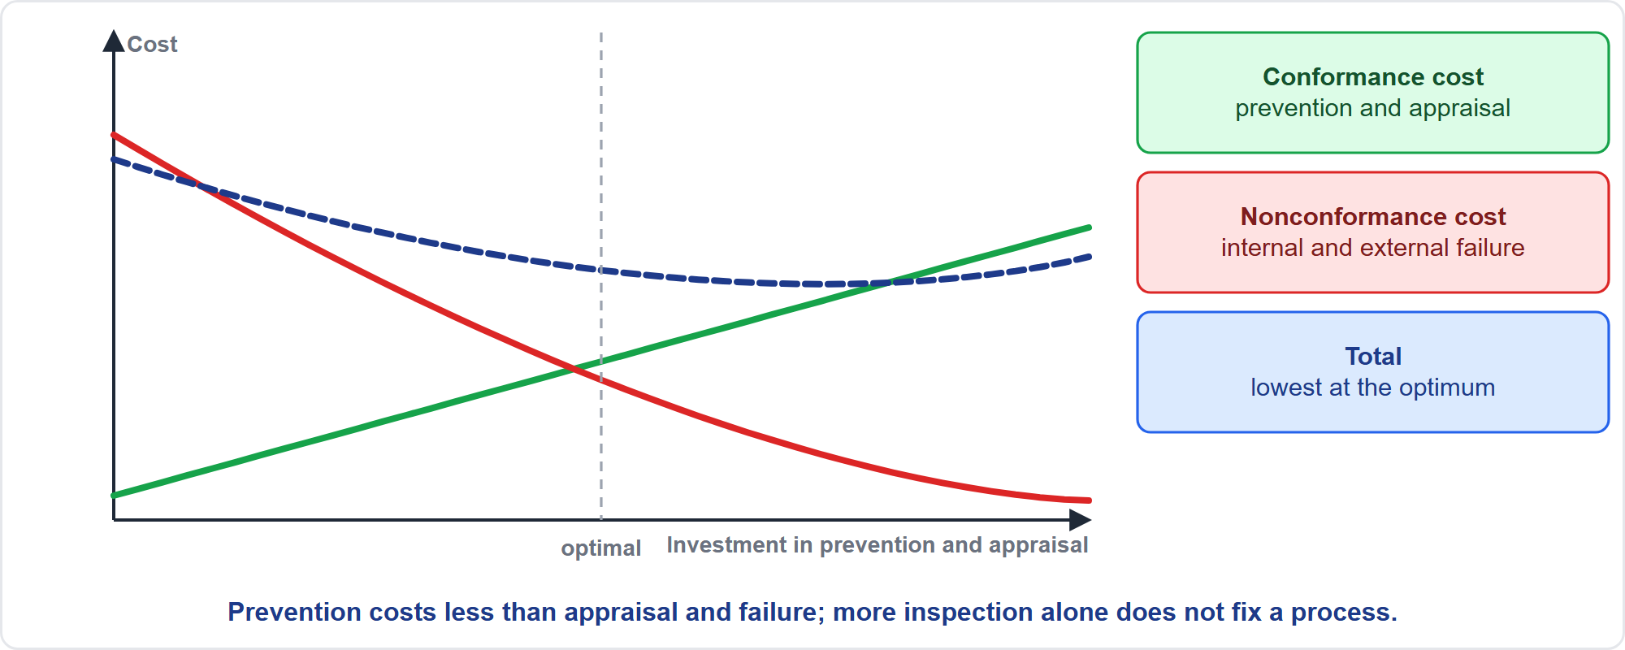
Cost of Quality
Part 1
Conformance against nonconformance
EXAM TIP More inspection alone does not fix a process that creates defects; prevention costs less than appraisal and failure.
PMP Exam Prep 2026 | PMBOK 8 and the New ECO
Module 8: Quality, Resources and Procurement
19 / 67
Notes:
Cost of quality has two sides. Conformance costs, prevention and appraisal, rise as you invest more. Nonconformance costs, internal failure such as rework and external failure such as warranty claims, fall as you invest more. The total has a minimum: the optimal cost of quality, where extra prevention and appraisal stop paying off. Prevention costs less than appraisal and failure. More inspection alone does not fix a process that creates defects. Include the cost of quality in estimates and the budget, and track failure costs as a sign that quality planning is weak.

Slide 20
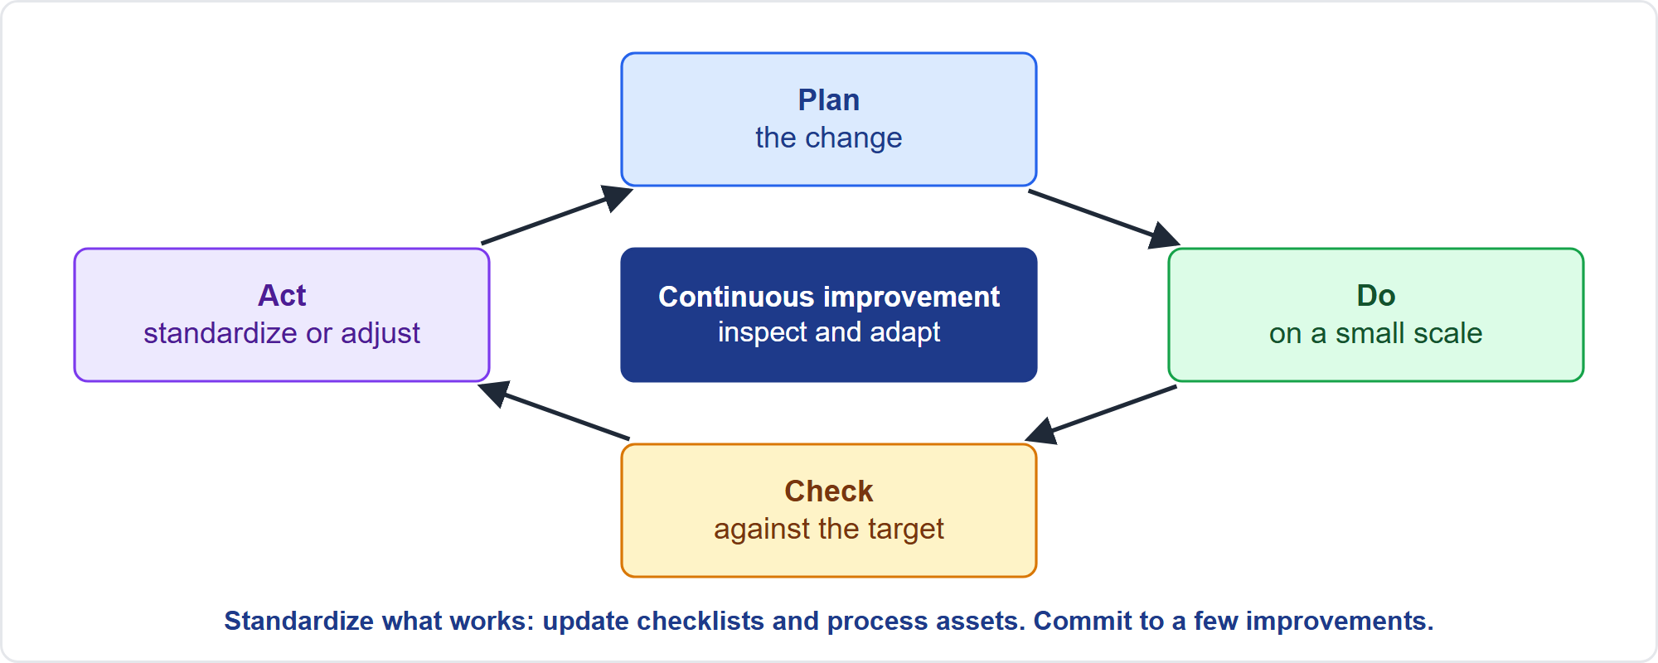
Continuous Improvement
Part 1
Plan, do, check, act
EXAM TIP Retrospectives that only list ideas do not improve anything: commit to a few actions, put them in the backlog and track them.
PMP Exam Prep 2026 | PMBOK 8 and the New ECO
Module 8: Quality, Resources and Procurement
20 / 67
Notes:
PMBOK 8 names several continuous improvement approaches: plan-do-check-act, Lean, Total Quality Management, Six Sigma and the five focusing steps from the theory of constraints. With plan-do-check-act, plan the change. Do it on a small scale. Check the results against the target. And act: standardize if it worked, otherwise adjust and repeat. Standardize what works by updating checklists and process assets. Retrospectives are the team-level engine: commit to a few improvements and track them. Inspect and adapt the improvement process itself.

Slide 21
Quality in Predictive, Agile and Hybrid Work
Part 1
 | Predictive | Agile | Hybrid
Planning | Quality plan, metrics, test plan | Acceptance criteria, definition of done | Plan for fixed parts; done criteria for iterations
Control | Inspections and tests at set points | Continuous testing each iteration | Both
Reviews | Peer reviews plus gates | Sprint reviews with feedback time | Gates outside, sprint reviews inside
Done | Criteria met and accepted | Definition of done per item | Both
Improvement | Lessons at gates and closure | Retrospective each iteration | Both
EXAM TIP Test-first and continuous integration are exam practice; PMBOK 8 stresses the definition of done.
PMP Exam Prep 2026 | PMBOK 8 and the New ECO
Module 8: Quality, Resources and Procurement
21 / 67
Notes:
Quality differs by approach. Predictive: a quality management plan up front, with metrics, audits and a test plan. Inspections and tests at defined points. Ongoing peer reviews plus gate reviews. And acceptance against criteria. Agile: acceptance criteria and a definition of done, continuous testing inside each iteration, sprint reviews with feedback time, and a retrospective every iteration. Hybrid: a plan for the fixed or regulated parts, a definition of done for the iterative parts, gates for the envelope and sprint reviews inside.

Slide 22
Quality Traps: What PMI Expects
Part 1
Assurance is process; control is product
Prevention beats inspection: fix the process; do not just add inspections
Build quality in: tests and compliance in the definition of done; test early
Reviews are ongoing, not only at gates
Rule of seven: investigate special causes; control limits are not specification limits
Audits are independent and constructive; quality problems create change requests
EXAM TIP Do not gold-plate: extra features are not quality.
PMP Exam Prep 2026 | PMBOK 8 and the New ECO
Module 8: Quality, Resources and Procurement
22 / 67
Notes:
The traps for quality. Assurance is about process and control is about product. Prevention beats inspection: when defects keep occurring, fix the process rather than adding inspections. Build quality in: put tests and compliance in the definition of done, and test early. Reviews are ongoing. Rule of seven: investigate a special cause, and remember that control limits are not specification limits. Audits are independent and constructive. Quality problems create change requests. And do not gold-plate: extra features are not quality.

Slide 23
Part 1 Recap
Part 1
1
Requirements and plan
2
Assurance and control
3
Charts and tools
measurable, with verification and metrics; quality work early
audit the process; inspect and test the product
rule of seven, limits, Pareto, root cause
4
Reviews
5
Cost of quality
6
Improvement
ongoing, with definition of done in every iteration
prevention is cheapest; find the optimum
plan-do-check-act; a few tracked actions
PMP Exam Prep 2026 | PMBOK 8 and the New ECO
Module 8: Quality, Resources and Procurement
23 / 67
Notes:
Let us recap Part 1. Quality requirements are measurable, with verification methods and metrics, and quality work starts early. Assurance audits the process, and control inspects and tests the product. Know the rule of seven, the difference between control and specification limits, Pareto analysis and root cause analysis. Reviews are ongoing, with a definition of done in every iteration. Prevention is the cheapest part of the cost of quality. And improvement uses plan-do-check-act, with a few tracked actions. In Part 2, we turn to resources.

Slide 24
Resources: Key Terms
Part 2
Term | Meaning
Resource manager | Someone with management authority over resources, such as a functional manager
Physical, material, virtual resources | Equipment, materials, facilities, software, licenses, test environments
Role, responsibility, authority, competence | Function; duty; right to decide; skill and capacity
Resource breakdown structure | Resources by category and type
Resource calendar | When each resource is available
Skill matrix | Required skills against available skills
Preassignment | Resources determined in advance
EXAM TIP Authority should match responsibility.
PMP Exam Prep 2026 | PMBOK 8 and the New ECO
Module 8: Quality, Resources and Procurement
24 / 67
Notes:
Part 2 covers resources. Key terms. A resource manager has management authority over resources, such as a functional manager. Resources include people and also physical, material or virtual resources: equipment, materials, facilities, software, licenses and test environments. A role is the function, a responsibility is the duty, authority is the right to decide and apply resources, and competence is skill and capacity. Authority should match responsibility. A resource breakdown structure lists resources by category and type, and a resource calendar shows when each is available.

Slide 25
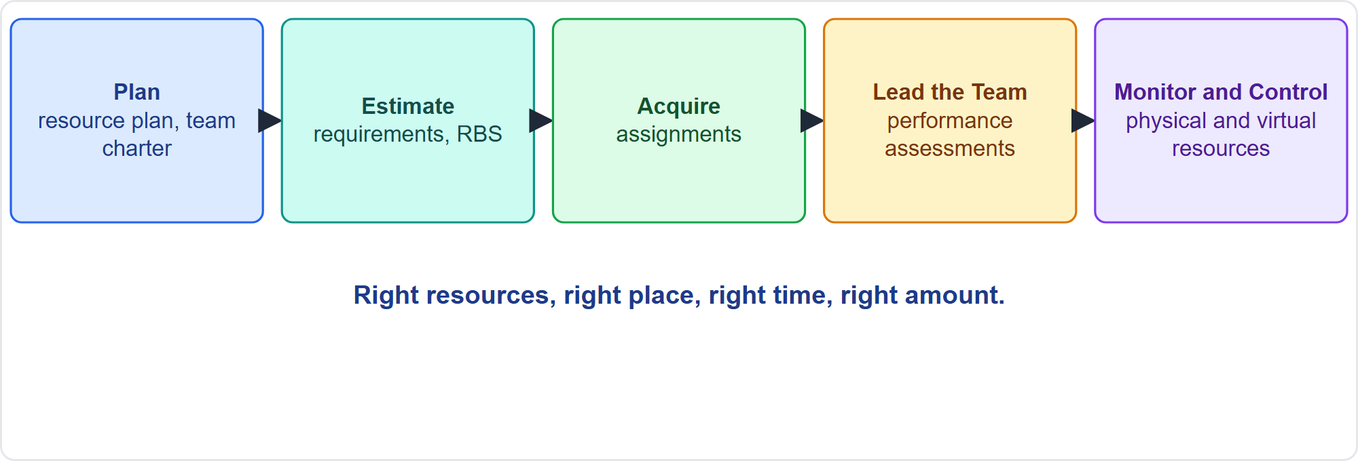
The Five Resource Processes
Part 2
Plan, estimate, acquire, lead, monitor
EXAM TIP Monitor and Control Resourcing covers physical and virtual resources; team members are handled in Lead the Team.
PMP Exam Prep 2026 | PMBOK 8 and the New ECO
Module 8: Quality, Resources and Procurement
25 / 67
Notes:
Five resource processes. Plan Resource Management produces the resource management plan and the team charter. Estimate Resources produces resource requirements and a resource breakdown structure. Acquire Resources produces resource and team assignments. Lead the Team guides, develops and manages the team, and produces team performance assessments. Monitor and Control Resourcing makes sure physical and virtual resources are available as planned, compares planned with actual use, and releases them when done. The aim: the right resources, in the right place, at the right time and amount.

Slide 26
Plan Resource Management
Part 2
Identify and quantify
Acquire
Roles, authority, responsibility, competence,
team and physical resources
the sourcing route, such as the PMO pool
and what to do about gaps
Organization charts,
Resource control
Recognition plan
release of team members, training and team development
inventory, equipment and supplies
which rewards, and when
EXAM TIP Follow the resource management plan's sourcing route; do not bypass it.
PMP Exam Prep 2026 | PMBOK 8 and the New ECO
Module 8: Quality, Resources and Procurement
26 / 67
Notes:
The resource management plan describes how resources are identified, acquired, allocated, monitored and controlled. It covers how to identify and quantify team and physical resources. It covers how to acquire them, including the sourcing route, such as the PMO pool. And it covers roles with their authority, responsibility and competence, and what to do about gaps. It includes organization charts, how team members are released, training and team development. It includes resource control for inventory, equipment and supplies, and a recognition plan.

Slide 27
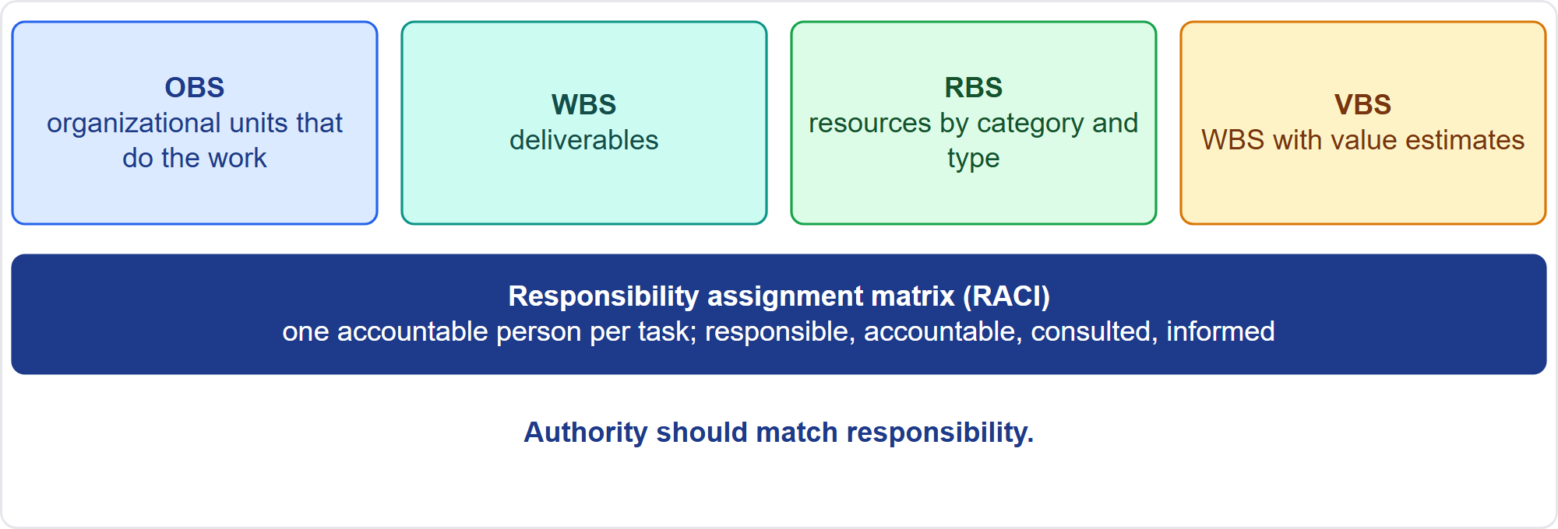
RACI and Hierarchical Charts
Part 2
Charts and the matrix
EXAM TIP In a responsibility assignment matrix, only one person is accountable per task.
PMP Exam Prep 2026 | PMBOK 8 and the New ECO
Module 8: Quality, Resources and Procurement
27 / 67
Notes:
The responsibility assignment matrix links work packages or activities to resources, showing all the work of one person and all the people on one activity. Only one person is accountable per task. RACI, responsible, accountable, consulted and informed, is a common form. Hierarchical charts include the organizational breakdown structure of units that do the work, the work breakdown structure of deliverables, the resource breakdown structure, and the value breakdown structure. Text-oriented formats, such as position descriptions, spell out responsibilities, authority and competencies.

Slide 28
Team Charter and Skill Matrix
Part 2
Team charter: values, communication, decisions, conflict resolution, meetings, agreements
Works best when the team creates it; revisit it when new members join
Skill matrix: required skills against available skills; keep it current
Green human resource management: people practices that favor sustainable resource use
Resource-based view: identify strategic resources; VRIO tests value, rarity, imitability, organization
EXAM TIP Do not hand a new member the rulebook privately; let them help shape the ground rules.
PMP Exam Prep 2026 | PMBOK 8 and the New ECO
Module 8: Quality, Resources and Procurement
28 / 67
Notes:
The team charter records the team's values, communication guidelines, decision-making, conflict resolution, meeting guidelines and agreements. It works best when the team creates it, and it should be revisited when new members join, so they help shape the ground rules. The skill matrix compares required and available skills and exposes gaps. Green human resource management uses people practices that favor sustainable use of resources. The resource-based view identifies strategic resources, tested with value, rarity, imitability and organization.

Slide 29
Estimate Resources
Part 2
For each work package, estimate type, quantity and characteristics of people and physical or virtual resources
Equipment, materials, test environments and licenses are estimated with the labor, with lead times
Align with cost estimates and the schedule
Techniques: expert judgment, bottom-up, analogous, parametric, alternative analysis
Outputs: resource requirements, basis of estimates, resource breakdown structure
Benefit: anticipate shortages and surpluses
EXAM TIP Resources are people and things: estimate equipment and materials with the labor.
PMP Exam Prep 2026 | PMBOK 8 and the New ECO
Module 8: Quality, Resources and Procurement
29 / 67
Notes:
Estimate resources for each work package or activity: the type, quantity and characteristics of people, and of physical or virtual resources. Equipment, materials, test environments and licenses must be estimated with the labor, including lead times, not as an afterthought. Align resource, cost and duration estimates. Techniques include expert judgment, bottom-up, analogous and parametric estimating, and alternative analysis. Outputs are resource requirements with assumptions about availability, a basis of estimates and a resource breakdown structure. The benefit is anticipating shortages and surpluses.

Slide 30
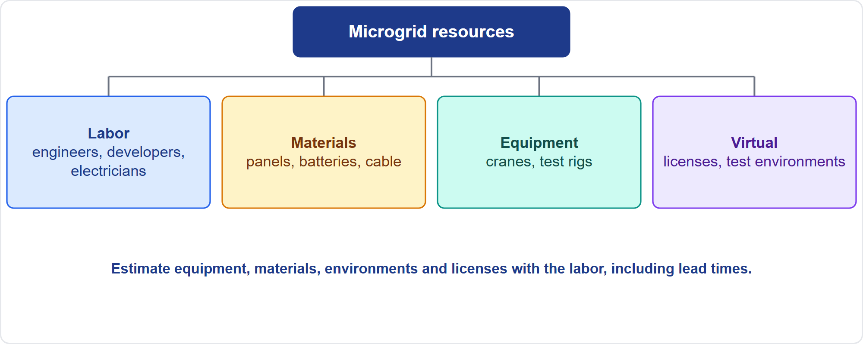
A Resource Breakdown Structure
Part 2
Categories and types
EXAM TIP A breakdown by category and type also shows skill level, grade or certification.
PMP Exam Prep 2026 | PMBOK 8 and the New ECO
Module 8: Quality, Resources and Procurement
30 / 67
Notes:
Here is a resource breakdown structure for the microgrid. Labor covers engineers, developers and electricians. Materials cover panels, batteries and cable. Equipment covers cranes and test rigs. Virtual resources cover licenses and test environments. The structure groups resources by category, and by type, such as skill level, grade or certification. It helps you estimate each category, spot shortages, and plan lead times. Remember that equipment, materials and environments are estimated together with the labor.

Slide 31
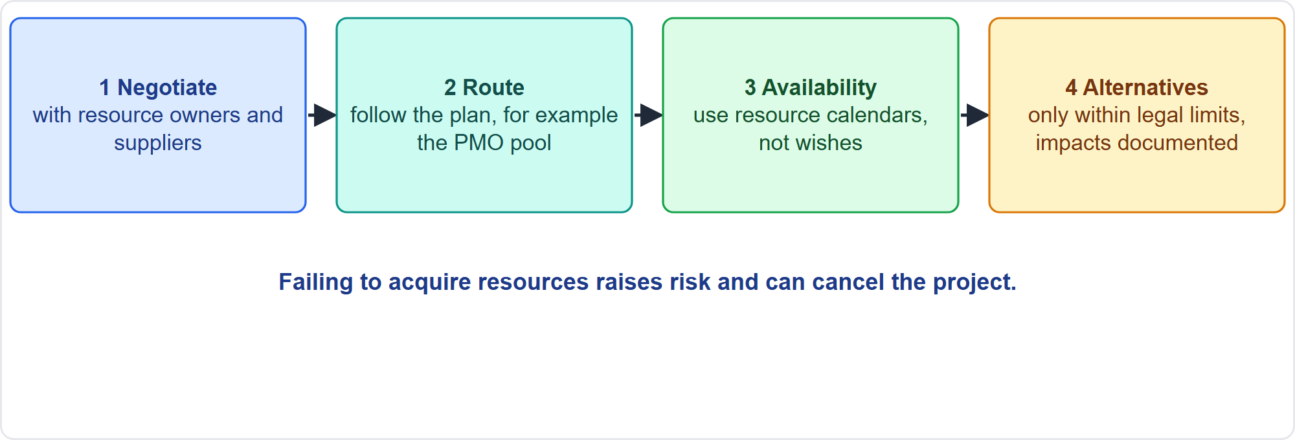
Acquire Resources
Part 2
Negotiate, route, availability, alternatives
EXAM TIP Preassigned resources come with their own availability: use the real calendars in estimates and schedule.
PMP Exam Prep 2026 | PMBOK 8 and the New ECO
Module 8: Quality, Resources and Procurement
31 / 67
Notes:
Acquire Resources obtains and assigns the team and physical or virtual resources. Collaborate, negotiate and influence the people who can provide them, such as functional managers, suppliers and partners. Follow the sourcing route in the resource management plan, rather than bypassing it. Use actual availability from resource calendars, especially for preassigned resources. If a resource is not available, an alternative is possible, within limits. Failing to acquire resources raises risk, and in the worst case can cancel the project.

Slide 32
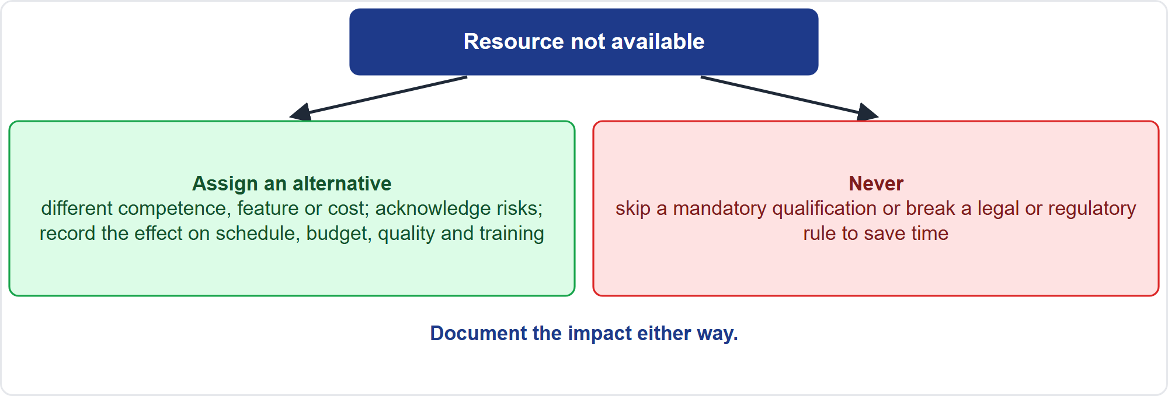
When a Resource Is Not Available
Part 2
Alternatives within limits
EXAM TIP Never skip a mandatory qualification to save time; document the effect on schedule, budget, risk, quality and training.
PMP Exam Prep 2026 | PMBOK 8 and the New ECO
Module 8: Quality, Resources and Procurement
32 / 67
Notes:
Suppose a needed resource is not available because of economic factors or assignment to other projects. You may assign an alternative with different competencies, features or cost, but only if the risks are acknowledged and legal, regulatory or mandatory criteria are not violated. Document the effect on schedule, budget, risks, quality and training plans. Never skip a mandatory qualification to save time. If a resource is available only part-time, remember that agile teams work best with dedicated, cross-functional members.

Slide 33
Virtual Teams and Colocation
Part 2
Virtual teams widen the pool: distributed locations, shifts, home offices, avoiding travel
They need more planning of communication, clear expectations, conflict protocols and cultural understanding
Collaboration sites, audio and video, messaging, time to get to know remote members
Hold at least one face-to-face meeting where possible
Colocation, temporary or full, improves communication and productivity
Use a team room and visible schedules
EXAM TIP A new virtual team needs deliberate setup: charter, tools and relationship-building time.
PMP Exam Prep 2026 | PMBOK 8 and the New ECO
Module 8: Quality, Resources and Procurement
33 / 67
Notes:
Virtual teams widen the talent pool: distributed locations, shifts, home offices, and no travel cost. But they need more planning of communication, clear expectations, conflict protocols and cultural understanding. Provide collaboration sites, audio and video, ongoing messaging, and time to get to know remote members. Hold at least one face-to-face meeting where possible. Colocation, temporary or full, improves communication and productivity, with a team room and visible schedules. A new virtual team needs deliberate setup, starting with a team charter.

Slide 34
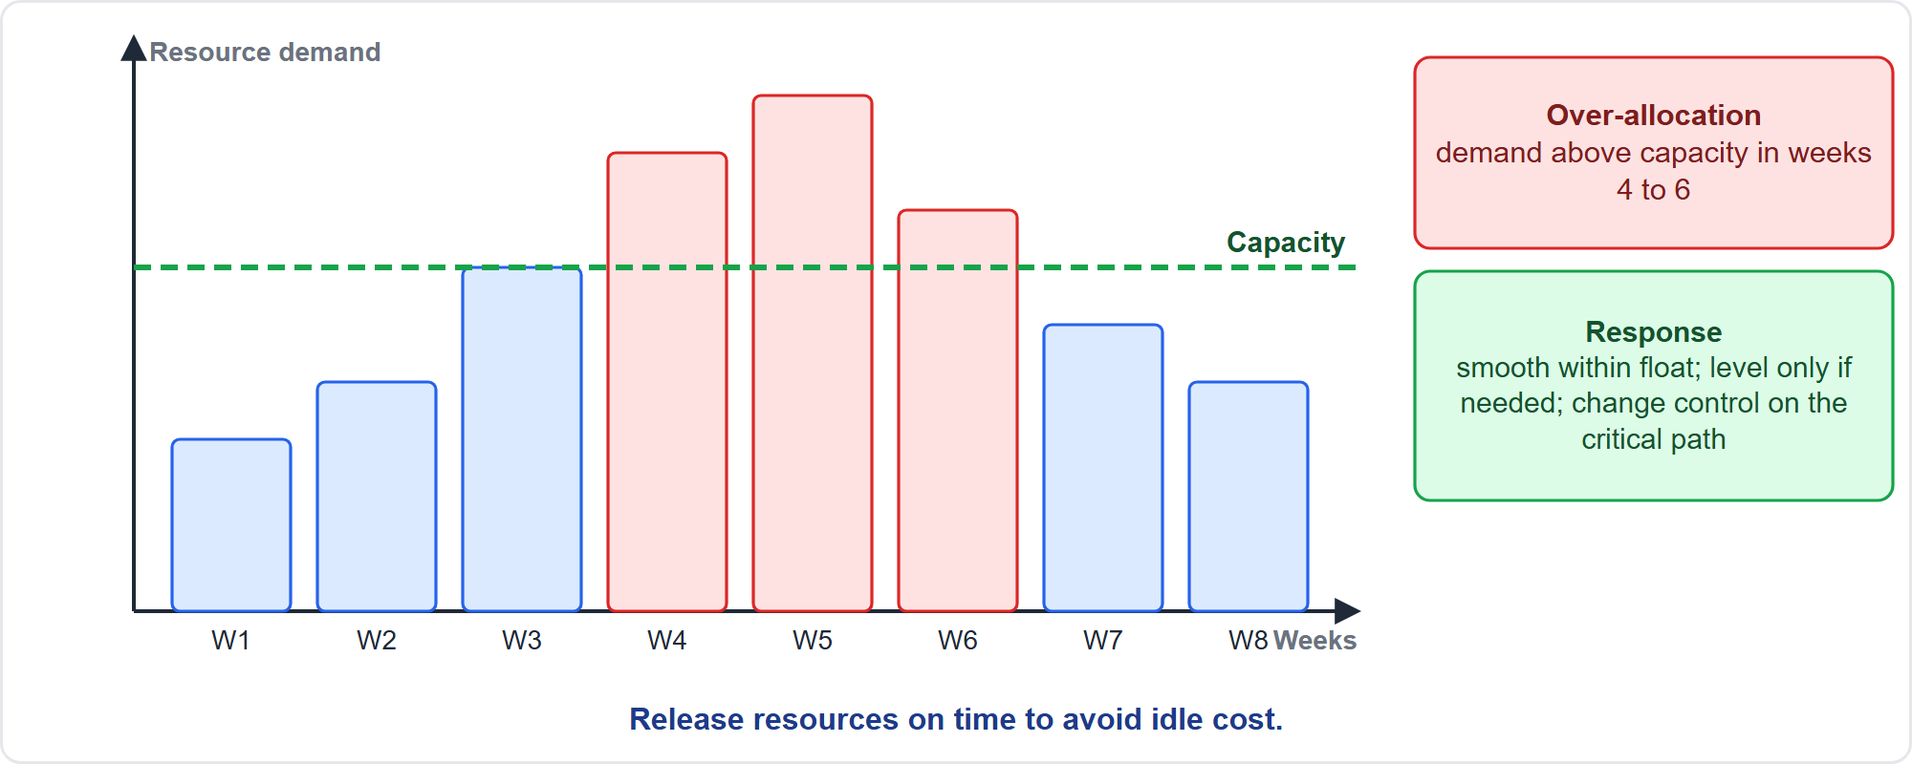
Optimizing Resource Needs
Part 2
Demand against capacity
EXAM TIP Over-allocation on non-critical work: smooth within float; on the critical path, analyze and use change control.
PMP Exam Prep 2026 | PMBOK 8 and the New ECO
Module 8: Quality, Resources and Procurement
34 / 67
Notes:
A resource histogram shows demand against capacity week by week. In weeks four to six, demand exceeds capacity: over-allocation. If the activities are not critical, use resource smoothing within float, so the end date is unchanged. Leveling may move the end date. If the over-allocation is on the critical path, leveling may delay the finish. So evaluate adding capacity, reassigning, resequencing or reducing scope. Use cost and risk analysis, and change control. Release resources on time when they are no longer needed.

Slide 35
Resource Situations and Responses
Part 2
Situation | Response
Skill gap | Skill matrix; training, coaching, mentoring, hiring or contracting, by time, cost and risk
Competing demand from other projects | Negotiate with owners; escalate through governance
Resource idle or not needed | Release it on time
Agile capacity changes | Plan iterations on actual capacity; do not squeeze the team
Burnout signs | Adjust the plan, support well-being; do not just add overtime incentives
Sustainability | Consider value chain impact: hiring, sourcing, transport, disposal
EXAM TIP Plan agile iterations on actual capacity; do not hold the scope and ask the team to work harder.
PMP Exam Prep 2026 | PMBOK 8 and the New ECO
Module 8: Quality, Resources and Procurement
35 / 67
Notes:
Common resource situations. A skill gap: use the skill matrix and choose training, coaching, mentoring, hiring or contracting by time, cost and risk. Competing demand from other projects: negotiate with the resource owners, and escalate through governance. A resource idle or no longer needed: release it on time. Agile capacity changes: plan iterations on actual capacity, and do not squeeze the team. Signs of burnout, such as minimum effort or silence in meetings: adjust the plan and support well-being. And consider sustainability across the value chain.

Slide 36
Monitor and Control Resourcing
Part 2
Concerned with physical and virtual resources
Monitor expenditures and planned versus actual use
Identify shortages and surpluses in good time
Ensure resources are used and released per plan
Inform stakeholders of resource issues; manage changes
Utilization indicators: actual versus planned use, downtime, units produced per hour, scrap and rework
EXAM TIP Too much inventory raises cost; too little blocks delivery.
PMP Exam Prep 2026 | PMBOK 8 and the New ECO
Module 8: Quality, Resources and Procurement
36 / 67
Notes:
Monitor and Control Resourcing is concerned with physical and virtual resources, and runs continuously. Monitor expenditures and planned versus actual use. Identify and deal with shortages and surpluses in good time. Make sure resources are used and released per plan. Inform stakeholders of resource issues and manage changes as they occur. Utilization indicators include actual against planned use, downtime against planned time, units produced against hours worked, and materials used, scrap and rework. Too much inventory raises cost, and too little blocks delivery.

Slide 37
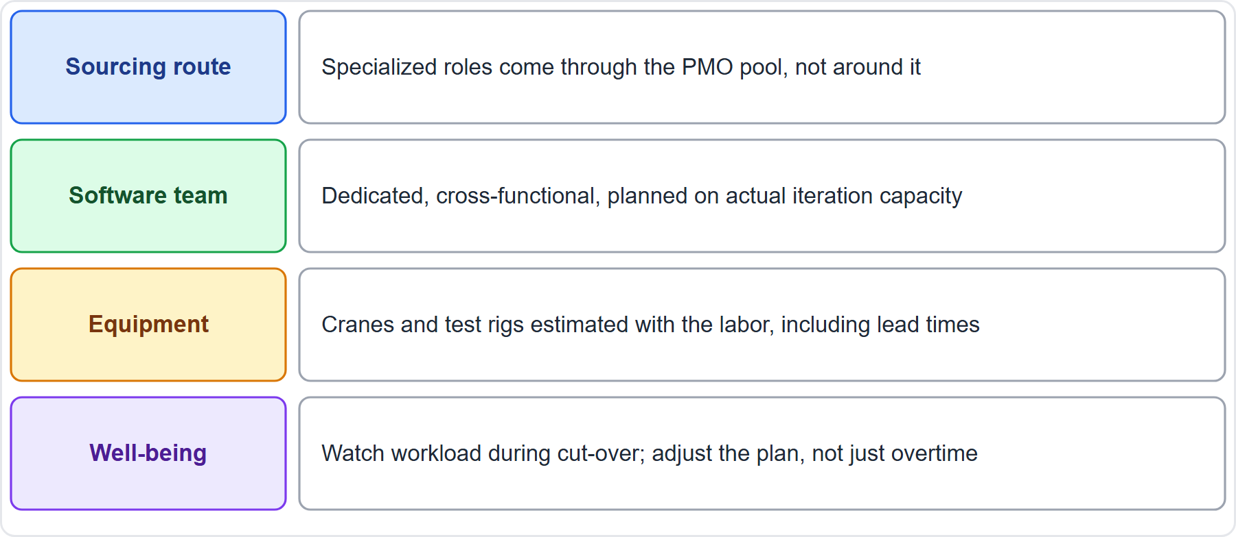
Case Check-In: Resources for the Microgrid
Part 2
CASE CHECK-IN · Sunrise Campus Microgrid
Sourcing route: specialized roles through the PMO pool
Capacity: dedicated software team; plan iterations on actual capacity
PMP Exam Prep 2026 | PMBOK 8 and the New ECO
Module 8: Quality, Resources and Procurement
37 / 67
Notes:
Back to our microgrid. Specialized roles come through the PMO pool, not around it. The software team is dedicated and cross-functional, and iterations are planned on actual capacity. Cranes and test rigs are estimated with the labor, including lead times. During the cut-over, watch workload and well-being: if the team shows burnout signs, adjust the plan and capacity, not just overtime. And release equipment and people on time when their work ends, so idle resources do not cost money.

Slide 38
Resources in Predictive, Agile and Hybrid Work
Part 2
 | Predictive | Agile | Hybrid
Planning | Defined early from the schedule; availability secured | Self-organizing teams; flexible agreements | Predictive for specialists; adaptive for variable work
Structure | Functional or matrix; formal roles; RAM | Dedicated, cross-functional, often 3 to 9 | Mix
Leadership | Centralized | Distributed or servant | Mix
Capacity | Leveling and smoothing | Capacity-based iteration planning | Both
Control | Planned versus actual use | Velocity, capacity, impediments | Both
EXAM TIP Dedicated, cross-functional agile team members beat part-time shared ones.
PMP Exam Prep 2026 | PMBOK 8 and the New ECO
Module 8: Quality, Resources and Procurement
38 / 67
Notes:
Resources differ by approach. Predictive: allocation defined early from the schedule, and a detailed resource management plan. Functional or matrix structures with formal roles. Centralized leadership. And leveling and smoothing. Agile: self-organizing, collaborative teams, dedicated and cross-functional, often three to nine members. Distributed or servant leadership. Capacity-based iteration planning. And control through velocity and impediment removal. Hybrid: predictive for fixed or specialist resources, adaptive teams for variable work.

Slide 39
Resource Traps: What PMI Expects
Part 2
Resources are people and things: estimate equipment, materials, environments with the labor
One accountable person per activity
Follow the sourcing route; alternatives only within legal limits, with documented impact
Authority must match responsibility: negotiate with managers; escalate if needed
Smooth within float first; plan agile iterations on actual capacity
Release idle resources; watch well-being; co-create the team charter
EXAM TIP Skill gaps: choose training, coaching, hiring or contracting by time, cost and risk.
PMP Exam Prep 2026 | PMBOK 8 and the New ECO
Module 8: Quality, Resources and Procurement
39 / 67
Notes:
The traps for resources. Resources are people and things, so estimate equipment, materials and environments with the labor. One accountable person per activity. Follow the sourcing route, and use alternatives only within legal limits, with documented impact. Authority must match responsibility: negotiate with managers, and escalate if they cannot agree. Smooth within float first, and plan agile iterations on actual capacity. Release idle resources, watch well-being, and co-create the team charter, revisiting it when members join.

Slide 40
Procurement: Key Terms
Part 2
Term | Meaning
Procurement | Acquiring goods, services or results from external sources
Buyer, seller | Purchaser; vendor, contractor or supplier
Agreement | Contract, purchase order, SLA, MOU, letter of agreement
Statement of work | The work or deliverables to be purchased
Sourcing strategy plan | What is insourced or outsourced, and the selection criteria
Source selection | Choosing the seller on predefined, weighted criteria
Claim, ADR | A request for relief under the agreement; alternative dispute resolution
EXAM TIP A letter of intent is non-binding; it is not a contract.
PMP Exam Prep 2026 | PMBOK 8 and the New ECO
Module 8: Quality, Resources and Procurement
40 / 67
Notes:
Now procurement. Key terms. Procurement is acquiring goods, services or results from external sources. The buyer purchases, and the seller, vendor, contractor or supplier, provides. An agreement is any document that defines initial intentions: a contract, purchase order, service-level agreement, memorandum of understanding or letter of agreement. The statement of work describes what is purchased. The sourcing strategy plan records what is insourced or outsourced. Source selection uses predefined weighted criteria. A claim is a request for relief under the agreement, and alternative dispute resolution settles disputes.

Slide 41
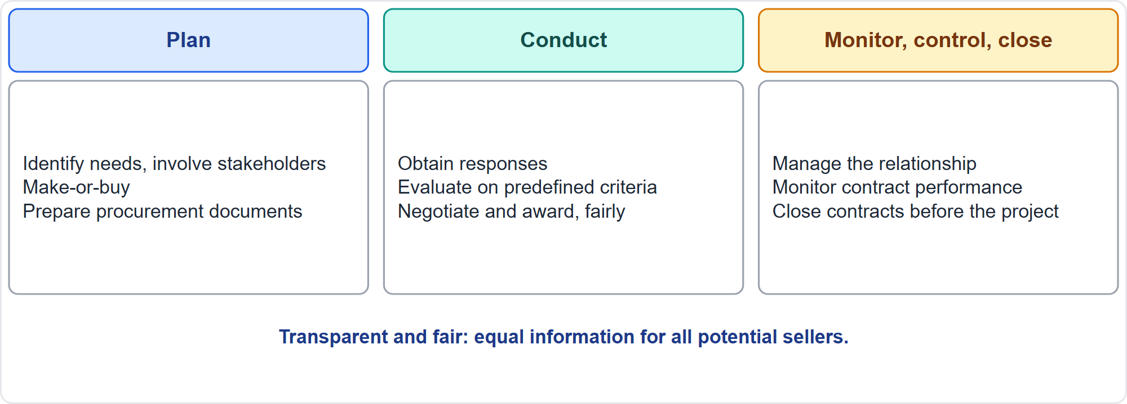
The Procurement Flow
Part 2
Plan, conduct, monitor and close
EXAM TIP Negotiation is led by a procurement team member with authority to sign contracts; the project manager assists.
PMP Exam Prep 2026 | PMBOK 8 and the New ECO
Module 8: Quality, Resources and Procurement
41 / 67
Notes:
Procurement has three stages. Plan: identify needs, involve key stakeholders early, analyze whether to buy, set procurement rules, identify potential sellers and prepare procurement documents. Conduct: obtain responses, evaluate, select, negotiate and award. The process must be transparent and fair, with equal opportunity for all potential sellers and bidder questions answered adequately and to everyone. Monitor, control and close: manage relationships, monitor contract performance, make changes, and close the contracts, confirming all obligations were met. The people authorized to procure may be team members, management or the purchasing department.

Slide 42
Plan Sourcing Strategy
Part 2
Purpose: document sourcing decisions, the source selection approach, the scope of work for external sourcing, and the contracts
Include procurement and legal in planning
Different from resource planning: sourcing is about outsourcing work and deliverables
Tools: market research, make-or-buy analysis, source selection analysis
Output: the sourcing strategy plan
EXAM TIP Make-or-buy comes first: outsource for missing expertise, a temporary need or to avoid permanent headcount.
PMP Exam Prep 2026 | PMBOK 8 and the New ECO
Module 8: Quality, Resources and Procurement
42 / 67
Notes:
Plan Sourcing Strategy documents sourcing decisions, specifies the source selection approach, defines the scope of work for external sourcing, and chooses appropriate contracts and sources. Include procurement and legal in the planning. It is different from resource planning: sourcing is about outsourcing work and deliverables. Tools include market research, make-or-buy analysis and source selection analysis. The output is the sourcing strategy plan, with insourcing and outsourcing decisions and the selection criteria.

Slide 43
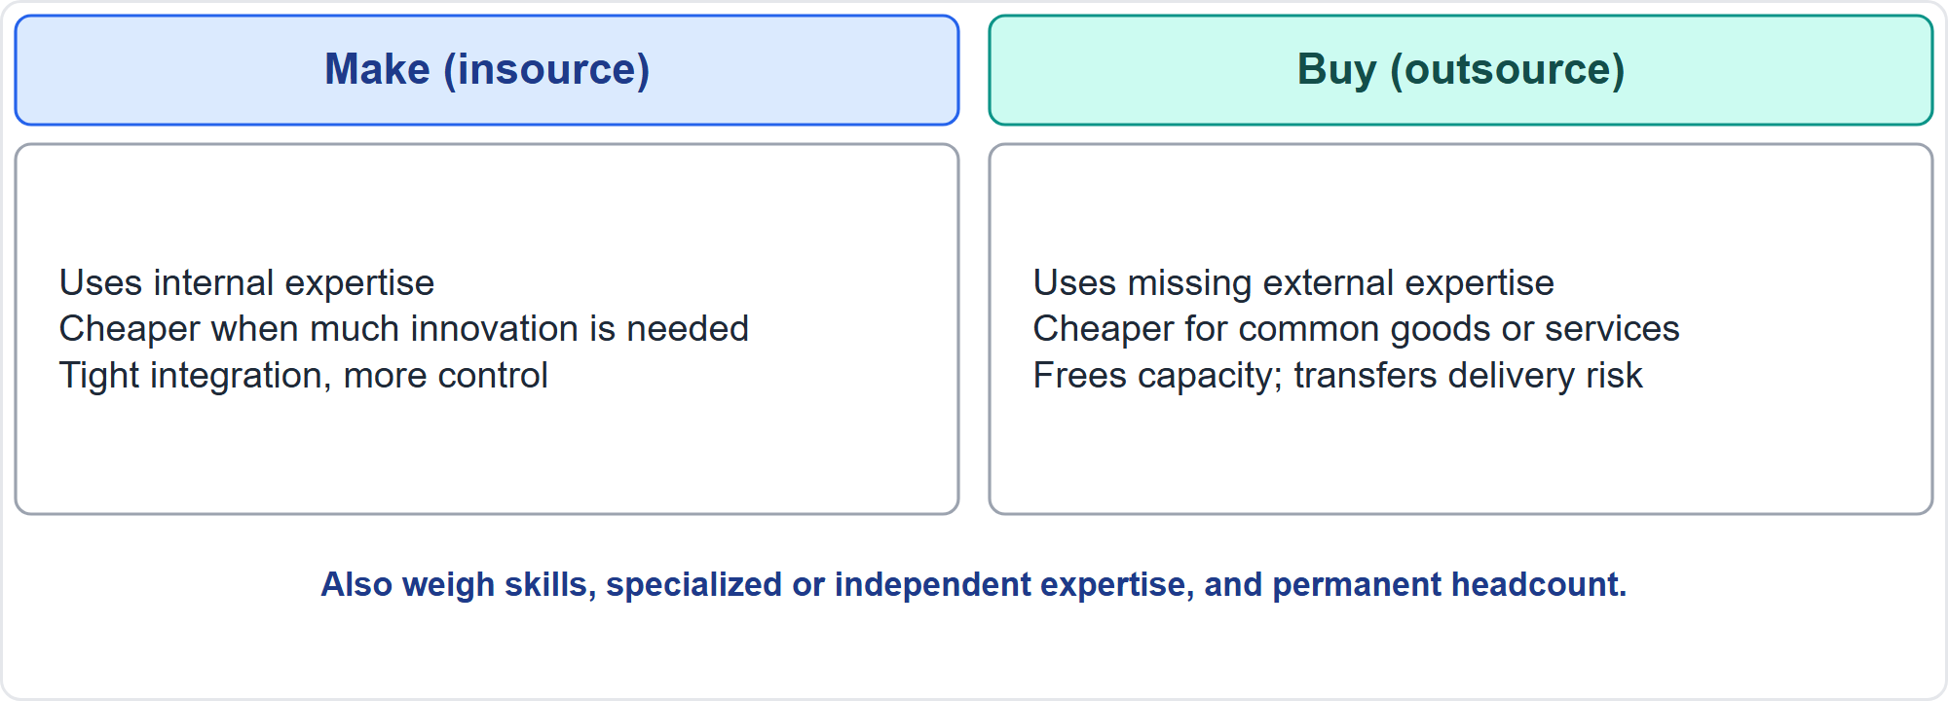
Make or Buy
Part 2
Insource or outsource
EXAM TIP Outsourcing transfers delivery risk to the supplier but not accountability for the outcome.
PMP Exam Prep 2026 | PMBOK 8 and the New ECO
Module 8: Quality, Resources and Procurement
43 / 67
Notes:
Make-or-buy compares insourcing with outsourcing. Insourcing uses internal expertise, is often cheaper when much innovation is needed, integrates tightly with strategic advantage, and gives more control. Outsourcing uses external expertise when missing internally, is often cheaper when the goods or services are common, frees capacity and capital, and transfers delivery risk to the supplier. Weigh current allocation, skills, the need for specialized or independent expertise, and the wish to avoid permanent employment obligations. The analysis may use payback, return on investment or net present value.

Slide 44
The Procurement Management Plan
Part 2
Element | Content
Coordination | How procurement links to the schedule and other aspects
Timetable and metrics | Key dates; metrics to manage contracts
Roles and authority | Team authority when a procurement department exists
Constraints and assumptions | Anything that could affect purchases
Legal and money | Jurisdiction and payment currency
Bidding approach | International, national or local competitive bidding
Risk and sellers | Bonds or insurance; prequalified sellers
EXAM TIP Independent estimates may be used as evaluation criteria.
PMP Exam Prep 2026 | PMBOK 8 and the New ECO
Module 8: Quality, Resources and Procurement
44 / 67
Notes:
The procurement management plan describes how the team acquires goods and services from outside. It covers coordination with the schedule, a timetable and metrics, roles and the team's authority when a procurement department exists, and constraints and assumptions. It covers the legal jurisdiction and payment currency, and the bidding approach. It covers whether independent estimates are used. It covers risk measures, such as performance bonds or insurance, and any prequalified sellers. The procurement strategy then decides the delivery method, the type of binding agreement and the phases.

Slide 45
Part 2 Recap
Part 2
1
Plan and estimate
2
Acquire
3
Teams
sourcing route, RBS, equipment and materials with the labor
negotiate; real availability; alternatives within legal limits
charter, virtual setup, capacity-based planning
4
Optimize
5
Control
6
Procurement basics
smooth within float; release idle resources; well-being
planned versus actual use; shortages and surpluses
terms, three stages, fair process, sourcing, make-or-buy, plan
PMP Exam Prep 2026 | PMBOK 8 and the New ECO
Module 8: Quality, Resources and Procurement
45 / 67
Notes:
Let us recap Part 2. Plan and estimate resources using the sourcing route and a resource breakdown structure, with equipment and materials estimated with the labor. Acquire by negotiating, using real availability, and using alternatives only within legal limits. Set up teams with a charter, deliberate virtual arrangements and capacity-based planning. Optimize by smoothing within float, releasing idle resources and watching well-being. Control by comparing planned with actual use. And procurement starts with its terms, three stages and a fair process, then sourcing strategy, make or buy, and the procurement plan. In Part 3, we complete procurement: strategy, selection, contracts and disputes.

Slide 46
Procurement Strategy and Delivery Methods
Part 3
Professional services
Build-out supply
Integrated project delivery
with or without subcontracting, joint venture, provider as the buyer's representative
turnkey, design-build, design-bid-build, build-own-operate-transfer
one multiparty agreement, shared risk and reward, open-book accounting
Phases
Delivery solution
objectives, indicators, criteria for moving on, and knowledge transfer
build, buy, lease, adapt or partner
EXAM TIP Integrated project delivery shares risks and rewards among owner, designer and contractor.
PMP Exam Prep 2026 | PMBOK 8 and the New ECO
Module 8: Quality, Resources and Procurement
46 / 67
Notes:
The procurement strategy decides the delivery method, the type of legally binding agreement, and how procurement advances through phases. For professional services: buyer and provider with or without subcontracting, a joint venture, or a provider acting as the buyer's representative. For build-out supply: turnkey, design-build, design-bid-build and build-own-operate-transfer. Integrated project delivery uses one multiparty agreement with shared risk and reward and open-book accounting. Define procurement phases with objectives, indicators, criteria for moving on, and knowledge transfer.

Slide 47
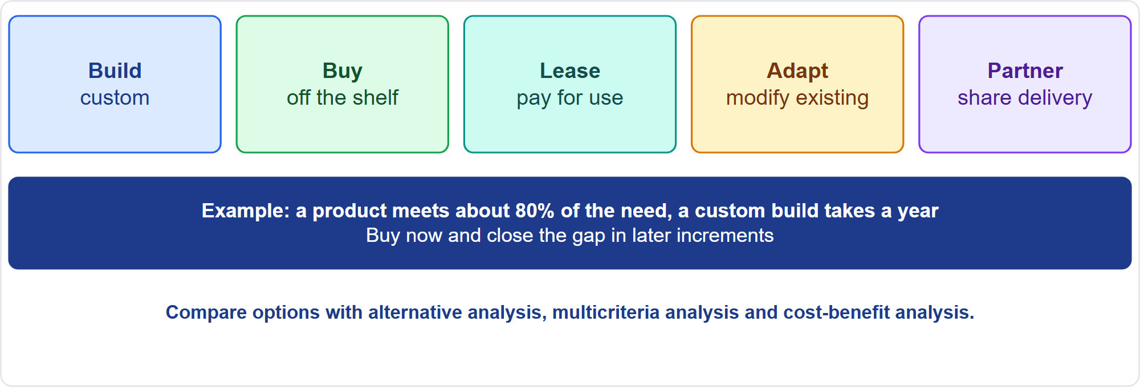
Develop a Delivery Solution
Part 3
Build, buy, lease, adapt, partner
EXAM TIP Buy now and fill the remaining gap in later increments when a product meets most needs and a custom build would delay all value.
PMP Exam Prep 2026 | PMBOK 8 and the New ECO
Module 8: Quality, Resources and Procurement
47 / 67
Notes:
Choose how the need will actually be met: build, buy, lease, adapt or partner. Compare options with alternative analysis, multicriteria decision analysis and cost-benefit analysis, and favor options that deliver value early and reduce risk. For example, an off-the-shelf product meets about eighty percent of the need, and a custom build would take a year. Then buy now, and close the gap in later increments. This is exam practice. The point is to avoid one big, irreversible bet.

Slide 48
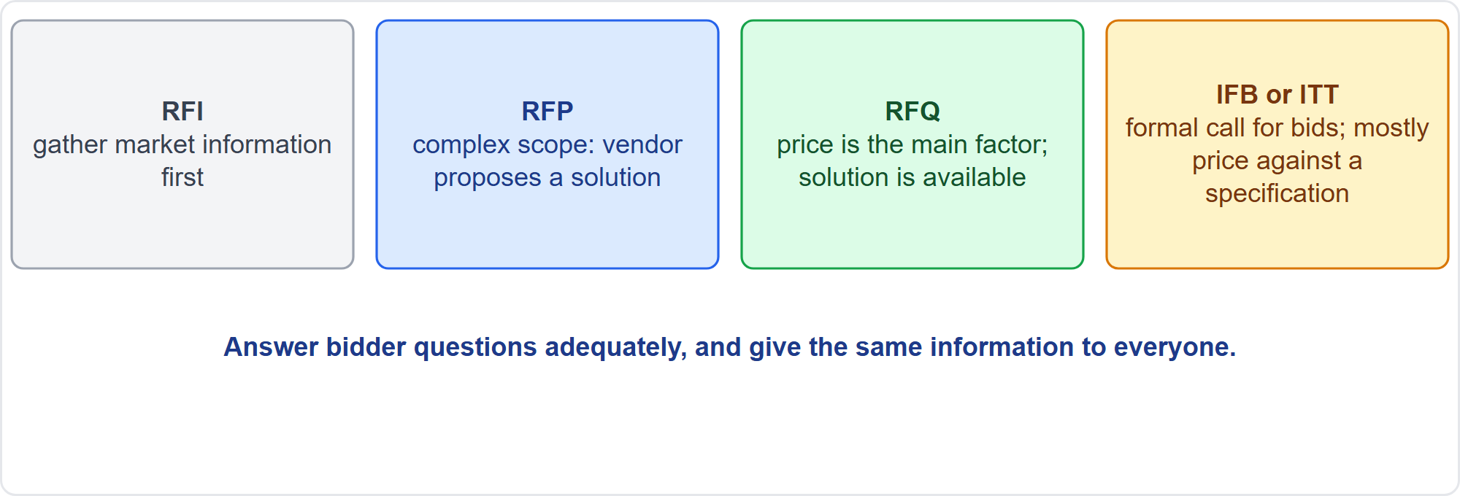
Bid Documents
Part 3
RFI, RFP, RFQ, IFB
EXAM TIP Answer bidder questions adequately and give the same information to everyone.
PMP Exam Prep 2026 | PMBOK 8 and the New ECO
Module 8: Quality, Resources and Procurement
48 / 67
Notes:
Four bid documents. A request for information gathers market information before sending bid documents to selected vendors. A request for proposal suits complex or complicated scope where the buyer wants the vendor to propose a solution. A request for quote suits purchases where price is the main factor and the solution is readily available. An invitation for bid, or invitation to tender, is a formal call for bids, evaluated mostly on price against a defined specification. At the bidder conference, give the same information to all bidders.

Slide 49
Source Selection Methods
Part 3
Method | Use when
Least cost | Standard, low-risk purchases
Qualifications only | Small purchases; qualifications matter most
Quality-based | Highest technical proposal score wins
Quality and cost based | Both quality and price matter
Single source | Only one qualified seller, or an existing partner
Fixed budget | A set budget; best value within it
EXAM TIP Review the competing priorities before choosing; publish the evaluation method in the tender documents.
PMP Exam Prep 2026 | PMBOK 8 and the New ECO
Module 8: Quality, Resources and Procurement
49 / 67
Notes:
PMBOK 8 names selection methods. Least cost suits standard, low-risk purchases. Qualifications only suits small purchases. Quality-based selection awards to the highest technical proposal score. Quality and cost based selection balances both. Single source applies when only one qualified seller exists, or an existing partner is used. Fixed budget gives the best value within a set budget. Review the priorities of the competing demands before choosing, and publish the evaluation method in the tender documents, so bidders know how they will be judged.

Slide 50
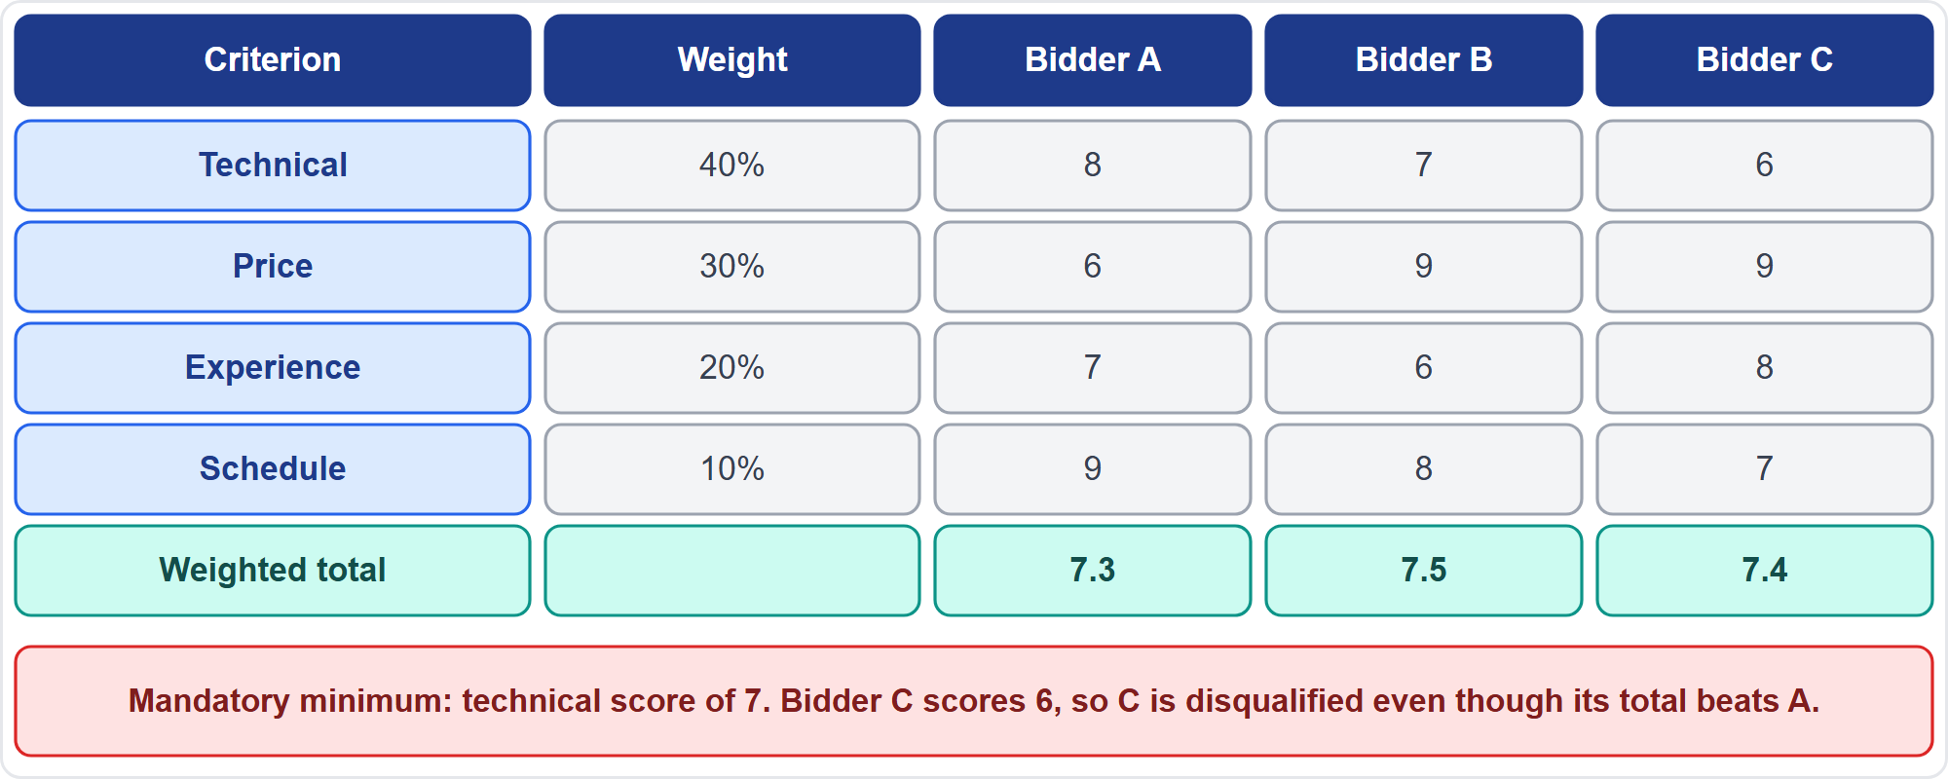
Weighted Scoring and Mandatory Minimums
Part 3
Weights, scores and totals
EXAM TIP A bidder below a mandatory minimum is disqualified even with the highest weighted total; rank the rest by weighted score.
PMP Exam Prep 2026 | PMBOK 8 and the New ECO
Module 8: Quality, Resources and Procurement
50 / 67
Notes:
Score each criterion, weight it by importance, and rank proposals by weighted total. The ranking sets the negotiation sequence. Typical criteria include capability and capacity, product and life cycle cost, and delivery dates. They include technical approach, experience and past performance, key staff, and financial strength. In this example, bidder B scores seven point five and bidder C seven point four. But there is a mandatory minimum technical score of seven, and bidder C scores six, so C is disqualified. Apply the minimum first, then rank the rest.

Slide 51
A Fair Selection Process
Part 3
Equal information for all bidders; the same answers to questions
Follow the published criteria, including past performance
Follow the gift and conflict-of-interest policy
Never steer the award to a favored provider
Disclose a relationship with a bidder and step back
Keep records of evaluations
EXAM TIP A lavish gift during evaluation is declined and handled under policy; it must not influence the decision.
PMP Exam Prep 2026 | PMBOK 8 and the New ECO
Module 8: Quality, Resources and Procurement
51 / 67
Notes:
Fairness is central. Give equal information to all bidders, with the same answers to questions. Follow the published criteria, including past performance. Follow the organization's gift and conflict-of-interest policy. Never steer the award to a favored provider. If you have a relationship with a bidder, disclose it and step back. And keep records of evaluations. If a bidder offers a lavish gift during evaluation, decline it and handle it under policy. It must not influence the decision.

Slide 52
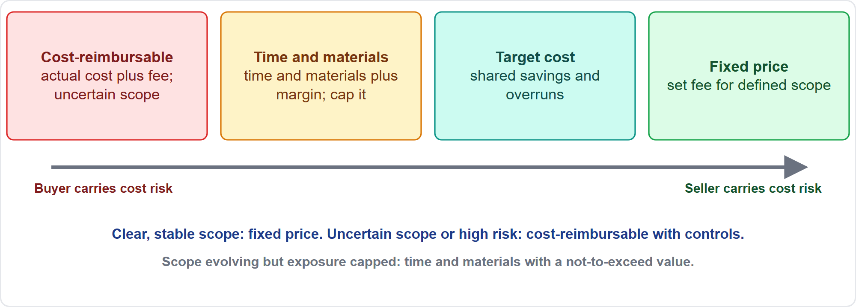
Contract Types and Cost Risk
Part 3
From buyer risk to seller risk
EXAM TIP Fixed price moves cost-overrun risk to the seller; cost-reimbursable leaves it with the buyer.
PMP Exam Prep 2026 | PMBOK 8 and the New ECO
Module 8: Quality, Resources and Procurement
52 / 67
Notes:
Contract types shift cost risk. Fixed price: a predetermined fee for a clearly defined scope. The seller bears the cost risk, and the buyer gets budget certainty, perhaps with a risk premium. Cost-reimbursable: the seller's actual costs plus a fee, used when scope is uncertain or risk is high. The buyer bears the cost escalation risk. Time and materials: actual time and materials plus a margin, a hybrid for smaller projects, maintenance or unclear scope. Target cost: a target with sharing of savings and overruns, encouraging cost control.

Slide 53
Choosing the Contract Type
Part 3
Situation | Likely contract
Clear, stable scope; buyer wants certainty | Fixed price
Uncertain scope or high risk, such as research | Cost-reimbursable with cost controls
Scope evolving but exposure must be capped | Time and materials with a not-to-exceed value
Wish to share efficiency gains | Target cost or incentive terms
Agile, collaborative or outcome-based work | Agile or collaborative contracts
EXAM TIP Think from both sides: a project manager is often both a buyer and a seller; structure contracts to benefit both.
PMP Exam Prep 2026 | PMBOK 8 and the New ECO
Module 8: Quality, Resources and Procurement
53 / 67
Notes:
Choose the contract type by the situation. Clear, stable scope and a buyer who wants certainty: fixed price. Uncertain scope or high risk, such as research or complex construction: cost-reimbursable, with cost controls. Scope still evolving but exposure must be capped: time and materials with a not-to-exceed value. A wish to share efficiency gains: target cost or incentive terms. Agile, collaborative or outcome-based work: agile or collaborative contracts, with iteration-based deliverables, caps and incentives. Think from both sides, and structure contracts so they benefit all parties.

Slide 54
Emerging Contracting Practices
Part 3
Agile or collaborative contracts: shared risk and reward, caps, reduced rates, performance incentives
Outcome-based contracts: pay for results
Sustainable (ESG) contracting: environmental, social and governance terms with measurable outcomes
Smart contracts: milestone-based, for example on blockchain
AI tools analyze contracts, assess risk and predict overruns; a human validates
EXAM TIP Tie payments to validated results when you need to learn before committing; sustainability can be a selection criterion.
PMP Exam Prep 2026 | PMBOK 8 and the New ECO
Module 8: Quality, Resources and Procurement
54 / 67
Notes:
PMBOK 8 describes emerging practices. Agile or collaborative contracts: shared risk and reward, caps, reduced rates and performance incentives. Outcome-based contracts pay for results, so tie payments to validated results when you need to learn before committing. Sustainable contracting embeds environmental, social and governance principles in contracts, with measurable outcomes. Smart contracts, for example on blockchain, can pay on milestones. AI tools help analyze contracts, assess risk and predict overruns, but a human validates. Alignment with sustainability goals can also be a source selection criterion.

Slide 55
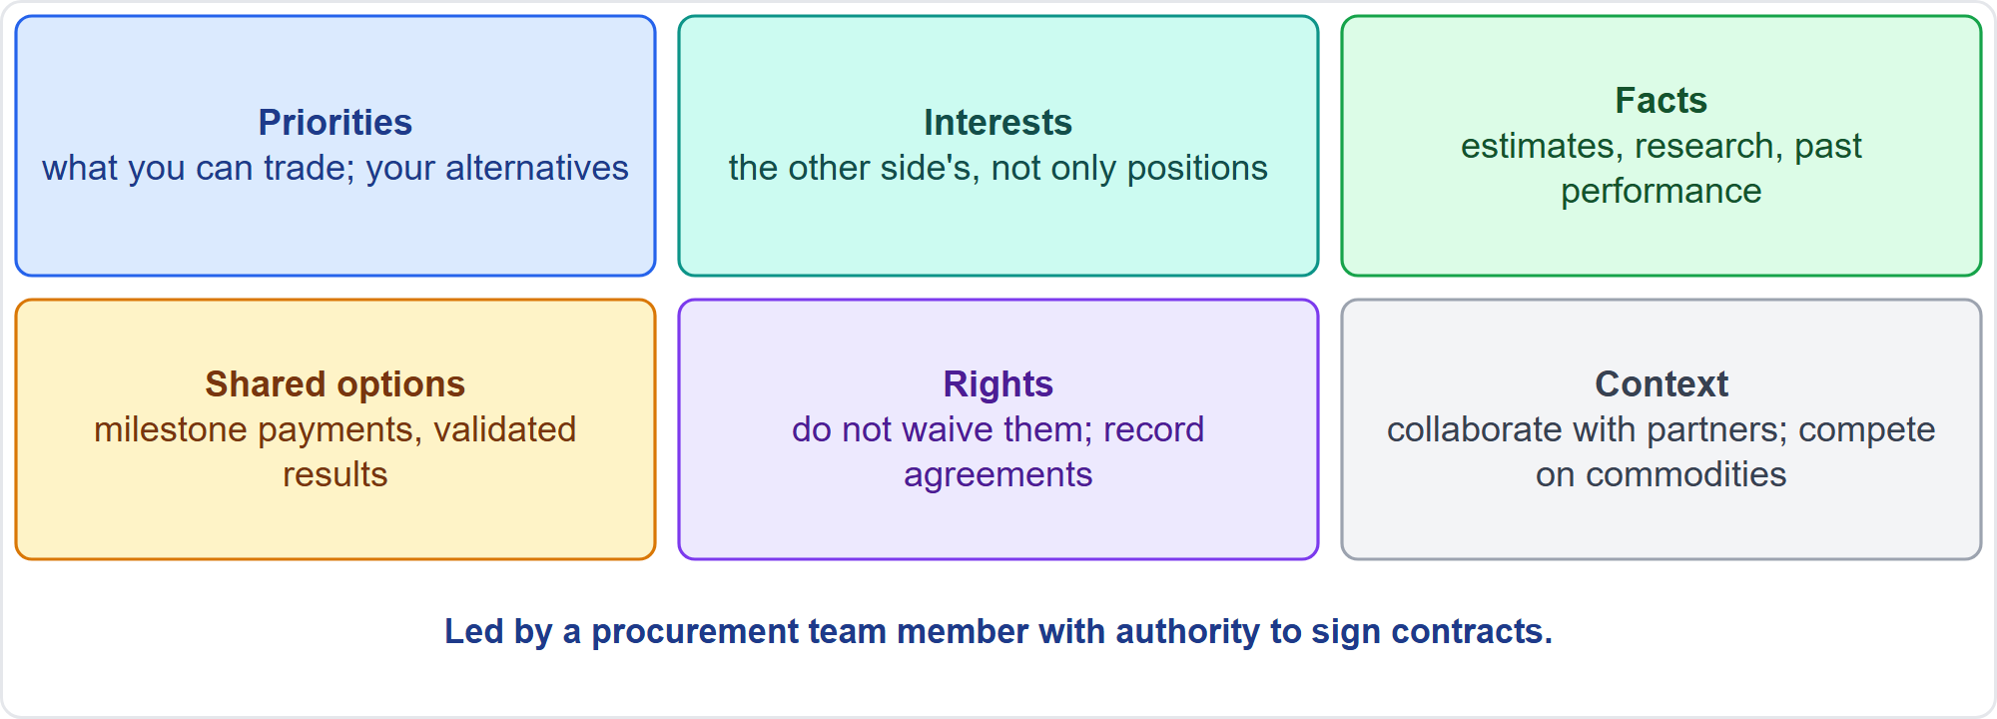
Negotiation
Part 3
A negotiation strategy
EXAM TIP Negotiation is led by someone with authority to sign contracts; the project manager supports with technical and project knowledge.
PMP Exam Prep 2026 | PMBOK 8 and the New ECO
Module 8: Quality, Resources and Procurement
55 / 67
Notes:
Negotiation clarifies the structure, rights and obligations so both parties agree before signing. Almost everything is negotiable: cost, delivery and payment dates, location of work, intellectual property. A procurement team member with authority to sign leads, and the project manager supports. Strategy: clarify your priorities and alternatives. Understand the other side's interests, not only positions. Use facts. Look for options that serve both parties, such as payments tied to milestones. Do not waive rights. And match the approach to the context.

Slide 56
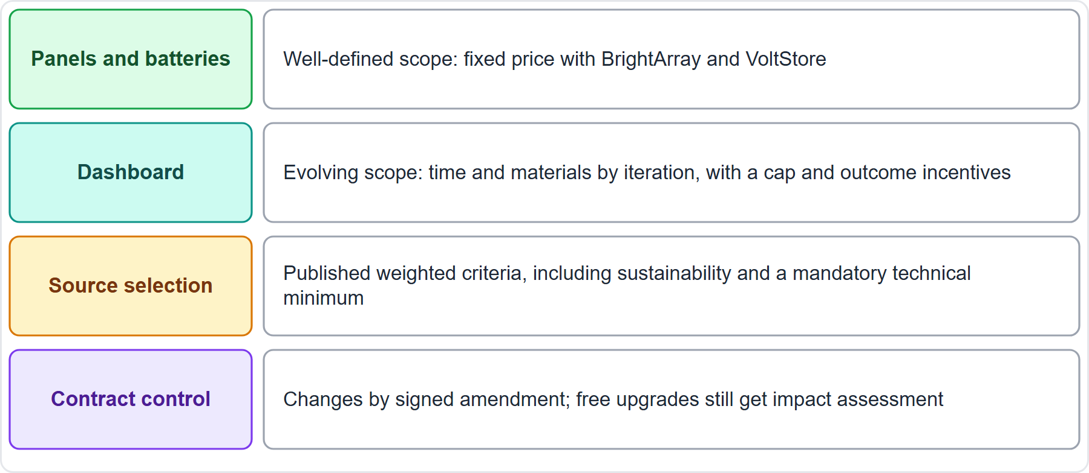
Case Check-In: Procurement on the Microgrid
Part 3
CASE CHECK-IN · Sunrise Campus Microgrid
Panels and batteries: well-defined scope, fixed price
Dashboard: evolving scope, time and materials by iteration with a cap
PMP Exam Prep 2026 | PMBOK 8 and the New ECO
Module 8: Quality, Resources and Procurement
56 / 67
Notes:
Procurement on our microgrid fits the contract to the risk. Panels and batteries have a well-defined scope, so use fixed price with the suppliers. The dashboard has an evolving scope, so use time and materials by iteration, with a cap and outcome incentives. Select suppliers on published weighted criteria, including sustainability and a mandatory technical minimum. Control changes by signed amendment, and remember that a free upgrade still needs impact assessment. A procurement team member with authority leads the negotiation.

Slide 57
Manage Suppliers and Contracts
Part 3
Activity | What to do
Monitor performance | Against the contract; status updates, reviews, walkthroughs
Inspect and accept | Against acceptance criteria; a miss: notify formally, require correction, withhold acceptance as allowed
Control changes | Change control and a signed amendment; free upgrades too
Manage roles | Who directs whose people; reporting lines
Audit | Review contracts and processes
Evaluate vendors | Record delivery, quality, cost, responsiveness
Verify and close | Confirm obligations; close contracts before the project
EXAM TIP A sole-source supplier that is late: build a joint recovery plan while preserving contract rights.
PMP Exam Prep 2026 | PMBOK 8 and the New ECO
Module 8: Quality, Resources and Procurement
57 / 67
Notes:
Managing suppliers and contracts. Monitor performance against the contract, using regular and milestone status updates, reviews and walkthroughs. Inspect and accept deliverables against acceptance criteria. Handle a miss under the contract terms: notify the vendor formally, require correction, and withhold acceptance as the contract allows. Do not fix it quietly yourself, and do not accept it. Control changes through formal change control and a signed amendment, even for a free upgrade. Clarify who directs whose people. A procurement audit reviews contracts and processes. Evaluate vendor performance and keep records. Verify the objectives of the agreement were met, then close all contracts before the project is closed.

Slide 58
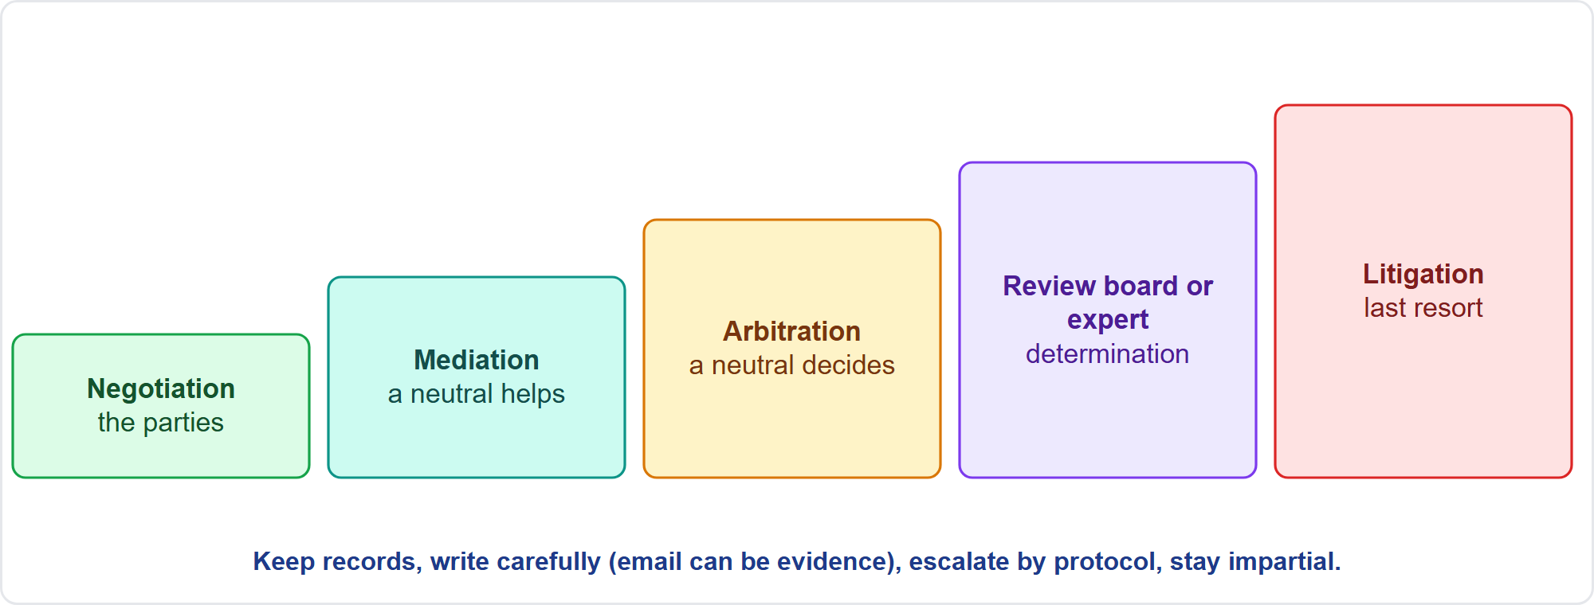
Claims and Disputes
Part 3
From negotiation to litigation
EXAM TIP Variation orders and overruns are leading causes of claims; be careful with written language, because email can be evidence.
PMP Exam Prep 2026 | PMBOK 8 and the New ECO
Module 8: Quality, Resources and Procurement
58 / 67
Notes:
Disputes rise with complexity and the number of stakeholders. Variation orders and time and cost overruns are leading causes of claims. PMBOK 8 lists alternative dispute resolution methods: negotiation, mediation, arbitration, dispute review boards, expert determination, and litigation as the last resort. As a project manager, understand the contract terms, keep detailed records, communicate openly, spot conflict early, and work with legal. Be careful with written language, since email can become evidence. Set escalation protocols, protect confidentiality, and stay impartial and factual.

Slide 59
Procurement in Predictive, Agile and Hybrid Work
Part 3
 | Predictive | Agile | Hybrid
Scope | Detailed statement of work before bidding | Evolving; outcomes and backlog guide the work | Detailed for fixed parts; flexible for evolving parts
Contract | Fixed price for defined work; cost-reimbursable for uncertain | Agile or collaborative: T&M by iteration, caps, incentives | Mixed
Acceptance | Milestones | Per increment | Both
Change | Formal contract change orders | Backlog inside agreed boundaries; approval above thresholds | Both
Vendors | Report to the project manager | Work in the team; clarify reporting lines | Both
EXAM TIP Check the team's contracts follow the iteration cadence.
PMP Exam Prep 2026 | PMBOK 8 and the New ECO
Module 8: Quality, Resources and Procurement
59 / 67
Notes:
Procurement differs by approach. Predictive: a detailed statement of work before bidding, fixed price for well-defined work, cost-reimbursable for uncertain work, and milestone acceptance. Change goes through formal contract change orders, and vendors report to the project manager. Agile: evolving requirements, and agile or collaborative contracts such as time and materials by iteration, with caps and incentives. Acceptance is per increment, and vendor staff work in the team. Hybrid mixes both.

Slide 60
Procurement Traps: What PMI Expects
Part 3
Make-or-buy first; compare options with analysis
Fair process: equal information, published criteria, no favoritism
Match the contract to the risk: fixed price for clear scope, cost-reimbursable for uncertain
A mandatory minimum disqualifies even a top weighted score
Changes need a signed amendment; free upgrades need impact assessment
Close all contracts before the project, after verifying obligations
EXAM TIP Disputes: negotiate first, escalate by protocol, keep records, involve legal.
PMP Exam Prep 2026 | PMBOK 8 and the New ECO
Module 8: Quality, Resources and Procurement
60 / 67
Notes:
The traps for procurement. Make or buy first, and compare options with analysis. Run a fair process: equal information, published criteria, no favoritism. Match the contract to the risk: fixed price for clear scope, cost-reimbursable for uncertain scope. A mandatory minimum disqualifies a bidder even with a top weighted score. Changes need a signed amendment, and free upgrades need impact assessment. Close all contracts before the project, after verifying that obligations were met. For disputes, negotiate first and escalate by protocol.

Slide 61
Module Recap
Part 3
1
Quality
2
Resources
3
Procurement
prevention, continuous checks, charts and tools, definition of done
people and things, real availability, sourcing route, well-being
make-or-buy, fair selection, contract fits the risk
4
Control
5
Improvement
6
Next
audits, planned versus actual use, supplier performance
a few tracked actions; standardize what works
five practice questions
PMP Exam Prep 2026 | PMBOK 8 and the New ECO
Module 8: Quality, Resources and Procurement
61 / 67
Notes:
Let us recap the whole module. Quality: prevention, continuous checks, charts and tools, and the definition of done. Resources: people and things, real availability, the sourcing route, and well-being. Procurement: make or buy first, fair selection, and a contract that fits the risk. Control: audits, planned against actual use, and supplier performance. Improvement: a few tracked actions, and standardize what works. Now it is time to test yourself. Five questions follow. For each one, pause the video, choose your answer, and then listen to the explanation.

Slide 62
Practice Question 1
Part 3
Q1
The same wiring defect keeps appearing in finished units, and the team proposes adding another inspection step at the end of the line. What should the project manager do?
A
Approve the extra inspection step and report the defect rate each week
B
Ask the team to work more slowly so that fewer defects are produced
C
Replace the supplier of the wiring components at once, before any analysis
D
Find the root cause and improve the process so the defect is prevented
PMP Exam Prep 2026 | PMBOK 8 and the New ECO
Module 8: Quality, Resources and Procurement
62 / 67
Notes:
Question one. The same wiring defect keeps appearing in finished units, and the team proposes adding another inspection step at the end of the line. What should the project manager do? The four options are on the screen. Choose your answer. [PAUSE 12] The answer is D. Prevention costs less than finding defects, so the project manager finds the root cause and improves the process. More inspection alone does not fix a process that creates defects. More inspection treats the symptom, slowing down is not an analysis, and replacing a supplier before analysis is a guess.

Slide 63
Practice Question 2
Part 3
Q2
On a control chart, seven consecutive measurements fall above the mean, but all of them are inside the control limits. What should the project manager do?
A
Treat it as normal variation because every point is inside the limits
B
Investigate the assignable cause, since the run signals a special cause
C
Widen the control limits so that the chart shows the process as stable
D
Adjust the process immediately to bring the measurements back to the mean
PMP Exam Prep 2026 | PMBOK 8 and the New ECO
Module 8: Quality, Resources and Procurement
63 / 67
Notes:
Question two. On a control chart, seven consecutive measurements fall above the mean, but all of them are inside the control limits. What should the project manager do? The four options are on the screen. Choose your answer. [PAUSE 12] The answer is B. Seven consecutive points on one side of the mean signal a special cause even inside the control limits, so the project manager investigates the cause. Ignoring it, widening the limits, or adjusting a stable process without cause all miss the signal.

Slide 64
Practice Question 3
Part 3
Q3
A team planned its iterations assuming five full-time members, but two were moved to operations support. The product owner still expects the same scope each iteration. What should the project manager do?
A
Ask the remaining members to work overtime so the same scope is delivered
B
Keep the scope unchanged and report the shortfall at the end of the whole release
C
Plan iterations on actual capacity and agree the scope with the product owner
D
Ask the sponsor to move the two members back without any discussion
PMP Exam Prep 2026 | PMBOK 8 and the New ECO
Module 8: Quality, Resources and Procurement
64 / 67
Notes:
Question three. A team planned its iterations assuming five full-time members, but two were moved to operations support. The product owner still expects the same scope each iteration. What should the project manager do? The four options are on the screen. Choose your answer. [PAUSE 12] The answer is C. Agile iterations are planned on actual available capacity, with the fixed team and flexible scope, agreed with the product owner. Overtime, hiding the shortfall, or demanding the members back without discussion ignore actual capacity.

Slide 65
Practice Question 4
Part 3
Q4
A research-based development effort has an uncertain scope and high risk, and the buyer wants to keep flexibility. Which contract type fits best?
A
Cost-reimbursable, with cost controls and regular reviews
B
Fixed price, with the full scope defined in advance of the work
C
Fixed price, with a high risk premium added to the bid
D
Time and materials, with no cap on hours or total cost
PMP Exam Prep 2026 | PMBOK 8 and the New ECO
Module 8: Quality, Resources and Procurement
65 / 67
Notes:
Question four. A research-based development effort has an uncertain scope and high risk, and the buyer wants to keep flexibility. Which contract type fits best? The four options are on the screen. Choose your answer. [PAUSE 12] The answer is A. Uncertain scope and high risk call for a cost-reimbursable contract with cost controls, because a fixed price would push risk onto a seller who cannot estimate it. Fixed price needs a defined scope, and uncapped time and materials leaves the buyer's exposure open.

Slide 66
Practice Question 5
Part 3
Q5
In a tender, one bidder has the highest weighted score but falls below the mandatory minimum technical score. What should the project manager do?
A
Award the contract to that bidder because it has the highest weighted total
B
Disqualify the bidder and rank the remaining bidders by weighted score
C
Lower the minimum score so that the bidder can stay in the evaluation
D
Ask the bidder to improve its technical score and resubmit the proposal
PMP Exam Prep 2026 | PMBOK 8 and the New ECO
Module 8: Quality, Resources and Procurement
66 / 67
Notes:
Question five. In a tender, one bidder has the highest weighted score but falls below the mandatory minimum technical score. What should the project manager do? The four options are on the screen. Choose your answer. [PAUSE 12] The answer is B. A mandatory minimum is applied first, so a bidder below it is disqualified even with the highest weighted total, and the others are ranked. Awarding anyway, changing the published rule, or letting one bidder resubmit are all unfair.

Slide 67
Answers at a Glance
Part 3
Question | Answer | Why
Q1 | D | Find the root cause and prevent the defect instead of inspecting more
Q2 | B | A run of seven on one side of the mean signals a special cause
Q3 | C | Plan iterations on actual capacity and agree the scope
Q4 | A | Uncertain scope and high risk call for cost-reimbursable with controls
Q5 | B | A bidder below a mandatory minimum is disqualified before ranking
PMP Exam Prep 2026 | PMBOK 8 and the New ECO
Module 8: Quality, Resources and Procurement
67 / 67
Notes:
Here are all five answers together. Question one: D. Find the root cause and prevent the defect instead of inspecting more. Question two: B. A run of seven on one side of the mean signals a special cause. Question three: C. Plan iterations on actual capacity and agree the scope. Question four: A. Uncertain scope and high risk call for cost-reimbursable with controls. Question five: B. A bidder below a mandatory minimum is disqualified before ranking. That completes Module 8. Next, Module 9 covers managing execution, status and metrics, and closure. See you there.

