Slide 1
Module 9: Executing, Status Reporting and Closure
Part 1 of 3: Executing the plan
Process domain · ECO tasks 1, 9 and 10
PMP Exam Prep 2026: PMBOK 8 and the New ECO
Module 9: Executing, Status Reporting and Closure · Part 1
Notes:
Welcome to Module 9. This module follows the project through the rest of its life: doing the work, telling the truth about progress, and ending properly. In Part 1, we look at executing: directing and managing the work, implementing approved changes, and executing in agile and hybrid projects. Part 2 covers metrics and status. Part 3 covers closure, including acceptance, transition and benefits.

Slide 2
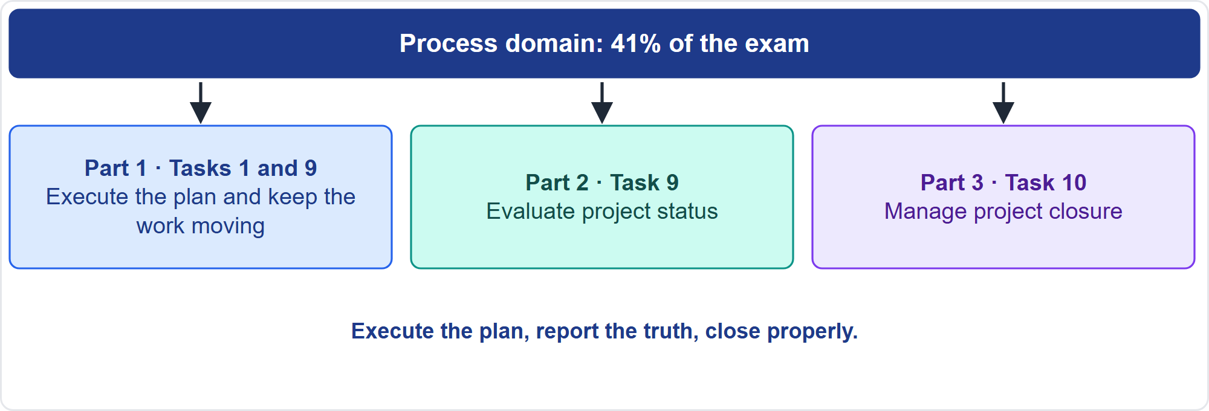
Where This Module Sits in the Exam
Part 1
Three Process-domain tasks
EXAM TIP Execution questions test discipline: follow the plan, change it through the process, keep records and protect value.
PMP Exam Prep 2026 | PMBOK 8 and the New ECO
Module 9: Executing, Status Reporting and Closure
2 / 54
Notes:
Here is where this module sits. In the Process domain, this module covers three tasks. Task one, the integrated plan and delivery, shows up here as execution. Task nine: evaluate project status, with metrics, analysis and reporting. Task ten: manage project closure. Execution questions test discipline: follow the plan, change it only through the process, keep the records current and protect value. Status questions test honest, audience-fit reporting. Closure questions test acceptance, readiness and formal completion.

Slide 3
What You Will Learn
Part 1
Direct and manage the work, and implement approved changes correctly
Execute in agile and hybrid projects on real capacity
Build metrics, avoid measurement pitfalls and report status by audience
Manage artifacts so that they are current and findable
Set closure criteria, obtain acceptance and check transition readiness
Conclude financial, contractual and administrative work, and hand over benefits
PMP Exam Prep 2026 | PMBOK 8 and the New ECO
Module 9: Executing, Status Reporting and Closure
3 / 54
Notes:
By the end of this module you will be able to do six things. Direct and manage the work, and implement approved changes correctly. Execute in agile and hybrid projects on real capacity. Build metrics, avoid measurement pitfalls and report status to each audience. Manage artifacts so they are current and findable. Set closure criteria, obtain acceptance and check transition readiness. And conclude financial, contractual and administrative work, and hand over benefits.

Slide 4
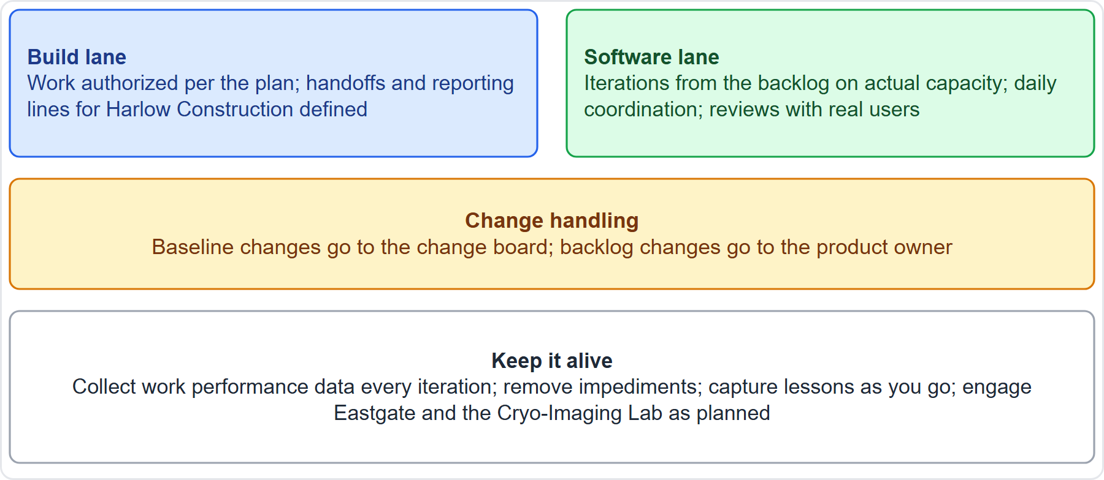
Case Check-In: Executing the Microgrid
Part 1
CASE CHECK-IN · Sunrise Campus Microgrid
Build lane: work authorized per the plan, with handoffs defined
Software lane: iterations on real capacity; baseline changes to the board, backlog changes to the product owner
PMP Exam Prep 2026 | PMBOK 8 and the New ECO
Module 9: Executing, Status Reporting and Closure
4 / 54
Notes:
Now we execute the microgrid. In the build lane, work is authorized per the plan, and handoffs and reporting lines with Harlow Construction are defined. In the software lane, iterations come from the backlog on actual capacity, with daily coordination and reviews with real users. Baseline changes go to the change board, and backlog changes go to the product owner. Throughout, collect work performance data every iteration, remove impediments, capture lessons as you go, and engage the lab and the neighbors as planned.

Slide 5
Executing: Key Terms
Part 1
Term | Meaning
Executing Focus Area | Completing the work consistent with the currently agreed course of action
Manage Project Execution | Leading and performing the work, and implementing approved changes
Work performance data | Raw observations: actual dates, costs, defects, story points
Change request | A formal proposal to modify a document, deliverable or baseline
Change log, issue log | Submitted changes and their disposition; issues recorded and monitored
PMIS | The project management information system
EXAM TIP The plan can and should change whenever the change enhances the value proposition, through the change process.
PMP Exam Prep 2026 | PMBOK 8 and the New ECO
Module 9: Executing, Status Reporting and Closure
5 / 54
Notes:
Key terms. The Executing Focus Area covers the actions performed to complete the work consistently with the currently agreed course of action. Manage Project Execution leads and performs the work and implements approved changes. Work performance data is raw observations: actual dates, costs, defects and story points. A change request is a formal proposal to modify a document, deliverable or baseline, and types include corrective action, preventive action and defect repair. The change log lists submitted changes and their disposition. The issue log records issues. And the project management information system supports all of it.

Slide 6
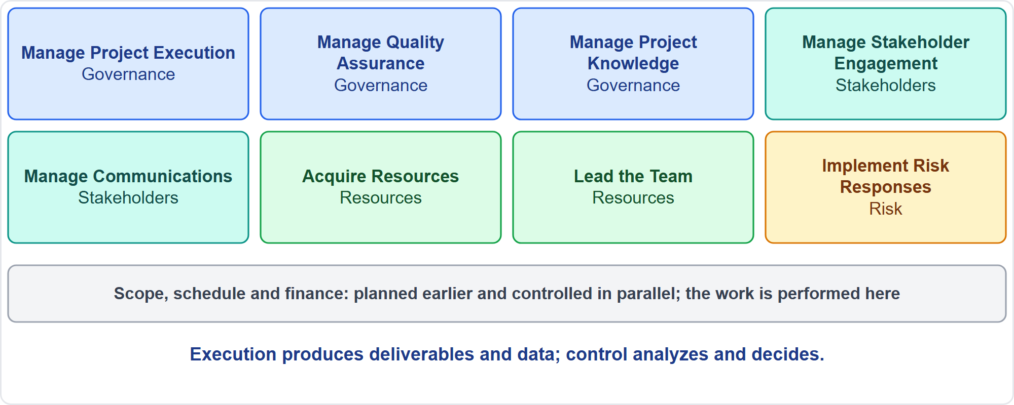
What Runs in Executing
Part 1
Eight processes
EXAM TIP Do not confuse execution with control: execution produces deliverables and data; control analyzes and decides on corrective action.
PMP Exam Prep 2026 | PMBOK 8 and the New ECO
Module 9: Executing, Status Reporting and Closure
6 / 54
Notes:
Eight processes run in the Executing Focus Area. Three in Governance: Manage Project Execution, Manage Quality Assurance and Manage Project Knowledge. Two in Stakeholders: Manage Stakeholder Engagement and Manage Communications. Two in Resources: Acquire Resources and Lead the Team. And Implement Risk Responses in Risk. Scope, schedule and finance have no executing-only process. Their work is planned in Planning. And it is controlled in Monitoring and Controlling, which runs in parallel and receives the work performance data.

Slide 7
Manage Project Execution
Part 1
Aspect | Detail
Purpose | Align the team's knowledge and skills; produce deliverables per the plan; fit technical and functional work together
Inputs | Plan components, logs, schedule, risk register, approved change requests
Tools | Expert judgment, PMIS, meetings, including daily coordination
Outputs | Deliverables, work performance data, issue log, change requests, plan and document updates
Also | Review the impact of all changes; implement approved ones
Quality | Process assurance plus deliverable quality through scope control
EXAM TIP Execution is not heads-down: it includes engaging stakeholders, communicating, coordinating resources and leading the team.
PMP Exam Prep 2026 | PMBOK 8 and the New ECO
Module 9: Executing, Status Reporting and Closure
7 / 54
Notes:
Manage Project Execution aims to align the knowledge and skills of the team toward the objectives. It produces deliverables from activities carried out according to the plan. And it makes technical and functional work fit together. Inputs include plan components, logs, the schedule, the risk register and approved change requests. Tools are expert judgment, the information system and meetings. Outputs are deliverables, work performance data, an issue log, change requests and updates. It also reviews the impact of all changes. And it implements the approved ones. Quality has two routes: process assurance, and deliverable quality through scope control.

Slide 8
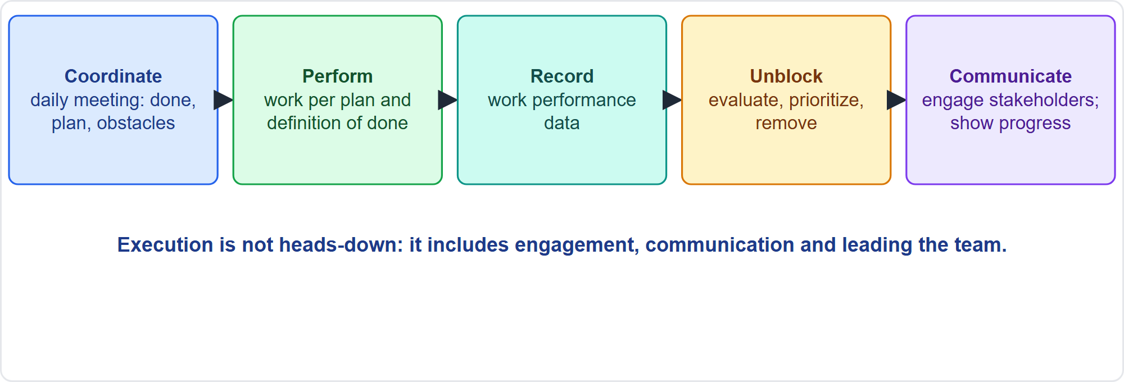
Directing and Managing Day to Day
Part 1
Coordinate, perform, record, unblock, communicate
EXAM TIP Check the agreed plan, documents and contracts first, then act within them; escalate only what is beyond your authority.
PMP Exam Prep 2026 | PMBOK 8 and the New ECO
Module 9: Executing, Status Reporting and Closure
8 / 54
Notes:
A good execution day has five habits. Coordinate: a short daily meeting on what was done, what is planned and what blocks progress. Perform: work per the plan and the definition of done. Record work performance data consistently, so monitoring can turn it into information. Unblock: evaluate, prioritize and remove impediments, and check that a resolved blocker has really ended, not just moved. Communicate: engage stakeholders and make progress visible. Start well with a kickoff aligned on vision, plan, roles and team agreements.

Slide 9
Keep the Plan Alive
Part 1
When reality or value changes, use the change process (predictive) or reprioritize the backlog (adaptive)
The plan is not an unchangeable contract
Keep information in the PMIS and a controlled repository, with configuration control
Assign and coordinate: handoffs, dependencies, interfaces, vendor reporting lines
Capture lessons during the work, not only at the end
Protect value: watch the business case and outside changes; output is not outcome
EXAM TIP Follow the plan, but change it when value demands it, through the change process and not informally.
PMP Exam Prep 2026 | PMBOK 8 and the New ECO
Module 9: Executing, Status Reporting and Closure
9 / 54
Notes:
Keep the plan alive. When reality or value changes, use the change process in predictive work, or reprioritize the backlog in adaptive work. The plan is not an unchangeable contract. Keep information in the project management information system and in a controlled repository, with configuration control, so people use current versions. Assign and coordinate work with defined handoffs and reporting lines, including for vendors. Capture lessons during the work, not only at the end. And protect value: watch the business case and external changes, and do not let output replace outcomes.

Slide 10
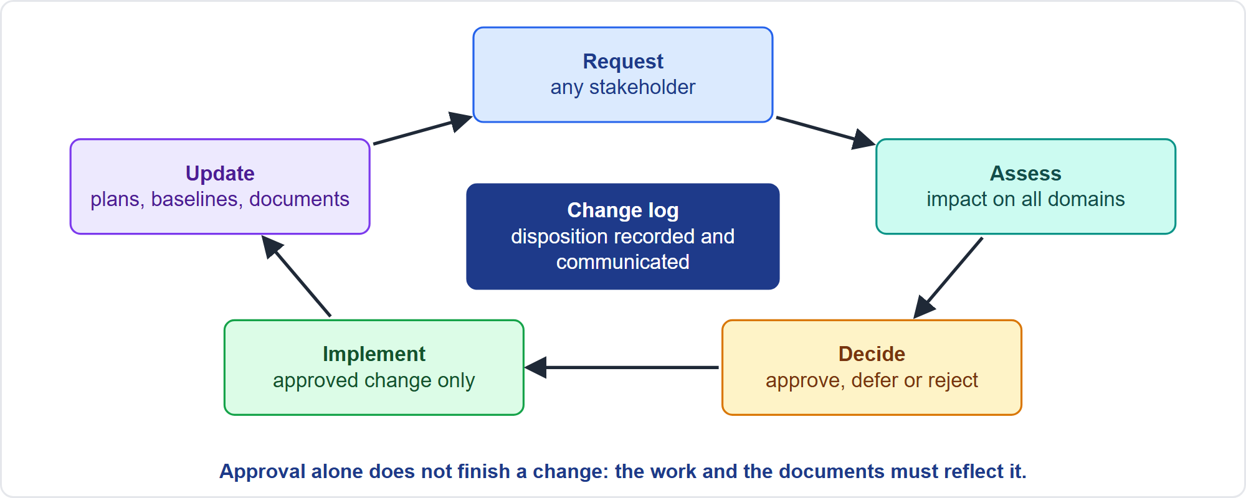
Implementing Approved Changes
Part 1
From request to updated documents
EXAM TIP Approved changes must be implemented and the documents updated, including drawings, schedule and backlog.
PMP Exam Prep 2026 | PMBOK 8 and the New ECO
Module 9: Executing, Status Reporting and Closure
10 / 54
Notes:
Here is the change loop. Any stakeholder may request a change. Requests are assessed through integrated change control, with impact on all domains. The change is approved, deferred or rejected, and the disposition goes in the change log and is communicated, including to those whose requests were deferred or rejected. Execution then implements approved changes: corrective actions, preventive actions and defect repairs. And update everything affected, such as designs, schedule, baselines, backlog, requirements and the risk register. Approval is not complete until the work and the documents reflect it.

Slide 11
Unapproved Changes
Part 1
Do not make unapproved changes, even harmless-looking or free ones
A free design improvement or a higher-capacity part still needs impact assessment
Passing tests does not replace configuration review
Do not just remove the change or keep it unreviewed: submit it through change control
Deferred or rejected requests are communicated to the requester
Gold plating is unapproved scope
EXAM TIP Unapproved changes, even free or beneficial ones, go through change control.
PMP Exam Prep 2026 | PMBOK 8 and the New ECO
Module 9: Executing, Status Reporting and Closure
11 / 54
Notes:
Do not make unapproved changes, even harmless-looking or free ones. A free design improvement, or a higher-capacity part from a vendor, still needs impact assessment on power, piping, safety and testing. Checking that tests pass does not replace configuration review. If you find an unapproved change, do not just remove it or keep it unreviewed: evaluate the impact and submit it through change control. Deferred or rejected requests are communicated to the requester. And gold plating is unapproved scope, a form of scope growth.

Slide 12
Executing in Adaptive and Hybrid Work
Part 1
Iterations are small execution cycles: plan from the backlog on actual capacity
Work within the definition of done; hold the daily meeting
Review the increment with stakeholders, with feedback time; retrospect and commit to a few improvements
Protect the iteration: mid-iteration requests go to the product owner and backlog
Make progress visible; a burnup shows scope growth
Hybrid: milestones with iterations beneath; fixed commitments under change control
EXAM TIP If members are partly assigned elsewhere, the sprint scope shrinks; do not keep the scope and ask the team to be more efficient.
PMP Exam Prep 2026 | PMBOK 8 and the New ECO
Module 9: Executing, Status Reporting and Closure
12 / 54
Notes:
In adaptive work, iterations are small execution cycles. Plan from the backlog on actual capacity. Work within the definition of done and hold the daily coordination meeting. Review the increment with stakeholders, with real feedback time. Hold a retrospective that commits to a few improvements. Protect the iteration: mid-iteration requests go to the product owner and the backlog. The project manager represents the team's capacity. Make progress visible with boards and burn charts. In hybrid work, fixed regulatory or contractual commitments run under change control, while the iterative layer adapts inside them.

Slide 13
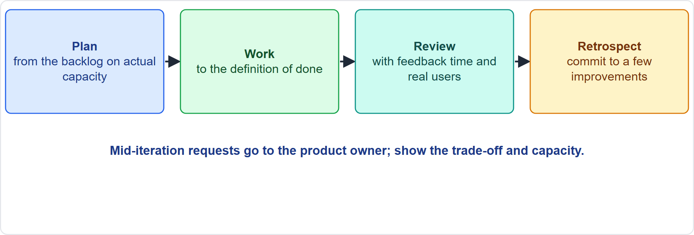
Iteration Execution
Part 1
Plan, work, review, retrospect
EXAM TIP Quality is built in: automated tests and compliance checks belong in the definition of done, not in a late testing phase.
PMP Exam Prep 2026 | PMBOK 8 and the New ECO
Module 9: Executing, Status Reporting and Closure
13 / 54
Notes:
An iteration is a small execution cycle. Plan it from the backlog on actual capacity. Work to the definition of done, with automated tests and compliance checks built in. Review the increment with feedback time and real users. Retrospect, and commit to a few improvements. If an executive asks for an urgent feature mid-iteration, send the request to the product owner. Show the trade-off and the capacity. Protect the committed scope unless the team and product owner agree a swap.

Slide 14
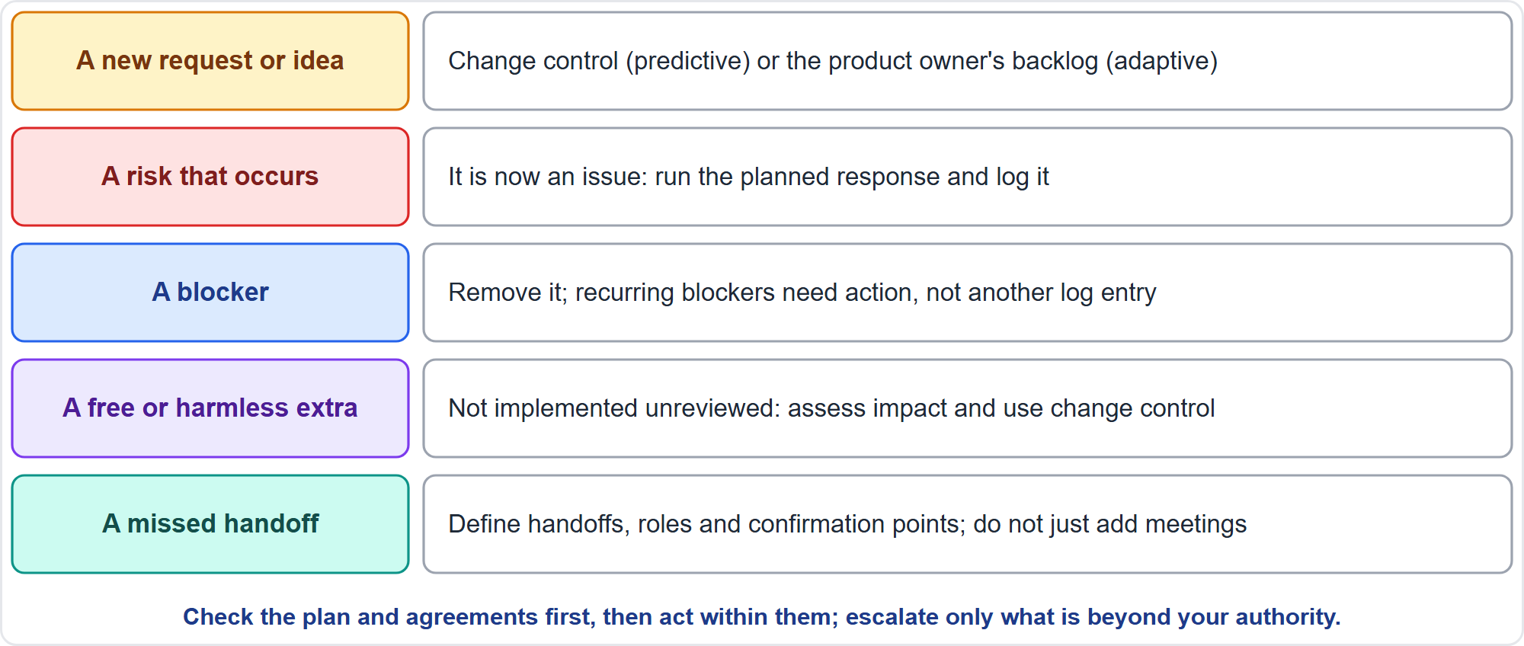
Event Routing: What Goes Where
Part 1
Five common events
EXAM TIP A risk that occurs is an issue: execute the planned response and log it.
PMP Exam Prep 2026 | PMBOK 8 and the New ECO
Module 9: Executing, Status Reporting and Closure
14 / 54
Notes:
Where does an event go? A new request or idea goes to change control in predictive work, or to the product owner's backlog in adaptive work. A risk that occurs is now an issue: run the planned response and log it. A blocker is removed. A recurring blocker needs action, not another log entry. A free or harmless extra is not implemented unreviewed: assess its impact and use change control. A missed handoff is fixed by defining the handoff, roles and confirmation points, not by adding meetings. Never skip the record: the logs and the backlog keep decisions alive through turnover and audits.

Slide 15
Executing in Predictive, Agile and Hybrid Work
Part 1
 | Predictive | Agile | Hybrid
Unit | Work packages and activities against baselines | Iterations from a prioritized backlog | Baselined envelope with iterations inside
Authorizing | Per the plan and work authorization | Team pulls from the sprint backlog | Both
Coordination | Status meetings, dependencies, PMO | Daily coordination, shared boards | Both
Change | Change requests, board, baseline updates | Backlog reprioritization; approval above contract thresholds | Change control for the envelope only
Data | Actuals against baseline; earned value | Velocity, burn charts, accepted work | Both
EXAM TIP Hybrid change control applies to the envelope only, not every iteration change.
PMP Exam Prep 2026 | PMBOK 8 and the New ECO
Module 9: Executing, Status Reporting and Closure
15 / 54
Notes:
Execution differs by approach. Predictive: work packages and activities against baselines, authorized per the plan. Coordination is through status meetings and dependency management. Change uses formal requests and a change board, and data comes from actuals against baseline and earned value. Agile: iterations from a prioritized backlog, and the team pulls work from the sprint backlog. Coordination is through daily meetings and shared boards. Change is backlog reprioritization, and data comes from velocity, burn charts and accepted work. Hybrid: change control for the baselined envelope only.

Slide 16
Execution Traps: What PMI Expects
Part 1
Implement approved changes and update the documents
Unapproved changes, even free ones, go through change control
Mid-iteration requests go to the product owner; plan on actual capacity
Remove impediments; define handoffs, roles and reporting lines
Collect performance data consistently; make progress visible
Build quality in; capture lessons while working
EXAM TIP Resolve conflict early and at the source; do not let it grow.
PMP Exam Prep 2026 | PMBOK 8 and the New ECO
Module 9: Executing, Status Reporting and Closure
16 / 54
Notes:
The traps for execution. Approved changes must be implemented and the documents updated. Unapproved changes, even free ones, go through change control. Mid-iteration requests go to the product owner, and iterations are planned on actual capacity. Remove impediments, and define handoffs, roles and reporting lines rather than adding review meetings. Collect work performance data consistently, and make progress visible where stakeholders can see it. Build quality in, capture lessons while working, and resolve conflict early and at the source.

Slide 17
Part 1 Recap
Part 1
1
Execution
2
Changes
3
Unapproved changes
perform the work, record data, unblock, communicate
assess, approve, implement, update everything affected
even free ones go through change control
4
Adaptive
5
Event routing
6
Execution versus control
actual capacity, protected iterations, quality built in
requests, occurred risks, blockers, handoffs
produce versus analyze and decide
PMP Exam Prep 2026 | PMBOK 8 and the New ECO
Module 9: Executing, Status Reporting and Closure
17 / 54
Notes:
Let us recap Part 1. Execution means performing the work, recording data, removing blockers and communicating. Changes are assessed, approved, implemented, and every affected document updated. Unapproved changes, even free ones, go through change control. In adaptive work, plan on actual capacity, protect the iteration and build quality in. Know where events go: requests, occurred risks, blockers and handoffs. And remember that execution produces deliverables and data, while control analyzes and decides. In Part 2, we turn to status.

Slide 18
Monitoring and Controlling: Key Terms
Part 2
Term | Meaning
Monitoring | Collect, measure and assess data; compare actual with planned; report
Controlling | Analyze variances; evaluate alternatives; recommend action; follow up
Leading, lagging indicator | Shows upcoming trends; reflects past performance
Input, output, outcome metric | What goes in; what is produced; the value achieved
Status report, dashboard | Current progress and forecasts; charts with red-amber-green
Information radiator | A visible, often low-tech display of status
Reconciliation | Checking figures agree across sources and definitions
EXAM TIP Governance prefers outcome metrics over input metrics.
PMP Exam Prep 2026 | PMBOK 8 and the New ECO
Module 9: Executing, Status Reporting and Closure
18 / 54
Notes:
Part 2 covers status. Key terms. Monitoring collects, measures and assesses data, compares actual with planned performance, and reports. Controlling analyzes variances, evaluates alternatives, recommends action and follows up. A leading indicator shows upcoming trends, and a lagging indicator reflects past performance. An input metric measures what goes in, an output metric what is produced, and an outcome metric the value achieved. A dashboard shows progress against key measures, often in red, amber and green. An information radiator is a visible display of status. And reconciliation checks that figures agree across sources and definitions.

Slide 19
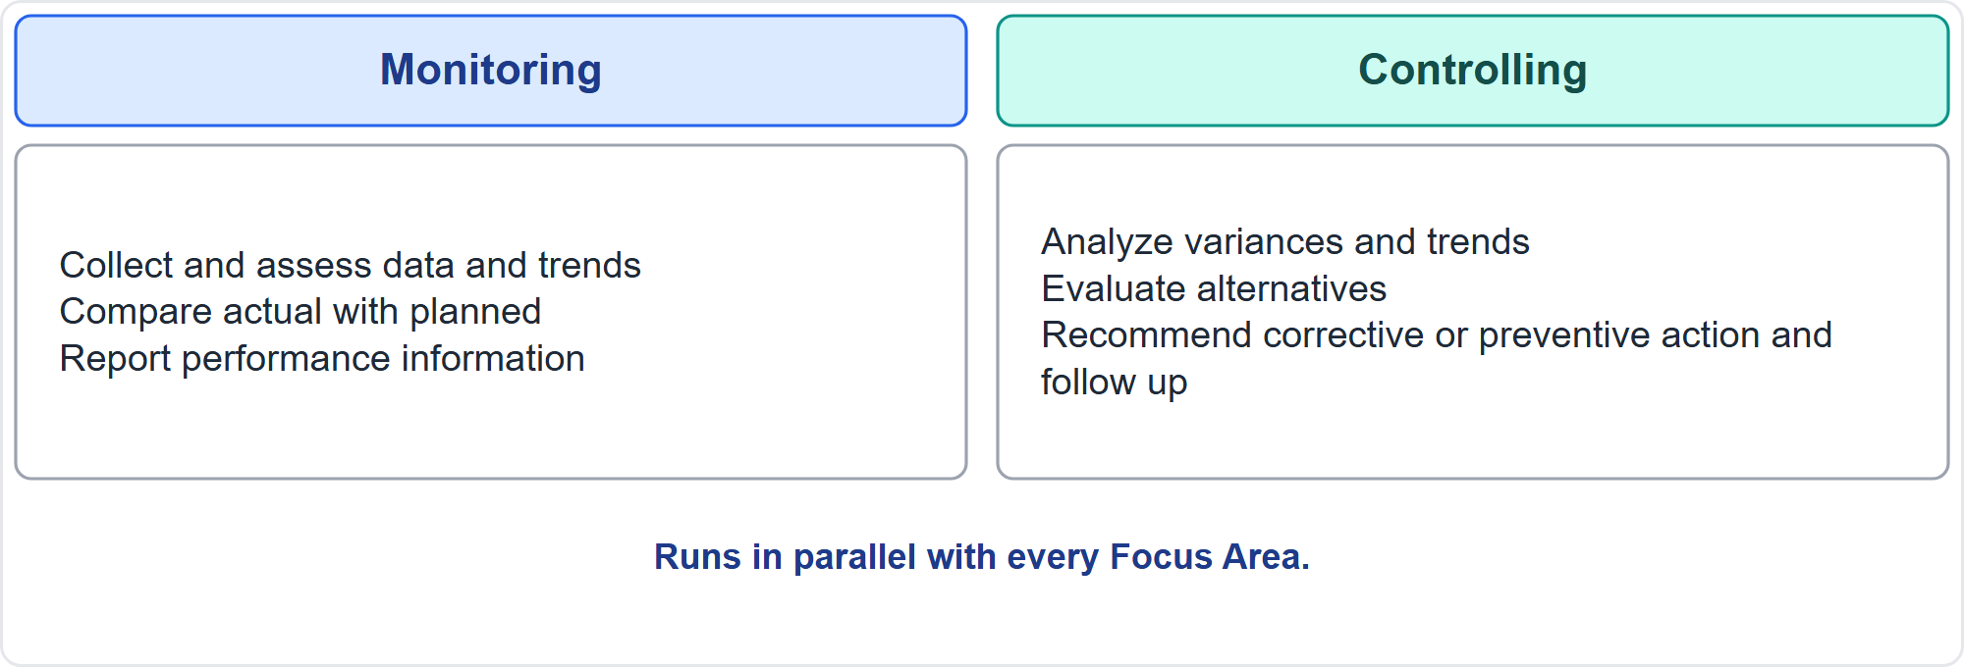
Monitor and Control Project Performance
Part 2
Measure, then decide
EXAM TIP If a beneficial decision changes a baseline, use integrated change control.
PMP Exam Prep 2026 | PMBOK 8 and the New ECO
Module 9: Executing, Status Reporting and Closure
19 / 54
Notes:
The Monitor and Control Project Performance process tracks, reviews and reports overall progress. So stakeholders understand the current state, see actions taken on performance issues, and see forecasts of cost and schedule. It also evaluates whether decisions might enhance the value proposition. It involves evaluating performance against the plan, and tracking resource use, work completed and budget spent. It involves informing stakeholders. And it involves assessing whether deliverables are on track to deliver planned benefits. The diagram splits the work in two. Monitoring collects and assesses data, compares actual with planned, and reports. Controlling analyzes variances, evaluates alternatives, recommends corrective or preventive action, and follows up. If a beneficial decision changes a baseline, use integrated change control.

Slide 20
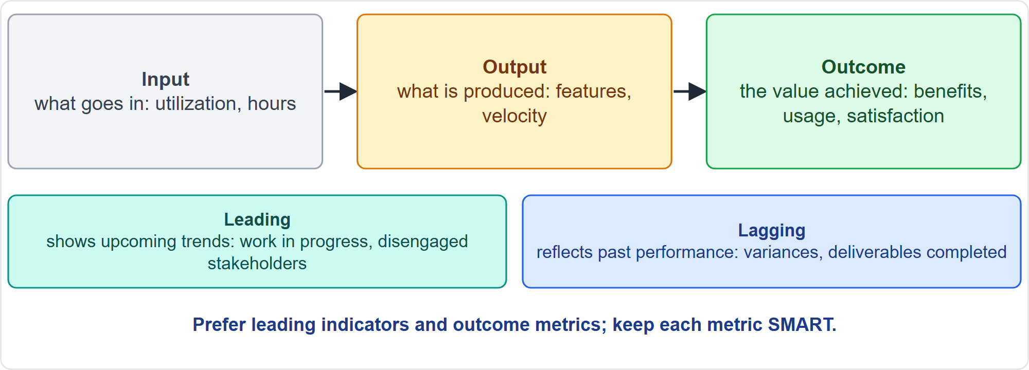
Types of Metric
Part 2
Input, output, outcome, and leading or lagging
EXAM TIP Prefer leading indicators to prevent problems; use lagging indicators to learn and find correlations.
PMP Exam Prep 2026 | PMBOK 8 and the New ECO
Module 9: Executing, Status Reporting and Closure
20 / 54
Notes:
Metrics come in types. Input metrics measure what goes in: utilization, hours. Output metrics measure what is produced: features, velocity. Outcome metrics measure the value achieved: benefits, usage and satisfaction. Governance prefers outcome metrics. Separately, leading indicators show upcoming trends, such as growing work in progress or disengaged stakeholders, so you can act before a tolerance is crossed. Lagging indicators reflect past performance and are easier to measure, such as variances and deliverables completed. Keep each metric specific, measurable, achievable, realistic and time-bound.

Slide 21
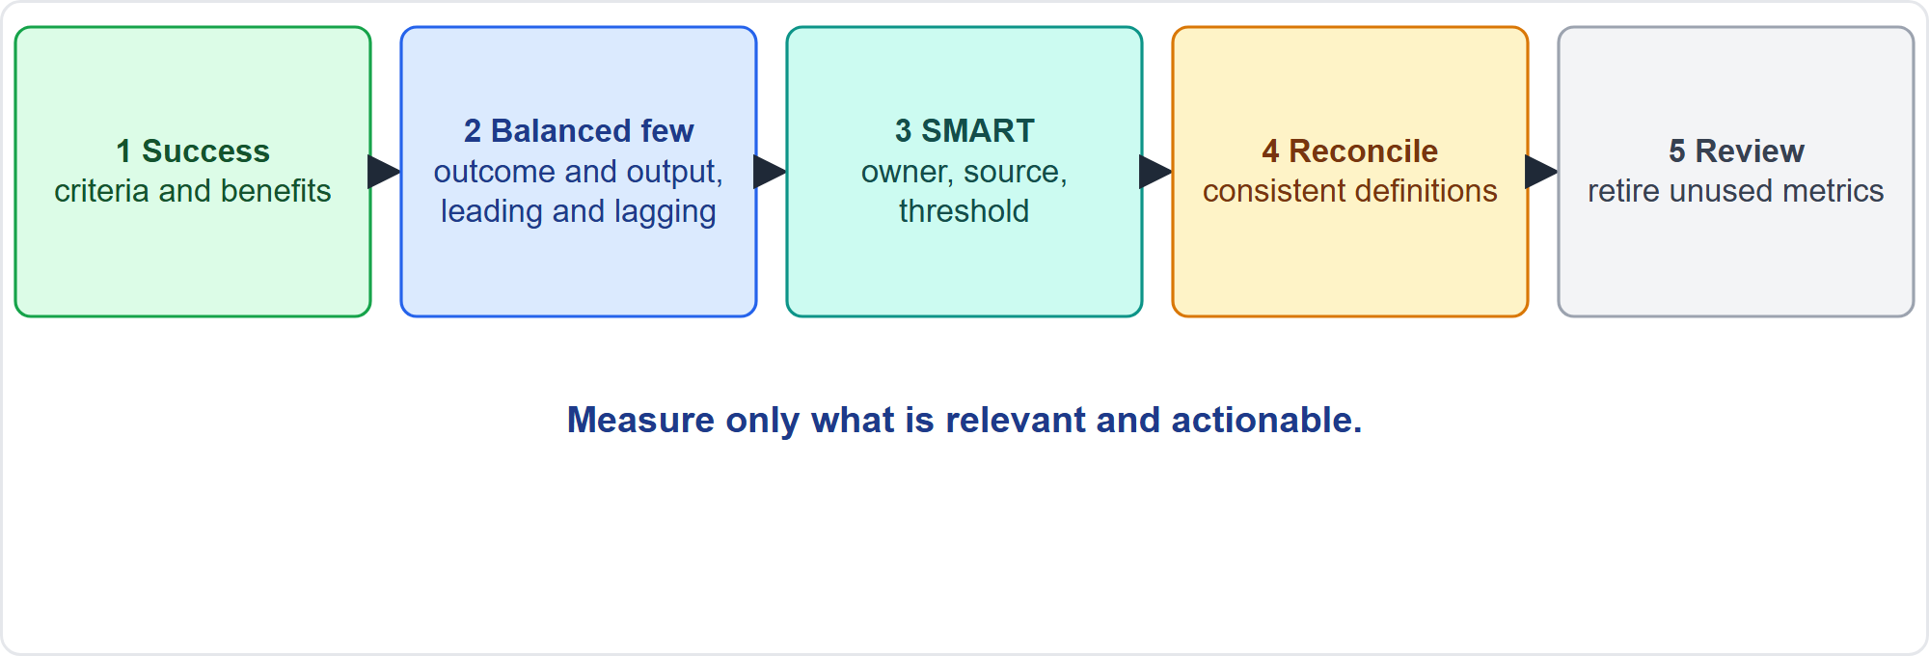
Developing a Metric Set
Part 2
Five steps
EXAM TIP Reconcile data and definitions before reporting: project cost against accounting records, reported progress against accepted work.
PMP Exam Prep 2026 | PMBOK 8 and the New ECO
Module 9: Executing, Status Reporting and Closure
21 / 54
Notes:
Governance needs three components: target metrics aligned with strategy, signaling mechanisms, usually leading indicators, and feedback mechanisms. To build a metric set, start from the success criteria and the benefits plan. Choose a balanced few: outcome and output, leading and lagging, process and product. Make each metric specific, with a definition, source, owner, frequency, target and threshold. Reconcile the data so sources and definitions agree before reporting. And review and retire metrics that nobody uses or that mislead.

Slide 22
Typical Metrics by Domain
Part 2
Domain | Examples
Scope | Scope definition accuracy, requirements stability, acceptance rate
Schedule | SV, SPI, milestone variance, velocity, burn charts, cycle time
Finance | CV, CPI, EAC, spend per iteration against value
Quality | Defects found and escaped, test coverage, rework
Resources | Utilization, downtime, turnover, team satisfaction
Stakeholders | Satisfaction, engagement, Net Promoter Score
Risk | Open high risks, exposure, reserve use
Benefits | Benefits realized, adoption and usage
EXAM TIP Measure only what is relevant and actionable.
PMP Exam Prep 2026 | PMBOK 8 and the New ECO
Module 9: Executing, Status Reporting and Closure
22 / 54
Notes:
Here are typical metrics. Scope: scope definition accuracy, requirements stability and acceptance rate. Schedule: schedule variance and index, milestone variance, velocity, burn charts and cycle time. Finance: cost variance, cost index, estimate at completion, and spend per iteration against value. Quality: defects found and escaped, test coverage and rework. Resources: utilization, downtime, turnover and team satisfaction. Stakeholders: satisfaction, engagement and Net Promoter Score. Risk: open high risks, exposure and reserve use. Benefits: benefits realized, adoption and usage.

Slide 23
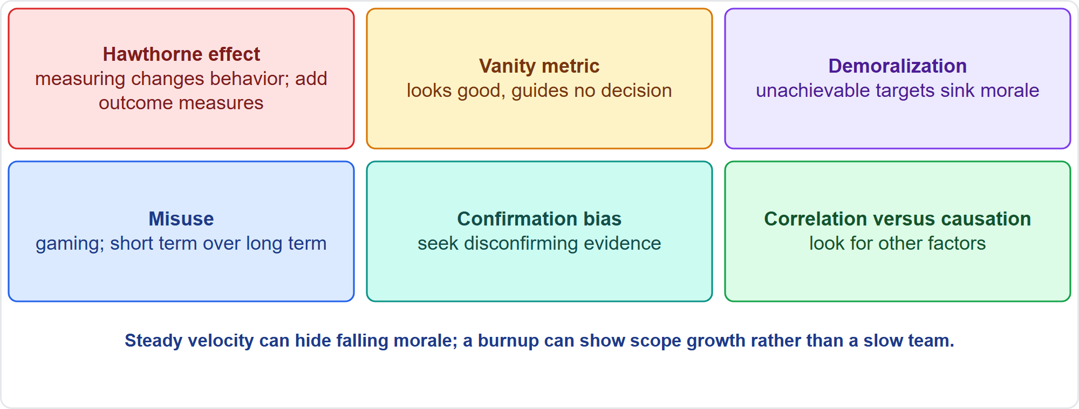
Measurement Pitfalls
Part 2
Six pitfalls
EXAM TIP A team meeting velocity targets while clients rarely use the features needs usage and outcome measures.
PMP Exam Prep 2026 | PMBOK 8 and the New ECO
Module 9: Executing, Status Reporting and Closure
23 / 54
Notes:
PMBOK 8 names six pitfalls. The Hawthorne effect: measuring changes behavior, so output-only measures push volume over customer value. A vanity metric looks good but informs no decision. Demoralization: unachievable targets sink morale. Misuse: gaming, favoring the short term, or doing easy out-of-sequence work to move an indicator. Confirmation bias: seeing only data that supports your view, so seek disconfirming evidence. And correlation is not causation. Steady velocity can hide falling morale, and a burnup showing scope growth explains slow completion without blaming the team.

Slide 24
Assess Progress and Analyze Performance
Part 2
Technique | Use
Performance reviews | Compare actual work with the baseline: dates, percent complete
Variance analysis | Cause and degree of difference; view cost, time, technical and resource together
Trend analysis | Forecast from history; early warning
Earned value | PV, EV, AC, CV, SV, CPI, SPI, EAC, TCPI
Burn charts, velocity, cycle time | Adaptive progress and accepted work
Root cause analysis | Find why before deciding what to do
EXAM TIP An SPI above 1 with a CPI below 1 means speed was bought: analyze the causes and report through governance.
PMP Exam Prep 2026 | PMBOK 8 and the New ECO
Module 9: Executing, Status Reporting and Closure
24 / 54
Notes:
Techniques for assessing progress. Performance reviews compare actual work with the baseline: dates, percent complete and remaining duration. Variance analysis finds the cause and degree of difference, viewing cost, time, technical and resource variances together. Trend analysis forecasts from history, an early warning of slippage. Earned value integrates scope, cost and schedule. Burn charts, velocity and cycle time show adaptive progress. Root cause analysis finds why before deciding what to do. An SPI above one with a CPI below one means speed was bought.

Slide 25
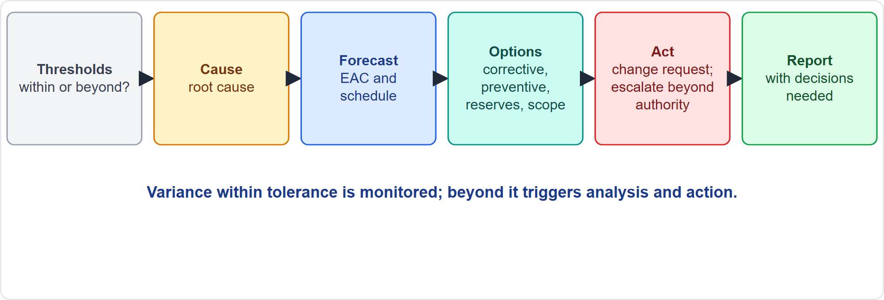
From Analysis to Action
Part 2
Thresholds to report
EXAM TIP Forecast with the EAC, not the BAC; raise change requests where baselines change.
PMP Exam Prep 2026 | PMBOK 8 and the New ECO
Module 9: Executing, Status Reporting and Closure
25 / 54
Notes:
Move from analysis to action. Compare with the thresholds set in the plans. If outside, find the cause, forecast, and evaluate options: corrective or preventive action, reserves, scope or schedule changes. Raise change requests where baselines change, escalate beyond your authority, and report with the decisions needed. Variance within tolerance is monitored. Beyond tolerance, it triggers analysis and action. And forecast total cost with the estimate at completion, not the budget at completion.

Slide 26
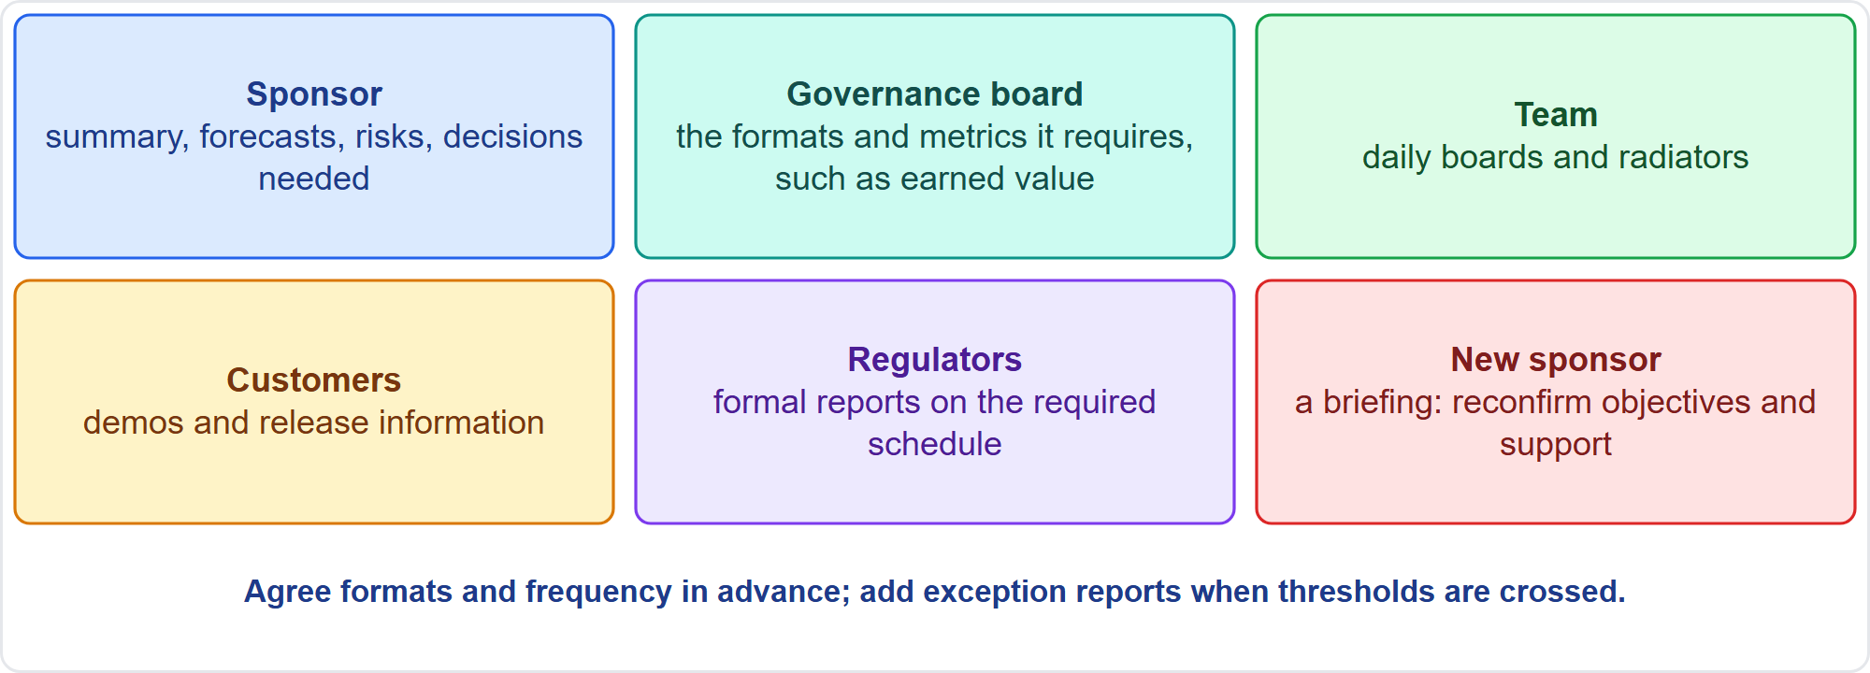
Communicating Project Status
Part 2
Know the audience and the decision
EXAM TIP Report in the form governance needs, such as earned value; do not reuse one format for everyone.
PMP Exam Prep 2026 | PMBOK 8 and the New ECO
Module 9: Executing, Status Reporting and Closure
26 / 54
Notes:
Know the audience and the decision. The sponsor needs a summary, forecasts, risks and decisions needed. The governance board needs the formats and metrics it requires, for example earned value. The team needs daily boards. Customers need demos and release information. Regulators need formal reports on the required schedule. A new sponsor needs a briefing that reconfirms objectives and support, not just the latest report. Agree formats and frequency in advance, and add exception reports when thresholds are crossed. Support governance: if several bodies ask for different formats, agree one reporting structure.

Slide 27
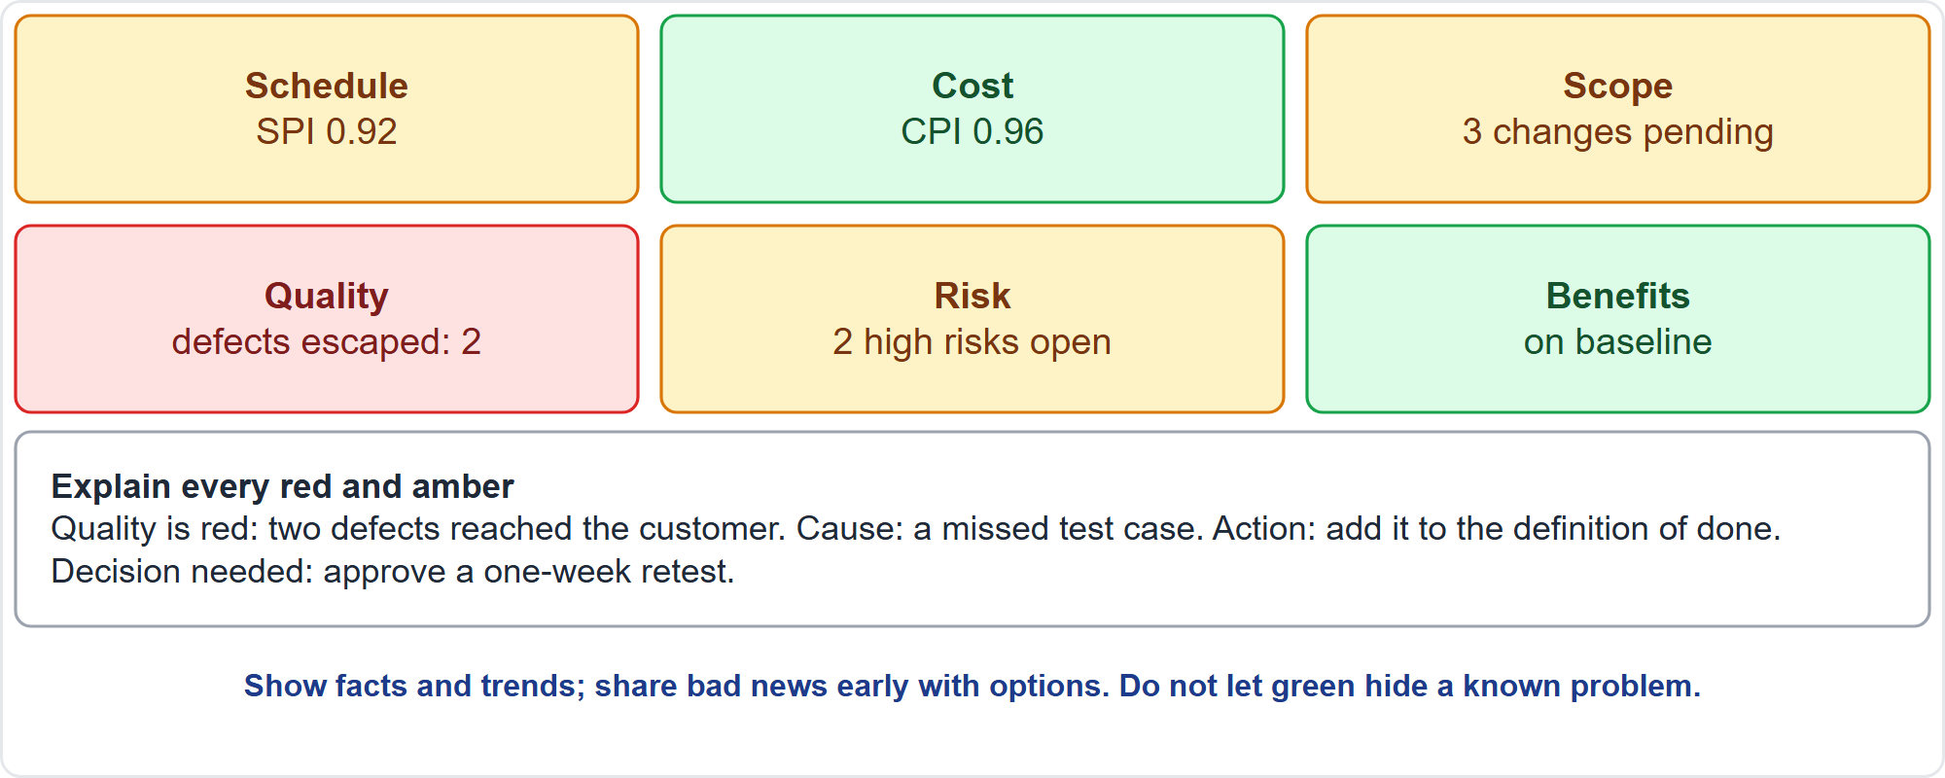
Status Report Content and Dashboards
Part 2
Red, amber, green with explanations
EXAM TIP Explain red and amber with causes, actions and decisions needed; do not report only colors.
PMP Exam Prep 2026 | PMBOK 8 and the New ECO
Module 9: Executing, Status Reporting and Closure
27 / 54
Notes:
A status report shows progress since the last report, and forecasts of cost and schedule. It shows scope and change status, and quality and benefit indicators. It lists key risks and issues, decisions or support needed, and the next period. On a dashboard, use red, amber and green with a text explanation for any measure outside its threshold, and drill-down for detail. Here, quality is red because two defects reached the customer: state the cause, the action and the decision needed. Be accurate and timely: share bad news early, with options. Do not let green hide a known problem.

Slide 28
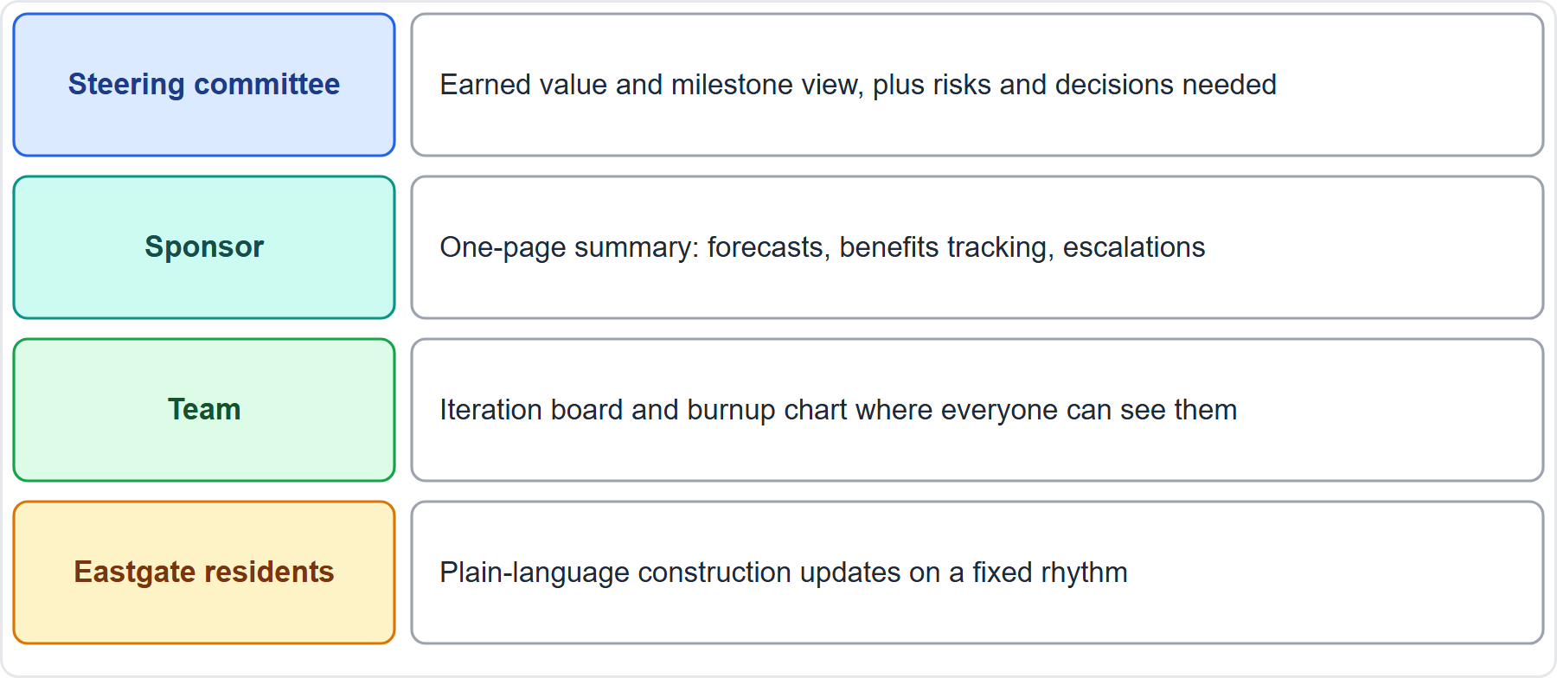
Case Check-In: Status Reporting for the Microgrid
Part 2
CASE CHECK-IN · Sunrise Campus Microgrid
Steering committee: earned value and milestone view, risks, decisions needed
Team and neighbors: a visible board and burnup; plain-language construction updates
PMP Exam Prep 2026 | PMBOK 8 and the New ECO
Module 9: Executing, Status Reporting and Closure
28 / 54
Notes:
On the microgrid, each audience gets a view. The steering committee gets an earned value and milestone view, plus risks and decisions needed. Elena Vasquez gets a one-page summary: forecasts, benefits tracking and escalations. The team gets an iteration board and a burnup chart where everyone can see them. The Eastgate residents get plain-language construction updates on a fixed rhythm. These are different views of one truth. Never let one audience see green while another sees red for the same fact.

Slide 29
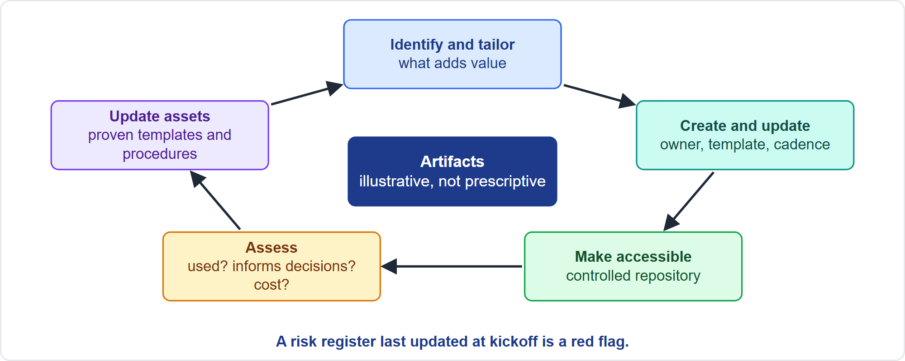
Managing Project Artifacts
Part 2
Five habits
EXAM TIP Keep what stakeholders use; retire, merge or simplify the rest; do not merge unused content into one bigger report.
PMP Exam Prep 2026 | PMBOK 8 and the New ECO
Module 9: Executing, Status Reporting and Closure
29 / 54
Notes:
Artifacts are plans, baselines, documents, reports and deliverables. PMBOK 8 lists a sampling, illustrative and not prescriptive, and each organization tailors them. Identify and tailor: pick artifacts that add value for the project's size, risk, regulation and audience. Create and update: give each an owner, a template and a cadence, and review them. Make them accessible: one controlled repository with permissions and version control, so auditors do not hunt through personal drives. Assess effectiveness: are they used, do they inform decisions, what do they cost? And update organizational assets with proven templates.

Slide 30
Status in Predictive, Agile and Hybrid Work
Part 2
 | Predictive | Agile | Hybrid
Progress | Percent complete, earned value, milestones | Accepted working increments, burn charts, velocity | Milestones outside; burn charts inside
Metrics | SPI, CPI, variances, thresholds | Value delivered, usage, defects escaped, team health | Both
Visibility | Reports, dashboards, steering packs | Radiators, boards, demos | Both
Cadence | Monthly or by phase, plus exceptions | Every iteration, continuously | Both
Artifacts | Formal plans and logs | Backlog, board, working agreements | Formal envelope, light inside
EXAM TIP Predictive reporting can describe activity instead of outcomes; agile reporting can describe output instead of value.
PMP Exam Prep 2026 | PMBOK 8 and the New ECO
Module 9: Executing, Status Reporting and Closure
30 / 54
Notes:
Status looks different by approach. Predictive: percent complete, earned value and milestones, with indices and thresholds. Reports and dashboards come monthly or by phase, plus exceptions. Artifacts are formal plans and logs. Agile: accepted working increments, burn charts and velocity. Value delivered, usage and team health matter, shown on radiators and in demos every iteration, with light artifacts. Hybrid: milestones for the envelope and burn charts inside. The pitfalls differ: predictive reporting can describe activity instead of outcomes, and agile reporting can describe output instead of value.

Slide 31
Status Traps: What PMI Expects
Part 2
Report in the form governance needs; agree formats per audience
Output is not value: include usage, benefits and outcomes
Prefer leading indicators; read SPI and CPI together
Forecast with the EAC, not the BAC
Watch the pitfalls: Hawthorne, vanity metrics, gaming, bias
Keep artifacts current and findable; explain red and amber
EXAM TIP Brief a new sponsor and reconfirm objectives rather than just sending the latest report.
PMP Exam Prep 2026 | PMBOK 8 and the New ECO
Module 9: Executing, Status Reporting and Closure
31 / 54
Notes:
The traps for status. Report in the form governance needs, and agree formats with each audience. Output is not value: include usage, benefits and outcomes. Prefer leading indicators, and read the schedule and cost indices together. Forecast with the estimate at completion, not the budget at completion. Watch the measurement pitfalls. Keep artifacts current and findable in a controlled repository. Explain red and amber with causes, actions and decisions. Show the real cause of slow progress, such as a burnup with growing scope, instead of pressuring the team.

Slide 32
Closure: Key Terms
Part 2
Term | Meaning
Closing Focus Area | Formally completing a project, phase or contract, or terminating early
Close Project or Phase | Finalizing all activities, successful or not; archiving; releasing resources; confirming the value achieved
Closure (exit) criteria | Conditions that must be met before closing; agreed early
Transition readiness | The receiver's ability to run the result
Final report | Summary of scope, quality, cost, schedule, benefits, risks and issues
Benefits owner | Accountable for tracking benefits after closure
EXAM TIP A terminated project still closes formally.
PMP Exam Prep 2026 | PMBOK 8 and the New ECO
Module 9: Executing, Status Reporting and Closure
32 / 54
Notes:
Now closure. Key terms. The Closing Focus Area formally completes a project, phase or contract, or terminates a project early. Close Project or Phase finalizes all activities, for successful and unsuccessful projects. It archives information and releases resources. And it confirms the extent to which value, or the capability to deliver value, was achieved. Closure criteria are the conditions that must be met before closing, agreed early. Transition readiness is the receiver's ability to run the result. The final report summarizes performance. And the benefits owner tracks benefits after closure.

Slide 33
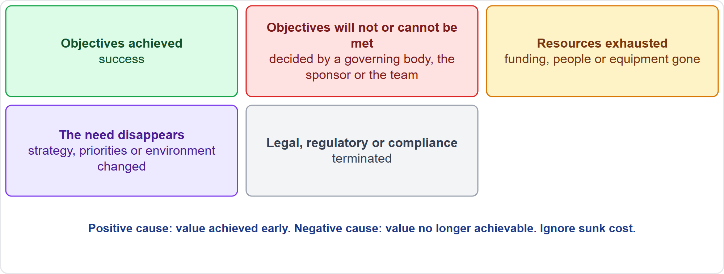
When and How a Project Ends
Part 2
Five ways a project ends
EXAM TIP Termination is a valid value decision; the sponsor and governance decide; ignore sunk costs.
PMP Exam Prep 2026 | PMBOK 8 and the New ECO
Module 9: Executing, Status Reporting and Closure
33 / 54
Notes:
A project usually ends in one of five ways. The objectives are achieved. A governing body, the sponsor or the team determines the objectives will not or cannot be met. Resources are exhausted. Changes in strategy, priorities or the external environment mean the need no longer exists. Or it is terminated for legal, regulatory or compliance reasons. Early termination for a positive cause means the desired value was achieved early. For a negative cause, value is no longer achievable. The sponsor holds decision authority, and the project manager analyzes, recommends and carries out closure.

Slide 34
Part 2 Recap
Part 2
1
Metrics
2
Pitfalls
3
Analysis
outcomes over inputs; leading over lagging; SMART and reconciled
Hawthorne, vanity, demoralization, misuse, bias, correlation
thresholds, cause, forecast, options, change request, report
4
Reports and artifacts
5
Approaches
6
Closure basics
by audience; explain red and amber; current and findable
accepted increments versus percent complete
the five ways a project ends
PMP Exam Prep 2026 | PMBOK 8 and the New ECO
Module 9: Executing, Status Reporting and Closure
34 / 54
Notes:
Let us recap Part 2. Prefer outcome metrics to inputs and leading to lagging indicators, with metrics that are specific and reconciled. Know the pitfalls: the Hawthorne effect, vanity metrics, demoralization, misuse, bias and correlation. Analysis runs from thresholds to cause, forecast, options, change request and report. Report by audience, explain red and amber, and add exception reports. Keep artifacts tailored, current, findable and assessed. In agile work, report accepted increments rather than percent complete. And a project ends in one of five ways, with value as the primary factor. In Part 3, we run the closure sequence.

Slide 35
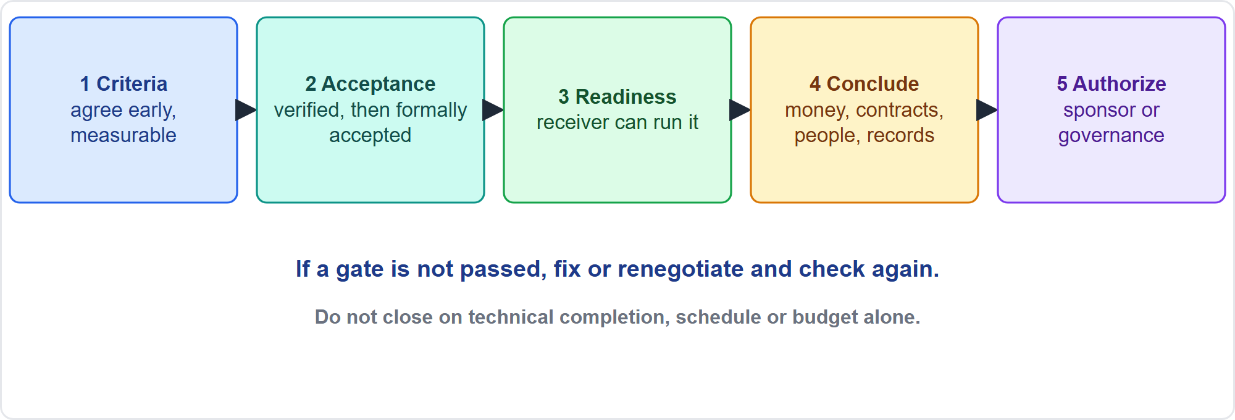
The Closure Sequence
Part 3
Five gates
EXAM TIP If a gate is not passed, fix or renegotiate and check again; do not close on technical completion alone.
PMP Exam Prep 2026 | PMBOK 8 and the New ECO
Module 9: Executing, Status Reporting and Closure
35 / 54
Notes:
Closure has five gates. One, set the criteria for closing successfully, agreed early and kept current. Two, obtain acceptance: verified deliverables are formally accepted, and vendors' work is accepted. Three, validate readiness for transition: the receiver can operate or continue the work. Four, conclude activities: financials, procurement, resources, records, final lessons and the final report. Five, authorize completion: the sponsor or governance authorizes closure, and stakeholders are informed. If a gate is not passed, fix or renegotiate and check again.

Slide 36
Determine Closure Criteria
Part 3
Category | Typical criteria
Product and scope | Deliverables meet acceptance criteria and are formally accepted
Quality and compliance | Verification complete; operational, safety and regulatory checks passed
Administrative | Documents updated; issues resolved; costs charged; accounts closed
Contractual | Seller's work accepted; claims and warranties final; invoices paid
Transition | Receivers trained; documentation and support ready; risks transferred
Knowledge and value | Lessons captured; records archived; value plan and benefits owner set
EXAM TIP Define closure criteria early, in the charter, plan, contract and benefits plan, and make them measurable.
PMP Exam Prep 2026 | PMBOK 8 and the New ECO
Module 9: Executing, Status Reporting and Closure
36 / 54
Notes:
Define closure criteria early, in the charter, the plan, the contract and the benefits plan, with the sponsor and customer. Make them measurable and agreed. Product and scope: deliverables meet acceptance criteria and are formally accepted. Quality and compliance: verification complete, and operational, safety and regulatory checks passed. Administrative: documents updated, issues resolved, costs charged, accounts closed. Contractual: the seller's work accepted, claims and warranties finalized, invoices paid. Transition: receivers trained, documentation and support ready, risks transferred. Knowledge and value: lessons captured, records archived, a value plan and a benefits owner.

Slide 37
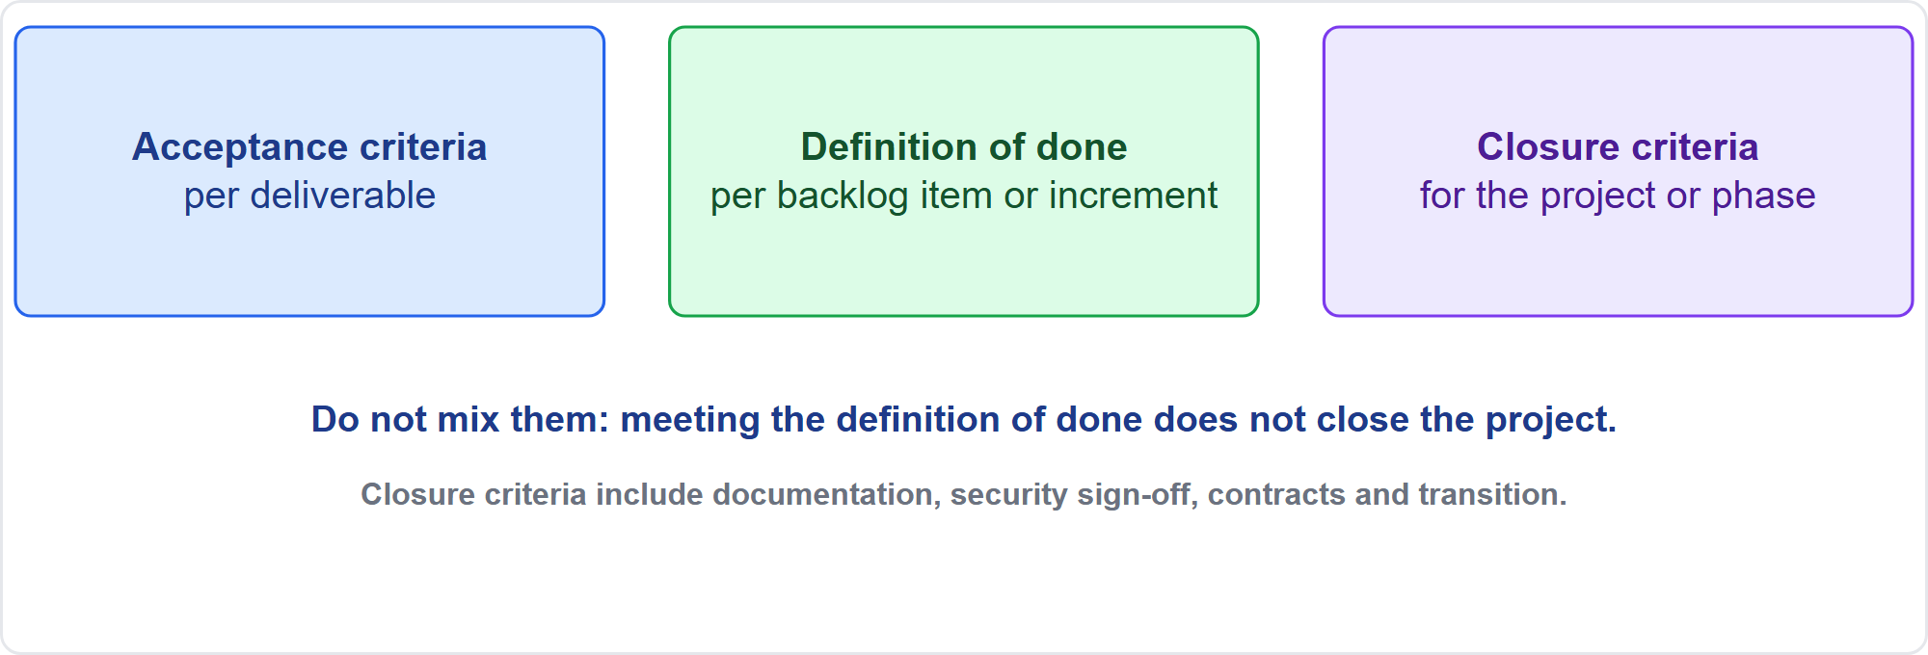
Three Kinds of Done
Part 3
Acceptance criteria, definition of done, closure criteria
EXAM TIP Meeting the definition of done for the last release does not close the project: check the closure criteria separately.
PMP Exam Prep 2026 | PMBOK 8 and the New ECO
Module 9: Executing, Status Reporting and Closure
37 / 54
Notes:
Do not mix three kinds of done. Acceptance criteria apply to each deliverable. The definition of done applies to each backlog item or increment. Closure criteria apply to the project or phase. Suppose every story in the last release met the definition of done, but the contract lists closure criteria such as final documentation and a security sign-off. The project is not finished. Check the closure criteria separately. In adaptive work, when funding ends, agree closure criteria and transfer the remaining backlog to the product owner.

Slide 38
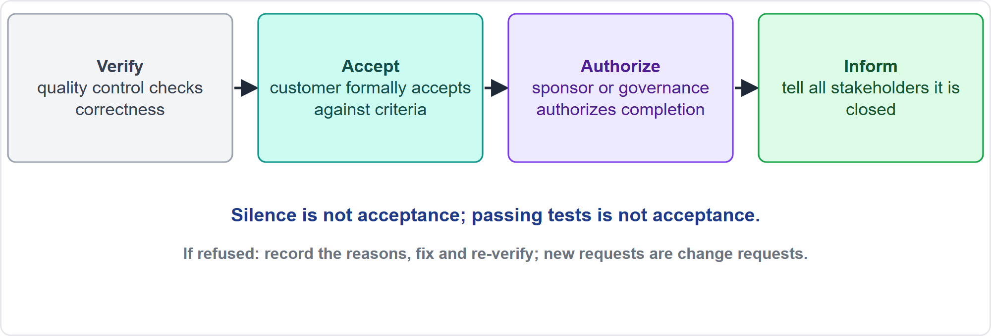
Obtain Stakeholder Approval of Completion
Part 3
Verify, accept, authorize, inform
EXAM TIP Silence is not acceptance; if acceptance is refused, record the reasons, fix and re-verify, and treat new requests as change requests.
PMP Exam Prep 2026 | PMBOK 8 and the New ECO
Module 9: Executing, Status Reporting and Closure
38 / 54
Notes:
The chain is: verify, accept, authorize, inform. Quality control verifies correctness. The customer formally accepts against the acceptance criteria. The sponsor or governance authorizes completion. Then inform all stakeholders. Passing quality control is not acceptance, and silence is not acceptance. Hold a formal acceptance review and document it with a signed acceptance, minutes and a closure notice. If acceptance is refused, record the reasons, fix and re-verify, treat new requests as change requests, and do not close. Engage a new sponsor before closure.

Slide 39
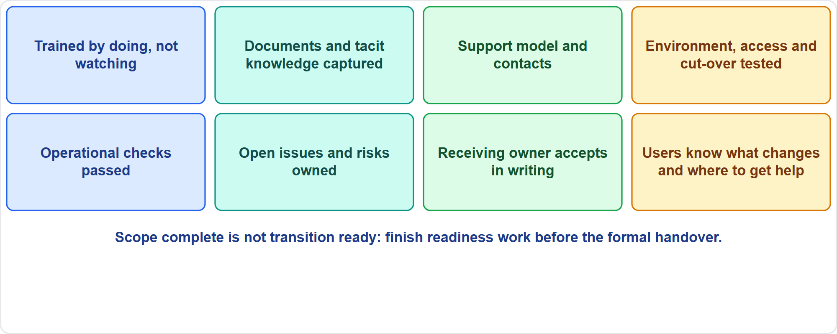
Validate Readiness for Transition
Part 3
Eight checks
EXAM TIP If training is incomplete, complete it before the formal handover; do not close and leave operations to arrange it.
PMP Exam Prep 2026 | PMBOK 8 and the New ECO
Module 9: Executing, Status Reporting and Closure
39 / 54
Notes:
Scope complete is not transition ready. Check eight things. People and skills: the receivers have done the work with support, not only watched demonstrations. Documentation and knowledge, including tacit knowledge captured from people who are leaving. The support model. Environment and access, with cut-over tested. Verification and compliance. Open items and risks, accepted or transitioned with owners. Ownership: the receiving owner accepts in writing, and a benefits owner is set. And communication to users. If people holding critical knowledge are leaving soon, capture it from them first.

Slide 40
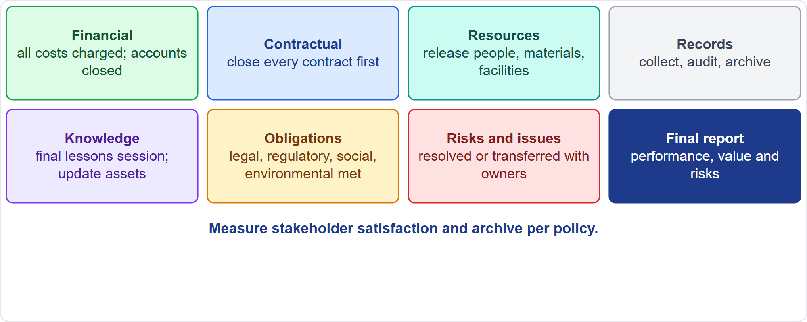
Conclude Activities
Part 3
Eight areas
EXAM TIP Financial closure comes before project closure; every contract must be closed before the project is.
PMP Exam Prep 2026 | PMBOK 8 and the New ECO
Module 9: Executing, Status Reporting and Closure
40 / 54
Notes:
Conclude activities in eight areas. Financial: all costs charged, accounts closed. Contractual: every contract closed first. Resources: reassign or release people, address excess materials, release facilities and equipment. Records: collect, audit and archive in a controlled repository. Knowledge: a final lessons session, even if retrospectives ran every iteration, and update process assets. Obligations: verify that contractual, regulatory, legal, social and environmental obligations are met. Risks and issues: resolved or transferred with owners. And the final report.

Slide 41
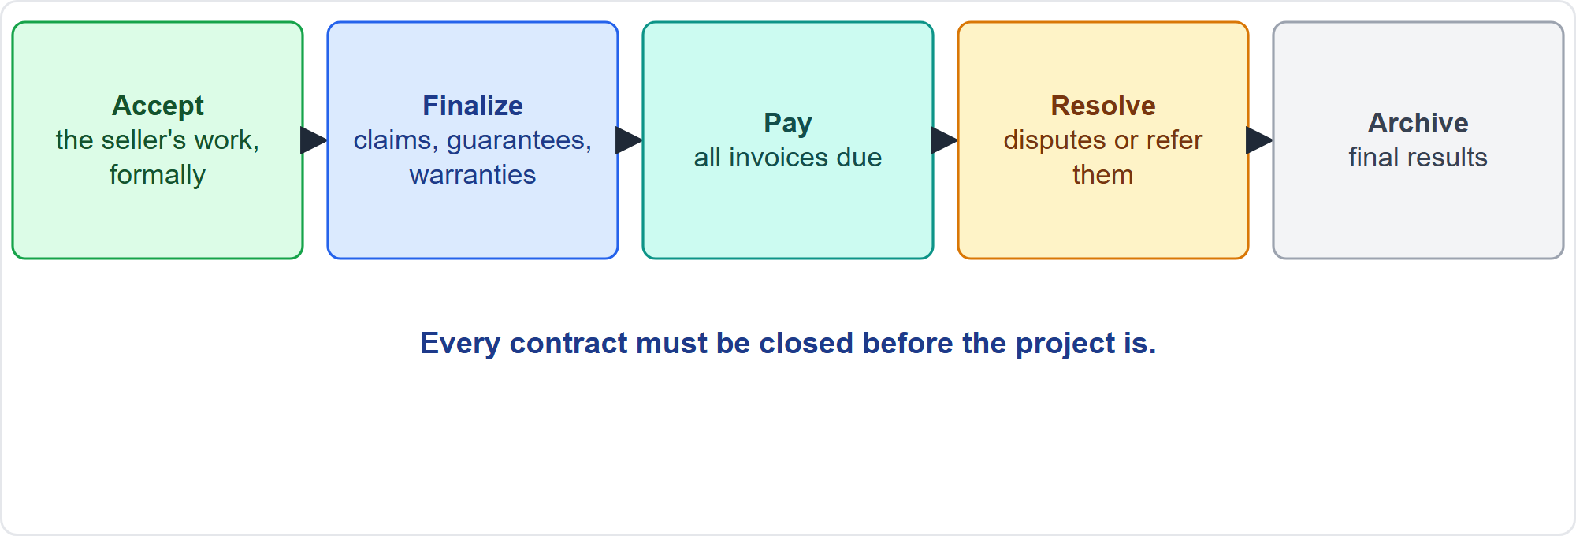
Closing Contracts
Part 3
Accept, finalize, pay, resolve, archive
EXAM TIP Do not close the project with open claims, unpaid invoices or unresolved disputes.
PMP Exam Prep 2026 | PMBOK 8 and the New ECO
Module 9: Executing, Status Reporting and Closure
41 / 54
Notes:
Closing a contract has five steps. Accept the external source's work formally. Finalize open claims, guarantees and warranties. Pay all invoices due. Resolve disputes or refer them to the dispute board. And update the records with the final results and archive the information. Every contract must be closed before the project is. Do not close the project with open claims, unpaid invoices or unresolved disputes. A terminated project settles contracts under their termination provisions: accept and pay for what was delivered, and finalize claims.

Slide 42
The Final Report and Lessons
Part 3
Final report: performance, validation of the product, benefits achieved or expected, risks and issues
Assess success or failure against objectives, the business case and benefits
Hold a final lessons session; make lessons searchable; update process assets
Measure stakeholder satisfaction; tell everyone the project is closed
Forward suggestions for improving organizational policies
Archive records in a controlled repository per policy
EXAM TIP Make lessons searchable and walk the next team through them.
PMP Exam Prep 2026 | PMBOK 8 and the New ECO
Module 9: Executing, Status Reporting and Closure
42 / 54
Notes:
The final report summarizes performance. It describes the project or phase, and the evidence that completion criteria were met. It gives quality, cost and schedule results with reasons for variances. It covers validation of the final product, benefits and business needs achieved or expected, and the risks and issues met. Assess success or failure against objectives, the business case and benefits. Hold a final lessons session and update process assets, forwarding suggestions for improving organizational policies to their owners. Measure stakeholder satisfaction, and tell everyone the project is closed. Archive records in a controlled repository.

Slide 43
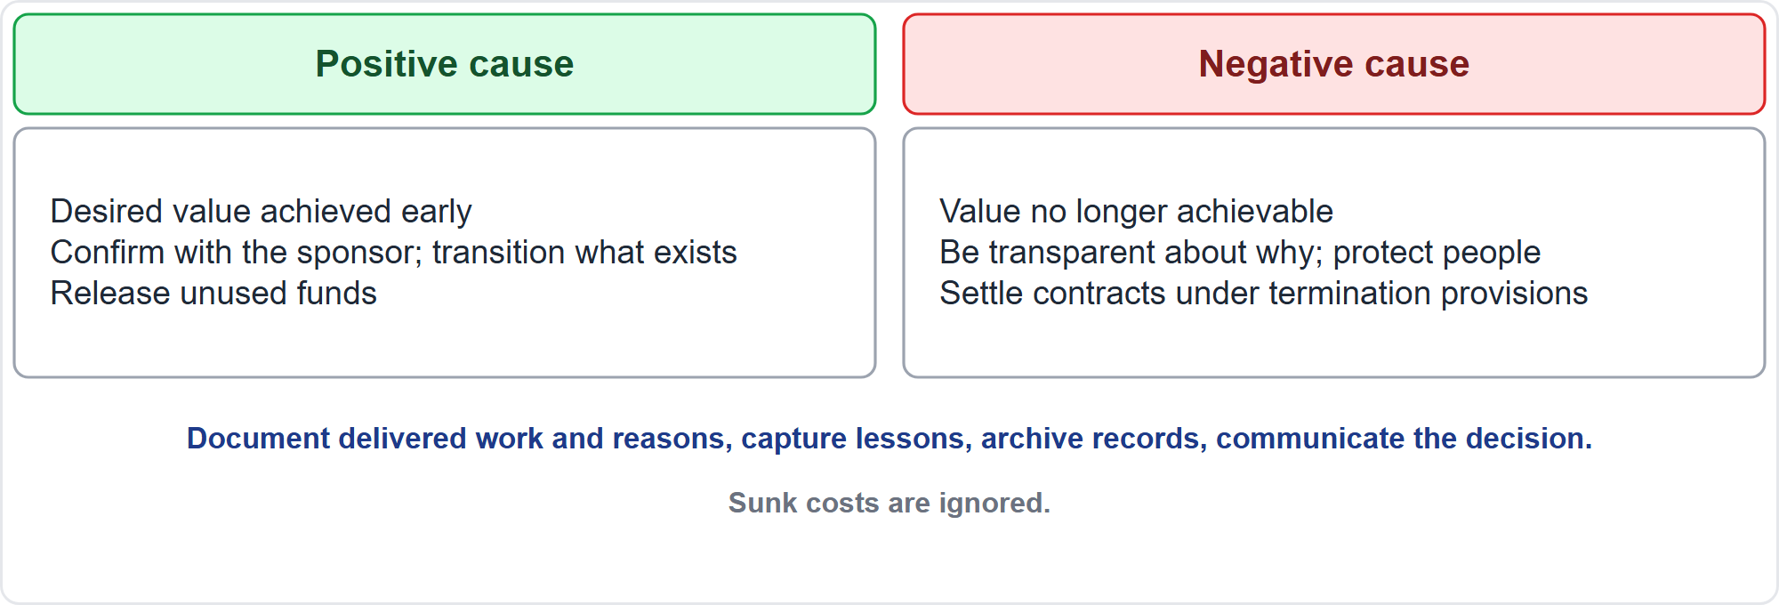
Early Termination and Cancelled Projects
Part 3
Positive cause, negative cause
EXAM TIP Do not finish a project only to avoid wasting spent money: sunk costs are ignored.
PMP Exam Prep 2026 | PMBOK 8 and the New ECO
Module 9: Executing, Status Reporting and Closure
43 / 54
Notes:
A terminated project still closes formally. PMBOK 8 expects procedures to investigate and document the reasons for early termination and to engage the relevant stakeholders. Document the work delivered, and decide what can be transitioned or reused. Settle contracts under their termination provisions. Release people and resources. Capture lessons and archive records. And communicate the decision and its reasons. For a positive cause, confirm the value with the sponsor, transition what exists and release unused funds. For a negative cause, be transparent about why, and protect people and relationships.

Slide 44
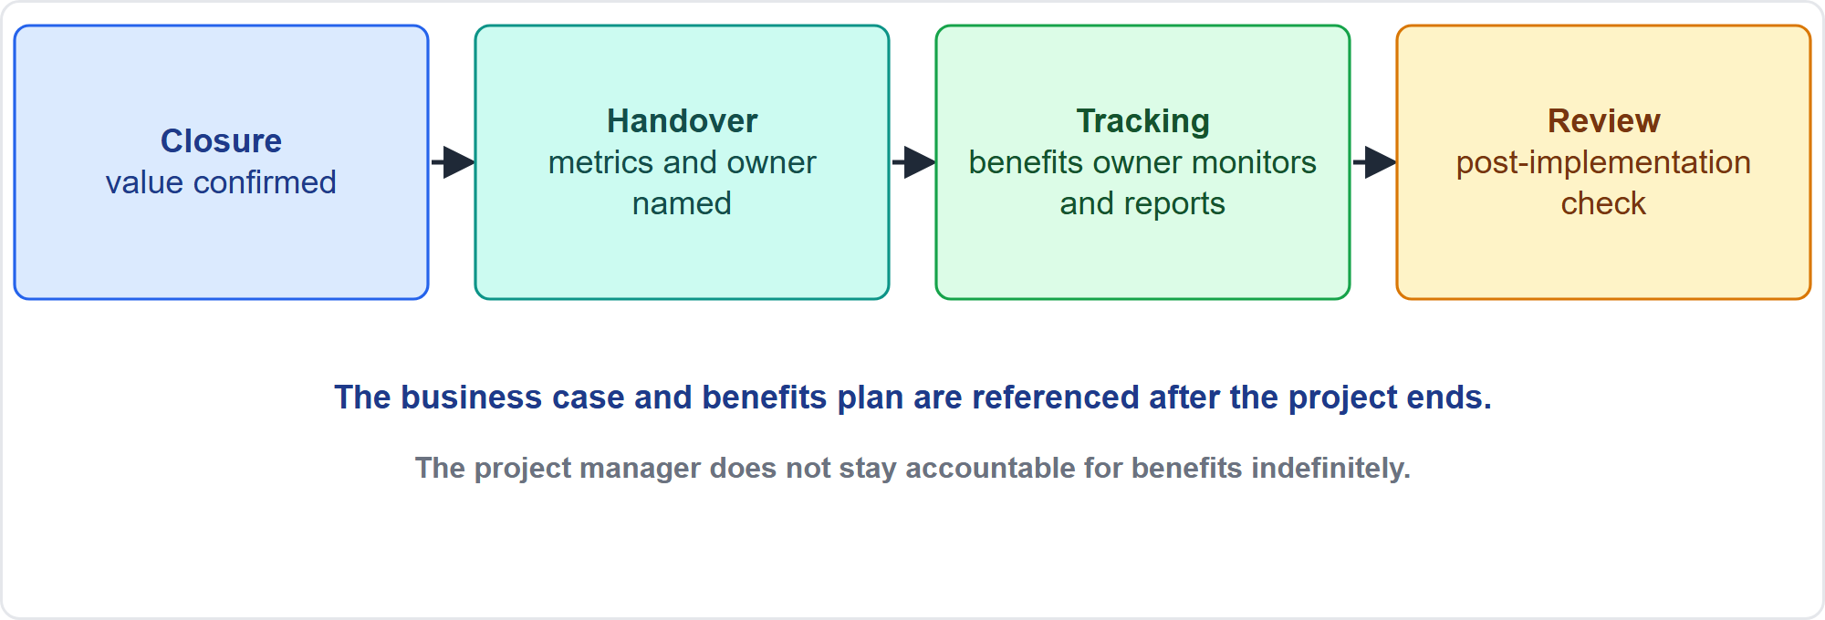
Benefits After Closure
Part 3
Closure, handover, tracking, review
EXAM TIP Name a benefits owner and hand over the metrics before closing; the project manager does not stay accountable for benefits indefinitely.
PMP Exam Prep 2026 | PMBOK 8 and the New ECO
Module 9: Executing, Status Reporting and Closure
44 / 54
Notes:
Value and benefits outlast the project. The business case and the benefits management plan are business documents, developed before the project and referenced after it ends. The benefits owner monitors, records and reports realized benefits over the planned timeframe. The project manager hands this over with the metrics and does not stay accountable for benefits indefinitely. As exam practice, a post-implementation review some time later checks whether the intended benefits materialized. Oversight may continue after deliverables are finalized but before formal closure, for benefits realization and sustainment.

Slide 45
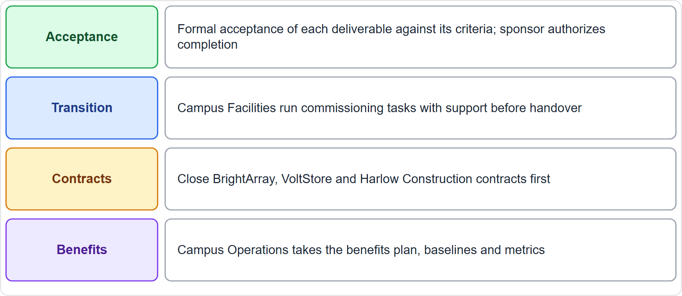
Case Check-In: Closing the Microgrid
Part 3
CASE CHECK-IN · Sunrise Campus Microgrid
Acceptance and transition: formal acceptance; Campus Facilities perform tasks with support
Contracts and benefits: contracts closed first; Campus Operations takes the benefits plan
PMP Exam Prep 2026 | PMBOK 8 and the New ECO
Module 9: Executing, Status Reporting and Closure
45 / 54
Notes:
Closing our microgrid follows the sequence. Each deliverable is formally accepted against its criteria, and Elena Vasquez authorizes completion. Campus Facilities perform the commissioning tasks with support before handover: watching is not doing. Close the BrightArray, VoltStore and Harlow Construction contracts first, after verifying obligations. Then hand the benefits management plan, baselines and metrics to Campus Operations, the benefits owner. Hold a final lessons session, archive the records, and release the team.

Slide 46
Closure in Predictive, Agile and Hybrid Work
Part 3
 | Predictive | Agile | Hybrid
Closure unit | Phase and project, with gates | Iteration, release, product | Both
Acceptance | Formal sign-off against criteria | Review against the definition of done | Formal for baselined parts
Criteria | Exit criteria in plan and contract | Definition of done; closure criteria when funding ends | Both
Knowledge | Final lessons; archive | Retrospectives plus a final session | Both
Remaining work | Open items go to owners | Backlog goes to the product owner | Mixed
EXAM TIP In agile work the project may close while the product continues.
PMP Exam Prep 2026 | PMBOK 8 and the New ECO
Module 9: Executing, Status Reporting and Closure
46 / 54
Notes:
Closure looks different by approach. Predictive: closure at phases and the project, with gates, formal acceptance against criteria with sign-off, and exit criteria in the plan and contract. Open items go to owners. Agile: closure at iteration, release and product, with stakeholder review against the definition of done, and closure criteria agreed when funding ends. Unfinished backlog goes to the product owner, because unfinished value belongs to the product, not the project. The project may close while the product continues. Hybrid: formal for the baselined parts, review-based for increments.

Slide 47
Closure Traps: What PMI Expects
Part 3
Passing tests is not acceptance; silence is not acceptance
Each phase closes formally with acceptance
Scope complete is not transition ready: finish readiness before handover
Financial closure and contract closure come first
A terminated project still closes formally; ignore sunk costs
The sponsor or governance authorizes completion; name a benefits owner
EXAM TIP Capture knowledge from departing people first; hands-on practice beats demos and manuals.
PMP Exam Prep 2026 | PMBOK 8 and the New ECO
Module 9: Executing, Status Reporting and Closure
47 / 54
Notes:
The traps for closure. Passing tests is not acceptance, and silence is not acceptance. Each phase closes formally with acceptance. Scope complete is not transition ready: finish readiness work before handover. Financial closure and contract closure come first. A terminated project still closes formally, and sunk costs are ignored. The sponsor or governance authorizes completion, not the project manager alone. Value outlasts the project, so name a benefits owner. New requests after acceptance go through change control as new work. Do not close on schedule and budget alone.

Slide 48
Module Recap
Part 3
1
Execute
2
Report
3
Accept
follow the plan, change it through the process, record and unblock
outcome metrics, honest status by audience, current artifacts
verified, formally accepted, sponsor authorizes
4
Hand over
5
Learn
6
Next
ready receivers, closed contracts, a benefits owner
final lessons, archived records, assets updated
five practice questions
PMP Exam Prep 2026 | PMBOK 8 and the New ECO
Module 9: Executing, Status Reporting and Closure
48 / 54
Notes:
Let us recap the whole module. Execute: follow the plan, change it through the process, record data and remove blockers. Report: use outcome metrics, honest status for each audience and current artifacts. Accept: deliverables are verified and formally accepted, and the sponsor authorizes completion. Hand over: ready receivers, closed contracts and a benefits owner. Learn: a final lessons session, archived records and updated process assets. Now it is time to test yourself. Five questions follow. For each one, pause the video, choose your answer, and then listen to the explanation.

Slide 49
Practice Question 1
Part 3
Q1
A vendor delivers a pump with a higher capacity than specified, at no extra cost, and the team wants to install it because it passed its tests. What should the project manager do?
A
Install the pump, since it costs nothing and passed every test
B
Evaluate the impact and submit the pump through change control
C
Reject the pump and require the exact model in the original specification
D
Install it and update the specification after the commissioning phase
PMP Exam Prep 2026 | PMBOK 8 and the New ECO
Module 9: Executing, Status Reporting and Closure
49 / 54
Notes:
Question one. A vendor delivers a pump with a higher capacity than specified, at no extra cost, and the team wants to install it because it passed its tests. What should the project manager do? The four options are on the screen. Choose your answer. [PAUSE 12] The answer is B. Even free upgrades need impact assessment, and passing tests does not replace configuration review, so the change goes through change control. Installing it, rejecting it automatically, or updating records afterward all skip the assessment.

Slide 50
Practice Question 2
Part 3
Q2
Two teams keep missing handoffs, and the project manager is considering adding a weekly review meeting. What is the best action?
A
Add the weekly review meeting and escalate each missed handoff to the sponsor
B
Ask both team leads to coordinate informally and report any problems later
C
Increase the number of status reports that each team submits every week
D
Define the handoffs, responsibilities and confirmation points between the teams
PMP Exam Prep 2026 | PMBOK 8 and the New ECO
Module 9: Executing, Status Reporting and Closure
50 / 54
Notes:
Question two. Two teams keep missing handoffs, and the project manager is considering adding a weekly review meeting. What is the best action? The four options are on the screen. Choose your answer. [PAUSE 12] The answer is D. Missed handoffs are fixed at the source by defining the handoff, who is responsible and how completion is confirmed, rather than adding meetings. More meetings, informal coordination, or more reports leave the handoff itself undefined.

Slide 51
Practice Question 3
Part 3
Q3
A team meets its velocity target every sprint, but surveys show that clients rarely use the new features. What should the project manager do?
A
Add usage and outcome measures to the progress report, alongside velocity
B
Raise the velocity target so that more features are delivered in each sprint
C
Stop reporting velocity so that the team is not judged on output
D
Report that the project is on track because velocity targets were met
PMP Exam Prep 2026 | PMBOK 8 and the New ECO
Module 9: Executing, Status Reporting and Closure
51 / 54
Notes:
Question three. A team meets its velocity target every sprint, but surveys show that clients rarely use the new features. What should the project manager do? The four options are on the screen. Choose your answer. [PAUSE 12] The answer is A. Velocity is output, not value, so the project manager adds usage and outcome measures to show whether the features create value. Raising the target, dropping the measure, or declaring success ignores the outcome gap.

Slide 52
Practice Question 4
Part 3
Q4
All tests on the final deliverable passed, and the vendor says the work is complete. The customer has not responded to the acceptance request. What should the project manager do?
A
Treat the customer's silence as acceptance and close the whole work package
B
Mark the deliverable as accepted because quality control confirmed it
C
Hold a formal acceptance review with the customer against the criteria
D
Ask the vendor to repeat the tests until the customer replies in writing
PMP Exam Prep 2026 | PMBOK 8 and the New ECO
Module 9: Executing, Status Reporting and Closure
52 / 54
Notes:
Question four. All tests on the final deliverable passed, and the vendor says the work is complete. The customer has not responded to the acceptance request. What should the project manager do? The four options are on the screen. Choose your answer. [PAUSE 12] The answer is C. Passing quality control is verification, not acceptance, and silence is not acceptance, so a formal review with the customer is needed. Treating silence as acceptance, marking it accepted, or repeating tests skip the customer's formal acceptance.

Slide 53
Practice Question 5
Part 3
Q5
A new system is complete and accepted, but the operations staff who will run it have only watched demonstrations. The project is scheduled to close next week. What should the project manager do?
A
Close the project on schedule and let operations arrange its own training
B
Complete hands-on training before the formal handover, then close
C
Hand over the manuals and close, since the deliverables were accepted
D
Extend the project indefinitely until operations says that it feels ready
PMP Exam Prep 2026 | PMBOK 8 and the New ECO
Module 9: Executing, Status Reporting and Closure
53 / 54
Notes:
Question five. A new system is complete and accepted, but the operations staff who will run it have only watched demonstrations. The project is scheduled to close next week. What should the project manager do? The four options are on the screen. Choose your answer. [PAUSE 12] The answer is B. Scope complete is not transition ready, so the receivers must perform the work with support before the formal handover and closure. Leaving training to operations, handing over manuals, or an open-ended extension do not confirm readiness.

Slide 54
Answers at a Glance
Part 3
Question | Answer | Why
Q1 | B | Even a free upgrade needs impact assessment and change control
Q2 | D | Define handoffs and confirmation points instead of adding meetings
Q3 | A | Velocity is output, so add usage and outcome measures
Q4 | C | Verified is not accepted, and silence is not acceptance
Q5 | B | Scope complete is not transition ready, so finish hands-on training first
PMP Exam Prep 2026 | PMBOK 8 and the New ECO
Module 9: Executing, Status Reporting and Closure
54 / 54
Notes:
Here are all five answers together. Question one: B. Even a free upgrade needs impact assessment and change control. Question two: D. Define handoffs and confirmation points instead of adding meetings. Question three: A. Velocity is output, so add usage and outcome measures. Question four: C. Verified is not accepted, and silence is not acceptance. Question five: B. Scope complete is not transition ready, so finish hands-on training first. That completes Module 9. Next, Module 10 covers project governance and compliance. See you there.

