Slide 1
Module 10: Governance and Compliance
Part 1 of 2: Governance
Business Environment domain · ECO tasks 1 and 2
PMP Exam Prep 2026: PMBOK 8 and the New ECO
Module 10: Governance and Compliance · Part 1
Notes:
Welcome to Module 10. This is the first of three Business Environment modules, and the Business Environment domain carries twenty-six percent of the exam. This module covers two tasks that frame everything else. Governance is how decisions are made and who makes them. And compliance is the set of rules the project is bound by. Part 1 covers governance. Part 2 covers compliance.

Slide 2
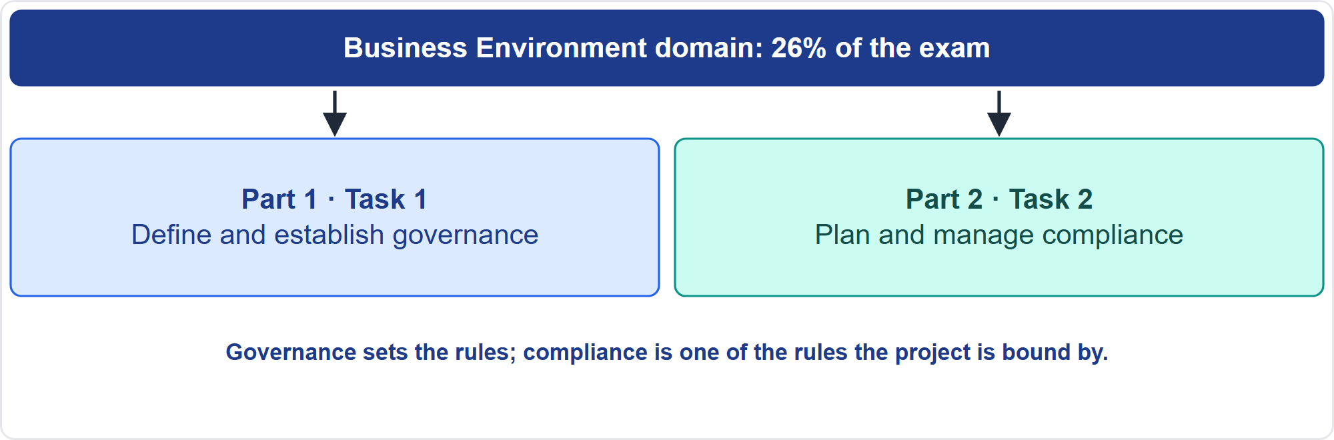
Where This Module Sits in the Exam
Part 1
Two Business Environment tasks
EXAM TIP When a decision exceeds your authority and no threshold exists, work with the sponsor to define it; do not infer it.
PMP Exam Prep 2026 | PMBOK 8 and the New ECO
Module 10: Governance and Compliance
2 / 44
Notes:
Here is where this module sits. The Business Environment domain has eight tasks, and this module covers two. Task one: define and establish governance. That includes structure, rules, procedures and reporting. It includes ethics and policies, success metrics, and escalation paths and thresholds. Task two: plan and manage compliance, from confirming requirements to measuring how compliant the project is. A reliable exam habit: when a decision exceeds your authority and no threshold exists, work with the sponsor to define it. Do not infer it.

Slide 3
What You Will Learn
Part 1
Explain organizational versus project governance, and right-size it
Choose between structured governance and self-governance
Establish structure, rules, reporting, ethics and policies from process assets
Define success metrics, escalation paths and thresholds
Confirm, classify and plan compliance, and analyze threats and consequences
Use methods to support compliance and measure it
PMP Exam Prep 2026 | PMBOK 8 and the New ECO
Module 10: Governance and Compliance
3 / 44
Notes:
By the end of this module you will be able to do six things. Explain organizational versus project governance, and right-size it. Choose between structured governance and self-governance. Establish structure, rules, reporting, ethics and policies from process assets. Define success metrics, escalation paths and thresholds. Confirm, classify and plan compliance, and analyze threats and consequences. And use methods to support compliance and measure how compliant the project is.

Slide 4
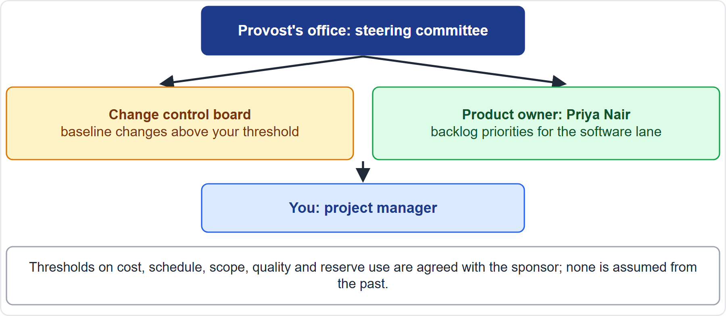
Case Check-In: Governance of the Microgrid
Part 1
CASE CHECK-IN · Sunrise Campus Microgrid
Steering committee: chaired by the Provost's office
Change control board for baseline changes; product owner for the backlog
PMP Exam Prep 2026 | PMBOK 8 and the New ECO
Module 10: Governance and Compliance
4 / 44
Notes:
Our microgrid has hybrid governance. A steering committee, chaired by the Provost's office, oversees funding discipline and milestones. A change control board decides baseline changes above your threshold. The product owner, Priya Nair, orders the backlog for the software lane. You are the project manager, integrating all of it. Thresholds on cost, schedule, scope, quality and reserve use are agreed with the sponsor. None is assumed from the past.

Slide 5
What Project Governance Is
Part 1
The framework, functions and processes that guide project management decisions to optimize value delivery
Holistic and integrative: it considers all other performance domains
It ensures alignment with portfolio, strategy and goals
It uses technology and data for real-time tracking and reporting
It includes the authority to cancel a project when necessary
Shaped by the organization's governance model and by customers and regulators
EXAM TIP Governance should be right-sized: focused on value delivery, not bureaucracy.
PMP Exam Prep 2026 | PMBOK 8 and the New ECO
Module 10: Governance and Compliance
5 / 44
Notes:
Project governance is the framework, functions and processes that guide project management decisions and activities to optimize value delivery. It is holistic and integrative, considering all other performance domains. It ensures alignment with the portfolio, strategy and goals. It often uses technology and data for real-time tracking and reporting. It includes the authority to cancel a project when necessary. And it is shaped by the performing organization's governance model, and by stakeholders such as customers and regulators. Right-size it: focus on value delivery, not bureaucracy.

Slide 6
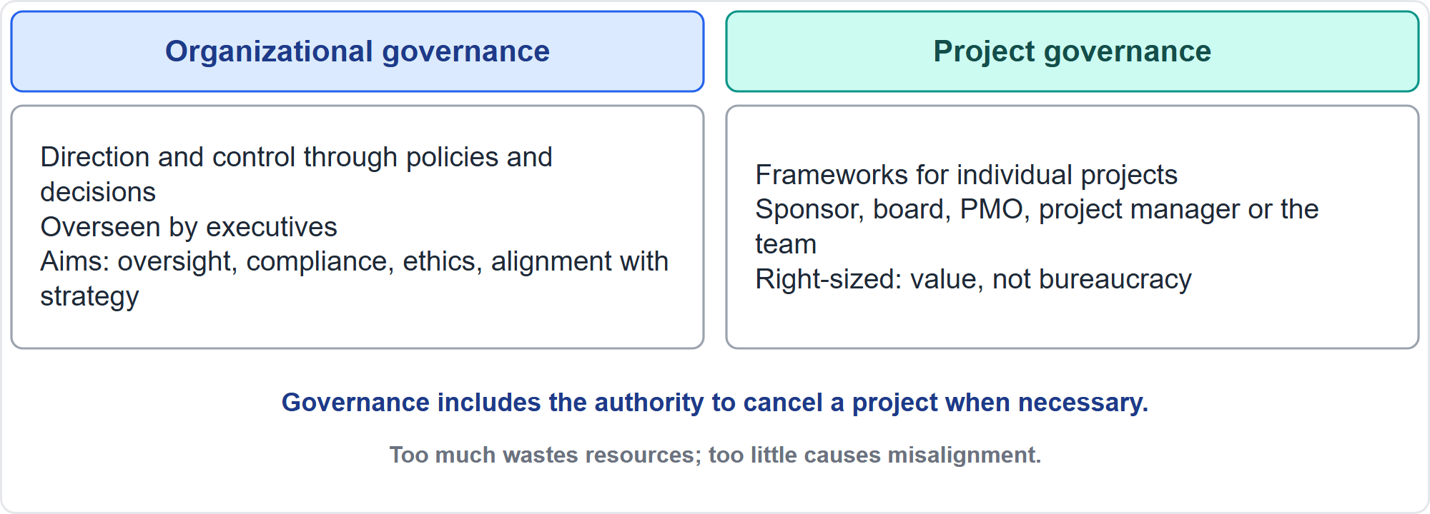
Organizational and Project Governance
Part 1
Direction for the whole, rules for one project
EXAM TIP Too much governance wastes resources; too little causes misalignment and performance problems.
PMP Exam Prep 2026 | PMBOK 8 and the New ECO
Module 10: Governance and Compliance
6 / 44
Notes:
Organizational governance gives direction and control for the whole organization through policies, processes, procedures and decisions. It is overseen by executives, and aims at transparency, oversight, compliance, resilience and alignment of portfolios, programs and projects with strategy. Project governance applies specific processes and frameworks to manage individual projects effectively. It is overseen by the sponsor, a steering committee or board, the PMO, the project manager, or the team in self-governance. Too much governance wastes resources. Too little causes misalignment.

Slide 7
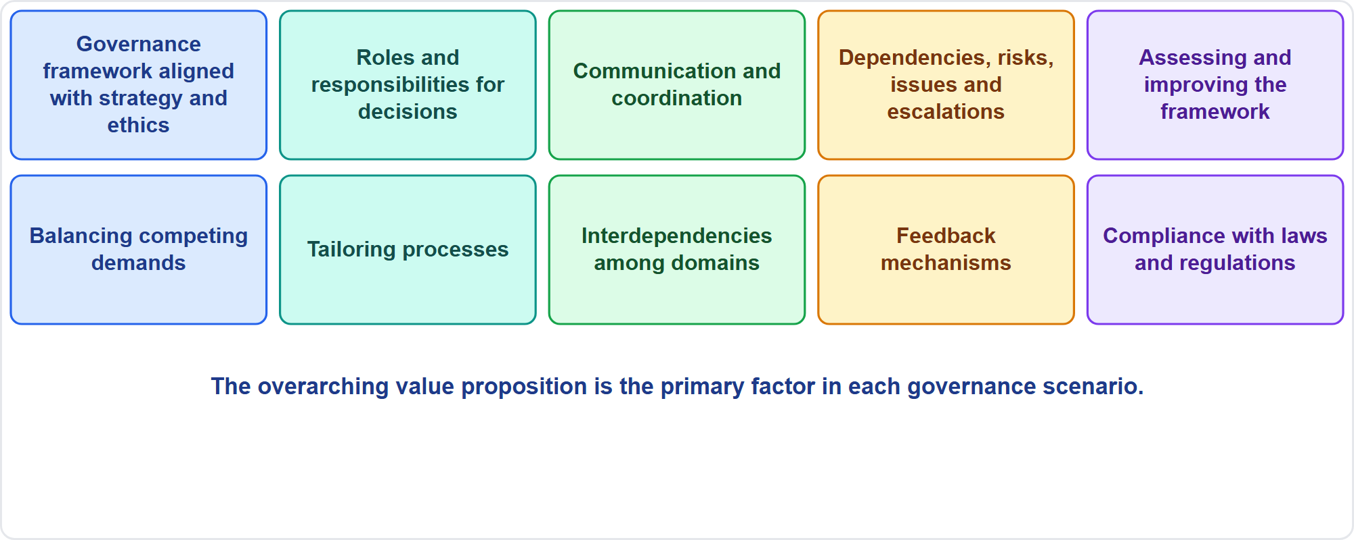
What Governance Decides
Part 1
Ten choices
EXAM TIP Governance is continuous, with feedback and lessons learned throughout, not only at closing.
PMP Exam Prep 2026 | PMBOK 8 and the New ECO
Module 10: Governance and Compliance
7 / 44
Notes:
The Governance domain makes ten kinds of choices. Establish a governance framework aligned with strategy and ethics. Define roles and responsibilities for decision-making, oversight and control. Ensure communication and coordination. Monitor and manage dependencies, risks, issues and escalations. Continuously assess and improve the framework. Balance competing demands. Tailor processes to objectives. Manage interdependencies among domains. Build in feedback mechanisms. And ensure compliance with regulatory and legal requirements.

Slide 8
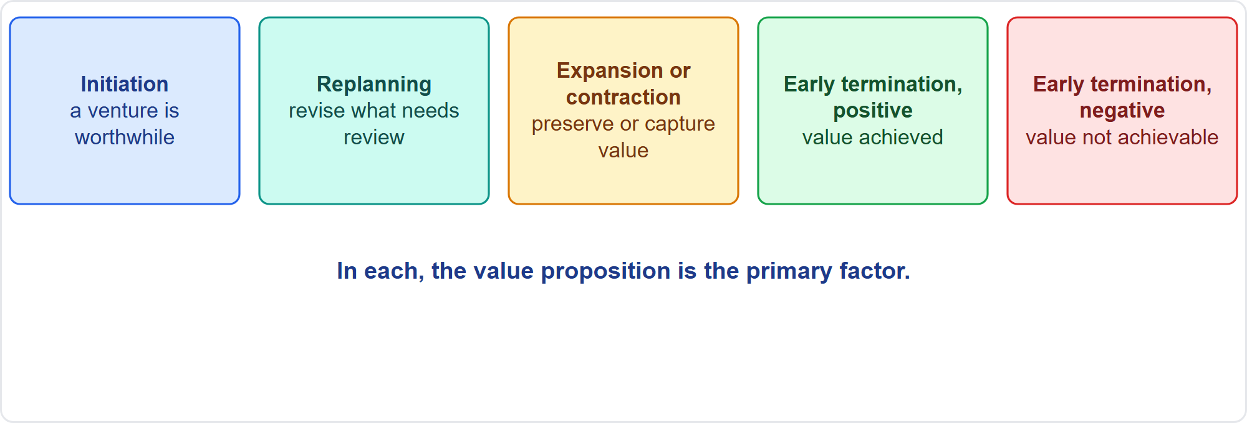
Governance Scenarios
Part 1
Five value scenarios
EXAM TIP When value cannot be delivered, the right path to stopping goes through governance.
PMP Exam Prep 2026 | PMBOK 8 and the New ECO
Module 10: Governance and Compliance
8 / 44
Notes:
PMBOK 8 describes five governance scenarios. Project initiation: a venture is deemed worthwhile. Project replanning: revising any plan element that needs deliberate review. Project expansion or contraction: changing constraints to preserve or capture value. Early termination for positive cause: the desired value was achieved before the schedule or budget was used up. Early termination for negative cause: the desired value is no longer achievable. In each, the overarching value proposition is the primary factor.

Slide 9
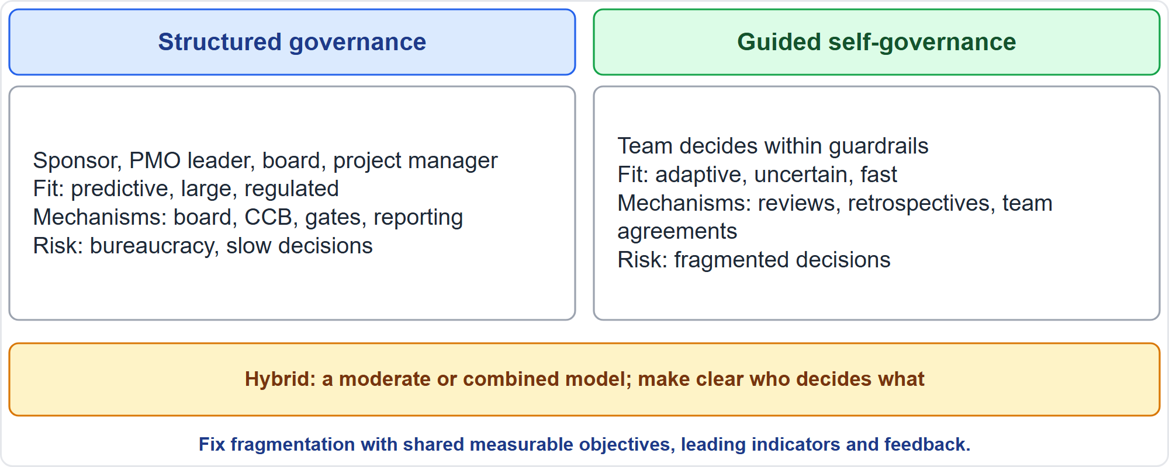
Governance Models
Part 1
Structured versus guided self-governance
EXAM TIP Self-governance needs guardrails: shared measurable objectives, leading indicators and feedback.
PMP Exam Prep 2026 | PMBOK 8 and the New ECO
Module 10: Governance and Compliance
9 / 44
Notes:
Two models. Structured governance often has an executive sponsor, a PMO leader, some governance board and a project manager. It suits predictive, large, regulated work, with mechanisms such as a board, change control board, phase gates and formal reporting. Its challenge is bureaucracy and slow decisions. Guided self-governance suits adaptive work: the team decides within guardrails, using reviews, retrospectives and team agreements. Its challenge is fragmented decisions, fixed with clear measurable common objectives, leading indicators and feedback. Hybrid projects use a moderate or combined model.

Slide 10
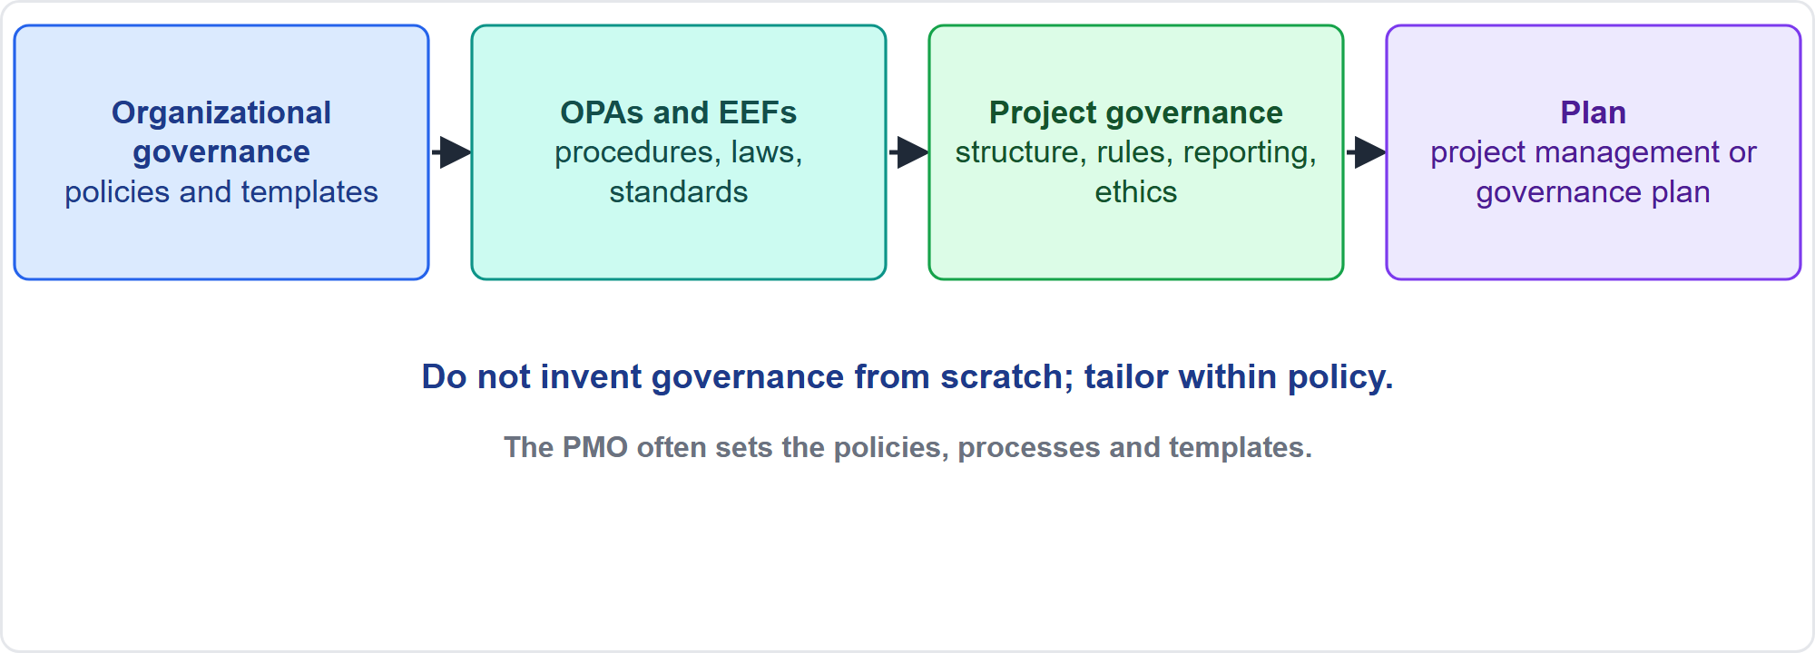
Establish Governance From Process Assets
Part 1
Draw on what exists
EXAM TIP Base governance on organizational policies, templates and procedures; tailor within policy.
PMP Exam Prep 2026 | PMBOK 8 and the New ECO
Module 10: Governance and Compliance
10 / 44
Notes:
Governance is not invented from scratch. It draws on organizational process assets and environmental factors, and the result is recorded in the project management plan or a governance plan. The PMO, where one exists, often establishes the governance policies, processes and templates, may lead structured governance, and reviews and approves tailoring. Organizational policies are not updated by the project. They are tailored within policy. Also identify the control boards, committees and stakeholders involved, and decide whether the team will have its own governance board.

Slide 11
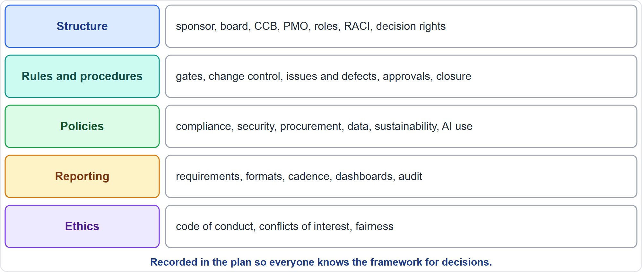
Elements of a Governance Framework
Part 1
Structure, rules, policies, reporting, ethics
EXAM TIP Ethics is part of governance: a framework aligns with ethical principles.
PMP Exam Prep 2026 | PMBOK 8 and the New ECO
Module 10: Governance and Compliance
11 / 44
Notes:
Five elements make up the framework. Structure: who sponsors, steers and decides. That includes the sponsor, board, change control board and PMO. It includes roles, a responsibility matrix, and decision rights. Rules and procedures: the life cycle and phase gates, change control, issue and defect management, work authorization, verification, validation and closure requirements. Policies: compliance, security, procurement, data protection, sustainability and AI use. Reporting: requirements, formats, cadence and dashboards. Ethics: the code of conduct, conflict-of-interest disclosure and fairness. All are recorded in the plan.

Slide 12
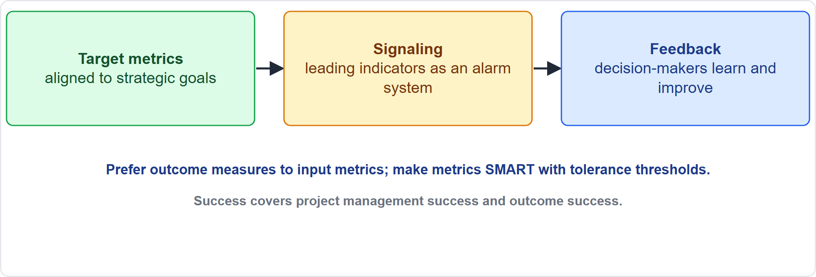
Define Success Metrics
Part 1
Target, signal, feedback
EXAM TIP Use leading indicators and outcome metrics aligned to strategy, not only activity counts.
PMP Exam Prep 2026 | PMBOK 8 and the New ECO
Module 10: Governance and Compliance
12 / 44
Notes:
Effective governance needs three components. Target metrics clearly aligned with strategic goals. Signaling mechanisms, or alarm systems, typically leading indicators that show whether delivery is moving toward the goal. And feedback mechanisms, so decision-makers learn and improve. Examples: the effectiveness of prioritization decisions, due-date performance, and whether the current integrated baseline carries the highest value proposition. Prefer outcome measures to input metrics. Make metrics specific, measurable, achievable, realistic and time-bound, with tolerance thresholds that trigger action.

Slide 13
Metrics Governance Tracks
Part 1
Metric type | Examples
Leading | Backlog items in progress; missing risk process; unengaged stakeholders; poor success criteria
Lagging | Deliverables completed; schedule and cost variance; resources consumed
Regular tracking | Status and progress; resource needs; risks and escalation criteria; benefits realized; change control; compliance; issues; funding
Success | Both project management success and outcome success
EXAM TIP Watch the pitfalls: Hawthorne effect, vanity metrics, demoralization, misuse, confirmation bias, correlation versus causation.
PMP Exam Prep 2026 | PMBOK 8 and the New ECO
Module 10: Governance and Compliance
13 / 44
Notes:
Governance tracks several kinds of metric. Leading indicators reveal upcoming trends: backlog items in progress, a missing risk process, unengaged stakeholders and poorly defined success criteria. Lagging indicators measure after the fact: deliverables completed, variances and resources consumed. Governance also tracks, regularly, status and progress, and resource needs. It tracks risks and escalation criteria, and benefits realized. And it tracks change control, compliance, issues and funding. Success has two dimensions: project management success and outcome success. Watch the measurement pitfalls from Module 6.

Slide 14
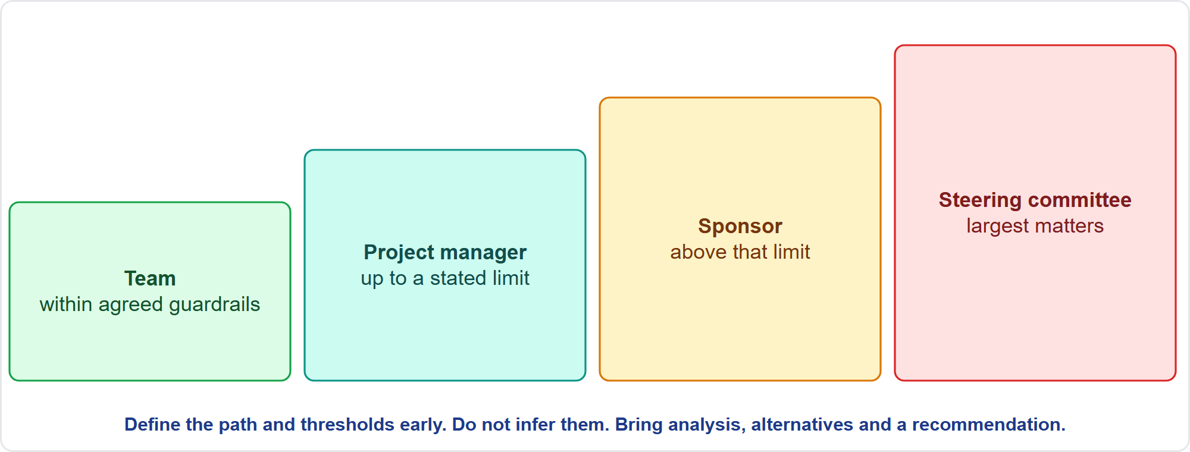
Escalation Paths and Thresholds
Part 1
Decide by level
EXAM TIP Do not infer authority from past decisions; define the path and thresholds early with the sponsor.
PMP Exam Prep 2026 | PMBOK 8 and the New ECO
Module 10: Governance and Compliance
14 / 44
Notes:
Define the path and the thresholds early: who decides what, up to what limit, and to whom a matter goes next. The team decides within agreed guardrails. The project manager decides up to a stated limit. Matters above that go to the sponsor, and the largest to the steering committee. When a decision is beyond the team's authority, the team investigates alternatives, considers the impact of each, and escalates to the person with proper authority. That is the idea behind the saying: do not bring me problems, bring me solutions. Do not infer authority from past decisions.

Slide 15
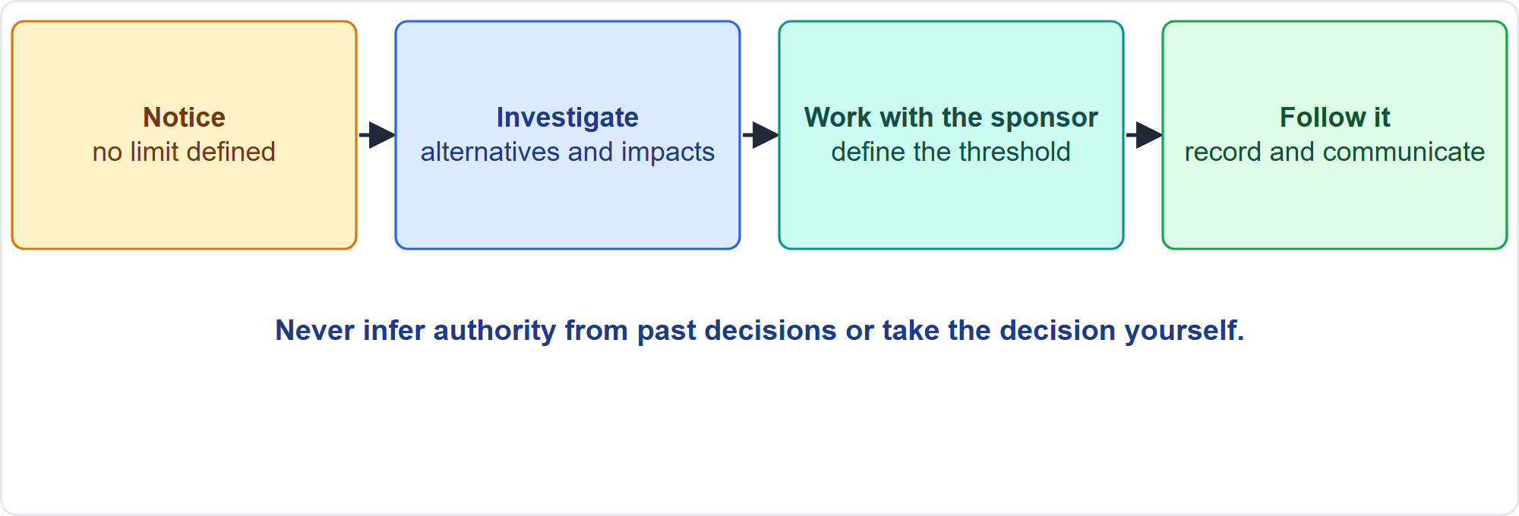
No Threshold Defined
Part 1
Work with the sponsor
EXAM TIP If a decision exceeds your spending authority and no threshold exists, work with the sponsor to define it; do not take the decision yourself.
PMP Exam Prep 2026 | PMBOK 8 and the New ECO
Module 10: Governance and Compliance
15 / 44
Notes:
Here is a common exam pattern. A decision exceeds your spending authority, and no threshold exists. The wrong answers are to take the decision yourself, to infer a limit from past projects, or to wait until it causes a problem. The right answer is to investigate alternatives and impacts, work with the sponsor to define the threshold, then follow it and record it. Unclear decision rights cause delay, so clarify them in the governance structure, for example with a responsibility matrix, not by assumption.

Slide 16
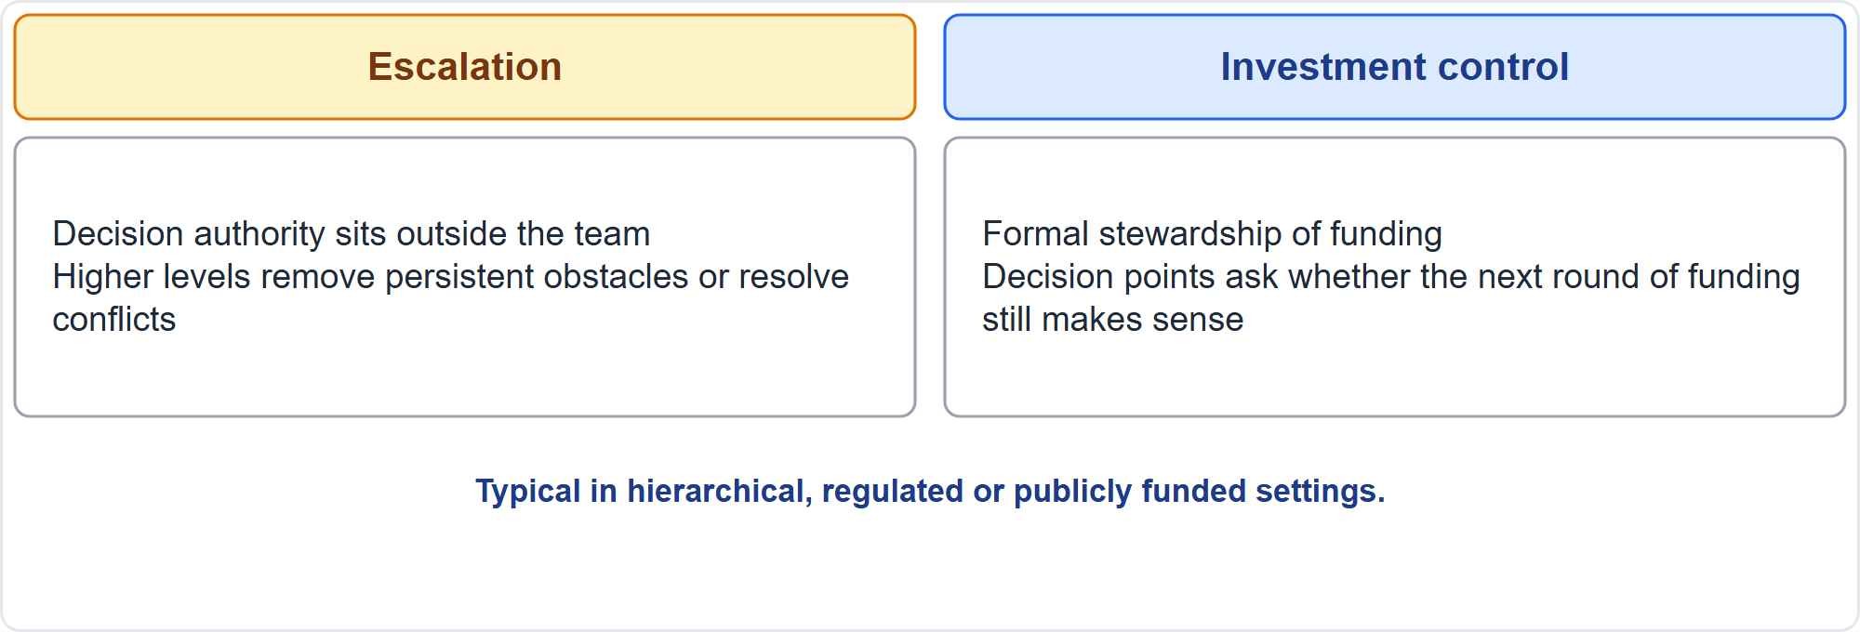
Escalation and Investment Control
Part 1
Two predictive components
EXAM TIP Risks outside the project's scope or beyond your authority are escalated; the receiving party must accept ownership.
PMP Exam Prep 2026 | PMBOK 8 and the New ECO
Module 10: Governance and Compliance
16 / 44
Notes:
Predictive environments add two governance components. Escalation is useful in hierarchical organizations where decision authority sits outside the team, or where higher-ranking people can remove persistent obstacles or resolve conflicts. Investment control applies where formal stewardship of funding is required, such as public corporations, government agencies and certain financial entities. It includes thorough risk evaluation, and decision points that decide whether the next round of funding still makes sense. Risks beyond your authority are escalated, and the receiving party must accept ownership.

Slide 17
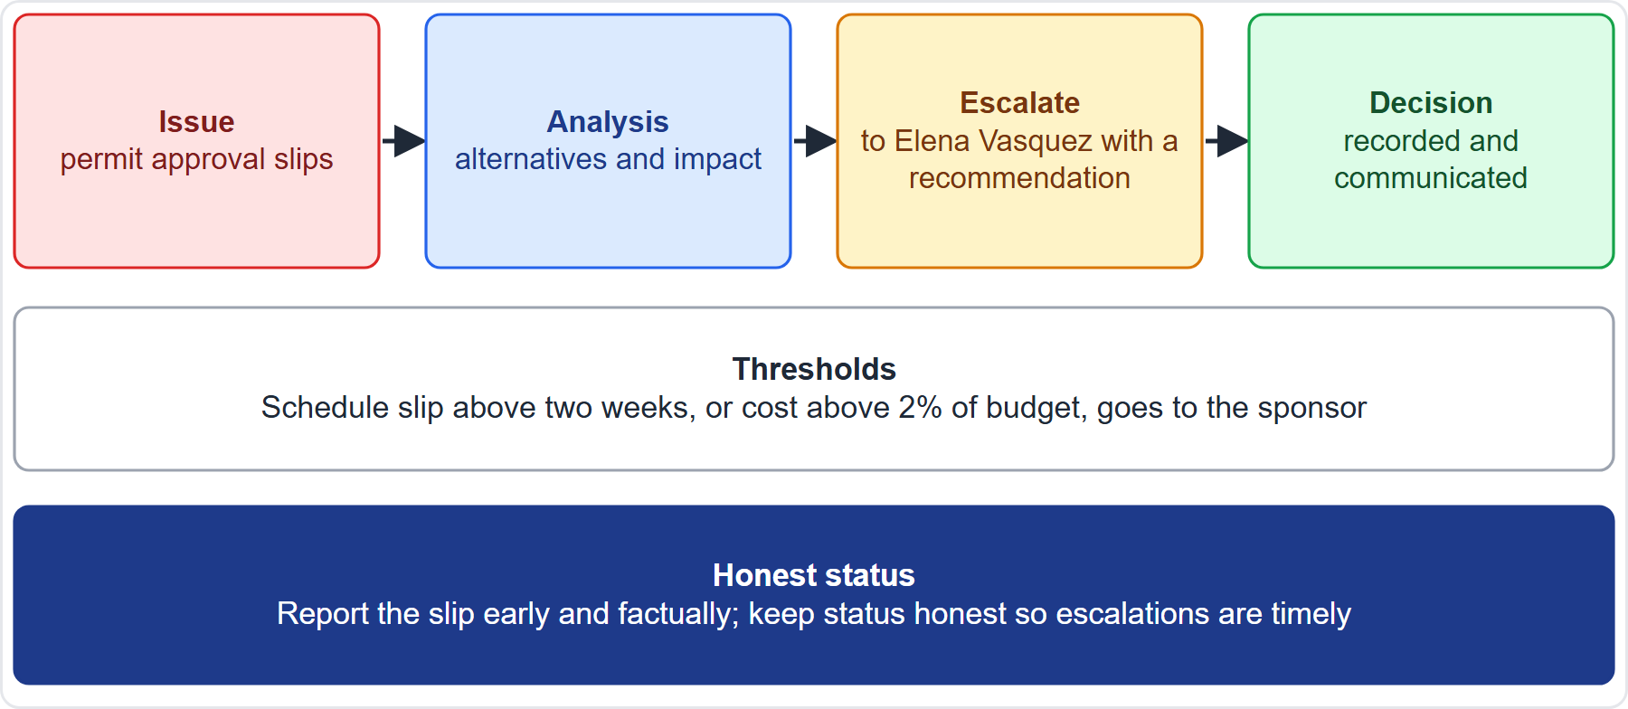
Case Check-In: Escalating a Permit Delay
Part 1
CASE CHECK-IN · Sunrise Campus Microgrid
Issue: permit approval slips beyond your authority
Path: analysis, alternatives, then escalation to the sponsor with a recommendation
PMP Exam Prep 2026 | PMBOK 8 and the New ECO
Module 10: Governance and Compliance
17 / 44
Notes:
Suppose permit approval slips and the delay exceeds your authority. You investigate alternatives and the impact of each, and escalate to Elena Vasquez with a recommendation. The thresholds agreed earlier, for example a schedule slip beyond two weeks or cost beyond two percent of the budget, tell you when to escalate. Report the slip early and factually. Keeping status honest makes escalation timely. The decision is recorded and communicated.

Slide 18
Sourcing and Tailoring Governance
Part 1
Sourcing is a governance decision: insource, outsource or both affects schedule, scope, finance, capacity and risk
Tailor governance to the industry, regulation, organization and project context
Customizing governance is part of Initiate Project or Phase and may be iterative
Small projects decide with key leaders; a PMO partners with the PM
Rapid innovation may use self-governance with no external body
Multinational projects integrate governance across domains and handle regional variation at program level
EXAM TIP Governance interacts with every domain; the governance-scope interaction is often the most important.
PMP Exam Prep 2026 | PMBOK 8 and the New ECO
Module 10: Governance and Compliance
18 / 44
Notes:
Sourcing strategy is a governance decision, with effects on schedule, scope, finance, resource capacity and risk. Insourcing suits culture, differentiating skills and proximity, and outsourcing suits specialized skills and scaled or variable capacity. Tailor governance to the industry, regulation, organization and project context. Customizing governance is typically part of Initiate Project or Phase, and may be iterative. A small project's manager decides with key leaders. A project needing rapid innovation may use self-governance with no external body. A multinational project integrates governance across domains and handles regional variation at program or portfolio level.

Slide 19
Governance in Predictive, Agile and Hybrid Work
Part 1
 | Predictive | Agile | Hybrid
Model | Structured: sponsor, PMO, board, project manager | Guided self-governance with guardrails | Moderate or combined
Decisions | Gates, change control board, investment control | Reviews, retrospectives, backlog, product owner | Gates for fixed parts; reviews for iterative
Escalation | Formal path and thresholds | Impediments to the facilitator and sponsor; team decides within guardrails | Both
Reporting | Status reports, baselines, dashboards | Radiators, burn charts, reviews | One consolidated view
Misfit risk | Over-control | Fragmented decisions | Unclear who decides what
EXAM TIP In hybrid work, make clear who decides what.
PMP Exam Prep 2026 | PMBOK 8 and the New ECO
Module 10: Governance and Compliance
19 / 44
Notes:
Governance differs by approach. Predictive: a structured model with a sponsor, PMO, board and project manager. Decisions at gates and through the change control board. A formal escalation path with thresholds. And status reports and dashboards. The risk is over-control. Agile: guided self-governance, with decisions in reviews and retrospectives and by the product owner, impediments escalated to the facilitator and sponsor, and reporting through radiators and burn charts. The risk is fragmented decisions. Hybrid: a combined model, with one consolidated view for governance, and a clear answer to who decides what.

Slide 20
Governance Traps: What PMI Expects
Part 1
Define escalation paths and thresholds; do not infer them
Unclear decision rights cause delay: clarify them in the structure
Right-size governance; self-governance needs guardrails
Follow the structure: do not bypass the board or the steering committee
Use outcome metrics and leading indicators; keep reports honest
Governance can stop a project; ethics and feedback are part of it
EXAM TIP Base governance on organizational policies and templates, and tailor within policy.
PMP Exam Prep 2026 | PMBOK 8 and the New ECO
Module 10: Governance and Compliance
20 / 44
Notes:
The traps for governance. Define escalation paths and thresholds, and do not infer them. Unclear decision rights cause delay, so clarify them in the structure, not by assumption. Right-size governance, and give self-governance guardrails. Follow the structure, including customer governance requirements and audits, and do not bypass the change control board or the steering committee. Use outcome metrics and leading indicators, and keep reports honest. Governance has authority to stop a project. And ethics and feedback are part of governance.

Slide 21
Part 1 Recap
Part 1
1
Definition
2
Models
3
Framework
framework for decisions that optimize value delivery; can cancel a project
structured, guided self-governance, hybrid
structure, rules, policies, reporting, ethics from process assets
4
Metrics
5
Escalation
6
Tailoring
target, signaling and feedback components; leading and outcome measures
path and thresholds defined early with the sponsor
right-size; sourcing is a governance decision
PMP Exam Prep 2026 | PMBOK 8 and the New ECO
Module 10: Governance and Compliance
21 / 44
Notes:
Let us recap Part 1. Governance is a framework for decisions that optimize value delivery, and it can cancel a project. The models are structured, guided self-governance and hybrid. The framework has structure, rules, policies, reporting and ethics, drawn from process assets. Metrics have target, signaling and feedback components, and favor leading and outcome measures. Define escalation paths and thresholds early, with the sponsor. And right-size governance, remembering that sourcing is a governance decision. In Part 2, we turn to compliance.

Slide 22
Compliance: Key Terms
Part 2
Term | Meaning
Compliance | Meeting the requirements the project is bound by: laws, standards, contracts, policies
Regulation | A requirement imposed by a government body
Compliance requirement | A specific obligation: a rule, control, report, certification, test or record
Mandatory, voluntary | Law, regulation and contract; optional standards adopted by decision
Threat to compliance | A condition that could cause failure; a risk until it occurs, then an issue
Compliance evidence | Records that prove compliance
EXAM TIP A compliance requirement is a requirement: confirm it, plan it, verify it and evidence it.
PMP Exam Prep 2026 | PMBOK 8 and the New ECO
Module 10: Governance and Compliance
22 / 44
Notes:
Part 2 covers compliance. Key terms. Compliance means meeting the requirements the project is bound by: laws and regulations, standards, contractual terms and organizational policies. A regulation is a requirement imposed by a governmental body. A compliance requirement is a specific obligation: a rule, control, report, certification, approval, test or record. Mandatory requirements come from law, regulation or contract, and voluntary ones are optional standards adopted by decision. A threat to compliance is a risk until it occurs, then an issue. Compliance evidence is the records that prove it.

Slide 23
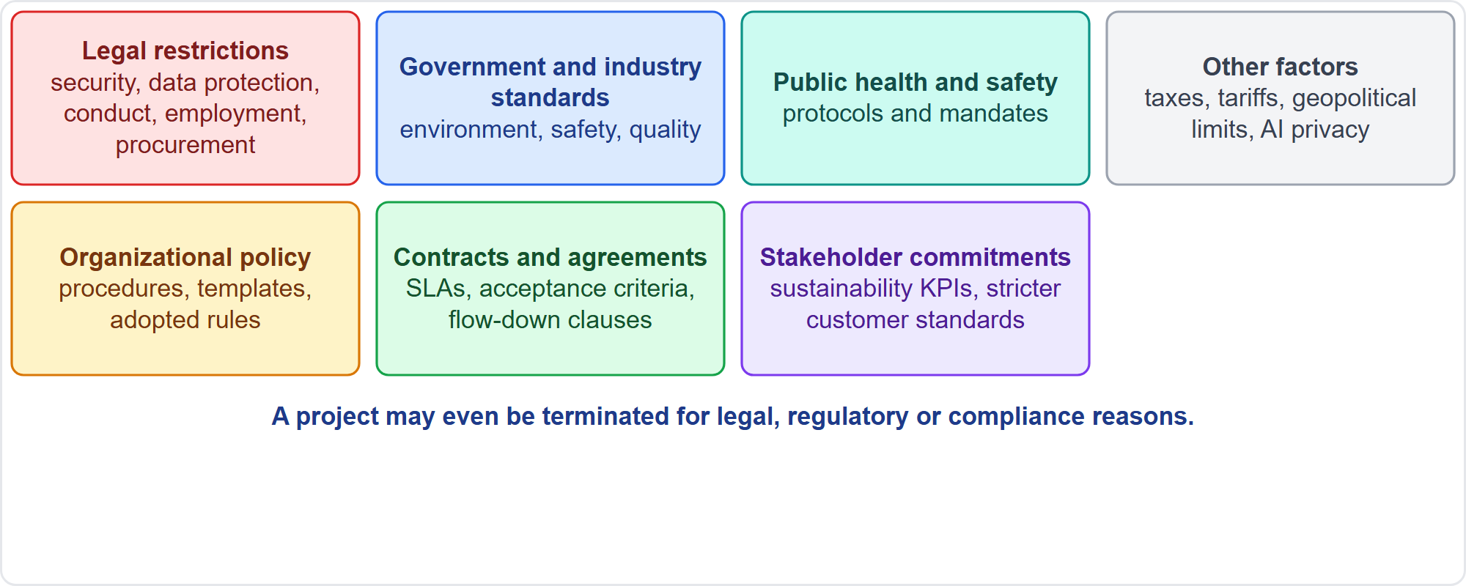
Where Compliance Requirements Come From
Part 2
Seven sources
EXAM TIP Sponsor or customer requirements may be stricter than the law; customer-required sustainability criteria are quality requirements.
PMP Exam Prep 2026 | PMBOK 8 and the New ECO
Module 10: Governance and Compliance
23 / 44
Notes:
Compliance requirements come from seven kinds of source. Legal restrictions: laws on security, data protection, business conduct, employment and procurement. Government and industry standards: for environment, safety, quality and workmanship. Public health and safety regulations. Other factors, such as taxes, tariffs, geopolitical limits and emerging-technology rules. Organizational policies and procedures. Contracts and agreements: customer and supplier terms, service-level agreements and flow-down clauses. And stakeholder commitments, such as sustainability indicators and stricter customer standards. A project may even be terminated for compliance reasons.

Slide 24
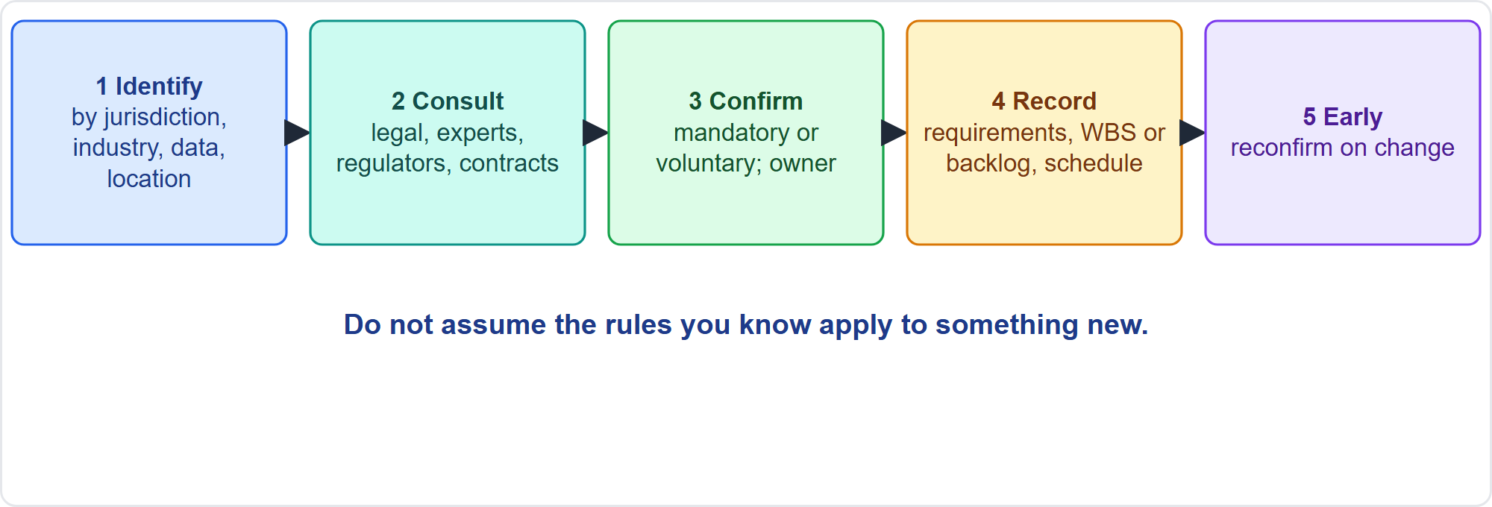
Confirm Compliance Requirements
Part 2
Identify, consult, confirm, record, early
EXAM TIP Do not assume the rules you know apply to something new: a new market, material, data store or technology needs confirmation.
PMP Exam Prep 2026 | PMBOK 8 and the New ECO
Module 10: Governance and Compliance
24 / 44
Notes:
Confirm compliance requirements in five steps. Identify what applies by jurisdiction, industry, product, data type, technology, location and market. Consult the experts: legal and compliance, subject matter experts, regulators and certifying bodies, and review contracts and policies. Confirm with the sponsor and governance which obligations are mandatory, which are voluntary, and who is accountable. Record them where work is planned: requirements, quality requirements, the WBS or backlog, the schedule, the budget and the assumption log. Do it early, and reconfirm when scope, location, supplier or technology changes.

Slide 25
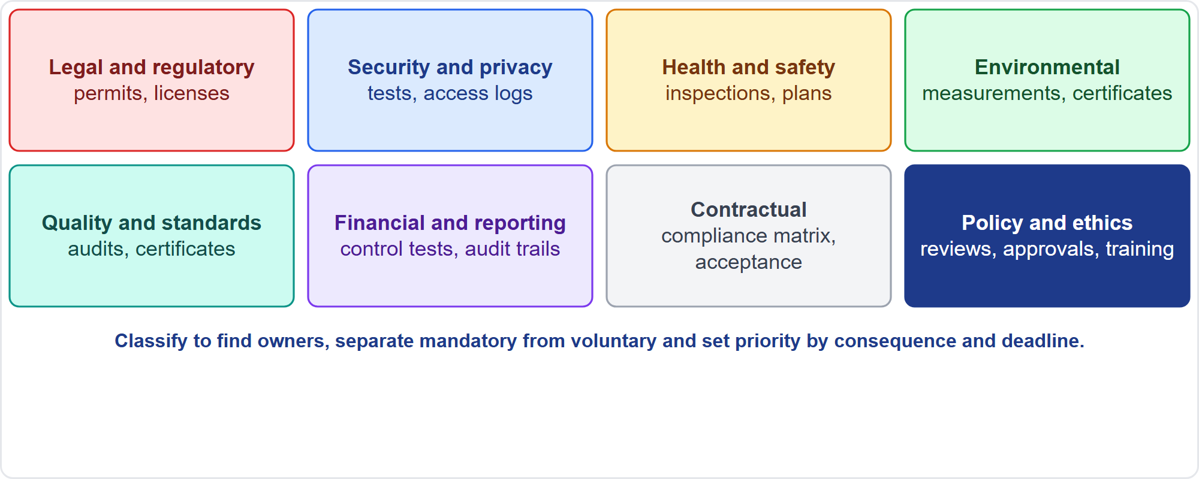
Classify Compliance Categories
Part 2
Eight categories
EXAM TIP Unowned requirements are the ones that fail: classify and assign owners.
PMP Exam Prep 2026 | PMBOK 8 and the New ECO
Module 10: Governance and Compliance
25 / 44
Notes:
Classify requirements into categories, because each has different owners, experts, evidence and risk. The categories are a study aid. Legal and regulatory, with permits and licenses. Security and privacy, with tests and access logs. Health and safety, with inspections and plans. Environmental and sustainability, with measurements and certifications. Quality and industry standards. Financial and reporting. Contractual, with compliance matrices. And organizational policy and ethics. Classification also separates mandatory from voluntary and sets priority by consequence and deadline.

Slide 26
Examples of Fast-Changing Situations
Part 2
Situation | What to do
A regulation takes effect in three months | Confirm its requirements; prioritize them in the backlog
Data about children or health | Check residency and privacy duties before choosing storage
A restricted ingredient in one export market | Settle the compliance approach before launch
A new substance | Determine which regulations apply, with experts
A rule changes mid-project | Reassess scope and backlog; reprioritize by effective date
EXAM TIP Releasing first and fixing later breaks the rule.
PMP Exam Prep 2026 | PMBOK 8 and the New ECO
Module 10: Governance and Compliance
26 / 44
Notes:
Some situations change fast. A regulation takes effect in three months: confirm its requirements and prioritize them in the backlog. Data about children or health: check residency and privacy obligations before choosing storage. A restricted ingredient in one export market: determine the compliance approach before launch. A new substance: determine which regulations apply, with experts. A rule changes in mid-project: reassess scope and backlog, and reprioritize by effective date and consequence. In every case, releasing first and fixing later breaks the rule.

Slide 27
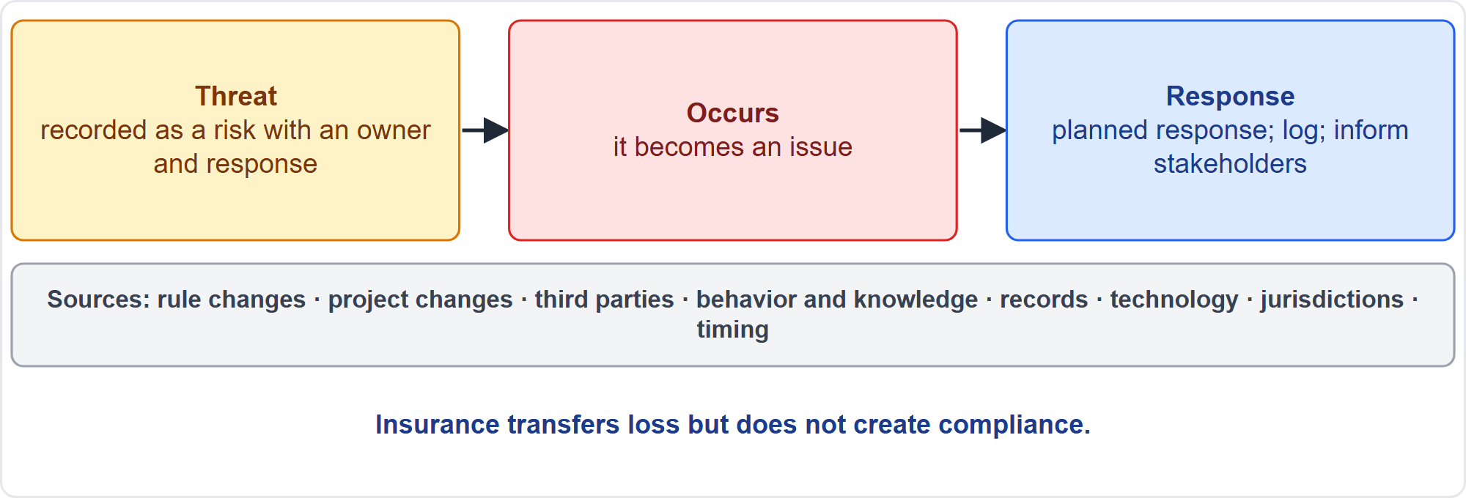
Threats to Compliance
Part 2
A risk, then an issue
EXAM TIP Insurance transfers loss but does not create compliance.
PMP Exam Prep 2026 | PMBOK 8 and the New ECO
Module 10: Governance and Compliance
27 / 44
Notes:
Threats to compliance come from changes in rules and changes in the project. They come from third parties, and gaps in knowledge and behavior. And they come from missing evidence, technology, jurisdictional differences and timing. Examples include a supplier that does not meet requirements, and staff without certification. They include data processing abroad, and uncontrolled files. And they include an unvetted AI tool processing personal data, or permit delays. Treat threats as risks: register them with an owner and a response. When a threat occurs, it becomes an issue: log it, run the planned response, update the register and inform stakeholders. Insurance transfers loss, but does not create compliance.

Slide 28
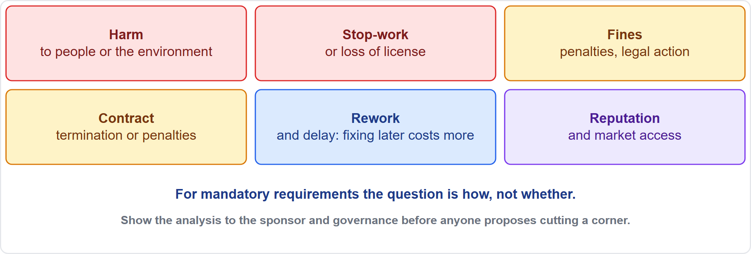
Consequences of Noncompliance
Part 2
Six kinds
EXAM TIP Show the analysis to the sponsor and governance before anyone proposes cutting a corner.
PMP Exam Prep 2026 | PMBOK 8 and the New ECO
Module 10: Governance and Compliance
28 / 44
Notes:
Analyze the consequences of noncompliance, as a grouping from exam practice. Harm to people or the environment. Stop-work orders or loss of license to operate. Fines, penalties and legal action. Contract termination or penalties. Rework and delay, because fixing later costs more. Loss of market access and reputation. Assess likelihood and impact, and who is affected. Compare the cost of compliance with the cost of noncompliance. For mandatory requirements, the question is how, not whether. Document the analysis, and show it to the sponsor and governance.

Slide 29
Deadline Against a Mandatory Requirement
Part 2
Mandatory means comply: a deadline does not justify skipping it
Present the consequences and schedule-safe alternatives to the sponsor
A shortcut that bypasses a policy needs a formal exception through governance, with risk analysis
No silent workarounds or private decisions
Free improvements still go through change control
Document the analysis for decisions, audits and escalation
EXAM TIP Exceptions and waivers go through governance and are documented.
PMP Exam Prep 2026 | PMBOK 8 and the New ECO
Module 10: Governance and Compliance
29 / 44
Notes:
Suppose a deadline conflicts with a mandatory requirement. Mandatory means comply. Present the consequences and schedule-safe alternatives to the sponsor and governance. If a shortcut would bypass an internal policy, it needs a formal exception through governance, with risk analysis. It must not be a private decision, and there are no silent workarounds. Free improvements still go through change control. And document the analysis, because it supports decisions, audits and escalation.

Slide 30
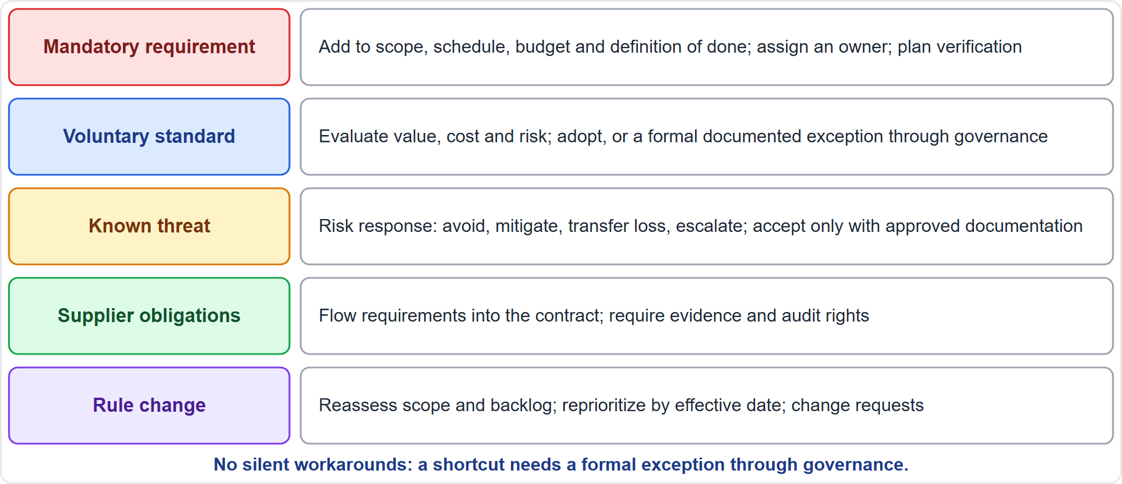
Determine the Compliance Approach
Part 2
By situation
EXAM TIP For a voluntary standard, weigh value, cost and risk with governance, then adopt it or document an exception.
PMP Exam Prep 2026 | PMBOK 8 and the New ECO
Module 10: Governance and Compliance
30 / 44
Notes:
Choose the approach by situation. A mandatory requirement: build it in. Add it to scope, the WBS or backlog, the schedule and the budget. Add it to the definition of done or phase exit criteria. Assign an owner, plan how compliance will be verified, train, and monitor. A voluntary standard: evaluate value, cost and risk with governance, then adopt it or document a formal exception. A known threat: a risk response. Supplier obligations: put them in the contract, with evidence and audit rights. A rule change: reassess scope and backlog, reprioritize and raise change requests.

Slide 31
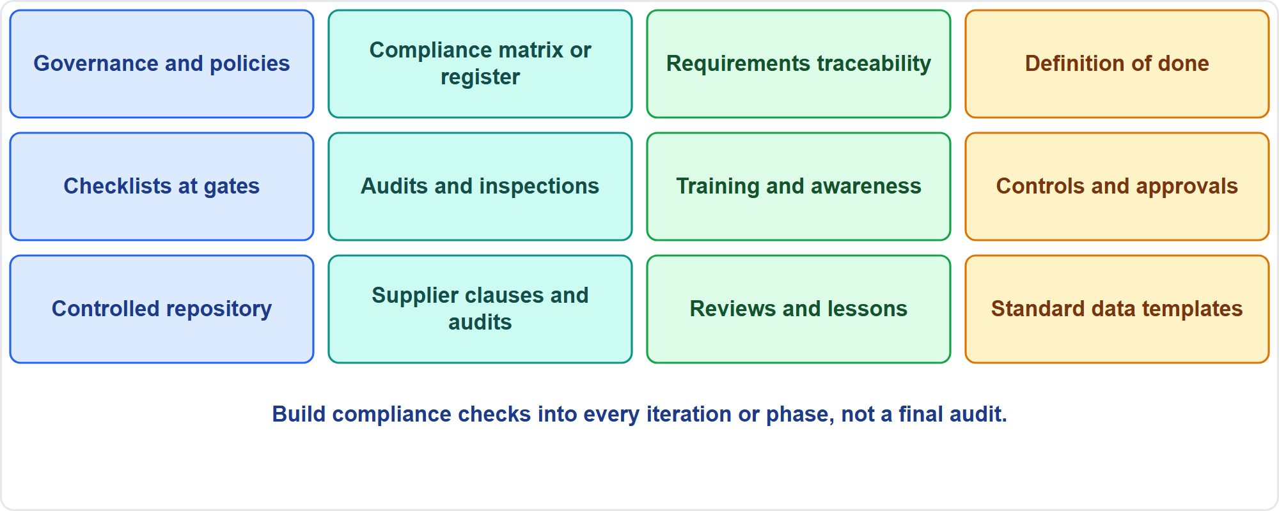
Methods That Support Compliance
Part 2
Twelve methods
EXAM TIP Put compliance checks in every iteration or phase, not in a final audit.
PMP Exam Prep 2026 | PMBOK 8 and the New ECO
Module 10: Governance and Compliance
31 / 44
Notes:
Many methods support compliance. Governance and policies define standards and thresholds. A compliance matrix maps each requirement to an owner, control, verification method, evidence and status. Requirements traceability links requirements to deliverables, tests and acceptance. The definition of done and acceptance criteria put checks into each iteration. Checklists confirm obligations at gates. Audits and inspections test against standards. Training builds awareness. Controls and approvals segregate duties. A controlled repository keeps approved versions findable. Supplier clauses and audits flow requirements down. When a regulator requires a reporting format, standardize inputs at the source.

Slide 32
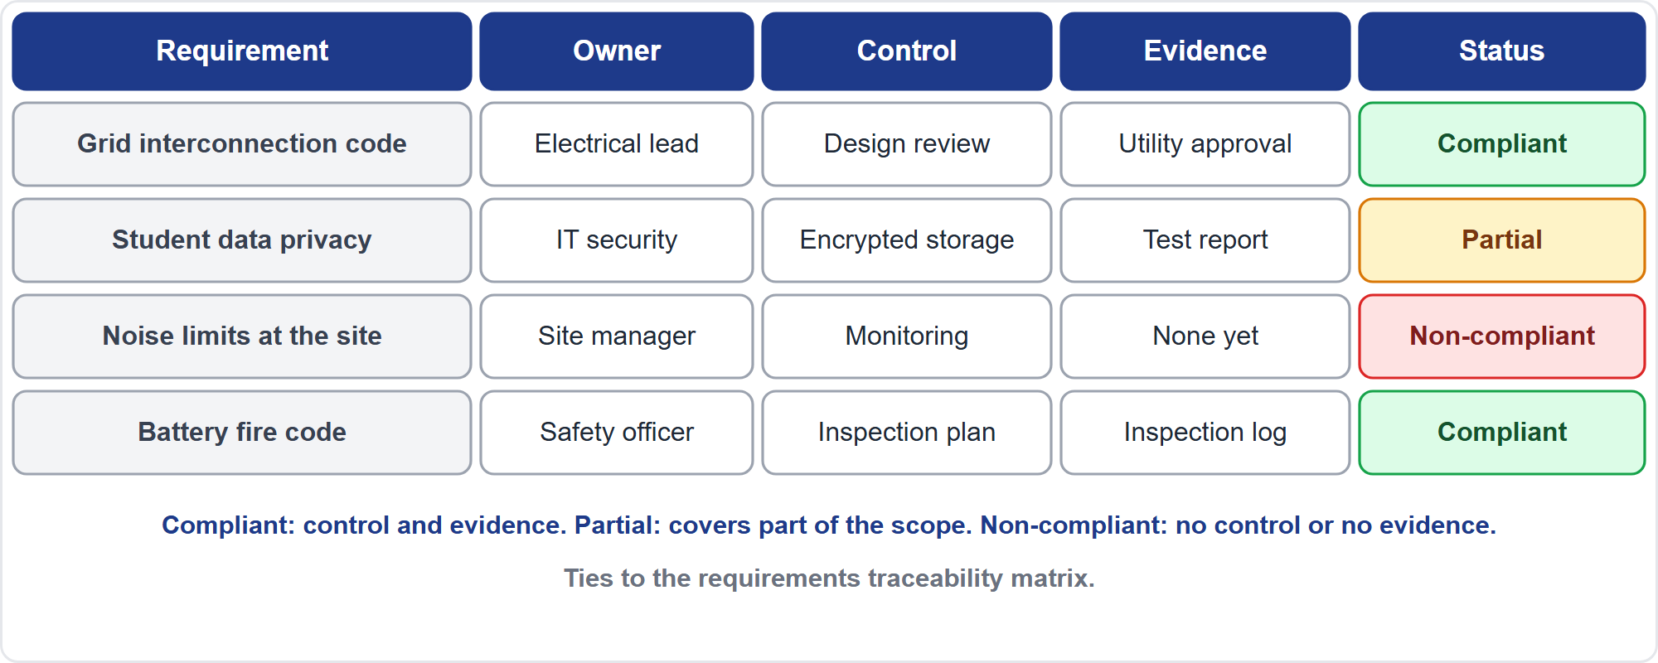
Compliance Matrix and Statuses
Part 2
An example matrix
EXAM TIP Partially compliant means the control covers only part of the scope, for example a retention rule enforced in some systems but not others.
PMP Exam Prep 2026 | PMBOK 8 and the New ECO
Module 10: Governance and Compliance
32 / 44
Notes:
A compliance matrix records, for each requirement, an owner, a control, a verification method, evidence and a status. It ties to the requirements traceability matrix. Compliant means the control is in place and evidence is available. Partially compliant means the control covers only part of the scope, for example a retention rule enforced in some systems but not others. Non-compliant means no control or no evidence. Not applicable means the requirement does not apply to the project. This is exam practice. The example shows four requirements with different statuses.

Slide 33
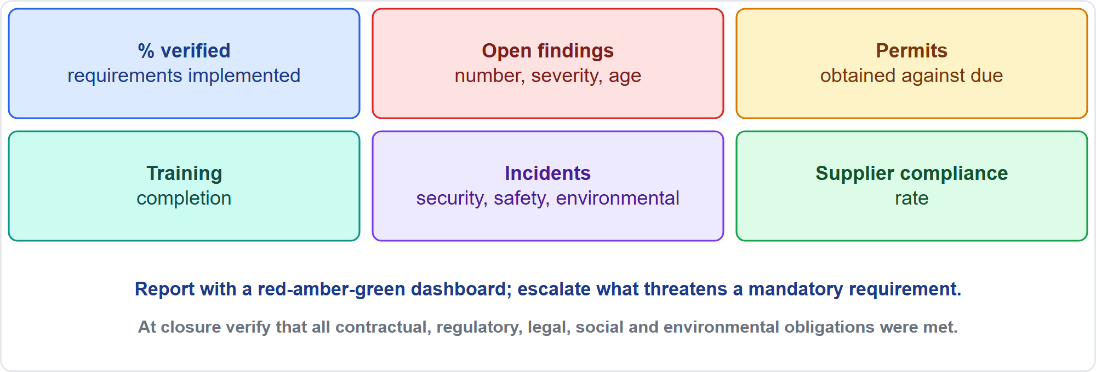
Measure Compliance
Part 2
Indicators to track
EXAM TIP Report compliance with measurable indicators, not general assurances.
PMP Exam Prep 2026 | PMBOK 8 and the New ECO
Module 10: Governance and Compliance
33 / 44
Notes:
Measure the extent to which the project is compliant. PMBOK 8 points to compliance audits or checklists against standards and benchmarks, metrics that track compliance with policies, and verification at closure that all obligations were met. As exam practice, track the share of requirements implemented and verified, and open audit findings by number, severity and age. Track nonconformances, and permits and certifications obtained against due. Track training completion, incidents and breaches, and the supplier compliance rate. Add sustainability indicators and compliance cost against plan. Report with a dashboard and escalate what threatens a mandatory requirement.

Slide 34
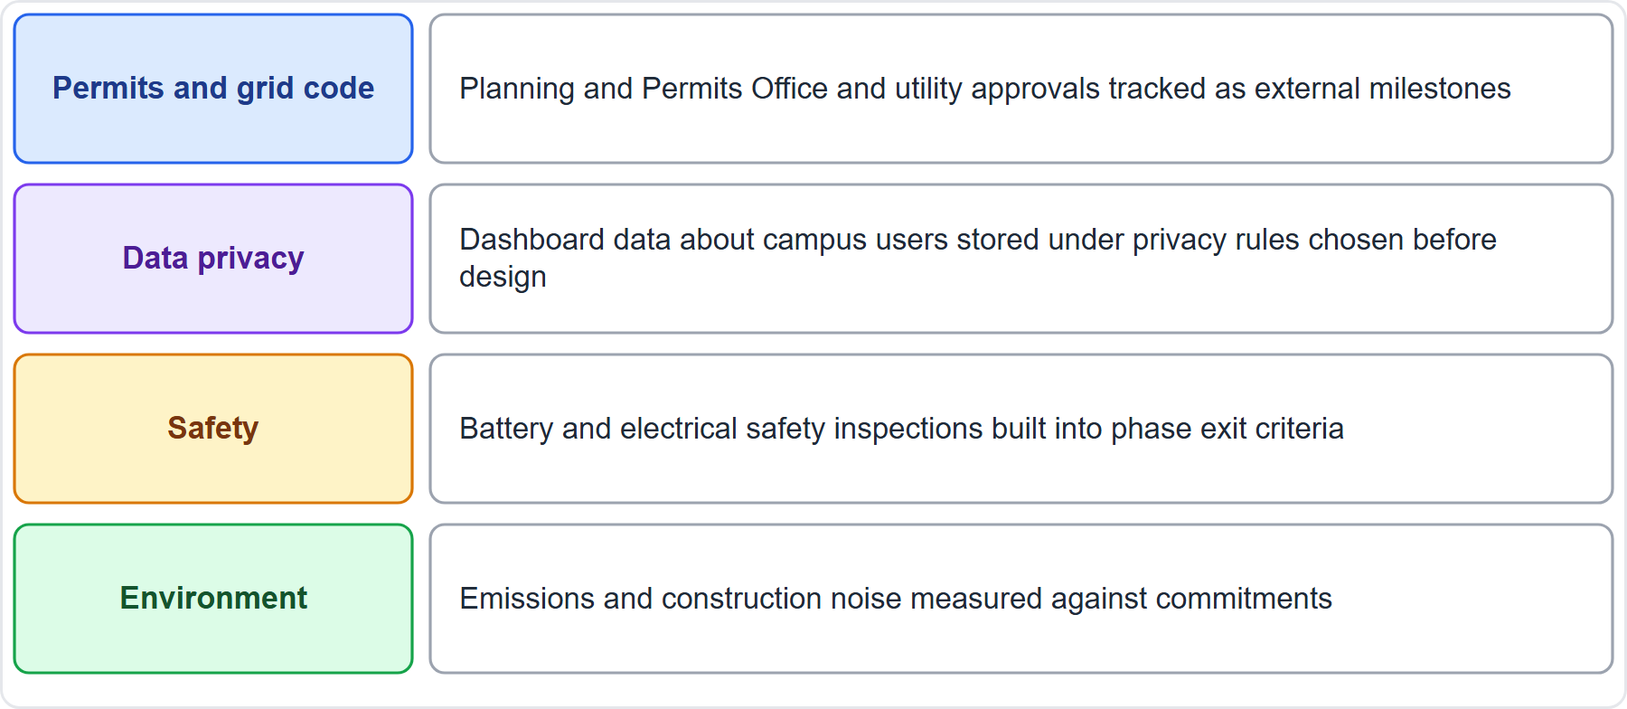
Case Check-In: Compliance on the Microgrid
Part 2
CASE CHECK-IN · Sunrise Campus Microgrid
Permits and grid code: external milestones with named owners
Privacy, safety, environment: controls and evidence built into exit criteria
PMP Exam Prep 2026 | PMBOK 8 and the New ECO
Module 10: Governance and Compliance
34 / 44
Notes:
On the microgrid, compliance spans four areas. The Planning and Permits Office and the utility approve permits and the grid interconnection, tracked as external milestones. Data about campus users on the dashboard is stored under privacy rules chosen before design. Battery and electrical safety inspections are built into phase exit criteria. Emissions and construction noise are measured against commitments to Eastgate residents. Each has an owner, a control and evidence, in a compliance matrix kept in a controlled repository.

Slide 35
Supplier Compliance and Multinational Work
Part 2
Supplier compliance is yours to enforce: flow requirements into the contract, require evidence and audit rights
Stop affected work until a noncompliant supplier meets the requirement
Multinational projects coordinate regional variations through program or portfolio governance
Training and a speak-up culture are compliance controls
Connect compliance to value people care about; adoption suffers when it feels like a tax
Verify obligations at closure before closing
EXAM TIP Supplier compliance is your responsibility to enforce: flow requirements down by contract and verify them.
PMP Exam Prep 2026 | PMBOK 8 and the New ECO
Module 10: Governance and Compliance
35 / 44
Notes:
Supplier compliance is yours to enforce. Put requirements in the contract, require evidence and audit rights, and enforce them. Stop affected work until a noncompliant supplier meets the requirement. Multinational projects must follow different regional rules, so coordinate variations through program or portfolio governance. Do not ignore the human side. Training and a speak-up culture are compliance controls. And adoption suffers when compliance feels like a tax, so connect it to value people care about. And verify obligations at closure before closing the project.

Slide 36
Compliance in Predictive, Agile and Hybrid Work
Part 2
 | Predictive | Agile | Hybrid
Requirements | Up front in documentation and traceability matrix | In the backlog, prioritized by effective date and consequence | Fixed ones in the baseline; others in the backlog
Verification | Phase exit criteria, gate reviews, audits | Definition of done includes compliance every iteration | Gates for regulated parts; done criteria inside
Evidence | Controlled repository, formal records | Lightweight but traceable | Both
Change | Change control with compliance review | Backlog changes with compliance in acceptance criteria | Both
EXAM TIP Regulated environments are often predictive with phase gates, but agile is possible when regulatory evidence is built into the definition of done.
PMP Exam Prep 2026 | PMBOK 8 and the New ECO
Module 10: Governance and Compliance
36 / 44
Notes:
Compliance differs by approach. Predictive: requirements up front in the documentation and traceability matrix. Verification through phase exit criteria, gate reviews and audits. A controlled repository. And change control with compliance review. Agile: compliance items go into the backlog, prioritized by effective date and consequence, and new rules reprioritize it. The definition of done includes compliance checks every iteration, and evidence is lightweight but traceable. Hybrid: fixed regulatory requirements in the baseline, others in the backlog, gates for regulated parts.

Slide 37
Compliance Traps: What PMI Expects
Part 2
A compliance requirement is a requirement: confirm, plan, verify and evidence it
Do not borrow: a new product, market or data type needs fresh confirmation
Classify and assign owners; plan the verification method
Put compliance in the definition of done, not a final audit
Threats are risks; insurance does not create compliance
Mandatory means comply: exceptions go through governance
EXAM TIP Keep evidence findable in a controlled repository: auditors should not have to hunt.
PMP Exam Prep 2026 | PMBOK 8 and the New ECO
Module 10: Governance and Compliance
37 / 44
Notes:
The traps for compliance. A compliance requirement is a requirement: confirm it, plan it, verify it and evidence it. Do not borrow rules from a different situation: a new product, market or data type needs fresh confirmation. Classify requirements, assign owners, and plan the verification method. Put compliance in the definition of done or exit criteria, not in a final audit. Threats are risks, and insurance does not create compliance. Mandatory means comply, and exceptions go through governance. A new rule reshapes the backlog or scope.

Slide 38
Module Recap
Part 2
1
Governance
2
Models
3
Compliance
right-sized framework from process assets; escalation and thresholds defined with the sponsor
structured, self-governing with guardrails, or combined
confirm early, classify, assign owners, plan verification
4
Threats
5
Methods
6
Next
risks until they occur; consequences shown to the sponsor
definition of done, matrix, audits, controlled repository
five practice questions
PMP Exam Prep 2026 | PMBOK 8 and the New ECO
Module 10: Governance and Compliance
38 / 44
Notes:
Let us recap the whole module. Governance: a right-sized framework from process assets, with escalation and thresholds defined with the sponsor. Models: structured, self-governing with guardrails, or combined. Compliance: confirm requirements early, classify them, assign owners and plan the verification. Threats are risks until they occur, and the consequences go to the sponsor. Methods: put compliance in the definition of done, keep a compliance matrix, audit, and keep evidence in a controlled repository. Now it is time to test yourself. Five questions follow. For each one, pause the video, choose your answer, and then listen to the explanation.

Slide 39
Practice Question 1
Part 2
Q1
A decision on a vendor change order exceeds the project manager's spending authority, and no threshold exists for it. What should the project manager do?
A
Approve it, because earlier similar orders were approved at this level
B
Delay the decision until the vendor submits a claim for the delay
C
Work with the sponsor to define a threshold for it, then follow that threshold
D
Split the order into smaller amounts that fit within the authority
PMP Exam Prep 2026 | PMBOK 8 and the New ECO
Module 10: Governance and Compliance
39 / 44
Notes:
Question one. A decision on a vendor change order exceeds the project manager's spending authority, and no threshold exists for it. What should the project manager do? The four options are on the screen. Choose your answer. [PAUSE 12] The answer is C. Authority is defined, not inferred, so the project manager investigates alternatives and works with the sponsor to define the threshold. Inferring authority from the past, waiting for a claim, or splitting the order each avoid the governance decision.

Slide 40
Practice Question 2
Part 2
Q2
A self-governing agile team makes decisions that often contradict one another, and stakeholders are confused about priorities. What would help most?
A
Clear, measurable common objectives, leading indicators and feedback
B
Replace the team's decisions with a weekly approval by the steering committee itself
C
Assign one team member as the final decision-maker without any consultation
D
Ask the team to stop recording decisions to avoid disagreements in meetings
PMP Exam Prep 2026 | PMBOK 8 and the New ECO
Module 10: Governance and Compliance
40 / 44
Notes:
Question two. A self-governing agile team makes decisions that often contradict one another, and stakeholders are confused about priorities. What would help most? The four options are on the screen. Choose your answer. [PAUSE 12] The answer is A. Fragmented decision-making in self-governance is fixed by shared measurable objectives, leading indicators and feedback mechanisms inside clear guardrails. Heavy approvals, an appointed dictator, or stopping records remove the guardrails or the transparency.

Slide 41
Practice Question 3
Part 2
Q3
An optional industry accessibility standard would add three weeks to the plan, and the contract does not require it. What should the project manager do?
A
Skip the standard, since it is voluntary and the contract does not require it at all
B
Postpone the decision until a customer or regulator complains about it
C
Adopt the standard fully without asking anyone, to be on the safe side
D
Weigh value, cost and risk with governance, then adopt or document an exception
PMP Exam Prep 2026 | PMBOK 8 and the New ECO
Module 10: Governance and Compliance
41 / 44
Notes:
Question three. An optional industry accessibility standard would add three weeks to the plan, and the contract does not require it. What should the project manager do? The four options are on the screen. Choose your answer. [PAUSE 12] The answer is D. Voluntary standards are evaluated for value, cost and risk with governance, which then either adopts them or records a formal, documented exception. Skipping silently, waiting for a complaint, or adopting without approval each avoid that decision.

Slide 42
Practice Question 4
Part 2
Q4
A mandatory data-protection rule will take effect in three months, and the team has no work planned for it. What should the project manager do?
A
Wait until the effective date, then assess what needs to change
B
Confirm the requirements and prioritize them in the backlog now
C
Treat the rule as voluntary until a regulator contacts the project
D
Add a general statement that the project will comply with all laws
PMP Exam Prep 2026 | PMBOK 8 and the New ECO
Module 10: Governance and Compliance
42 / 44
Notes:
Question four. A mandatory data-protection rule will take effect in three months, and the team has no work planned for it. What should the project manager do? The four options are on the screen. Choose your answer. [PAUSE 12] The answer is B. A new mandatory rule is confirmed early and reshapes the backlog by effective date and consequence, with an owner and a plan to verify compliance. Waiting, treating it as voluntary, or a general statement do not plan the work.

Slide 43
Practice Question 5
Part 2
Q5
Auditors ask an agile team to show that each regulatory requirement is implemented and verified, but the requirements are scattered across several documents. What would best support the team?
A
A compliance matrix of requirements, owners, controls and evidence
B
A single long narrative report that describes the team's general intentions on compliance
C
A promise from the team lead that all regulations are being followed
D
A final audit in the last sprint to collect all the evidence at once
PMP Exam Prep 2026 | PMBOK 8 and the New ECO
Module 10: Governance and Compliance
43 / 44
Notes:
Question five. Auditors ask an agile team to show that each regulatory requirement is implemented and verified, but the requirements are scattered across several documents. What would best support the team? The four options are on the screen. Choose your answer. [PAUSE 12] The answer is A. A compliance matrix ties each requirement to an owner, control, verification method and evidence, and links to traceability. Narratives, promises, or a final audit do not give measurable, current evidence.

Slide 44
Answers at a Glance
Part 2
Question | Answer | Why
Q1 | C | With no threshold, work with the sponsor to define one
Q2 | A | Self-governance needs shared objectives, leading indicators and feedback
Q3 | D | Weigh a voluntary standard with governance, then adopt or document an exception
Q4 | B | Confirm a new mandatory rule early and prioritize it in the backlog
Q5 | A | A compliance matrix links each requirement to controls and evidence
PMP Exam Prep 2026 | PMBOK 8 and the New ECO
Module 10: Governance and Compliance
44 / 44
Notes:
Here are all five answers together. Question one: C. With no threshold, work with the sponsor to define one. Question two: A. Self-governance needs shared objectives, leading indicators and feedback. Question three: D. Weigh a voluntary standard with governance, then adopt or document an exception. Question four: B. Confirm a new mandatory rule early and prioritize it in the backlog. Question five: A. A compliance matrix links each requirement to controls and evidence. That completes Module 10. Next, Module 11 covers risk management, issues and impediments. See you there.

