Slide 1
Module 11: Risk, Issues and Impediments
Part 1 of 3: Planning and analyzing risk
Business Environment domain · ECO tasks 5 and 4
PMP Exam Prep 2026: PMBOK 8 and the New ECO
Module 11: Risk, Issues and Impediments · Part 1
Notes:
Welcome to Module 11. This is the second Business Environment module. It covers what might happen, what has happened, and what is blocking the team. In Part 1, we plan risk management, identify risks and analyze them. Part 2 covers risk responses, reserves and monitoring. Part 3 covers issues and impediments, and what to do when a risk occurs. The central idea of the module is the line between a risk and an issue.

Slide 2
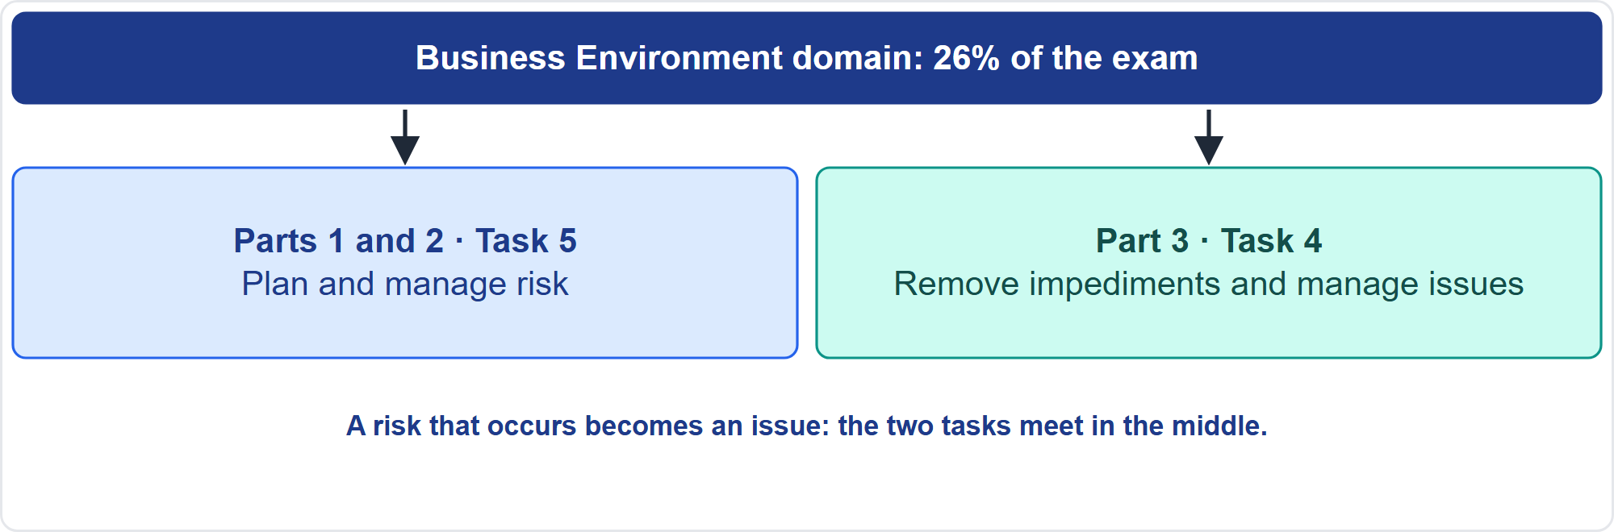
Where This Module Sits in the Exam
Part 1
Two Business Environment tasks
EXAM TIP A risk that has occurred is an issue: log it, run the planned response and update the register.
PMP Exam Prep 2026 | PMBOK 8 and the New ECO
Module 11: Risk, Issues and Impediments
2 / 59
Notes:
Here is where this module sits. The Business Environment domain has eight tasks, and this module covers two. Task five: plan and manage risk, from identifying risks to quantifying contingency and executing the risk plan. Task four: remove impediments and manage issues, including recognizing when a risk becomes an issue. The line between a risk and an issue is one of the most tested ideas on the exam. A risk that has occurred is an issue: log it, run the planned response and update the register.

Slide 3
What You Will Learn
Part 1
Write risk statements, and set appetite, thresholds and scales
Identify and analyze risks, qualitatively and quantitatively
Choose response strategies and size reserves
Monitor risks, and tell risks, issues, impediments and change requests apart
Evaluate, prioritize and resolve impediments, and escalate correctly
Recognize when a risk becomes an issue
PMP Exam Prep 2026 | PMBOK 8 and the New ECO
Module 11: Risk, Issues and Impediments
3 / 59
Notes:
By the end of this module you will be able to do six things. Write risk statements, and set appetite, thresholds and scales. Identify and analyze risks, qualitatively and quantitatively. Choose response strategies and size reserves. Monitor risks, and tell risks, issues, impediments and change requests apart. Evaluate, prioritize and resolve impediments, and escalate correctly. And recognize when a risk becomes an issue.

Slide 4
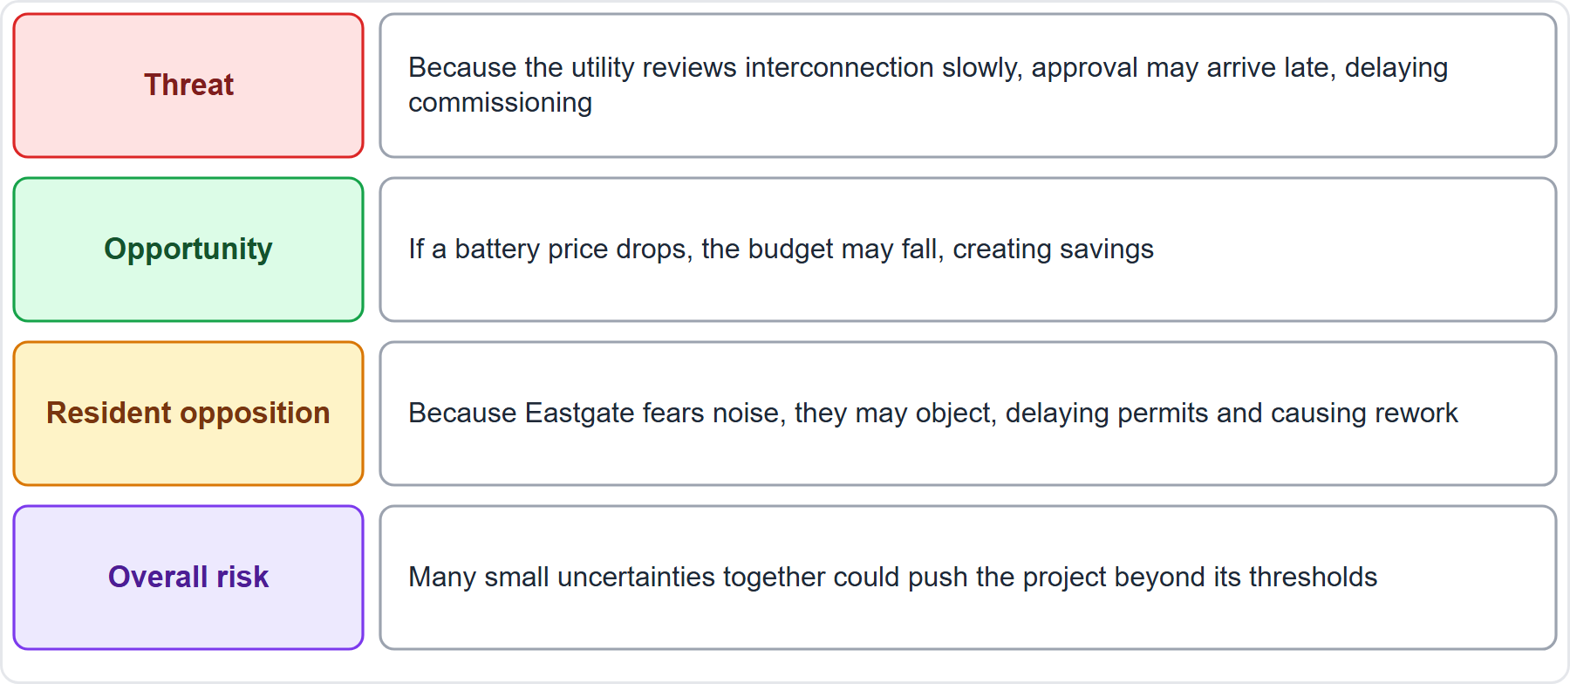
Case Check-In: Risks on the Microgrid
Part 1
CASE CHECK-IN · Sunrise Campus Microgrid
Threat: slow utility review may delay commissioning
Opportunity: a battery price drop may free budget
PMP Exam Prep 2026 | PMBOK 8 and the New ECO
Module 11: Risk, Issues and Impediments
4 / 59
Notes:
Our microgrid has risks of several kinds. A threat: because the utility reviews interconnection slowly, approval may arrive late, delaying commissioning. An opportunity: if a battery price drops, the budget may fall, creating savings. Resident opposition: because Eastgate fears noise, they may object, delaying permits and causing rework. And overall risk: many small uncertainties together could push the whole project beyond its thresholds. Notice that each statement has a cause, an event and a consequence.

Slide 5
Risk: Key Terms
Part 1
Term | Meaning
Risk | An uncertain event with a positive or negative effect on objectives
Threat, opportunity | Negative effect; positive effect
Issue | A condition that has already occurred
Overall risk | Uncertainty's effect on the whole project
Appetite, threshold | Uncertainty accepted; its measurable limit
Exposure, resilience | Aggregate impact of all risks; ability to recover
EXAM TIP Known-knowns are not risks: they are facts and requirements managed in scope.
PMP Exam Prep 2026 | PMBOK 8 and the New ECO
Module 11: Risk, Issues and Impediments
5 / 59
Notes:
Key terms. A risk is an uncertain event or condition that, if it occurs, has a positive or negative effect on objectives. A threat is a risk with a negative effect, and an opportunity has a positive one. An issue is a current condition that has already occurred or is occurring. Overall risk is the effect of uncertainty on the project as a whole. Risk appetite is the uncertainty accepted for a reward, and a threshold is the measurable acceptable variation. Exposure is the aggregate impact of all risks. And resilience is the ability to absorb impacts and recover quickly.

Slide 6
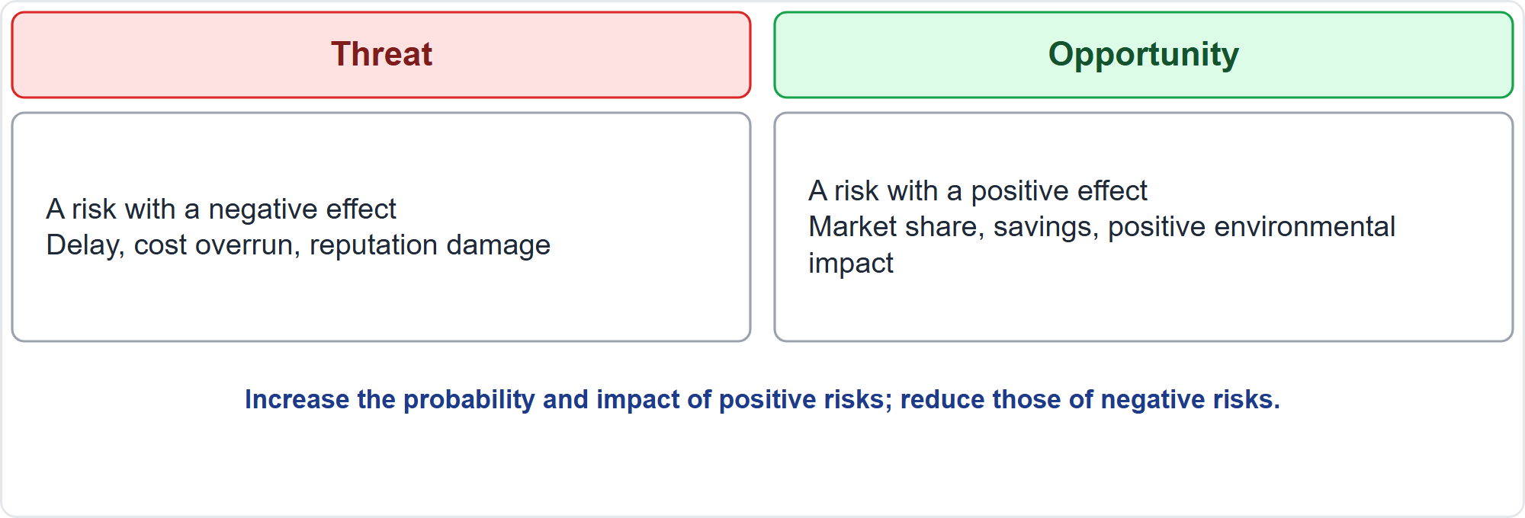
Threats and Opportunities
Part 1
Negative and positive effects
EXAM TIP Positive risks deserve active responses, not a shrug.
PMP Exam Prep 2026 | PMBOK 8 and the New ECO
Module 11: Risk, Issues and Impediments
6 / 59
Notes:
Risk is not only bad news. A threat is a risk with a negative effect on objectives, such as delay, cost overrun or reputation damage. An opportunity is a risk with a positive effect, such as market share, cost savings or a positive environmental impact. The goal of the domain is to increase the probability and impact of positive risks, and decrease the probability and impact of negative risks, building resilience and reducing uncertainty. Positive risks deserve active responses: exploit, enhance or share them.

Slide 7
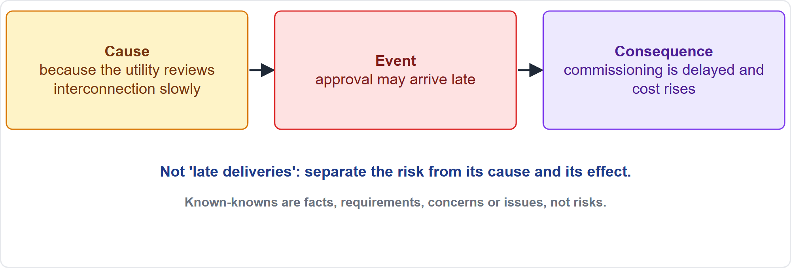
Writing a Risk Statement
Part 1
Cause, event, consequence
EXAM TIP A risk register entry that reads late deliveries is not a risk statement; write cause, event and consequence.
PMP Exam Prep 2026 | PMBOK 8 and the New ECO
Module 11: Risk, Issues and Impediments
7 / 59
Notes:
Write each risk as cause, event, consequence. A register entry that says late deliveries is not a risk statement. A proper one says: because the utility reviews interconnection slowly, approval may arrive late, and commissioning is then delayed and cost rises. This separates the risk from its cause and its effect. It also helps separate real risks from concerns, issues and assumptions, because the event is uncertain and in the future.

Slide 8
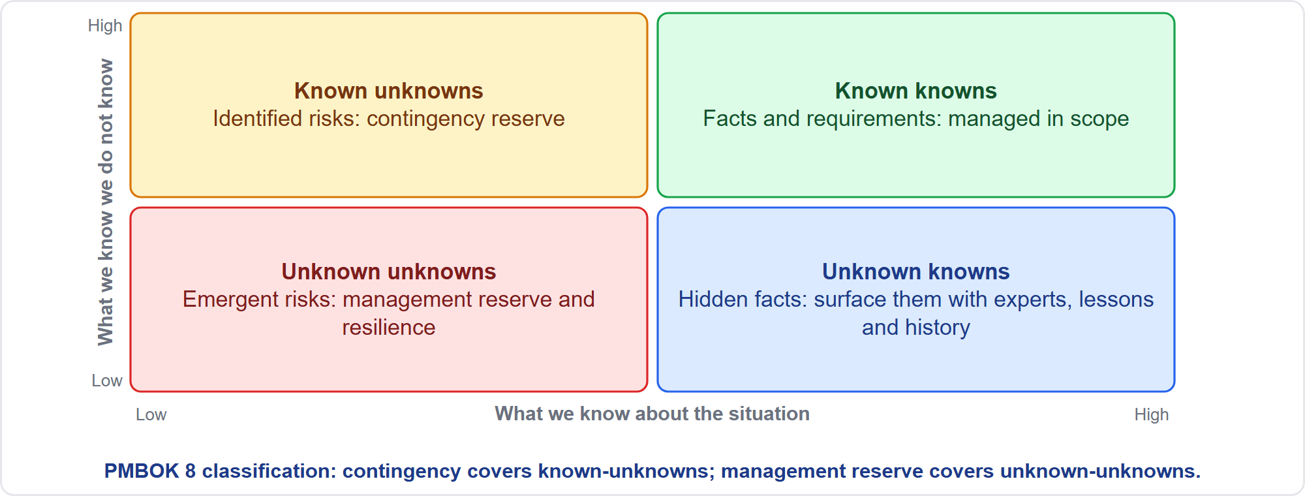
Known and Unknown
Part 1
What counts as a risk
EXAM TIP Contingency reserve covers known-unknowns; management reserve covers unknown-unknowns.
PMP Exam Prep 2026 | PMBOK 8 and the New ECO
Module 11: Risk, Issues and Impediments
8 / 59
Notes:
PMBOK 8 classifies what is known and unknown. Known-knowns are facts and requirements, managed as part of scope: not a risk. Known-unknowns are the classic risks: there is knowledge to identify probability and impact, so use the risk register, a response strategy and a contingency reserve. Unknown-unknowns are emergent risks: handle them with management reserve and resilience, the ability to absorb and recover. Unknown-knowns are hidden facts: surface them through experts, lessons learned, historical information and stakeholders.

Slide 9
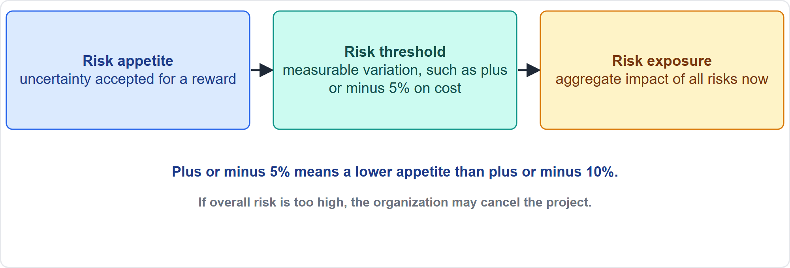
Appetite, Threshold and Exposure
Part 1
How much risk is acceptable
EXAM TIP Overall risk that is too high may lead the organization to cancel the project.
PMP Exam Prep 2026 | PMBOK 8 and the New ECO
Module 11: Risk, Issues and Impediments
9 / 59
Notes:
Risk appetite is the degree of uncertainty an organization or individual will accept in anticipation of a reward. A risk threshold turns appetite into a measurable acceptable variation around an objective. For example, plus or minus five percent on cost means a lower appetite than plus or minus ten percent. Risk exposure is the aggregate measure of the potential impact of all risks at a point in time. Overall risk is the effect of uncertainty on the project as a whole. If it is too high, the organization may cancel the project.

Slide 10
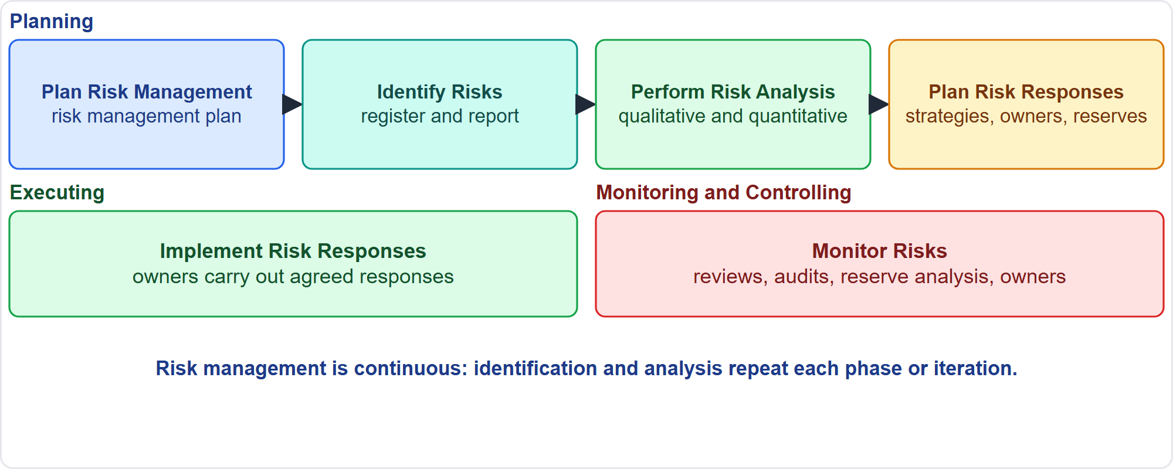
The Six Risk Processes
Part 1
Plan, identify, analyze, respond, implement, monitor
EXAM TIP Risk management is continuous: a register last updated at kickoff is a red flag.
PMP Exam Prep 2026 | PMBOK 8 and the New ECO
Module 11: Risk, Issues and Impediments
10 / 59
Notes:
Six risk processes. Four are in Planning. Plan Risk Management produces the risk management plan. Identify Risks produces the risk register and risk report. Perform Risk Analysis does qualitative analysis, and quantitative analysis when needed. Plan Risk Responses develops strategies, owners and reserves. In Executing, Implement Risk Responses carries out the agreed responses. In Monitoring and Controlling, Monitor Risks tracks risks, responses and effectiveness, and assigns owners. Identification and analysis repeat at the start of each phase or iteration.

Slide 11
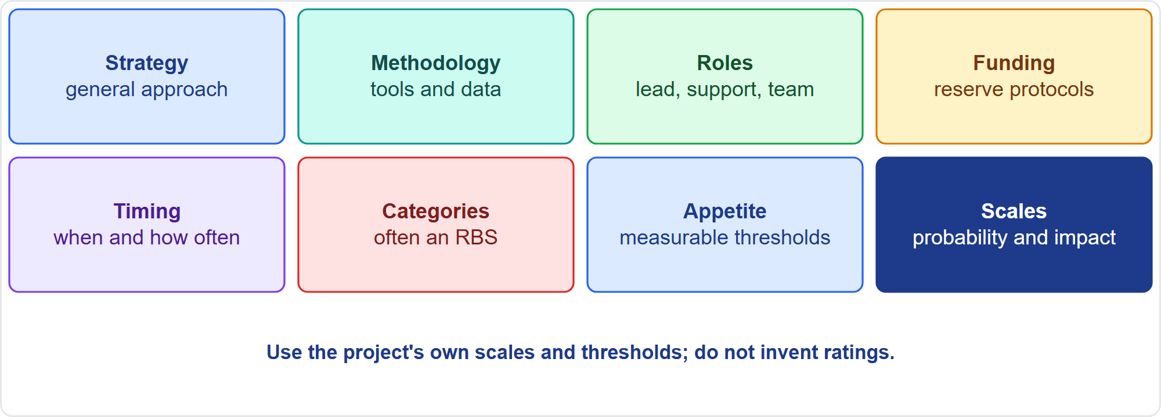
Plan Risk Management
Part 1
Eight elements
EXAM TIP Use the project's own scales and thresholds from the risk management plan; do not invent ratings.
PMP Exam Prep 2026 | PMBOK 8 and the New ECO
Module 11: Risk, Issues and Impediments
11 / 59
Notes:
The risk management plan begins when the project is conceived and is completed early. It defines the risk strategy, the methodology, and roles and responsibilities. It covers funding, including protocols for contingency and management reserves, and timing. It covers risk categories, often a risk breakdown structure. And it records stakeholder risk appetite as measurable thresholds, with probability and impact definitions. Not everything fits the scales: ethical, reputation and morale risks need judgment alongside the numbers. Use the project's own scales and thresholds.

Slide 12
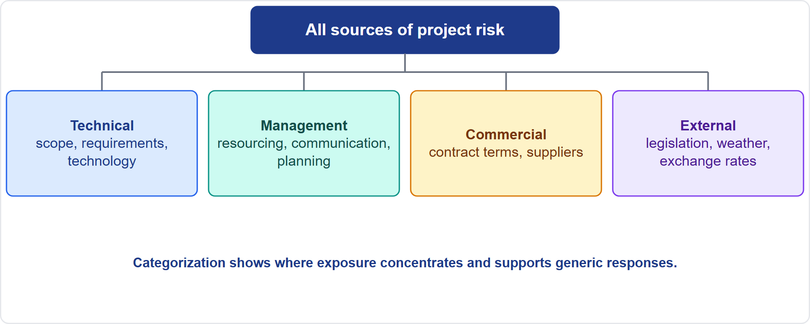
Risk Breakdown Structure
Part 1
Four sources of risk
EXAM TIP Categorizing risks shows where exposure is concentrated and supports generic responses to groups of risks.
PMP Exam Prep 2026 | PMBOK 8 and the New ECO
Module 11: Risk, Issues and Impediments
12 / 59
Notes:
A risk breakdown structure groups sources of risk. In the PMBOK 8 example, level zero is all sources of project risk, and level one has four categories: technical, management, commercial and external. Technical covers scope definition, requirements and technology. Management covers resourcing, communication and planning. Commercial covers contract terms and suppliers. External covers legislation, exchange rates and the environment or weather. Categorizing risks shows where exposure concentrates, and supports generic responses to groups of risks.

Slide 13
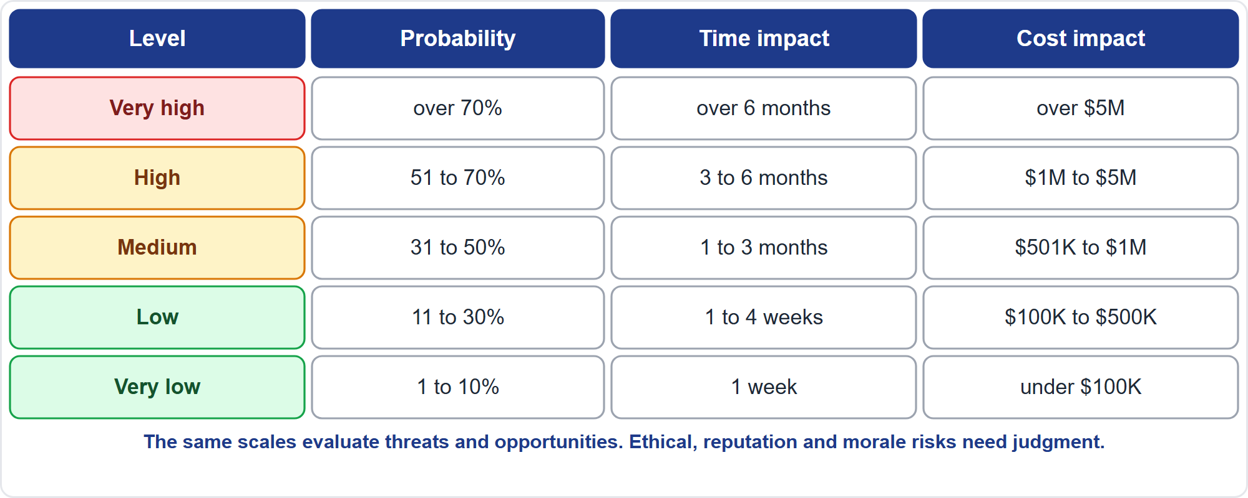
Probability and Impact Scales
Part 1
An example five-level scale
EXAM TIP The same scales evaluate threats and opportunities, using negative or positive impact definitions.
PMP Exam Prep 2026 | PMBOK 8 and the New ECO
Module 11: Risk, Issues and Impediments
13 / 59
Notes:
Each project defines its own probability and impact scales, typically five levels for a detailed approach, three for a simple one. Here is an example. Very high: over seventy percent probability, over six months, over five million dollars. High: fifty-one to seventy percent, three to six months, one to five million. Medium: thirty-one to fifty percent. Low: eleven to thirty percent. Very low: one to ten percent. The same scales evaluate threats and opportunities. Each project sets its own numbers.

Slide 14
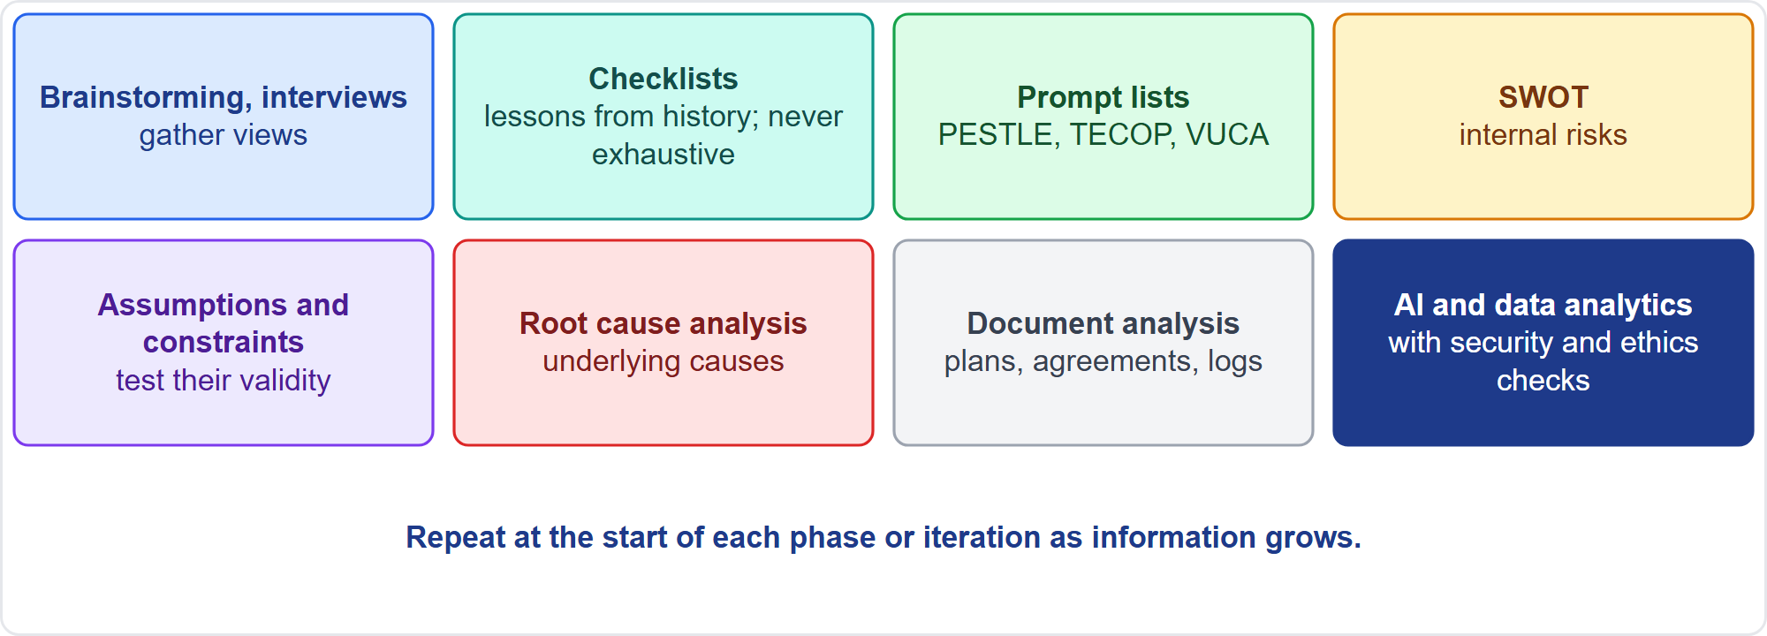
Identify Risks
Part 1
Eight techniques
EXAM TIP Identification is iterative: not all risks can be found at the start, and new information means new identification.
PMP Exam Prep 2026 | PMBOK 8 and the New ECO
Module 11: Risk, Issues and Impediments
14 / 59
Notes:
Identify risks iteratively: not all can be found at the start, so repeat at the start of each phase or iteration. Separate real risks from concerns, issues and assumptions, and include opportunities. Techniques: brainstorming, interviews and facilitation. Checklists from lessons learned, which are never exhaustive. Prompt lists such as PESTLE, TECOP and VUCA. SWOT, which adds internal risks. Assumption and constraint analysis, root cause analysis, and document analysis. AI and data analytics can broaden identification, with security and ethics checks.

Slide 15
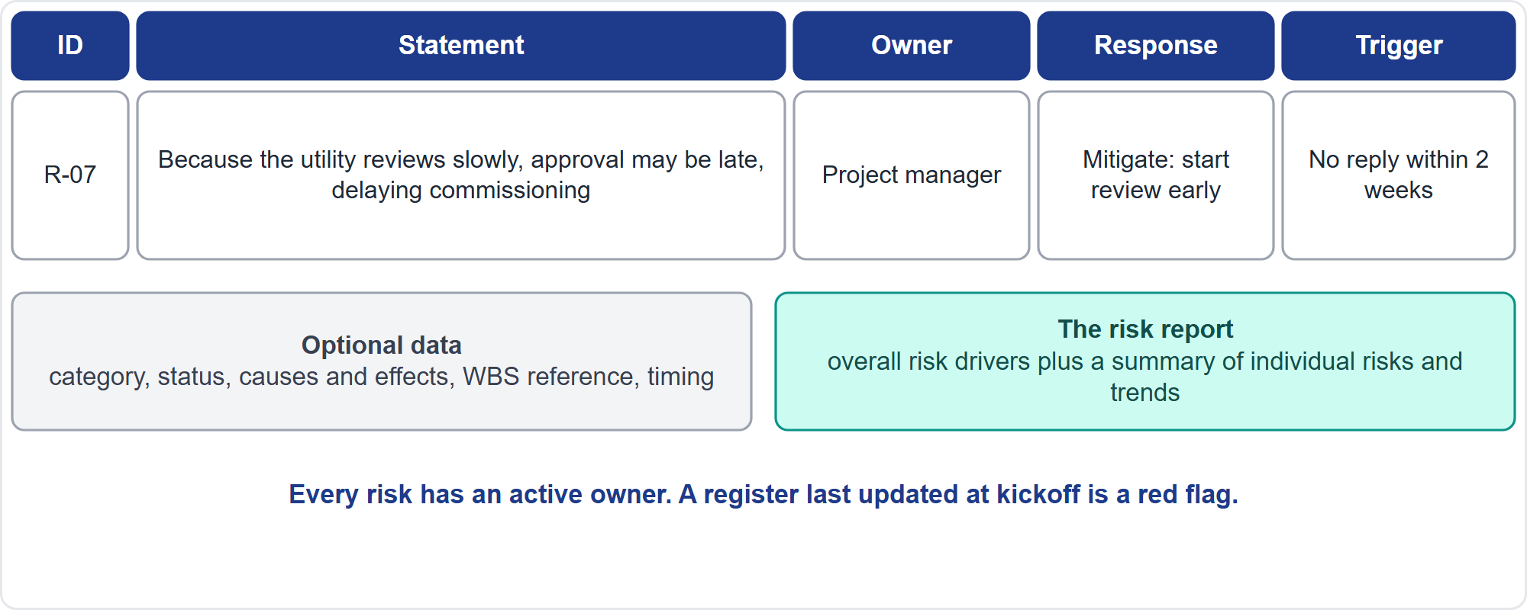
The Risk Register and Risk Report
Part 1
An entry and the report
EXAM TIP If the owner leaves, assign a new one and confirm the response is ready; re-scoring does not fill the gap.
PMP Exam Prep 2026 | PMBOK 8 and the New ECO
Module 11: Risk, Issues and Impediments
15 / 59
Notes:
The risk register is created at identification and updated by every later process. Always record a unique identifier, a description in cause, event and effect form, a potential risk owner and potential responses. Optional data includes a title, category, status, causes and effects, risk triggers, the affected work and timing. A trigger is an event or condition showing that a risk is about to occur. The risk report gives sources of overall risk, plus a summary of individual risks, and communicates risk status to stakeholders.

Slide 16
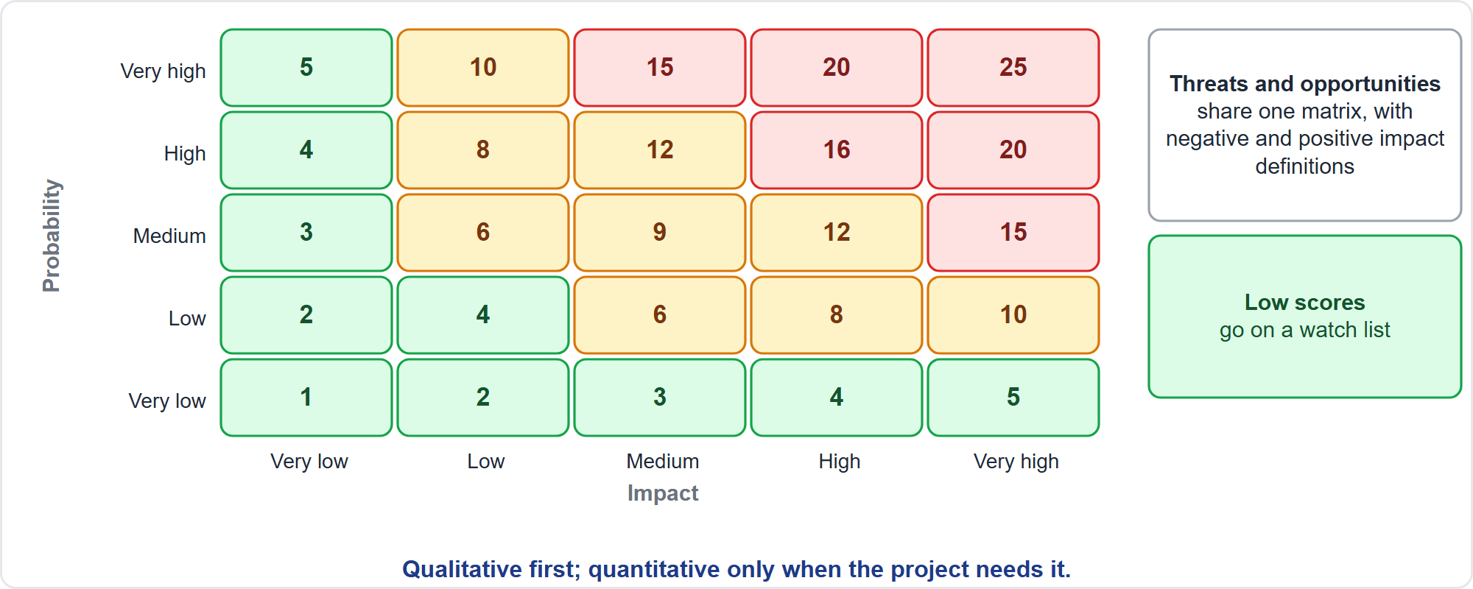
Qualitative Analysis
Part 1
Probability times impact
EXAM TIP Qualitative first; quantitative only when the project needs it.
PMP Exam Prep 2026 | PMBOK 8 and the New ECO
Module 11: Risk, Issues and Impediments
16 / 59
Notes:
Qualitative analysis evaluates each individual risk for probability and impact, using the plan's definitions. Score equals probability times impact, and thresholds for high, medium and low come from the plan. Threats and opportunities share one matrix. Stakeholders may perceive differences. Explore them and record the assumptions. Low-scoring risks go on a watch list. Risk categorization, by source, by work area, by phase or by root cause, shows where exposure concentrates. Qualitative analysis is done throughout the project.

Slide 17
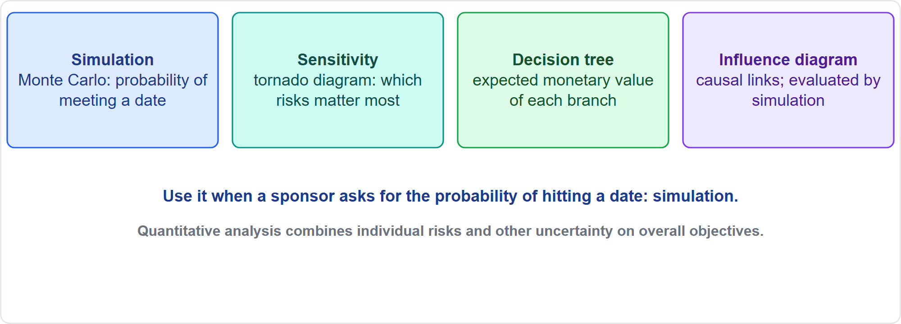
Quantitative Analysis
Part 1
Four techniques
EXAM TIP If a sponsor asks for the probability of hitting a date, the answer is simulation.
PMP Exam Prep 2026 | PMBOK 8 and the New ECO
Module 11: Risk, Issues and Impediments
17 / 59
Notes:
Quantitative analysis numerically analyzes the combined effect of individual risks and other uncertainty on overall objectives, and it is used only when the project needs it. Simulation, such as Monte Carlo, models combined effects and gives, for example, the probability of finishing by a target date. Sensitivity analysis shows which risks matter most, displayed as a tornado diagram. Decision tree analysis calculates the expected monetary value of each branch to pick the best path. Influence diagrams show causal influences and relationships.

Slide 18
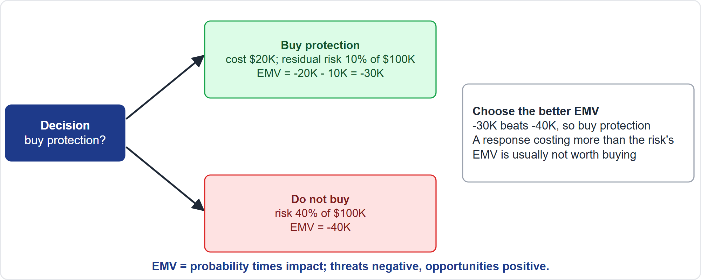
Expected Monetary Value
Part 1
Choose the better EMV
EXAM TIP A response that costs more than the EMV of the risk it addresses is usually not worth buying.
PMP Exam Prep 2026 | PMBOK 8 and the New ECO
Module 11: Risk, Issues and Impediments
18 / 59
Notes:
Expected monetary value equals probability times impact value. Threats are negative and opportunities are positive. For a decision, add the values along each branch, including the cost of the response, and choose the better, higher, expected value. In our example, buying protection costs twenty thousand and leaves a ten percent chance of a hundred thousand loss, which is ten thousand: a total of minus thirty thousand. Not buying leaves a forty percent chance of the same loss: minus forty thousand. Buy protection. Do not pay fifty thousand to remove a thirty thousand exposure.

Slide 19
Risk Planning and Analysis Traps: What PMI Expects
Part 1
A risk that has occurred is an issue
Every risk needs an active owner
Use the project's own scales and thresholds
Positive risks deserve active responses
Qualitative first; quantitative only when needed
Risk management is continuous; do not confuse risk with issue, assumption, constraint or concern
EXAM TIP First action when unsure: check the risk register and risk management plan, then act within them.
PMP Exam Prep 2026 | PMBOK 8 and the New ECO
Module 11: Risk, Issues and Impediments
19 / 59
Notes:
The traps so far. A risk that has occurred is an issue. Every risk needs an active owner. Use the project's own scales and thresholds, and do not invent ratings. Positive risks deserve active responses. Do qualitative analysis first, and quantitative only when needed. Risk management is continuous, so a register last updated at kickoff, or reviewed only at gates in an agile project, is the wrong answer. And do not confuse risk with issue, assumption, constraint or concern.

Slide 20
Part 1 Recap
Part 1
1
Risk statement
2
Known and unknown
3
Plan
cause, event, consequence
facts are not risks; known-unknowns get contingency
appetite as thresholds; the project's own scales
4
Identify
5
Qualitative
6
Quantitative
iterative; real risks only; register with owners
probability times impact; watch list
simulation, sensitivity, decision trees with EMV
PMP Exam Prep 2026 | PMBOK 8 and the New ECO
Module 11: Risk, Issues and Impediments
20 / 59
Notes:
Let us recap Part 1. A risk statement has a cause, an event and a consequence. Facts are not risks, and known-unknowns get contingency. The plan turns appetite into measurable thresholds and uses the project's own scales. Identification is iterative, for real risks only, with owners in the register. Qualitative analysis multiplies probability by impact and keeps a watch list. Quantitative analysis uses simulation, sensitivity analysis and decision trees with expected monetary value. In Part 2, we turn to responses and monitoring.

Slide 21
Plan Risk Responses
Part 2
Develop options, choose strategies, agree actions, assign owners, allocate resources and reserves
Responses must be timely, cost-effective, realistic and agreed
Early action is usually more effective than repairing damage later
Responses often need change requests
Escalate only what is outside the project's scope or your authority
Insert response activities into the plans and baselines
EXAM TIP Compare response cost with the risk's EMV: do not pay 50 thousand to remove a 30 thousand exposure.
PMP Exam Prep 2026 | PMBOK 8 and the New ECO
Module 11: Risk, Issues and Impediments
21 / 59
Notes:
Part 2 covers responses. Plan Risk Responses develops options, selects strategies, agrees actions, assigns owners, and allocates resources and reserves. Responses must be timely, cost-effective, realistic and agreed by the parties involved. Early action is usually more effective than repairing damage later. Responses often need change requests, and response activities go into the plans and baselines. Compare the cost of a response with the expected monetary value of the risk. Do not pay fifty thousand to remove a thirty thousand exposure.

Slide 22
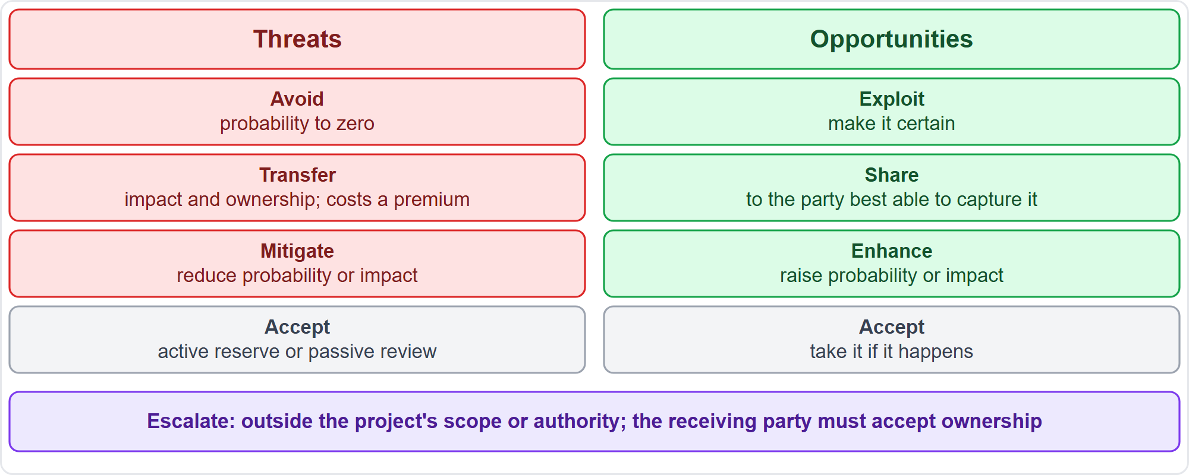
Response Strategies
Part 2
Threats and opportunities
EXAM TIP Transfer shifts the impact and ownership of the response, usually for a premium; it does not make the risk disappear.
PMP Exam Prep 2026 | PMBOK 8 and the New ECO
Module 11: Risk, Issues and Impediments
22 / 59
Notes:
For threats: avoid reduces probability to zero or isolates the objectives. Mitigate reduces probability or impact. Transfer shifts the impact and ownership of the response, through insurance, performance bonds, warranties or agreements, usually for a risk premium. Accept can be active, with a contingency reserve, or passive, with periodic review. For opportunities: exploit makes it certain, enhance raises probability or impact, share gives ownership to the party best able to capture it, and accept takes it if it happens. Escalate applies to both, when the risk is outside the project's scope or authority.

Slide 23
Escalating a Risk
Part 2
Escalate when the risk is outside the project's scope or beyond the project manager's authority
It is managed at program, portfolio or organization level
The receiving party must accept ownership
The project team does not monitor it further; it may stay in the register for information
Use the defined path; bring facts, options and a recommendation
Do not escalate before analysis
EXAM TIP After a valid escalation, ownership moves and the project stops monitoring the risk.
PMP Exam Prep 2026 | PMBOK 8 and the New ECO
Module 11: Risk, Issues and Impediments
23 / 59
Notes:
Escalate a risk when it is outside the project's scope or beyond the project manager's authority. It is then managed at program, portfolio or organization level. The receiving party must accept ownership, and the project team does not monitor it further, though it may stay in the register for information. Use the defined escalation path, and bring facts, options and a recommendation. Do not escalate before analysis. And escalate only what is beyond scope or authority.

Slide 24
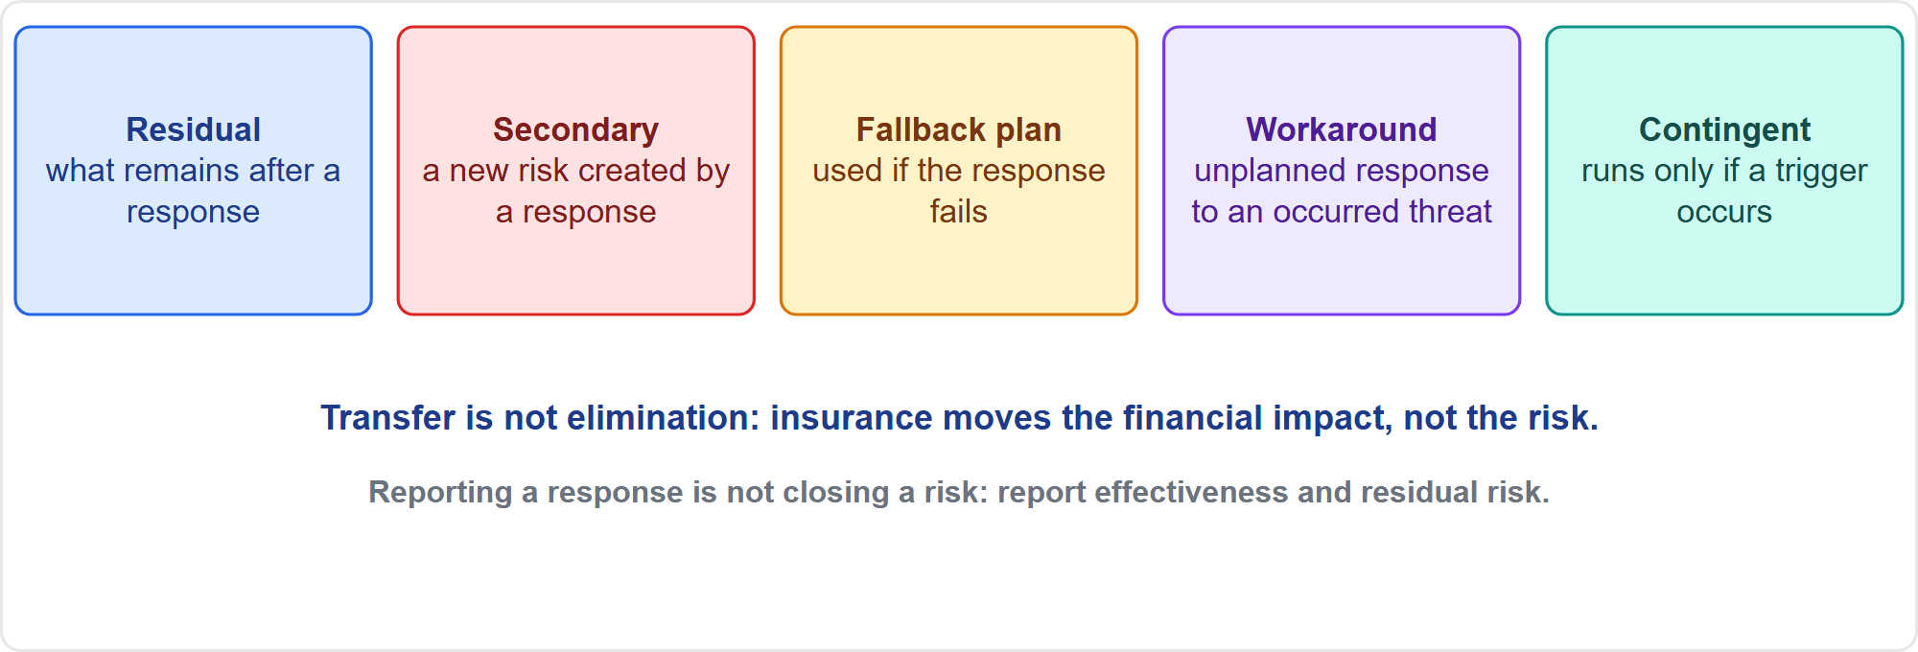
Terms the Exam Still Uses
Part 2
Five terms
EXAM TIP Reporting a response is not closing a risk: report effectiveness and residual risk.
PMP Exam Prep 2026 | PMBOK 8 and the New ECO
Module 11: Risk, Issues and Impediments
24 / 59
Notes:
Several terms are not in PMBOK 8 as strategy names, but the exam uses them. Residual risk is what remains after a response is implemented, and you keep reporting it. A secondary risk is a new risk created by a response. A fallback plan is used if the primary response proves ineffective. A workaround is an unplanned response to a threat that has occurred. A contingent response runs only if a defined trigger happens. Transfer is not elimination: insurance moves the financial impact, but the risk may remain.

Slide 25
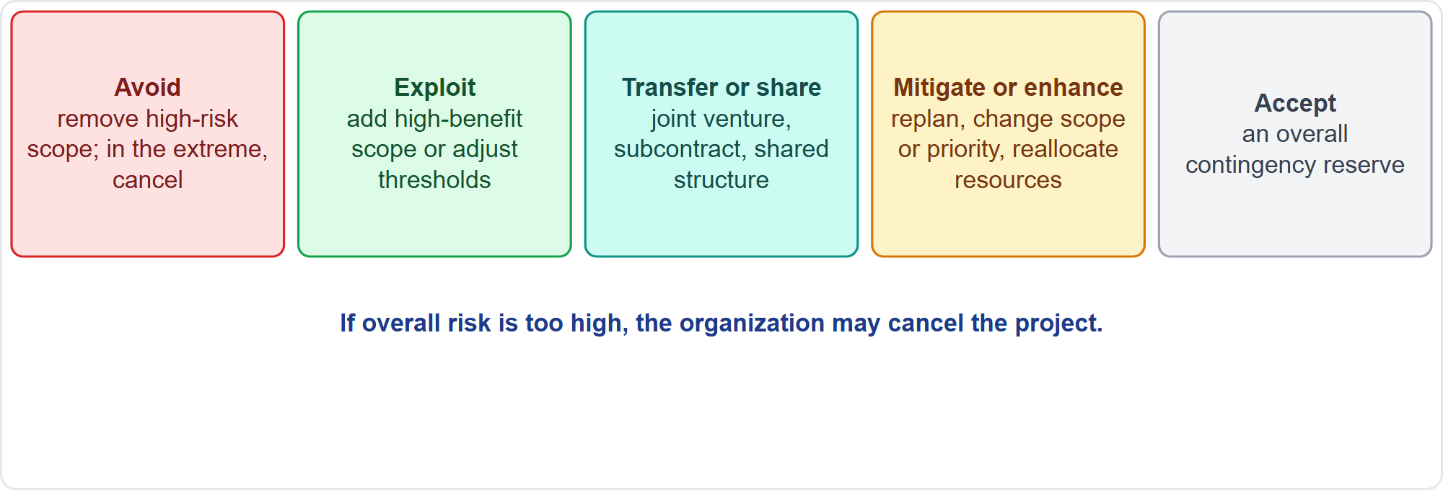
Responses to Overall Project Risk
Part 2
Same ideas, whole project
EXAM TIP The extreme avoidance response to overall risk is to cancel the project, or to remove high-risk scope.
PMP Exam Prep 2026 | PMBOK 8 and the New ECO
Module 11: Risk, Issues and Impediments
25 / 59
Notes:
Overall project risk uses the same ideas applied to the whole project. Avoid: remove high-risk scope, and in the extreme case cancel the project. Exploit: add high-benefit scope or adjust thresholds. Transfer or share: a joint venture, subcontracting or a shared business structure. Mitigate or enhance: replan, change scope or priority, or reallocate resources. Accept: an overall contingency reserve. If overall risk is too high, the organization may cancel the project.

Slide 26
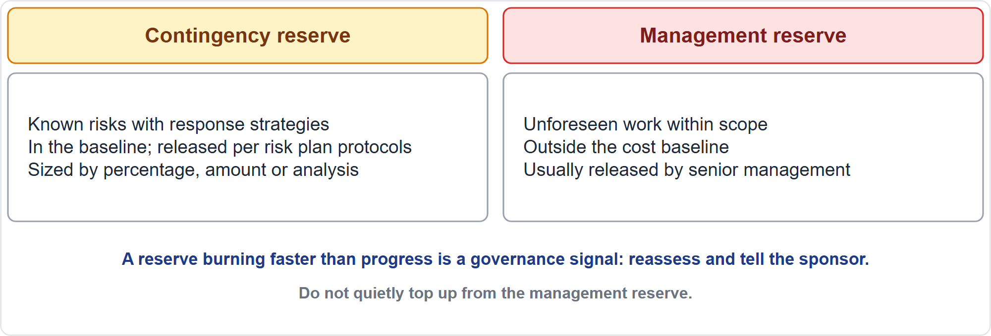
Reserves
Part 2
Contingency and management reserve
EXAM TIP Using the management reserve normally needs a change request, so the baseline reflects the new authorization.
PMP Exam Prep 2026 | PMBOK 8 and the New ECO
Module 11: Risk, Issues and Impediments
26 / 59
Notes:
Contingency reserve covers known risks with active response strategies, the known-unknowns. It sits in the schedule or cost baseline, and is released per the protocols in the risk management plan. It can be sized by a percentage, a fixed amount or quantitative analysis. Management reserve covers unforeseen work within scope, the unknown-unknowns. It is in addition to the baseline, never part of the cost baseline, and is usually released by senior management. Reserve analysis compares remaining risk with remaining reserve. A reserve burning faster than progress is a governance signal.

Slide 27
Quantifying Contingency
Part 2
Assess risks, then size the reserve from expected monetary values or simulation
Example: EMVs of 30, 20 and 20 thousand suggest about 70 thousand, adjusted for dependencies and confidence
Identify contingency clearly in the cost documentation; do not hide it in estimates
Reduce or release it as risks pass
Reserve analysis: is the reserve sufficient for the remaining risk?
Small and government projects often hold larger buffers
EXAM TIP Summing expected values for accepted risks is exam practice.
PMP Exam Prep 2026 | PMBOK 8 and the New ECO
Module 11: Risk, Issues and Impediments
27 / 59
Notes:
To quantify contingency, assess the risks, then size the reserve from expected monetary values or simulation. As an example from exam practice, risks with expected values of thirty, twenty and twenty thousand suggest a contingency of about seventy thousand, adjusted for dependencies and confidence. Identify contingency clearly in the cost documentation, and do not hide it in estimates. Reduce or release it as risks pass. Reserve analysis asks whether the reserve is sufficient for the remaining risk. Small and government projects often hold larger buffers.

Slide 28
Implement Risk Responses
Part 2
Risk owners carry out the agreed responses; the project manager influences and supports
Tools: influencing, the project information system, interpersonal skills
Outputs: change requests, register, report, issue log, lessons learned, assignments
If a response does not work: use the fallback plan or re-plan
Secondary risks go into the register
Responses that change a baseline go through change control
EXAM TIP Risk owners execute the responses; fallback plan and secondary risk are exam practice terms.
PMP Exam Prep 2026 | PMBOK 8 and the New ECO
Module 11: Risk, Issues and Impediments
28 / 59
Notes:
In Executing, risk owners carry out the agreed responses as planned, and the project manager influences and supports them. Tools are influencing, the project information system and interpersonal skills. Outputs include change requests, and updates to the risk register, the risk report, the issue log, the lessons learned register and team assignments. If a response does not work, use the fallback plan or re-plan. Secondary risks go into the register. And a response that changes a baseline goes through change control. Fallback plan and secondary risk are exam practice terms. PMBOK 8 does not use them.

Slide 29
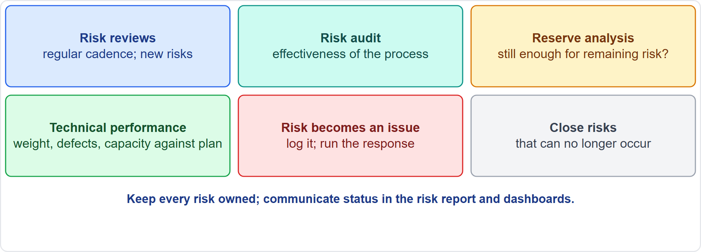
Monitor Risks
Part 2
Six activities
EXAM TIP A risk audit examines the effectiveness of the risk management process, not individual risks.
PMP Exam Prep 2026 | PMBOK 8 and the New ECO
Module 11: Risk, Issues and Impediments
29 / 59
Notes:
Monitor Risks tracks identified risks, the implementation of responses, new risks and the effectiveness of responses, and keeps every risk owned. Risk reviews reassess existing risks and find new ones, on a regular cadence. A risk audit examines the effectiveness of the risk management process, not individual risks. Reserve analysis asks whether reserves are still enough. Technical performance analysis compares technical achievement with plan, and deviations can signal threats or opportunities. A risk that occurs becomes an issue. Risks that can no longer occur are closed.

Slide 30
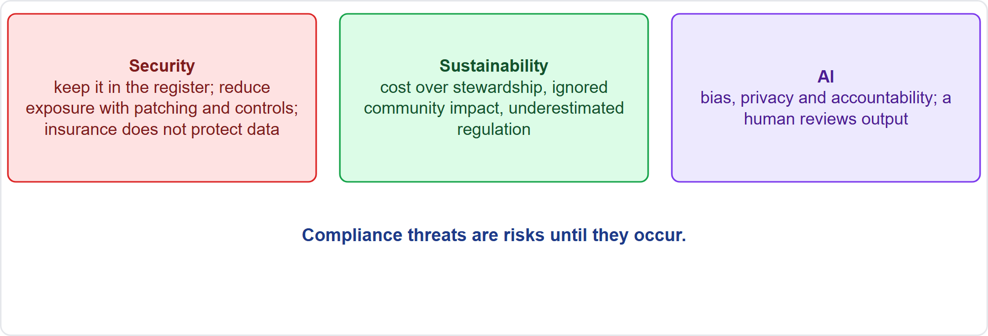
Security, Sustainability and AI Risks
Part 2
ECO examples
EXAM TIP Insurance transfers financial loss but does not protect the data.
PMP Exam Prep 2026 | PMBOK 8 and the New ECO
Module 11: Risk, Issues and Impediments
30 / 59
Notes:
The ECO gives three example areas. Security: a poor IT security risk stays in the register with an owner and a response that reduces exposure, such as patching, controls or replacing the weak component. Insurance transfers financial loss but does not protect the data. Sustainability: risks arise when cost is prioritized over stewardship, community impact is ignored, or regulation is underestimated. AI: ethical risks of bias, privacy and accountability, so a human reviews AI output. Compliance threats are risks until they occur.

Slide 31
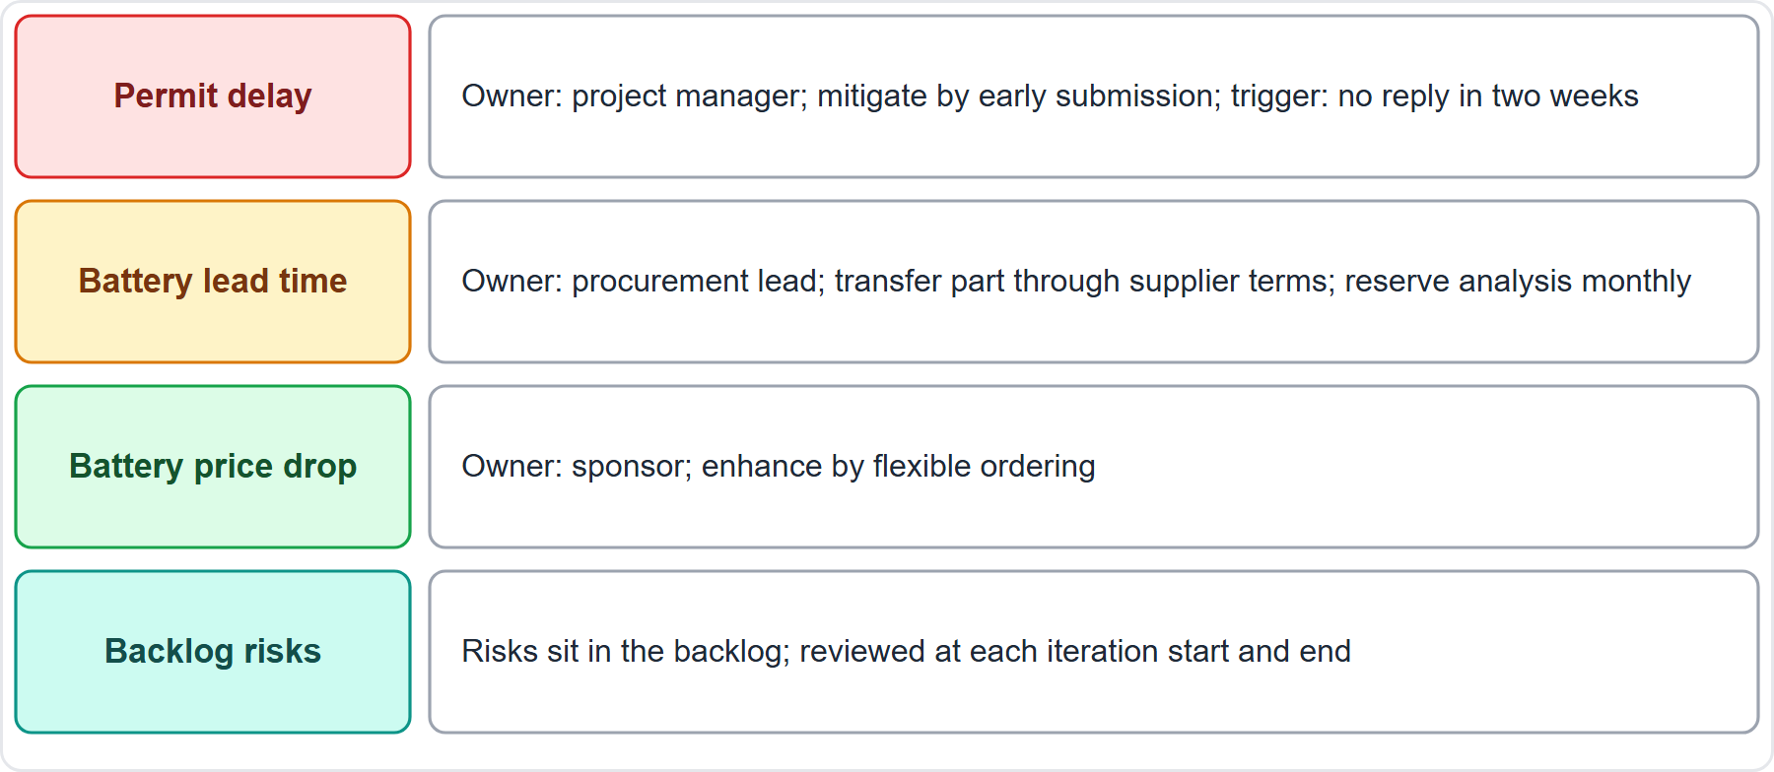
Case Check-In: Risk Handling on the Microgrid
Part 2
CASE CHECK-IN · Sunrise Campus Microgrid
Owners and triggers: a named owner and a trigger for each risk
Cadence: reserve analysis monthly; backlog risks reviewed each iteration
PMP Exam Prep 2026 | PMBOK 8 and the New ECO
Module 11: Risk, Issues and Impediments
31 / 59
Notes:
On the microgrid, each risk has an owner and a response. The permit delay is owned by the project manager: mitigate by early submission, with a trigger of no reply within two weeks. The battery lead time is owned by the procurement lead: transfer part of it through supplier terms, with reserve analysis each month. The battery price drop is an opportunity owned by the sponsor: enhance it through flexible ordering. And software risks sit in the backlog, reviewed at the start and end of each iteration.

Slide 32
Risk in Predictive, Agile and Hybrid Work
Part 2
 | Predictive | Agile | Hybrid
Planning | Formal plan, RBS, scales | Light; shared view of appetite | Formal for fixed parts
Identification | Workshops at planning and gates | Start of each iteration | Both
Visibility | Register and report | Risk-adjusted backlog | Register plus backlog
Reserves | Contingency and management | Short feedback loops | Mix
Quantitative | Common on large work | Rare | Where needed
EXAM TIP In agile work make risks visible in the backlog; do not hide them in private reports or a monthly side meeting.
PMP Exam Prep 2026 | PMBOK 8 and the New ECO
Module 11: Risk, Issues and Impediments
32 / 59
Notes:
Risk looks different by approach. Predictive: a formal plan, risk breakdown structure and scales up front, and workshops at planning and gates. A register and report go to the steering committee, with contingency and management reserves, and quantitative analysis on large work. Agile: lightweight planning, and risk identification at the start of each iteration by the whole team. Risks sit in the backlog, with short feedback loops and a risk review at the end of each iteration. Hybrid: a register for fixed elements and the backlog for iterative ones.

Slide 33
Risk Response Traps: What PMI Expects
Part 2
Contingency versus management reserve: known risks versus unknown-unknowns
Proportionality: compare the response cost with the risk's EMV
Transfer is not elimination
Escalate only what is beyond scope or authority
Reporting a response is not closing a risk: report residual risk
Make agile risks visible in the backlog
EXAM TIP Use change control when a response changes the baseline.
PMP Exam Prep 2026 | PMBOK 8 and the New ECO
Module 11: Risk, Issues and Impediments
33 / 59
Notes:
The traps for responses and monitoring. Contingency covers known risks, and management reserve covers unknown unknowns and is not the project manager's to spend unilaterally. Compare the cost of a response with the risk's expected value. Transfer is not elimination. Escalate only what is beyond scope or authority, and after a valid escalation, ownership moves. Reporting a response is not closing a risk: report effectiveness and residual risk. In agile work, make risks visible in the backlog. And use change control when a response changes the baseline.

Slide 34
Issues and Impediments: Key Terms
Part 2
Term | Meaning
Impediment | An obstacle that stops the team reaching its objectives
Issue | A current condition that has occurred
Issue log | Records and monitors issues
Impediment list | A visual chart: description, severity, actions
Risk trigger | An event showing a risk is about to occur
Workaround | A temporary response; the cause remains
EXAM TIP A workaround (exam practice wording) keeps the item open until the real fix.
PMP Exam Prep 2026 | PMBOK 8 and the New ECO
Module 11: Risk, Issues and Impediments
34 / 59
Notes:
Now issues and impediments. Key terms. An impediment is an obstacle that prevents the team from achieving its objectives. Examples are a waiting approval, missing access or data, a broken environment, an unavailable expert, or an unclear decision. An issue is a current condition that has already occurred and may need management attention. The issue log records and monitors issues. The impediment list is a visual chart showing description, severity and actions being taken. A risk trigger shows a risk is about to occur. And a workaround is temporary: the cause remains. The term workaround is exam practice wording, not PMBOK 8.

Slide 35
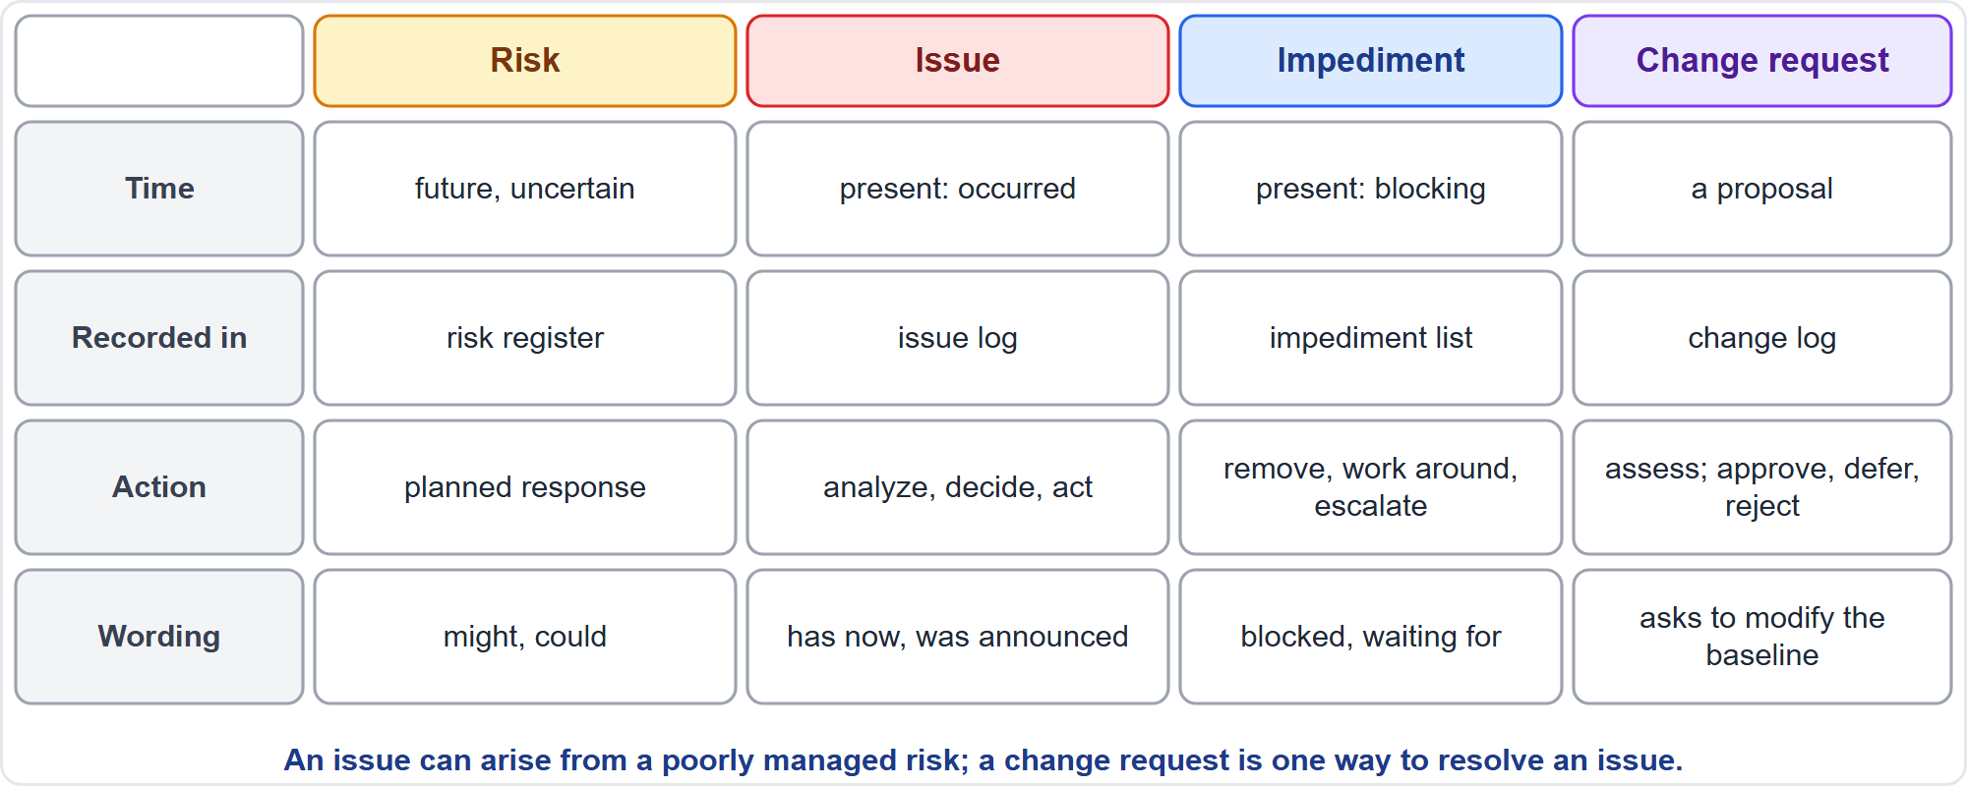
Risk, Issue, Impediment and Change Request
Part 2
Telling them apart
EXAM TIP A change request is one way to resolve an issue; it is not a synonym for an issue.
PMP Exam Prep 2026 | PMBOK 8 and the New ECO
Module 11: Risk, Issues and Impediments
35 / 59
Notes:
Tell them apart. A risk is future and uncertain, recorded in the risk register, with a planned response. Wording: might, could. An issue is present: it has occurred, recorded in the issue log, with analysis, decision and action. Wording: has now, was announced. An impediment is present and blocking the team, on the impediment list, to remove, work around or escalate. Wording: blocked, waiting for. A change request is a proposal to modify a baseline, in the change log, to assess and approve, defer or reject.

Slide 36
Key Relationships
Part 2
An issue can arise from a poorly managed risk, or from an unforeseen event
An impediment is an issue seen from the team's work
A change request resolves an issue when a baseline must change
A conflict between people that disrupts work is an issue
A false assumption or missed dependency can create an issue
Read the logs together: they can reveal stakeholder challenges
EXAM TIP Wording gives it away: might means risk; has now means issue; blocked means impediment.
PMP Exam Prep 2026 | PMBOK 8 and the New ECO
Module 11: Risk, Issues and Impediments
36 / 59
Notes:
Some key relationships. An issue can arise from a poorly managed risk, but it can also appear with no risk behind it. An impediment is an issue seen from the team's work: something that stops or slows the flow. A change request is one way to resolve an issue when a baseline or document must change. A conflict between people that disrupts the work is an issue to resolve. A false assumption, a missed dependency or a failed test can also create an issue. And read the issue log and the risk register together: they can reveal challenges tied to individual stakeholders.

Slide 37
Part 2 Recap
Part 2
1
Strategies
2
Escalation
3
Reserves
avoid, transfer, mitigate, accept; exploit, share, enhance, accept
only beyond scope or authority; the receiver owns it
contingency for known risks; management reserve for unforeseen work
4
Execution and monitoring
5
Special areas
6
Issues basics
owners, fallback plans, reviews, audits, reserve analysis
security, sustainability and AI risks
impediment, issue, risk and change request compared
PMP Exam Prep 2026 | PMBOK 8 and the New ECO
Module 11: Risk, Issues and Impediments
37 / 59
Notes:
Let us recap Part 2. For threats: avoid, transfer, mitigate or accept. For opportunities: exploit, share, enhance or accept. Escalate only what is beyond scope or authority, and the receiver owns it. Contingency covers known risks, and management reserve covers unforeseen work. Risk owners run responses, with fallback plans for failures, and secondary risks go into the register. Monitoring means reviews, audits, reserve analysis and closing risks. Security, sustainability and AI risks have their own treatment. And we compared risks, issues, impediments and change requests. In Part 3, we manage issues and impediments.

Slide 38
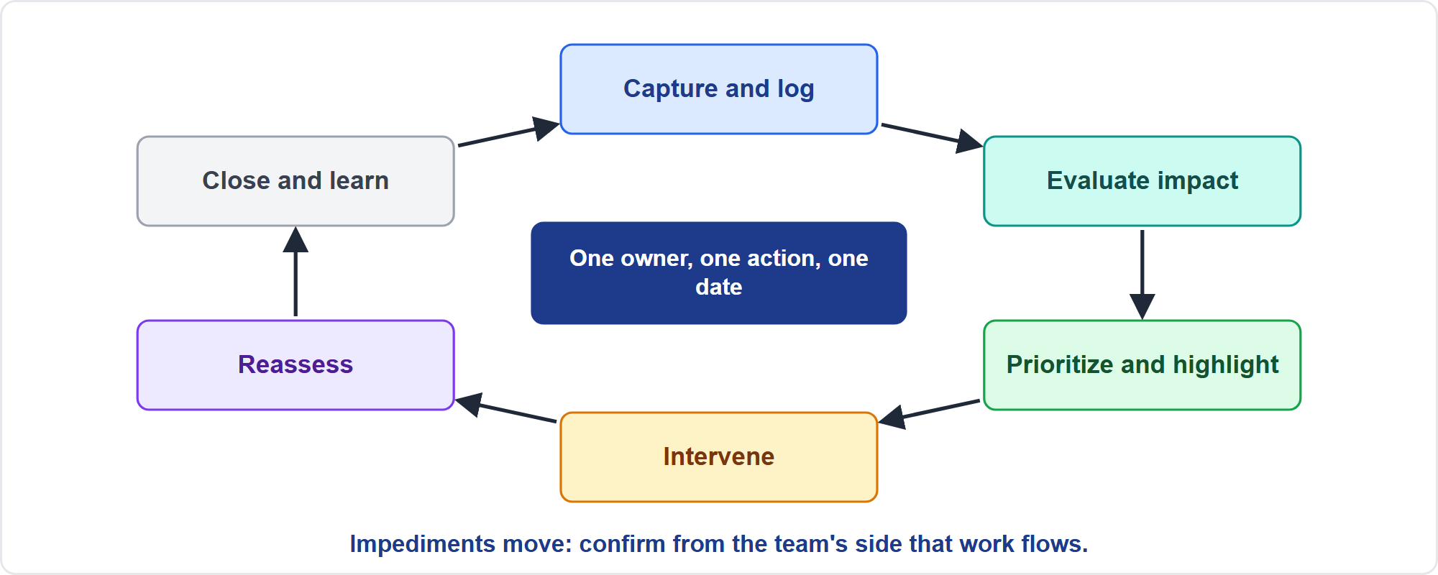
The Management Loop
Part 3
Six steps
EXAM TIP Give every item one named owner, one action and one date; the owner must be able to act.
PMP Exam Prep 2026 | PMBOK 8 and the New ECO
Module 11: Risk, Issues and Impediments
38 / 59
Notes:
The management loop has six steps, matching the ECO enablers. Capture and log: this is the entry point, including recognizing a risk that has become an issue. Evaluate the impact. Prioritize and highlight. Choose and apply an intervention strategy, collaborating with stakeholders. Reassess continually, so impediments are being addressed. Close and learn, feeding the lessons learned register. Give every item one named owner, one action and one date.

Slide 39
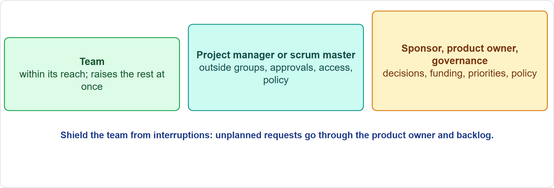
Who Removes Impediments
Part 3
Three levels
EXAM TIP Unplanned requests go through the product owner and the backlog; the project manager shields the team.
PMP Exam Prep 2026 | PMBOK 8 and the New ECO
Module 11: Risk, Issues and Impediments
39 / 59
Notes:
Three levels remove impediments. The team self-organizes and removes the impediments within its reach, and raises the rest at once, for example at the daily coordination meeting. The project manager or scrum master, as a servant leader, removes what the team cannot. That means working with outside groups, negotiating and replanning. It means shielding the team from outside disruption, and escalating. The sponsor, customer, product owner and governance act on matters beyond the project management team's authority: decisions, funding, priorities, policy.

Slide 40
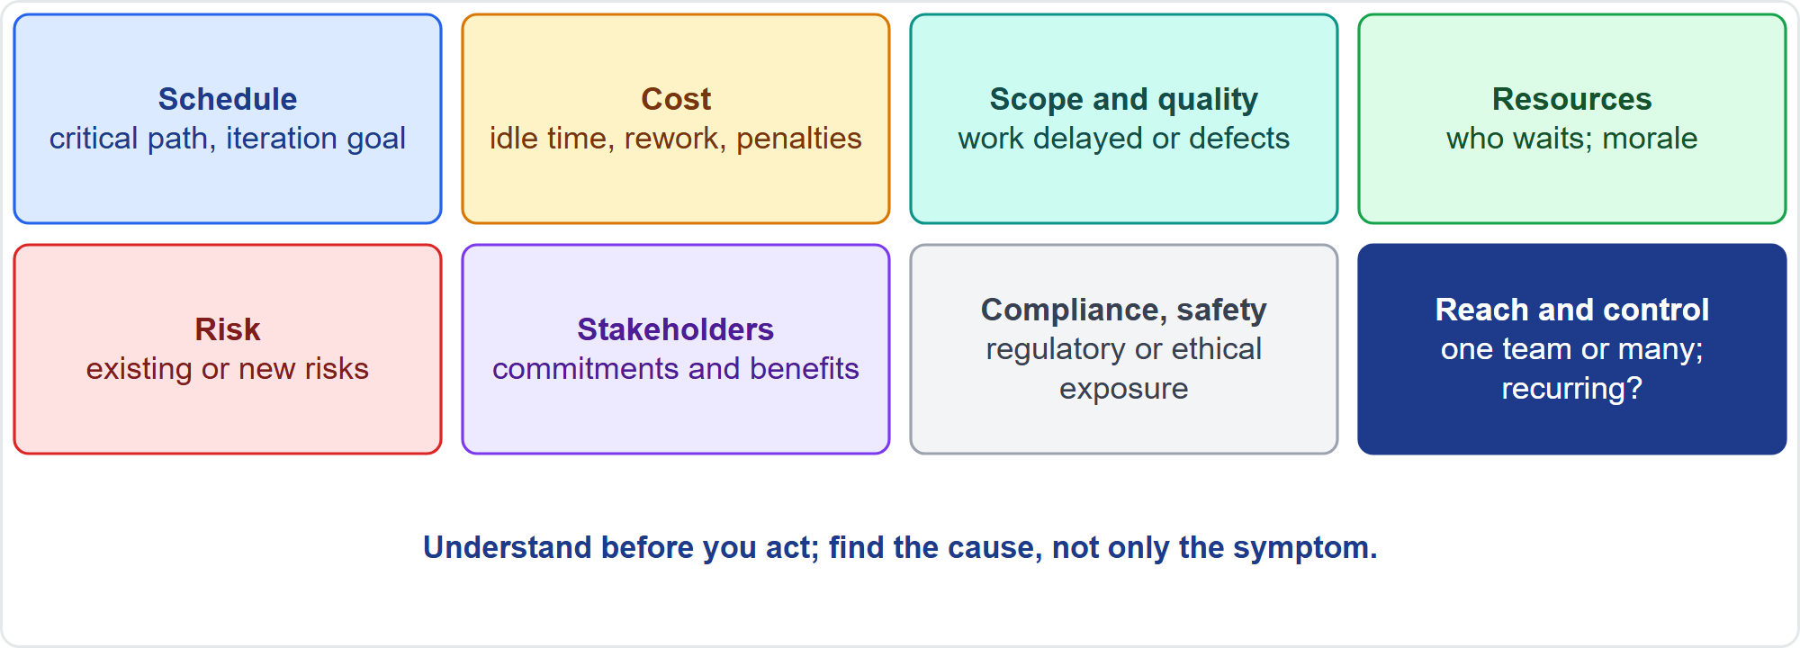
Evaluate the Impact
Part 3
Eight dimensions
EXAM TIP Find the cause, not only the symptom; when several fixes have already failed, do not repeat the same repair.
PMP Exam Prep 2026 | PMBOK 8 and the New ECO
Module 11: Risk, Issues and Impediments
40 / 59
Notes:
Understand before you act. Establish what is blocked, for whom, for how long and what happens if nothing changes. Look at eight dimensions. Schedule: is the critical path or iteration goal affected? Cost: idle time, rework, penalties. Scope and quality. Resources: who is waiting, and the morale. Risk: does it raise or create risks? Stakeholders and benefits. Compliance and safety exposure. And reach and control: one team or several, inside the team's control or not, recurring or not. Find the cause with root cause analysis.

Slide 41
Problem Solving and Root Cause
Part 3
Define the problem, identify the root cause, generate solutions, choose the best, implement, verify
Root cause analysis and the fishbone diagram; the 5 Whys is exam practice
When several fixes have failed, agree a different intervention: work around, replace the component or reprioritize
Do not repeat the same repair, and do not halt everything
Record the evaluation in the issue log so the priority can be defended
EXAM TIP A root cause may sit behind several variances, defects or risks; removing it stops recurrence.
PMP Exam Prep 2026 | PMBOK 8 and the New ECO
Module 11: Risk, Issues and Impediments
41 / 59
Notes:
PMBOK 8's problem-solving method: define the problem, identify the root cause, generate possible solutions, choose the best, implement it, and verify that it worked. Tools are root cause analysis and the cause-and-effect diagram, and the five whys is a common exam-practice way to drill down. When several fixes have already failed, do not repeat the same repair and do not halt everything. Assess the impact and agree a different intervention strategy: work around it, replace the component, or reprioritize. Record the evaluation in the issue log.

Slide 42
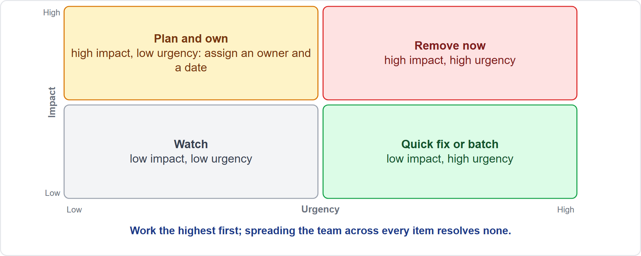
Prioritize and Highlight
Part 3
Impact and urgency
EXAM TIP Spreading the team across every open item resolves none of them: work the highest first, with one owner each.
PMP Exam Prep 2026 | PMBOK 8 and the New ECO
Module 11: Risk, Issues and Impediments
42 / 59
Notes:
Rank open items by impact on the objectives and urgency, and work the highest first. As exam practice, an impact and urgency grid helps: high impact and urgent, remove now. High impact but not urgent, plan and own. Low impact but urgent, a quick fix or batch. Low impact and not urgent, watch. Give every item one named owner and limit how many are worked at once. Keep an impediment list where the team and stakeholders can see it, make it the first item at the daily coordination meeting, and report key issues upward. Report honestly: no green status while the team is blocked.

Slide 43
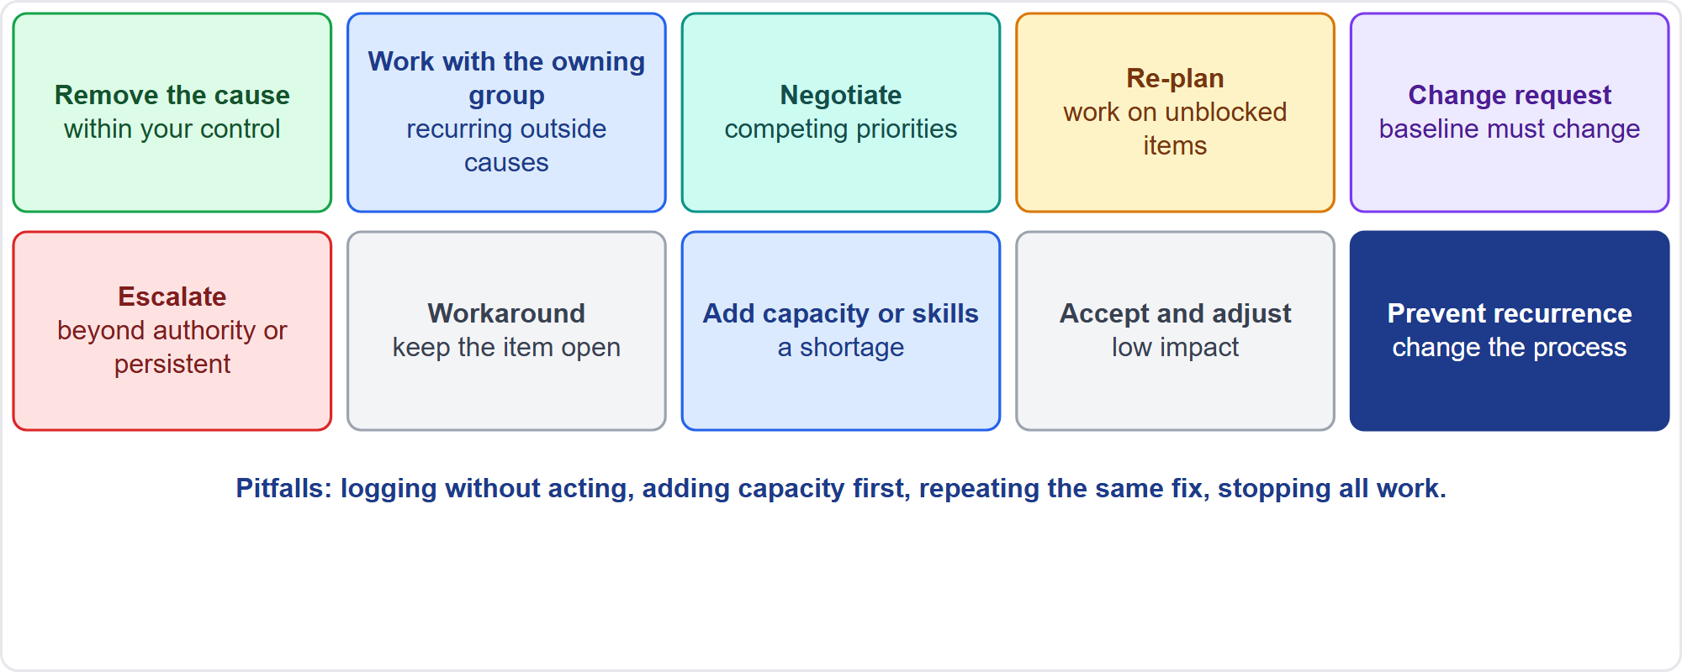
Intervention Strategies
Part 3
Ten strategies
EXAM TIP Pitfalls: logging without acting, adding capacity as the first move, repeating the same fix, stopping all work, waiting for someone else to notice.
PMP Exam Prep 2026 | PMBOK 8 and the New ECO
Module 11: Risk, Issues and Impediments
43 / 59
Notes:
Match the strategy to the cause and the impact. Remove the cause when it is within your control. Work with the owning group when the cause sits elsewhere, especially if it recurs. Negotiate or influence when priorities compete. Re-plan or re-sequence to work on unblocked items. Raise a change request when a baseline must change. Escalate when beyond your authority or persistent. Use a temporary workaround, keeping the item open. Add capacity or skills for a shortage. Accept and adjust when impact is low. And prevent recurrence by changing the process.

Slide 44
Apply and Reassess
Part 3
Assign an owner, an action and a date; the owner must be able to act
Tell the team and stakeholders what is being done and when to expect relief
Verify the effect: a blocker cleared on paper may still slow the team
Ask the team: has it gone, or shifted?
Repeats are systemic: change the process and update assets
Close only when work flows
EXAM TIP Confirming that your arrangement was made is not the same as confirming that work flows.
PMP Exam Prep 2026 | PMBOK 8 and the New ECO
Module 11: Risk, Issues and Impediments
44 / 59
Notes:
Apply the strategy. Assign an owner, an action and a date, and make sure the owner can act. Tell the team and affected stakeholders what is being done and when to expect relief. Then reassess, because impediments move. A blocker can be cleared on paper and still slow the team, or shift into a new form. Ask the team whether it is gone. If the same impediment keeps returning, treat it as systemic: analyze it together, change the process, and update process assets. Close only when work flows.

Slide 45
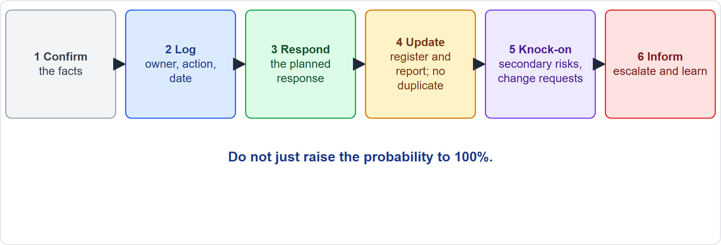
When a Risk Becomes an Issue
Part 3
Six steps
EXAM TIP Do not just raise the probability to 100 percent and do not add a duplicate risk for the same event.
PMP Exam Prep 2026 | PMBOK 8 and the New ECO
Module 11: Risk, Issues and Impediments
45 / 59
Notes:
You notice a risk has become an issue when a stated event has happened, a trigger has fired, or monitoring shows it. Then: confirm the facts. Log it in the issue log with an owner, action and date. Implement the planned response, using the reserves defined in the plan. Update the risk register and report: record that the risk occurred. Do not just raise the probability to one hundred percent, and do not add a duplicate. Check knock-on effects, including secondary and residual risks, and raise change requests. Inform stakeholders, escalate what is beyond your authority, and capture the lesson. Residual risk is an exam practice term for what remains after a response.

Slide 46
Related Situations
Part 3
Situation | What to do
No response was planned | It arrives as an issue: evaluate, act, update for new risks
A risk whose window has passed | Close it; it does not become an issue
A register last updated at kickoff | Set a review cadence; update statuses
An escalated risk | Ownership moved; the team no longer monitors it
A response needs more than contingency | Use the governance route for funding
EXAM TIP Keep the register alive: do not archive it, replace it once or start again.
PMP Exam Prep 2026 | PMBOK 8 and the New ECO
Module 11: Risk, Issues and Impediments
46 / 59
Notes:
Related situations. If no response was planned, an unforeseen event arrives as an issue. Evaluate the impact. Collaborate on a resolution. Act, perhaps with a workaround. Then update the register for any new risks it reveals. A risk that never occurs, or whose window has passed, is closed in the register. It does not become an issue. A register last updated at kickoff is stale: set a regular review cadence. Once a valid escalation is accepted, ownership moves. And if a response needs more than the contingency reserve, follow the governance route for more funding.

Slide 47
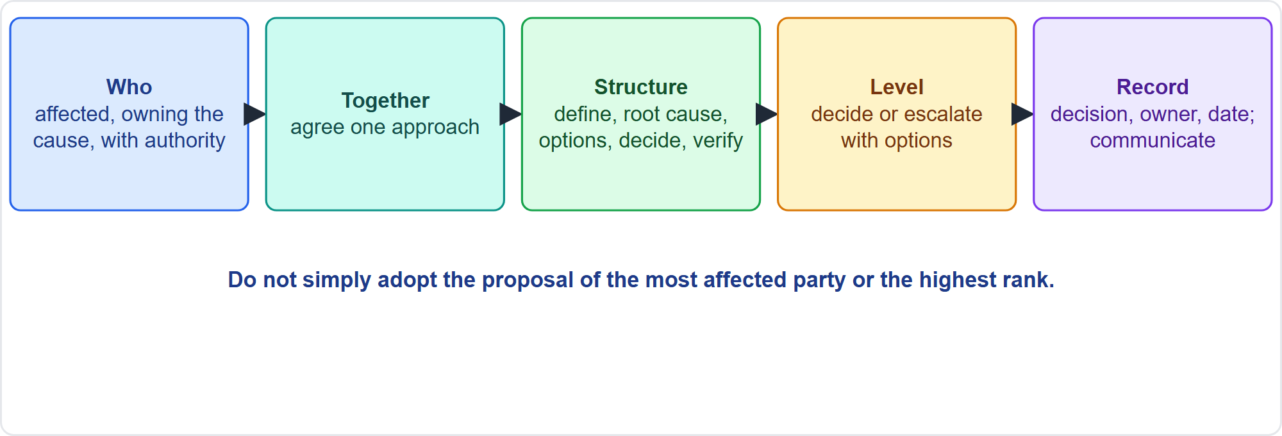
Collaborate With Stakeholders to Resolve Issues
Part 3
Five habits
EXAM TIP When several stakeholders propose different fixes, bring them together and agree one approach; do not adopt the proposal of the highest rank.
PMP Exam Prep 2026 | PMBOK 8 and the New ECO
Module 11: Risk, Issues and Impediments
47 / 59
Notes:
Collaborate with stakeholders. Identify the right people: who is affected, who owns the cause, who has authority, who can help. Bring them together when several are affected, especially when each proposes a different fix, and agree one approach. Do not simply adopt the proposal of the most affected party, the highest-ranking person or the owner of the cause. Use a structured approach, with facilitation, negotiation and conflict management. Decide at the right level. Record decisions, owners and dates, and communicate. With external parties, act within the agreement, and send contract changes through change control.

Slide 48
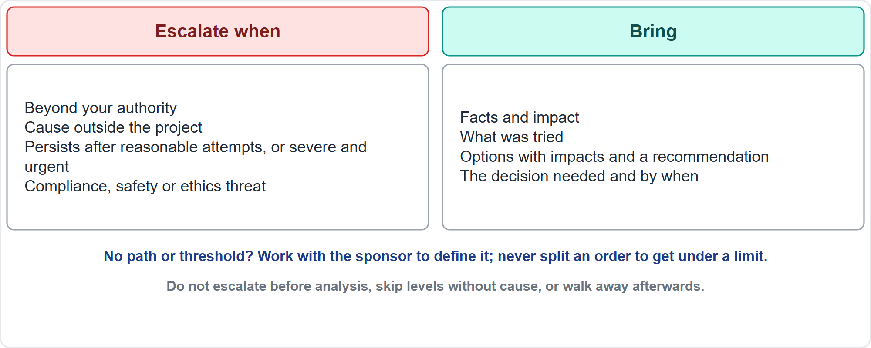
Escalating an Issue
Part 3
When and what to bring
EXAM TIP Do not guess a threshold from past decisions or split an order to get under a limit; work with the sponsor to define it.
PMP Exam Prep 2026 | PMBOK 8 and the New ECO
Module 11: Risk, Issues and Impediments
48 / 59
Notes:
Escalate when the matter is beyond your authority, or the cause sits outside the project. Escalate when it persists after reasonable attempts, or is severe and time-critical. And escalate when a compliance, safety or ethical threat is involved. Use the defined path and thresholds. Bring the facts and impact, what was tried, the options with their impacts, your recommendation, and the decision needed and by when. Agree who owns the matter afterwards. Do not escalate before analysis, skip levels without cause, hide a blocked item from the sponsor, or escalate and walk away. An escalated issue stays in the log until work flows.

Slide 49
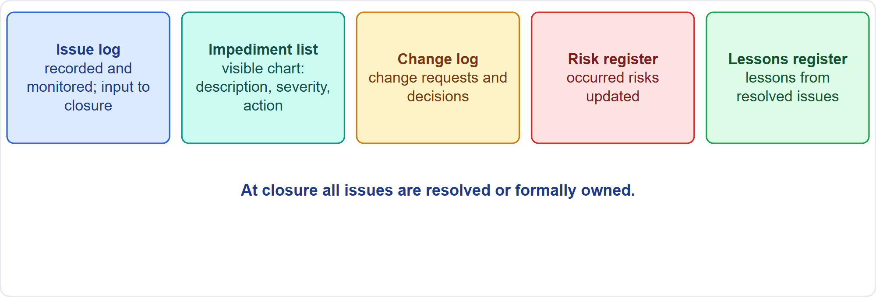
The Issue Log and Impediment List
Part 3
Five records
EXAM TIP At closure all issues are resolved or have a formal decision and a named owner.
PMP Exam Prep 2026 | PMBOK 8 and the New ECO
Module 11: Risk, Issues and Impediments
49 / 59
Notes:
Know the records. The issue log records and monitors issues. It is an output of Manage Project Execution, and an input to closing. The impediment list is a visual chart of description, severity and actions, on the team board. The change log records change requests and decisions. The risk register is updated when a risk occurs. The lessons learned register captures lessons. A typical issue entry has an identifier, a description, and the impact and priority. It has an owner, actions and a due date. And it has a status and links. At closure, anything still open needs a formal decision and a named owner.

Slide 50
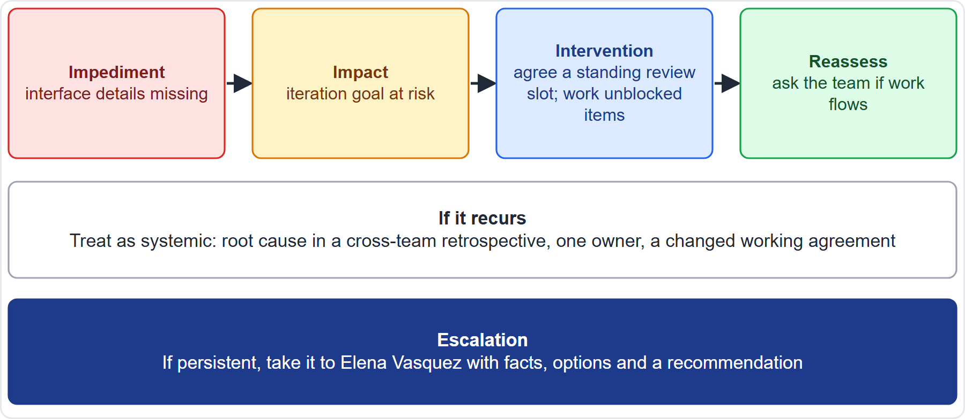
Case Check-In: An Impediment on the Microgrid
Part 3
CASE CHECK-IN · Sunrise Campus Microgrid
Impediment: dashboard developers wait for controller interface details
Intervention: a standing review slot; work unblocked items; ask the team if work flows
PMP Exam Prep 2026 | PMBOK 8 and the New ECO
Module 11: Risk, Issues and Impediments
50 / 59
Notes:
On our microgrid, the dashboard developers are waiting for controller interface details from the engineers. That is an impediment. Evaluate the impact: the iteration goal is at risk. Intervene: agree a standing review slot with the engineers, and work on unblocked items meanwhile. Reassess by asking the team whether work flows. If it recurs, treat it as systemic: run a cross-team retrospective, name one owner and change the working agreement. If it persists, take it to Elena Vasquez with facts, options and a recommendation.

Slide 51
Issues in Predictive, Agile and Hybrid Work
Part 3
 | Predictive | Agile | Hybrid
Captured in | Issue log; status meetings | Daily meeting; impediment list | Both
Removed by | Project manager; governance | Team, then scrum master, then sponsor | Both
Priority | Baselines, critical path, risk | Iteration goal, flow, value | Envelope first
Cadence | Periodic review | Daily; each retrospective | Mixed
Risk to issue | Register to issue log | Backlog, then impediment | Both
EXAM TIP Raising the same blocker at every stand-up without action is not management.
PMP Exam Prep 2026 | PMBOK 8 and the New ECO
Module 11: Risk, Issues and Impediments
51 / 59
Notes:
Issues look different by approach. Predictive: issues go in the issue log and are reviewed at status meetings. The project manager removes them with the item's owner, with escalation to governance. Priority comes from baselines, the critical path and risk. Agile: captured in the daily meeting and the impediment list. Removed by the team first, then the scrum master or project manager. And prioritized by the iteration goal and flow. A risk that occurs becomes an impediment or backlog item. Hybrid mixes both, with the baseline envelope first.

Slide 52
Issue and Impediment Traps: What PMI Expects
Part 3
A risk that occurs is an issue: log, respond, update the register
Impediments get removed, not just logged; recurring ones need action
Evaluate before acting; find the root cause
Prioritize by impact and urgency; one owner each
Reassess from the team's side; repeats are systemic
Escalate with facts and options, by the defined path
EXAM TIP Do not stop all work, repeat the same fix, or blame people.
PMP Exam Prep 2026 | PMBOK 8 and the New ECO
Module 11: Risk, Issues and Impediments
52 / 59
Notes:
The traps for issues and impediments. A risk that occurs is an issue: log it, run the response, update the register. Impediments get removed, not just logged, and recurring ones need action. Evaluate before acting, and find the root cause. Prioritize by impact and urgency, with one owner each. Reassess from the team's side, and treat repeats as systemic. Escalate with facts and options, by the defined path. And do not stop all work, repeat the same fix, or assign blame.

Slide 53
Module Recap
Part 3
1
Risk
2
Responses
3
Monitoring
cause, event, consequence; owners; the project's own scales
strategies, escalation, reserves, fallback plans
reviews, audits, reserve analysis, a live register
4
Issues and impediments
5
The line
6
Next
evaluate, prioritize, intervene, reassess
a risk that occurs becomes an issue
five practice questions
PMP Exam Prep 2026 | PMBOK 8 and the New ECO
Module 11: Risk, Issues and Impediments
53 / 59
Notes:
Let us recap the whole module. Risk: cause, event and consequence, with owners and the project's own scales. Responses: strategies, escalation, reserves and fallback plans. Monitoring: reviews, audits and reserve analysis, with a live register. Issues and impediments: evaluate, prioritize, intervene and reassess. And the line that matters most: a risk that occurs becomes an issue. Now it is time to test yourself. Five questions follow. For each one, pause the video, choose your answer, and then listen to the explanation.

Slide 54
Practice Question 1
Part 3
Q1
A permit authority announces a three-month backlog. The project risk register lists this as a risk with a planned response. What should the project manager do now?
A
Raise the probability of the risk to 100 percent and keep monitoring it
B
Log it as an issue, run the planned response and update the register
C
Add a new risk to the register to describe the announced backlog
D
Wait for the permit authority to confirm the exact dates in writing
PMP Exam Prep 2026 | PMBOK 8 and the New ECO
Module 11: Risk, Issues and Impediments
54 / 59
Notes:
Question one. A permit authority announces a three-month backlog. The project risk register lists this as a risk with a planned response. What should the project manager do now? The four options are on the screen. Choose your answer. [PAUSE 12] The answer is B. A risk that has occurred is an issue, so it is logged, the planned response is executed, and the register is updated. Raising the probability, adding a duplicate risk, or waiting leaves the occurred event unmanaged.

Slide 55
Practice Question 2
Part 3
Q2
The owner of an important risk has left the project, and the risk register has not been reviewed for two months. What should the project manager do?
A
Increase the risk's score so that it attracts more attention at the next review
B
Archive the register and start a new one at the next phase
C
Ask the sponsor to take over every risk that has no owner
D
Assign a new owner, confirm the response is ready and set a review cadence
PMP Exam Prep 2026 | PMBOK 8 and the New ECO
Module 11: Risk, Issues and Impediments
55 / 59
Notes:
Question two. The owner of an important risk has left the project, and the risk register has not been reviewed for two months. What should the project manager do? The four options are on the screen. Choose your answer. [PAUSE 12] The answer is D. Every risk needs an active owner, and the register must be kept alive, so a new owner is assigned and the response is confirmed. Re-scoring, archiving, or pushing every risk to the sponsor does not fix ownership or cadence.

Slide 56
Practice Question 3
Part 3
Q3
A threat could cost 30,000 dollars if it occurs, and a vendor offers to remove it for 50,000 dollars. What is the best action?
A
Accept the threat actively and hold a contingency reserve for it
B
Pay the vendor 50,000 dollars so that the threat is fully removed
C
Transfer the threat to the sponsor without any further discussion
D
Ignore the threat because the vendor's price is higher than the loss
PMP Exam Prep 2026 | PMBOK 8 and the New ECO
Module 11: Risk, Issues and Impediments
56 / 59
Notes:
Question three. A threat could cost 30,000 dollars if it occurs, and a vendor offers to remove it for 50,000 dollars. What is the best action? The four options are on the screen. Choose your answer. [PAUSE 12] The answer is A. A response costing more than the risk's exposure is usually not worth buying, so the threat is accepted actively with a contingency reserve. Paying more than the exposure, handing it to the sponsor, or ignoring it all skip a proportionate response.

Slide 57
Practice Question 4
Part 3
Q4
A team waits every week for the same approval from a central group, and the project manager has so far only logged the delay each time. What should the project manager do?
A
Ask the team to plan around the delay permanently, as a normal condition
B
Add more people to the team so that more work is done while it waits
C
Work with the owning group to remove the cause, with a standing slot
D
Escalate to the sponsor at once, before any attempt to resolve it
PMP Exam Prep 2026 | PMBOK 8 and the New ECO
Module 11: Risk, Issues and Impediments
57 / 59
Notes:
Question four. A team waits every week for the same approval from a central group, and the project manager has so far only logged the delay each time. What should the project manager do? The four options are on the screen. Choose your answer. [PAUSE 12] The answer is C. A recurring impediment caused by another group needs action with that group to remove the cause, not another log entry or a permanent workaround. Planning around it, adding capacity, or escalating before any attempt do not fix the recurring cause.

Slide 58
Practice Question 5
Part 3
Q5
Three stakeholders propose three different fixes for a serious issue that affects all of them. What should the project manager do?
A
Adopt the proposal of the most senior stakeholder to save time
B
Bring the stakeholders together and agree one approach
C
Adopt the proposal of the stakeholder who is most affected by the whole issue
D
Choose the fix that the project team prefers and inform the stakeholders later on
PMP Exam Prep 2026 | PMBOK 8 and the New ECO
Module 11: Risk, Issues and Impediments
58 / 59
Notes:
Question five. Three stakeholders propose three different fixes for a serious issue that affects all of them. What should the project manager do? The four options are on the screen. Choose your answer. [PAUSE 12] The answer is B. When several stakeholders are affected and each proposes a different fix, the project manager brings them together and agrees one approach with a structured method. Following seniority, the most affected party, or the team's preference leaves others unheard.

Slide 59
Answers at a Glance
Part 3
Question | Answer | Why
Q1 | B | A risk that occurs becomes an issue to log, respond to and update
Q2 | D | Assign a new owner, confirm the response and keep the register alive
Q3 | A | A response costing more than the exposure is not worth buying
Q4 | C | A recurring blocker needs action with the owning group
Q5 | B | Bring the affected stakeholders together and agree one approach
PMP Exam Prep 2026 | PMBOK 8 and the New ECO
Module 11: Risk, Issues and Impediments
59 / 59
Notes:
Here are all five answers together. Question one: B. A risk that occurs becomes an issue to log, respond to and update. Question two: D. Assign a new owner, confirm the response and keep the register alive. Question three: A. A response costing more than the exposure is not worth buying. Question four: C. A recurring blocker needs action with the owning group. Question five: B. Bring the affected stakeholders together and agree one approach. That completes Module 11. Next, Module 12 covers change control, continuous improvement, organizational change and the external environment. See you there.

