Slide 1
Module 12: Change, Improvement, Culture and the External Environment
Part 1 of 3: Change control
Business Environment domain · ECO tasks 3, 6, 7 and 8
PMP Exam Prep 2026: PMBOK 8 and the New ECO
Module 12 · Part 1
Notes:
Welcome to Module 12, the last Business Environment module. Four kinds of change meet here. Changes to the project, which is change control. Changes to how we work, which is continuous improvement. Changes to the organization and its culture. And changes in the world outside the project. In Part 1, we cover change control. Part 2 covers lessons learned, improvement and culture. Part 3 covers organizational change and the external environment.

Slide 2
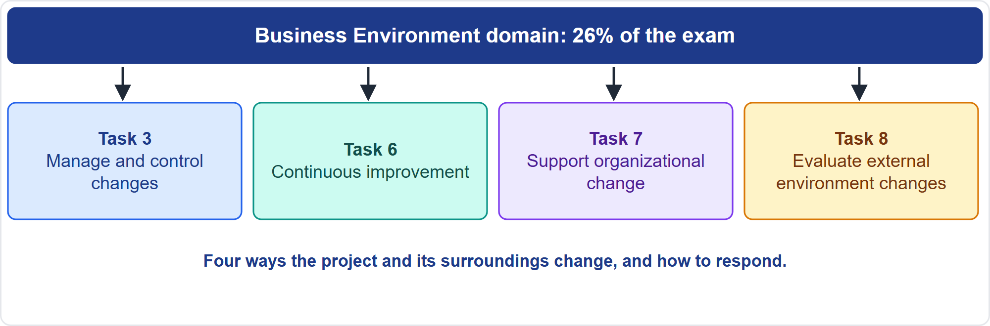
Where This Module Sits in the Exam
Part 1
Four Business Environment tasks
EXAM TIP Work out which kind of change a scenario describes: to the project, to the way of working, to the organization, or outside.
PMP Exam Prep 2026 | PMBOK 8 and the New ECO
Module 12
2 / 64
Notes:
Here is where this module sits. The Business Environment domain has eight tasks, and this module covers four. Task three: manage and control changes. Task six: continuous improvement. Task seven: support organizational change. Task eight: evaluate external business environment changes. A habit that helps on the exam: work out which kind of change a scenario describes. A change to the project goes through change control. A change to the way of working goes through improvement. A change to the organization needs people support. A change outside needs scanning and assessment.

Slide 3
What You Will Learn
Part 1
Run the change control process and know who decides
Implement approved changes and update every document
Use lessons learned and continuous improvement properly
Assess culture and support the organization through change
Survey and assess external changes and respond through the right channel
Tell change control, change management and improvement apart
PMP Exam Prep 2026 | PMBOK 8 and the New ECO
Module 12
3 / 64
Notes:
By the end of this module you will be able to do six things. Run the change control process and know who decides. Implement approved changes and update every document. Use lessons learned and continuous improvement properly. Assess culture and support the organization through change. Survey and assess external changes and respond through the right channel. And tell change control, change management and improvement apart.

Slide 4
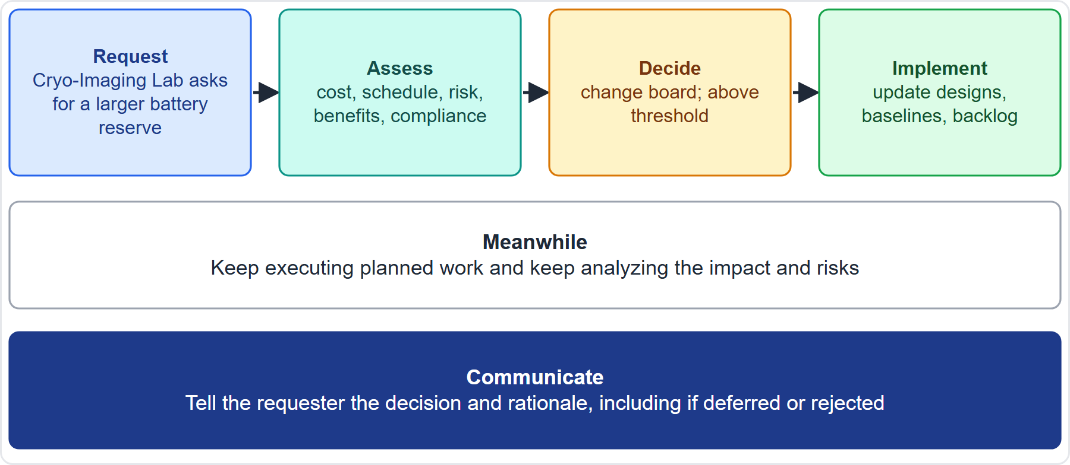
Case Check-In: A Change Request
Part 1
CASE CHECK-IN · Sunrise Campus Microgrid
Request: the Cryo-Imaging Lab asks for a larger battery reserve
Path: assess, board decision, implement, update the documents
PMP Exam Prep 2026 | PMBOK 8 and the New ECO
Module 12
4 / 64
Notes:
Here is a change on our microgrid. The Cryo-Imaging Lab asks for a larger battery reserve, to protect sensitive equipment during outages. You log it. You assess the impact on cost, schedule, risk, benefits and compliance. And you take it to the change board, because it exceeds your threshold. Meanwhile, keep executing planned work and keep analyzing impact and risk. If approved, implement it, and update the designs, baselines and backlog. Tell the lab the decision and the reason, whatever it is.

Slide 5
Change Control: Key Terms
Part 1
Term | Meaning
Change request | A formal proposal to change a document, deliverable or baseline
Change control | Identifying, documenting, approving or rejecting changes
Integrated change control | Assessing impact across the whole project, then deciding
Change control board | A chartered group that approves, defers or rejects changes
Change management plan | Sets up the board, its authority and the control system
Configuration management plan | Which artifacts are controlled and recorded
Change log | Submitted changes with status
EXAM TIP In PMBOK 8 the change management plan means the board and change control, not organizational change.
PMP Exam Prep 2026 | PMBOK 8 and the New ECO
Module 12
5 / 64
Notes:
Key terms. A change request is a formal proposal to modify a document, deliverable or baseline. Change control identifies, documents and approves or rejects changes. Integrated change control evaluates the impact across the whole project and then decides. A change control board is a formally chartered group, also called a steering committee, that approves, defers or rejects changes. The change management plan sets up the board, its authority and the change control system. The configuration management plan says which artifacts are controlled. And the change log lists submitted changes with their status.

Slide 6
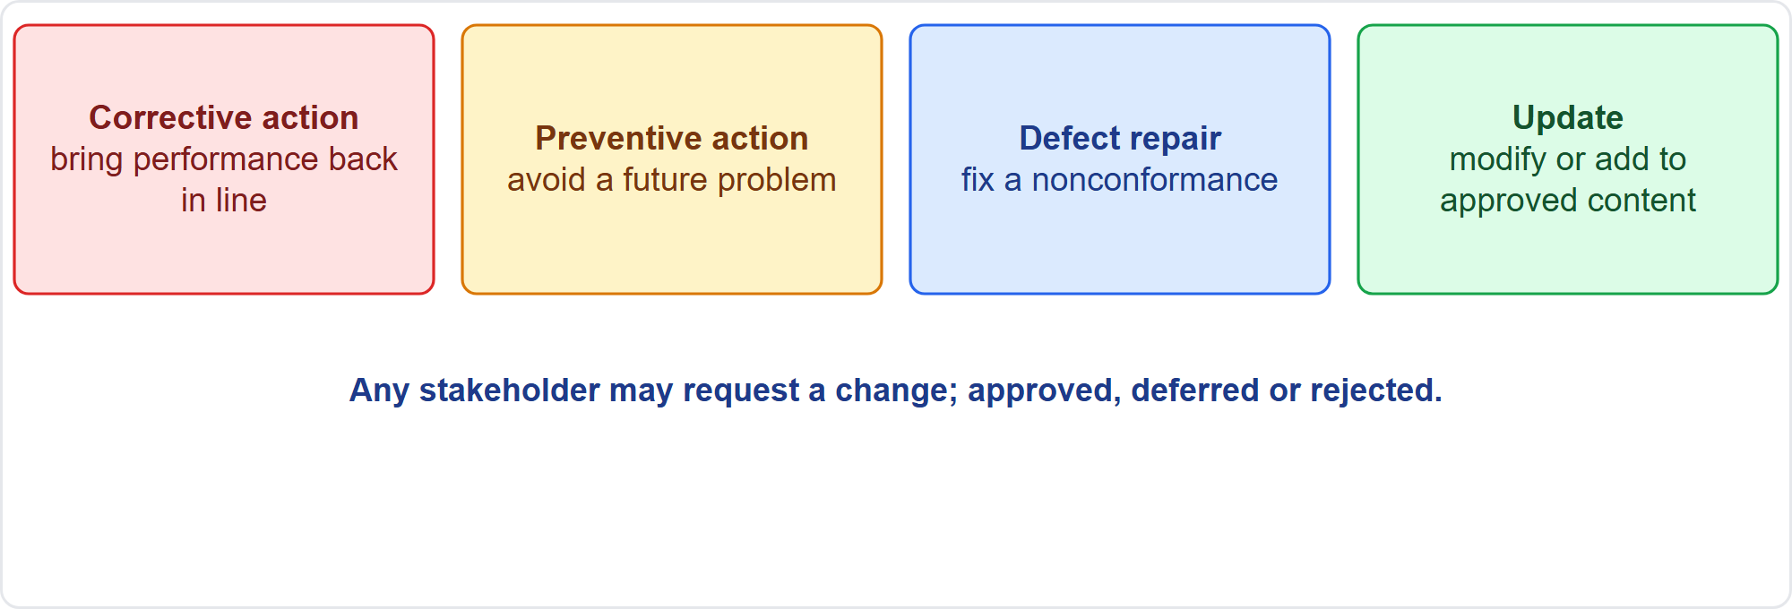
Four Types of Change Request
Part 1
Corrective, preventive, defect repair, update
EXAM TIP Know the four types; a change request modifies a baseline or document, an issue is a current problem, a risk is uncertainty.
PMP Exam Prep 2026 | PMBOK 8 and the New ECO
Module 12
6 / 64
Notes:
Four types of change request. Corrective action brings performance back in line with the plan. Preventive action avoids a future problem. Defect repair fixes a nonconformance. An update modifies or adds to approved content. Any stakeholder may request a change, and it may be internal or external. Each request is approved, deferred or rejected. Do not confuse a change request with an issue or a risk. A change request modifies a baseline or document. An issue is a current problem. A risk is uncertainty. A change may be raised to address either.

Slide 7
Assess and Implement Changes
Part 1
Aspect | Detail
Purpose | Manage changes to scope, plans and documents so the project stays aligned
Inputs | Change and configuration plans, baselines, change log, traceability matrix, risk report, change requests
Tools | Expert judgment, change control tools, cost-benefit and alternative analysis, voting, multicriteria analysis, backlog management
Outputs | Approved change requests, plan updates, document updates including the change log
EXAM TIP How formal change management is depends on the project's scope, complexity, contract and approach.
PMP Exam Prep 2026 | PMBOK 8 and the New ECO
Module 12
7 / 64
Notes:
The Assess and Implement Changes process manages changes to scope, product scope, plan components and documents, so the project stays aligned with its objectives and constraints. Inputs include the change and configuration management plans, the baselines, the change log, the traceability matrix, the risk report and the change requests. Tools include expert judgment, change control tools, cost-benefit and multicriteria analysis, voting, and backlog management. Outputs are approved change requests, and updates to plans and documents. How formal it is depends on the project's scope, complexity, contract and approach.

Slide 8
Predictive Change Control
Part 1
Not formally controlled until baselines exist; after that, all changes go through the process
Requests may start verbally but are documented in writing and logged
Requests typically include estimated schedule and cost impact before approval
Each is approved, deferred or rejected by a designated person or the board
Keep executing planned work while awaiting the decision
Customer or sponsor approval may be needed after the board unless they sit on it
EXAM TIP Before a baseline exists, drafts are refined and versions tracked; once approved, every change goes through the formal process.
PMP Exam Prep 2026 | PMBOK 8 and the New ECO
Module 12
8 / 64
Notes:
In predictive work, scope is not formally controlled until baselines exist. Once a baseline is approved, all changes go through the formal process. Requests may start verbally, but they must be documented in writing and entered in the change system. They typically include estimated schedule and cost impacts before approval. Each is approved, deferred or rejected by a designated person, such as the sponsor or project manager, or by the board. While awaiting the decision, keep executing planned work, and keep analyzing the impact and risks. After board approval, the customer or sponsor may need to approve, unless they sit on the board.

Slide 9
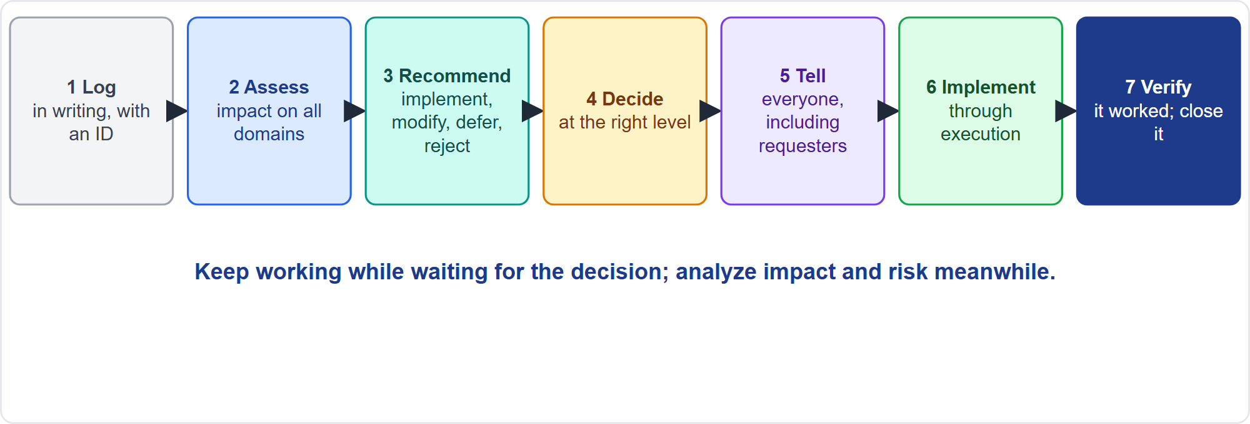
The Change Control Flow
Part 1
Seven steps
EXAM TIP Assess impact first, then decide; do not approve or reject blindly.
PMP Exam Prep 2026 | PMBOK 8 and the New ECO
Module 12
9 / 64
Notes:
The flow has seven steps. One, receive and log the request in writing, with an identifier, requester, date and status. Two, assess the impact across all domains, estimating effects on schedule and cost, and checking the business case and compliance. Three, develop options and recommend: implement, modify, defer or reject. Four, decide at the right level, recording the rationale. Five, communicate the decision. Six, implement through Manage Project Execution. Seven, verify that the change achieved its purpose, and close it in the log.

Slide 10
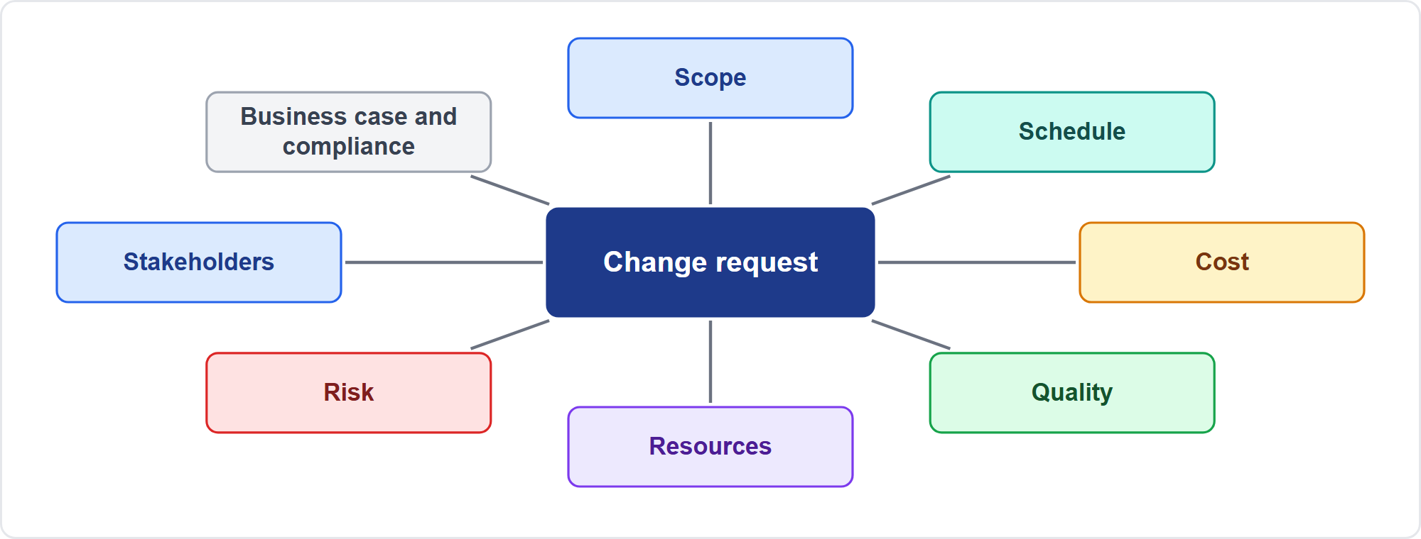
Impact Assessment
Part 1
Look at everything it touches
EXAM TIP A change that threatens the business case goes to the sponsor or governance: revalidate value.
PMP Exam Prep 2026 | PMBOK 8 and the New ECO
Module 12
10 / 64
Notes:
Assess the impact of a change across the whole project. Scope and requirements. Schedule and cost, with new estimates. Quality. Resources. Risk, including new risks and reserve use. Stakeholders. The business case and benefits. And compliance. A change that threatens the business case or external commitments needs the sponsor or governance, so that value is revalidated. Changes ripple, so a change to scope also changes cost, schedule, risk and often contracts.

Slide 11
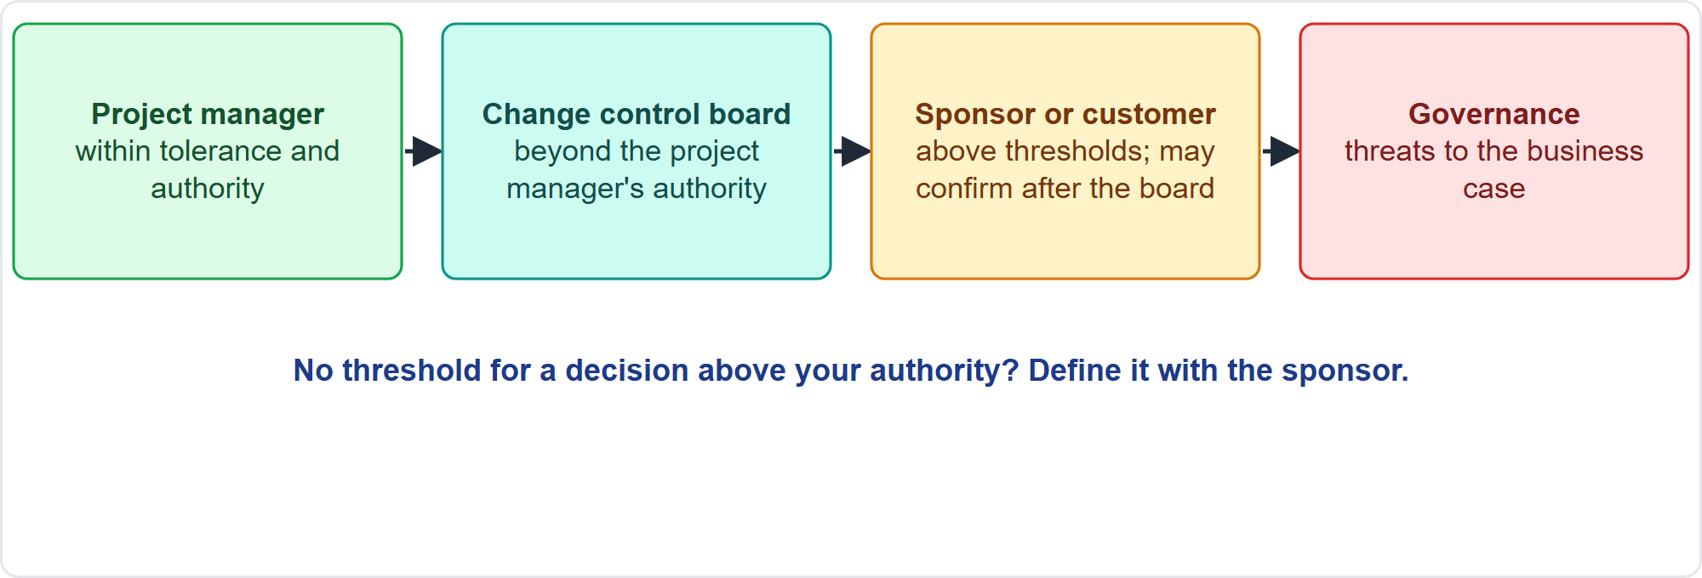
Who Decides
Part 1
Decide at the right level
EXAM TIP If no threshold exists for a decision above your authority, define it with the sponsor; do not infer it.
PMP Exam Prep 2026 | PMBOK 8 and the New ECO
Module 12
11 / 64
Notes:
Decide at the right level. The project manager decides within tolerance and authority. The change control board decides beyond that. The sponsor or customer decides above thresholds, and may need to confirm after the board. Governance decides when the business case is threatened. Know the thresholds in the change management plan or the governance framework. If none is defined for a decision above your authority, define it with the sponsor. Do not infer it from past decisions.

Slide 12
Governing Principles
Part 1
Never implement an unapproved change, even a free, harmless or tested one; if already made, submit it retroactively
Corrections of baseline errors are changes and go through change control
Scope creep and gold plating are uncontrolled changes
Do not freeze progress while a decision is pending
Emergency changes use a fast, authorized path and prompt documentation
Verify results of an implemented change and record lessons
EXAM TIP Passing tests does not replace configuration review.
PMP Exam Prep 2026 | PMBOK 8 and the New ECO
Module 12
12 / 64
Notes:
Some governing principles. Never implement an unapproved change. Even a free improvement, a harmless deviation such as a higher-capacity part, or a verified fix is a change: assess its impact and submit it through change control. If it was already made, submit it retroactively and decide. Corrections of baseline errors, such as a wrong unit or a missed dependency, also go through change control. Scope creep and gold plating are uncontrolled changes. Do not freeze progress while a decision is pending. Emergency changes need a fast, authorized path and prompt documentation. And verify the results of an implemented change, and record the lessons.

Slide 13
Communicate the Status of Proposed Changes
Part 1
Keep the change log current: submitted, under assessment, approved, deferred, rejected, implemented
Tell the requester the decision and rationale, including deferred and rejected requests
Inform affected stakeholders and the team what changed and what it means for them
Report pending and approved changes in status reports and dashboards
Give board members clear packages: description, impact, options, recommendation, risks
In adaptive work, show the backlog and its ordering openly
EXAM TIP PMBOK 8 requires deferred or rejected requests to be communicated to the requester.
PMP Exam Prep 2026 | PMBOK 8 and the New ECO
Module 12
13 / 64
Notes:
Communicate the status of proposed changes. Keep the change log current, with a status for every request. Tell the requester the decision and the rationale, including for deferred and rejected requests. PMBOK 8 requires that. Inform affected stakeholders and the team of what changed and what it means for them: scope, dates, cost and roles. Report pending and approved changes in status reports and dashboards. Give board members clear packages with the description, impact analysis, options, recommendation and risks. In adaptive work, show the backlog and its order openly.

Slide 14
Implement Approved Changes
Part 1
Update plan components and baselines; re-baseline only through the approved change
Adjust resources, procurement and contracts: amendments, new estimates
Update the risk register: new risks, reserve use
Brief the team and stakeholders; train if the way of working changes
Implement and test; confirm acceptance criteria still hold
Monitor the effect and record lessons
EXAM TIP Approved changes are implemented through Manage Project Execution.
PMP Exam Prep 2026 | PMBOK 8 and the New ECO
Module 12
14 / 64
Notes:
Approved changes are implemented through Manage Project Execution. Update the plan components and baselines, and funding requirements if needed, re-baselining only through the approved change. Adjust resources, procurement and contracts, with amendments or variation orders and new estimates. Update the risk register. Brief the team and stakeholders, and train if the way of working changes. Implement and test, and confirm that acceptance criteria still hold. Then monitor the effect: did the change deliver the benefit? And record lessons.

Slide 15
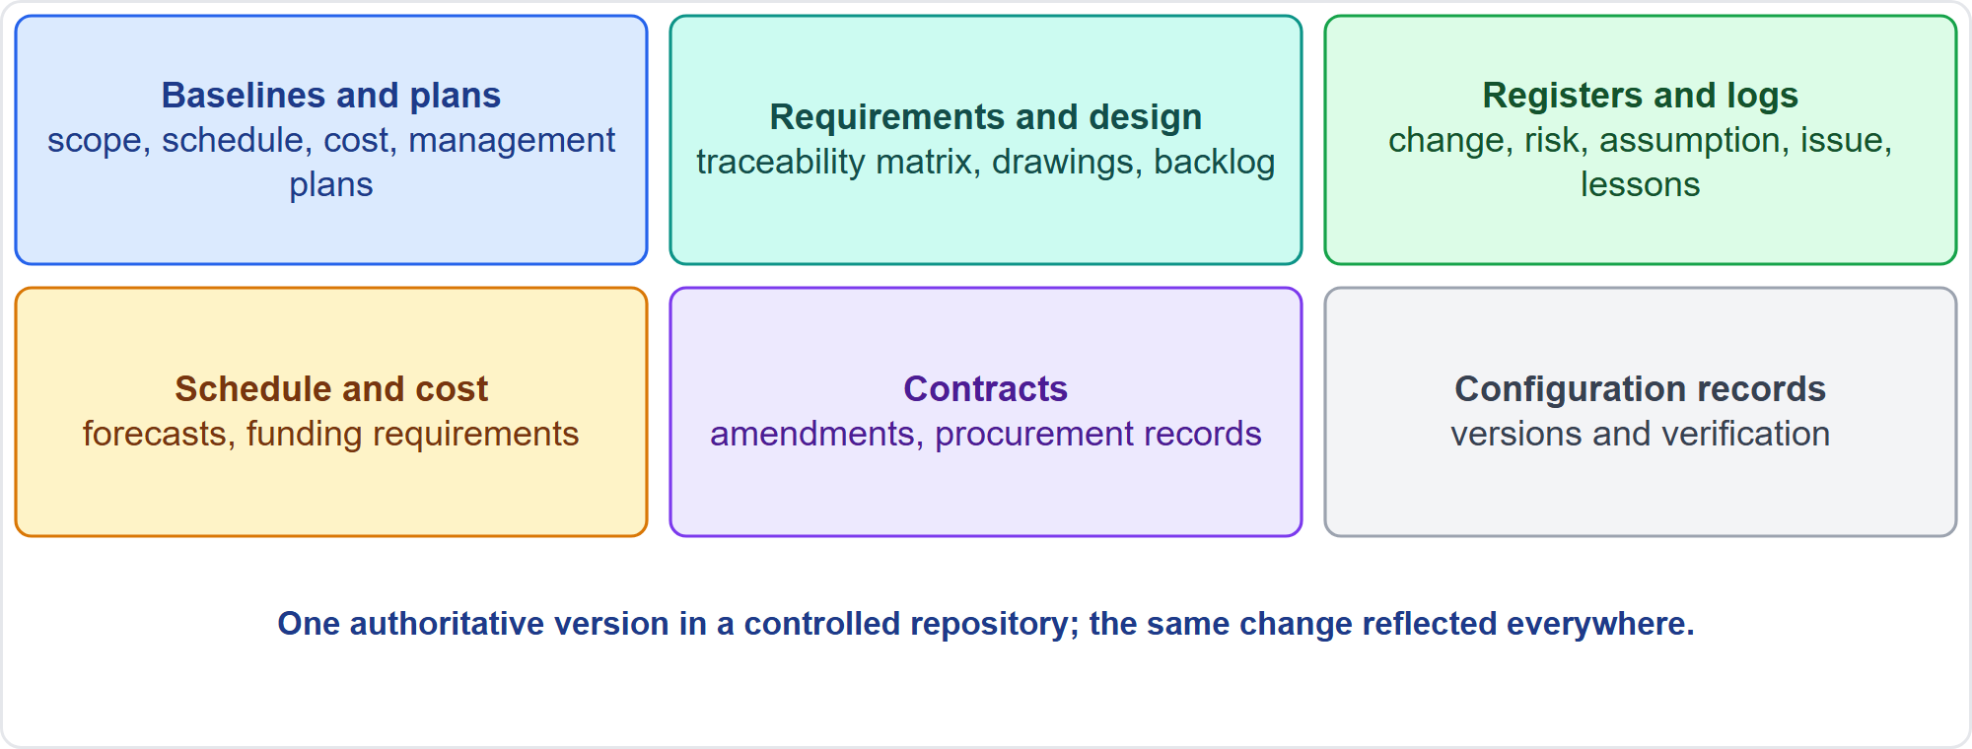
Update the Documents
Part 1
Six groups
EXAM TIP If a design change is approved and the build starts, the drawings, specifications and schedule must be updated.
PMP Exam Prep 2026 | PMBOK 8 and the New ECO
Module 12
15 / 64
Notes:
An approval is not finished until the documents reflect it. Update baselines and plans: the scope, schedule and cost baselines and related management plans. Update requirements and design: the traceability matrix, specifications, drawings, backlog and acceptance criteria. Update registers and logs: the change log, risk register, assumption log, issue log, stakeholder register and lessons register. Update the schedule and cost records. Update contracts. And update configuration records. Keep one authoritative version in a controlled repository, with the same change reflected everywhere.

Slide 16
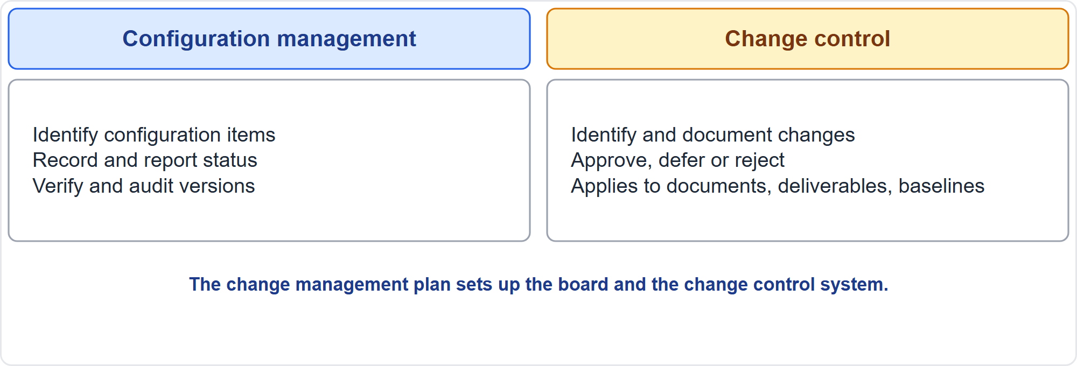
Configuration Management
Part 1
Two related disciplines
EXAM TIP Configuration control specifies deliverables and processes; change control approves or rejects changes to documents, deliverables and baselines.
PMP Exam Prep 2026 | PMBOK 8 and the New ECO
Module 12
16 / 64
Notes:
Configuration management and change control are related. Configuration management identifies configuration items, records and reports their status, and verifies and audits versions, so the product stays consistent and accountability is kept. Change control identifies and documents changes, and approves, defers or rejects them, for documents, deliverables and baselines. Tools support both: they register requests, track assessment and approval, and manage the board's requests and decisions. Choose tools by stakeholder needs and organizational constraints, manual or automated.

Slide 17
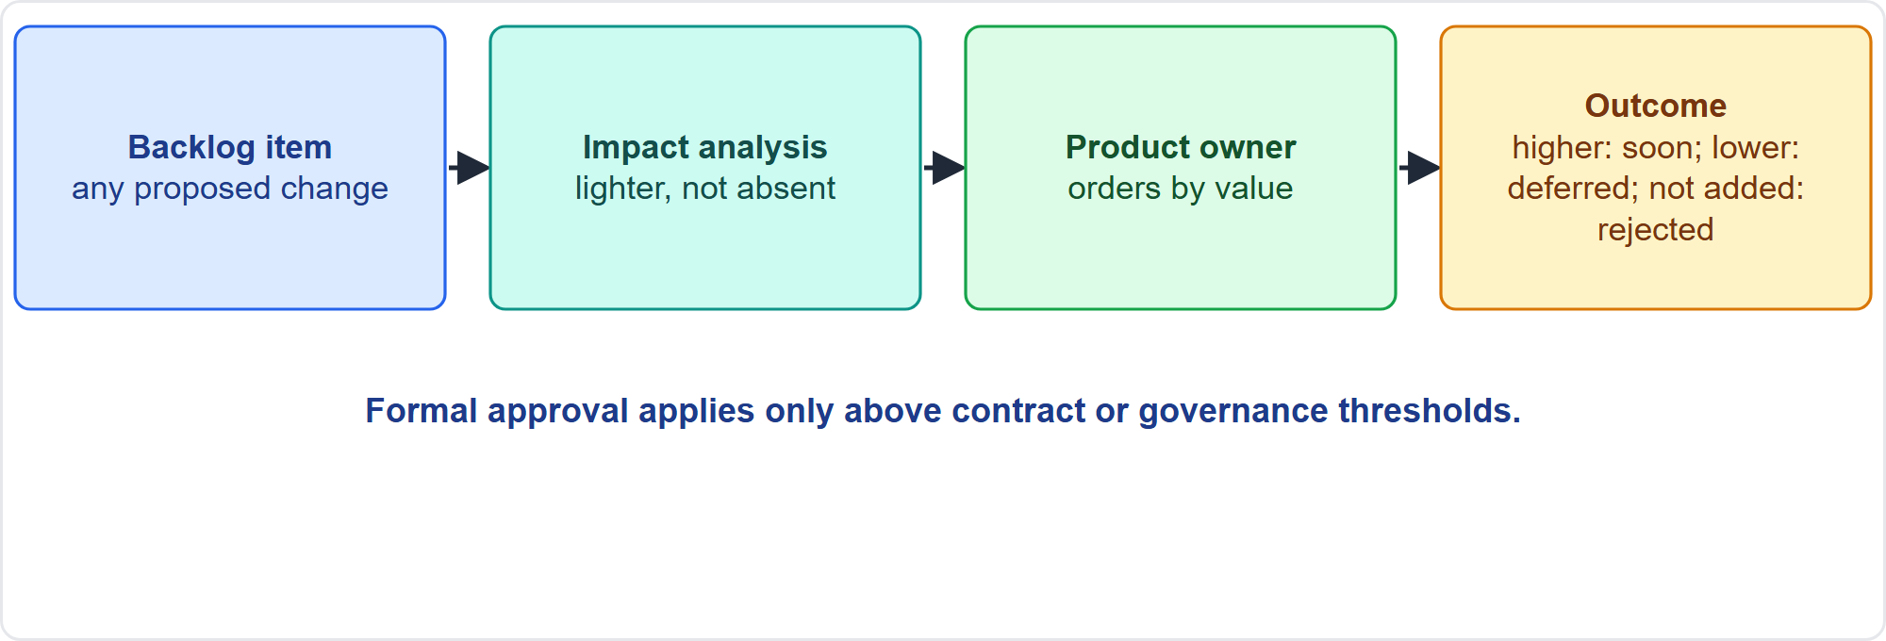
Change in Adaptive Work
Part 1
Backlog, analysis, product owner, outcome
EXAM TIP Lower priority means deferred; not added means rejected; formal approval applies only above contract or governance thresholds.
PMP Exam Prep 2026 | PMBOK 8 and the New ECO
Module 12
17 / 64
Notes:
In adaptive work, change is managed mainly through backlog management, not formal change requests. A proposed change is recorded as a backlog item, and an impact analysis, lighter but not absent, evaluates its effect and priority. There is typically no formal approval: any proposed change can be added. A lower priority means the change is effectively deferred, and not adding it means it is rejected. The product owner orders the backlog by value. Formal approval applies only above contract or governance thresholds, such as a scope change above ten percent of effort.

Slide 18
Protecting the Iteration
Part 1
New requests from executives go to the backlog through the product owner
The project manager represents the team's capacity and shows trade-offs
Update the roadmap and backlog regularly; do not freeze a year-old roadmap
Formal approval above thresholds, for example scope changes above 10% of effort
Hybrid: formal control for the baselined envelope; the backlog adapts inside
Impact analysis still happens; it is lighter, not absent
EXAM TIP In hybrid work a change request is needed only when the envelope changes.
PMP Exam Prep 2026 | PMBOK 8 and the New ECO
Module 12
18 / 64
Notes:
Protect the iteration. New requests from executives go to the backlog through the product owner, and the project manager represents the team's capacity and shows the trade-offs. Update the roadmap and backlog regularly, because customer feedback and market learning change them. Routine backlog changes flow normally, and those above a contractual threshold go through formal approval. In hybrid work, formal control covers the baselined envelope: milestones, committed scope, budget and regulatory commitments. The backlog adapts inside it. Impact analysis still happens in adaptive work. It is lighter, not absent.

Slide 19
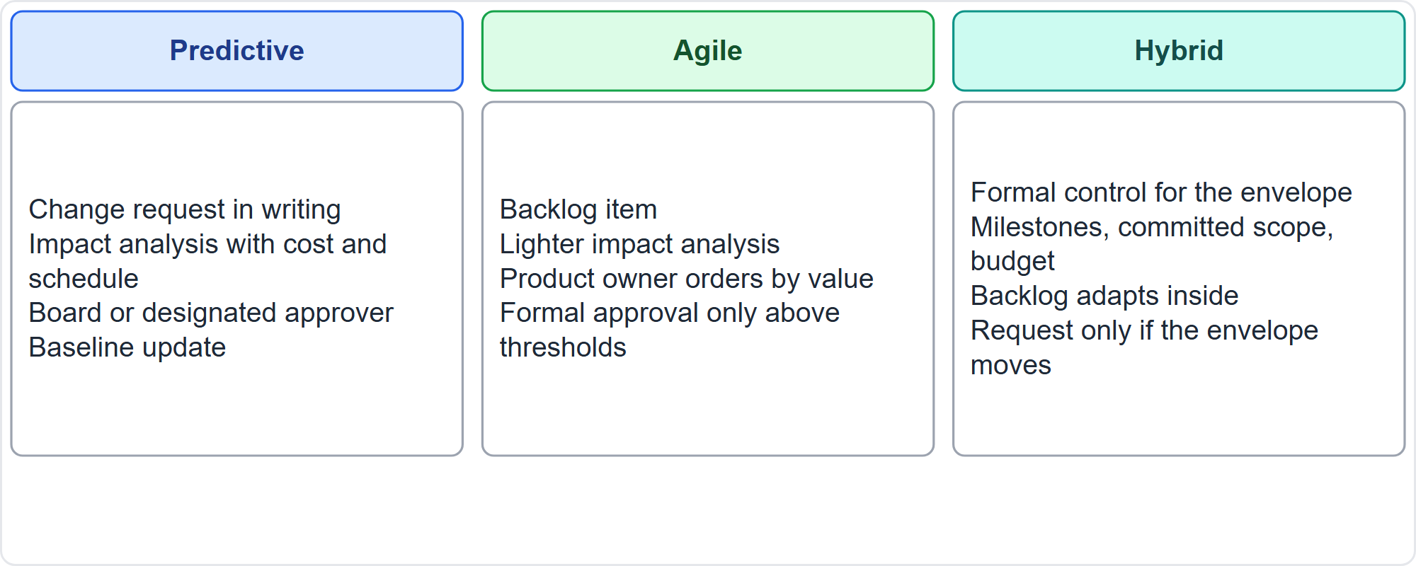
Change Control by Approach
Part 1
Predictive, agile, hybrid
EXAM TIP Name the mechanism that fits the approach in the scenario.
PMP Exam Prep 2026 | PMBOK 8 and the New ECO
Module 12
19 / 64
Notes:
Change control looks different by approach. Predictive: a written change request, impact analysis with cost and schedule, a board or designated approver, and a baseline update. Agile: a backlog item, lighter impact analysis, the product owner ordering by value, and formal approval only above thresholds. Hybrid: formal control for the envelope of milestones, committed scope and budget, with the backlog adapting inside it, and a request only if the envelope moves. Name the mechanism that fits the approach in the scenario.

Slide 20
Change Control Traps: What PMI Expects
Part 1
No unapproved changes, even free, beneficial or tested ones
Assess impact first, then decide; document in writing; log everything
Know the authority level; define missing thresholds with the sponsor
Keep working while waiting; communicate all outcomes
Implement and update everything; baseline corrections are changes
Agile change goes through the backlog; do not confuse change control with change management
EXAM TIP A change that threatens the business case goes to the sponsor or governance.
PMP Exam Prep 2026 | PMBOK 8 and the New ECO
Module 12
20 / 64
Notes:
The traps for change control. No unapproved changes, even free, beneficial or tested ones. Assess impact first, then decide, document in writing, and log everything. Know the authority level, and define missing thresholds with the sponsor. Keep working while waiting for the decision, and communicate all outcomes, including deferred and rejected requests. Implement and update everything: schedule, drawings, backlog and documents. Baseline corrections are changes. Agile change goes through the backlog. And do not confuse the change management plan with organizational change management.

Slide 21
Part 1 Recap
Part 1
1
Types
2
Flow
3
Authority
corrective, preventive, defect repair, update
log, assess, recommend, decide, communicate, implement, verify
the right level; define missing thresholds
4
Principles
5
Documents
6
Approaches
no unapproved changes; baseline corrections count; keep working
update everything affected
formal, backlog, or formal envelope plus backlog
PMP Exam Prep 2026 | PMBOK 8 and the New ECO
Module 12
21 / 64
Notes:
Let us recap Part 1. There are four types of change request: corrective, preventive, defect repair and update. The flow is log, assess, recommend, decide, communicate, implement and verify. Decide at the right level, and define missing thresholds with the sponsor. Never implement an unapproved change, count baseline corrections as changes, and keep working while you wait. Update every document the change affects. And match the mechanism to the approach: formal requests, the backlog, or a formal envelope with a backlog inside. In Part 2, we look at lessons, improvement and culture.

Slide 22
Lessons Learned: Key Terms
Part 2
Term | Meaning
Lessons learned register | Project document of knowledge gained, updated throughout
Lessons learned repository | Organizational asset that receives it at the end
Retrospective | Regular workshop to improve process and product
After-action review | Structured review of what happened and what to learn
In-progress postmortem | Structured review at stages of the life cycle
Continuous improvement | Incremental improvement of processes and products
EXAM TIP The register is a project document; the repository is an organizational asset.
PMP Exam Prep 2026 | PMBOK 8 and the New ECO
Module 12
22 / 64
Notes:
Part 2 covers learning and improving. Key terms. The lessons learned register is a project document of knowledge gained, created early and updated throughout. The lessons learned repository is the organizational asset that receives it when a project or phase ends. A retrospective is a regular workshop to improve process and product, at least at the end of every iteration. An after-action review is a structured review of what happened and what to learn. An in-progress postmortem is a structured review at stages of the life cycle. And continuous improvement means incremental improvement of processes, products and services.

Slide 23
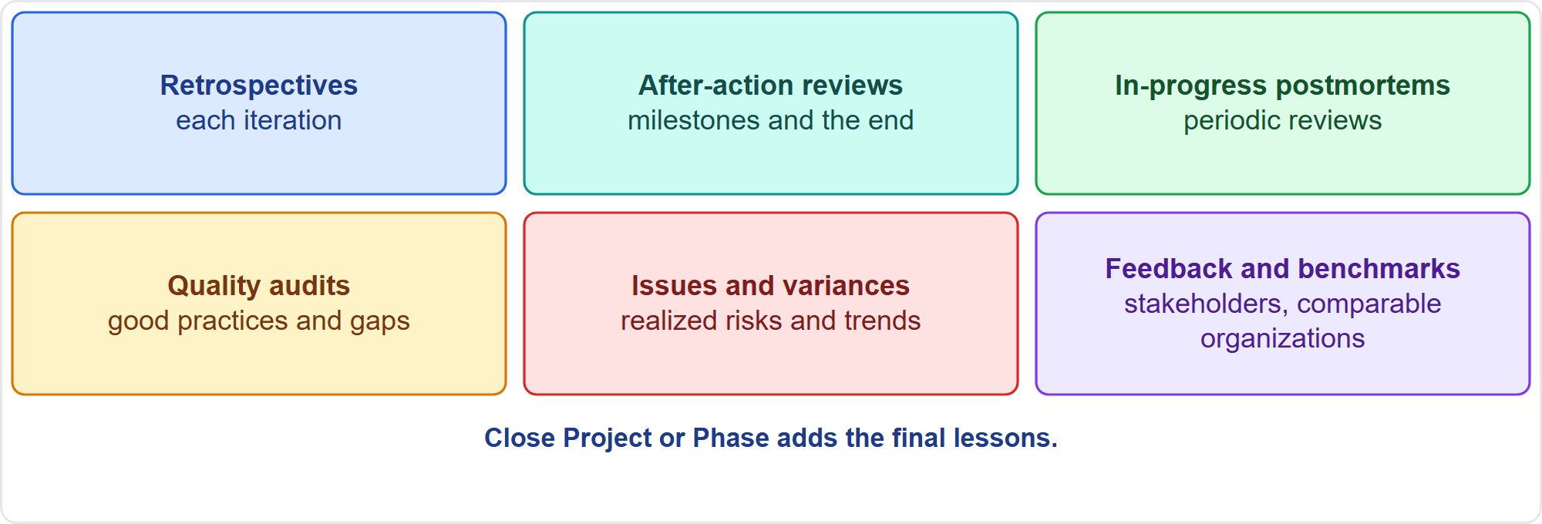
Where Lessons Come From
Part 2
Six sources
EXAM TIP Capture lessons as events happen, while details are fresh.
PMP Exam Prep 2026 | PMBOK 8 and the New ECO
Module 12
23 / 64
Notes:
Lessons come from many places. Retrospectives, at least each iteration. After-action reviews, at the end of the project or after significant milestones. In-progress postmortems, periodically. Quality audits, which identify good practices and nonconformities. Issues, realized risks and opportunities, variances and trends. Stakeholder feedback and benchmarking against comparable organizations. And Close Project or Phase adds the final lessons. Capture lessons as events happen, while details are fresh. Waiting for one session at the end loses detail and delays use.

Slide 24
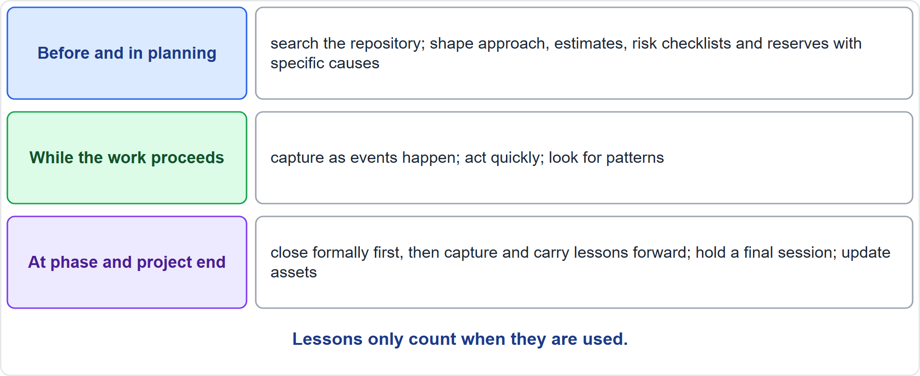
Lessons Across the Life of a Project
Part 2
Before, during and after
EXAM TIP Close the phase formally first, then capture its lessons and carry them into the next phase before it starts.
PMP Exam Prep 2026 | PMBOK 8 and the New ECO
Module 12
24 / 64
Notes:
Use lessons at three moments. Before and in planning: search the repository before planning, and use lessons to shape the approach, estimates, risk checklists and reserves. While the work proceeds: capture as events happen, act quickly, and look for patterns, because the same issue in several entries is a systemic problem. At phase and project end: close the phase formally first, then capture its lessons and carry them into the next phase. Hold a final session for project-level lessons, even if retrospectives ran every iteration.

Slide 25
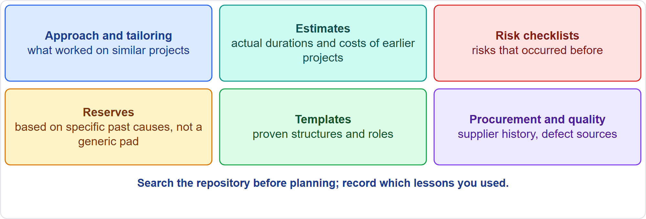
Using Lessons in Planning
Part 2
Six uses
EXAM TIP Base reserves on the specific causes an earlier project suffered, such as late permits, not on a generic pad.
PMP Exam Prep 2026 | PMBOK 8 and the New ECO
Module 12
25 / 64
Notes:
Use lessons in planning. Approach and tailoring: what worked on similar projects. Estimates: analogous estimating uses actual durations and costs of earlier projects, adjusted for known differences. Risk identification: checklists built from completed projects list risks that occurred before. Reserves and buffers: base them on the specific causes an earlier project suffered, like late permits or commissioning problems, not on a generic pad. Templates and structures. And stakeholder, procurement and quality history. Search the repository before planning, and record which lessons you used.

Slide 26
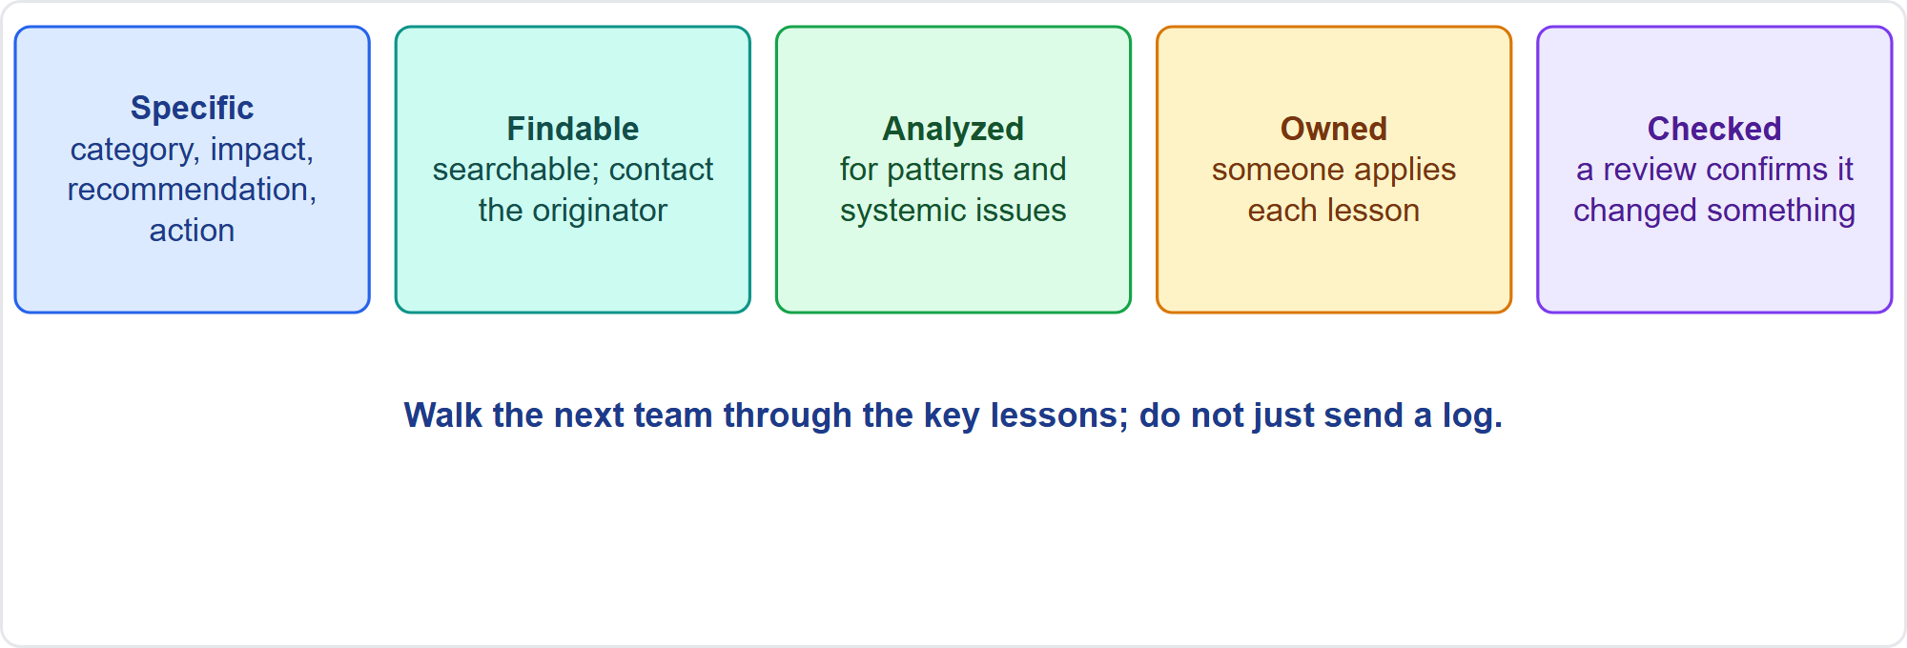
What Makes Lessons Usable
Part 2
Specific, findable, analyzed, owned, checked
EXAM TIP If the next team says the log was never useful, the problem is access and interaction, not more detail.
PMP Exam Prep 2026 | PMBOK 8 and the New ECO
Module 12
26 / 64
Notes:
Lessons are usable when they are specific and actionable, with a category, description, impact, recommendation and proposed action. They are searchable and accessible in a controlled repository, ideally with a way to contact the originators. They are analyzed for common issues that call for changes to procedures. And they are owned and checked: someone applies each lesson, and a later review confirms it changed something. Common failures: logging only at the end, a long unsearchable log, a generic buffer, no owner, and blame instead of learning.

Slide 27
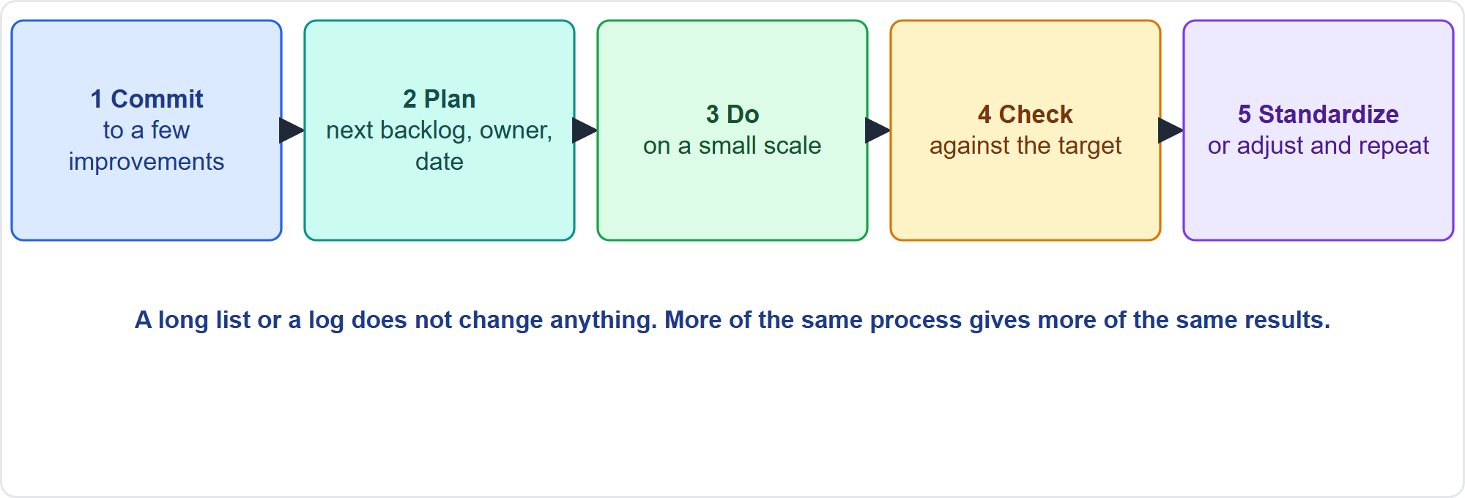
Continuous Improvement in Practice
Part 2
Commit, plan, do, check, standardize
EXAM TIP Retrospectives that only list ideas do not improve anything; commit to a few, put them in the next backlog and check the result.
PMP Exam Prep 2026 | PMBOK 8 and the New ECO
Module 12
27 / 64
Notes:
Continuous improvement means small, repeated improvements. Commit to a few improvements from each retrospective. Put them in the next iteration's backlog or plan, with an owner and a date. And check the result at the next review. A long action list or a log does not change anything. If the same format yields the same ideas, or results stop improving, inspect and adapt the improvement process itself. Change the format and bring data. Track follow-through, and rotate the facilitator. And add cross-team sessions. More of the same process gives more of the same results.

Slide 28
Shared Problems and Systemic Fixes
Part 2
Several teams report the same issue: run a cross-team analysis and fix
Separate retrospectives lack the full picture
Look for patterns across entries, iterations and teams
Fix at the system level, not team by team
Standardize best practices: one tested checklist or template instead of many variants
A proven procedure goes to the asset owner, not into a private log
EXAM TIP Check the effect of an improvement before standardizing it.
PMP Exam Prep 2026 | PMBOK 8 and the New ECO
Module 12
28 / 64
Notes:
Shared problems need shared fixes. If several teams report the same issue, run a cross-team analysis and fix. Separate retrospectives lack the full picture. Look for patterns across entries, iterations and teams, and fix them at the system level, not team by team. Standardize best practices: where teams keep varying checklists or templates, consolidate them into one tested standard and update the asset. A proven procedure goes to the asset owner. And check the effect of an improvement before standardizing it.

Slide 29
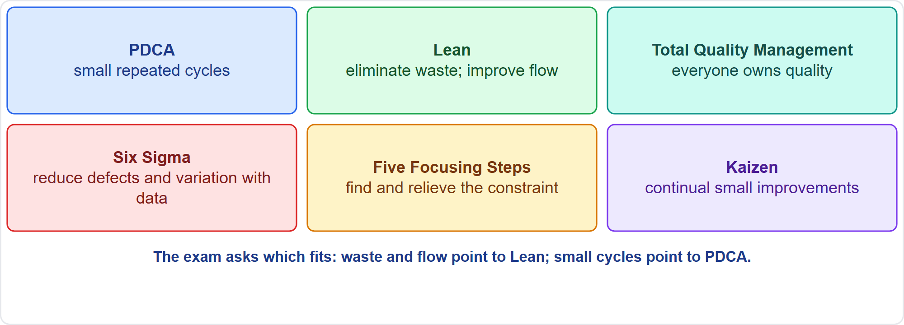
Improvement Approaches
Part 2
Six approaches
EXAM TIP Eliminate waste and improve flow points to Lean; small repeated cycles point to PDCA.
PMP Exam Prep 2026 | PMBOK 8 and the New ECO
Module 12
29 / 64
Notes:
PMBOK 8 names several approaches. Plan-do-check-act is the basic loop of small repeated cycles. Lean maximizes value and eliminates waste, using value stream mapping. Total Quality Management is an organization-wide commitment to quality where everyone owns it. Six Sigma is data-driven reduction of defects and variation. The Five Focusing Steps from the theory of constraints identify the constraint, exploit it, subordinate everything else to it, elevate it, and repeat. And Kaizen is continual small improvement. The exam asks which fits the situation.

Slide 30
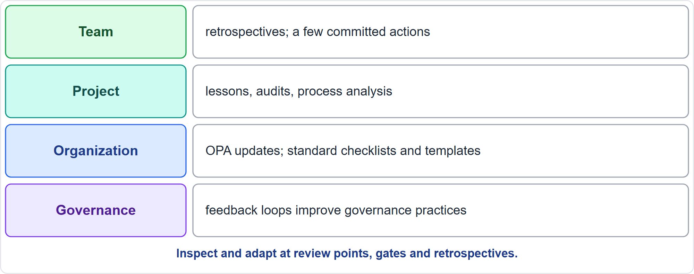
Improvement at Four Levels
Part 2
Team, project, organization, governance
EXAM TIP Tailoring is not a one-time exercise: review points, gates and retrospectives are chances to inspect and adapt.
PMP Exam Prep 2026 | PMBOK 8 and the New ECO
Module 12
30 / 64
Notes:
Improvement works at four levels. The team improves through retrospectives and a few committed actions. The project improves through lessons, audits and process analysis. The organization improves through updates to process assets, such as standard checklists and templates. And governance improves through feedback loops: periodic reviews, lessons learned and iterative adjustments. Teams own and improve their processes, while organizations provide methodologies as starting points. Review points, gates and retrospectives are chances to inspect and adapt.

Slide 31
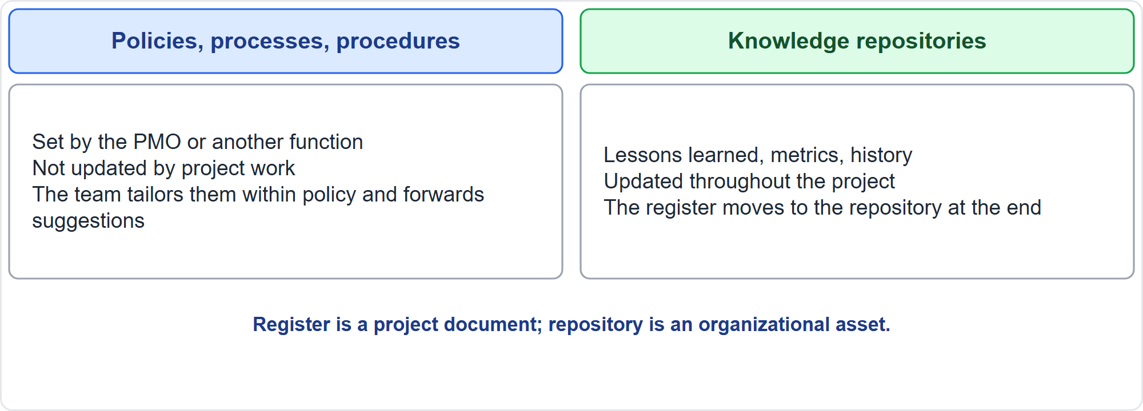
Two Kinds of Process Asset
Part 2
Policies versus repositories
EXAM TIP The project tailors policies and templates and updates repositories; it does not rewrite organizational policy.
PMP Exam Prep 2026 | PMBOK 8 and the New ECO
Module 12
31 / 64
Notes:
Organizational process assets come in two categories. Policies, processes and procedures are usually set by the PMO or another function outside the project. They are generally not updated as part of project work, but only through the organization's own update policy. The team may tailor templates, life cycles and checklists for its project. Knowledge repositories, in contrast, are updated throughout the project with project information. That includes lessons learned, financial performance and metrics. It includes issues and defects, completed schedules, risk data and earned value data.

Slide 32
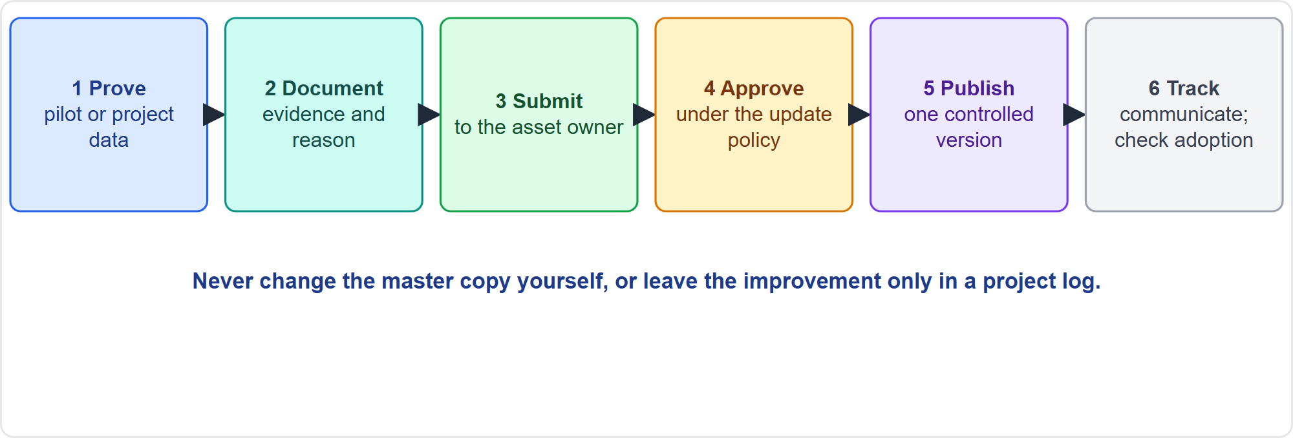
Updating Organizational Assets
Part 2
Six steps
EXAM TIP A proven procedure goes to the owner of the library through the organization's process; do not overwrite it yourself or leave it in a project log.
PMP Exam Prep 2026 | PMBOK 8 and the New ECO
Module 12
32 / 64
Notes:
To update an organizational asset, follow six steps. Prove it: show results from a pilot or project data. Document it: draft the new version with the evidence and the reason. Submit it to the owner of the asset, the PMO or process owner. Review and approve it under the organization's update policy. Publish a new controlled version and retire the old one. Communicate, train if needed, and check adoption. Do not change the master copy on your own, or update before it is proven. Forward suggestions for policies to the appropriate unit.

Slide 33
Improvement in Predictive, Agile and Hybrid Work
Part 2
 | Predictive | Agile | Hybrid
Capture points | Gates, reviews, postmortems, audits, closure | Retrospective each iteration, release retrospective | Both
Applying | Plan updates through change control; process changes at gates | Actions go into the next backlog; agreements change at once | Envelope through change control; team practices adapt
Cadence | Per phase or milestone | Every iteration | Mixed
Risk | Lessons collected too late | Retrospectives that change nothing | Neither level improves
EXAM TIP Do not skip short retrospectives because things went well or work is heavy.
PMP Exam Prep 2026 | PMBOK 8 and the New ECO
Module 12
33 / 64
Notes:
Improvement looks different by approach. Predictive: capture points at gates, reviews, postmortems, audits and closure, with plan updates through change control and process changes at gates. The risk is lessons collected too late. Agile: a retrospective each iteration and a release retrospective, with actions going into the next backlog and working agreements changing at once. The risk is retrospectives that change nothing. Hybrid: the envelope through change control while team practices adapt. Do not skip short retrospectives because things went well or work is heavy.

Slide 34
Improvement Traps: What PMI Expects
Part 2
Capture lessons throughout, not only at the end
Use lessons to shape the plan; specific lessons beat a generic buffer
Make lessons accessible, and walk the next team through them
Retrospective actions must be implemented; update the improvement process when it stagnates
Shared problems need a cross-team fix; standardize best practices in assets
Do not blame; hold a final lessons session; close terminated projects formally
EXAM TIP A final lessons session is held even if sprint retrospectives were held.
PMP Exam Prep 2026 | PMBOK 8 and the New ECO
Module 12
34 / 64
Notes:
The traps for improvement. Capture lessons throughout, not only at the end. Use lessons to shape the plan: specific lessons beat a generic buffer. Make lessons accessible and walk the next team through them. Retrospective actions must be implemented, and when the process stagnates, update the improvement process itself. Shared problems need a cross-team fix, and best practices are standardized in the assets. Policies owned elsewhere change only through the organization's policy. Do not blame, because a blame culture stops sharing. And a cancelled project still closes formally.

Slide 35
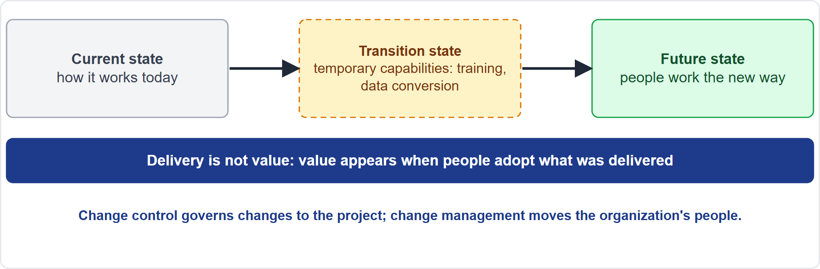
The Project as a Vehicle of Change
Part 2
Current, transition, future
EXAM TIP Delivery is not value: value appears when people use what was delivered.
PMP Exam Prep 2026 | PMBOK 8 and the New ECO
Module 12
35 / 64
Notes:
Now the organization. A project moves the organization from its current state, perhaps through a transition state, to a future state. Success means the organization reaches the future state and gets the value key stakeholders defined. Delivery is not value: value appears when people use what was delivered. That is why PMBOK 8 asks for transition and readiness requirements, such as training and data conversion, and a plan to maintain value. There are two sides to manage: the product side, and the people side.

Slide 36
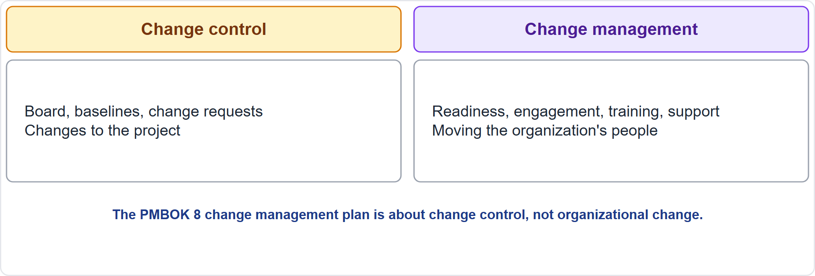
Change Control Versus Change Management
Part 2
Two meanings of change
EXAM TIP Baseline changes caused by organizational change still go through change control.
PMP Exam Prep 2026 | PMBOK 8 and the New ECO
Module 12
36 / 64
Notes:
Do not confuse two kinds of change. Change control, with the board, baselines and change requests, governs changes to the project. Change management moves the organization's people to the future state: readiness, engagement, training and support. PMBOK 8 defines change management as a comprehensive, cyclic, structured approach for transitioning individuals, groups and organizations to a future state. It is not change control, and not the Guide's change management plan. Baseline changes caused by organizational change still go through change control.

Slide 37
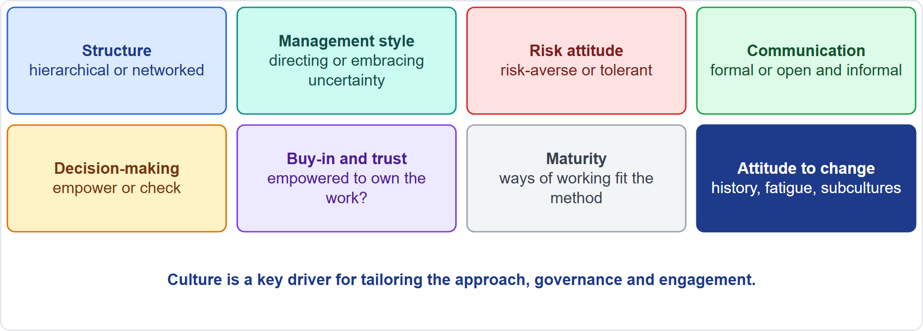
Assess Organizational Culture
Part 2
Nine dimensions
EXAM TIP Assess culture before choosing the approach and the engagement style.
PMP Exam Prep 2026 | PMBOK 8 and the New ECO
Module 12
37 / 64
Notes:
Assess organizational culture. Structure: fixed, hierarchical structures lean predictive, and network-oriented ones suit adaptive or hybrid. Management style: a culture of managing and directing fits predictive, while one that embraces uncertainty fits adaptive. Risk attitude: risk-averse cultures prefer detailed, fixed schedules. Communication: flat organizations use open, informal channels, hierarchical ones use formal approaches. Decision-making, buy-in and trust, maturity, ethics, and attitude to change complete the picture. Review the environmental factors, interview and survey, and use cultural intelligence without stereotyping.

Slide 38
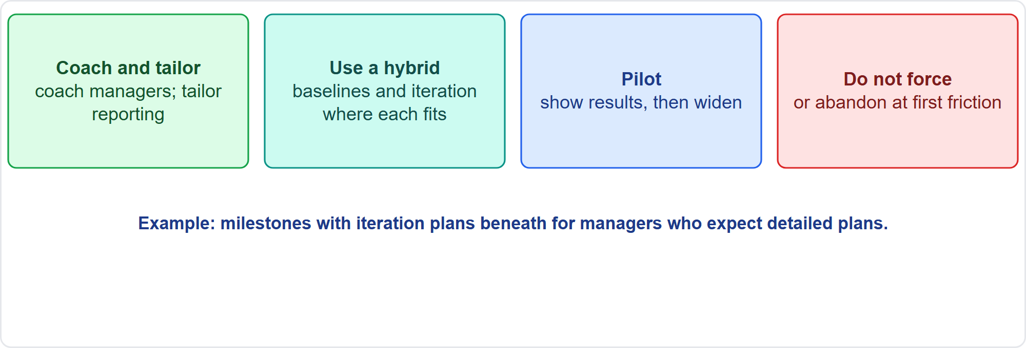
When Way of Working and Culture Do Not Match
Part 2
Coach and tailor
EXAM TIP An agile pilot in a hierarchical organization needs coaching for managers and tailored reporting, not a switch back to the old way.
PMP Exam Prep 2026 | PMBOK 8 and the New ECO
Module 12
38 / 64
Notes:
When the way of working and the culture do not match, coach and tailor. Take an agile pilot in a hierarchical organization, where managers expect detailed plans and signed weekly reports. It needs coaching for the managers, and tailored reporting, such as milestones with iteration plans beneath. Use a hybrid where one part of the culture requires baselines and another benefits from iteration. Pilot the new practice, show results, then widen it. Do not force an approach on a culture that cannot support it, and do not abandon it at the first friction.

Slide 39
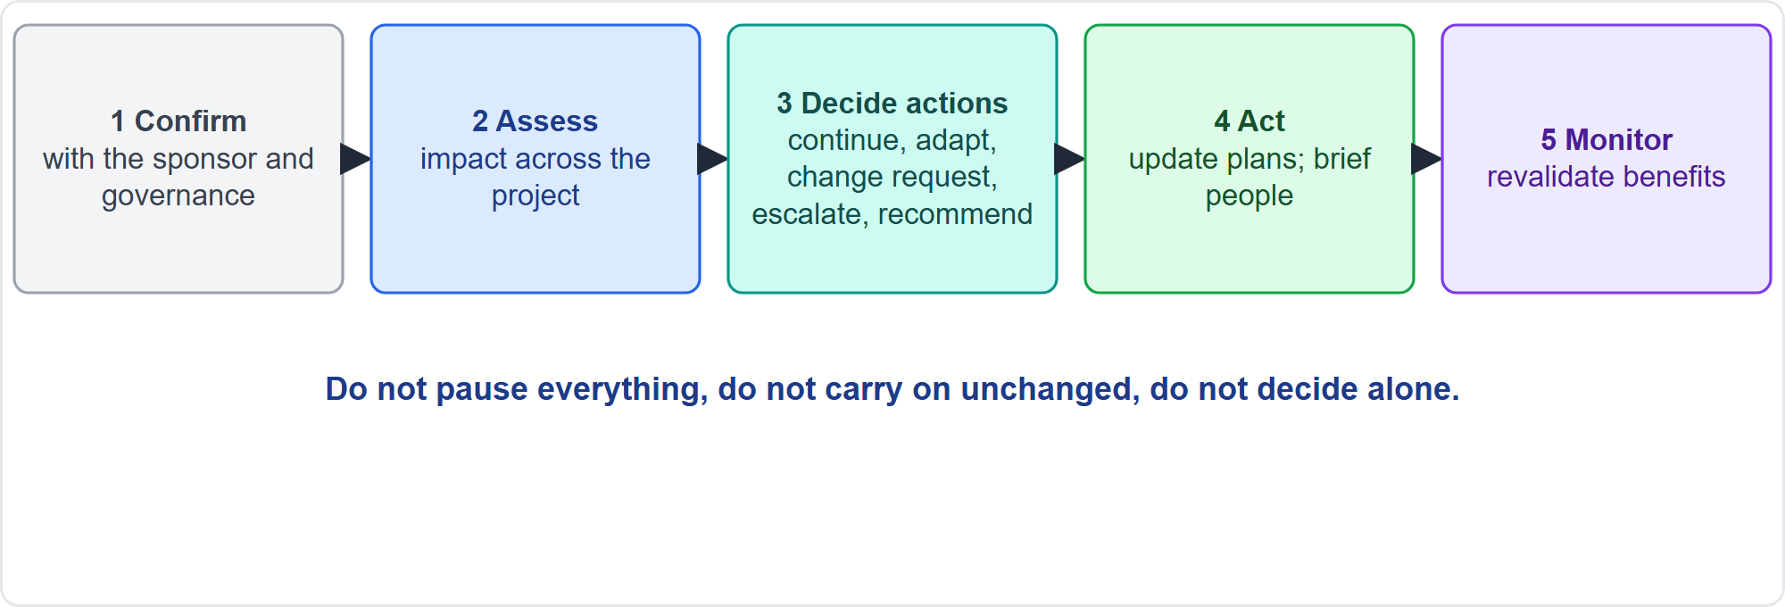
When the Organization Changes
Part 2
Five steps
EXAM TIP Do not pause everything, do not continue unchanged, do not decide alone.
PMP Exam Prep 2026 | PMBOK 8 and the New ECO
Module 12
39 / 64
Notes:
Now organizational change: a merger, restructuring, a new sponsor or a shift in strategy. Follow five steps. Confirm the facts with the sponsor and governance: what is changing, when, and what is unknown. Assess the impact across the project. Determine the actions: continue as planned, adapt within your authority, raise a change request, escalate, or recommend pausing or stopping through governance. Act and communicate. And monitor and reassess. Do not pause everything, do not continue unchanged, and do not decide alone.

Slide 40
Impact Areas
Part 2
Area | Questions
Objectives and business case | Do objectives, criteria and benefits still hold?
Scope and requirements | What changes in needs and backlog?
Schedule and budget | New dates, funding, approvals?
Resources and team | Who is reassigned, lost or added?
Stakeholders and sponsor | New decision-makers and expectations?
Governance and authority | New approval paths and thresholds?
Contracts and risks | New terms; new risks and obligations?
EXAM TIP The value proposition is the primary factor in deciding whether to continue.
PMP Exam Prep 2026 | PMBOK 8 and the New ECO
Module 12
40 / 64
Notes:
Assess the impact across the project. Objectives and business case: do the objectives, success criteria and benefits still hold? Scope and requirements: what changes in needs and backlog? Schedule and budget: new dates, funding and approvals? Resources and team: who is reassigned, lost or added? Stakeholders and sponsor: new decision-makers and expectations. Governance and authority: new approval paths and thresholds. Contracts and risks: new terms, risks and obligations. The value proposition is the primary factor in deciding whether to continue, replan or end.

Slide 41
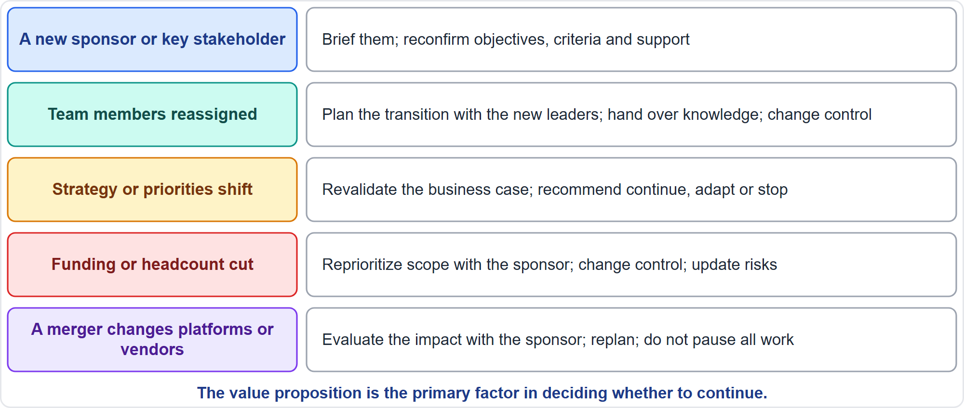
Typical Actions for Organizational Change
Part 2
Five situations
EXAM TIP A merger that changes platforms or vendors: evaluate the impact with the sponsor; do not pause everything and do not carry on blindly.
PMP Exam Prep 2026 | PMBOK 8 and the New ECO
Module 12
41 / 64
Notes:
Match the action to the change. A new sponsor or key stakeholder: brief them, and reconfirm objectives, success criteria and support. Team members reassigned: plan the transition with the new leaders, hand over knowledge, and update the resource plan through change control. Strategy or priorities shift: revalidate the business case, and recommend continue, adapt or stop. Funding or headcount cut: reprioritize scope with the sponsor and use change control. A merger that changes platforms or vendors: evaluate the impact with the sponsor, and replan.

Slide 42
Part 2 Recap
Part 2
1
Lessons
2
Improvement
3
Assets
capture throughout; use before planning; make them usable
a few committed actions; check results; adapt the process
tailor policies; update repositories through their owners
4
Two meanings
5
Culture
6
Organizational change
change control moves the project; change management moves people
assess it, then tailor; coach, pilot or hybrid
evaluate with the sponsor, then act
PMP Exam Prep 2026 | PMBOK 8 and the New ECO
Module 12
42 / 64
Notes:
Let us recap Part 2. Capture lessons throughout the project, use them before planning, and make them usable. Improvement means a few committed actions, with the results checked, and the improvement process itself adapted when it stalls. Tailor policies, and update repositories through their owners. Change control moves the project, while change management moves people. Assess culture first, then coach, pilot or use a hybrid. And when the organization changes, evaluate the impact with the sponsor, then act. In Part 3, we support people through change, and survey the external environment.

Slide 43
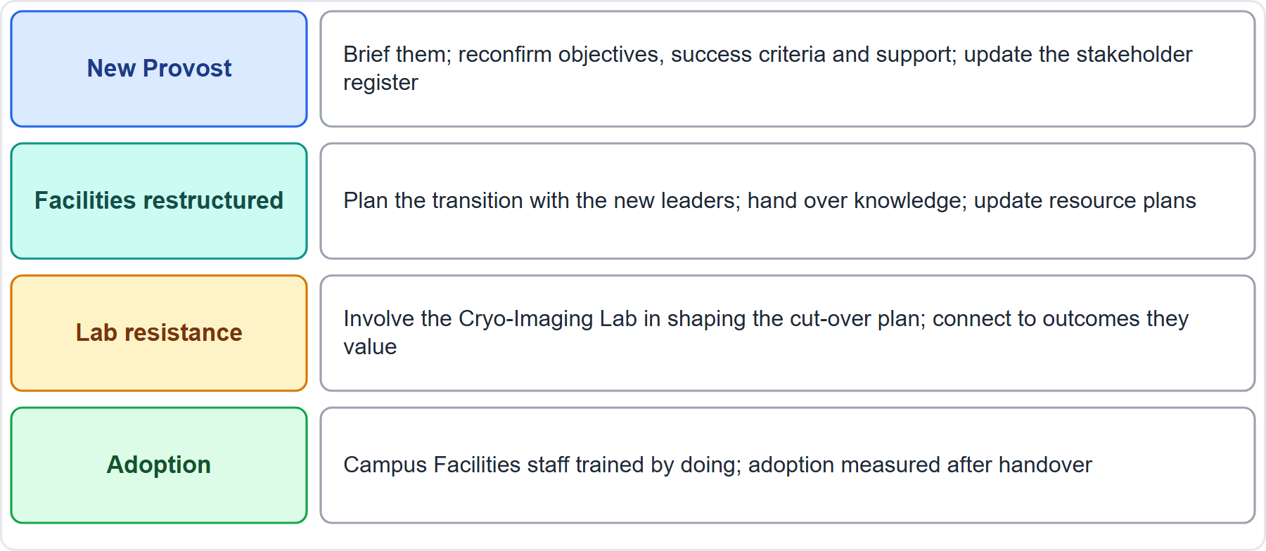
Case Check-In: Organizational Change
Part 3
CASE CHECK-IN · Sunrise Campus Microgrid
New Provost: brief them; reconfirm objectives and support
Facilities restructured: plan the transition; hand over knowledge
PMP Exam Prep 2026 | PMBOK 8 and the New ECO
Module 12
43 / 64
Notes:
Part 3 begins with the microgrid. Suppose a new Provost arrives and Campus Facilities is restructured. Brief the new Provost and reconfirm objectives, success criteria and support, and update the stakeholder register. Plan the transition with the new Facilities leaders, hand over knowledge, and update the resource plan. The Cryo-Imaging Lab remains resistant: involve the lab in shaping the cut-over plan and connect the purpose to outcomes they value. And plan adoption: Facilities staff trained by doing, with adoption measured after handover.

Slide 44
Supporting People Through Change
Part 3
Assess readiness: who is affected, how, and how prepared
Explain the why in terms each group values; use two-way channels
Involve people in designing the new way
Plan change activities in schedule and budget: training, coaching, pilots, support
Make sponsorship visible; hand adoption to the business owner
Reinforce: quick wins, support after go-live, measure adoption and benefits
EXAM TIP Value is realized by adoption: check readiness before handover and track adoption after.
PMP Exam Prep 2026 | PMBOK 8 and the New ECO
Module 12
44 / 64
Notes:
Plan the people side into the project. Assess readiness: who is affected, how, and how prepared they are. Explain the why, in terms each group values, using two-way channels. Involve people in designing the new way. Plan specific change activities in the schedule and budget: communications, training, coaching, pilots and support channels. Make sponsorship visible. Hand adoption to the business owner after closure. Reinforce: celebrate quick wins, keep support available after go-live, and measure adoption and benefits, not only delivery.

Slide 45
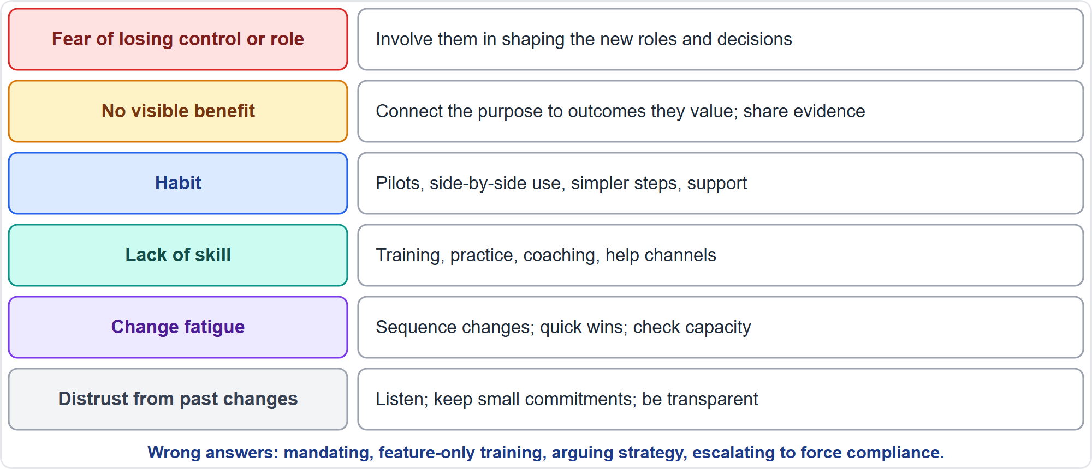
Managing Resistance
Part 3
Cause, then action
EXAM TIP Mandating use, feature-only training, arguing strategy and escalating to force compliance usually fall short.
PMP Exam Prep 2026 | PMBOK 8 and the New ECO
Module 12
45 / 64
Notes:
Find the cause of resistance, then match the action. Fear of losing control or role: involve people in shaping new roles and decisions. No visible benefit: connect the purpose to outcomes they value, and share evidence. Habit: pilots, side-by-side use and simpler steps. Lack of skill: training, practice and coaching. Change fatigue: sequence changes, show quick wins, check capacity. Distrust from past changes: listen, keep small commitments, be transparent. Typical wrong answers: mandating use, training on features only, arguing the strategic case, and escalating to force compliance.

Slide 46
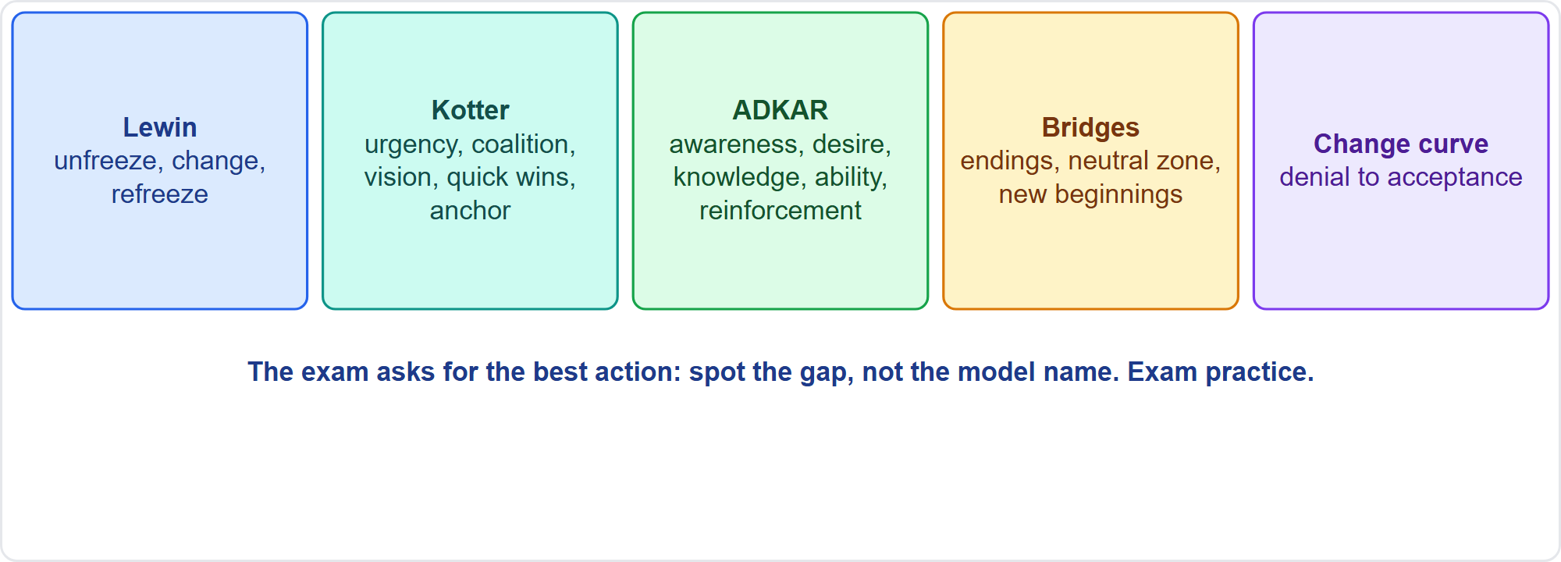
Change Models
Part 3
Five models
EXAM TIP The exam asks for the best action in the situation: spotting the gap matters more than naming the model.
PMP Exam Prep 2026 | PMBOK 8 and the New ECO
Module 12
46 / 64
Notes:
As exam practice, you may meet several models. Lewin: unfreeze, change, refreeze. Kotter's eight steps: create urgency, build a guiding coalition, and form a vision. Enlist volunteers and remove barriers. Generate short-term wins, sustain momentum, and anchor the change in the culture. ADKAR: awareness, desire, knowledge, ability and reinforcement. Bridges: endings, the neutral zone and new beginnings. The change curve: denial, anger, bargaining, depression and acceptance. The exam asks for the best action. Spotting the gap matters more than naming the model.

Slide 47
Organizational Change in Predictive, Agile and Hybrid Work
Part 3
 | Predictive | Agile | Hybrid
Impact | Formal assessment; change request and re-baseline | Backlog reprioritized; team agreement revisited | Both
Engaging people | Communication plan; training before go-live; readiness gates | Frequent demos and early user involvement | Both
Adoption | Larger cut-overs need readiness checks | Incremental release allows phased adoption | Mixed
Risk | Resistance discovered late | Team reshuffles and change fatigue | Neither side supported
EXAM TIP Team agreements are co-created with the whole team, including newcomers.
PMP Exam Prep 2026 | PMBOK 8 and the New ECO
Module 12
47 / 64
Notes:
Organizational change looks different by approach. Predictive: a formal impact assessment, a change request and re-baseline, a communication plan, training before go-live and readiness gates. Resistance may be discovered late. Agile: the backlog is reprioritized with the product owner, and the team agreement is revisited when members change. Frequent demos involve users early, and incremental release allows phased adoption. The risk is team reshuffles and change fatigue. Team agreements are co-created with the whole team, including newcomers.

Slide 48
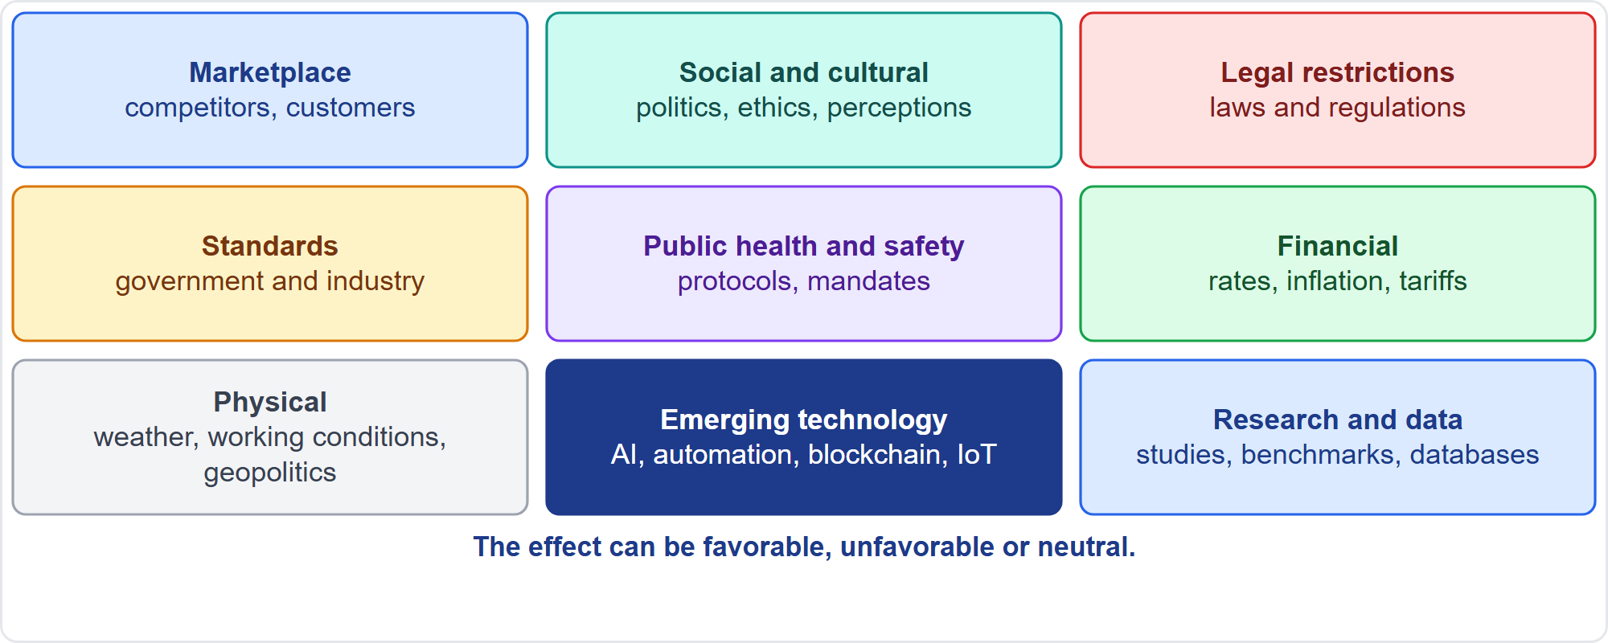
The External Environment
Part 3
Nine groups of external factors
EXAM TIP Environmental factors are not under the team's control; they influence, constrain or direct the project.
PMP Exam Prep 2026 | PMBOK 8 and the New ECO
Module 12
48 / 64
Notes:
Environmental factors are conditions not under the team's immediate control that influence, constrain or direct the project. The internal environment sits inside the larger external environment. External groups include marketplace conditions, social and cultural influences, and legal restrictions. They include government and industry standards, and public health and safety regulations. They include financial considerations, physical environmental elements, emerging technologies and academic research. Their effect can be favorable, unfavorable or neutral. The Standard also stresses global pressures such as climate change, resource constraints and geopolitical instability.

Slide 49
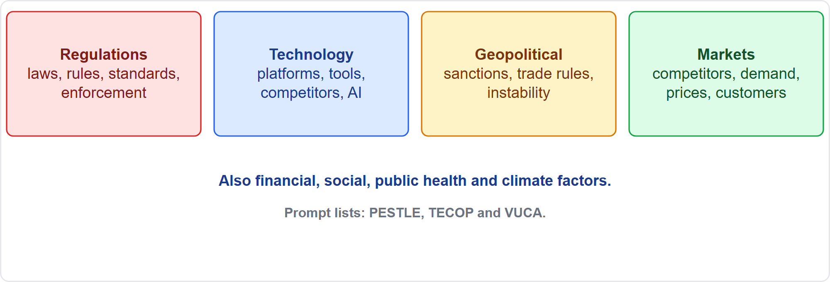
Survey Changes to the External Environment
Part 3
Regulations, technology, geopolitics, markets
EXAM TIP PESTLE, TECOP and VUCA are prompt lists PMBOK 8 names for finding external sources of overall project risk.
PMP Exam Prep 2026 | PMBOK 8 and the New ECO
Module 12
49 / 64
Notes:
The ECO names four families to survey. Regulations: laws, rules, standards and enforcement. Technology: platforms, tools, competitors' technology and AI. Geopolitical conditions: sanctions, trade rules and instability. And markets: competitors, demand, prices and customer behavior. Financial, social, public health and climate factors belong here too. Prompt lists help. PESTLE covers political, economic, sociocultural, technological, legal and environmental. TECOP covers technical, environmental, commercial, operational and political. VUCA covers volatility, uncertainty, complexity and ambiguity.

Slide 50
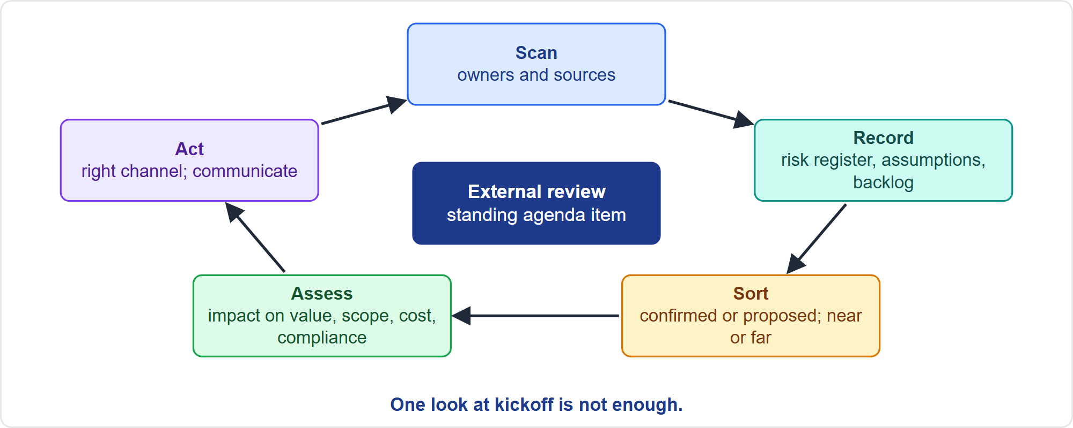
A Routine Scan
Part 3
Scan, record, sort, assess, act
EXAM TIP Scan routinely with owners and sources; one look at kickoff is not enough.
PMP Exam Prep 2026 | PMBOK 8 and the New ECO
Module 12
50 / 64
Notes:
Make scanning routine. Name owners and sources: regulators and legal counsel, standards bodies, trade press, customers, suppliers, the PMO and compliance teams. Add an external scan to backlog refinement, planning, reviews, gates and steering meetings, not just kickoff. Record findings in the risk register, assumption log, stakeholder register and backlog. Sort the signals: confirmed or proposed, direct or indirect, near-term or far-term. Reassess as soon as a trigger appears: an announcement, a competitor launch, an enforcement date.

Slide 51
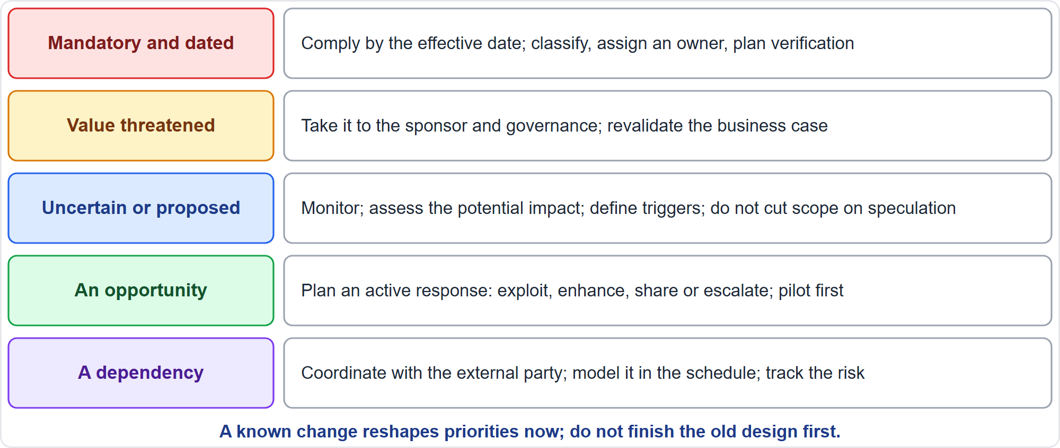
Assess and Triage an External Change
Part 3
Five kinds
EXAM TIP A known change should reshape priorities now; do not finish the old design first or wait for the final text.
PMP Exam Prep 2026 | PMBOK 8 and the New ECO
Module 12
51 / 64
Notes:
First confirm the facts: what exactly changed, who it applies to, and the effective date. Then assess the impact on objectives, the business case, scope and backlog. Assess schedule, cost and risk. And assess compliance and suppliers. Respond in proportion. A mandatory dated requirement: comply by the effective date. A threat to value: take it to the sponsor and governance to revalidate the business case. An uncertain or proposed change: monitor, assess the potential impact, define triggers, and do not cut scope on speculation. An opportunity: an active response. A dependency: coordinate and model it.

Slide 52
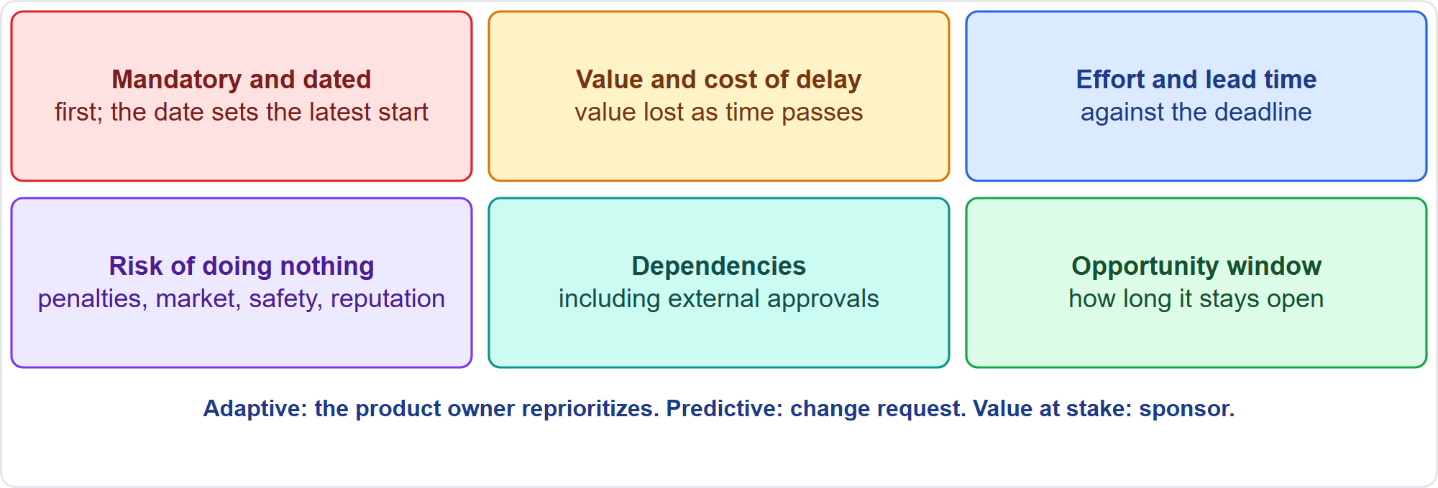
Prioritizing the Impact
Part 3
Six criteria
EXAM TIP Adaptive: the product owner reprioritizes the backlog; predictive: a change request; value at stake: the sponsor and governance.
PMP Exam Prep 2026 | PMBOK 8 and the New ECO
Module 12
52 / 64
Notes:
Prioritize the impact on scope or backlog. Mandatory and dated items come first: they are not negotiable, and the effective date sets the latest start. Then weigh value and cost of delay, effort against lead time, the risk of doing nothing, dependencies including external approvals, and the opportunity window. Then act through the right channel. In adaptive work, the product owner reprioritizes the backlog and updates the roadmap. In predictive work, raise a change request. If value is threatened, go to the sponsor and governance.

Slide 53
Situations the Exam Likes
Part 3
Situation | Best first action
A regulation takes effect in a year | Assess; reprioritize now
A competitor launches a cheaper product | Reassess value; options to sponsor
Sanctions hit a supplier's country | Assess impact; plan alternatives
The business-case market closes | Revalidate value with sponsor
A trade deal could change quotas | Monitor; define triggers
New technology halves processing time | Plan an opportunity response
EXAM TIP On time and on budget is not enough when the market, forecast or need changes.
PMP Exam Prep 2026 | PMBOK 8 and the New ECO
Module 12
53 / 64
Notes:
Some situations the exam likes. A known regulation takes effect in a year: assess the impact and reprioritize now. A competitor launches a cheaper product: reassess priorities and value, and take options to the sponsor. Sanctions hit a supplier's country, but deliveries are not yet affected: assess the supply impact and plan alternatives before deliveries stop. The market in the business case closes while the plan is on track: revalidate value with the sponsor. A trade agreement under negotiation: monitor, define triggers, and do not cut scope on speculation. A new technology that could halve processing time: plan an opportunity response.

Slide 54
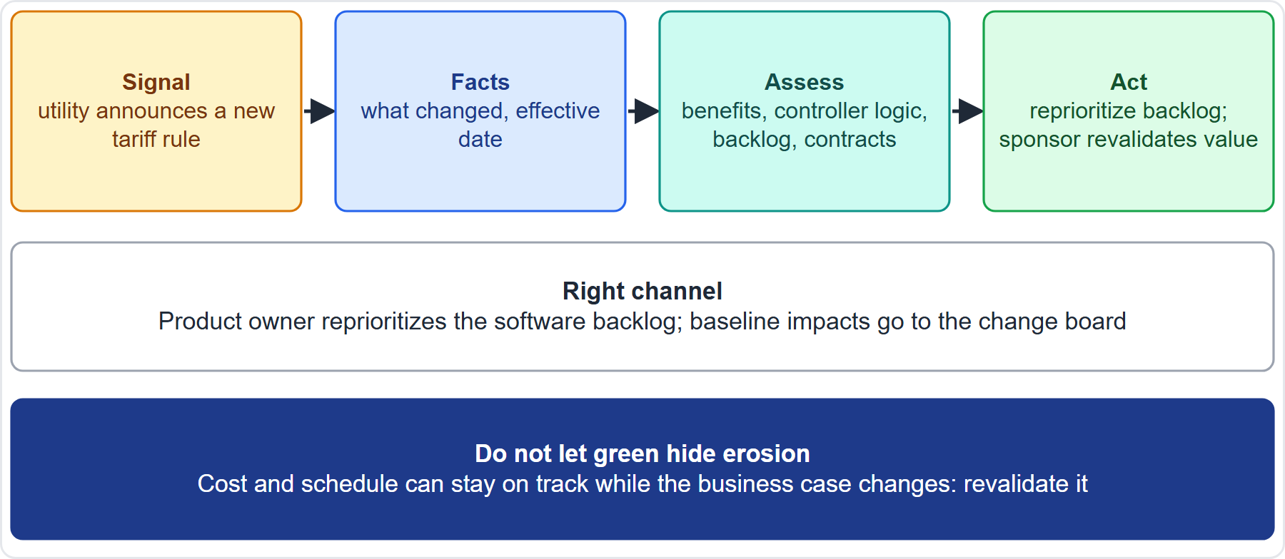
Case Check-In: An External Change
Part 3
CASE CHECK-IN · Sunrise Campus Microgrid
Signal: the utility announces a new tariff rule
Response: reprioritize the backlog; revalidate value
PMP Exam Prep 2026 | PMBOK 8 and the New ECO
Module 12
54 / 64
Notes:
Back to our microgrid. The utility announces a new tariff rule that changes the value of stored energy. Confirm the facts and the effective date. Assess the impact on the benefits, the controller logic, the backlog and contracts. Use the right channel: the product owner reprioritizes the software backlog, and baseline impacts go to the change board. And because the rule may change the business case, take it to Elena Vasquez to revalidate the value. Cost and schedule can stay on track while the business case changes.

Slide 55
Continually Review the External Environment
Part 3
Standing cadence: scan in refinement, planning, reviews, gates and before major commitments
Triggers: announcements, enforcement dates, competitor launches, supplier news
Keep assumptions and constraints current; a false assumption is a trigger
Report honestly: what changed, the impact, options and a recommendation
A project may end early when the need no longer exists
Do not let good performance hide value erosion
EXAM TIP Early termination is a valid outcome when value can no longer be achieved; governance decides on your analysis.
PMP Exam Prep 2026 | PMBOK 8 and the New ECO
Module 12
55 / 64
Notes:
Continually review the external environment. Keep a standing cadence, and re-assess when a trigger appears. Keep assumptions and constraints current: an assumption about a market or regulation that is no longer true is a trigger. Report honestly to the sponsor: what changed, the impact, options and a recommendation. A project may end early when the need no longer exists because of changes in strategy, priorities or the external environment. Reassessing value regularly is how you notice. And do not let good performance hide value erosion.

Slide 56
External Change in Predictive, Agile and Hybrid Work
Part 3
 | Predictive | Agile | Hybrid
Survey | At initiation and planning, then gates and status meetings | At refinement, planning, reviews and retrospectives | Both
Absorbing change | Impact analysis, change request, baseline update | Product owner reprioritizes backlog and roadmap | Formal envelope; backlog inside
Mandatory items | Added to scope by controlled change | Ranked at the top of the backlog by effective date | Both
Business case | Revalidated at gates | Revisited each release or review | Both
EXAM TIP Scanning that stops after planning causes late discovery; constant reshuffling without checking value is the agile risk.
PMP Exam Prep 2026 | PMBOK 8 and the New ECO
Module 12
56 / 64
Notes:
External change looks different by approach. Predictive: scan at initiation and planning, then at gates and status meetings. Absorb change through impact analysis, a change request and a baseline update. Mandatory items are added by controlled change, and the business case is revalidated at gates. Agile: scan at refinement, planning, reviews and retrospectives. The product owner reprioritizes the backlog and roadmap, with mandatory items at the top by effective date. Hybrid: formal control for the envelope, with the backlog inside.

Slide 57
Organizational and External Change Traps: What PMI Expects
Part 3
Evaluate the impact with the sponsor first; do not pause, ignore or decide alone
A new sponsor is briefed; reassigned staff need a planned transition
Assess culture before choosing the approach; coach and tailor on a mismatch
Resistance: understand the cause and involve people
A known change reshapes priorities now; revalidate the business case
Right channel: backlog, change request or sponsor; scan routinely
EXAM TIP Do not confuse change management with change control.
PMP Exam Prep 2026 | PMBOK 8 and the New ECO
Module 12
57 / 64
Notes:
The traps for organizational and external change. Evaluate the impact of organizational change with the sponsor first: do not pause everything, carry on unchanged, or decide alone. Brief a new sponsor. Plan the transition for reassigned staff. Assess culture before choosing the approach, and coach and tailor if there is a mismatch. For resistance, understand the cause and involve people. A known external change should reshape priorities now, and a changed market means revalidating the business case. Use the right channel, and scan routinely.

Slide 58
Module Recap
Part 3
1
Change control
2
Improvement
3
Organizational change
assess, decide at the right level, implement, update everything
lessons used early, a few tracked actions, assets updated by their owners
evaluate with the sponsor; assess culture; involve people
4
External change
5
Four kinds of change
6
Next
scan routinely; triage; right channel; revalidate value
project, way of working, organization, outside
five practice questions
PMP Exam Prep 2026 | PMBOK 8 and the New ECO
Module 12
58 / 64
Notes:
Let us recap the whole module. Change control: assess, decide at the right level, implement and update everything. Improvement: use lessons early, commit to a few tracked actions, and let asset owners update assets. Organizational change: evaluate with the sponsor, assess culture, and involve people. External change: scan routinely, triage, use the right channel, and revalidate value. Remember the four kinds of change: to the project, to the way of working, to the organization, and outside. Now it is time to test yourself. Five questions follow. For each one, pause the video, choose your answer, and then listen to the explanation.

Slide 59
Practice Question 1
Part 3
Q1
A team lead tells the project manager that a free design improvement was already built into the product and has passed all tests. What should the project manager do?
A
Keep it, because it costs nothing and has already been tested successfully by the team
B
Remove it immediately so that the product matches the approved design exactly
C
Assess its impact and submit it through change control, even though already made
D
Ask the sponsor to approve it informally and update the documents afterwards
PMP Exam Prep 2026 | PMBOK 8 and the New ECO
Module 12
59 / 64
Notes:
Question one. A team lead tells the project manager that a free design improvement was already built into the product and has passed all tests. What should the project manager do? The four options are on the screen. Choose your answer. [PAUSE 12] The answer is C. Even free or tested improvements are changes, so the project manager assesses the impact and submits it through change control, retroactively if it was already made. Keeping it, removing it automatically, or informal approval all skip the assessment and the record.

Slide 60
Practice Question 2
Part 3
Q2
After every sprint retrospective, the team lists many good ideas, but nothing seems to change. What should the project manager do?
A
Commit to a few improvements, put them in the next backlog and track them
B
Hold retrospectives more often so that many more ideas can be collected from the team
C
Stop the retrospectives until the team shows that it genuinely wants to change
D
Add the ideas to a lessons log so that the next project can review them
PMP Exam Prep 2026 | PMBOK 8 and the New ECO
Module 12
60 / 64
Notes:
Question two. After every sprint retrospective, the team lists many good ideas, but nothing seems to change. What should the project manager do? The four options are on the screen. Choose your answer. [PAUSE 12] The answer is A. Retrospective actions must be implemented: a few are committed, put in the next backlog with owners and checked, and the improvement process itself is adapted. More meetings, stopping them, or only logging ideas do not change anything.

Slide 61
Practice Question 3
Part 3
Q3
A merger will change the platforms and vendors that the project depends on. What should the project manager do first?
A
Pause all work until the merger is complete and the new rules have been published
B
Carry on as planned, because the merger has not yet changed any of the contracts
C
Decide alone which vendors will be kept and update the plan
D
Evaluate the impact with the sponsor, then determine the actions
PMP Exam Prep 2026 | PMBOK 8 and the New ECO
Module 12
61 / 64
Notes:
Question three. A merger will change the platforms and vendors that the project depends on. What should the project manager do first? The four options are on the screen. Choose your answer. [PAUSE 12] The answer is D. Organizational change is evaluated with the sponsor first, and then the actions are determined, with change control for baseline changes. Pausing everything, carrying on blindly, or deciding alone each skip the evaluation.

Slide 62
Practice Question 4
Part 3
Q4
Staff say the new approval tool is a surveillance burden and keep using their old spreadsheets. What is the best response?
A
Mandate the new tool and review each person's use of it every week for a month
B
Connect the purpose to outcomes they value and involve them in tuning
C
Provide extra training on every feature of the new tool, then test the staff
D
Escalate to the sponsor so that compliance is enforced
PMP Exam Prep 2026 | PMBOK 8 and the New ECO
Module 12
62 / 64
Notes:
Question four. Staff say the new approval tool is a surveillance burden and keep using their old spreadsheets. What is the best response? The four options are on the screen. Choose your answer. [PAUSE 12] The answer is B. Resistance rooted in a lack of visible benefit is addressed by connecting the purpose to outcomes people value and involving them in tuning the solution. Mandates, feature-only training, or escalation to force compliance harden resistance.

Slide 63
Practice Question 5
Part 3
Q5
A new regulation will take effect in twelve months, and the team is midway through designing a feature that will not comply. What should the project manager do?
A
Finish the current design first and then fix compliance after the release
B
Wait for the final text of the regulation before taking any action on the design
C
Assess the impact and reprioritize the backlog so the mandatory work is ready
D
Ask the sponsor to request a temporary exemption for the first release
PMP Exam Prep 2026 | PMBOK 8 and the New ECO
Module 12
63 / 64
Notes:
Question five. A new regulation will take effect in twelve months, and the team is midway through designing a feature that will not comply. What should the project manager do? The four options are on the screen. Choose your answer. [PAUSE 12] The answer is C. A known mandatory change reshapes priorities now, so the impact is assessed and the mandatory work is prioritized ahead of its effective date. Finishing first, waiting, or an exemption request avoid planning for compliance.

Slide 64
Answers at a Glance
Part 3
Question | Answer | Why
Q1 | C | An already-made free change is assessed and submitted retroactively
Q2 | A | Commit to a few tracked actions, not a longer list
Q3 | D | Evaluate organizational change with the sponsor, then act
Q4 | B | Connect the purpose to outcomes people value and involve them
Q5 | C | A known mandatory change reshapes priorities now
PMP Exam Prep 2026 | PMBOK 8 and the New ECO
Module 12
64 / 64
Notes:
Here are all five answers together. Question one: C. An already-made free change is assessed and submitted retroactively. Question two: A. Commit to a few tracked actions, not a longer list. Question three: D. Evaluate organizational change with the sponsor, then act. Question four: B. Connect the purpose to outcomes people value and involve them. Question five: C. A known mandatory change reshapes priorities now. That completes Module 12. Next, Module 13 covers the calculations the exam uses, with worked examples. See you there.

