Slide 1
Module 13: Formula Workshop
Part 1 of 2: Schedule, cost and risk
Process domain · Tasks 5, 6, 8 and 9
PMP Exam Prep 2026: PMBOK 8 and the New ECO
Module 13: Formula Workshop · Part 1
Notes:
Welcome to Module 13, the formula workshop. Calculation questions are a minority of the exam, but they are quick points when the formulas are automatic. In Part 1, we work through the schedule, cost and risk formulas, using numbers from our microgrid. Part 2 covers people, value, contracts, quality and flow metrics.

Slide 2
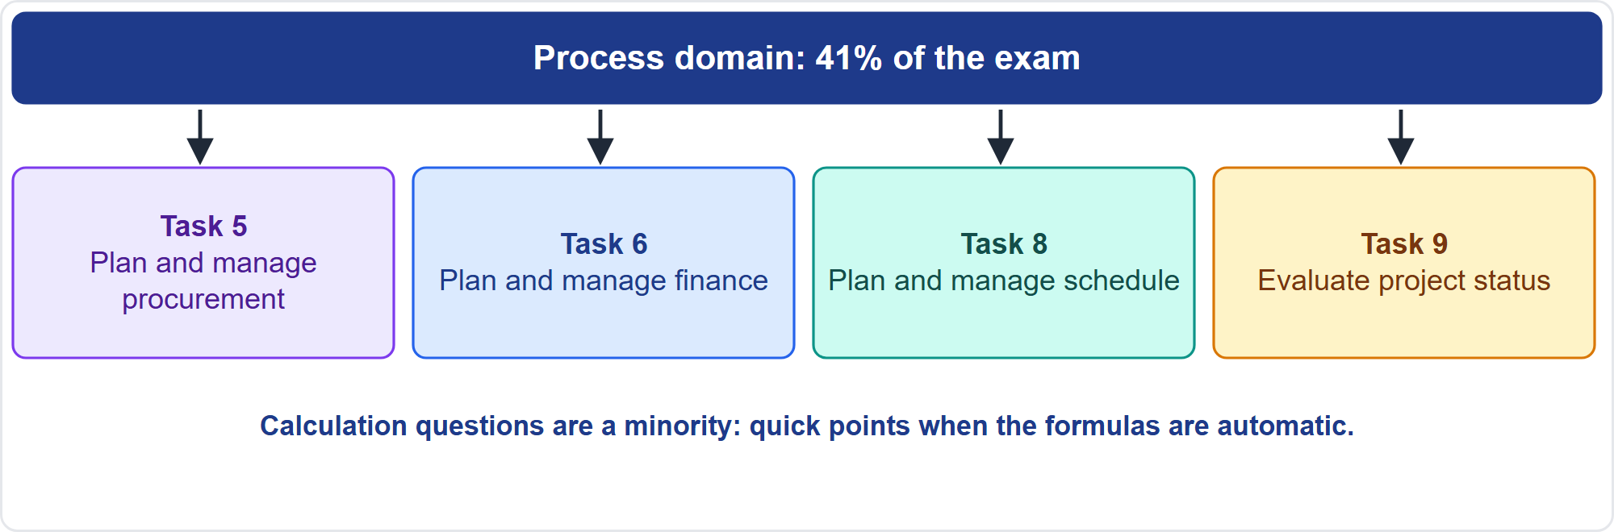
Where This Module Sits in the Exam
Part 1
Four Process domain tasks
EXAM TIP Most items are scenario judgment; the formulas are the quick points.
PMP Exam Prep 2026 | PMBOK 8 and the New ECO
Module 13: Formula Workshop
2 / 43
Notes:
Here is where the numbers appear. The Process domain is forty-one percent of the exam, and this module touches four of its tasks. Task five, procurement, for contract and make-or-buy formulas. Task six, finance, for earned value, risk and value measures. Task eight, schedule, for estimating and the critical path. And task nine, status, for metrics. Most exam items are scenario judgment. The formulas are the quick points, so make them automatic.

Slide 3
What You Will Learn
Part 1
Work schedule problems: estimates, probability and critical path
Work cost problems: earned value, EAC and TCPI
Calculate EMV and read a decision tree
Compare investments with NPV, IRR and payback
Use contract, statistics and agile formulas
Pick the right formula from the assumption words
PMP Exam Prep 2026 | PMBOK 8 and the New ECO
Module 13: Formula Workshop
3 / 43
Notes:
By the end of this module you will be able to do six things. Work schedule problems: estimates, probability and the critical path. Work cost problems: earned value, the estimate at completion and the to-complete index. Calculate expected monetary value and read a decision tree. Compare investments with net present value, internal rate of return and payback. Use the contract, statistics and agile formulas. And pick the right formula from the assumption words in the question.

Slide 4
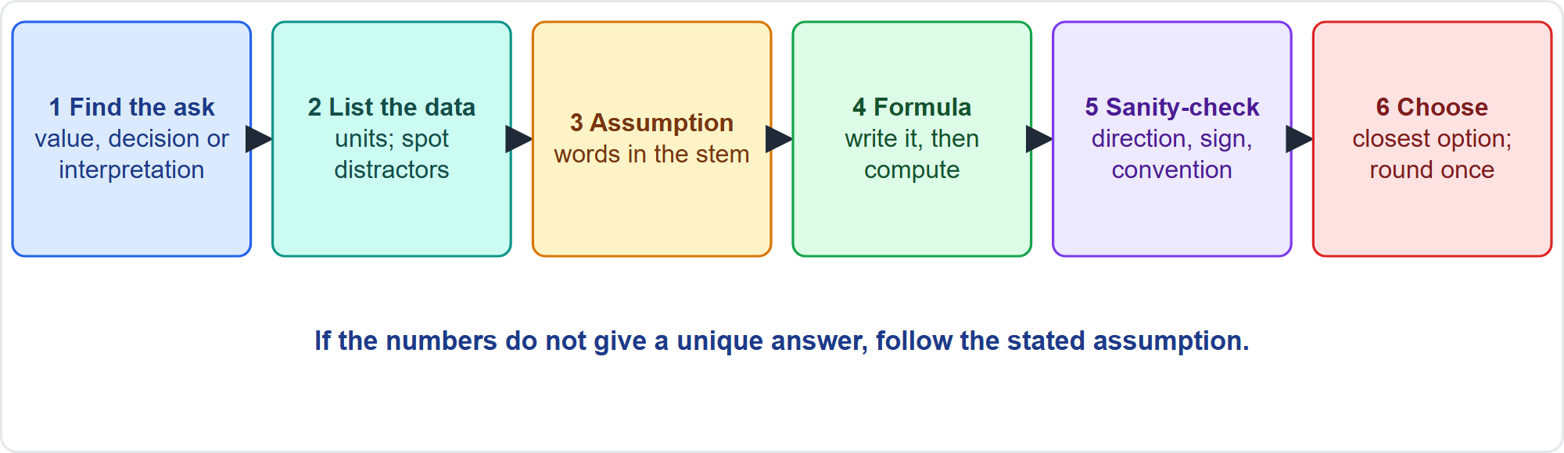
How to Approach Any Calculation Question
Part 1
Six steps
EXAM TIP Check the direction: a CPI below 1 means the EAC is above the BAC.
PMP Exam Prep 2026 | PMBOK 8 and the New ECO
Module 13: Formula Workshop
4 / 43
Notes:
Use the same six steps every time. One, find what is asked: a value, a decision or an interpretation. Two, list the data with units, and spot distractors, which are extra numbers. Three, find the assumption words in the stem. Four, write the formula, then compute, keeping fractions until the end. Five, sanity-check the direction, the sign and the convention. Six, choose the closest option, rounding once. If the numbers do not give a unique answer, follow the stated assumption.

Slide 5
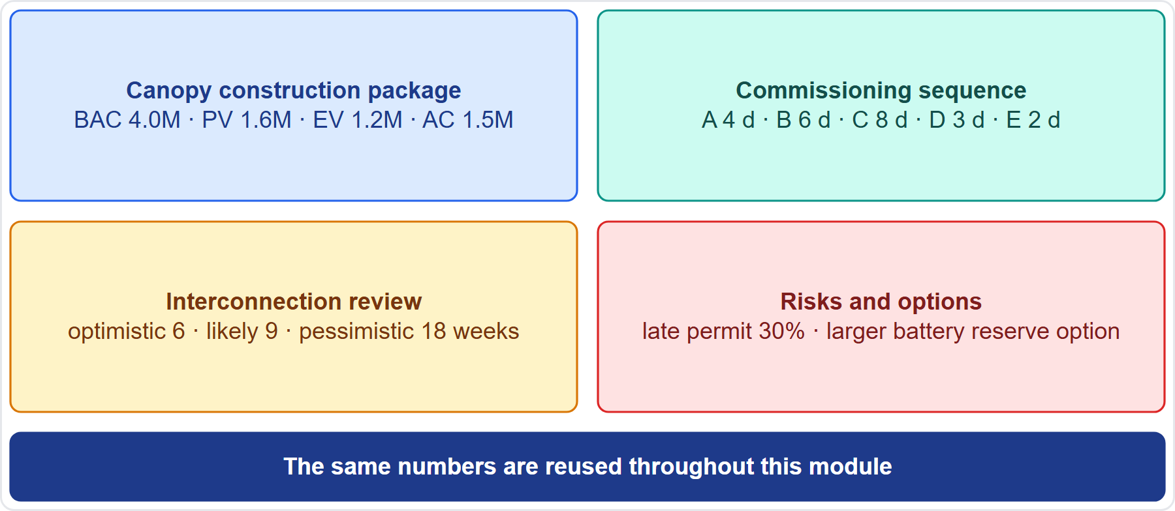
Case Check-In: The Numbers
Part 1
CASE CHECK-IN · Sunrise Campus Microgrid
Package: the canopy construction work, budget 4.0 million
Reuse: the same numbers appear in the worked examples
PMP Exam Prep 2026 | PMBOK 8 and the New ECO
Module 13: Formula Workshop
5 / 43
Notes:
Here are the microgrid numbers we will use. The canopy construction package has a budget of four million dollars, and we will check its status. The commissioning sequence has five activities. The utility interconnection review has a three-point estimate in weeks. And there are a few risks and options. The numbers are for practice, and they sit inside the fourteen point two million dollar budget.

Slide 6
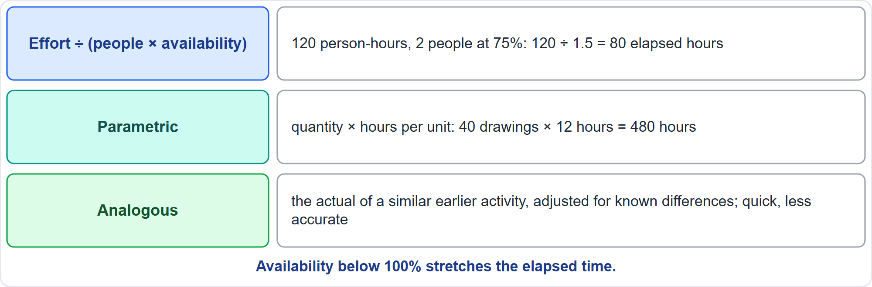
Estimating Duration
Part 1
Three ways
EXAM TIP Availability below 100% stretches the elapsed time.
PMP Exam Prep 2026 | PMBOK 8 and the New ECO
Module 13: Formula Workshop
6 / 43
Notes:
Three ways to estimate duration. Effort divided by people times availability: a hundred and twenty person-hours, with two people each seventy-five percent available, takes eighty elapsed hours. Parametric estimating multiplies quantity by hours per unit: forty drawings at twelve hours each is four hundred and eighty hours. Analogous estimating uses the actual of a similar earlier activity, adjusted for known differences. It is quick but less accurate. The effort formula is exam practice.

Slide 7
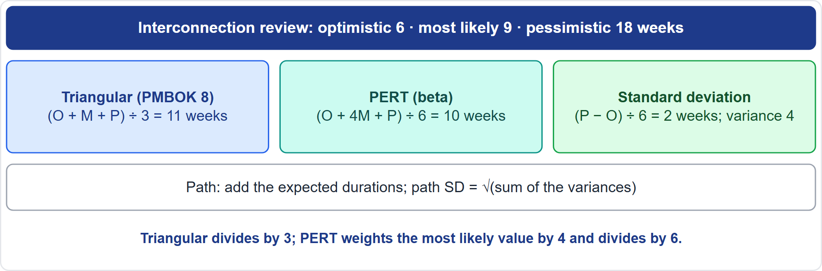
Three-Point Estimates
Part 1
Triangular, PERT and standard deviation
EXAM TIP Triangular divides by 3; PERT weights the most likely value by 4 and divides by 6.
PMP Exam Prep 2026 | PMBOK 8 and the New ECO
Module 13: Formula Workshop
7 / 43
Notes:
The interconnection review has an optimistic estimate of six weeks, a most likely of nine, and a pessimistic of eighteen. The triangular average, the one PMBOK 8 prints, adds the three and divides by three: eleven weeks. The PERT or beta estimate weights the most likely value by four and divides by six: ten weeks. That one is exam practice. The standard deviation is pessimistic minus optimistic, divided by six: two weeks, with a variance of four. For a path, add the expected durations, and take the square root of the summed variances.

Slide 8
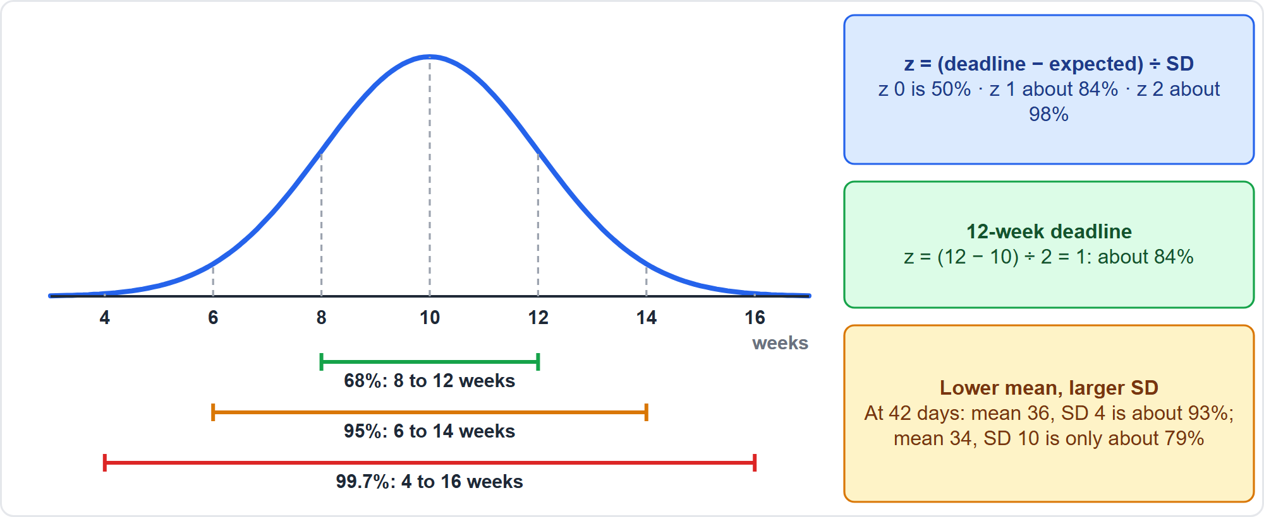
Standard Deviation and Probability
Part 1
Mean 10 weeks, SD 2
EXAM TIP A path with a lower mean but a larger standard deviation can be riskier than a longer path.
PMP Exam Prep 2026 | PMBOK 8 and the New ECO
Module 13: Formula Workshop
8 / 43
Notes:
Use the normal curve. About sixty-eight percent of outcomes fall within one standard deviation of the mean: eight to twelve weeks here. About ninety-five percent fall within two: six to fourteen. And about ninety-nine point seven percent fall within three. For the chance of finishing by a date, compute z as the deadline minus the expected duration, divided by the standard deviation. A twelve-week deadline gives z of one, about eighty-four percent. A path with a lower mean but a larger spread can be riskier. The standard deviation bands and the z rule are exam practice.

Slide 9
Critical Path: The Day-1 Formulas
Part 1
Step | Formula
Forward pass | ES = latest EF of predecessors + 1; EF = ES + D − 1
Backward pass | LF = earliest LS of successors − 1; LS = LF − D + 1
Total float | LS − ES = LF − EF
Free float | ES of successor − EF − 1
Critical path | The longest path; zero total float
EXAM TIP Check which convention the question states; older sources use EF = ES + D.
PMP Exam Prep 2026 | PMBOK 8 and the New ECO
Module 13: Formula Workshop
9 / 43
Notes:
PMBOK 8 starts the project on day one. In the forward pass, early start is the latest early finish of the predecessors plus one, and early finish is early start plus duration minus one. In the backward pass, late finish is the earliest late start of the successors minus one, and late start is late finish minus duration plus one. Total float is late start minus early start, or late finish minus early finish. Free float is the successor's early start, minus this early finish, minus one. The critical path is the longest path, and it has zero total float.

Slide 10
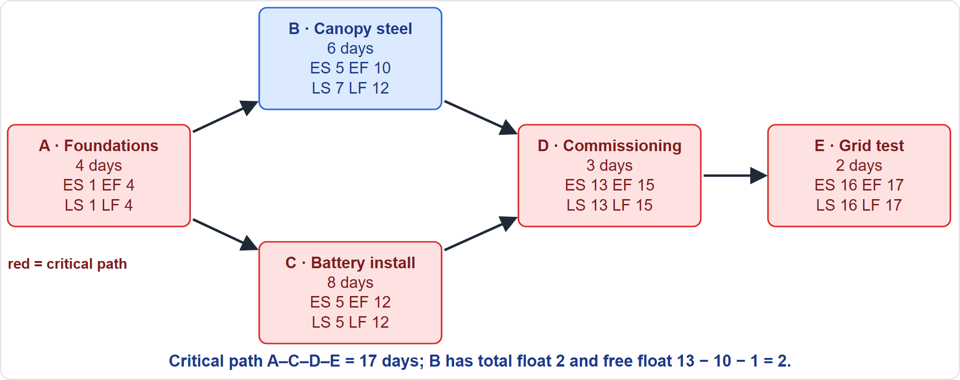
Critical Path Worked Example
Part 1
Five activities
EXAM TIP Add the days along each path: the longest path sets the project duration.
PMP Exam Prep 2026 | PMBOK 8 and the New ECO
Module 13: Formula Workshop
10 / 43
Notes:
Here is the commissioning sequence. Foundations take four days and are followed by canopy steel, six days, and battery installation, eight days, in parallel. Both precede commissioning, three days, then the grid test, two days. In the forward pass, A runs days one to four, and C runs five to twelve. D runs thirteen to fifteen, and E runs sixteen to seventeen. The critical path is A, C, D, E: seventeen days. B finishes on day ten but has until day twelve, so it has two days of total float.

Slide 11
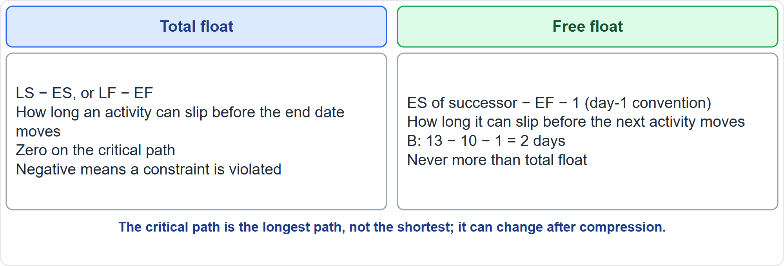
Total Float and Free Float
Part 1
Two kinds of float
EXAM TIP Total float delays the end date; free float delays the next activity.
PMP Exam Prep 2026 | PMBOK 8 and the New ECO
Module 13: Formula Workshop
11 / 43
Notes:
Total float is how long an activity can slip before the end date moves. It is late start minus early start, zero on the critical path, and negative when a constraint is violated. Free float is how long it can slip before the next activity moves: the successor's early start, minus this early finish, minus one. For canopy steel, thirteen minus ten minus one is two days. Free float is never more than total float. And remember, the critical path is the longest path, not the shortest. It can change after compression.

Slide 12
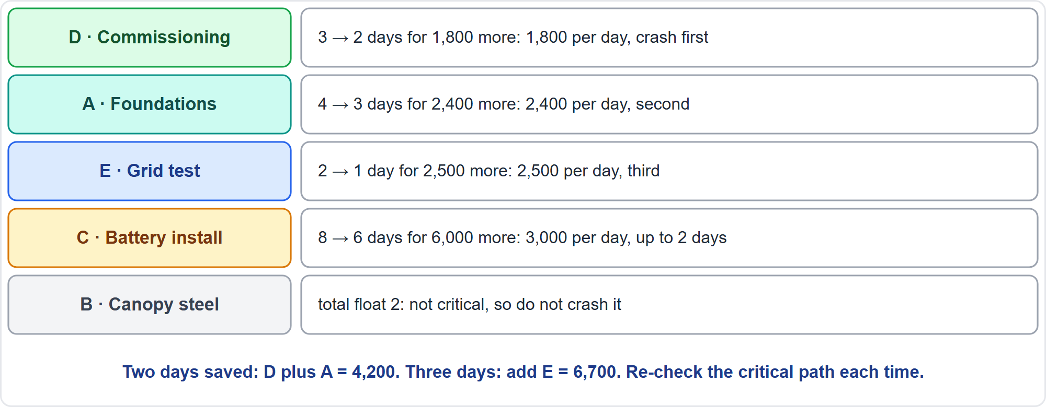
Compression: Crashing and Fast Tracking
Part 1
Cheapest per day first
EXAM TIP Crash only critical-path activities, cheapest per day first, and re-check the critical path after each step.
PMP Exam Prep 2026 | PMBOK 8 and the New ECO
Module 13: Formula Workshop
12 / 43
Notes:
Crashing adds resources to save time. The extra cost per day is crash cost minus normal cost, divided by the days saved. Crash only critical activities, cheapest per day first. Commissioning costs eighteen hundred a day, foundations twenty-four hundred, the grid test twenty-five hundred, and battery installation three thousand. Canopy steel has float, so do not crash it. Two days saved costs four thousand two hundred, and three days costs six thousand seven hundred. Fast tracking overlaps activities and adds risk. A lead lets a successor start earlier, a lag adds waiting time, and durations never include them. The crashing cost formula is exam practice.

Slide 13
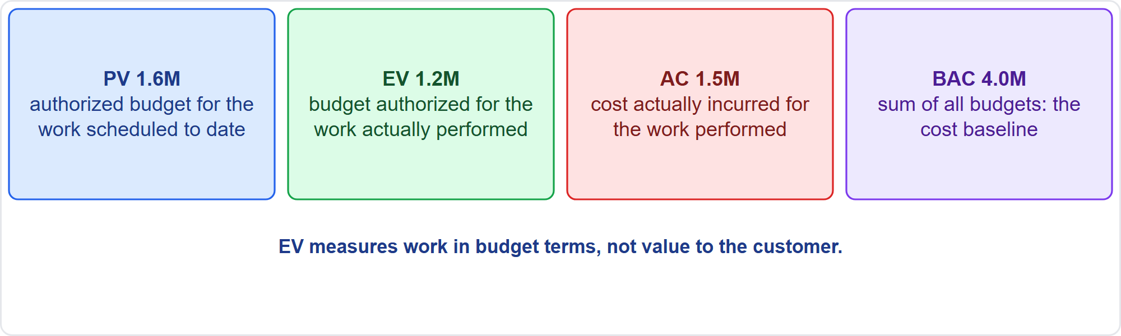
Earned Value: The Measures
Part 1
PV, EV, AC and BAC
EXAM TIP EV measures work in budget terms, not value delivered to the customer.
PMP Exam Prep 2026 | PMBOK 8 and the New ECO
Module 13: Formula Workshop
13 / 43
Notes:
Earned value starts with four measures. Planned value is the authorized budget for the work scheduled to date: one point six million for the canopy package. Earned value is the budget authorized for the work actually performed: one point two million. Actual cost is what was incurred for that work: one point five million. And the budget at completion is the sum of all budgets, the cost baseline: four million. Earned value measures work in budget terms, not value to the customer.

Slide 14
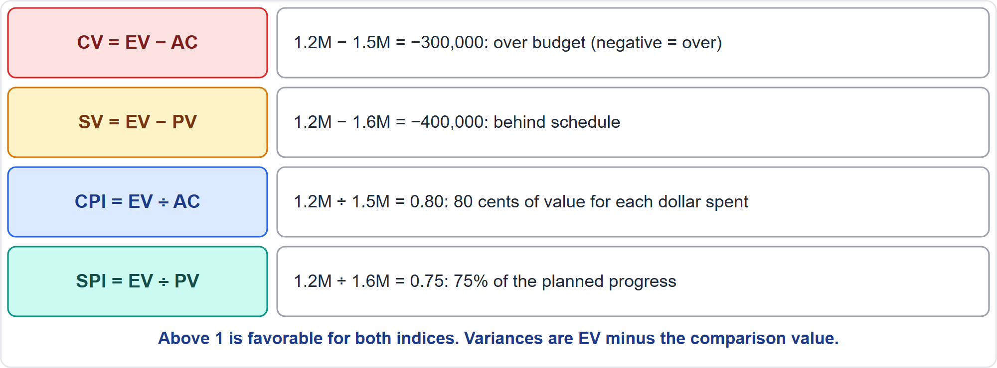
Variances and Indices
Part 1
CV, SV, CPI and SPI
EXAM TIP PMBOK 8 variances are EV minus the comparison value; above 1 is favorable for both indices.
PMP Exam Prep 2026 | PMBOK 8 and the New ECO
Module 13: Formula Workshop
14 / 43
Notes:
Four formulas. Cost variance is earned value minus actual cost: minus three hundred thousand, so we are over budget. Schedule variance is earned value minus planned value: minus four hundred thousand, so we are behind. The cost performance index is earned value divided by actual cost: zero point eight, or eighty cents of value per dollar spent. The schedule performance index is earned value divided by planned value: zero point seven five. For both indices, above one is favorable.

Slide 15
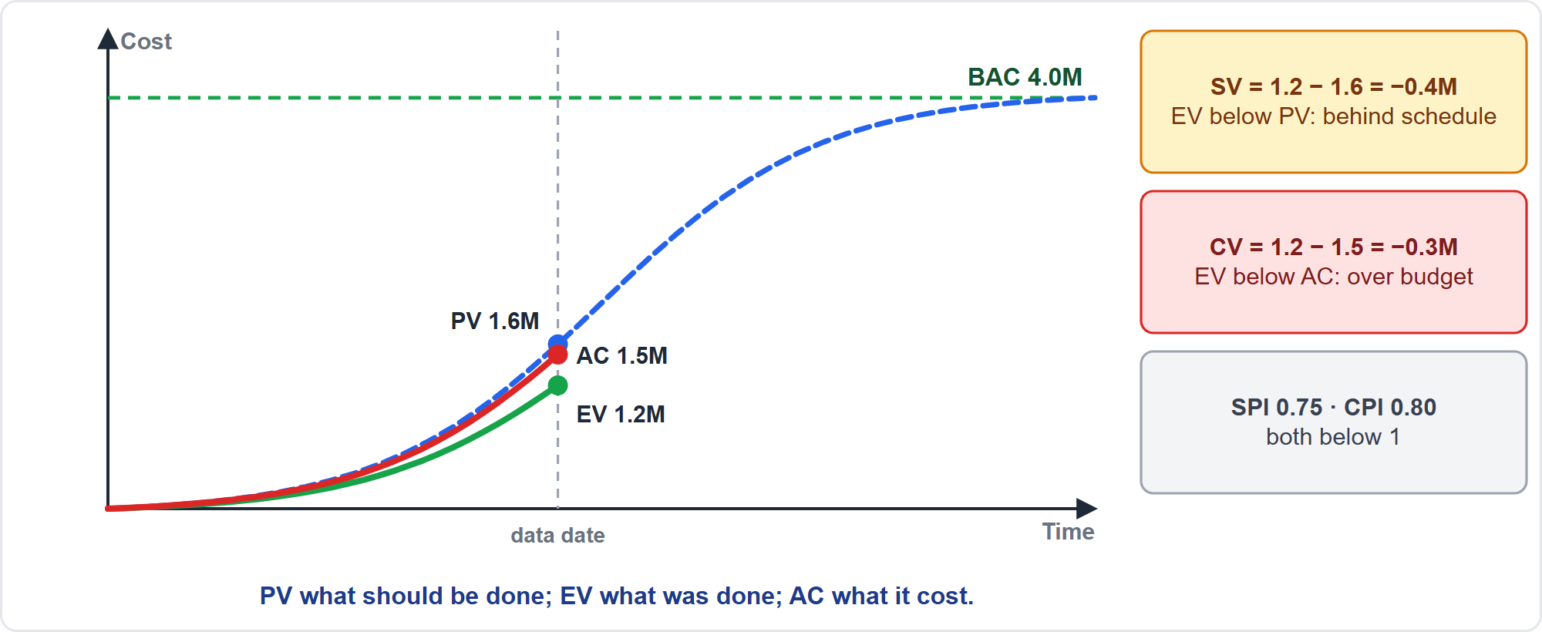
Earned Value Curves
Part 1
PV, EV and AC
EXAM TIP Check the critical path before reacting to a low SPI: non-critical work may not threaten the end date.
PMP Exam Prep 2026 | PMBOK 8 and the New ECO
Module 13: Formula Workshop
15 / 43
Notes:
Picture the three curves at the data date. Planned value is highest, at one point six million. Actual cost is next, one point five. Earned value is lowest, one point two. Earned value below planned value means behind schedule. Earned value below actual cost means over budget. Here both indices are below one. Before reacting to a low schedule index, check the critical path, because slow non-critical work may not threaten the end date.

Slide 16
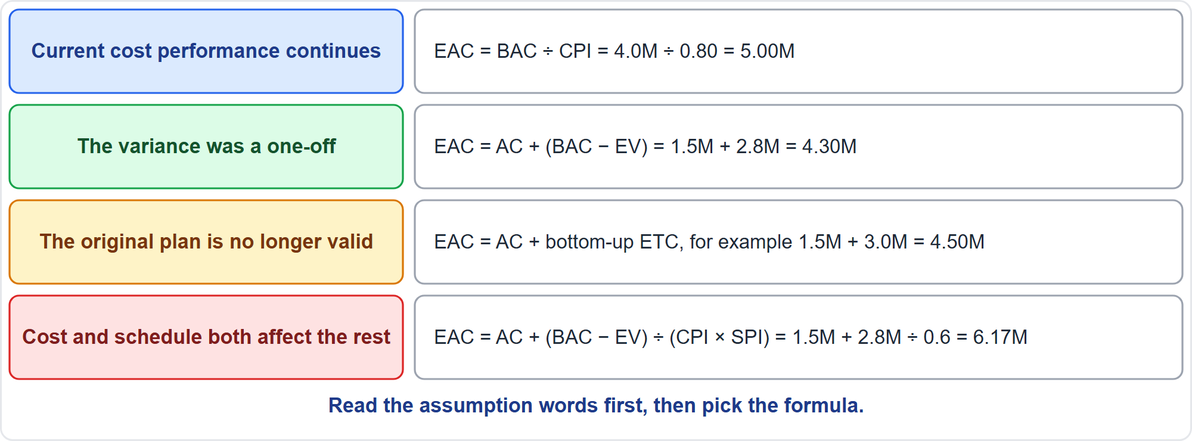
Choosing the EAC Formula
Part 1
Four formulas
EXAM TIP Read the assumption words before choosing the formula.
PMP Exam Prep 2026 | PMBOK 8 and the New ECO
Module 13: Formula Workshop
16 / 43
Notes:
Choose the estimate at completion by the assumption. If current cost performance will continue, divide the budget by the cost index: four million over zero point eight is five million. If the variance was a one-off, add the remaining planned work to the actual cost: one point five plus two point eight is four point three million. If the original plan is no longer valid, add a bottom-up estimate to complete to the actual cost. And if cost and schedule both affect the rest, divide the remaining work by cost index times schedule index: six point one seven million.

Slide 17
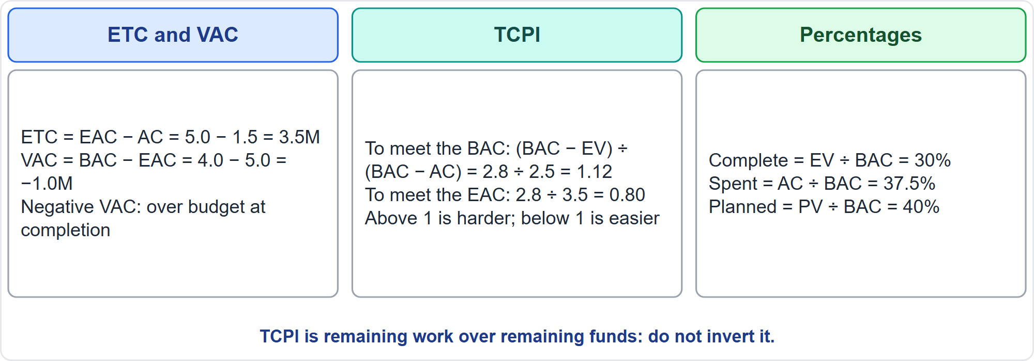
ETC, VAC and TCPI
Part 1
Forecast and efficiency needed
EXAM TIP A TCPI far above 1 signals that the BAC is probably out of reach: forecast with the EAC.
PMP Exam Prep 2026 | PMBOK 8 and the New ECO
Module 13: Formula Workshop
17 / 43
Notes:
Now forecast the rest. Estimate to complete is the estimate at completion minus actual cost: five minus one point five is three point five million. Variance at completion is the budget minus the estimate at completion: minus one million. The to-complete index is remaining work over remaining funds. To meet the budget, two point eight over two point five is one point one two: twelve percent more efficient. To meet the estimate, two point eight over three point five is zero point eight. Above one is harder. Percent complete is thirty, spent thirty-seven and a half, planned forty.

Slide 18
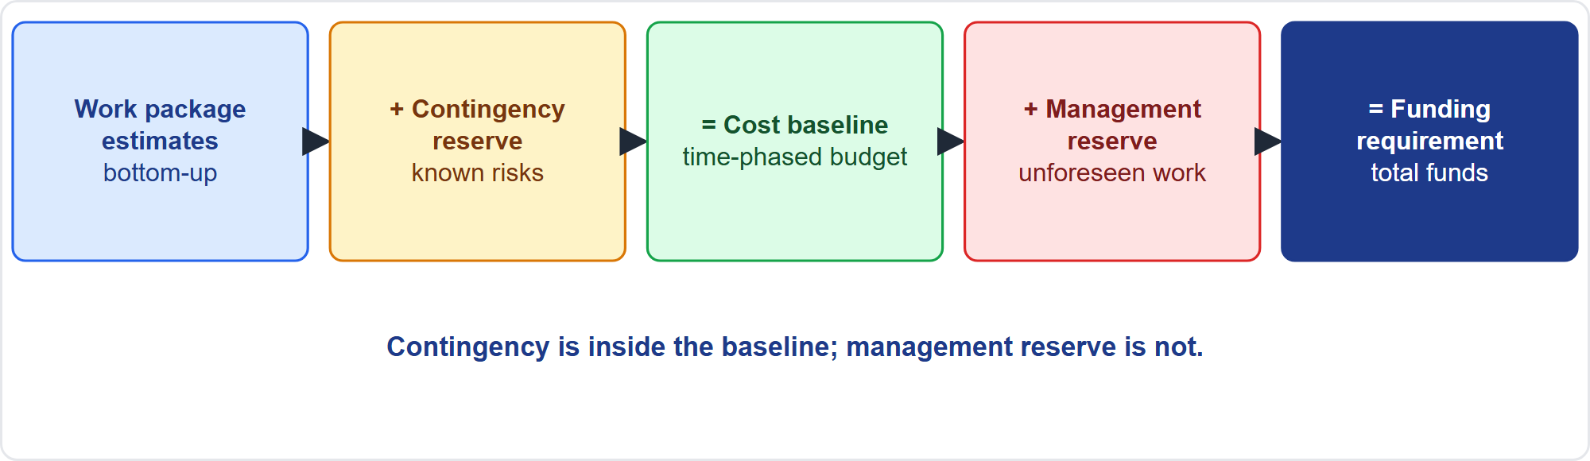
Reserves and the Cost Baseline
Part 1
Estimates to funding
EXAM TIP Contingency reserve is part of the cost baseline; management reserve is not.
PMP Exam Prep 2026 | PMBOK 8 and the New ECO
Module 13: Formula Workshop
18 / 43
Notes:
Here is how the budget builds up. Work package estimates, plus a contingency reserve for known risks, make the cost baseline. Add a management reserve for unforeseen in-scope work, and you get the funding requirement. Contingency is inside the baseline. Management reserve is outside it. That is why a draw on contingency does not change the baseline, but a release of management reserve needs the approved process.

Slide 19
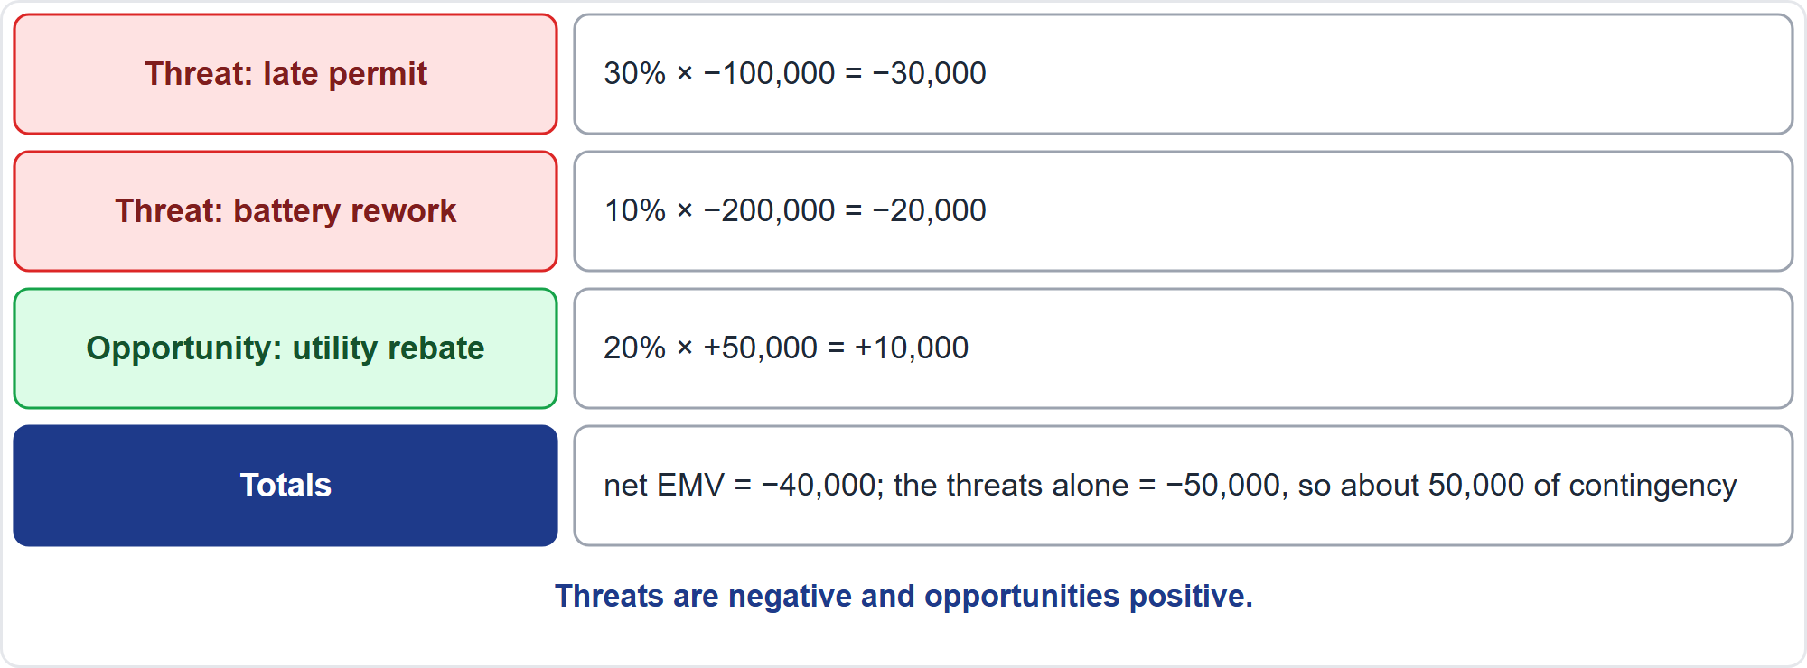
Expected Monetary Value
Part 1
Probability times impact
EXAM TIP Threats are negative and opportunities are positive; sum the threats you will fund to estimate contingency.
PMP Exam Prep 2026 | PMBOK 8 and the New ECO
Module 13: Formula Workshop
19 / 43
Notes:
Now risk. A qualitative score is probability times impact. Expected monetary value is probability times the impact in money. Threats are negative and opportunities are positive. A late permit with thirty percent probability and a hundred thousand impact is minus thirty thousand. Battery rework, ten percent of two hundred thousand, is minus twenty thousand. A utility rebate, twenty percent of fifty thousand, is plus ten thousand. The net is minus forty thousand, and the threats alone are minus fifty thousand, so about fifty thousand of contingency covers the threats.

Slide 20
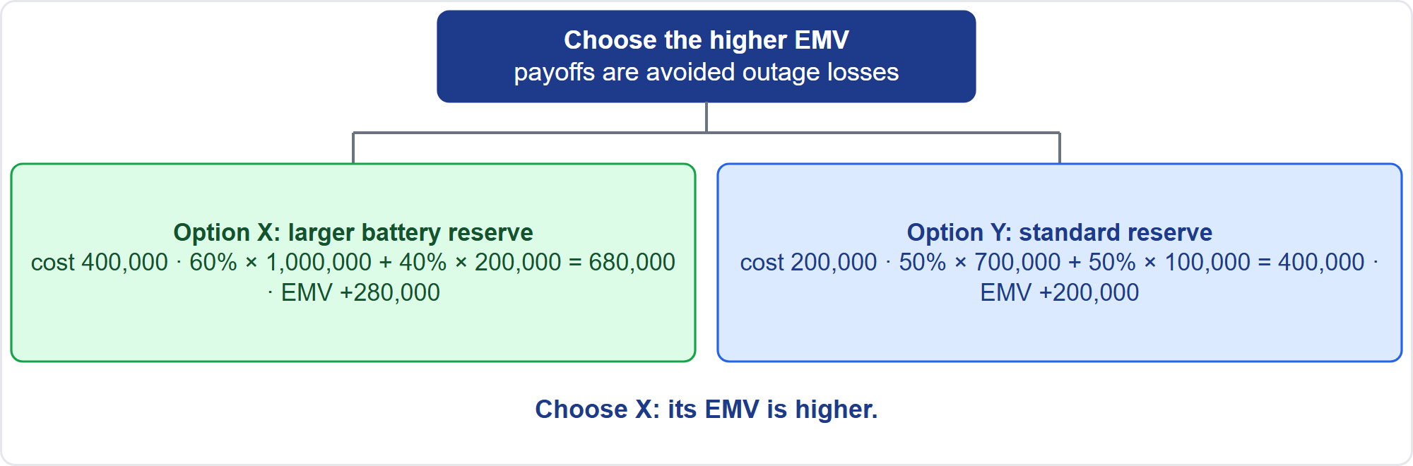
Decision Tree
Part 1
Two options
EXAM TIP For a decision tree, add each branch's probability times payoff, subtract the cost of the choice, and pick the higher EMV.
PMP Exam Prep 2026 | PMBOK 8 and the New ECO
Module 13: Formula Workshop
20 / 43
Notes:
A decision tree compares options. Option X, a larger battery reserve, costs four hundred thousand. It has a sixty percent chance of a million in avoided outage losses, and a forty percent chance of two hundred thousand. That is six hundred eighty thousand, less the cost: plus two hundred eighty thousand. Option Y, the standard reserve, costs two hundred thousand, with fifty percent of seven hundred thousand and fifty percent of a hundred thousand: plus two hundred thousand. Choose X, the higher expected value. PMBOK 8's own example picks a plant upgrade at forty-six million.

Slide 21
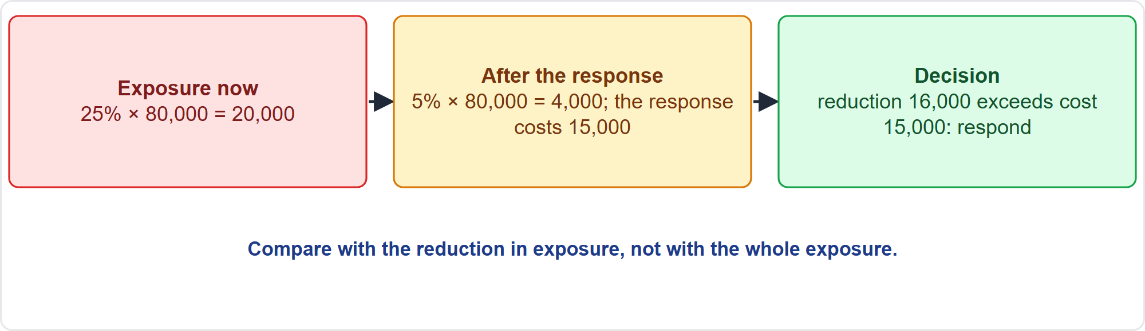
Is a Response Worth Buying?
Part 1
Compare cost with the reduction
EXAM TIP Respond only if the cost is less than the reduction in expected loss.
PMP Exam Prep 2026 | PMBOK 8 and the New ECO
Module 13: Formula Workshop
21 / 43
Notes:
Is a response worth buying? Suppose a threat has a twenty-five percent chance of an eighty thousand penalty: an exposure of twenty thousand. A response costing fifteen thousand cuts the probability to five percent, which leaves four thousand. The response removes sixteen thousand of exposure for fifteen thousand, so it is worth doing. Compare the cost with the reduction in exposure, not with the whole exposure. A contingency reserve can be a percentage, a fixed amount, or the result of a quantitative analysis.

Slide 22
Schedule, Cost and Risk Traps: What PMI Expects
Part 1
Read the assumption before choosing an EAC formula
Mind the direction: above 1 is favorable; negative variances are bad
TCPI is remaining work over remaining funds; do not invert it
EF = ES + D − 1 under the day-1 convention
The critical path is the longest path; it can change after crashing
EMV signs: threats negative, opportunities positive
EXAM TIP Round at the end; if the numbers do not give a unique answer, follow the stated assumption.
PMP Exam Prep 2026 | PMBOK 8 and the New ECO
Module 13: Formula Workshop
22 / 43
Notes:
The traps for schedule, cost and risk. Read the assumption before choosing an estimate-at-completion formula. Mind the direction: above one is favorable, and negative variances are bad. The to-complete index is remaining work over remaining funds, so do not invert it. Under the day-one convention, early finish is early start plus duration minus one. The critical path is the longest path, and it can change after crashing. Expected monetary value signs: threats are negative, opportunities positive. And round at the end, without mixing percent and decimal forms.

Slide 23
Part 1 Recap
Part 1
1
Method
2
Schedule
3
Earned value
ask, data, assumption, formula, check, choose
three-point, day-1 critical path, float, crashing
variances, indices, four EAC formulas, TCPI
4
Reserves
5
Risk
6
Traps
contingency inside the baseline
EMV, decision trees, worthwhile responses
direction, assumption, convention
PMP Exam Prep 2026 | PMBOK 8 and the New ECO
Module 13: Formula Workshop
23 / 43
Notes:
Let us recap Part 1. The method: find the ask, list the data, spot the assumption, write the formula, check, and choose. For schedule: the triangular and PERT averages, the day-one critical path, float, and crashing the cheapest critical activity first. For earned value: the variances, the indices, four estimate-at-completion formulas and the to-complete index. Contingency sits inside the baseline. For risk: expected monetary value, decision trees, and responses that are worth their cost. And the traps are direction, assumption and convention. In Part 2, we cover people, value, contracts, quality and flow metrics.

Slide 24
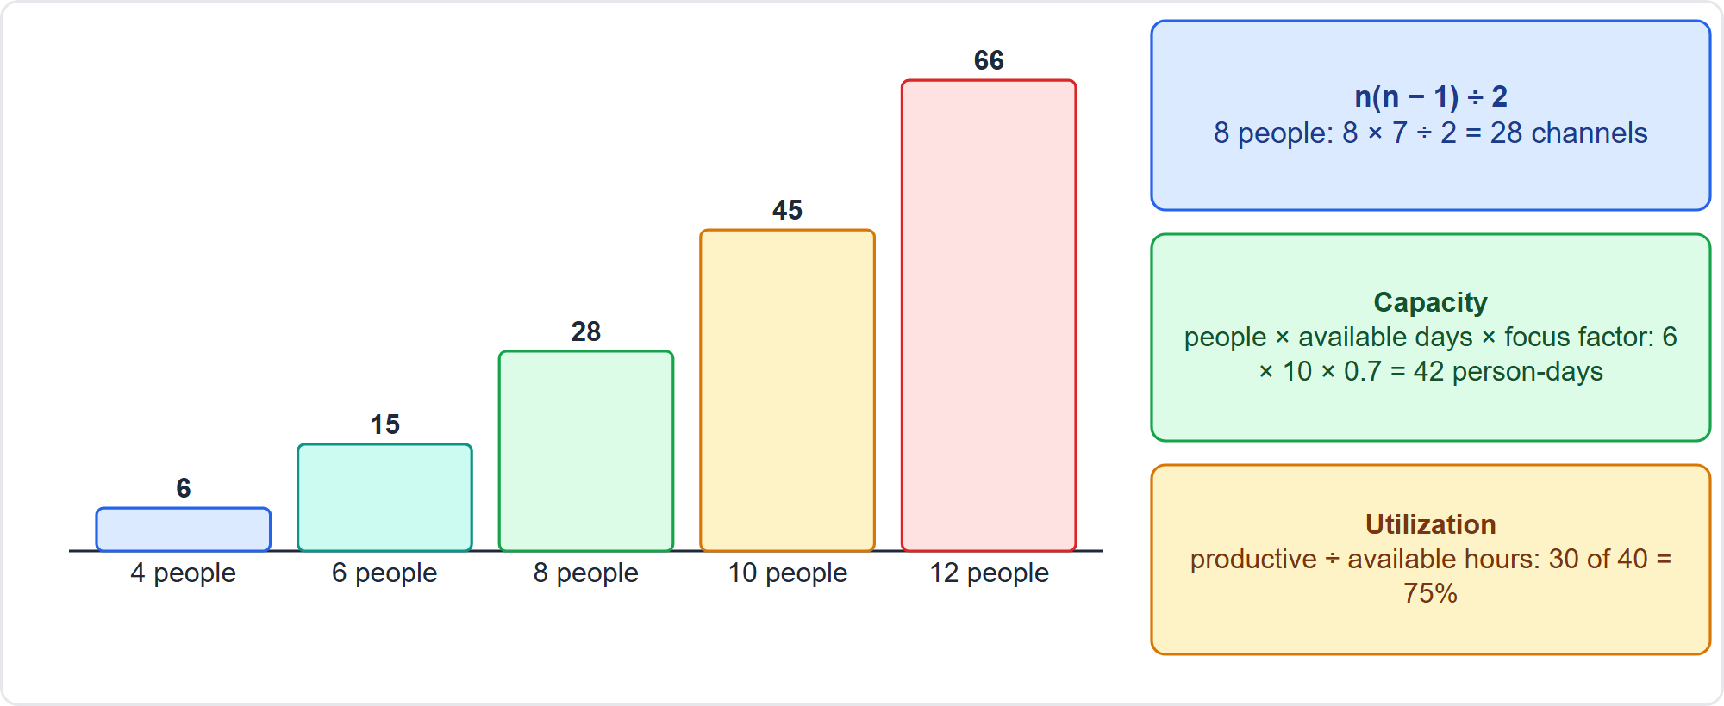
Communication Channels and Capacity
Part 2
Quadratic growth
EXAM TIP Channels grow quadratically: n(n − 1) ÷ 2, not n.
PMP Exam Prep 2026 | PMBOK 8 and the New ECO
Module 13: Formula Workshop
24 / 43
Notes:
Part 2 starts with people. Communication channels equal n times n minus one, divided by two. Four people have six channels, six have fifteen, eight have twenty-eight, ten have forty-five, and twelve have sixty-six. Channels grow quadratically, not in step with the headcount. Capacity is people times available days times a focus factor: six people for ten days at zero point seven is forty-two person-days. Utilization is productive hours over available hours: thirty of forty is seventy-five percent. PMBOK 8 asks you only to consider the number of channels. The formula, capacity and utilization are exam practice.

Slide 25
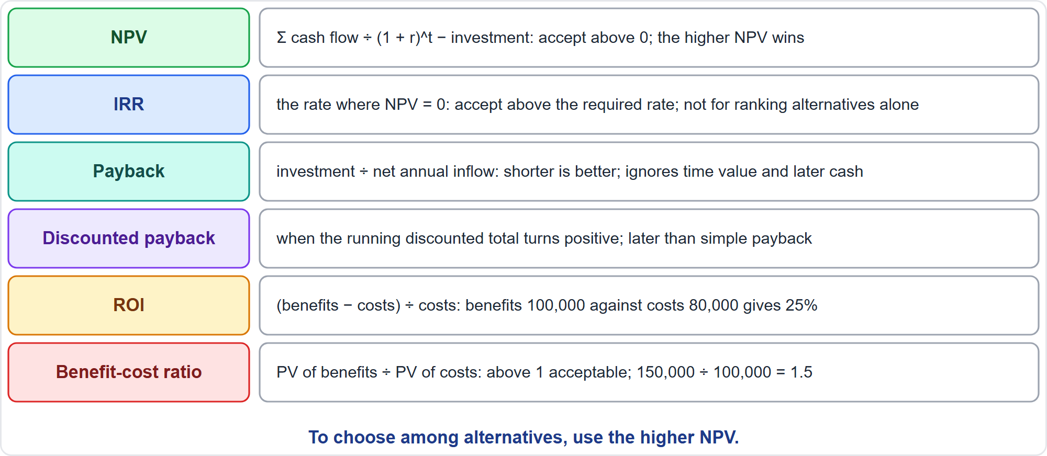
Value Measures: Decision Rules
Part 2
Six measures
EXAM TIP NPV beats IRR and payback for choosing among alternatives.
PMP Exam Prep 2026 | PMBOK 8 and the New ECO
Module 13: Formula Workshop
25 / 43
Notes:
PMBOK 8 names these value measures but prints no formulas, so the formulas are exam practice. Net present value is the sum of discounted cash flows minus the investment. Accept if it is above zero, and choose the higher one among alternatives. Internal rate of return is the rate where the NPV is zero. Payback is investment over net annual inflow. It ignores the time value of money and later cash. Discounted payback is later than simple payback. Return on investment is net benefit over cost. And a benefit-cost ratio above one is acceptable.

Slide 26
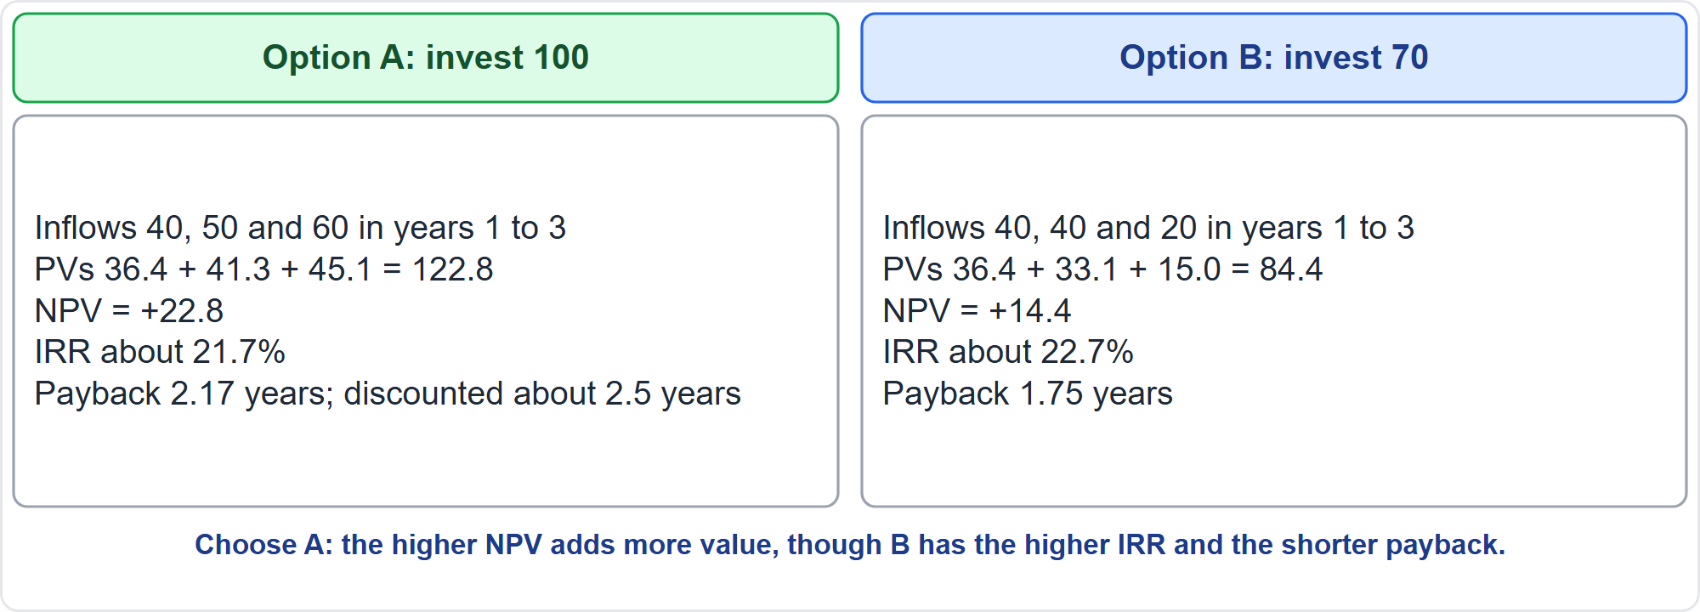
NPV Worked Example
Part 2
Option A against Option B
EXAM TIP Do not rank mutually exclusive projects by IRR or payback alone.
PMP Exam Prep 2026 | PMBOK 8 and the New ECO
Module 13: Formula Workshop
26 / 43
Notes:
Two battery add-on options, at a ten percent required rate, in thousands. Option A invests a hundred and returns forty, fifty and sixty. The present values add to one hundred twenty-two point eight, so the NPV is plus twenty-two point eight. The IRR is about twenty-one point seven percent, and the payback is two point one seven years. Option B invests seventy and returns forty, forty and twenty: NPV plus fourteen point four, IRR twenty-two point seven percent, payback one point seven five years. Choose A. It adds the most value, even though B has the higher IRR and the shorter payback.

Slide 27
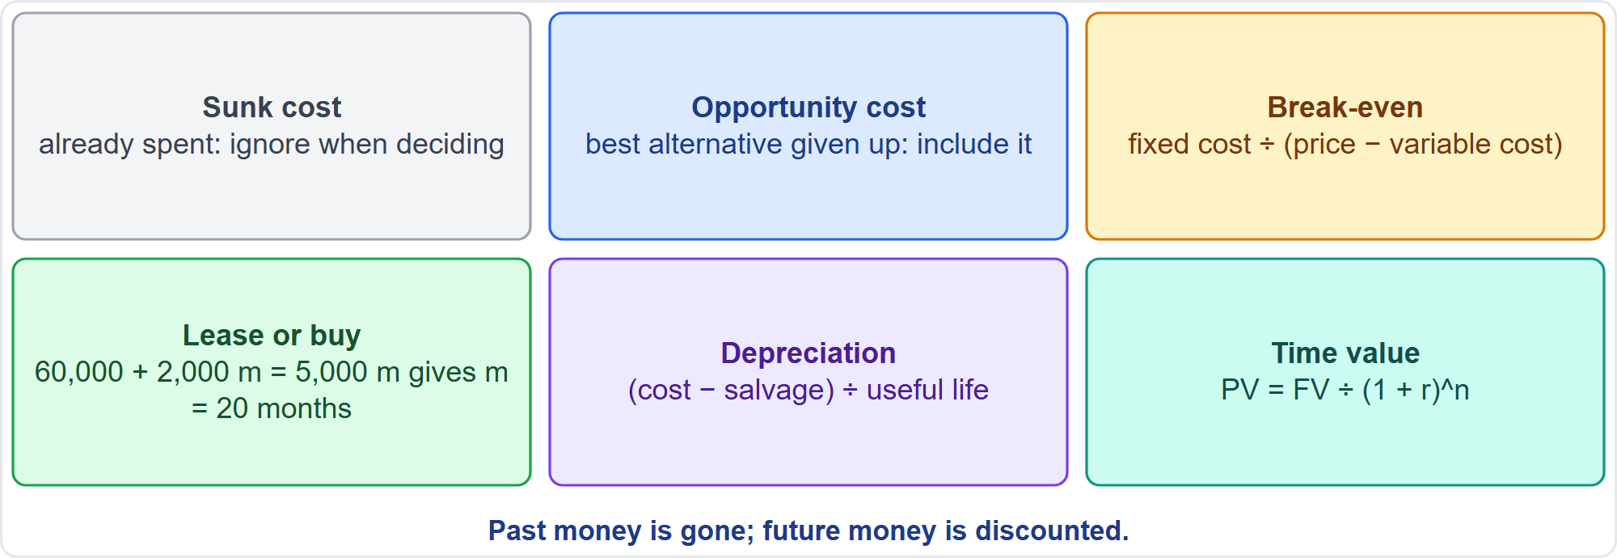
Costs That Matter and Costs That Do Not
Part 2
Six ideas
EXAM TIP Ignore sunk costs when deciding whether to continue; include the opportunity cost.
PMP Exam Prep 2026 | PMBOK 8 and the New ECO
Module 13: Formula Workshop
27 / 43
Notes:
Six related ideas. A sunk cost is already spent, so ignore it when deciding whether to continue. Opportunity cost is the best alternative given up, and it belongs in the choice. Break-even is fixed cost divided by price minus variable cost. For lease or buy, set the two costs equal: sixty thousand plus two thousand a month equals five thousand a month, so twenty months. Straight-line depreciation is cost minus salvage value, over useful life. And present value is future value divided by one plus the rate, to the power of the years. These ideas are exam practice, not PMBOK 8 formulas.

Slide 28
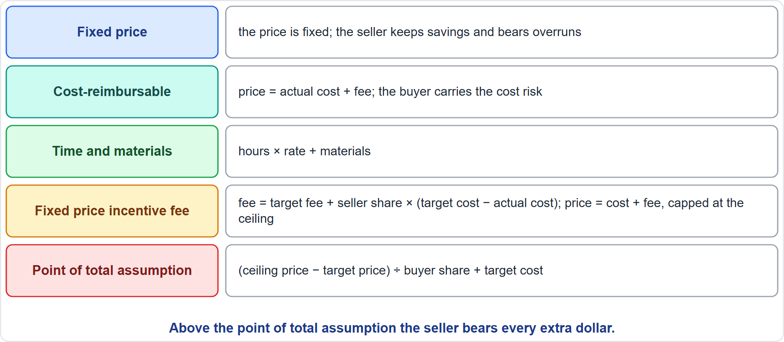
Contract Formulas
Part 2
Five formulas
EXAM TIP In a cost-reimbursable contract the buyer carries the cost risk; a fixed fee does not change with cost.
PMP Exam Prep 2026 | PMBOK 8 and the New ECO
Module 13: Formula Workshop
28 / 43
Notes:
Contract formulas. In a fixed-price contract, the price is fixed: the seller keeps savings and bears overruns. In a cost-reimbursable contract, the price is actual cost plus a fee, and the buyer carries the cost risk. Time and materials is hours times rate, plus materials. In a fixed price incentive fee contract, the seller's fee is the target fee plus the seller's share of the saving or overrun. The price is capped at the ceiling. The point of total assumption is the ceiling price minus the target price, divided by the buyer's share, plus the target cost. PMBOK 8 describes target-cost contracts that share savings and overruns, but these formulas are exam practice.

Slide 29
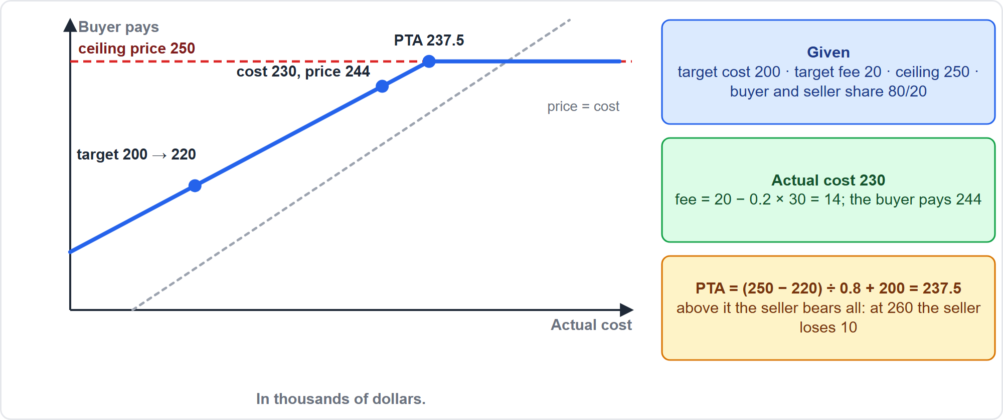
Target-Cost Worked Example
Part 2
Price against actual cost
EXAM TIP Above the point of total assumption the seller bears every extra dollar; the ceiling caps the buyer's price.
PMP Exam Prep 2026 | PMBOK 8 and the New ECO
Module 13: Formula Workshop
29 / 43
Notes:
Take a commissioning support contract. Target cost is two hundred thousand, target fee twenty thousand, ceiling two hundred fifty thousand, shared eighty-twenty between buyer and seller. At an actual cost of two hundred thirty thousand, the seller's fee is twenty thousand minus twenty percent of the thirty thousand overrun: fourteen thousand. The buyer pays two hundred forty-four thousand. The point of total assumption is two hundred fifty minus two hundred twenty, over zero point eight, plus two hundred: two hundred thirty-seven thousand five hundred. Above it, the seller bears every extra dollar.

Slide 30
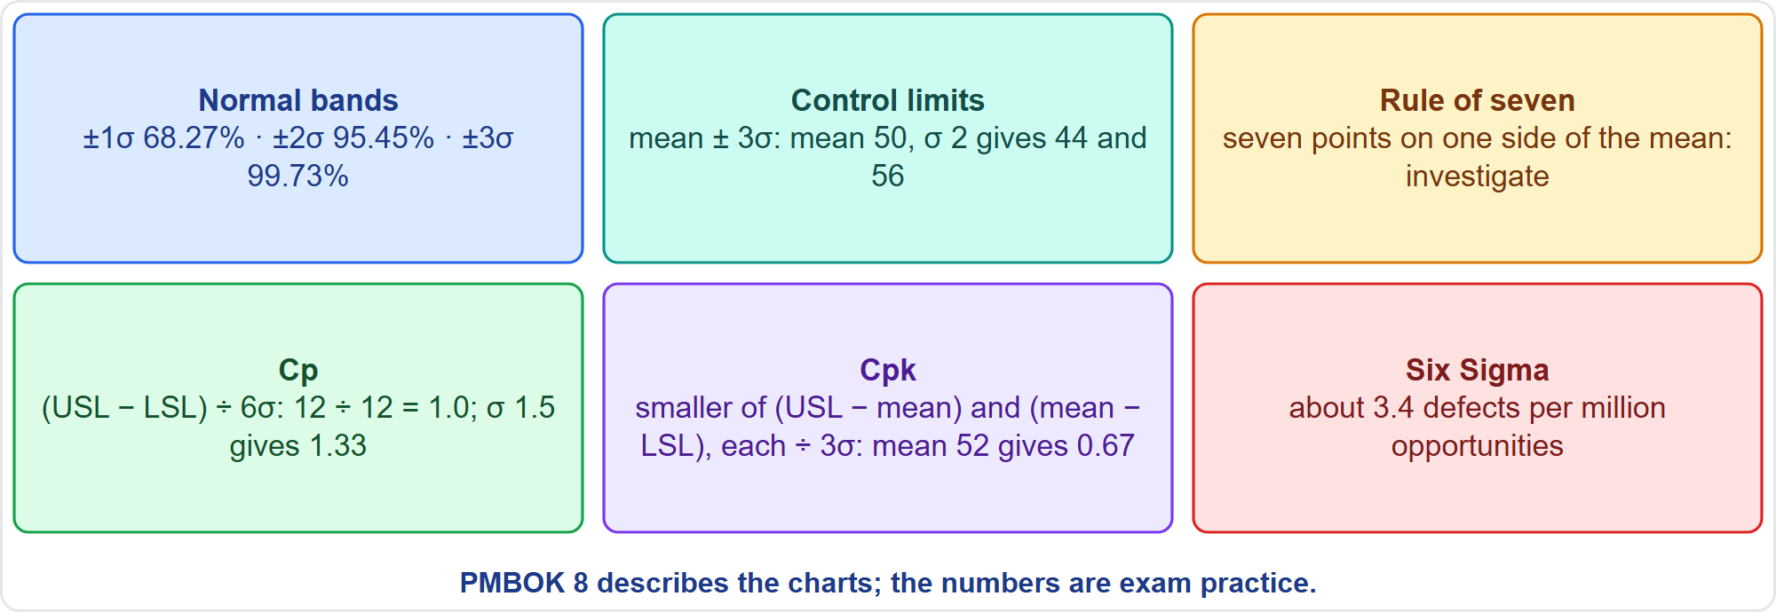
Quality Statistics
Part 2
Six rules
EXAM TIP PMBOK 8 describes control charts and limits but gives no numeric rules; these are exam practice.
PMP Exam Prep 2026 | PMBOK 8 and the New ECO
Module 13: Formula Workshop
30 / 43
Notes:
Quality statistics. About sixty-eight, ninety-five and ninety-nine point seven percent fall within one, two and three standard deviations. Control limits sit at the mean plus or minus three sigma: a mean of fifty and sigma of two give forty-four and fifty-six. The rule of seven says seven points on one side of the mean are a pattern to investigate. Cp is the specification range divided by six sigma: one point zero here. Cpk uses the nearer limit, so an off-center mean of fifty-two gives zero point six seven. Six Sigma means about three point four defects per million.

Slide 31
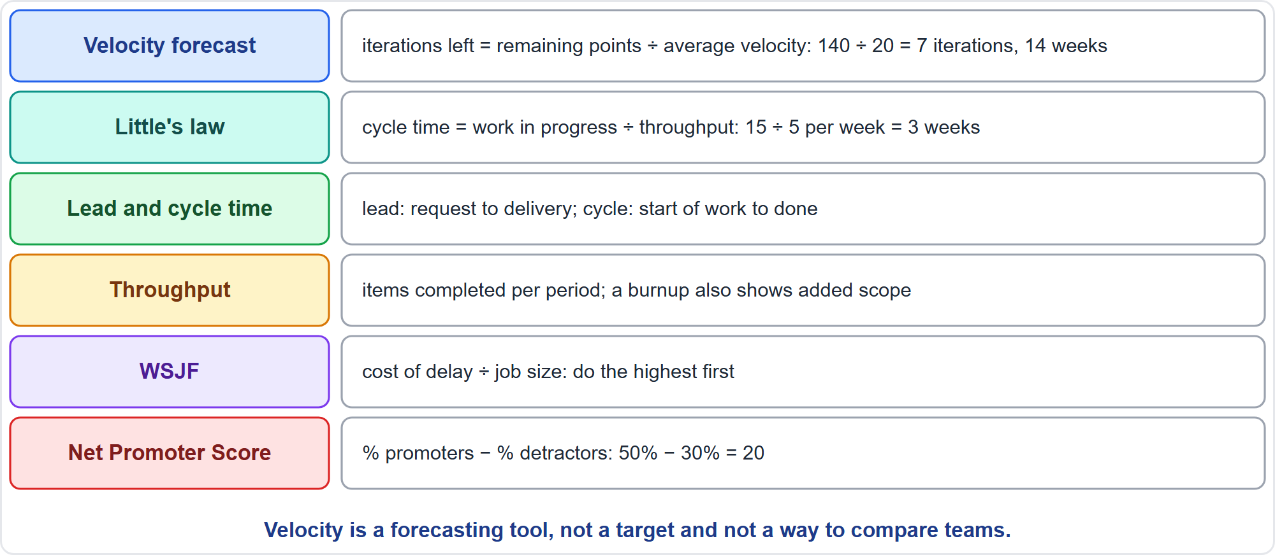
Agile Flow and Status Metrics
Part 2
Six metrics
EXAM TIP Velocity is a forecasting tool, not a performance target and not a way to compare teams.
PMP Exam Prep 2026 | PMBOK 8 and the New ECO
Module 13: Formula Workshop
31 / 43
Notes:
Agile and flow metrics. Forecast the finish by dividing remaining points by average velocity: a hundred and forty points at twenty a sprint is seven iterations, fourteen weeks. Little's law says cycle time equals work in progress divided by throughput: fifteen items in progress and five done a week gives three weeks. Lead time runs from request to delivery, cycle time from start to done. WSJF divides cost of delay by job size. And the Net Promoter Score is the percentage of promoters minus the percentage of detractors: fifty minus thirty is twenty. PMBOK 8 names the Net Promoter Score. The velocity forecast, Little's law, weighted shortest job first and the NPS formula are exam practice.

Slide 32
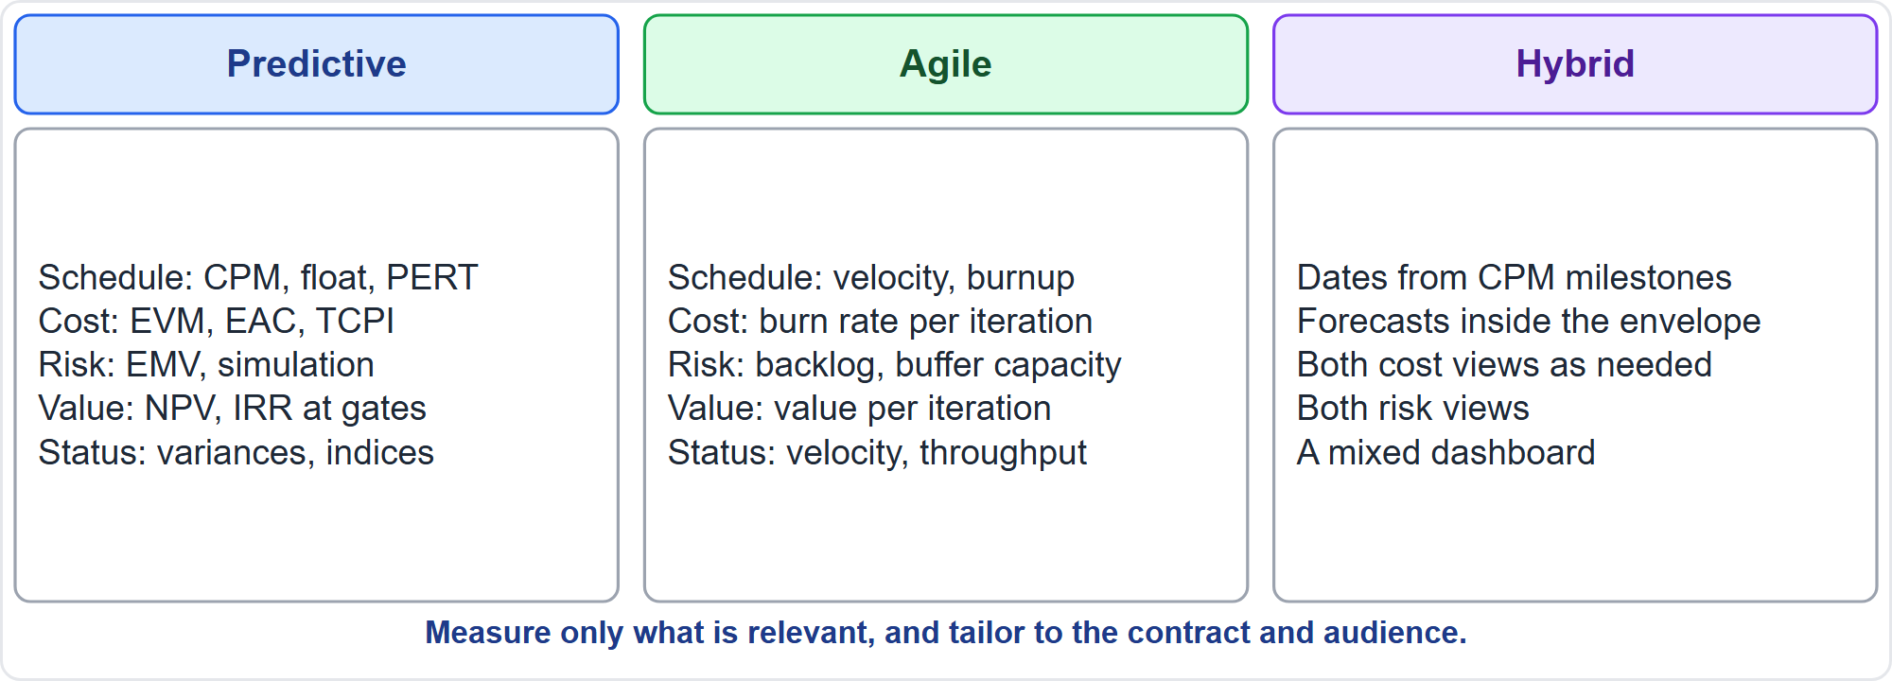
Formulas by Approach
Part 2
Predictive, agile, hybrid
EXAM TIP Tailor metrics to the approach, contract and audience, and measure only what is relevant.
PMP Exam Prep 2026 | PMBOK 8 and the New ECO
Module 13: Formula Workshop
32 / 43
Notes:
Formulas depend on the approach. Predictive work uses the critical path, float and PERT for schedule. It uses earned value for cost, expected monetary value and simulation for risk, and NPV at the gates. Agile work uses velocity forecasts and burnup for schedule, burn rate per iteration for cost, backlog items for risk, and value per iteration. Hybrid work uses milestone dates from the critical path, with iteration forecasts inside, and a mixed dashboard. A fixed-price government contract may mandate earned value, while a small agile team may need only velocity.

Slide 33
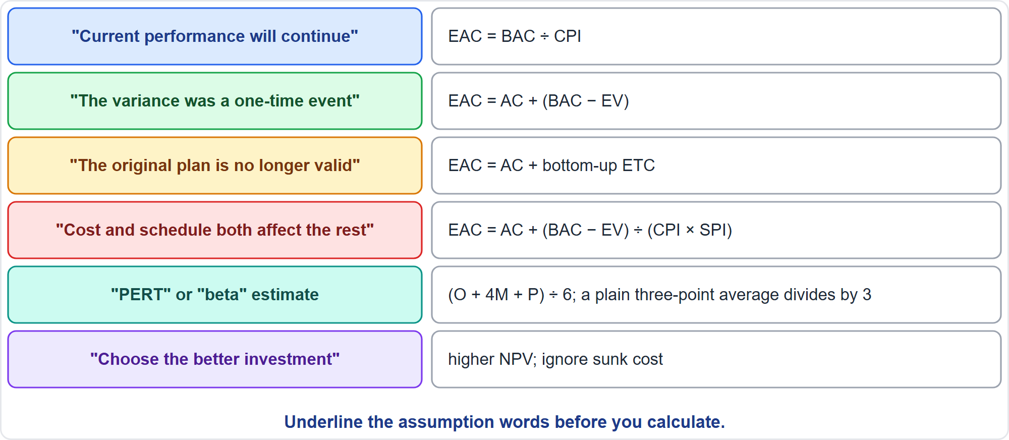
Which Formula? Cue Words
Part 2
Six cues
EXAM TIP The stem usually names the assumption; choose the formula that matches it.
PMP Exam Prep 2026 | PMBOK 8 and the New ECO
Module 13: Formula Workshop
33 / 43
Notes:
Look for cue words. Current performance will continue: budget over the cost index. The variance was a one-time event: actual cost plus the remaining budget. The original plan is no longer valid: actual cost plus a bottom-up estimate. Cost and schedule both affect the rest: divide by the product of both indices. A PERT or beta estimate: weight the most likely value by four and divide by six. And choose the better investment: the higher net present value, ignoring sunk cost.

Slide 34
Value, Contract and Flow Traps: What PMI Expects
Part 2
Control limits are mean ± 3σ; Cpk uses the nearer limit
Contingency is inside the baseline; management reserve is outside
Channels grow quadratically, not in step with the headcount
NPV beats IRR and payback; ignore sunk costs
Above the point of total assumption the seller bears every dollar
EV is work done in budget terms, not value delivered
EXAM TIP Round at the end and pick the closest option.
PMP Exam Prep 2026 | PMBOK 8 and the New ECO
Module 13: Formula Workshop
34 / 43
Notes:
The traps for formulas. Control limits sit at the mean plus or minus three sigma, and Cpk uses the nearer limit. Contingency is inside the baseline, and management reserve is outside it. Channels grow quadratically. Net present value beats internal rate of return and payback when choosing, and sunk costs are ignored. Above the point of total assumption, the seller bears every extra dollar. And earned value is work done in budget terms, not value delivered. Round at the end, and pick the closest option.

Slide 35
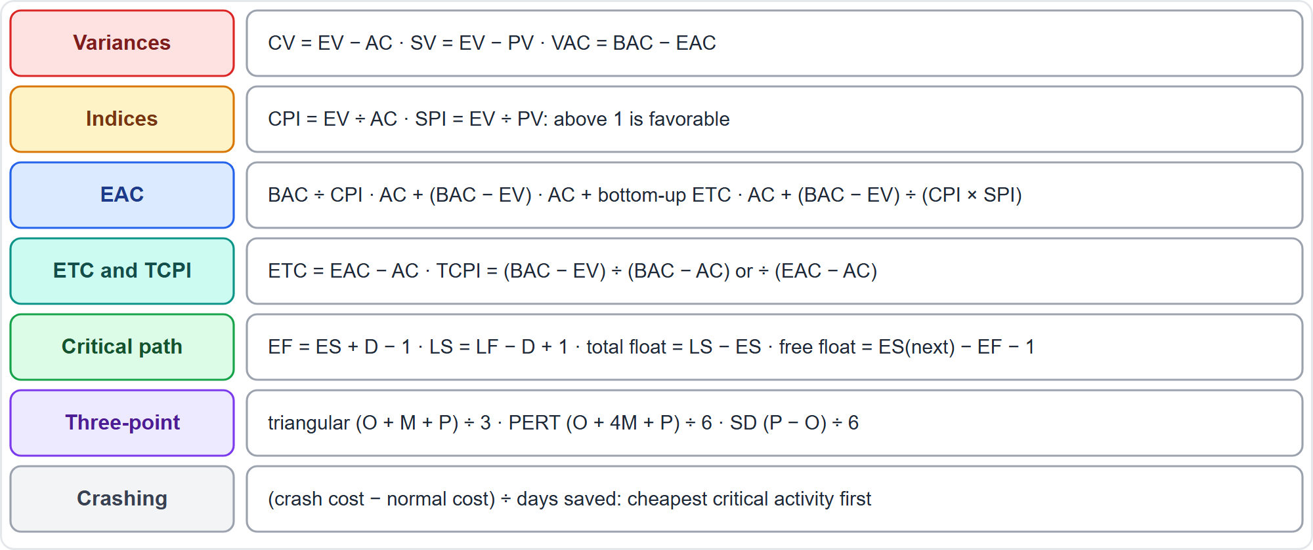
Quick Reference: Schedule and Cost
Part 2
Seven rows
EXAM TIP Write the formula first; the arithmetic is the easy part.
PMP Exam Prep 2026 | PMBOK 8 and the New ECO
Module 13: Formula Workshop
35 / 43
Notes:
Here is a quick reference for schedule and cost. Variances: CV is EV minus AC, SV is EV minus PV, and VAC is BAC minus EAC. Indices: CPI is EV over AC, SPI is EV over PV. Four EAC formulas. ETC is EAC minus AC, and TCPI has two forms. Critical path: early finish equals early start plus duration minus one, and late start equals late finish minus duration plus one. Three-point: triangular divides by three, PERT weights the most likely by four and divides by six. And crashing: crash cost minus normal cost, over days saved.

Slide 36
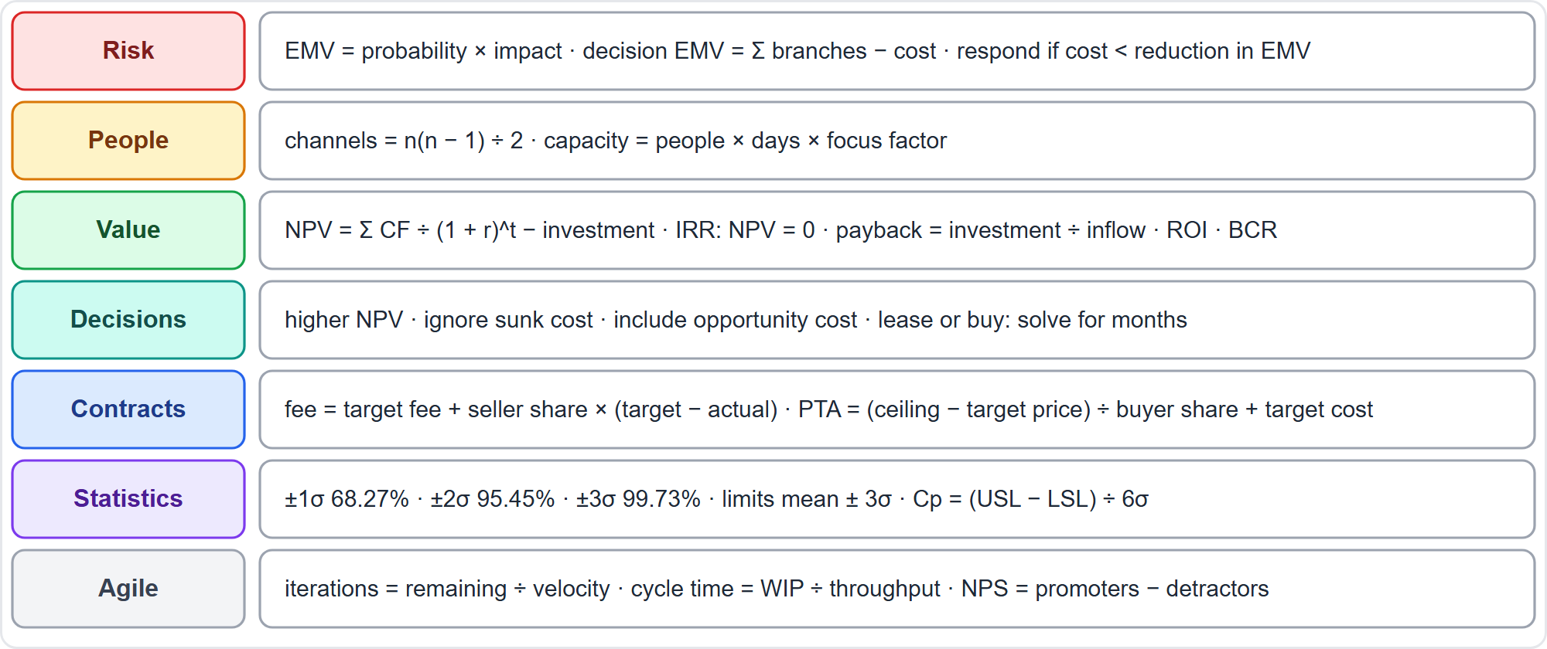
Quick Reference: Risk, Value, Contracts and Flow
Part 2
Seven rows
EXAM TIP Know the decision rules, not only the formulas.
PMP Exam Prep 2026 | PMBOK 8 and the New ECO
Module 13: Formula Workshop
36 / 43
Notes:
Quick reference for the rest. Risk: EMV is probability times impact, a decision tree sums the branches less the cost, and respond only if the cost is below the reduction. People: channels are n times n minus one over two, and capacity is people times days times the focus factor. Value: NPV, IRR, payback, ROI and the benefit-cost ratio. Decisions: the higher NPV, ignoring sunk cost. Contracts: the fee formula and the point of total assumption. Statistics: the bands, the control limits and Cp. Agile: forecast iterations, Little's law and the Net Promoter Score.

Slide 37
Module Recap
Part 2
1
Method
2
Schedule and cost
3
Risk
assumption first, then the formula
critical path, earned value, four EACs, TCPI
EMV, decision trees, worthwhile responses
4
Value
5
Contracts and flow
6
Next
the higher NPV wins; ignore sunk costs
point of total assumption, velocity, Little's law
five practice questions
PMP Exam Prep 2026 | PMBOK 8 and the New ECO
Module 13: Formula Workshop
37 / 43
Notes:
Let us recap the module. The method: read the assumption first, then write the formula. Schedule and cost: the critical path, earned value, four estimate-at-completion formulas and the to-complete index. Risk: expected monetary value, decision trees, and responses that are worth their cost. Value: the higher net present value wins, and sunk costs are ignored. Contracts and flow: the point of total assumption, velocity forecasts and Little's law. Now it is time to test yourself. Five questions follow. For each one, pause the video, choose your answer, and then listen to the explanation.

Slide 38
Practice Question 1
Part 2
Q1
A package has a budget at completion of 600,000. At the status date, earned value is 240,000 and actual cost is 300,000. The overrun came from a one-time equipment failure, and the remaining work will go as planned. What is the estimate at completion?
A
750,000, the budget divided by the cost performance index of the package
B
660,000, the actual cost plus all of the remaining planned work
C
600,000, because the budget at completion does not change after an overrun
D
360,000, the budget of the work that still remains to be done
PMP Exam Prep 2026 | PMBOK 8 and the New ECO
Module 13: Formula Workshop
38 / 43
Notes:
Question one. A package has a budget at completion of 600,000. At the status date, earned value is 240,000 and actual cost is 300,000. The overrun came from a one-time equipment failure, and the remaining work will go as planned. What is the estimate at completion? The four options are on the screen. Choose your answer. [PAUSE 15] The answer is B. The variance was a one-off, so future work goes at the planned rate. EAC equals AC plus BAC minus EV. That is 300,000 plus 360,000, or 660,000. Dividing by CPI assumes the overrun continues. 600,000 ignores the overrun. 360,000 is only the remaining work.

Slide 39
Practice Question 2
Part 2
Q2
Task P takes 3 days and precedes Q, which takes 5 days, and R, which takes 2 days. Both Q and R precede S, which takes 4 days. Using the day-1 convention, what is the total float of R?
A
0 days, because R is on the critical path of this network
B
2 days, which is the duration of R in this network
C
4 days, found by subtracting the finish of R from the start of S
D
3 days, found from the late start minus the early start
PMP Exam Prep 2026 | PMBOK 8 and the New ECO
Module 13: Formula Workshop
39 / 43
Notes:
Question two. Task P takes 3 days and precedes Q, which takes 5 days, and R, which takes 2 days. Both Q and R precede S, which takes 4 days. Using the day-1 convention, what is the total float of R? The four options are on the screen. Choose your answer. [PAUSE 15] The answer is D. R starts on day 4 at the earliest, and S starts on day 9. So R's late finish is day 8 and its late start is day 7. Seven minus four is three. R is not critical because Q is longer. 2 is its duration. 4 forgets the minus one in the day-1 convention.

Slide 40
Practice Question 3
Part 2
Q3
Option 1 costs 20,000 and has a 50% chance of returning 60,000 and a 50% chance of returning 10,000. Option 2 costs 10,000 and has a 70% chance of returning 25,000 and a 30% chance of returning 5,000. Which is better by EMV?
A
Option 1, with an EMV of +15,000 against only +9,000 for Option 2
B
Option 2, because it needs the smaller investment at the start
C
Option 1, with an EMV of +35,000, because the investment is not counted
D
Both are equal, because each one has a positive expected return
PMP Exam Prep 2026 | PMBOK 8 and the New ECO
Module 13: Formula Workshop
40 / 43
Notes:
Question three. Option 1 costs 20,000 and has a 50% chance of returning 60,000 and a 50% chance of returning 10,000. Option 2 costs 10,000 and has a 70% chance of returning 25,000 and a 30% chance of returning 5,000. Which is better by EMV? The four options are on the screen. Choose your answer. [PAUSE 15] The answer is A. Option 1 is 30,000 plus 5,000 minus 20,000, or +15,000. Option 2 is 17,500 plus 1,500 minus 10,000, or +9,000. The higher EMV wins. A smaller investment does not decide it. 35,000 ignores the cost. Positive EMVs are not equal.

Slide 41
Practice Question 4
Part 2
Q4
A project invests 80,000 and returns 44,000 at the end of each of the next two years. The required rate is 10%. What is the NPV, and what should the team do?
A
+8,000, so accept because the returns exceed the investment
B
Zero, so the project only earns exactly the required return
C
−3,636, so reject because the discounted returns fall short
D
+76,364, so accept because the present value is positive
PMP Exam Prep 2026 | PMBOK 8 and the New ECO
Module 13: Formula Workshop
41 / 43
Notes:
Question four. A project invests 80,000 and returns 44,000 at the end of each of the next two years. The required rate is 10%. What is the NPV, and what should the team do? The four options are on the screen. Choose your answer. [PAUSE 15] The answer is C. The present values are 40,000 and 36,364, a total of 76,364. That is below 80,000, so the NPV is minus 3,636, and the project should be rejected. 8,000 ignores discounting. Zero is wrong arithmetic. 76,364 is the present value, not the NPV.

Slide 42
Practice Question 5
Part 2
Q5
A project has a budget at completion of 400,000, earned value of 100,000 and actual cost of 150,000. The team wants to finish within the original budget. What is the TCPI, and what does it mean?
A
0.67, so the team is working at two-thirds of the planned efficiency
B
1.20, so the remaining work must be done 20% more efficiently than planned
C
0.83, so the remaining work can be done a little less efficiently than planned
D
1.50, so the team has overspent by half of the earned value so far
PMP Exam Prep 2026 | PMBOK 8 and the New ECO
Module 13: Formula Workshop
42 / 43
Notes:
Question five. A project has a budget at completion of 400,000, earned value of 100,000 and actual cost of 150,000. The team wants to finish within the original budget. What is the TCPI, and what does it mean? The four options are on the screen. Choose your answer. [PAUSE 15] The answer is B. TCPI to meet the BAC is 300,000 divided by 250,000, or 1.20, so the remaining work must be done 20% more efficiently. 0.67 is the CPI. 0.83 inverts the ratio. 1.50 divides AC by EV, which is not the TCPI.

Slide 43
Answers at a Glance
Part 2
Question | Answer | Why
Q1 | B | A one-off variance: AC + (BAC − EV)
Q2 | D | Total float is LS minus ES: 7 − 4 = 3
Q3 | A | Pick the higher EMV after deducting the cost
Q4 | C | Discount the cash flows, then subtract the investment
Q5 | B | TCPI = remaining work ÷ remaining funds
PMP Exam Prep 2026 | PMBOK 8 and the New ECO
Module 13: Formula Workshop
43 / 43
Notes:
Here are all five answers together. Question one: B. A one-off variance means actual cost plus the remaining planned work. Question two: D. Total float is late start minus early start: seven minus four is three. Question three: A. Pick the higher expected monetary value, after deducting the cost. Question four: C. Discount the cash flows, then subtract the investment. Question five: B. The to-complete index is remaining work divided by remaining funds. That completes Module 13. Next, Module 14 covers the question types, the interactive formats, time management and the final steps of preparation. See you there.

