Slide 1
Module 14: Exam Formats, Visual Practice and Final Strategy
Part 1 of 2: Reading questions and formats
All domains · case, graphic and interactive items
PMP Exam Prep 2026: PMBOK 8 and the New ECO
Module 14 · Part 1
Notes:
Welcome to Module 14, the last module. You know the content. Now we turn that knowledge into exam technique. In Part 1, we cover the question formats and how to read cases, graphics and scenarios. In Part 2, we practice interactive items, and finish with your study plan and exam day.

Slide 2
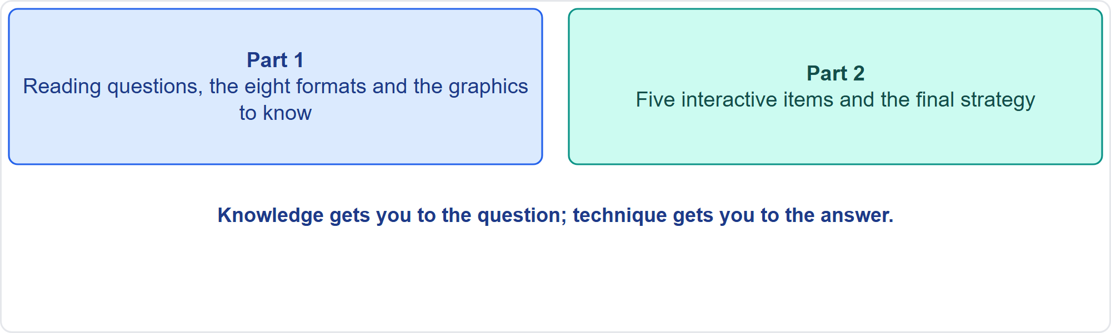
What This Module Adds
Part 1
Two parts
EXAM TIP Module 0 introduced the exam; this module turns it into technique.
PMP Exam Prep 2026 | PMBOK 8 and the New ECO
Module 14
2 / 44
Notes:
Module 0 introduced the exam. This module adds technique. Part 1 teaches you to read questions, handle all eight formats, and read the graphics. Part 2 gives you five items in the interactive formats, and the final strategy. Knowledge gets you to the question. Technique gets you to the answer.

Slide 3
What You Will Learn
Part 1
Know the eight question formats and how each is answered
Read a case and a graphic the efficient way
Spot the four distractor types in real options
Recall the best-answer patterns for fourteen situations
Practice five interactive-format items
Plan your last weeks and exam day
PMP Exam Prep 2026 | PMBOK 8 and the New ECO
Module 14
3 / 44
Notes:
By the end of this module you will be able to do six things. Know the eight question formats and how each is answered. Read a case and a graphic the efficient way. Spot the four distractor types in real options. Recall the best-answer patterns for fourteen situations. Practice five interactive-format items. And plan your last weeks and your exam day.

Slide 4
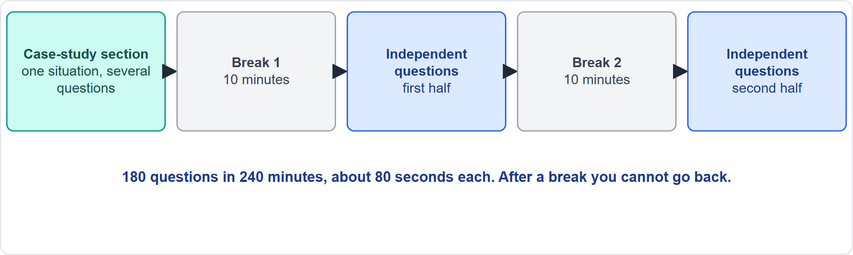
How the Exam Is Laid Out
Part 1
Five blocks
EXAM TIP Flag and revisit items only within the section you are in; a break closes the section behind you.
PMP Exam Prep 2026 | PMBOK 8 and the New ECO
Module 14
4 / 44
Notes:
Here is the layout. The exam opens with a case-study section, then the independent questions, with two ten-minute breaks. There are one hundred eighty questions in two hundred forty minutes, about eighty seconds each. Ten of the questions are unscored pretest items. Once you start a break, you cannot return to the earlier section. So flag and revisit items only inside the section you are in, and finish your review before each break.

Slide 5
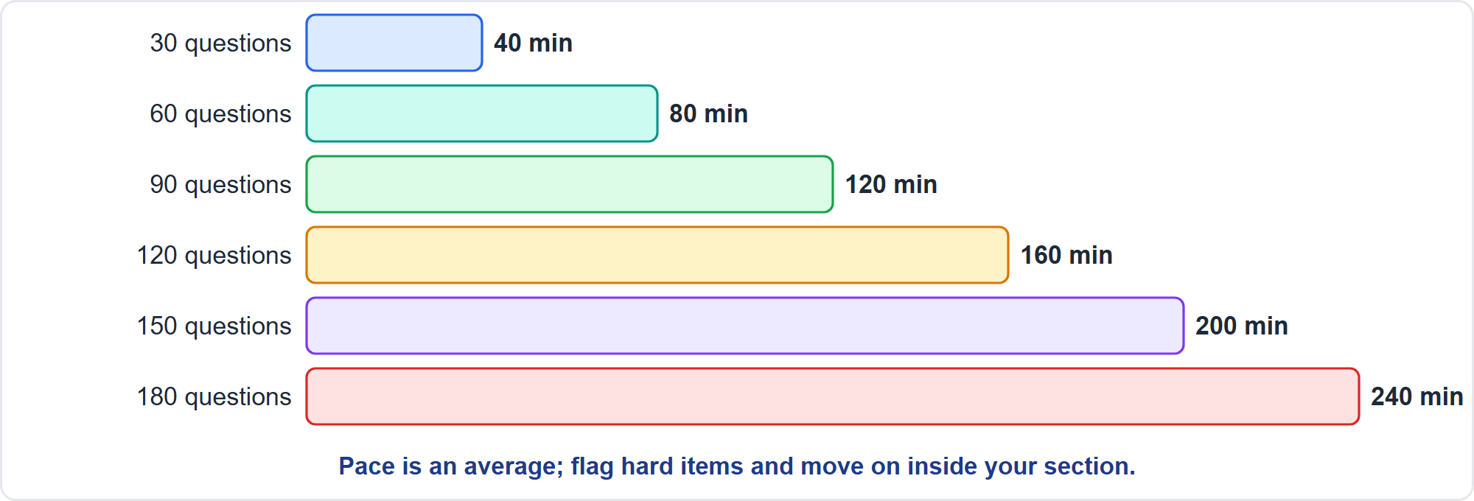
Pacing Checkpoints
Part 1
Minutes at 80 seconds a question
EXAM TIP Pace is an average: spend less on easy items so that the case and calculation items get more.
PMP Exam Prep 2026 | PMBOK 8 and the New ECO
Module 14
5 / 44
Notes:
Use checkpoints. At eighty seconds a question, thirty questions take about forty minutes. Sixty take eighty. Ninety take a hundred twenty. And a hundred twenty take a hundred sixty. The full one hundred eighty questions use the two hundred forty minutes. Pace is an average. Spend less on easy items so that case and calculation items can get more. And if you are behind at a checkpoint, flag the hard items and move on, inside your section.

Slide 6
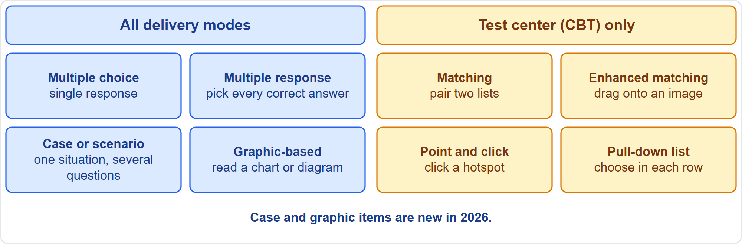
Eight Question Formats
Part 1
Four everywhere, four at a test center
EXAM TIP Case and graphic items are new in 2026; the other four extras exist only in computer-based testing at a test center.
PMP Exam Prep 2026 | PMBOK 8 and the New ECO
Module 14
6 / 44
Notes:
The outline lists eight question types. Four are offered in every delivery mode: multiple choice with a single response, multiple response, case or scenario, and graphic-based. Four exist only in computer-based testing at a test center: matching, enhanced matching, point and click, and pull-down lists. Case and graphic items are new in twenty twenty-six. Be ready for all eight, because you may not know which ones you will get.

Slide 7
Multiple Choice and Multiple Response
Part 1
Single response: pick the one best answer
Multiple response: pick every correct answer
Judge each option on its own against the stem
Do not stop at the first correct option
Read how many answers are asked for
Wrong options usually follow a distractor type
EXAM TIP In a multiple-response item, an option can be correct even if another one looks more appealing.
PMP Exam Prep 2026 | PMBOK 8 and the New ECO
Module 14
7 / 44
Notes:
Multiple choice with a single response asks for the one best answer. Use the patterns in this module. Multiple response asks for every correct answer. Judge each option on its own against the stem, and do not stop at the first correct one. Read how many answers are asked for. And remember that wrong options are rarely nonsense: they usually follow one of the distractor types.

Slide 8
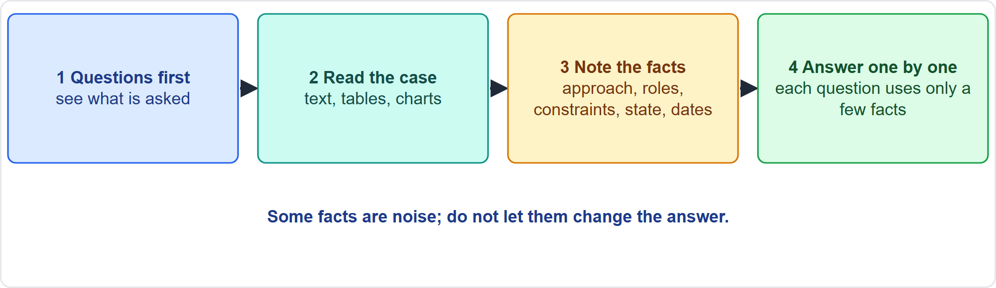
Case or Scenario Questions
Part 1
Four steps
EXAM TIP Some facts are noise; each question usually depends on only a few of them.
PMP Exam Prep 2026 | PMBOK 8 and the New ECO
Module 14
8 / 44
Notes:
A case gives one situation, in text, tables or charts, followed by a series of questions. Read the questions first, so you know what to look for. Then read the case, and note the facts that matter: the approach, the roles, the constraints, the state and the dates. Then answer each question on its own. Some facts are noise, and each question usually depends on only a few of them.

Slide 9
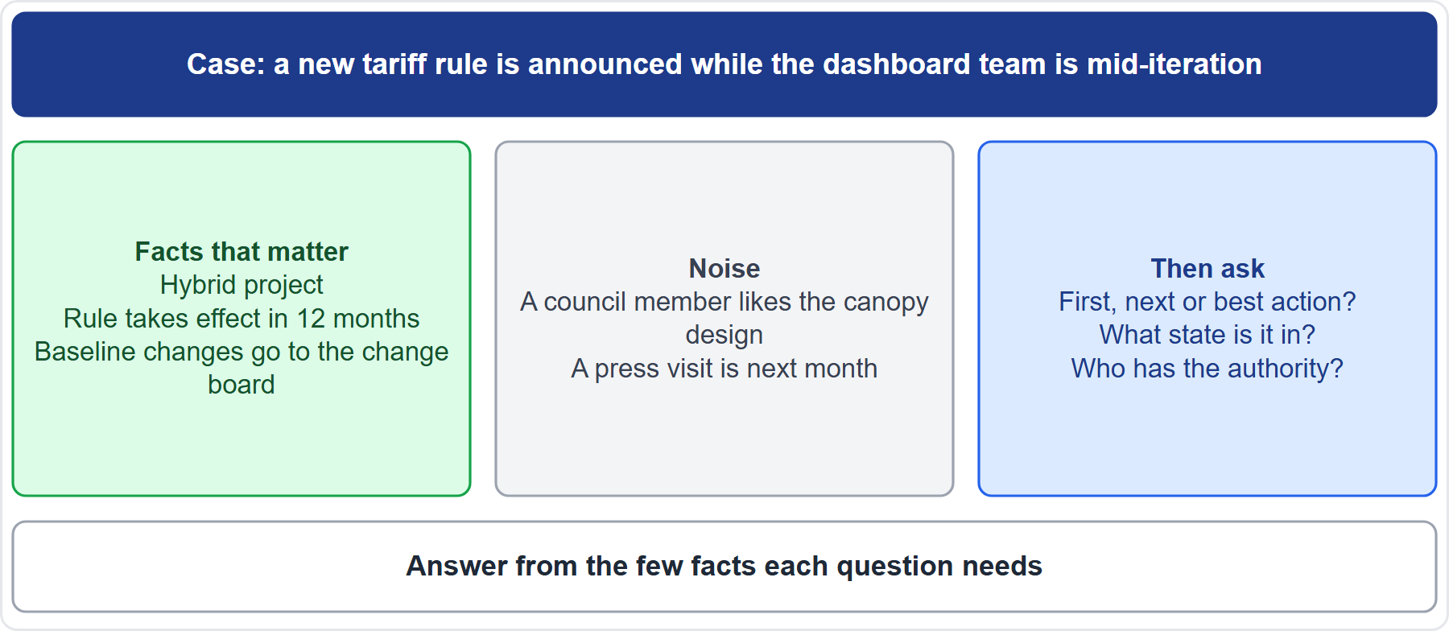
Case Check-In: Reading a Case
Part 1
CASE CHECK-IN · Sunrise Campus Microgrid
Facts that matter: hybrid project; change board; effective date
Noise: a compliment on the design; a press visit
PMP Exam Prep 2026 | PMBOK 8 and the New ECO
Module 14
9 / 44
Notes:
Try it on our microgrid. A new tariff rule is announced while the dashboard team is mid-iteration. The facts that matter: it is a hybrid project, the rule takes effect in twelve months, and baseline changes go to the change board. The noise: a council member likes the canopy design, and a press visit is next month. Then ask: is the question about the first, next or best action? What state is it in? And who has the authority?

Slide 10
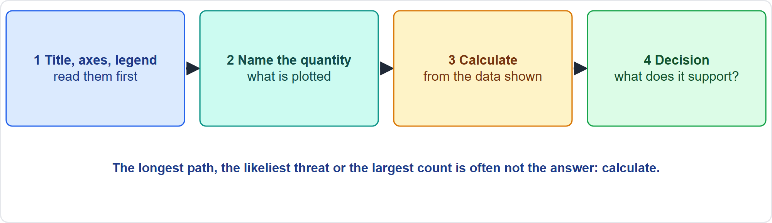
Graphic-Based Questions
Part 1
Four steps
EXAM TIP The longest path, the likeliest threat or the largest count is often not the answer: calculate.
PMP Exam Prep 2026 | PMBOK 8 and the New ECO
Module 14
10 / 44
Notes:
For a graphic, take four steps. Read the title, the axes and the legend first. Name the quantity that is plotted. Calculate from the data shown, rather than judging by eye. Then ask what decision the graphic supports. The longest path, the likeliest threat, or the largest count is often not the answer. Read a Pareto chart by cost, not by count.

Slide 11
Matching and Enhanced Matching
Part 1
Matching: drag items from one list to pair them with another
Enhanced matching: drag items onto an image, or match to two lists at once
Start with the surest pairs; use them to work out the rest
Some choices are decoys; most choices are used once
Check whether choices can be reused
Do not force a match
EXAM TIP In enhanced matching, the second match often depends on the first.
PMP Exam Prep 2026 | PMBOK 8 and the New ECO
Module 14
11 / 44
Notes:
Matching items pair two lists. Enhanced matching drags items onto locations in an image, or matches items to two lists at once. Start with the surest pairs, then use them to work out the rest. Some choices are decoys, and most choices are used once. Check whether a choice may be reused. And do not force a match: extra choices are there to be left unused. In enhanced matching, the second match often depends on the first.

Slide 12
Point and Click, and Pull-Down Lists
Part 1
Point and click: click the hotspot on an image that answers the question
Work out the value first: the highest score, the first month over a limit, the lowest probability
Note what is maximized or minimized
Pull-down list: choose from a drop-down in each row
The same options often repeat across rows
Decide each row on its own facts
EXAM TIP In point and click, calculate first and click second.
PMP Exam Prep 2026 | PMBOK 8 and the New ECO
Module 14
12 / 44
Notes:
In point and click, you click the hotspot on an image that answers the question. Work out the value first: the highest score, the first month over a limit, or the lowest probability. Note what is being maximized or minimized. In a pull-down list, you choose from a drop-down in each row. The same options often repeat across rows, so decide each row on its own facts.

Slide 13
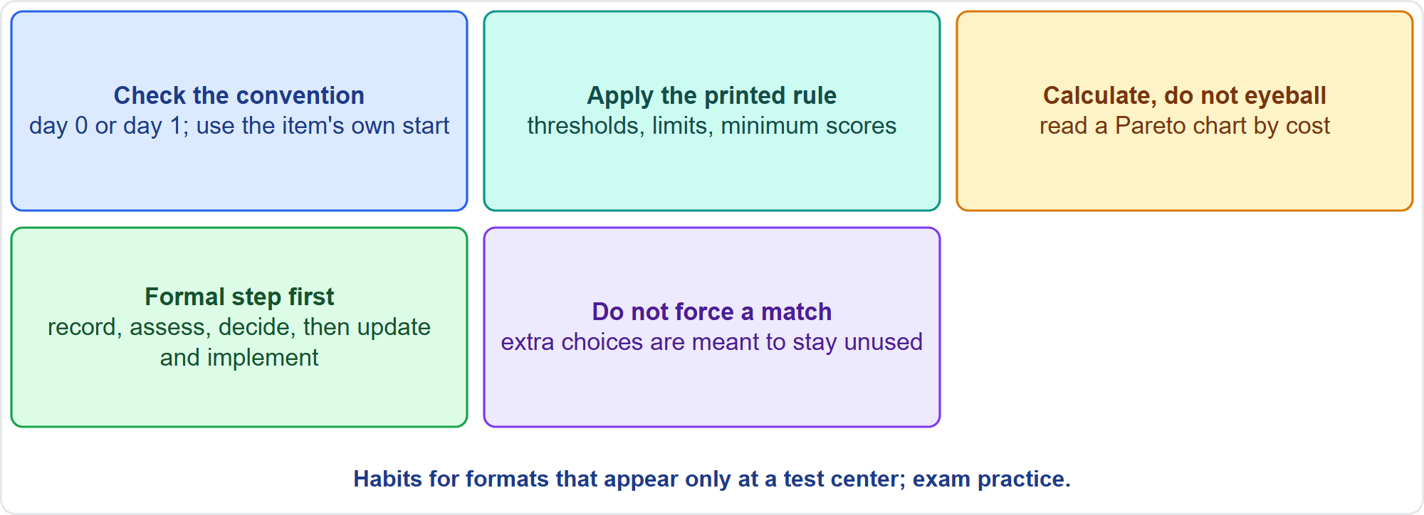
Habits for the Interactive Formats
Part 1
Five habits
EXAM TIP A network that starts at day 0 uses EF = ES + duration; PMBOK 8 counts from day 1. Use the item's own start.
PMP Exam Prep 2026 | PMBOK 8 and the New ECO
Module 14
13 / 44
Notes:
Five habits for the interactive formats. Check the convention before you calculate: a network starting at day zero uses early finish equals early start plus duration, while PMBOK 8 counts from day one. Use the item's own start. Apply the rule printed in the item, such as authority limits or thresholds, not what you remember. Calculate, do not eyeball. In sequences, the formal step comes first. And do not force a match.

Slide 14
Reading a Scenario Question
Part 1
Find the approach: predictive, agile or hybrid
Find the ask: first, next or best action; what should have been done; which tool or term
Find the state: has it happened or might it; is there a baseline; who has authority
Remove the distractors; keep the option that treats the cause and respects the process
Do not choose by length or position
EXAM TIP The same problem has a different best answer in each approach: find the approach first.
PMP Exam Prep 2026 | PMBOK 8 and the New ECO
Module 14
14 / 44
Notes:
Here is the method for any scenario. Find the approach: predictive, agile or hybrid. Find the ask: the first action, the next action, the best action, what should have been done, or which tool or term. Find the state: has it happened or might it, is there a baseline, and who has the authority? Remove the distractors, and keep the option that treats the cause and respects the process. And never choose by length or position.

Slide 15
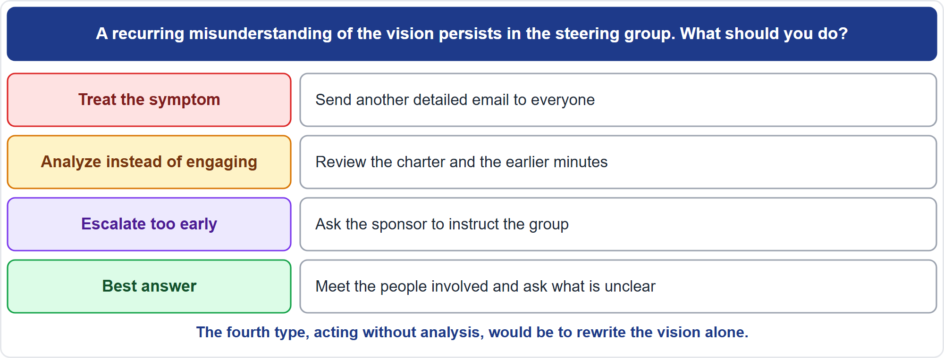
Distractors in Action
Part 1
Four options, four roles
EXAM TIP When two options look sensible, prefer the one that deals with the cause and keeps the process intact.
PMP Exam Prep 2026 | PMBOK 8 and the New ECO
Module 14
15 / 44
Notes:
See the four types in action. A misunderstanding of the vision keeps recurring in the steering group. Sending another detailed email treats the symptom. Reviewing the charter and the minutes analyzes instead of engaging. Asking the sponsor to instruct the group escalates too early. Meeting the people involved to ask what is unclear is the best answer. The fourth type, acting without analysis, would be rewriting the vision alone.

Slide 16
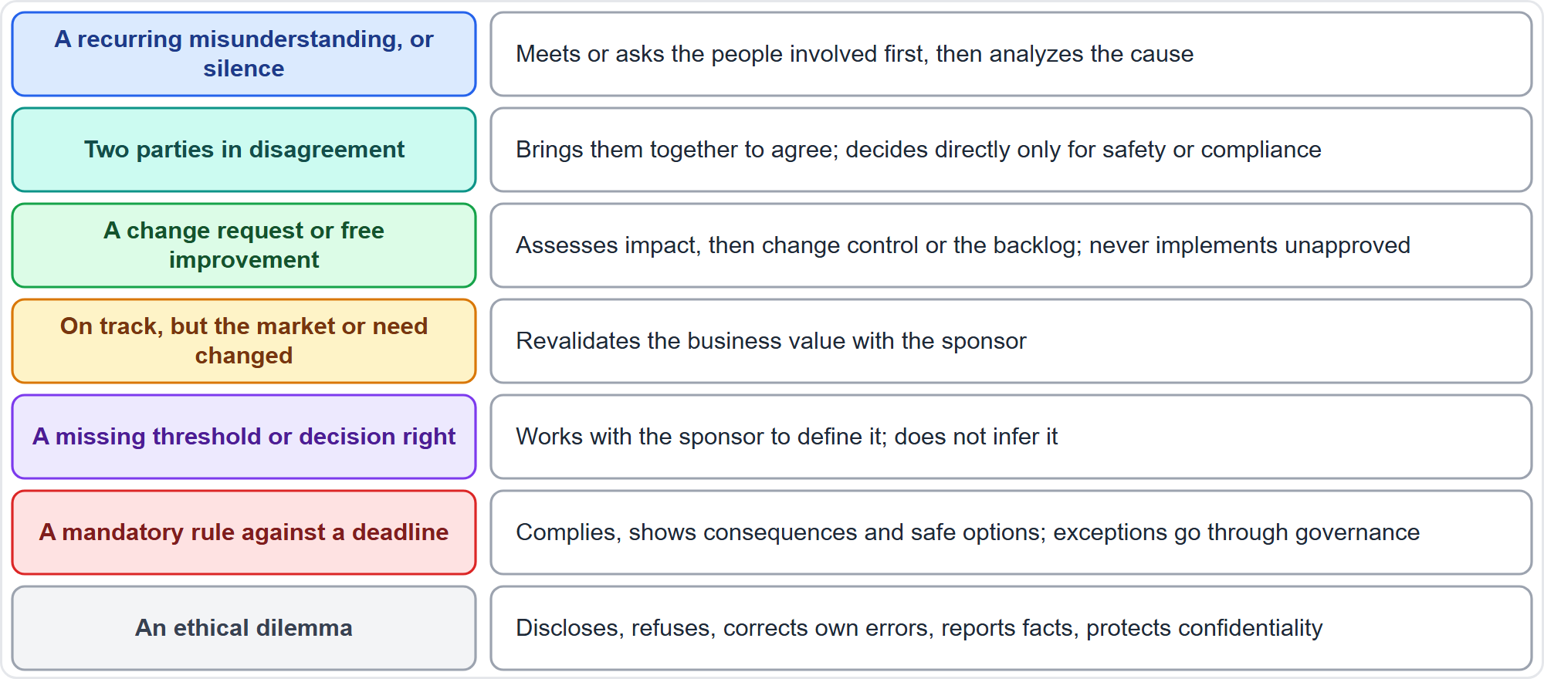
What the Best Answer Usually Does: Part 1
Part 1
Seven patterns
EXAM TIP Learn the pattern, not a memorized answer.
PMP Exam Prep 2026 | PMBOK 8 and the New ECO
Module 14
16 / 44
Notes:
Seven patterns. A recurring misunderstanding or silence: meet or ask the people involved first, then analyze the cause. Two parties in disagreement: bring them together to agree, and decide directly only for safety or compliance. A change request or a free improvement: assess the impact, then use change control or the backlog, and never implement an unapproved change. On track, but the market changed: revalidate the value with the sponsor. A missing threshold: define it with the sponsor. A mandatory rule against a deadline: comply, and take exceptions through governance. An ethical dilemma: disclose, refuse, correct your errors, report facts, and protect confidentiality.

Slide 17
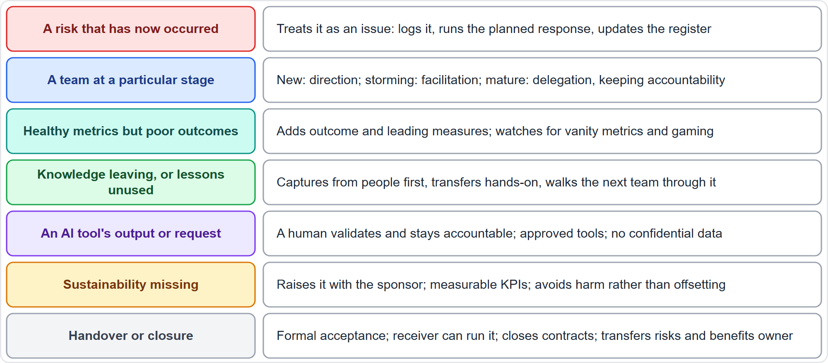
What the Best Answer Usually Does: Part 2
Part 1
Seven more patterns
EXAM TIP A risk that has occurred is an issue; do not keep calling it a risk.
PMP Exam Prep 2026 | PMBOK 8 and the New ECO
Module 14
17 / 44
Notes:
Seven more. A risk that has occurred: treat it as an issue, log it, run the planned response, and update the register. A team at a stage: direction for a new team, facilitation in storming, delegation for a mature team, without giving up accountability. Healthy metrics but poor outcomes: add outcome and leading measures. Knowledge about to leave: capture from people first, and transfer hands-on. An AI tool's output: a human validates it and stays accountable. Missing sustainability: raise it with the sponsor and write measurable indicators. Handover: get formal acceptance and confirm the receiver can run the result.

Slide 18
Words That Steer the Answer
Part 1
First, next, best: each asks something different
Assumption words: "the variance was a one-off"
State words: "has occurred" or "might occur"
Authority words: threshold, sponsor, board
Approach words: baseline, backlog, iteration, gate
Hasty actions such as deciding alone or acting now often mark distractors
EXAM TIP Underline the words that name the ask, the state and the approach before you read the options.
PMP Exam Prep 2026 | PMBOK 8 and the New ECO
Module 14
18 / 44
Notes:
Underline the words that steer the answer. First, next and best each ask something different. Assumption words choose a formula, such as the variance was a one-off. State words separate what has occurred from what might occur. Authority words, like threshold, sponsor and board, tell you who decides. Approach words, like baseline, backlog and iteration, tell you the mechanism. And hasty actions, such as deciding alone or acting now, often mark distractors.

Slide 19
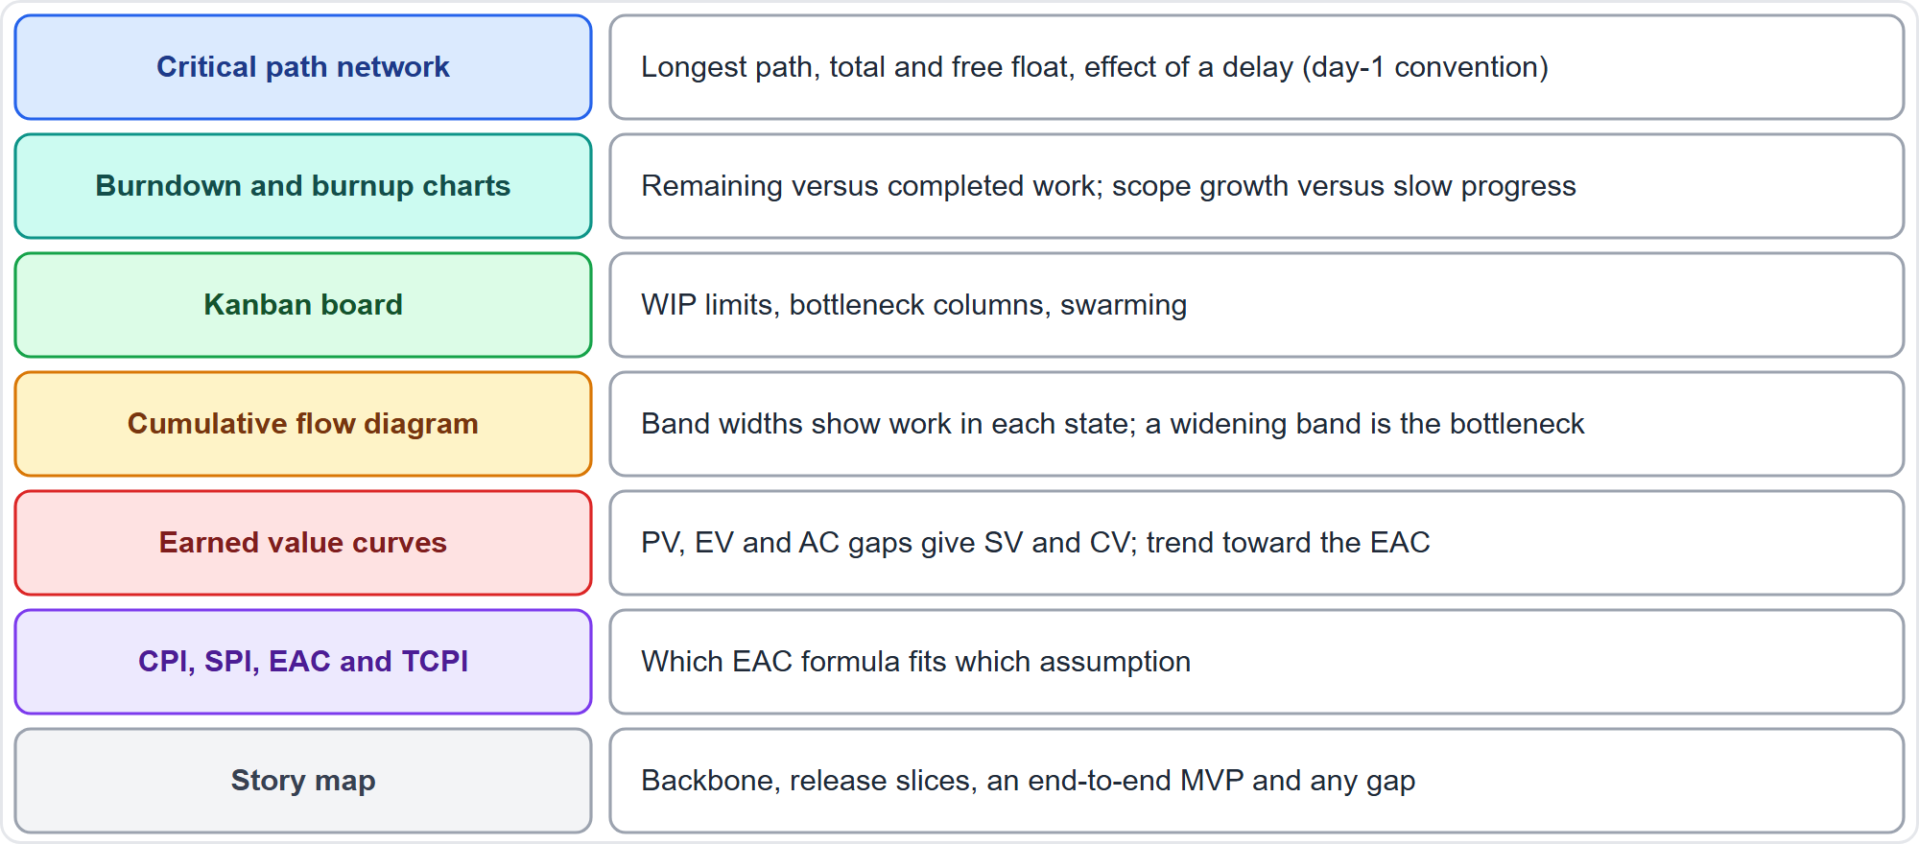
Graphics to Practice Reading: Schedule, Cost and Flow
Part 1
Seven graphics
EXAM TIP Read a critical path network with the day-1 convention unless the item says otherwise.
PMP Exam Prep 2026 | PMBOK 8 and the New ECO
Module 14
19 / 44
Notes:
Now graphics to practice reading. First, schedule, cost and flow. A critical path network: the longest path, total and free float, and the effect of a delay. Burndown and burnup charts: remaining against completed work, and scope growth against slow progress. A Kanban board: work-in-progress limits and bottleneck columns. A cumulative flow diagram: a widening band is the bottleneck. Earned value curves: the gaps give the variances. The EAC formulas, by assumption. And a story map: the backbone, the release slices and any gap.

Slide 20
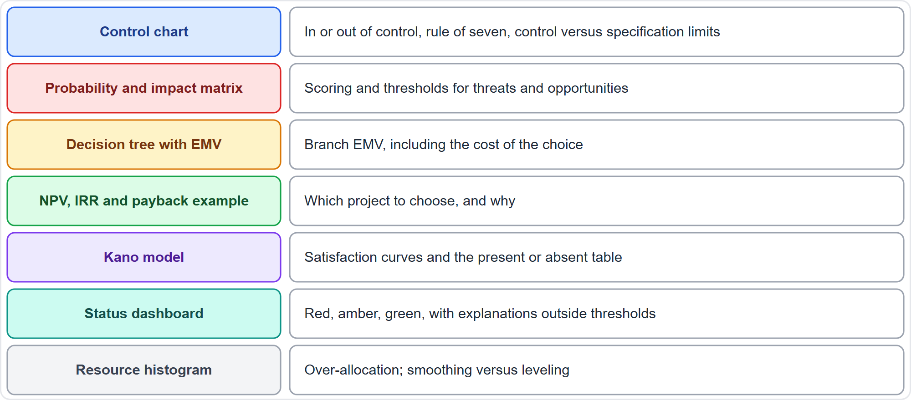
Graphics to Practice Reading: Risk, Quality, Value and Status
Part 1
Seven graphics
EXAM TIP On a dashboard, measures outside thresholds need an explanation, not only a color.
PMP Exam Prep 2026 | PMBOK 8 and the New ECO
Module 14
20 / 44
Notes:
Next, risk, quality, value and status. A control chart: in or out of control, the rule of seven, and control against specification limits. A probability and impact matrix: scores and thresholds. A decision tree: branch values, including the cost of the choice. An NPV example: which project to choose, and why. The Kano model: satisfaction curves and the present or absent table. A status dashboard: red, amber and green, with explanations when a measure is outside its threshold. And a resource histogram: over-allocation, smoothing and leveling.

Slide 21
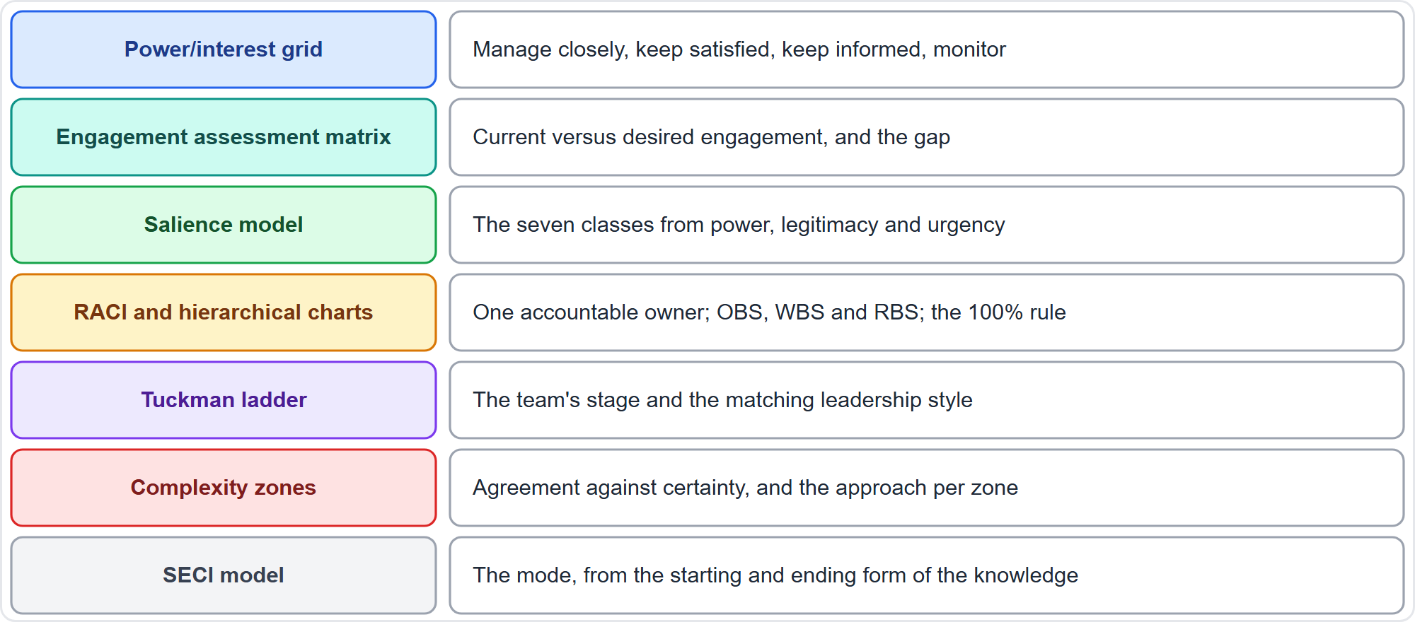
Graphics to Practice Reading: People, Structure and Knowledge
Part 1
Seven graphics
EXAM TIP One accountable owner per activity is the RACI rule to check first.
PMP Exam Prep 2026 | PMBOK 8 and the New ECO
Module 14
21 / 44
Notes:
Last, people, structure and knowledge. Know these graphics well. The power and interest grid: manage closely, keep satisfied, keep informed, monitor. The engagement assessment matrix: current against desired engagement, and the gap. The salience model: seven classes from power, legitimacy and urgency. RACI and hierarchy charts: one accountable owner, and the hundred percent rule. The Tuckman ladder: the team's stage and the matching style. Complexity zones: agreement against certainty. And the SECI model: the mode from the starting and ending form of the knowledge.

Slide 22
Part 1 Recap
Part 1
1
Formats
2
Cases
3
Graphics
eight types; four only at a test center
questions first, then the facts that matter
read, name, calculate, decide
4
Interactive
5
Method
6
Patterns
surest pairs first; apply the printed rule
approach, ask, state, then remove distractors
fourteen situations, one best action each
PMP Exam Prep 2026 | PMBOK 8 and the New ECO
Module 14
22 / 44
Notes:
Let us recap Part 1. There are eight formats, four of them only at a test center. For cases, read the questions first, then note the facts that matter. For graphics, read, name the quantity, calculate and decide. For interactive items, take the surest pairs first and apply the rule printed in the item. The method is approach, ask and state, then remove the distractors. And fourteen situations each have one usual best action. In Part 2, we practice five interactive items, then plan the final weeks.

Slide 23
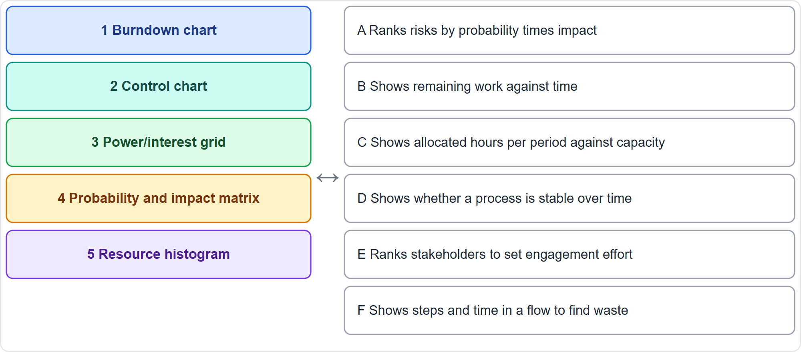
Format Practice 1: Matching
Part 2
Match five terms
EXAM TIP Start with the surest pairs, and leave any decoy unused.
PMP Exam Prep 2026 | PMBOK 8 and the New ECO
Module 14
23 / 44
Notes:
Part 2 begins with practice. Format practice one: matching. This format appears at a test center. The five terms on the left are the burndown chart, the control chart, the power and interest grid, the probability and impact matrix, and the resource histogram. The six descriptions on the right are lettered A to F. Match each term to its description. One description is a decoy, so do not force a match. Pause the video and decide. [PAUSE 25]

Slide 24
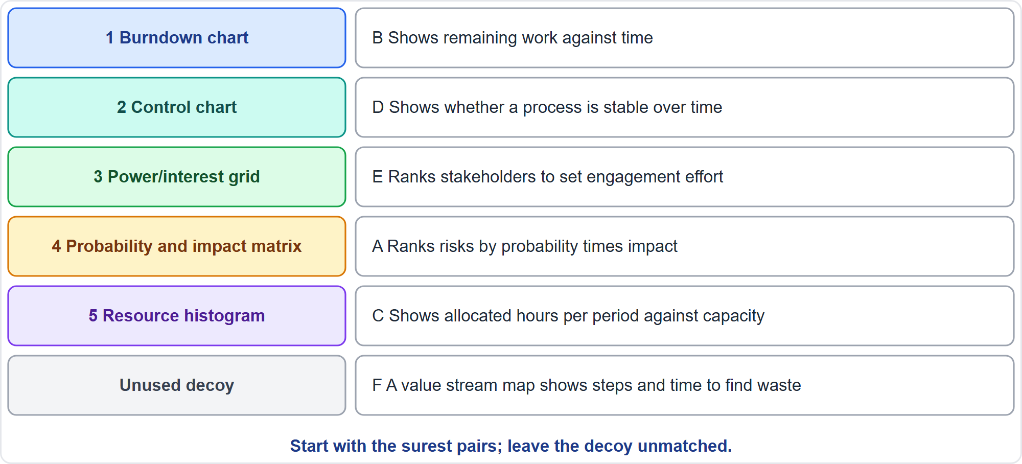
Matching: The Answers
Part 2
Five pairs and a decoy
EXAM TIP A value stream map shows steps and time to find waste; it was the decoy here.
PMP Exam Prep 2026 | PMBOK 8 and the New ECO
Module 14
24 / 44
Notes:
Here are the answers. The burndown chart shows remaining work against time. The control chart shows whether a process is stable. The power and interest grid ranks stakeholders to set engagement effort. The probability and impact matrix ranks risks. And the resource histogram shows allocated hours against capacity. The description of steps and time to find waste belongs to a value stream map, so it was the decoy. Start with the surest pairs, and leave the decoy unmatched.

Slide 25
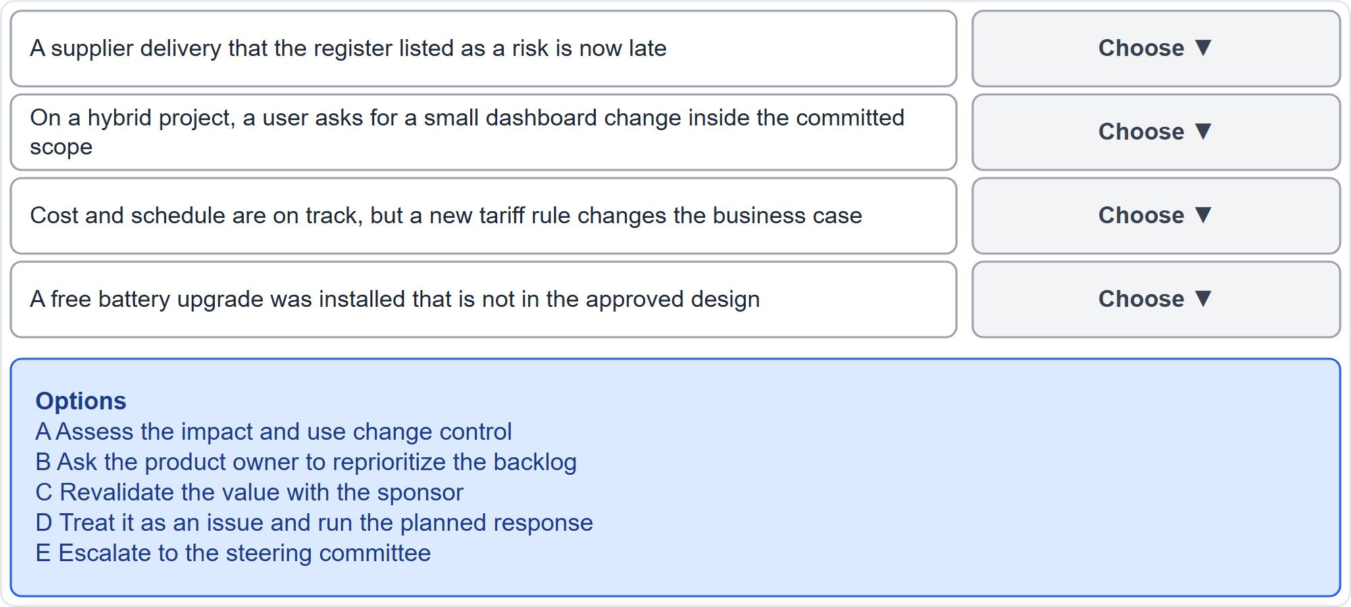
Format Practice 2: Pull-Down Lists
Part 2
Four situations
EXAM TIP Decide each row on its own facts; one option may stay unused.
PMP Exam Prep 2026 | PMBOK 8 and the New ECO
Module 14
25 / 44
Notes:
Format practice two: pull-down lists. For each situation, choose the best first action from the list. The four situations are these. A risk that the register listed is now late. A small dashboard change inside the committed scope of a hybrid project. Cost and schedule on track, but a new tariff rule changes the business case. And a free battery upgrade that is not in the approved design. The five actions are lettered A to E. The same option can appear in more than one row, and one option may not be needed at all. Decide each row on its own facts. Pause the video and decide. [PAUSE 30]

Slide 26
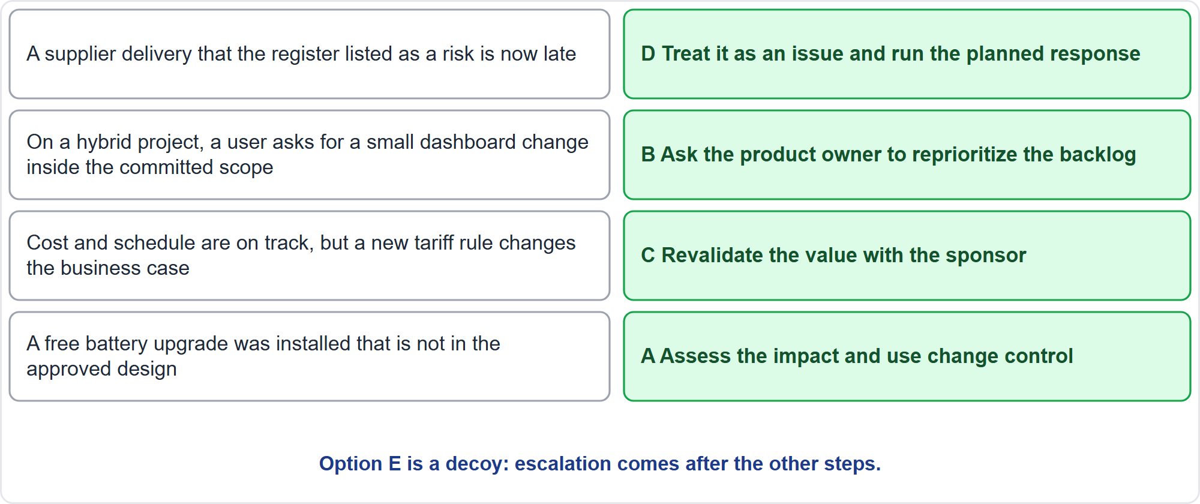
Pull-Down: The Answers
Part 2
D, B, C, A
EXAM TIP Escalating to the steering committee was the decoy: it comes after the other steps.
PMP Exam Prep 2026 | PMBOK 8 and the New ECO
Module 14
26 / 44
Notes:
The answers. Row one: a risk that the register listed has occurred, so it is an issue. Treat it as an issue and run the planned response. Row two: a small request inside the committed scope of a hybrid project goes to the product owner, who reprioritizes the backlog. Row three: cost and schedule are on track, but the business case changed, so revalidate the value with the sponsor. Row four: even a free upgrade is a change, so assess the impact and use change control. Escalation was the decoy.

Slide 27
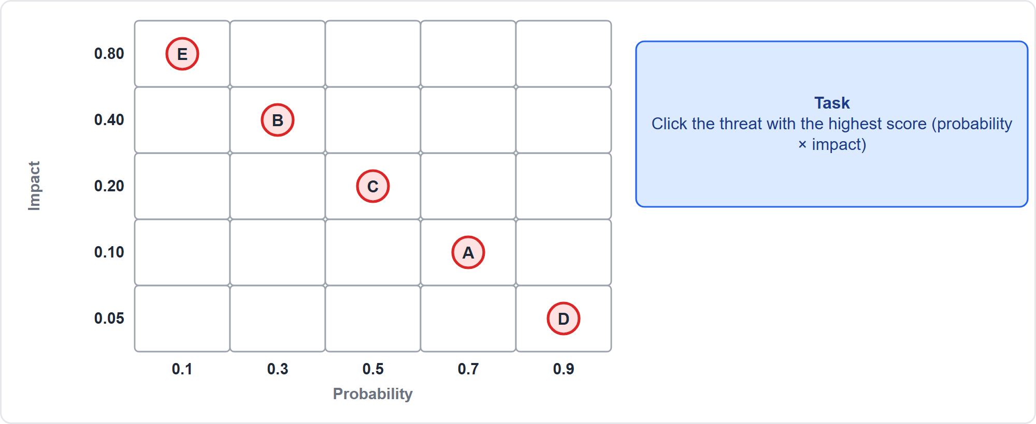
Format Practice 3: Point and Click
Part 2
Five threats on a grid
EXAM TIP Work out the value first, then click.
PMP Exam Prep 2026 | PMBOK 8 and the New ECO
Module 14
27 / 44
Notes:
Format practice three: point and click. Five threats, A to E, are plotted by probability across and impact up. Click the threat with the highest score, probability times impact. Work out the value first, then click. Pause the video and decide. [PAUSE 25]

Slide 28
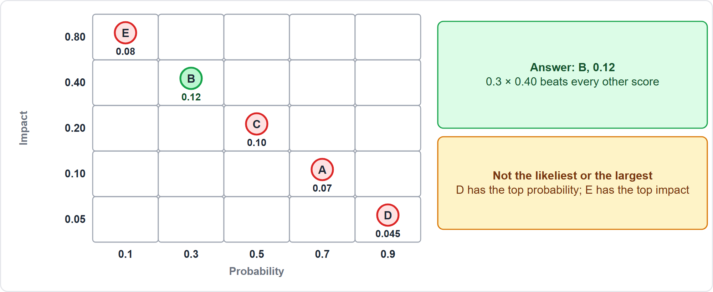
Point and Click: The Answer
Part 2
Threat B scores 0.12
EXAM TIP The likeliest threat and the largest impact are often not the highest score.
PMP Exam Prep 2026 | PMBOK 8 and the New ECO
Module 14
28 / 44
Notes:
The answer is threat B. Zero point three times zero point four is zero point one two. C scores zero point one zero, E zero point zero eight, A zero point zero seven, and D zero point zero four five. The likeliest threat is D, and the largest impact is E, but neither has the highest score. That is why you calculate first and click second.

Slide 29
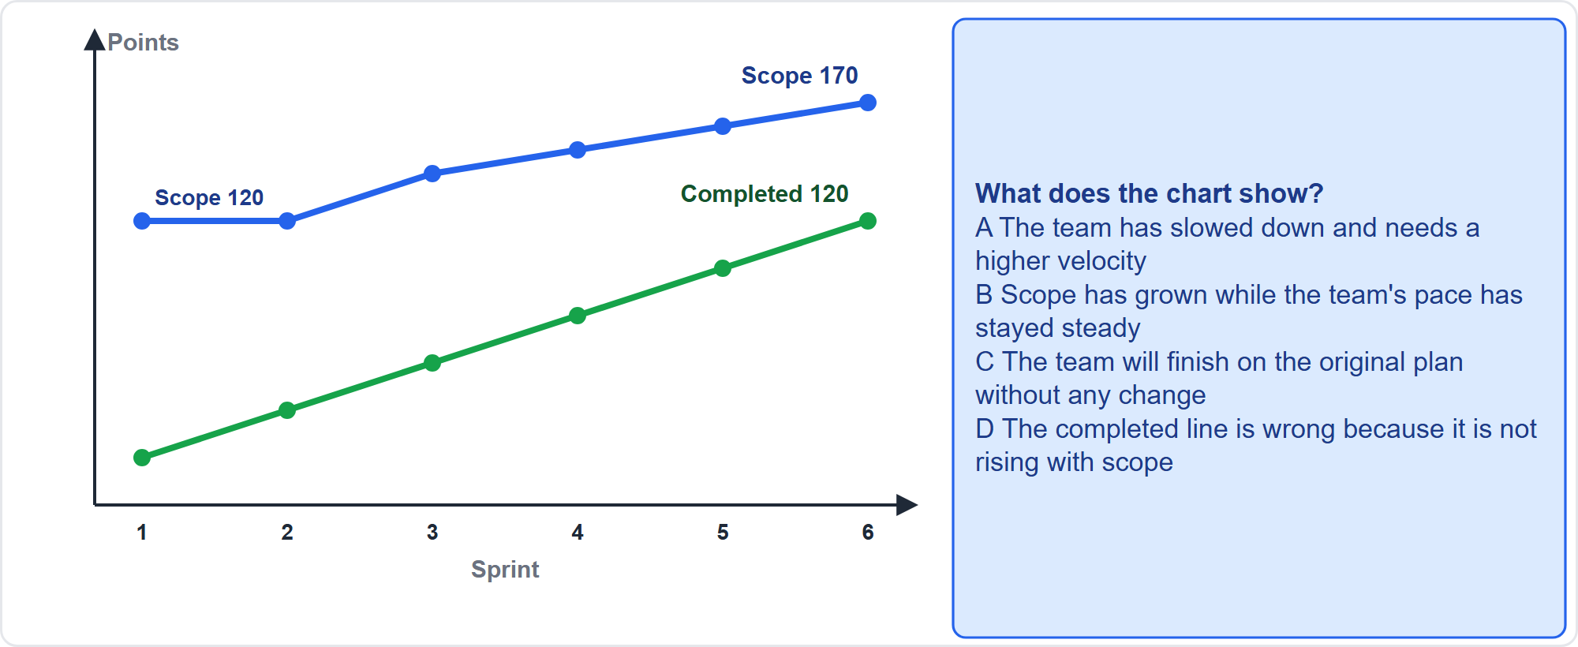
Format Practice 4: A Graphic-Based Item
Part 2
Burnup chart
EXAM TIP Read the title, axes and legend first.
PMP Exam Prep 2026 | PMBOK 8 and the New ECO
Module 14
29 / 44
Notes:
Format practice four: a graphic-based item. This burnup chart shows completed work rising by twenty points a sprint, while the scope line has climbed from one hundred twenty to one hundred seventy points. What does the chart show? The four options, A to D, are on the screen. Pause the video and decide. [PAUSE 22]

Slide 30
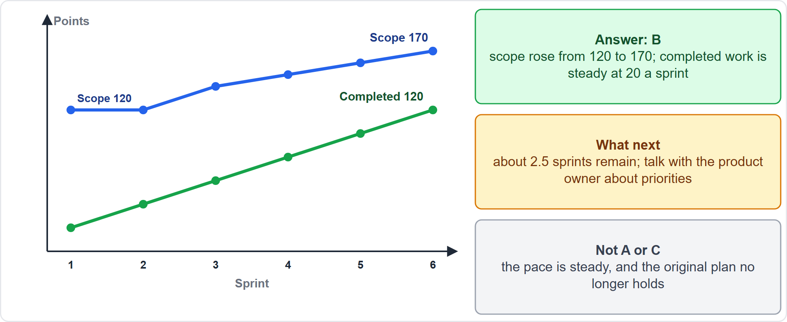
Graphic-Based: The Answer
Part 2
Scope growth
EXAM TIP A burnup chart separates scope growth from slow progress; a burndown chart can hide it.
PMP Exam Prep 2026 | PMBOK 8 and the New ECO
Module 14
30 / 44
Notes:
The answer is B. Scope has grown by fifty points, while the pace has stayed steady at twenty points a sprint. About two and a half sprints of work remain. A is wrong because the pace has not slowed. C is wrong because the original plan no longer holds. And D is wrong because completed work does not rise with scope. The next step is to talk with the product owner about priorities, and to take it to the sponsor if a threshold is crossed.

Slide 31
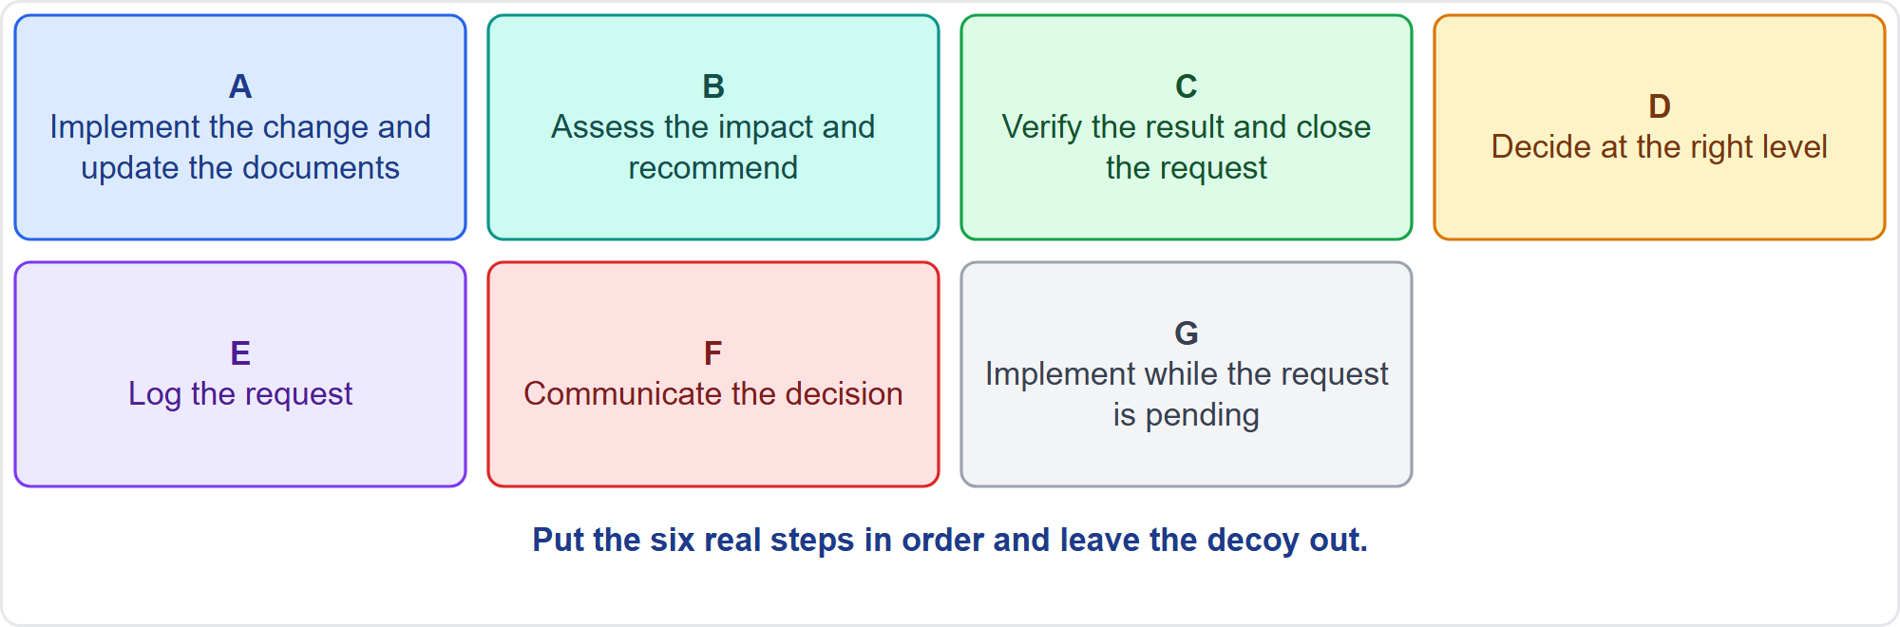
Format Practice 5: Sequence
Part 2
Seven cards
EXAM TIP The formal step comes first; decoys are shortcuts that skip a step.
PMP Exam Prep 2026 | PMBOK 8 and the New ECO
Module 14
31 / 44
Notes:
Format practice five: a sequence, in the style of a drag-and-drop item. Put the change control steps in order. The seven cards, A to G, are on the screen. One card is a decoy. Remember that the formal step comes first. Pause the video and decide. [PAUSE 22]

Slide 32
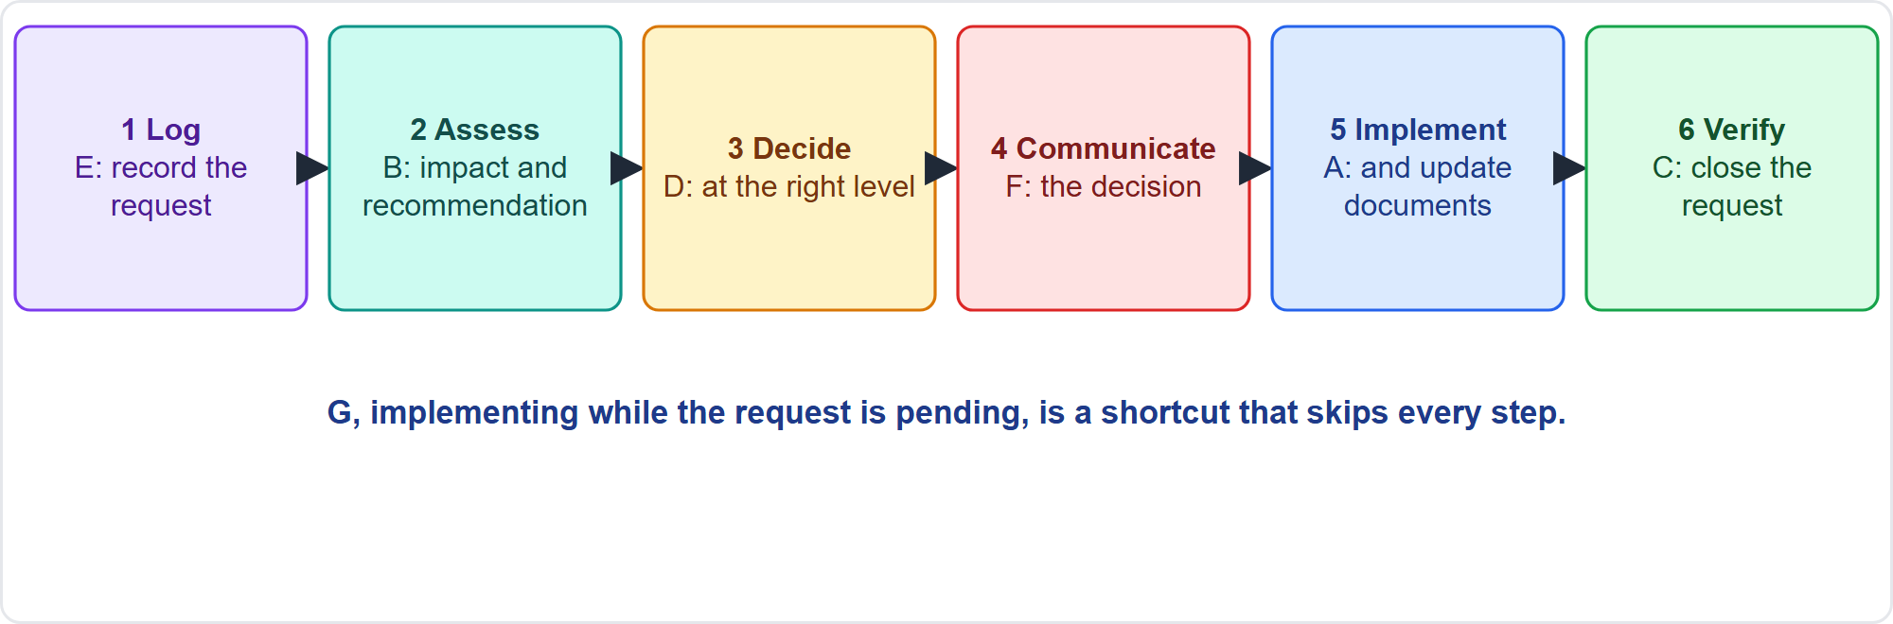
Sequence: The Answer
Part 2
E, B, D, F, A, C
EXAM TIP Implementing while the request is pending skips every step.
PMP Exam Prep 2026 | PMBOK 8 and the New ECO
Module 14
32 / 44
Notes:
The order is: log the request. Assess the impact and recommend. Decide at the right level. Communicate the decision. Implement and update the documents. Then verify the result and close the request. Implementing while the request is pending is a shortcut that skips every step. Decoys in sequence items are almost always shortcuts.

Slide 33
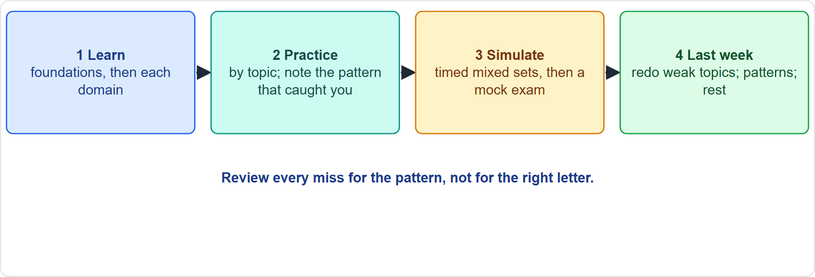
Your Practice Plan
Part 2
Learn, practice, simulate, last week
EXAM TIP Review every miss for the pattern that caught you, not for the right letter.
PMP Exam Prep 2026 | PMBOK 8 and the New ECO
Module 14
33 / 44
Notes:
Your practice plan has four steps. Learn the foundations first, then each domain. Practice by topic: answer each scenario before reading the explanation, then note which pattern or distractor caught you. Simulate with timed mixed sets, then a mock exam. And in the last week, redo only the topics you miss. Throughout, review every miss for the pattern, not for the right letter.

Slide 34
Simulate and Review
Part 2
Timed mixed sets: for example 60 questions in about 80 minutes
Follow the domain weights: 33%, 41% and 26%
Then a full mock exam under exam conditions
Review every miss for the pattern, not the answer
Redo the formulas with the quick reference cards
Practice the interactive formats as well as multiple choice
EXAM TIP Real items can be longer and combine ideas; practice items test one idea in a short setting.
PMP Exam Prep 2026 | PMBOK 8 and the New ECO
Module 14
34 / 44
Notes:
Simulate the exam. Take timed mixed sets, for example sixty questions in about eighty minutes, following the domain weights. Then take a full mock exam under exam conditions. Review every miss for the pattern, not the answer. Redo the formulas with the quick reference cards. And practice the interactive formats as well as multiple choice. Remember that real items can be longer and may combine ideas, while practice items test one idea in a short setting.

Slide 35
The Last Week
Part 2
Redo only the weak topics: where you miss more than a third of scenarios
Re-read the best-answer patterns and the four distractor types
Use the quick reference cards the day before
Do not start new material
Rest before the exam
EXAM TIP Where sources disagree, follow the ECO and PMBOK 8.
PMP Exam Prep 2026 | PMBOK 8 and the New ECO
Module 14
35 / 44
Notes:
In the last week, redo only the topics where you miss more than a third of the scenario questions. Re-read the best-answer patterns and the four distractor types. Use the quick reference cards the day before. Do not start new material. And rest before the exam. If any source disagrees with the content outline or PMBOK 8, follow the outline and PMBOK 8.

Slide 36
Exam Day
Part 2
Pace: about 80 seconds a question; do not stay stuck
Case section: questions first, then the case
Flag and review only inside your current section
Breaks close the section behind you
Interactive items: apply the rule printed in the item
Confirm the current format on PMI's official site before you book
EXAM TIP Finish your review before a break starts; you cannot go back after it.
PMP Exam Prep 2026 | PMBOK 8 and the New ECO
Module 14
36 / 44
Notes:
On exam day, pace yourself at about eighty seconds a question, and do not stay stuck. In the case section, read the questions first, then the case. Flag and review only inside your current section, and remember that a break closes the section behind you. For interactive items, apply the rule printed in the item. And before you book, confirm the current format, fees and eligibility on PMI's official site.

Slide 37
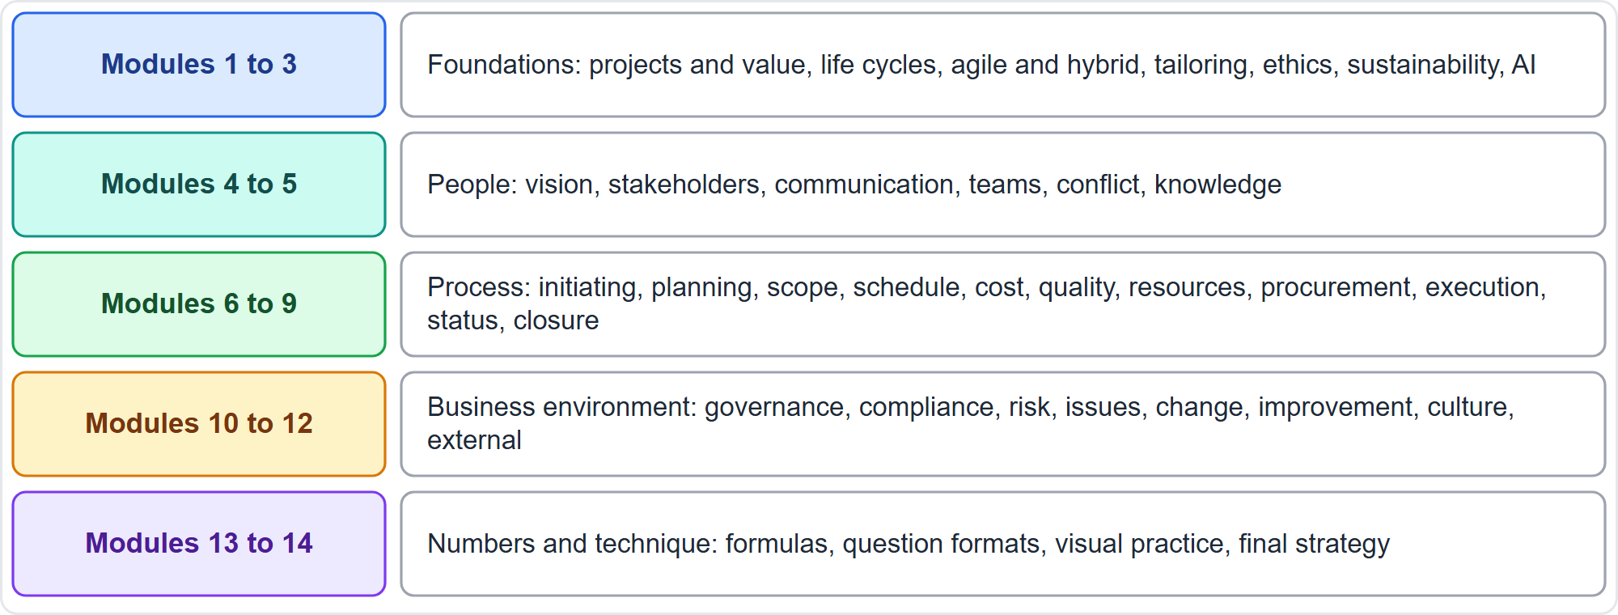
What You Have Covered
Part 2
Five blocks
EXAM TIP The exam tests judgment across all of these; the patterns repeat from module to module.
PMP Exam Prep 2026 | PMBOK 8 and the New ECO
Module 14
37 / 44
Notes:
Look back at the whole course. Modules one to three gave you the foundations: projects, life cycles, tailoring, ethics, sustainability and AI. Modules four and five covered people: vision, stakeholders, communication and teams. Modules six to nine covered process: initiating, planning, executing, status and closure. Modules ten to twelve covered the business environment: governance, compliance, risk, issues, change and the external environment. And modules thirteen and fourteen gave you the numbers and the exam technique.

Slide 38
Module Recap
Part 2
1
Formats
2
Reading
3
Distractors
eight types; know the four that appear at a test center
approach, ask, state; questions first in a case
symptom, analysis, escalation, action without analysis
4
Patterns
5
Practice
6
Next
the usual best action in fourteen situations
simulate, review every miss for the pattern
five practice questions
PMP Exam Prep 2026 | PMBOK 8 and the New ECO
Module 14
38 / 44
Notes:
Let us recap the module. The formats: eight types, including the four that appear only at a test center. Reading: find the approach, the ask and the state, and in a case read the questions first. The distractors: treat the symptom, analyze instead of engaging, escalate too early, and act without analysis. The patterns: the usual best action in fourteen situations. And practice: simulate the exam, and review every miss for the pattern. Now it is time for the last test in this course. Five questions follow. For each one, pause the video, choose your answer, and then listen to the explanation.

Slide 39
Practice Question 1
Part 2
Q1
A matching item has five terms and six descriptions. You are sure of three pairs and unsure about the other two. What is the best approach?
A
Match the two unsure terms first, because they need the most time
B
Match every description in order, because each one must be used once
C
Skip the item and return to it after the next scheduled break
D
Place the three sure pairs first, then work the others out from them
PMP Exam Prep 2026 | PMBOK 8 and the New ECO
Module 14
39 / 44
Notes:
Question one. A matching item has five terms and six descriptions. You are sure of three pairs and unsure about the other two. What is the best approach? The four options are on the screen. Choose your answer. [PAUSE 12] The answer is D. Start with the surest pairs and use them to work out the rest. Some choices are decoys, so a choice may stay unused. Not every description must be used. And a break closes the section, so you cannot return after it.

Slide 40
Practice Question 2
Part 2
Q2
You are about to start the case-study section, which has a long text and several questions. What is the best way to use your time?
A
Read the whole case twice, and only then read the questions
B
Read the questions first, then the case, noting the key facts
C
Skip the case text and answer from general knowledge of the topic
D
Memorize every number in the case before you read any question
PMP Exam Prep 2026 | PMBOK 8 and the New ECO
Module 14
40 / 44
Notes:
Question two. You are about to start the case-study section, which has a long text and several questions. What is the best way to use your time? The four options are on the screen. Choose your answer. [PAUSE 12] The answer is B. Reading the questions first tells you which facts to look for, and each question usually depends on only a few facts. Reading twice wastes time, skipping the case ignores its facts, and memorizing every number is unnecessary.

Slide 41
Practice Question 3
Part 2
Q3
Two engineers have argued about the controller design for a week, and the sprint work has stalled. You have not yet spoken to either of them. What should you do first?
A
Bring the two of them together to agree on a single approach
B
Ask the sponsor to decide which design the team will use
C
Choose the design yourself and tell both engineers to follow it
D
Ask both for written positions and review the design documents
PMP Exam Prep 2026 | PMBOK 8 and the New ECO
Module 14
41 / 44
Notes:
Question three. Two engineers have argued about the controller design for a week, and the sprint work has stalled. You have not yet spoken to either of them. What should you do first? The four options are on the screen. Choose your answer. [PAUSE 12] The answer is A. The first move is to engage the people involved and help them agree. Deciding directly is for safety or compliance. Escalating too early, deciding alone and analyzing documents each avoid talking with the people involved.

Slide 42
Practice Question 4
Part 2
Q4
Cost and schedule indices are on track, but the market assumed in the business case has closed. What should the project manager do?
A
Continue as planned, because the project is on time and on budget
B
Replan the schedule so that the lost value can be recovered
C
Revalidate the value with the sponsor and present the options
D
Cancel the project immediately to avoid wasting more money on it
PMP Exam Prep 2026 | PMBOK 8 and the New ECO
Module 14
42 / 44
Notes:
Question four. Cost and schedule indices are on track, but the market assumed in the business case has closed. What should the project manager do? The four options are on the screen. Choose your answer. [PAUSE 12] The answer is C. On time and on budget is not enough when the market or need changes, so the value is revalidated with the sponsor. Continuing ignores the lost value, replanning does not recover it, and cancelling is a decision for governance.

Slide 43
Practice Question 5
Part 2
Q5
A team member wants to paste confidential meeting minutes into a public AI tool to summarize them. What should the project manager do?
A
Allow it, because AI summaries save a lot of time and are usually accurate enough
B
Use an approved tool only, keep confidential data out of it, and check the output
C
Ban every AI tool on the project until the organization writes a policy for them
D
Allow it, provided the summary is deleted after the minutes have been shared
PMP Exam Prep 2026 | PMBOK 8 and the New ECO
Module 14
43 / 44
Notes:
Question five. A team member wants to paste confidential meeting minutes into a public AI tool to summarize them. What should the project manager do? The four options are on the screen. Choose your answer. [PAUSE 12] The answer is B. Use approved tools, keep confidential data out of public tools, and have a human validate the output and stay accountable. Allowing it exposes confidential data. A blanket ban ignores approved tools. Deleting the summary later does not undo the exposure.

Slide 44
Answers at a Glance
Part 2
Question | Answer | Why
Q1 | D | Sure pairs first; leave decoys unused
Q2 | B | Questions first, then the case, then the facts
Q3 | A | Bring the parties together to agree
Q4 | C | A changed market means revalidating the value
Q5 | B | Approved tools only; a human validates the output
PMP Exam Prep 2026 | PMBOK 8 and the New ECO
Module 14
44 / 44
Notes:
Here are all five answers together. Question one: D. Sure pairs first. Leave decoys unused. Question two: B. Questions first, then the case, then the facts. Question three: A. Bring the parties together to agree. Question four: C. A changed market means revalidating the value. Question five: B. Approved tools only. A human validates the output. That completes Module 14. Good luck on exam day.

