Slide 1
TOGAF 10 ASSOCIATE MASTERCLASS
TOGAF 10 Associate Masterclass
Complete Foundation Exam Preparation — 15 Lessons
Based on the TOGAF Standard, 10th Edition · The Open Group
Module 0 of 15 — Course Introduction & Exam Guide
40
60
Closed
≥60%
questions
minutes
book
to pass
TOGAF 10 Associate Masterclass | The Open Group
opengroup.org
Notes:
: TOGAF 10 ASSOCIATE MASTERCLASS
Welcome to the TOGAF 10 Associate Masterclass — your complete preparation course for the TOGAF Foundation certification. Over fifteen focused lessons, we'll take you from never having opened the TOGAF Standard to walking into your exam with genuine confidence. This is the same proven format used by our data-management course: clear explanations, memory anchors, and exam-style practice questions in every single module. Let's begin by getting you oriented.
---

Slide 2
Welcome — What This Course Is
Module 0 — Course Introduction
Complete, exam-focused preparation for the TOGAF 10 Foundation certification:
"Every concept paired with memory anchors, exam tips, and practice questions."
15 structured lessons covering every topic on the exam blueprint
Built from the official TOGAF Standard, 10th Edition — explained in plain English
The credential is officially called TOGAF Enterprise Architecture Foundation
TOGAF 10 Associate Masterclass | The Open Group
opengroup.org
Notes:
: Welcome — What This Course Is
So what exactly is this course? It's a complete, exam-focused preparation program for the TOGAF 10 Foundation certification — that's the Level 1, or Part 1, exam. Across fifteen structured lessons we cover every topic on the exam blueprint, all built directly from the official TOGAF Standard, 10th Edition, but explained in plain, everyday English rather than dense specification language. And every concept comes paired with a memory anchor, an exam tip, and practice questions so the learning actually sticks. One quick note on naming: the credential you earn is officially called the TOGAF Enterprise Architecture Foundation. "Associate" is just the informal label many people use for this entry level — they mean the same thing.
---

Slide 3
Who This Course Is For
Module 0 — Course Introduction
Ideal for:
No prior TOGAF knowledge needed:
Enterprise, Business, Data, Application, Solution & Technology Architects
IT professionals moving into an architecture role
Project & program managers alongside architecture teams
Business analysts, consultants, and students
Starts from first principles
Clear explanations — no jargon overload
Each concept built up step by step
Practice questions every module
TOGAF 10 Associate Masterclass | The Open Group
opengroup.org
Notes:
: Who This Course Is For
Who is this course for? Really, anyone involved in shaping how an organization uses technology. That includes enterprise, business, data, application, solution, and technology architects; IT professionals stepping into an architecture role for the first time; and the project and program managers who work alongside architecture teams. Business analysts, consultants, and students chasing a respected, globally recognized credential will all feel right at home too. And here's the reassuring part — no prior TOGAF knowledge is assumed. We start from first principles and build up, so even if this is brand new to you, you're in exactly the right place.
---

Slide 4
How the Course Is Structured
Module 0 — Course Introduction
Module 0 — Course orientation & exam guide
Module 1 — Enterprise Architecture & TOGAF
Module 2 — ADM Overview
Modules 3–7 — ADM phases in depth
Module 8 — Enterprise Continuum & Repository
Module 9 — Content Framework: Deliverables & Artifacts
Module 10 — Partitioning, Landscapes, Views & Viewpoints
Module 11 — Stakeholder Management & Communication
Module 12 — Architecture Governance
Module 13 — Reference Models (TRM & III-RM)
Module 14 — Applying TOGAF & Final Exam Strategy
⭐ EXAM TIP: The course order mirrors how the TOGAF Standard itself is organized.
TOGAF 10 Associate Masterclass | The Open Group
opengroup.org
Notes:
: How the Course Is Structured
Let's look at the roadmap. Module 0 — this one — is your orientation and exam guide. Module 1 introduces Enterprise Architecture and the TOGAF framework itself. Module 2 gives you the big-picture overview of the Architecture Development Method, or ADM. Then modules 3 through 7 walk through each ADM phase in depth — the Architecture Vision; the Business, Information Systems, and Technology architectures; the planning phases; the governance and change phases; and Requirements Management. Modules 8 through 13 cover the supporting concepts — the Enterprise Continuum, the Content Framework, partitioning, stakeholders, governance, and the reference models. And Module 14 pulls it all together with applying TOGAF and your final exam strategy. The order deliberately mirrors how the TOGAF Standard itself is organized.
---

Slide 5
What Is TOGAF?
Module 0 — Course Introduction
TOGAF = The Open Group Architecture Framework
Open, industry-consensus framework for Enterprise Architecture, maintained by The Open Group
A foundational framework — applicable to any kind of architecture in any context
First released 1995, based on the US DoD TAFIM; current release is the 10th Edition (2022)
Provides: a method (ADM), a content framework, a continuum, and governance guidance
TOGAF is a framework, not a rigid recipe — it is meant to be tailored to each enterprise
⭐ EXAM TIP: TOGAF is a framework, not a rigid recipe — it is meant to be tailored to each enterprise.
TOGAF 10 Associate Masterclass | The Open Group
opengroup.org
Notes:
: What Is TOGAF?
Before we go further, let's answer the obvious question — what is TOGAF? The name is an acronym: The Open Group Architecture Framework. It's an open, industry-consensus framework for Enterprise Architecture, maintained by a global consortium called The Open Group. The key word is "foundational" — TOGAF is designed to be applicable to any kind of architecture, in any context, in any industry. It was first released back in 1995, originally based on a US Department of Defense framework called TAFIM, and the version we're studying is the 10th Edition, published in 2022. TOGAF gives you four big things: a method called the ADM, a content framework, a continuum of reusable assets, and governance guidance. And remember — it's a framework, not a rigid recipe. It's meant to be tailored to each organization.
---

Slide 6
Why TOGAF Certification Is Worth It
Module 0 — Course Introduction
One of the most widely recognized EA credentials in the world
Used by governments, defense, finance, telecom, consulting, and large enterprises globally
Gives you a common language to talk to executives, IT, and delivery teams
Often a hiring requirement or salary differentiator for architecture roles
Foundation level: proves you know the framework
Practitioner level: proves you can apply it — this course targets Foundation
⭐ EXAM TIP: This course targets Foundation — knowledge and comprehension of the framework.
TOGAF 10 Associate Masterclass | The Open Group
opengroup.org
Notes:
: Why TOGAF Certification Is Worth It
Why bother getting certified? Because TOGAF is one of the most widely recognized Enterprise Architecture credentials in the world. You'll find it used across governments, defense, finance, telecom, consulting, and large enterprises on every continent. Earning it gives you a common language — a shared vocabulary you can use to talk to executives, IT teams, and delivery groups without things getting lost in translation. In many architecture roles it's either an outright hiring requirement or a clear salary differentiator. The Foundation level, which this course targets, proves that you know the framework. The higher Practitioner level proves you can apply it in real scenarios. We're focused on getting you that solid Foundation first.
---

Slide 7
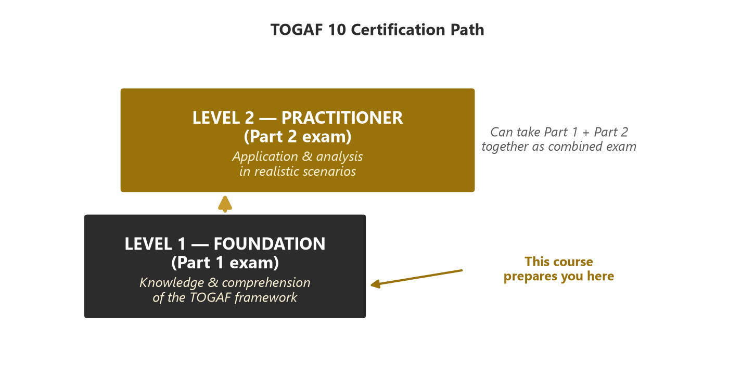
The Two TOGAF 10 Certification Levels
Module 0 — Course Introduction
Level 1 — Foundation (Part 1): knowledge & comprehension
Level 2 — Practitioner (Part 2): application & analysis in scenarios
Parts can be taken separately or combined in one sitting
This course prepares you for Part 1 — Foundation
⭐ EXAM TIP: You can take Part 1 and Part 2 separately, or together as a combined exam. This course prepares you for Part 1 (Foundation).
TOGAF 10 Associate Masterclass | The Open Group
opengroup.org
Notes:
: The Two TOGAF 10 Certification Levels
TOGAF 10 certification comes in two levels, and it's worth being clear on the difference. Level 1 is the TOGAF Enterprise Architecture Foundation, earned through the Part 1 exam. It tests your knowledge and comprehension of the framework — do you know the concepts, the phases, the vocabulary? Level 2 is the TOGAF Enterprise Architecture Practitioner, earned through the Part 2 exam, and it tests application and analysis — can you apply the framework to a realistic scenario? As the tiers on screen show, Foundation comes first and Practitioner builds on it. You can take the two parts separately or combined in a single sitting. This course prepares you specifically for Part 1 — Foundation.
---

Slide 8
The Foundation (Part 1) Exam Format
Module 0 — Course Introduction
40 multiple-choice questions
60 minutes (time extension typically applies if English is not your first language)
Closed book — no reference material allowed
Delivered via Pearson VUE test centres or online proctored
Each question has one best answer (no gradient scoring at Foundation)
Questions test recall and understanding: definitions, phase purposes, which output comes from which phase
⭐ EXAM TIP: Foundation questions test recall and understanding — definitions, phase purposes, which output comes from which phase.
TOGAF 10 Associate Masterclass | The Open Group
opengroup.org
Notes:
: The Foundation (Part 1) Exam Format
Let's talk about the exam itself, because knowing the format removes a lot of anxiety. The Foundation exam is forty multiple-choice questions, and you get sixty minutes to complete them. If English isn't your first language, a time extension typically applies — check the rules when you book. It's a closed-book exam, so no reference material is allowed; everything has to come from your memory and understanding. You can sit it at a Pearson VUE test center or take it online with a proctor. Each question has a single best answer — there's no complicated gradient scoring at Foundation level. The questions test recall and understanding: definitions, the purpose of each phase, and which output comes from which phase.
---

Slide 9
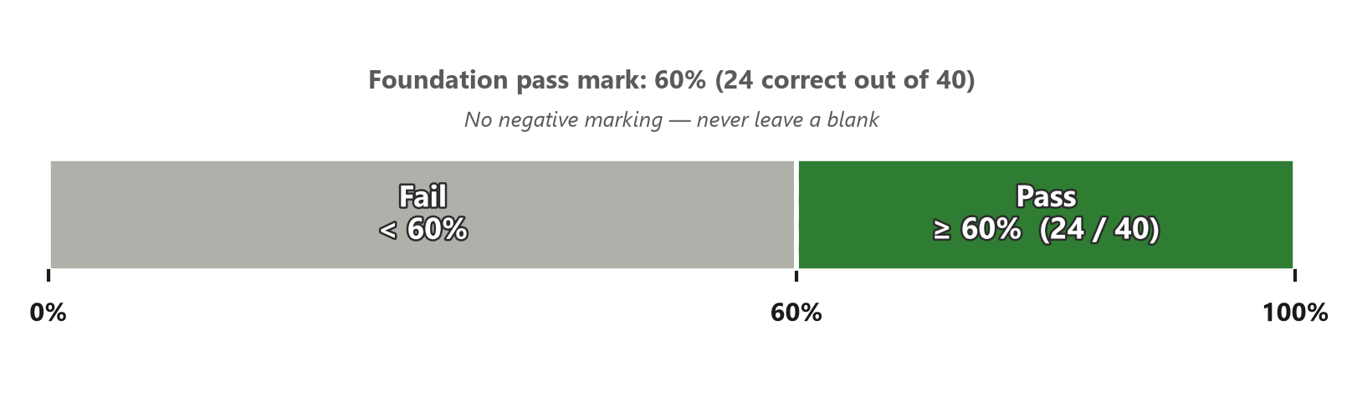
Scoring & Pass Mark
Module 0 — Course Introduction
Pass mark: 60% — 24 out of 40 correct answers
No negative marking — never leave a question blank
Result is pass/fail; shown on screen immediately
~90 seconds per question — comfortable pacing
Confirm current pass mark on the official Open Group site before booking
⭐ EXAM TIP: Confirm the current pass mark and pricing on the official Open Group site before booking — logistics can change.
TOGAF 10 Associate Masterclass | The Open Group
opengroup.org
Notes:
: Scoring & Pass Mark
Here's what you need to score. The pass mark is sixty percent — that's twenty-four correct answers out of forty. There's no negative marking, which leads to the single most important exam-day rule: never leave a question blank. A guess can only help you. The result is simply pass or fail, and you'll see your outcome on screen the moment you finish. With sixty minutes for forty questions, you have about ninety seconds per question — a comfortable, unhurried pace. One caveat shown on screen: always confirm the current pass mark and pricing on the official Open Group site before you book, because these logistics can change over time.
---

Slide 10
What the Exam Covers — The Blueprint
Module 0 — Course Introduction
The Foundation exam draws from the whole TOGAF Standard. Heaviest themes:
  The ADM — the nine phases, their purpose, and their order
  ADM phase inputs, outputs, and key deliverables
  Core concepts — building blocks (ABB/SBB), deliverables vs. artifacts
  Enterprise Continuum & Architecture Repository
  Architecture Governance, Stakeholder Management, Views & Viewpoints
Master the ADM phases and their outputs → largest share of the exam
⭐ EXAM TIP: If you master the ADM phases and their outputs, you have covered the largest share of the exam.
TOGAF 10 Associate Masterclass | The Open Group
opengroup.org
Notes:
: What the Exam Covers — The Blueprint
What does the exam actually test? It draws from across the whole TOGAF Standard, but the weight is far from even. The heaviest themes are the ADM — those nine phases, their purpose, and their order; the inputs, outputs, and key deliverables of each phase; the core concepts like building blocks and the difference between deliverables and artifacts; the Enterprise Continuum and Architecture Repository; and the supporting disciplines of governance, stakeholder management, and views and viewpoints. If you take just one thing from this slide, let it be this: if you truly master the ADM phases and what each one produces, you've already covered the single largest share of the exam.
---

Slide 11
Where the Questions Concentrate
Module 0 — Course Introduction
Theme | Relative weight | Course modules
ADM phases & their purpose | Highest | 2–7
Deliverables, artifacts, building blocks | High | 9
Enterprise Continuum & Repository | High | 8
Governance & Stakeholder Management | Medium | 11, 12
Core definitions & concepts | Medium | 1
Reference Models (TRM, III-RM) | Lower | 13
⭐ EXAM TIP: Spend most of your study time on the ADM — it is the spine of the entire framework.
TOGAF 10 Associate Masterclass | The Open Group
opengroup.org
Notes:
: Where the Questions Concentrate
Let's make that concentration explicit. As the table shows, questions about the ADM phases and their purpose carry the highest weight — that's modules 2 through 7. Deliverables, artifacts, and building blocks are high-value too, covered in Module 9. The Enterprise Continuum and Repository, in Module 8, are also heavily tested. Governance and stakeholder management sit in the medium band, along with the core definitions from Module 1. The reference models — the TRM and the III-RM — carry a lighter weight. The takeaway is simple: spend the bulk of your study time on the ADM. It's the spine that holds the entire framework together.
---

Slide 12
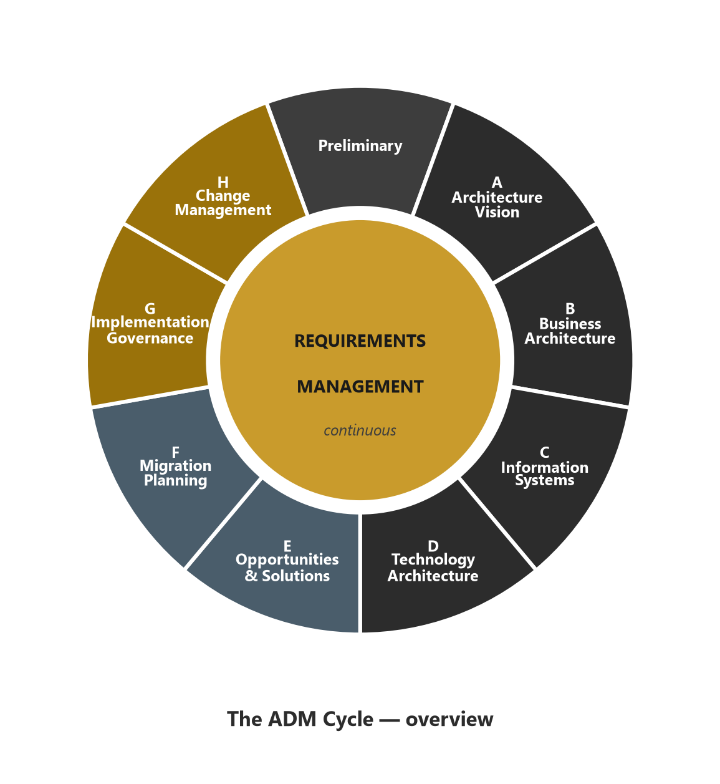
The Big Picture — The ADM Cycle
Module 0 — Course Introduction
ADM = TOGAF's step-by-step method for developing an architecture
9 activities: Preliminary → A → B → C → D → E → F → G → H
Requirements Management sits at the hub, active throughout every phase
It is a continuous cycle — H loops back into a new Preliminary
Memorize this wheel early — almost everything else hangs off it
⭐ EXAM TIP: Memorize this wheel early. Almost everything else in TOGAF hangs off it.
TOGAF 10 Associate Masterclass | The Open Group
opengroup.org
Notes:
: The Big Picture — The ADM Cycle
Here's the single most important picture in all of TOGAF — the ADM cycle. The Architecture Development Method is TOGAF's step-by-step method for actually developing an architecture, and it runs as a continuous cycle of nine activities. You start with a Preliminary Phase to get ready, then move through Phases A to H around the wheel, and crucially, Requirements Management sits right in the center, connected to every phase. As you can see from the diagram, it's a loop, not a straight line — once you reach the end, change management feeds straight back into a new cycle. Memorize this wheel early in your studies, because almost everything else in TOGAF hangs off it.
---

Slide 13
Memory Anchor — The ADM Phases
Module 0 — Course Introduction
1. Preliminary — get ready
2. A — Architecture Vision
3. B — Business Architecture
4. C — Information Systems (Data + Application)
5. D — Technology Architecture
6. E — Opportunities & Solutions
7. F — Migration Planning
8. G — Implementation Governance
9. H — Architecture Change Management
B, C, D = architecture domains · E, F = planning · G, H = realization & change
⭐ EXAM TIP: B, C, D are the "architecture domains" phases; E, F are planning; G, H are realization & change.
TOGAF 10 Associate Masterclass | The Open Group
opengroup.org
Notes:
: Memory Anchor — The ADM Phases
Let's lock the phases into memory with a simple anchor. After the Preliminary Phase, the phases are literally in alphabetical order — A through H. A is Architecture Vision. B is Business Architecture. C is Information Systems, which is Data plus Application. D is Technology Architecture. E is Opportunities and Solutions. F is Migration Planning. G is Implementation Governance. And H is Architecture Change Management. So the whole sequence is just Preliminary, then A-B-C-D-E-F-G-H. Group them in your mind: B, C, and D are the architecture-domain phases; E and F are the planning phases; and G and H are about realization and managing change. That grouping makes the whole cycle much easier to recall under pressure.
---

Slide 14
Memory Anchor — BDAT Domains
Module 0 — Course Introduction
TOGAF covers four architecture domains — remember as BDAT:
B — Business Architecture (Phase B)
D — Data Architecture (Phase C)
A — Application Architecture (Phase C)
T — Technology Architecture (Phase D)
Phase C = TWO domains in one: Data + Application = Information Systems Architecture
⭐ EXAM TIP: Remember that Phase C is two domains in one — Data and Application.
TOGAF 10 Associate Masterclass | The Open Group
opengroup.org
Notes:
: Memory Anchor — BDAT Domains
Here's another anchor that pays off again and again — the four architecture domains, which spell BDAT. B is Business Architecture, developed in Phase B. D is Data Architecture. A is Application Architecture. And T is Technology Architecture, developed in Phase D. Now notice the catch that trips people up: Data and Application together make up the Information Systems Architecture, and they're both developed in Phase C. So Phase C is really two domains in one. Keep BDAT in your head, and remember that the middle two share a single phase.
---

Slide 15
Memory Anchor — Key Acronyms
Module 0 — Course Introduction
Acronym | Meaning
ADM | Architecture Development Method
ABB / SBB | Architecture / Solution Building Block
ADD | Architecture Definition Document
ASR | Architecture Significant Requirement
TRM | Technical Reference Model
III-RM | Integrated Information Infrastructure Reference Model
BDAT | Business, Data, Application, Technology
⭐ EXAM TIP: The exam loves acronyms. Learn what each one expands to and which phase it belongs to.
TOGAF 10 Associate Masterclass | The Open Group
opengroup.org
Notes:
: Memory Anchor — Key Acronyms
The TOGAF exam genuinely loves acronyms, so let's get ahead of them. ADM is the Architecture Development Method. ABB and SBB are Architecture and Solution Building Blocks — we'll dig into the difference later, but the architecture one is the "what" and the solution one is the "with what." ADD is the Architecture Definition Document. TRM is the Technical Reference Model. Triple-I-RM, or III-RM, is the Integrated Information Infrastructure Reference Model. And BDAT, as we just saw, is the four domains. For each acronym, learn two things: what it expands to, and which phase or concept it belongs to. That combination is exactly what the questions test.
---

Slide 16
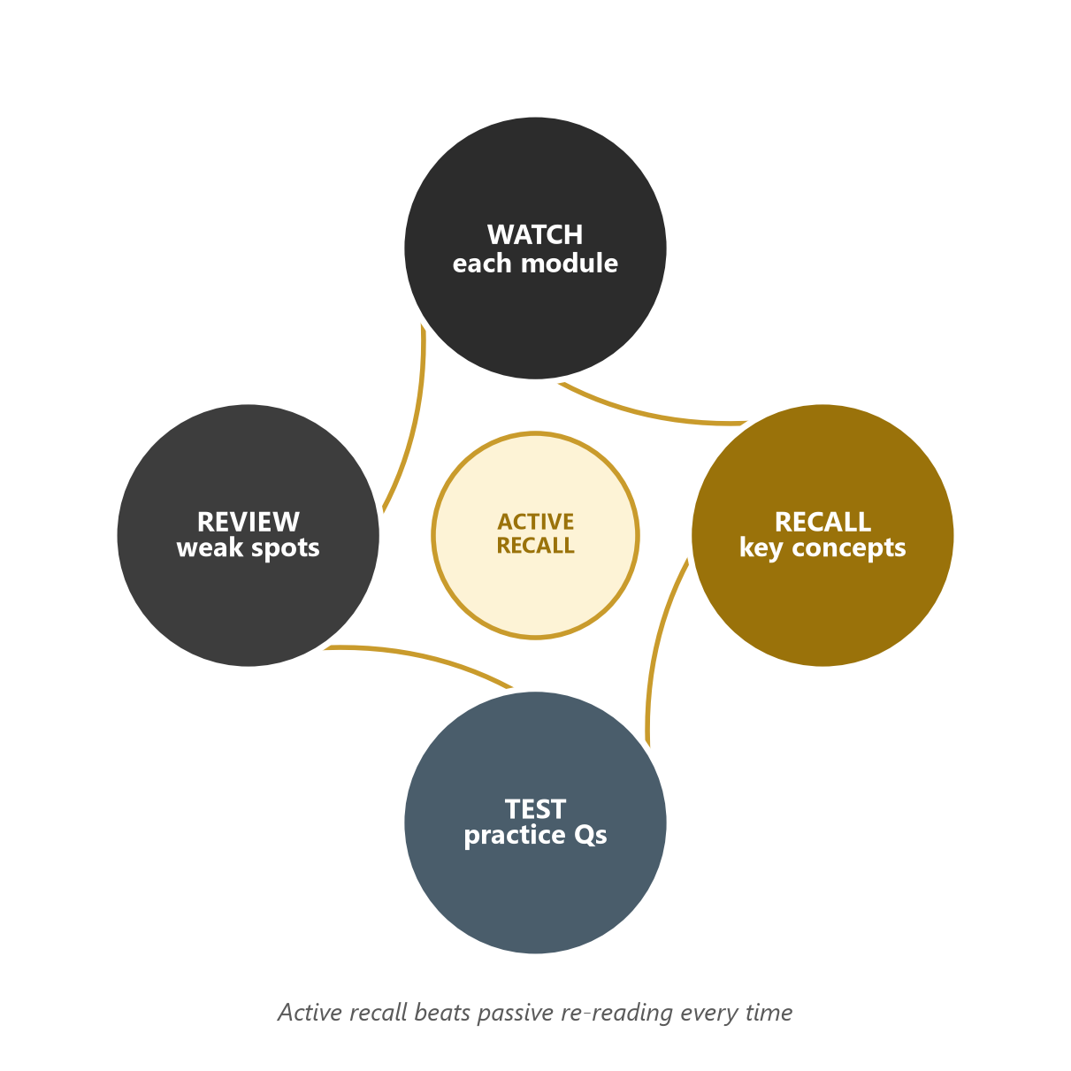
How to Study — A 6-Step Plan
Module 0 — Course Introduction
1. Watch each module in order, start to finish
2. Draw the ADM cycle from memory after Module 2 — repeat until automatic
3. Make flashcards for definitions, phase outputs, and acronyms
4. Do the practice questions at the end of every module
5. Re-watch heavy modules (ADM, Content Framework, Continuum)
6. Take a full timed mock exam the week before your test
⭐ EXAM TIP: Active recall (drawing the ADM, writing definitions) beats passive re-reading every time.
TOGAF 10 Associate Masterclass | The Open Group
opengroup.org
Notes:
: How to Study — A 6-Step Plan
Let me give you a study plan that actually works. Step one: watch each module in order, from start to finish. Step two: right after Module 2, draw the ADM cycle from memory, and keep repeating it until it's automatic. Step three: make flashcards for definitions, phase outputs, and acronyms. Step four: do the practice questions at the end of every module — don't skip them. Step five: re-watch the heavy modules, especially the ADM phases, the Content Framework, and the Continuum. And step six: take a full, timed mock exam in the week before your test. As the loop on screen shows, the rhythm is watch, recall, test, review — and active recall beats passive re-reading every single time.
---

Slide 17
How to Read an Exam Question
Module 0 — Course Introduction
Read the full question and all four options before choosing
Identify the TOGAF term being tested — one keyword usually unlocks the answer
Watch the phase context: many questions are really 'which phase produces / does this?'
Eliminate options that describe the right idea but the wrong phase
When two answers look close, the more TOGAF-specific wording is usually correct
⭐ EXAM TIP: When two answers look close, the more TOGAF-specific wording is usually correct.
TOGAF 10 Associate Masterclass | The Open Group
opengroup.org
Notes:
: How to Read an Exam Question
Reading the question well is half the battle. Always read the full question and all four options before you commit to an answer. Then identify the specific TOGAF term being tested — very often, a single keyword unlocks the whole thing. Pay close attention to phase context, because a huge number of questions are secretly asking "which phase produces this, or does this?" Once you spot that, you can eliminate any option that describes the right idea but attaches it to the wrong phase. And here's a tiebreaker: when two answers look almost identical, the one with the more precise, TOGAF-specific wording is usually the correct one.
---

Slide 18
Common Exam Traps
Module 0 — Course Introduction
Confusing a deliverable (signed-off, contractual) with an artifact (catalog/matrix/diagram)
Mixing up ABB (capability, the 'what') with SBB (implementation, the 'with what')
Thinking the ADM must run strictly in sequence — it is iterative and tailorable
Placing Data Architecture in Phase B — it belongs to Phase C
Assuming Requirements Management is a one-time phase — it runs continuously at the center
Tip: 'always / never / only' answers are usually wrong in a tailorable framework
⭐ EXAM TIP: Note the "always / never / only" answers — in a tailorable framework, absolute statements are often wrong.
TOGAF 10 Associate Masterclass | The Open Group
opengroup.org
Notes:
: Common Exam Traps
Now let's defuse the traps before you ever meet them. First, don't confuse a deliverable with an artifact — a deliverable is formally signed off and contractual, while an artifact is a catalog, matrix, or diagram. Second, don't mix up an ABB with an SBB — the architecture building block is a capability, the "what," and the solution building block is the implementation, the "with what." Third, don't assume the ADM must run strictly in sequence; it's iterative and tailorable. Fourth, don't put Data Architecture in Phase B — it lives in Phase C. And fifth, don't treat Requirements Management as a one-time phase; it runs continuously at the center. One more tip: be suspicious of any answer containing "always," "never," or "only" — in a flexible framework, absolutes are usually wrong.
---

Slide 19
Red-Flag Words in Answers
Module 0 — Course Introduction
Be cautious with options containing 'always,' 'never,' 'must always,' 'the only way'
TOGAF is deliberately flexible and tailorable — rigid absolutes rarely match its language
Prefer answers that say 'may,' 'typically,' 'is recommended,' 'supports'
This single habit can rescue several borderline questions on exam day
⭐ EXAM TIP: This single habit can rescue several borderline questions on exam day.
TOGAF 10 Associate Masterclass | The Open Group
opengroup.org
Notes:
: Red-Flag Words in Answers
Let's expand on that last point, because it's worth a slide of its own. Be cautious whenever an answer option contains words like "always," "never," "must always," or "the only way." TOGAF is deliberately flexible and tailorable, so rigid, absolute statements rarely match its actual language. Instead, lean toward answers that use softer, more accurate words — "may," "typically," "is recommended," "supports." This one simple habit — distrusting absolutes — can rescue several borderline questions on exam day, and those marginal points are often the difference between a pass and a fail.
---

Slide 20
Exam-Day Technique
Module 0 — Course Introduction
First pass: answer every easy question; flag the hard ones
Second pass: return to flagged questions with remaining time
Never leave a blank — no penalty for a wrong guess
Keep an eye on the clock: ~90 seconds per question is your budget
Trust your first instinct unless you find a clear reason to change — second-guessing causes avoidable errors
⭐ EXAM TIP: Trust your first instinct unless you find a clear reason to change — second-guessing causes avoidable errors.
TOGAF 10 Associate Masterclass | The Open Group
opengroup.org
Notes:
: Exam-Day Technique
Here's how to run the exam itself. On your first pass, answer every question you find easy and flag the hard ones to come back to — don't get stuck. On your second pass, return to those flagged questions with your remaining time. Remember the golden rule: never leave a blank, because there's no penalty for a wrong guess. Keep half an eye on the clock — your budget is about ninety seconds per question. And generally, trust your first instinct; only change an answer if you find a clear, concrete reason to. Endless second-guessing causes far more errors than it fixes.
---

Slide 21
The Three Things You Must Know Cold
Module 0 — Course Introduction
1. The ADM — all nine phases, their order, and the one-line purpose of each
2. Phase outputs — which deliverable or document each phase produces
3. Core vocabulary — building blocks, deliverables vs. artifacts, the Continuum, the Repository
Master these three and you are already most of the way to a pass.
⭐ EXAM TIP: If you are short on time, prioritize the ADM phases above everything else.
TOGAF 10 Associate Masterclass | The Open Group
opengroup.org
Notes:
: The Three Things You Must Know Cold
If you remember nothing else from this orientation, remember these three things you must know cold. One: the ADM — all nine phases, their order, and the one-line purpose of each. Two: phase outputs — which deliverable or document each phase produces. And three: the core vocabulary — building blocks, deliverables versus artifacts, the Continuum, and the Repository. Master those three and you're already most of the way to a pass. And if you're ever short on study time, prioritize the ADM phases above absolutely everything else.
---

Slide 22
What You'll Be Able to Do by the End
Module 0 — Course Introduction
Draw and explain the full ADM cycle from memory
State the purpose, inputs, and outputs of every ADM phase
Define every core TOGAF concept the exam tests
Navigate the Enterprise Continuum, Architecture Repository, and Content Framework
Answer Foundation exam questions with confidence and speed
Treat each module's practice questions as a mini mock exam
⭐ EXAM TIP: Treat each module's practice questions as a mini mock exam.
TOGAF 10 Associate Masterclass | The Open Group
opengroup.org
Notes:
: What You'll Be Able to Do by the End
Let's set your expectations for the finish line. By the end of this course, you'll be able to draw and explain the full ADM cycle from memory. You'll be able to state the purpose, inputs, and outputs of every ADM phase. You'll be able to define every core TOGAF concept the exam tests. You'll be comfortable navigating the Enterprise Continuum, the Architecture Repository, and the Content Framework. And above all, you'll be able to answer Foundation exam questions with both confidence and speed. Treat each module's practice questions as a mini mock exam along the way.
---

Slide 23
A Note on the TOGAF Documentation Set
Module 0 — Course Introduction
1. Introduction and Core Concepts
2. Architecture Development Method
3. ADM Techniques
4. Applying the ADM
5. Architecture Content
6. Enterprise Architecture Capability and Governance
Plus the TOGAF Library and TOGAF Series Guides for extra guidance.
⭐ EXAM TIP: You don't need to memorize the document set, but knowing this structure helps the concepts fall into place.
TOGAF 10 Associate Masterclass | The Open Group
opengroup.org
Notes:
: A Note on the TOGAF Documentation Set
A quick orientation to the source material. The TOGAF Standard, 10th Edition isn't one giant book — it's published as six core documents: Introduction and Core Concepts; the Architecture Development Method; ADM Techniques; Applying the ADM; Architecture Content; and Enterprise Architecture Capability and Governance. On top of those sit the TOGAF Library and the TOGAF Series Guides, which provide extra, practical guidance. Now, you don't need to memorize this document set for the exam, but knowing how the standard is organized genuinely helps the concepts fall into place as we go — each module maps neatly onto parts of this structure.
---

Slide 24
Key Numbers & Quick Facts (Cheat Sheet)
Module 0 — Course Introduction
Fact | Value
TOGAF current edition | 10th (2022)
Maintained by | The Open Group
ADM phases | Preliminary + A–H = 9 activities
Architecture domains (BDAT) | 4
Foundation exam questions | 40
Exam duration | 60 minutes
Pass mark | 60% (24 / 40)
Exam style | Multiple choice, closed book
Building block types | 2 (ABB, SBB)
Content work-product types | 3 (deliverable, artifact, building block)
TOGAF 10 Associate Masterclass | The Open Group
opengroup.org
Notes:
: Key Numbers & Quick Facts (Cheat Sheet)
Let's consolidate the must-know numbers onto one cheat-sheet slide. TOGAF's current edition is the 10th, from 2022, maintained by The Open Group. The ADM has nine activities — the Preliminary Phase plus Phases A through H. There are four architecture domains, captured by BDAT. The Foundation exam is forty questions in sixty minutes, with a sixty-percent pass mark — that's twenty-four out of forty — and it's multiple choice and closed book. There are two types of building block, ABB and SBB, and three types of content work product: deliverables, artifacts, and building blocks. Screenshot this slide; it's your quick-reference card for the whole course.
---

Slide 25
Module Summary
Module 0 — Course Introduction
This course prepares you for the TOGAF 10 Foundation (Part 1) exam in 15 lessons
The exam is 40 questions, 60 minutes, closed book, 60% to pass
The ADM is the heart of TOGAF — learn its nine phases and their outputs first
Use active recall, practice questions, and a timed mock to be exam-ready
Watch for deliverable-vs-artifact and ABB-vs-SBB traps, and distrust absolute wording
TOGAF 10 Associate Masterclass | The Open Group
opengroup.org
Notes:
: Module Summary
Let's recap this orientation. This course prepares you for the TOGAF 10 Foundation, or Part 1, exam across fifteen lessons. The exam is forty questions, sixty minutes, closed book, and you need sixty percent to pass. The ADM is the beating heart of TOGAF, so learn its nine phases and their outputs first. Use active recall, work through every practice question, and finish with a timed mock exam to be truly ready. And keep your guard up for the deliverable-versus-artifact and ABB-versus-SBB traps, and stay skeptical of absolute wording. Next up, Module 1 — where we properly meet Enterprise Architecture and the TOGAF framework.
---

Slide 26
Practice Question 1
Module 0 — Course Introduction
Q1
How many multiple-choice questions are on the TOGAF 10 Foundation (Part 1) exam, and what is the pass mark?
A) 60 questions, 50% to pass
B) 40 questions, 60% to pass
C) 40 questions, 55% to pass
D) 50 questions, 70% to pass
Explanation: The Foundation exam has 40 multiple-choice questions with a 60% pass mark (24 of 40). It is closed book and runs for 60 minutes. Always verify current logistics on the official Open Group site.
TOGAF 10 Associate Masterclass | The Open Group
opengroup.org
Notes:
: Practice Questions (Q1–Q5)
Let's test what you've absorbed with five quick questions, and we'll do this at the end of every module. Take a moment with each one, pick your answer, and then we'll reveal it. Question one asks about the exam format and pass mark. Question two checks which two domains share a single ADM phase. Question three is about the activity that runs continuously at the center of the cycle. Question four simply confirms what TOGAF stands for. And question five asks which study approach best fits how the exam is framed. Pause if you need to, then let's walk through the answers together. Getting comfortable with this question rhythm now will pay off all the way to exam day.
---
*End of Module 0 — Course Introduction & Exam Guide.*

Slide 27
Practice Question 2
Module 0 — Course Introduction
Q2
In the TOGAF ADM, which two architecture domains are developed together within a single phase?
A) Business and Data, in Phase B
B) Data and Application, in Phase C
C) Application and Technology, in Phase D
D) Business and Technology, in Phase A
Explanation: Phase C — Information Systems Architectures covers both Data and Application architecture. Business is Phase B and Technology is Phase D. Remembering "Phase C = two domains" prevents a common trap.
TOGAF 10 Associate Masterclass | The Open Group
opengroup.org
Notes:
: Practice Questions (Q1–Q5)
Let's test what you've absorbed with five quick questions, and we'll do this at the end of every module. Take a moment with each one, pick your answer, and then we'll reveal it. Question one asks about the exam format and pass mark. Question two checks which two domains share a single ADM phase. Question three is about the activity that runs continuously at the center of the cycle. Question four simply confirms what TOGAF stands for. And question five asks which study approach best fits how the exam is framed. Pause if you need to, then let's walk through the answers together. Getting comfortable with this question rhythm now will pay off all the way to exam day.
---
*End of Module 0 — Course Introduction & Exam Guide.*

Slide 28
Practice Question 3
Module 0 — Course Introduction
Q3
Which activity in the ADM operates continuously at the center of the cycle rather than as a one-time step?
A) Architecture Vision
B) Implementation Governance
C) Requirements Management
D) Migration Planning
Explanation: Requirements Management sits at the center of the ADM and runs throughout every phase, capturing and feeding requirements continuously. The other options are discrete phases (A, G, and F respectively).
TOGAF 10 Associate Masterclass | The Open Group
opengroup.org
Notes:
: Practice Questions (Q1–Q5)
Let's test what you've absorbed with five quick questions, and we'll do this at the end of every module. Take a moment with each one, pick your answer, and then we'll reveal it. Question one asks about the exam format and pass mark. Question two checks which two domains share a single ADM phase. Question three is about the activity that runs continuously at the center of the cycle. Question four simply confirms what TOGAF stands for. And question five asks which study approach best fits how the exam is framed. Pause if you need to, then let's walk through the answers together. Getting comfortable with this question rhythm now will pay off all the way to exam day.
---
*End of Module 0 — Course Introduction & Exam Guide.*

Slide 29
Practice Question 4
Module 0 — Course Introduction
Q4
What is the correct expansion of "TOGAF"?
A) Total Organization Governance and Architecture Framework
B) The Open Group Architecture Framework
C) Technical Operations Group Architecture Format
D) The Official Guide to Architecture Frameworks
Explanation: TOGAF stands for The Open Group Architecture Framework. It is an open, industry-consensus framework for Enterprise Architecture maintained by The Open Group.
TOGAF 10 Associate Masterclass | The Open Group
opengroup.org
Notes:
: Practice Questions (Q1–Q5)
Let's test what you've absorbed with five quick questions, and we'll do this at the end of every module. Take a moment with each one, pick your answer, and then we'll reveal it. Question one asks about the exam format and pass mark. Question two checks which two domains share a single ADM phase. Question three is about the activity that runs continuously at the center of the cycle. Question four simply confirms what TOGAF stands for. And question five asks which study approach best fits how the exam is framed. Pause if you need to, then let's walk through the answers together. Getting comfortable with this question rhythm now will pay off all the way to exam day.
---
*End of Module 0 — Course Introduction & Exam Guide.*

Slide 30
Practice Question 5
Module 0 — Course Introduction
Q5
Which study approach is most effective for the TOGAF Foundation exam, given how the questions are framed?
A) Memorizing the page numbers of the TOGAF documents
B) Re-reading the standard passively several times
C) Active recall of the ADM phases, their order, and their outputs
D) Focusing only on the Reference Models (TRM and III-RM)
Explanation: The exam concentrates on the ADM phases and their outputs, so active recall of the cycle is the highest-yield strategy. Passive re-reading and memorizing page numbers are inefficient, and the Reference Models are a smaller slice of the exam. End of Module 0 — Course Introduction & Exam Guide.
TOGAF 10 Associate Masterclass | The Open Group
opengroup.org
Notes:
: Practice Questions (Q1–Q5)
Let's test what you've absorbed with five quick questions, and we'll do this at the end of every module. Take a moment with each one, pick your answer, and then we'll reveal it. Question one asks about the exam format and pass mark. Question two checks which two domains share a single ADM phase. Question three is about the activity that runs continuously at the center of the cycle. Question four simply confirms what TOGAF stands for. And question five asks which study approach best fits how the exam is framed. Pause if you need to, then let's walk through the answers together. Getting comfortable with this question rhythm now will pay off all the way to exam day.
---
*End of Module 0 — Course Introduction & Exam Guide.*

