Slide 1
TOGAF 10 ASSOCIATE MASTERCLASS
THE ARCHITECTURE DEVELOPMENT METHOD (ADM)
Module 2: The ADM — Overview
TOGAF Standard, 10th Edition · Foundation Exam Preparation
Module 2 — ADM Overview
40
60
Closed
≥60%
questions
minutes
book
to pass
TOGAF 10 Associate Masterclass | The Open Group
opengroup.org
Notes:
: THE ARCHITECTURE DEVELOPMENT METHOD (ADM)
Welcome to Module 2 — and this is the big one. The Architecture Development Method, the ADM, is the beating heart of TOGAF and by far the most heavily tested topic on the exam. If you only truly master one module in this whole course, make it this one. We'll meet all nine activities of the cycle, see how they fit together, and learn how the method is scoped and iterated. By the end, you'll be able to draw the ADM wheel from memory. Let's get into it.
---

Slide 2
Module Overview & Learning Objectives
Module 2 — ADM Overview
By the end of this module, you'll be able to:
  Explain what the ADM is and what it is not
  Draw the ADM cycle — Preliminary + Phases A–H + Requirements Management
  State the one-line purpose of every phase
  Explain how the ADM is iterative and how it is scoped (4 dimensions)
  Trace the key deliverables that flow between phases
  Understand version numbering and adapting the ADM
⭐ EXAM TIP: This is the highest-yield module in the course. Master the cycle here.
TOGAF 10 Associate Masterclass | The Open Group
opengroup.org
Notes:
: Module Overview & Learning Objectives
Here's our plan for this module. You'll be able to explain what the ADM is — and just as importantly, what it is not. You'll draw the full cycle: the Preliminary Phase, Phases A through H, and Requirements Management in the center. You'll state the one-line purpose of every phase. You'll understand how the method is iterative and how its scope is set using four dimensions. You'll trace the key deliverables as they flow from phase to phase. And you'll learn the version-numbering convention and how the ADM is adapted. This is the highest-yield module in the course, so let's make the cycle second nature.
---

Slide 3
What Is the ADM?
Module 2 — ADM Overview
The Architecture Development Method is a tested, repeatable process for developing architectures.
It covers: establishing an architecture framework, developing architecture content, transitioning, and governing the realization of architectures.
It runs as an iterative cycle of continuous architecture definition and realization.
It lets an organization transform in a controlled way in response to business goals and opportunities.
⭐ EXAM TIP: The ADM is the method at the core of TOGAF — phases A–H plus Preliminary and Requirements Management.
TOGAF 10 Associate Masterclass | The Open Group
opengroup.org
Notes:
: What Is the ADM?
So what exactly is the ADM? It's a tested, repeatable process for developing architectures. It covers the full journey: establishing your architecture framework, developing the actual architecture content, transitioning toward it, and governing how it gets realized in practice. And it does all of this within an iterative cycle of continuous architecture definition and realization. The point of that cycle is to let an organization transform itself in a controlled, deliberate way — responding to business goals and new opportunities rather than lurching from crisis to crisis. In short, the ADM is the method at the very core of TOGAF: the Preliminary Phase, Phases A through H, and Requirements Management binding it all together.
---

Slide 4
What the ADM Is NOT
Module 2 — ADM Overview
It does NOT mandate that phases run in a strict, fixed sequence.
It does NOT mandate a "waterfall" approach.
It is better seen as a reference model of what must be done than as a literal process flow.
It is meant to be adapted to the enterprise and to different architecture styles.
⭐ EXAM TIP: Any answer saying "the ADM must always be followed step-by-step in order" is wrong.
TOGAF 10 Associate Masterclass | The Open Group
opengroup.org
Notes:
: What the ADM Is NOT
Now let's clear up the most common misconception, because the exam tests it directly. The ADM does not mandate that the phases be performed in a strict, fixed sequence. It does not mandate a waterfall approach. Instead, it's far more useful to think of the ADM as a reference model of what must be done, rather than a literal, one-way process flow. And it's explicitly meant to be adapted — to your enterprise and to different architecture styles, whether that's Agile, security-focused, or digital. So burn this in: any exam answer claiming the ADM must always be followed step-by-step, in order, is wrong. Flexibility is a core design feature.
---

Slide 5
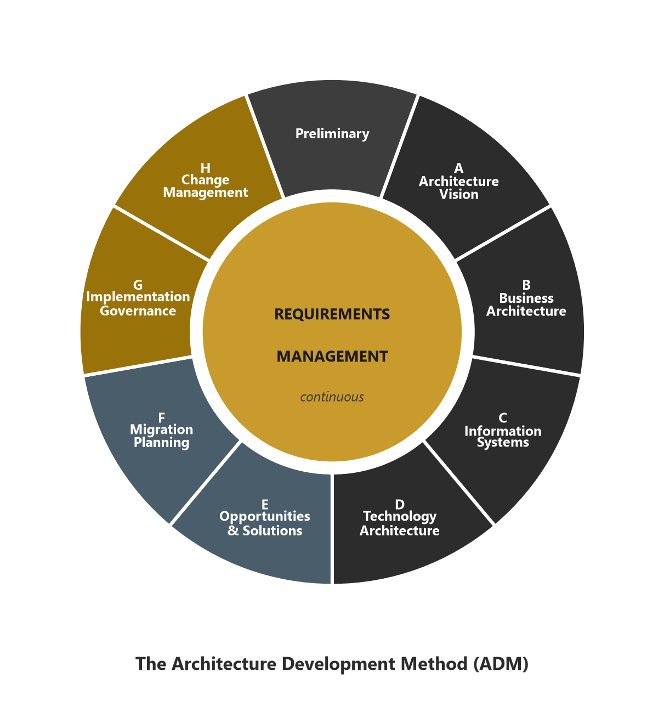
The ADM Cycle
Module 2 — ADM Overview
Nine activities arranged as a continuous loop, with Requirements Management at the center:
Preliminary → A Vision → B Business → C Information Systems → D Technology → E Opportunities & Solutions → F Migration Planning → G Implementation Governance → H Architecture Change Management → (loop back).
⭐ EXAM TIP: Requirements Management is not a step in the loop — it sits in the middle, feeding every phase.
TOGAF 10 Associate Masterclass | The Open Group
opengroup.org
Notes:
: The ADM Cycle
Here it is — the picture to memorize. The ADM is nine activities arranged as a continuous loop. You begin with the Preliminary Phase, then move clockwise: Phase A, Architecture Vision; Phase B, Business; Phase C, Information Systems; Phase D, Technology; Phase E, Opportunities and Solutions; Phase F, Migration Planning; Phase G, Implementation Governance; and Phase H, Architecture Change Management — which loops you back around to start again. And right in the middle sits Requirements Management. Here's the subtlety the exam loves: Requirements Management is not a step in the loop. It sits in the center, connected to every single phase, feeding requirements in and out. Practice drawing this wheel until you can do it blind.
---

Slide 6
The Preliminary Phase
Module 2 — ADM Overview
Purpose: Prepare and initiate — get the organization ready to do architecture.
Key activities: define the scope, establish the architecture team & organization, define Architecture Principles, and tailor the TOGAF framework.
Establishes the Architecture Capability and selects tools.
Answers: "Where, what, why, who, and how do we do architecture in this enterprise?"
⭐ EXAM TIP: The Preliminary Phase is where Architecture Principles are first defined and the framework is tailored.
TOGAF 10 Associate Masterclass | The Open Group
opengroup.org
Notes:
: The Preliminary Phase
Let's walk the phases one at a time, starting with Preliminary. Its purpose is to prepare and initiate — to get the organization genuinely ready to do architecture work in the first place. This is where you define the scope of your architecture effort, establish the architecture team and organizational structure, define your Architecture Principles, and tailor the TOGAF framework to your needs. It's also where you stand up the Architecture Capability itself and select your tools. Think of it as answering the questions: where, what, why, who, and how will we do architecture in this enterprise? The two facts to remember: the Preliminary Phase is where Architecture Principles are first defined, and where the framework gets tailored.
---

Slide 7
Phase A — Architecture Vision
Module 2 — ADM Overview
Purpose: Set the scope, vision, and stakeholders for this architecture cycle.
Triggered by a Request for Architecture Work.
Produces the Architecture Vision and the Statement of Architecture Work (which is then approved).
Identifies stakeholders, concerns, business requirements, and business transformation readiness/risks.
⭐ EXAM TIP: Phase A delivers the Statement of Architecture Work — the "contract" to do the cycle. (Detailed in Module 3.)
TOGAF 10 Associate Masterclass | The Open Group
opengroup.org
Notes:
: Phase A — Architecture Vision
Phase A is Architecture Vision, and it kicks off each individual cycle of architecture work. Its purpose is to set the scope, the vision, and the stakeholders for this particular cycle. It's triggered by a document called the Request for Architecture Work. During Phase A you identify your stakeholders, their concerns, and the business requirements; you assess readiness for business transformation and the associated risks. And it produces two headline outputs: the Architecture Vision itself, a high-level aspirational picture, and the Statement of Architecture Work — essentially the contract to carry out this cycle, which then gets formally approved. Remember that link: Phase A delivers the Statement of Architecture Work. We'll go deep on Phase A in Module 3.
---

Slide 8
Phase B — Business Architecture
Module 2 — ADM Overview
Purpose: Develop the Business Architecture that supports the agreed Vision.
Describes baseline and target business structure, processes, capabilities, and organization.
Performs gap analysis between baseline and target.
Domain: the B in BDAT.
⭐ EXAM TIP: Phase B = Business domain. Uses business capabilities and value streams. (Detailed in Module 4.)
TOGAF 10 Associate Masterclass | The Open Group
opengroup.org
Notes:
: Phase B — Business Architecture
Phase B is the Business Architecture phase — the B in BDAT. Its purpose is to develop the Business Architecture that supports the Vision you agreed in Phase A. Here you describe both the baseline, or as-is, and the target, or to-be, state of the business: its structure, its processes, its capabilities, and its organization. And you perform a gap analysis to identify the difference between where the business is today and where it needs to be. Phase B leans heavily on two modern tools — business capabilities and value streams. We'll cover Phase B in detail in Module 4; for now, just anchor it as the Business domain.
---

Slide 9
Phase C — Information Systems Architectures
Module 2 — ADM Overview
Purpose: Develop the Data and Application architectures supporting the Vision.
Two domains in one phase:
  Data Architecture — structure of data assets & data management
  Application Architecture — applications, their interactions, and links to processes
Either may be developed first, depending on the situation.
⭐ EXAM TIP: Phase C = Data + Application = Information Systems. The classic "two domains, one phase." (Module 4.)
TOGAF 10 Associate Masterclass | The Open Group
opengroup.org
Notes:
: Phase C — Information Systems Architectures
Phase C is the one with the famous twist. Its purpose is to develop the Information Systems Architectures supporting the Vision — and that means two domains in a single phase. Data Architecture covers the structure of your data assets and how data is managed. Application Architecture covers your applications, how they interact, and how they link to business processes. Either one can be developed first, depending on the situation and the drivers. This is the classic exam fact you must never forget: Phase C equals Data plus Application, together making up Information Systems. Two domains, one phase. We'll unpack both in Module 4.
---

Slide 10
Phase D — Technology Architecture
Module 2 — ADM Overview
Purpose: Develop the Technology Architecture supporting the Vision.
Describes the logical & physical technology — platforms, networks, infrastructure, standards.
Provides the foundation that the implementation projects in Phase E will build on.
Domain: the T in BDAT.
⭐ EXAM TIP: Phase D = Technology domain — the infrastructure that realizes the business, data, and application services. (Module 4.)
TOGAF 10 Associate Masterclass | The Open Group
opengroup.org
Notes:
: Phase D — Technology Architecture
Phase D is Technology Architecture — the T in BDAT. Its purpose is to develop the Technology Architecture that supports the agreed Vision. This is where you describe the logical and physical technology: the platforms, the networks, the infrastructure, and the standards that everything else runs on. Phase D provides the technical foundation that the implementation projects, identified later in Phase E, will actually build upon. So in the architecture-development sequence, Technology is the layer that realizes the business, data, and application services above it. We'll detail Phase D alongside B and C in Module 4.
---

Slide 11
Phase E — Opportunities & Solutions
Module 2 — ADM Overview
Purpose: First implementation planning — identify delivery vehicles (projects, programs).
Consolidates gaps from Phases B, C, D into work packages.
Defines Transition Architectures — incremental, deliverable states between baseline and target.
The pivot from "what" (architecture) to "how/when" (delivery).
⭐ EXAM TIP: Phase E is where Transition Architectures and work packages first appear. (Module 5.)
TOGAF 10 Associate Masterclass | The Open Group
opengroup.org
Notes:
: Phase E — Opportunities & Solutions
With Phases B, C, and D done, we've described the architecture. Phase E, Opportunities and Solutions, is where we pivot toward making it real. Its purpose is the first round of implementation planning — identifying the delivery vehicles, meaning the actual projects and programs that will deliver the change. Phase E takes all the gaps identified in the Business, Data, Application, and Technology phases and consolidates them into work packages. It's also where Transition Architectures first appear — those incremental, deliverable states that sit between your baseline and your final target. So Phase E is the hinge between "what" and "how and when." Remember it as the home of work packages and Transition Architectures. Full detail in Module 5.
---

Slide 12
Phase F — Migration Planning
Module 2 — ADM Overview
Purpose: Finalize a detailed Implementation & Migration Plan — how to move from baseline to target.
Prioritizes projects (cost/benefit/risk), confirms the Transition Architectures.
Produces the finished, agreed roadmap and migration plan.
⭐ EXAM TIP: Phase E identifies the work; Phase F plans and sequences it. Don't swap them. (Module 5.)
TOGAF 10 Associate Masterclass | The Open Group
opengroup.org
Notes:
: Phase F — Migration Planning
Phase F is Migration Planning, and it follows naturally from Phase E. Its purpose is to finalize a detailed Implementation and Migration Plan — the concrete answer to how you move from baseline to target. Here you prioritize the projects by cost, benefit, and risk, and you confirm the Transition Architectures. The output is the finished, agreed roadmap and migration plan that delivery teams will actually follow. Here's the exam trap to sidestep: Phase E identifies the work, but Phase F plans and sequences it in detail. Don't swap those two. We'll cover both planning phases together in Module 5.
---

Slide 13
Phase G — Implementation Governance
Module 2 — ADM Overview
Purpose: Provide architectural oversight of the implementation.
Ensures projects conform to the target architecture via the Architecture Contract.
The architecture team supports and governs delivery; produces compliance assessments.
⭐ EXAM TIP: Phase G is where the Architecture Contract governs implementation and compliance is checked. (Module 6.)
TOGAF 10 Associate Masterclass | The Open Group
opengroup.org
Notes:
: Phase G — Implementation Governance
Phase G is Implementation Governance. Now that there's a plan, the projects start building — and Phase G provides the architectural oversight while they do. Its purpose is to make sure what actually gets built conforms to the target architecture you defined. The key mechanism here is the Architecture Contract, which binds the delivery teams to the architecture. The architecture team supports and governs delivery, and produces compliance assessments to confirm projects are staying on track. So whenever you see "Architecture Contract" or "compliance" in the context of building solutions, think Phase G. We'll explore it in Module 6.
---

Slide 14
Phase H — Architecture Change Management
Module 2 — ADM Overview
Purpose: Establish procedures for managing change to the new architecture.
Monitors changes (technology, business) and decides whether they need a new ADM cycle.
Keeps the architecture relevant and alive rather than letting it decay.
⭐ EXAM TIP: Phase H manages change; a significant change triggers a new iteration of the ADM. (Module 6.)
TOGAF 10 Associate Masterclass | The Open Group
opengroup.org
Notes:
: Phase H — Architecture Change Management
Phase H is Architecture Change Management, and it closes the loop. Its purpose is to establish the procedures for managing change to the new architecture once it's in place. The architecture team monitors what's changing — new technology, shifting business needs — and decides whether each change can be absorbed, or whether it's significant enough to warrant kicking off a whole new ADM cycle. This is what keeps the architecture relevant and alive, rather than letting it slowly decay into a shelf document. The exam point: Phase H manages change, and a significant change triggers a new iteration of the ADM. Detail in Module 6.
---

Slide 15
Requirements Management (The Center)
Module 2 — ADM Overview
Purpose: Manage architecture requirements continuously, throughout every phase.
It is the center of the ADM — every phase feeds requirements into it and draws requirements from it.
It is a dynamic process, not a static phase with a start and end.
⭐ EXAM TIP: Requirements Management never stops — it operates across the whole cycle. (Module 7.)
TOGAF 10 Associate Masterclass | The Open Group
opengroup.org
Notes:
: Requirements Management (The Center)
And now the center of the wheel — Requirements Management. Its purpose is to manage architecture requirements continuously, throughout every single phase. Picture it sitting in the middle, with spokes connecting it to all nine surrounding activities: every phase feeds requirements into it, and every phase draws requirements from it. The crucial thing to understand is that this is a dynamic, ongoing process — it is not a static phase with a clean start and finish. Requirements are constantly arriving, changing, and being resolved as the work proceeds. So lock this in: Requirements Management never stops; it operates across the whole cycle. We give it its own module, Module 7.
---

Slide 16
One-Line Purpose of Each Phase
Module 2 — ADM Overview
Phase | One-line purpose
Preliminary | Get ready — capability, principles, tailoring
A | Vision, scope, stakeholders → Statement of Arch Work
B | Business Architecture
C | Data + Application (Information Systems)
D | Technology Architecture
E | Identify delivery vehicles & Transition Architectures
F | Detailed Implementation & Migration Plan
G | Govern the implementation
H | Manage architecture change
Req. Mgmt | Manage requirements throughout (center)
⭐ EXAM TIP: If you can reproduce this table from memory, you've covered a large chunk of the exam.
TOGAF 10 Associate Masterclass | The Open Group
opengroup.org
Notes:
: One-Line Purpose of Each Phase
Let's consolidate everything onto one table you can revise from. Preliminary: get ready — capability, principles, tailoring. Phase A: vision, scope, stakeholders, producing the Statement of Architecture Work. Phase B: Business Architecture. Phase C: Data plus Application, the Information Systems. Phase D: Technology Architecture. Phase E: identify delivery vehicles and Transition Architectures. Phase F: the detailed Implementation and Migration Plan. Phase G: govern the implementation. Phase H: manage architecture change. And Requirements Management: manage requirements throughout, from the center. If you can reproduce this single table from memory, you've already covered a very large chunk of the exam. I'd genuinely recommend writing it out by hand a few times.
---

Slide 17
The ADM Is Iterative
Module 2 — ADM Overview
Iteration happens at multiple levels:
  Around the whole cycle — repeated over time as the enterprise evolves
  Between phases — e.g., looping between Vision and the Preliminary Phase
  Within a phase — refining detail
Each iteration adds assets to the Architecture Repository.
⭐ EXAM TIP: The ADM "cycles" — there is no single, one-shot pass. Iteration is fundamental.
TOGAF 10 Associate Masterclass | The Open Group
opengroup.org
Notes:
: The ADM Is Iterative
We've called the ADM iterative several times — let's make that concrete, because iteration happens at three distinct levels. First, around the whole cycle: you run the entire ADM again and again over time as the enterprise evolves. Second, between phases: for example, you might loop back and forth between the Architecture Vision and the Preliminary Phase to get things aligned. And third, within a single phase: refining and adding detail as you go. And every iteration adds new assets into the Architecture Repository, so the organization's body of architecture work keeps growing. The takeaway: there's no single, one-shot pass through the ADM. Iteration is fundamental to how it works.
---

Slide 18
Decisions Made Each Iteration
Module 2 — ADM Overview
For each iteration of the ADM, a fresh decision is taken on:
  The breadth of coverage
  The level of detail (depth)
  The time period (and number of Transition Architectures)
  The architecture assets to leverage (from the Repository / Continuum)
⭐ EXAM TIP: Every iteration re-decides scope and reuse — nothing is assumed fixed from last time.
TOGAF 10 Associate Masterclass | The Open Group
opengroup.org
Notes:
: Decisions Made Each Iteration
Because the ADM is iterative, each time you begin an iteration you make a fresh set of decisions — nothing is just assumed from last time. Specifically, you re-decide four things: the breadth of coverage — how much of the enterprise you're tackling; the level of detail, or depth; the time period, including how many Transition Architectures you'll define; and which architecture assets you'll leverage from the Repository and the Continuum. Notice that the first three of those map directly onto the scoping dimensions we're about to see, and the fourth is about reuse. Every iteration re-decides scope and reuse, deliberately and explicitly.
---

Slide 19
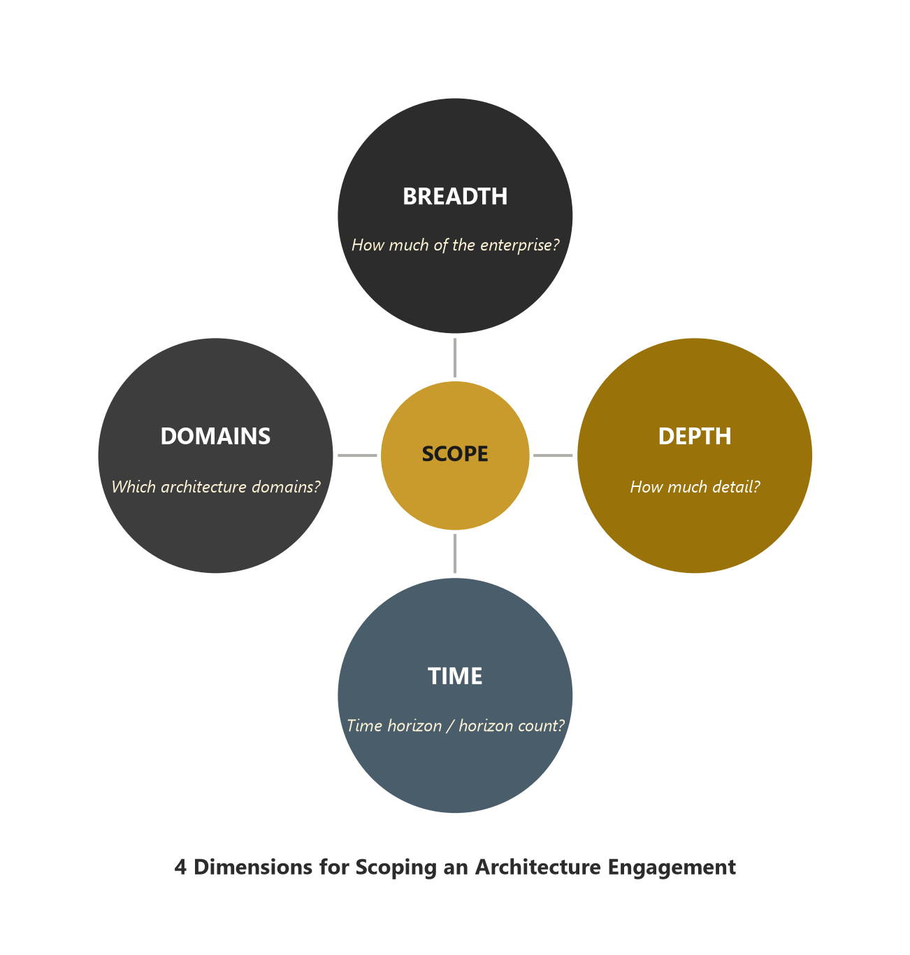
Scoping the Architecture — 4 Dimensions
Module 2 — ADM Overview
Breadth, Depth, Time Period, and Architecture Domains bound a single architecture's scope.
⭐ EXAM TIP: Scope is usually set by breadth, depth, and time first, then a suitable set of domains is chosen.
TOGAF 10 Associate Masterclass | The Open Group
opengroup.org
Notes:
: Scoping the Architecture — 4 Dimensions
Let's formalize scoping, because it's a reliable exam topic. Four dimensions are used to define and limit the scope of any architecture. Breadth asks: how much of the enterprise does this effort cover? Depth asks: to what level of detail? Time Period asks: what timeframe are we articulating, and how many Transition Architectures will we need? And Architecture Domains asks: which of Business, Data, Application, and Technology are actually in scope? As the diagram shows, these four dimensions together bound a single architecture's scope. And the standard gives us the typical order: you usually fix breadth, depth, and time first, and then choose a suitable combination of domains to fit the problem. Four dimensions — breadth, depth, time, domains.
---

Slide 20
Depth — Consistency Across Domains
Module 2 — ADM Overview
A consistent, equal level of depth should be completed in each domain in scope.
Too little detail → the architecture isn't useful; too much → it exceeds time/resources and becomes cluttered.
Depth should be "sufficient for its purpose, and no more."
⭐ EXAM TIP: Keep the same depth across BDAT domains that are in scope — don't over-build one and starve another.
TOGAF 10 Associate Masterclass | The Open Group
opengroup.org
Notes:
: Depth — Consistency Across Domains
Let's dwell on the depth dimension for a moment, because there's a specific principle here that gets tested. When you include several domains in an effort, you should complete a consistent, equal level of depth in each one. If you leave out pertinent detail, the architecture simply won't be useful. But if you cram in unnecessary detail, you'll blow through your time and resources, and the result becomes cluttered and confusing. The guiding phrase is that depth should be sufficient for its purpose, and no more. So the practical rule is: keep the same depth across whichever BDAT domains are in scope — don't lovingly over-build the Technology Architecture while starving the Business Architecture. Balance is the goal.
---

Slide 21
Baseline, Target & Transition Architectures
Module 2 — ADM Overview
Baseline Architecture — the current "as-is" state.
Target Architecture — the desired "to-be" state (may be partly defined).
Transition Architecture — a deliverable intermediate state between baseline and target.
The ADM moves the enterprise from baseline to target, often via one or more transitions.
⭐ EXAM TIP: Transition Architectures are intermediate, implementable states — first defined in Phase E.
TOGAF 10 Associate Masterclass | The Open Group
opengroup.org
Notes:
: Baseline, Target & Transition Architectures
Three architecture states you must keep straight. The Baseline Architecture is the current state — the as-is. The Target Architecture is the desired future state — the to-be — and it may only be partially defined at first. And a Transition Architecture is a deliverable intermediate state that sits between the baseline and the target. The whole job of the ADM is to move the enterprise from its baseline to its target, and for anything non-trivial, that journey passes through one or more transitions. The exam-relevant detail: Transition Architectures are intermediate, genuinely implementable states, and they're first defined in Phase E. As-is, to-be, and the stepping stones in between.
---

Slide 22
Key Deliverables That Flow Through the ADM
Module 2 — ADM Overview
Deliverable | First produced / used | Purpose
Request for Architecture Work | Into Phase A | Triggers a cycle
Statement of Architecture Work | Phase A | Defines & approves the cycle's scope
Architecture Vision | Phase A | High-level aspirational view
Architecture Definition Document (ADD) | Phases B–D | The evolving architecture description
Architecture Requirements Specification | Phases B–D | Quantitative requirements to meet
Architecture Roadmap | Phases B–F | Ordered list of work packages over time
Implementation & Migration Plan | Phase F | Detailed delivery schedule
Architecture Contract | Phase G | Governs implementation
⭐ EXAM TIP: Know which phase first creates each key deliverable — a favorite question style.
TOGAF 10 Associate Masterclass | The Open Group
opengroup.org
Notes:
: Key Deliverables That Flow Through the ADM
Now let's trace the key deliverables, because a favorite exam-question style is "which phase first produces this?" The Request for Architecture Work flows into Phase A and triggers a cycle. Phase A then produces the Statement of Architecture Work, which defines and approves the cycle's scope, plus the Architecture Vision. Through Phases B to D you build the Architecture Definition Document and the Architecture Requirements Specification. The Architecture Roadmap takes shape across Phases B through F. Phase F produces the detailed Implementation and Migration Plan. And Phase G introduces the Architecture Contract to govern implementation. Study this table until you can name the originating phase for each deliverable on demand — it's worth real marks.
---

Slide 23
ADD vs Architecture Requirements Specification
Module 2 — ADM Overview
Architecture Definition Document (ADD) — the qualitative description: the architecture itself, baseline & target, across domains.
Architecture Requirements Specification — the quantitative requirements: measurable criteria the work must meet.
They are companion documents, developed and updated together through Phases B–D.
⭐ EXAM TIP: ADD = the "what it looks like" (qualitative); Requirements Spec = the "what it must satisfy" (quantitative/measurable).
TOGAF 10 Associate Masterclass | The Open Group
opengroup.org
Notes:
: ADD vs Architecture Requirements Specification
Two companion documents that students constantly mix up, so let's separate them cleanly. The Architecture Definition Document, the ADD, is the qualitative description — it's the architecture itself: the baseline and target, described across all the domains. It's the "what it looks like." The Architecture Requirements Specification, by contrast, is quantitative — it's the set of measurable requirements and criteria that the architecture work must satisfy. It's the "what it must achieve." They're developed and updated together as companions through Phases B, C, and D. So remember the pairing: ADD is qualitative, the picture; the Requirements Specification is quantitative, the measurable targets. Two halves of the same story.
---

Slide 24
Architecture Version Numbering
Module 2 — ADM Overview
TOGAF suggests a simple convention for evolving deliverables:
  Version 0.1 — an informal, draft working version
  Version 1.0 — a formally reviewed and agreed version
Drafts use 0.x; approved baselines use 1.0, then 1.1, 2.0, etc.
⭐ EXAM TIP: 0.1 = draft / not yet agreed, 1.0 = approved. Simple but testable.
TOGAF 10 Associate Masterclass | The Open Group
opengroup.org
Notes:
: Architecture Version Numbering
Here's a small but genuinely testable convention — version numbering. As your deliverables evolve, TOGAF suggests a simple scheme. Version 0.1 is an informal, draft working version — something you're still shaping and that hasn't been formally agreed. Version 1.0 is a formally reviewed and agreed version. So anything in the 0-point-something range is a draft, and 1.0 onwards — 1.0, 1.1, 2.0 — represents approved, baselined work. It's a tiny detail, but it shows up in questions, so just remember: 0.1 means draft and not yet agreed; 1.0 means approved.
---

Slide 25
Adapting & Tailoring the ADM
Module 2 — ADM Overview
The ADM is expected to be adapted to the enterprise's needs and architecture style (e.g., Agile, security, digital).
Adaptation may re-order, combine, or omit phases, and integrate with other frameworks (e.g., PRINCE2, ITIL, Scrum).
Tailoring is decided largely in the Preliminary Phase.
⭐ EXAM TIP: Adapting the ADM is encouraged; the standard explicitly supports different architecture styles.
TOGAF 10 Associate Masterclass | The Open Group
opengroup.org
Notes:
: Adapting & Tailoring the ADM
We return one more time to adaptation, now specifically for the ADM. The method is explicitly expected to be adapted to your enterprise's needs and to your chosen architecture style — and the standard calls out styles like Agile, security, and digital. Adaptation can mean re-ordering phases, combining them, or even omitting some, as well as integrating the ADM with other frameworks you already use, like PRINCE2 for projects, ITIL for service management, or Scrum for delivery. Most of these tailoring decisions are made up front, in the Preliminary Phase. The headline: adapting the ADM isn't a workaround, it's encouraged — and the standard is designed to support many different architecture styles.
---

Slide 26
Governance & the ADM
Module 2 — ADM Overview
Architecture Governance runs across all phases of the ADM, not just Phase G.
It ensures the method is applied correctly and that outputs are compliant and controlled.
Backed by the Architecture Board, Architecture Contracts, and compliance reviews (covered in Module 12).
⭐ EXAM TIP: Governance is continuous across the ADM; Phase G is specifically implementation governance.
TOGAF 10 Associate Masterclass | The Open Group
opengroup.org
Notes:
: Governance & the ADM
A point that trips people up: where does governance happen in the ADM? The instinctive answer is Phase G — but that's only part of the truth. Architecture Governance actually runs across all phases of the ADM, continuously. It ensures the method is being applied correctly and that the outputs are compliant and properly controlled the whole way through. It's backed by the Architecture Board, Architecture Contracts, and compliance reviews, all of which we'll cover in Module 12. So distinguish the two ideas: governance is continuous across the entire ADM, whereas Phase G is specifically about governing the implementation. Both are true at once.
---

Slide 27
How the ADM Uses the Continuum & Repository
Module 2 — ADM Overview
Each ADM phase draws on reusable assets from the Architecture Repository (via the Enterprise Continuum).
Each phase returns new, refined assets back into the Repository.
This is how generic Foundation assets get specialized into Organization-Specific architectures.
⭐ EXAM TIP: The ADM consumes and produces Repository assets every cycle — it doesn't start from a blank page.
TOGAF 10 Associate Masterclass | The Open Group
opengroup.org
Notes:
: How the ADM Uses the Continuum & Repository
Finally, let's see how the ADM connects to the wider TOGAF machinery. Each phase of the ADM draws on reusable assets from the Architecture Repository, accessed and classified through the Enterprise Continuum. And each phase returns new, more refined assets back into that Repository. This back-and-forth is exactly how generic Foundation-level assets get progressively specialized into your Organization-Specific architecture. The practical implication, and a nice exam point, is that the ADM never starts from a completely blank page — it consumes existing assets and produces new ones, every single cycle. We'll dive into the Continuum and Repository properly in Module 8.
---

Slide 28
Common Exam Traps
Module 2 — ADM Overview
❌ "Requirements Management is a phase you finish" → ✅ it runs continuously at the center.
❌ "Phase E plans the migration in detail" → ✅ Phase F does the detailed plan; E identifies delivery vehicles.
❌ "The ADD and the Requirements Specification are the same" → ✅ ADD = qualitative, Spec = quantitative.
❌ "Transition Architectures appear in Phase B" → ✅ they first appear in Phase E.
❌ "The ADM is a strict waterfall" → ✅ it is iterative and adaptable.
⭐ EXAM TIP: Phase E vs F and Requirements Management's role are the two most-tested confusions.
TOGAF 10 Associate Masterclass | The Open Group
opengroup.org
Notes:
: Common Exam Traps
Let's disarm this module's traps. One: "Requirements Management is a phase you finish" — no, it runs continuously at the center. Two: "Phase E plans the migration in detail" — no, Phase F does the detailed plan; Phase E identifies the delivery vehicles. Three: "the ADD and the Requirements Specification are the same" — no, the ADD is qualitative and the Specification is quantitative. Four: "Transition Architectures appear in Phase B" — no, they first appear in Phase E. And five: "the ADM is a strict waterfall" — no, it's iterative and adaptable. If you remember nothing else, remember that Phase E versus F, and the role of Requirements Management, are the two most-tested confusions in this whole area.
---

Slide 29
Key Numbers & Quick Facts (Cheat Sheet)
Module 2 — ADM Overview
Fact | Value
ADM activities | 9 (Preliminary + A–H)
Phase that defines principles & tailoring | Preliminary
Phase that produces Statement of Arch Work | A
Information Systems phase | C (Data + Application)
Phase introducing Transition Architectures | E
Phase with detailed Migration Plan | F
Implementation governance phase | G
Change management phase | H
Center of the cycle | Requirements Management
Scoping dimensions | 4 (Breadth, Depth, Time, Domains)
Draft / approved versions | 0.1 / 1.0
TOGAF 10 Associate Masterclass | The Open Group
opengroup.org
Notes:
: Key Numbers & Quick Facts (Cheat Sheet)
Here's your ADM cheat-sheet. Nine activities — Preliminary plus A through H. Principles and tailoring are defined in the Preliminary Phase. The Statement of Architecture Work comes from Phase A. Information Systems is Phase C — Data plus Application. Transition Architectures are introduced in Phase E. The detailed Migration Plan is Phase F. Implementation governance is Phase G. Change management is Phase H. The center of the cycle is Requirements Management. There are four scoping dimensions — breadth, depth, time, and domains. And version 0.1 is a draft while 1.0 is approved. Screenshot this slide; it distills the most exam-critical facts in TOGAF onto a single card.
---

Slide 30
Module Summary
Module 2 — ADM Overview
The ADM is TOGAF's iterative method: Preliminary + Phases A–H + Requirements Management at the center.
Preliminary prepares; A sets vision; B/C/D build the BDAT architectures; E/F plan delivery; G/H govern and manage change.
Requirements Management runs continuously — it is not a discrete phase.
Scope is set by four dimensions; the ADM is iterative, adaptable, and governed throughout.
Know the key deliverables and which phase first creates each.
TOGAF 10 Associate Masterclass | The Open Group
opengroup.org
Notes:
: Module Summary
Let's wrap up the most important module in the course. The ADM is TOGAF's iterative method: the Preliminary Phase, Phases A through H, and Requirements Management at the center. Preliminary prepares the ground; Phase A sets the vision; Phases B, C, and D build the BDAT architectures; Phases E and F plan the delivery; and Phases G and H govern and manage change. Requirements Management runs continuously — it's not a discrete phase. Scope is set by four dimensions, and the method is iterative, adaptable, and governed throughout. And you should know the key deliverables and which phase first creates each. Next, we go deep — Module 3, Phase A, Architecture Vision.
---

Slide 31
Practice Question 1
Module 2 — ADM Overview
Q1
Which phase of the ADM produces the Statement of Architecture Work that is then approved to authorize the architecture cycle?
A) Preliminary Phase
B) Phase A: Architecture Vision
C) Phase B: Business Architecture
D) Phase G: Implementation Governance
Explanation: Phase A establishes the project, develops the Architecture Vision, and produces the Statement of Architecture Work, which is then approved to authorize the cycle. The Preliminary Phase sets up the capability and principles but does not produce this document.
TOGAF 10 Associate Masterclass | The Open Group
opengroup.org
Notes:
: Practice Questions (Q1–Q5)
Five questions to consolidate the ADM. Question one asks which phase produces the Statement of Architecture Work. Question two tests the all-important difference between Phase E and Phase F. Question three checks where Requirements Management sits and how often it runs. Question four asks for the four scoping dimensions. And question five is about the version-numbering convention. These five hit the exact points the exam concentrates on, so take them seriously — pause, commit to an answer, and then we'll work through each one. If any of these feel shaky, that's your signal to re-watch the relevant slide before moving on to Phase A.
---
*End of Module 2 — The ADM — Overview.*

Slide 32
Practice Question 2
Module 2 — ADM Overview
Q2
What distinguishes Phase E (Opportunities & Solutions) from Phase F (Migration Planning)?
A) Phase E produces the detailed migration plan; Phase F identifies projects
B) Phase E identifies delivery vehicles and Transition Architectures; Phase F produces the detailed Implementation & Migration Plan
C) They are the same phase under two names
D) Phase E governs implementation; Phase F manages change
Explanation: Phase E does the first implementation planning — identifying delivery vehicles (projects/programs) and defining Transition Architectures. Phase F then finalizes the detailed Implementation & Migration Plan. E identifies; F plans and sequences.
TOGAF 10 Associate Masterclass | The Open Group
opengroup.org
Notes:
: Practice Questions (Q1–Q5)
Five questions to consolidate the ADM. Question one asks which phase produces the Statement of Architecture Work. Question two tests the all-important difference between Phase E and Phase F. Question three checks where Requirements Management sits and how often it runs. Question four asks for the four scoping dimensions. And question five is about the version-numbering convention. These five hit the exact points the exam concentrates on, so take them seriously — pause, commit to an answer, and then we'll work through each one. If any of these feel shaky, that's your signal to re-watch the relevant slide before moving on to Phase A.
---
*End of Module 2 — The ADM — Overview.*

Slide 33
Practice Question 3
Module 2 — ADM Overview
Q3
Where does Requirements Management sit in the ADM, and how often does it operate?
A) It is Phase I, performed after Phase H
B) It is performed once, in the Preliminary Phase
C) It sits at the center of the cycle and operates continuously throughout all phases
D) It is performed only during Phases B, C, and D
Explanation: Requirements Management is the center of the ADM and operates continuously — every phase feeds requirements into it and draws requirements from it. It is a dynamic process, not a discrete one-time phase.
TOGAF 10 Associate Masterclass | The Open Group
opengroup.org
Notes:
: Practice Questions (Q1–Q5)
Five questions to consolidate the ADM. Question one asks which phase produces the Statement of Architecture Work. Question two tests the all-important difference between Phase E and Phase F. Question three checks where Requirements Management sits and how often it runs. Question four asks for the four scoping dimensions. And question five is about the version-numbering convention. These five hit the exact points the exam concentrates on, so take them seriously — pause, commit to an answer, and then we'll work through each one. If any of these feel shaky, that's your signal to re-watch the relevant slide before moving on to Phase A.
---
*End of Module 2 — The ADM — Overview.*

Slide 34
Practice Question 4
Module 2 — ADM Overview
Q4
Which four dimensions are typically used to scope an architecture?
A) Cost, Time, Quality, Scope
B) Business, Data, Application, Technology
C) Breadth, Depth, Time Period, Architecture Domains
D) People, Process, Technology, Information
Explanation: The four scoping dimensions are Breadth, Depth, Time Period, and Architecture Domains. Scope is typically set by breadth, depth, and time first, after which a suitable set of architecture domains is selected. (BDAT lists the domains, but that's only one of the four dimensions.)
TOGAF 10 Associate Masterclass | The Open Group
opengroup.org
Notes:
: Practice Questions (Q1–Q5)
Five questions to consolidate the ADM. Question one asks which phase produces the Statement of Architecture Work. Question two tests the all-important difference between Phase E and Phase F. Question three checks where Requirements Management sits and how often it runs. Question four asks for the four scoping dimensions. And question five is about the version-numbering convention. These five hit the exact points the exam concentrates on, so take them seriously — pause, commit to an answer, and then we'll work through each one. If any of these feel shaky, that's your signal to re-watch the relevant slide before moving on to Phase A.
---
*End of Module 2 — The ADM — Overview.*

Slide 35
Practice Question 5
Module 2 — ADM Overview
Q5
In TOGAF's architecture version-numbering convention, what does version 0.1 indicate?
A) A formally approved, baselined architecture
B) The final production release
C) An informal, draft working version not yet formally agreed
D) A version that has failed compliance review
Explanation: Version 0.1 denotes an informal draft working version. Version 1.0 denotes a formally reviewed and agreed version. The 0.x range is for drafts; 1.0 and above are approved. End of Module 2 — The Architecture Development Method (ADM) — Overview.
TOGAF 10 Associate Masterclass | The Open Group
opengroup.org
Notes:
: Practice Questions (Q1–Q5)
Five questions to consolidate the ADM. Question one asks which phase produces the Statement of Architecture Work. Question two tests the all-important difference between Phase E and Phase F. Question three checks where Requirements Management sits and how often it runs. Question four asks for the four scoping dimensions. And question five is about the version-numbering convention. These five hit the exact points the exam concentrates on, so take them seriously — pause, commit to an answer, and then we'll work through each one. If any of these feel shaky, that's your signal to re-watch the relevant slide before moving on to Phase A.
---
*End of Module 2 — The ADM — Overview.*

