Slide 1
TOGAF 10 ASSOCIATE MASTERCLASS
ADM PHASE A — ARCHITECTURE VISION
Module 3: Phase A — Architecture Vision
TOGAF Standard, 10th Edition · Foundation Exam Preparation
Module 3 — Phase A: Architecture Vision
40
60
Closed
≥60%
questions
minutes
book
to pass
TOGAF 10 Associate Masterclass | The Open Group
opengroup.org
Notes:
: ADM PHASE A — ARCHITECTURE VISION
Welcome to Module 3. We're now going deep into the first phase of the ADM cycle — Phase A, Architecture Vision. If the Preliminary Phase is about getting the organization ready to do architecture at all, Phase A is about kicking off one specific cycle of work: setting its scope, painting the aspirational picture, and getting formal approval to proceed. It's a phase the exam loves, particularly around what triggers it and what it produces. Let's see exactly how a cycle of architecture gets started.
---

Slide 2
Module Overview & Learning Objectives
Module 3 — Phase A: Architecture Vision
By the end of this module, you'll be able to:
  State the two objectives of Phase A
  Explain the Request for Architecture Work (the trigger) and the Statement of Architecture Work (the output)
  Walk the 11 steps of Phase A
  Describe the Architecture Vision, stakeholder map, and business scenarios technique
  Explain business transformation readiness and risk (initial vs residual)
⭐ EXAM TIP: Phase A is heavily tested for what triggers it and what it produces.
TOGAF 10 Associate Masterclass | The Open Group
opengroup.org
Notes:
: Module Overview & Learning Objectives
Here's what you'll take away from this module. You'll know the two objectives of Phase A. You'll be able to clearly distinguish the Request for Architecture Work — the trigger that comes in — from the Statement of Architecture Work — the document that goes out and gets approved. You'll walk through all eleven steps of the phase. You'll understand the Architecture Vision itself, the stakeholder map, and the business scenarios technique used to discover requirements. And you'll grasp business transformation readiness and the two levels of risk — initial and residual. These last two distinctions are reliable exam points, so we'll give them real attention.
---

Slide 3
Where Phase A Sits
Module 3 — Phase A: Architecture Vision
Phase A is the first phase of an architecture development cycle (after the one-time Preliminary Phase).
It takes a Request for Architecture Work and turns it into an approved Statement of Architecture Work.
It sets the scope, vision, stakeholders, and constraints for this cycle of the ADM.
It feeds directly into Phase B (Business Architecture).
⭐ EXAM TIP: Preliminary is one-time setup; Phase A begins each cycle. Don't confuse the two.
TOGAF 10 Associate Masterclass | The Open Group
opengroup.org
Notes:
: Where Phase A Sits
Let's place Phase A precisely. It's the first phase of an architecture development cycle, coming right after the one-time Preliminary Phase. Its job is to take a Request for Architecture Work and turn it into an approved Statement of Architecture Work. Along the way it sets the scope, the vision, the stakeholders, and the constraints for this particular cycle of the ADM. And it feeds directly into Phase B, where the Business Architecture work begins. Here's a distinction worth nailing down now: the Preliminary Phase is one-time setup for your whole architecture capability, whereas Phase A begins each and every cycle. Don't let the exam blur those two together.
---

Slide 4
The Two Objectives of Phase A
Module 3 — Phase A: Architecture Vision
Develop a high-level aspirational vision of the capabilities and business value to be delivered by the proposed architecture.
Obtain approval for a Statement of Architecture Work that defines the program of work to develop and deploy that architecture.
⭐ EXAM TIP: Two objectives — (1) the Vision, (2) the approved Statement of Architecture Work. Memorize both.
TOGAF 10 Associate Masterclass | The Open Group
opengroup.org
Notes:
: The Two Objectives of Phase A
Phase A has exactly two objectives, and they're worth memorizing word-for-word in spirit. The first is to develop a high-level, aspirational vision of the capabilities and business value that the proposed architecture will deliver. The second is to obtain approval for a Statement of Architecture Work — the document that defines the program of work to actually develop and deploy that architecture. So, two objectives: first the Vision, and second the approved Statement of Architecture Work. Notice how cleanly they map onto the phase's name and its endpoint — you envision, then you get the mandate to proceed.
---

Slide 5
The Request for Architecture Work
Module 3 — Phase A: Architecture Vision
The Request for Architecture Work is the trigger that initiates a cycle — the main input to Phase A.
It is typically created in the Preliminary Phase or by Architecture Change Management (Phase H) or sponsoring management.
It describes the business need, drivers, and the mandate to begin architecture work.
⭐ EXAM TIP: Request for Architecture Work = input that starts Phase A. Do not confuse it with the Statement of Architecture Work (the output).
TOGAF 10 Associate Masterclass | The Open Group
opengroup.org
Notes:
: The Request for Architecture Work
Let's look at what actually kicks Phase A off — the Request for Architecture Work. This is the trigger, the main input that initiates a cycle. It's typically created in the Preliminary Phase when you first stand things up, or later by Architecture Change Management in Phase H, or directly by sponsoring management who recognize a need. It describes the business need, the drivers behind it, and the mandate to begin architecture work. Now here's the single most common confusion the exam exploits, so let's pre-empt it: the Request for Architecture Work is the input that starts Phase A. Do not mix it up with the Statement of Architecture Work, which is the output. Request comes in; Statement goes out.
---

Slide 6
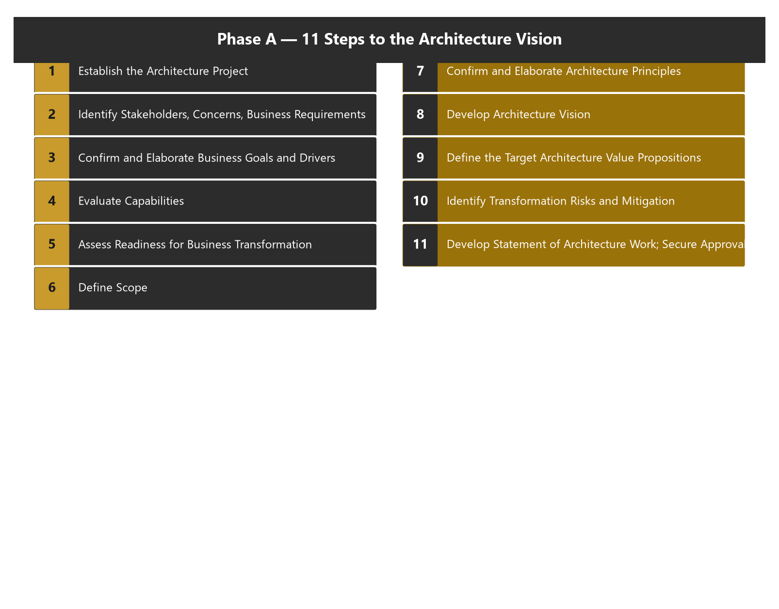
Inputs to Phase A
Module 3 — Phase A: Architecture Vision
Non-architectural: Request for Architecture Work; business principles, goals, and drivers.
Architectural:
  Organizational Model for Enterprise Architecture (scope, roles, budget, governance)
  Tailored Architecture Framework (method, content, principles, tools)
  Populated Architecture Repository (existing baselines, ABBs, reference materials)
⭐ EXAM TIP: Phase A relies on the Preliminary Phase outputs — the tailored framework, the org model, and the populated repository.
TOGAF 10 Associate Masterclass | The Open Group
opengroup.org
Notes:
: Inputs to Phase A
Beyond that trigger, Phase A draws on several inputs, and they fall into two groups. The non-architectural inputs are the Request for Architecture Work itself, plus the business principles, goals, and drivers. The architectural inputs are three things that mostly come out of the Preliminary Phase: the Organizational Model for Enterprise Architecture, which covers scope, roles, budget, and governance; the Tailored Architecture Framework, which is your customized method, content, principles, and tools; and the populated Architecture Repository, holding existing baselines, building blocks, and reference materials. The pattern to notice is that Phase A leans directly on what the Preliminary Phase set up — the tailored framework, the org model, and the repository.
---

Slide 7
The 11 Steps of Phase A
Module 3 — Phase A: Architecture Vision
Establish the architecture project
Identify stakeholders, concerns & business requirements
Confirm & elaborate business goals, drivers & constraints
Evaluate capabilities
Assess readiness for business transformation
Define scope
Confirm & elaborate Architecture Principles
Develop Architecture Vision
Define Target Architecture value propositions & KPIs
Identify business transformation risks & mitigation
Develop the Statement of Architecture Work; secure approval
⭐ EXAM TIP: The order is adaptable per governance — but know that step 11 ends with securing approval.
TOGAF 10 Associate Masterclass | The Open Group
opengroup.org
Notes:
: The 11 Steps of Phase A
Phase A has eleven steps, and while you don't need to recite them in perfect order, you should recognize them. One, establish the architecture project. Two, identify stakeholders, concerns, and business requirements. Three, confirm and elaborate the business goals, drivers, and constraints. Four, evaluate capabilities. Five, assess readiness for business transformation. Six, define scope. Seven, confirm and elaborate the Architecture Principles. Eight, develop the Architecture Vision. Nine, define the target value propositions and KPIs. Ten, identify business transformation risks and mitigation. And eleven, develop the Statement of Architecture Work and secure approval. Importantly, the order is adaptable to your situation under governance — but always remember that the phase ends, at step eleven, by securing formal approval.
---

Slide 8
Step 1 — Establish the Architecture Project
Module 3 — Phase A: Architecture Vision
Enterprise Architecture is a business capability; each ADM cycle is normally run as a project.
Secure recognition, executive endorsement, and line-management support.
May be stand-alone or a subset of a larger project.
Reference and relate it to other management frameworks in use (e.g., PRINCE2).
⭐ EXAM TIP: Each cycle of the ADM is handled using the enterprise's project management framework.
TOGAF 10 Associate Masterclass | The Open Group
opengroup.org
Notes:
: Step 1 — Establish the Architecture Project
Step one: establish the architecture project. The key idea here is that Enterprise Architecture is itself a business capability, and each cycle of the ADM should normally be run as a project, using whatever project management framework the enterprise already uses. Sometimes the architecture work is a stand-alone project; other times it's a subset of activities within a larger project. Either way, you secure recognition for the project, get executive endorsement, and line up the support of the necessary line management. You also relate it to other management frameworks in play — like PRINCE2. The exam point: each ADM cycle is handled using the enterprise's project management framework.
---

Slide 9
Step 2 — Stakeholders, Concerns & the Stakeholder Map
Module 3 — Phase A: Architecture Vision
Identify key stakeholders, their concerns/objectives, and the key business requirements.
The major product is a Stakeholder Map — who's involved, their level of involvement, and their concerns.
Used to choose the viewpoints needed and to shape how the architecture is communicated.
⭐ EXAM TIP: The Stakeholder Map is the key output of this step — it drives later views and viewpoints.
TOGAF 10 Associate Masterclass | The Open Group
opengroup.org
Notes:
: Step 2 — Stakeholders, Concerns & the Stakeholder Map
Step two is all about people. You identify the key stakeholders, their concerns and objectives, and the key business requirements the engagement must address. The major product of this step is the Stakeholder Map — a clear picture of who's involved, how involved they are, and what they care about. And this map isn't just paperwork; it does real work later. It drives which viewpoints you'll need to develop, and it shapes how you present and communicate the architecture to each audience. So whenever you see a question about identifying stakeholders and concerns in Phase A, the answer usually centers on the Stakeholder Map, which in turn feeds the views and viewpoints you'll build down the line.
---

Slide 10
Step 3 — Business Goals, Drivers & Constraints
Module 3 — Phase A: Architecture Vision
Confirm and elaborate the business goals, business drivers, and constraints.
These usually come from existing business strategy/plans — the architect refines, not invents, them.
They anchor the Vision in real business intent.
⭐ EXAM TIP: Architects confirm and elaborate existing business goals — they don't create business strategy from scratch.
TOGAF 10 Associate Masterclass | The Open Group
opengroup.org
Notes:
: Step 3 — Business Goals, Drivers & Constraints
Step three: confirm and elaborate the business goals, the business drivers, and the constraints. Notice the verbs carefully — confirm and elaborate. These goals and drivers usually already exist, in the organization's business strategy and plans. The architect's job is to refine and sharpen them for the architecture work, not to invent business strategy from scratch. This anchors the whole Vision in genuine business intent rather than the architect's personal preferences. It's a subtle but testable point: in Phase A, architects confirm and elaborate existing business goals — they don't author the company's strategy.
---

Slide 11
Step 4 — Evaluate Capabilities
Module 3 — Phase A: Architecture Vision
Assess the enterprise's capabilities — what it can do today versus what the vision requires.
Produces a Capability Assessment (business, IT, and architecture-maturity capability).
Reveals the gap between current capability and the target.
⭐ EXAM TIP: The Capability Assessment is a Phase A output describing the baseline & target capability.
TOGAF 10 Associate Masterclass | The Open Group
opengroup.org
Notes:
: Step 4 — Evaluate Capabilities
Step four is to evaluate capabilities. Here you assess what the enterprise can actually do today, and compare that against what the vision will require of it. This produces a deliverable called the Capability Assessment, which looks at business capability, IT capability, and the maturity of the architecture capability itself. The real value is that it exposes the gap between current capability and the target — telling you honestly whether the organization can pull off what the vision describes. So remember: the Capability Assessment is a Phase A output that describes both the baseline and target capability, and the distance between them.
---

Slide 12
Step 5 — Assess Business Transformation Readiness
Module 3 — Phase A: Architecture Vision
Evaluate whether the organization is ready to undergo the change the vision implies.
Uses readiness factors (vision, desire, need, business case, funding, sponsorship, governance, skills, etc.).
Surfaces risks early, so they can be mitigated in the plan.
⭐ EXAM TIP: Business Transformation Readiness Assessment gauges the organization's ability and willingness to change.
TOGAF 10 Associate Masterclass | The Open Group
opengroup.org
Notes:
: Step 5 — Assess Business Transformation Readiness
Step five, closely related, is the Business Transformation Readiness Assessment. Evaluating capability tells you whether the organization can do it; readiness tells you whether it's actually ready and willing to go through the change the vision implies. You assess a set of readiness factors — things like vision, desire, need, a clear business case, funding, sponsorship, governance, and skills. The point of doing this early is to surface the soft, organizational risks up front, while there's still time to mitigate them in the plan. So in short, the Business Transformation Readiness Assessment gauges the organization's ability and willingness to change — and weak readiness is a risk you want to spot now, not later.
---

Slide 13
Step 6 — Define Scope
Module 3 — Phase A: Architecture Vision
Fix the scope of this cycle using the four dimensions — breadth, depth, time period, domains.
Decide which architecture domains (B/D/A/T) are in scope and to what level of detail.
Identify architecture assets to reuse from the Repository.
⭐ EXAM TIP: Scope here uses the same four dimensions introduced in the ADM overview.
TOGAF 10 Associate Masterclass | The Open Group
opengroup.org
Notes:
: Step 6 — Define Scope
Step six is to define scope, and this is where the four scoping dimensions from Module 2 come back into play. You fix the breadth — how much of the enterprise this cycle covers; the depth — the level of detail; the time period — the timeframe and any transition points; and the architecture domains — which of Business, Data, Application, and Technology are actually in scope. You also identify which existing assets you'll reuse from the Repository. There's nothing new to memorize here — it's the same four dimensions, applied concretely to this specific cycle. Scope discipline now prevents runaway effort later.
---

Slide 14
Step 7 — Confirm Architecture Principles
Module 3 — Phase A: Architecture Vision
Confirm and elaborate the Architecture Principles (including business principles) defined in the Preliminary Phase.
Principles guide every later decision and trade-off.
They must align with the broader Enterprise Principles.
⭐ EXAM TIP: Principles are defined in the Preliminary Phase and confirmed/elaborated in Phase A.
TOGAF 10 Associate Masterclass | The Open Group
opengroup.org
Notes:
: Step 7 — Confirm Architecture Principles
Step seven: confirm and elaborate the Architecture Principles, including any business principles. Again, note the verbs. The principles themselves were first defined back in the Preliminary Phase. In Phase A you confirm they still apply, and you elaborate them for this engagement. These principles then guide every later decision and trade-off you'll make through Phases B, C, and D. And they have to align with the broader Enterprise Principles sitting above them. The clean exam distinction is this: Architecture Principles are defined in the Preliminary Phase, and confirmed or elaborated in Phase A. Definition versus confirmation — two different phases.
---

Slide 15
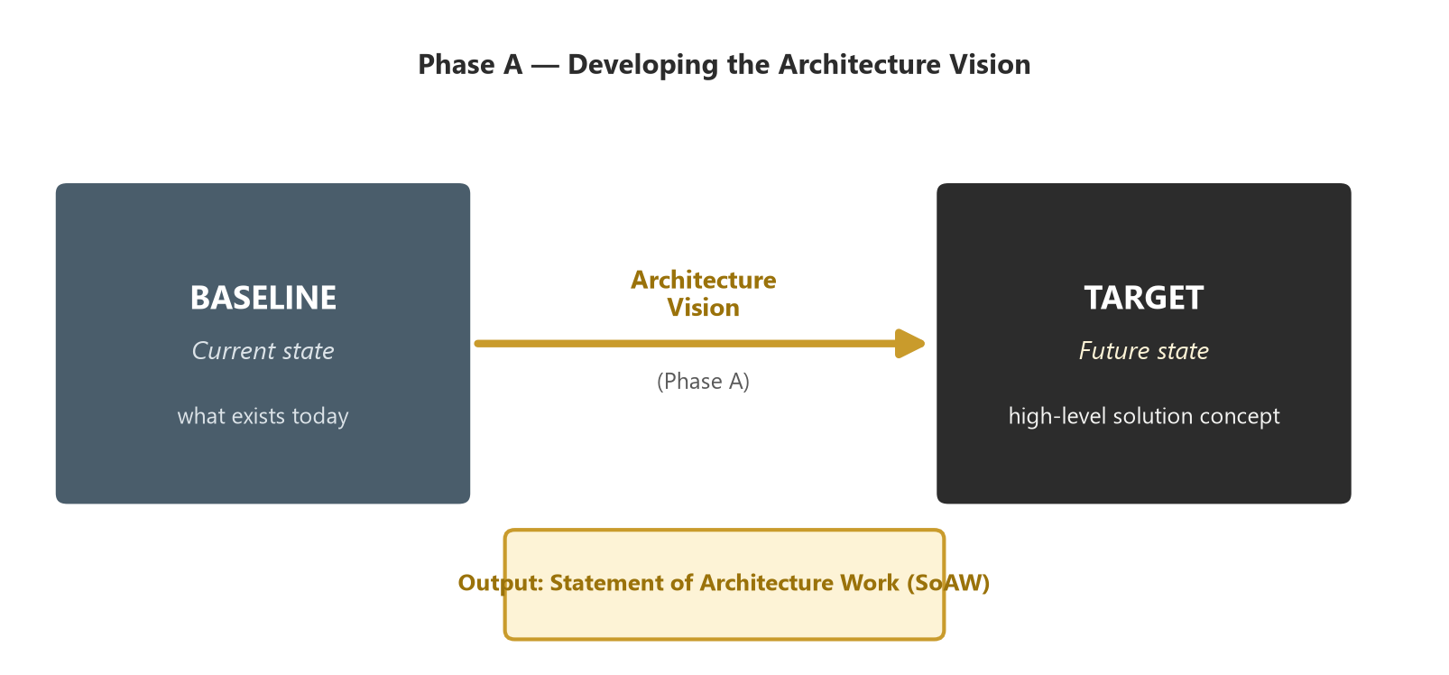
Step 8 — Develop the Architecture Vision
Module 3 — Phase A: Architecture Vision
Create a high-level view of the Baseline and Target Architectures, across business, information systems, and technology.
Often expressed with a Solution Concept Diagram — a concise picture of the major components and the benefit.
Covers the breadth of scope at a high level — this is aspirational, not detailed.
A high-level sketch of the target solution and the value it delivers to the enterprise.
⭐ EXAM TIP: The Solution Concept Diagram gives a high-level, "elevator-pitch" view of the target solution.
TOGAF 10 Associate Masterclass | The Open Group
opengroup.org
Notes:
: Step 8 — Develop the Architecture Vision
Step eight is the heart of the phase — developing the Architecture Vision itself. Here you create a high-level view of both the baseline and the target architectures, spanning business, information systems, and technology. A common and very practical way to express it is the Solution Concept Diagram, shown on screen — a concise picture of the major components of the solution and how it'll benefit the enterprise. Think of it as the architecture's elevator pitch. Crucially, the Vision covers the full breadth of scope but only at a high level — it's aspirational, not detailed. The detail comes later. So when a question describes a high-level sketch of the target solution, that's your Solution Concept Diagram, and it lives in Phase A.
---

Slide 16
Technique — Business Scenarios
Module 3 — Phase A: Architecture Vision
Business Scenarios are a technique to discover and document business requirements and articulate a Vision that responds to them.
A complete business scenario captures: the problem, the environment, the desired outcome, the human and computer actors, and the roles.
May be reused at more detailed levels (e.g., Phase B).
⭐ EXAM TIP: Business Scenarios = a requirements-discovery technique, used first in Phase A.
TOGAF 10 Associate Masterclass | The Open Group
opengroup.org
Notes:
: Technique — Business Scenarios
Let's highlight a specific technique that powers the Vision — Business Scenarios. A business scenario is a method for discovering and documenting business requirements, and then articulating a Vision that genuinely responds to them. A complete business scenario captures several things: the problem you're solving, the environment it sits in, the desired outcome, the human and computer actors involved, and the roles they play. And it's not limited to Phase A — the same technique can be reused at more detailed levels, for instance in Phase B. The exam framing is simple: Business Scenarios are a requirements-discovery technique, used first in Phase A to ground the Vision in real needs.
---

Slide 17
Step 9 — Value Propositions & KPIs
Module 3 — Phase A: Architecture Vision
Develop the business case and a value proposition for each stakeholder grouping.
Define the KPIs / performance metrics to be built into the architecture.
Assess procurement requirements and the business risk.
Feed these into the Statement of Architecture Work so performance can be tracked.
⭐ EXAM TIP: Value propositions + KPIs make the Vision measurable and fundable.
TOGAF 10 Associate Masterclass | The Open Group
opengroup.org
Notes:
: Step 9 — Value Propositions & KPIs
Step nine makes the Vision fundable and measurable. Here you develop the business case and craft a value proposition for each stakeholder grouping — because different stakeholders value different things. You define the KPIs and performance metrics that will be built right into the architecture, so success can be tracked objectively. You assess procurement requirements and the business risk. And critically, you feed all of this into the Statement of Architecture Work, so performance can be monitored throughout the cycle. The headline idea: value propositions plus KPIs are what turn an inspiring but vague Vision into something measurable that sponsors will actually fund.
---

Slide 18
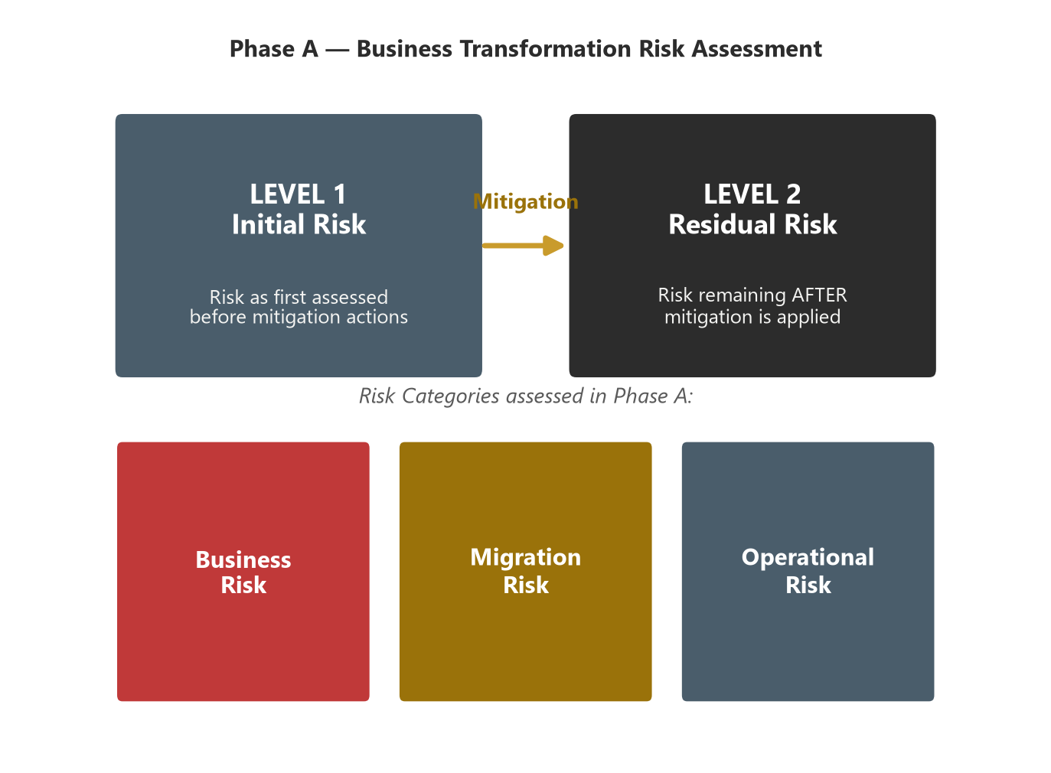
Step 10 — Business Transformation Risks
Module 3 — Phase A: Architecture Vision
Identify risks tied to the Vision; assess the initial level of risk and assign a mitigation strategy to each.
Two risk levels:
  Initial Level of Risk — before mitigation
  Residual Level of Risk — after mitigation
Risk is categorized by impact (catastrophic, critical, marginal, negligible) and frequency.
Risk assessed before mitigation (initial) and re-assessed after mitigation (residual).
⭐ EXAM TIP: Initial = before mitigation, Residual = after mitigation. A very common exam question.
TOGAF 10 Associate Masterclass | The Open Group
opengroup.org
Notes:
: Step 10 — Business Transformation Risks
Step ten is risk, and this contains one of the most reliably tested distinctions in the whole exam. You identify the risks tied to the Vision, assess each one's initial level of risk, and assign a mitigation strategy. And there are two distinct levels of risk to track. The initial level of risk is the categorization before you apply any mitigating actions. The residual level of risk is the categorization after mitigation. As the comparison on screen shows, you assess, you mitigate, then you re-assess. Risk itself is categorized by impact — catastrophic, critical, marginal, or negligible — and by frequency. Lock this in firmly: initial means before mitigation, residual means after. The exam will absolutely try to flip those two on you.
---

Slide 19
Step 11 — The Statement of Architecture Work
Module 3 — Phase A: Architecture Vision
The Statement of Architecture Work defines the program of work: scope, roadmap, schedule, resources, metrics, and the Communications Plan.
It is reviewed, agreed with sponsors, and formally approved under governance — this authorizes the cycle.
Think of it as the "contract" to perform this ADM cycle.
⭐ EXAM TIP: Statement of Architecture Work = approved output of Phase A that authorizes the architecture work.
TOGAF 10 Associate Masterclass | The Open Group
opengroup.org
Notes:
: Step 11 — The Statement of Architecture Work
Step eleven brings the phase to its conclusion — developing the Statement of Architecture Work and securing its approval. This document defines the entire program of work for the cycle: the scope, the roadmap, the schedule, the resources, the performance metrics, and the Communications Plan. It's then reviewed, agreed with the sponsors, and formally approved under governance — and that approval is what actually authorizes the cycle to proceed. The cleanest way to think about it is as the contract to perform this ADM cycle. For the exam: the Statement of Architecture Work is the approved output of Phase A, and it authorizes the architecture work that follows.
---

Slide 20
The Communications Plan
Module 3 — Phase A: Architecture Vision
Defines where, how, and when the architects will communicate with stakeholders about progress.
Targets affinity groupings and communities of stakeholders.
Keeps stakeholders engaged and informed throughout the cycle.
⭐ EXAM TIP: The Communications Plan is developed in Phase A (as part of the Statement of Architecture Work).
TOGAF 10 Associate Masterclass | The Open Group
opengroup.org
Notes:
: The Communications Plan
One specific component of the Statement of Architecture Work deserves its own mention — the Communications Plan. This defines where, how, and when the architects will communicate with stakeholders about the progress of the work. It targets the various affinity groupings and communities of stakeholders you mapped earlier, making sure each gets the right information at the right time. Its whole purpose is to keep stakeholders engaged and informed throughout the cycle, so the architecture doesn't drift away from the people it's meant to serve. Remember that the Communications Plan is developed in Phase A, bundled into the Statement of Architecture Work.
---

Slide 21
Key Outputs of Phase A
Module 3 — Phase A: Architecture Vision
Approved Statement of Architecture Work
Refined business principles, goals & drivers
Architecture Principles (confirmed)
Capability Assessment
Tailored Architecture Framework (updated)
Architecture Vision (incl. draft Architecture Definition Document, high-level baseline/target)
Communications Plan
Additions to the Architecture Repository
⭐ EXAM TIP: The two "headline" outputs are the Architecture Vision and the approved Statement of Architecture Work.
TOGAF 10 Associate Masterclass | The Open Group
opengroup.org
Notes:
: Key Outputs of Phase A
Let's gather up everything Phase A produces. You get the approved Statement of Architecture Work. You get refined business principles, goals, and drivers. You get the confirmed Architecture Principles. You get the Capability Assessment. You get an updated Tailored Architecture Framework. You get the Architecture Vision itself, which includes a draft Architecture Definition Document with high-level baseline and target sketches. You get the Communications Plan. And you get additions to the Architecture Repository. That's a long list, but if you remember just the two headline outputs — the Architecture Vision and the approved Statement of Architecture Work — you'll have the most-tested ones covered.
---

Slide 22
Request vs Statement — Don't Confuse Them
Module 3 — Phase A: Architecture Vision
Document | Role | When
Request for Architecture Work | Input that triggers the cycle | Into Phase A
Statement of Architecture Work | Output that defines & authorizes the cycle | Out of Phase A (approved)
⭐ EXAM TIP: Request = trigger (in); Statement = authorization (out). This pairing is tested again and again.
TOGAF 10 Associate Masterclass | The Open Group
opengroup.org
Notes:
: Request vs Statement — Don't Confuse Them
Let's hammer home the distinction that catches the most people, side by side. The Request for Architecture Work is an input — it's the document that triggers the cycle, flowing into Phase A. The Statement of Architecture Work is an output — it defines and authorizes the cycle, and it comes out of Phase A once approved. So: Request equals trigger, coming in; Statement equals authorization, going out. If you internalize just this one table, you'll bank the marks on what is genuinely one of the exam's favourite question patterns. Request in, Statement out.
---

Slide 23
Common Exam Traps
Module 3 — Phase A: Architecture Vision
❌ "Phase A creates a detailed architecture" → ✅ it's a high-level, aspirational Vision.
❌ "The Request for Architecture Work is an output" → ✅ it's the input/trigger.
❌ "Architecture Principles are first defined in Phase A" → ✅ defined in Preliminary, confirmed in A.
❌ "Residual risk is before mitigation" → ✅ residual is after; initial is before.
❌ "Phase A produces the Implementation Plan" → ✅ that's Phase F.
⭐ EXAM TIP: Watch the Request vs Statement and initial vs residual risk distinctions especially.
TOGAF 10 Associate Masterclass | The Open Group
opengroup.org
Notes:
: Common Exam Traps
Let's defuse the Phase A traps. One: "Phase A creates a detailed architecture" — no, it's a high-level, aspirational Vision. Two: "the Request for Architecture Work is an output" — no, it's the input and trigger. Three: "Architecture Principles are first defined in Phase A" — no, they're defined in the Preliminary Phase and merely confirmed in A. Four: "residual risk is before mitigation" — no, residual is after; initial is before. And five: "Phase A produces the Implementation Plan" — no, that's Phase F. Keep an especially close eye on the Request-versus-Statement and the initial-versus-residual-risk distinctions; those two appear constantly.
---

Slide 24
Key Numbers & Quick Facts (Cheat Sheet)
Module 3 — Phase A: Architecture Vision
Fact | Value
Phase A objectives | 2
Phase A steps | 11
Trigger / input | Request for Architecture Work
Headline output | Architecture Vision + approved Statement of Architecture Work
Requirements-discovery technique | Business Scenarios
Vision picture | Solution Concept Diagram
Risk levels | 2 (Initial, Residual)
Risk impact categories | Catastrophic, Critical, Marginal, Negligible
Capability output | Capability Assessment
TOGAF 10 Associate Masterclass | The Open Group
opengroup.org
Notes:
: Key Numbers & Quick Facts (Cheat Sheet)
Here's your Phase A cheat-sheet. Two objectives. Eleven steps. The trigger and input is the Request for Architecture Work. The headline output is the Architecture Vision plus the approved Statement of Architecture Work. The requirements-discovery technique is Business Scenarios. The Vision is often drawn as a Solution Concept Diagram. There are two risk levels — initial and residual — and risk impact is categorized as catastrophic, critical, marginal, or negligible. And the capability output is the Capability Assessment. Capture this slide; it covers nearly every recall question Phase A can throw at you.
---

Slide 25
How Phase A Connects Forward
Module 3 — Phase A: Architecture Vision
The approved scope and Vision constrain Phases B, C, D.
The Architecture Requirements identified here feed Requirements Management (the center).
The high-level baseline/target sketches are refined domain-by-domain in B/C/D.
⭐ EXAM TIP: Phase A is deliberately high-level — the detail is added in the domain phases that follow.
TOGAF 10 Associate Masterclass | The Open Group
opengroup.org
Notes:
: How Phase A Connects Forward
Before we summarize, let's see how Phase A hands off. The approved scope and Vision act as constraints on Phases B, C, and D — they keep the detailed work bounded and aligned. The architecture requirements identified here flow into Requirements Management, that process at the center of the cycle. And the high-level baseline and target sketches you produced get progressively refined, domain by domain, in the phases that follow. The key mindset: Phase A is deliberately high-level. It's not where the detail lives — its job is to point the way and authorize the journey. The detail is added next.
---

Slide 26
Module Summary
Module 3 — Phase A: Architecture Vision
Phase A starts each ADM cycle, turning a Request for Architecture Work into an approved Statement of Architecture Work.
Its two objectives: a high-level Vision and approval to proceed.
Key products: Stakeholder Map, Capability Assessment, Architecture Vision, value propositions/KPIs, risk assessment, Communications Plan.
Business Scenarios discover requirements; the Solution Concept Diagram sketches the target.
Risk is assessed at initial and residual levels.
TOGAF 10 Associate Masterclass | The Open Group
opengroup.org
Notes:
: Module Summary
Let's recap Phase A. It starts each ADM cycle, taking a Request for Architecture Work and turning it into an approved Statement of Architecture Work. Its two objectives are a high-level Vision and approval to proceed. Along the way it produces the Stakeholder Map, the Capability Assessment, the Architecture Vision, value propositions and KPIs, a risk assessment, and the Communications Plan. Business Scenarios discover the requirements, and the Solution Concept Diagram sketches the target. And risk is assessed at two levels — initial, before mitigation, and residual, after. That's Phase A: vision set, scope fixed, mandate secured.
---

Slide 27
Bridge to Module 4
Module 3 — Phase A: Architecture Vision
With the Vision approved, the cycle moves into the architecture domain phases: B (Business), C (Data + Application), D (Technology).
Each follows the same rhythm: baseline → target → gap analysis → roadmap components.
⭐ EXAM TIP: The B/C/D phases share a common structure — learn it once, apply it three times. (Module 4.)
TOGAF 10 Associate Masterclass | The Open Group
opengroup.org
Notes:
: Bridge to Module 4
So where to next? With the Vision approved, the cycle moves into the architecture domain phases — Phase B for Business, Phase C for Data and Application, and Phase D for Technology. And here's some good news that'll make Module 4 much easier: these three phases all share a common structure. Each one follows the same rhythm — describe the baseline, describe the target, perform a gap analysis, and define candidate roadmap components. Learn that pattern once in the next module, and you can apply it three times over. Let's go meet the domain phases.
---

Slide 28
Practice Question 1
Module 3 — Phase A: Architecture Vision
Q1
Which document triggers Phase A, and which document does Phase A produce and get approved?
A) It is triggered by the Statement of Architecture Work and produces the Request for Architecture Work
B) It is triggered by the Request for Architecture Work and produces the approved Statement of Architecture Work
C) Both are produced in Phase A
D) It is triggered by the Architecture Contract and produces the Architecture Vision only
Explanation: Phase A is triggered by the Request for Architecture Work (the input) and produces the Statement of Architecture Work, which is then formally approved to authorize the cycle. Request in, Statement out.
TOGAF 10 Associate Masterclass | The Open Group
opengroup.org
Notes:
: Practice Questions (Q1–Q5)
Five questions to lock in Phase A. Question one tests the Request-versus-Statement distinction directly — the trigger in, the authorization out. Question two asks about initial versus residual risk. Question three is about the requirements-discovery technique. Question four asks for the main product of identifying stakeholders. And question five checks your understanding of what the Architecture Vision actually is. Notice how four of these five map straight onto the distinctions we flagged as exam favourites — that's not a coincidence. Pause, choose your answers, and then we'll work through them together.
---
*End of Module 3 — ADM Phase A: Architecture Vision.*

Slide 29
Practice Question 2
Module 3 — Phase A: Architecture Vision
Q2
What is the difference between the "initial level of risk" and the "residual level of risk" in Phase A?
A) Initial risk is after mitigation; residual risk is before mitigation
B) Initial risk applies to technology; residual risk applies to business
C) Initial risk is before mitigating actions; residual risk is after mitigating actions
D) They are two names for the same assessment
Explanation: Initial level of risk is the categorization before any mitigating actions; residual level of risk is the categorization after mitigations have been applied. Both are assessed by impact (catastrophic/critical/marginal/negligible) and frequency.
TOGAF 10 Associate Masterclass | The Open Group
opengroup.org
Notes:
: Practice Questions (Q1–Q5)
Five questions to lock in Phase A. Question one tests the Request-versus-Statement distinction directly — the trigger in, the authorization out. Question two asks about initial versus residual risk. Question three is about the requirements-discovery technique. Question four asks for the main product of identifying stakeholders. And question five checks your understanding of what the Architecture Vision actually is. Notice how four of these five map straight onto the distinctions we flagged as exam favourites — that's not a coincidence. Pause, choose your answers, and then we'll work through them together.
---
*End of Module 3 — ADM Phase A: Architecture Vision.*

Slide 30
Practice Question 3
Module 3 — Phase A: Architecture Vision
Q3
Which technique is used in Phase A to discover and document business requirements and articulate a Vision that responds to them?
A) Gap analysis
B) Business Scenarios
C) The Architecture Contract
D) Migration Planning
Explanation: Business Scenarios are the recommended technique for discovering and documenting business requirements in Phase A (and they can be reused at more detailed levels, such as Phase B). Gap analysis happens in the domain phases; the others belong to later phases.
TOGAF 10 Associate Masterclass | The Open Group
opengroup.org
Notes:
: Practice Questions (Q1–Q5)
Five questions to lock in Phase A. Question one tests the Request-versus-Statement distinction directly — the trigger in, the authorization out. Question two asks about initial versus residual risk. Question three is about the requirements-discovery technique. Question four asks for the main product of identifying stakeholders. And question five checks your understanding of what the Architecture Vision actually is. Notice how four of these five map straight onto the distinctions we flagged as exam favourites — that's not a coincidence. Pause, choose your answers, and then we'll work through them together.
---
*End of Module 3 — ADM Phase A: Architecture Vision.*

Slide 31
Practice Question 4
Module 3 — Phase A: Architecture Vision
Q4
What is the primary product of identifying stakeholders and their concerns in Phase A?
A) The Implementation and Migration Plan
B) A Stakeholder Map showing involvement and concerns
C) The Technology Architecture
D) The Architecture Contract
Explanation: Identifying stakeholders, concerns, and business requirements produces a Stakeholder Map — showing who is involved, their level of involvement, and their key concerns. This map then drives the selection of relevant viewpoints and how the architecture is communicated.
TOGAF 10 Associate Masterclass | The Open Group
opengroup.org
Notes:
: Practice Questions (Q1–Q5)
Five questions to lock in Phase A. Question one tests the Request-versus-Statement distinction directly — the trigger in, the authorization out. Question two asks about initial versus residual risk. Question three is about the requirements-discovery technique. Question four asks for the main product of identifying stakeholders. And question five checks your understanding of what the Architecture Vision actually is. Notice how four of these five map straight onto the distinctions we flagged as exam favourites — that's not a coincidence. Pause, choose your answers, and then we'll work through them together.
---
*End of Module 3 — ADM Phase A: Architecture Vision.*

Slide 32
Practice Question 5
Module 3 — Phase A: Architecture Vision
Q5
Which statement best describes the Architecture Vision produced in Phase A?
A) A detailed, implementation-ready design of all four domains
B) A high-level, aspirational view of the capabilities and business value to be delivered
C) The final signed Architecture Contract for delivery teams
D) A complete physical Technology Architecture
Explanation: The Architecture Vision is a high-level, aspirational view of the target capabilities and business value — deliberately not detailed. The detailed, domain-level work happens later in Phases B, C, and D; the Architecture Contract belongs to Phase G. End of Module 3 — ADM Phase A: Architecture Vision.
TOGAF 10 Associate Masterclass | The Open Group
opengroup.org
Notes:
: Practice Questions (Q1–Q5)
Five questions to lock in Phase A. Question one tests the Request-versus-Statement distinction directly — the trigger in, the authorization out. Question two asks about initial versus residual risk. Question three is about the requirements-discovery technique. Question four asks for the main product of identifying stakeholders. And question five checks your understanding of what the Architecture Vision actually is. Notice how four of these five map straight onto the distinctions we flagged as exam favourites — that's not a coincidence. Pause, choose your answers, and then we'll work through them together.
---
*End of Module 3 — ADM Phase A: Architecture Vision.*

