Slide 1
TOGAF 10 ASSOCIATE MASTERCLASS
THE ENTERPRISE CONTINUUM & ARCHITECTURE REPOSITORY
Module 8: Enterprise Continuum & Architecture Repository
TOGAF Standard, 10th Edition · Foundation Exam Preparation
Module 8 — Enterprise Continuum & Repository
40
60
Closed
≥60%
questions
minutes
book
to pass
TOGAF 10 Associate Masterclass | The Open Group
opengroup.org
Notes:
: THE ENTERPRISE CONTINUUM & ARCHITECTURE REPOSITORY
Welcome to Module 8. Every cycle of the ADM produces architecture assets — descriptions, building blocks, requirements, standards. Where do they all live, and how do we organize them so they can be found and reused? That's what this module answers. We'll cover the Enterprise Continuum, which is TOGAF's way of classifying assets from generic to specific, and the Architecture Repository, which is where those assets are physically stored. Two structures, both reliable exam topics. Let's dig in.
---

Slide 2
Module Overview & Learning Objectives
Module 8 — Enterprise Continuum & Repository
By the end of this module, you'll be able to:
  Explain the Enterprise Continuum and why it exists
  Distinguish the Architecture Continuum from the Solutions Continuum
  Name the four stages of each continuum
  List the eight components of the Architecture Repository
  Describe the three levels of the Architecture Landscape
⭐ EXAM TIP: Know the two continua + their four stages, and the eight repository components.
TOGAF 10 Associate Masterclass | The Open Group
opengroup.org
Notes:
: Module Overview & Learning Objectives
Here's the plan. You'll be able to explain what the Enterprise Continuum is and why it exists. You'll distinguish its two halves — the Architecture Continuum and the Solutions Continuum. You'll name the four stages each continuum runs through. You'll list the eight components of the Architecture Repository. And you'll describe the three levels of the Architecture Landscape. The two highest-value things to memorize from this module are the two continua with their four stages, and the eight repository components. Let's build them up piece by piece.
---

Slide 3
Why a Continuum?
Module 8 — Enterprise Continuum & Repository
Organizations shouldn't start every architecture from a blank page.
The Enterprise Continuum classifies reusable assets so they can be leveraged and specialized.
It shows how generic solutions evolve into organization-specific ones.
⭐ EXAM TIP: The Continuum is fundamentally about reuse — generic → specific.
TOGAF 10 Associate Masterclass | The Open Group
opengroup.org
Notes:
: Why a Continuum?
Let's start with the motivation. Organizations shouldn't have to start every architecture from a completely blank page — that would be slow, expensive, and inconsistent. The Enterprise Continuum exists to classify reusable assets so that they can be leveraged and specialized rather than reinvented. It shows how generic solutions gradually evolve into organization-specific ones. So at its heart, the Continuum is about reuse: capturing the generic so you can specialize it for your enterprise. Keep that one word — reuse — in mind, because it explains everything else about the Continuum.
---

Slide 4
What the Enterprise Continuum Is
Module 8 — Enterprise Continuum & Repository
A categorization for all assets available to an enterprise (held in the Enterprise Repositories).
Classifies assets as they evolve from generic Foundation Architectures to Organization-Specific Architectures.
Includes assets beyond pure architecture — products, strategies, market factors, legislation.
⭐ EXAM TIP: The Enterprise Continuum classifies all relevant assets, not just architectures.
TOGAF 10 Associate Masterclass | The Open Group
opengroup.org
Notes:
: What the Enterprise Continuum Is
Let's define it properly. The Enterprise Continuum is a categorization for all the assets available to an enterprise, held in the enterprise's repositories. It classifies those assets as they evolve from generic Foundation Architectures all the way to Organization-Specific Architectures. And here's a point that sometimes surprises people: it includes assets beyond pure architecture — things like products, business strategies, market factors, and even legislation. So the Enterprise Continuum isn't just an architecture filing cabinet; it's a classification scheme for all the relevant assets an enterprise can draw on, architectural or not.
---

Slide 5
Two Complementary Continua
Module 8 — Enterprise Continuum & Repository
The Enterprise Continuum comprises two complementary parts:
  Architecture Continuum — formal architecture descriptions (provides ABBs)
  Solutions Continuum — implementations of those architectures (provides SBBs)
The Architecture Continuum guides and selects elements in the Solutions Continuum.
⭐ EXAM TIP: Architecture Continuum = ABBs (what); Solutions Continuum = SBBs (with what).
TOGAF 10 Associate Masterclass | The Open Group
opengroup.org
Notes:
: Two Complementary Continua
The Enterprise Continuum is made of two complementary parts, and distinguishing them is essential. The Architecture Continuum holds the formal architecture descriptions — and it provides the Architecture Building Blocks, the ABBs. The Solutions Continuum holds the implementations of those architectures — and it provides the Solution Building Blocks, the SBBs. The relationship between them has a direction: the Architecture Continuum guides and selects the elements in the Solutions Continuum. So the clean memory hook is: Architecture Continuum equals ABBs, the "what"; Solutions Continuum equals SBBs, the "with what." Architecture guides solutions.
---

Slide 6
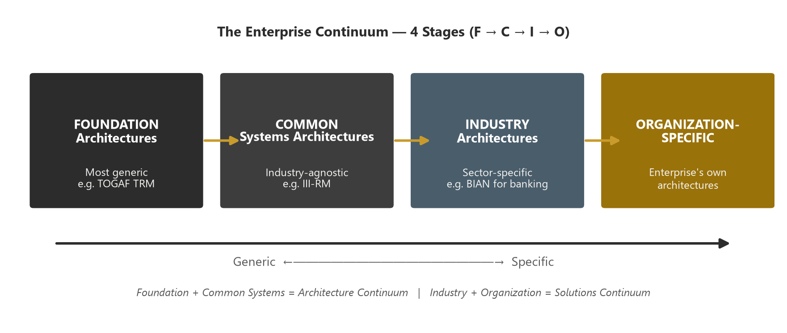
The Architecture Continuum — 4 Stages
Module 8 — Enterprise Continuum & Repository
Increasing detail and specificity from left to right.
Architects look left for reusable elements; build right for their enterprise.
Foundation → Common Systems → Industry → Organization-Specific architectures.
⭐ EXAM TIP: Memorize the order: Foundation → Common Systems → Industry → Organization-Specific.
TOGAF 10 Associate Masterclass | The Open Group
opengroup.org
Notes:
: The Architecture Continuum — 4 Stages
Now the four stages of the Architecture Continuum, which you should be able to recite in order. From left to right: Foundation, then Common Systems, then Industry, then Organization-Specific. As you move from left to right, the architectures become more detailed and more specific to your particular enterprise. And here's the practical behaviour the standard describes: architects look to the left of the continuum to find reusable elements, and they build toward the right to create something tailored to their own organization. As the chevron on screen shows, it's a flow from generic to specific. Memorize that order — Foundation, Common Systems, Industry, Organization-Specific — because the exam tests it directly.
---

Slide 7
Architecture Continuum — Definitions
Module 8 — Enterprise Continuum & Repository
Stage | What it is | Example
Foundation | Generic components, principles, guidelines | TOGAF TRM
Common Systems | Reusable across many domains | Security, network, management architecture; III-RM
Industry | Specific to an industry vertical | Banking, telecom reference models
Organization-Specific | Tailored to one enterprise | Your company's architecture
⭐ EXAM TIP: The TRM is a Foundation Architecture; the III-RM supports Common Systems (application domain).
TOGAF 10 Associate Masterclass | The Open Group
opengroup.org
Notes:
: Architecture Continuum — Definitions
Let's put meaning to each stage. A Foundation Architecture is generic — common components, principles, and guidelines that anything can be built on. The canonical example is the TOGAF Technical Reference Model, the TRM. Common Systems Architectures are reusable across many domains — think of a security architecture, a network architecture, or a management architecture; each is complete for its problem domain. The III-RM lives here, supporting the application domain. Industry Architectures are specific to a vertical — banking or telecom reference models, for instance. And Organization-Specific Architectures are tailored to a single enterprise — your company's own architecture. Two facts worth pinning: the TRM is a Foundation Architecture, and the III-RM supports Common Systems.
---

Slide 8
The Solutions Continuum — 4 Stages
Module 8 — Enterprise Continuum & Repository
Mirrors the Architecture Continuum, but for implementations (SBBs).
Describes what is available as reusable solution building blocks.
⭐ EXAM TIP: Same four stages, but Solutions = the realized SBBs, not the architecture descriptions.
TOGAF 10 Associate Masterclass | The Open Group
opengroup.org
Notes:
: The Solutions Continuum — 4 Stages
The Solutions Continuum mirrors the Architecture Continuum exactly — same four stages, but now for implementations rather than descriptions. So you have Foundation Solutions, Common Systems Solutions, Industry Solutions, and Organization-Specific Solutions. Where the Architecture Continuum described what was needed, the Solutions Continuum describes what's actually available as reusable solution building blocks to realize those architectures. The thing to keep straight is the parallel: same four stages, same generic-to-specific direction, but the Solutions side holds the realized SBBs — the concrete implementations — not the architecture descriptions.
---

Slide 9
Architecture vs Solutions Continuum
Module 8 — Enterprise Continuum & Repository
 | Architecture Continuum | Solutions Continuum
Contains | ABBs — architecture descriptions | SBBs — implementations
Answers | What capability is needed | With what it's realized
Direction | Guides ↓ | Is guided by ↑
⭐ EXAM TIP: ABBs (Architecture) shape SBBs (Solutions). Architecture guides Solutions.
TOGAF 10 Associate Masterclass | The Open Group
opengroup.org
Notes:
: Architecture vs Solutions Continuum
Let's put the two continua side by side. The Architecture Continuum contains ABBs — the architecture descriptions; the Solutions Continuum contains SBBs — the implementations. The Architecture Continuum answers what capability is needed; the Solutions Continuum answers with what it's realized. And the direction of influence matters: the Architecture Continuum guides downward into the Solutions Continuum, and the Solutions Continuum is guided by it. So the relationship echoes the ABB-and-SBB relationship we learned right back in Module 1: ABBs shape SBBs, and architecture guides solutions. Same idea, now at the continuum level.
---

Slide 10
The Direction of the Continuum
Module 8 — Enterprise Continuum & Repository
The progression runs along several axes:
  Logical → Physical
  Horizontal (IT-focused) → Vertical (business-focused)
  Generalization → Specialization
  Taxonomy → complete & specific specification
⭐ EXAM TIP: The left end is generic/logical; the right end is specific/physical.
TOGAF 10 Associate Masterclass | The Open Group
opengroup.org
Notes:
: The Direction of the Continuum
It's worth understanding what "generic to specific" actually means, because TOGAF describes the progression along several axes at once. It runs from logical to physical. It runs from horizontal, meaning IT-focused, to vertical, meaning business-focused. It runs from generalization to specialization. And it runs from a simple taxonomy to a complete and specific architecture specification. All of these describe the same left-to-right journey. So whenever you picture the continuum, the left end is generic, logical, and reusable, and the right end is specific, physical, and tailored. That mental image will help you place any asset correctly.
---

Slide 11
From Continuum to Repository
Module 8 — Enterprise Continuum & Repository
The Continuum is the classification scheme; the Architecture Repository is where assets are stored.
The Repository holds outputs of the ADM at different levels of abstraction.
The Continuum + Repository together enable co-operation across stakeholders and reuse.
⭐ EXAM TIP: Continuum = how assets are classified; Repository = where they live.
TOGAF 10 Associate Masterclass | The Open Group
opengroup.org
Notes:
: From Continuum to Repository
Now let's connect the Continuum to the Repository, because students often blur them. The Enterprise Continuum is the classification scheme — it tells you how assets are categorized, generic to specific. The Architecture Repository is where those assets are actually stored. The Repository holds the outputs of the ADM at different levels of abstraction, and together with the Continuum it enables co-operation across stakeholders and genuine reuse. So hold this clean distinction: the Continuum is how assets are classified; the Repository is where they live. Two different jobs, working together.
---

Slide 12
The Architecture Repository — Overview
Module 8 — Enterprise Continuum & Repository
A structured store for all architecture-related output, supporting the Enterprise Continuum.
Has eight major components (next slides).
Lets architects reuse, govern, and relate assets across the enterprise.
⭐ EXAM TIP: Know the eight components — a frequent exam target.
TOGAF 10 Associate Masterclass | The Open Group
opengroup.org
Notes:
: The Architecture Repository — Overview
Let's turn to the Architecture Repository itself. It's a structured store for all your architecture-related output, and it's designed to support the Enterprise Continuum. It has eight major components, which we'll go through over the next few slides. Its whole purpose is to let architects reuse, govern, and relate assets across the enterprise rather than losing them in scattered documents. The headline task for the exam is simply to know those eight components — it's a frequent target, and it's very answerable once you've grouped them sensibly, which we'll do.
---

Slide 13
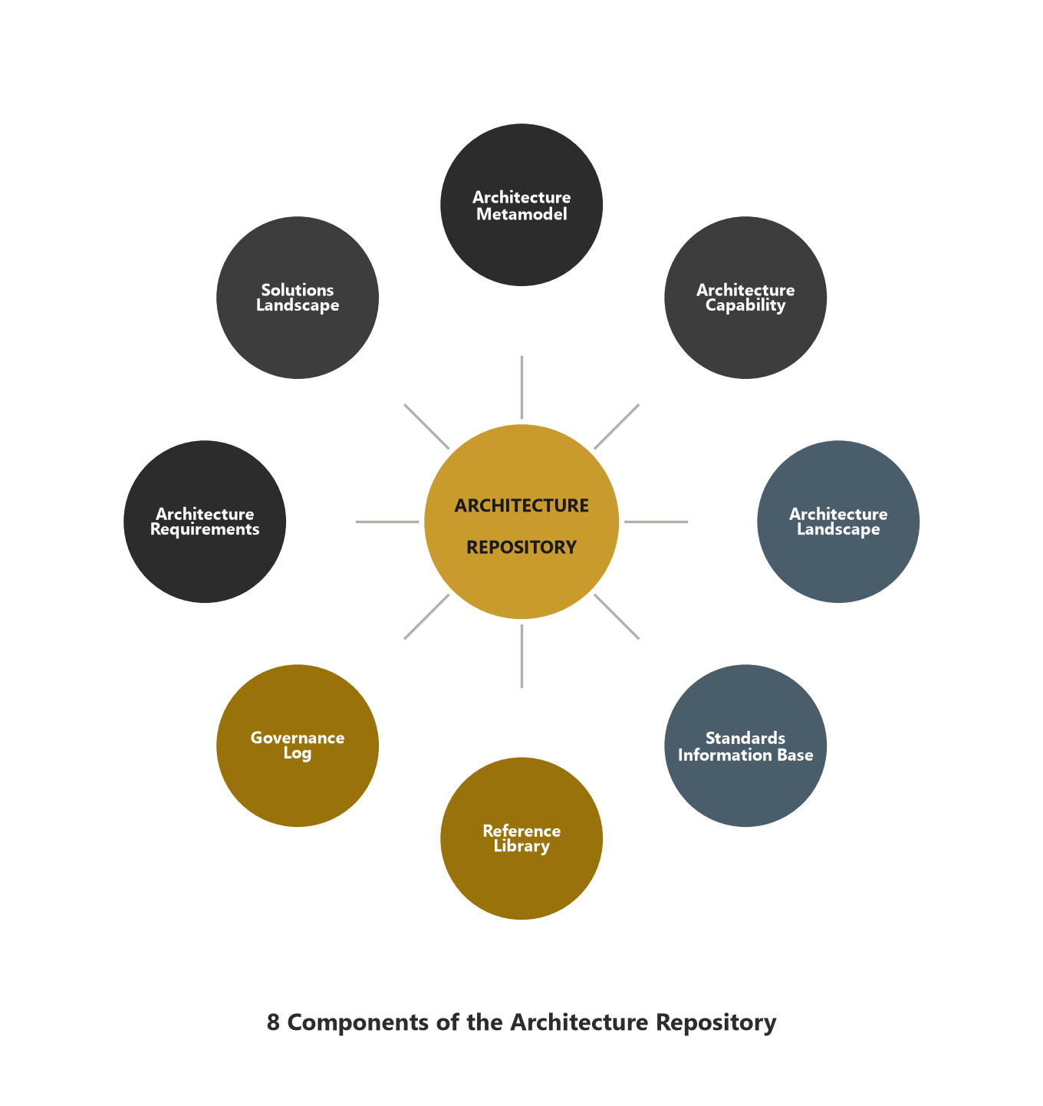
Architecture Repository — The 8 Components
Module 8 — Enterprise Continuum & Repository
1. Architecture Metamodel — the tailored framework & content metamodel
2. Architecture Capability — parameters, structures, processes for governance
3. Architecture Landscape — assets deployed now, at multiple abstraction levels
4. Standards Library — the standards new architectures must comply with
5. Reference Library — guidelines, templates, patterns, reference material
6. Governance Repository — record of governance activity
7. Architecture Requirements Repository — all authorized requirements
8. Solutions Landscape — the SBBs supporting the Architecture Landscape
⭐ EXAM TIP: Eight components — Metamodel, Capability, Landscape, Standards Library, Reference Library, Governance, Requirements, Solutions Landscape.
TOGAF 10 Associate Masterclass | The Open Group
opengroup.org
Notes:
: Architecture Repository — The 8 Components
Here are all eight components. One, the Architecture Metamodel — your tailored framework and content metamodel. Two, the Architecture Capability — the parameters, structures, and processes that govern the repository. Three, the Architecture Landscape — the assets deployed right now, at multiple levels of abstraction. Four, the Standards Library — the standards new architectures must comply with. Five, the Reference Library — guidelines, templates, and patterns. Six, the Governance Repository — the record of governance activity. Seven, the Architecture Requirements Repository — all your authorized requirements. And eight, the Solutions Landscape — the solution building blocks supporting the Architecture Landscape. Eight components: Metamodel, Capability, Landscape, Standards, Reference, Governance, Requirements, Solutions Landscape. We'll group them to make them stick.
---

Slide 14
Component 1 & 2 — Metamodel & Capability
Module 8 — Enterprise Continuum & Repository
Architecture Metamodel — describes the organizationally tailored application of the framework, including the content metamodel (the entities and relationships you model).
Architecture Capability — defines the parameters, structures, and processes that govern the repository.
⭐ EXAM TIP: Metamodel = how you model; Capability = how you govern the repository.
TOGAF 10 Associate Masterclass | The Open Group
opengroup.org
Notes:
: Component 1 & 2 — Metamodel & Capability
Let's take the components in pairs. First, the Architecture Metamodel and the Architecture Capability. The Architecture Metamodel describes your organizationally tailored application of the framework, including the content metamodel — that's the set of entities and relationships you actually model. The Architecture Capability defines the parameters, structures, and processes that govern the repository itself. So a neat way to remember this pair: the Metamodel is how you model, and the Capability is how you govern. One shapes your content; the other keeps the repository under control.
---

Slide 15
Component 3 — The Architecture Landscape
Module 8 — Enterprise Continuum & Repository
The architectural representation of assets deployed in the operating enterprise at a point in time.
Exists at three levels of abstraction:
  Strategic — long-term, enterprise-wide, executive summary level
  Segment — a coherent portion of the enterprise (program/portfolio)
  Capability — detailed, used to guide implementation changes
⭐ EXAM TIP: Architecture Landscape has 3 levels: Strategic, Segment, Capability.
TOGAF 10 Associate Masterclass | The Open Group
opengroup.org
Notes:
: Component 3 — The Architecture Landscape
The third component is the Architecture Landscape, and it deserves special attention because it has internal structure the exam likes. The Landscape is the architectural representation of the assets deployed in the operating enterprise at a particular point in time. And it exists at three levels of abstraction. The Strategic level is long-term, enterprise-wide, and executive in nature. The Segment level covers a coherent portion of the enterprise — a program or portfolio. And the Capability level is detailed and is used to guide actual implementation changes. So remember: the Architecture Landscape has three levels — Strategic, Segment, and Capability.
---

Slide 16
The 3 Landscape Levels Explained
Module 8 — Enterprise Continuum & Repository
Level | Scope | Detail | Time horizon
Strategic | Whole enterprise | Low (summary) | Long-term
Segment | A business segment | Medium | Mid-term
Capability | A specific capability | High (detailed) | Short-term
⭐ EXAM TIP: Strategic (broad/low detail) → Segment → Capability (narrow/high detail).
TOGAF 10 Associate Masterclass | The Open Group
opengroup.org
Notes:
: The 3 Landscape Levels Explained
Let's make those three levels concrete with a simple table of trade-offs. The Strategic level spans the whole enterprise, with low detail — it's a summary — and a long-term horizon. The Segment level covers a single business segment, with medium detail and a mid-term horizon. And the Capability level zooms into a specific capability, with high detail and a short-term horizon. Notice the pattern: as you move from Strategic to Segment to Capability, the scope narrows but the detail increases. Strategic is broad and shallow; Capability is narrow and deep. That inverse relationship between scope and detail is the thing to remember.
---

Slide 17
Component 4 & 5 — Standards & Reference Libraries
Module 8 — Enterprise Continuum & Repository
Standards Library — captures the standards with which new architectures must comply (industry standards, products, shared services).
Reference Library — guidelines, templates, patterns, and reference material to accelerate new architectures (the TOGAF Library lives here).
⭐ EXAM TIP: Standards Library = must comply; Reference Library = reusable accelerators.
TOGAF 10 Associate Masterclass | The Open Group
opengroup.org
Notes:
: Component 4 & 5 — Standards & Reference Libraries
The next pair: two libraries. The Standards Library captures the standards that new architectures must comply with — industry standards, selected products, and shared services already deployed. The Reference Library provides guidelines, templates, patterns, and other reference material that accelerate the creation of new architectures — and this is where the TOGAF Library itself sits. The clean distinction to hold: the Standards Library is about what you must comply with, while the Reference Library is about reusable accelerators you can choose to draw on. Compliance versus acceleration.
---

Slide 18
Component 6 & 7 — Governance & Requirements
Module 8 — Enterprise Continuum & Repository
Governance Repository — a record of governance activity across the enterprise (compliance, dispensations, decisions).
Architecture Requirements Repository — all authorized architecture requirements agreed with the Architecture Board (from Module 7).
⭐ EXAM TIP: Requirements live in the Architecture Requirements Repository — a component of the wider repository.
TOGAF 10 Associate Masterclass | The Open Group
opengroup.org
Notes:
: Component 6 & 7 — Governance & Requirements
The next pair: two repositories within the Repository. The Governance Repository holds a record of governance activity across the enterprise — compliance assessments, dispensations, and decisions. And the Architecture Requirements Repository holds all the authorized architecture requirements that have been agreed with the Architecture Board — this is the very repository we met back in Module 7 on Requirements Management. So when a question asks where authorized requirements live, the answer is the Architecture Requirements Repository, and it's one of the eight components of the wider Architecture Repository.
---

Slide 19
Component 8 — The Solutions Landscape
Module 8 — Enterprise Continuum & Repository
The architectural representation of the SBBs (solution building blocks) supporting the Architecture Landscape.
Shows what has been planned or deployed by the enterprise.
The solutions counterpart to the Architecture Landscape.
⭐ EXAM TIP: Solutions Landscape = SBBs; Architecture Landscape = the architecture (ABBs).
TOGAF 10 Associate Masterclass | The Open Group
opengroup.org
Notes:
: Component 8 — The Solutions Landscape
The eighth and final component is the Solutions Landscape. It's the architectural representation of the solution building blocks — the SBBs — that support the Architecture Landscape. It shows what the enterprise has actually planned or deployed in terms of solutions. Think of it as the solutions-side counterpart to the Architecture Landscape: where the Architecture Landscape captures the architecture itself, the Solutions Landscape captures the implementations that realize it. So the simple contrast to lock in is: Solutions Landscape equals SBBs; Architecture Landscape equals the architecture, the ABB level.
---

Slide 20
Landscape vs Solutions Landscape
Module 8 — Enterprise Continuum & Repository
 | Architecture Landscape | Solutions Landscape
Holds | The architecture (ABB-level) | The SBBs (implementations)
Levels | Strategic / Segment / Capability | Mirrors deployed solutions
Question | What is architected? | What is built/deployed?
⭐ EXAM TIP: Don't confuse the two Landscapes — one is architecture, one is solutions.
TOGAF 10 Associate Masterclass | The Open Group
opengroup.org
Notes:
: Landscape vs Solutions Landscape
Let's reinforce that contrast, because the two Landscapes are easy to confuse. The Architecture Landscape holds the architecture, at the ABB level, and it's organized into the Strategic, Segment, and Capability levels. The Solutions Landscape holds the SBBs — the implementations — and mirrors what's actually deployed. The Architecture Landscape answers "what is architected?"; the Solutions Landscape answers "what is built or deployed?" So don't let an exam question slip these past you as identical. One is about architecture; the other is about solutions. Architecture versus implementation, one more time.
---

Slide 21
How It All Fits Together
Module 8 — Enterprise Continuum & Repository
The Enterprise Continuum classifies assets generic → specific.
The Architecture Repository stores those assets in its eight components.
The ADM draws from and returns to the Repository each cycle.
⭐ EXAM TIP: Continuum classifies, Repository stores, ADM uses and feeds both.
TOGAF 10 Associate Masterclass | The Open Group
opengroup.org
Notes:
: How It All Fits Together
Let's zoom out and see the whole machine working together. The Enterprise Continuum classifies assets from generic to specific. The Architecture Repository stores those assets across its eight components. And the ADM draws from the Repository at the start of each phase and returns refined assets to it at the end. So there's a continuous flow: the Continuum classifies, the Repository stores, and the ADM both uses and feeds both of them, cycle after cycle. That's how generic Foundation assets get progressively specialized into your organization-specific architecture over time. Three structures, one integrated system.
---

Slide 22
The Foundation Architecture & the TRM
Module 8 — Enterprise Continuum & Repository
The Foundation Architecture is the most generic end of the Architecture Continuum.
The TOGAF Technical Reference Model (TRM) is the canonical example of a Foundation Architecture.
The ADM specializes Foundation Architectures into organization-specific ones.
⭐ EXAM TIP: TRM = Foundation Architecture (detailed in Module 13).
TOGAF 10 Associate Masterclass | The Open Group
opengroup.org
Notes:
: The Foundation Architecture & the TRM
A quick spotlight on the most generic end of the continuum — the Foundation Architecture. This is the far-left, most generic point of the Architecture Continuum, consisting of generic components, principles, and guidelines on which more specific architectures are built. The TOGAF Technical Reference Model, the TRM, is the canonical example of a Foundation Architecture. And the ADM is precisely the process that specializes these Foundation Architectures into organization-specific models. We'll cover the TRM in full in Module 13, but for now, lock in the association: the TRM is a Foundation Architecture.
---

Slide 23
Common Exam Traps
Module 8 — Enterprise Continuum & Repository
❌ "The Architecture and Solutions Continua are the same" → ✅ one holds ABBs, the other SBBs.
❌ "The continuum runs specific → generic" → ✅ it runs generic (Foundation) → specific (Org).
❌ "The TRM is an Industry Architecture" → ✅ the TRM is a Foundation Architecture.
❌ "The Architecture Repository has three components" → ✅ it has eight.
❌ "Architecture Landscape and Solutions Landscape are identical" → ✅ one is architecture, one is solutions.
⭐ EXAM TIP: Anchor the order and the ABB/SBB split.
TOGAF 10 Associate Masterclass | The Open Group
opengroup.org
Notes:
: Common Exam Traps
Let's clear the traps. One: "the Architecture and Solutions Continua are the same" — no, one holds ABBs, the other SBBs. Two: "the continuum runs specific to generic" — no, it runs generic, starting at Foundation, to specific, ending at Organization-Specific. Three: "the TRM is an Industry Architecture" — no, the TRM is a Foundation Architecture. Four: "the Architecture Repository has three components" — no, it has eight. And five: "the Architecture Landscape and the Solutions Landscape are identical" — no, one is architecture, one is solutions. The two anchors that defend against most of these are the continuum order and the ABB-versus-SBB split.
---

Slide 24
Key Numbers & Quick Facts (Cheat Sheet)
Module 8 — Enterprise Continuum & Repository
Fact | Value
Enterprise Continuum parts | 2 (Architecture, Solutions)
Continuum stages (each) | 4 (Foundation, Common Systems, Industry, Org-Specific)
Architecture Continuum holds | ABBs
Solutions Continuum holds | SBBs
Architecture Repository components | 8
Architecture Landscape levels | 3 (Strategic, Segment, Capability)
Foundation Architecture example | TRM
Common Systems example | III-RM
TOGAF 10 Associate Masterclass | The Open Group
opengroup.org
Notes:
: Key Numbers & Quick Facts (Cheat Sheet)
Your cheat-sheet for this module. The Enterprise Continuum has two parts — Architecture and Solutions. Each continuum has four stages — Foundation, Common Systems, Industry, Organization-Specific. The Architecture Continuum holds ABBs; the Solutions Continuum holds SBBs. The Architecture Repository has eight components. The Architecture Landscape has three levels — Strategic, Segment, Capability. The Foundation Architecture example is the TRM, and the Common Systems example is the III-RM. Capture this slide — it's the densest collection of testable facts in the module.
---

Slide 25
Module Summary
Module 8 — Enterprise Continuum & Repository
The Enterprise Continuum classifies all reusable assets, generic → specific, in two continua.
The Architecture Continuum holds ABBs; the Solutions Continuum holds SBBs; both have 4 stages.
The Architecture Repository stores assets in 8 components.
The Architecture Landscape has 3 levels: Strategic, Segment, Capability.
The TRM is a Foundation Architecture; the III-RM supports Common Systems.
TOGAF 10 Associate Masterclass | The Open Group
opengroup.org
Notes:
: Module Summary
Let's recap. The Enterprise Continuum classifies all reusable assets from generic to specific, in two continua. The Architecture Continuum holds ABBs, the Solutions Continuum holds SBBs, and each has four stages — Foundation, Common Systems, Industry, Organization-Specific. The Architecture Repository stores assets across eight components. The Architecture Landscape, one of those components, has three levels — Strategic, Segment, and Capability. And the TRM is a Foundation Architecture while the III-RM supports Common Systems. Classification, storage, and reuse — that's the trio this module delivers.
---

Slide 26
Bridge to Module 9
Module 8 — Enterprise Continuum & Repository
The Repository stores deliverables, artifacts, and building blocks — but how are they structured?
That's the Content Framework and Content Metamodel — Module 9.
⭐ EXAM TIP: The Content Framework defines what goes into the Repository and how it's organized.
TOGAF 10 Associate Masterclass | The Open Group
opengroup.org
Notes:
: Bridge to Module 9
So where to next? We now know the Repository stores deliverables, artifacts, and building blocks — but we haven't yet seen how those work products are actually structured and related. That's the job of the Content Framework and the Content Metamodel, and they're the subject of Module 9. Here's the connecting thread: the Content Framework defines exactly what goes into the Repository and how it's all organized. So having built the shelving in this module, we'll next look at how the contents are catalogued. On to the Content Framework.
---

Slide 27
Quick Self-Check
Module 8 — Enterprise Continuum & Repository
Can you, from memory:
  Name the two continua and what each holds (ABB/SBB)?
  List the four stages in order?
  Name five of the eight repository components?
  List the three Architecture Landscape levels?
⭐ EXAM TIP: If the eight components are hard, group them: model/govern, two landscapes, two libraries, two repositories.
TOGAF 10 Associate Masterclass | The Open Group
opengroup.org
Notes:
: Quick Self-Check
A quick self-check. From memory: can you name the two continua and say what each holds — ABBs or SBBs? Can you list the four stages in the correct order? Can you name at least five of the eight repository components? And can you list the three Architecture Landscape levels? If the eight components feel like a lot, here's a grouping trick: think of them as model-and-govern, two landscapes, two libraries, and two repositories. That structure turns an intimidating list of eight into four easy pairs. Try reciting them that way before the questions.
---

Slide 28
Memory Hook
Module 8 — Enterprise Continuum & Repository
Continuum direction: "F-C-I-O" — Foundation, Common, Industry, Organization (generic → specific).
Landscape levels: "S-S-C" — Strategic, Segment, Capability (broad → detailed).
⭐ EXAM TIP: Two tiny acronyms — F-C-I-O and S-S-C — cover the two most-tested lists here.
TOGAF 10 Associate Masterclass | The Open Group
opengroup.org
Notes:
: Memory Hook
Let me give you two tiny acronyms that carry the two most-tested lists in this module. For the continuum direction, remember F-C-I-O: Foundation, Common, Industry, Organization — generic to specific. And for the Architecture Landscape levels, remember S-S-C: Strategic, Segment, Capability — broad to detailed. F-C-I-O and S-S-C. Two short strings, and between them they cover the continuum order and the landscape levels — exactly the facts most likely to come up. Drill those two acronyms and you've banked some easy marks.
---

Slide 29
Practice Question 1
Module 8 — Enterprise Continuum & Repository
Q1
What are the two complementary parts of the Enterprise Continuum?
A) The Foundation Continuum and the Industry Continuum
B) The Architecture Continuum and the Solutions Continuum
C) The Strategic Continuum and the Capability Continuum
D) The Standards Library and the Reference Library
Explanation: The Enterprise Continuum comprises the Architecture Continuum (which holds architecture descriptions / ABBs) and the Solutions Continuum (which holds implementations / SBBs). The Architecture Continuum guides the Solutions Continuum.
TOGAF 10 Associate Masterclass | The Open Group
opengroup.org
Notes:
: Practice Questions (Q1–Q5)
Five questions to consolidate the Continuum and the Repository. Question one asks for the two parts of the Enterprise Continuum. Question two tests the order of the four continuum stages. Question three asks how many repository components there are and to identify one. Question four asks for the three Architecture Landscape levels. And question five asks which reference model is a Foundation Architecture. Notice that these map straight onto our two memory hooks — F-C-I-O and S-S-C — plus the eight components and the ABB-SBB split. Pause, answer, and then we'll review. Strong work here means this whole supporting structure is solid.
---
*End of Module 8 — The Enterprise Continuum & Architecture Repository.*

Slide 30
Practice Question 2
Module 8 — Enterprise Continuum & Repository
Q2
What is the correct order of the four stages of the Architecture Continuum, from most generic to most specific?
A) Organization-Specific → Industry → Common Systems → Foundation
B) Foundation → Common Systems → Industry → Organization-Specific
C) Common Systems → Foundation → Industry → Organization-Specific
D) Industry → Foundation → Common Systems → Organization-Specific
Explanation: The Architecture Continuum runs Foundation → Common Systems → Industry → Organization-Specific, moving from the most generic and reusable on the left to the most specific on the right, with increasing detail.
TOGAF 10 Associate Masterclass | The Open Group
opengroup.org
Notes:
: Practice Questions (Q1–Q5)
Five questions to consolidate the Continuum and the Repository. Question one asks for the two parts of the Enterprise Continuum. Question two tests the order of the four continuum stages. Question three asks how many repository components there are and to identify one. Question four asks for the three Architecture Landscape levels. And question five asks which reference model is a Foundation Architecture. Notice that these map straight onto our two memory hooks — F-C-I-O and S-S-C — plus the eight components and the ABB-SBB split. Pause, answer, and then we'll review. Strong work here means this whole supporting structure is solid.
---
*End of Module 8 — The Enterprise Continuum & Architecture Repository.*

Slide 31
Practice Question 3
Module 8 — Enterprise Continuum & Repository
Q3
How many major components does the TOGAF Architecture Repository have, and which of these is one of them?
A) Three components, including the Architecture Vision
B) Eight components, including the Standards Library
C) Five components, including the Architecture Contract
D) Four components, including the Statement of Architecture Work
Explanation: The Architecture Repository has eight components: the Architecture Metamodel, Architecture Capability, Architecture Landscape, Standards Library, Reference Library, Governance Repository, Architecture Requirements Repository, and Solutions Landscape.
TOGAF 10 Associate Masterclass | The Open Group
opengroup.org
Notes:
: Practice Questions (Q1–Q5)
Five questions to consolidate the Continuum and the Repository. Question one asks for the two parts of the Enterprise Continuum. Question two tests the order of the four continuum stages. Question three asks how many repository components there are and to identify one. Question four asks for the three Architecture Landscape levels. And question five asks which reference model is a Foundation Architecture. Notice that these map straight onto our two memory hooks — F-C-I-O and S-S-C — plus the eight components and the ABB-SBB split. Pause, answer, and then we'll review. Strong work here means this whole supporting structure is solid.
---
*End of Module 8 — The Enterprise Continuum & Architecture Repository.*

Slide 32
Practice Question 4
Module 8 — Enterprise Continuum & Repository
Q4
The Architecture Landscape exists at three levels of abstraction. Which set is correct?
A) Foundation, Common Systems, Industry
B) Strategic, Segment, Capability
C) Baseline, Transition, Target
D) Business, Data, Technology
Explanation: The Architecture Landscape exists at three levels: Strategic (broad, long-term, low detail), Segment (a portion of the enterprise), and Capability (detailed, guiding implementation). Foundation/Common/Industry are continuum stages, not landscape levels.
TOGAF 10 Associate Masterclass | The Open Group
opengroup.org
Notes:
: Practice Questions (Q1–Q5)
Five questions to consolidate the Continuum and the Repository. Question one asks for the two parts of the Enterprise Continuum. Question two tests the order of the four continuum stages. Question three asks how many repository components there are and to identify one. Question four asks for the three Architecture Landscape levels. And question five asks which reference model is a Foundation Architecture. Notice that these map straight onto our two memory hooks — F-C-I-O and S-S-C — plus the eight components and the ABB-SBB split. Pause, answer, and then we'll review. Strong work here means this whole supporting structure is solid.
---
*End of Module 8 — The Enterprise Continuum & Architecture Repository.*

Slide 33
Practice Question 5
Module 8 — Enterprise Continuum & Repository
Q5
Which TOGAF reference model is an example of a Foundation Architecture in the Architecture Continuum?
A) The Integrated Information Infrastructure Reference Model (III-RM)
B) The Technical Reference Model (TRM)
C) The Zachman Framework
D) The Architecture Contract
Explanation: The Technical Reference Model (TRM) is the canonical example of a Foundation Architecture — generic components and guidelines on which more specific architectures are built. The III-RM, by contrast, supports Common Systems Architecture in the application domain. End of Module 8 — The Enterprise Continuum & Architecture Repository.
TOGAF 10 Associate Masterclass | The Open Group
opengroup.org
Notes:
: Practice Questions (Q1–Q5)
Five questions to consolidate the Continuum and the Repository. Question one asks for the two parts of the Enterprise Continuum. Question two tests the order of the four continuum stages. Question three asks how many repository components there are and to identify one. Question four asks for the three Architecture Landscape levels. And question five asks which reference model is a Foundation Architecture. Notice that these map straight onto our two memory hooks — F-C-I-O and S-S-C — plus the eight components and the ABB-SBB split. Pause, answer, and then we'll review. Strong work here means this whole supporting structure is solid.
---
*End of Module 8 — The Enterprise Continuum & Architecture Repository.*

