Slide 1
TOGAF 10 ASSOCIATE MASTERCLASS
PARTITIONING, LANDSCAPES, VIEWS & VIEWPOINTS
Module 10: Partitioning · Landscapes · Views & Viewpoints
TOGAF Standard, 10th Edition · Foundation Exam Preparation
Module 10 — Partitioning, Landscapes & Viewpoints
40
60
Closed
≥60%
questions
minutes
book
to pass
TOGAF 10 Associate Masterclass | The Open Group
opengroup.org
Notes:
: PARTITIONING, LANDSCAPES, VIEWS & VIEWPOINTS
Welcome to Module 10. A real enterprise is far too big and complex to capture in a single architecture, and its many stakeholders all care about different things. This module covers the three tools TOGAF gives you to cope with that reality: partitioning, which divides the enterprise into manageable pieces; the architecture landscape levels, which organize those pieces by abstraction; and views and viewpoints, which let you communicate with each stakeholder in terms they care about. The view-versus-viewpoint distinction in particular is a guaranteed exam topic, so let's get it exactly right.
---

Slide 2
Module Overview & Learning Objectives
Module 10 — Partitioning, Landscapes & Viewpoints
By the end of this module, you'll be able to:
  Explain why and how architectures are partitioned
  Describe the three Architecture Landscape levels (Strategic, Segment, Capability)
  Define stakeholder, concern, view, and viewpoint
  Explain the view ↔ viewpoint relationship precisely
  Locate the Viewpoint Library in the repository
⭐ EXAM TIP: The view-vs-viewpoint distinction is a guaranteed exam topic.
TOGAF 10 Associate Masterclass | The Open Group
opengroup.org
Notes:
: Module Overview & Learning Objectives
Here's our plan. You'll explain why and how architectures are partitioned. You'll describe the three architecture landscape levels — Strategic, Segment, and Capability. You'll define the key terms: stakeholder, concern, view, and viewpoint. You'll explain the precise relationship between a view and a viewpoint — which is the part students most often get backwards. And you'll know where the Viewpoint Library lives in the repository. Of everything here, the view-versus-viewpoint distinction is the one to nail down hardest, because the exam tests it almost every time.
---

Slide 3
Why Partition Architectures?
Module 10 — Partitioning, Landscapes & Viewpoints
Enterprises are too large and complex for one monolithic architecture.
Partitions simplify the development and management of the EA.
Reasons to partition:
  Different teams work on different elements concurrently
  Organizational unit architectures may conflict
  Different elements change at different rates
⭐ EXAM TIP: Partitions lie at the foundation of Architecture Governance.
TOGAF 10 Associate Masterclass | The Open Group
opengroup.org
Notes:
: Why Partition Architectures?
Let's start with partitioning. Why bother? Because enterprises are simply too large and complex to capture in one monolithic architecture — it would be unwieldy and impossible to maintain. Partitions exist to simplify the development and management of the Enterprise Architecture. There are several concrete reasons to partition: different teams need to work on different elements at the same time; organizational-unit architectures can conflict with each other; and different elements of the architecture change at different rates. One especially important point for the exam: partitions lie at the very foundation of Architecture Governance. They're not just a convenience — they're how governance gets its grip.
---

Slide 4
Partitions vs Levels vs Continuum
Module 10 — Partitioning, Landscapes & Viewpoints
Partitions are distinct from levels and from the Architecture Continuum.
Partition = a division for ownership and concurrent work.
Level = Strategic / Segment / Capability (abstraction).
Continuum = generic → specific classification.
⭐ EXAM TIP: Don't conflate partitions (ownership/governance) with levels (abstraction).
TOGAF 10 Associate Masterclass | The Open Group
opengroup.org
Notes:
: Partitions vs Levels vs Continuum
Now an important clarification, because TOGAF has three related but distinct organizing ideas. Partitions are distinct from levels, and distinct from the Architecture Continuum. A partition is a division created for ownership and concurrent work — it answers "who owns and develops this piece?" A level is the Strategic, Segment, or Capability classification — it's about abstraction. And the Continuum is the generic-to-specific classification we covered in Module 8. The exam can try to blur these, so keep them separate: partitions are about ownership and governance, while levels are about abstraction. Three different lenses, three different jobs.
---

Slide 5
Classification Criteria for Partitioning
Module 10 — Partitioning, Landscapes & Viewpoints
Architectures are partitioned/organized using characteristics such as:
  Breadth (subject matter) — the primary organizing characteristic
  Depth (level of detail)
  Time (baseline → target horizon)
  Recency (how current/accurate the architecture is)
  Maturity, volatility, governance needs
⭐ EXAM TIP: Breadth (subject matter) is the primary organizing characteristic.
TOGAF 10 Associate Masterclass | The Open Group
opengroup.org
Notes:
: Classification Criteria for Partitioning
How do you actually decide where to draw partition boundaries? TOGAF lists several classification characteristics. Breadth — the subject-matter area — is the primary organizing characteristic; architectures are functionally decomposed into a hierarchy of subject areas or segments. Then there's depth, the level of detail; time, the baseline-to-target horizon; and recency, meaning how current and accurate an architecture still is. Maturity, volatility, and governance needs can also play a role. But for the exam, the headline fact is that breadth — subject matter — is the primary organizing characteristic. If a question asks which characteristic comes first, the answer is breadth.
---

Slide 6
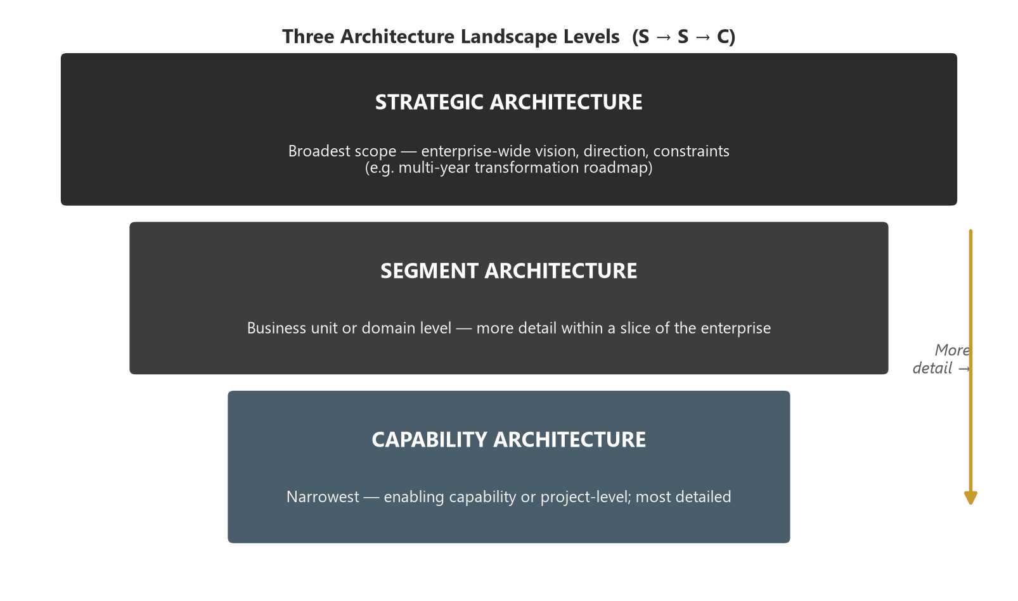
The Three Architecture Landscape Levels
Module 10 — Partitioning, Landscapes & Viewpoints
Architectures group into three levels by breadth, depth, and time:
Strategic (broad, summary) → Segment (a portion) → Capability (detailed).
⭐ EXAM TIP: Strategic → Segment → Capability — broad/summary to narrow/detailed.
TOGAF 10 Associate Masterclass | The Open Group
opengroup.org
Notes:
: The Three Architecture Landscape Levels
Using those characteristics, especially breadth, depth, and time, architectures group naturally into three levels — and we previewed these back in Module 8. As the pyramid on screen shows, they run from Strategic at the top, which is broad and summary, down through Segment, which covers a portion of the enterprise, to Capability at the bottom, which is narrow and detailed. The progression is from broad and summary to narrow and detailed. Commit the order to memory: Strategic, Segment, Capability. We'll now take each one in turn, because the exam expects you to know the character of all three.
---

Slide 7
Strategic Architecture
Module 10 — Partitioning, Landscapes & Viewpoints
Broad, enterprise-wide, summary-level architecture.
Sets direction and context for the lower levels.
Long time horizon; low detail.
Aimed at executive decision-makers.
⭐ EXAM TIP: Strategic = the big-picture, long-term view that directs the others.
TOGAF 10 Associate Masterclass | The Open Group
opengroup.org
Notes:
: Strategic Architecture
First, Strategic Architecture. This is the broad, enterprise-wide, summary-level architecture. Its job is to set the direction and context for everything below it — the lower levels take their cues from it. It has a long time horizon and deliberately low detail, because at this altitude you want the big picture, not the fine print. And its natural audience is executive decision-makers, who need to understand the shape of the enterprise without drowning in specifics. So picture Strategic as the big-picture, long-term view that directs the others. Broad, summary, executive — that's Strategic.
---

Slide 8
Segment Architecture
Module 10 — Partitioning, Landscapes & Viewpoints
Covers a coherent portion (segment) of the enterprise — e.g., a business line or program.
Medium detail and mid-term horizon.
Bridges strategic direction and capability-level delivery.
⭐ EXAM TIP: Segment = a defined portion of the enterprise, between strategic and capability.
TOGAF 10 Associate Masterclass | The Open Group
opengroup.org
Notes:
: Segment Architecture
Next, Segment Architecture. This covers a coherent portion — a segment — of the enterprise, such as a particular business line or a major program. It sits in the middle on every dimension: medium detail, mid-term horizon. Its role is to bridge the gap between the high-level strategic direction above it and the detailed, capability-level delivery below it. So when a question describes an architecture scoped to a defined chunk of the enterprise — not the whole thing, but not a single capability either — that's the Segment level. It's the connective tissue between strategy and detailed delivery.
---

Slide 9
Capability Architecture
Module 10 — Partitioning, Landscapes & Viewpoints
Detailed, narrow architecture for a specific capability.
Short time horizon; high detail.
Guides the actual implementation of changes.
⭐ EXAM TIP: Capability = the detailed level that drives implementation.
TOGAF 10 Associate Masterclass | The Open Group
opengroup.org
Notes:
: Capability Architecture
Third, Capability Architecture. This is the detailed, narrow architecture for a specific capability. It has a short time horizon and high detail — it's where the rubber meets the road. Its defining purpose is to guide the actual implementation of changes; this is the level that delivery teams work from. So the contrast across the three is now clear: Strategic directs, Segment bridges, and Capability delivers. For the exam, anchor Capability as the detailed level that drives implementation. If a question mentions guiding actual delivery with high detail and a short horizon, that's Capability.
---

Slide 10
Landscape Levels — Comparison
Module 10 — Partitioning, Landscapes & Viewpoints
Level | Breadth | Detail | Horizon | Audience
Strategic | Whole enterprise | Low | Long | Executives
Segment | A portion | Medium | Mid | Program/portfolio
Capability | One capability | High | Short | Delivery teams
⭐ EXAM TIP: As breadth narrows, detail increases and the horizon shortens.
TOGAF 10 Associate Masterclass | The Open Group
opengroup.org
Notes:
: Landscape Levels — Comparison
Let's compare all three at a glance, because the pattern is what makes them memorable. Strategic spans the whole enterprise, with low detail, a long horizon, and an executive audience. Segment covers a portion, with medium detail, a mid-term horizon, and a program or portfolio audience. And Capability covers one capability, with high detail, a short horizon, and a delivery-team audience. Notice the consistent relationship running through the table: as breadth narrows, detail increases and the time horizon shortens. That inverse relationship — narrow means detailed and short-term — is the single insight that lets you reconstruct the whole table under exam pressure.
---

Slide 11
How Levels Are Developed
Module 10 — Partitioning, Landscapes & Viewpoints
Two strategies to develop architectures at different levels:
Iterations within a single ADM cycle
A hierarchy of ADM processes, executed concurrently
In practice, architects blend both to fit the Request for Architecture Work.
⭐ EXAM TIP: Broad/summary architectures set direction for narrow/detailed ones.
TOGAF 10 Associate Masterclass | The Open Group
opengroup.org
Notes:
: How Levels Are Developed
How do you actually develop architectures at these different levels? TOGAF describes two strategies. The first is to develop the different levels through iterations within a single cycle of the ADM. The second is to develop them through a hierarchy of ADM processes, executed concurrently — different teams running their own ADM cycles at different levels. In practice, an architect blends elements of both to fit the specific Request for Architecture Work. And there's a governing principle to remember: broad, summary architectures set the direction for the narrow, detailed ones. Direction flows downward, from Strategic toward Capability. The higher levels constrain and guide the lower ones.
---

Slide 12
Stakeholders & Concerns
Module 10 — Partitioning, Landscapes & Viewpoints
A stakeholder = an individual, team, or organization with an interest in the architecture.
A concern = an interest relevant to a stakeholder (e.g., performance, security, cost).
The architect's job: address stakeholder concerns and reconcile conflicts.
⭐ EXAM TIP: Stakeholders have concerns; architecture work exists to address them.
TOGAF 10 Associate Masterclass | The Open Group
opengroup.org
Notes:
: Stakeholders & Concerns
Now let's pivot to communication, starting with two foundational terms. A stakeholder is any individual, team, or organization with an interest in the architecture — sponsors, users, developers, regulators, and so on. A concern is an interest that's relevant to a stakeholder: things like performance, security, cost, or compliance. The architect's core job, as we saw all the way back in the Executive Overview, is to address stakeholder concerns and to reconcile the conflicts between them. So the relationship to hold is simple: stakeholders have concerns, and the entire point of architecture work is to address those concerns. Everything about views and viewpoints flows from this.
---

Slide 13
What Is a View?
Module 10 — Partitioning, Landscapes & Viewpoints
A view is a representation of the architecture from the perspective of a related set of concerns.
It is what a specific stakeholder actually sees.
A view is built to address one or more stakeholder concerns.
⭐ EXAM TIP: A view = the actual representation a stakeholder looks at.
TOGAF 10 Associate Masterclass | The Open Group
opengroup.org
Notes:
: What Is a View?
Let's define a view. A view is a representation of the architecture from the perspective of a related set of concerns. In plainer terms, it's what a specific stakeholder actually sees — the picture tailored to what they care about. A view is built precisely to address one or more stakeholder concerns. So if your security officer cares about security, you build a security view that shows them how security is handled. The essence to remember: a view is the actual representation a stakeholder looks at. It's concrete — something you can point to on a page. Keep that concreteness in mind, because the contrast with viewpoint depends on it.
---

Slide 14
What Is a Viewpoint?
Module 10 — Partitioning, Landscapes & Viewpoints
A viewpoint defines the conventions for constructing and using a view — the perspective/template.
It specifies how to create the view: the notations, models, and analysis techniques.
The view conforms to its viewpoint.
⭐ EXAM TIP: A viewpoint = the template/specification; the view = the result.
TOGAF 10 Associate Masterclass | The Open Group
opengroup.org
Notes:
: What Is a Viewpoint?
Now the term people get backwards — the viewpoint. A viewpoint defines the conventions for constructing and using a view. It's the perspective, the template, the specification. It tells you how to create the view: which notations to use, which models to build, which analysis techniques to apply. And critically, the view conforms to its viewpoint. So the viewpoint is the abstract definition, and the view is the concrete result that follows that definition. The exam-critical statement is this: a viewpoint is the template or set of conventions, while the view is the result produced from it. Template versus result. Definition versus instance. Get the direction right and you'll never lose these marks.
---

Slide 15
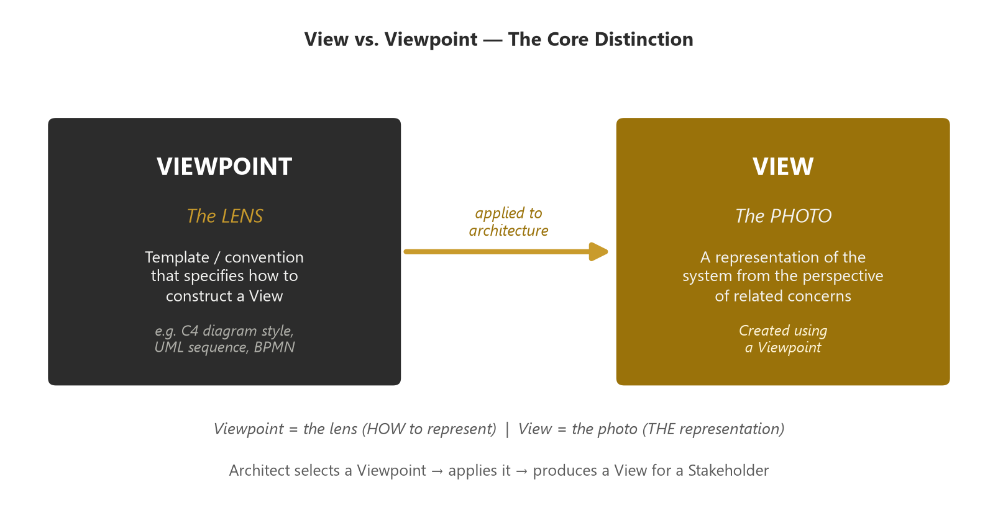
View vs Viewpoint — The Core Distinction
Module 10 — Partitioning, Landscapes & Viewpoints
Stakeholder → concerns → viewpoint (template) → view (result).
⭐ EXAM TIP: Viewpoint = blueprint; View = the building. Memorize this.
TOGAF 10 Associate Masterclass | The Open Group
opengroup.org
Notes:
: View vs Viewpoint — The Core Distinction
This is the slide to memorize, so let's lay it out fully. A viewpoint is the definition or template; a view is the actual representation. A viewpoint answers how to construct a view; a view answers what the stakeholder sees. The analogy I love is photography: the viewpoint is the camera angle or the lens specification — say, "a side-on elevation shot" — and the view is the actual photograph you take following that specification. And the relationship is one-directional: a view conforms to a viewpoint, never the reverse. As the diagram shows, the chain runs stakeholder, to concerns, to viewpoint as template, to view as result. The phrase to carry into the exam is dead simple: viewpoint is the blueprint, view is the building.
---

Slide 16
A Helpful Analogy
Module 10 — Partitioning, Landscapes & Viewpoints
A viewpoint is like the specification for a kind of photograph — e.g., "a side-on elevation."
A view is the actual photo you take following that specification.
Many views can be created from one viewpoint (different systems, same perspective).
⭐ EXAM TIP: One viewpoint → many possible views. The viewpoint comes first.
TOGAF 10 Associate Masterclass | The Open Group
opengroup.org
Notes:
: A Helpful Analogy
Let me reinforce that with the analogy spelled out, because analogies survive exam-day nerves better than definitions. A viewpoint is like the specification for a kind of photograph — for instance, "a side-on elevation." A view is the actual photo you take by following that specification. And here's a subtle point that confirms the direction: many different views can be created from one viewpoint. You can apply the same "side-on elevation" specification to lots of different buildings, producing many photos from one spec. The viewpoint always comes first; the views follow from it. One viewpoint, potentially many views — that asymmetry tells you which is the template.
---

Slide 17
ISO/IEC/IEEE 42010 Alignment
Module 10 — Partitioning, Landscapes & Viewpoints
TOGAF's view/viewpoint concepts align with ISO/IEC/IEEE 42010.
In that model: a system has stakeholders who have concerns; a viewpoint frames concerns; a view addresses them.
⭐ EXAM TIP: Views and viewpoints come from the ISO 42010 architecture-description standard.
TOGAF 10 Associate Masterclass | The Open Group
opengroup.org
Notes:
: ISO/IEC/IEEE 42010 Alignment
It's worth knowing where these concepts come from, because the exam may reference it. TOGAF's view and viewpoint concepts align with the ISO/IEC/IEEE 42010 standard — the international standard for architecture description. In that model, a system has stakeholders, those stakeholders have concerns, a viewpoint frames a set of those concerns, and a view addresses them. It's exactly the structure we've been building, just expressed in the formal standard's language. So if a question mentions the standard behind views and viewpoints, the answer is ISO 42010. TOGAF didn't invent these terms; it adopted them from that architecture-description standard.
---

Slide 18
The Viewpoint Library
Module 10 — Partitioning, Landscapes & Viewpoints
TOGAF maintains a Viewpoint Library of reusable viewpoints.
It is stored within the Reference Library part of the Architecture Repository.
Architects select appropriate viewpoints to address the stakeholder concerns at hand.
⭐ EXAM TIP: The Viewpoint Library lives in the Reference Library of the repository.
TOGAF 10 Associate Masterclass | The Open Group
opengroup.org
Notes:
: The Viewpoint Library
Where do viewpoints actually live? TOGAF maintains a Viewpoint Library — a collection of reusable viewpoints that architects can draw on rather than inventing perspectives from scratch each time. And here's the locational fact the exam likes: the Viewpoint Library is stored within the Reference Library part of the Architecture Repository — the same Reference Library we met in Module 8, full of guidelines, templates, and patterns. Architects select appropriate viewpoints from this library to address whatever stakeholder concerns are in play. So remember: Viewpoint Library, inside the Reference Library, inside the Architecture Repository. A reusable catalogue of perspectives.
---

Slide 19
Selecting Views for Stakeholders
Module 10 — Partitioning, Landscapes & Viewpoints
In Phase A, the Stakeholder Map identifies stakeholders and concerns.
The architect selects viewpoints that address those concerns.
Views are then created to demonstrate the concerns are addressed.
⭐ EXAM TIP: The flow: stakeholders → concerns → viewpoints → views.
TOGAF 10 Associate Masterclass | The Open Group
opengroup.org
Notes:
: Selecting Views for Stakeholders
Let's connect this back to the ADM. Way back in Phase A, the Stakeholder Map identified your stakeholders and their concerns. The architect then selects viewpoints — from the Viewpoint Library — that address those concerns. And from those viewpoints, the architect creates views that demonstrate the concerns have actually been addressed. So there's a clean, four-step flow you can recite: stakeholders, to concerns, to viewpoints, to views. Each step follows from the last. That flow is not just exam fodder; it's the actual logic of how an architect decides what pictures to draw and for whom. Stakeholders drive concerns; concerns drive viewpoints; viewpoints produce views.
---

Slide 20
Why Views & Viewpoints Matter
Module 10 — Partitioning, Landscapes & Viewpoints
They ensure the architecture is communicated in terms each stakeholder cares about.
They provide evidence that concerns have been addressed.
They make a complex architecture digestible and reviewable.
⭐ EXAM TIP: Views are how you prove to stakeholders that their concerns are met.
TOGAF 10 Associate Masterclass | The Open Group
opengroup.org
Notes:
: Why Views & Viewpoints Matter
Let's not lose sight of why any of this matters. Views and viewpoints ensure the architecture is communicated to each stakeholder in terms they actually care about — the finance director gets a cost view, the security lead gets a security view. They provide concrete evidence that each concern has been addressed, which is invaluable when you're seeking sign-off. And they make an otherwise overwhelming architecture digestible and reviewable, one perspective at a time. The exam-relevant essence: views are how you prove to stakeholders that their concerns have been met. They turn a sprawling architecture into something a busy stakeholder can engage with and approve.
---

Slide 21
Partitioning + Views = Managing Complexity
Module 10 — Partitioning, Landscapes & Viewpoints
Partitioning breaks the enterprise into manageable, owned architectures.
Levels organize them by abstraction (Strategic/Segment/Capability).
Views & viewpoints make each architecture stakeholder-relevant.
Together they tame complexity and enable federated working.
⭐ EXAM TIP: Partition for ownership, level for abstraction, view for communication.
TOGAF 10 Associate Masterclass | The Open Group
opengroup.org
Notes:
: Partitioning + Views = Managing Complexity
Let's tie the whole module together, because all three tools serve one goal — managing complexity. Partitioning breaks the enterprise into manageable, owned architectures, so different teams can work without colliding. Levels organize those architectures by abstraction — Strategic, Segment, Capability. And views and viewpoints make each architecture relevant and intelligible to its stakeholders. Used together, they tame the complexity of a large enterprise and enable federated working, where many teams contribute coherently. A neat three-word summary to carry away: partition for ownership, level for abstraction, view for communication. Three tools, three purposes, one outcome — complexity made manageable.
---

Slide 22
Common Exam Traps
Module 10 — Partitioning, Landscapes & Viewpoints
❌ "A view defines how to build itself" → ✅ the viewpoint defines how; the view is the result.
❌ "Viewpoint = what the stakeholder sees" → ✅ that's the view; the viewpoint is the template.
❌ "Partitions and levels are the same" → ✅ partitions = ownership/governance; levels = abstraction.
❌ "Depth is the primary organizing characteristic" → ✅ breadth (subject matter) is primary.
⭐ EXAM TIP: View-vs-viewpoint and partition-vs-level are the two trap pairs.
TOGAF 10 Associate Masterclass | The Open Group
opengroup.org
Notes:
: Common Exam Traps
Let's clear the traps, and they cluster into two pairs. First pair, view and viewpoint. Trap: "a view defines how to build itself" — no, the viewpoint defines how; the view is the result. Trap: "the viewpoint is what the stakeholder sees" — no, that's the view; the viewpoint is the template. Second pair, partition and level. Trap: "partitions and levels are the same" — no, partitions are about ownership and governance, levels about abstraction. And one more: "depth is the primary organizing characteristic" — no, breadth, the subject matter, is primary. The two trap pairs to guard are view-versus-viewpoint and partition-versus-level.
---

Slide 23
Key Numbers & Quick Facts (Cheat Sheet)
Module 10 — Partitioning, Landscapes & Viewpoints
Fact | Value
Architecture Landscape levels | 3 (Strategic, Segment, Capability)
Primary organizing characteristic | Breadth (subject matter)
Other organizing characteristics | Depth, Time, Recency
View = | the representation a stakeholder sees
Viewpoint = | the template/conventions for a view
View ↔ Viewpoint | a view conforms to a viewpoint
Viewpoint Library location | Reference Library (repository)
Standard | ISO/IEC/IEEE 42010
TOGAF 10 Associate Masterclass | The Open Group
opengroup.org
Notes:
: Key Numbers & Quick Facts (Cheat Sheet)
Your cheat-sheet. The Architecture Landscape has three levels — Strategic, Segment, Capability. The primary organizing characteristic is breadth, the subject matter, with depth, time, and recency as secondary. A view is the representation a stakeholder sees; a viewpoint is the template and conventions for a view; and a view conforms to a viewpoint. The Viewpoint Library lives in the Reference Library of the repository. And the underlying standard is ISO/IEC/IEEE 42010. Capture this card — between the three levels and the view-viewpoint pair, it covers the module's most-tested facts.
---

Slide 24
Module Summary
Module 10 — Partitioning, Landscapes & Viewpoints
Partitioning divides the enterprise into manageable, owned architectures — the foundation of governance.
The Architecture Landscape has 3 levels: Strategic (broad), Segment (a portion), Capability (detailed).
Breadth (subject matter) is the primary organizing characteristic.
A view is what a stakeholder sees; a viewpoint is the template that defines it — a view conforms to a viewpoint.
The Viewpoint Library sits in the Reference Library; the concepts come from ISO 42010.
TOGAF 10 Associate Masterclass | The Open Group
opengroup.org
Notes:
: Module Summary
Let's recap. Partitioning divides the enterprise into manageable, owned architectures, and it's the foundation of governance. The Architecture Landscape has three levels — Strategic, broad and summary; Segment, a portion of the enterprise; and Capability, detailed and implementation-guiding. Breadth, the subject matter, is the primary organizing characteristic. A view is what a stakeholder sees, and a viewpoint is the template that defines it — the view conforms to the viewpoint. The Viewpoint Library sits in the Reference Library, and these concepts come from ISO 42010. Three tools for taming complexity, now firmly in hand.
---

Slide 25
Memory Hook
Module 10 — Partitioning, Landscapes & Viewpoints
Viewpoint = the lens; View = the photo.
Levels = abstraction (S-S-C); Partitions = ownership.
Breadth first — subject matter is the primary organizer.
⭐ EXAM TIP: "Lens vs photo" resolves nearly every view/viewpoint question.
TOGAF 10 Associate Masterclass | The Open Group
opengroup.org
Notes:
: Memory Hook
Two quick memory hooks to make this stick. For views and viewpoints: the viewpoint is the lens, and the view is the photo. The lens specification comes first; the photo follows from it. For the organizing structures: levels are about abstraction — remember S-S-C, Strategic, Segment, Capability — while partitions are about ownership. And one more: breadth first, because subject matter is the primary organizer. Of these, the lens-versus-photo hook is the workhorse — it resolves very nearly every view-and-viewpoint question the exam can pose. Reach for it whenever those two words appear.
---

Slide 26
Bridge to Module 11
Module 10 — Partitioning, Landscapes & Viewpoints
Identifying and managing stakeholders deserves its own focus.
Module 11 covers stakeholder management, the power/interest grid, and communication.
⭐ EXAM TIP: Views exist to serve stakeholders — Module 11 is the natural companion.
TOGAF 10 Associate Masterclass | The Open Group
opengroup.org
Notes:
: Bridge to Module 11
So where next? We've leaned heavily on the idea of stakeholders and their concerns throughout this module — and that whole topic of identifying and managing stakeholders deserves a focused treatment of its own. That's Module 11, which covers stakeholder management, the power-and-interest grid for classifying stakeholders, and communication. The natural link is this: views exist precisely to serve stakeholders, so understanding stakeholders better makes your views better. Module 11 is the human counterpart to the structural concepts we've just covered. Let's go meet the people the architecture is ultimately for.
---

Slide 27
Quick Self-Check
Module 10 — Partitioning, Landscapes & Viewpoints
Can you, from memory:
  Define view and viewpoint and state which conforms to which?
  Name the three landscape levels and order them by detail?
  Say the primary organizing characteristic?
  Locate the Viewpoint Library?
⭐ EXAM TIP: If view/viewpoint blurs, re-watch slide 15.
TOGAF 10 Associate Masterclass | The Open Group
opengroup.org
Notes:
: Quick Self-Check
A quick self-check before the questions. From memory: can you define a view and a viewpoint, and state clearly which one conforms to the other? Can you name the three landscape levels and order them by detail? Can you say the primary organizing characteristic? And can you locate the Viewpoint Library? If the view-versus-viewpoint relationship still feels even slightly slippery, go back and re-watch slide fifteen — the side-by-side table with the camera analogy. That one slide is the conceptual heart of the module and the source of the marks most often won or lost here.
---

Slide 28
Practice Question 1
Module 10 — Partitioning, Landscapes & Viewpoints
Q1
What is the relationship between a view and a viewpoint in TOGAF?
A) A viewpoint is what the stakeholder sees; a view defines how to build it
B) A view is a representation that conforms to a viewpoint, which defines the conventions for constructing it
C) They are identical
D) A view is a reusable template; a viewpoint is a one-off picture
Explanation: A viewpoint defines the conventions (the template/perspective) for constructing and using a view; the view is the actual representation a stakeholder sees, and it conforms to its viewpoint. Think "viewpoint = lens, view = photograph."
TOGAF 10 Associate Masterclass | The Open Group
opengroup.org
Notes:
: Practice Questions (Q1–Q5)
Five questions to consolidate the module. Question one tests the view-versus-viewpoint relationship head-on. Question two asks for the three landscape levels. Question three asks for the primary organizing characteristic. Question four asks why architectures are partitioned. And question five asks where the Viewpoint Library is stored. Notice that question one is the linchpin — if you answer that one confidently, with the lens-and-photo image in mind, you've mastered the module's central idea. Pause on each, commit to an answer, and then we'll review them together. Let's see how it lands.
---
*End of Module 10 — Partitioning, Landscapes, Views & Viewpoints.*

Slide 29
Practice Question 2
Module 10 — Partitioning, Landscapes & Viewpoints
Q2
What are the three levels of the Architecture Landscape?
A) Foundation, Common Systems, Industry
B) Strategic, Segment, Capability
C) Baseline, Transition, Target
D) Business, Data, Technology
Explanation: The Architecture Landscape has three levels: Strategic (broad, summary, long-term), Segment (a coherent portion of the enterprise), and Capability (detailed, short-term, guiding implementation).
TOGAF 10 Associate Masterclass | The Open Group
opengroup.org
Notes:
: Practice Questions (Q1–Q5)
Five questions to consolidate the module. Question one tests the view-versus-viewpoint relationship head-on. Question two asks for the three landscape levels. Question three asks for the primary organizing characteristic. Question four asks why architectures are partitioned. And question five asks where the Viewpoint Library is stored. Notice that question one is the linchpin — if you answer that one confidently, with the lens-and-photo image in mind, you've mastered the module's central idea. Pause on each, commit to an answer, and then we'll review them together. Let's see how it lands.
---
*End of Module 10 — Partitioning, Landscapes, Views & Viewpoints.*

Slide 30
Practice Question 3
Module 10 — Partitioning, Landscapes & Viewpoints
Q3
Which characteristic is generally the primary one used to organize the Architecture Landscape?
A) Depth (level of detail)
B) Recency
C) Breadth (subject matter)
D) Cost
Explanation: Breadth — the subject matter area — is generally the primary organizing characteristic for describing an Architecture Landscape. Architectures are functionally decomposed into a hierarchy of subject areas or segments; depth, time, and recency are secondary.
TOGAF 10 Associate Masterclass | The Open Group
opengroup.org
Notes:
: Practice Questions (Q1–Q5)
Five questions to consolidate the module. Question one tests the view-versus-viewpoint relationship head-on. Question two asks for the three landscape levels. Question three asks for the primary organizing characteristic. Question four asks why architectures are partitioned. And question five asks where the Viewpoint Library is stored. Notice that question one is the linchpin — if you answer that one confidently, with the lens-and-photo image in mind, you've mastered the module's central idea. Pause on each, commit to an answer, and then we'll review them together. Let's see how it lands.
---
*End of Module 10 — Partitioning, Landscapes, Views & Viewpoints.*

Slide 31
Practice Question 4
Module 10 — Partitioning, Landscapes & Viewpoints
Q4
Why are architectures partitioned in TOGAF?
A) To replace the need for governance
B) To simplify development and management, allow concurrent work by different teams, and resolve conflicting unit architectures
C) Because the ADM mandates exactly four partitions
D) To eliminate the Architecture Continuum
Explanation: Partitions simplify the development and management of the Enterprise Architecture, let different teams work concurrently on different elements, and help resolve conflicting organizational-unit architectures. They lie at the foundation of Architecture Governance — they don't replace it.
TOGAF 10 Associate Masterclass | The Open Group
opengroup.org
Notes:
: Practice Questions (Q1–Q5)
Five questions to consolidate the module. Question one tests the view-versus-viewpoint relationship head-on. Question two asks for the three landscape levels. Question three asks for the primary organizing characteristic. Question four asks why architectures are partitioned. And question five asks where the Viewpoint Library is stored. Notice that question one is the linchpin — if you answer that one confidently, with the lens-and-photo image in mind, you've mastered the module's central idea. Pause on each, commit to an answer, and then we'll review them together. Let's see how it lands.
---
*End of Module 10 — Partitioning, Landscapes, Views & Viewpoints.*

Slide 32
Practice Question 5
Module 10 — Partitioning, Landscapes & Viewpoints
Q5
Where is the Viewpoint Library stored?
A) In the Standards Library
B) In the Reference Library part of the Architecture Repository
C) In the Architecture Contract
D) In the Implementation & Migration Plan
Explanation: The Viewpoint Library — a collection of reusable viewpoints — is held within the Reference Library part of the Architecture Repository, alongside other guidelines, templates, and patterns. End of Module 10 — Architecture Partitioning, Landscapes, Views & Viewpoints.
TOGAF 10 Associate Masterclass | The Open Group
opengroup.org
Notes:
: Practice Questions (Q1–Q5)
Five questions to consolidate the module. Question one tests the view-versus-viewpoint relationship head-on. Question two asks for the three landscape levels. Question three asks for the primary organizing characteristic. Question four asks why architectures are partitioned. And question five asks where the Viewpoint Library is stored. Notice that question one is the linchpin — if you answer that one confidently, with the lens-and-photo image in mind, you've mastered the module's central idea. Pause on each, commit to an answer, and then we'll review them together. Let's see how it lands.
---
*End of Module 10 — Partitioning, Landscapes, Views & Viewpoints.*

