Slide 1
Module 1: Security and Compliance Concepts
Describe the shared responsibility model
SC-900 exam prep · Concepts of security, compliance, and identity · 10 to 15% of the exam
SC-900 Exam Prep: Microsoft Security, Compliance and Identity Fundamentals Study Course
Module 1
Notes:
Welcome to Module one: Security and Compliance Concepts. It covers the exam area Concepts of security, compliance, and identity.
Each part of this module comes from the study notes of the same name, so you can read the notes after you watch.

Slide 2
What You Will Learn
Module 1
Describe the shared responsibility model
Describe defense-in-depth
Describe the Zero Trust model
Describe encryption and hashing
Describe Governance, Risk, and Compliance (GRC) concepts
Practice with exam-style questions and a recall check
SC-900 Exam Prep | Microsoft Security, Compliance and Identity Fundamentals exam
Module 1: Security and Compliance Concepts
2 / 19
Notes:
By the end of this module you will be able to do six things.
Describe the shared responsibility model.
Describe defense-in-depth.
Describe the Zero Trust model.
Describe encryption and hashing.
Describe Governance, Risk, and Compliance (G R C) concepts.
Practice with exam-style questions and a recall check.

Slide 3
Where This Fits in the Exam
DATES
Module 1
EXAM CHECK-IN · Where this fits
Exam area: Concepts of security, compliance, and identity (10–15%)
Exam format: 45 minutes; a score of 700 on a scale of 1 to 1,000 passes
Validated against: the official SC-900 study guide, skills measured as of October 21, 2026
SC-900 Exam Prep | Microsoft Security, Compliance and Identity Fundamentals exam
Module 1: Security and Compliance Concepts
3 / 19
Notes:
Here is where this module sits in the exam.
Exam area: Concepts of security, compliance, and identity (ten to fifteen percent).
Exam format: forty-five minutes; a score of seven hundred on a scale of one to one thousand passes.
Validated against: the official S C nine hundred study guide, skills measured as of October twenty-one, two thousand twenty-six.

Slide 4
The shared responsibility model
Module 1
Layer | On-premises | IaaS | PaaS | SaaS
Information and data | You | You | You | You
Devices | You | You | You | You
Accounts and identities | You | You | You | You
Identity and directory infrastructure | You | You | Shared | Shared
Applications | You | You | Shared | Provider
Network controls | You | You | Shared | Provider
Operating system | You | You | Provider | Provider
Physical hosts, network, datacenter | You | Provider | Provider | Provider
In the cloud, security is shared between the cloud provider and the customer. What is shared depends on the service type.
SC-900 Exam Prep | Microsoft Security, Compliance and Identity Fundamentals exam
Module 1: Security and Compliance Concepts
4 / 19
Notes:
The shared responsibility model.
In the cloud, security is shared between the cloud provider and the customer. What is shared depends on the service type.
Information and data. On-premises: You. I A A S: You. pass: You. sass: You.
Devices. On-premises: You. I A A S: You. pass: You. sass: You.
Accounts and identities. On-premises: You. I A A S: You. pass: You. sass: You.
Identity and directory infrastructure. On-premises: You. I A A S: You. pass: Shared. sass: Shared.
Applications. On-premises: You. I A A S: You. pass: Shared. sass: Provider.
Network controls. On-premises: You. I A A S: You. pass: Shared. sass: Provider.
Operating system. On-premises: You. I A A S: You. pass: Provider. sass: Provider.
Physical hosts, network, datacenter. On-premises: You. I A A S: Provider. pass: Provider. sass: Provider.

Slide 5
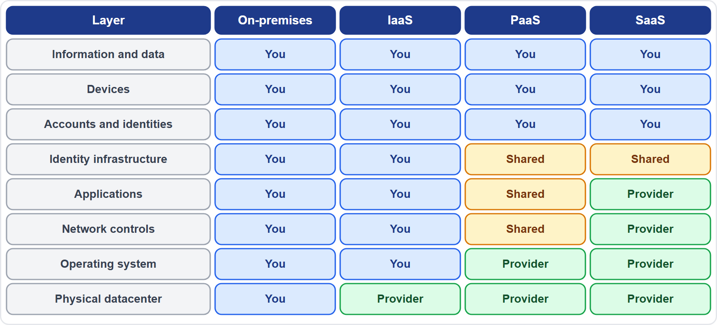
The shared responsibility model, continued
Module 1
The shared responsibility model: customer always owns data, devices and identities; provider owns the physical layer
EXAM TIP Data, devices and accounts and identities are always yours, in every model. The physical datacenter is always the provider's (except on-premises). The more managed the service (IaaS to PaaS to SaaS), the more the provider handles.
SC-900 Exam Prep | Microsoft Security, Compliance and Identity Fundamentals exam
Module 1: Security and Compliance Concepts
5 / 19
Notes:
The shared responsibility model.
The figure shows this: The shared responsibility model: customer always owns data, devices and identities; provider owns the physical layer.
Exam tip: Data, devices and accounts and identities are always yours, in every model. The physical datacenter is always the provider's (except on-premises). The more managed the service (I A A S to pass to sass), the more the provider handles.

Slide 6
Defense in depth
Module 1
Layer (outer to inner) | Protects | Examples
Physical security | Buildings and hardware | Locks, badges, cameras
Identity and access | Who signs in and what they can do | MFA, Conditional Access
Perimeter | The network edge | DDoS protection, firewalls
Network | Traffic between systems | Segmentation, network security groups
Compute | Servers and VMs | Patching, endpoint protection
Application | App code and APIs | Secure development, WAF
Data | The information itself | Encryption, labels, access control
Defense in depth uses layers of protection, so if one layer fails the next still protects the data.
The data is at the center and each layer wraps around it.
SC-900 Exam Prep | Microsoft Security, Compliance and Identity Fundamentals exam
Module 1: Security and Compliance Concepts
6 / 19
Notes:
Defense in depth.
Defense in depth uses layers of protection, so if one layer fails the next still protects the data.
Physical security. Protects: Buildings and hardware. Examples: Locks, badges, cameras.
Identity and access. Protects: Who signs in and what they can do. Examples: M F A, Conditional Access.
Perimeter. Protects: The network edge. Examples: D dos (distributed denial of service) protection, firewalls.
Network. Protects: Traffic between systems. Examples: Segmentation, network security groups.
Compute. Protects: Servers and V Ms. Examples: Patching, endpoint protection.
Application. Protects: App code and A P Is. Examples: Secure development, waff.
Data. Protects: The information itself. Examples: Encryption, labels, access control.
The data is at the center and each layer wraps around it.

Slide 7
The Zero Trust model
Module 1
Principle | Meaning
Verify explicitly | Always authenticate and authorize using all available data: identity, location, device health, service, data classification, anomalies
Use least-privilege access | Limit access with just-in-time and just-enough access and risk-based policies
Assume breach | Segment access, encrypt data, use analytics to detect threats and improve defenses
Zero Trust does not trust anything by default, even inside the corporate network. The slogan is "never trust, always verify."
Zero Trust protects six areas, often drawn as pillars: identities, endpoints, applications, data, infrastructure and network.
SC-900 Exam Prep | Microsoft Security, Compliance and Identity Fundamentals exam
Module 1: Security and Compliance Concepts
7 / 19
Notes:
The Zero Trust model.
Zero Trust does not trust anything by default, even inside the corporate network. The slogan is "never trust, always verify.".
Verify explicitly. Always authenticate and authorize using all available data: identity, location, device health, service, data classification, anomalies.
Use least-privilege access. Limit access with just-in-time and just-enough access and risk-based policies.
Assume breach. Segment access, encrypt data, use analytics to detect threats and improve defenses.
Zero Trust protects six areas, often drawn as pillars: identities, endpoints, applications, data, infrastructure and network.

Slide 8
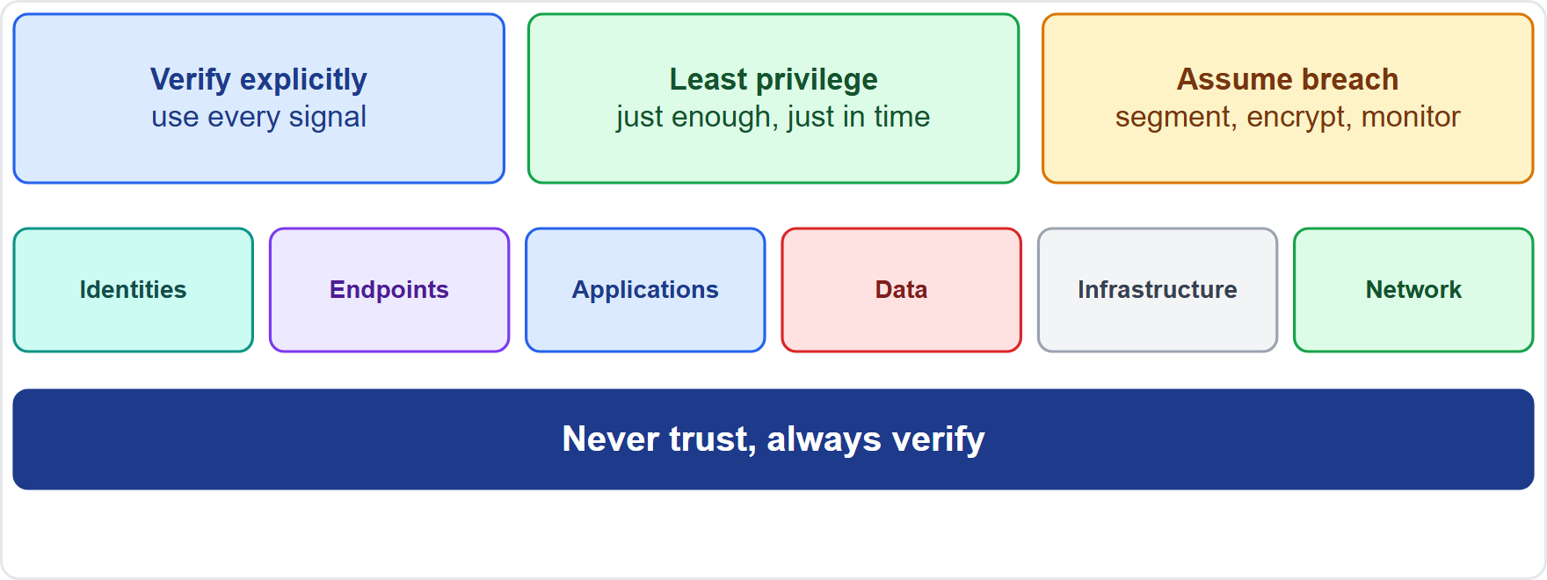
The Zero Trust model, continued
Module 1
Zero Trust principles and the six areas they protect
EXAM TIP The three principles are verify explicitly, least privilege, assume breach. The old model trusted everything inside the network perimeter; Zero Trust replaces it because users, devices and data are everywhere.
SC-900 Exam Prep | Microsoft Security, Compliance and Identity Fundamentals exam
Module 1: Security and Compliance Concepts
8 / 19
Notes:
The Zero Trust model.
The figure shows this: Zero Trust principles and the six areas they protect.
Exam tip: The three principles are verify explicitly, least privilege, assume breach. The old model trusted everything inside the network perimeter; Zero Trust replaces it because users, devices and data are everywhere.

Slide 9
Encryption and hashing
Module 1
 | Encryption | Hashing
Purpose | Confidentiality: keep data secret | Integrity: show data was not changed
Reversible? | Yes, with the key | No, one way
Output | Ciphertext | A fixed-length hash
Example | Disk encryption, HTTPS | Password storage, file checks
Type | Keys | Use
Symmetric | One shared key to encrypt and decrypt | Fast, for bulk data
Asymmetric | Public key and private key | Key exchange, digital signatures
Types of encryption
Where encryption is used: at rest (stored data: disks, databases) and in transit (moving data: HTTPS, VPN). A digital signature is a hash signed with a private key.
EXAM TIP Encryption can be reversed; hashing cannot. A hash proves integrity, not secrecy. Asymmetric uses two keys; symmetric uses one.
SC-900 Exam Prep | Microsoft Security, Compliance and Identity Fundamentals exam
Module 1: Security and Compliance Concepts
9 / 19
Notes:
Encryption and hashing.
Purpose. Encryption: Confidentiality: keep data secret. Hashing: Integrity: show data was not changed.
Reversible? Encryption: Yes, with the key. Hashing: No, one way.
Output. Encryption: Ciphertext. Hashing: A fixed-length hash.
Example. Encryption: Disk encryption, H T T P S. Hashing: Password storage, file checks.
Types of encryption.
Symmetric. Keys: One shared key to encrypt and decrypt. Use: Fast, for bulk data.
Asymmetric. Keys: Public key and private key. Use: Key exchange, digital signatures.
Where encryption is used: at rest (stored data: disks, databases) and in transit (moving data: H T T P S, V P N (virtual private network)). A digital signature is a hash signed with a private key.
Exam tip: Encryption can be reversed; hashing cannot. A hash proves integrity, not secrecy. Asymmetric uses two keys; symmetric uses one.

Slide 10
Governance, risk and compliance (GRC)
Module 1
Part | Meaning | Example
Governance | The rules, roles and oversight that guide how security is managed | Security policies, who approves changes
Risk | Identifying and managing threats and their impact | Risk assessments, treating risks
Compliance | Following laws, regulations and standards | GDPR, HIPAA, ISO 27001
GRC ties together what you must do (compliance), what could go wrong (risk) and how the organization directs it (governance).
SC-900 Exam Prep | Microsoft Security, Compliance and Identity Fundamentals exam
Module 1: Security and Compliance Concepts
10 / 19
Notes:
Governance, risk and compliance (G R C).
Governance. Meaning: The rules, roles and oversight that guide how security is managed. Example: Security policies, who approves changes.
Risk. Meaning: Identifying and managing threats and their impact. Example: Risk assessments, treating risks.
Compliance. Meaning: Following laws, regulations and standards. Example: G D P R, hip ah, I S O twenty-seven thousand one.
G R C ties together what you must do (compliance), what could go wrong (risk) and how the organization directs it (governance).

Slide 11
Practice Question 1
Module 1
Q1
Fabrikam Outdoors uses a SaaS email service. Which responsibility stays with Fabrikam?
A
The physical datacenter
B
Its data and who has access to it
C
The operating system of the servers
D
The network cables
SC-900 Exam Prep | Microsoft Security, Compliance and Identity Fundamentals exam
Module 1: Security and Compliance Concepts
11 / 19
Notes:
Question one. Fabrikam Outdoors uses a sass email service. Which responsibility stays with Fabrikam? The four options are on the screen.
[PAUSE 10]
The answer is B: Its data and who has access to it. Data, devices and identities are the customer's responsibility in every service type.

Slide 12
Practice Question 2
Module 1
Q2
A company layers a firewall, MFA, encryption and a locked server room so that one failure does not expose data. Which approach is this?
A
A single perimeter
B
Federation
C
Defense in depth
D
Hashing
SC-900 Exam Prep | Microsoft Security, Compliance and Identity Fundamentals exam
Module 1: Security and Compliance Concepts
12 / 19
Notes:
Question two. A company layers a firewall, M F A, encryption and a locked server room so that one failure does not expose data. Which approach is this? The four options are on the screen.
[PAUSE 10]
The answer is C: Defense in depth. Using several layers of protection is defense in depth.

Slide 13
Practice Question 3
Module 1
Q3
An access policy checks the user, the device health and the location before every request. Which Zero Trust principle is this?
A
Assume breach
B
Verify explicitly
C
Trust the network
D
Use a shared key
SC-900 Exam Prep | Microsoft Security, Compliance and Identity Fundamentals exam
Module 1: Security and Compliance Concepts
13 / 19
Notes:
Question three. An access policy checks the user, the device health and the location before every request. Which Zero Trust principle is this? The four options are on the screen.
[PAUSE 10]
The answer is B: Verify explicitly. Using all available signals for every request is verifying explicitly.

Slide 14
Practice Question 4
Module 1
Q4
Which statement is true about hashing?
A
It can be reversed with a key held by the owner of the data
B
It keeps data secret by scrambling it for authorized readers
C
It is one way and shows whether data changed
D
It needs a public and a private key to check the result
SC-900 Exam Prep | Microsoft Security, Compliance and Identity Fundamentals exam
Module 1: Security and Compliance Concepts
14 / 19
Notes:
Question four. Which statement is true about hashing? The four options are on the screen.
[PAUSE 10]
The answer is C: It is one way and shows whether data changed. A hash is a one-way fingerprint used to check integrity.

Slide 15
Practice Question 5
Module 1
Q5
Which type of encryption uses a public key and a private key?
A
Symmetric
B
Hashing
C
Obfuscation
D
Asymmetric
SC-900 Exam Prep | Microsoft Security, Compliance and Identity Fundamentals exam
Module 1: Security and Compliance Concepts
15 / 19
Notes:
Question five. Which type of encryption uses a public key and a private key? The four options are on the screen.
[PAUSE 10]
The answer is D: Asymmetric. Asymmetric encryption uses a key pair.

Slide 16
Practice Question 6
Module 1
Q6
A company writes security policies, assigns oversight roles and reviews risks. Which concept covers this?
A
SIEM
B
XDR
C
GRC
D
SSO
SC-900 Exam Prep | Microsoft Security, Compliance and Identity Fundamentals exam
Module 1: Security and Compliance Concepts
16 / 19
Notes:
Question six. A company writes security policies, assigns oversight roles and reviews risks. Which concept covers this? The four options are on the screen.
[PAUSE 10]
The answer is C: G R C. Governance, risk and compliance organize how security is directed, assessed and regulated.

Slide 17
Recall Check 1
Module 1
Q1. Which three things are always the customer's responsibility?
Q2. What is defense in depth?
Q3. Name the three Zero Trust principles.
SC-900 Exam Prep | Microsoft Security, Compliance and Identity Fundamentals exam
Module 1: Security and Compliance Concepts
17 / 19
Notes:
Recall check one. Say each answer out loud before you listen to mine.
Question one. Which three things are always the customer's responsibility?
[PAUSE 5]
Answer: Data, devices, and accounts and identities.
Question two. What is defense in depth?
[PAUSE 5]
Answer: Using multiple layers of protection.
Question three. Name the three Zero Trust principles.
[PAUSE 5]
Answer: Verify explicitly, use least-privilege access, assume breach.

Slide 18
Recall Check 2
Module 1
Q4. What is the difference between encryption and hashing?
Q5. Symmetric or asymmetric: which uses one key?
Q6. What does GRC stand for?
SC-900 Exam Prep | Microsoft Security, Compliance and Identity Fundamentals exam
Module 1: Security and Compliance Concepts
18 / 19
Notes:
Recall check two. Say each answer out loud before you listen to mine.
Question four. What is the difference between encryption and hashing?
[PAUSE 5]
Answer: Encryption is reversible and gives confidentiality; hashing is one way and shows integrity.
Question five. Symmetric or asymmetric: which uses one key?
[PAUSE 5]
Answer: Symmetric.
Question six. What does G R C stand for?
[PAUSE 5]
Answer: Governance, risk and compliance.

Slide 19
Module Recap
Module 1
1
Shared responsibility
2
Defense in depth
3
Zero Trust
physical, identity, perimeter, network, compute, application, data
verify explicitly, least privilege, assume breach; six areas
data, devices, identities always yours; physical layer always the provider's
4
Encryption vs hashing
5
GRC
governance (rules), risk (threats), compliance (laws and standards)
reversible confidentiality vs one-way integrity; symmetric one key, asymmetric two
SC-900 Exam Prep | Microsoft Security, Compliance and Identity Fundamentals exam
Module 1: Security and Compliance Concepts
19 / 19
Notes:
Here is the recap.
Shared responsibility: data, devices, identities always yours; physical layer always the provider's.
Defense in depth: physical, identity, perimeter, network, compute, application, data.
Zero Trust: verify explicitly, least privilege, assume breach; six areas.
Encryption versus hashing: reversible confidentiality versus one-way integrity; symmetric one key, asymmetric two.
G R C: governance (rules), risk (threats), compliance (laws and standards).
In the next module, we continue the course.

