Slide 1
Module 2: Identity Concepts
Define identity as the primary security perimeter
SC-900 exam prep · Concepts of security, compliance, and identity · 10 to 15% of the exam
SC-900 Exam Prep: Microsoft Security, Compliance and Identity Fundamentals Study Course
Module 2
Notes:
Welcome to Module two: Identity Concepts. It covers the exam area Concepts of security, compliance, and identity.
Each part of this module comes from the study notes of the same name, so you can read the notes after you watch.

Slide 2
What You Will Learn
Module 2
Define identity as the primary security perimeter
Define authentication
Define authorization
Describe identity providers
Describe the concept of directory services and Active Directory
Describe the concept of federation
Practice with exam-style questions and a recall check
SC-900 Exam Prep | Microsoft Security, Compliance and Identity Fundamentals exam
Module 2: Identity Concepts
2 / 21
Notes:
By the end of this module you will be able to do seven things.
Define identity as the primary security perimeter.
Define authentication.
Define authorization.
Describe identity providers.
Describe the concept of directory services and Active Directory.
Describe the concept of federation.
Practice with exam-style questions and a recall check.

Slide 3
Where This Fits in the Exam
DATES
Module 2
EXAM CHECK-IN · Where this fits
Exam area: Concepts of security, compliance, and identity (10–15%)
Exam format: 45 minutes; a score of 700 on a scale of 1 to 1,000 passes
Validated against: the official SC-900 study guide, skills measured as of October 21, 2026
SC-900 Exam Prep | Microsoft Security, Compliance and Identity Fundamentals exam
Module 2: Identity Concepts
3 / 21
Notes:
Here is where this module sits in the exam.
Exam area: Concepts of security, compliance, and identity (ten to fifteen percent).
Exam format: forty-five minutes; a score of seven hundred on a scale of one to one thousand passes.
Validated against: the official S C nine hundred study guide, skills measured as of October twenty-one, two thousand twenty-six.

Slide 4
Identity is the new perimeter
Module 2
In the past, security relied on a network perimeter: everything inside the office network was trusted. Today users, devices, apps and data are everywhere (cloud, home, mobile), so the network edge no longer protects them. Identity becomes the primary security perimeter: every request is checked by who is asking (the identity), the device and the context.
SC-900 Exam Prep | Microsoft Security, Compliance and Identity Fundamentals exam
Module 2: Identity Concepts
4 / 21
Notes:
Identity is the new perimeter.
In the past, security relied on a network perimeter: everything inside the office network was trusted. Today users, devices, apps and data are everywhere (cloud, home, mobile), so the network edge no longer protects them. Identity becomes the primary security perimeter: every request is checked by who is asking (the identity), the device and the context.

Slide 5
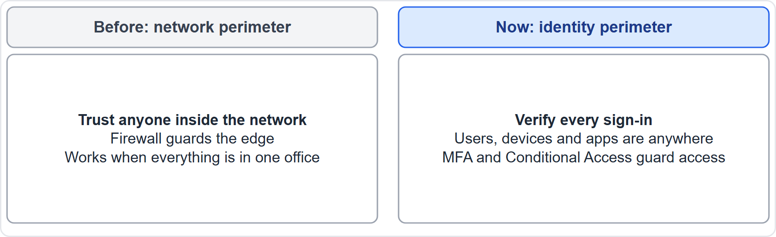
Identity is the new perimeter, continued
Module 2
From the network perimeter to the identity perimeter
SC-900 Exam Prep | Microsoft Security, Compliance and Identity Fundamentals exam
Module 2: Identity Concepts
5 / 21
Notes:
Identity is the new perimeter.
The figure shows this: From the network perimeter to the identity perimeter.

Slide 6
Identity is the new perimeter, continued
Module 2
An identity can be a person (employee, customer, partner), a device, or an application or service. Each needs to prove who or what it is and be given only the access it needs.
EXAM TIP "Identity is the primary security perimeter" is the Zero Trust idea: verify identity and device for every request instead of trusting the network location.
SC-900 Exam Prep | Microsoft Security, Compliance and Identity Fundamentals exam
Module 2: Identity Concepts
6 / 21
Notes:
Identity is the new perimeter.
An identity can be a person (employee, customer, partner), a device, or an application or service. Each needs to prove who or what it is and be given only the access it needs.
Exam tip: "Identity is the primary security perimeter" is the Zero Trust idea: verify identity and device for every request instead of trusting the network location.

Slide 7
Authentication and authorization
Module 2
Term | Question | Example
Authentication (AuthN) | Who are you? Proving identity | Password plus a code from an app
Authorization (AuthZ) | What may you do? Granting permissions after sign-in | Read-only access to a document library
Factor | Meaning | Examples
Something you know | A secret | Password, PIN
Something you have | A device | Phone, security key
Something you are | A body trait | Fingerprint, face
Authentication comes first, then authorization. A person can be authenticated yet not authorized to open a resource.
EXAM TIP Authentication proves identity; authorization grants rights. If a question says "proves who you are" it is authentication; "what you are allowed to do" is authorization.
SC-900 Exam Prep | Microsoft Security, Compliance and Identity Fundamentals exam
Module 2: Identity Concepts
7 / 21
Notes:
Authentication and authorization.
Authentication (Auth N). Question: Who are you? Proving identity. Example: Password plus a code from an app.
Authorization (Auth Z). Question: What may you do? Granting permissions after sign-in. Example: Read-only access to a document library.
Authentication comes first, then authorization. A person can be authenticated yet not authorized to open a resource.
Something you know. Meaning: A secret. Examples: Password, P I N.
Something you have. Meaning: A device. Examples: Phone, security key.
Something you are. Meaning: A body trait. Examples: Fingerprint, face.
Exam tip: Authentication proves identity; authorization grants rights. If a question says "proves who you are" it is authentication; "what you are allowed to do" is authorization.

Slide 8
Identity providers
Module 2
Examples of IdPs | Notes
Microsoft Entra ID | The Microsoft cloud identity provider
Active Directory | The traditional on-premises directory
Social providers | For example sign-in with a personal account
An identity provider (IdP) creates, maintains and manages identities and authenticates users for applications. When an app trusts an IdP, users sign in at the IdP and the app receives proof (a token).
An IdP gives single sign-on (SSO): sign in once and reach many apps.
SC-900 Exam Prep | Microsoft Security, Compliance and Identity Fundamentals exam
Module 2: Identity Concepts
8 / 21
Notes:
Identity providers.
An identity provider (I D P) creates, maintains and manages identities and authenticates users for applications. When an app trusts an I D P, users sign in at the I D P and the app receives proof (a token).
Microsoft Entra I D. The Microsoft cloud identity provider.
Active Directory. The traditional on-premises directory.
Social providers. For example sign-in with a personal account.
An I D P gives single sign-on: sign in once and reach many apps.

Slide 9
Directory services and Active Directory
Module 2
 | Active Directory Domain Services (AD DS) | Microsoft Entra ID
Where | On-premises: domain controllers | Cloud
Protocols | Kerberos, NTLM, LDAP | OAuth, SAML, OpenID Connect and HTTPS
Main use | Sign-in to Windows domain resources | Sign-in to cloud and web apps
Structure | Domains, trees, forests, OUs, Group Policy | A tenant with users, groups and apps (flat, no OUs or Group Policy)
A directory service is a central database of identities and resources (users, groups, devices) with rules for access.
SC-900 Exam Prep | Microsoft Security, Compliance and Identity Fundamentals exam
Module 2: Identity Concepts
9 / 21
Notes:
Directory services and Active Directory.
A directory service is a central database of identities and resources (users, groups, devices) with rules for access.
Where. Active Directory Domain Services (A D D S): On-premises: domain controllers. Microsoft Entra I D: Cloud.
Protocols. Active Directory Domain Services (A D D S): Kerberos, N T L M, L D A P (Lightweight Directory Access Protocol). Microsoft Entra I D: oh auth, sam el, Open I D Connect and H T T P S.
Main use. Active Directory Domain Services (A D D S): Sign-in to Windows domain resources. Microsoft Entra I D: Sign-in to cloud and web apps.
Structure. Active Directory Domain Services (A D D S): Domains, trees, forests, O U s, Group Policy. Microsoft Entra I D: A tenant with users, groups and apps (flat, no O U s or Group Policy).

Slide 10
Directory services and Active Directory, continued
Module 2
Active Directory is Microsoft's on-premises directory service. Microsoft Entra ID is not a cloud copy of AD DS: it is a cloud identity and access management service built for web protocols.
EXAM TIP AD DS = on-premises, Kerberos and LDAP. Entra ID = cloud, OAuth and SAML. Many organizations use both (hybrid identity, module 3).
SC-900 Exam Prep | Microsoft Security, Compliance and Identity Fundamentals exam
Module 2: Identity Concepts
10 / 21
Notes:
Directory services and Active Directory.
Active Directory is Microsoft's on-premises directory service. Microsoft Entra I D is not a cloud copy of A D D S: it is a cloud identity and access management service built for web protocols.
Exam tip: A D D S equals on-premises, Kerberos and L D A P. Entra I D equals cloud, oh auth and sam el. Many organizations use both (hybrid identity, module three).

Slide 11
Federation
Module 2
Part | Role
Identity provider | Authenticates the user and issues a token
Service provider (relying party) | The app that trusts the token
Federation is a trust relationship between two organizations or systems so that a user who is authenticated by one can access resources of the other without a separate account.
Federation makes SSO across organizations possible: a partner's employee signs in with their own company credentials and gets access to your app. Standards include SAML, OAuth 2.0 and OpenID Connect.
SC-900 Exam Prep | Microsoft Security, Compliance and Identity Fundamentals exam
Module 2: Identity Concepts
11 / 21
Notes:
Federation.
Federation is a trust relationship between two organizations or systems so that a user who is authenticated by one can access resources of the other without a separate account.
Identity provider. Authenticates the user and issues a token.
Service provider (relying party). The app that trusts the token.
Federation makes S S O across organizations possible: a partner's employee signs in with their own company credentials and gets access to your app. Standards include sam el, oh auth two point zero and Open I D Connect.

Slide 12
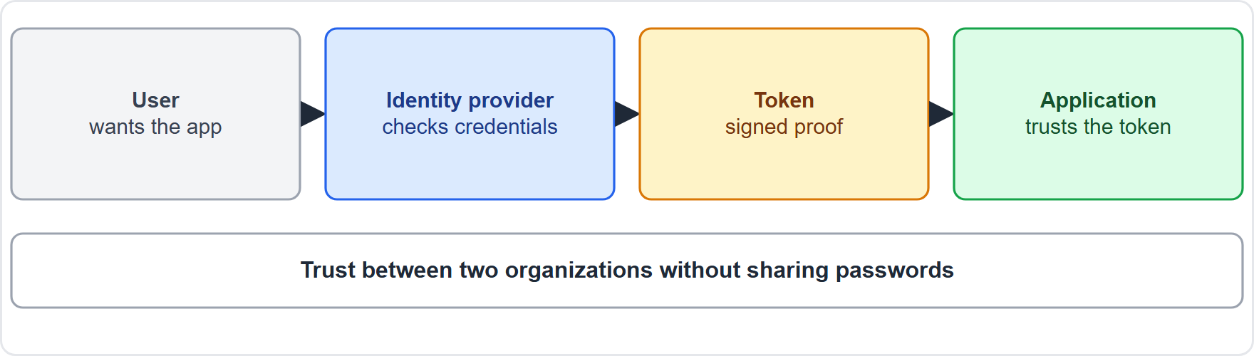
Federation, continued
Module 2
Federation: a user signs in at their identity provider and the app trusts the token
EXAM TIP Federation = trust between identity systems so a user needs one set of credentials. The IdP authenticates; the app trusts the IdP.
SC-900 Exam Prep | Microsoft Security, Compliance and Identity Fundamentals exam
Module 2: Identity Concepts
12 / 21
Notes:
Federation.
The figure shows this: Federation: a user signs in at their identity provider and the app trusts the token.
Exam tip: Federation equals trust between identity systems so a user needs one set of credentials. The I D P authenticates; the app trusts the I D P.

Slide 13
Practice Question 1
Module 2
Q1
Fabrikam Outdoors staff work from home and use cloud apps. Why is the network perimeter no longer enough?
A
Cloud apps do not need sign-in because Microsoft secures every account automatically for you
B
Users, devices and data are outside the office network, so identity must be verified
C
Firewalls are illegal in the cloud, so the network cannot be used for security at all
D
Identity only matters for administrators because ordinary users never reach sensitive data
SC-900 Exam Prep | Microsoft Security, Compliance and Identity Fundamentals exam
Module 2: Identity Concepts
13 / 21
Notes:
Question one. Fabrikam Outdoors staff work from home and use cloud apps. Why is the network perimeter no longer enough? The four options are on the screen.
[PAUSE 10]
The answer is B: Users, devices and data are outside the office network, so identity must be verified. When resources are everywhere, identity becomes the primary perimeter.

Slide 14
Practice Question 2
Module 2
Q2
A user signs in with a password and a code and then opens a file. The system checks that the user has read access. Which step is the check?
A
Authentication
B
Federation
C
Authorization
D
Hashing
SC-900 Exam Prep | Microsoft Security, Compliance and Identity Fundamentals exam
Module 2: Identity Concepts
14 / 21
Notes:
Question two. A user signs in with a password and a code and then opens a file. The system checks that the user has read access. Which step is the check? The four options are on the screen.
[PAUSE 10]
The answer is C: Authorization. Deciding what an authenticated user may do is authorization.

Slide 15
Practice Question 3
Module 2
Q3
Which component creates and manages identities and authenticates users for applications?
A
A firewall
B
A load balancer
C
A virtual network
D
An identity provider
SC-900 Exam Prep | Microsoft Security, Compliance and Identity Fundamentals exam
Module 2: Identity Concepts
15 / 21
Notes:
Question three. Which component creates and manages identities and authenticates users for applications? The four options are on the screen.
[PAUSE 10]
The answer is D: An identity provider. An identity provider manages identities and authenticates users.

Slide 16
Practice Question 4
Module 2
Q4
Which statement about Active Directory Domain Services is true?
A
It is an on-premises directory that uses Kerberos and LDAP
B
It is a cloud service that uses OAuth only and has no directory of users
C
It is a firewall that blocks traffic between two networks
D
It stores only encryption keys and nothing about users
SC-900 Exam Prep | Microsoft Security, Compliance and Identity Fundamentals exam
Module 2: Identity Concepts
16 / 21
Notes:
Question four. Which statement about Active Directory Domain Services is true? The four options are on the screen.
[PAUSE 10]
The answer is A: It is an on-premises directory that uses Kerberos and L D A P. A D D S is the traditional on-premises directory service.

Slide 17
Practice Question 5
Module 2
Q5
A partner's employees sign in to Fabrikam's app with their own company accounts. Which concept makes this possible?
A
Federation
B
Hashing
C
Defense in depth
D
Obfuscation
SC-900 Exam Prep | Microsoft Security, Compliance and Identity Fundamentals exam
Module 2: Identity Concepts
17 / 21
Notes:
Question five. A partner's employees sign in to Fabrikam's app with their own company accounts. Which concept makes this possible? The four options are on the screen.
[PAUSE 10]
The answer is A: Federation. Federation is a trust between identity systems so users can use one identity across organizations.

Slide 18
Practice Question 6
Module 2
Q6
A user has a phone that receives a code. Which authentication factor is the phone?
A
Something you know
B
Something you have
C
Something you are
D
Somewhere you are
SC-900 Exam Prep | Microsoft Security, Compliance and Identity Fundamentals exam
Module 2: Identity Concepts
18 / 21
Notes:
Question six. A user has a phone that receives a code. Which authentication factor is the phone? The four options are on the screen.
[PAUSE 10]
The answer is B: Something you have. A device the user possesses is a possession factor.

Slide 19
Recall Check 1
Module 2
Q1. Why is identity called the primary security perimeter?
Q2. What is the difference between authentication and authorization?
Q3. What does an identity provider do?
SC-900 Exam Prep | Microsoft Security, Compliance and Identity Fundamentals exam
Module 2: Identity Concepts
19 / 21
Notes:
Recall check one. Say each answer out loud before you listen to mine.
Question one. Why is identity called the primary security perimeter?
[PAUSE 5]
Answer: Because users, devices and data are outside the office network, so access is decided by identity.
Question two. What is the difference between authentication and authorization?
[PAUSE 5]
Answer: Authentication proves who you are; authorization decides what you may do.
Question three. What does an identity provider do?
[PAUSE 5]
Answer: Creates and manages identities and authenticates users.

Slide 20
Recall Check 2
Module 2
Q4. Name the on-premises and the cloud Microsoft identity services.
Q5. What is federation?
Q6. Name the three authentication factor types.
SC-900 Exam Prep | Microsoft Security, Compliance and Identity Fundamentals exam
Module 2: Identity Concepts
20 / 21
Notes:
Recall check two. Say each answer out loud before you listen to mine.
Question four. Name the on-premises and the cloud Microsoft identity services.
[PAUSE 5]
Answer: Active Directory Domain Services and Microsoft Entra I D.
Question five. What is federation?
[PAUSE 5]
Answer: A trust between identity systems so one sign-in works across organizations.
Question six. Name the three authentication factor types.
[PAUSE 5]
Answer: Something you know, have and are.

Slide 21
Module Recap
Module 2
1
Identity perimeter
2
AuthN vs AuthZ
3
Identity provider
who you are vs what you may do; factors: know, have, are
creates and authenticates identities; gives SSO
identity (person, device, app) replaces the network edge as the main boundary
4
Directory services
5
Federation
trust between identity systems; IdP authenticates, app trusts the token
AD DS on-premises (Kerberos, LDAP); Entra ID cloud (OAuth, SAML, OpenID Connect)
SC-900 Exam Prep | Microsoft Security, Compliance and Identity Fundamentals exam
Module 2: Identity Concepts
21 / 21
Notes:
Here is the recap.
Identity perimeter: identity (person, device, app) replaces the network edge as the main boundary.
Auth N versus Auth Z: who you are versus what you may do; factors: know, have, are.
Identity provider: creates and authenticates identities; gives S S O.
Directory services: A D D S on-premises (Kerberos, L D A P); Entra I D cloud (oh auth, sam el, Open I D Connect).
Federation: trust between identity systems; I D P authenticates, app trusts the token.
In the next module, we continue the course.

