Slide 1
Module 3: Microsoft Entra ID, Identities and Hybrid Identity
Describe Microsoft Entra ID
SC-900 exam prep · Capabilities of Microsoft Entra · 25 to 30% of the exam
SC-900 Exam Prep: Microsoft Security, Compliance and Identity Fundamentals Study Course
Module 3
Notes:
Welcome to Module three: Microsoft Entra I D, Identities and Hybrid Identity. It covers the exam area Capabilities of Microsoft Entra.
Each part of this module comes from the study notes of the same name, so you can read the notes after you watch.

Slide 2
What You Will Learn
Module 3
Describe Microsoft Entra ID
Describe types of identities, including workload identities
Describe hybrid identity
Practice with exam-style questions and a recall check
SC-900 Exam Prep | Microsoft Security, Compliance and Identity Fundamentals exam
Module 3
2 / 22
Notes:
By the end of this module you will be able to do four things.
Describe Microsoft Entra I D.
Describe types of identities, including workload identities.
Describe hybrid identity.
Practice with exam-style questions and a recall check.

Slide 3
Where This Fits in the Exam
DATES
Module 3
EXAM CHECK-IN · Where this fits
Exam area: Capabilities of Microsoft Entra (25–30%)
Exam format: 45 minutes; a score of 700 on a scale of 1 to 1,000 passes
Validated against: the official SC-900 study guide, skills measured as of October 21, 2026
SC-900 Exam Prep | Microsoft Security, Compliance and Identity Fundamentals exam
Module 3
3 / 22
Notes:
Here is where this module sits in the exam.
Exam area: Capabilities of Microsoft Entra (twenty-five to thirty percent).
Exam format: forty-five minutes; a score of seven hundred on a scale of one to one thousand passes.
Validated against: the official S C nine hundred study guide, skills measured as of October twenty-one, two thousand twenty-six.

Slide 4
Microsoft Entra and Microsoft Entra ID
Module 3
Microsoft Entra is the family of Microsoft identity and network access products. Microsoft Entra ID is the cloud-based identity and access management service: it stores identities and signs people in to Azure, Microsoft 365 and thousands of other apps. [Old name] It was called Azure Active Directory (Azure AD).
SC-900 Exam Prep | Microsoft Security, Compliance and Identity Fundamentals exam
Module 3
4 / 22
Notes:
Microsoft Entra and Microsoft Entra I D.
Microsoft Entra is the family of Microsoft identity and network access products. Microsoft Entra I D is the cloud-based identity and access management service: it stores identities and signs people in to Azure, Microsoft three sixty-five and thousands of other apps. It was called Azure Active Directory (Azure A D).

Slide 5
Microsoft Entra and Microsoft Entra ID, continued
Module 3
Piece | Meaning
Tenant | A dedicated instance of Microsoft Entra ID for an organization
Users, groups, devices, apps | The objects stored in the tenant
Single sign-on (SSO) | Sign in once, reach many apps
Licenses | Free (core features), P1 and P2 (more features), plus Microsoft Entra ID Governance [Verify live]
Entra ID provides authentication (sign-in, MFA), access management (Conditional Access, roles) and identity protection and governance (modules 4–6).
SC-900 Exam Prep | Microsoft Security, Compliance and Identity Fundamentals exam
Module 3
5 / 22
Notes:
Microsoft Entra and Microsoft Entra I D.
Tenant. A dedicated instance of Microsoft Entra I D for an organization.
Users, groups, devices, apps. The objects stored in the tenant.
Single sign-on. Sign in once, reach many apps.
Licenses. Free (core features), P one and P two (more features), plus Microsoft Entra I D Governance.
Entra I D provides authentication (sign-in, M F A), access management (Conditional Access, roles) and identity protection and governance (modules four to six).

Slide 6
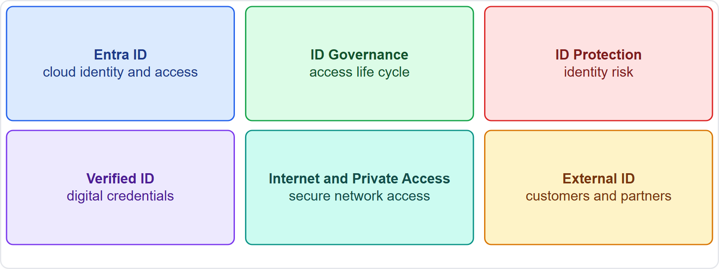
Microsoft Entra and Microsoft Entra ID, continued
Module 3
The Microsoft Entra product family around Microsoft Entra ID
EXAM TIP Entra ID = the cloud identity service (formerly Azure AD). It is not a cloud version of Windows domain controllers; that is a different service (Microsoft Entra Domain Services). Microsoft Entra is the name of the whole family.
SC-900 Exam Prep | Microsoft Security, Compliance and Identity Fundamentals exam
Module 3
6 / 22
Notes:
Microsoft Entra and Microsoft Entra I D.
The figure shows this: The Microsoft Entra product family around Microsoft Entra I D.
Exam tip: Entra I D equals the cloud identity service (formerly Azure A D). It is not a cloud version of Windows domain controllers; that is a different service (Microsoft Entra Domain Services). Microsoft Entra is the name of the whole family.

Slide 7
Types of identities
Module 3
Identity type | What it is | Examples
User (member) | A person inside the organization | An employee
External user (guest) | A person outside the organization invited to collaborate | A partner, a contractor
Group | A set of users managed together | A security group
Device identity | A computer or phone registered or joined to Entra | A laptop
Workload identity | An identity for software, not a person | An app, a script, a service
SC-900 Exam Prep | Microsoft Security, Compliance and Identity Fundamentals exam
Module 3
7 / 22
Notes:
Types of identities.
User (member). What it is: A person inside the organization. Examples: An employee.
External user (guest). What it is: A person outside the organization invited to collaborate. Examples: A partner, a contractor.
Group. What it is: A set of users managed together. Examples: A security group.
Device identity. What it is: A computer or phone registered or joined to Entra. Examples: A laptop.
Workload identity. What it is: An identity for software, not a person. Examples: An app, a script, a service.

Slide 8
Workload identities
Module 3
Kind | Meaning
Application (app registration) | The definition of an app in Entra ID
Service principal | The identity of the app in a tenant; used to get access
Managed identity | An identity managed automatically by Azure for an Azure resource: no credentials to store or rotate
A workload identity lets an application, service or script authenticate and access resources without a person.
Managed identity types: system-assigned (tied to one resource, deleted with it) and user-assigned (a separate resource that can be shared by several).
SC-900 Exam Prep | Microsoft Security, Compliance and Identity Fundamentals exam
Module 3
8 / 22
Notes:
Workload identities.
A workload identity lets an application, service or script authenticate and access resources without a person.
Application (app registration). The definition of an app in Entra I D.
Service principal. The identity of the app in a tenant; used to get access.
Managed identity. An identity managed automatically by Azure for an Azure resource: no credentials to store or rotate.
Managed identity types: system-assigned (tied to one resource, deleted with it) and user-assigned (a separate resource that can be shared by several).

Slide 9
Device identities
Module 3
State | Meaning
Microsoft Entra registered | Personal or BYOD device registered
Microsoft Entra joined | Organization-owned device joined to the cloud
Microsoft Entra hybrid joined | Device joined to both on-premises AD and Entra ID
SC-900 Exam Prep | Microsoft Security, Compliance and Identity Fundamentals exam
Module 3
9 / 22
Notes:
Device identities.
Microsoft Entra registered. Personal or B Y O D device registered.
Microsoft Entra joined. Organization-owned device joined to the cloud.
Microsoft Entra hybrid joined. Device joined to both on-premises A D and Entra I D.

Slide 10
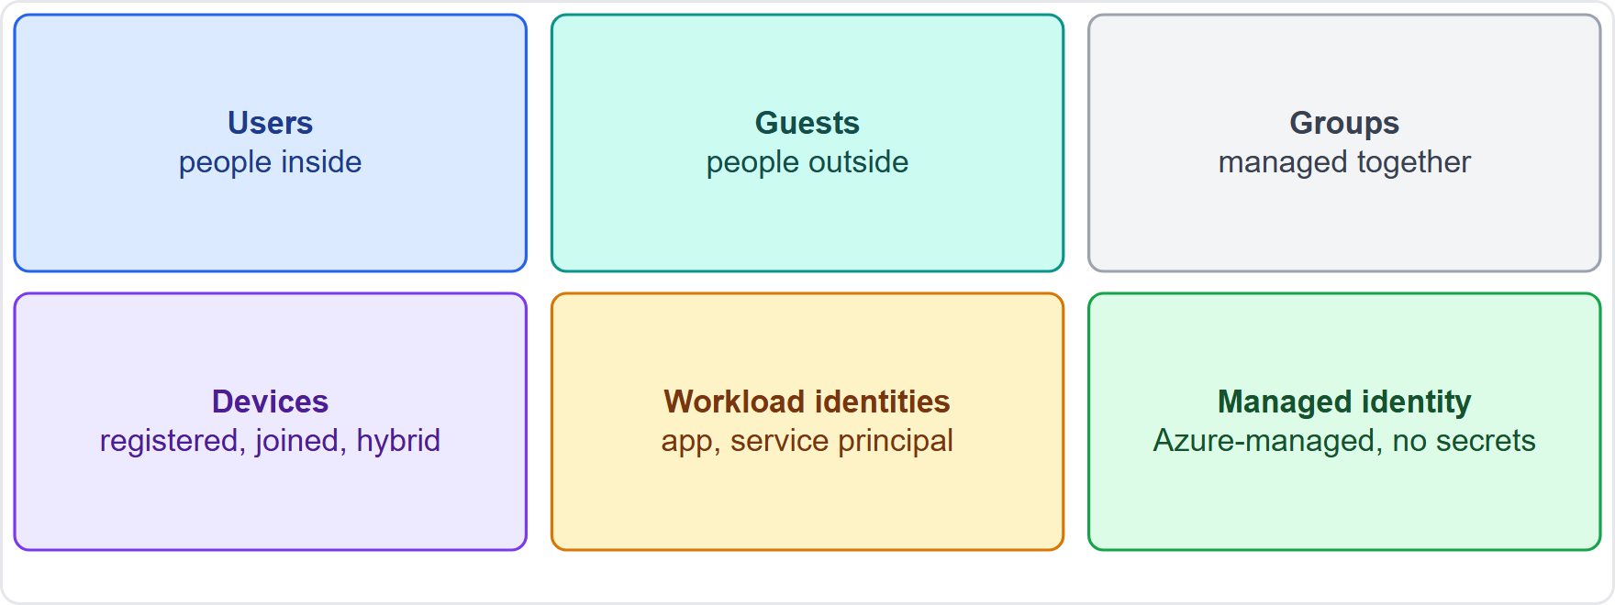
Device identities, continued
Module 3
Identity types in Microsoft Entra: users, guests, groups, devices and workload identities
EXAM TIP A workload identity belongs to software. A managed identity is the best choice for an Azure resource that needs access, because it needs no secrets. System-assigned = lifecycle tied to the resource; user-assigned = reusable.
SC-900 Exam Prep | Microsoft Security, Compliance and Identity Fundamentals exam
Module 3
10 / 22
Notes:
Device identities.
The figure shows this: Identity types in Microsoft Entra: users, guests, groups, devices and workload identities.
Exam tip: A workload identity belongs to software. A managed identity is the best choice for an Azure resource that needs access, because it needs no secrets. System-assigned equals lifecycle tied to the resource; user-assigned equals reusable.

Slide 11
Hybrid identity
Module 3
Tool | Purpose
Microsoft Entra Connect | Synchronizes on-premises AD DS identities to Entra ID
Microsoft Entra Cloud Sync | A lightweight, cloud-managed agent for sync
Hybrid identity means one identity that works for both on-premises and cloud resources. Organizations that already use Active Directory Domain Services (AD DS) synchronize their identities to Microsoft Entra ID.
SC-900 Exam Prep | Microsoft Security, Compliance and Identity Fundamentals exam
Module 3
11 / 22
Notes:
Hybrid identity.
Hybrid identity means one identity that works for both on-premises and cloud resources. Organizations that already use Active Directory Domain Services (A D D S) synchronize their identities to Microsoft Entra I D.
Microsoft Entra Connect. Synchronizes on-premises A D D S identities to Entra I D.
Microsoft Entra Cloud Sync. A lightweight, cloud-managed agent for sync.

Slide 12
Sign-in methods for hybrid identity
Module 3
Method | How sign-in is checked
Password hash synchronization | A hash of the password hash is synced to Entra ID; the cloud validates sign-in
Pass-through authentication | Entra ID passes the sign-in to an on-premises agent that checks AD DS
Federation (for example AD FS) | Sign-in is redirected to an on-premises federation service
Users get one set of credentials and SSO across cloud and on-premises apps.
SC-900 Exam Prep | Microsoft Security, Compliance and Identity Fundamentals exam
Module 3
12 / 22
Notes:
Sign-in methods for hybrid identity.
Password hash synchronization. A hash of the password hash is synced to Entra I D; the cloud validates sign-in.
Pass-through authentication. Entra I D passes the sign-in to an on-premises agent that checks A D D S.
Federation (for example A D F S). Sign-in is redirected to an on-premises federation service.
Users get one set of credentials and S S O across cloud and on-premises apps.

Slide 13
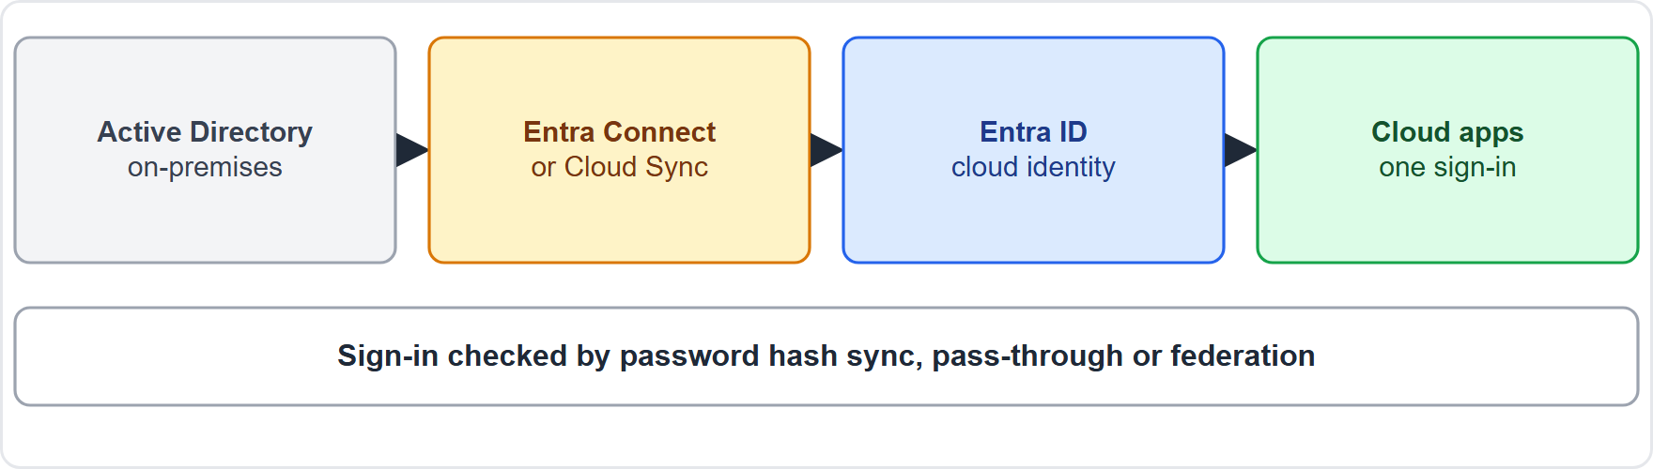
Sign-in methods for hybrid identity, continued
Module 3
Hybrid identity: on-premises Active Directory synchronized to Microsoft Entra ID
EXAM TIP Hybrid identity = on-premises AD synchronized to Entra ID. The tool is Entra Connect (or Cloud Sync). Password hash sync is the simplest; pass-through keeps checks on-premises; federation uses a separate federation service.
SC-900 Exam Prep | Microsoft Security, Compliance and Identity Fundamentals exam
Module 3
13 / 22
Notes:
Sign-in methods for hybrid identity.
The figure shows this: Hybrid identity: on-premises Active Directory synchronized to Microsoft Entra I D.
Exam tip: Hybrid identity equals on-premises A D synchronized to Entra I D. The tool is Entra Connect (or Cloud Sync). Password hash sync is the simplest; pass-through keeps checks on-premises; federation uses a separate federation service.

Slide 14
Practice Question 1
Module 3
Q1
Fabrikam Outdoors wants an Azure web app to read a storage account without storing a password in code. Which identity is the best choice?
A
A managed identity
B
A guest user
C
A shared administrator account
D
A device identity
SC-900 Exam Prep | Microsoft Security, Compliance and Identity Fundamentals exam
Module 3
14 / 22
Notes:
Question one. Fabrikam Outdoors wants an Azure web app to read a storage account without storing a password in code. Which identity is the best choice? The four options are on the screen.
[PAUSE 10]
The answer is A: A managed identity. A managed identity gives an Azure resource an identity with no credentials to manage.

Slide 15
Practice Question 2
Module 3
Q2
A contractor from another company needs access to one Fabrikam app. Which identity type represents the contractor?
A
External user (guest)
B
Workload identity
C
Service principal
D
Managed identity
SC-900 Exam Prep | Microsoft Security, Compliance and Identity Fundamentals exam
Module 3
15 / 22
Notes:
Question two. A contractor from another company needs access to one Fabrikam app. Which identity type represents the contractor? The four options are on the screen.
[PAUSE 10]
The answer is A: External user (guest). A person outside the organization invited to collaborate is an external (guest) user.

Slide 16
Practice Question 3
Module 3
Q3
Which tool synchronizes on-premises Active Directory identities to Microsoft Entra ID?
A
Microsoft Entra Connect
B
Azure Firewall
C
Azure Bastion
D
Microsoft Purview
SC-900 Exam Prep | Microsoft Security, Compliance and Identity Fundamentals exam
Module 3
16 / 22
Notes:
Question three. Which tool synchronizes on-premises Active Directory identities to Microsoft Entra I D? The four options are on the screen.
[PAUSE 10]
The answer is A: Microsoft Entra Connect. Microsoft Entra Connect (or Cloud Sync) provides the synchronization for hybrid identity.

Slide 17
Practice Question 4
Module 3
Q4
A managed identity is tied to one virtual machine and is deleted when the VM is deleted. Which type is it?
A
User-assigned, created as a separate resource
B
System-assigned
C
Federated through an identity provider
D
Guest invited from another organization
SC-900 Exam Prep | Microsoft Security, Compliance and Identity Fundamentals exam
Module 3
17 / 22
Notes:
Question four. A managed identity is tied to one virtual machine and is deleted when the V M is deleted. Which type is it? The four options are on the screen.
[PAUSE 10]
The answer is B: System-assigned. A system-assigned managed identity shares the lifecycle of its resource.

Slide 18
Practice Question 5
Module 3
Q5
Microsoft Entra ID was previously known by which name?
A
Microsoft Defender XDR
B
Azure Policy
C
Azure Active Directory
D
Microsoft Sentinel
SC-900 Exam Prep | Microsoft Security, Compliance and Identity Fundamentals exam
Module 3
18 / 22
Notes:
Question five. Microsoft Entra I D was previously known by which name? The four options are on the screen.
[PAUSE 10]
The answer is C: Azure Active Directory. Azure Active Directory was renamed Microsoft Entra I D.

Slide 19
Practice Question 6
Module 3
Q6
An organization wants sign-in to be checked by an on-premises agent that queries Active Directory. Which method fits?
A
Password hash synchronization
B
Pass-through authentication
C
Managed identity
D
Guest invitation
SC-900 Exam Prep | Microsoft Security, Compliance and Identity Fundamentals exam
Module 3
19 / 22
Notes:
Question six. An organization wants sign-in to be checked by an on-premises agent that queries Active Directory. Which method fits? The four options are on the screen.
[PAUSE 10]
The answer is B: Pass-through authentication. Pass-through authentication validates sign-in against on-premises A D D S through an agent.

Slide 20
Recall Check 1
Module 3
Q1. What was Microsoft Entra ID called before?
Q2. What is a workload identity?
Q3. Name the two managed identity types.
SC-900 Exam Prep | Microsoft Security, Compliance and Identity Fundamentals exam
Module 3
20 / 22
Notes:
Recall check one. Say each answer out loud before you listen to mine.
Question one. What was Microsoft Entra I D called before?
[PAUSE 5]
Answer: Azure Active Directory (Azure A D).
Question two. What is a workload identity?
[PAUSE 5]
Answer: An identity for software, such as an app, service or script.
Question three. Name the two managed identity types.
[PAUSE 5]
Answer: System-assigned and user-assigned.

Slide 21
Recall Check 2
Module 3
Q4. What does hybrid identity mean?
Q5. Which tool synchronizes AD DS to Entra ID?
Q6. Name the three device identity states.
SC-900 Exam Prep | Microsoft Security, Compliance and Identity Fundamentals exam
Module 3
21 / 22
Notes:
Recall check two. Say each answer out loud before you listen to mine.
Question four. What does hybrid identity mean?
[PAUSE 5]
Answer: One identity that works for both on-premises and cloud resources.
Question five. Which tool synchronizes A D D S to Entra I D?
[PAUSE 5]
Answer: Microsoft Entra Connect (or Entra Cloud Sync).
Question six. Name the three device identity states.
[PAUSE 5]
Answer: Registered, joined and hybrid joined.

Slide 22
Module Recap
Module 3
1
Entra ID
2
Identity types
cloud identity and access management (formerly Azure AD); tenant; Free, P1, P2, ID Governance
users (members), external guests, groups, device identities, workload identities
3
Workload identities
4
Hybrid identity
app registration, service principal, managed identity (system-assigned or user-assigned; no secrets)
Entra Connect or Cloud Sync; password hash sync, pass-through authentication, federation (AD FS)
SC-900 Exam Prep | Microsoft Security, Compliance and Identity Fundamentals exam
Module 3
22 / 22
Notes:
Here is the recap.
Entra I D: cloud identity and access management (formerly Azure A D); tenant; Free, P one, P two, I D Governance.
Identity types: users (members), external guests, groups, device identities, workload identities.
Workload identities: app registration, service principal, managed identity (system-assigned or user-assigned; no secrets).
Hybrid identity: Entra Connect or Cloud Sync; password hash sync, pass-through authentication, federation (A D F S).
In the next module, we continue the course.

