Slide 1
Module 4: Authentication in Microsoft Entra ID
Describe the authentication methods
SC-900 exam prep · Capabilities of Microsoft Entra · 25 to 30% of the exam
SC-900 Exam Prep: Microsoft Security, Compliance and Identity Fundamentals Study Course
Module 4
Notes:
Welcome to Module four: Authentication in Microsoft Entra I D. It covers the exam area Capabilities of Microsoft Entra.
Each part of this module comes from the study notes of the same name, so you can read the notes after you watch.

Slide 2
What You Will Learn
Module 4
Describe the authentication methods
Describe multifactor authentication (MFA)
Describe password protection and management capabilities
Practice with exam-style questions and a recall check
SC-900 Exam Prep | Microsoft Security, Compliance and Identity Fundamentals exam
Module 4: Authentication in Microsoft Entra ID
2 / 21
Notes:
By the end of this module you will be able to do four things.
Describe the authentication methods.
Describe multifactor authentication.
Describe password protection and management capabilities.
Practice with exam-style questions and a recall check.

Slide 3
Where This Fits in the Exam
DATES
Module 4
EXAM CHECK-IN · Where this fits
Exam area: Capabilities of Microsoft Entra (25–30%)
Exam format: 45 minutes; a score of 700 on a scale of 1 to 1,000 passes
Validated against: the official SC-900 study guide, skills measured as of October 21, 2026
SC-900 Exam Prep | Microsoft Security, Compliance and Identity Fundamentals exam
Module 4: Authentication in Microsoft Entra ID
3 / 21
Notes:
Here is where this module sits in the exam.
Exam area: Capabilities of Microsoft Entra (twenty-five to thirty percent).
Exam format: forty-five minutes; a score of seven hundred on a scale of one to one thousand passes.
Validated against: the official S C nine hundred study guide, skills measured as of October twenty-one, two thousand twenty-six.

Slide 4
Authentication methods
Module 4
Method | What it is | Strength
Password | Something you know | Weakest: can be guessed, phished or reused
Microsoft Authenticator app | Approve a push notification or enter a code; can be passwordless | Strong
Windows Hello for Business | PIN or biometric tied to the device; passwordless | Strong
FIDO2 security key | A physical key (USB or NFC) | Strongest: phishing-resistant
Passkey | A cryptographic key pair stored on a device or key; phishing-resistant | Strong
Microsoft Entra ID supports several ways to prove who you are. They range from weak (password only) to strong (passwordless and phishing-resistant).
SC-900 Exam Prep | Microsoft Security, Compliance and Identity Fundamentals exam
Module 4: Authentication in Microsoft Entra ID
4 / 21
Notes:
Authentication methods.
Microsoft Entra I D supports several ways to prove who you are. They range from weak (password only) to strong (passwordless and phishing-resistant).
Password. What it is: Something you know. Strength: Weakest: can be guessed, phished or reused.
Microsoft Authenticator app. What it is: Approve a push notification or enter a code; can be passwordless. Strength: Strong.
Windows Hello for Business. What it is: P I N or biometric tied to the device; passwordless. Strength: Strong.
fido two security key. What it is: A physical key (U S B or N F C). Strength: Strongest: phishing-resistant.
Passkey. What it is: A cryptographic key pair stored on a device or key; phishing-resistant. Strength: Strong.

Slide 5
Authentication methods, continued
Module 4
Method | What it is | Strength
Certificate-based authentication | Sign in with a certificate | Strong
OATH tokens | Hardware or software code generators | Medium
SMS and voice call | A code by text or call | Weaker: can be intercepted or SIM-swapped
Temporary Access Pass | A time-limited code to set up passwordless methods | For onboarding and recovery
SC-900 Exam Prep | Microsoft Security, Compliance and Identity Fundamentals exam
Module 4: Authentication in Microsoft Entra ID
5 / 21
Notes:
Authentication methods.
Certificate-based authentication. What it is: Sign in with a certificate. Strength: Strong.
O A T H tokens. What it is: Hardware or software code generators. Strength: Medium.
S M S and voice call. What it is: A code by text or call. Strength: Weaker: can be intercepted or S I M-swapped.
Temporary Access Pass. What it is: A time-limited code to set up passwordless methods. Strength: For onboarding and recovery.

Slide 6
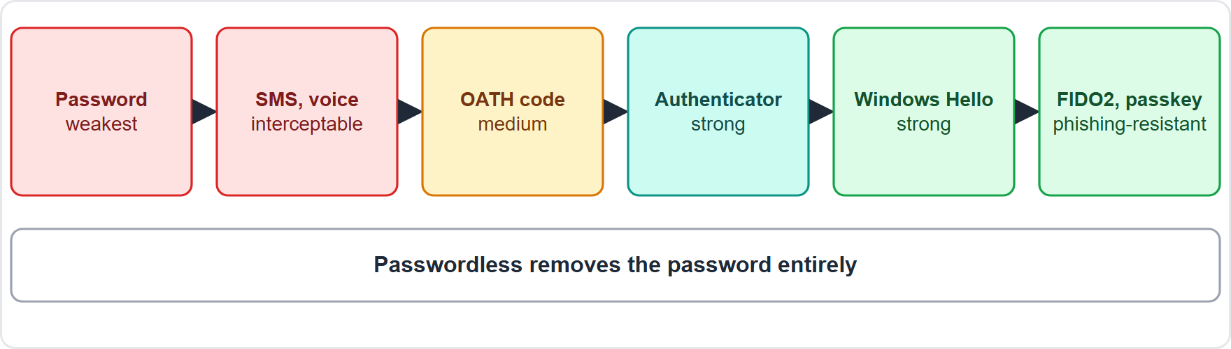
Authentication methods, continued
Module 4
Authentication methods from weakest to strongest
SC-900 Exam Prep | Microsoft Security, Compliance and Identity Fundamentals exam
Module 4: Authentication in Microsoft Entra ID
6 / 21
Notes:
Authentication methods.
The figure shows this: Authentication methods from weakest to strongest.

Slide 7
Authentication methods, continued
Module 4
Passwordless means signing in without typing a password: the user proves possession of a device and (usually) a biometric or PIN. It is more secure (nothing to phish) and easier.
EXAM TIP Strongest and phishing-resistant: FIDO2 keys, passkeys, Windows Hello for Business, certificate-based authentication. Weakest second factors: SMS and voice. Passwordless removes the password entirely.
SC-900 Exam Prep | Microsoft Security, Compliance and Identity Fundamentals exam
Module 4: Authentication in Microsoft Entra ID
7 / 21
Notes:
Authentication methods.
Passwordless means signing in without typing a password: the user proves possession of a device and (usually) a biometric or P I N. It is more secure (nothing to phish) and easier.
Exam tip: Strongest and phishing-resistant: fido two keys, passkeys, Windows Hello for Business, certificate-based authentication. Weakest second factors: S M S and voice. Passwordless removes the password entirely.

Slide 8
Multifactor authentication (MFA)
Module 4
Factor | Examples
Something you know | Password, PIN
Something you have | Phone with Authenticator, security key
Something you are | Fingerprint, face
MFA requires two or more different factor types, so a stolen password alone is not enough.
A password plus a PIN is not MFA (both are knowledge). MFA blocks over 99% of account compromise attacks according to Microsoft. [Verify live]
SC-900 Exam Prep | Microsoft Security, Compliance and Identity Fundamentals exam
Module 4: Authentication in Microsoft Entra ID
8 / 21
Notes:
Multifactor authentication.
M F A requires two or more different factor types, so a stolen password alone is not enough.
Something you know. Password, P I N.
Something you have. Phone with Authenticator, security key.
Something you are. Fingerprint, face.
A password plus a P I N is not M F A (both are knowledge). M F A blocks over ninety-nine percent of account compromise attacks according to Microsoft.

Slide 9
Ways to require MFA
Module 4
Way | Notes
Security defaults | Free, preset protections that require MFA for all users and block legacy sign-in; good for small organizations
Conditional Access policy | Flexible rules: require MFA under conditions (module 5); needs P1
Per-user MFA | The older way to enable MFA user by user
SC-900 Exam Prep | Microsoft Security, Compliance and Identity Fundamentals exam
Module 4: Authentication in Microsoft Entra ID
9 / 21
Notes:
Ways to require M F A.
Security defaults. Free, preset protections that require M F A for all users and block legacy sign-in; good for small organizations.
Conditional Access policy. Flexible rules: require M F A under conditions (module five); needs P one.
Per-user M F A. The older way to enable M F A user by user.

Slide 10
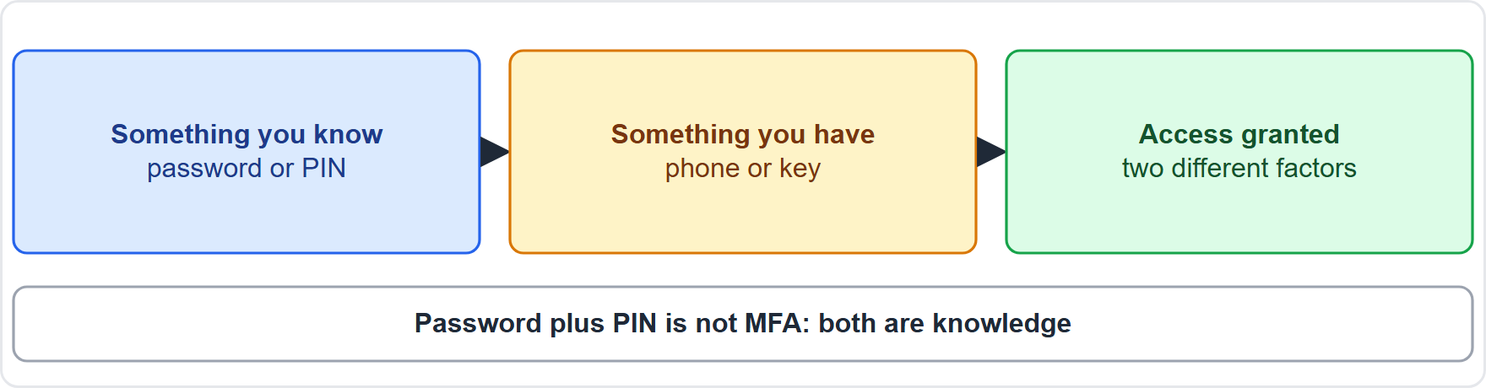
Ways to require MFA, continued
Module 4
MFA combines two different factors, such as a password and an app approval
EXAM TIP MFA = two different factor types. Security defaults = simplest, free. Conditional Access = most flexible ("require MFA when the user is outside the office"). Push fatigue attacks are reduced by number matching in Authenticator.
SC-900 Exam Prep | Microsoft Security, Compliance and Identity Fundamentals exam
Module 4: Authentication in Microsoft Entra ID
10 / 21
Notes:
Ways to require M F A.
The figure shows this: M F A combines two different factors, such as a password and an app approval.
Exam tip: M F A equals two different factor types. Security defaults equals simplest, free. Conditional Access equals most flexible ("require M F A when the user is outside the office"). Push fatigue attacks are reduced by number matching in Authenticator.

Slide 11
Password protection and management
Module 4
Capability | What it does
Microsoft Entra Password Protection | Blocks weak and commonly used passwords: a global banned password list maintained by Microsoft plus a custom banned list (for example company names); can be extended on-premises with agents
Smart lockout | Locks out attackers after repeated failures but keeps legitimate users working by telling them apart
Self-service password reset (SSPR) | Users reset or change their own password after proving identity, which cuts help desk calls
Password writeback | Sends a reset password back to on-premises AD in a hybrid setup
Passwordless | The best way to avoid password problems
SC-900 Exam Prep | Microsoft Security, Compliance and Identity Fundamentals exam
Module 4: Authentication in Microsoft Entra ID
11 / 21
Notes:
Password protection and management.
Microsoft Entra Password Protection. Blocks weak and commonly used passwords: a global banned password list maintained by Microsoft plus a custom banned list (for example company names); can be extended on-premises with agents.
Smart lockout. Locks out attackers after repeated failures but keeps legitimate users working by telling them apart.
Self-service password reset (S S P R). Users reset or change their own password after proving identity, which cuts help desk calls.
Password writeback. Sends a reset password back to on-premises A D in a hybrid setup.
Passwordless. The best way to avoid password problems.

Slide 12
Password protection and management, continued
Module 4
Modern password guidance: length matters more than complexity, do not reuse passwords, check against banned lists and use MFA.
EXAM TIP Banned password list = blocks weak passwords. Smart lockout = stops guessing without locking out real users. SSPR = users fix their own password. Password writeback = needed so SSPR works with on-premises AD.
SC-900 Exam Prep | Microsoft Security, Compliance and Identity Fundamentals exam
Module 4: Authentication in Microsoft Entra ID
12 / 21
Notes:
Password protection and management.
Modern password guidance: length matters more than complexity, do not reuse passwords, check against banned lists and use M F A.
Exam tip: Banned password list equals blocks weak passwords. Smart lockout equals stops guessing without locking out real users. S S P R equals users fix their own password. Password writeback equals needed so S S P R works with on-premises A D.

Slide 13
Practice Question 1
Module 4
Q1
Fabrikam Outdoors wants the most phishing-resistant sign-in method for administrators. Which should it choose?
A
A FIDO2 security key
B
SMS codes
C
A longer password
D
Security questions
SC-900 Exam Prep | Microsoft Security, Compliance and Identity Fundamentals exam
Module 4: Authentication in Microsoft Entra ID
13 / 21
Notes:
Question one. Fabrikam Outdoors wants the most phishing-resistant sign-in method for administrators. Which should it choose? The four options are on the screen.
[PAUSE 10]
The answer is A: A fido two security key. fido two keys are phishing-resistant and among the strongest methods.

Slide 14
Practice Question 2
Module 4
Q2
A user signs in with a password and then a PIN. Why is this not MFA?
A
Both are something you know
B
A PIN is a biometric
C
MFA must use SMS
D
A password is a possession factor
SC-900 Exam Prep | Microsoft Security, Compliance and Identity Fundamentals exam
Module 4: Authentication in Microsoft Entra ID
14 / 21
Notes:
Question two. A user signs in with a password and then a P I N. Why is this not M F A? The four options are on the screen.
[PAUSE 10]
The answer is A: Both are something you know. M F A needs two different factor types, and a password and a P I N are both knowledge factors.

Slide 15
Practice Question 3
Module 4
Q3
A small business wants free, preset protections that require MFA for everyone. What should it enable?
A
Security defaults
B
A custom Conditional Access policy only
C
Microsoft Sentinel
D
Azure Firewall
SC-900 Exam Prep | Microsoft Security, Compliance and Identity Fundamentals exam
Module 4: Authentication in Microsoft Entra ID
15 / 21
Notes:
Question three. A small business wants free, preset protections that require M F A for everyone. What should it enable? The four options are on the screen.
[PAUSE 10]
The answer is A: Security defaults. Security defaults are free preset protections that include M F A for all users.

Slide 16
Practice Question 4
Module 4
Q4
Which feature stops people from choosing passwords such as "Password123"?
A
Smart lockout after repeated failed sign-ins
B
Microsoft Entra Password Protection
C
Self-service password reset for forgotten passwords
D
Federation with an on-premises identity provider
SC-900 Exam Prep | Microsoft Security, Compliance and Identity Fundamentals exam
Module 4: Authentication in Microsoft Entra ID
16 / 21
Notes:
Question four. Which feature stops people from choosing passwords such as "Password one hundred twenty-three"? The four options are on the screen.
[PAUSE 10]
The answer is B: Microsoft Entra Password Protection. Password Protection blocks weak and commonly used passwords with banned lists.

Slide 17
Practice Question 5
Module 4
Q5
Users forget passwords often and the help desk is overloaded. Which capability helps most?
A
Defender for Endpoint on company devices
B
Azure Bastion for remote desktop access
C
A sensitivity label on every shared file
D
Self-service password reset
SC-900 Exam Prep | Microsoft Security, Compliance and Identity Fundamentals exam
Module 4: Authentication in Microsoft Entra ID
17 / 21
Notes:
Question five. Users forget passwords often and the help desk is overloaded. Which capability helps most? The four options are on the screen.
[PAUSE 10]
The answer is D: Self-service password reset. S S P R lets users reset their own passwords after proving who they are.

Slide 18
Practice Question 6
Module 4
Q6
A sign-in method that uses no password and relies on a device plus a biometric or PIN is called what?
A
Federation between two identity providers
B
Hashing of passwords before storage
C
Passwordless authentication
D
Obfuscation of the sign-in page code
SC-900 Exam Prep | Microsoft Security, Compliance and Identity Fundamentals exam
Module 4: Authentication in Microsoft Entra ID
18 / 21
Notes:
Question six. A sign-in method that uses no password and relies on a device plus a biometric or P I N is called what? The four options are on the screen.
[PAUSE 10]
The answer is C: Passwordless authentication. Signing in without a password using a device and a biometric or P I N is passwordless.

Slide 19
Recall Check 1
Module 4
Q1. Which methods are phishing-resistant?
Q2. Which second factors are the weakest?
Q3. What does MFA require?
SC-900 Exam Prep | Microsoft Security, Compliance and Identity Fundamentals exam
Module 4: Authentication in Microsoft Entra ID
19 / 21
Notes:
Recall check one. Say each answer out loud before you listen to mine.
Question one. Which methods are phishing-resistant?
[PAUSE 5]
Answer: fido two security keys, passkeys, Windows Hello for Business and certificate-based authentication.
Question two. Which second factors are the weakest?
[PAUSE 5]
Answer: S M S and voice calls.
Question three. What does M F A require?
[PAUSE 5]
Answer: Two or more different factor types.

Slide 20
Recall Check 2
Module 4
Q4. What are security defaults?
Q5. What does smart lockout do?
Q6. What is SSPR?
SC-900 Exam Prep | Microsoft Security, Compliance and Identity Fundamentals exam
Module 4: Authentication in Microsoft Entra ID
20 / 21
Notes:
Recall check two. Say each answer out loud before you listen to mine.
Question four. What are security defaults?
[PAUSE 5]
Answer: Free preset protections that require M F A and block legacy sign-in.
Question five. What does smart lockout do?
[PAUSE 5]
Answer: Locks out attackers after failures while keeping legitimate users working.
Question six. What is S S P R?
[PAUSE 5]
Answer: Self-service password reset: users reset their own passwords.

Slide 21
Module Recap
Module 4
1
Methods
2
Passwordless
password (weakest), Authenticator, Windows Hello, FIDO2, passkeys, certificates, OATH, SMS and voice, Temporary Access Pass
no password typed; device plus PIN or biometric; phishing-resistant options
3
MFA
4
Passwords
two different factor types; ways: security defaults, Conditional Access, per-user MFA
Password Protection (banned lists), smart lockout, SSPR, password writeback
SC-900 Exam Prep | Microsoft Security, Compliance and Identity Fundamentals exam
Module 4: Authentication in Microsoft Entra ID
21 / 21
Notes:
Here is the recap.
Methods: password (weakest), Authenticator, Windows Hello, fido two, passkeys, certificates, O A T H, S M S and voice, Temporary Access Pass.
Passwordless: no password typed; device plus P I N or biometric; phishing-resistant options.
M F A: two different factor types; ways: security defaults, Conditional Access, per-user M F A.
Passwords: Password Protection (banned lists), smart lockout, S S P R, password writeback.
In the next module, we continue the course.

