Slide 1
Module 5: Access Management: Conditional Access and Roles
Describe Microsoft Entra Conditional Access
SC-900 exam prep · Capabilities of Microsoft Entra · 25 to 30% of the exam
SC-900 Exam Prep: Microsoft Security, Compliance and Identity Fundamentals Study Course
Module 5
Notes:
Welcome to Module five: Access Management: Conditional Access and Roles. It covers the exam area Capabilities of Microsoft Entra.
Each part of this module comes from the study notes of the same name, so you can read the notes after you watch.

Slide 2
What You Will Learn
Module 5
Describe Microsoft Entra Conditional Access
Describe Microsoft Entra roles and role-based access control (RBAC)
Practice with exam-style questions and a recall check
SC-900 Exam Prep | Microsoft Security, Compliance and Identity Fundamentals exam
Module 5: Access Management: Conditional Access and Roles
2 / 20
Notes:
By the end of this module you will be able to do three things.
Describe Microsoft Entra Conditional Access.
Describe Microsoft Entra roles and role-based access control (R B A C).
Practice with exam-style questions and a recall check.

Slide 3
Where This Fits in the Exam
DATES
Module 5
EXAM CHECK-IN · Where this fits
Exam area: Capabilities of Microsoft Entra (25–30%)
Exam format: 45 minutes; a score of 700 on a scale of 1 to 1,000 passes
Validated against: the official SC-900 study guide, skills measured as of October 21, 2026
SC-900 Exam Prep | Microsoft Security, Compliance and Identity Fundamentals exam
Module 5: Access Management: Conditional Access and Roles
3 / 20
Notes:
Here is where this module sits in the exam.
Exam area: Capabilities of Microsoft Entra (twenty-five to thirty percent).
Exam format: forty-five minutes; a score of seven hundred on a scale of one to one thousand passes.
Validated against: the official S C nine hundred study guide, skills measured as of October twenty-one, two thousand twenty-six.

Slide 4
Microsoft Entra Conditional Access
Module 5
Signals (the "if") | Decisions (the "then")
User or group | Block access
Location (country or IP range) | Grant access
Device (platform, compliant, managed) | Grant but require MFA
Application being accessed | Require a compliant or hybrid-joined device
Sign-in risk and user risk (from ID Protection) | Require an approved app, a password change or terms of use
Client app (browser, legacy protocols) | Session controls, such as limited access or sign-in frequency
Conditional Access is the policy engine of Zero Trust. It makes if-then decisions at sign-in: if certain signals are true, then apply a decision.
SC-900 Exam Prep | Microsoft Security, Compliance and Identity Fundamentals exam
Module 5: Access Management: Conditional Access and Roles
4 / 20
Notes:
Microsoft Entra Conditional Access.
Conditional Access is the policy engine of Zero Trust. It makes if-then decisions at sign-in: if certain signals are true, then apply a decision.
User or group. Block access.
Location (country or I P range). Grant access.
Device (platform, compliant, managed). Grant but require M F A.
Application being accessed. Require a compliant or hybrid-joined device.
Sign-in risk and user risk (from I D Protection). Require an approved app, a password change or terms of use.
Client app (browser, legacy protocols). Session controls, such as limited access or sign-in frequency.

Slide 5
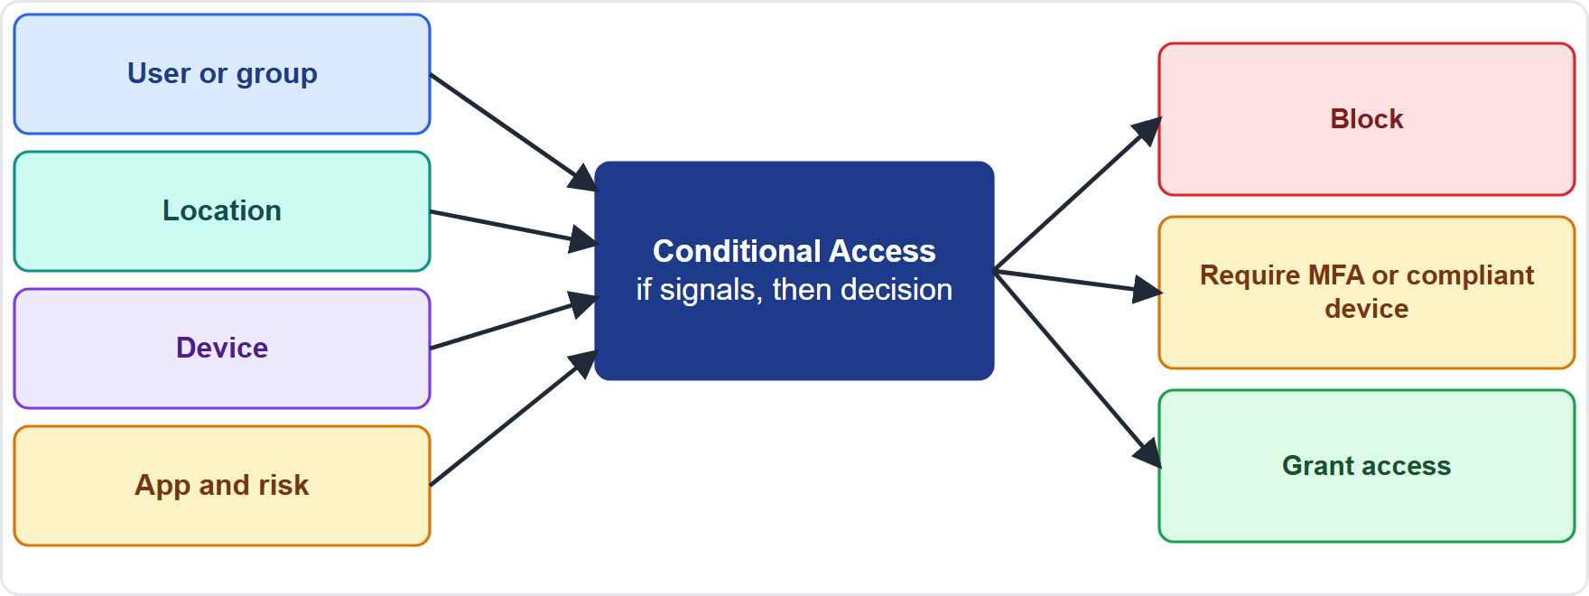
Microsoft Entra Conditional Access, continued
Module 5
Conditional Access: signals go in, a policy decides to block, require MFA or grant access
SC-900 Exam Prep | Microsoft Security, Compliance and Identity Fundamentals exam
Module 5: Access Management: Conditional Access and Roles
5 / 20
Notes:
Microsoft Entra Conditional Access.
The figure shows this: Conditional Access: signals go in, a policy decides to block, require M F A or grant access.

Slide 6
Microsoft Entra Conditional Access, continued
Module 5
Key facts:
Conditional Access needs Microsoft Entra ID P1 or higher; risk-based conditions need P2. [Verify live]
Policies can run in report-only mode to test the effect before enforcing them.
Exclude emergency access (break-glass) accounts so an administrator cannot be locked out by mistake.
Conditional Access is evaluated after the first factor (the user has signed in with the first method).
Security defaults are the free alternative; they cannot be used together with Conditional Access policies.
SC-900 Exam Prep | Microsoft Security, Compliance and Identity Fundamentals exam
Module 5: Access Management: Conditional Access and Roles
6 / 20
Notes:
Microsoft Entra Conditional Access.
Key facts.
Conditional Access needs Microsoft Entra I D P one or higher; risk-based conditions need P two.
Policies can run in report-only mode to test the effect before enforcing them.
Exclude emergency access (break-glass) accounts so an administrator cannot be locked out by mistake.
Conditional Access is evaluated after the first factor (the user has signed in with the first method).
Security defaults are the free alternative; they cannot be used together with Conditional Access policies.

Slide 7
Microsoft Entra Conditional Access, continued
Module 5
Typical policies: require MFA for all users, require MFA for administrators, block legacy authentication, require a compliant device for corporate apps, block sign-in from certain countries.
EXAM TIP "If the user is outside the office then require MFA" = Conditional Access. It is identity-driven policy and it needs P1. Report-only mode tests a policy without enforcing it.
SC-900 Exam Prep | Microsoft Security, Compliance and Identity Fundamentals exam
Module 5: Access Management: Conditional Access and Roles
7 / 20
Notes:
Microsoft Entra Conditional Access.
Typical policies: require M F A for all users, require M F A for administrators, block legacy authentication, require a compliant device for corporate apps, block sign-in from certain countries.
Exam tip: "If the user is outside the office then require M F A" equals Conditional Access. It is identity-driven policy and it needs P one. Report-only mode tests a policy without enforcing it.
Exam tip: Global Administrator can do everything, so keep very few and protect them with M F A. Other tasks need the narrowest role (least privilege).

Slide 8
Microsoft Entra roles
Module 5
Built-in role | What it can do
Global Administrator | Everything in Entra ID and connected Microsoft services; use very few
User Administrator | Manage users and groups and reset passwords
Security Administrator | Manage security features and read security information
Global Reader | Read everything, change nothing
Conditional Access Administrator | Manage Conditional Access policies
Microsoft Entra roles (also called directory roles or administrator roles) give people the permissions to manage Microsoft Entra resources, such as users, groups and applications.
Use the least-privilege principle: give people the narrowest role that lets them do their job, and keep the number of Global Administrators small (and protected with MFA).
SC-900 Exam Prep | Microsoft Security, Compliance and Identity Fundamentals exam
Module 5: Access Management: Conditional Access and Roles
8 / 20
Notes:
Microsoft Entra roles.
Microsoft Entra roles (also called directory roles or administrator roles) give people the permissions to manage Microsoft Entra resources, such as users, groups and applications.
Global Administrator. Everything in Entra I D and connected Microsoft services; use very few.
User Administrator. Manage users and groups and reset passwords.
Security Administrator. Manage security features and read security information.
Global Reader. Read everything, change nothing.
Conditional Access Administrator. Manage Conditional Access policies.
Use the least-privilege principle: give people the narrowest role that lets them do their job, and keep the number of Global Administrators small (and protected with M F A).

Slide 9
Role-based access control (RBAC)
Module 5
Part | Meaning
Security principal | Who: a user, group, service principal or managed identity
Role definition | What: a collection of permissions
Scope | Where: the resource, resource group, subscription or management group
SC-900 Exam Prep | Microsoft Security, Compliance and Identity Fundamentals exam
Module 5: Access Management: Conditional Access and Roles
9 / 20
Notes:
Role-based access control (R B A C).
Role-based access control (R B A C) grants access by role instead of by person. A role assignment has three parts.
Security principal. Who: a user, group, service principal or managed identity.
Role definition. What: a collection of permissions.
Scope. Where: the resource, resource group, subscription or management group.

Slide 10
Two role systems
Module 5
 | Microsoft Entra roles | Azure RBAC
Manages access to | Microsoft Entra resources (users, groups, apps) | Azure resources (VMs, storage, networks)
Scope | Tenant, administrative unit, or an object | Management group, subscription, resource group, resource
Example roles | Global Administrator, User Administrator | Owner, Contributor, Reader
Azure RBAC built-in roles: Owner (full access and can assign roles), Contributor (create and manage resources, cannot assign roles), Reader (view only).
SC-900 Exam Prep | Microsoft Security, Compliance and Identity Fundamentals exam
Module 5: Access Management: Conditional Access and Roles
10 / 20
Notes:
Two role systems.
Manages access to. Microsoft Entra roles: Microsoft Entra resources (users, groups, apps). Azure R B A C: Azure resources (V Ms, storage, networks).
Scope. Microsoft Entra roles: Tenant, administrative unit, or an object. Azure R B A C: Management group, subscription, resource group, resource.
Example roles. Microsoft Entra roles: Global Administrator, User Administrator. Azure R B A C: Owner, Contributor, Reader.
Azure R B A C built-in roles: Owner (full access and can assign roles), Contributor (create and manage resources, cannot assign roles), Reader (view only).

Slide 11
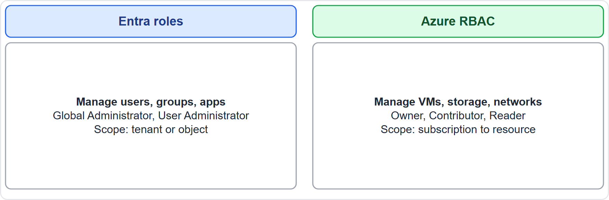
Two role systems, continued
Module 5
Microsoft Entra roles manage identity resources; Azure RBAC manages Azure resources
EXAM TIP Entra roles = manage identities. Azure RBAC = manage Azure resources. Owner can assign roles; Contributor cannot. Least privilege is the principle behind both. Assign roles to groups rather than individuals where possible.
SC-900 Exam Prep | Microsoft Security, Compliance and Identity Fundamentals exam
Module 5: Access Management: Conditional Access and Roles
11 / 20
Notes:
Two role systems.
The figure shows this: Microsoft Entra roles manage identity resources; Azure R B A C manages Azure resources.
Exam tip: Entra roles equals manage identities. Azure R B A C equals manage Azure resources. Owner can assign roles; Contributor cannot. Least privilege is the principle behind both. Assign roles to groups rather than individuals where possible.

Slide 12
Practice Question 1
Module 5
Q1
Fabrikam Outdoors wants to require MFA only when a user signs in from outside the country. Which feature fits?
A
Self-service password reset
B
Azure Firewall
C
A sensitivity label
D
Conditional Access
SC-900 Exam Prep | Microsoft Security, Compliance and Identity Fundamentals exam
Module 5: Access Management: Conditional Access and Roles
12 / 20
Notes:
Question one. Fabrikam Outdoors wants to require M F A only when a user signs in from outside the country. Which feature fits? The four options are on the screen.
[PAUSE 10]
The answer is D: Conditional Access. Conditional Access applies if-then rules using signals such as location.

Slide 13
Practice Question 2
Module 5
Q2
Before enforcing a new Conditional Access policy, the team wants to see its effect without blocking anyone. What should it use?
A
A Global Administrator account
B
Report-only mode
C
Password writeback
D
Federation
SC-900 Exam Prep | Microsoft Security, Compliance and Identity Fundamentals exam
Module 5: Access Management: Conditional Access and Roles
13 / 20
Notes:
Question two. Before enforcing a new Conditional Access policy, the team wants to see its effect without blocking anyone. What should it use? The four options are on the screen.
[PAUSE 10]
The answer is B: Report-only mode. Report-only mode evaluates a policy and logs the result without enforcing it.

Slide 14
Practice Question 3
Module 5
Q3
Which role should be given to a person who only needs to reset user passwords?
A
User Administrator
B
Global Administrator
C
Owner of the subscription
D
Global Reader
SC-900 Exam Prep | Microsoft Security, Compliance and Identity Fundamentals exam
Module 5: Access Management: Conditional Access and Roles
14 / 20
Notes:
Question three. Which role should be given to a person who only needs to reset user passwords? The four options are on the screen.
[PAUSE 10]
The answer is A: User Administrator. Least privilege means the narrowest role that fits, such as User Administrator.

Slide 15
Practice Question 4
Module 5
Q4
A user needs to create virtual machines in a resource group but must not assign roles to others. Which Azure RBAC role fits?
A
Owner
B
Reader
C
Global Administrator
D
Contributor
SC-900 Exam Prep | Microsoft Security, Compliance and Identity Fundamentals exam
Module 5: Access Management: Conditional Access and Roles
15 / 20
Notes:
Question four. A user needs to create virtual machines in a resource group but must not assign roles to others. Which Azure R B A C role fits? The four options are on the screen.
[PAUSE 10]
The answer is D: Contributor. Contributor can create and manage resources but cannot assign roles.

Slide 16
Practice Question 5
Module 5
Q5
Which statement describes Microsoft Entra roles?
A
They manage virtual machines, storage accounts and virtual networks in Azure subscriptions and resource groups
B
They replace Conditional Access policies and remove the need for any MFA settings
C
They encrypt data at rest in storage accounts and databases using customer keys
D
They give permissions to manage Microsoft Entra resources such as users and applications
SC-900 Exam Prep | Microsoft Security, Compliance and Identity Fundamentals exam
Module 5: Access Management: Conditional Access and Roles
16 / 20
Notes:
Question five. Which statement describes Microsoft Entra roles? The four options are on the screen.
[PAUSE 10]
The answer is D: They give permissions to manage Microsoft Entra resources such as users and applications. Entra roles control administration of identity resources, while Azure R B A C controls Azure resources.

Slide 17
Practice Question 6
Module 5
Q6
Which part of an RBAC role assignment states where the permissions apply?
A
Security principal
B
Role definition
C
Token
D
Scope
SC-900 Exam Prep | Microsoft Security, Compliance and Identity Fundamentals exam
Module 5: Access Management: Conditional Access and Roles
17 / 20
Notes:
Question six. Which part of an R B A C role assignment states where the permissions apply? The four options are on the screen.
[PAUSE 10]
The answer is D: Scope. The scope says where, such as a subscription or resource group.

Slide 18
Recall Check 1
Module 5
Q1. What does Conditional Access do?
Q2. Which license level does Conditional Access need?
Q3. Name three Conditional Access decisions.
SC-900 Exam Prep | Microsoft Security, Compliance and Identity Fundamentals exam
Module 5: Access Management: Conditional Access and Roles
18 / 20
Notes:
Recall check one. Say each answer out loud before you listen to mine.
Question one. What does Conditional Access do?
[PAUSE 5]
Answer: Makes if-then access decisions at sign-in using signals.
Question two. Which license level does Conditional Access need?
[PAUSE 5]
Answer: Microsoft Entra I D P one or higher.
Question three. Name three Conditional Access decisions.
[PAUSE 5]
Answer: For example block, grant, require M F A, require a compliant device.

Slide 19
Recall Check 2
Module 5
Q4. What are the three parts of a role assignment?
Q5. Which Azure RBAC role can assign roles?
Q6. Why exclude emergency access accounts from policies?
SC-900 Exam Prep | Microsoft Security, Compliance and Identity Fundamentals exam
Module 5: Access Management: Conditional Access and Roles
19 / 20
Notes:
Recall check two. Say each answer out loud before you listen to mine.
Question four. What are the three parts of a role assignment?
[PAUSE 5]
Answer: Security principal, role definition and scope.
Question five. Which Azure R B A C role can assign roles?
[PAUSE 5]
Answer: Owner.
Question six. Why exclude emergency access accounts from policies?
[PAUSE 5]
Answer: So administrators cannot be locked out by a mistake.

Slide 20
Module Recap
Module 5
1
Conditional Access
2
Entra roles
if-then at sign-in; signals (user, location, device, app, risk)
manage identity resources; Global Administrator (few), User Administrator, Security Administrator, Global Reader
3
RBAC
4
Two systems
principal + role definition + scope; Azure roles Owner, Contributor, Reader; least privilege
Entra roles = identities; Azure RBAC = Azure resources
SC-900 Exam Prep | Microsoft Security, Compliance and Identity Fundamentals exam
Module 5: Access Management: Conditional Access and Roles
20 / 20
Notes:
Here is the recap.
Conditional Access: if-then at sign-in; signals (user, location, device, app, risk).
Entra roles: manage identity resources; Global Administrator (few), User Administrator, Security Administrator, Global Reader.
R B A C: principal plus role definition plus scope; Azure roles Owner, Contributor, Reader; least privilege.
Two systems: Entra roles equals identities; Azure R B A C equals Azure resources.
In the next module, we continue the course.

