Slide 1
Module 6: Identity Protection and Governance
Describe Microsoft Entra ID Governance
SC-900 exam prep · Capabilities of Microsoft Entra · 25 to 30% of the exam
SC-900 Exam Prep: Microsoft Security, Compliance and Identity Fundamentals Study Course
Module 6
Notes:
Welcome to Module six: Identity Protection and Governance. It covers the exam area Capabilities of Microsoft Entra.
Each part of this module comes from the study notes of the same name, so you can read the notes after you watch.

Slide 2
What You Will Learn
Module 6
Describe Microsoft Entra ID Governance
Describe access reviews
Describe the capabilities of Microsoft Entra Privileged Identity Management
Describe Microsoft Entra ID Protection
Practice with exam-style questions and a recall check
SC-900 Exam Prep | Microsoft Security, Compliance and Identity Fundamentals exam
Module 6: Identity Protection and Governance
2 / 21
Notes:
By the end of this module you will be able to do five things.
Describe Microsoft Entra I D Governance.
Describe access reviews.
Describe the capabilities of Microsoft Entra Privileged Identity Management.
Describe Microsoft Entra I D Protection.
Practice with exam-style questions and a recall check.

Slide 3
Where This Fits in the Exam
DATES
Module 6
EXAM CHECK-IN · Where this fits
Exam area: Capabilities of Microsoft Entra (25–30%)
Exam format: 45 minutes; a score of 700 on a scale of 1 to 1,000 passes
Validated against: the official SC-900 study guide, skills measured as of October 21, 2026
SC-900 Exam Prep | Microsoft Security, Compliance and Identity Fundamentals exam
Module 6: Identity Protection and Governance
3 / 21
Notes:
Here is where this module sits in the exam.
Exam area: Capabilities of Microsoft Entra (twenty-five to thirty percent).
Exam format: forty-five minutes; a score of seven hundred on a scale of one to one thousand passes.
Validated against: the official S C nine hundred study guide, skills measured as of October twenty-one, two thousand twenty-six.

Slide 4
Four tools, four jobs
Module 6
Tool | Job in one line | Question it answers
Microsoft Entra ID Governance | Make sure the right people have the right access for the right time | Who should have access, and for how long?
Access reviews | Regularly re-check who has access and remove what is not needed | Do they still need it?
SC-900 Exam Prep | Microsoft Security, Compliance and Identity Fundamentals exam
Module 6: Identity Protection and Governance
4 / 21
Notes:
Four tools, four jobs.
Microsoft Entra I D Governance. Job in one line: Make sure the right people have the right access for the right time. Question it answers: Who should have access, and for how long?
Access reviews. Job in one line: Regularly re-check who has access and remove what is not needed. Question it answers: Do they still need it?

Slide 5
Four tools, four jobs, continued
Module 6
Tool | Job in one line | Question it answers
Privileged Identity Management (PIM) | Give privileged roles just in time, not permanently | Can administrators be admins only when needed?
Microsoft Entra ID Protection | Detect and respond to identity risks | Is this sign-in or user risky?
SC-900 Exam Prep | Microsoft Security, Compliance and Identity Fundamentals exam
Module 6: Identity Protection and Governance
5 / 21
Notes:
Four tools, four jobs.
Privileged Identity Management (P I M). Job in one line: Give privileged roles just in time, not permanently. Question it answers: Can administrators be admins only when needed?
Microsoft Entra I D Protection. Job in one line: Detect and respond to identity risks. Question it answers: Is this sign-in or user risky?

Slide 6
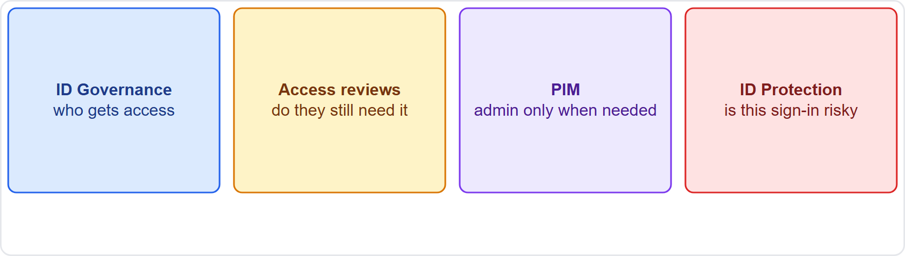
Four tools, four jobs, continued
Module 6
Governance decides who gets access, PIM limits privilege, access reviews clean up, ID Protection detects risk
SC-900 Exam Prep | Microsoft Security, Compliance and Identity Fundamentals exam
Module 6: Identity Protection and Governance
6 / 21
Notes:
Four tools, four jobs.
The figure shows this: Governance decides who gets access, P I M limits privilege, access reviews clean up, I D Protection detects risk.

Slide 7
Microsoft Entra ID Governance
Module 6
Capability | What it does
Entitlement management | Bundles resources into access packages that users request, with approval and expiry
Lifecycle workflows | Automates joiner, mover and leaver tasks (create, change, remove access)
Access reviews | Periodically confirm or remove access
Privileged Identity Management | Just-in-time, time-bound privileged access
Terms of use | Require users to accept terms before access
ID Governance manages the identity and access life cycle at scale, balancing security and productivity. It adds capabilities to Entra ID. [Verify live] for licensing.
EXAM TIP Joiner, mover, leaver = lifecycle workflows. Access packages (a bundle of access that expires) = entitlement management.
SC-900 Exam Prep | Microsoft Security, Compliance and Identity Fundamentals exam
Module 6: Identity Protection and Governance
7 / 21
Notes:
Microsoft Entra I D Governance.
I D Governance manages the identity and access life cycle at scale, balancing security and productivity. It adds capabilities to Entra I D. for licensing.
Entitlement management. Bundles resources into access packages that users request, with approval and expiry.
Lifecycle workflows. Automates joiner, mover and leaver tasks (create, change, remove access).
Access reviews. Periodically confirm or remove access.
Privileged Identity Management. Just-in-time, time-bound privileged access.
Terms of use. Require users to accept terms before access.
Exam tip: Joiner, mover, leaver equals lifecycle workflows. Access packages (a bundle of access that expires) equals entitlement management.

Slide 8
Access reviews
Module 6
Item | Details
What can be reviewed | Group memberships, application access, Entra and Azure roles, access packages
Reviewers | Resource owners, managers, the users themselves, or selected reviewers
Frequency | One time or recurring (monthly, quarterly, yearly)
Outcome | Approve or deny; access can be removed automatically when the review ends
Why | Fights privilege creep and stale access and supports compliance and audits
An access review lets the right people confirm whether access is still needed.
SC-900 Exam Prep | Microsoft Security, Compliance and Identity Fundamentals exam
Module 6: Identity Protection and Governance
8 / 21
Notes:
Access reviews.
An access review lets the right people confirm whether access is still needed.
What can be reviewed. Group memberships, application access, Entra and Azure roles, access packages.
Reviewers. Resource owners, managers, the users themselves, or selected reviewers.
Frequency. One time or recurring (monthly, quarterly, yearly).
Outcome. Approve or deny; access can be removed automatically when the review ends.
Why. Fights privilege creep and stale access and supports compliance and audits.

Slide 9
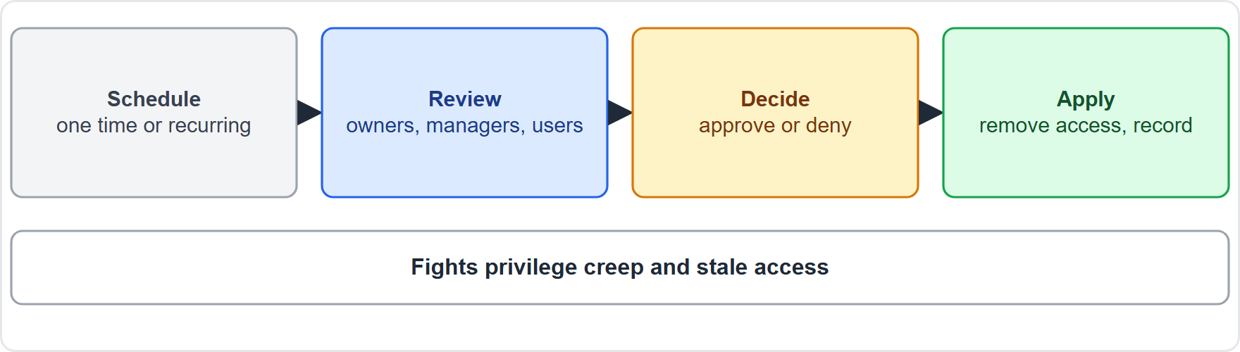
Access reviews, continued
Module 6
An access review cycle: schedule, reviewers decide, access removed or kept, results recorded
EXAM TIP "Periodically verify that group members still need access" = access review. It removes excess access; it does not detect risky sign-ins (that is ID Protection).
SC-900 Exam Prep | Microsoft Security, Compliance and Identity Fundamentals exam
Module 6: Identity Protection and Governance
9 / 21
Notes:
Access reviews.
The figure shows this: An access review cycle: schedule, reviewers decide, access removed or kept, results recorded.
Exam tip: "Periodically verify that group members still need access" equals access review. It removes excess access; it does not detect risky sign-ins (that is I D Protection).

Slide 10
Privileged Identity Management (PIM)
Module 6
Feature | Meaning
Just-in-time (JIT) access | Privileges are activated only when needed
Time-bound access | Roles expire after a set time
Eligible vs active | Eligible = can activate the role; active = has it now
Approval | Activation can require approval
MFA on activation | Require MFA to activate
Justification and notifications | Users give a reason; admins get alerts
Audit history and reviews | Every activation is logged; access reviews of roles
PIM manages, controls and monitors access to important resources: Entra roles, Azure roles and groups.
SC-900 Exam Prep | Microsoft Security, Compliance and Identity Fundamentals exam
Module 6: Identity Protection and Governance
10 / 21
Notes:
Privileged Identity Management (P I M).
P I M manages, controls and monitors access to important resources: Entra roles, Azure roles and groups.
Just-in-time (J I T) access. Privileges are activated only when needed.
Time-bound access. Roles expire after a set time.
Eligible versus active. Eligible equals can activate the role; active equals has it now.
Approval. Activation can require approval.
M F A on activation. Require M F A to activate.
Justification and notifications. Users give a reason; admins get alerts.
Audit history and reviews. Every activation is logged; access reviews of roles.

Slide 11
Privileged Identity Management (PIM), continued
Module 6
PIM reduces standing privilege: an attacker who steals an eligible admin's password still cannot use the role without activation. PIM needs Entra ID P2 (or ID Governance). [Verify live]
EXAM TIP PIM = just-in-time, time-limited admin rights. The key word is eligible: the person can become admin, but is not admin all the time.
SC-900 Exam Prep | Microsoft Security, Compliance and Identity Fundamentals exam
Module 6: Identity Protection and Governance
11 / 21
Notes:
Privileged Identity Management (P I M).
P I M reduces standing privilege: an attacker who steals an eligible admin's password still cannot use the role without activation. P I M needs Entra I D P two (or I D Governance).
Exam tip: P I M equals just-in-time, time-limited admin rights. The key word is eligible: the person can become admin, but is not admin all the time.

Slide 12
Microsoft Entra ID Protection
Module 6
Risk type | Meaning
User risk | The account may be compromised (for example leaked credentials)
Sign-in risk | This sign-in may not be the real user (for example anonymous IP address, atypical or impossible travel, unfamiliar sign-in properties, password spray)
ID Protection uses machine learning and Microsoft's threat data to detect identity risks, report them and automate responses. It needs Entra ID P2. [Verify live]
Responses: risk-based Conditional Access policies can require MFA for risky sign-ins and a password change for risky users; admins can investigate, confirm or dismiss risks in reports.
EXAM TIP User risk = account (leaked credentials). Sign-in risk = this login (impossible travel). ID Protection detects; Conditional Access acts on the risk.
SC-900 Exam Prep | Microsoft Security, Compliance and Identity Fundamentals exam
Module 6: Identity Protection and Governance
12 / 21
Notes:
Microsoft Entra I D Protection.
I D Protection uses machine learning and Microsoft's threat data to detect identity risks, report them and automate responses. It needs Entra I D P two.
User risk. The account may be compromised (for example leaked credentials).
Sign-in risk. This sign-in may not be the real user (for example anonymous I P address, atypical or impossible travel, unfamiliar sign-in properties, password spray).
Responses: risk-based Conditional Access policies can require M F A for risky sign-ins and a password change for risky users; admins can investigate, confirm or dismiss risks in reports.
Exam tip: User risk equals account (leaked credentials). Sign-in risk equals this login (impossible travel). I D Protection detects; Conditional Access acts on the risk.

Slide 13
Practice Question 1
Module 6
Q1
Fabrikam Outdoors wants administrators to be admins only when they need to do admin work, for a limited time. Which tool fits?
A
Access reviews of group membership
B
Self-service password reset for users
C
Privileged Identity Management
D
Azure Bastion for remote desktop sessions
SC-900 Exam Prep | Microsoft Security, Compliance and Identity Fundamentals exam
Module 6: Identity Protection and Governance
13 / 21
Notes:
Question one. Fabrikam Outdoors wants administrators to be admins only when they need to do admin work, for a limited time. Which tool fits? The four options are on the screen.
[PAUSE 10]
The answer is C: Privileged Identity Management. P I M gives just-in-time, time-bound privileged access.

Slide 14
Practice Question 2
Module 6
Q2
Each quarter, managers must confirm that group members still need access. Which capability does this?
A
Access reviews
B
ID Protection
C
Smart lockout
D
Federation
SC-900 Exam Prep | Microsoft Security, Compliance and Identity Fundamentals exam
Module 6: Identity Protection and Governance
14 / 21
Notes:
Question two. Each quarter, managers must confirm that group members still need access. Which capability does this? The four options are on the screen.
[PAUSE 10]
The answer is A: Access reviews. Access reviews periodically confirm or remove access.

Slide 15
Practice Question 3
Module 6
Q3
A sign-in comes from an anonymous IP address and an unusual location. Which tool classifies this as risky?
A
Azure Firewall for network filtering
B
Microsoft Purview for data compliance
C
Microsoft Entra ID Protection
D
Azure Key Vault for secrets and keys
SC-900 Exam Prep | Microsoft Security, Compliance and Identity Fundamentals exam
Module 6: Identity Protection and Governance
15 / 21
Notes:
Question three. A sign-in comes from an anonymous I P address and an unusual location. Which tool classifies this as risky? The four options are on the screen.
[PAUSE 10]
The answer is C: Microsoft Entra I D Protection. I D Protection detects risky sign-ins and users.

Slide 16
Practice Question 4
Module 6
Q4
A user's credentials appear in a leaked list. Which risk type is this?
A
User risk
B
Sign-in risk
C
Device risk
D
Network risk
SC-900 Exam Prep | Microsoft Security, Compliance and Identity Fundamentals exam
Module 6: Identity Protection and Governance
16 / 21
Notes:
Question four. A user's credentials appear in a leaked list. Which risk type is this? The four options are on the screen.
[PAUSE 10]
The answer is A: User risk. Leaked credentials indicate that the account may be compromised, which is user risk.

Slide 17
Practice Question 5
Module 6
Q5
In PIM, what does "eligible" mean?
A
The user has the role permanently and can never lose it
B
The user can activate the role when needed
C
The user is blocked from the role until an admin approves
D
The role is deleted from the directory for everyone
SC-900 Exam Prep | Microsoft Security, Compliance and Identity Fundamentals exam
Module 6: Identity Protection and Governance
17 / 21
Notes:
Question five. In P I M, what does "eligible" mean? The four options are on the screen.
[PAUSE 10]
The answer is B: The user can activate the role when needed. Eligible users must activate the role before using it.

Slide 18
Practice Question 6
Module 6
Q6
New employees, movers and leavers should get and lose access automatically as part of their life cycle. Which capability fits?
A
Lifecycle workflows in ID Governance
B
Conditional Access report-only mode for testing
C
Managed identity for an Azure resource
D
Password protection with banned password lists
SC-900 Exam Prep | Microsoft Security, Compliance and Identity Fundamentals exam
Module 6: Identity Protection and Governance
18 / 21
Notes:
Question six. New employees, movers and leavers should get and lose access automatically as part of their life cycle. Which capability fits? The four options are on the screen.
[PAUSE 10]
The answer is A: Lifecycle workflows in I D Governance. Lifecycle workflows automate joiner, mover and leaver tasks.

Slide 19
Recall Check 1
Module 6
Q1. What does ID Governance manage?
Q2. What can an access review check?
Q3. What does PIM stand for?
SC-900 Exam Prep | Microsoft Security, Compliance and Identity Fundamentals exam
Module 6: Identity Protection and Governance
19 / 21
Notes:
Recall check one. Say each answer out loud before you listen to mine.
Question one. What does I D Governance manage?
[PAUSE 5]
Answer: The identity and access life cycle: the right access for the right people for the right time.
Question two. What can an access review check?
[PAUSE 5]
Answer: Group memberships, application access, roles and access packages.
Question three. What does P I M stand for?
[PAUSE 5]
Answer: Privileged Identity Management.

Slide 20
Recall Check 2
Module 6
Q4. What is the difference between eligible and active in PIM?
Q5. Name the two risk types in ID Protection.
Q6. Which license level do PIM and ID Protection need?
SC-900 Exam Prep | Microsoft Security, Compliance and Identity Fundamentals exam
Module 6: Identity Protection and Governance
20 / 21
Notes:
Recall check two. Say each answer out loud before you listen to mine.
Question four. What is the difference between eligible and active in P I M?
[PAUSE 5]
Answer: Eligible can activate the role; active has it now.
Question five. Name the two risk types in I D Protection.
[PAUSE 5]
Answer: User risk and sign-in risk.
Question six. Which license level do P I M and I D Protection need?
[PAUSE 5]
Answer: Microsoft Entra I D P two (or I D Governance for P I M).

Slide 21
Module Recap
Module 6
1
ID Governance
2
Access reviews
entitlement management (access packages), lifecycle workflows (joiner, mover, leaver), access reviews, PIM, terms of use
periodic; reviewers owners, managers, users; approve or deny; auto-remove access
3
PIM
4
ID Protection
just-in-time, time-bound, eligible vs active, approval, MFA on activation, audit; P2
detects user risk (leaked credentials) and sign-in risk (impossible travel, anonymous IP)
SC-900 Exam Prep | Microsoft Security, Compliance and Identity Fundamentals exam
Module 6: Identity Protection and Governance
21 / 21
Notes:
Here is the recap.
I D Governance: entitlement management (access packages), lifecycle workflows (joiner, mover, leaver), access reviews, P I M, terms of use.
Access reviews: periodic; reviewers owners, managers, users; approve or deny; auto-remove access.
P I M: just-in-time, time-bound, eligible versus active, approval, M F A on activation, audit; P two.
I D Protection: detects user risk (leaked credentials) and sign-in risk (impossible travel, anonymous I P).
In the next module, we continue the course.

