Slide 1
Module 7: Core Infrastructure Security in Azure
Describe Azure DDoS Protection
SC-900 exam prep · Capabilities of Microsoft security solutions · 35 to 40% of the exam
SC-900 Exam Prep: Microsoft Security, Compliance and Identity Fundamentals Study Course
Module 7
Notes:
Welcome to Module seven: Core Infrastructure Security in Azure. It covers the exam area Capabilities of Microsoft security solutions.
Each part of this module comes from the study notes of the same name, so you can read the notes after you watch.

Slide 2
What You Will Learn
Module 7
Describe Azure DDoS Protection
Describe Azure Firewall
Describe Azure Web Application Firewall (WAF)
Describe network segmentation with Azure virtual networks
Describe network security groups (NSGs)
Describe Azure Bastion
Practice with exam-style questions and a recall check
SC-900 Exam Prep | Microsoft Security, Compliance and Identity Fundamentals exam
Module 7: Core Infrastructure Security in Azure
2 / 24
Notes:
By the end of this module you will be able to do seven things.
Describe Azure D dos (distributed denial of service) Protection.
Describe Azure Firewall.
Describe Azure Web Application Firewall (waff).
Describe network segmentation with Azure virtual networks.
Describe network security groups (N S Gs).
Describe Azure Bastion.
Practice with exam-style questions and a recall check.

Slide 3
Where This Fits in the Exam
DATES
Module 7
EXAM CHECK-IN · Where this fits
Exam area: Capabilities of Microsoft security solutions (35–40%)
Exam format: 45 minutes; a score of 700 on a scale of 1 to 1,000 passes
Validated against: the official SC-900 study guide, skills measured as of October 21, 2026
SC-900 Exam Prep | Microsoft Security, Compliance and Identity Fundamentals exam
Module 7: Core Infrastructure Security in Azure
3 / 24
Notes:
Here is where this module sits in the exam.
Exam area: Capabilities of Microsoft security solutions (thirty-five to forty percent).
Exam format: forty-five minutes; a score of seven hundred on a scale of one to one thousand passes.
Validated against: the official S C nine hundred study guide, skills measured as of October twenty-one, two thousand twenty-six.

Slide 4
Seven services at a glance
Module 7
Service | Job in one line | Works at
Azure DDoS Protection | Defends against flood attacks that try to make a service unavailable | Layers 3 and 4
Azure Firewall | Managed, cloud-native firewall that filters traffic for virtual networks | Layers 3 to 7 (network and application rules)
Azure Web Application Firewall (WAF) | Protects web applications from common web attacks | Layer 7 (HTTP)
Virtual networks and subnets | Segment resources into isolated networks | Network design
SC-900 Exam Prep | Microsoft Security, Compliance and Identity Fundamentals exam
Module 7: Core Infrastructure Security in Azure
4 / 24
Notes:
Seven services at a glance.
Azure D dos Protection. Job in one line: Defends against flood attacks that try to make a service unavailable. Works at: Layers three and four.
Azure Firewall. Job in one line: Managed, cloud-native firewall that filters traffic for virtual networks. Works at: Layers three to seven (network and application rules).
Azure Web Application Firewall (waff). Job in one line: Protects web applications from common web attacks. Works at: Layer seven (H T T P).
Virtual networks and subnets. Job in one line: Segment resources into isolated networks. Works at: Network design.

Slide 5
Seven services at a glance, continued
Module 7
Service | Job in one line | Works at
Network security groups (NSGs) | Allow or deny traffic to and from resources by rules | Layers 3 and 4
Azure Bastion | Secure RDP and SSH to VMs without exposing public IP addresses | Access
Azure Key Vault | Store and control secrets, keys and certificates | Data and secrets
SC-900 Exam Prep | Microsoft Security, Compliance and Identity Fundamentals exam
Module 7: Core Infrastructure Security in Azure
5 / 24
Notes:
Seven services at a glance.
Network security groups (N S Gs). Job in one line: Allow or deny traffic to and from resources by rules. Works at: Layers three and four.
Azure Bastion. Job in one line: Secure R D P and S S H to V Ms without exposing public I P addresses. Works at: Access.
Azure Key Vault. Job in one line: Store and control secrets, keys and certificates. Works at: Data and secrets.

Slide 6
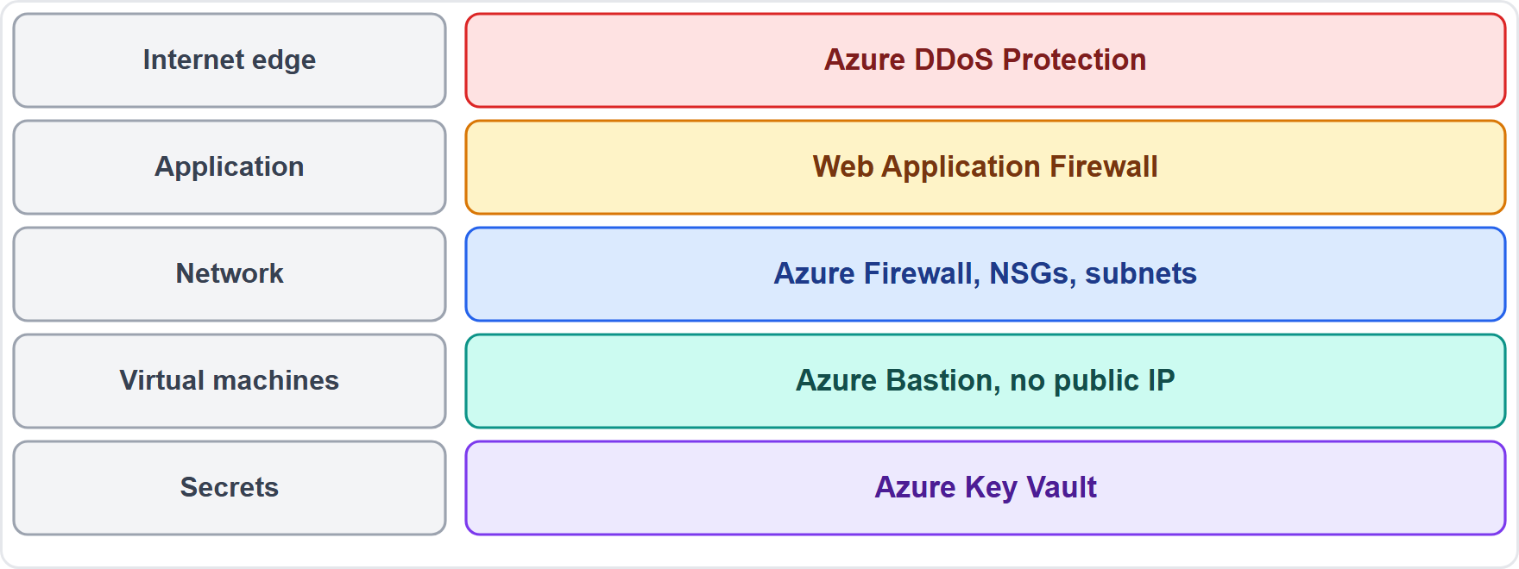
Seven services at a glance, continued
Module 7
Where each Azure security service sits: internet edge, application, network, virtual machines and secrets
SC-900 Exam Prep | Microsoft Security, Compliance and Identity Fundamentals exam
Module 7: Core Infrastructure Security in Azure
6 / 24
Notes:
Seven services at a glance.
The figure shows this: Where each Azure security service sits: internet edge, application, network, virtual machines and secrets.

Slide 7
Azure DDoS Protection
Module 7
Feature | Meaning
Infrastructure protection | Default protection included for Azure services at no extra charge
DDoS Network Protection and IP Protection | Paid tiers with adaptive tuning to your traffic, attack analytics and metrics, alerts, and rapid response support
Layers | Defends network (layer 3) and transport (layer 4) attacks
A distributed denial-of-service (DDoS) attack floods a target with traffic so real users cannot reach it.
EXAM TIP DDoS = availability attack, many sources, volume. DDoS Protection handles layers 3 and 4; the WAF handles layer 7 web attacks.
SC-900 Exam Prep | Microsoft Security, Compliance and Identity Fundamentals exam
Module 7: Core Infrastructure Security in Azure
7 / 24
Notes:
Azure D dos Protection.
A distributed denial-of-service (D dos) attack floods a target with traffic so real users cannot reach it.
Infrastructure protection. Default protection included for Azure services at no extra charge.
D dos Network Protection and I P Protection. Paid tiers with adaptive tuning to your traffic, attack analytics and metrics, alerts, and rapid response support.
Layers. Defends network (layer three) and transport (layer four) attacks.
Exam tip: D dos equals availability attack, many sources, volume. D dos Protection handles layers three and four; the waff handles layer seven web attacks.

Slide 8
Azure Firewall
Module 7
Feature | Meaning
Network and application rules | Filter by IP, port and protocol, and by FQDN (website names)
Threat intelligence filtering | Alert or block traffic to and from known malicious IP addresses and domains
NAT rules (DNAT) | Publish an internal service through the firewall
Tiers | Basic, Standard and Premium (Premium adds TLS inspection and intrusion detection and prevention) [Verify live]
Central management | One policy for many networks and subscriptions
Azure Firewall is a managed, cloud-based, stateful network security service with built-in high availability and unlimited scaling.
EXAM TIP Azure Firewall = central, managed firewall for network traffic (including FQDN filtering). An NSG is simpler, per subnet or NIC. The WAF is only for web applications.
SC-900 Exam Prep | Microsoft Security, Compliance and Identity Fundamentals exam
Module 7: Core Infrastructure Security in Azure
8 / 24
Notes:
Azure Firewall.
Azure Firewall is a managed, cloud-based, stateful network security service with built-in high availability and unlimited scaling.
Network and application rules. Filter by I P, port and protocol, and by F Q D N (website names).
Threat intelligence filtering. Alert or block traffic to and from known malicious I P addresses and domains.
nat rules (D N A T). Publish an internal service through the firewall.
Tiers. Basic, Standard and Premium (Premium adds T L S inspection and intrusion detection and prevention).
Central management. One policy for many networks and subscriptions.
Exam tip: Azure Firewall equals central, managed firewall for network traffic (including F Q D N filtering). An N S G is simpler, per subnet or N I C. The waff is only for web applications.

Slide 9
Azure Web Application Firewall (WAF)
Module 7
The WAF protects web applications against common exploits and vulnerabilities such as SQL injection and cross-site scripting, using OWASP rule sets. It inspects HTTP and HTTPS (layer 7) requests. It runs on Azure Application Gateway, Azure Front Door and Azure CDN. [Verify live]
SC-900 Exam Prep | Microsoft Security, Compliance and Identity Fundamentals exam
Module 7: Core Infrastructure Security in Azure
9 / 24
Notes:
Azure Web Application Firewall (waff).
The waff protects web applications against common exploits and vulnerabilities such as sequel injection and cross-site scripting, using oh wasp rule sets. It inspects H T T P and H T T P S (layer seven) requests. It runs on Azure Application Gateway, Azure Front Door and Azure C D N.

Slide 10
Network segmentation and NSGs
Module 7
Tool | Segmentation role
Azure virtual network (VNet) | A private, isolated network in Azure
Subnets | Segments of a VNet for tiers such as web, app and data
VNet peering | Connects virtual networks privately
Network security group (NSG) | Filters traffic between subnets and to or from the internet
Segmentation splits a network into smaller, isolated parts so a breach cannot spread easily.
SC-900 Exam Prep | Microsoft Security, Compliance and Identity Fundamentals exam
Module 7: Core Infrastructure Security in Azure
10 / 24
Notes:
Network segmentation and N S Gs.
Segmentation splits a network into smaller, isolated parts so a breach cannot spread easily.
Azure virtual network (V net). A private, isolated network in Azure.
Subnets. Segments of a V net for tiers such as web, app and data.
V net peering. Connects virtual networks privately.
Network security group. Filters traffic between subnets and to or from the internet.

Slide 11
How an NSG works
Module 7
An NSG contains security rules. Each rule has priority, source, destination, port, protocol and action (allow or deny). Rules are processed from the lowest priority number first; the first match wins. NSGs are stateful and can be applied to a subnet or a network interface.
SC-900 Exam Prep | Microsoft Security, Compliance and Identity Fundamentals exam
Module 7: Core Infrastructure Security in Azure
11 / 24
Notes:
How an N S G works.
An N S G contains security rules. Each rule has priority, source, destination, port, protocol and action (allow or deny). Rules are processed from the lowest priority number first; the first match wins. N S Gs are stateful and can be applied to a subnet or a network interface.

Slide 12
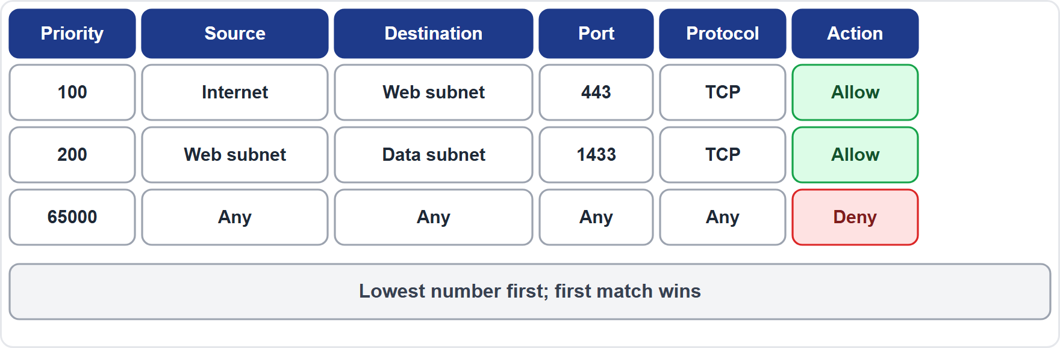
How an NSG works, continued
Module 7
An NSG rule table: priority, source, destination, port, protocol and action
EXAM TIP NSG = allow or deny by rule (5-tuple: source, destination, port, protocol, plus priority). Lowest number is checked first. Subnets plus NSGs are the basic way to segment an Azure network.
SC-900 Exam Prep | Microsoft Security, Compliance and Identity Fundamentals exam
Module 7: Core Infrastructure Security in Azure
12 / 24
Notes:
How an N S G works.
The figure shows this: An N S G rule table: priority, source, destination, port, protocol and action.
Exam tip: N S G equals allow or deny by rule (five-tuple: source, destination, port, protocol, plus priority). Lowest number is checked first. Subnets plus N S Gs are the basic way to segment an Azure network.

Slide 13
Azure Bastion
Module 7
Azure Bastion is a fully managed service that gives secure RDP and SSH access to virtual machines directly in the Azure portal over TLS, without a public IP address on the VM and without opening RDP or SSH ports to the internet.
SC-900 Exam Prep | Microsoft Security, Compliance and Identity Fundamentals exam
Module 7: Core Infrastructure Security in Azure
13 / 24
Notes:
Azure Bastion.
Azure Bastion is a fully managed service that gives secure R D P and S S H access to virtual machines directly in the Azure portal over T L S, without a public I P address on the V M and without opening R D P or S S H ports to the internet.

Slide 14
Azure Bastion, continued
Module 7
Benefit | Meaning
No public IP on the VM | Shrinks the attack surface
Protection from port scanning | RDP and SSH ports are not exposed
Browser-based | Connect from the portal, no client software
SC-900 Exam Prep | Microsoft Security, Compliance and Identity Fundamentals exam
Module 7: Core Infrastructure Security in Azure
14 / 24
Notes:
Azure Bastion.
No public I P on the V M. Shrinks the attack surface.
Protection from port scanning. R D P and S S H ports are not exposed.
Browser-based. Connect from the portal, no client software.

Slide 15
Azure Key Vault
Module 7
Feature | Meaning
Centralized secret management | No secrets in code or config files
Access control | By Azure RBAC (or access policies) and managed identities
HSM-backed keys | Hardware security module protection (Premium tier)
Logging | Audit who accessed what
Certificate lifecycle | Request, store and renew certificates
Key Vault is a secure store for secrets (passwords, connection strings, API keys), keys (encryption keys) and certificates.
EXAM TIP "Store secrets, keys and certificates securely and keep passwords out of code" = Key Vault. Apps reach it with a managed identity.
SC-900 Exam Prep | Microsoft Security, Compliance and Identity Fundamentals exam
Module 7: Core Infrastructure Security in Azure
15 / 24
Notes:
Azure Key Vault.
Key Vault is a secure store for secrets (passwords, connection strings, A P I keys), keys (encryption keys) and certificates.
Centralized secret management. No secrets in code or config files.
Access control. By Azure R B A C (or access policies) and managed identities.
H S M-backed keys. Hardware security module protection (Premium tier).
Logging. Audit who accessed what.
Certificate lifecycle. Request, store and renew certificates.
Exam tip: "Store secrets, keys and certificates securely and keep passwords out of code" equals Key Vault. Apps reach it with a managed identity.

Slide 16
Practice Question 1
Module 7
Q1
Fabrikam Outdoors needs to connect to a VM over RDP without giving the VM a public IP address or opening RDP to the internet. Which service fits?
A
Azure Bastion
B
Azure DDoS Protection
C
Azure Key Vault
D
A network security group alone
SC-900 Exam Prep | Microsoft Security, Compliance and Identity Fundamentals exam
Module 7: Core Infrastructure Security in Azure
16 / 24
Notes:
Question one. Fabrikam Outdoors needs to connect to a V M over R D P without giving the V M a public I P address or opening R D P to the internet. Which service fits? The four options are on the screen.
[PAUSE 10]
The answer is A: Azure Bastion. Bastion provides R D P and S S H through the portal over T L S without exposing public I P s.

Slide 17
Practice Question 2
Module 7
Q2
A web shop wants protection against SQL injection and cross-site scripting. Which service fits?
A
Azure DDoS Protection
B
Azure Bastion
C
Azure Key Vault
D
Azure Web Application Firewall
SC-900 Exam Prep | Microsoft Security, Compliance and Identity Fundamentals exam
Module 7: Core Infrastructure Security in Azure
17 / 24
Notes:
Question two. A web shop wants protection against sequel injection and cross-site scripting. Which service fits? The four options are on the screen.
[PAUSE 10]
The answer is D: Azure Web Application Firewall. The waff protects web applications from common layer seven attacks.

Slide 18
Practice Question 3
Module 7
Q3
Which service helps keep a site available during a large flood of traffic from many sources?
A
Azure Firewall rule for one IP
B
Azure Key Vault
C
Microsoft Purview
D
Azure DDoS Protection
SC-900 Exam Prep | Microsoft Security, Compliance and Identity Fundamentals exam
Module 7: Core Infrastructure Security in Azure
18 / 24
Notes:
Question three. Which service helps keep a site available during a large flood of traffic from many sources? The four options are on the screen.
[PAUSE 10]
The answer is D: Azure D dos Protection. D dos Protection defends against volumetric attacks at layers three and four.

Slide 19
Practice Question 4
Module 7
Q4
A team needs to store database passwords and encryption keys so that they are not in application code. What should it use?
A
Azure Key Vault
B
Azure Bastion
C
An NSG
D
A sensitivity label
SC-900 Exam Prep | Microsoft Security, Compliance and Identity Fundamentals exam
Module 7: Core Infrastructure Security in Azure
19 / 24
Notes:
Question four. A team needs to store database passwords and encryption keys so that they are not in application code. What should it use? The four options are on the screen.
[PAUSE 10]
The answer is A: Azure Key Vault. Key Vault stores secrets, keys and certificates securely.

Slide 20
Practice Question 5
Module 7
Q5
Which control allows or denies traffic to a subnet based on source, destination, port, protocol and priority?
A
Azure DDoS Protection for traffic floods
B
Azure Key Vault for secrets and keys
C
A network security group
D
Microsoft Sentinel for security analytics
SC-900 Exam Prep | Microsoft Security, Compliance and Identity Fundamentals exam
Module 7: Core Infrastructure Security in Azure
20 / 24
Notes:
Question five. Which control allows or denies traffic to a subnet based on source, destination, port, protocol and priority? The four options are on the screen.
[PAUSE 10]
The answer is C: A network security group. N S Gs filter traffic with prioritized allow and deny rules.

Slide 21
Practice Question 6
Module 7
Q6
A company wants one managed service with FQDN filtering and threat intelligence for traffic across several virtual networks. Which fits best?
A
An NSG on one subnet
B
Azure Bastion
C
Azure Firewall
D
The WAF
SC-900 Exam Prep | Microsoft Security, Compliance and Identity Fundamentals exam
Module 7: Core Infrastructure Security in Azure
21 / 24
Notes:
Question six. A company wants one managed service with F Q D N filtering and threat intelligence for traffic across several virtual networks. Which fits best? The four options are on the screen.
[PAUSE 10]
The answer is C: Azure Firewall. Azure Firewall is a managed central firewall with F Q D N filtering and threat intelligence.

Slide 22
Recall Check 1
Module 7
Q1. Which layers does Azure DDoS Protection defend?
Q2. What does the WAF protect?
Q3. What is an NSG?
SC-900 Exam Prep | Microsoft Security, Compliance and Identity Fundamentals exam
Module 7: Core Infrastructure Security in Azure
22 / 24
Notes:
Recall check one. Say each answer out loud before you listen to mine.
Question one. Which layers does Azure D dos Protection defend?
[PAUSE 5]
Answer: Layers three and four (network and transport).
Question two. What does the waff protect?
[PAUSE 5]
Answer: Web applications from attacks such as sequel injection and cross-site scripting.
Question three. What is an N S G?
[PAUSE 5]
Answer: A set of allow and deny rules for network traffic.

Slide 23
Recall Check 2
Module 7
Q4. What does Azure Bastion avoid?
Q5. What three things does Key Vault store?
Q6. How do NSG rules get processed?
SC-900 Exam Prep | Microsoft Security, Compliance and Identity Fundamentals exam
Module 7: Core Infrastructure Security in Azure
23 / 24
Notes:
Recall check two. Say each answer out loud before you listen to mine.
Question four. What does Azure Bastion avoid?
[PAUSE 5]
Answer: Public I P addresses and open R D P or S S H ports on V Ms.
Question five. What three things does Key Vault store?
[PAUSE 5]
Answer: Secrets, keys and certificates.
Question six. How do N S G rules get processed?
[PAUSE 5]
Answer: By priority, lowest number first, first match wins.

Slide 24
Module Recap
Module 7
1
DDoS Protection
2
Azure Firewall
3
WAF
floods; layers 3 and 4; default infrastructure protection, paid Network or IP Protection
managed central firewall; network and application rules, FQDN, threat intelligence
layer 7 web attacks (SQL injection, XSS); on Application Gateway, Front Door, CDN
4
VNet, subnets, NSGs
5
Bastion and Key Vault
segmentation; NSG rules by priority, source, destination, port, protocol, action
RDP and SSH without public IP; secrets, keys, certificates, HSM-backed, managed identities
SC-900 Exam Prep | Microsoft Security, Compliance and Identity Fundamentals exam
Module 7: Core Infrastructure Security in Azure
24 / 24
Notes:
Here is the recap.
D dos Protection: floods; layers three and four; default infrastructure protection, paid Network or I P Protection.
Azure Firewall: managed central firewall; network and application rules, F Q D N, threat intelligence.
waff: layer seven web attacks (sequel injection, X S S); on Application Gateway, Front Door, C D N.
V net, subnets, N S Gs: segmentation; N S G rules by priority, source, destination, port, protocol, action.
Bastion and Key Vault: R D P and S S H without public I P; secrets, keys, certificates, H S M-backed, managed identities.
In the next module, we continue the course.

