Slide 1
Module 8: Microsoft Defender for Cloud
Describe cloud security posture management (CSPM)
SC-900 exam prep · Capabilities of Microsoft security solutions · 35 to 40% of the exam
SC-900 Exam Prep: Microsoft Security, Compliance and Identity Fundamentals Study Course
Module 8
Notes:
Welcome to Module eight: Microsoft Defender for Cloud. It covers the exam area Capabilities of Microsoft security solutions.
Each part of this module comes from the study notes of the same name, so you can read the notes after you watch.

Slide 2
What You Will Learn
Module 8
Describe cloud security posture management (CSPM)
Describe Microsoft Defender for Cloud
Describe security policies and standards
Describe security recommendations
Describe cloud workload protection
Practice with exam-style questions and a recall check
SC-900 Exam Prep | Microsoft Security, Compliance and Identity Fundamentals exam
Module 8: Microsoft Defender for Cloud
2 / 20
Notes:
By the end of this module you will be able to do six things.
Describe cloud security posture management (C S P M).
Describe Microsoft Defender for Cloud.
Describe security policies and standards.
Describe security recommendations.
Describe cloud workload protection.
Practice with exam-style questions and a recall check.

Slide 3
Where This Fits in the Exam
DATES
Module 8
EXAM CHECK-IN · Where this fits
Exam area: Capabilities of Microsoft security solutions (35–40%)
Exam format: 45 minutes; a score of 700 on a scale of 1 to 1,000 passes
Validated against: the official SC-900 study guide, skills measured as of October 21, 2026
SC-900 Exam Prep | Microsoft Security, Compliance and Identity Fundamentals exam
Module 8: Microsoft Defender for Cloud
3 / 20
Notes:
Here is where this module sits in the exam.
Exam area: Capabilities of Microsoft security solutions (thirty-five to forty percent).
Exam format: forty-five minutes; a score of seven hundred on a scale of one to one thousand passes.
Validated against: the official S C nine hundred study guide, skills measured as of October twenty-one, two thousand twenty-six.

Slide 4
What Defender for Cloud is
Module 8
Job | Name | Question it answers
Find and fix weaknesses | Cloud security posture management (CSPM) | Is my environment configured securely?
Detect and stop threats | Cloud workload protection (CWP), delivered by Defender plans | Are my workloads under attack right now?
It protects Azure, on-premises servers and other clouds such as AWS and Google Cloud (multicloud).
SC-900 Exam Prep | Microsoft Security, Compliance and Identity Fundamentals exam
Module 8: Microsoft Defender for Cloud
4 / 20
Notes:
What Defender for Cloud is.
Microsoft Defender for Cloud is a cloud-native application protection platform (C N A P P) that does two jobs.
Find and fix weaknesses. Name: Cloud security posture management (C S P M). Question it answers: Is my environment configured securely?
Detect and stop threats. Name: Cloud workload protection (C W P), delivered by Defender plans. Question it answers: Are my workloads under attack right now?
It protects Azure, on-premises servers and other clouds such as A W S and Google Cloud (multicloud).

Slide 5
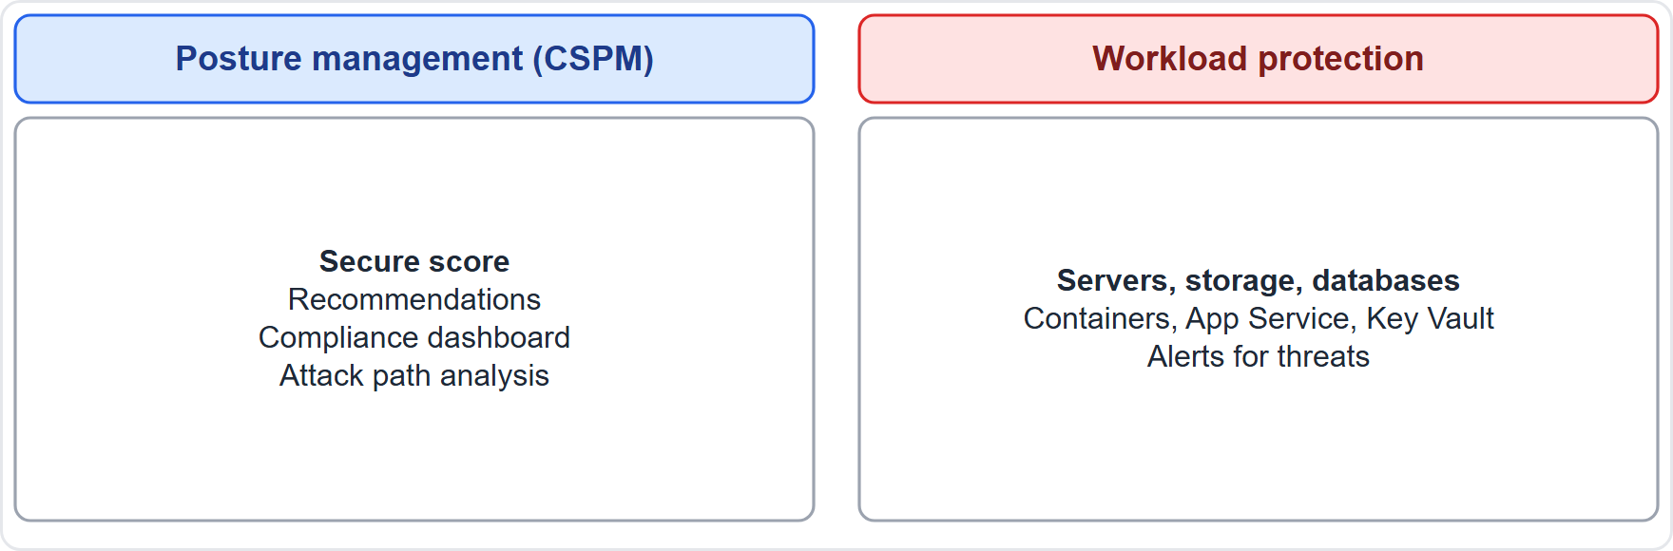
What Defender for Cloud is, continued
Module 8
Defender for Cloud: posture management finds weaknesses, workload protection stops threats
EXAM TIP CSPM = posture (misconfiguration, recommendations, secure score). Workload protection = threats (alerts and defenses per resource type). Defender for Cloud covers multicloud and hybrid, not Azure only.
SC-900 Exam Prep | Microsoft Security, Compliance and Identity Fundamentals exam
Module 8: Microsoft Defender for Cloud
5 / 20
Notes:
What Defender for Cloud is.
The figure shows this: Defender for Cloud: posture management finds weaknesses, workload protection stops threats.
Exam tip: C S P M (cloud security posture management) equals posture (misconfiguration, recommendations, secure score). Workload protection equals threats (alerts and defenses per resource type). Defender for Cloud covers multicloud and hybrid, not Azure only.

Slide 6
Cloud security posture management (CSPM)
Module 8
Feature | What it does
Secure score | A percentage showing how well you follow security recommendations; higher is better
Security recommendations | Prioritized, actionable steps to fix weaknesses
Regulatory compliance dashboard | Shows how you measure against standards
Asset inventory | One view of all resources and their security state
Attack path analysis and cloud security graph | Shows how an attacker could reach critical assets (Defender CSPM plan) [Verify live]
Governance rules | Assign owners and due dates to recommendations
Free foundational CSPM is included for Azure; Defender CSPM is the paid plan with advanced features. [Verify live]
SC-900 Exam Prep | Microsoft Security, Compliance and Identity Fundamentals exam
Module 8: Microsoft Defender for Cloud
6 / 20
Notes:
Cloud security posture management (C S P M).
Secure score. A percentage showing how well you follow security recommendations; higher is better.
Security recommendations. Prioritized, actionable steps to fix weaknesses.
Regulatory compliance dashboard. Shows how you measure against standards.
Asset inventory. One view of all resources and their security state.
Attack path analysis and cloud security graph. Shows how an attacker could reach critical assets (Defender C S P M plan).
Governance rules. Assign owners and due dates to recommendations.
Free foundational C S P M is included for Azure; Defender C S P M is the paid plan with advanced features.

Slide 7
Security recommendations
Module 8
A recommendation tells you what to fix, why, and how. Each shows severity, affected resources and remediation steps, and many offer Quick fix or Fix buttons. Examples: enable MFA for accounts, close management ports on VMs, enable encryption, apply system updates.
Recommendations are generated by security policies and standards that are assessed continuously. Secure score rises as you fix them.
SC-900 Exam Prep | Microsoft Security, Compliance and Identity Fundamentals exam
Module 8: Microsoft Defender for Cloud
7 / 20
Notes:
Security recommendations.
A recommendation tells you what to fix, why, and how. Each shows severity, affected resources and remediation steps, and many offer Quick fix or Fix buttons. Examples: enable M F A for accounts, close management ports on V Ms, enable encryption, apply system updates.
Recommendations are generated by security policies and standards that are assessed continuously. Secure score rises as you fix them.

Slide 8
Security policies and standards
Module 8
Term | Meaning
Security policy | A rule about how resources should be configured (built on Azure Policy)
Initiative | A group of policies assigned together
Standard | A set of controls from a benchmark or regulation
Microsoft cloud security benchmark (MCSB) | The default standard, Microsoft's security best practices for Azure and multicloud
Regulatory standards | For example ISO 27001, PCI DSS, NIST SP 800-53, SOC 2 can be added
SC-900 Exam Prep | Microsoft Security, Compliance and Identity Fundamentals exam
Module 8: Microsoft Defender for Cloud
8 / 20
Notes:
Security policies and standards.
Security policy. A rule about how resources should be configured (built on Azure Policy).
Initiative. A group of policies assigned together.
Standard. A set of controls from a benchmark or regulation.
Microsoft cloud security benchmark (M C S B). The default standard, Microsoft's security best practices for Azure and multicloud.
Regulatory standards. For example I S O twenty-seven thousand one, P C I D S S, nist S P eight hundred to fifty-three, S O C two can be added.

Slide 9
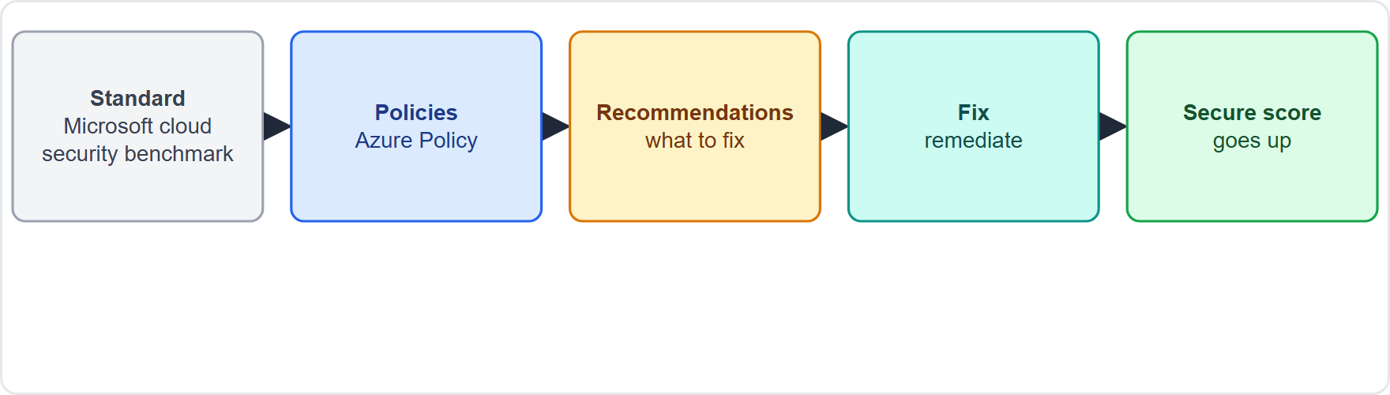
Security policies and standards, continued
Module 8
Policies and standards produce recommendations, which raise secure score when fixed
EXAM TIP Policies and standards define what is expected; recommendations tell you what to do; secure score shows progress. The default standard is the Microsoft cloud security benchmark.
SC-900 Exam Prep | Microsoft Security, Compliance and Identity Fundamentals exam
Module 8: Microsoft Defender for Cloud
9 / 20
Notes:
Security policies and standards.
The figure shows this: Policies and standards produce recommendations, which raise secure score when fixed.
Exam tip: Policies and standards define what is expected; recommendations tell you what to do; secure score shows progress. The default standard is the Microsoft cloud security benchmark.

Slide 10
Cloud workload protection (Defender plans)
Module 8
Plan | Protects
Defender for Servers | Virtual machines and servers (Azure, on-premises, other clouds); includes vulnerability assessment and endpoint protection with Defender for Endpoint
Defender for Storage | Storage accounts: malware scanning, unusual access
Defender for Databases (SQL, open-source databases, Cosmos DB) | Databases: SQL injection and anomalous access
Defender for App Service | Web apps
Defender for Key Vault | Key vault misuse
Defender for Containers | Kubernetes and container images
Defender for Resource Manager | Suspicious management operations
Defender for APIs | API threats
SC-900 Exam Prep | Microsoft Security, Compliance and Identity Fundamentals exam
Module 8: Microsoft Defender for Cloud
10 / 20
Notes:
Cloud workload protection (Defender plans).
Each Defender plan protects a resource type with threat detection and alerts.
Defender for Servers. Virtual machines and servers (Azure, on-premises, other clouds); includes vulnerability assessment and endpoint protection with Defender for Endpoint.
Defender for Storage. Storage accounts: malware scanning, unusual access.
Defender for Databases (sequel, open-source databases, Cosmos D B). Databases: sequel injection and anomalous access.
Defender for App Service. Web apps.
Defender for Key Vault. Key vault misuse.
Defender for Containers. Kubernetes and container images.
Defender for Resource Manager. Suspicious management operations.
Defender for A P Is. A P I threats.

Slide 11
Cloud workload protection (Defender plans), continued
Module 8
Key points: plans are enabled per subscription, are paid by resource, and raise security alerts with recommended responses; alerts can be sent to Microsoft Sentinel and the Defender XDR portal. [Verify live]
EXAM TIP "Detect attacks on virtual machines, databases or storage" = a Defender plan (workload protection). "Score and recommendations about configuration" = CSPM.
SC-900 Exam Prep | Microsoft Security, Compliance and Identity Fundamentals exam
Module 8: Microsoft Defender for Cloud
11 / 20
Notes:
Cloud workload protection (Defender plans).
Key points: plans are enabled per subscription, are paid by resource, and raise security alerts with recommended responses; alerts can be sent to Microsoft Sentinel and the Defender X D R portal.
Exam tip: "Detect attacks on virtual machines, databases or storage" equals a Defender plan (workload protection). "Score and recommendations about configuration" equals C S P M.

Slide 12
Practice Question 1
Module 8
Q1
Fabrikam Outdoors wants a percentage that shows how well its Azure resources follow security recommendations. What is it?
A
Compliance score in Purview
B
Secure score
C
Sign-in risk
D
NSG priority
SC-900 Exam Prep | Microsoft Security, Compliance and Identity Fundamentals exam
Module 8: Microsoft Defender for Cloud
12 / 20
Notes:
Question one. Fabrikam Outdoors wants a percentage that shows how well its Azure resources follow security recommendations. What is it? The four options are on the screen.
[PAUSE 10]
The answer is B: Secure score. Secure score in Defender for Cloud measures posture against recommendations.

Slide 13
Practice Question 2
Module 8
Q2
Which Defender for Cloud capability detects an attack on a SQL database?
A
Cloud workload protection with a Defender plan
B
Secure score, which only shows configuration posture
C
The asset inventory of all your resources
D
Sensitivity labels applied to documents
SC-900 Exam Prep | Microsoft Security, Compliance and Identity Fundamentals exam
Module 8: Microsoft Defender for Cloud
13 / 20
Notes:
Question two. Which Defender for Cloud capability detects an attack on a sequel database? The four options are on the screen.
[PAUSE 10]
The answer is A: Cloud workload protection with a Defender plan. Defender plans provide threat detection for specific workloads such as databases.

Slide 14
Practice Question 3
Module 8
Q3
What is the default security standard in Defender for Cloud?
A
ISO 27001 only, which must be added first
B
PCI DSS only, which must be added first
C
GDPR, a regulation that the customer adds afterward
D
Microsoft cloud security benchmark
SC-900 Exam Prep | Microsoft Security, Compliance and Identity Fundamentals exam
Module 8: Microsoft Defender for Cloud
14 / 20
Notes:
Question three. What is the default security standard in Defender for Cloud? The four options are on the screen.
[PAUSE 10]
The answer is D: Microsoft cloud security benchmark. The Microsoft cloud security benchmark is the default standard.

Slide 15
Practice Question 4
Module 8
Q4
A team wants guidance on which settings to change to improve security, with severity and remediation steps. Which feature gives this?
A
Azure Bastion
B
A Conditional Access policy
C
Security recommendations
D
Access reviews
SC-900 Exam Prep | Microsoft Security, Compliance and Identity Fundamentals exam
Module 8: Microsoft Defender for Cloud
15 / 20
Notes:
Question four. A team wants guidance on which settings to change to improve security, with severity and remediation steps. Which feature gives this? The four options are on the screen.
[PAUSE 10]
The answer is C: Security recommendations. Recommendations are prioritized, actionable remediation guidance.

Slide 16
Practice Question 5
Module 8
Q5
Which statement about Defender for Cloud is true?
A
It protects only Azure virtual machines and nothing else
B
It is a SIEM only and has no posture features at all
C
It manages user passwords for every employee account
D
It protects Azure, on-premises and other clouds
SC-900 Exam Prep | Microsoft Security, Compliance and Identity Fundamentals exam
Module 8: Microsoft Defender for Cloud
16 / 20
Notes:
Question five. Which statement about Defender for Cloud is true? The four options are on the screen.
[PAUSE 10]
The answer is D: It protects Azure, on-premises and other clouds. Defender for Cloud covers multicloud and hybrid environments.

Slide 17
Practice Question 6
Module 8
Q6
Which term describes a group of policies assigned together?
A
Recommendation
B
Alert
C
Initiative
D
Tenant
SC-900 Exam Prep | Microsoft Security, Compliance and Identity Fundamentals exam
Module 8: Microsoft Defender for Cloud
17 / 20
Notes:
Question six. Which term describes a group of policies assigned together? The four options are on the screen.
[PAUSE 10]
The answer is C: Initiative. An initiative bundles several policies.

Slide 18
Recall Check 1
Module 8
Q1. What does CSPM stand for?
Q2. What does secure score show?
Q3. What do Defender plans provide?
SC-900 Exam Prep | Microsoft Security, Compliance and Identity Fundamentals exam
Module 8: Microsoft Defender for Cloud
18 / 20
Notes:
Recall check one. Say each answer out loud before you listen to mine.
Question one. What does C S P M stand for?
[PAUSE 5]
Answer: Cloud security posture management.
Question two. What does secure score show?
[PAUSE 5]
Answer: How well you follow security recommendations; higher is better.
Question three. What do Defender plans provide?
[PAUSE 5]
Answer: Cloud workload protection: threat detection and alerts per resource type.

Slide 19
Recall Check 2
Module 8
Q4. Name the default standard.
Q5. Which Azure service do Defender for Cloud policies build on?
Q6. Which paid plan adds attack path analysis?
SC-900 Exam Prep | Microsoft Security, Compliance and Identity Fundamentals exam
Module 8: Microsoft Defender for Cloud
19 / 20
Notes:
Recall check two. Say each answer out loud before you listen to mine.
Question four. Name the default standard.
[PAUSE 5]
Answer: Microsoft cloud security benchmark.
Question five. Which Azure service do Defender for Cloud policies build on?
[PAUSE 5]
Answer: Azure Policy.
Question six. Which paid plan adds attack path analysis?
[PAUSE 5]
Answer: Defender C S P M.

Slide 20
Module Recap
Module 8
1
Defender for Cloud
2
CSPM
CNAPP; CSPM plus cloud workload protection; Azure, on-premises, multicloud
secure score, recommendations, compliance dashboard, inventory, attack paths (Defender CSPM)
3
Policies and standards
4
Workload protection
Azure Policy based; initiatives; default Microsoft cloud security benchmark; add ISO, PCI, NIST
Defender for Servers, Storage, Databases, App Service, Key Vault, Containers, Resource Manager, APIs
SC-900 Exam Prep | Microsoft Security, Compliance and Identity Fundamentals exam
Module 8: Microsoft Defender for Cloud
20 / 20
Notes:
Here is the recap.
Defender for Cloud: C N A P P; C S P M plus cloud workload protection; Azure, on-premises, multicloud.
C S P M: secure score, recommendations, compliance dashboard, inventory, attack paths (Defender C S P M).
Policies and standards: Azure Policy based; initiatives; default Microsoft cloud security benchmark; add I S O, P C I, nist.
Workload protection: Defender for Servers, Storage, Databases, App Service, Key Vault, Containers, Resource Manager, A P Is.
In the next module, we continue the course.

