Slide 1
Module 9: Microsoft Sentinel
Describe security information and event management (SIEM) and security orchestration automated response (SOAR)
SC-900 exam prep · Capabilities of Microsoft security solutions · 35 to 40% of the exam
SC-900 Exam Prep: Microsoft Security, Compliance and Identity Fundamentals Study Course
Module 9
Notes:
Welcome to Module nine: Microsoft Sentinel. It covers the exam area Capabilities of Microsoft security solutions.
Each part of this module comes from the study notes of the same name, so you can read the notes after you watch.

Slide 2
What You Will Learn
Module 9
Describe security information and event management (SIEM) and security orchestration automated response (SOAR)
Describe how Microsoft Sentinel provides integrated threat protection
Describe threat detection and mitigation capabilities in Microsoft Sentinel
Practice with exam-style questions and a recall check
SC-900 Exam Prep | Microsoft Security, Compliance and Identity Fundamentals exam
Module 9: Microsoft Sentinel
2 / 17
Notes:
By the end of this module you will be able to do four things.
Describe security information and event management (sim) and security orchestration automated response (soar).
Describe how Microsoft Sentinel provides integrated threat protection.
Describe threat detection and mitigation capabilities in Microsoft Sentinel.
Practice with exam-style questions and a recall check.

Slide 3
Where This Fits in the Exam
DATES
Module 9
EXAM CHECK-IN · Where this fits
Exam area: Capabilities of Microsoft security solutions (35–40%)
Exam format: 45 minutes; a score of 700 on a scale of 1 to 1,000 passes
Validated against: the official SC-900 study guide, skills measured as of October 21, 2026
SC-900 Exam Prep | Microsoft Security, Compliance and Identity Fundamentals exam
Module 9: Microsoft Sentinel
3 / 17
Notes:
Here is where this module sits in the exam.
Exam area: Capabilities of Microsoft security solutions (thirty-five to forty percent).
Exam format: forty-five minutes; a score of seven hundred on a scale of one to one thousand passes.
Validated against: the official S C nine hundred study guide, skills measured as of October twenty-one, two thousand twenty-six.

Slide 4
SIEM and SOAR
Module 9
Term | Stands for | What it does
SIEM | Security information and event management | Collects and analyzes security data from many sources to detect threats
SOAR | Security orchestration, automation and response | Automates responses to alerts and incidents with playbooks
Microsoft Sentinel is Microsoft's cloud-native SIEM and SOAR solution. It is built on Azure, so it scales without servers to manage, and it is now part of the Microsoft Defender portal experience. [Verify live]
SC-900 Exam Prep | Microsoft Security, Compliance and Identity Fundamentals exam
Module 9: Microsoft Sentinel
4 / 17
Notes:
sim and soar.
sim. Stands for: Security information and event management. What it does: Collects and analyzes security data from many sources to detect threats.
soar. Stands for: Security orchestration, automation and response. What it does: Automates responses to alerts and incidents with playbooks.
Microsoft Sentinel is Microsoft's cloud-native sim and soar solution. It is built on Azure, so it scales without servers to manage, and it is now part of the Microsoft Defender portal experience.

Slide 5
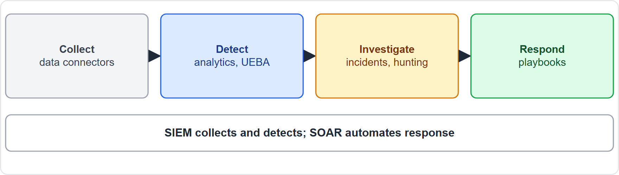
SIEM and SOAR, continued
Module 9
Sentinel collects data, detects threats, investigates incidents and automates response
EXAM TIP SIEM = collect, correlate, detect. SOAR = automate response. Sentinel does both. It is not an endpoint antivirus; it uses data from Defender products.
SC-900 Exam Prep | Microsoft Security, Compliance and Identity Fundamentals exam
Module 9: Microsoft Sentinel
5 / 17
Notes:
sim and soar.
The figure shows this: Sentinel collects data, detects threats, investigates incidents and automates response.
Exam tip: sim equals collect, correlate, detect. soar equals automate response. Sentinel does both. It is not an endpoint antivirus; it uses data from Defender products.

Slide 6
Integrated threat protection: the four jobs
Module 9
Job | How Sentinel does it
Collect | Data connectors bring in data from Microsoft services (Entra ID, Microsoft 365, Defender), Azure, on-premises, other clouds and third-party products
Detect | Analytics rules find threats; machine learning and User and Entity Behavior Analytics (UEBA) spot unusual behavior; threat intelligence matches known bad indicators
Investigate | Incidents group related alerts; the investigation graph shows entities and relationships; hunting searches proactively
Respond | Automation rules and playbooks (built on Azure Logic Apps)
Data is stored in a Log Analytics workspace and queried with Kusto Query Language (KQL).
EXAM TIP Sentinel ingests data through data connectors, including from Microsoft Defender products, Azure and third parties.
SC-900 Exam Prep | Microsoft Security, Compliance and Identity Fundamentals exam
Module 9: Microsoft Sentinel
6 / 17
Notes:
Integrated threat protection: the four jobs.
Collect. Data connectors bring in data from Microsoft services (Entra I D, Microsoft three sixty-five, Defender), Azure, on-premises, other clouds and third-party products.
Detect. Analytics rules find threats; machine learning and User and Entity Behavior Analytics (you ee bee ay) spot unusual behavior; threat intelligence matches known bad indicators.
Investigate. Incidents group related alerts; the investigation graph shows entities and relationships; hunting searches proactively.
Respond. Automation rules and playbooks (built on Azure Logic Apps).
Data is stored in a Log Analytics workspace and queried with Kusto Query Language.
Exam tip: Sentinel ingests data through data connectors, including from Microsoft Defender products, Azure and third parties.

Slide 7
Threat detection and mitigation
Module 9
Capability | Meaning
Data connectors | Ingest logs from many sources
Workbooks | Dashboards and visualizations of the data
Analytics rules | Scheduled or near-real-time queries that create alerts and incidents
Incidents | A collection of related alerts to investigate as one case
Hunting | Proactive searching with KQL before alerts fire; bookmarks save findings
Notebooks | Use Jupyter notebooks for advanced analysis
Threat intelligence | Match logs against known malicious indicators
UEBA | Baseline normal behavior to flag anomalies
Automation rules and playbooks | Respond automatically: block a user, isolate a device, open a ticket, notify a team
Content hub | Ready-made solutions: connectors, rules, workbooks, playbooks
SC-900 Exam Prep | Microsoft Security, Compliance and Identity Fundamentals exam
Module 9: Microsoft Sentinel
7 / 17
Notes:
Threat detection and mitigation.
Data connectors. Ingest logs from many sources.
Workbooks. Dashboards and visualizations of the data.
Analytics rules. Scheduled or near-real-time queries that create alerts and incidents.
Incidents. A collection of related alerts to investigate as one case.
Hunting. Proactive searching with K Q L before alerts fire; bookmarks save findings.
Notebooks. Use Jupyter notebooks for advanced analysis.
Threat intelligence. Match logs against known malicious indicators.
you ee bee ay. Baseline normal behavior to flag anomalies.
Automation rules and playbooks. Respond automatically: block a user, isolate a device, open a ticket, notify a team.
Content hub. Ready-made solutions: connectors, rules, workbooks, playbooks.

Slide 8
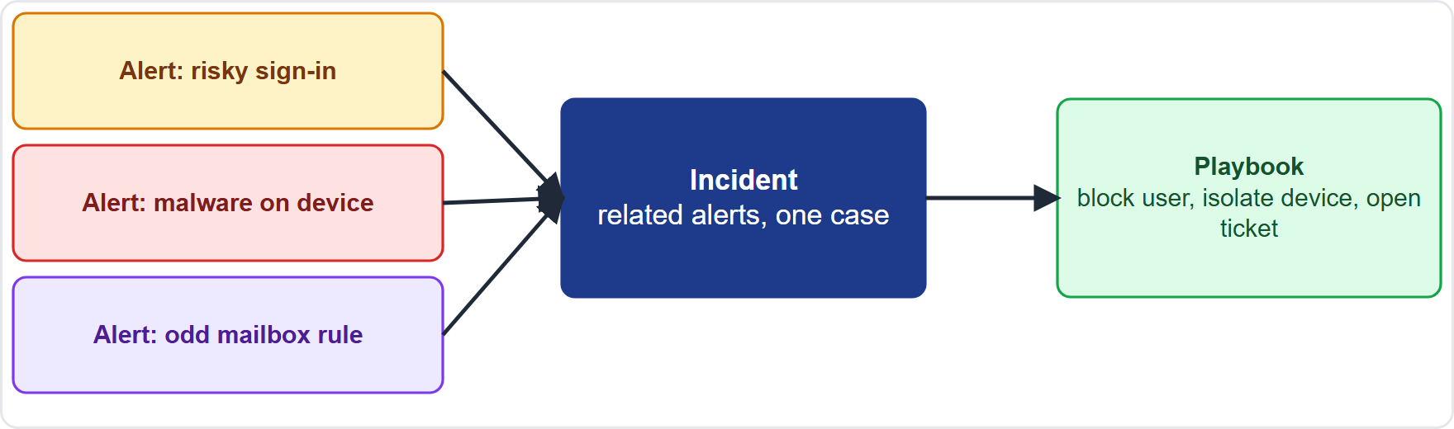
Threat detection and mitigation, continued
Module 9
A Sentinel incident groups alerts from several sources and can trigger a playbook
EXAM TIP Workbooks = see. Analytics rules = detect. Incidents = investigate. Hunting = look proactively. Playbooks = automate (Logic Apps). Everything is queried with KQL.
SC-900 Exam Prep | Microsoft Security, Compliance and Identity Fundamentals exam
Module 9: Microsoft Sentinel
8 / 17
Notes:
Threat detection and mitigation.
The figure shows this: A Sentinel incident groups alerts from several sources and can trigger a playbook.
Exam tip: Workbooks equals see. Analytics rules equals detect. Incidents equals investigate. Hunting equals look proactively. Playbooks equals automate (Logic Apps). Everything is queried with K Q L.

Slide 9
Practice Question 1
Module 9
Q1
Fabrikam Outdoors wants one cloud-native service to collect security logs from many sources, detect threats and automate responses. Which fits?
A
Azure Bastion
B
Azure Key Vault
C
Microsoft Sentinel
D
Microsoft Entra Connect
SC-900 Exam Prep | Microsoft Security, Compliance and Identity Fundamentals exam
Module 9: Microsoft Sentinel
9 / 17
Notes:
Question one. Fabrikam Outdoors wants one cloud-native service to collect security logs from many sources, detect threats and automate responses. Which fits? The four options are on the screen.
[PAUSE 10]
The answer is C: Microsoft Sentinel. Sentinel is a cloud-native sim and soar.

Slide 10
Practice Question 2
Module 9
Q2
Which Sentinel feature automates a response, such as blocking a user, when an incident occurs?
A
Workbook
B
Data connector
C
Bookmark
D
Playbook
SC-900 Exam Prep | Microsoft Security, Compliance and Identity Fundamentals exam
Module 9: Microsoft Sentinel
10 / 17
Notes:
Question two. Which Sentinel feature automates a response, such as blocking a user, when an incident occurs? The four options are on the screen.
[PAUSE 10]
The answer is D: Playbook. Playbooks, built on Azure Logic Apps, automate responses.

Slide 11
Practice Question 3
Module 9
Q3
An analyst wants to search proactively for suspicious activity before any alert fires. Which capability is this?
A
Hunting
B
Workbooks only
C
Incident closing
D
Secure score
SC-900 Exam Prep | Microsoft Security, Compliance and Identity Fundamentals exam
Module 9: Microsoft Sentinel
11 / 17
Notes:
Question three. An analyst wants to search proactively for suspicious activity before any alert fires. Which capability is this? The four options are on the screen.
[PAUSE 10]
The answer is A: Hunting. Hunting uses queries to look for threats proactively.

Slide 12
Practice Question 4
Module 9
Q4
What does a Sentinel incident represent?
A
A single database table that stores one log type
B
A user license that unlocks Sentinel features
C
A collection of related alerts to investigate together
D
A network security rule that allows or blocks traffic
SC-900 Exam Prep | Microsoft Security, Compliance and Identity Fundamentals exam
Module 9: Microsoft Sentinel
12 / 17
Notes:
Question four. What does a Sentinel incident represent? The four options are on the screen.
[PAUSE 10]
The answer is C: A collection of related alerts to investigate together. Incidents group related alerts into one case.

Slide 13
Practice Question 5
Module 9
Q5
Which language is used to query data in Microsoft Sentinel?
A
SQL only
B
HTML
C
Kusto Query Language (KQL)
D
YAML
SC-900 Exam Prep | Microsoft Security, Compliance and Identity Fundamentals exam
Module 9: Microsoft Sentinel
13 / 17
Notes:
Question five. Which language is used to query data in Microsoft Sentinel? The four options are on the screen.
[PAUSE 10]
The answer is C: Kusto Query Language. Sentinel queries Log Analytics data with K Q L.

Slide 14
Practice Question 6
Module 9
Q6
Which term describes automating response to security alerts?
A
SOAR
B
CSPM
C
DLP
D
SSPR
SC-900 Exam Prep | Microsoft Security, Compliance and Identity Fundamentals exam
Module 9: Microsoft Sentinel
14 / 17
Notes:
Question six. Which term describes automating response to security alerts? The four options are on the screen.
[PAUSE 10]
The answer is A: soar. soar is security orchestration, automation and response.

Slide 15
Recall Check 1
Module 9
Q1. What does SIEM stand for?
Q2. What does SOAR do?
Q3. What brings data into Sentinel?
SC-900 Exam Prep | Microsoft Security, Compliance and Identity Fundamentals exam
Module 9: Microsoft Sentinel
15 / 17
Notes:
Recall check one. Say each answer out loud before you listen to mine.
Question one. What does sim stand for?
[PAUSE 5]
Answer: Security information and event management.
Question two. What does soar do?
[PAUSE 5]
Answer: Automates responses to alerts and incidents.
Question three. What brings data into Sentinel?
[PAUSE 5]
Answer: Data connectors.

Slide 16
Recall Check 2
Module 9
Q4. What do workbooks provide?
Q5. What are playbooks built on?
Q6. Where is Sentinel data stored?
SC-900 Exam Prep | Microsoft Security, Compliance and Identity Fundamentals exam
Module 9: Microsoft Sentinel
16 / 17
Notes:
Recall check two. Say each answer out loud before you listen to mine.
Question four. What do workbooks provide?
[PAUSE 5]
Answer: Dashboards and visualizations.
Question five. What are playbooks built on?
[PAUSE 5]
Answer: Azure Logic Apps.
Question six. Where is Sentinel data stored?
[PAUSE 5]
Answer: In a Log Analytics workspace.

Slide 17
Module Recap
Module 9
1
SIEM and SOAR
2
Sentinel jobs
3
Tools
collect, correlate, detect; automate response
collect (connectors), detect (analytics, UEBA, threat intelligence), investigate (incidents, hunting), respond (playbooks)
workbooks, analytics rules, incidents, hunting, notebooks, content hub; KQL; Log Analytics
SC-900 Exam Prep | Microsoft Security, Compliance and Identity Fundamentals exam
Module 9: Microsoft Sentinel
17 / 17
Notes:
Here is the recap.
sim and soar: collect, correlate, detect; automate response.
Sentinel jobs: collect (connectors), detect (analytics, you ee bee ay, threat intelligence), investigate (incidents, hunting), respond (playbooks).
Tools: workbooks, analytics rules, incidents, hunting, notebooks, content hub; K Q L; Log Analytics.
In the next module, we continue the course.

