Slide 1
Module 10: Threat Protection with Microsoft Defender XDR
Describe Microsoft Defender XDR services
SC-900 exam prep · Capabilities of Microsoft security solutions · 35 to 40% of the exam
SC-900 Exam Prep: Microsoft Security, Compliance and Identity Fundamentals Study Course
Module 10
Notes:
Welcome to Module ten: Threat Protection with Microsoft Defender X D R. It covers the exam area Capabilities of Microsoft security solutions.
Each part of this module comes from the study notes of the same name, so you can read the notes after you watch.

Slide 2
What You Will Learn
Module 10
Describe Microsoft Defender XDR services
Describe Microsoft Defender for Office 365
Describe Microsoft Defender for Endpoint
Describe Microsoft Defender for Cloud Apps
Describe Microsoft Defender for Identity
Describe Microsoft Defender Vulnerability Management
Practice with exam-style questions and a recall check
SC-900 Exam Prep | Microsoft Security, Compliance and Identity Fundamentals exam
Module 10: Threat Protection with Microsoft Defender XDR
2 / 23
Notes:
By the end of this module you will be able to do seven things.
Describe Microsoft Defender X D R services.
Describe Microsoft Defender for Office three sixty-five.
Describe Microsoft Defender for Endpoint.
Describe Microsoft Defender for Cloud Apps.
Describe Microsoft Defender for Identity.
Describe Microsoft Defender Vulnerability Management.
Practice with exam-style questions and a recall check.

Slide 3
Where This Fits in the Exam
DATES
Module 10
EXAM CHECK-IN · Where this fits
Exam area: Capabilities of Microsoft security solutions (35–40%)
Exam format: 45 minutes; a score of 700 on a scale of 1 to 1,000 passes
Validated against: the official SC-900 study guide, skills measured as of October 21, 2026
SC-900 Exam Prep | Microsoft Security, Compliance and Identity Fundamentals exam
Module 10: Threat Protection with Microsoft Defender XDR
3 / 23
Notes:
Here is where this module sits in the exam.
Exam area: Capabilities of Microsoft security solutions (thirty-five to forty percent).
Exam format: forty-five minutes; a score of seven hundred on a scale of one to one thousand passes.
Validated against: the official S C nine hundred study guide, skills measured as of October twenty-one, two thousand twenty-six.

Slide 4
Defender XDR: the idea
Module 10
Product | Protects
Defender for Office 365 | Email and collaboration (Outlook, Teams, SharePoint, OneDrive)
Defender for Endpoint | Devices (Windows, macOS, Linux, iOS, Android)
Defender for Identity | On-premises Active Directory identities and signals
Defender for Cloud Apps | Cloud apps (a CASB), including shadow IT
Microsoft Entra ID Protection | Identity risk signals
Defender Vulnerability Management | Weaknesses in devices and apps
SC-900 Exam Prep | Microsoft Security, Compliance and Identity Fundamentals exam
Module 10: Threat Protection with Microsoft Defender XDR
4 / 23
Notes:
Defender X D R: the idea.
Extended detection and response (X D R) joins signals from many protection areas so related attacks appear as one incident. Microsoft Defender X D R (formerly Microsoft three sixty-five Defender) combines these products.
Defender for Office three sixty-five. Email and collaboration (Outlook, Teams, Share Point, One Drive).
Defender for Endpoint. Devices (Windows, mac O S, Linux, i O S, Android).
Defender for Identity. On-premises Active Directory identities and signals.
Defender for Cloud Apps. Cloud apps (a cas bee), including shadow I T.
Microsoft Entra I D Protection. Identity risk signals.
Defender Vulnerability Management. Weaknesses in devices and apps.

Slide 5
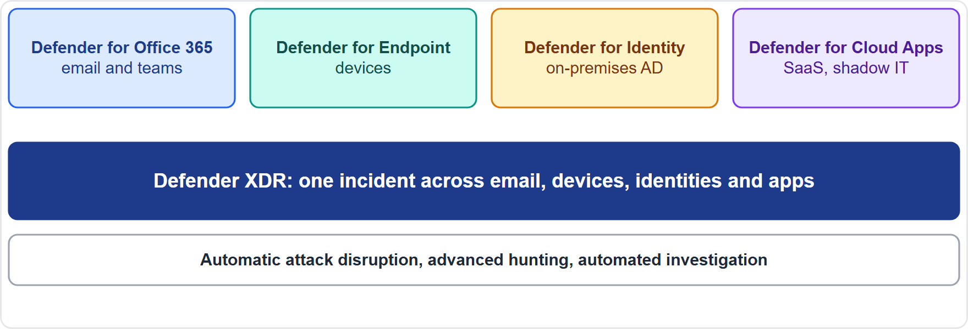
Defender XDR: the idea, continued
Module 10
Defender XDR joins email, devices, identities and cloud apps into one incident view
SC-900 Exam Prep | Microsoft Security, Compliance and Identity Fundamentals exam
Module 10: Threat Protection with Microsoft Defender XDR
5 / 23
Notes:
Defender X D R: the idea.
The figure shows this: Defender X D R joins email, devices, identities and cloud apps into one incident view.

Slide 6
Defender XDR: the idea, continued
Module 10
Core XDR features: correlated incidents, automatic attack disruption, advanced hunting, and automated investigation and response (AIR).
EXAM TIP XDR = one incident across email, endpoints, identities and apps. Old name: Microsoft 365 Defender. Do not mix up Defender XDR (threat protection for workplace) and Defender for Cloud (Azure and multicloud workloads).
SC-900 Exam Prep | Microsoft Security, Compliance and Identity Fundamentals exam
Module 10: Threat Protection with Microsoft Defender XDR
6 / 23
Notes:
Defender X D R: the idea.
Core X D R features: correlated incidents, automatic attack disruption, advanced hunting, and automated investigation and response (A I R).
Exam tip: X D R equals one incident across email, endpoints, identities and apps. Old name: Microsoft three sixty-five Defender. Do not mix up Defender X D R (threat protection for workplace) and Defender for Cloud (Azure and multicloud workloads).

Slide 7
Defender for Office 365
Module 10
Feature | Meaning
Safe Links | Checks links when clicked (time of click)
Safe Attachments | Opens attachments in a sandbox before delivery
Anti-phishing | Detects impersonation and spoofing, using machine learning
Attack simulation training | Simulated phishing to train users
Threat Explorer and automated investigation | Investigate and remediate threats
Protects email and collaboration against phishing, malware, business email compromise and malicious links and attachments.
SC-900 Exam Prep | Microsoft Security, Compliance and Identity Fundamentals exam
Module 10: Threat Protection with Microsoft Defender XDR
7 / 23
Notes:
Defender for Office three sixty-five.
Protects email and collaboration against phishing, malware, business email compromise and malicious links and attachments.
Safe Links. Checks links when clicked (time of click).
Safe Attachments. Opens attachments in a sandbox before delivery.
Anti-phishing. Detects impersonation and spoofing, using machine learning.
Attack simulation training. Simulated phishing to train users.
Threat Explorer and automated investigation. Investigate and remediate threats.

Slide 8
Defender for Endpoint
Module 10
Capability | Meaning
Next-generation protection | Antivirus and antimalware
Endpoint detection and response (EDR) | Detects advanced attacks and shows the attack story
Attack surface reduction | Rules that block risky behavior
Automated investigation and remediation | Fixes threats automatically
Device isolation | Cut an infected device off the network
Threat and vulnerability information | Links to Defender Vulnerability Management
An enterprise endpoint security platform that prevents, detects, investigates and responds to threats on devices.
SC-900 Exam Prep | Microsoft Security, Compliance and Identity Fundamentals exam
Module 10: Threat Protection with Microsoft Defender XDR
8 / 23
Notes:
Defender for Endpoint.
An enterprise endpoint security platform that prevents, detects, investigates and responds to threats on devices.
Next-generation protection. Antivirus and antimalware.
Endpoint detection and response (E D R). Detects advanced attacks and shows the attack story.
Attack surface reduction. Rules that block risky behavior.
Automated investigation and remediation. Fixes threats automatically.
Device isolation. Cut an infected device off the network.
Threat and vulnerability information. Links to Defender Vulnerability Management.

Slide 9
Defender for Cloud Apps
Module 10
Capability | Meaning
Cloud Discovery | Finds apps in use, including shadow IT, and rates their risk
Information protection | Finds and protects sensitive data in cloud apps
Threat protection | Detects anomalous behavior and compromised accounts
Policies and Conditional Access App Control | Real-time session monitoring and limits
App connectors | Connect to apps through APIs
A cloud access security broker (CASB) that gives visibility and control over cloud apps and data.
EXAM TIP Shadow IT (unsanctioned cloud apps) = Defender for Cloud Apps / CASB / Cloud Discovery.
SC-900 Exam Prep | Microsoft Security, Compliance and Identity Fundamentals exam
Module 10: Threat Protection with Microsoft Defender XDR
9 / 23
Notes:
Defender for Cloud Apps.
A cloud access security broker (cas bee) that gives visibility and control over cloud apps and data.
Cloud Discovery. Finds apps in use, including shadow I T, and rates their risk.
Information protection. Finds and protects sensitive data in cloud apps.
Threat protection. Detects anomalous behavior and compromised accounts.
Policies and Conditional Access App Control. Real-time session monitoring and limits.
App connectors. Connect to apps through A P Is.
Exam tip: Shadow I T (unsanctioned cloud apps) equals Defender for Cloud Apps or cas bee or Cloud Discovery.

Slide 10
Defender for Identity
Module 10
Uses signals from on-premises Active Directory (domain controllers) to detect compromised identities and advanced threats, such as pass-the-hash, reconnaissance, lateral movement and privilege escalation. It uses sensors installed on domain controllers.
EXAM TIP On-premises AD attacks and lateral movement = Defender for Identity. Cloud sign-in risk = Entra ID Protection.
SC-900 Exam Prep | Microsoft Security, Compliance and Identity Fundamentals exam
Module 10: Threat Protection with Microsoft Defender XDR
10 / 23
Notes:
Defender for Identity.
Uses signals from on-premises Active Directory (domain controllers) to detect compromised identities and advanced threats, such as pass-the-hash, reconnaissance, lateral movement and privilege escalation. It uses sensors installed on domain controllers.
Exam tip: On-premises A D attacks and lateral movement equals Defender for Identity. Cloud sign-in risk equals Entra I D Protection.

Slide 11
Defender Vulnerability Management
Module 10
Continuously discovers, prioritizes and helps remediate vulnerabilities and misconfigurations across devices, applications and certificates, with risk-based prioritization, a software inventory, security baselines and remediation tracking. It is included in Defender for Endpoint (full capabilities as an add-on). [Verify live]
SC-900 Exam Prep | Microsoft Security, Compliance and Identity Fundamentals exam
Module 10: Threat Protection with Microsoft Defender XDR
11 / 23
Notes:
Defender Vulnerability Management.
Continuously discovers, prioritizes and helps remediate vulnerabilities and misconfigurations across devices, applications and certificates, with risk-based prioritization, a software inventory, security baselines and remediation tracking. It is included in Defender for Endpoint (full capabilities as an add-on).

Slide 12
Microsoft Defender Threat Intelligence
Module 10
Microsoft Defender Threat Intelligence (Defender TI) gives analysts insight into threat actors, infrastructure and tactics (Microsoft Threat Intelligence), helping them investigate and understand attackers. Microsoft's threat intelligence also feeds all Defender products.
SC-900 Exam Prep | Microsoft Security, Compliance and Identity Fundamentals exam
Module 10: Threat Protection with Microsoft Defender XDR
12 / 23
Notes:
Microsoft Defender Threat Intelligence.
Microsoft Defender Threat Intelligence (Defender T I) gives analysts insight into threat actors, infrastructure and tactics (Microsoft Threat Intelligence), helping them investigate and understand attackers. Microsoft's threat intelligence also feeds all Defender products.

Slide 13
The Microsoft Defender portal
Module 10
The Microsoft Defender portal (security.microsoft.com) is the single place to work with XDR products: incidents and alerts, hunting, actions and submissions, threat intelligence, reports, and secure score for Microsoft 365. It now also hosts Microsoft Sentinel (unified security operations). [Verify live]
SC-900 Exam Prep | Microsoft Security, Compliance and Identity Fundamentals exam
Module 10: Threat Protection with Microsoft Defender XDR
13 / 23
Notes:
The Microsoft Defender portal.
The Microsoft Defender portal (security.microsoft.com) is the single place to work with X D R products: incidents and alerts, hunting, actions and submissions, threat intelligence, reports, and secure score for Microsoft three sixty-five. It now also hosts Microsoft Sentinel (unified security operations).

Slide 14
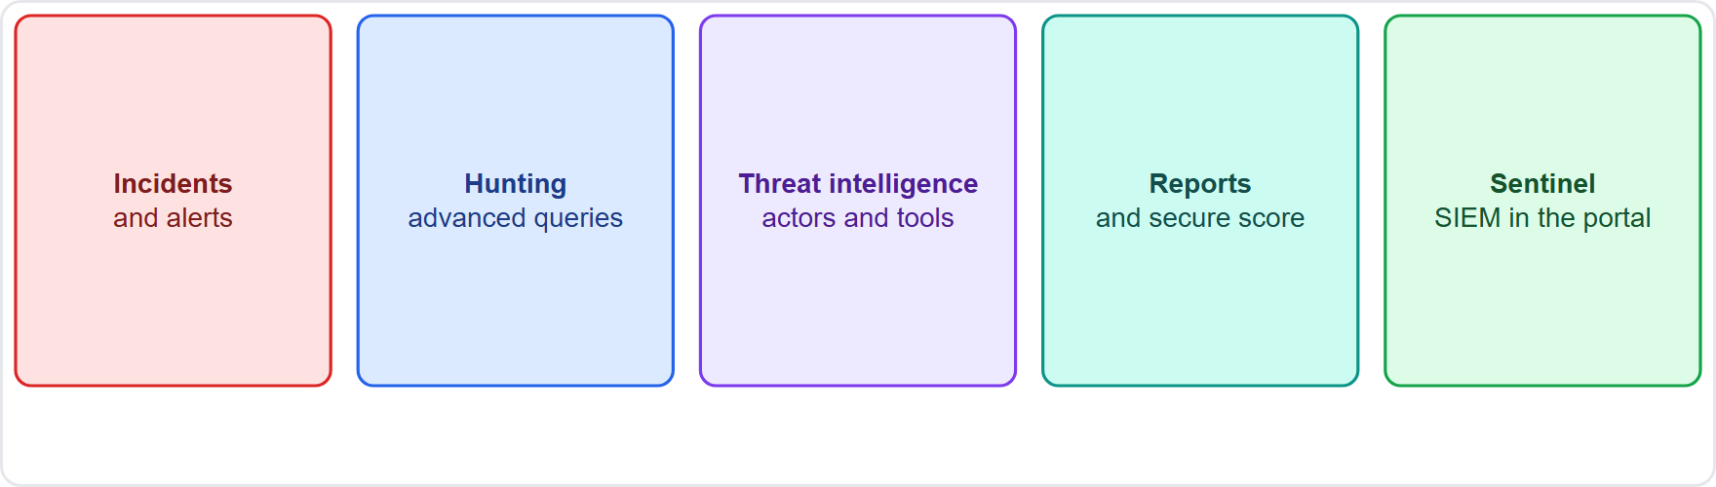
The Microsoft Defender portal, continued
Module 10
The Defender portal brings incidents, hunting, threat intelligence and Sentinel into one place
SC-900 Exam Prep | Microsoft Security, Compliance and Identity Fundamentals exam
Module 10: Threat Protection with Microsoft Defender XDR
14 / 23
Notes:
The Microsoft Defender portal.
The figure shows this: The Defender portal brings incidents, hunting, threat intelligence and Sentinel into one place.

Slide 15
Practice Question 1
Module 10
Q1
Fabrikam Outdoors wants to detonate email attachments in a sandbox before they reach users. Which feature does this?
A
Azure Bastion for remote desktop sessions to VMs
B
Smart lockout for repeated failed sign-ins by attackers
C
Safe Attachments in Defender for Office 365
D
Defender for Key Vault alerts on secret access
SC-900 Exam Prep | Microsoft Security, Compliance and Identity Fundamentals exam
Module 10: Threat Protection with Microsoft Defender XDR
15 / 23
Notes:
Question one. Fabrikam Outdoors wants to detonate email attachments in a sandbox before they reach users. Which feature does this? The four options are on the screen.
[PAUSE 10]
The answer is C: Safe Attachments in Defender for Office three sixty-five. Safe Attachments opens attachments in a sandbox before delivery.

Slide 16
Practice Question 2
Module 10
Q2
An administrator needs to find which unsanctioned cloud apps employees use. Which product helps?
A
Defender for Identity on domain controllers
B
Azure Firewall for network filtering
C
Defender for Cloud Apps
D
Key Vault for secrets and keys
SC-900 Exam Prep | Microsoft Security, Compliance and Identity Fundamentals exam
Module 10: Threat Protection with Microsoft Defender XDR
16 / 23
Notes:
Question two. An administrator needs to find which unsanctioned cloud apps employees use. Which product helps? The four options are on the screen.
[PAUSE 10]
The answer is C: Defender for Cloud Apps. Cloud Discovery in Defender for Cloud Apps finds shadow I T.

Slide 17
Practice Question 3
Module 10
Q3
Which product detects attacks such as pass-the-hash on on-premises Active Directory?
A
Defender for Identity
B
Defender for Office 365
C
Defender Vulnerability Management
D
Azure DDoS Protection
SC-900 Exam Prep | Microsoft Security, Compliance and Identity Fundamentals exam
Module 10: Threat Protection with Microsoft Defender XDR
17 / 23
Notes:
Question three. Which product detects attacks such as pass-the-hash on on-premises Active Directory? The four options are on the screen.
[PAUSE 10]
The answer is A: Defender for Identity. Defender for Identity monitors domain controllers for identity threats.

Slide 18
Practice Question 4
Module 10
Q4
Which capability lets an administrator isolate an infected laptop from the network?
A
Defender for Cloud Apps
B
Defender for Endpoint
C
Access reviews
D
Sensitivity labels
SC-900 Exam Prep | Microsoft Security, Compliance and Identity Fundamentals exam
Module 10: Threat Protection with Microsoft Defender XDR
18 / 23
Notes:
Question four. Which capability lets an administrator isolate an infected laptop from the network? The four options are on the screen.
[PAUSE 10]
The answer is B: Defender for Endpoint. Defender for Endpoint can isolate devices.

Slide 19
Practice Question 5
Module 10
Q5
What was Microsoft Defender XDR called before?
A
Azure Security Center
B
Cloud App Security
C
Microsoft 365 Defender
D
Azure AD
SC-900 Exam Prep | Microsoft Security, Compliance and Identity Fundamentals exam
Module 10: Threat Protection with Microsoft Defender XDR
19 / 23
Notes:
Question five. What was Microsoft Defender X D R called before? The four options are on the screen.
[PAUSE 10]
The answer is C: Microsoft three sixty-five Defender. Microsoft three sixty-five Defender was renamed Microsoft Defender X D R.

Slide 20
Practice Question 6
Module 10
Q6
Which capability prioritizes software weaknesses on devices by risk?
A
Safe Links for URLs in email and Office files
B
Cloud Discovery of unsanctioned cloud apps
C
Password writeback to on-premises directories
D
Defender Vulnerability Management
SC-900 Exam Prep | Microsoft Security, Compliance and Identity Fundamentals exam
Module 10: Threat Protection with Microsoft Defender XDR
20 / 23
Notes:
Question six. Which capability prioritizes software weaknesses on devices by risk? The four options are on the screen.
[PAUSE 10]
The answer is D: Defender Vulnerability Management. Defender Vulnerability Management discovers and prioritizes vulnerabilities.

Slide 21
Recall Check 1
Module 10
Q1. What does XDR stand for?
Q2. What does Safe Links do?
Q3. What does CASB stand for?
SC-900 Exam Prep | Microsoft Security, Compliance and Identity Fundamentals exam
Module 10: Threat Protection with Microsoft Defender XDR
21 / 23
Notes:
Recall check one. Say each answer out loud before you listen to mine.
Question one. What does X D R stand for?
[PAUSE 5]
Answer: Extended detection and response.
Question two. What does Safe Links do?
[PAUSE 5]
Answer: Checks links at the time of click.
Question three. What does cas bee stand for?
[PAUSE 5]
Answer: Cloud access security broker.

Slide 22
Recall Check 2
Module 10
Q4. Where does Defender for Identity get signals?
Q5. What is Defender Threat Intelligence for?
Q6. What is the Defender portal?
SC-900 Exam Prep | Microsoft Security, Compliance and Identity Fundamentals exam
Module 10: Threat Protection with Microsoft Defender XDR
22 / 23
Notes:
Recall check two. Say each answer out loud before you listen to mine.
Question four. Where does Defender for Identity get signals?
[PAUSE 5]
Answer: On-premises Active Directory domain controllers.
Question five. What is Defender Threat Intelligence for?
[PAUSE 5]
Answer: Insight into threat actors and their methods.
Question six. What is the Defender portal?
[PAUSE 5]
Answer: The single portal for X D R incidents, hunting and more.

Slide 23
Module Recap
Module 10
1
Defender XDR
2
Office 365
3
Endpoint
formerly Microsoft 365 Defender; Office 365, Endpoint, Identity, Cloud Apps combined into incidents
Safe Links, Safe Attachments, anti-phishing, attack simulation
antivirus, EDR, attack surface reduction, isolation
4
Cloud Apps
5
Identity
6
Vulnerability Management and Threat Intelligence
CASB; Cloud Discovery; shadow IT
on-premises AD sensors; pass-the-hash, lateral movement
prioritize weaknesses; threat actor insight
7
Defender portal
single place for incidents, hunting, reports; hosts Sentinel
SC-900 Exam Prep | Microsoft Security, Compliance and Identity Fundamentals exam
Module 10: Threat Protection with Microsoft Defender XDR
23 / 23
Notes:
Here is the recap.
Defender X D R: formerly Microsoft three sixty-five Defender; Office three sixty-five, Endpoint, Identity, Cloud Apps combined into incidents.
Office three sixty-five: Safe Links, Safe Attachments, anti-phishing, attack simulation.
Endpoint: antivirus, E D R, attack surface reduction, isolation.
Cloud Apps: cas bee; Cloud Discovery; shadow I T.
Identity: on-premises A D sensors; pass-the-hash, lateral movement.
Vulnerability Management and Threat Intelligence: prioritize weaknesses; threat actor insight.
Defender portal: single place for incidents, hunting, reports; hosts Sentinel.
In the next module, we continue the course.

