Slide 1
Module 11: Service Trust Portal and Privacy Principles
Describe the Service Trust Portal
SC-900 exam prep · Capabilities of Microsoft compliance solutions · 20 to 25% of the exam
SC-900 Exam Prep: Microsoft Security, Compliance and Identity Fundamentals Study Course
Module 11
Notes:
Welcome to Module eleven: Service Trust Portal and Privacy Principles. It covers the exam area Capabilities of Microsoft compliance solutions.
Each part of this module comes from the study notes of the same name, so you can read the notes after you watch.

Slide 2
What You Will Learn
Module 11
Describe the Service Trust Portal
Describe Microsoft's privacy principles
Describe the Microsoft Priva capabilities
Practice with exam-style questions and a recall check
SC-900 Exam Prep | Microsoft Security, Compliance and Identity Fundamentals exam
Module 11: Service Trust Portal and Privacy Principles
2 / 17
Notes:
By the end of this module you will be able to do four things.
Describe the Service Trust Portal.
Describe Microsoft's privacy principles.
Describe the Microsoft Pree va capabilities.
Practice with exam-style questions and a recall check.

Slide 3
Where This Fits in the Exam
DATES
Module 11
EXAM CHECK-IN · Where this fits
Exam area: Capabilities of Microsoft compliance solutions (20–25%)
Exam format: 45 minutes; a score of 700 on a scale of 1 to 1,000 passes
Validated against: the official SC-900 study guide, skills measured as of October 21, 2026
SC-900 Exam Prep | Microsoft Security, Compliance and Identity Fundamentals exam
Module 11: Service Trust Portal and Privacy Principles
3 / 17
Notes:
Here is where this module sits in the exam.
Exam area: Capabilities of Microsoft compliance solutions (twenty to twenty-five percent).
Exam format: forty-five minutes; a score of seven hundred on a scale of one to one thousand passes.
Validated against: the official S C nine hundred study guide, skills measured as of October twenty-one, two thousand twenty-six.

Slide 4
Service Trust Portal (STP)
Module 11
Content | Examples
Audit reports and certifications | ISO/IEC 27001, SOC 1, 2 and 3, FedRAMP, PCI DSS
Compliance guides | How to use Microsoft services to meet GDPR and other rules
Security assessments and white papers | Penetration test results, risk assessments
Data protection resources | Information on where data is stored and handled
My Library | Save documents and get update notifications
The Service Trust Portal is Microsoft's public site for compliance documentation about its cloud services. It shows how Microsoft protects data and how its services meet standards. Sign in with a Microsoft account (or work account) to download.
SC-900 Exam Prep | Microsoft Security, Compliance and Identity Fundamentals exam
Module 11: Service Trust Portal and Privacy Principles
4 / 17
Notes:
Service Trust Portal (S T P).
The Service Trust Portal is Microsoft's public site for compliance documentation about its cloud services. It shows how Microsoft protects data and how its services meet standards. Sign in with a Microsoft account (or work account) to download.
Audit reports and certifications. I S O or I E C twenty-seven thousand one, S O C one, two and three, fed ramp, P C I D S S.
Compliance guides. How to use Microsoft services to meet G D P R and other rules.
Security assessments and white papers. Penetration test results, risk assessments.
Data protection resources. Information on where data is stored and handled.
My Library. Save documents and get update notifications.

Slide 5
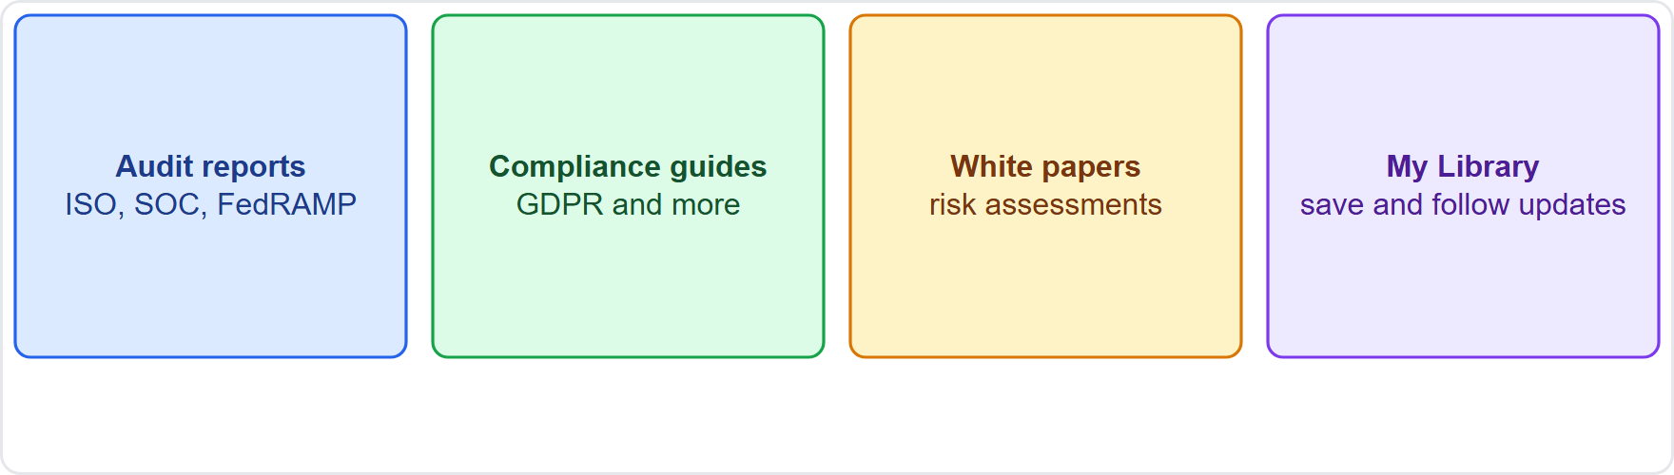
Service Trust Portal (STP), continued
Module 11
The Service Trust Portal: audits, certifications, guides and data protection resources
EXAM TIP "Where do I find Microsoft's audit reports (SOC, ISO) for my auditor?" = Service Trust Portal. It documents Microsoft's compliance, while Compliance Manager (module 12) tracks yours.
SC-900 Exam Prep | Microsoft Security, Compliance and Identity Fundamentals exam
Module 11: Service Trust Portal and Privacy Principles
5 / 17
Notes:
Service Trust Portal (S T P).
The figure shows this: The Service Trust Portal: audits, certifications, guides and data protection resources.
Exam tip: "Where do I find Microsoft's audit reports (S O C, I S O) for my auditor?" equals Service Trust Portal. It documents Microsoft's compliance, while Compliance Manager (module twelve) tracks yours.

Slide 6
Microsoft privacy principles
Module 11
Principle | Meaning
Control | You control your data, with tools to make choices
Transparency | Microsoft is clear about how data is collected and used
Security | Data is protected with strong security and encryption
Strong legal protections | Respect for local privacy laws and fight for privacy as a human right
No content-based targeting | Customer email, chat, files are not used to target ads
Benefits to you | Data collection must bring value to you
SC-900 Exam Prep | Microsoft Security, Compliance and Identity Fundamentals exam
Module 11: Service Trust Portal and Privacy Principles
6 / 17
Notes:
Microsoft privacy principles.
Microsoft commits to six privacy principles.
Control. You control your data, with tools to make choices.
Transparency. Microsoft is clear about how data is collected and used.
Security. Data is protected with strong security and encryption.
Strong legal protections. Respect for local privacy laws and fight for privacy as a human right.
No content-based targeting. Customer email, chat, files are not used to target ads.
Benefits to you. Data collection must bring value to you.

Slide 7
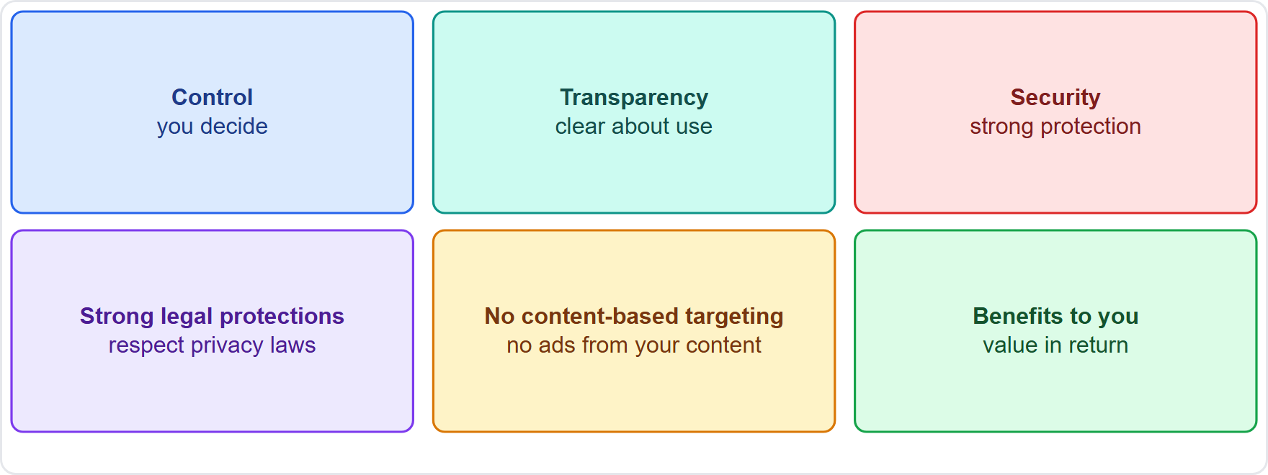
Microsoft privacy principles, continued
Module 11
Six privacy principles: control, transparency, security, strong legal protections, no content-based targeting, benefits to you
EXAM TIP Memorize the six: control, transparency, security, strong legal protections, no content-based targeting, benefits. "Does not use customer content for advertising" = no content-based targeting.
SC-900 Exam Prep | Microsoft Security, Compliance and Identity Fundamentals exam
Module 11: Service Trust Portal and Privacy Principles
7 / 17
Notes:
Microsoft privacy principles.
The figure shows this: Six privacy principles: control, transparency, security, strong legal protections, no content-based targeting, benefits to you.
Exam tip: Memorize the six: control, transparency, security, strong legal protections, no content-based targeting, benefits. "Does not use customer content for advertising" equals no content-based targeting.

Slide 8
Microsoft Priva
Module 11
Solution | What it does
Privacy Risk Management | Finds personal data in Microsoft 365, spots risks (such as data overexposure, transfers or hoarding) and suggests remediation
Subject Rights Requests | Handles data subject requests (find, export, delete personal data) under rules like GDPR with a guided workflow
Privacy Assessments | Help assess privacy impact of projects [Verify live]
Consent management | Tracks consent [Verify live]
Microsoft Priva helps organizations protect personal data and meet privacy rules.
EXAM TIP Priva = privacy. Subject rights request = a person asks "what data do you hold about me?" or "delete it." Priva finds personal data and tracks the response.
SC-900 Exam Prep | Microsoft Security, Compliance and Identity Fundamentals exam
Module 11: Service Trust Portal and Privacy Principles
8 / 17
Notes:
Microsoft Pree va.
Microsoft Pree va helps organizations protect personal data and meet privacy rules.
Privacy Risk Management. Finds personal data in Microsoft three sixty-five, spots risks (such as data overexposure, transfers or hoarding) and suggests remediation.
Subject Rights Requests. Handles data subject requests (find, export, delete personal data) under rules like G D P R with a guided workflow.
Privacy Assessments. Help assess privacy impact of projects.
Consent management. Tracks consent.
Exam tip: Pree va equals privacy. Subject rights request equals a person asks "what data do you hold about me?" or "delete it." Pree va finds personal data and tracks the response.

Slide 9
Practice Question 1
Module 11
Q1
Fabrikam Outdoors' auditor asks for Microsoft's SOC 2 report. Where can the company get it?
A
Azure Firewall for traffic filtering
B
Conditional Access sign-in policies
C
Service Trust Portal
D
Microsoft Sentinel for security analytics
SC-900 Exam Prep | Microsoft Security, Compliance and Identity Fundamentals exam
Module 11: Service Trust Portal and Privacy Principles
9 / 17
Notes:
Question one. Fabrikam Outdoors' auditor asks for Microsoft's S O C two report. Where can the company get it? The four options are on the screen.
[PAUSE 10]
The answer is C: Service Trust Portal. The Service Trust Portal hosts Microsoft's audit reports and certifications.

Slide 10
Practice Question 2
Module 11
Q2
Which Microsoft privacy principle states that customer email is not used to target advertising?
A
Transparency
B
Benefits to you
C
Control
D
No content-based targeting
SC-900 Exam Prep | Microsoft Security, Compliance and Identity Fundamentals exam
Module 11: Service Trust Portal and Privacy Principles
10 / 17
Notes:
Question two. Which Microsoft privacy principle states that customer email is not used to target advertising? The four options are on the screen.
[PAUSE 10]
The answer is D: No content-based targeting. Customer content is not used for content-based advertising.

Slide 11
Practice Question 3
Module 11
Q3
A customer asks a company to find and delete all personal data it holds about them. Which Priva capability helps?
A
Secure score for configuration posture
B
Safe Links for URLs in email
C
Password Protection with banned lists
D
Subject Rights Requests
SC-900 Exam Prep | Microsoft Security, Compliance and Identity Fundamentals exam
Module 11: Service Trust Portal and Privacy Principles
11 / 17
Notes:
Question three. A customer asks a company to find and delete all personal data it holds about them. Which Pree va capability helps? The four options are on the screen.
[PAUSE 10]
The answer is D: Subject Rights Requests. Subject Rights Requests supports finding and exporting or deleting personal data.

Slide 12
Practice Question 4
Module 11
Q4
Which solution finds personal data and risks such as overexposure in Microsoft 365?
A
Defender for Endpoint for device threats
B
Azure Bastion for remote desktop access
C
Key Vault for secrets, keys and certificates
D
Priva Privacy Risk Management
SC-900 Exam Prep | Microsoft Security, Compliance and Identity Fundamentals exam
Module 11: Service Trust Portal and Privacy Principles
12 / 17
Notes:
Question four. Which solution finds personal data and risks such as overexposure in Microsoft three sixty-five? The four options are on the screen.
[PAUSE 10]
The answer is D: Pree va Privacy Risk Management. Privacy Risk Management identifies personal data and privacy risks.

Slide 13
Practice Question 5
Module 11
Q5
How many privacy principles does Microsoft state?
A
Three
B
Ten
C
Six
D
Twelve
SC-900 Exam Prep | Microsoft Security, Compliance and Identity Fundamentals exam
Module 11: Service Trust Portal and Privacy Principles
13 / 17
Notes:
Question five. How many privacy principles does Microsoft state? The four options are on the screen.
[PAUSE 10]
The answer is C: Six. Microsoft lists six privacy principles.

Slide 14
Practice Question 6
Module 11
Q6
Which principle means people can make choices about their data using tools?
A
Control
B
Security
C
Strong legal protections
D
Benefits
SC-900 Exam Prep | Microsoft Security, Compliance and Identity Fundamentals exam
Module 11: Service Trust Portal and Privacy Principles
14 / 17
Notes:
Question six. Which principle means people can make choices about their data using tools? The four options are on the screen.
[PAUSE 10]
The answer is A: Control. Control means customers manage their own data and choices.

Slide 15
Recall Check 1
Module 11
Q1. What is the Service Trust Portal?
Q2. Name the six privacy principles.
Q3. What is Priva?
SC-900 Exam Prep | Microsoft Security, Compliance and Identity Fundamentals exam
Module 11: Service Trust Portal and Privacy Principles
15 / 17
Notes:
Recall check one. Say each answer out loud before you listen to mine.
Question one. What is the Service Trust Portal?
[PAUSE 5]
Answer: Microsoft's site for compliance documents, audit reports and guides.
Question two. Name the six privacy principles.
[PAUSE 5]
Answer: Control, transparency, security, strong legal protections, no content-based targeting and benefits to you.
Question three. What is Pree va?
[PAUSE 5]
Answer: Microsoft's privacy management solution for personal data.

Slide 16
Recall Check 2
Module 11
Q4. What does a subject rights request ask for?
Q5. What feature saves documents in the portal?
Q6. Which regulation do subject rights requests relate to?
SC-900 Exam Prep | Microsoft Security, Compliance and Identity Fundamentals exam
Module 11: Service Trust Portal and Privacy Principles
16 / 17
Notes:
Recall check two. Say each answer out loud before you listen to mine.
Question four. What does a subject rights request ask for?
[PAUSE 5]
Answer: Access to, export of, or deletion of a person's data.
Question five. What feature saves documents in the portal?
[PAUSE 5]
Answer: My Library.
Question six. Which regulation do subject rights requests relate to?
[PAUSE 5]
Answer: G D P R (and similar privacy laws).

Slide 17
Module Recap
Module 11
1
Service Trust Portal
2
Privacy principles
3
Priva
Privacy Risk Management; Subject Rights Requests
Microsoft's audit reports (ISO, SOC, FedRAMP), compliance guides, white papers; My Library
control, transparency, security, strong legal protections, no content-based targeting, benefits
SC-900 Exam Prep | Microsoft Security, Compliance and Identity Fundamentals exam
Module 11: Service Trust Portal and Privacy Principles
17 / 17
Notes:
Here is the recap.
Service Trust Portal: Microsoft's audit reports (I S O, S O C, fed ramp), compliance guides, white papers; My Library.
Privacy principles: control, transparency, security, strong legal protections, no content-based targeting, benefits.
Pree va: Privacy Risk Management; Subject Rights Requests.
In the next module, we continue the course.

