Slide 1
Module 12: Compliance Management with Microsoft Purview
Describe the Microsoft Purview portal
SC-900 exam prep · Capabilities of Microsoft compliance solutions · 20 to 25% of the exam
SC-900 Exam Prep: Microsoft Security, Compliance and Identity Fundamentals Study Course
Module 12
Notes:
Welcome to Module twelve: Compliance Management with Microsoft Purview. It covers the exam area Capabilities of Microsoft compliance solutions.
Each part of this module comes from the study notes of the same name, so you can read the notes after you watch.

Slide 2
What You Will Learn
Module 12
Describe the Microsoft Purview portal
Describe Microsoft Purview Compliance Manager
Describe the compliance score
Practice with exam-style questions and a recall check
SC-900 Exam Prep | Microsoft Security, Compliance and Identity Fundamentals exam
Module 12: Compliance Management with Microsoft Purview
2 / 19
Notes:
By the end of this module you will be able to do four things.
Describe the Microsoft Purview portal.
Describe Microsoft Purview Compliance Manager.
Describe the compliance score.
Practice with exam-style questions and a recall check.

Slide 3
Where This Fits in the Exam
DATES
Module 12
EXAM CHECK-IN · Where this fits
Exam area: Capabilities of Microsoft compliance solutions (20–25%)
Exam format: 45 minutes; a score of 700 on a scale of 1 to 1,000 passes
Validated against: the official SC-900 study guide, skills measured as of October 21, 2026
SC-900 Exam Prep | Microsoft Security, Compliance and Identity Fundamentals exam
Module 12: Compliance Management with Microsoft Purview
3 / 19
Notes:
Here is where this module sits in the exam.
Exam area: Capabilities of Microsoft compliance solutions (twenty to twenty-five percent).
Exam format: forty-five minutes; a score of seven hundred on a scale of one to one thousand passes.
Validated against: the official S C nine hundred study guide, skills measured as of October twenty-one, two thousand twenty-six.

Slide 4
Microsoft Purview
Module 12
Area | Examples
Data security | Information Protection, DLP, Insider Risk Management
Data governance | Data Map, Unified Catalog, data classification
Risk and compliance | Compliance Manager, eDiscovery, Audit, Communication Compliance
Microsoft Purview is a family of data governance, risk and compliance solutions. It helps you know your data, protect it, and meet regulations.
SC-900 Exam Prep | Microsoft Security, Compliance and Identity Fundamentals exam
Module 12: Compliance Management with Microsoft Purview
4 / 19
Notes:
Microsoft Purview.
Microsoft Purview is a family of data governance, risk and compliance solutions. It helps you know your data, protect it, and meet regulations.
Data security. Information Protection, D L P, Insider Risk Management.
Data governance. Data Map, Unified Catalog, data classification.
Risk and compliance. Compliance Manager, e discovery, Audit, Communication Compliance.

Slide 5
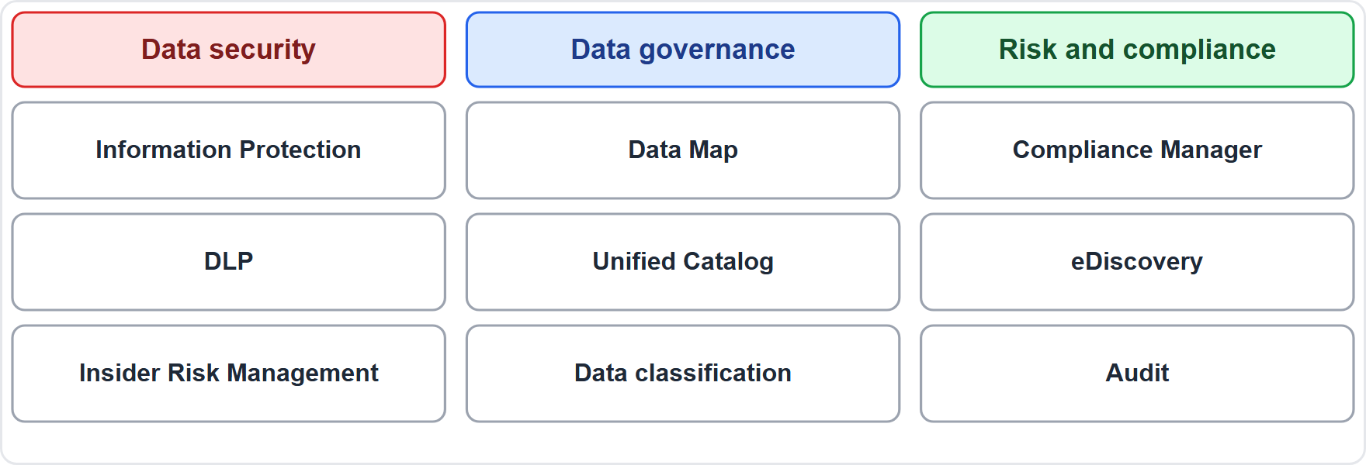
Microsoft Purview, continued
Module 12
Microsoft Purview: data security, data governance and risk and compliance solutions
SC-900 Exam Prep | Microsoft Security, Compliance and Identity Fundamentals exam
Module 12: Compliance Management with Microsoft Purview
5 / 19
Notes:
Microsoft Purview.
The figure shows this: Microsoft Purview: data security, data governance and risk and compliance solutions.

Slide 6
The Microsoft Purview portal
Module 12
The Microsoft Purview portal (purview.microsoft.com) is the single place to manage these solutions: Compliance Manager, Data Loss Prevention, Information Protection, eDiscovery, Audit, Insider Risk Management, data lifecycle management and more. Older Microsoft 365 compliance center and Microsoft Purview compliance portal names are earlier versions. [Old wording] [Verify live]
Access to features depends on licensing and role groups (for example Compliance Administrator).
EXAM TIP Purview portal = where compliance and data protection solutions live. Defender portal = threat protection. Know which portal does which.
SC-900 Exam Prep | Microsoft Security, Compliance and Identity Fundamentals exam
Module 12: Compliance Management with Microsoft Purview
6 / 19
Notes:
The Microsoft Purview portal.
The Microsoft Purview portal (purview.microsoft.com) is the single place to manage these solutions: Compliance Manager, Data Loss Prevention, Information Protection, e discovery, Audit, Insider Risk Management, data lifecycle management and more. Older Microsoft three sixty-five compliance center and Microsoft Purview compliance portal names are earlier versions.
Access to features depends on licensing and role groups (for example Compliance Administrator).
Exam tip: Purview portal equals where compliance and data protection solutions live. Defender portal equals threat protection. Know which portal does which.
Exam tip: Purview portal equals compliance and data solutions. Compliance Manager equals assess controls against regulations and get improvement actions.

Slide 7
Compliance Manager
Module 12
Term | Meaning
Assessment | An evaluation of your controls against a regulation or standard (GDPR, ISO 27001, NIST, HIPAA, and others)
Template | Starting point for an assessment
Control | A requirement of the regulation
Improvement action | A recommended step to meet a control
Solution | The product feature that implements the action
Microsoft actions | Controls Microsoft is responsible for
Your actions | Controls you are responsible for (customer-managed)
Shared actions | Responsibility split
Microsoft Purview Compliance Manager helps you understand and improve your compliance posture by assessing controls against regulations and standards and giving improvement actions.
SC-900 Exam Prep | Microsoft Security, Compliance and Identity Fundamentals exam
Module 12: Compliance Management with Microsoft Purview
7 / 19
Notes:
Compliance Manager.
Microsoft Purview Compliance Manager helps you understand and improve your compliance posture by assessing controls against regulations and standards and giving improvement actions.
Assessment. An evaluation of your controls against a regulation or standard (G D P R, I S O twenty-seven thousand one, nist, hip ah, and others).
Template. Starting point for an assessment.
Control. A requirement of the regulation.
Improvement action. A recommended step to meet a control.
Solution. The product feature that implements the action.
Microsoft actions. Controls Microsoft is responsible for.
Your actions. Controls you are responsible for (customer-managed).
Shared actions. Responsibility split.

Slide 8
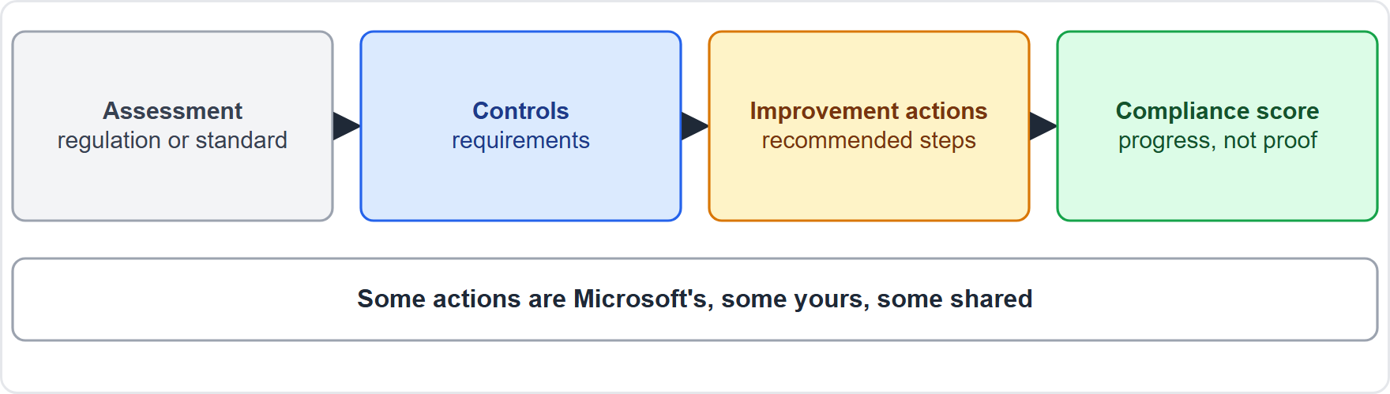
Compliance Manager, continued
Module 12
Compliance Manager: assessments contain controls, which have improvement actions that raise the compliance score
SC-900 Exam Prep | Microsoft Security, Compliance and Identity Fundamentals exam
Module 12: Compliance Management with Microsoft Purview
8 / 19
Notes:
Compliance Manager.
The figure shows this: Compliance Manager: assessments contain controls, which have improvement actions that raise the compliance score.

Slide 9
Compliance Manager, continued
Module 12
Compliance Manager supports the shared responsibility idea: some actions are Microsoft's, some yours.
SC-900 Exam Prep | Microsoft Security, Compliance and Identity Fundamentals exam
Module 12: Compliance Management with Microsoft Purview
9 / 19
Notes:
Compliance Manager.
Compliance Manager supports the shared responsibility idea: some actions are Microsoft's, some yours.

Slide 10
Compliance score
Module 12
Point | Detail
Points | Each action has points; higher-risk actions carry more
Microsoft-managed actions | Add to the score automatically
Your actions | You implement and test them to earn points
Meaning | It is a measure of progress, not proof of compliance or a certification
The compliance score is a percentage that measures progress toward completing recommended improvement actions. It shows your overall posture and per-assessment scores.
EXAM TIP Compliance score (Purview) is not the same as secure score (Defender for Cloud and Microsoft 365). Compliance score = regulatory improvement actions. A high score does not guarantee legal compliance.
SC-900 Exam Prep | Microsoft Security, Compliance and Identity Fundamentals exam
Module 12: Compliance Management with Microsoft Purview
10 / 19
Notes:
Compliance score.
The compliance score is a percentage that measures progress toward completing recommended improvement actions. It shows your overall posture and per-assessment scores.
Points. Each action has points; higher-risk actions carry more.
Microsoft-managed actions. Add to the score automatically.
Your actions. You implement and test them to earn points.
Meaning. It is a measure of progress, not proof of compliance or a certification.
Exam tip: Compliance score (Purview) is not the same as secure score (Defender for Cloud and Microsoft three sixty-five). Compliance score equals regulatory improvement actions. A high score does not guarantee legal compliance.

Slide 11
Practice Question 1
Module 12
Q1
Fabrikam Outdoors wants to assess its controls against GDPR and get recommended improvement actions. Which tool fits?
A
Microsoft Purview Compliance Manager
B
Azure Bastion
C
Microsoft Sentinel
D
Defender for Endpoint
SC-900 Exam Prep | Microsoft Security, Compliance and Identity Fundamentals exam
Module 12: Compliance Management with Microsoft Purview
11 / 19
Notes:
Question one. Fabrikam Outdoors wants to assess its controls against G D P R and get recommended improvement actions. Which tool fits? The four options are on the screen.
[PAUSE 10]
The answer is A: Microsoft Purview Compliance Manager. Compliance Manager assesses controls against regulations and recommends actions.

Slide 12
Practice Question 2
Module 12
Q2
What does the compliance score measure?
A
The number of users who signed in during the last month
B
Network latency between the datacenters and the users
C
Password strength across all accounts in the directory
D
Progress toward completing recommended improvement actions
SC-900 Exam Prep | Microsoft Security, Compliance and Identity Fundamentals exam
Module 12: Compliance Management with Microsoft Purview
12 / 19
Notes:
Question two. What does the compliance score measure? The four options are on the screen.
[PAUSE 10]
The answer is D: Progress toward completing recommended improvement actions. It measures progress on improvement actions.

Slide 13
Practice Question 3
Module 12
Q3
Which portal gives access to Compliance Manager, DLP and eDiscovery?
A
Azure Key Vault
B
Microsoft Purview portal
C
Microsoft Defender portal only
D
Azure Bastion
SC-900 Exam Prep | Microsoft Security, Compliance and Identity Fundamentals exam
Module 12: Compliance Management with Microsoft Purview
13 / 19
Notes:
Question three. Which portal gives access to Compliance Manager, D L P and e discovery? The four options are on the screen.
[PAUSE 10]
The answer is B: Microsoft Purview portal. The Purview portal hosts compliance and data protection solutions.

Slide 14
Practice Question 4
Module 12
Q4
In Compliance Manager, who performs a "Microsoft action"?
A
The customer
B
Microsoft
C
The auditor
D
The regulator
SC-900 Exam Prep | Microsoft Security, Compliance and Identity Fundamentals exam
Module 12: Compliance Management with Microsoft Purview
14 / 19
Notes:
Question four. In Compliance Manager, who performs a "Microsoft action"? The four options are on the screen.
[PAUSE 10]
The answer is B: Microsoft. Microsoft actions are controls that Microsoft is responsible for.

Slide 15
Practice Question 5
Module 12
Q5
A high compliance score means what?
A
The organization is legally compliant with every regulation
B
Progress toward actions, but not proof of legal compliance
C
The organization has eliminated every compliance risk entirely
D
Audits are not needed any more because the score proves compliance
SC-900 Exam Prep | Microsoft Security, Compliance and Identity Fundamentals exam
Module 12: Compliance Management with Microsoft Purview
15 / 19
Notes:
Question five. A high compliance score means what? The four options are on the screen.
[PAUSE 10]
The answer is B: Progress toward actions, but not proof of legal compliance. The score shows progress and is not a guarantee of compliance.

Slide 16
Practice Question 6
Module 12
Q6
What is an improvement action?
A
A user license assigned in the admin center
B
A recommended step to meet a control
C
A firewall rule that blocks outside traffic
D
A sign-in method for passwordless access
SC-900 Exam Prep | Microsoft Security, Compliance and Identity Fundamentals exam
Module 12: Compliance Management with Microsoft Purview
16 / 19
Notes:
Question six. What is an improvement action? The four options are on the screen.
[PAUSE 10]
The answer is B: A recommended step to meet a control. Improvement actions help satisfy controls.

Slide 17
Recall Check 1
Module 12
Q1. What is Microsoft Purview?
Q2. What is an assessment?
Q3. What does the compliance score show?
SC-900 Exam Prep | Microsoft Security, Compliance and Identity Fundamentals exam
Module 12: Compliance Management with Microsoft Purview
17 / 19
Notes:
Recall check one. Say each answer out loud before you listen to mine.
Question one. What is Microsoft Purview?
[PAUSE 5]
Answer: A family of data governance, risk and compliance solutions.
Question two. What is an assessment?
[PAUSE 5]
Answer: An evaluation of your controls against a regulation or standard.
Question three. What does the compliance score show?
[PAUSE 5]
Answer: Progress on recommended improvement actions.

Slide 18
Recall Check 2
Module 12
Q4. What are the three action owners?
Q5. Which portal hosts Purview solutions?
Q6. Is the compliance score proof of compliance?
SC-900 Exam Prep | Microsoft Security, Compliance and Identity Fundamentals exam
Module 12: Compliance Management with Microsoft Purview
18 / 19
Notes:
Recall check two. Say each answer out loud before you listen to mine.
Question four. What are the three action owners?
[PAUSE 5]
Answer: Microsoft, you and shared.
Question five. Which portal hosts Purview solutions?
[PAUSE 5]
Answer: The Microsoft Purview portal.
Question six. Is the compliance score proof of compliance?
[PAUSE 5]
Answer: No, it measures progress only.

Slide 19
Module Recap
Module 12
1
Purview
2
Portal
data security, governance, risk and compliance solutions
purview.microsoft.com; hosts Compliance Manager, DLP, eDiscovery, Audit, and more
3
Compliance Manager
4
Compliance score
assessments, templates, controls, improvement actions; Microsoft, your and shared actions
percent progress on actions; not proof of compliance
SC-900 Exam Prep | Microsoft Security, Compliance and Identity Fundamentals exam
Module 12: Compliance Management with Microsoft Purview
19 / 19
Notes:
Here is the recap.
Purview: data security, governance, risk and compliance solutions.
Portal: purview.microsoft.com; hosts Compliance Manager, D L P, e discovery, Audit, and more.
Compliance Manager: assessments, templates, controls, improvement actions; Microsoft, your and shared actions.
Compliance score: percent progress on actions; not proof of compliance.
In the next module, we continue the course.

