Slide 1
Module 13: Information Protection, Data Lifecycle and Governance
Describe data classification capabilities
SC-900 exam prep · Capabilities of Microsoft compliance solutions · 20 to 25% of the exam
SC-900 Exam Prep: Microsoft Security, Compliance and Identity Fundamentals Study Course
Module 13
Notes:
Welcome to Module thirteen: Information Protection, Data Lifecycle and Governance. It covers the exam area Capabilities of Microsoft compliance solutions.
Each part of this module comes from the study notes of the same name, so you can read the notes after you watch.

Slide 2
What You Will Learn
Module 13
Describe data classification capabilities
Describe the value of content explorer and activity explorer
Describe sensitivity labels and sensitivity label policies
Describe data loss prevention (DLP)
Describe records management
Describe retention policies, retention labels and retention label policies
Practice with exam-style questions and a recall check
SC-900 Exam Prep | Microsoft Security, Compliance and Identity Fundamentals exam
Module 13
2 / 24
Notes:
By the end of this module you will be able to do seven things.
Describe data classification capabilities.
Describe the value of content explorer and activity explorer.
Describe sensitivity labels and sensitivity label policies.
Describe data loss prevention (D L P).
Describe records management.
Describe retention policies, retention labels and retention label policies.
Practice with exam-style questions and a recall check.

Slide 3
Where This Fits in the Exam
DATES
Module 13
EXAM CHECK-IN · Where this fits
Exam area: Capabilities of Microsoft compliance solutions (20–25%)
Exam format: 45 minutes; a score of 700 on a scale of 1 to 1,000 passes
Validated against: the official SC-900 study guide, skills measured as of October 21, 2026
SC-900 Exam Prep | Microsoft Security, Compliance and Identity Fundamentals exam
Module 13
3 / 24
Notes:
Here is where this module sits in the exam.
Exam area: Capabilities of Microsoft compliance solutions (twenty to twenty-five percent).
Exam format: forty-five minutes; a score of seven hundred on a scale of one to one thousand passes.
Validated against: the official S C nine hundred study guide, skills measured as of October twenty-one, two thousand twenty-six.

Slide 4
The data protection journey
Module 13
Step | Capability
Know your data | Data classification, content explorer, activity explorer
Protect your data | Sensitivity labels and policies, encryption
Prevent data loss | Data loss prevention (DLP)
Govern your data | Retention, records management
Microsoft Purview protects data in four steps: know it, protect it, prevent loss, and govern it over time.
SC-900 Exam Prep | Microsoft Security, Compliance and Identity Fundamentals exam
Module 13
4 / 24
Notes:
The data protection journey.
Microsoft Purview protects data in four steps: know it, protect it, prevent loss, and govern it over time.
Know your data. Data classification, content explorer, activity explorer.
Protect your data. Sensitivity labels and policies, encryption.
Prevent data loss. Data loss prevention (D L P).
Govern your data. Retention, records management.

Slide 5
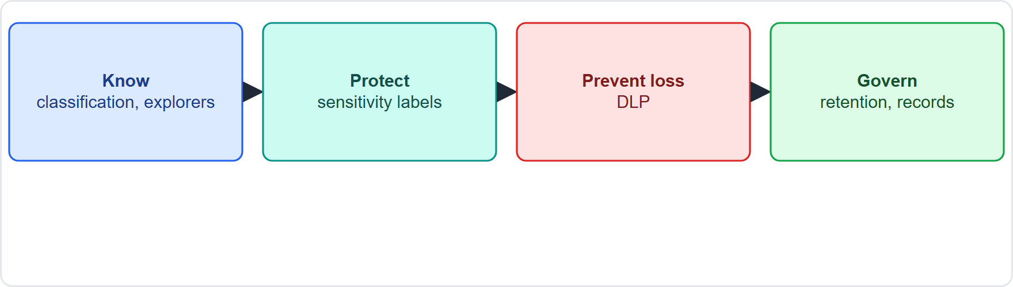
The data protection journey, continued
Module 13
Know, protect, prevent loss and govern: the Purview data protection journey
SC-900 Exam Prep | Microsoft Security, Compliance and Identity Fundamentals exam
Module 13
5 / 24
Notes:
The data protection journey.
The figure shows this: Know, protect, prevent loss and govern: the Purview data protection journey.

Slide 6
Data classification
Module 13
Classifier | How it identifies
Sensitive information types (SITs) | Patterns such as credit card or national ID numbers, using patterns, keywords and checksums
Trainable classifiers | Machine learning models that learn what a document type looks like (for example contracts)
Exact data match (EDM) | Match against your own sensitive data in a table
Data classification finds and labels data by type and sensitivity.
EXAM TIP Credit card numbers = sensitive information type. "Documents that look like resumes or contracts" = trainable classifier.
SC-900 Exam Prep | Microsoft Security, Compliance and Identity Fundamentals exam
Module 13
6 / 24
Notes:
Data classification.
Data classification finds and labels data by type and sensitivity.
Sensitive information types (S I Ts). Patterns such as credit card or national I D numbers, using patterns, keywords and checksums.
Trainable classifiers. Machine learning models that learn what a document type looks like (for example contracts).
Exact data match (E D M). Match against your own sensitive data in a table.
Exam tip: Credit card numbers equals sensitive information type. "Documents that look like resumes or contracts" equals trainable classifier.

Slide 7
Content explorer and activity explorer
Module 13
Tool | Shows | Question
Content explorer | The actual items (files, emails) that carry sensitivity labels, retention labels or sensitive info types, with their location and content | What is labeled, and where is it?
Activity explorer | What happened to labeled content: label changes, file copies, shares, DLP matches over time | What activity is occurring?
SC-900 Exam Prep | Microsoft Security, Compliance and Identity Fundamentals exam
Module 13
7 / 24
Notes:
Content explorer and activity explorer.
Content explorer. Shows: The actual items (files, emails) that carry sensitivity labels, retention labels or sensitive info types, with their location and content. Question: What is labeled, and where is it?
Activity explorer. Shows: What happened to labeled content: label changes, file copies, shares, D L P matches over time. Question: What activity is occurring?

Slide 8
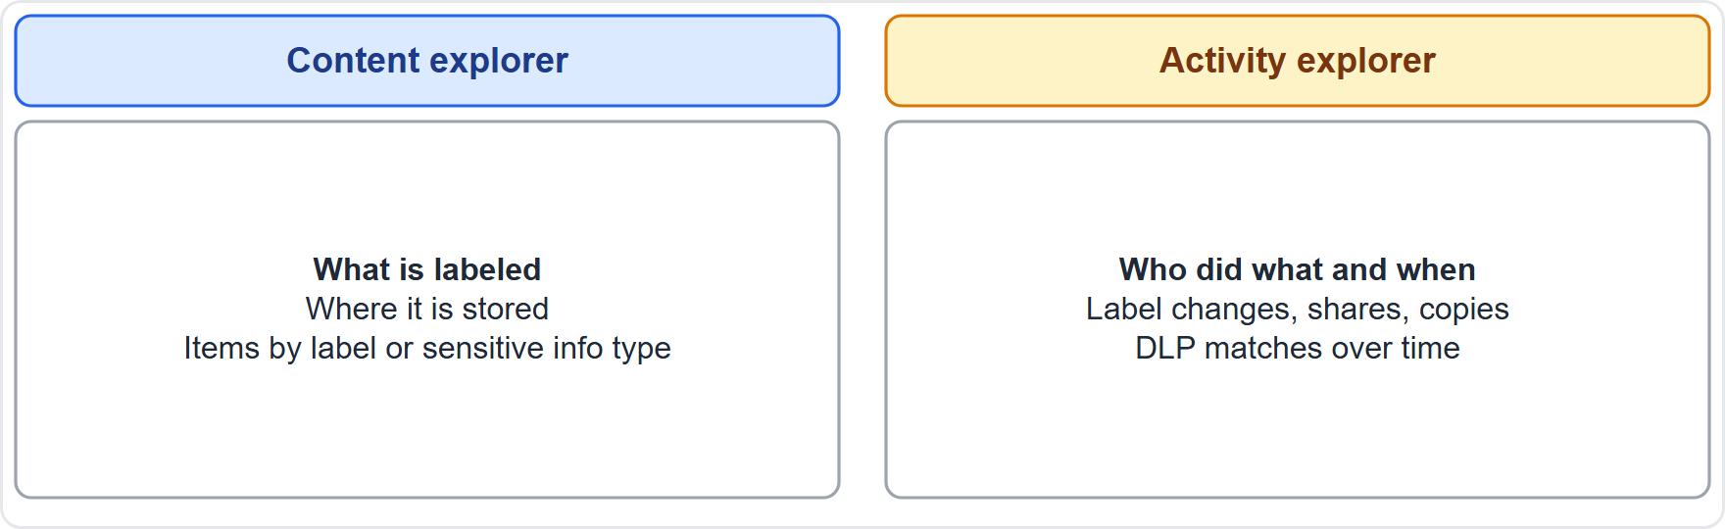
Content explorer and activity explorer, continued
Module 13
Content explorer lists labeled items; activity explorer shows actions taken on them
EXAM TIP Content explorer = the "what and where". Activity explorer = the "who did what and when". Both are in the Purview portal and need appropriate roles.
SC-900 Exam Prep | Microsoft Security, Compliance and Identity Fundamentals exam
Module 13
8 / 24
Notes:
Content explorer and activity explorer.
The figure shows this: Content explorer lists labeled items; activity explorer shows actions taken on them.
Exam tip: Content explorer equals the "what and where". Activity explorer equals the "who did what and when". Both are in the Purview portal and need appropriate roles.

Slide 9
Sensitivity labels and policies
Module 13
Label action | Example
Encryption | Only named people can open the file
Content marking | Header, footer, watermark such as "Confidential"
Access restrictions | Control who can copy, print, forward
Scope | Files, emails, Teams, SharePoint sites and groups, and more
A sensitivity label is a tag that classifies and protects a file or email. The label travels with the content.
SC-900 Exam Prep | Microsoft Security, Compliance and Identity Fundamentals exam
Module 13
9 / 24
Notes:
Sensitivity labels and policies.
A sensitivity label is a tag that classifies and protects a file or email. The label travels with the content.
Encryption. Only named people can open the file.
Content marking. Header, footer, watermark such as "Confidential".
Access restrictions. Control who can copy, print, forward.
Scope. Files, emails, Teams, Share Point sites and groups, and more.

Slide 10
Sensitivity labels and policies, continued
Module 13
Term | Meaning
Sensitivity label | The tag and its protections
Sensitivity label policy | Publishes labels to chosen users or groups and sets rules such as mandatory labeling, default label and justification for downgrade
SC-900 Exam Prep | Microsoft Security, Compliance and Identity Fundamentals exam
Module 13
10 / 24
Notes:
Sensitivity labels and policies.
Sensitivity label. The tag and its protections.
Sensitivity label policy. Publishes labels to chosen users or groups and sets rules such as mandatory labeling, default label and justification for downgrade.

Slide 11
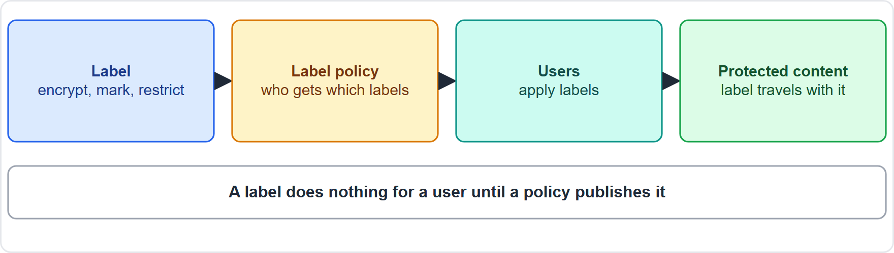
Sensitivity labels and policies, continued
Module 13
A label policy publishes sensitivity labels to users, who apply them to files and email
SC-900 Exam Prep | Microsoft Security, Compliance and Identity Fundamentals exam
Module 13
11 / 24
Notes:
Sensitivity labels and policies.
The figure shows this: A label policy publishes sensitivity labels to users, who apply them to files and email.

Slide 12
Sensitivity labels and policies, continued
Module 13
Labels can be applied manually by users or automatically when content matches a sensitive information type.
EXAM TIP Label = the tag and protection. Label policy = who gets which labels and the rules for using them. A label does nothing for a user until it is published in a policy.
SC-900 Exam Prep | Microsoft Security, Compliance and Identity Fundamentals exam
Module 13
12 / 24
Notes:
Sensitivity labels and policies.
Labels can be applied manually by users or automatically when content matches a sensitive information type.
Exam tip: Label equals the tag and protection. Label policy equals who gets which labels and the rules for using them. A label does nothing for a user until it is published in a policy.

Slide 13
Data loss prevention (DLP)
Module 13
Item | Details
Locations | Exchange email, SharePoint, OneDrive, Teams, Windows and macOS endpoints, and more
Conditions | Content contains a sensitive info type, a label, or is shared externally
Actions | Block, warn (policy tip with override), audit only, notify
Tips | Policy tips teach users why an action is risky
DLP identifies, monitors and protects sensitive information to stop it leaving the organization by accident or on purpose.
Example: block email that contains a credit card number sent to an external address, and notify the sender.
EXAM TIP DLP = prevent sensitive data from leaving (email, share, copy to USB). Sensitivity labels = classify and protect the content. They work together.
SC-900 Exam Prep | Microsoft Security, Compliance and Identity Fundamentals exam
Module 13
13 / 24
Notes:
Data loss prevention (D L P).
D L P identifies, monitors and protects sensitive information to stop it leaving the organization by accident or on purpose.
Locations. Exchange email, Share Point, One Drive, Teams, Windows and mac O S endpoints, and more.
Conditions. Content contains a sensitive info type, a label, or is shared externally.
Actions. Block, warn (policy tip with override), audit only, notify.
Tips. Policy tips teach users why an action is risky.
Example: block email that contains a credit card number sent to an external address, and notify the sender.
Exam tip: D L P equals prevent sensitive data from leaving (email, share, copy to U S B). Sensitivity labels equals classify and protect the content. They work together.

Slide 14
Retention and records management
Module 13
Tool | What it does
Retention policy | Applies broadly to locations (all mailboxes, a site) to retain, delete, or retain then delete
Retention label | Applied to individual items; the label travels with the item and can start retention from an event or declare a record
Retention label policy | Publishes retention labels to users or applies them automatically
Records management | Marks items as records or regulatory records so they are immutable (cannot be edited or deleted by users), with file plan, disposition review and proof of disposal
Data lifecycle management keeps what you need and removes what you do not.
Whichever retain rule applies, the item is kept; retention wins over deletion if both apply. [Verify live]
SC-900 Exam Prep | Microsoft Security, Compliance and Identity Fundamentals exam
Module 13
14 / 24
Notes:
Retention and records management.
Data lifecycle management keeps what you need and removes what you do not.
Retention policy. Applies broadly to locations (all mailboxes, a site) to retain, delete, or retain then delete.
Retention label. Applied to individual items; the label travels with the item and can start retention from an event or declare a record.
Retention label policy. Publishes retention labels to users or applies them automatically.
Records management. Marks items as records or regulatory records so they are immutable (cannot be edited or deleted by users), with file plan, disposition review and proof of disposal.
Whichever retain rule applies, the item is kept; retention wins over deletion if both apply.

Slide 15
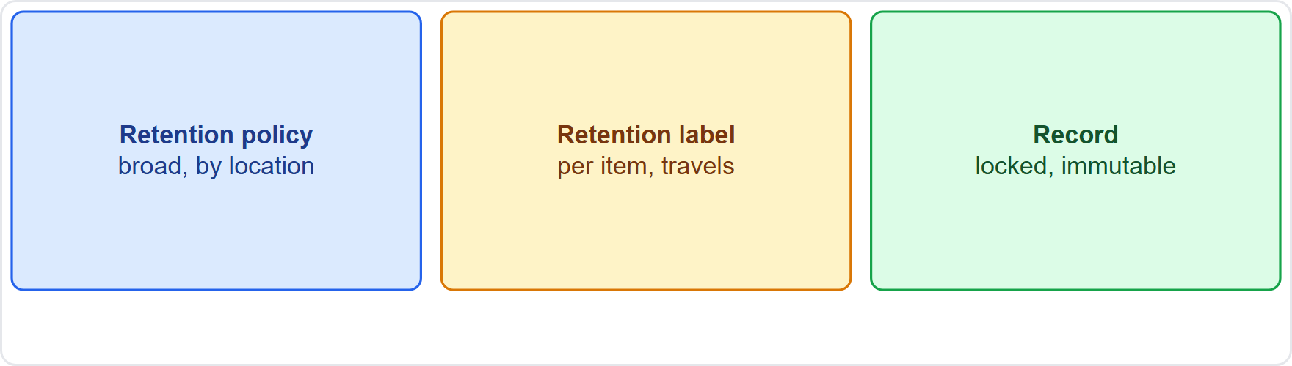
Retention and records management, continued
Module 13
Retention policy applies broadly; retention labels apply per item; records are locked
EXAM TIP Policy = broad, location-based. Label = per item and follows the file. Record = locked so it cannot be changed or deleted. Retention label policy = how labels are published to users.
SC-900 Exam Prep | Microsoft Security, Compliance and Identity Fundamentals exam
Module 13
15 / 24
Notes:
Retention and records management.
The figure shows this: Retention policy applies broadly; retention labels apply per item; records are locked.
Exam tip: Policy equals broad, location-based. Label equals per item and follows the file. Record equals locked so it cannot be changed or deleted. Retention label policy equals how labels are published to users.

Slide 16
Practice Question 1
Module 13
Q1
Fabrikam Outdoors wants to stop emails containing credit card numbers from being sent externally. Which solution fits?
A
Access reviews
B
Data loss prevention
C
Azure Bastion
D
Safe Links
SC-900 Exam Prep | Microsoft Security, Compliance and Identity Fundamentals exam
Module 13
16 / 24
Notes:
Question one. Fabrikam Outdoors wants to stop emails containing credit card numbers from being sent externally. Which solution fits? The four options are on the screen.
[PAUSE 10]
The answer is B: Data loss prevention. D L P can block or warn on sensitive information leaving the organization.

Slide 17
Practice Question 2
Module 13
Q2
Which tool shows the actual files that have a particular sensitivity label and where they are stored?
A
Activity explorer
B
Secure score
C
Sentinel workbook
D
Content explorer
SC-900 Exam Prep | Microsoft Security, Compliance and Identity Fundamentals exam
Module 13
17 / 24
Notes:
Question two. Which tool shows the actual files that have a particular sensitivity label and where they are stored? The four options are on the screen.
[PAUSE 10]
The answer is D: Content explorer. Content explorer lists labeled items and their locations.

Slide 18
Practice Question 3
Module 13
Q3
An admin wants to see how many times labeled files were copied or shared last month. Which tool?
A
Activity explorer
B
Content explorer for labeled items
C
Compliance score for improvement actions
D
Key Vault for secrets and keys
SC-900 Exam Prep | Microsoft Security, Compliance and Identity Fundamentals exam
Module 13
18 / 24
Notes:
Question three. An admin wants to see how many times labeled files were copied or shared last month. Which tool? The four options are on the screen.
[PAUSE 10]
The answer is A: Activity explorer. Activity explorer shows actions taken on labeled content over time.

Slide 19
Practice Question 4
Module 13
Q4
What makes sensitivity labels available to chosen users?
A
A retention policy
B
A sensitivity label policy
C
A DLP alert
D
A Conditional Access policy
SC-900 Exam Prep | Microsoft Security, Compliance and Identity Fundamentals exam
Module 13
19 / 24
Notes:
Question four. What makes sensitivity labels available to chosen users? The four options are on the screen.
[PAUSE 10]
The answer is B: A sensitivity label policy. Label policies publish labels to users or groups.

Slide 20
Practice Question 5
Module 13
Q5
A company wants to keep all Exchange mailboxes for seven years, then delete. Which tool fits best?
A
A retention policy
B
A trainable classifier
C
An NSG
D
A sensitivity label
SC-900 Exam Prep | Microsoft Security, Compliance and Identity Fundamentals exam
Module 13
20 / 24
Notes:
Question five. A company wants to keep all Exchange mailboxes for seven years, then delete. Which tool fits best? The four options are on the screen.
[PAUSE 10]
The answer is A: A retention policy. Retention policies apply broadly to locations to retain and delete.

Slide 21
Practice Question 6
Module 13
Q6
What does declaring an item a record do?
A
Encrypts it with a key stored in Azure Key Vault for the owner
B
Locks it so it cannot be edited or deleted by users
C
Moves it to Azure Bastion for safe remote access by administrators
D
Marks it as risky and sends an alert to the security team
SC-900 Exam Prep | Microsoft Security, Compliance and Identity Fundamentals exam
Module 13
21 / 24
Notes:
Question six. What does declaring an item a record do? The four options are on the screen.
[PAUSE 10]
The answer is B: Locks it so it cannot be edited or deleted by users. Records are immutable under records management.

Slide 22
Recall Check 1
Module 13
Q1. Name the three classifier types.
Q2. What does a sensitivity label do?
Q3. What does DLP stand for?
SC-900 Exam Prep | Microsoft Security, Compliance and Identity Fundamentals exam
Module 13
22 / 24
Notes:
Recall check one. Say each answer out loud before you listen to mine.
Question one. Name the three classifier types.
[PAUSE 5]
Answer: Sensitive information types, trainable classifiers and exact data match.
Question two. What does a sensitivity label do?
[PAUSE 5]
Answer: Classifies and protects content with encryption, markings and access limits.
Question three. What does D L P stand for?
[PAUSE 5]
Answer: Data loss prevention.

Slide 23
Recall Check 2
Module 13
Q4. What is the difference between a retention policy and label?
Q5. What is a regulatory record?
Q6. Which explorer shows activity over time?
SC-900 Exam Prep | Microsoft Security, Compliance and Identity Fundamentals exam
Module 13
23 / 24
Notes:
Recall check two. Say each answer out loud before you listen to mine.
Question four. What is the difference between a retention policy and label?
[PAUSE 5]
Answer: A policy applies broadly to locations; a label applies to individual items.
Question five. What is a regulatory record?
[PAUSE 5]
Answer: A stricter record that nobody can alter or remove, including administrators.
Question six. Which explorer shows activity over time?
[PAUSE 5]
Answer: Activity explorer.

Slide 24
Module Recap
Module 13
1
Classification
2
Explorers
3
Sensitivity labels
sensitive information types, trainable classifiers, exact data match
content explorer = what and where; activity explorer = what happened
encryption, markings, access limits; label policy publishes them
4
DLP
5
Retention and records
blocks or warns on sensitive data leaving; email, SharePoint, OneDrive, Teams, endpoints
retention policy broad; retention label per item and publishes via label policy
SC-900 Exam Prep | Microsoft Security, Compliance and Identity Fundamentals exam
Module 13
24 / 24
Notes:
Here is the recap.
Classification: sensitive information types, trainable classifiers, exact data match.
Explorers: content explorer equals what and where; activity explorer equals what happened.
Sensitivity labels: encryption, markings, access limits; label policy publishes them.
D L P: blocks or warns on sensitive data leaving; email, Share Point, One Drive, Teams, endpoints.
Retention and records: retention policy broad; retention label per item and publishes via label policy.
In the next module, we continue the course.

