Slide 1
Module 14: Insider Risk, eDiscovery and Audit
Describe the insider risk management solution
SC-900 exam prep · Capabilities of Microsoft compliance solutions · 20 to 25% of the exam
SC-900 Exam Prep: Microsoft Security, Compliance and Identity Fundamentals Study Course
Module 14
Notes:
Welcome to Module fourteen: Insider Risk, e discovery and Audit. It covers the exam area Capabilities of Microsoft compliance solutions.
Each part of this module comes from the study notes of the same name, so you can read the notes after you watch.

Slide 2
What You Will Learn
Module 14
Describe the insider risk management solution
Describe communication compliance
Describe information barriers
Describe the eDiscovery solutions
Describe the Audit solutions
Practice with exam-style questions and a recall check
SC-900 Exam Prep | Microsoft Security, Compliance and Identity Fundamentals exam
Module 14: Insider Risk, eDiscovery and Audit
2 / 22
Notes:
By the end of this module you will be able to do six things.
Describe the insider risk management solution.
Describe communication compliance.
Describe information barriers.
Describe the e discovery solutions.
Describe the Audit solutions.
Practice with exam-style questions and a recall check.

Slide 3
Where This Fits in the Exam
DATES
Module 14
EXAM CHECK-IN · Where this fits
Exam area: Capabilities of Microsoft compliance solutions (20–25%)
Exam format: 45 minutes; a score of 700 on a scale of 1 to 1,000 passes
Validated against: the official SC-900 study guide, skills measured as of October 21, 2026
SC-900 Exam Prep | Microsoft Security, Compliance and Identity Fundamentals exam
Module 14: Insider Risk, eDiscovery and Audit
3 / 22
Notes:
Here is where this module sits in the exam.
Exam area: Capabilities of Microsoft compliance solutions (twenty to twenty-five percent).
Exam format: forty-five minutes; a score of seven hundred on a scale of one to one thousand passes.
Validated against: the official S C nine hundred study guide, skills measured as of October twenty-one, two thousand twenty-six.

Slide 4
Four jobs, four tools
Module 14
Tool | Job in one line | Typical question
Insider Risk Management | Detect risky actions by people inside the organization | Is someone taking data before leaving?
Communication Compliance | Detect inappropriate or policy-breaking messages | Are messages offensive or leaking data?
Information barriers | Block communication between groups to avoid conflicts of interest | Should these two teams be able to chat?
SC-900 Exam Prep | Microsoft Security, Compliance and Identity Fundamentals exam
Module 14: Insider Risk, eDiscovery and Audit
4 / 22
Notes:
Four jobs, four tools.
Insider Risk Management. Job in one line: Detect risky actions by people inside the organization. Typical question: Is someone taking data before leaving?
Communication Compliance. Job in one line: Detect inappropriate or policy-breaking messages. Typical question: Are messages offensive or leaking data?
Information barriers. Job in one line: Block communication between groups to avoid conflicts of interest. Typical question: Should these two teams be able to chat?

Slide 5
Four jobs, four tools, continued
Module 14
Tool | Job in one line | Typical question
eDiscovery | Find, hold and export content for legal cases | Which emails relate to this lawsuit?
Audit | Record activities and let you search them | Who did what, and when?
SC-900 Exam Prep | Microsoft Security, Compliance and Identity Fundamentals exam
Module 14: Insider Risk, eDiscovery and Audit
5 / 22
Notes:
Four jobs, four tools.
e discovery. Job in one line: Find, hold and export content for legal cases. Typical question: Which emails relate to this lawsuit?
Audit. Job in one line: Record activities and let you search them. Typical question: Who did what, and when?

Slide 6
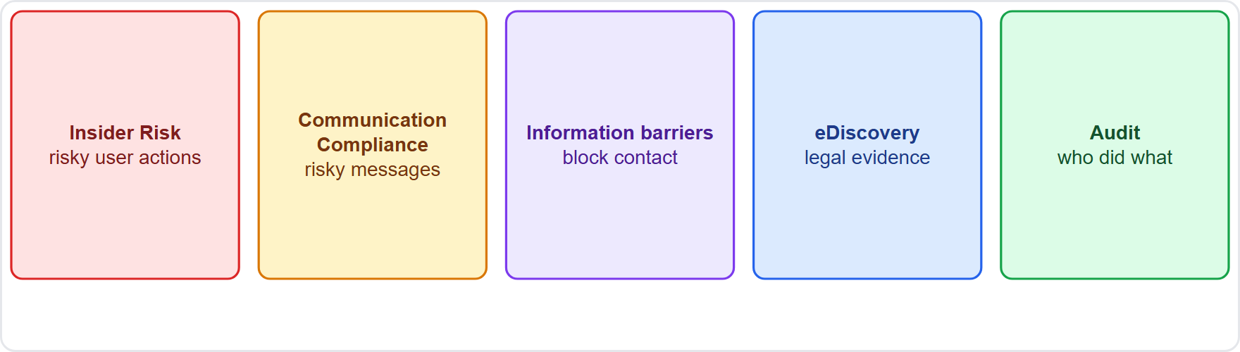
Four jobs, four tools, continued
Module 14
Insider risk, communication compliance, information barriers, eDiscovery and audit at a glance
SC-900 Exam Prep | Microsoft Security, Compliance and Identity Fundamentals exam
Module 14: Insider Risk, eDiscovery and Audit
6 / 22
Notes:
Four jobs, four tools.
The figure shows this: Insider risk, communication compliance, information barriers, e discovery and audit at a glance.

Slide 7
Insider Risk Management
Module 14
Feature | Meaning
Policies from templates | For example data theft by departing users, data leaks, risky AI usage [Verify live]
Indicators and risk scores | Signals from Microsoft 365 activity, risk levels for users
Alerts and cases | Investigate and take action
Pseudonymization | Usernames are anonymized by default to protect privacy
Triggers | Events such as an HR resignation start closer monitoring
Helps detect, investigate and act on risky activities by users such as data theft, data leaks, security policy violations and sabotage, while protecting privacy.
EXAM TIP "An employee about to leave downloads many files" = Insider Risk Management. It watches user behavior, not external attackers.
SC-900 Exam Prep | Microsoft Security, Compliance and Identity Fundamentals exam
Module 14: Insider Risk, eDiscovery and Audit
7 / 22
Notes:
Insider Risk Management.
Helps detect, investigate and act on risky activities by users such as data theft, data leaks, security policy violations and sabotage, while protecting privacy.
Policies from templates. For example data theft by departing users, data leaks, risky A I usage.
Indicators and risk scores. Signals from Microsoft three sixty-five activity, risk levels for users.
Alerts and cases. Investigate and take action.
Pseudonymization. Usernames are anonymized by default to protect privacy.
Triggers. Events such as an H R resignation start closer monitoring.
Exam tip: "An employee about to leave downloads many files" equals Insider Risk Management. It watches user behavior, not external attackers.

Slide 8
Communication Compliance
Module 14
Detects inappropriate content or regulatory violations in email, Teams, Viva Engage and other channels: harassment, threats, sharing sensitive information, and conflicts of interest. Reviewers can investigate and remediate messages. Policies use sensitive info types, keywords and trainable classifiers.
SC-900 Exam Prep | Microsoft Security, Compliance and Identity Fundamentals exam
Module 14: Insider Risk, eDiscovery and Audit
8 / 22
Notes:
Communication Compliance.
Detects inappropriate content or regulatory violations in email, Teams, Vee va Engage and other channels: harassment, threats, sharing sensitive information, and conflicts of interest. Reviewers can investigate and remediate messages. Policies use sensitive info types, keywords and trainable classifiers.

Slide 9
Information barriers
Module 14
Information barriers restrict communication and collaboration between defined groups to avoid conflicts of interest or meet legal separation (for example, between investment bankers and analysts in finance, or between teams working for competing clients). They apply to Teams, SharePoint, OneDrive and more. [Verify live]
EXAM TIP Information barriers = prevent two groups from talking or sharing (conflict of interest). Communication compliance = review the messages that were sent.
SC-900 Exam Prep | Microsoft Security, Compliance and Identity Fundamentals exam
Module 14: Insider Risk, eDiscovery and Audit
9 / 22
Notes:
Information barriers.
Information barriers restrict communication and collaboration between defined groups to avoid conflicts of interest or meet legal separation (for example, between investment bankers and analysts in finance, or between teams working for competing clients). They apply to Teams, Share Point, One Drive and more.
Exam tip: Information barriers equals prevent two groups from talking or sharing (conflict of interest). Communication compliance equals review the messages that were sent.

Slide 10
eDiscovery
Module 14
Tier | Highlights
Content Search | Search mailboxes, sites and Teams; basic
eDiscovery (Standard) | Cases, holds to preserve content, search, export
eDiscovery (Premium) | Adds custodians, review sets, analytics, predictive coding and advanced workflows
eDiscovery is the process of identifying and delivering electronic information used as evidence in legal, regulatory or internal investigations.
SC-900 Exam Prep | Microsoft Security, Compliance and Identity Fundamentals exam
Module 14: Insider Risk, eDiscovery and Audit
10 / 22
Notes:
e discovery.
e discovery is the process of identifying and delivering electronic information used as evidence in legal, regulatory or internal investigations.
Content Search. Search mailboxes, sites and Teams; basic.
e discovery (Standard). Cases, holds to preserve content, search, export.
e discovery (Premium). Adds custodians, review sets, analytics, predictive coding and advanced workflows.

Slide 11
eDiscovery, continued
DATES
Module 14
Microsoft retired the classic eDiscovery experiences on August 31, 2025; today you work in the new eDiscovery experience in the Microsoft Purview portal, and the Standard and Premium names describe the feature sets and licensing. [Verify live]
Key steps: create a case → place a legal hold → search → review → export. A hold stops people from deleting relevant content.
SC-900 Exam Prep | Microsoft Security, Compliance and Identity Fundamentals exam
Module 14: Insider Risk, eDiscovery and Audit
11 / 22
Notes:
e discovery.
Microsoft retired the classic e discovery experiences on August thirty-one, two thousand twenty-five; today you work in the new e discovery experience in the Microsoft Purview portal, and the Standard and Premium names describe the feature sets and licensing.
Key steps: create a case to place a legal hold to search to review to export. A hold stops people from deleting relevant content.

Slide 12
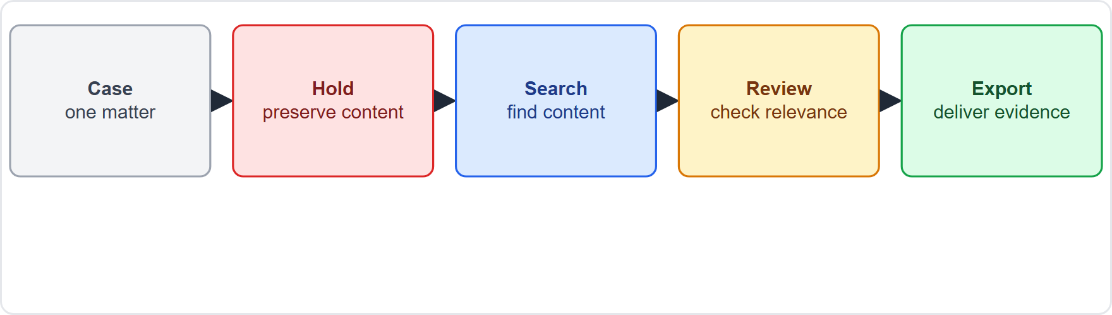
eDiscovery, continued
Module 14
The eDiscovery flow: case, hold, search, review, export
EXAM TIP Hold = preserve content for a case. Standard = cases, holds, search, export. Premium = custodians, review sets, analytics. [Verify live]
SC-900 Exam Prep | Microsoft Security, Compliance and Identity Fundamentals exam
Module 14: Insider Risk, eDiscovery and Audit
12 / 22
Notes:
e discovery.
The figure shows this: The e discovery flow: case, hold, search, review, export.
Exam tip: Hold equals preserve content for a case. Standard equals cases, holds, search, export. Premium equals custodians, review sets, analytics.

Slide 13
Audit
Module 14
Tier | Highlights
Audit (Standard) | Search the audit log, 180 days retention by default [Verify live]
Audit (Premium) | Longer retention (up to 1 year, 10 years with add-on), audit retention policies, high-value events such as mail items accessed, higher bandwidth access via API
Microsoft Purview Audit records user and admin activities across Microsoft 365 so you can search them for investigations, security and compliance.
Examples of events: file opened, mailbox login, role change, label change.
EXAM TIP Audit = a searchable log of who did what. Premium = longer retention and more events. It helps investigations, and feeds Insider Risk Management and others.
SC-900 Exam Prep | Microsoft Security, Compliance and Identity Fundamentals exam
Module 14: Insider Risk, eDiscovery and Audit
13 / 22
Notes:
Audit.
Microsoft Purview Audit records user and admin activities across Microsoft three sixty-five so you can search them for investigations, security and compliance.
Audit (Standard). Search the audit log, one hundred eighty days retention by default.
Audit (Premium). Longer retention (up to one year, ten years with add-on), audit retention policies, high-value events such as mail items accessed, higher bandwidth access via A P I.
Examples of events: file opened, mailbox login, role change, label change.
Exam tip: Audit equals a searchable log of who did what. Premium equals longer retention and more events. It helps investigations, and feeds Insider Risk Management and others.

Slide 14
Practice Question 1
Module 14
Q1
Fabrikam Outdoors wants to spot employees who download unusual amounts of data before leaving the company. Which solution fits?
A
Azure DDoS Protection
B
Conditional Access
C
Safe Links
D
Insider Risk Management
SC-900 Exam Prep | Microsoft Security, Compliance and Identity Fundamentals exam
Module 14: Insider Risk, eDiscovery and Audit
14 / 22
Notes:
Question one. Fabrikam Outdoors wants to spot employees who download unusual amounts of data before leaving the company. Which solution fits? The four options are on the screen.
[PAUSE 10]
The answer is D: Insider Risk Management. Insider Risk Management detects risky user actions such as data theft by departing users.

Slide 15
Practice Question 2
Module 14
Q2
Two teams working for competing clients must not communicate or share files. Which feature fits?
A
Information barriers
B
Communication compliance
C
Smart lockout
D
Content explorer
SC-900 Exam Prep | Microsoft Security, Compliance and Identity Fundamentals exam
Module 14: Insider Risk, eDiscovery and Audit
15 / 22
Notes:
Question two. Two teams working for competing clients must not communicate or share files. Which feature fits? The four options are on the screen.
[PAUSE 10]
The answer is A: Information barriers. Information barriers prevent communication between defined groups.

Slide 16
Practice Question 3
Module 14
Q3
Legal asks IT to preserve and export emails relevant to a lawsuit. Which solution fits?
A
Secure score
B
eDiscovery
C
Azure Firewall
D
Entra Connect
SC-900 Exam Prep | Microsoft Security, Compliance and Identity Fundamentals exam
Module 14: Insider Risk, eDiscovery and Audit
16 / 22
Notes:
Question three. Legal asks I T to preserve and export emails relevant to a lawsuit. Which solution fits? The four options are on the screen.
[PAUSE 10]
The answer is B: e discovery. e discovery finds, holds and exports content for legal matters.

Slide 17
Practice Question 4
Module 14
Q4
An administrator needs to find who deleted a file last week. Which solution helps?
A
Microsoft Purview Audit
B
Azure Bastion
C
Defender for Cloud
D
Key Vault
SC-900 Exam Prep | Microsoft Security, Compliance and Identity Fundamentals exam
Module 14: Insider Risk, eDiscovery and Audit
17 / 22
Notes:
Question four. An administrator needs to find who deleted a file last week. Which solution helps? The four options are on the screen.
[PAUSE 10]
The answer is A: Microsoft Purview Audit. Audit records user and admin activities and supports searching.

Slide 18
Practice Question 5
Module 14
Q5
Which solution detects harassing language in Teams messages?
A
Information barriers
B
Insider Risk Management data theft policy
C
Communication Compliance
D
eDiscovery hold
SC-900 Exam Prep | Microsoft Security, Compliance and Identity Fundamentals exam
Module 14: Insider Risk, eDiscovery and Audit
18 / 22
Notes:
Question five. Which solution detects harassing language in Teams messages? The four options are on the screen.
[PAUSE 10]
The answer is C: Communication Compliance. Communication Compliance reviews messages for inappropriate content.

Slide 19
Practice Question 6
Module 14
Q6
What does a hold in eDiscovery do?
A
Encrypts the content with a customer-managed key
B
Sends it to Sentinel for threat analysis later
C
Moves it to a record in the file plan folder
D
Preserves content so it cannot be deleted
SC-900 Exam Prep | Microsoft Security, Compliance and Identity Fundamentals exam
Module 14: Insider Risk, eDiscovery and Audit
19 / 22
Notes:
Question six. What does a hold in e discovery do? The four options are on the screen.
[PAUSE 10]
The answer is D: Preserves content so it cannot be deleted. A hold preserves relevant content for the case.

Slide 20
Recall Check 1
Module 14
Q1. What does Insider Risk Management protect against?
Q2. What do information barriers prevent?
Q3. Name the eDiscovery tiers.
SC-900 Exam Prep | Microsoft Security, Compliance and Identity Fundamentals exam
Module 14: Insider Risk, eDiscovery and Audit
20 / 22
Notes:
Recall check one. Say each answer out loud before you listen to mine.
Question one. What does Insider Risk Management protect against?
[PAUSE 5]
Answer: Risky actions by people inside the organization, such as data theft and leaks.
Question two. What do information barriers prevent?
[PAUSE 5]
Answer: Communication between defined groups to avoid conflicts of interest.
Question three. Name the e discovery tiers.
[PAUSE 5]
Answer: Content Search, e discovery (Standard) and e discovery (Premium).

Slide 21
Recall Check 2
Module 14
Q4. What are the basic eDiscovery steps?
Q5. What does Audit record?
Q6. What does Audit Premium add?
SC-900 Exam Prep | Microsoft Security, Compliance and Identity Fundamentals exam
Module 14: Insider Risk, eDiscovery and Audit
21 / 22
Notes:
Recall check two. Say each answer out loud before you listen to mine.
Question four. What are the basic e discovery steps?
[PAUSE 5]
Answer: Case, hold, search, review, export.
Question five. What does Audit record?
[PAUSE 5]
Answer: User and admin activities in Microsoft three sixty-five.
Question six. What does Audit Premium add?
[PAUSE 5]
Answer: Longer retention and more high-value events.

Slide 22
Module Recap
Module 14
1
Insider Risk
2
Communication Compliance
3
Information barriers
risky user actions; templates; risk scores; pseudonymized by default
review messages for harassment, leaks, violations
block groups from communicating (conflict of interest)
4
eDiscovery
5
Audit
case, hold, search, review, export; Standard vs Premium
searchable log of activities; Premium longer retention
SC-900 Exam Prep | Microsoft Security, Compliance and Identity Fundamentals exam
Module 14: Insider Risk, eDiscovery and Audit
22 / 22
Notes:
Here is the recap.
Insider Risk: risky user actions; templates; risk scores; pseudonymized by default.
Communication Compliance: review messages for harassment, leaks, violations.
Information barriers: block groups from communicating (conflict of interest).
e discovery: case, hold, search, review, export; Standard versus Premium.
Audit: searchable log of activities; Premium longer retention.
In the next module, we continue the course.

