Slide 1
Module 1: Security Concepts and Controls
1.1 Explain security concepts and controls
SY0-801 exam prep · General Security Concepts · 16% of the exam
SY0-801 Exam Prep: CompTIA Security+ Study Course
Module 1
Notes:
Welcome to Module one: Security Concepts and Controls. It covers the exam area General Security Concepts.
Each part of this module comes from the study notes of the same name, so you can read the notes after you watch.

Slide 2
What You Will Learn
Module 1
The core ideas
Security principles
Control categories
Control types
Practice with exam-style questions and a recall check
SY0-801 Exam Prep | CompTIA Security+ exam
Module 1: Security Concepts and Controls
2 / 20
Notes:
By the end of this module you will be able to do five things.
The core ideas.
Security principles.
Control categories.
Control types.
Practice with exam-style questions and a recall check.

Slide 3
Where This Fits in the Exam
Module 1
EXAM CHECK-IN · Where this fits
Exam area: General Security Concepts (16%)
Exam format: up to 90 questions in 90 minutes; a score of 750 on a scale of 100 to 900 passes
Validated against: the official CompTIA Security+ SY0-801 V8 exam objectives
SY0-801 Exam Prep | CompTIA Security+ exam
Module 1: Security Concepts and Controls
3 / 20
Notes:
Here is where this module sits in the exam.
Exam area: General Security Concepts (sixteen percent).
Exam format: up to ninety questions in ninety minutes; a score of seven hundred fifty on a scale of one hundred to nine hundred passes.
Validated against: the official Comp T I A Security plus S Y zero eight oh one V eight exam objectives.

Slide 4
The core ideas
Module 1
Concept | Meaning | Example
Confidentiality | Only authorized people can read the data | Encrypting a customer file
Integrity | Data is accurate and has not been changed without permission | A hash that shows a file was altered
Availability | Systems and data are usable when needed | Backups and redundant servers
These three form the CIA triad. Every control protects at least one of them.
SY0-801 Exam Prep | CompTIA Security+ exam
Module 1: Security Concepts and Controls
4 / 20
Notes:
The core ideas.
Confidentiality. Meaning: Only authorized people can read the data. Example: Encrypting a customer file.
Integrity. Meaning: Data is accurate and has not been changed without permission. Example: A hash that shows a file was altered.
Availability. Meaning: Systems and data are usable when needed. Example: Backups and redundant servers.
These three form the C I A triad. Every control protects at least one of them.

Slide 5
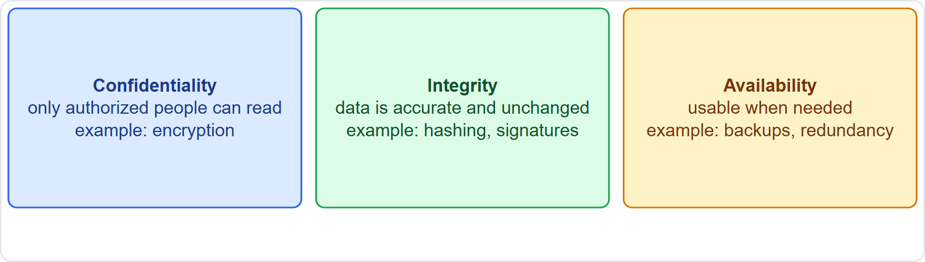
The core ideas, continued
Module 1
The CIA triad: confidentiality, integrity, availability, each with an example control
SY0-801 Exam Prep | CompTIA Security+ exam
Module 1: Security Concepts and Controls
5 / 20
Notes:
The core ideas.
The figure shows this: The C I A triad: confidentiality, integrity, availability, each with an example control.

Slide 6
Authentication, authorization and accounting (AAA)
Module 1
Step | Question | Example
Authentication | Who are you? | Password plus an app code
Authorization | What may you do? | Read-only access to a share
Accounting | What did you do? | Logs of sign-ins and changes
Non-repudiation means a person cannot deny an action. Digital signatures and audit logs give it.
EXAM TIP Authentication proves identity; authorization grants rights after that; accounting records activity. A digital signature gives integrity and non-repudiation.
SY0-801 Exam Prep | CompTIA Security+ exam
Module 1: Security Concepts and Controls
6 / 20
Notes:
Authentication, authorization and accounting (A A A).
Authentication. Question: Who are you? Example: Password plus an app code.
Authorization. Question: What may you do? Example: Read-only access to a share.
Accounting. Question: What did you do? Example: Logs of sign-ins and changes.
Non-repudiation means a person cannot deny an action. Digital signatures and audit logs give it.
Exam tip: Authentication proves identity; authorization grants rights after that; accounting records activity. A digital signature gives integrity and non-repudiation.

Slide 7
Security principles
Module 1
Defense in depth
Least privilege
use several layers of controls so one failure does not expose everything.
give users and systems only the access needed for the task, and no more.
Zero Trust
Separation of duties
never trust, always verify. No device or user is trusted because of its network location; every request is authenticated and authorized, and access is continuously evaluated.
no one person controls a whole critical process. [Beyond the objectives]
SY0-801 Exam Prep | CompTIA Security+ exam
Module 1: Security Concepts and Controls
7 / 20
Notes:
Security principles.
Defense in depth: use several layers of controls so one failure does not expose everything.
Least privilege: give users and systems only the access needed for the task, and no more.
Zero Trust: never trust, always verify. No device or user is trusted because of its network location; every request is authenticated and authorized, and access is continuously evaluated.
Separation of duties: no one person controls a whole critical process.

Slide 8
Control categories
Module 1
Category | Meaning | Examples
Technical (logical) | Done by technology | Firewall, encryption, antivirus, access control lists
Managerial (administrative) | Policies and oversight | Risk assessments, security policies, awareness programs
Operational | Done by people in daily work | Guards, security awareness procedures, backup routines
Physical (environmental) | Protect buildings and equipment | Locks, fences, badges, cameras, fire suppression
Controls are grouped by how they are implemented.
SY0-801 Exam Prep | CompTIA Security+ exam
Module 1: Security Concepts and Controls
8 / 20
Notes:
Control categories.
Controls are grouped by how they are implemented.
Technical (logical). Meaning: Done by technology. Examples: Firewall, encryption, antivirus, access control lists.
Managerial (administrative). Meaning: Policies and oversight. Examples: Risk assessments, security policies, awareness programs.
Operational. Meaning: Done by people in daily work. Examples: Guards, security awareness procedures, backup routines.
Physical (environmental). Meaning: Protect buildings and equipment. Examples: Locks, fences, badges, cameras, fire suppression.

Slide 9
Control types
Module 1
Type | Purpose | Examples
Preventive | Stops an incident | Firewall rule, door lock, patching
Deterring | Discourages an attacker | Warning signs, visible cameras, banners
Detective | Finds an incident that happened | IDS alerts, log review, motion sensors
Corrective | Fixes the damage or restores | Restoring from backup, patching after an attack
Controls are also grouped by what they do.
SY0-801 Exam Prep | CompTIA Security+ exam
Module 1: Security Concepts and Controls
9 / 20
Notes:
Control types.
Controls are also grouped by what they do.
Preventive. Purpose: Stops an incident. Examples: Firewall rule, door lock, patching.
Deterring. Purpose: Discourages an attacker. Examples: Warning signs, visible cameras, banners.
Detective. Purpose: Finds an incident that happened. Examples: I D S alerts, log review, motion sensors.
Corrective. Purpose: Fixes the damage or restores. Examples: Restoring from backup, patching after an attack.

Slide 10
Control types, continued
Module 1
Type | Purpose | Examples
Compensating | Substitutes when the main control cannot be used | Extra monitoring on a legacy system that cannot be patched
Directive | Instructs what must be done | Policies, procedures, standards
EXAM TIP A compensating control is a substitute for a control that cannot be used. A corrective control happens after the event. Do not confuse them.
SY0-801 Exam Prep | CompTIA Security+ exam
Module 1: Security Concepts and Controls
10 / 20
Notes:
Control types.
Compensating. Purpose: Substitutes when the main control cannot be used. Examples: Extra monitoring on a legacy system that cannot be patched.
Directive. Purpose: Instructs what must be done. Examples: Policies, procedures, standards.
Exam tip: A compensating control is a substitute for a control that cannot be used. A corrective control happens after the event. Do not confuse them.

Slide 11
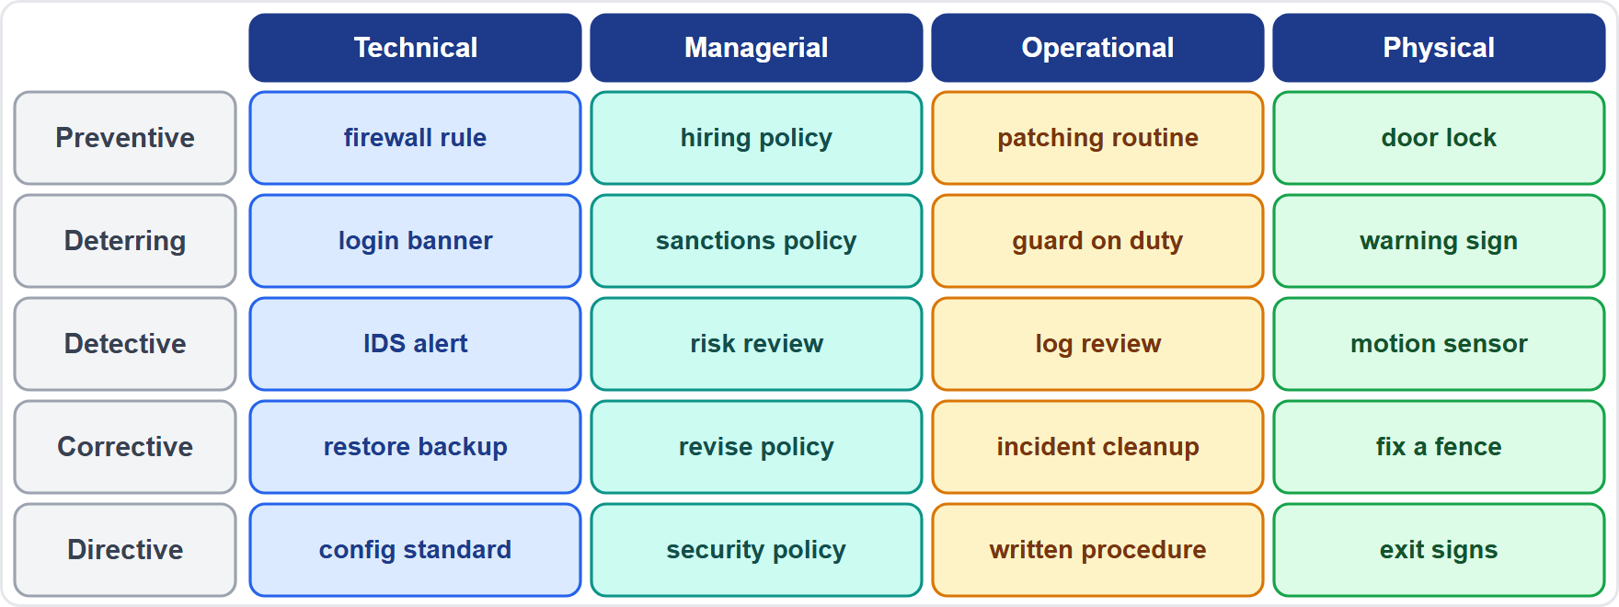
Control types, continued
Module 1
A matrix of control categories and control types with one example for each
EXAM TIP Ask two questions: how is it implemented (technical, managerial, operational, physical) and what does it do (preventive, deterring, detective, corrective, compensating, directive). A camera is physical and detective (and also deterring). A policy is managerial and directive.
SY0-801 Exam Prep | CompTIA Security+ exam
Module 1: Security Concepts and Controls
11 / 20
Notes:
Control types.
The figure shows this: A matrix of control categories and control types with one example for each.
Exam tip: Ask two questions: how is it implemented (technical, managerial, operational, physical) and what does it do (preventive, deterring, detective, corrective, compensating, directive). A camera is physical and detective (and also deterring). A policy is managerial and directive.

Slide 12
Practice Question 1
Module 1
Q1
Fabrikam Outdoors adds a banner that warns that all activity on its network is monitored. Which control type is mainly shown?
A
Corrective
B
Deterring
C
Compensating
D
Preventive
SY0-801 Exam Prep | CompTIA Security+ exam
Module 1: Security Concepts and Controls
12 / 20
Notes:
Question one. Fabrikam Outdoors adds a banner that warns that all activity on its network is monitored. Which control type is mainly shown? The four options are on the screen.
[PAUSE 10]
The answer is B: Deterring. A warning banner discourages misuse, which is a deterring control. It does not stop or fix anything.

Slide 13
Practice Question 2
Module 1
Q2
A legacy server cannot be patched, so the team places it on an isolated segment with extra logging. Which control type is this?
A
Compensating
B
Directive
C
Corrective
D
Deterring
SY0-801 Exam Prep | CompTIA Security+ exam
Module 1: Security Concepts and Controls
13 / 20
Notes:
Question two. A legacy server cannot be patched, so the team places it on an isolated segment with extra logging. Which control type is this? The four options are on the screen.
[PAUSE 10]
The answer is A: Compensating. The isolation and logging substitute for patching that cannot be done, so they are compensating controls.

Slide 14
Practice Question 3
Module 1
Q3
A company writes an acceptable use policy that tells staff what they must and must not do. Which category and type fit best?
A
Technical and preventive
B
Physical and detective
C
Managerial and directive
D
Operational and corrective
SY0-801 Exam Prep | CompTIA Security+ exam
Module 1: Security Concepts and Controls
14 / 20
Notes:
Question three. A company writes an acceptable use policy that tells staff what they must and must not do. Which category and type fit best? The four options are on the screen.
[PAUSE 10]
The answer is C: Managerial and directive. A policy is a managerial control that directs behavior, so it is a directive control.

Slide 15
Practice Question 4
Module 1
Q4
Which concept is provided by a digital signature on a signed contract?
A
Availability and accounting
B
Integrity and non-repudiation
C
Obfuscation and masking
D
Authorization and accounting
SY0-801 Exam Prep | CompTIA Security+ exam
Module 1: Security Concepts and Controls
15 / 20
Notes:
Question four. Which concept is provided by a digital signature on a signed contract? The four options are on the screen.
[PAUSE 10]
The answer is B: Integrity and non-repudiation. A signature shows the content was not changed (integrity) and the signer cannot deny signing it (non-repudiation).

Slide 16
Practice Question 5
Module 1
Q5
An administrator gives a help desk analyst only the rights needed to reset passwords. Which principle is applied?
A
Defense in depth
B
Least privilege
C
Zero Trust
D
Non-repudiation
SY0-801 Exam Prep | CompTIA Security+ exam
Module 1: Security Concepts and Controls
16 / 20
Notes:
Question five. An administrator gives a help desk analyst only the rights needed to reset passwords. Which principle is applied? The four options are on the screen.
[PAUSE 10]
The answer is B: Least privilege. Granting only the access needed for the task is least privilege.

Slide 17
Practice Question 6
Module 1
Q6
A user signs in and the system then checks which files the user may open. Which step of AAA is the file check?
A
Accounting
B
Authentication
C
Authorization
D
Attestation
SY0-801 Exam Prep | CompTIA Security+ exam
Module 1: Security Concepts and Controls
17 / 20
Notes:
Question six. A user signs in and the system then checks which files the user may open. Which step of A A A is the file check? The four options are on the screen.
[PAUSE 10]
The answer is C: Authorization. Deciding what the authenticated user may access is authorization.

Slide 18
Recall Check 1
Module 1
Q1. What are the three parts of the CIA triad?
Q2. What does AAA stand for?
Q3. Name the four control categories.
SY0-801 Exam Prep | CompTIA Security+ exam
Module 1: Security Concepts and Controls
18 / 20
Notes:
Recall check one. Say each answer out loud before you listen to mine.
Question one. What are the three parts of the C I A triad?
[PAUSE 5]
Answer: Confidentiality, integrity and availability.
Question two. What does A A A stand for?
[PAUSE 5]
Answer: Authentication, authorization and accounting.
Question three. Name the four control categories.
[PAUSE 5]
Answer: Technical, managerial, operational and physical.

Slide 19
Recall Check 2
Module 1
Q4. Name the six control types.
Q5. What is the slogan of Zero Trust?
Q6. What does non-repudiation prevent?
SY0-801 Exam Prep | CompTIA Security+ exam
Module 1: Security Concepts and Controls
19 / 20
Notes:
Recall check two. Say each answer out loud before you listen to mine.
Question four. Name the six control types.
[PAUSE 5]
Answer: Preventive, deterring, detective, corrective, compensating and directive.
Question five. What is the slogan of Zero Trust?
[PAUSE 5]
Answer: Never trust, always verify.
Question six. What does non-repudiation prevent?
[PAUSE 5]
Answer: A person denying an action they performed.

Slide 20
Module Recap
Module 1
1
CIA
2
AAA
3
Principles
confidentiality (secret), integrity (unchanged), availability (usable)
who you are, what you may do, what you did
defense in depth, least privilege, Zero Trust (verify every request)
4
Categories
5
Types
technical, managerial, operational, physical
preventive stops, deterring discourages, detective finds, corrective fixes, compensating substitutes, directive instructs
SY0-801 Exam Prep | CompTIA Security+ exam
Module 1: Security Concepts and Controls
20 / 20
Notes:
Here is the recap.
C I A: confidentiality (secret), integrity (unchanged), availability (usable).
A A A: who you are, what you may do, what you did.
Principles: defense in depth, least privilege, Zero Trust (verify every request).
Categories: technical, managerial, operational, physical.
Types: preventive stops, deterring discourages, detective finds, corrective fixes, compensating substitutes, directive instructs.
In the next module, we continue the course.

