Slide 1
Module 3: Cryptographic Solutions
1.3 Explain the importance of using appropriate cryptographic solutions
SY0-801 exam prep · General Security Concepts · 16% of the exam
SY0-801 Exam Prep: CompTIA Security+ Study Course
Module 3
Notes:
Welcome to Module three: Cryptographic Solutions. It covers the exam area General Security Concepts.
Each part of this module comes from the study notes of the same name, so you can read the notes after you watch.

Slide 2
What You Will Learn
Module 3
Encryption: symmetric and asymmetric
Levels of encryption
Public key infrastructure (PKI) and certificates
Other cryptographic tools
Practice with exam-style questions and a recall check
SY0-801 Exam Prep | CompTIA Security+ exam
Module 3: Cryptographic Solutions
2 / 21
Notes:
By the end of this module you will be able to do five things.
Encryption: symmetric and asymmetric.
Levels of encryption.
Public key infrastructure (P K I) and certificates.
Other cryptographic tools.
Practice with exam-style questions and a recall check.

Slide 3
Where This Fits in the Exam
Module 3
EXAM CHECK-IN · Where this fits
Exam area: General Security Concepts (16%)
Exam format: up to 90 questions in 90 minutes; a score of 750 on a scale of 100 to 900 passes
Validated against: the official CompTIA Security+ SY0-801 V8 exam objectives
SY0-801 Exam Prep | CompTIA Security+ exam
Module 3: Cryptographic Solutions
3 / 21
Notes:
Here is where this module sits in the exam.
Exam area: General Security Concepts (sixteen percent).
Exam format: up to ninety questions in ninety minutes; a score of seven hundred fifty on a scale of one hundred to nine hundred passes.
Validated against: the official Comp T I A Security plus S Y zero eight oh one V eight exam objectives.

Slide 4
Encryption: symmetric and asymmetric
Module 3
 | Symmetric | Asymmetric
Keys | One shared secret key for both encrypting and decrypting | A key pair: a public key and a private key
Speed | Fast: good for large amounts of data | Slow: used for small data, key exchange and signatures
Main problem | Sharing the key safely | Slower; needs a way to trust public keys
Examples | AES, 3DES (weak), ChaCha20 | RSA, ECC, Diffie-Hellman (key exchange)
Encryption turns readable data (plaintext) into unreadable data (ciphertext) with a key.
SY0-801 Exam Prep | CompTIA Security+ exam
Module 3: Cryptographic Solutions
4 / 21
Notes:
Encryption: symmetric and asymmetric.
Encryption turns readable data (plaintext) into unreadable data (ciphertext) with a key.
Keys. Symmetric: One shared secret key for both encrypting and decrypting. Asymmetric: A key pair: a public key and a private key.
Speed. Symmetric: Fast: good for large amounts of data. Asymmetric: Slow: used for small data, key exchange and signatures.
Main problem. Symmetric: Sharing the key safely. Asymmetric: Slower; needs a way to trust public keys.
Examples. Symmetric: A E S, triple D E S (weak), Cha Cha twenty. Asymmetric: R S A, E C C, Diffie-Hellman (key exchange).

Slide 5
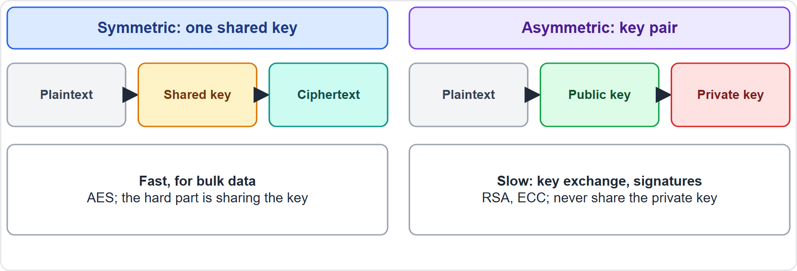
Encryption: symmetric and asymmetric, continued
Module 3
Symmetric encryption uses one shared key; asymmetric uses a public and a private key
SY0-801 Exam Prep | CompTIA Security+ exam
Module 3: Cryptographic Solutions
5 / 21
Notes:
Encryption: symmetric and asymmetric.
The figure shows this: Symmetric encryption uses one shared key; asymmetric uses a public and a private key.

Slide 6
Encryption: symmetric and asymmetric, continued
Module 3
How they work together: a session uses asymmetric cryptography to exchange a key (key exchange), then symmetric encryption for the data (this is what TLS does).
Public key rule: data encrypted with the public key is opened with the private key (confidentiality). A signature is made with the private key and checked with the public key (authenticity).
EXAM TIP Symmetric = fast, one key, bulk data. Asymmetric = two keys, key exchange and signatures. The private key must never be shared. Longer keys are harder to break (key length), for example AES-256 is stronger than AES-128, and RSA needs much longer keys than AES for similar strength.
SY0-801 Exam Prep | CompTIA Security+ exam
Module 3: Cryptographic Solutions
6 / 21
Notes:
Encryption: symmetric and asymmetric.
How they work together: a session uses asymmetric cryptography to exchange a key (key exchange), then symmetric encryption for the data (this is what T L S does).
Public key rule: data encrypted with the public key is opened with the private key (confidentiality). A signature is made with the private key and checked with the public key (authenticity).
Exam tip: Symmetric equals fast, one key, bulk data. Asymmetric equals two keys, key exchange and signatures. The private key must never be shared. Longer keys are harder to break (key length), for example A E S two fifty-six is stronger than A E S one twenty-eight, and R S A needs much longer keys than A E S for similar strength.

Slide 7
Levels of encryption
Module 3
Level | Protects | Example
Full disk | The whole drive, including the operating system | BitLocker, a laptop theft
Partition / volume | One partition or volume | An encrypted data volume
File | Individual files | An encrypted spreadsheet
Database | The database files (transparent encryption) | Database at rest
Record | Specific rows or fields | An encrypted card-number column
Transport / communication | Data moving over a network | TLS, VPN, IPsec
Where the encryption is applied decides what is protected.
SY0-801 Exam Prep | CompTIA Security+ exam
Module 3: Cryptographic Solutions
7 / 21
Notes:
Levels of encryption.
Where the encryption is applied decides what is protected.
Full disk. Protects: The whole drive, including the operating system. Example: Bit Locker, a laptop theft.
Partition or volume. Protects: One partition or volume. Example: An encrypted data volume.
File. Protects: Individual files. Example: An encrypted spreadsheet.
Database. Protects: The database files (transparent encryption). Example: Database at rest.
Record. Protects: Specific rows or fields. Example: An encrypted card-number column.
Transport or communication. Protects: Data moving over a network. Example: T L S, V P N (virtual private network), I P sec.

Slide 8
Public key infrastructure (PKI) and certificates
Module 3
Term | Meaning
Certificate | Binds a public key to an identity, signed by a certificate authority
Certificate authority (CA) | The trusted entity that issues and signs certificates
Root of trust | The root CA whose certificate devices trust by default; other certificates chain to it
Certificate signing request (CSR) | A request that contains the public key and identity details, sent to a CA to get a certificate
Certificate revocation list (CRL) | A list of certificates that are no longer valid
A PKI is the system of people, policies and tools that creates, distributes and revokes digital certificates.
SY0-801 Exam Prep | CompTIA Security+ exam
Module 3: Cryptographic Solutions
8 / 21
Notes:
Public key infrastructure (P K I) and certificates.
A P K I is the system of people, policies and tools that creates, distributes and revokes digital certificates.
Certificate. Binds a public key to an identity, signed by a certificate authority.
Certificate authority (C A). The trusted entity that issues and signs certificates.
Root of trust. The root C A whose certificate devices trust by default; other certificates chain to it.
Certificate signing request (C S R). A request that contains the public key and identity details, sent to a C A to get a certificate.
Certificate revocation list (C R L). A list of certificates that are no longer valid.

Slide 9
Public key infrastructure (PKI) and certificates, continued
Module 3
Term | Meaning
Online Certificate Status Protocol (OCSP) | Real-time check of one certificate's status
Self-signed | Signed by its own key: no outside trust, fine for testing
Third-party | Issued by a public CA that browsers trust
Wildcard | One certificate for all subdomains, such as *.fabrikam.example
Key escrow | A trusted third party holds a copy of a private key for recovery
EXAM TIP To get a certificate you create a CSR. To check if it was revoked use CRL (a list) or OCSP (a live query). A self-signed certificate causes browser warnings on the public internet.
SY0-801 Exam Prep | CompTIA Security+ exam
Module 3: Cryptographic Solutions
9 / 21
Notes:
Public key infrastructure (P K I) and certificates.
Online Certificate Status Protocol (O C S P). Real-time check of one certificate's status.
Self-signed. Signed by its own key: no outside trust, fine for testing.
Third-party. Issued by a public C A that browsers trust.
Wildcard. One certificate for all subdomains, such as dot fabrikam dot example.
Key escrow. A trusted third party holds a copy of a private key for recovery.
Exam tip: To get a certificate you create a C S R. To check if it was revoked use C R L (a list) or O C S P (a live query). A self-signed certificate causes browser warnings on the public internet.

Slide 10
Other cryptographic tools
Module 3
Tool | Purpose | Notes
Hashing | A one-way fingerprint of data; same input gives the same output | Checks integrity; cannot be reversed; algorithms SHA-256, SHA-3; MD5 and SHA-1 are weak
Salting | Random data added to a password before hashing | Makes identical passwords hash differently and defeats rainbow tables
Digital signature | A hash signed with the private key | Gives integrity, authentication and non-repudiation
SY0-801 Exam Prep | CompTIA Security+ exam
Module 3: Cryptographic Solutions
10 / 21
Notes:
Other cryptographic tools.
Hashing. Purpose: A one-way fingerprint of data; same input gives the same output. Notes: Checks integrity; cannot be reversed; algorithms S H A two fifty-six, S H A three; M D five and S H A one are weak.
Salting. Purpose: Random data added to a password before hashing. Notes: Makes identical passwords hash differently and defeats rainbow tables.
Digital signature. Purpose: A hash signed with the private key. Notes: Gives integrity, authentication and non-repudiation.

Slide 11
Other cryptographic tools, continued
Module 3
Tool | Purpose | Notes
Key exchange | A way to agree on a shared key over an open network | Diffie-Hellman
Key stretching | Slows guessing by repeating hashing many times | bcrypt, PBKDF2 [Beyond the objectives]
Obfuscation | Hiding the meaning of data or code | Not strong security: steganography, masking, tokenization (module 10)
Tools | Hardware and software that manage keys | TPM, HSM (hardware security module), key management system
SY0-801 Exam Prep | CompTIA Security+ exam
Module 3: Cryptographic Solutions
11 / 21
Notes:
Other cryptographic tools.
Key exchange. Purpose: A way to agree on a shared key over an open network. Notes: Diffie-Hellman.
Key stretching. Purpose: Slows guessing by repeating hashing many times. Notes: bcrypt, P B K D F two.
Obfuscation. Purpose: Hiding the meaning of data or code. Notes: Not strong security: steganography, masking, tokenization (module ten).
Tools. Purpose: Hardware and software that manage keys. Notes: T P M, H S M (hardware security module), key management system.

Slide 12
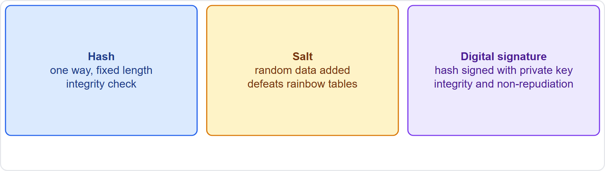
Other cryptographic tools, continued
Module 3
A hash, a salt and a digital signature compared
EXAM TIP Hash = integrity, one way. Encryption = confidentiality, reversible with the key. Salt goes into the password hash, it is not secret. A digital signature uses the sender's private key.
SY0-801 Exam Prep | CompTIA Security+ exam
Module 3: Cryptographic Solutions
12 / 21
Notes:
Other cryptographic tools.
The figure shows this: A hash, a salt and a digital signature compared.
Exam tip: Hash equals integrity, one way. Encryption equals confidentiality, reversible with the key. Salt goes into the password hash, it is not secret. A digital signature uses the sender's private key.

Slide 13
Practice Question 1
Module 3
Q1
Fabrikam Outdoors must encrypt a 200 GB database backup quickly. Which type of encryption fits best?
A
Asymmetric encryption such as RSA only
B
Hashing with SHA-256
C
A digital signature
D
Symmetric encryption such as AES
SY0-801 Exam Prep | CompTIA Security+ exam
Module 3: Cryptographic Solutions
13 / 21
Notes:
Question one. Fabrikam Outdoors must encrypt a two hundred gigabytes database backup quickly. Which type of encryption fits best? The four options are on the screen.
[PAUSE 10]
The answer is D: Symmetric encryption such as A E S. Symmetric encryption is fast and suited to large amounts of data. Hashing is one way and does not allow decryption.

Slide 14
Practice Question 2
Module 3
Q2
A web team needs a certificate for its server. What does it send to the certificate authority?
A
A certificate revocation list
B
A private key
C
A salted hash
D
A certificate signing request
SY0-801 Exam Prep | CompTIA Security+ exam
Module 3: Cryptographic Solutions
14 / 21
Notes:
Question two. A web team needs a certificate for its server. What does it send to the certificate authority? The four options are on the screen.
[PAUSE 10]
The answer is D: A certificate signing request. A C S R holds the public key and identity details. The private key is never sent.

Slide 15
Practice Question 3
Module 3
Q3
A company wants one certificate to cover shop.fabrikam.example and pay.fabrikam.example. Which type fits?
A
Self-signed certificate
B
Root certificate
C
Wildcard certificate
D
Key escrow certificate
SY0-801 Exam Prep | CompTIA Security+ exam
Module 3: Cryptographic Solutions
15 / 21
Notes:
Question three. A company wants one certificate to cover shop.fabrikam.example and pay.fabrikam.example. Which type fits? The four options are on the screen.
[PAUSE 10]
The answer is C: Wildcard certificate. A wildcard certificate covers all subdomains of a domain.

Slide 16
Practice Question 4
Module 3
Q4
Two users have the same password but their stored hashes differ. What explains this?
A
Key escrow
B
Tokenization
C
Salting
D
Obfuscation
SY0-801 Exam Prep | CompTIA Security+ exam
Module 3: Cryptographic Solutions
16 / 21
Notes:
Question four. Two users have the same password but their stored hashes differ. What explains this? The four options are on the screen.
[PAUSE 10]
The answer is C: Salting. A unique salt added before hashing makes identical passwords produce different hashes.

Slide 17
Practice Question 5
Module 3
Q5
Which control gives a recipient proof that a document came from the sender and was not changed?
A
Full disk encryption
B
A digital signature
C
A salted hash alone
D
A wildcard certificate
SY0-801 Exam Prep | CompTIA Security+ exam
Module 3: Cryptographic Solutions
17 / 21
Notes:
Question five. Which control gives a recipient proof that a document came from the sender and was not changed? The four options are on the screen.
[PAUSE 10]
The answer is B: A digital signature. A signature made with the sender's private key proves origin and integrity.

Slide 18
Practice Question 6
Module 3
Q6
A browser needs to know right now whether one server certificate has been revoked. Which method gives a live answer?
A
A downloaded CRL
B
A CSR
C
OCSP
D
A self-signed root
SY0-801 Exam Prep | CompTIA Security+ exam
Module 3: Cryptographic Solutions
18 / 21
Notes:
Question six. A browser needs to know right now whether one server certificate has been revoked. Which method gives a live answer? The four options are on the screen.
[PAUSE 10]
The answer is C: O C S P. O C S P queries the status of a single certificate in real time. A C R L is a list that may be out of date.

Slide 19
Recall Check 1
Module 3
Q1. How many keys does symmetric encryption use?
Q2. Which key signs a message, and which key verifies it?
Q3. What does a CA do?
SY0-801 Exam Prep | CompTIA Security+ exam
Module 3: Cryptographic Solutions
19 / 21
Notes:
Recall check one. Say each answer out loud before you listen to mine.
Question one. How many keys does symmetric encryption use?
[PAUSE 5]
Answer: One shared secret key.
Question two. Which key signs a message, and which key verifies it?
[PAUSE 5]
Answer: The private key signs; the public key verifies.
Question three. What does a C A do?
[PAUSE 5]
Answer: Issues and signs digital certificates.

Slide 20
Recall Check 2
Module 3
Q4. CRL or OCSP: which is a live query?
Q5. What does salting protect against?
Q6. Which hardware stores and protects keys?
SY0-801 Exam Prep | CompTIA Security+ exam
Module 3: Cryptographic Solutions
20 / 21
Notes:
Recall check two. Say each answer out loud before you listen to mine.
Question four. C R L or O C S P: which is a live query?
[PAUSE 5]
Answer: O C S P.
Question five. What does salting protect against?
[PAUSE 5]
Answer: Precomputed attacks such as rainbow tables, and identical hashes for identical passwords.
Question six. Which hardware stores and protects keys?
[PAUSE 5]
Answer: A hardware security module (H S M) or a T P M.

Slide 21
Module Recap
Module 3
1
Symmetric vs asymmetric
2
Encryption levels
3
PKI
full disk, partition, volume, file, database, record, transport
CA issues certificates; CSR requests one; CRL and OCSP check revocation; root of trust
one key, fast, bulk (AES) vs key pair, slow, key exchange and signatures (RSA, ECC)
4
Hash and salt
5
Signature
hash is one way for integrity; salt randomizes password hashes
hash signed with the private key: integrity, authentication, non-repudiation
SY0-801 Exam Prep | CompTIA Security+ exam
Module 3: Cryptographic Solutions
21 / 21
Notes:
Here is the recap.
Symmetric versus asymmetric: one key, fast, bulk (A E S) versus key pair, slow, key exchange and signatures (R S A, E C C).
Encryption levels: full disk, partition, volume, file, database, record, transport.
P K I: C A issues certificates; C S R requests one; C R L and O C S P check revocation; root of trust.
Hash and salt: hash is one way for integrity; salt randomizes password hashes.
Signature: hash signed with the private key: integrity, authentication, non-repudiation.
In the next module, we continue the course.

