Slide 1
Module 5: Threat Vectors and Sources
2.3 Describe threat vectors and sources
SY0-801 exam prep · Threats, Vulnerabilities, and Attacks · 24% of the exam
SY0-801 Exam Prep: CompTIA Security+ Study Course
Module 5
Notes:
Welcome to Module five: Threat Vectors and Sources. It covers the exam area Threats, Vulnerabilities, and Attacks.
Each part of this module comes from the study notes of the same name, so you can read the notes after you watch.

Slide 2
What You Will Learn
Module 5
Vectors and the attack surface
Message-based and content-based vectors
Network, remote and endpoint vectors
Supply chain, media and human vectors
Practice with exam-style questions and a recall check
SY0-801 Exam Prep | CompTIA Security+ exam
Module 5: Threat Vectors and Sources
2 / 18
Notes:
By the end of this module you will be able to do five things.
Vectors and the attack surface.
Message-based and content-based vectors.
Network, remote and endpoint vectors.
Supply chain, media and human vectors.
Practice with exam-style questions and a recall check.

Slide 3
Where This Fits in the Exam
Module 5
EXAM CHECK-IN · Where this fits
Exam area: Threats, Vulnerabilities, and Attacks (24%)
Exam format: up to 90 questions in 90 minutes; a score of 750 on a scale of 100 to 900 passes
Validated against: the official CompTIA Security+ SY0-801 V8 exam objectives
SY0-801 Exam Prep | CompTIA Security+ exam
Module 5: Threat Vectors and Sources
3 / 18
Notes:
Here is where this module sits in the exam.
Exam area: Threats, Vulnerabilities, and Attacks (twenty-four percent).
Exam format: up to ninety questions in ninety minutes; a score of seven hundred fifty on a scale of one hundred to nine hundred passes.
Validated against: the official Comp T I A Security plus S Y zero eight oh one V eight exam objectives.

Slide 4
Vectors and the attack surface
Module 5
A threat vector is a path an attacker uses to reach a target. The attack surface is all the places an attacker could try. A smaller surface means less risk.
A related term from the objectives is the advanced persistent threat (APT): a skilled, patient attacker, often state-backed, who stays hidden in a network for a long time.
SY0-801 Exam Prep | CompTIA Security+ exam
Module 5: Threat Vectors and Sources
4 / 18
Notes:
Vectors and the attack surface.
A threat vector is a path an attacker uses to reach a target. The attack surface is all the places an attacker could try. A smaller surface means less risk.
A related term from the objectives is the advanced persistent threat (A P T): a skilled, patient attacker, often state-backed, who stays hidden in a network for a long time.

Slide 5
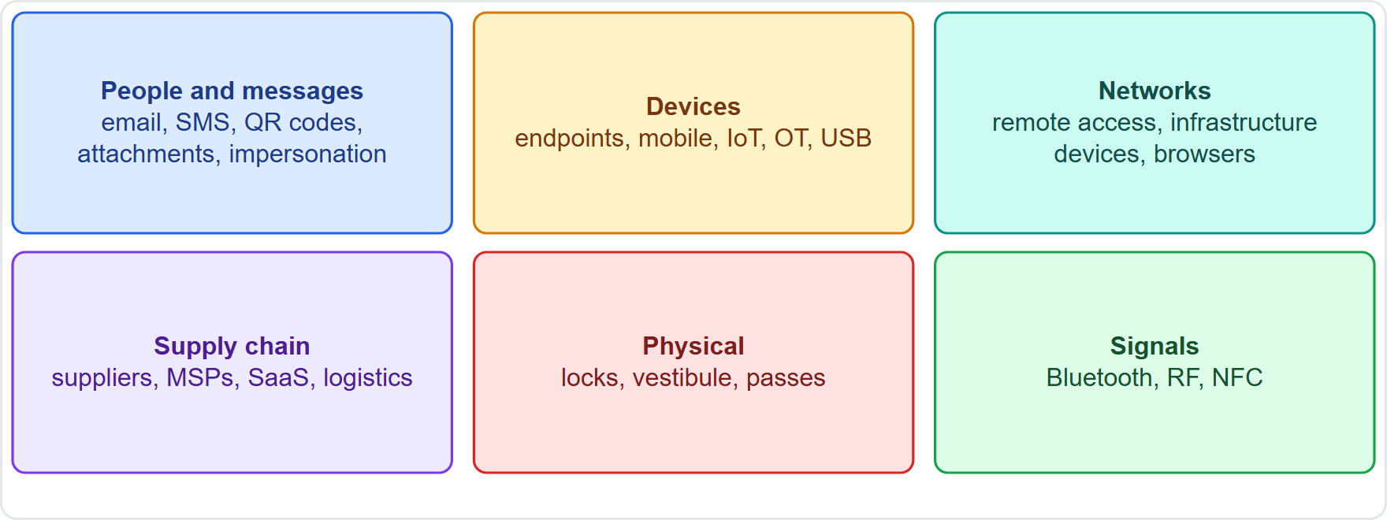
Vectors and the attack surface, continued
Module 5
Common threat vectors grouped by where they reach: people, devices, networks, supply chain, physical
SY0-801 Exam Prep | CompTIA Security+ exam
Module 5: Threat Vectors and Sources
5 / 18
Notes:
Vectors and the attack surface.
The figure shows this: Common threat vectors grouped by where they reach: people, devices, networks, supply chain, physical.

Slide 6
Message-based and content-based vectors
Module 5
Vector | Details
Message-based | Email, SMS, RCS (Rich Communication Services), instant messaging, collaboration tools: used for phishing, smishing and malicious links
Image-based | QR codes (quishing), embedded content, and CAPTCHA images abused to trick users
Attachment-based | Embedded macros in documents, RTF documents, PDFs with malicious code or links
Browser-based | Extensions, JavaScript, password managers, cookies and session tokens that can be stolen
EXAM TIP A QR code that sends a victim to a fake site is image-based (quishing). Macros in an Office file are attachment-based. A stolen session token lets an attacker skip the password.
SY0-801 Exam Prep | CompTIA Security+ exam
Module 5: Threat Vectors and Sources
6 / 18
Notes:
Message-based and content-based vectors.
Message-based. Email, S M S, R C S (Rich Communication Services), instant messaging, collaboration tools: used for phishing, smishing and malicious links.
Image-based. Q R codes (quishing), embedded content, and cap cha images abused to trick users.
Attachment-based. Embedded macros in documents, R T F documents, P D Fs with malicious code or links.
Browser-based. Extensions, Java Script, password managers, cookies and session tokens that can be stolen.
Exam tip: A Q R code that sends a victim to a fake site is image-based (quishing). Macros in an Office file are attachment-based. A stolen session token lets an attacker skip the password.

Slide 7
Network, remote and endpoint vectors
Module 5
Vector | Details
Network-based | Infrastructure devices (switches, routers), virtualized devices, stolen session keys
Remote access | Remote desktop (RDP), VNC, VPN: exposed or weakly protected entry points
Endpoint-based | Mobile devices, workstations, servers, tablets, trusted devices, built-in tools and living-off-the-land tools (legitimate system tools that attackers abuse)
IoT-based | Cameras, sensors, printers: often weak or default passwords and no patching
OT-based | Operational technology such as industrial control systems: long life, hard to patch
EXAM TIP Living off the land means attackers use tools already on the system (PowerShell, scripts) to avoid detection. An exposed remote desktop with a weak password is a classic remote access vector.
SY0-801 Exam Prep | CompTIA Security+ exam
Module 5: Threat Vectors and Sources
7 / 18
Notes:
Network, remote and endpoint vectors.
Network-based. Infrastructure devices (switches, routers), virtualized devices, stolen session keys.
Remote access. Remote desktop (R D P), V N C, V P N (virtual private network): exposed or weakly protected entry points.
Endpoint-based. Mobile devices, workstations, servers, tablets, trusted devices, built-in tools and living-off-the-land tools (legitimate system tools that attackers abuse).
Io T-based. Cameras, sensors, printers: often weak or default passwords and no patching.
O T-based. Operational technology such as industrial control systems: long life, hard to patch.
Exam tip: Living off the land means attackers use tools already on the system (Power Shell, scripts) to avoid detection. An exposed remote desktop with a weak password is a classic remote access vector.

Slide 8
Supply chain, media and human vectors
Module 5
Vector | Details
Supply chain-based | Third-party providers, managed service providers (MSPs), logistics providers, SaaS providers: a compromised supplier reaches many customers
External media-based | A malicious USB drive left or handed to a victim
Human-based | Impersonation, contractor, visitor, biometric spoofing, watering hole (compromising a site the targets visit)
Physical-based | Lock and key, access vestibule (a double-door entry), access passes
Signal-based | Bluetooth, radio frequency (RF), near-field communications (NFC)
SY0-801 Exam Prep | CompTIA Security+ exam
Module 5: Threat Vectors and Sources
8 / 18
Notes:
Supply chain, media and human vectors.
Supply chain-based. Third-party providers, managed service providers (M S Ps), logistics providers, sass providers: a compromised supplier reaches many customers.
External media-based. A malicious U S B drive left or handed to a victim.
Human-based. Impersonation, contractor, visitor, biometric spoofing, watering hole (compromising a site the targets visit).
Physical-based. Lock and key, access vestibule (a double-door entry), access passes.
Signal-based. Bluetooth, radio frequency (R F), near-field communications (N F C).

Slide 9
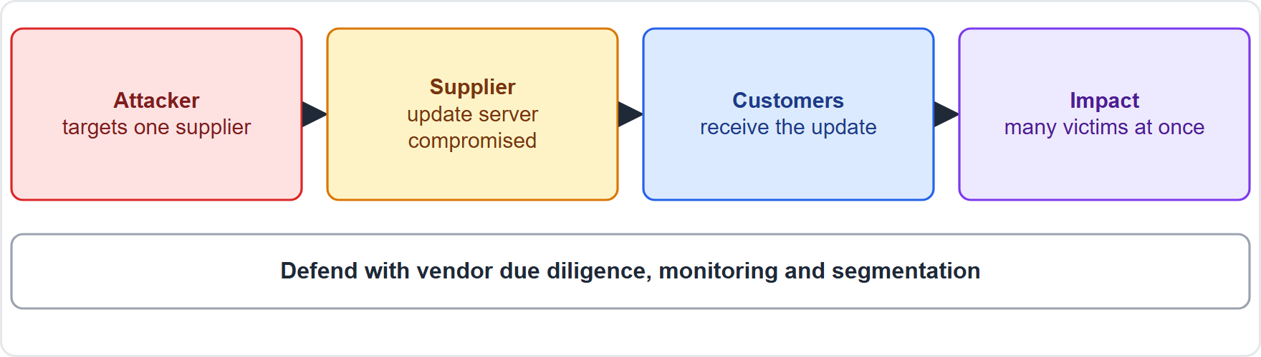
Supply chain, media and human vectors, continued
Module 5
A supply chain attack reaches many customers through one supplier
EXAM TIP A watering hole attack compromises a website the target group visits. A compromise of a managed service provider that reaches all its customers is a supply chain attack. An access vestibule helps stop tailgating (physical).
SY0-801 Exam Prep | CompTIA Security+ exam
Module 5: Threat Vectors and Sources
9 / 18
Notes:
Supply chain, media and human vectors.
The figure shows this: A supply chain attack reaches many customers through one supplier.
Exam tip: A watering hole attack compromises a website the target group visits. A compromise of a managed service provider that reaches all its customers is a supply chain attack. An access vestibule helps stop tailgating (physical).

Slide 10
Practice Question 1
Module 5
Q1
Fabrikam Outdoors finds that a poster with a QR code led visitors to a fake sign-in page. Which vector is this?
A
Attachment-based
B
Image-based
C
Supply chain-based
D
Remote access
SY0-801 Exam Prep | CompTIA Security+ exam
Module 5: Threat Vectors and Sources
10 / 18
Notes:
Question one. Fabrikam Outdoors finds that a poster with a Q R code led visitors to a fake sign-in page. Which vector is this? The four options are on the screen.
[PAUSE 10]
The answer is B: Image-based. A malicious Q R code is an image-based vector, often called quishing.

Slide 11
Practice Question 2
Module 5
Q2
Attackers compromise a software vendor's update server and push malware to all of the vendor's customers. Which vector is this?
A
Watering hole
B
Supply chain
C
Removable media
D
Signal-based
SY0-801 Exam Prep | CompTIA Security+ exam
Module 5: Threat Vectors and Sources
11 / 18
Notes:
Question two. Attackers compromise a software vendor's update server and push malware to all of the vendor's customers. Which vector is this? The four options are on the screen.
[PAUSE 10]
The answer is B: Supply chain. A compromised supplier delivering malicious updates to many customers is a supply chain attack.

Slide 12
Practice Question 3
Module 5
Q3
A user plugs in a USB drive found in the parking lot and malware runs. Which vector is this?
A
External media-based
B
Browser-based
C
Message-based
D
Network-based
SY0-801 Exam Prep | CompTIA Security+ exam
Module 5: Threat Vectors and Sources
12 / 18
Notes:
Question three. A user plugs in a U S B drive found in the parking lot and malware runs. Which vector is this? The four options are on the screen.
[PAUSE 10]
The answer is A: External media-based. A malicious U S B device is an external media-based vector.

Slide 13
Practice Question 4
Module 5
Q4
Attackers use PowerShell already installed on a workstation to move through the network without dropping new files. What is this technique called?
A
Living off the land
B
Tailgating
C
Watering hole
D
Pretexting
SY0-801 Exam Prep | CompTIA Security+ exam
Module 5: Threat Vectors and Sources
13 / 18
Notes:
Question four. Attackers use Power Shell already installed on a workstation to move through the network without dropping new files. What is this technique called? The four options are on the screen.
[PAUSE 10]
The answer is A: Living off the land. Using legitimate built-in tools to avoid detection is living off the land.

Slide 14
Practice Question 5
Module 5
Q5
An attacker infects a trade association's website that the target engineers visit daily. Which attack is this?
A
Watering hole
B
Smishing
C
Vishing
D
Shoulder surfing
SY0-801 Exam Prep | CompTIA Security+ exam
Module 5: Threat Vectors and Sources
14 / 18
Notes:
Question five. An attacker infects a trade association's website that the target engineers visit daily. Which attack is this? The four options are on the screen.
[PAUSE 10]
The answer is A: Watering hole. Compromising a site that the target group often visits is a watering hole attack.

Slide 15
Practice Question 6
Module 5
Q6
A building adds a double-door entry where only one person can pass at a time after badge validation. Which risk does it reduce the most?
A
Phishing
B
Tailgating
C
Cookie theft
D
DNS poisoning
SY0-801 Exam Prep | CompTIA Security+ exam
Module 5: Threat Vectors and Sources
15 / 18
Notes:
Question six. A building adds a double-door entry where only one person can pass at a time after badge validation. Which risk does it reduce the most? The four options are on the screen.
[PAUSE 10]
The answer is B: Tailgating. An access vestibule prevents unauthorized people from following an authorized person inside.

Slide 16
Recall Check 1
Module 5
Q1. What is a threat vector?
Q2. What does RCS stand for, and which vector is it?
Q3. Which browser items can be abused?
SY0-801 Exam Prep | CompTIA Security+ exam
Module 5: Threat Vectors and Sources
16 / 18
Notes:
Recall check one. Say each answer out loud before you listen to mine.
Question one. What is a threat vector?
[PAUSE 5]
Answer: A path an attacker uses to reach a target.
Question two. What does R C S stand for, and which vector is it?
[PAUSE 5]
Answer: Rich Communication Services; a message-based vector.
Question three. Which browser items can be abused?
[PAUSE 5]
Answer: Extensions, Java Script, password managers, cookies and session tokens.

Slide 17
Recall Check 2
Module 5
Q4. Name three IoT devices named in the objectives.
Q5. What is a watering hole attack?
Q6. Name three signal-based vectors.
SY0-801 Exam Prep | CompTIA Security+ exam
Module 5: Threat Vectors and Sources
17 / 18
Notes:
Recall check two. Say each answer out loud before you listen to mine.
Question four. Name three I O T devices named in the objectives.
[PAUSE 5]
Answer: Cameras, sensors and printers.
Question five. What is a watering hole attack?
[PAUSE 5]
Answer: Compromising a site that the target group visits.
Question six. Name three signal-based vectors.
[PAUSE 5]
Answer: Bluetooth, radio frequency and near-field communications.

Slide 18
Module Recap
Module 5
1
Message and content
2
Network and endpoint
email, SMS, RCS, IM, collaboration; QR codes, embedded content, CAPTCHA; macros, RTF, PDF
infrastructure devices, remote access (RDP, VNC, VPN); mobile, workstations, servers, living-off-the-land tools
3
Supply chain and people
4
Physical and signal
third parties, MSPs, logistics, SaaS; malicious USB; impersonation, contractor, visitor, watering hole
lock and key, access vestibule, passes; Bluetooth, RF, NFC
SY0-801 Exam Prep | CompTIA Security+ exam
Module 5: Threat Vectors and Sources
18 / 18
Notes:
Here is the recap.
Message and content: email, S M S, R C S, I M, collaboration; Q R codes, embedded content, cap cha; macros, R T F, P D F.
Network and endpoint: infrastructure devices, remote access (R D P, V N C, V P N); mobile, workstations, servers, living-off-the-land tools.
Supply chain and people: third parties, M S Ps, logistics, sass; malicious U S B; impersonation, contractor, visitor, watering hole.
Physical and signal: lock and key, access vestibule, passes; Bluetooth, R F, N F C.
In the next module, we continue the course.

