Slide 1
Module 10: Protecting Data
3.3 Summarize concepts and strategies used to protect data
SY0-801 exam prep · Security Architecture · 19% of the exam
SY0-801 Exam Prep: CompTIA Security+ Study Course
Module 10
Notes:
Welcome to Module ten: Protecting Data. It covers the exam area Security Architecture.
Each part of this module comes from the study notes of the same name, so you can read the notes after you watch.

Slide 2
What You Will Learn
Module 10
Data types and states
Data classification
Methods used to secure data
Data protection roles
Data handling and life cycle
Practice with exam-style questions and a recall check
SY0-801 Exam Prep | CompTIA Security+ exam
Module 10: Protecting Data
2 / 20
Notes:
By the end of this module you will be able to do six things.
Data types and states.
Data classification.
Methods used to secure data.
Data protection roles.
Data handling and life cycle.
Practice with exam-style questions and a recall check.

Slide 3
Where This Fits in the Exam
Module 10
EXAM CHECK-IN · Where this fits
Exam area: Security Architecture (19%)
Exam format: up to 90 questions in 90 minutes; a score of 750 on a scale of 100 to 900 passes
Validated against: the official CompTIA Security+ SY0-801 V8 exam objectives
SY0-801 Exam Prep | CompTIA Security+ exam
Module 10: Protecting Data
3 / 20
Notes:
Here is where this module sits in the exam.
Exam area: Security Architecture (nineteen percent).
Exam format: up to ninety questions in ninety minutes; a score of seven hundred fifty on a scale of one hundred to nine hundred passes.
Validated against: the official Comp T I A Security plus S Y zero eight oh one V eight exam objectives.

Slide 4
Data types and states
Module 10
Group | Items | Meaning
Data types | Structured | Organized in fields such as a database table
 | Unstructured | No fixed format: documents, email, images, video
Data states | Data at rest | Stored (disk, database, backup): protect with encryption and access control
 | Data in use | Being processed in memory: protect with access control and secure processing
 | Data in transit | Moving over a network: protect with TLS, VPN, IPsec
SY0-801 Exam Prep | CompTIA Security+ exam
Module 10: Protecting Data
4 / 20
Notes:
Data types and states.
Data types. Items: Structured. Meaning: Organized in fields such as a database table.
Items: Unstructured. Meaning: No fixed format: documents, email, images, video.
Data states. Items: Data at rest. Meaning: Stored (disk, database, backup): protect with encryption and access control.
Items: Data in use. Meaning: Being processed in memory: protect with access control and secure processing.
Items: Data in transit. Meaning: Moving over a network: protect with T L S, V P N (virtual private network), I P sec.

Slide 5
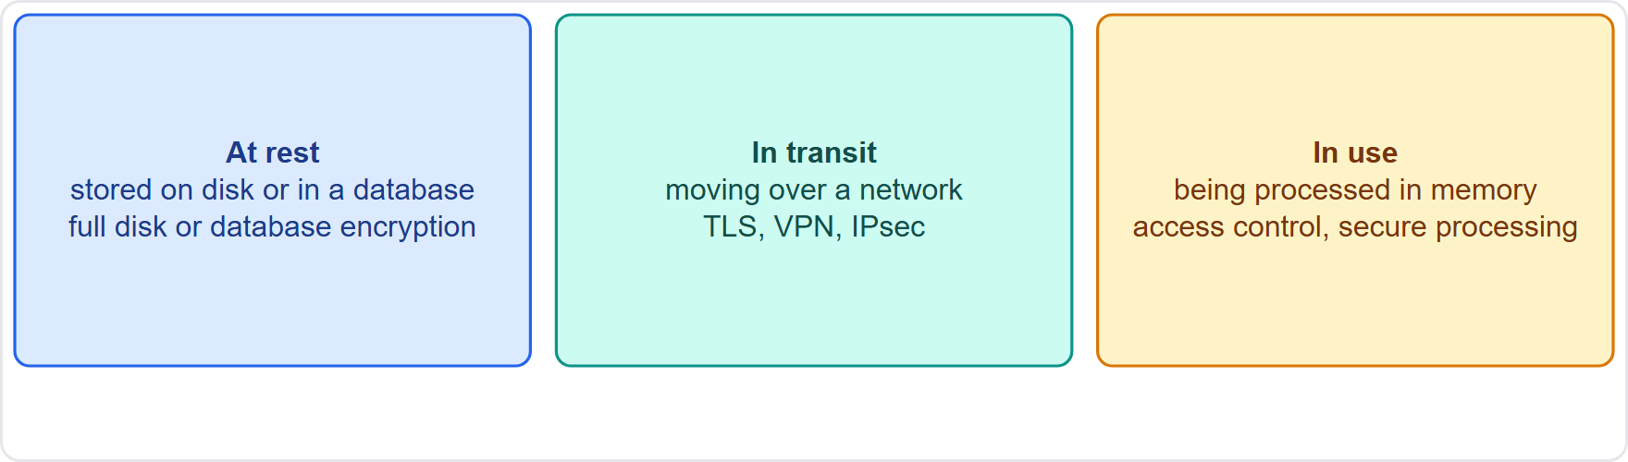
Data types and states, continued
Module 10
The three data states: at rest, in use and in transit, with a protection for each
EXAM TIP At rest = stored (encrypt the disk or database). In transit = moving (TLS or VPN). In use = in memory (hardest to protect).
SY0-801 Exam Prep | CompTIA Security+ exam
Module 10: Protecting Data
5 / 20
Notes:
Data types and states.
The figure shows this: The three data states: at rest, in use and in transit, with a protection for each.
Exam tip: At rest equals stored (encrypt the disk or database). In transit equals moving (T L S or V P N). In use equals in memory (hardest to protect).

Slide 6
Data classification
Module 10
Label | Typical meaning
Public | Safe to share with anyone
Restricted | Limited to specific groups
Confidential | Harm if disclosed outside the company
Sensitive | Needs care: for example personal or financial data
Secret / Top secret | Government-style high levels: serious or grave damage if exposed
Critical | Essential to operations: loss halts the business
Classification labels data by how sensitive it is, so it gets the right level of protection.
Organizations choose their own scheme; the key is applying handling rules to each level.
SY0-801 Exam Prep | CompTIA Security+ exam
Module 10: Protecting Data
6 / 20
Notes:
Data classification.
Classification labels data by how sensitive it is, so it gets the right level of protection.
Public. Safe to share with anyone.
Restricted. Limited to specific groups.
Confidential. Harm if disclosed outside the company.
Sensitive. Needs care: for example personal or financial data.
Secret or Top secret. Government-style high levels: serious or grave damage if exposed.
Critical. Essential to operations: loss halts the business.
Organizations choose their own scheme; the key is applying handling rules to each level.

Slide 7
Methods used to secure data
Module 10
Method | Meaning | Reversible?
Encryption | Scrambles data with a key | Yes, with the key
Hashing | One-way fingerprint | No
Masking | Hides part of a value (****-1234) | No (display only)
Tokenization | Replaces a value with a random token; the real value is in a secure vault | Yes, through the vault
Obfuscation | Makes data hard to understand | Often weak
SY0-801 Exam Prep | CompTIA Security+ exam
Module 10: Protecting Data
7 / 20
Notes:
Methods used to secure data.
Encryption. Meaning: Scrambles data with a key. Reversible?: Yes, with the key.
Hashing. Meaning: One-way fingerprint. Reversible?: No.
Masking. Meaning: Hides part of a value ( -one thousand two hundred thirty-four ). Reversible?: No (display only).
Tokenization. Meaning: Replaces a value with a random token; the real value is in a secure vault. Reversible?: Yes, through the vault.
Obfuscation. Meaning: Makes data hard to understand. Reversible?: Often weak.

Slide 8
Methods used to secure data, continued
Module 10
Method | Meaning | Reversible?
Deidentification | Removes personal identifiers | Not meant to be
Filtering | Blocks or removes sensitive content from data flows | n/a
Data transpose | Rearranges data (for example swapping fields) | Depends
SY0-801 Exam Prep | CompTIA Security+ exam
Module 10: Protecting Data
8 / 20
Notes:
Methods used to secure data.
Deidentification. Meaning: Removes personal identifiers. Reversible?: Not meant to be.
Filtering. Meaning: Blocks or removes sensitive content from data flows. Reversible?: n or a.
Data transpose. Meaning: Rearranges data (for example swapping fields). Reversible?: Depends.

Slide 9
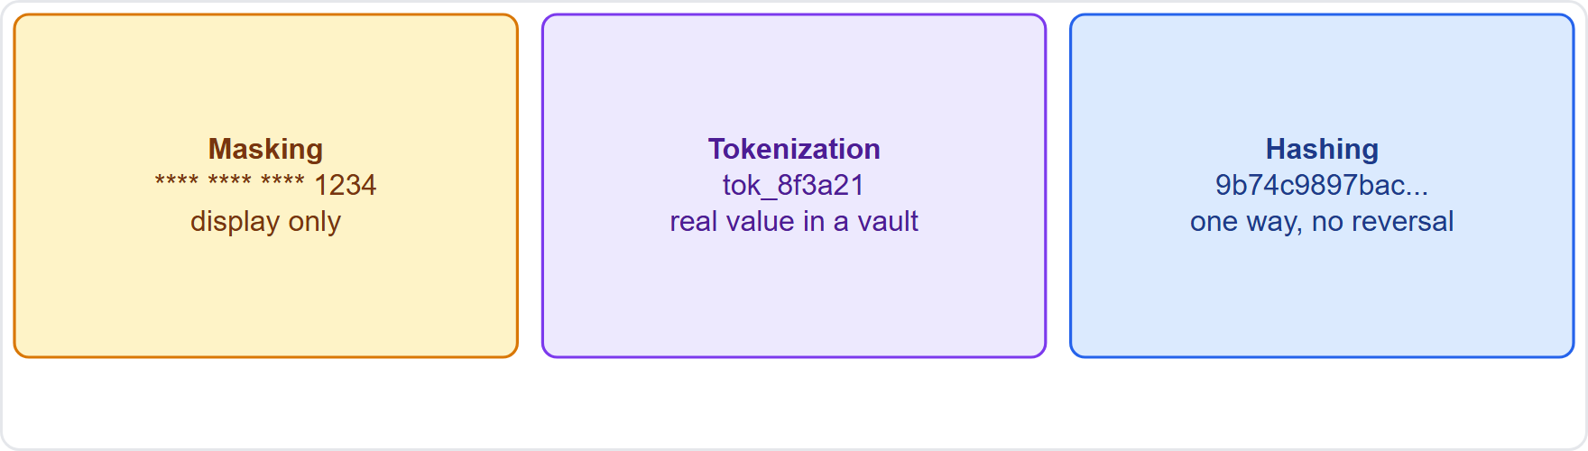
Methods used to secure data, continued
Module 10
Masking, tokenization and hashing compared with the same card number
EXAM TIP Tokenization swaps the value for a token stored with a vault; it is common for payment cards. Masking is display protection. Hashing cannot be reversed. Deidentification supports privacy.
SY0-801 Exam Prep | CompTIA Security+ exam
Module 10: Protecting Data
9 / 20
Notes:
Methods used to secure data.
The figure shows this: Masking, tokenization and hashing compared with the same card number.
Exam tip: Tokenization swaps the value for a token stored with a vault; it is common for payment cards. Masking is display protection. Hashing cannot be reversed. Deidentification supports privacy.

Slide 10
Data protection roles
Module 10
Role | Responsibility
Data owner | Accountable for the data; decides classification and access
Data custodian | Operates and protects the data day to day (technical controls, backups)
Data steward | Ensures data quality and proper use under policy
Data operator | Processes data on instructions
Data controller | Decides why and how personal data is processed
Data subprocessor | A third party that processes data for a processor
SY0-801 Exam Prep | CompTIA Security+ exam
Module 10: Protecting Data
10 / 20
Notes:
Data protection roles.
Data owner. Accountable for the data; decides classification and access.
Data custodian. Operates and protects the data day to day (technical controls, backups).
Data steward. Ensures data quality and proper use under policy.
Data operator. Processes data on instructions.
Data controller. Decides why and how personal data is processed.
Data subprocessor. A third party that processes data for a processor.

Slide 11
Data handling and life cycle
Module 10
Topic | Items
Handling | Endpoints, marking and labeling, geofencing (limit by location), data location, data placement
Life cycle | Creation, management, distribution, retention, disposal
Compliance | Standards, health data, personal information, financial, child or minor data, intellectual property, legal data
EXAM TIP Disposal must be secure (shredding, cryptographic erase, degaussing). The data owner classifies; the custodian implements controls. A controller decides purposes; a processor acts on its behalf.
SY0-801 Exam Prep | CompTIA Security+ exam
Module 10: Protecting Data
11 / 20
Notes:
Data handling and life cycle.
Handling. Endpoints, marking and labeling, geofencing (limit by location), data location, data placement.
Life cycle. Creation, management, distribution, retention, disposal.
Compliance. Standards, health data, personal information, financial, child or minor data, intellectual property, legal data.
Exam tip: Disposal must be secure (shredding, cryptographic erase, degaussing). The data owner classifies; the custodian implements controls. A controller decides purposes; a processor acts on its behalf.

Slide 12
Practice Question 1
Module 10
Q1
Fabrikam Outdoors wants to keep real card numbers out of its order system but still allow refunds. Which method fits best?
A
Hashing
B
Salting
C
Tokenization
D
Deidentification
SY0-801 Exam Prep | CompTIA Security+ exam
Module 10: Protecting Data
12 / 20
Notes:
Question one. Fabrikam Outdoors wants to keep real card numbers out of its order system but still allow refunds. Which method fits best? The four options are on the screen.
[PAUSE 10]
The answer is C: Tokenization. Tokenization replaces the card number with a token while the real value stays in a secure vault for authorized use.

Slide 13
Practice Question 2
Module 10
Q2
A call center screen shows only the last four digits of a card. Which method is this?
A
Encryption
B
Masking
C
Filtering
D
Steganography
SY0-801 Exam Prep | CompTIA Security+ exam
Module 10: Protecting Data
13 / 20
Notes:
Question two. A call center screen shows only the last four digits of a card. Which method is this? The four options are on the screen.
[PAUSE 10]
The answer is B: Masking. Showing part of a value and hiding the rest is masking.

Slide 14
Practice Question 3
Module 10
Q3
Customer files on a laptop are encrypted with full disk encryption. Which data state does this protect?
A
Data in use
B
Data in transit
C
Data at rest
D
Data in memory
SY0-801 Exam Prep | CompTIA Security+ exam
Module 10: Protecting Data
14 / 20
Notes:
Question three. Customer files on a laptop are encrypted with full disk encryption. Which data state does this protect? The four options are on the screen.
[PAUSE 10]
The answer is C: Data at rest. Stored data is data at rest, and disk encryption protects it.

Slide 15
Practice Question 4
Module 10
Q4
Who decides how a company's customer database is classified and who may access it?
A
Data custodian
B
Data subprocessor
C
Data operator
D
Data owner
SY0-801 Exam Prep | CompTIA Security+ exam
Module 10: Protecting Data
15 / 20
Notes:
Question four. Who decides how a company's customer database is classified and who may access it? The four options are on the screen.
[PAUSE 10]
The answer is D: Data owner. The data owner is accountable for the data and sets its classification and access rules.

Slide 16
Practice Question 5
Module 10
Q5
An administrator backs up and secures the database servers according to the owner's rules. Which role is this?
A
Data custodian
B
Data controller
C
Data steward
D
Data owner
SY0-801 Exam Prep | CompTIA Security+ exam
Module 10: Protecting Data
16 / 20
Notes:
Question five. An administrator backs up and secures the database servers according to the owner's rules. Which role is this? The four options are on the screen.
[PAUSE 10]
The answer is A: Data custodian. The custodian operates and protects the data using technical controls.

Slide 17
Practice Question 6
Module 10
Q6
A company restricts who can download files depending on the country they are in. Which handling technique is this?
A
Tokenization
B
Salting
C
Data transpose
D
Geofencing
SY0-801 Exam Prep | CompTIA Security+ exam
Module 10: Protecting Data
17 / 20
Notes:
Question six. A company restricts who can download files depending on the country they are in. Which handling technique is this? The four options are on the screen.
[PAUSE 10]
The answer is D: Geofencing. Geofencing limits access or use based on location.

Slide 18
Recall Check 1
Module 10
Q1. Name the three data states.
Q2. What is the difference between structured and unstructured data?
Q3. Which method is reversible only through a vault?
SY0-801 Exam Prep | CompTIA Security+ exam
Module 10: Protecting Data
18 / 20
Notes:
Recall check one. Say each answer out loud before you listen to mine.
Question one. Name the three data states.
[PAUSE 5]
Answer: At rest, in use and in transit.
Question two. What is the difference between structured and unstructured data?
[PAUSE 5]
Answer: Structured data has fixed fields; unstructured data has no fixed format.
Question three. Which method is reversible only through a vault?
[PAUSE 5]
Answer: Tokenization.

Slide 19
Recall Check 2
Module 10
Q4. What is the data steward responsible for?
Q5. Name the five stages of the data life cycle.
Q6. What is a data controller?
SY0-801 Exam Prep | CompTIA Security+ exam
Module 10: Protecting Data
19 / 20
Notes:
Recall check two. Say each answer out loud before you listen to mine.
Question four. What is the data steward responsible for?
[PAUSE 5]
Answer: Data quality and proper use under policy.
Question five. Name the five stages of the data life cycle.
[PAUSE 5]
Answer: Creation, management, distribution, retention and disposal.
Question six. What is a data controller?
[PAUSE 5]
Answer: The party that decides why and how personal data is processed.

Slide 20
Module Recap
Module 10
1
States
2
Classification
3
Methods
at rest (stored), in use (memory), in transit (network)
public, restricted, confidential, sensitive, secret, top secret, critical
encryption, hashing, masking, tokenization (vault), obfuscation, deidentification, filtering, transpose
4
Roles
5
Handling
owner (accountable), custodian (operates), steward (quality), operator, controller, subprocessor
labeling, geofencing, location, placement; life cycle ends with secure disposal
SY0-801 Exam Prep | CompTIA Security+ exam
Module 10: Protecting Data
20 / 20
Notes:
Here is the recap.
States: at rest (stored), in use (memory), in transit (network).
Classification: public, restricted, confidential, sensitive, secret, top secret, critical.
Methods: encryption, hashing, masking, tokenization (vault), obfuscation, deidentification, filtering, transpose.
Roles: owner (accountable), custodian (operates), steward (quality), operator, controller, subprocessor.
Handling: labeling, geofencing, location, placement; life cycle ends with secure disposal.
In the next module, we continue the course.

