Slide 1
Module 11: Resilience and Recovery
3.4 Explain the importance of resilience and recovery in security architecture
SY0-801 exam prep · Security Architecture · 19% of the exam
SY0-801 Exam Prep: CompTIA Security+ Study Course
Module 11
Notes:
Welcome to Module eleven: Resilience and Recovery. It covers the exam area Security Architecture.
Each part of this module comes from the study notes of the same name, so you can read the notes after you watch.

Slide 2
What You Will Learn
Module 11
The goal
Recovery sites
Platform diversity and redundancy
Backups
Testing, planning and metrics
Practice with exam-style questions and a recall check
SY0-801 Exam Prep | CompTIA Security+ exam
Module 11: Resilience and Recovery
2 / 20
Notes:
By the end of this module you will be able to do six things.
The goal.
Recovery sites.
Platform diversity and redundancy.
Backups.
Testing, planning and metrics.
Practice with exam-style questions and a recall check.

Slide 3
Where This Fits in the Exam
Module 11
EXAM CHECK-IN · Where this fits
Exam area: Security Architecture (19%)
Exam format: up to 90 questions in 90 minutes; a score of 750 on a scale of 100 to 900 passes
Validated against: the official CompTIA Security+ SY0-801 V8 exam objectives
SY0-801 Exam Prep | CompTIA Security+ exam
Module 11: Resilience and Recovery
3 / 20
Notes:
Here is where this module sits in the exam.
Exam area: Security Architecture (nineteen percent).
Exam format: up to ninety questions in ninety minutes; a score of seven hundred fifty on a scale of one hundred to nine hundred passes.
Validated against: the official Comp T I A Security plus S Y zero eight oh one V eight exam objectives.

Slide 4
The goal
Module 11
Resilience keeps services running when something fails; recovery brings them back after an outage or attack. Both protect availability (the "A" in CIA).
SY0-801 Exam Prep | CompTIA Security+ exam
Module 11: Resilience and Recovery
4 / 20
Notes:
The goal.
Resilience keeps services running when something fails; recovery brings them back after an outage or attack. Both protect availability (the "A" in C I A).

Slide 5
Recovery sites
Module 11
Site | State | Recovery speed | Cost
Hot site | Fully equipped and running, data kept current | Minutes to hours | Highest
Warm site | Equipment ready, data needs restoring | Hours to days | Medium
Cold site | Empty space with power and connectivity | Days to weeks | Lowest
Also consider environmental factors (power, cooling, floods, location) when choosing a site.
SY0-801 Exam Prep | CompTIA Security+ exam
Module 11: Resilience and Recovery
5 / 20
Notes:
Recovery sites.
Hot site. State: Fully equipped and running, data kept current. Recovery speed: Minutes to hours. Cost: Highest.
Warm site. State: Equipment ready, data needs restoring. Recovery speed: Hours to days. Cost: Medium.
Cold site. State: Empty space with power and connectivity. Recovery speed: Days to weeks. Cost: Lowest.
Also consider environmental factors (power, cooling, floods, location) when choosing a site.

Slide 6
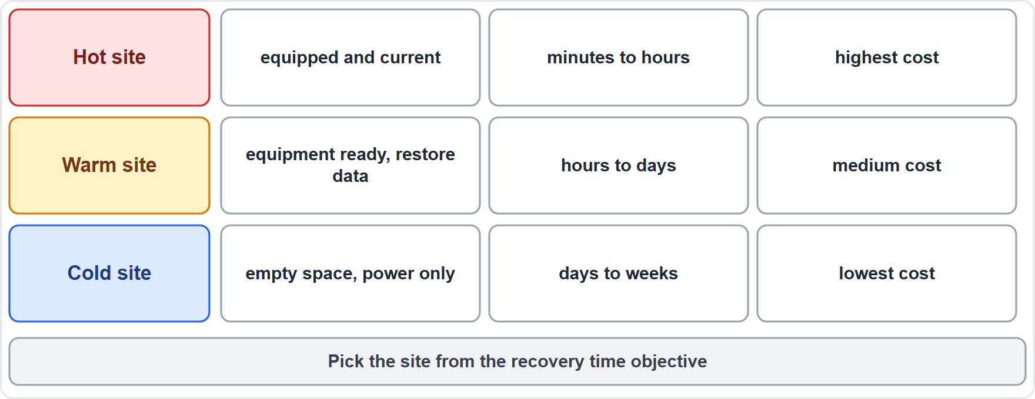
Recovery sites, continued
Module 11
Hot, warm and cold sites compared by readiness, speed and cost
EXAM TIP Hot = fastest and most expensive; cold = slowest and cheapest; warm = in between. The choice follows the recovery time objective.
SY0-801 Exam Prep | CompTIA Security+ exam
Module 11: Resilience and Recovery
6 / 20
Notes:
Recovery sites.
The figure shows this: Hot, warm and cold sites compared by readiness, speed and cost.
Exam tip: Hot equals fastest and most expensive; cold equals slowest and cheapest; warm equals in between. The choice follows the recovery time objective.

Slide 7
Platform diversity and redundancy
Module 11
Strategy | Meaning
Platform diversity | Use different vendors, hardware and virtualization so one flaw or outage does not hit everything
Load balancing | Spreads traffic across servers
Clustering | Servers work together and take over if one fails
Autoscaling | Adds or removes capacity automatically with demand
High availability (HA) | Design with no single point of failure
Multicloud systems | Run across more than one cloud
Power | UPS (battery), redundant power supply (RPS), generator, surge protector
Storage | RAID and replicated storage [Beyond the objectives]
EXAM TIP UPS bridges a short outage; a generator covers a long one. Clustering gives automatic failover; load balancing shares load and can remove failed nodes.
SY0-801 Exam Prep | CompTIA Security+ exam
Module 11: Resilience and Recovery
7 / 20
Notes:
Platform diversity and redundancy.
Platform diversity. Use different vendors, hardware and virtualization so one flaw or outage does not hit everything.
Load balancing. Spreads traffic across servers.
Clustering. Servers work together and take over if one fails.
Autoscaling. Adds or removes capacity automatically with demand.
High availability (H A). Design with no single point of failure.
Multicloud systems. Run across more than one cloud.
Power. U P S (battery), redundant power supply (R P S), generator, surge protector.
Storage. raid and replicated storage.
Exam tip: U P S bridges a short outage; a generator covers a long one. Clustering gives automatic failover; load balancing shares load and can remove failed nodes.

Slide 8
Backups
Module 11
Topic | Key points
Retention | How long backups are kept (legal and business needs)
Immutability | Backups that cannot be changed or deleted for a set time: protect against ransomware
Scope | What is backed up: full, incremental (changes since the last backup of any type), differential (changes since the last full)
Restoration testing | Test restores regularly: an untested backup is not a backup
Offline and offsite copies | Keep a copy away from the network and in another place
A common rule is 3-2-1: 3 copies, on 2 types of media, 1 offsite. [Beyond the objectives]
SY0-801 Exam Prep | CompTIA Security+ exam
Module 11: Resilience and Recovery
8 / 20
Notes:
Backups.
Retention. How long backups are kept (legal and business needs).
Immutability. Backups that cannot be changed or deleted for a set time: protect against ransomware.
Scope. What is backed up: full, incremental (changes since the last backup of any type), differential (changes since the last full).
Restoration testing. Test restores regularly: an untested backup is not a backup.
Offline and offsite copies. Keep a copy away from the network and in another place.
A common rule is three to two-one: three copies, on two types of media, one offsite.

Slide 9
Testing, planning and metrics
Module 11
Item | Meaning
Testing | Failover tests, simulation and parallel processing (run the recovery system alongside production)
Disaster recovery (DR) | Restore IT systems after a major event
Business continuity (BC) | Keep the business running during and after a disruption
Capacity planning | Ensure enough people, technology and infrastructure for the future
SY0-801 Exam Prep | CompTIA Security+ exam
Module 11: Resilience and Recovery
9 / 20
Notes:
Testing, planning and metrics.
Testing. Failover tests, simulation and parallel processing (run the recovery system alongside production).
Disaster recovery (D R). Restore I T systems after a major event.
Business continuity (B C). Keep the business running during and after a disruption.
Capacity planning. Ensure enough people, technology and infrastructure for the future.

Slide 10
Testing, planning and metrics, continued
Module 11
Metric | Meaning
RTO (recovery time objective) | Maximum time a system can be down
RPO (recovery point objective) | Maximum data loss measured in time (how old the last backup may be)
MTTR (mean time to repair) | Average time to fix a failure
MTBF (mean time between failures) | Average time a system works between failures
SY0-801 Exam Prep | CompTIA Security+ exam
Module 11: Resilience and Recovery
10 / 20
Notes:
Testing, planning and metrics.
R T O (recovery time objective). Maximum time a system can be down.
R P O (recovery point objective). Maximum data loss measured in time (how old the last backup may be).
M T T R (mean time to repair). Average time to fix a failure.
M T B F (mean time between failures). Average time a system works between failures.

Slide 11
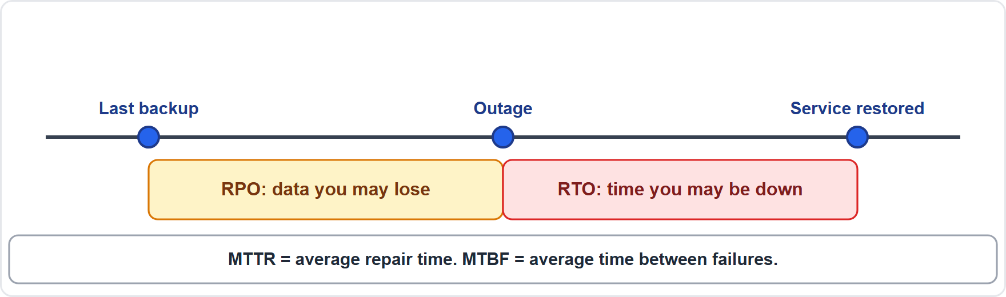
Testing, planning and metrics, continued
Module 11
RTO and RPO on a timeline around an outage
EXAM TIP RTO = how long down. RPO = how much data you can lose. If backups run every 4 hours, the RPO is up to 4 hours. Higher MTBF is better; lower MTTR is better.
SY0-801 Exam Prep | CompTIA Security+ exam
Module 11: Resilience and Recovery
11 / 20
Notes:
Testing, planning and metrics.
The figure shows this: R T O and R P O on a timeline around an outage.
Exam tip: R T O equals how long down. R P O equals how much data you can lose. If backups run every four hours, the R P O is up to four hours. Higher M T B F is better; lower M T T R is better.

Slide 12
Practice Question 1
Module 11
Q1
Fabrikam Outdoors must resume operations within one hour after a disaster and can afford a fully equipped duplicate site. Which site fits?
A
Hot site
B
Cold site
C
Warm site
D
Air-gapped site
SY0-801 Exam Prep | CompTIA Security+ exam
Module 11: Resilience and Recovery
12 / 20
Notes:
Question one. Fabrikam Outdoors must resume operations within one hour after a disaster and can afford a fully equipped duplicate site. Which site fits? The four options are on the screen.
[PAUSE 10]
The answer is A: Hot site. A hot site is fully equipped and current, giving the fastest recovery.

Slide 13
Practice Question 2
Module 11
Q2
A company backs up every 6 hours. What is the best description of its RPO?
A
The system can be down 6 hours
B
A repair takes 6 hours on average
C
Up to 6 hours of data could be lost
D
A failure happens every 6 hours
SY0-801 Exam Prep | CompTIA Security+ exam
Module 11: Resilience and Recovery
13 / 20
Notes:
Question two. A company backs up every six hours. What is the best description of its R P O? The four options are on the screen.
[PAUSE 10]
The answer is C: Up to six hours of data could be lost. The R P O is the amount of data loss tolerated, which depends on the backup interval.

Slide 14
Practice Question 3
Module 11
Q3
Which backup feature helps most to protect against ransomware that tries to delete backups?
A
Deduplication
B
Compression
C
Immutability
D
Encryption in transit
SY0-801 Exam Prep | CompTIA Security+ exam
Module 11: Resilience and Recovery
14 / 20
Notes:
Question three. Which backup feature helps most to protect against ransomware that tries to delete backups? The four options are on the screen.
[PAUSE 10]
The answer is C: Immutability. Immutable backups cannot be changed or deleted for a set time, so ransomware cannot destroy them.

Slide 15
Practice Question 4
Module 11
Q4
A data center loses power for 20 seconds before the generator starts. Which device keeps servers running in that gap?
A
Surge protector
B
Load balancer
C
Switch
D
UPS
SY0-801 Exam Prep | CompTIA Security+ exam
Module 11: Resilience and Recovery
15 / 20
Notes:
Question four. A data center loses power for twenty seconds before the generator starts. Which device keeps servers running in that gap? The four options are on the screen.
[PAUSE 10]
The answer is D: U P S. A U P S provides battery power for short outages until the generator takes over.

Slide 16
Practice Question 5
Module 11
Q5
Which test runs the recovery environment next to production without switching users to it?
A
Full failover
B
Tabletop exercise
C
Restoration of one file
D
Parallel processing
SY0-801 Exam Prep | CompTIA Security+ exam
Module 11: Resilience and Recovery
16 / 20
Notes:
Question five. Which test runs the recovery environment next to production without switching users to it? The four options are on the screen.
[PAUSE 10]
The answer is D: Parallel processing. Parallel processing runs the recovery system alongside production to check it without disruption.

Slide 17
Practice Question 6
Module 11
Q6
A team measures the average time a server runs before it fails. Which metric is this?
A
MTBF
B
MTTR
C
RTO
D
RPO
SY0-801 Exam Prep | CompTIA Security+ exam
Module 11: Resilience and Recovery
17 / 20
Notes:
Question six. A team measures the average time a server runs before it fails. Which metric is this? The four options are on the screen.
[PAUSE 10]
The answer is A: M T B F. Mean time between failures is the average operating time between failures.

Slide 18
Recall Check 1
Module 11
Q1. Which recovery site is cheapest and slowest?
Q2. What does RTO measure?
Q3. What does RPO measure?
SY0-801 Exam Prep | CompTIA Security+ exam
Module 11: Resilience and Recovery
18 / 20
Notes:
Recall check one. Say each answer out loud before you listen to mine.
Question one. Which recovery site is cheapest and slowest?
[PAUSE 5]
Answer: A cold site.
Question two. What does R T O measure?
[PAUSE 5]
Answer: The maximum time a system may be down.
Question three. What does R P O measure?
[PAUSE 5]
Answer: The maximum acceptable data loss in time.

Slide 19
Recall Check 2
Module 11
Q4. What is the difference between disaster recovery and business continuity?
Q5. What is platform diversity?
Q6. Why test restores?
SY0-801 Exam Prep | CompTIA Security+ exam
Module 11: Resilience and Recovery
19 / 20
Notes:
Recall check two. Say each answer out loud before you listen to mine.
Question four. What is the difference between disaster recovery and business continuity?
[PAUSE 5]
Answer: D R restores I T systems; B C keeps the business running.
Question five. What is platform diversity?
[PAUSE 5]
Answer: Using different vendors or platforms so one failure does not affect everything.
Question six. Why test restores?
[PAUSE 5]
Answer: To prove that backups actually work.

Slide 20
Module Recap
Module 11
1
Sites
2
Redundancy
3
Backups
hot (fast, costly), warm (middle), cold (slow, cheap)
load balancing, clustering, autoscaling, HA, multicloud; UPS, RPS, generator, surge protector
retention, immutability, scope (full, incremental, differential), restoration testing
4
Plans and tests
5
Metrics
failover, simulation, parallel processing; DR vs BC; capacity planning
RTO (downtime), RPO (data loss), MTTR (repair time), MTBF (time between failures)
SY0-801 Exam Prep | CompTIA Security+ exam
Module 11: Resilience and Recovery
20 / 20
Notes:
Here is the recap.
Sites: hot (fast, costly), warm (middle), cold (slow, cheap).
Redundancy: load balancing, clustering, autoscaling, H A, multicloud; U P S, R P S, generator, surge protector.
Backups: retention, immutability, scope (full, incremental, differential), restoration testing.
Plans and tests: failover, simulation, parallel processing; D R versus B C; capacity planning.
Metrics: R T O (downtime), R P O (data loss), M T T R (repair time), M T B F (time between failures).
In the next module, we continue the course.

