Slide 1
Module 12: Mitigating Controls and Techniques
4.1 Given a scenario, apply mitigating controls, techniques, and solutions to secure the environment
SY0-801 exam prep · Security Operations · 27% of the exam
SY0-801 Exam Prep: CompTIA Security+ Study Course
Module 12
Notes:
Welcome to Module twelve: Mitigating Controls and Techniques. It covers the exam area Security Operations.
Each part of this module comes from the study notes of the same name, so you can read the notes after you watch.

Slide 2
What You Will Learn
Module 12
Overview of the toolbox
Deception and disruption technology
Detection and prevention systems and firewalls
Content, endpoint and network access controls
Applications, email and operating systems
Practice with exam-style questions and a recall check
SY0-801 Exam Prep | CompTIA Security+ exam
Module 12: Mitigating Controls and Techniques
2 / 19
Notes:
By the end of this module you will be able to do six things.
Overview of the toolbox.
Deception and disruption technology.
Detection and prevention systems and firewalls.
Content, endpoint and network access controls.
Applications, email and operating systems.
Practice with exam-style questions and a recall check.

Slide 3
Where This Fits in the Exam
Module 12
EXAM CHECK-IN · Where this fits
Exam area: Security Operations (27%)
Exam format: up to 90 questions in 90 minutes; a score of 750 on a scale of 100 to 900 passes
Validated against: the official CompTIA Security+ SY0-801 V8 exam objectives
SY0-801 Exam Prep | CompTIA Security+ exam
Module 12: Mitigating Controls and Techniques
3 / 19
Notes:
Here is where this module sits in the exam.
Exam area: Security Operations (twenty-seven percent).
Exam format: up to ninety questions in ninety minutes; a score of seven hundred fifty on a scale of one hundred to nine hundred passes.
Validated against: the official Comp T I A Security plus S Y zero eight oh one V eight exam objectives.

Slide 4
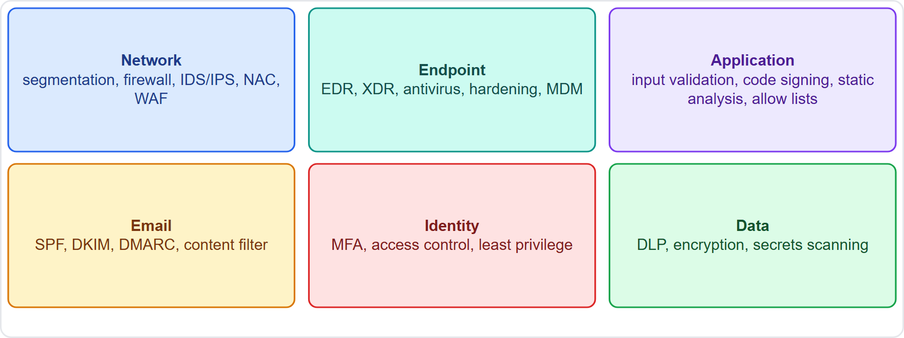
Overview of the toolbox
Module 12
Mitigations grouped by where they protect: network, endpoint, application, email, identity and data
SY0-801 Exam Prep | CompTIA Security+ exam
Module 12: Mitigating Controls and Techniques
4 / 19
Notes:
Overview of the toolbox.
The figure shows this: Mitigations grouped by where they protect: network, endpoint, application, email, identity and data.

Slide 5
Overview of the toolbox, continued
Module 12
Technique | Purpose
Segmentation | Split the network into zones so an attacker cannot move freely
Access controls | Allow only the right users and devices (module 15)
Hardening | Remove what is not needed, apply secure settings, patch, change defaults
Sandboxing | Run code in an isolated environment to study or limit it
Monitoring and alerting | Detect problems quickly (module 14)
Mobile device management (MDM) | Enroll, configure and wipe phones and tablets
Application control | Allow lists (only approved apps run) or block lists (known bad apps are blocked)
EXAM TIP Allow list = deny everything except what is approved (stronger). Block list = allow everything except what is listed (weaker). Hardening = reduce the attack surface.
SY0-801 Exam Prep | CompTIA Security+ exam
Module 12: Mitigating Controls and Techniques
5 / 19
Notes:
Overview of the toolbox.
Segmentation. Split the network into zones so an attacker cannot move freely.
Access controls. Allow only the right users and devices (module fifteen).
Hardening. Remove what is not needed, apply secure settings, patch, change defaults.
Sandboxing. Run code in an isolated environment to study or limit it.
Monitoring and alerting. Detect problems quickly (module fourteen).
Mobile device management (M D M). Enroll, configure and wipe phones and tablets.
Application control. Allow lists (only approved apps run) or block lists (known bad apps are blocked).
Exam tip: Allow list equals deny everything except what is approved (stronger). Block list equals allow everything except what is listed (weaker). Hardening equals reduce the attack surface.

Slide 6
Deception and disruption technology
Module 12
Tool | Meaning
Honeypot | A decoy system that attracts attackers
Honeynet | A network of honeypots
Honeyfile | A fake file that raises an alert when opened
Honeytoken | Fake data or credentials that raise an alert when used
Canary account | A fake account that alerts when someone tries to use it
They give early warning and reveal attacker methods.
SY0-801 Exam Prep | CompTIA Security+ exam
Module 12: Mitigating Controls and Techniques
6 / 19
Notes:
Deception and disruption technology.
Honeypot. A decoy system that attracts attackers.
Honeynet. A network of honeypots.
Honeyfile. A fake file that raises an alert when opened.
Honeytoken. Fake data or credentials that raise an alert when used.
Canary account. A fake account that alerts when someone tries to use it.
They give early warning and reveal attacker methods.

Slide 7
Detection and prevention systems and firewalls
Module 12
Item | Meaning
IDS | Detects and alerts
IPS | Detects and blocks
NIDS / NIPS | Network-based sensor on the network
HIDS / HIPS | Host-based, on one computer
WIPS | Wireless intrusion prevention (rogue access points)
Firewall | Filters traffic by rules; layer 4 (ports, protocols) or layer 7 (application content)
Rate limiting | Caps requests per time to slow floods and brute force
WAF | Web application firewall protects web apps from injection and cross-site scripting
Rule-based | Traffic matched against ordered rules; ends with an implicit deny
UTM | Unified threat management: firewall plus IPS, filtering and antivirus in one device
EXAM TIP IPS blocks, IDS only alerts. A WAF protects web applications at layer 7. A UTM combines several functions in one appliance.
SY0-801 Exam Prep | CompTIA Security+ exam
Module 12: Mitigating Controls and Techniques
7 / 19
Notes:
Detection and prevention systems and firewalls.
I D S. Detects and alerts.
I P S. Detects and blocks.
N I D S or N I P S. Network-based sensor on the network.
H I D S or H I P S. Host-based, on one computer.
W I P S. Wireless intrusion prevention (rogue access points).
Firewall. Filters traffic by rules; layer four (ports, protocols) or layer seven (application content).
Rate limiting. Caps requests per time to slow floods and brute force.
waff. Web application firewall protects web apps from injection and cross-site scripting.
Rule-based. Traffic matched against ordered rules; ends with an implicit deny.
U T M. Unified threat management: firewall plus I P S, filtering and antivirus in one device.
Exam tip: I P S blocks, I D S only alerts. A waff protects web applications at layer seven. A U T M combines several functions in one appliance.

Slide 8
Content, endpoint and network access controls
Module 12
Item | Meaning
Content filter | Blocks bad sites and content
Data loss prevention (DLP) | Stops sensitive data leaving; agent-based (on the endpoint) or via a centralized proxy
EDR | Endpoint detection and response: records endpoint behavior, detects, isolates and remediates
XDR | Extended detection and response: combines endpoint, network, email and cloud signals
Antivirus | Detects known malware by signatures and behavior
Network access control (NAC) | Decides who may connect; captive portals (a sign-in page), 802.1X (port-based authentication), endpoint posture checks
SY0-801 Exam Prep | CompTIA Security+ exam
Module 12: Mitigating Controls and Techniques
8 / 19
Notes:
Content, endpoint and network access controls.
Content filter. Blocks bad sites and content.
Data loss prevention (D L P). Stops sensitive data leaving; agent-based (on the endpoint) or via a centralized proxy.
E D R. Endpoint detection and response: records endpoint behavior, detects, isolates and remediates.
X D R. Extended detection and response: combines endpoint, network, email and cloud signals.
Antivirus. Detects known malware by signatures and behavior.
Network access control (N A C). Decides who may connect; captive portals (a sign-in page), eight oh two dot one X (port-based authentication), endpoint posture checks.

Slide 9
Applications, email and operating systems
Module 12
Area | Controls
Repositories | Secrets scanning finds keys and passwords in code
Application security | Input validation, secure cookies, static code analysis, code signing
Email security | SPF (which servers may send for a domain), DKIM (signs messages), DMARC (policy and reporting using SPF and DKIM), BIMI (shows a verified brand logo)
Operating system security | Group Policy (central Windows settings), SELinux (mandatory access control on Linux)
SY0-801 Exam Prep | CompTIA Security+ exam
Module 12: Mitigating Controls and Techniques
9 / 19
Notes:
Applications, email and operating systems.
Repositories. Secrets scanning finds keys and passwords in code.
Application security. Input validation, secure cookies, static code analysis, code signing.
Email security. S P F (which servers may send for a domain), dee kim (signs messages), dee mark (policy and reporting using S P F and dee kim), bim ee (shows a verified brand logo).
Operating system security. Group Policy (central Windows settings), S E Linux (mandatory access control on Linux).

Slide 10
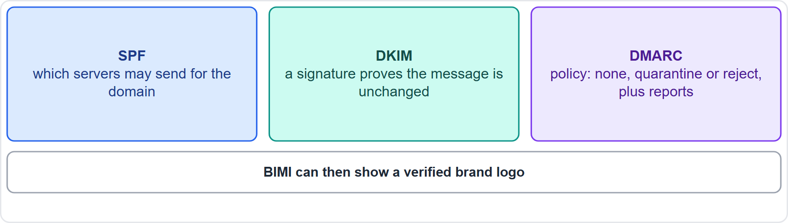
Applications, email and operating systems, continued
Module 12
SPF, DKIM and DMARC: who may send, signed messages, and what to do when checks fail
EXAM TIP SPF lists allowed sending servers; DKIM gives a signature; DMARC tells receivers what to do when SPF or DKIM fail and sends reports. Code signing proves who wrote code and that it is unchanged.
SY0-801 Exam Prep | CompTIA Security+ exam
Module 12: Mitigating Controls and Techniques
10 / 19
Notes:
Applications, email and operating systems.
The figure shows this: S P F, dee kim and dee mark: who may send, signed messages, and what to do when checks fail.
Exam tip: S P F lists allowed sending servers; dee kim gives a signature; dee mark tells receivers what to do when S P F or dee kim fail and sends reports. Code signing proves who wrote code and that it is unchanged.

Slide 11
Practice Question 1
Module 12
Q1
Fabrikam Outdoors wants only approved programs to run on kiosk computers. Which control fits best?
A
A block list of known malware
B
A honeypot
C
An application allow list
D
A captive portal
SY0-801 Exam Prep | CompTIA Security+ exam
Module 12: Mitigating Controls and Techniques
11 / 19
Notes:
Question one. Fabrikam Outdoors wants only approved programs to run on kiosk computers. Which control fits best? The four options are on the screen.
[PAUSE 10]
The answer is C: An application allow list. An allow list permits only approved applications, which is stronger than blocking known bad ones.

Slide 12
Practice Question 2
Module 12
Q2
A fake database account has no real use, and any sign-in attempt on it triggers an alert. What is it?
A
Service account
B
Emergency access account
C
Canary account
D
Guest account
SY0-801 Exam Prep | CompTIA Security+ exam
Module 12: Mitigating Controls and Techniques
12 / 19
Notes:
Question two. A fake database account has no real use, and any sign-in attempt on it triggers an alert. What is it? The four options are on the screen.
[PAUSE 10]
The answer is C: Canary account. A canary account is a decoy that alerts when anyone tries to use it.

Slide 13
Practice Question 3
Module 12
Q3
Which device both detects malicious traffic and blocks it automatically on the network?
A
NIPS
B
NIDS
C
SIEM
D
Packet analyzer
SY0-801 Exam Prep | CompTIA Security+ exam
Module 12: Mitigating Controls and Techniques
13 / 19
Notes:
Question three. Which device both detects malicious traffic and blocks it automatically on the network? The four options are on the screen.
[PAUSE 10]
The answer is A: N I P S. A network-based intrusion prevention system detects and blocks, while an I D S only alerts.

Slide 14
Practice Question 4
Module 12
Q4
A web shop wants to filter SQL injection attempts at the application layer. Which control fits?
A
Layer 4 packet filter
B
Antivirus
C
WAF
D
Honeyfile
SY0-801 Exam Prep | CompTIA Security+ exam
Module 12: Mitigating Controls and Techniques
14 / 19
Notes:
Question four. A web shop wants to filter sequel injection attempts at the application layer. Which control fits? The four options are on the screen.
[PAUSE 10]
The answer is C: waff. A web application firewall inspects layer seven web traffic for injection and similar attacks.

Slide 15
Practice Question 5
Module 12
Q5
A domain owner wants receivers to reject mail that fails SPF and DKIM checks and to receive reports. Which record does this?
A
BIMI
B
CNAME
C
MX
D
DMARC
SY0-801 Exam Prep | CompTIA Security+ exam
Module 12: Mitigating Controls and Techniques
15 / 19
Notes:
Question five. A domain owner wants receivers to reject mail that fails S P F and dee kim checks and to receive reports. Which record does this? The four options are on the screen.
[PAUSE 10]
The answer is D: dee mark. dee mark sets the policy for failed checks and provides reporting.

Slide 16
Practice Question 6
Module 12
Q6
A tool records process activity on laptops, detects suspicious behavior and can isolate a laptop. Which solution is this?
A
EDR
B
WAF
C
MDM
D
NAC
SY0-801 Exam Prep | CompTIA Security+ exam
Module 12: Mitigating Controls and Techniques
16 / 19
Notes:
Question six. A tool records process activity on laptops, detects suspicious behavior and can isolate a laptop. Which solution is this? The four options are on the screen.
[PAUSE 10]
The answer is A: E D R. Endpoint detection and response monitors endpoints and can contain compromised ones.

Slide 17
Recall Check 1
Module 12
Q1. What is hardening?
Q2. What is the difference between a honeypot and a honeytoken?
Q3. What do SPF, DKIM and DMARC do?
SY0-801 Exam Prep | CompTIA Security+ exam
Module 12: Mitigating Controls and Techniques
17 / 19
Notes:
Recall check one. Say each answer out loud before you listen to mine.
Question one. What is hardening?
[PAUSE 5]
Answer: Reducing the attack surface by removing unneeded features and applying secure settings.
Question two. What is the difference between a honeypot and a honeytoken?
[PAUSE 5]
Answer: A honeypot is a decoy system; a honeytoken is fake data or credentials that alert when used.
Question three. What do S P F, dee kim and dee mark do?
[PAUSE 5]
Answer: S P F lists allowed senders, dee kim signs messages, dee mark sets policy and reporting.

Slide 18
Recall Check 2
Module 12
Q4. What does 802.1X provide?
Q5. What does XDR add to EDR?
Q6. What does secrets scanning find?
SY0-801 Exam Prep | CompTIA Security+ exam
Module 12: Mitigating Controls and Techniques
18 / 19
Notes:
Recall check two. Say each answer out loud before you listen to mine.
Question four. What does eight oh two dot one X provide?
[PAUSE 5]
Answer: Port-based network access authentication.
Question five. What does X D R add to E D R?
[PAUSE 5]
Answer: Correlation across endpoint, network, email and cloud signals.
Question six. What does secrets scanning find?
[PAUSE 5]
Answer: Keys, tokens and passwords stored in code repositories.

Slide 19
Module Recap
Module 12
1
Basics
2
Deception
3
Detection and filtering
segmentation, access control, hardening, sandboxing, MDM, allow lists (strong) and block lists
honeypot, honeynet, honeyfile, honeytoken, canary account
IDS alerts, IPS blocks; NIDS/NIPS, HIDS/HIPS, WIPS
4
Endpoint and access
5
Apps, email, OS
secrets scanning, input validation, secure cookies, static analysis, code signing; SPF, DKIM, DMARC, BIMI
DLP, EDR, XDR, antivirus; NAC (captive portal, 802.1X, posture)
SY0-801 Exam Prep | CompTIA Security+ exam
Module 12: Mitigating Controls and Techniques
19 / 19
Notes:
Here is the recap.
Basics: segmentation, access control, hardening, sandboxing, M D M, allow lists (strong) and block lists.
Deception: honeypot, honeynet, honeyfile, honeytoken, canary account.
Detection and filtering: I D S alerts, I P S blocks; N I D S or N I P S, H I D S or H I P S, W I P S.
Endpoint and access: D L P, E D R, X D R, antivirus; N A C (captive portal, eight oh two dot one X, posture).
Apps, email, O S: secrets scanning, input validation, secure cookies, static analysis, code signing; S P F, dee kim, dee mark, bim ee.
In the next module, we continue the course.

