Slide 1
Module 15: Identity and Access Management
4.5 Given a scenario, apply concepts related to identity and access management
SY0-801 exam prep · Security Operations · 27% of the exam
SY0-801 Exam Prep: CompTIA Security+ Study Course
Module 15
Notes:
Welcome to Module fifteen: Identity and Access Management. It covers the exam area Security Operations.
Each part of this module comes from the study notes of the same name, so you can read the notes after you watch.

Slide 2
What You Will Learn
Module 15
The identity life cycle
Federation and single sign-on
Account types
Multifactor authentication
Access control models
Password concepts
Practice with exam-style questions and a recall check
SY0-801 Exam Prep | CompTIA Security+ exam
Module 15: Identity and Access Management
2 / 21
Notes:
By the end of this module you will be able to do seven things.
The identity life cycle.
Federation and single sign-on.
Account types.
Multifactor authentication.
Access control models.
Password concepts.
Practice with exam-style questions and a recall check.

Slide 3
Where This Fits in the Exam
Module 15
EXAM CHECK-IN · Where this fits
Exam area: Security Operations (27%)
Exam format: up to 90 questions in 90 minutes; a score of 750 on a scale of 100 to 900 passes
Validated against: the official CompTIA Security+ SY0-801 V8 exam objectives
SY0-801 Exam Prep | CompTIA Security+ exam
Module 15: Identity and Access Management
3 / 21
Notes:
Here is where this module sits in the exam.
Exam area: Security Operations (twenty-seven percent).
Exam format: up to ninety questions in ninety minutes; a score of seven hundred fifty on a scale of one hundred to nine hundred passes.
Validated against: the official Comp T I A Security plus S Y zero eight oh one V eight exam objectives.

Slide 4
The identity life cycle
Module 15
Topic | Meaning
Provisioning / deprovisioning | Create accounts when people join and remove or disable them when they leave or change roles (prompt deprovisioning prevents stale accounts)
Permissions assignments and implications | Grant only what is needed; broad rights raise risk
Identity proofing | Verify that a person is who they claim before creating an account
Access review | Regularly check who has which rights and remove excess (fights privilege creep)
SY0-801 Exam Prep | CompTIA Security+ exam
Module 15: Identity and Access Management
4 / 21
Notes:
The identity life cycle.
Provisioning or deprovisioning. Create accounts when people join and remove or disable them when they leave or change roles (prompt deprovisioning prevents stale accounts).
Permissions assignments and implications. Grant only what is needed; broad rights raise risk.
Identity proofing. Verify that a person is who they claim before creating an account.
Access review. Regularly check who has which rights and remove excess (fights privilege creep).

Slide 5
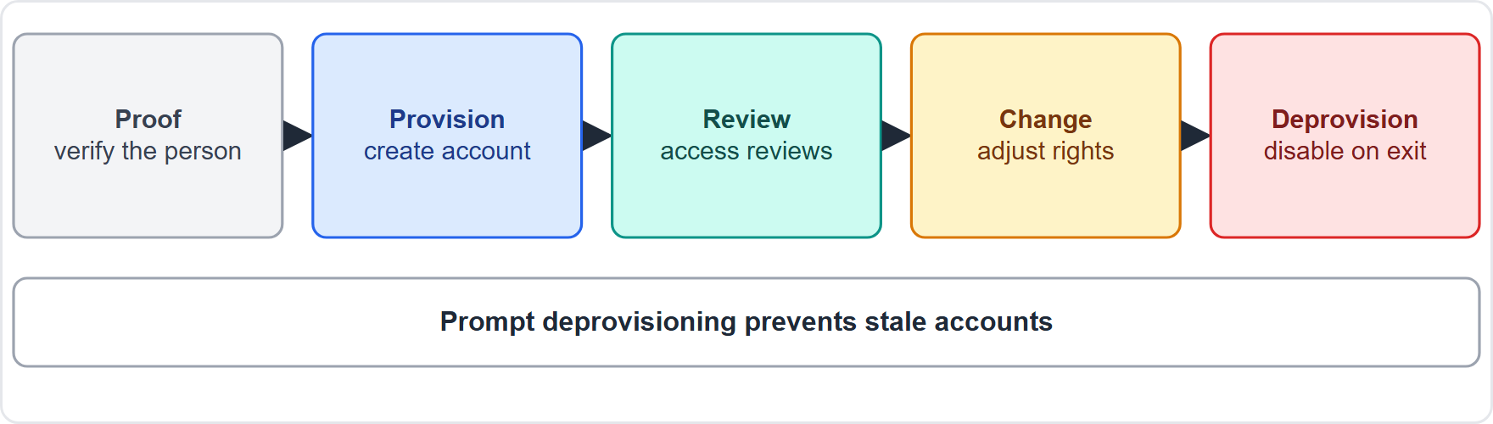
The identity life cycle, continued
Module 15
Identity life cycle: prove identity, provision, review, change, deprovision
SY0-801 Exam Prep | CompTIA Security+ exam
Module 15: Identity and Access Management
5 / 21
Notes:
The identity life cycle.
The figure shows this: Identity life cycle: prove identity, provision, review, change, deprovision.

Slide 6
Federation and single sign-on
Module 15
Term | Meaning
Federation | Trust between organizations so users can use one identity across them
Single sign-on (SSO) | Sign in once and reach many applications
SAML | XML-based standard to pass authentication between an identity provider and an application (common for web SSO at work)
LDAP | Lightweight Directory Access Protocol: query and manage a directory such as Active Directory
OAuth | Open standard for authorization: lets one app access another on your behalf without sharing your password
EXAM TIP SAML = authentication across domains (SSO). OAuth = delegated authorization (access to resources). LDAP = directory access. An identity provider (IdP) authenticates; the service provider relies on it.
SY0-801 Exam Prep | CompTIA Security+ exam
Module 15: Identity and Access Management
6 / 21
Notes:
Federation and single sign-on.
Federation. Trust between organizations so users can use one identity across them.
Single sign-on. Sign in once and reach many applications.
sam el. X M L-based standard to pass authentication between an identity provider and an application (common for web S S O at work).
L D A P (Lightweight Directory Access Protocol). Lightweight Directory Access Protocol: query and manage a directory such as Active Directory.
oh auth. Open standard for authorization: lets one app access another on your behalf without sharing your password.
Exam tip: sam el equals authentication across domains. oh auth equals delegated authorization (access to resources). L D A P equals directory access. An identity provider (I D P) authenticates; the service provider relies on it.

Slide 7
Account types
Module 15
Type | Notes
User | Normal day-to-day access
Privileged | Administrator rights: global (whole environment) or local (one system). Needs extra protection
Service | Used by applications and services, not people; avoid interactive sign-in, rotate secrets
Third-party | Accounts for vendors or partners: time-limit and monitor
Emergency access (break-glass) | Highly privileged, stored securely, used only in emergencies, heavily monitored
SY0-801 Exam Prep | CompTIA Security+ exam
Module 15: Identity and Access Management
7 / 21
Notes:
Account types.
User. Normal day-to-day access.
Privileged. Administrator rights: global (whole environment) or local (one system). Needs extra protection.
Service. Used by applications and services, not people; avoid interactive sign-in, rotate secrets.
Third-party. Accounts for vendors or partners: time-limit and monitor.
Emergency access (break-glass). Highly privileged, stored securely, used only in emergencies, heavily monitored.

Slide 8
Multifactor authentication (MFA)
Module 15
Method | Meaning
Hard token | Physical device (key fob, security key)
Soft token | Software on a phone (authenticator app)
Biometrics | Fingerprint, face, iris
One-time password (OTP) | A code valid once (time-based or counter-based)
Backup code | Single-use recovery codes
MFA combines two or more factors: something you know, have, are, plus (sometimes) where you are or what you do.
SY0-801 Exam Prep | CompTIA Security+ exam
Module 15: Identity and Access Management
8 / 21
Notes:
Multifactor authentication.
M F A combines two or more factors: something you know, have, are, plus (sometimes) where you are or what you do.
Hard token. Physical device (key fob, security key).
Soft token. Software on a phone (authenticator app).
Biometrics. Fingerprint, face, iris.
One-time password (O T P). A code valid once (time-based or counter-based).
Backup code. Single-use recovery codes.

Slide 9
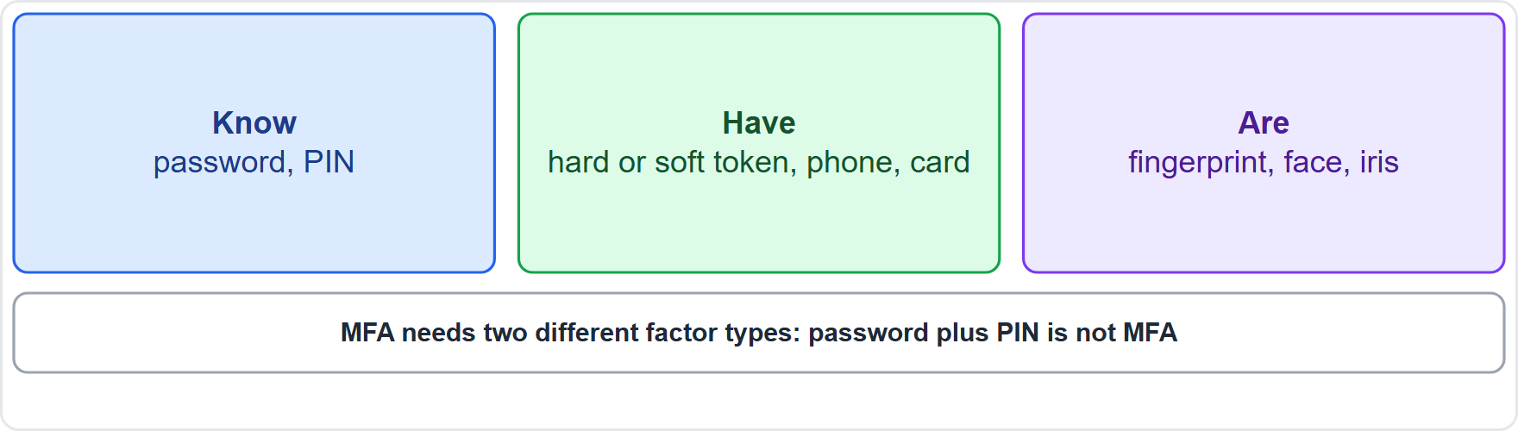
Multifactor authentication (MFA), continued
Module 15
Authentication factors: know, have, are
EXAM TIP A password plus a PIN is not MFA (both are something you know). Password plus a security key is MFA. Store backup codes safely.
SY0-801 Exam Prep | CompTIA Security+ exam
Module 15: Identity and Access Management
9 / 21
Notes:
Multifactor authentication.
The figure shows this: Authentication factors: know, have, are.
Exam tip: A password plus a P I N is not M F A (both are something you know). Password plus a security key is M F A. Store backup codes safely.

Slide 10
Access control models
Module 15
Model | How access is decided
Discretionary (DAC) | The owner decides who gets access
Mandatory (MAC) | The system enforces access by labels and clearances (military style)
Role-based (RBAC) | By job role
Rule-based | By rules (for example firewall rules, "no access from outside the office")
Time-based | Allowed only in certain hours
Just-in-time (JIT) | Temporary elevated access, only when needed
SY0-801 Exam Prep | CompTIA Security+ exam
Module 15: Identity and Access Management
10 / 21
Notes:
Access control models.
Discretionary (D A C). The owner decides who gets access.
Mandatory (M A C). The system enforces access by labels and clearances (military style).
Role-based (R B A C). By job role.
Rule-based. By rules (for example firewall rules, "no access from outside the office").
Time-based. Allowed only in certain hours.
Just-in-time (J I T). Temporary elevated access, only when needed.

Slide 11
Access management
Module 15
Authentication, and policies: logical (technical) such as groups and permissions, and administrative (business) such as hiring and approval rules.
SY0-801 Exam Prep | CompTIA Security+ exam
Module 15: Identity and Access Management
11 / 21
Notes:
Access management.
Authentication, and policies: logical (technical) such as groups and permissions, and administrative (business) such as hiring and approval rules.

Slide 12
Password concepts
Module 15
Topic | Notes
Passkey | Passwordless sign-in using a cryptographic key pair; resists phishing
Password managers | Create and store unique strong passwords
Passwordless | Sign in with something other than a password (passkey, biometrics, security key)
Best practices | Length (longer is better), complexity, no reuse, expiration and age (modern guidance favors changing only after compromise), compromised credential monitoring, account auditing, policy report
EXAM TIP Length beats complexity. Never reuse passwords. Passkeys are phishing-resistant. Just-in-time access reduces standing privileges.
SY0-801 Exam Prep | CompTIA Security+ exam
Module 15: Identity and Access Management
12 / 21
Notes:
Password concepts.
Passkey. Passwordless sign-in using a cryptographic key pair; resists phishing.
Password managers. Create and store unique strong passwords.
Passwordless. Sign in with something other than a password (passkey, biometrics, security key).
Best practices. Length (longer is better), complexity, no reuse, expiration and age (modern guidance favors changing only after compromise), compromised credential monitoring, account auditing, policy report.
Exam tip: Length beats complexity. Never reuse passwords. Passkeys are phishing-resistant. Just-in-time access reduces standing privileges.

Slide 13
Practice Question 1
Module 15
Q1
Fabrikam Outdoors wants staff to sign in once and reach many cloud apps using the company identity provider. Which concept fits?
A
Key escrow
B
Single sign-on with federation
C
Honeypot
D
Port mirroring
SY0-801 Exam Prep | CompTIA Security+ exam
Module 15: Identity and Access Management
13 / 21
Notes:
Question one. Fabrikam Outdoors wants staff to sign in once and reach many cloud apps using the company identity provider. Which concept fits? The four options are on the screen.
[PAUSE 10]
The answer is B: Single sign-on with federation. S S O lets users authenticate once, and federation extends the trusted identity to other services.

Slide 14
Practice Question 2
Module 15
Q2
A user must enter a password and then a six-digit code from an authenticator app. Which factors are used?
A
Something you know and something you have
B
Something you know and something you know
C
Something you are and something you do
D
Somewhere you are and something you know
SY0-801 Exam Prep | CompTIA Security+ exam
Module 15: Identity and Access Management
14 / 21
Notes:
Question two. A user must enter a password and then a six-digit code from an authenticator app. Which factors are used? The four options are on the screen.
[PAUSE 10]
The answer is A: Something you know and something you have. The password is knowledge and the app code from a phone is a possession factor.

Slide 15
Practice Question 3
Module 15
Q3
A vendor needs administrator rights for two hours to fix a system. Which approach reduces standing privilege?
A
Just-in-time access
B
A shared administrator password
C
Permanent global admin
D
A service account for the vendor
SY0-801 Exam Prep | CompTIA Security+ exam
Module 15: Identity and Access Management
15 / 21
Notes:
Question three. A vendor needs administrator rights for two hours to fix a system. Which approach reduces standing privilege? The four options are on the screen.
[PAUSE 10]
The answer is A: Just-in-time access. Just-in-time grants temporary elevated access only when needed.

Slide 16
Practice Question 4
Module 15
Q4
A web app wants to read a user's calendar from another service without getting the user's password. Which standard fits?
A
LDAP
B
OAuth
C
RADIUS
D
Kerberos only
SY0-801 Exam Prep | CompTIA Security+ exam
Module 15: Identity and Access Management
16 / 21
Notes:
Question four. A web app wants to read a user's calendar from another service without getting the user's password. Which standard fits? The four options are on the screen.
[PAUSE 10]
The answer is B: oh auth. oh auth provides delegated authorization without sharing credentials.

Slide 17
Practice Question 5
Module 15
Q5
After a quarterly review, managers remove access that employees no longer need after moving teams. Which problem is this addressing?
A
Privilege creep
B
Replay attacks
C
Key escrow
D
Tailgating
SY0-801 Exam Prep | CompTIA Security+ exam
Module 15: Identity and Access Management
17 / 21
Notes:
Question five. After a quarterly review, managers remove access that employees no longer need after moving teams. Which problem is this addressing? The four options are on the screen.
[PAUSE 10]
The answer is A: Privilege creep. Access reviews remove accumulated permissions, which is privilege creep.

Slide 18
Practice Question 6
Module 15
Q6
A company sets a rule that a payroll system can only be used from the office between 8 and 6. Which models are combined?
A
Time-based and rule-based
B
Mandatory and discretionary
C
Role-based and mandatory
D
Just-in-time and discretionary
SY0-801 Exam Prep | CompTIA Security+ exam
Module 15: Identity and Access Management
18 / 21
Notes:
Question six. A company sets a rule that a payroll system can only be used from the office between eight and six. Which models are combined? The four options are on the screen.
[PAUSE 10]
The answer is A: Time-based and rule-based. The rule limits by hours (time-based) and by location through rules (rule-based).

Slide 19
Recall Check 1
Module 15
Q1. What is identity proofing?
Q2. SAML or OAuth: which is for authentication across domains?
Q3. Name the five account types in the objectives.
SY0-801 Exam Prep | CompTIA Security+ exam
Module 15: Identity and Access Management
19 / 21
Notes:
Recall check one. Say each answer out loud before you listen to mine.
Question one. What is identity proofing?
[PAUSE 5]
Answer: Verifying that a person is who they claim to be before creating an account.
Question two. sam el or oh auth: which is for authentication across domains?
[PAUSE 5]
Answer: sam el.
Question three. Name the five account types in the objectives.
[PAUSE 5]
Answer: User, privileged, service, third-party and emergency access.

Slide 20
Recall Check 2
Module 15
Q4. Name three MFA methods.
Q5. What is a passkey?
Q6. Which access control model uses labels and clearances?
SY0-801 Exam Prep | CompTIA Security+ exam
Module 15: Identity and Access Management
20 / 21
Notes:
Recall check two. Say each answer out loud before you listen to mine.
Question four. Name three M F A methods.
[PAUSE 5]
Answer: For example hard token, soft token, biometrics, one-time password, backup code.
Question five. What is a passkey?
[PAUSE 5]
Answer: A passwordless credential based on a cryptographic key pair.
Question six. Which access control model uses labels and clearances?
[PAUSE 5]
Answer: Mandatory access control.

Slide 21
Module Recap
Module 15
1
Life cycle
2
Federation
3
Accounts
identity proofing, provisioning, permissions, access reviews, deprovisioning
SSO; SAML (authentication), OAuth (delegated authorization), LDAP (directory)
user, privileged (global or local), service, third-party, emergency (break-glass)
4
MFA
5
Models
6
Passwords
hard and soft tokens, biometrics, OTP, backup codes; two different factor types
DAC, MAC, role-based, rule-based, time-based, just-in-time
passkeys, password managers, passwordless; length, no reuse, monitor compromised credentials
SY0-801 Exam Prep | CompTIA Security+ exam
Module 15: Identity and Access Management
21 / 21
Notes:
Here is the recap.
Life cycle: identity proofing, provisioning, permissions, access reviews, deprovisioning.
Federation: S S O; sam el (authentication), oh auth (delegated authorization), L D A P (directory).
Accounts: user, privileged (global or local), service, third-party, emergency (break-glass).
M F A: hard and soft tokens, biometrics, O T P, backup codes; two different factor types.
Models: D A C, M A C, role-based, rule-based, time-based, just-in-time.
Passwords: passkeys, password managers, passwordless; length, no reuse, monitor compromised credentials.
In the next module, we continue the course.

