Slide 1
Module 16: Automation, Orchestration and AI in Operations
4.6 Given a scenario, apply automation and orchestration solutions to secure operations
SY0-801 exam prep · Security Operations · 27% of the exam
SY0-801 Exam Prep: CompTIA Security+ Study Course
Module 16
Notes:
Welcome to Module sixteen: Automation, Orchestration and A I in Operations. It covers the exam area Security Operations.
Each part of this module comes from the study notes of the same name, so you can read the notes after you watch.

Slide 2
What You Will Learn
Module 16
Automation and orchestration
Use cases
Considerations
AI in security operations
Intended outcomes and SecOps
Practice with exam-style questions and a recall check
SY0-801 Exam Prep | CompTIA Security+ exam
Module 16: Automation, Orchestration and AI in Operations
2 / 19
Notes:
By the end of this module you will be able to do six things.
Automation and orchestration.
Use cases.
Considerations.
A I in security operations.
Intended outcomes and Sec Ops.
Practice with exam-style questions and a recall check.

Slide 3
Where This Fits in the Exam
Module 16
EXAM CHECK-IN · Where this fits
Exam area: Security Operations (27%)
Exam format: up to 90 questions in 90 minutes; a score of 750 on a scale of 100 to 900 passes
Validated against: the official CompTIA Security+ SY0-801 V8 exam objectives
SY0-801 Exam Prep | CompTIA Security+ exam
Module 16: Automation, Orchestration and AI in Operations
3 / 19
Notes:
Here is where this module sits in the exam.
Exam area: Security Operations (twenty-seven percent).
Exam format: up to ninety questions in ninety minutes; a score of seven hundred fifty on a scale of one hundred to nine hundred passes.
Validated against: the official Comp T I A Security plus S Y zero eight oh one V eight exam objectives.

Slide 4
Automation and orchestration
Module 16
Term | Meaning | Example
Automation | A single task runs without manual steps | A script that disables a leaver's account
Orchestration | Many automated tasks and tools are coordinated into one workflow | Alert arrives, enrich the IP address, open a ticket, isolate the host, notify the owner
SOAR | Security orchestration, automation, and response: a platform for this | A playbook that handles phishing reports
SY0-801 Exam Prep | CompTIA Security+ exam
Module 16: Automation, Orchestration and AI in Operations
4 / 19
Notes:
Automation and orchestration.
Automation. Meaning: A single task runs without manual steps. Example: A script that disables a leaver's account.
Orchestration. Meaning: Many automated tasks and tools are coordinated into one workflow. Example: Alert arrives, enrich the I P address, open a ticket, isolate the host, notify the owner.
soar. Meaning: Security orchestration, automation, and response: a platform for this. Example: A playbook that handles phishing reports.

Slide 5
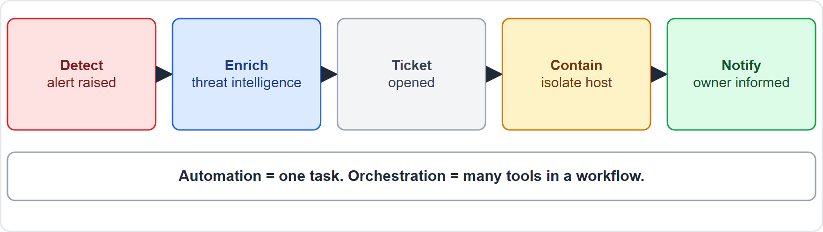
Automation and orchestration, continued
Module 16
Orchestration links tools: detection, enrichment, ticket, containment, notification
SY0-801 Exam Prep | CompTIA Security+ exam
Module 16: Automation, Orchestration and AI in Operations
5 / 19
Notes:
Automation and orchestration.
The figure shows this: Orchestration links tools: detection, enrichment, ticket, containment, notification.

Slide 6
Use cases
Module 16
Use case | Benefit
User provisioning | Accounts created and removed consistently
Resource provisioning | Servers and cloud resources built from templates
Desired state management | Systems return to the approved configuration automatically
Anomaly detection | Unusual behavior is flagged automatically
Ticket management | Tickets are created, updated and routed automatically
SY0-801 Exam Prep | CompTIA Security+ exam
Module 16: Automation, Orchestration and AI in Operations
6 / 19
Notes:
Use cases.
User provisioning. Accounts created and removed consistently.
Resource provisioning. Servers and cloud resources built from templates.
Desired state management. Systems return to the approved configuration automatically.
Anomaly detection. Unusual behavior is flagged automatically.
Ticket management. Tickets are created, updated and routed automatically.

Slide 7
Considerations (what can go wrong)
Module 16
Item | Meaning
Guardrails | Limits that stop automation from doing harm (approvals, scopes, rate limits)
Automation logic | Rules must be correct and tested; a bug is repeated at speed
Process engineering | Design the process well before automating it
Complexity | More moving parts to maintain and secure
Financial | Tool and maintenance costs
Process risks | A wrong action can spread quickly across many systems
Deployment | Roll out gradually and monitor
EXAM TIP Automating a bad process just makes mistakes faster. Use guardrails and human approval for high-impact actions. Orchestration coordinates many tools; automation is one task.
SY0-801 Exam Prep | CompTIA Security+ exam
Module 16: Automation, Orchestration and AI in Operations
7 / 19
Notes:
Considerations (what can go wrong).
Guardrails. Limits that stop automation from doing harm (approvals, scopes, rate limits).
Automation logic. Rules must be correct and tested; a bug is repeated at speed.
Process engineering. Design the process well before automating it.
Complexity. More moving parts to maintain and secure.
Financial. Tool and maintenance costs.
Process risks. A wrong action can spread quickly across many systems.
Deployment. Roll out gradually and monitor.
Exam tip: Automating a bad process just makes mistakes faster. Use guardrails and human approval for high-impact actions. Orchestration coordinates many tools; automation is one task.

Slide 8
AI in security operations
Module 16
Capability | Meaning
Agentic AI | AI that plans and takes actions with tools toward a goal (for example investigating an alert)
Chatbot | A conversational interface to ask for help, summaries or queries
Predictive analysis | Uses data to forecast problems or threats
AI-augmented baselines | AI helps learn normal behavior so abnormal behavior stands out
AI helps most when it assists analysts; humans stay accountable and verify results (module 8 risks: hallucinations, prompt injection, data leaks).
SY0-801 Exam Prep | CompTIA Security+ exam
Module 16: Automation, Orchestration and AI in Operations
8 / 19
Notes:
A I in security operations.
Agentic A I. A I that plans and takes actions with tools toward a goal (for example investigating an alert).
Chatbot. A conversational interface to ask for help, summaries or queries.
Predictive analysis. Uses data to forecast problems or threats.
A I-augmented baselines. A I helps learn normal behavior so abnormal behavior stands out.
A I helps most when it assists analysts; humans stay accountable and verify results (module eight risks: hallucinations, prompt injection, data leaks).

Slide 9
Intended outcomes and SecOps
Module 16
Outcome | Meaning
Efficiency and time saving | Less manual work
Enforcing baselines | Systems stay at the approved configuration
Continuous improvements | Learn from results and refine
Productivity improvements | Analysts focus on hard problems
Reduced downtime | Faster detection and repair
Increased proactivity | Fix issues before users notice
SecOps blends security and operations. CI/CD (continuous integration and continuous deployment) builds, tests and releases code automatically, so security checks (secrets scanning, static analysis) can be built into the pipeline. Workflows use automation and integrations between tools through APIs.
EXAM TIP If a question mentions coordinating many tools into one workflow, the answer is orchestration (SOAR); one task is automation.
SY0-801 Exam Prep | CompTIA Security+ exam
Module 16: Automation, Orchestration and AI in Operations
9 / 19
Notes:
Intended outcomes and Sec Ops.
Efficiency and time saving. Less manual work.
Enforcing baselines. Systems stay at the approved configuration.
Continuous improvements. Learn from results and refine.
Productivity improvements. Analysts focus on hard problems.
Reduced downtime. Faster detection and repair.
Increased proactivity. Fix issues before users notice.
Sec Ops blends security and operations. C I or C D (continuous integration and continuous deployment) builds, tests and releases code automatically, so security checks (secrets scanning, static analysis) can be built into the pipeline. Workflows use automation and integrations between tools through A P Is.
Exam tip: If a question mentions coordinating many tools into one workflow, the answer is orchestration (soar); one task is automation.

Slide 10
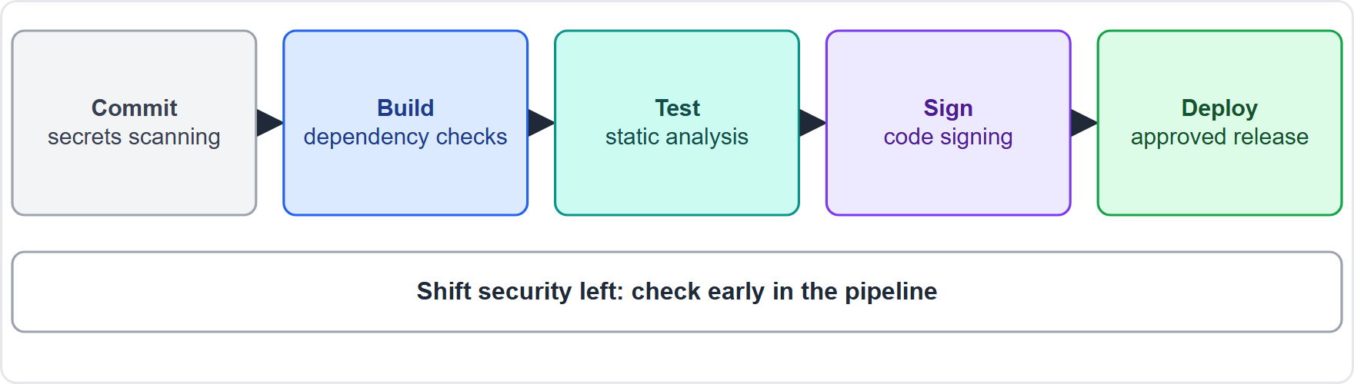
Intended outcomes and SecOps, continued
Module 16
Security checks inside a CI/CD pipeline: commit, scan, build, test, deploy
EXAM TIP In a CI/CD pipeline, add secrets scanning and static analysis early ("shift left"). Agentic AI takes actions, so apply least privilege and approval gates to the tools it can use.
SY0-801 Exam Prep | CompTIA Security+ exam
Module 16: Automation, Orchestration and AI in Operations
10 / 19
Notes:
Intended outcomes and Sec Ops.
The figure shows this: Security checks inside a C I or C D pipeline: commit, scan, build, test, deploy.
Exam tip: In a C I or C D pipeline, add secrets scanning and static analysis early ("shift left"). Agentic A I takes actions, so apply least privilege and approval gates to the tools it can use.

Slide 11
Practice Question 1
Module 16
Q1
Fabrikam Outdoors wants a phishing report to trigger enrichment of the sender, a ticket, quarantine of the email and a notice to the reporter, all without manual steps. Which approach fits?
A
Orchestration with a SOAR playbook
B
A single batch script for one task
C
A honeypot
D
A change advisory board
SY0-801 Exam Prep | CompTIA Security+ exam
Module 16: Automation, Orchestration and AI in Operations
11 / 19
Notes:
Question one. Fabrikam Outdoors wants a phishing report to trigger enrichment of the sender, a ticket, quarantine of the email and a notice to the reporter, all without manual steps. Which approach fits? The four options are on the screen.
[PAUSE 10]
The answer is A: Orchestration with a soar playbook. Coordinating several tools and steps into one workflow is orchestration, usually done in a soar platform.

Slide 12
Practice Question 2
Module 16
Q2
A team wants an automated task that disables an account when HR marks a worker as terminated. Which use case is this?
A
Desired state management
B
User provisioning and deprovisioning
C
Anomaly detection
D
Capacity planning
SY0-801 Exam Prep | CompTIA Security+ exam
Module 16: Automation, Orchestration and AI in Operations
12 / 19
Notes:
Question two. A team wants an automated task that disables an account when H R marks a worker as terminated. Which use case is this? The four options are on the screen.
[PAUSE 10]
The answer is B: User provisioning and deprovisioning. Automatically creating and removing accounts is a user provisioning use case.

Slide 13
Practice Question 3
Module 16
Q3
An automation script mistakenly isolates 400 production servers within seconds. Which control would have limited the damage?
A
Guardrails such as approval and scope limits
B
A longer password
C
More log retention
D
A larger bandwidth
SY0-801 Exam Prep | CompTIA Security+ exam
Module 16: Automation, Orchestration and AI in Operations
13 / 19
Notes:
Question three. An automation script mistakenly isolates four hundred production servers within seconds. Which control would have limited the damage? The four options are on the screen.
[PAUSE 10]
The answer is A: Guardrails such as approval and scope limits. Guardrails limit the scope and impact of automated actions.

Slide 14
Practice Question 4
Module 16
Q4
An AI assistant can investigate an alert by running queries and opening tickets on its own. Which capability is this?
A
Predictive analysis
B
A static chatbot
C
Port mirroring
D
Agentic AI
SY0-801 Exam Prep | CompTIA Security+ exam
Module 16: Automation, Orchestration and AI in Operations
14 / 19
Notes:
Question four. An A I assistant can investigate an alert by running queries and opening tickets on its own. Which capability is this? The four options are on the screen.
[PAUSE 10]
The answer is D: Agentic A I. An A I that plans and takes actions with tools toward a goal is agentic.

Slide 15
Practice Question 5
Module 16
Q5
A pipeline should stop a build if a developer commits a password. Which control belongs in the CI/CD pipeline?
A
Surveillance footage
B
Captive portal
C
Key escrow
D
Secrets scanning
SY0-801 Exam Prep | CompTIA Security+ exam
Module 16: Automation, Orchestration and AI in Operations
15 / 19
Notes:
Question five. A pipeline should stop a build if a developer commits a password. Which control belongs in the C I or C D pipeline? The four options are on the screen.
[PAUSE 10]
The answer is D: Secrets scanning. Secrets scanning in the pipeline catches credentials before release.

Slide 16
Practice Question 6
Module 16
Q6
Systems are checked daily and any that drift are reset to the approved configuration automatically. Which use case is this?
A
Ticket management
B
Resource provisioning
C
Process risk
D
Desired state management
SY0-801 Exam Prep | CompTIA Security+ exam
Module 16: Automation, Orchestration and AI in Operations
16 / 19
Notes:
Question six. Systems are checked daily and any that drift are reset to the approved configuration automatically. Which use case is this? The four options are on the screen.
[PAUSE 10]
The answer is D: Desired state management. Returning systems to an approved configuration automatically is desired state management.

Slide 17
Recall Check 1
Module 16
Q1. What is the difference between automation and orchestration?
Q2. What does SOAR stand for?
Q3. What is a guardrail?
SY0-801 Exam Prep | CompTIA Security+ exam
Module 16: Automation, Orchestration and AI in Operations
17 / 19
Notes:
Recall check one. Say each answer out loud before you listen to mine.
Question one. What is the difference between automation and orchestration?
[PAUSE 5]
Answer: Automation runs one task without manual steps; orchestration coordinates many tasks and tools.
Question two. What does soar stand for?
[PAUSE 5]
Answer: Security orchestration, automation, and response.
Question three. What is a guardrail?
[PAUSE 5]
Answer: A limit that stops automation from causing harm.

Slide 18
Recall Check 2
Module 16
Q4. Name two use cases of automation in security.
Q5. What is agentic AI?
Q6. What does CI/CD stand for?
SY0-801 Exam Prep | CompTIA Security+ exam
Module 16: Automation, Orchestration and AI in Operations
18 / 19
Notes:
Recall check two. Say each answer out loud before you listen to mine.
Question four. Name two use cases of automation in security.
[PAUSE 5]
Answer: For example user provisioning and desired state management.
Question five. What is agentic A I?
[PAUSE 5]
Answer: A I that plans and takes actions with tools toward a goal.
Question six. What does C I or C D stand for?
[PAUSE 5]
Answer: Continuous integration and continuous deployment.

Slide 19
Module Recap
Module 16
1
Concepts
2
Use cases
3
Considerations
automation = one task; orchestration = many tools in a workflow; SOAR platform
user and resource provisioning, desired state, anomaly detection, ticket management
guardrails, logic, process engineering, complexity, cost, process risk, gradual deployment
4
AI
5
Outcomes
agentic, chatbot, predictive analysis, AI-augmented baselines; humans verify
efficiency, baselines, continuous improvement, productivity, less downtime, proactivity; security in CI/CD
SY0-801 Exam Prep | CompTIA Security+ exam
Module 16: Automation, Orchestration and AI in Operations
19 / 19
Notes:
Here is the recap.
Concepts: automation equals one task; orchestration equals many tools in a workflow; soar platform.
Use cases: user and resource provisioning, desired state, anomaly detection, ticket management.
Considerations: guardrails, logic, process engineering, complexity, cost, process risk, gradual deployment.
A I: agentic, chatbot, predictive analysis, A I-augmented baselines; humans verify.
Outcomes: efficiency, baselines, continuous improvement, productivity, less downtime, proactivity; security in C I or C D.
In the next module, we continue the course.

